Slide 1
Worst-case Optimal
Join Algorithms
Techniques, Results, and Open Problems
Hung Q. Ngo
RelationalAI Inc.
Based on Joint Works with
Mahmoud Abo Khamis, Ely Porat, Chris Ré, Atri Rudra, Dan Suciu

Slide 2
Formulation sketch
Paper with the same title on ArXiV contains much more details and references

Slide 3
Three Fundamental Problems in RDBMS
Query plans
  Based on variable elimination and (equivalently) tree decompositions
    Very general query types (Boolean, aggregations, max, min, CSP, PGM, etc.)
  Refs:
    [FDB: Olteanu, Závodný TODS’13]
    [FAQ: Abo Khamis, Ngo, Rudra PODS’16 / SIGMOD Records 16]
    [TD: Gottlob, Greco, Leone, Scarcello PODS’16]
Output size bound
Worst-case optimal join algorithms
  To evaluate intermediate queries

Slide 4
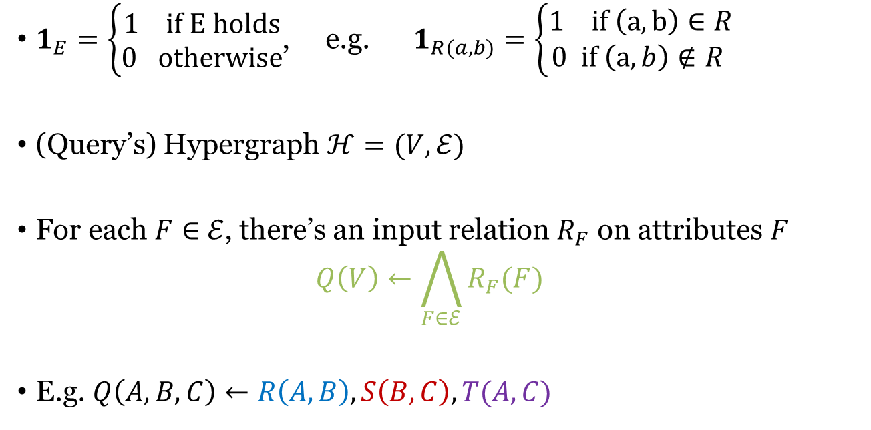
Notations
$1_{E}=\left\{\begin{aligned}1 if E holds \\ 0 otherwise\end{aligned}\right.$, e.g. $1_{R(a,b)}=\left\{\begin{aligned}1 if \left(a,b\right)∈R \\ 0 if \left(a,b\right)∉R \end{aligned}\right.$
(Query’s) Hypergraph $ℋ=(V,ℰ)$
For each $F∈$ $ℰ$, there’s an input relation $R_{F}$ on attributes $F$
$Q\left(V\right)←\bigwedge_{F∈ℰ}{R_{F}(F)}$
E.g. $Q\left(A,B,C\right)←R\left(A,B\right), S\left(B,C\right), T(A,C)$
R
T
A
S
B
C

Slide 5
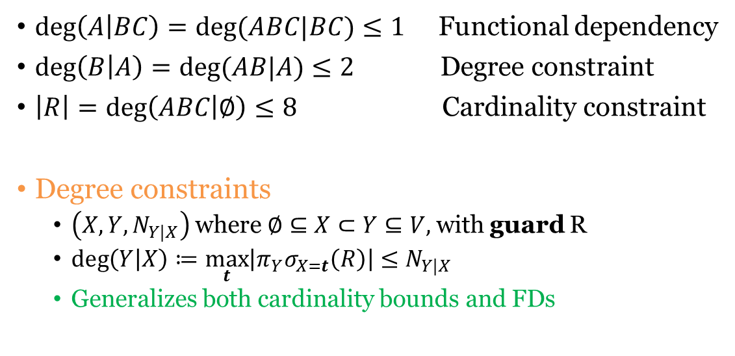

Degree Constraints
$$R(A,B,C)$$
A | B | C
1 | 1 | 1
1 | 1 | 2
1 | 2 | 3
2 | 1 | 4
2 | 1 | 5
2 | 1 | 6
3 | 1 | 7
3 | 2 | 8
$\deg\left(A | BC\right)=deg⁡(ABC|BC)≤1$ Functional dependency
$\deg\left(B | A\right)=deg⁡(AB|A)≤2$ Degree constraint
$\left|R\right|=\deg\left(ABC | ∅\right)≤8$ Cardinality constraint
Degree constraints
  $\left(X,Y,N_{Y|X}\right)$ where $∅⊆X⊂Y⊆V,$with guard R
  $\deg\left(Y | X\right)≔\max_{t}\left|π_{Y}σ_{X=t}\left(R\right)\right|≤N_{Y|X}$
  Generalizes both cardinality bounds and FDs

Slide 6
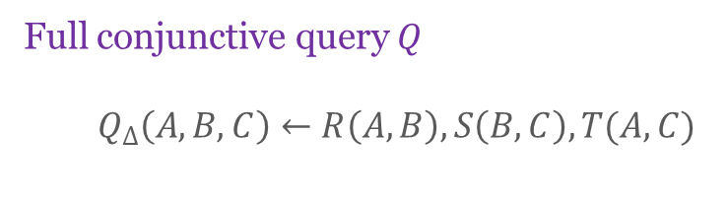
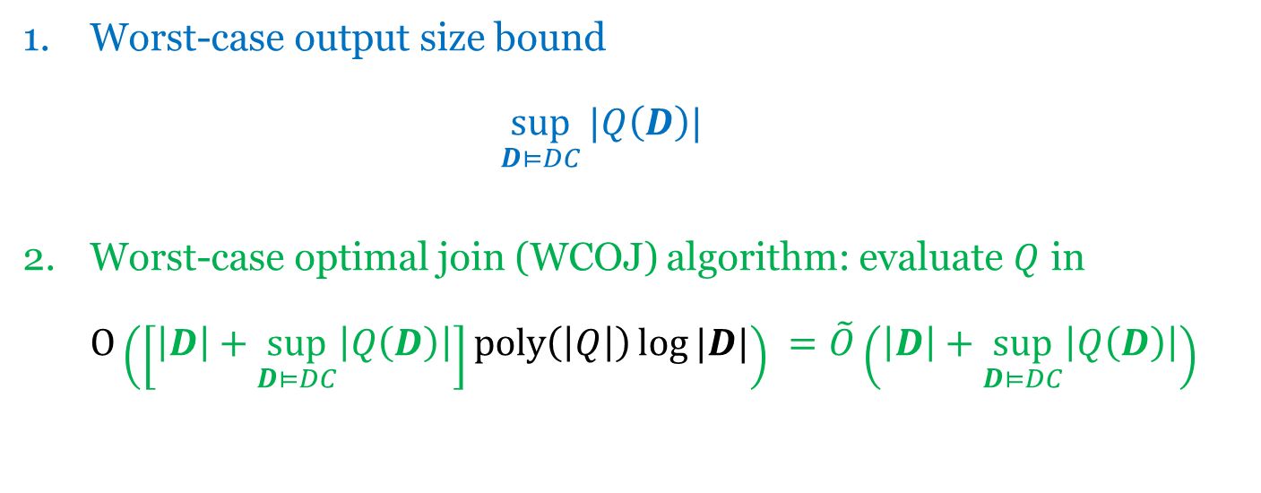
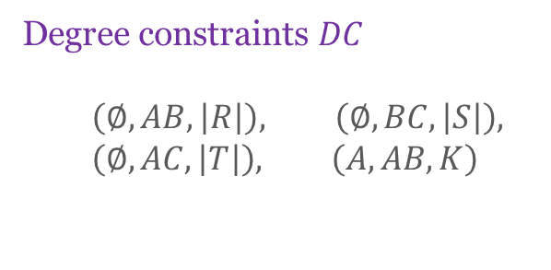
Twin Problems
Full conjunctive query $Q$
  $$Q_{Δ}\left(A,B,C\right)←R\left(A,B\right), S\left(B,C\right), T(A,C)$$
Degree constraints $DC$
  $$\left(∅, AB,\left|R\right|\right), \left(∅, BC,\left|S\right|\right), \\ \left(∅, AC,\left|T\right|\right), \left(A, AB,K\right)$$
Worst-case output size bound
$\sup_{D⊨DC}{|Q\left(D\right)|}$
Worst-case optimal join (WCOJ) algorithm: evaluate $Q$ in
$O\left(\left[\left|D\right|+\sup_{D⊨DC}\left|Q\left(D\right)\right|\right]poly\left(\left|Q\right|\right)\log{|D|}\right) =\tilde{O}\left(\left|D\right|+\sup_{D⊨DC}\left|Q\left(D\right)\right|\right)$

Slide 7

$$\sup_{D⊨DC}{|Q\left(D\right)|}$$
Geometry
  [Loomis-Whitney 1949, isoperimetric inequalities]
  [Bollobas-Thomason 1995] the Holder argument!
Extremal combinatorics, graph theory
  [Alon 81]
  [Chung, Graham, Frankl, Shearer, 86] the entropy argument!
  [Friedgut-Kahn 98]
Constraint satisfaction
  [Grohe & Marx SODA’06]
Databases
  [Atserias, Grohe, Marx FOCS’08]
  [Gottlob, Lee, Valiant, Valiant JACM’2012]
  [Ngo, Porat, Re, Rudra PODS’12]
  [Abo Khamis, Ngo, Suciu PODS’16, PODS’17]

Slide 8
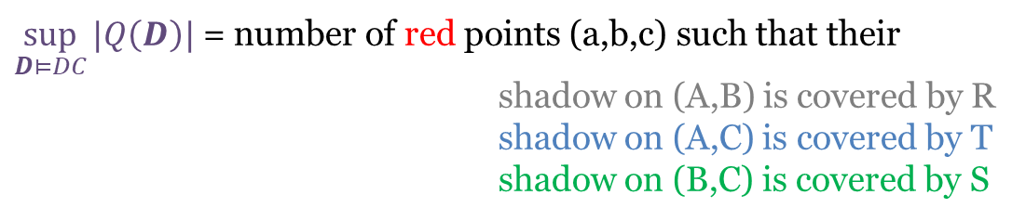
Geometric Connection
A
R(A,B)
T(A,C)
B
S(B,C)
C
$\sup_{D⊨DC}{|Q\left(D\right)|}$ = number of red points (a,b,c) such that their
shadow on (A,B) is covered by R
shadow on (A,C) is covered by T
shadow on (B,C) is covered by S

Slide 9
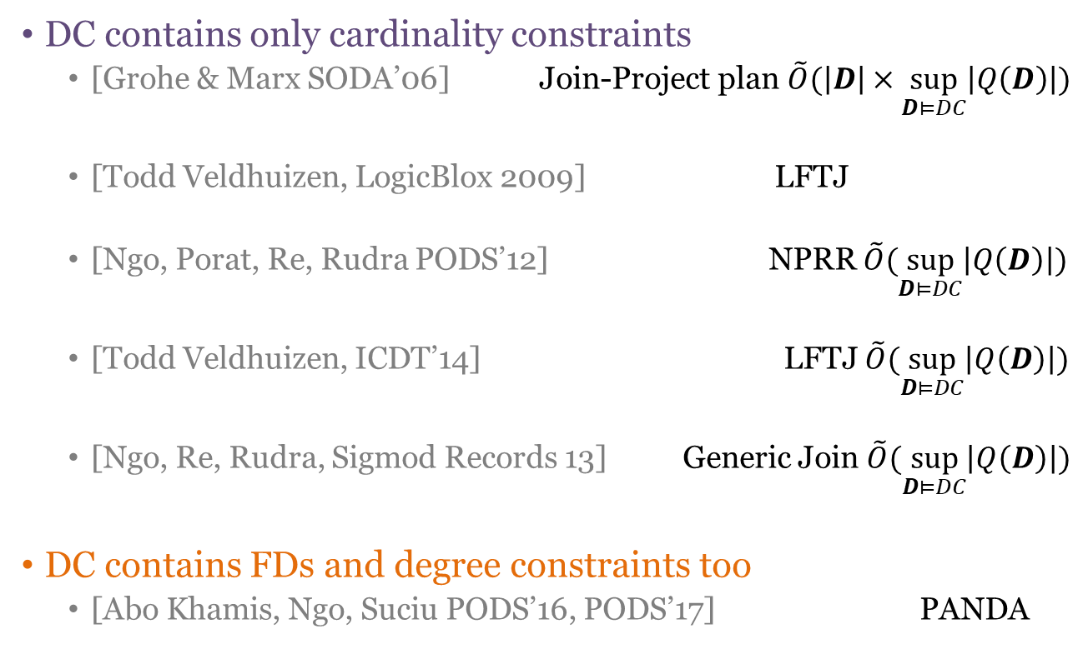
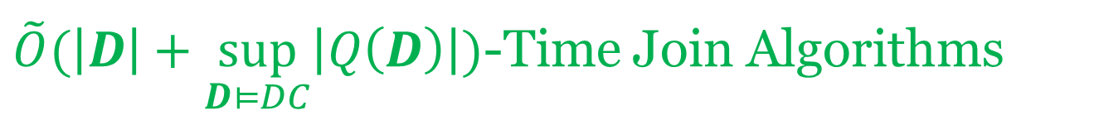
$\tilde{O}(\left|D\right|+\sup_{D⊨DC}\left|Q\left(D\right)\right|)$-Time Join Algorithms
DC contains only cardinality constraints
  [Grohe & Marx SODA’06] Join-Project plan $\tilde{O}(\left|D\right|×\sup_{D⊨DC}\left|Q\left(D\right)\right|)$
  [Todd Veldhuizen, LogicBlox 2009] LFTJ
  [Ngo, Porat, Re, Rudra PODS’12] NPRR $\tilde{O}(\sup_{D⊨DC}\left|Q\left(D\right)\right|)$
  [Todd Veldhuizen, ICDT’14] LFTJ $\tilde{O}(\sup_{D⊨DC}\left|Q\left(D\right)\right|)$
  [Ngo, Re, Rudra, Sigmod Records 13] Generic Join $\tilde{O}(\sup_{D⊨DC}\left|Q\left(D\right)\right|)$
DC contains FDs and degree constraints too
  [Abo Khamis, Ngo, Suciu PODS’16, PODS’17] PANDA

Slide 10
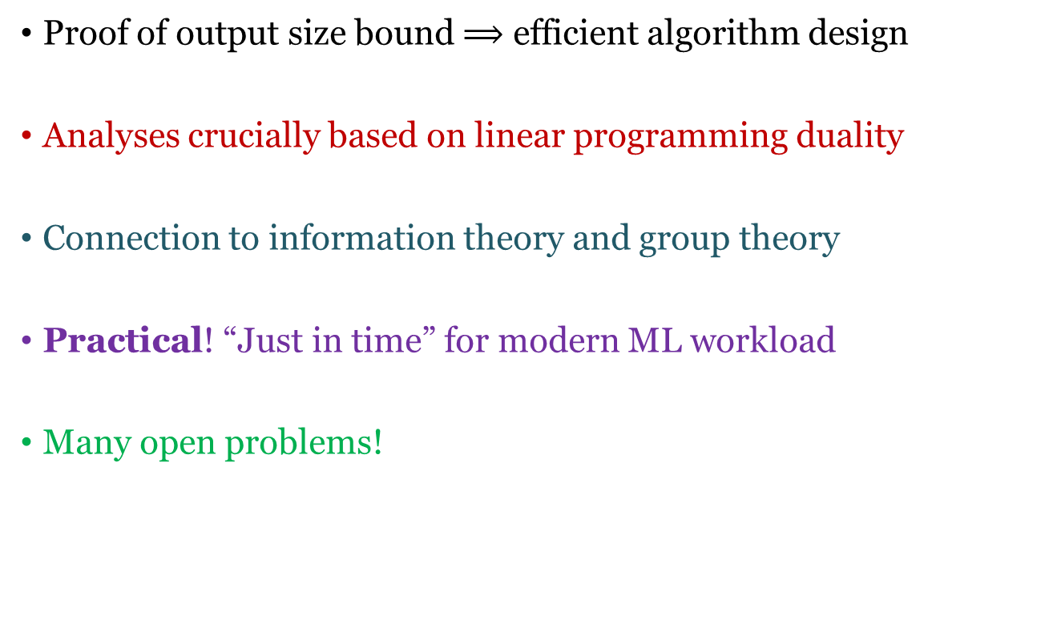
Takeaways
Proof of output size bound $⟹$ efficient algorithm design
Analyses crucially based on linear programming duality
Connection to information theory and group theory
Practical! “Just in time” for modern ML workload
Many open problems!

Slide 11

Triangle Query Dissected
Illustration for $n=3$, then let $3→∞$

Slide 12

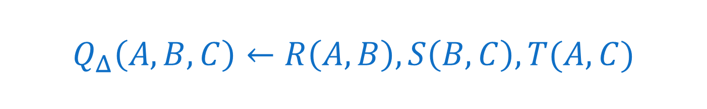
$$Q_{Δ}\left(A,B,C\right)←R\left(A,B\right), S\left(B,C\right), T(A,C)$$
$DC=\{\left(∅, AB,N_{R}\right), \left(∅, BC,N_{S}\right), \left(∅, AC,N_{T}\right)\}$
$\sup_{D⊨DC}{|Q\left(D\right)|}$= $\max{|R\left(A,B\right)⋈S\left(B,C\right)⋈T(A,C)|}$
subject to $\left|R\right|≤N_{R}$
$\left|S\right|≤N_{S}$
$\left|T\right|≤N_{T}$

Slide 13



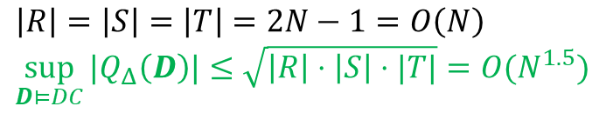

Any Pairwise Join Plan is Sub-Optimal
$$N$$
$$Q_{Δ}\left(A,B,C\right)←R\left(A,B\right), S\left(B,C\right), T(A,C)$$
R
T
$$\left|R\right|=\left|S\right|=\left|T\right|=2N−1=O\left(N\right) \\ \sup_{D⊨DC}{|Q_{Δ}\left(D\right)|}≤\sqrt{\left|R\right|⋅\left|S\right|⋅|T|}={O(N}^{1.5})$$
$$N$$
$$N$$
S
⨝
⨝
⨝
Ω(N²)
T
Ω(N²)
R
Ω(N²)
S
⨝
⨝
⨝
R
S
T
S
R
T

Slide 14
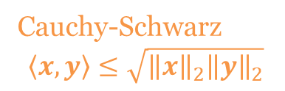
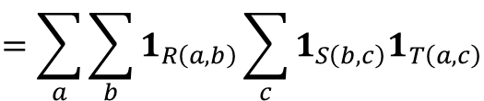
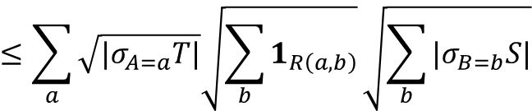
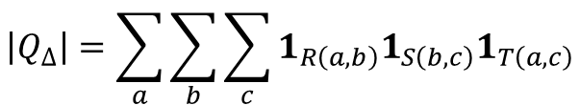
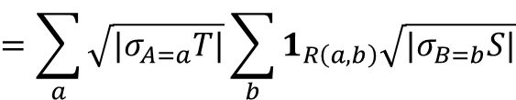

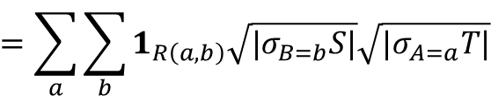
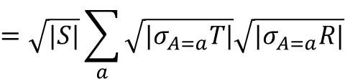
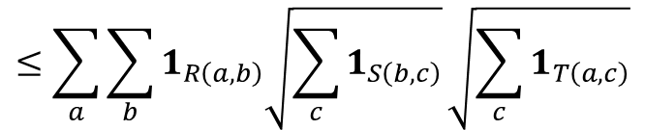
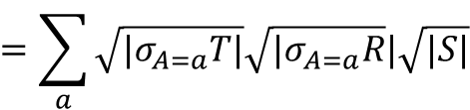
The Holder Argument
$$\left|Q_{Δ}\right|=\sum_{a}{\sum_{b}{\sum_{c}{1_{R\left(a,b\right)}1_{S\left(b,c\right)}1_{T\left(a,c\right)}}}}$$
$$=\sum_{a}{\sum_{b}{1_{R\left(a,b\right)}\sum_{c}{1_{S\left(b,c\right)}1_{T\left(a,c\right)}}}}$$
$$≤\sum_{a}{\sum_{b}{1_{R\left(a,b\right)}\sqrt{\sum_{c}{1_{S\left(b,c\right)}}}\sqrt{\sum_{c}{1_{T\left(a,c\right)}}}}}$$
Cauchy-Schwarz
$$\left\langle x,y\right\rangle ≤\sqrt{{\left\|x\right\|}_{2}{\left\|y\right\|}_{2}}$$
$$=\sum_{a}{\sum_{b}{1_{R\left(a,b\right)}\sqrt{{|σ}_{B=b}S|}\sqrt{{|σ}_{A=a}T|}}}$$
$$=\sum_{a}{\sqrt{|σ_{A=a}T|}\sum_{b}{1_{R\left(a,b\right)}\sqrt{|σ_{B=b}S|}}}$$
$$≤\sum_{a}{\sqrt{|σ_{A=a}T|}\sqrt{\sum_{b}{1_{R\left(a,b\right)}}}\sqrt{\sum_{b}{|σ_{B=b}S|}}}$$
Cauchy-Schwarz
$$=\sum_{a}{\sqrt{|σ_{A=a}T|}\sqrt{{|σ}_{A=a}R}|\sqrt{|S|}}$$
$$=\sqrt{|S|}\sum_{a}{\sqrt{{|σ}_{A=a}T|}\sqrt{{|σ}_{A=a}R|}}$$
$$\left|Q_{Δ}\right| ≤\sqrt{\left|R\right|⋅\left|S\right|⋅|T|}$$
E.g. number of triangles in a graph is $O(m^{1.5})$ [Alon, 1981]

Slide 15
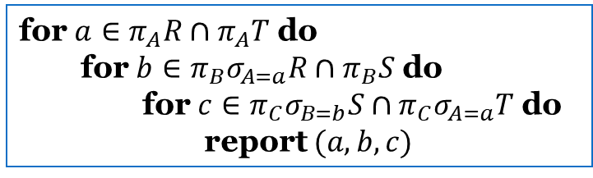
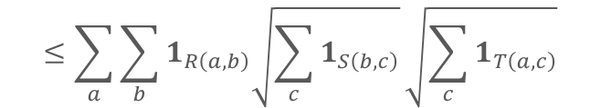



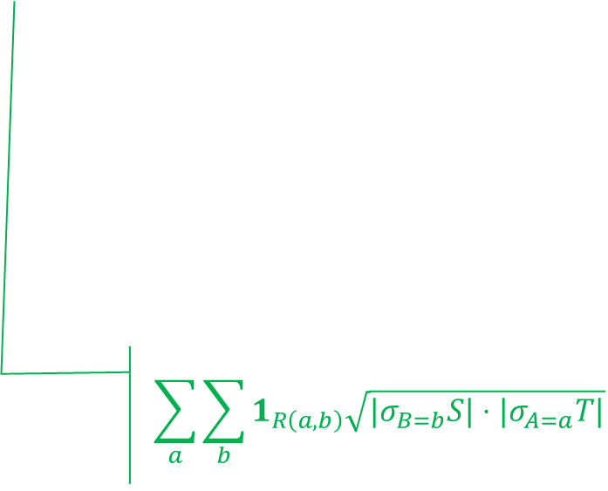
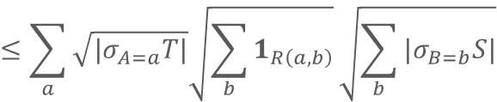
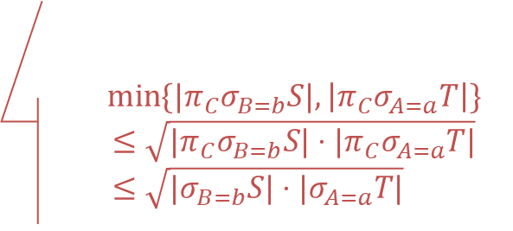


Algorithm from Holder argument
$$Q_{Δ}\left(A,B,C\right)←R\left(A,B\right), S\left(B,C\right), T(A,C)$$
for $a∈π_{A}R∩π_{A}T$ do
for $b∈π_{B}σ_{A=a}R∩π_{B}S$ do
for $c∈π_{C}σ_{B=b}S∩π_{C}σ_{A=a}T$ do
report $(a,b,c)$
$$\left|Q_{Δ}\right|=\sum_{a}{\sum_{b}{\sum_{c}{1_{R\left(a,b\right)}1_{S\left(b,c\right)}1_{T\left(a,c\right)}}}}$$
$$≤\sum_{a}{\sum_{b}{1_{R\left(a,b\right)}\sqrt{\sum_{c}{1_{S\left(b,c\right)}}}\sqrt{\sum_{c}{1_{T\left(a,c\right)}}}}}$$
$$\min{\{{|π}_{C}σ_{B=b}S|,\left|π_{C}σ_{A=a}T\right|\}}$$
$$≤\sqrt{{|π}_{C}σ_{B=b}S|⋅|π_{C}σ_{A=a}T|} \\ ≤\sqrt{|σ_{B=b}S|⋅|σ_{A=a}T|}$$
$$=\sum_{a}{\sum_{b}{1_{R\left(a,b\right)}\sqrt{{|σ}_{B=b}S|}\sqrt{|σ_{A=a}T|}}}$$
Total runtime:
$$≤\sum_{a}{\sqrt{{|σ}_{A=a}T|}\sqrt{\sum_{b}{1_{R\left(a,b\right)}}}\sqrt{\sum_{b}{{|σ}_{B=b}S|}}}$$
$$\sum_{a}{\sum_{b}{1_{R\left(a,b\right)}\sqrt{|σ_{B=b}S|⋅|σ_{A=a}T|} }}$$
$$=\sum_{a}{\sqrt{{|σ}_{A=a}T|}\sqrt{{|σ}_{A=a}R|}\sqrt{|S|}}$$
$$≤\sqrt{\left|R\right|⋅\left|S\right|⋅|T|}$$

Slide 16












The Entropy View (Shearer)
$$R$$
$$S$$
$$T$$
$$Q_{Δ}$$
A | B
1 | 1
1 | 2
2 | 2
2 | 5
2 | 6
B | C
1 | 1
1 | 2
2 | 1
2 | 2
3 | 1
3 | 3
A | C
1 | 1
1 | 2
2 | 1
2 | 2
A | B | C
1 | 1 | 1
1 | 1 | 2
1 | 2 | 1
1 | 2 | 2
2 | 2 | 1
2 | 2 | 2
1/3
1/3
1/3
¼
0
1/6
1/6
1/3
1/3
0
0
1/3
1/3
1/6
1/6
1/6
1/6
1/6
1/6
1/6
1/6
4
5
6
$$H\left[A,C\right]≤\log_{2}{|T|}$$
$$H\left[A,B\right]≤\log_{2}{|R|}$$
$$H\left[B,C\right]≤\log_{2}{|S|}$$
$$H\left[A,B,C\right]=\log_{2}{|Q_{Δ}|}$$
$$H\left[B|A\right]≤\log_{2}{3}$$
$H$ satisfies degree constraints
$H$ is entropic
$$H\left[A|B\right]≤\log_{2}{2}$$

Slide 17
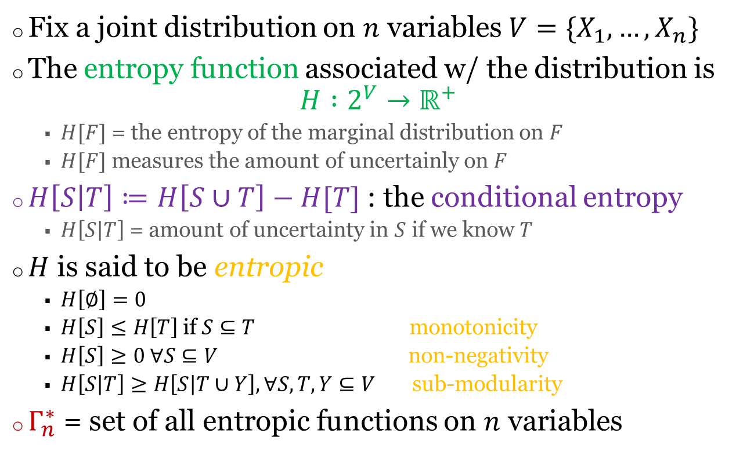
Information Theory Detour
Fix a joint distribution on $n$ variables$V=\{X_{1},…, X_{n}\}$
The entropy function associated w/ the distribution is
$H :2^{V}→ℝ^{+}$
  $H[F]$ = the entropy of the marginal distribution on $F$
  $H[F]$ measures the amount of uncertainly on $F$
$H\left[S | T\right]≔H\left[S∪T\right]−H[T]$ : the conditional entropy
  $H\left[S | T\right]$ = amount of uncertainty in $S$ if we know $T$
$H$ is said to be entropic
  $H\left[∅\right]=0$
  $H\left[S\right]≤H\left[T\right]$ if $S⊆T$ monotonicity
  $H\left[S\right]≥0 ∀S⊆V$ non-negativity
  $H\left[S | T\right]≥H\left[S | T∪Y\right], ∀S, T, Y⊆V$ sub-modularity
$Γ_{n}^{∗}$ = set of all entropic functions on $n$ variables
Shannon-type
inequalities

Slide 18


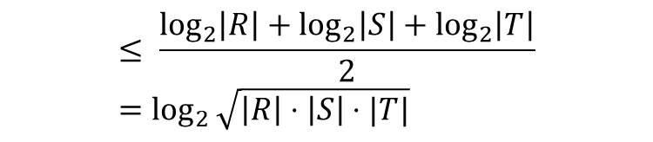

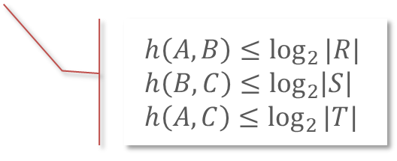

The Entropy Argument
There is a joint distribution on (A,B,C)
for which h is the entropy function of
$$\log\left|Q_{Δ}\right|=H\left[A,B,C\right]≤\max{h(A,B,C)}$$
s.t. $h$ is entropic
& $h$ satisfies degree constraints
$$h\left(A,B\right)≤\log_{2}{|R|} \\ h\left(B,C\right)≤\log_{2}\left|S\right| \\ h\left(A,C\right)≤\log_{2}{|T|}$$
$$h\left(A,B\right)+h\left(B,C\right)+h\left(A,C\right)$$
$$=h\left(A\right)+h\left(B | A\right)+h\left(B,C\right)+h\left(A,C\right)$$
Defn. of conditional entropy
$$=\left[h\left(A\right)+h\left(B,C\right)\right] +[h(B|A) +h\left(A,C\right)]$$
$$≥\left[h\left(A|B,C\right)+h\left(B,C\right)\right]+[h(B|A,C) +h\left(A,C\right)]$$
Submodularity, twice
$$=h\left(A,B,C\right) + h(A,B,C)$$
$$\log\left|Q_{Δ}\right|≤\max_{h∈Γ_{3}^{∗}∩DC}{h\left(A,B,C\right)}≤\max_{h∈Γ_{3}^{∗}∩DC}{\frac{h\left(A,B\right)+h\left(B,C\right)+h(A,C)}{2}}$$
$$≤ \frac{\log_{2}\left|R\right|+\log_{2}\left|S\right|+\log_{2}\left|T\right|}{2}=\log_{2}{\sqrt{\left|R\right|⋅\left|S\right|⋅|T|}}$$
$$⇒ \left|Q_{Δ}\right| ≤\sqrt{\left|R\right|⋅\left|S\right|⋅|T|}$$

Slide 19



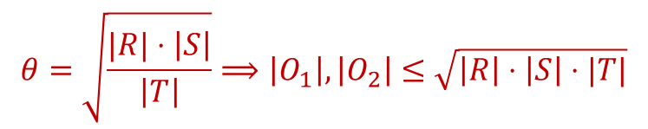













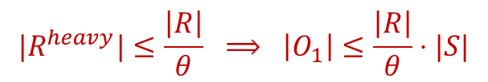



Algorithm from Entropy Argument
$$Q_{Δ}\left(A,B,C\right)←R\left(A,B\right), S\left(B,C\right), T(A,C)$$
$$R^{heavy}=\{\left(a,b\right)∈R :\left|σ_{A=a}R\right|>θ\}$$
$$R$$
$$S$$
$$T$$
$$R^{light}=\{\left(a,b\right)∈R :\left|σ_{A=a}R\right|≤θ\}$$
$$h\left(A,B\right)+h\left(B,C\right)+h\left(A,C\right)$$
$$R^{h}$$
$$R^{l}$$
$$=h\left(A\right)+h\left(B | A\right)+h\left(B,C\right)+h\left(A,C\right)$$
$$R(A,B)=R^{heavy}(A,B)∪R^{light}(A,B)$$
$$=\left[h\left(A\right)+h\left(B,C\right)\right] +[h(B|A) +h\left(A,C\right)]$$
$$R^{h}$$
$$S$$
$$R^{l}$$
$$T$$
$$O_{1}(A,B,C)=R^{heavy}(A,B)⋈S(B,C)$$
$$≥\left[h\left(A|B,C\right)+h\left(B,C\right)\right]+[h(B|A,C) +h\left(A,C\right)]$$
$$O_{2}(A,B,C)=R^{light}(A,B)⋈T(A,C)$$
$$=h\left(A,B,C\right) + h(A,B,C)$$
$${{Q_{Δ}=O}_{1}∪O}_{2}$$
$${|R}^{heavy}|≤\frac{\left|R\right|}{θ} ⟹ \left|O_{1}\right|≤\frac{\left|R\right|}{θ}⋅|S|$$
$$θ=\sqrt{\frac{|R|⋅\left|S\right|}{\left|T\right|}}⟹\left|O_{1}\right|, \left|O_{2}\right|≤\sqrt{\left|R\right|⋅\left|S\right|⋅|T|}$$
$$\left|O_{2}\right|≤\left|T\right|⋅θ$$

Slide 20
Holder-based Bound
Holder wasn’t the first to prove the inequality

Slide 21



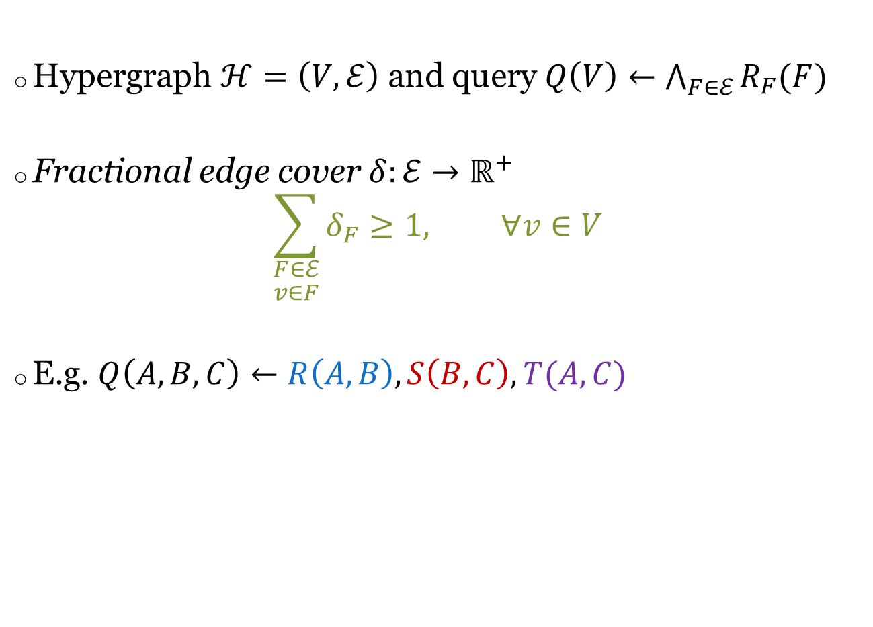



Fractional Edge Cover
Hypergraph $ℋ=\left(V,ℰ\right)$ and query $Q\left(V\right)←\bigwedge_{F∈ℰ}{R_{F}(F)}$
Fractional edge cover $δ:ℰ→ℝ^{+}$
$\sum_{\begin{aligned}F∈ℰ \\ v∈F\end{aligned}}{δ_{F}≥1, } ∀v∈V$
E.g. $Q\left(A,B,C\right)←R\left(A,B\right), S\left(B,C\right), T(A,C)$
R
T
R
T
A
A
$$δ_{R}=1/2$$
$$δ_{T}=1/2$$
$$δ_{R}=1$$
$$δ_{T}=1$$
S
S
B
C
B
C
$$δ_{S}=1/2$$
$$δ_{S}=0$$

Slide 22
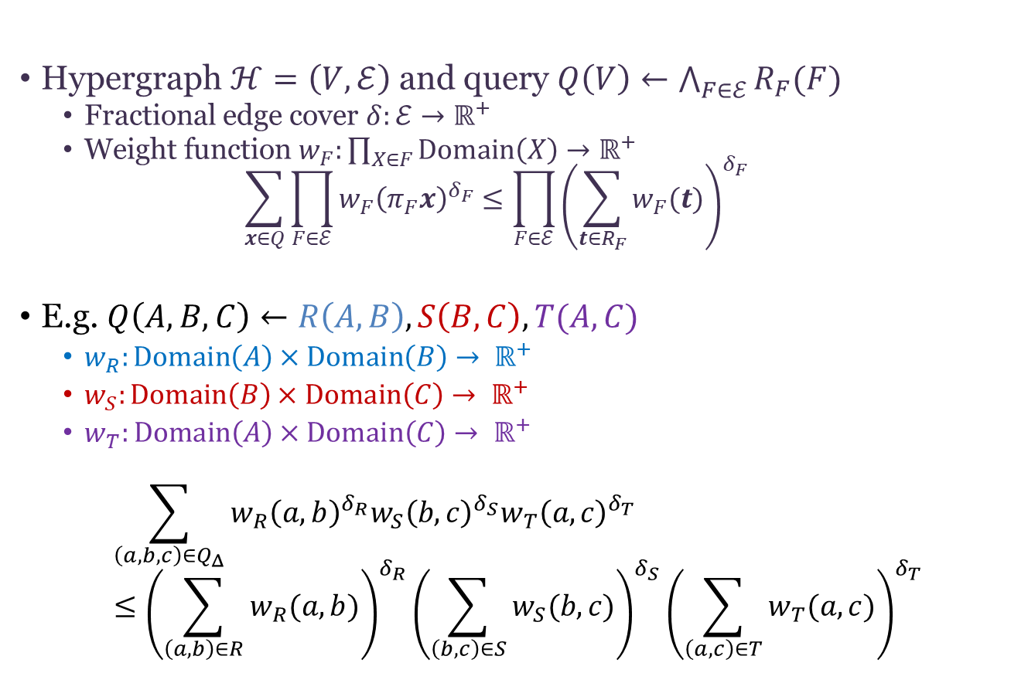
Friedgut Inequality (2004)
Hypergraph $ℋ=\left(V,ℰ\right)$ and query $Q\left(V\right)←\bigwedge_{F∈ℰ}{R_{F}(F)}$
  Fractional edge cover $δ:ℰ→ℝ^{+}$
  Weight function $w_{F}:\prod_{X∈F}{Domain\left(X\right)→ℝ^{+}}$
  $\sum_{x∈Q}{\prod_{F∈ℰ}{{w_{F}\left(π_{F}x\right)}^{δ_{F}}}≤\prod_{F∈ℰ}{{\left(\sum_{t∈R_{F}}{w_{F}(t)}\right)}^{δ_{F}}}}$
E.g. $Q\left(A,B,C\right)←R\left(A,B\right), S\left(B,C\right), T(A,C)$
  $w_{R}:Domain\left(A\right)×Domain\left(B\right)→ ℝ^{+}$
  $w_{S}:Domain\left(B\right)×Domain\left(C\right)→ ℝ^{+}$
  $w_{T}:Domain\left(A\right)×Domain\left(C\right)→ ℝ^{+}$
$$\sum_{\left(a,b,c\right)∈Q_{Δ}}{w_{R}{\left(a,b\right)}^{δ_{R}}w_{S}{\left(b,c\right)}^{δ_{S}}w_{T}{\left(a,c\right)}^{δ_{T}} }≤{\left(\sum_{\left(a,b\right)∈R}{w_{R}(a,b)}\right)}^{δ_{R}}{\left(\sum_{\left(b,c\right)∈S}{w_{S}(b,c)}\right)}^{δ_{S}}{\left(\sum_{\left(a,c\right)∈T}{w_{T}(a,c)}\right)}^{δ_{T}}$$
R
T
A
S
B
C

Slide 23
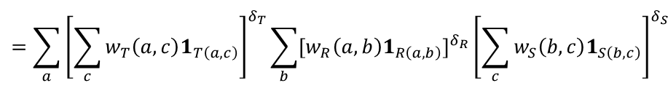
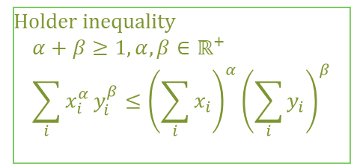
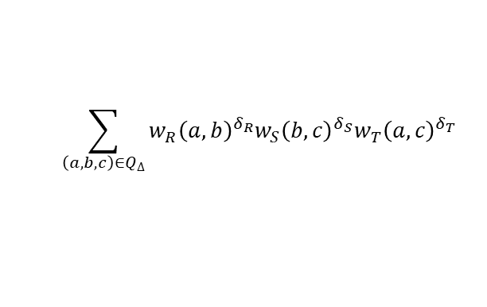
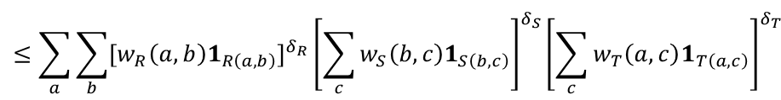


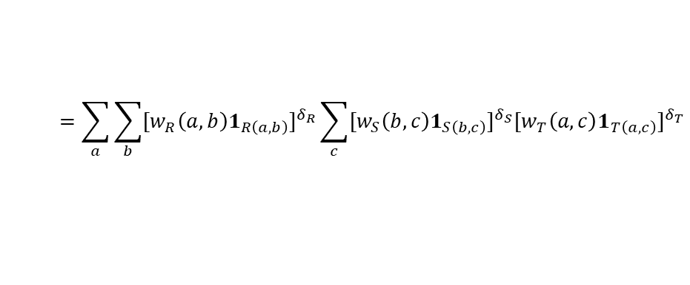
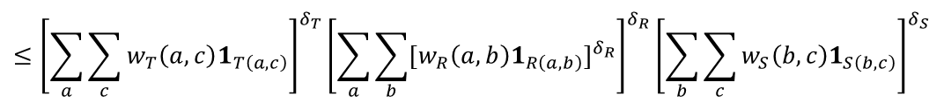
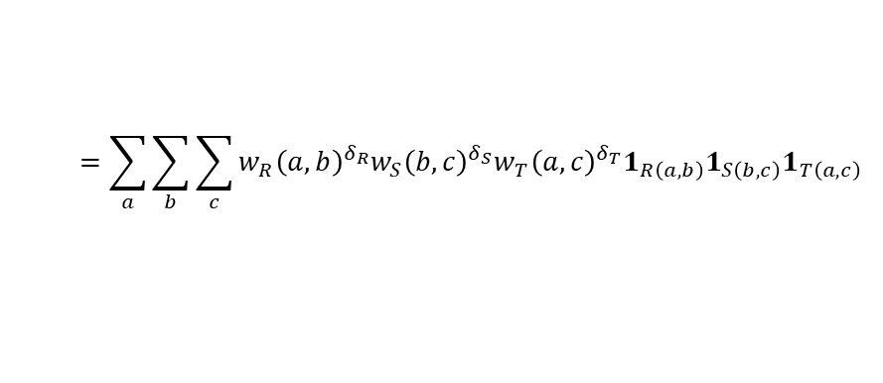
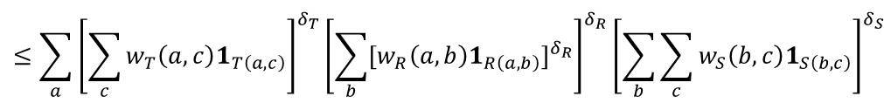
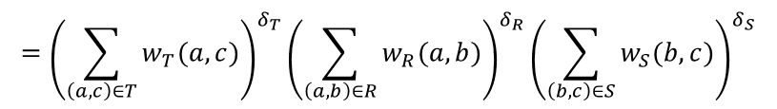
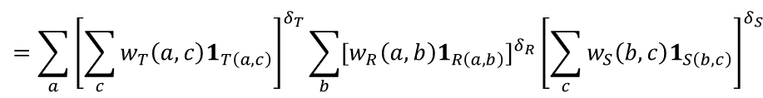
Proof for $n=3$, then let $3→∞$
$$\sum_{\left(a,b,c\right)∈Q_{Δ}}{w_{R}{\left(a,b\right)}^{δ_{R}}w_{S}{\left(b,c\right)}^{δ_{S}}w_{T}{\left(a,c\right)}^{δ_{T}} }$$
$$=\sum_{a}{\sum_{b}{\sum_{c}{w_{R}{\left(a,b\right)}^{δ_{R}}w_{S}{\left(b,c\right)}^{δ_{S}}w_{T}{\left(a,c\right)}^{δ_{T}}1_{R\left(a,b\right)}1_{S\left(b,c\right)}1_{T\left(a,c\right)}}} }$$
$$=\sum_{a}{\sum_{b}{{{[w}_{R}\left(a,b\right)1_{R\left(a,b\right)}]}^{δ_{R}}\sum_{c}{{{[w}_{S}\left(b,c\right)1_{S\left(b,c\right)}]}^{δ_{S}}{{[w}_{T}\left(a,c\right)1_{T\left(a,c\right)}]}^{δ_{T}}}} }$$
Holder inequality
$$α+β≥1, α, β∈ℝ^{+} \\ \sum_{i}{x_{i}^{α}}y_{i}^{β}≤{\left(\sum_{i}{x_{i}}\right)}^{α}{\left(\sum_{i}{y_{i}}\right)}^{β}$$
$$≤\sum_{a}{\sum_{b}{{{[w}_{R}\left(a,b\right)1_{R\left(a,b\right)}]}^{δ_{R}}{\left[\sum_{c}{w_{S}\left(b,c\right)1_{S\left(b,c\right)}}\right]}^{δ_{S}}{\left[\sum_{c}{w_{T}\left(a,c\right)1_{T\left(a,c\right)}}\right]}^{δ_{T}}} }$$
$$=\sum_{a}{{\left[\sum_{c}{w_{T}\left(a,c\right)1_{T\left(a,c\right)}}\right]}^{δ_{T}}\sum_{b}{{{[w}_{R}\left(a,b\right)1_{R\left(a,b\right)}]}^{δ_{R}}{\left[\sum_{c}{w_{S}\left(b,c\right)1_{S\left(b,c\right)}}\right]}^{δ_{S}}} }$$
$$=\sum_{a}{{\left[\sum_{c}{w_{T}\left(a,c\right)1_{T\left(a,c\right)}}\right]}^{δ_{T}}\sum_{b}{{{[w}_{R}\left(a,b\right)1_{R\left(a,b\right)}]}^{δ_{R}}{\left[\sum_{c}{w_{S}\left(b,c\right)1_{S\left(b,c\right)}}\right]}^{δ_{S}}} }$$
$$δ_{S}+δ_{T}≥1$$
$$≤\sum_{a}{{\left[\sum_{c}{w_{T}\left(a,c\right)1_{T\left(a,c\right)}}\right]}^{δ_{T}}{\left[\sum_{b}{{{[w}_{R}\left(a,b\right)1_{R\left(a,b\right)}]}^{δ_{R}}}\right]}^{δ_{R}}{\left[\sum_{b}{\sum_{c}{w_{S}\left(b,c\right)1_{S\left(b,c\right)}}}\right]}^{δ_{S}} }$$
$$≤{\left[\sum_{a}{\sum_{c}{w_{T}\left(a,c\right)1_{T\left(a,c\right)}}}\right]}^{δ_{T}}{\left[\sum_{a}{\sum_{b}{{{[w}_{R}\left(a,b\right)1_{R\left(a,b\right)}]}^{δ_{R}}}}\right]}^{δ_{R}}{\left[\sum_{b}{\sum_{c}{w_{S}\left(b,c\right)1_{S\left(b,c\right)}}}\right]}^{δ_{S}}$$
$$={\left(\sum_{\left(a,c\right)∈T}{w_{T}(a,c)}\right)}^{δ_{T}}{\left(\sum_{\left(a,b\right)∈R}{w_{R}(a,b)}\right)}^{δ_{R}}{\left(\sum_{\left(b,c\right)∈S}{w_{S}(b,c)}\right)}^{δ_{S}}$$

Slide 24
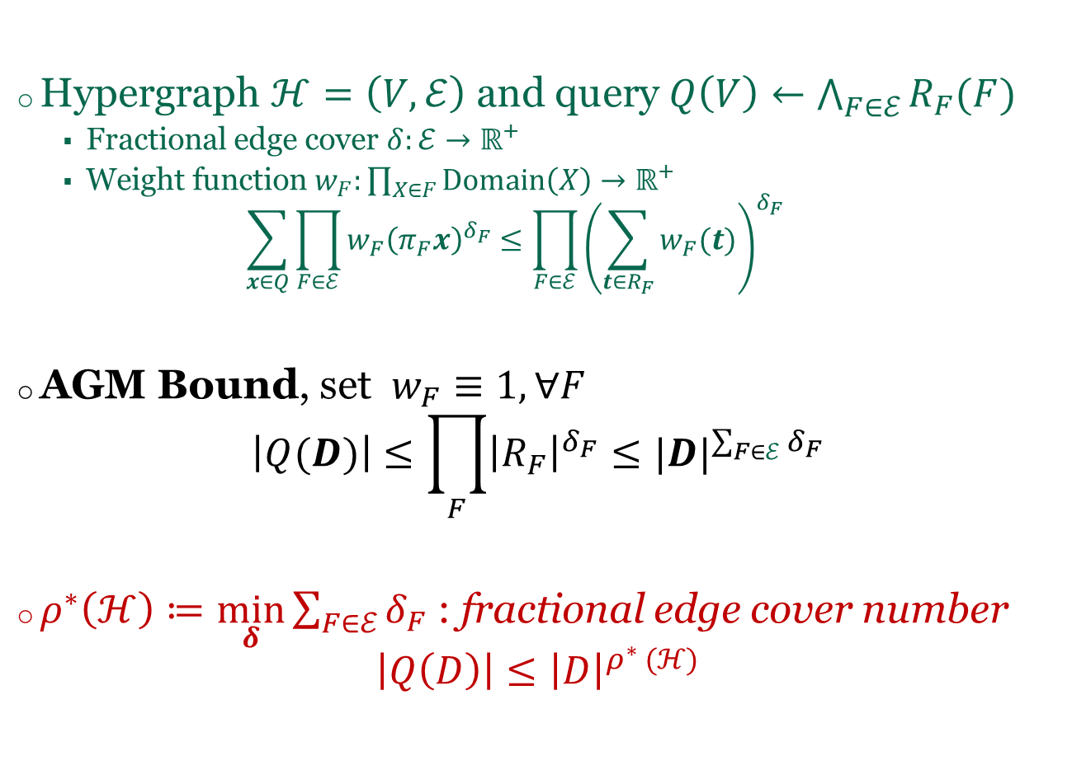

Friedgut Inequality $⇒$ AGM-Bound
Hypergraph $ℋ=\left(V,ℰ\right)$ and query $Q\left(V\right)←\bigwedge_{F∈ℰ}{R_{F}(F)}$
  Fractional edge cover $δ:ℰ→ℝ^{+}$
  Weight function $w_{F}:\prod_{X∈F}{Domain\left(X\right)→ℝ^{+}}$
  $\sum_{x∈Q}{\prod_{F∈ℰ}{{w_{F}\left(π_{F}x\right)}^{δ_{F}}}≤\prod_{F∈ℰ}{{\left(\sum_{t∈R_{F}}{w_{F}(t)}\right)}^{δ_{F}}}}$
AGM Bound, set $w_{F}≡1, ∀F$
$\left|Q(D)\right|≤\prod_{F}{{\left|R_{F}\right|}^{δ_{F}}}≤{|D|}^{\sum_{F∈ℰ}{δ_{F}}}$
$ρ^{∗}\left(ℋ\right)≔\min_{δ}{\sum_{F∈ℰ}{δ_{F}}}$ : fractional edge cover number
$\left|Q\left(D\right)\right|≤{\left|D\right|}^{ρ^{∗} (ℋ)}$

Slide 25
Entropy-based Bound
Lots of open problems

Slide 26
Information Theory Reminder
Fix a joint distribution on $n$ variables$V=\{X_{1},…, X_{n}\}$
The entropy function associated w/ the distribution is
$H :2^{V}→ℝ^{+}$
  $H[F]$ = the entropy of the marginal distribution on $F$
  $H[F]$ measures the amount of uncertainly on $F$
$H\left[S | T\right]≔H\left[S∪T\right]−H[T]$ : the conditional entropy
  $H\left[S | T\right]$ = amount of uncertainty in $S$ if we know $T$
$H$ is said to be entropic
  $H\left[∅\right]=0$
  $H\left[S\right]≤H\left[T\right]$ if $S⊆T$ monotonicity
  $H\left[S\right]≥0 ∀S⊆V$ non-negativity
  $H\left[S | T\right]≥H\left[S | T∪Y\right], ∀S, T, Y⊆V$ sub-modularity
$Γ_{n}^{∗}$ = set of all entropic functions on $n$ variables
Shannon-type
inequalities

Slide 27
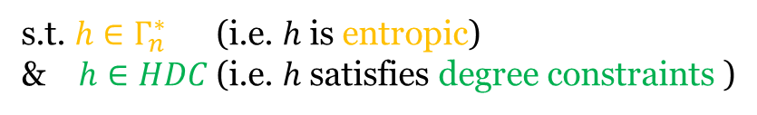

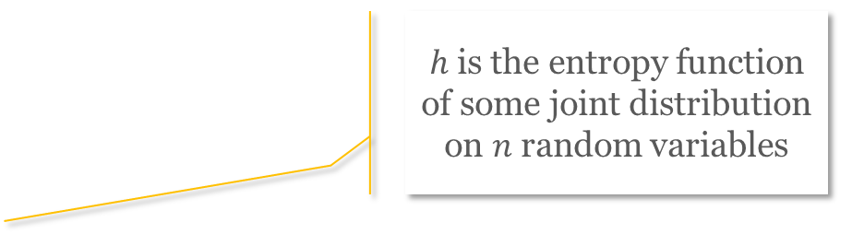
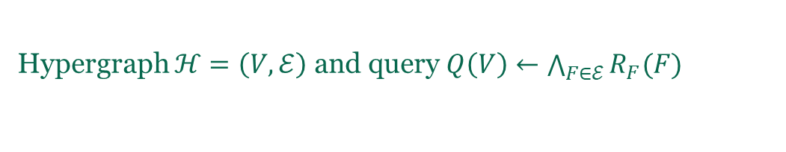
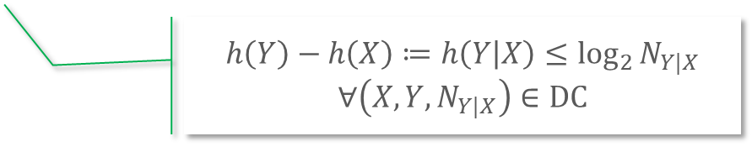
The Entropy Argument
$h$ is the entropy function of some joint distribution on $n$ random variables
Hypergraph $ℋ=\left(V,ℰ\right)$ and query $Q\left(V\right)←\bigwedge_{F∈ℰ}{R_{F}(F)}$
$$\log_{2}\left|Q(D)\right|=H\left[V\right]≤\sup{h(V)}$$
s.t. $h∈Γ_{n}^{∗}$ (i.e. $h$ is entropic)
& $h∈HDC$ (i.e. $h$satisfies degree constraints )
$$h\left(Y\right)−h\left(X\right)≔h\left(Y | X\right)≤\log_{2}{N_{Y|X}}$$
$∀\left(X, Y, N_{Y|X}\right)∈DC$
The entropic bound
$$\sup_{D⊨DC}{\log_{2}{|Q\left(D\right)|}}=\sup\left\{h\left(V\right) \right| h∈Γ_{n}^{∗}∩HDC\}$$
[ANS’16]
Is a cone
Not topologically closed
Not polyhedral
Membership not known to be decidable

Slide 28
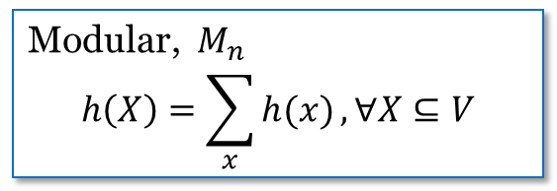






Relaxations $M_{n}⊂Γ_{n}^{∗}⊂{\overline{Γ}}_{n}^{∗}⊂Γ_{n}⊂{SA}_{n}$
Non-negative set functions $h :2^{V}→ℝ^{+}$
${SA}_{n}$
Monotonicity $h\left(S\right)≤h\left(T\right), S⊆T$
Subadditivity $h\left(S∪T\right)≤h\left(S)+h(T\right), ∀S,T⊆[V]$
Polymatroids,$Γ_{n}$
  Submodularity $h\left(S∪T\right)+h\left(S∩T\right)≤h\left(S\right)+h\left(T\right)$
Topological closure,${\overline{Γ}}_{n}^{∗}$
Entropic, $Γ_{n}^{∗}$
Modular, $M_{n}$
$$h\left(X\right)=\sum_{x}{h(x)}, ∀X⊆V$$

Slide 29





Hierarchy $M_{n}⊂Γ_{n}^{∗}⊂{\overline{Γ}}_{n}^{∗}⊂Γ_{n}⊂{SA}_{n}$
$$\max\left\{h\left(V\right) \right| h∈M_{n}∩HDC\}≤$$
Modular bound
Efficiently computable
$$\sup_{D⊨DC}{\log_{2}{|Q\left(D\right)|}}=\sup\left\{h\left(V\right) \right| h∈Γ_{n}^{∗}∩HDC\}$$
Entropic bound
Not known to be computable
$$=\max\left\{h\left(V\right) \right| h∈{\overline{Γ}}_{n}^{∗}∩HDC\}$$
Polymatroid bound
Computable
Not (known to be) efficiently computable
Not tight
Becomes fractional edge cover # under cardinality constraints
$$≤\max\left\{h\left(V\right) \right| h∈Γ_{n}∩HDC\}$$
$$≤\max\left\{h\left(V\right) \right| h∈{SA}_{n}∩HDC\}$$
Becomes integral edge cover # under cardinality constraints

Slide 30


Natural Follow-Up Questions
Entropic bound
Not known to be computable
Polymatroid bound
Computable, not tight
$$\sup_{D⊨DC}{\log_{2}{|Q\left(D\right)|}}=\max\left\{h\left(V\right) \right| h∈{\overline{Γ}}_{n}^{∗}∩HDC\}$$
$$≤\max\left\{h\left(V\right) \right| h∈Γ_{n}∩HDC\}$$
When do these two bounds collide?
When they do, is there a matching algorithm?

Slide 31

Degree-Constraint Dependency Graph
$G_{DC}=\left(V,E_{DC}\right)$
  $V$ = set of all variables -- same as $V$ in $ℋ=\left(V,ℰ\right)$
  $E_{DC}=\{X×\left(Y−X\right) :\left(X,Y,N\right)∈DC\}$
Ex 1: $Q\left(A,B,C\right)←R\left(A,B\right), S\left(B,C\right), T(A,C)$
  $\left(∅, AB, \left|R\right|\right), \left(∅, BC,\left|S\right|\right), \left(∅, AC, \left|T\right|\right)$
  $G_{DC}=(\left\{A,B,C,\right\}, ∅)$
Ex 2: $Q\left(A,B,C\right)←R\left(A,B\right), S\left(B,C\right), T(A,C)$
  $\left(∅, AB, \left|R\right|\right),\left(A AB, 1\right), \left(∅, BC,\left|S\right|\right),\left(C, BC,N_{2}\right),\left(∅, AC, \left|T\right|\right)$
Ex 3: $Q\left(A,B,C\right)←R\left(A,B\right), S\left(B,C\right), T(A,C)$
  $\left(∅, AB, \left|R\right|\right),\left(A AB, 1\right), \left(∅, BC,\left|S\right|\right),\left(B, BC,N_{2}\right),$
  $\left(∅, AC, \left|T\right|\right), (C, AC,N_{3})$
A
B
C
A
B
C
A
B
C

Slide 32


Acyclic Degree Constraints & Properties
DC is acyclic iff $G_{DC}$ is a directed acyclic graph (DAG)
  DC is acyclic if it contains only cardinality constraints
  DC is acyclic if it has cardinality constraints and key-foreign key FDs
Recall: the modular bound is efficiently computable!
$M_{n}=\left\{h:2^{V}→ℝ^{+} \right| h\left(X\right)=\sum_{x}{h(x)}, ∀X⊆V\}$
Theorem: given $Q$ and acyclic DC, then
$\max_{h∈M_{n}∩HDC}{h\left(V\right)=}\sup_{D⊨DC}{\log_{2}{|Q\left(D\right)|}}=\max_{h∈{\overline{Γ}}_{n}^{∗}∩HDC}{h\left(V\right)}$ =$\max_{h∈Γ_{n}∩HDC}{h\left(V\right)}$

Slide 33





$\max_{h∈M_{n}∩HDC}{h\left(V\right)}$ and Linear Programming Duality
$$\max{\sum_{v∈V}{h(v)}}$$
$$\sum_{v∈Y−X}{h\left(v\right)≤\log{N_{Y|X}}, \left(X,Y,N_{Y|X}\right)∈DC}$$
$h\left(v\right)≥0, v∈V$
$$\min{\sum_{\left(X,Y,N_{Y|X}\right)∈DC}{δ_{Y|X}\log{N_{Y|X}}}}$$
$$\sum_{\begin{aligned}\left(X,Y,N_{Y|X}\right)∈DC \\ v∈Y−X\end{aligned}}{δ_{Y|X}≥1, v∈V}$$
$δ_{Y|X}≥0, \left(X,Y,N_{Y|X}\right)∈DC$
Fractional vertex packing
Fractional edge covering
Exactly the AGM bound if all constraints are of the form $(∅, Y, N_{Y})$
$h^{∗}$ : primal optimal, and $δ^{∗}$ : dual optimal, then
$$\sup_{D⊨DC}\left|Q\left(D\right)\right|=2^{h^{∗}(V)}=\prod_{\left(X,Y,N_{Y|X}\right)∈DC}{N_{Y|X}^{δ_{Y|X}^{∗}}}$$

Slide 34
Natural Follow-Up Questions
Entropic bound
Not known to be computable
Polymatroid bound
Computable, not tight
$$\sup_{D⊨DC}{\log_{2}{|Q\left(D\right)|}}=\max\left\{h\left(V\right) \right| h∈{\overline{Γ}}_{n}^{∗}∩HDC\}$$
$$≤\max\left\{h\left(V\right) \right| h∈Γ_{n}∩HDC\}$$
When do these two bounds collide?
Acyclic DC is sufficient
When they do, is there a matching algorithm?
Yes, a Holder-based algorithm

Slide 35

But what if DC is not acyclic?
Run the entropy-based algorithm (PANDA)
Theorem: when $DC$ is not acyclic, we can construct $DC’$ from $DC$ such that
  $DC’$ is acyclic
  $D⊨DC⟹D⊨DC′$
Run Holder-based algorithm on $DC′$

Slide 36
Holder-based Algorithm
Backtracking search, along the line of LFTJ & Generic Join

Slide 37


Backtracking Search for Acylic DC
BTS
$ℋ=\left(V,ℰ\right)$Relations $R_{F}$ for $F∈$ $ℰ$
Acyclic DC set, each $\left(X,Y,N_{Y|X}\right)$ has a guard $R$
Input:
Pick $A∈V$ s.t. ${indegree}_{G_{DC}}\left(A\right)=0$
$I=\bigcap_{\begin{aligned}\left(∅,Y,N_{Y|∅}\right)∈DC \\ A∈Y, R guards it\end{aligned}}{π_{A}R}$
for each $a∈I$ do
$ℋ^{a}=\left(V^{a},ℰ^{a}\right);$ relations $R_{F}^{a}$ for $F∈$ $ℰ^{a}$, constraints ${DC}^{a}$
$Q^{a}=BTS(ℋ^{a}$, $R_{F}^{a},DC^{a})$
$Q←Q∪Q^{a}$
Return $Q$

Slide 38









The Sub-Problems
… // variable A selected
for each $a∈I$ do
$ℋ^{a}=\left(V^{a},ℰ^{a}\right);$ relations $R_{F}^{a}$ for $F∈$ $ℰ^{a}$, constraints ${DC}^{a}$
$Q^{a}=BTS(ℋ^{a}$, $R_{F}^{a},DC^{a})$
$Q←Q∪Q^{a}$
…
$$R(A,B,C)$$
$$V^{a}=V−\{A\}$$
$$ℰ^{a}=\{F∖\left\{A\right\} :F∈ℰ\}$$
A | B | C
a | 1 | 1
a | 1 | 2
a | 2 | 3
a’ | 1 | 1
a’ | 1 | 2
a’ | 1 | 3
a’’ | 1 | 1
a’’ | 2 | 2
$$R_{}^{a}$$
$$R_{F}^{a}=\left\{\begin{aligned}R_{F}, A∉F \\ {π_{F−\{A\}}σ}_{A=a}R_{F}, A∈F\end{aligned}\right.$$
$${DC}^{a}=\left\{ \left(X∖\left\{A\right\}, Y∖\left\{A\right\}, N_{Y∖\{A\}|∖\{A\}}\right) \right| \left(X,Y,N_{Y|X}\right)∈DC\}$$
$R^{a}$ guards this
$$⟸$$
$R$ guards this
$$⟸$$

Slide 39






Analysis
$$Time\left(Q\right)≤\sum_{a∈I}{Time(Q^{a})}$$
$$≤\sum_{a∈I}{\prod_{\begin{aligned}\left(∅, Y, N_{Y|∅}\right)∈DC \\ A∈Y \\ R is the guard\end{aligned}}{{|σ_{A=a}R|}^{δ_{Y|∅}}}\prod_{\begin{aligned}\left(X, Y, N_{Y|X}\right)∈DC \\ A∉Y\end{aligned}}{N_{Y|X}^{δ_{Y|X}}}}$$
Induction hypothesis
$$≤\prod_{\begin{aligned}\left(∅, Y, N_{Y|∅}\right)∈DC \\ A∈Y \\ R is the guard\end{aligned}}{{\left(\sum_{a∈I}{|σ_{A=a}R|}\right)}^{δ_{Y|∅}}}\prod_{\begin{aligned}\left(X, Y, N_{Y|X}\right)∈DC \\ A∉Y\end{aligned}}{N_{Y|X}^{δ_{Y|X}}}$$
Friedgut inequality
$$≤\prod_{\begin{aligned}\left(∅, Y, N_{Y|∅}\right)∈DC \\ A∈Y \\ R is the guard\end{aligned}}{{\left(N_{Y|∅}\right)}^{δ_{Y|∅}}}\prod_{\begin{aligned}\left(X, Y, N_{Y|X}\right)∈DC \\ A∉Y\end{aligned}}{N_{Y|X}^{δ_{Y|X}}}$$
$R$ guards $(∅, Y, N_{Y|∅})$
$$≤\prod_{\left(X, Y, N_{Y|X}\right)∈DC}{N_{Y|X}^{δ_{Y|X}}}$$

Slide 40
Entropy-based Algorithm
Where Shannon-type inequalities are interpreted as relational operators

Slide 41



So we have to settle for less
Entropic bound
Not known to be computable
Polymatroid bound
Computable, not tight
$$\sup_{D⊨DC}{\log_{2}{|Q\left(D\right)|}}=\max\left\{h\left(V\right) \right| h∈{\overline{Γ}}_{n}^{∗}∩HDC\}$$
$$≤\max\left\{h\left(V\right) \right| h∈Γ_{n}∩HDC\}$$
PANDA runs in time $\tilde{O}\left(\left|D\right|+2^{polymatroid bound}\right)$
  $\tilde{O}$ hides humongous factors in query size and polylog in data size
  Works for (a type of) disjunctive datalog rule $⊃$ conjunctive queries
Three main steps
  $\max\left\{h\left(V\right) \right| h∈Γ_{n}∩HDC\}$ and its dual gives Shannon-flow inequality
  Show that there’s a “proof sequence” for the SFI
  Convert each step in the proof sequence into a relational operator

Slide 42


Example
$Q←R\left(A,B\right),S\left(B,C\right),T\left(C,D\right),W\left(A,C,D\right),V\left(A,B,D\right)$
$2^{polymatroid bound}=\sqrt{N_{1}N_{2}N_{3}N_{4}N_{5}}$
  (under mild assumptions above relative magnitutes of $N_{i}$)
  E.g. $N_{1}=N_{2}=N_{3}=N, N_{4}=N_{5}=1$ then we want $O\left(N^{1.5}\right)$-time
Constraint | Guard
$$(∅, AB, N_{1})$$ | $$R$$
$$(∅, BC, N_{2})$$ | $$S$$
$(∅, CD, N_{3})$ | $$T$$
$$(AC,ACD,N_{4})$$ | $$W$$
$$(BD,ABD,N_{5})$$ | $$V$$

Slide 43


Corresponding Shannon-flow inequality
The following inequality holds for all polymatroids
Implies $\left|Q\right|≤\sqrt{N_{1}N_{2}N_{3}N_{4}N_{5}}$
$$h\left(ABCD\right)≤\frac{1}{2}\left(h\left(AB\right)+h(BC)+h\left(CD\right)+h\left(ACD | AC\right)+h(ABD|BD)\right)$$

Slide 44

Proof sequence
$$h\left(AB\right)+h\left(BC\right)+h\left(CD\right)+h\left(ACD | AC\right)+h\left(ABD | BD\right) \\ =h\left(AB\right)+h\left(B\right)+h\left(BC | B\right)+h\left(CD\right)+h\left(ACD | AC\right)+hABD\left|BD\right) \\ ≥h\left(AB\right)+h\left(B\right)+h\left(BC | B\right)+h\left(BCD | B\right)+h\left(ACD | AC\right)+h\left(ABD | BD\right) \\ =h\left(AB\right)+h\left(BC | B\right)+h\left(BCD\right)+h\left(ACD | AC\right)+h\left(ABD | BD\right) \\ ≥h\left(AB\right)+h\left(BC | B\right)+h\left(BCD\right)+h\left(ACD | AC\right)+h\left(ABCD | BCD\right) \\ =h\left(AB\right)+h\left(BC | B\right)+h\left(ACD | AC\right)+h\left(ABCD\right) \\ ≥h\left(AB\right)+h\left(ABC | AB\right)+h\left(ACD | AC\right)+h\left(ABCD\right) \\ =h\left(ABC\right)+h\left(ACD | AC\right)+h\left(ABCD\right) \\ ≥h\left(ABC\right)+h\left(ABCD | ABC\right)+h\left(ABCD\right)$$
$=h(ABCD)$ $+h\left(ABCD\right)$

Slide 45

PANDA
Proof step | Operation | Action
$h\left(BC\right)→h\left(B\right)+h(BC|B)$ | Partition | $S→S^{heavy}∪S^{light}$ threshold $θ$
$h\left(CD\right)→h(BCD|D)$ | NOOP | $T$ “affiliated” with $h(BCD\left|B\right|)$
$h\left(B\right)+h\left(BCD | B\right)→h(BCD)$ | Join | $I_{1}\left(B,C,D\right)←S^{heavy}\left(B,C\right)⋈T\left(C,D\right)$
$h\left(ABD | BD\right)→h(ABCD|BCD)$ | NOOP | $V$ “affiliated” with $h(ABCD|BCD)$
$$h\left(ABCD | BCD\right)+h\left(BCD\right)→h(ABCD)$$ | Join | $O_{1}←V\left(A,B,D\right)⋈I_{1}\left(B,C,D\right)$
$h\left(BC | B\right)→h(ABC|AB)$ | NOOP | $S^{light}$ “affiliated” with $h(ABC|AB)$
$h\left(AB\right)+h\left(ABC | AB\right)→h(ABC)$ | Join | $I_{2}\left(A,B,C\right)←R\left(A,B\right)⋈S^{light}(B,C)$
$h\left(ACD | AC\right)→h(ABCD|ACD)$ | NOOP | $W$ “affiliated with $h(ABCD|ACD)$
$$h\left(ABC\right)+h\left(ABCD | ABC\right)→h(ABCD)$$ | Join | $O_{2}\left(A,B,C,D\right)←I_{2}\left(A,B,C\right)⋈W(A,C,D)$

Slide 46
Open Problems
Some are much harder than others

Slide 47

1. Is the entropic bound computable?
2. What is the computational (query) complexity of computing the polymatroid bound?
3. For which class of $DC$ is the best acyclic modification tight w.r.t. $DC$?
4. For which class of $DC$ is the polymatroid bound tight?

Slide 48
5. Improve the (humongous) hidden factors in PANDA
6. Theory and algorithm for average case output size bound
7. Theory and practical algorithms for instance-optimal query evaluation
8. Theory and practical algorithms for optimizers of multi-way join operators

Slide 49

Spectrum of Problems and Solutions
 | Simple |  | Complex
Constraints | Cardinality only |  | General degree constraints ($⊃$ FDs & cardinality constraints)
Output size bound | Tight & poly-time computable in query complexity |  | Tight & not (known to be) computable
 |  |  | Not tight & computable (but not known to be in P)
Argument | Holder argument |  | Entropy argument
Best known algorithms | NPRR, LFTJ, Generic Join |  | PANDA
 | Simple |  | Complicated
 | Worst-case optimal |  | Not worst-case optimal
 | No hidden factor in $\tilde{O}$ |  | Large hidden factor in $\tilde{O}$
 | $O(1)$ memory footprint |  | Requires intermediates
 | Based on Holder-style proof |  | Based on Shannon-type inequality style proof
 | Practical (LogicBlox, RelationalAI, etc.) |  | …
See writeup

Slide 50
Thank you!

