Slide 1
Summary of C++ since the midterm
These are “single statements” that you should understand.
Buzzwords in RED.

Slide 2
Everything exists in one file
The file must contain a main( )
All functions are outside of main but called from main
All variables defined within main are known only to main
All variables defined within a function are known only to the function
All variables defined outside of main are considered “global” and can be accessed from any function in the file.

Slide 3
Functions
Functions that return values to main are int, double, char, string, bool
Functions that do not return values to main are void
Non-void functions are called using an assignment statement
Functions use parenthesis ( )
Variables passed to a function are defined in the parenthesis
e.g.
void drawLine( int length, char displayChar )

Slide 4
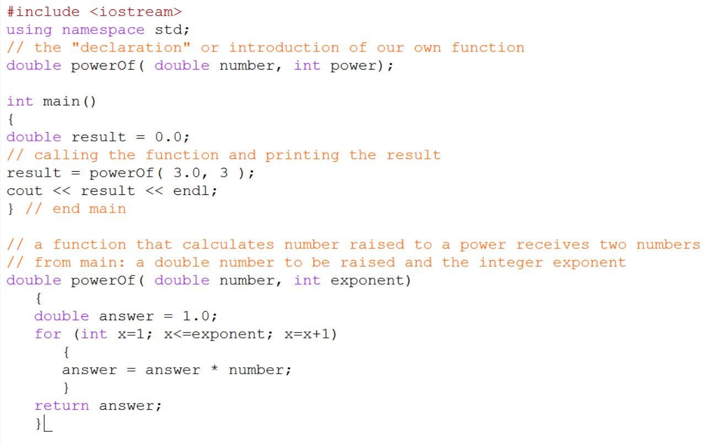
exercise
Write an int, double, string, and void function

Slide 5
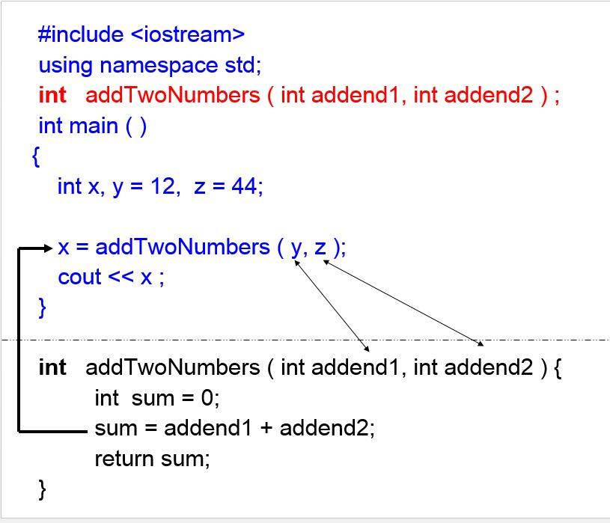
Please understand this statement
If a function is non-void, and requires two variables to be supplied by main, then there are 6 total variables involved in the exchange.

Slide 6
Arrays
Arrays are indexed from 0 to size-1
All array items are of the same type
Arrays use square brackets [ ]
Array initializations use { }
e.g.
int employeeID[ 5 ] = { 1, 2, 3, 4, 5 };
Either a number, or a constant int, must be used in array definitions
e.g.
const int size = 5;
int employeeID[ size ] = { 1, 2, 3, 4, 5 };
The word “index” cannot be used as a variable name.

Slide 7
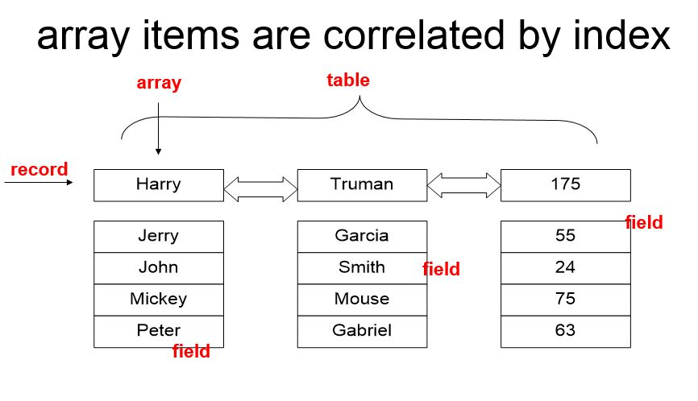
Arrays
Each array element is called a “field”
Correlated fields across more than one array form a “record”
Many records form a “table”
Many tables form a “database”

Slide 8
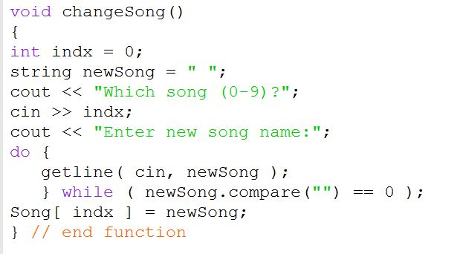
exercise
Understand the myTunes.cpp program. Change song values.

Slide 9
Bubble sort
“bubble sort” is used to order numbers in an array
in a nested for loop, the inner loop goes through every item for each change in the outer loop.
In the bubble sort, the inner loop begins at one item greater than the outer loop.
an array swap takes 3 steps

Slide 10
exercise
Experiment with nested for loops. Write one unrestricted, write one that mimics bubble sort.
Exchange two array items.

Slide 11
exercise
Be very familiar with the various uses of
( ) - math equations, function parameter passing, if/while conditions
{ } - code paragraphs after if/while, function boundaries (including main), initialize arrays
[ ] - define arrays

Slide 12
Excel, for next week
Windows link: http://www.buffalo.edu/ubit/service-guides/software/downloading/windows-software/managing-your-software/microsoft-office-2010-professional-plus.html
Mac link: http://www.buffalo.edu/ubit/service-guides/software/downloading/macintosh-software/managing-mac-software/microsoft-office-2011-standard.html

