Slide 1
Recitation 2 (Week 3)
CSE 305: Spring 2023
Slides modified by KWR and TAs from versions used by L. Ziarek in Spring 2022, in turn modified from slides by David Walker of Princeton.

Slide 2
Logistics and topics
Homework 1 (still not posted yet as on Monday 1pm) will be due next Monday (*both TopHat and Autolab parts), “midnight stretchy.”
No late submission, we will take the latest version of your submission for grading
You can submit as many times as you may need
Any extension requests should come by e-mail to KWR, not on Piazza.
[Have students sign a sheet of paper in hardcopy. I am not making separate TopHat sections, will lump together with TopHat lecture attendance if this doesn’t cause tangled-up issues from having multiple rec. sessions but 1 attendance item..]
Today: Functions, Parameters, and Built-In Types, including tuples and (maybe) lists.
Thursday’s Lecture: Generating Types and Pattern Matching (how both have some affinity to BNF grammars).
Next week: digging in to the OCaml type system.

Slide 3

Submission instruction: Autolab
Access autolab at : https://autograder.cse.buffalo.edu
If you already have an account, log in!
If you haven’t used autolab before, click on “Forgot your password?”, provide your buffalo email address, then an email with instruction on how to reset your password will be sent to you.

Slide 4
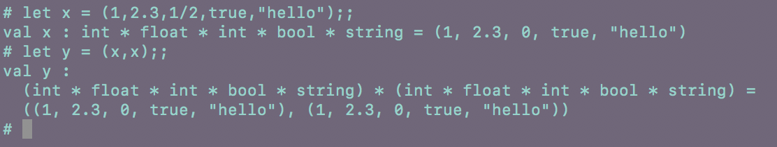
Tuples
Create collections of values:
Syntax:
(exp₁, exp₂, … , exp_{n})
Example:
let x = (1, 2.3, 1/2, true, “hello”);;
let y = (x,x);;
[Show error from copying the smart quotes, then change them to simple quotes and redo.]

Slide 5
Tuples and Cartesian Product Types
More simply put, if a is an element in a set A and b in a set B, then the ordered pair (i.e., “2-tuple”) (a,b) is a member of the Cartesian Product A x B.
This goes for more than pairs. Here OCaml gives a 5-tuple that belongs to the 5-fold Cartesian product {integers} x {floating-pt. #s} x {integers} x {true, false} x {strings}.
Don’t want “x” to be confused with a variable, so use * for Cartesian product instead. And use the official names of these sets, so the type is
int * float * int * bool * string.
Note it is AOK to use int twice. Indeed, you can do the Cartesian product of a set with itself, like A x A. Members can be pairs (a1,a2) with different a1,a2 in A. You don’t have to repeat the member as (a,a).
Tuple types can nest. Parentheses are needed to express the nesting.
The example let y = (x,x);; gives an example of a pair where the nested element does repeat. OCaml says that y has type
(int * float * int * bool * string) * (int * float * int * bool * string)
Now try it with let x2 = (1, 2.3, 1/2.0, true, hello);; (where I’ve saved the string ”hello” in a variable called hello because the ”ex-boyfriend” is not letting me type simple quotes in PowerPoint). The common way to ensure floating-point division in C/C++ etc does not work in OCaml because both arguments must be float and must write /. for the operator. Fiddle around showing errors, then fix it to (noting why space before 2.0 too):
let x2 = (1, 2.3, 1.0/. 2.0, true, hello);;

Slide 6
Functions in Ocaml
Syntax (which says that specifying types of argument and/or value is optional)
let <funname> <arg> = EXPR
| let <funname> [(]<arg>: TYPE[)] = EXPR
| let <funname> (<arg>: TYPE) : TYPE = EXPR
Red stuff is literal. The grey square brackets are “EBNF meta” saying that the literal parentheses are optional.
Italics mean any legal identifier. The BNF for TYPE will be on Thu.
The third line says that if you give the output type too, then the parens around the input type are not optional---examples next slide.
Parens could be optional in the first rule too, but we’ll later extend <arg> into more-general rules that can include parens automatically.
Recursive functions are the same syntax options with let rec in place of let. E.g. the third rule becomes
let rec <funname> (<arg>: TYPE) : TYPE = EXPR
The “rec” is needed whenever the function name appears in the body EXPR.
Notes:
Demo :
functions.sml
-What does _ do?
When you do not want to bind the value to some name – they act like wild cards

Slide 7
Simple Examples [again, fix the bad Courier quotes]
let f x = if x < 4 then “small” else “big”;;
Ocaml can infer both that the type of x is int and the return type is string. Python is similar:
def f(x):
return ("small" if x < 4 else "big")
[if you use the Python interpreter remember to enter a blank line to finish the function.]
Scala does not try to infer the argument type---you need to do
def f(x:Int) = if (x < 4) "small" else "big“
Now back to Ocaml: try let f2 x:int = if x < 4 then “small” else “big”;;
Even though you rammed “:int” right up against “x”, the parser thinks int is the return type, so you get an error. You need let f2 (x:int) = … etc.
Now try let f3 x = if x < 3.5 then “small” else “big”;;
Is this an error? Did we need to write “if x <. 3.5 …” ? Actually, unlike the arithmetic operators, the comparison operators < > = <= >= are truly polymorphic, working with various ordered types.

Slide 8
The Type of a Function
In math, if a function takes arguments in a set A and gives values that belong to a set B, we write f: A → B.
Some sets are regarded as being types. The base types include:
int for the set of integers
float for the set of (machine-representable) real numbers. (Note: this is “less base” in certain senses.)
bool for the set {true, false}
char for the set of legal characters
string for the set of legal immutable strings---treated as basic rather than as “char list”
unit is a special ML type standing for the set whose only member is ().
We will see in Thursday’s lecture how compound types are built up from these in general; ---well, we will see Cartesian product for tuples and list-making right now.
So if A and B are not just names of sets but names of types, then the type of f is
A -> B

Slide 9
Examples:
If you don’t give the type info for a function explicitly, OCaml can usually infer the type of the function from looking at the types of how the arguments are used and values given.
What’s the type of this function:
let foo1 (x : int) : bool =
if x < 0 then
true
else
false;;
[Then do it without giving the type info]
Notes:
Give alternative ways of specifying this function – change types to int

Slide 10
Examples:
What’s the type of this function?
let foo2 (x,y) =
if x < y then
x - y
else
y - x;;
Notice the argument is properly a tuple. What operator enables OCaml here to infer that x and y must both be integers? Try writing its floating-point version instead.
Notes:
Give alternative ways of specifying this function – change types to int

Slide 11
Arrows Versus Tuples
First try calling foo2 2,3;; without the parens around the tuple. You will get an error. What was OCaml trying to do?
Now let us redo the function definition without using a tuple (beware of “smart –”):
let foo3 x y = if x < y then x - y else y - x;;
And try foo3 2 3;; It is legal---!---but what exactly did you get as the value?
The type of foo3 is returned as int -> int -> int. As will follow from the Tue. 2/14 and Thu. 2/16 lectures together, this kind of chain groups right-to-left, so it is really
int -> (int -> int)
That is to say, foo3 is a function that takes a single argument x and returns a function from into to int. We can give it a name:
let goo3 = foo3 2;;
Then goo3 3;; will return the same action we got with foo3 2 3;;
Thus the arrows, as opposed to the tuple form of multiple arguments, do functions in a “knock-on” manner. The important first takeaway is that functions are treated as values. The second is that every OCaml function formally has just one argument: a tuple counts as a single object, and a list of arguments without parens or commas knocks-on one argument at a time.

Slide 12
YMMV
[This is where my Monday 1pm coverage ended. If time allows, you can go on to more slides. The next few are repetitive of the “let” forms. Then there are more tuple and function type examples. The slides at the end on lists and pattern matching will be started on in Thursday’s lecture and continued into next week in both recitations and lectures.]

Slide 13
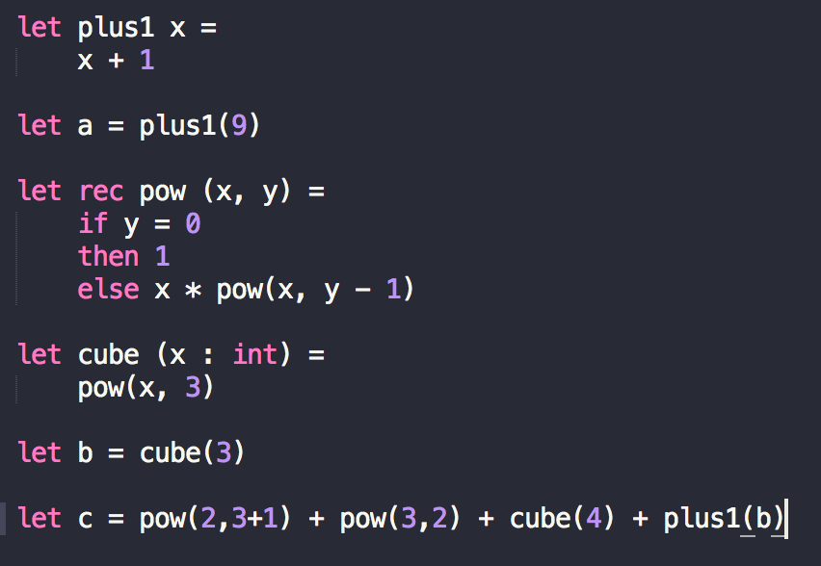
Functions – function.ml
Notes:
Give alternative ways of specifying this function – change types to int

Slide 14
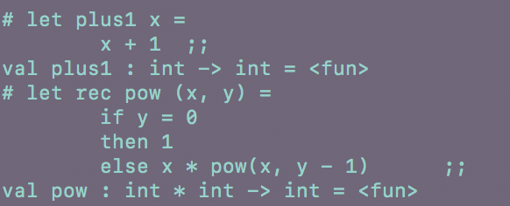

Type checking of Functions
Notes:
Give alternative ways of specifying this function – change types to int

Slide 15
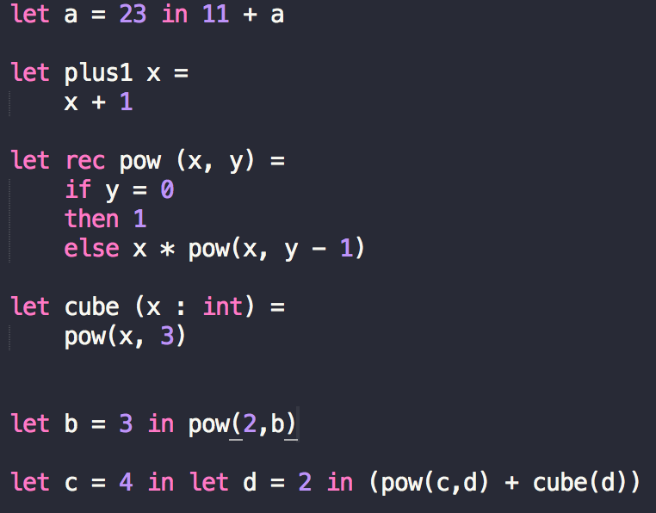
Example– let.ml
Notes:
Demo :
functions.sml
-What does _ do?
When you do not want to bind the value to some name – they act like wild cards

Slide 16
Types of Tuple
What would be the type of these tuples:
let x = (12,0.9,"foo",true);;
let z = (34,0.1);;
let y = ((z,"mix"),90);;

Slide 17
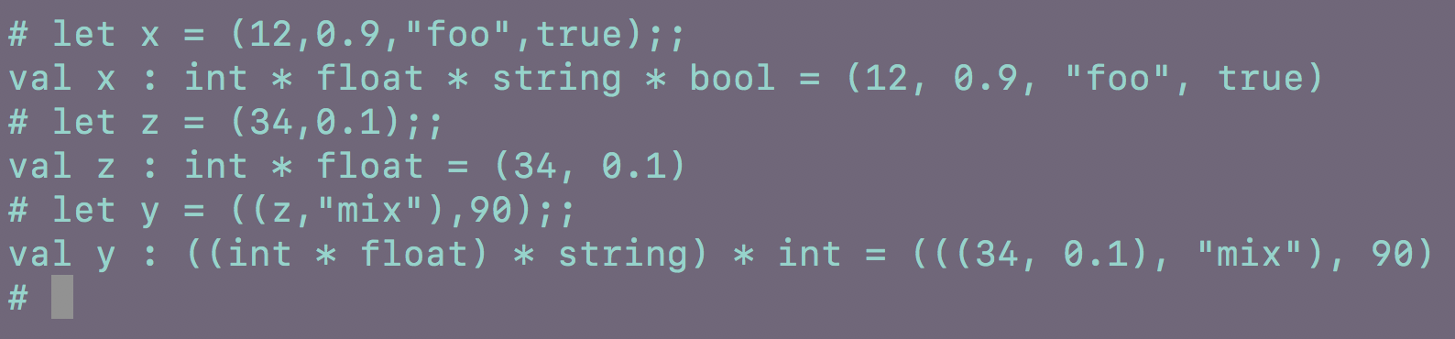
Types of Tuple
24
6

Slide 18
Type checking of Functions

Slide 19
Function Typing Checking Examples:
Lets look at an example
let munge ((b :bool), (x :int)) : string=
if not b then
string_of_int x
else
“Hello”;;

Slide 20
Function Typing Checking Examples:
Lets look at an example
let munge ((b :bool), (x :int)) : string=
if not b then
string_of_int x
else
“Hello”;;
val munge : bool * int -> string = <fun>

Slide 21
Function Typing Checking Examples:
What’s the type of this function:
let munge2 (x : ?) (y : ?) (z : ?) : ?? =
if (x + y) > 0 and z then
float_of_int x
else
float_of_int y ;;

Slide 22
Function Typing Checking Examples:
What’s the type of this function:
let munge2 (x : int) (y : int) (z : bool) : float =
if (x + y) > 0 && z then
float_of_int x
else
float_of_int y ;;
val munge2 : int -> int -> bool -> float = <fun>

Slide 23
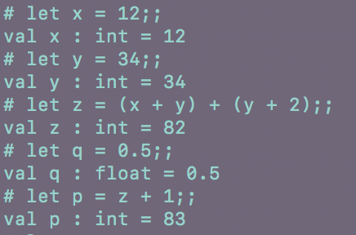

Let … in OCaml
Basic expression (syntax: let var = exp (bind an expression to a variable))
If… then… else… expression:
12

Slide 24
Let … in OCaml
Two types of let expressions:
let var = exp
Binds the value of an expression exp to variable var
Example: let a = 23;
let var = exp1 in exp2
The value of var is equal to value of expression exp1, only in the scope of expression exp2
Example: let x= 2+3 in x*x
13

Slide 25
Let … in … in OCaml
What is the value and type of the green expression in the following expressions:
let u = 90;;
let c = if u <100 then u else 0;;
let x = 4/2 in x;;
let y = 2 in 12/3 + y;;
let x = 12 in let y = 3 in let z = 8 in x + y * z;;
let x = 12 in let y = 3 in let x = 3 in x + y * x;;

Slide 26
Let … in … in OCaml

Slide 27
Ocaml has lists built in
the empty list is denoted by [ ]
- :: is an infix, right associative constructor:
takes an element of type ‘a, a list of type ‘a
returns a list of type ‘a.

Slide 28
Constructing lists in ocaml
[ ]
1::[ ]
0::(5::(9::[ ]))

Slide 29
Lists and Important list functions
@ is to append two lists together
:: is to concatenate an element to a list
@
let app = ["a";"b"] @ ["c"];;
val app : string list = ["a"; "b"; "c"]
::
let con = "a":: ["b"; "c"];;
val con : string list = ["a"; "b"; "c"]

Slide 30
Pattern matching on lists
Recall from class, lists are inductive types and its value is either [ ] or a value hd (head) followed by a smaller list of values tl (tail)
match ls with
| [ ] -> expr_1
| hd::tl -> expr_2
Base Case
Inductive Case

Slide 31
Example 1
How do I sum elements in a list of integers?
let rec sum(l : int list): int =
match l with
| [ ] ->
| hd :: tl ->

Slide 32
Example 1
How do I sum elements in a list of integers?
let rec sum(l : int list): int =
match l with
| [ ] -> 0
| hd :: tl ->

Slide 33
Example 1
How do I sum elements in a list of integers?
let rec sum(l : int list): int =
match l with
| [ ] -> 0
| hd :: tl -> hd +

Slide 34
Example 1
How do I sum elements in a list of integers?
let rec sum(l : int list): int =
match l with
| [ ] -> 0
| hd :: tl -> hd + (sum tl)

Slide 35
Example 2
How to create a list of tuples from an original list?
i.e [ 1; 2; 3 ] → [ (1,1); (2,2); (3,3) ]
let rec dup ls =
match ls with
| [ ] ->
| hd ::tl ->

Slide 36
Example 2
How to create a list of tuples from an original list?
i.e [ 1; 2; 3 ] → [ (1,1); (2,2); (3,3) ]
let rec dup ls =
match ls with
| [ ] -> [ ]
| hd ::tl ->

Slide 37
Example 2
How to create a list of tuples from an original list?
i.e [ 1; 2; 3 ] → [ (1,1); (2,2); (3,3) ]
let rec dup ls =
match ls with
| [ ] -> [ ]
| hd ::tl -> (hd,hd)::

Slide 38
Example 2
How to create a list of tuples from an original list?
i.e [ 1; 2; 3 ] → [ (1,1); (2,2); (3,3) ]
let rec dup ls =
match ls with
| [ ] -> [ ]
| hd ::tl -> (hd,hd)::(dup tl)

Slide 39
Example 3
How do I reverse a list?
let rec reverse l =
match l with
| [ ] ->
| hd :: tl ->

Slide 40
Example 3
How do I reverse a list?
let rec reverse l =
match l with
| [ ] -> [ ]
| hd :: tl ->

Slide 41
Example 3
How do I reverse a list?
let rec reverse l =
match l with
| [ ] -> [ ]
| hd :: tl -> @ [hd]

Slide 42
Example 3
How do I reverse a list?
let rec reverse l =
match l with
| [ ] -> [ ]
| hd :: tl -> (reverse tl) @ [hd]

Slide 43
Example 4
Convert a list of strings in lower case to a list of strings in upper case
(* uppercase_ascii : string -> string *)
let rec upperc l =
match l with
| [ ] -> [ ]
| hd :: tl -> (String.uppercase_ascii hd) :: (upperc tl)

Slide 44
Example 5
Printing elements in a list
let rec printlist l =
match l with
| [ ] -> ()
| hd::tl -> (print_endline hd; printlist tl)

Slide 45
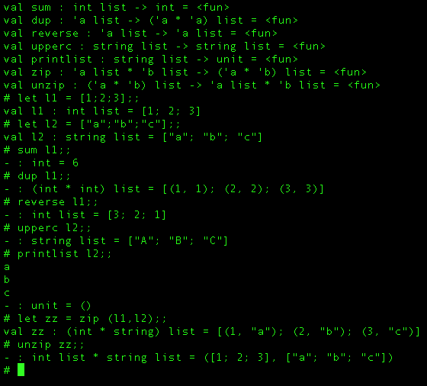
Demo – List.ml

Slide 46
Lists and list functions
let rec zip x =
match x with
| (h1::t1, h2::t2) -> (h1,h2)::zip(t1,t2)
| _ -> [ ]
You saw the zip function in class, what would be the type of function zip?

Slide 47
Lists and list functions
let rec zip x =
match x with
| (h1::t1, h2::t2) -> (h1,h2)::zip(t1,t2)
| _ -> [ ]
You saw the zip function in class, what would be the type of function zip?
val zip : 'a list * 'b list -> ('a * 'b) list = <fun>

Slide 48
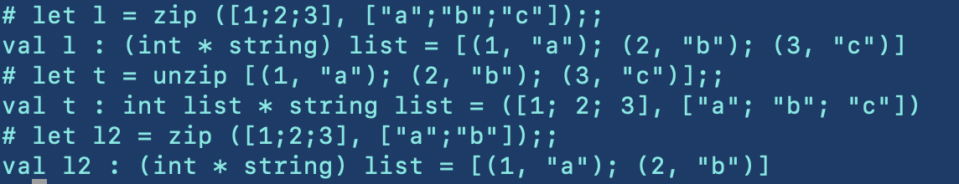
Lists and list functions
let rec zip x =
match x with
| (h1::t1, h2::t2) -> (h1,h2)::zip (t1,t2)
| _ -> [ ];;
let rec unzip x =
match x with
| (h1,h2)::t -> let (l1, l2) = unzip t in (h1::l1,h2::l2)
| _ -> ([ ], [ ])

Slide 49
Questions?
Start on Assignment 1 early!
Get TopHat up and running
Thank you!

