Slide 1
The GLAIR Architecture for Cognitive Robots
Stuart C. Shapiro
Department of Computer Science & Engineering
and Center for Cognitive Science
State University of New York at Buffalo
shapiro@buffalo.edu

Slide 2
GLAIR: Grounded Layered Architecture with Integrated Reasoning Focus of This Talk: Connecting Reasoning Mind with Acting/Sensing Body

Slide 3
Motivations
Add acting and sensing to a reasoning agent.
First person reasoning; on-line acting & sensing.
Layers
Motivated by mind/body connections/distinctions.
Let same mind be plugged into different bodies.
Embodiment
Origin of beliefs in sensation & proprioception.
First-person privileged knowledge of own body.
Situatedness
Has a sense of where it is in the world.
Symbol grounding
In body-layer structures.
Symbol as pivot between various modalities.

Slide 4
Outline
Some GLAIR Robots, Hardware & VR
The Layers
Symbol Grounding
Putting it Together: Two examples

Slide 5
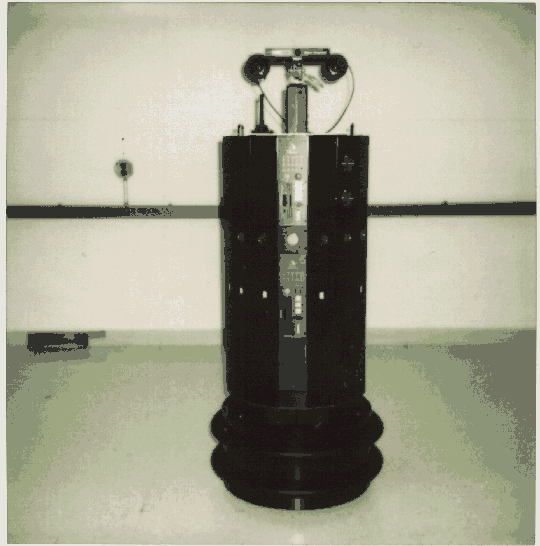
Cassie, the FEVAHR (Foveal ExtraVehicular Activity Helper-Retriever)
[Supported by NASA, 1994-96]

Slide 6
FEVAHR/Cassie in the Lab

Slide 7
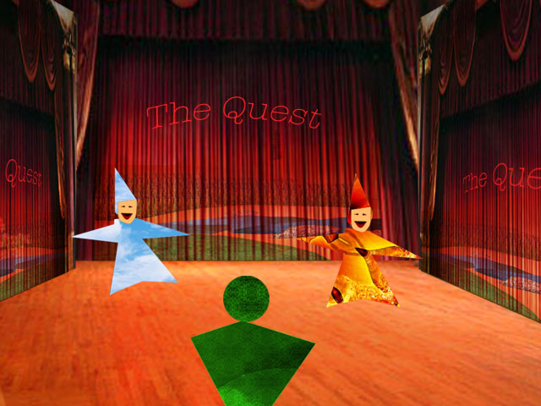
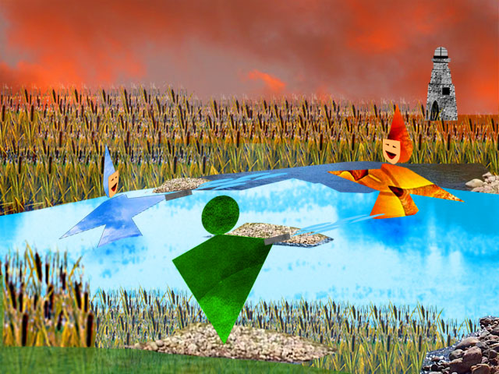
Patofil and Filopat from “The Trial, The Trail”
A VR drama by Josephine Anstey et al.
[Artificial Intelligence and Interactive Digital Entertainment (AIIDE) 2005]

Slide 8
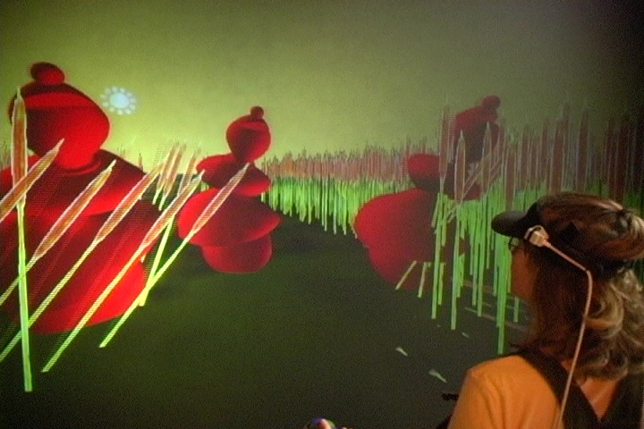
The Trial The Trail
& Human Trials
[E-Poetry Symposium, Buffalo, NY, April 1, 2006]

Slide 9
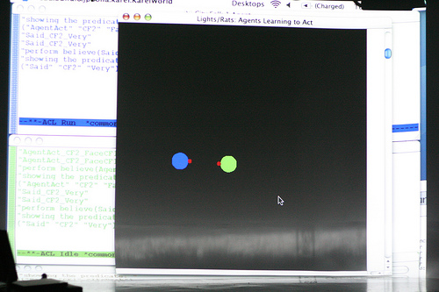
Lights/Rats
[365 Days/365 Plays by Suzan-Lori Parks, Week 24, Buffalo, NY, April, 26-27, 2007]

Slide 10
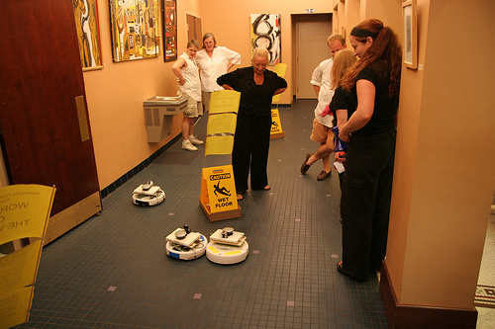
Workers of the World
[Buiffalo Infringement Festival, 2008
Maker Faire, Travis County, TX, 2008]

Slide 11
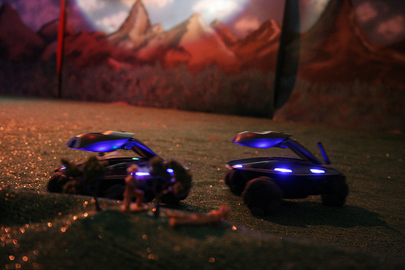
WoyUbu, “Robot War”
[Buffalo, NY, March, 2009]

Slide 12
Outline
Some GLAIR Robots, Hardware & VR
The Layers
Symbol Grounding
Putting it Together: Two examples

Slide 13
GLAIR Architecture
Mind
KL
Independent
of lower-body
implementation
Body
PMLa
PMLb
Dependent
on lower-body
implementation
I/P s o c k e t s
PMLc
Proprioception
Speech
W
O
R
L
D
Hearing
SAL
Vision
Motion

Slide 14
Sensori-Actuator Layer
Sensor and effector controllers

Slide 15
Perceptuo-Motor Layer
PMLa
PMLb
PMLc

Slide 16
PMLc
Abstracts sensors & effectors
Body’s behavioral repertoire

Slide 17
PMLb
Translation & Communication
Between PMLa & PMLc
Highest layer that knows body implementation

Slide 18
PMLa
Grounds KL symbols
Perceptual structures
Implementation of primitive actions
Registers for Embodiment & Situatedness
Deictic Registers
Modality Registers

Slide 19
The Knowledge Layer
Implemented in SNePS
Agent’s Beliefs
Representations of conceived of entities
Semantic Memory
Episodic Memory
Quantified & conditional beliefs
Plans for non-primitive acts
Plans to achieve goals
Beliefs re. preconditions & effects of acts
Policies: Conditions for performing acts
Self-knowledge
Meta-knowledge

Slide 20
SNePS
A KRR system
Every non-atomic expression is simultaneously
An expression of SNePS logic
An assertional frame
A propositional graph
Every SNePS expression is a term
Denoting a mental entity

Slide 21
Ontology of Mental Entities
Entity
Proposition
Agent can believe it or its negation
Includes quantified & conditional beliefs
Act
Agent can perform it
Policy
Condition-act rule agent can adopt
Thing
Other entities: individuals, properties, times, etc.

Slide 22
Outline
Some GLAIR Robots, Hardware & VR
The Layers
Symbol Grounding
Putting it Together: Two examples

Slide 23

Entities, Terms, Symbols, Objects
Agent’s mental entity: a person named Stu
SNePS term: b4
Object in world:
PCAR2010

Slide 24
Alignment
Mind (KL)
KL term
Body (PML/SAL)
PML structure
World
Object/Phenomenon
Action

Slide 25

World Objects to Feature Tuples
PML/SAL
World
<Height,
Width,
Texture,
.
.
. >
PCAR2010

Slide 26
Feature Tuples to KL Terms
KL
PML/SAL
ProperName(b4, Stu)
<Height,
Width,
Texture,
.
.
. >
Alignment

Slide 27
Incomplete PML-Descriptions
KL
PML/SAL
Height(b4, b12)
<Height,
nil,
nil,
.
.
. >

Slide 28
Unifying PML-Descriptions
KL
PML/SAL
b20
<x, nil, nil, ... >
b30
<nil, y, nil, ... >
Isa
Prop
b31
<nil, nil, z, ... >
Prop
b6
<x, y, z, ... >

Slide 29
Deictic Registers
For being situated in the world
PML registers hold KL terms
I term denoting agent
YOU term denoting dialogue partner
NOW term denoting current time

Slide 30
Modality Registers
For privileged first-person knowledge of what agent is doing
Register for each modality, m, holds
KL term denoting act that m is engaged in

Slide 31
Outline
Some GLAIR Robots, Hardware & VR
The Layers
Symbol Grounding
Putting it Together: Two examples

Slide 32
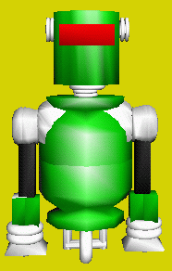
Language-Mind-World-Mind
KL
PML/SAL
WORLD
m76
b20
<green, nil>
cassie
b30
<nil, robotic>
Prop
m75
(find )
<green, robotic>
Isa
m2
VISION
robbie
b6
Find a green robot.

Slide 33
Building Episodic Memory
KL
m3!
m1!
m2!
time
before
after
event
event
time
e1
t1
t2
e2
agent
act
agent
act
m4!
time
a1
q
b1
a2
duration
I
COUNT
n
NOW
PML
0
hom
ACT

Slide 34
Summary
GLAIR is an architecture:
To connect mind and body
For symbol grounding
To provide first-person privileged knowledge of
The body
What it’s doing
To provide situatedness in the world
Via deictic registers

Slide 35
Some References
S. C. Shapiro & H. O. Ismail, Anchoring in a Grounded Layered Architecture with Integrated Reasoning,, Robotics and Autonomous Systems 43, 2-3 (May 2003), 97-108.
J. Anstey, S. Bay-Cheng, D. Pape, & S. C. Shapiro, Human trials: an experiment in intermedia performance, ACM Computers in Entertainment 5, 3, Article 4 (November 2007), 17 pages.
J. Anstey, A. P. Seyed, S. Bay-Cheng, D. Pape, S. C. Shapiro, J. Bona, & S. Hibit, The Agent Takes The Stage, International Journal of Arts and Technology (IJART) 2, 4 (2009), 277-296.
S. C. Shapiro & J. P. Bona, The GLAIR Cognitive Architecture, International Journal of Machine Consciousness, in press.

Slide 36
Collaborators
Past and present members of
SNeRG: The SNePS Research Group
http://www.cse.buffalo.edu/sneps/

