Slide 1

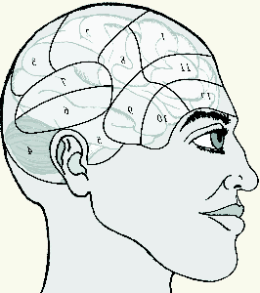
MGLAIR Modal Grounded Layered Architecture with Integrated Reasoning
Stuart C. Shapiro
Department of Computer Science and Engineering
and Center for Cognitive Science
University at Buffalo, The State University of New York

Slide 2
Collaborators
Henry Hexmoor
Josephine Anstey
Deepak Kumar
Haythem O. Ismail
Michael Kandefer
Jonathan Bona
Johan Lammens
Trupti Devdas Nayak
Dave Pape
Vikranth Rao

Slide 3
Outline
Motivations
Some (M)GLAIR Agents
The MGLAIR Architecture and its Layers
An Introduction to SNePS 2.8
Symbol Grounding
Modalities

Slide 4
Motivations
Add acting and sensing to a reasoning agent.
First person reasoning; on-line acting & sensing.
Layers
Motivated by mind/body connections/distinctions.
Let same mind be plugged into different bodies.
Embodiment
Origin of beliefs in sensation & proprioception.
First-person privileged knowledge of own body.
Situatedness
Has a sense of where it is in the world.
Symbol grounding
In body-layer structures.
Symbol as pivot between various modalities.

Slide 5
Motivations for Modalities
Independent but limited resources
Sensors and effectors are the resources
Different modalities can be used independently
Single modality has limited use

Slide 6
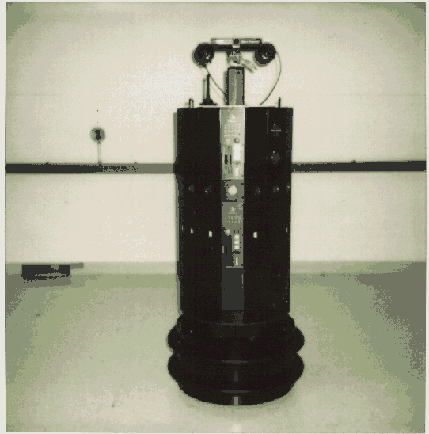
Cassie, the FEVAHR (Foveal ExtraVehicular Activity Helper-Retriever)
[Supported by NASA, 1994-96]

Slide 7
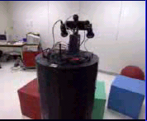
FEVAHR/Cassie in the Lab

Slide 8

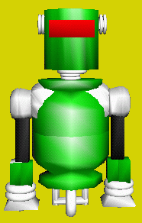
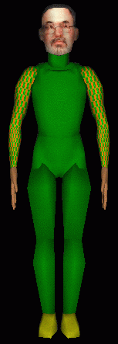
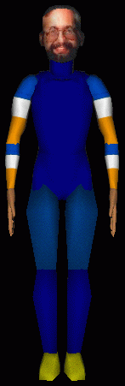

NL Capable Robots Showing Self-Awareness & Deixis
Who am I?
Your name is ‘Bill’
and you are a person.
Who are you?
I am the FEVAHR
and my name is ‘Cassie’.
Who have you talked to?
I talked to Stu
and I am talking to you.

Slide 9
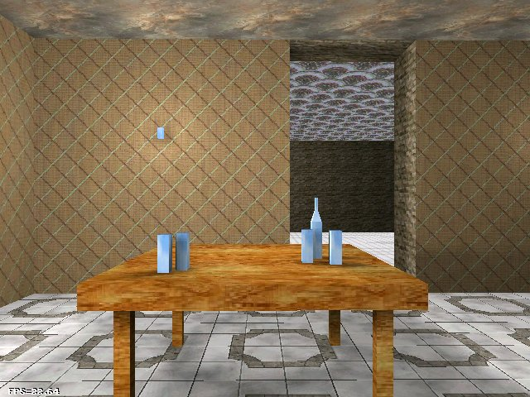
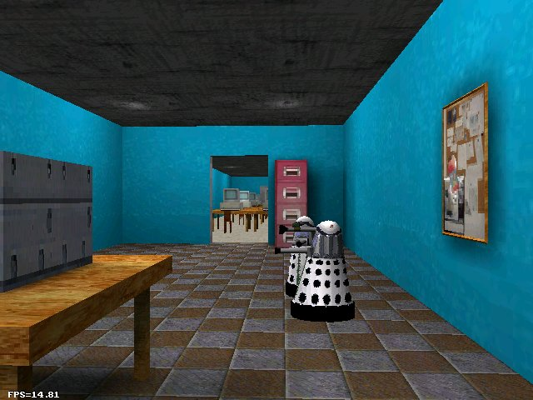
Recognizing Indistinguishable Objects

Slide 10
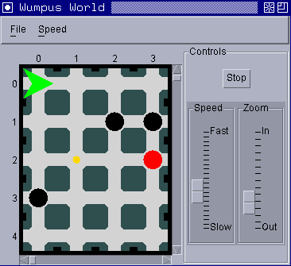
Wumpus World Agent
: perform get(gold)
No breeze here.
No stench here.
Exploring the cave...
Found a safe room...
[Shapiro & Kandefer, IJCAI-05 Workshop on Nonmonotonic Reasoning, Action, & Change]

Slide 11
GLAIR Agents in Intermedia Performances
As part of UB’s Intermedia Performance Studio
Supported by:
UB IRCAF, 2003-04
UB IRDF, 2006-07
Robert and Carol Morris Fund for Artistic Expression and Performing Arts, 2007-09

Slide 12
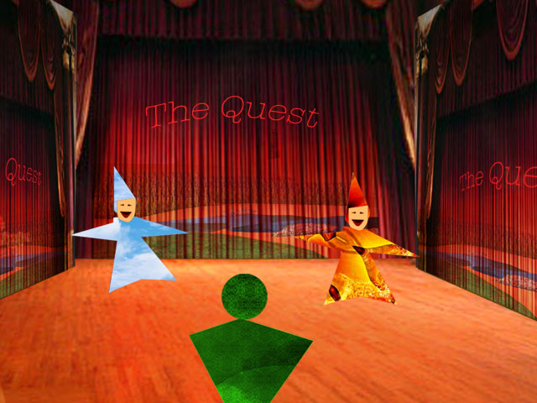
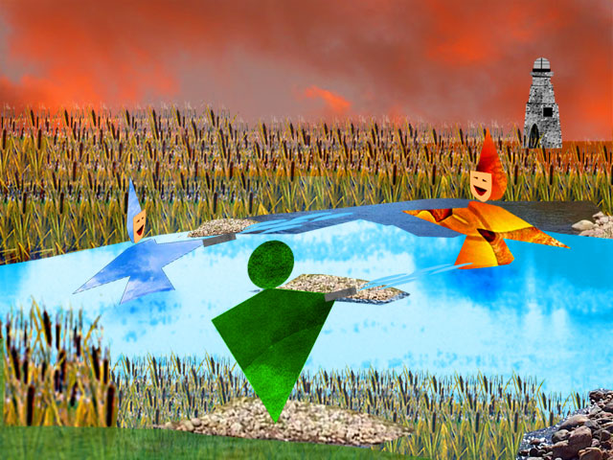
Patofil and Filopat from “The Trial, The Trail”
A VR drama by Josephine Anstey et al.
[Artificial Intelligence and Interactive Digital Entertainment (AIIDE) 2005]

Slide 13
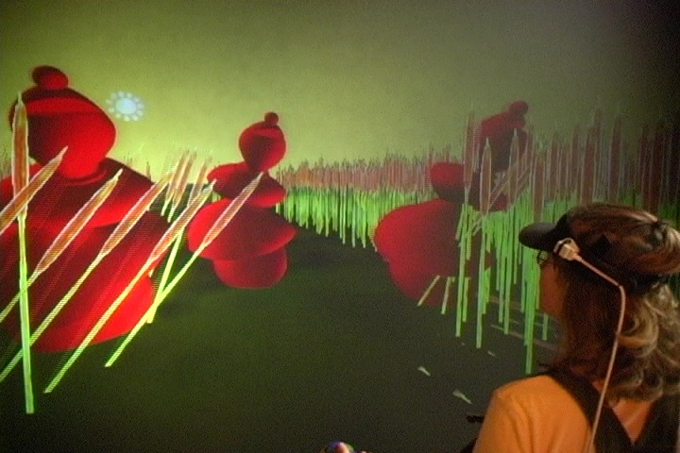
The Trial The Trail & Human Trials
[E-Poetry Symposium, Buffalo, NY, April 1, 2006]

Slide 14
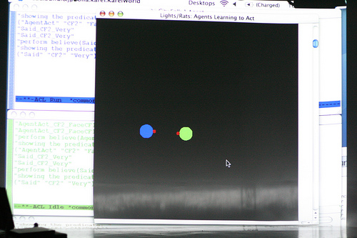
Lights/Rats
[365 Days/365 Plays by Suzan-Lori Parks, Week 24, Buffalo, NY, April, 26-27, 2007]

Slide 15
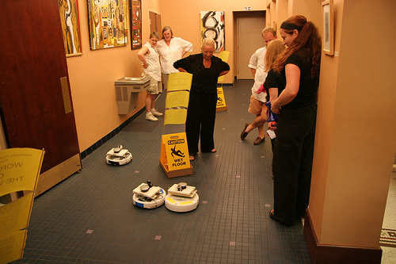
Workers of the World
[Buiffalo Infringement Festival, 2008
Maker Faire, Travis County, TX, 2008]

Slide 16
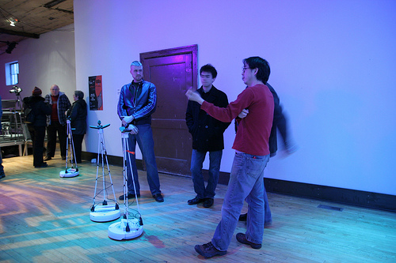
WoyUbu, “Dramaturgs”
[Buffalo, NY, March, 2009]

Slide 17
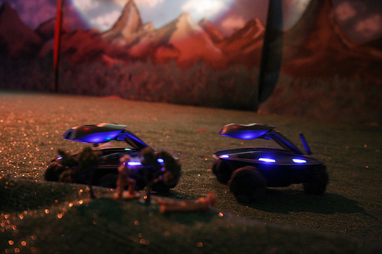
WoyUbu, “Robot War”
[Buffalo, NY, March, 2009]

Slide 18
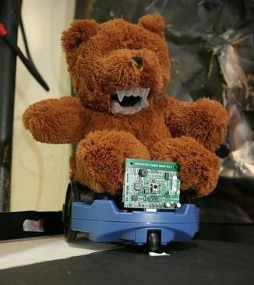
WoyUbu, “The Bear”

Slide 19
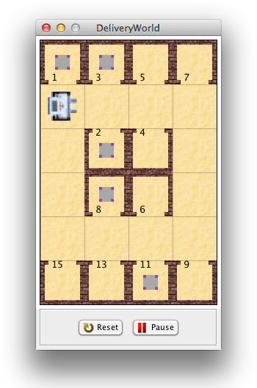
The Delivery Agent

Slide 20
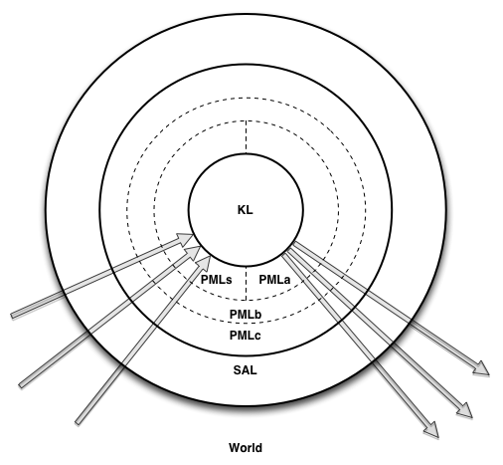

MGLAIR Architecture

Slide 21
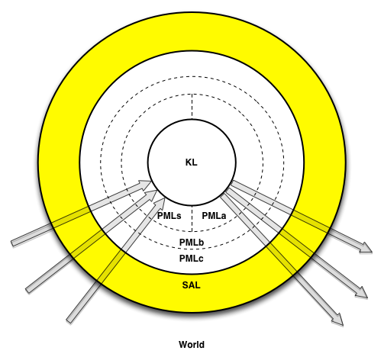
Sensori-Actuator Layer
Sensor and effector controllers

Slide 22
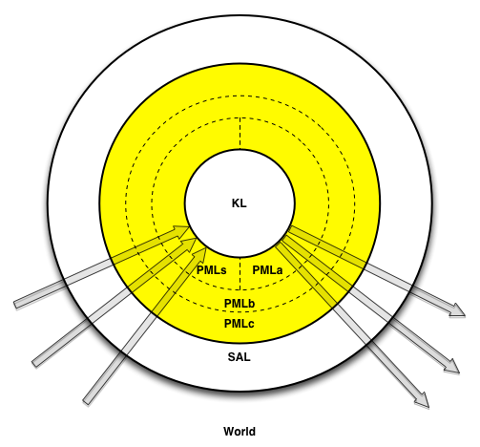
Perceptuo-Motor Layer
PMLa
PMLs
PMLb
PMLc

Slide 23
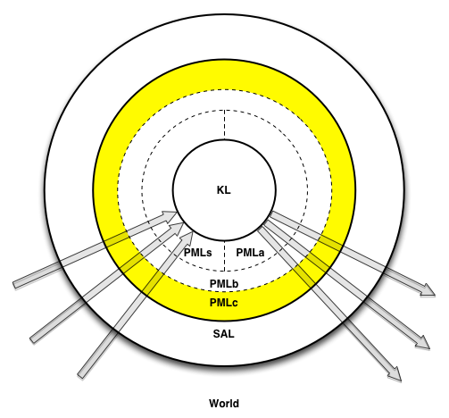
PMLc
Abstracts sensors & effectors
Body’s behavioral repertoire
Specific to body implementation

Slide 24
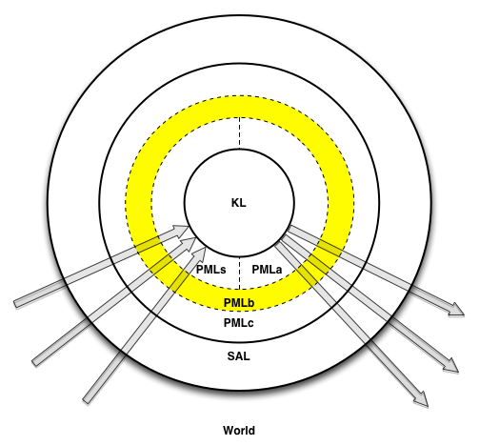
PMLb
Translation & Communication
Between PMLa/s & PMLc
Highest layer that knows body implementation

Slide 25
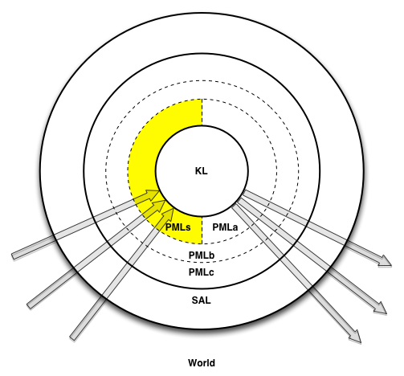
PMLs
Grounds KL symbols
Perceptual structures
Lowest layer that knows KL terms
Registers for Embodiment & Situatedness
Deictic Registers
Modality Registers

Slide 26
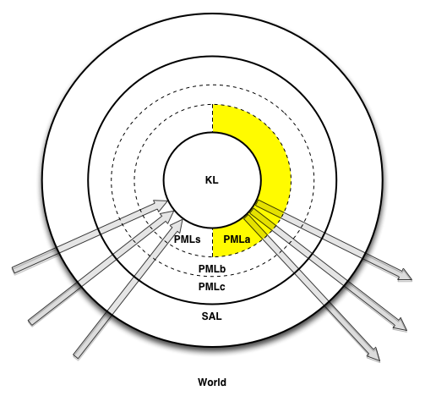
PMLa
Grounds KL symbols
Implementation of primitive actions
Lowest layer that knows KL terms
Registers for Embodiment & Situatedness
Deictic Registers
Modality Registers

Slide 27
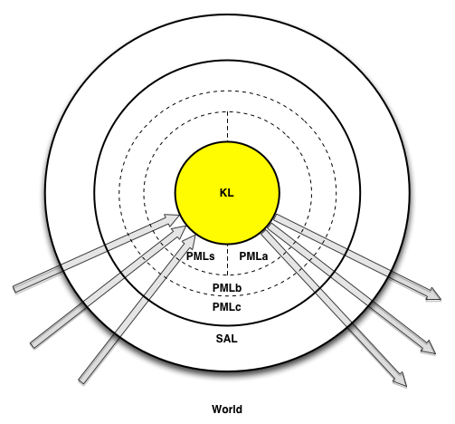
The Knowledge Layer
Implemented in SNePS
Agent’s Beliefs
Representations of conceived of entities
Semantic Memory
Episodic Memory
Quantified & conditional beliefs
Plans for non-primitive acts
Plans to achieve goals
Beliefs re. preconditions & effects of acts
Policies: Conditions for performing acts
Self-knowledge
Meta-knowledge

Slide 28
Afferent Modalities
Sensors
to Perceptual Structures
to Perception
to KL Terms

Slide 29
Efferent Modalities
KL Primitive Acts
to PMLa Methods
to act Impulses
to Effectors

Slide 30
SNePS 2.8
A KRR system
Every non-atomic expression is simultaneously
An expression of SNePS logic
An assertional frame
A node in a propositional graph
Every SNePS expression is a term
Denoting a mental entity

Slide 31
Ontology of Mental Entities
Entity
Proposition
Agent can believe it or its negation
Includes quantified & conditional beliefs
Act
Agent can perform it
Policy
Condition-act rule agent can adopt
Thing
Action: What some agent can perform on some object(s)
Category: A category/class of entities
Other entities: individuals, properties, times, etc.

Slide 32
Some Atomic Propositions
p()
ProperName(b4, Stu)
Height(b4, 68)
Isa(“New York State”, PopulatedPlace)
Isa(3.14, Number)
Ako(Dog, Mammal)
hypernym(|dog%1:05:00|, |canine%1:06:00|)

Slide 33
Some Non-Atomic Propositions
For any proposition, p, p1, …, pn:
~p
and{p1, …, pn}
p1 and … and pn
or{p1, …, pn}
p1 or … or pn
nand{p1, …, pn}
nor{p1, …, pn}
xor{p1, …, pn}
iff{p1, …, pn}
p1 <=> … <=> pn

Slide 34
Two Generalizations
For any propositions, p, integers, i<=j<=n:
andor(i,j){p1, …, pn}
thresh(i,j){p1, …, pn}

Slide 35
Some More Non-Atomic Propositions
For any integers n, m:
For any propositions, p1, …, pn, q1, …, qm:
{p1, …, pn} => {q1, …, qm}
{p1, …, pn} v=> {q1, …, qm}
{p1, …, pn} &=> {q1, …, qm}
{p1, …, pn} i=> {q1, …, qm}

Slide 36
Some More Non-Atomic Propositions
For any propositions, p, q:
For any integers i, j, k, n, m, i<=j<=k:
all(x1, …, xn}(p)
nexists(i,j,k)(x1,…,xn)(p1,…,pn : q1,…,qm}
nexists(_,j,_)(x1,…,xn)(p1,…,pn : q1,…,qm}
nexists(i,_,k)(x1,…,xn)(p1,…,pn : q1,…,qm}

Slide 37
Reasoning
Natural Deduction Derivations
Forward, Backward, Bi-directional, Focused Reasoning
Retain derived formulas for later use --- Lemmas
Paraconsistent
ATMS-style Belief Revision / Truth Maintenance
Manual (“Assisted”) or Automatic BR
User (Agent Architect) can specify epistemic entrenchment ordering function

Slide 38
Types of Acts I
External Acts
affect the environment
supplied by agent designer
Mental Acts
affect the knowledge layer
believe, disbelieve
adopt, unadopt
Control Acts
sequence, selection, loop, etc.

Slide 39
Types of Acts II
Primitive Acts
Implemented as part of SNePS
or by agent designer in PMLa
Composite Acts
Structured by control acts
Defined Acts
Defined by ActPlan(α, p) belief

Slide 40
Propositions About Acts
Precondition(α, φ)
ActPlan(α₁, α₂)
GoalPlan(φ, α)
Effect(α, φ)

Slide 41
Policies Reasoning Acting
Forward Reasoning
whendo(φ, α)
wheneverdo(φ, α)
Backward Reasoning
ifdo(φ, α)

Slide 42
Acting Reasoning Control Acts 1
snif({if(φ₁, α₁), …, if(φ_{n}, α_{n}), [else(δ)]})
sniterate({if(φ₁, α₁), …, if(φ_{n}, α_{n}), [else(δ)]})
withsome(x, φ(x), α(x), [δ])
withall(x, φ(x), α(x), [δ])

Slide 43
Control Acts 2
achieve(φ)
do-all({α₁, …, α_{n}})
do-one({α₁, …, α_{n}})
snsequence(α₁, α₂)

Slide 44
The Acting Executive
perform(act):
pre := {p | ├ Precondition(act, p)};
notyet := pre - {p | p ε pre & ├ p};
if notyet not empty
then
perform(snsequence(
do-all({a | p ε notyet
& a = achieve(p)}),
act))
else {effects := {p | ├ Effect(act,p)};
if act is primitive
then apply(primitive-function(act),
objects(act))
else perform(do-one({p | ├ ActPlan(act,p)}));
believe(effects)

Slide 45
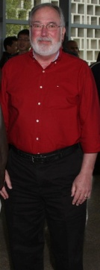
Entities, Terms, Symbols, Objects
Agent’s mental entity: a person named Stu
SNePS term: b4
Object in world:

Slide 46
Alignment
Afferent
Modality
Efferent
Modality
Mind (KL)
Thing
Action
Body (PML/SAL)
PMLs structure
PMLa method
World
Object/Phenomenon
Action

Slide 47


World Objects to Feature Tuples
PMLs
World
<Height,
Width,
Texture,
.
.
. >

Slide 48
Feature Tuples to KL Terms
KL
PMLs
ProperName(b4, Stu)
<Height,
Width,
Texture,
.
.
. >
Alignment

Slide 49
Incomplete PML-Descriptions
KL
PMLs
Height(b4, b12)
<Height,
nil,
nil,
.
.
. >

Slide 50
Unifying PML-Descriptions
KL
PMLs
b20
<x, nil, nil, ... >
b30
<nil, y, nil, ... >
Isa
Prop
b31
<nil, nil, z, ... >
Prop
b6
<x, y, z, ... >

Slide 51
Modality: A Nine-Tuple
Name | Unique name for modality
Type | afferent/efferent
Predicates | KL predicates to use
Channel | Data channel
Access | Allow/Deny agent conscious access
Focus | Default level; Permit/Forbid agent adjustment …
Conflict | Conflict handler for multiple use …
Description | Human readable description
Relations | Relations to other modalities

Slide 52
Efferent Modality Buffers
In PMLb of efferent modality
Fixed capacity or expiration interval
New act impulse queued or replaces old impulse
When impulse arrives that can’t fit, handled by conflict handler
Discarded impulses are never performed
Impulses removed by buffer management process and processed in PMLc

Slide 53
Perceptual Buffers
In PMLb of afferent modality
Queues perceptual (PML) structures (sensory data)
Fixed capacity or expiration interval
When structure arrives that can’t fit, either it or oldest structure discarded depending on conflict handler
Discarded structures are never perceived
Structures removed by buffer management process and given to perceptual function

Slide 54
Afferent Modality Focus
Affects frequency of execution of internal processes
From “ignore” to maximal focus
Initially at default setting
Agent might be permitted to adjust
Agent might miss perceiving phenomena in low-focused modalities
So adjust relative focus of different modalilties appropriately
Watching the road vs. talking on cell phone!

Slide 55
Summary
MGLAIR adds acting/sensing to reasoning agents.
Layers capture Mind/Body distinction & connection.
Modalities are independent, limited resources for acting and sensing.
SNePS has natural constructs for reasoning and acting.
Modality buffers queue act impulses & afferent structures but discard ones not processed.
Focus level determines how much a modality is ignored.

Slide 56
For More Information
Shapiro
Home page: http://www.cse.buffalo.edu/~shapiro
Papers: http://www.cse.buffalo.edu/~shapiro/Papers
Talks: http://www.cse.buffalo.edu/~shapiro/Talks
SNePS Research Group
Home page: http://www.cse.buffalo.edu/sneps
Bibliography: http://www.cse.buffalo.edu/sneps/Bibliography

