Slide 1


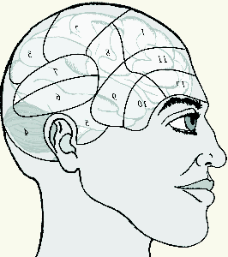
Use of Background Knowledge in Natural Language Understanding for Information Fusion
Stuart C. Shapiro
Department of Computer Science and Engineering
Center for Multisource Information Fusion
and Center for Cognitive Science
University at Buffalo, Buffalo, New York
shapiro@buffalo.edu
Daniel R. Schlegel
Department of Biomedical Informatics
Center for Multisource Information Fusion
and Center for Cognitive Science
University at Buffalo, Buffalo, New York
drschleg@buffalo.edu

Slide 2
Outline
Introduction to Tractor
Background Knowledge in:
  Text processing
  Propositionalizing
  Knowledge Base Enhancement
  Syntax-Semantics Mapping
Evaluation
Acknowledgments

Slide 3
Tractor
Input:
  Short English intelligence message.
Output:
  Semantic knowledge base (KB)
  representing contents of message.

Slide 4
Context: Hard & Soft Information Fusion
Information from multiple
  Soft information sources
    English messages
  Hard information sources
    RADAR, SONAR, LIDAR, …
are fused for situation assessment.
=> Requirement:
  Capture semantic content of each message
  as completely and correctly as possible.

Slide 5
Approach
Not: Information Extraction
  Look for prespecified
    classes of
      Entities
      Events
    Properties.
Instead: Natural Language Understanding
(Semantic Analysis)
  Translate
    Entities, Events, Properties, Relations, …
    Expressed in the text
    Into a formal Knowledge Representation (KR) language
    that supports reasoning.

Slide 6
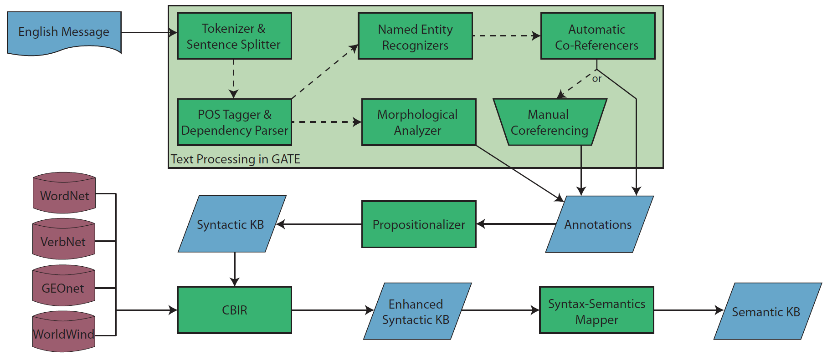
Tractor Architecture

Slide 7
Background Knowledge for NLU
Background knowledge includes:
  Knowledge of how the language is used
  Knowledge of the world
  Knowledge of the domain
  Knowledge of the axioms of the relations used in the text
Tractor makes use of all of these to identify and represent:
  Entities and events
  Attributes of entities and events
  Relations between entities and events

Slide 8
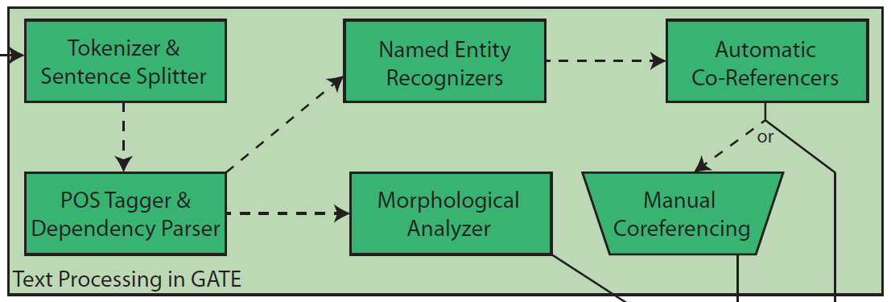
Background Knowledge in Text Processing
List-based background knowledge
  138 lists – people, places, job titles, companies, religious groups, etc…
Rule-based background knowledge
  Use results from list-based NER + syntactic properties
  Allows for identification of NEs not in lists.

Slide 9
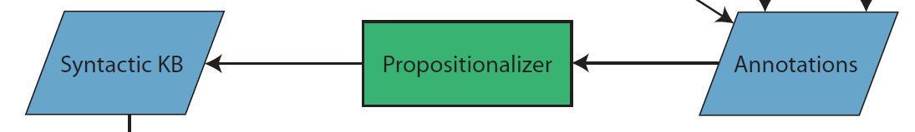
Background Knowledge in Propositionalizing
Uses knowledge about formats of dates, times, weights, and heights
  Converted into standardized formats
  “10/24/2010” -> 20101024
Domain knowledge to process structured portions of messages
  Headers containing date/time of message
  Messages with pre-defined structures for special purposes, e.g., communication intercepts

Slide 10
Background Knowledge in Propositionalizing
Date
Normalized to 20100316
Mode of communication
was satellite phone.
Message Number 248
Report time was 0700
248. 3/16/10 - RT: 0700hrs - |C:| || satellite phone|
|P1:| caller| Dhanun Ahmad|||| |P2:| receiver| Dhanun Ahmad’s handler’s voice drop-box|||| |A:| “Ahmad said he is in al-Kut after driving through the
night. He could not stay on the phone long, as the
man traveling with him was watching closely.”
Receiver was
Ahmad’s handler’s
voice drop box.
Caller was
Dhanun Ahmad
Analysts notes.

Slide 11
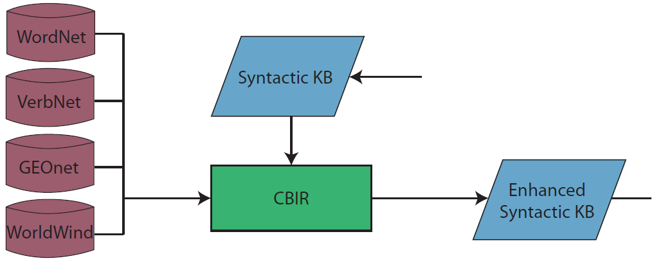
Enhancing the Knowledge Base
CBIR – Context Based Information Retrieval
Ontological Information
vehicle%1:06:00::’s are
conveyance%1:06:00::s
Geographical Information
“East Dora”:
Is a Section of populated place
MGRS: 38SMB4496078958
Lat/Long: 33.2482, 44.4091

Slide 12
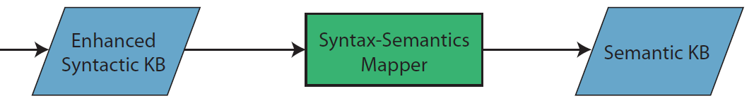
Background Knowledge in Syntax-Semantics Mapping
Makes use of linguistic, categorical, and domain-specific knowledge
  Data from all prior processing steps
  Curated databases of linguistic properties
  Hand-crafted mapping rules using the above

Slide 13
Semantic Databases
Database of adjective X category -> attribute
  “a young man”: a man whose age is young
  “a large gathering”: a group whose cardinality is large
Mereological database of parts and wholes
  “the man’s arm”: the arm is part of the man, not owned by the man
List of mass nouns
  “a man with dark hair”: a man who has as a part something which is made of hair whose color is dark

Slide 14
General Knowledge
Plural roles/job titles
  “BCT analysts”: a group of analysts
Noun phrases naming vehicles
  “his black 2010 Ford Escape SUV.”
Paths of movement
  “Dillinger was last seen driving his black 2010 Ford Escape SUV westward down Indianapolis Road at 1:20pm on 3/17/2013”: Indianapolis road forms a path, with the direction of movement being westward.
Searching a place and finding an object indicates the place of the object.
  “a search of his car netted IED devices”: the IED devices were located in the car.

Slide 15
Understanding Noun-Noun Modification
Noun-Noun Modification
  Express a wide variety of semantic relations.
  Mapping rules recognize several
Head noun
It is an office chair.
Modifying noun

Slide 16
Understanding Noun-Noun Modification
Inner locations
  If both nouns are locations, then the modifying noun is located in the head noun.
  “Rashid, Baghdad” : Rashid is a neighborhood within Baghdad
Facilities and buildings in locations
  If the head noun is a facility, then it’s in the location of the modifying noun.
  “Second District Courthouse” : a courthouse located in the Second District.

Slide 17
Understanding Noun-Noun Modification
Headquarters in a location
  If the modifying noun is a location, but the head noun is not, the head noun is headquartered in the location of the modifying noun
  “A Baghdad company” : a company headquartered in Baghdad.
Entity names
  If neither noun is a location, but both are proper nouns, they can both be assumed to be names of an entity.
  “Ahmad Mahmud”: a person with “Ahmad” and “Mahmud” as names, as well as the full name “Ahmad Mahmud.”
Religious Membership
  If the head noun is a person, and the modifying name is a religious group, the person is a member of the religious group and has that religion.
  “a Sunni munitions trafficker” : a munitions trafficker whose religion is Sunni and is a member of the religious group named “Sunni.”

Slide 18
Understanding Noun-Noun Modification
Subgroups
  If both nouns are groups, then the head noun denotes a group which is a subgroup of the group denoted by the modifying noun.
  “BCT analysts” : A group of analysts, all members of the organization “BCT”
Organization Membership
  If the modifying noun is an Organization, and the head noun is not, then the head noun is a member of the organization.
  “the ISG affiliate” : someone filling the role of affiliate within the “ISG” organization.

Slide 19
Understanding Copulas
Copulas link subjects to predicates.
Subject is a Noun
  If there is a copula between a subject and noun, then the subject is co-referential with an instance of the category of the noun.
  “the rented vehicle is a white van” : one entity is both a rented vehicle, and a white van.
Dimensional scale
  Predicate adjectives which imply a dimension can be used to say the subject has a value on that dimensional scale.
  “Dillinger is old” : Dillenger’s age has the linguistic value “old”
Simple properties
  Predicate adjectives which don’t imply a dimension, are simple properties of the subject.
  “he is secretive” : “he” has the property “secretive”

Slide 20
Making Inferences
Symmetric relations
  “The trigger devices netted in the arrest of Dhanun Ahmad Mahmud Ahmad on 01/27/10 match materials found in the truck of arrested ISG affiliate Abdul Wahied.” : “the devices match the materials” and “the materials match the devices” are represented.
Location of act participants
  If a person participates in an act at a location, that person was at that location at the time of the act.
  “Ahmad Mahmud was arrested at Expressway on 20100127” : Ahmad was located at the Expressway on 20100127

Slide 21
Making Inferences
Persons in vehicles
  If a person drives a vehicle, then they are located in that vehicle at that time.
  “Dillinger was last seen driving his black 2010 Ford Escape SUV westward down Indianapolis Road at 1:20pm on 3/17/2013,” Dillinger is understood both to be the driver of the SUV and to be located in the SUV at 1320 on 20130317.
Location and subgroup membership are transitive.
  Dillinger is in a car driving down Indianapolis Road, therefore Dillinger’s location is Indianapolis Road.

Slide 22
Evaluation
Mapping Rules developed using training messages
Evaluated using test messages
Previous results have shown:
  Rules are general
  Rules are very thorough
  Rules are not too general
Now: Grading rubric
  Measures correctness and completeness against manually produced gold standard
  Grades correctness of attributes, entities, and relations
  “Answer key” created by one or more humans (“gold standard”)
  “Submission” compared with answer key

Slide 23
Grading Rubric Results
Set | Count | R |  | P |  | F
 |  | Avg | StDev | Avg | StDev | Avg | StDev
Development | 37 | 0.83 | 0.09 | 0.82 | 0.10 | 0.82 | 0.08
Test | 77 | 0.83 | 0.09 | 0.83 | 0.09 | 0.83 | 0.09
Tractor generalizes well across datasets within the domain.
Most of the semantic content of the messages is understood

Slide 24
How General are the rules?
Rule firings on test messages
Type | Count | # Fired | % Fired | Times Fired | Times Per Msg
CBIR | 1 | 1 | 100% | 474 | 8.32
SYN | 23 | 13 | 56.5% | 1,596 | 28.00
SEM | 5 | 5 | 100% | 328 | 5.75
SYNSEM | 99 | 56 | 56.6% | 2,904 | 50.95
INFER | 9 | 8 | 88.9% | 135 | 2.37
CLEAN | 10 | 8 | 80% | 6,492 | 113.89
TOTAL | 147 | 91 | 61.9% | 11,929 | 209.28
Conclusion: Reasonably general.

Slide 25
How thorough are the rules?
Syntactic vs. Semantic Assertions
KB | Syntactic Assertions | Semantic Asertions | % Semantic
Syntactic | 2469 | 1,149 | 31.76%
Semantic w/ CBIR | 538 | 48,561 | 98.90%
Semantic w/o CBIR | 538 | 5,646 | 91.30%
Observation: Rules convert from 68% syntactic to 91% semantic w/o CBIR assertions
Conclusion: Very thorough.

Slide 26
Are the rules too general?
Rule firings on correct parses in test messages
Type | # Fired | Times Fired | # Correct | % Correct
CBIR | 1 | 474 | 474 | 100%
SYN | 13 | 1,567 | 1,548 | 98.8%
SEM | 5 | 328 | 328 | 100%
SYNSEM | 56 | 2,651 | 2,431 | 91.7%
INFER | 8 | 85 | 72 | 84.7%
CLEAN | 5 | 6,492 | 6,492 | 100%
TOTAL | 88 | 11,597 | 11,345 | 97.8%
Conclusion: Not too general.

Slide 27
Conclusions
Natural Language Understanding requires the use of background knowledge
Background knowledge includes:
  Knowledge of how the language is used
  Knowledge of the world
  Knowledge of the domain
  Knowledge of the axioms of the relations used in the text
Tractor makes use of all of these to identify and represent:
  Entities and events
  Attributes of entities and events
  Relations between entities and events
Evaluation shows that Tractor does this identification very well with few mistakes.

Slide 28
Acknowledgments
This work has been supported by a Multidisciplinary University Research Initiative (MURI) grant (Number W911NF-09-1-0392) for "Unified Research on Network-based Hard/Soft Information Fusion", issued by the US Army Research Office (ARO) under the program management of Dr. John Lavery.

