Slide 1
ACE in Clouds: Availability Changes Everything
Chunming Qiao, IEEE Fellow
Computer Science and Engineering, SUNY Buffalo
Collaborators: T. Furlani, R. Ramesh, S. Smith (SUNY Buffalo) and G. Lazsewski (Indiana University)
Notes:
Footnote should be bigger

Slide 2
Cloud Technologies
  Basic infrastructure components:
  Physical servers (and virtual machines, aka VMs), racks, clusters
  Power distribution units (PDUs) and cooling infrastructures
  Switches, routers and datacenter networks
  Increasing adoption/reliance
  Providers: Amazon, Google, Microsoft, Rackspace, SaleForce…
  Clients: individuals, and small to large companies/institutions
  Availability/reliability is a top concern
  availability = uptime / (total period) = 1 – downtime / (total period)
  cited by 67%, followed by device based security (66%) and cloud application performance (60%).
Notes:
1)Fix bullet format for the last one (using arrow) , and
2) Add in the footnote
Cisco Global Cloud Networking Survey, 2012.

Slide 3
Failures are all too common
  Frequent small-scale failures and infrequent large-scale failures
  Typical first year for a new cluster (Jeff Dean, Google)
  ~0.5 overheating (power down most machines in <5 mins, ~1-2 days to recover)
  ~1 PDU failure (~500-1000 machines suddenly disappear, ~6 hours to come back)
  ~20 rack failures (40-80 machines instantly disappear, 1-6 hours to get back)
  ~5 racks go wonky (40-80 machines see 50% packet loss)
  ~3 router failures (have to immediately pull traffic for an hour)
  ~dozens of minor 30-second blips for DNS
  ~1000 individual machine failures
  ~thousands of hard drive failures
Notes:
1) Fix format for all but the first two bullet items (using arrows for the 2nd level)
This is for you own ref: look at the slides at http://www.lamsade.dauphine.fr/~litwin/cours98/Doc-cours-clouds/dean-keynote-ladis2009_scalable_distributed_google_system.pdf

Slide 4
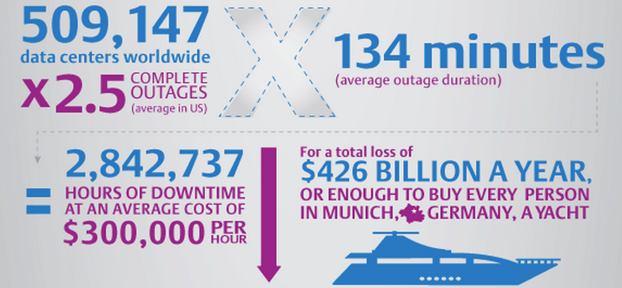
Failures cost too much
Notes:
Add ref/URL as the footnote

Slide 5
Why Current Cloud Services Are Flawed
  Current Service Level Agreement (SLA) is loosely defined in terms of availability/reliability measurements.
    SLA is a contract between a user and the service provider (price, service/duration, and penalty etc.)
  Penalty term is not user-friendly. The refund is usually issued in the form of credit with a lot of exclusions.
  Amazon EC2 will refund the user in the form of credit if fail to meet the SLA.
  Rackspace will credit the user 5% month fee for each 30 mins network/infrastructure downtime, up to 100% monthly fee of the affected server.
  Lack of high availability/reliability guarantee for critical services
  Cannot guarantee 3-9’s (99.9%), let alone 5-9’s as in Telco networks.

Slide 6
Key Challenges and Solutions
  A user/app may request:
  # of VMs n (e.g., 100) to achieve certain response-time performance
  Minimum desirable availability α (e.g., 99.9%)
  Desirable contract duration t (e.g., 3 months)
The cloud SP performs the following:
  Downtime prediction based on failure models
  Model component failures
  Determine downtime distributions
  Availability-aware cloud resource provisioning and allocation
  Determine the optimal (minimal) # of backup VMs, k, to be allocated
  Both risk and energy minimizing placement of n+k VMs
  SLA contract design*
  Determine its costs: Capex (~h(n; k)) and Opex (~energy consumption)
  A price list (schedule) for <duration, availability-guarantee, penalty>
Notes:
Fix the red parts (and change them bacl t black after done)

Slide 7
AQUA: An Analytic approach to Quantifying Availability for Cloud Resource Provisioning and Allocation
CSR Medium Collaborative 1409809 & 1409256
Lead: SUNY Buffalo
PI: Chunming Qiao
Co-I: S. Smith, R. Ramesh, T. Furlani
Collaborator: Indiana Univ.
PI: G. Laszewski
http://www.cse.buffalo.edu/AQUA/index.html
(the scope of the NSF project includes neither the work in the dashed ovals, nor SLA Contract Design)
Availability
prediction models
Mapped VMs
VM provision & allocation algorithm
Correlated
failure models
Analysis
Sample Path
Simulation
Compare
Verify
VM & Availability requirements
Predicted availability
Compare
Build/Improve
Verify
Service workloads &
perf. data
Compare
Physical component logs
Controlled experiments on a test bed
Data collection from IU-FG-Cloud and UB-CCR, make the VM data available

Slide 8
More Information
  (New) “Predicting Transient Downtime in Virtual Server Systems: An Efficient Sample Path Randomization Approach”, A. Y. Du, S.Das, Z. Yang, C. Qiao and R. Ramesh, to appear in IEEE Trans. on Computers.
  Z. Yang ,L. Liu, C. Qiao, S. Das, R. Ramesh and A.Y. Du, “Availability-aware and Energy-efficient Virtual Machine placement algorithm” accepted ICC 2015.
  Yuan, S., Das, S., Ramesh, R. and Qiao, C., “Availability-aware Resource Provisioning, Pricing, and Allocation Adjustment in the Cloud”, Conference on Information Systems and Technology (CIST 2014), San Francisco, CA.
  Yuan, S., Das, S., Du, A.Y., Ramesh, R. and Qiao, C., “Cloud Resource Provisioning and Contract Adjustment in the Backdrop of SLA Violation Risk Mitigation”, Conference on Information Systems and Technology (CIST 2013), Minneapolis, MN.
  A.Y. Du, S. Das, C. Qiao, R. Ramesh and Z. Yang, “Downtime Predictions for Virtual Servers: A Study under Two Checkpointing Scenarios,” in Conf. on Info. Systems and Technology (CIST), 2012.
  A.Y. Du, S. Das, C. Qiao, R. Ramesh and Z. Yang, “Reliability in Cloud Computing: Downtime Predictions for Virtual Servers,” in 21st Workshop on Information Technologies and Systems (WITS), 2011.
Contact:
Chunming Qiao
  CSE Department, SUNY Buffalo
  qiao@computer.org
Notes:
Qiao: pls add publication info.

