Slide 1

CSE 331: Algorithms & Complexity
“Introductions”
Prof. Charlie Anne Carlson (She/Her)
Lecture 0
Monday August 25th, 2025

Slide 2

Introduction: Me
Prof. Charlie (Anne) Carlson:
Algorithmist, Computologist, and Theoretical Computer Scientist
Former Engineer at Microsoft
From Rural Alaska
New Assistant Professor
Hobbies: Books, Video Games, Baking, Other Nerdy Things…
UAF $→$ Microsoft $→$ UIUC $→$ CU Boulder $→$ UCSB $→$ University at Buffalo

Slide 3



Introduction: TAs
Harshini Subbiah
John Nguyen
Tien Minh Tran
Andrew Brigman
Nirav Kanadia
Lindsey Xiao
Laibah Ahmed
Shambhavi Goyal
Daniel Lang
Sean Grzenda
Alexander Gherardi

Slide 4
Introduction: Contact Us
First Consider: Piazza!
Then Perhaps: cse-331-staff@buffalo.edu
Sometimes: cc387@buffalo.edu

Slide 5

Introduction: You

Slide 6
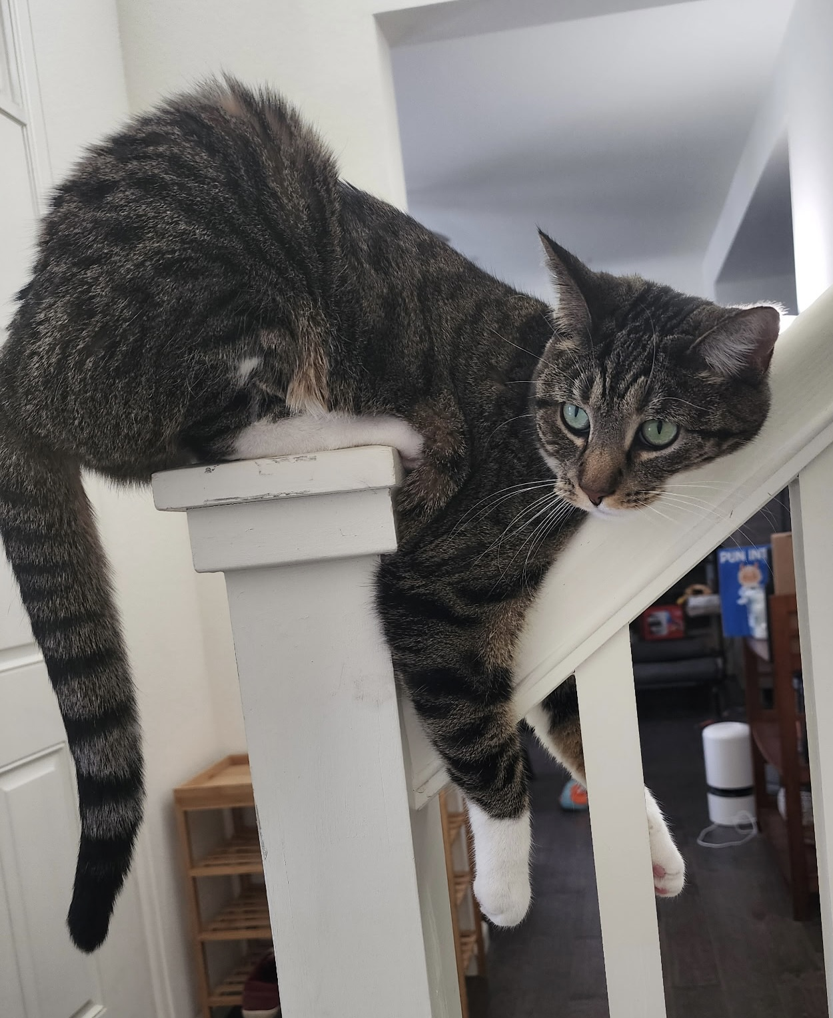
Questions?

Slide 7
Course Descriptions: Simplified
Idea: Introduces paradigms for designing algorithms and fundamental limitations to what algorithms can do.
Specific Algorithms Topics: greedy algorithms, divide and conquer algorithms, and dynamic programming.
Specific Complexity Topics: Topics related to limitations of algorithms include NP-completeness and undecidability.
Methods: Coverage includes analyzing algorithms via proofs and programming assignments to implement algorithms.

Slide 8
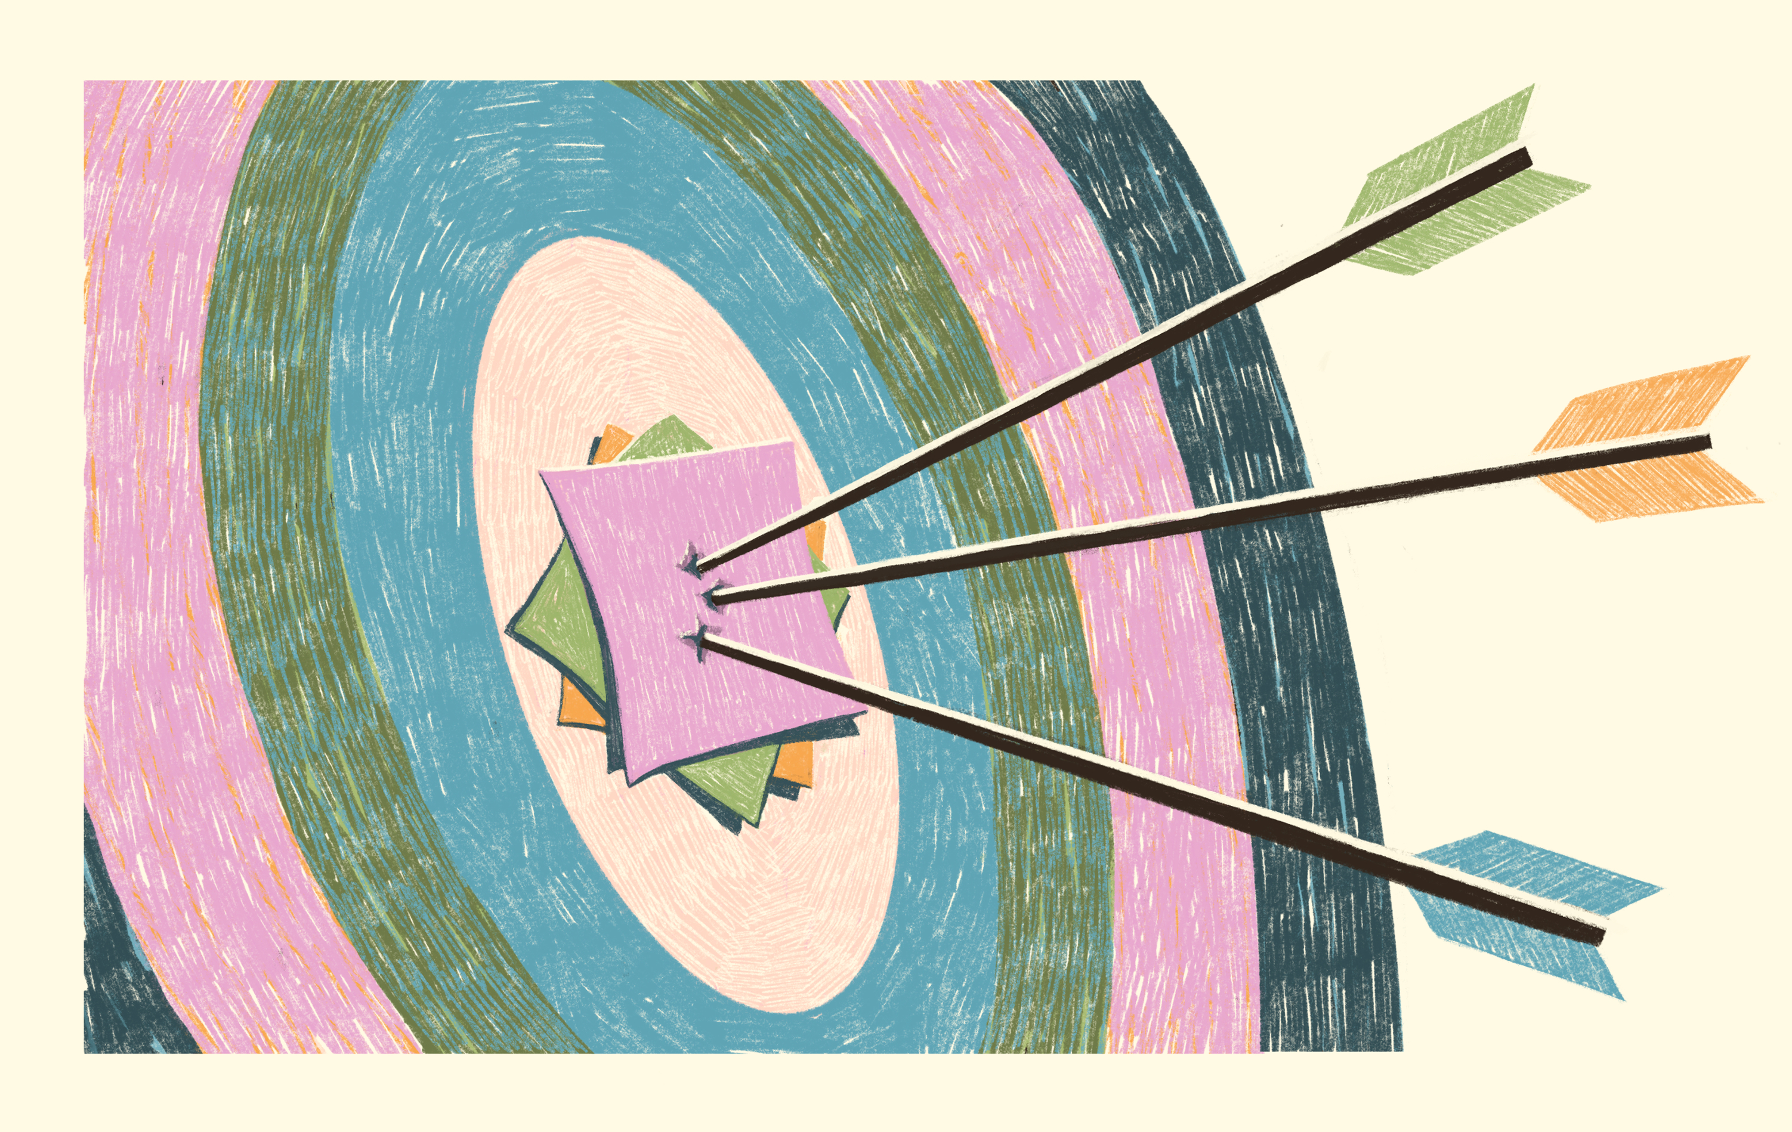
Course Descriptions: Goals
Keep in mind what you want out of this class.
Keep in mind what success means to you.
Keep in mind that this course is not the end of your algorithm journey.

Slide 9

Motivations…
Prepare for esoteric job interviews
Become better programmers
Become better mathematicians
Prepare for advance topics
Try something new and beautiful
Watch me act silly…
I WANT A JOB!

Slide 10

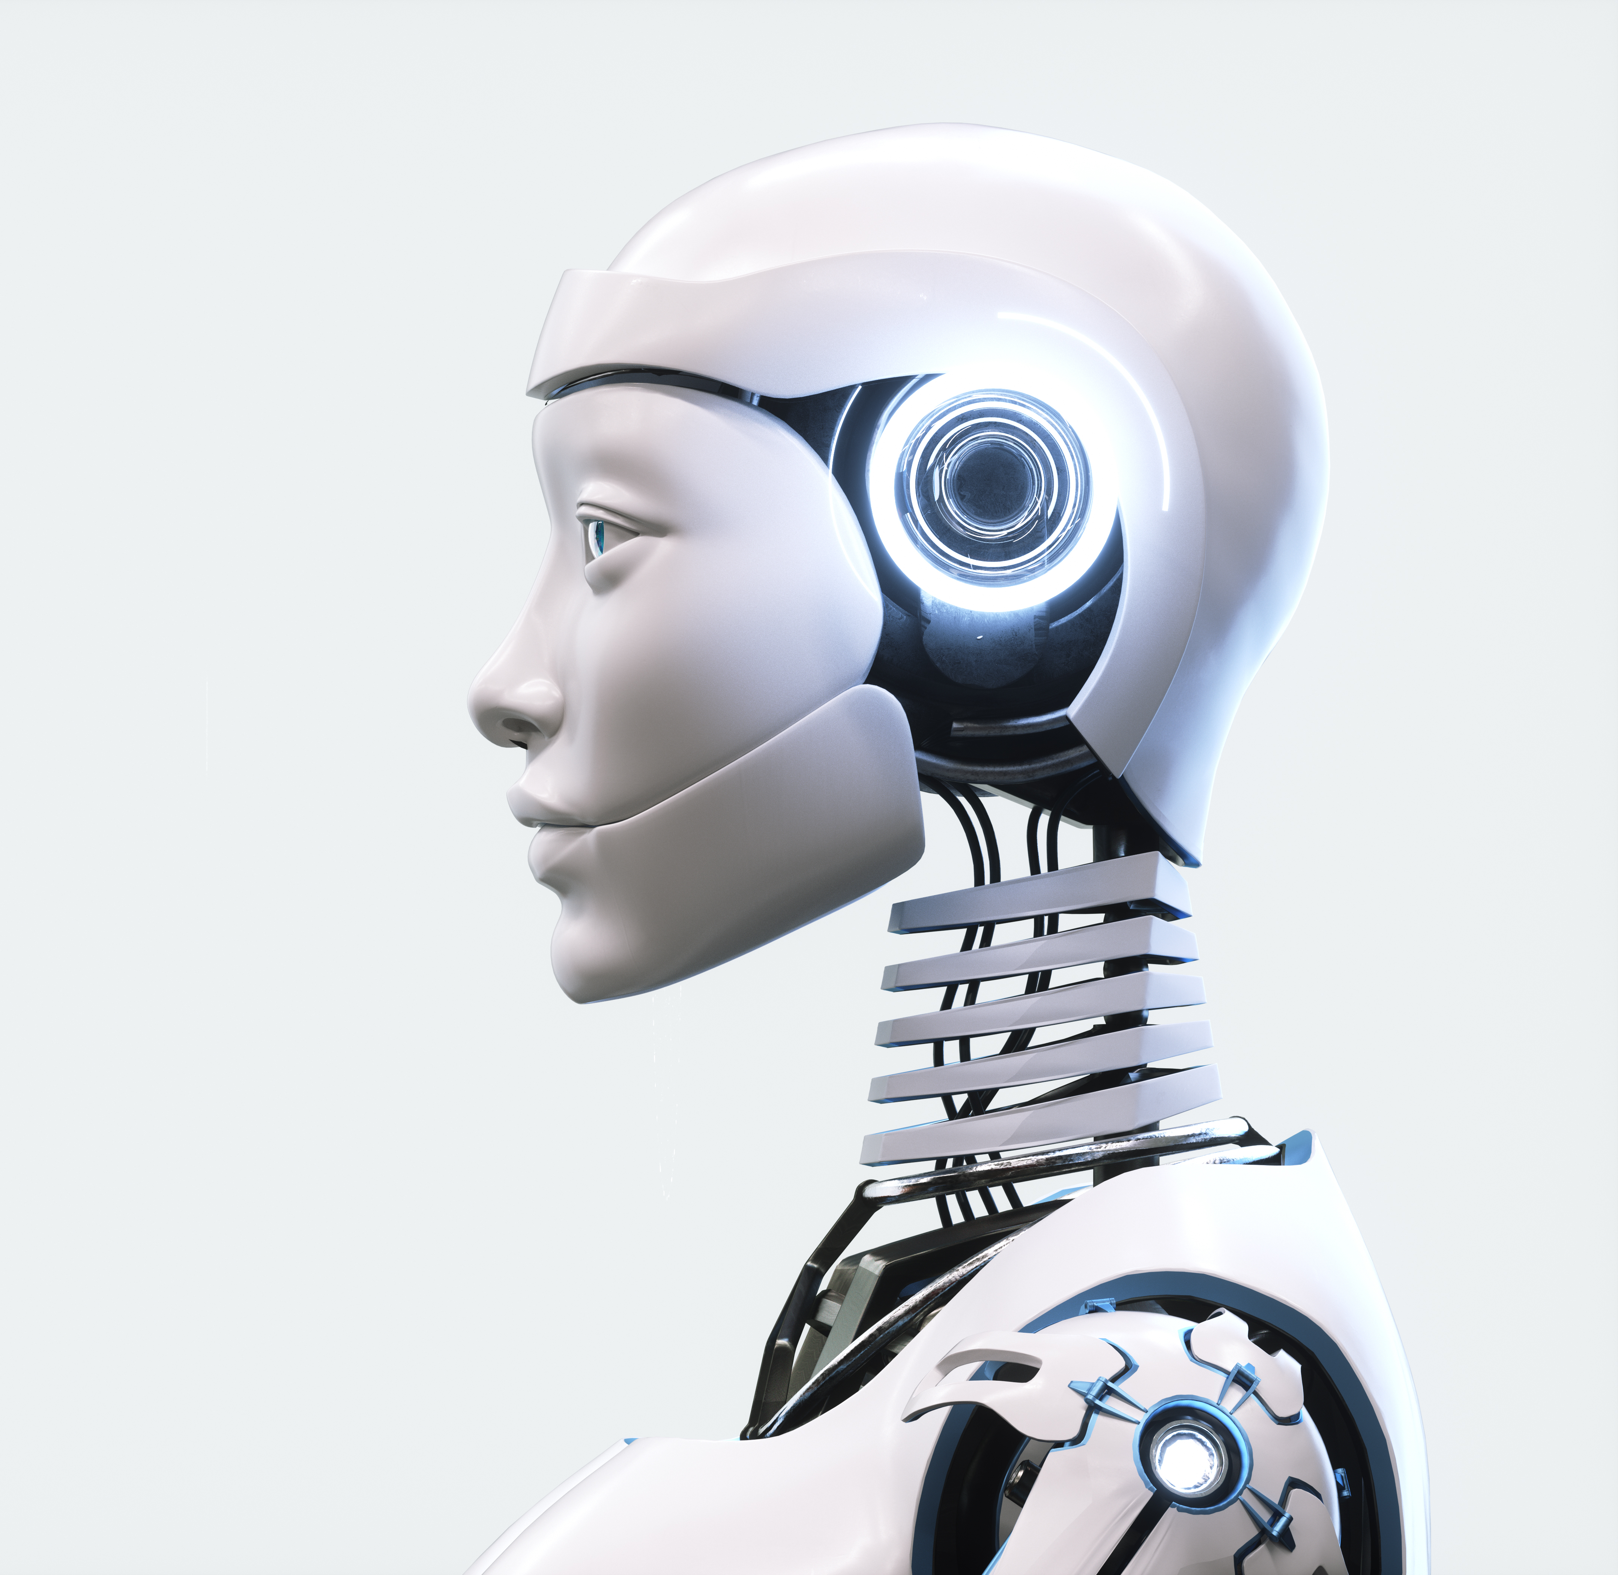
Motivation: You vs Machine

Slide 11

Proofs…
This class is about formally proving algorithms work or don’t work.
There will be proofs!
Proof writing takes practice, patience, and perseverance.

Slide 12
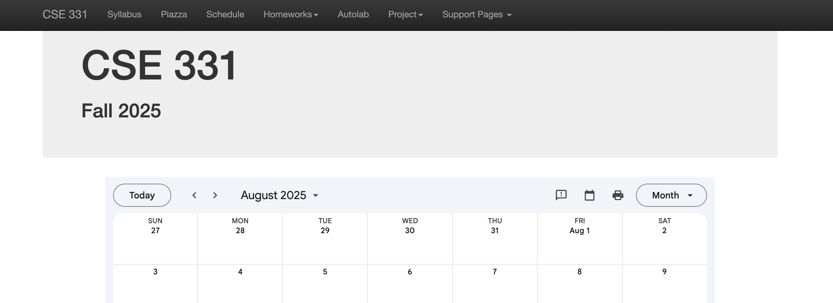
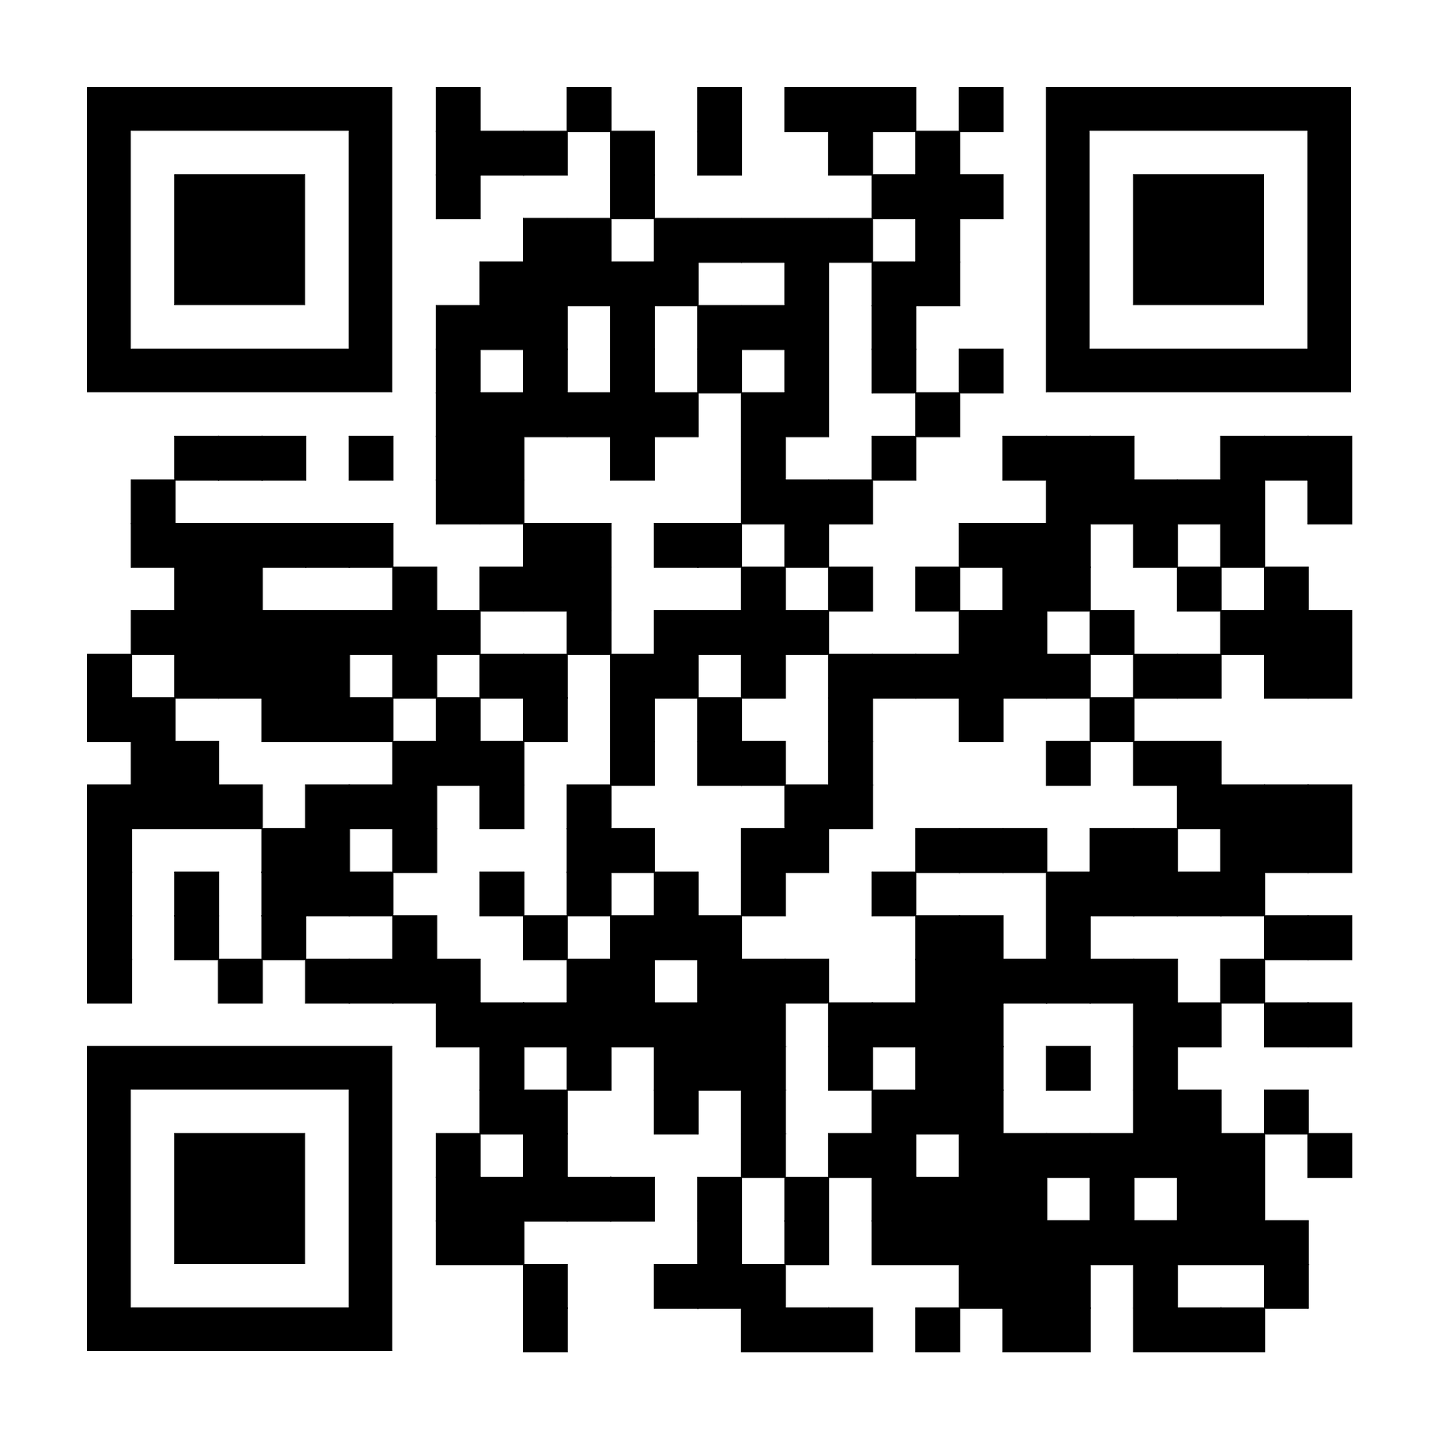
Website
https://www.buffalo.edu/~cc387/CSE331/fall25/

Slide 13
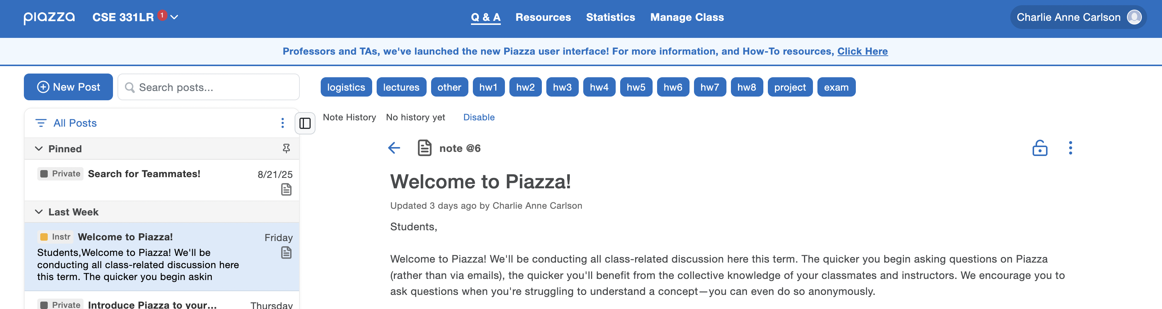
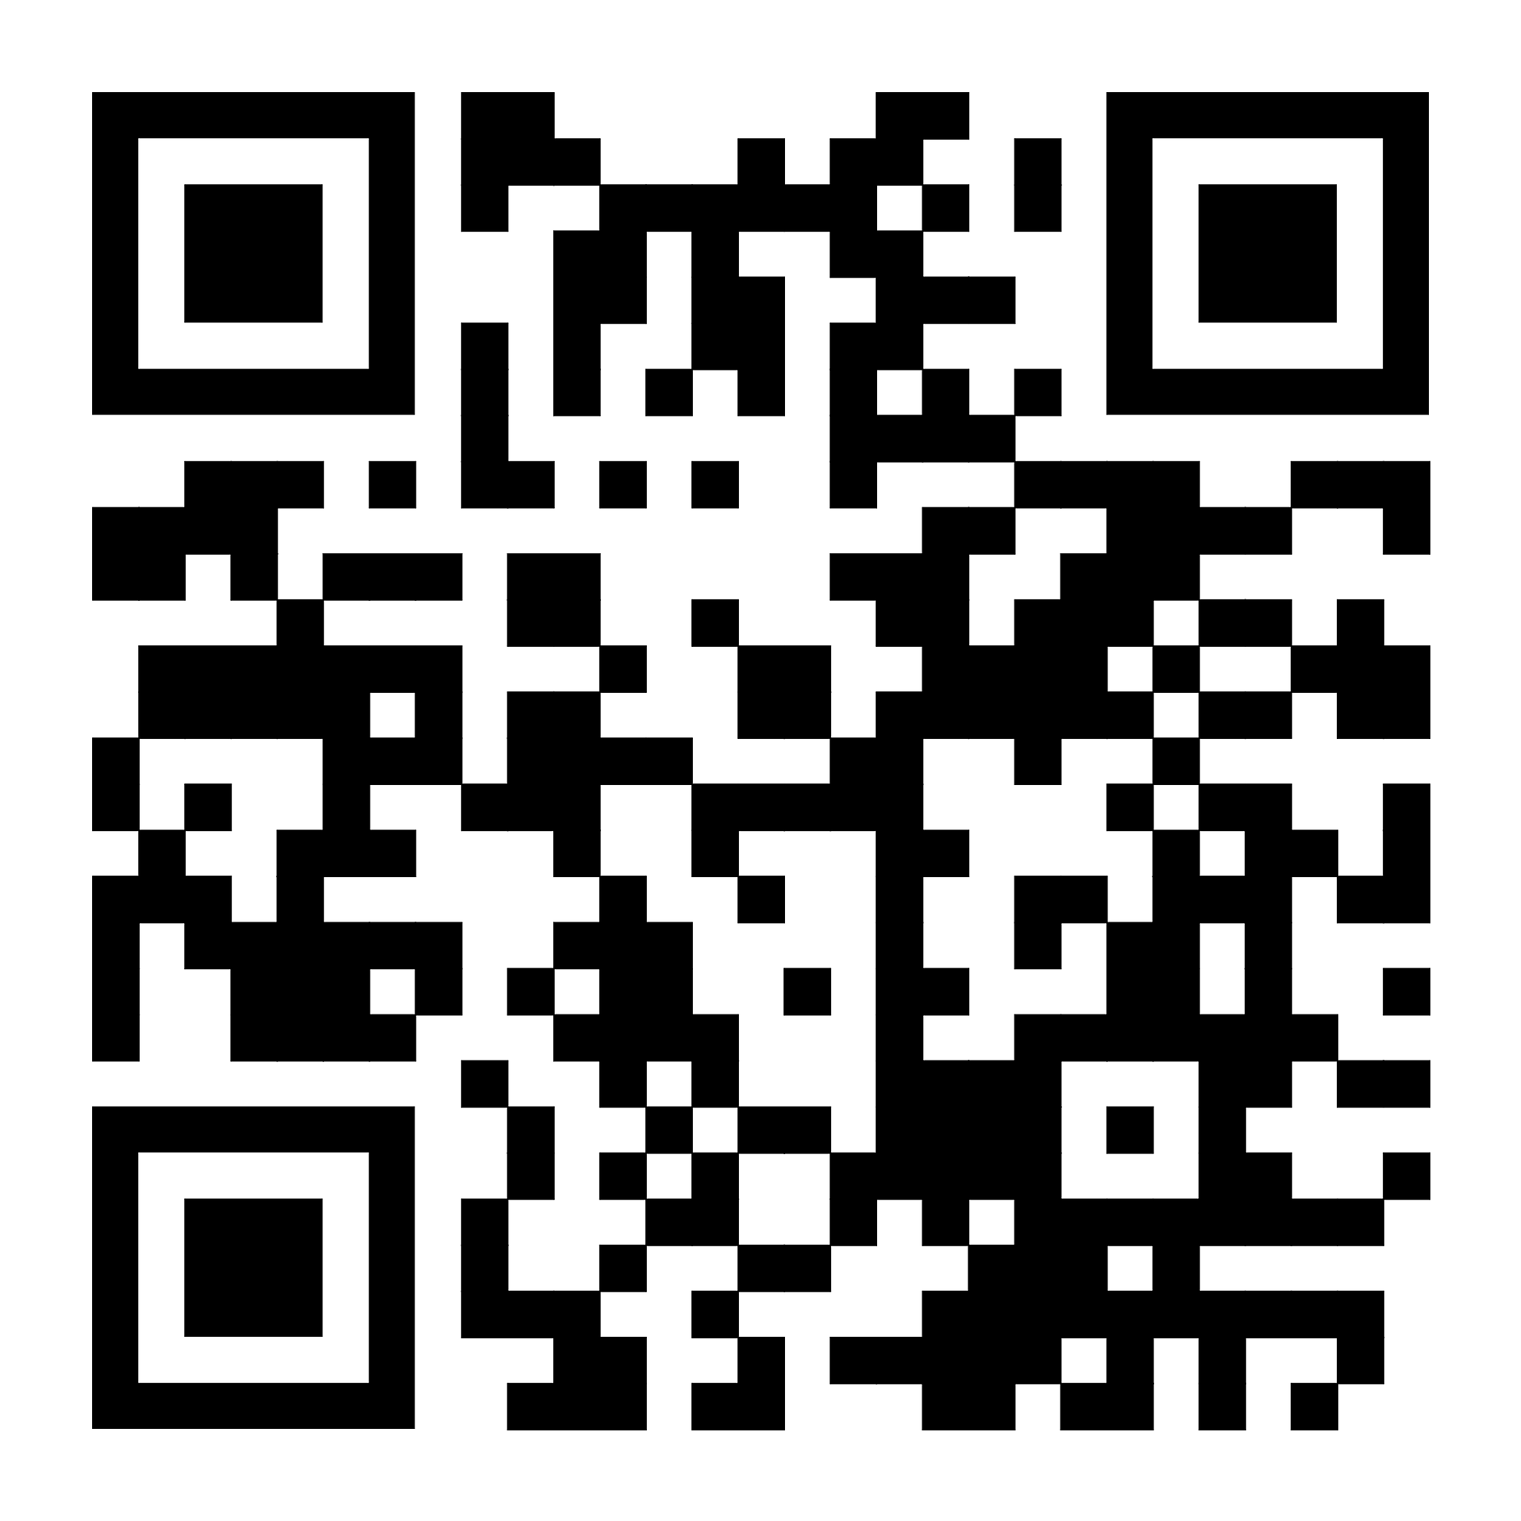
Piazza

Slide 14
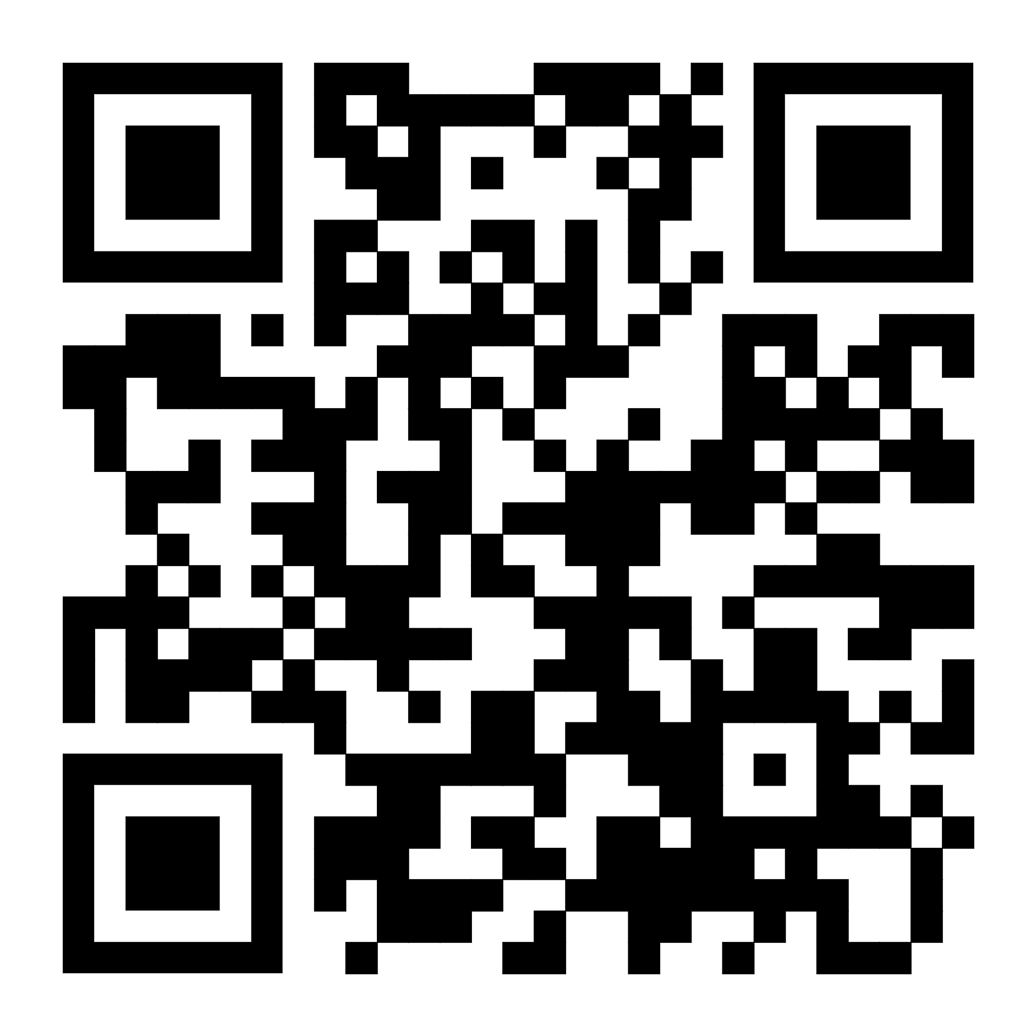
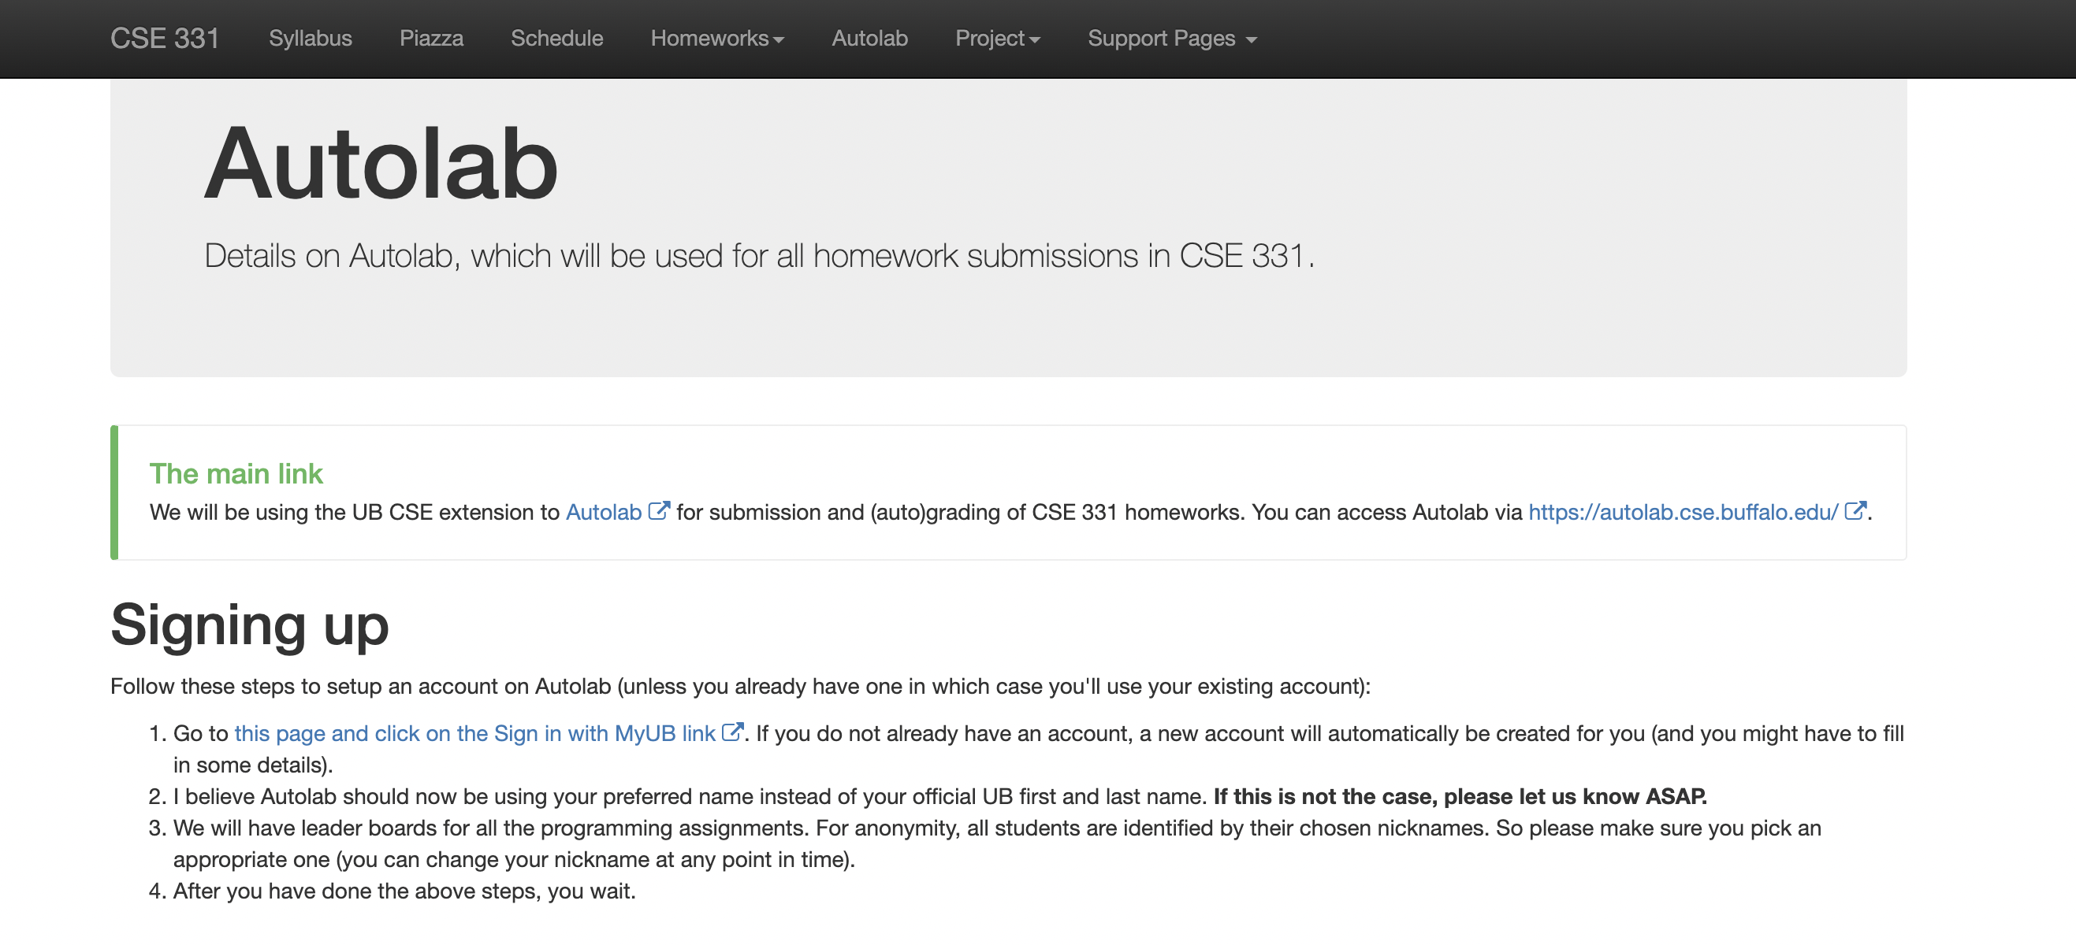
Autolab

Slide 15
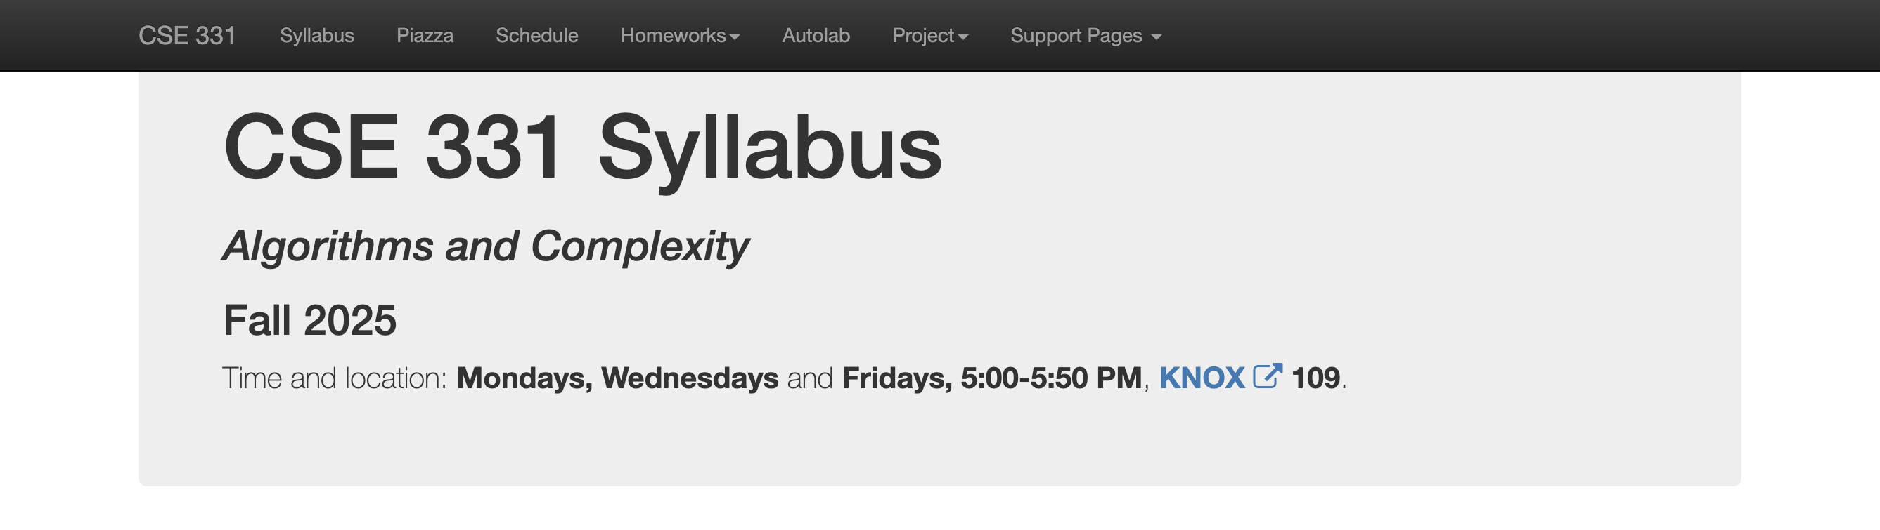
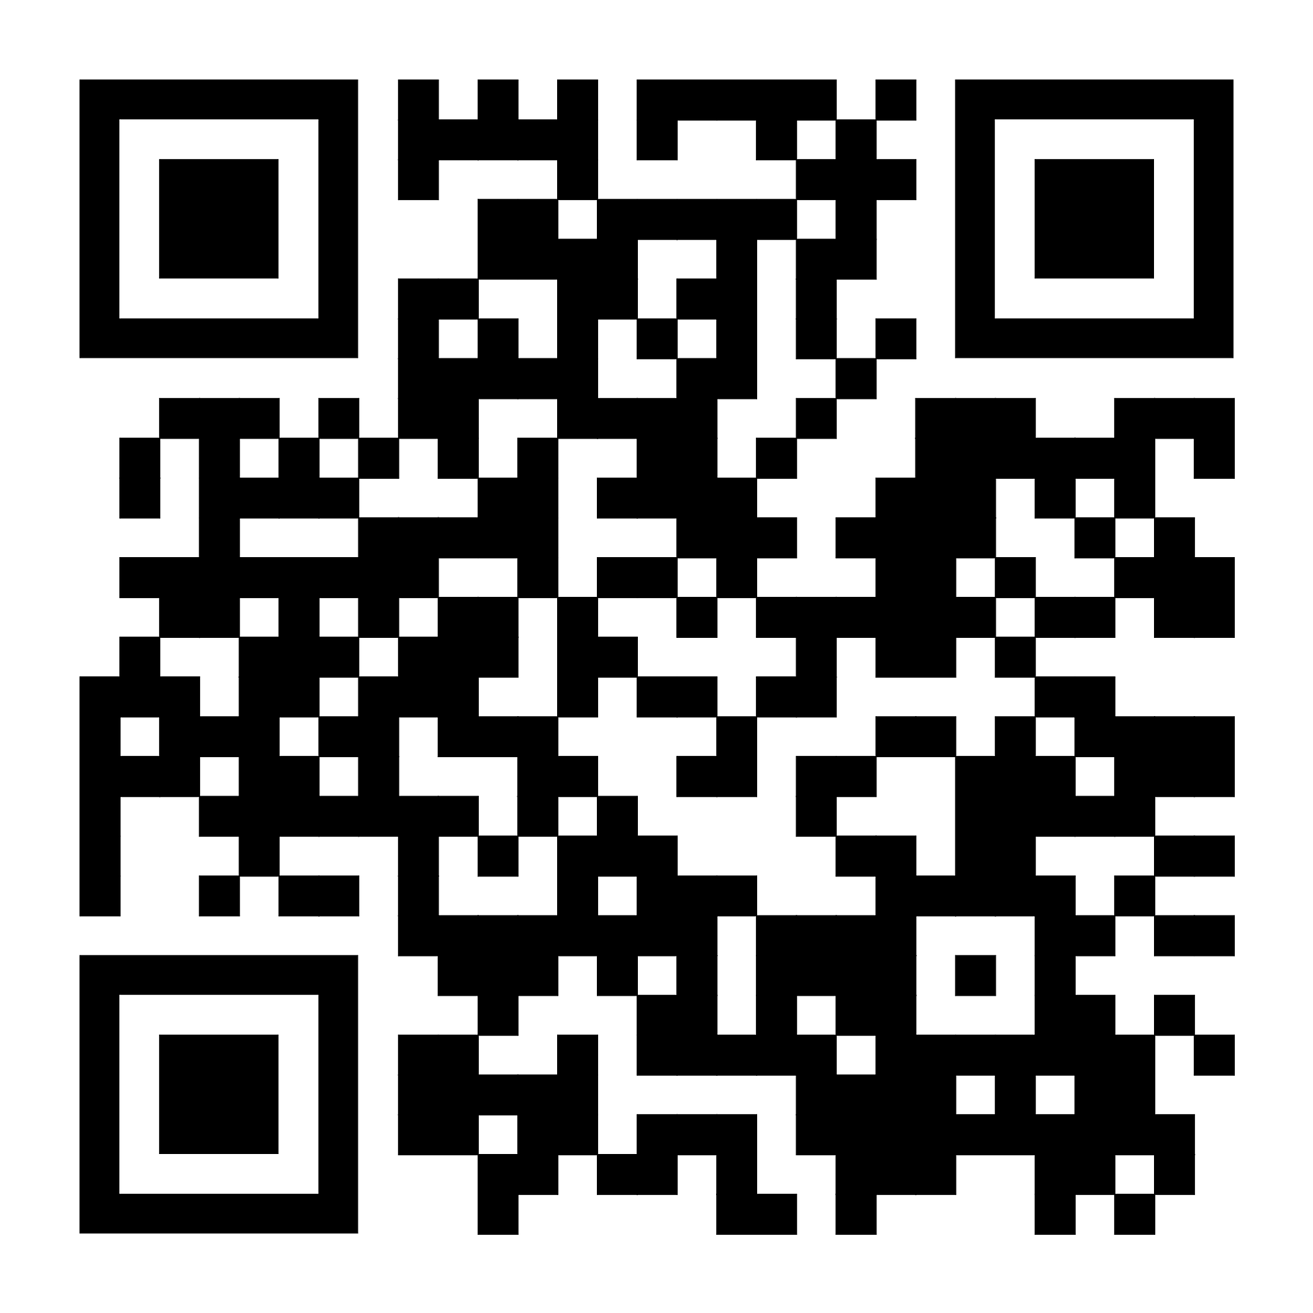
Syllabus: Overview
https://www.buffalo.edu/~cc387/CSE331/fall25/

Slide 16
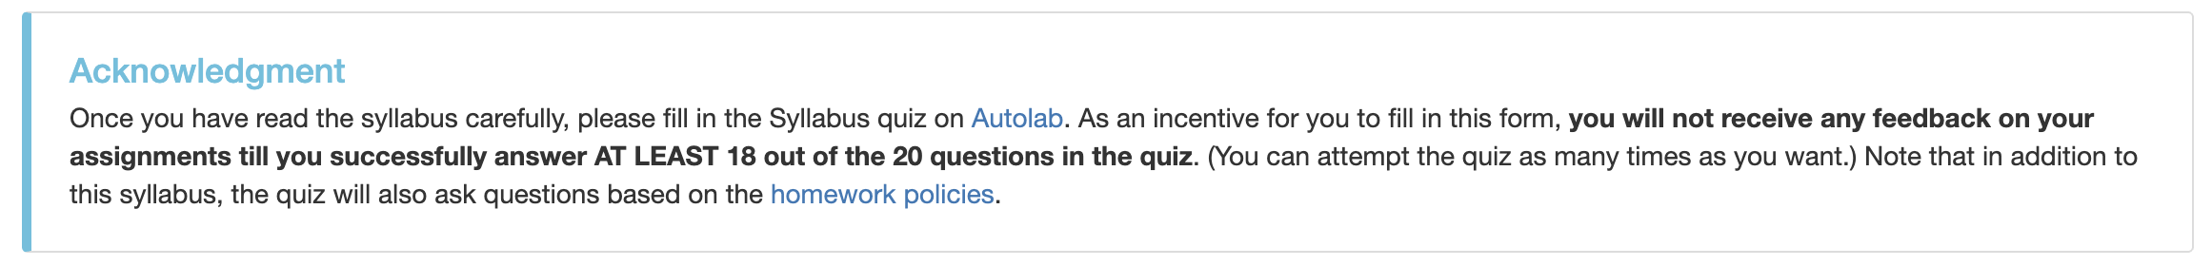




Syllabus: Syllabus Quiz
Watch Syllabus Video
Read Syllabus
Think About Syllabus
Destroy Quiz!

Slide 17
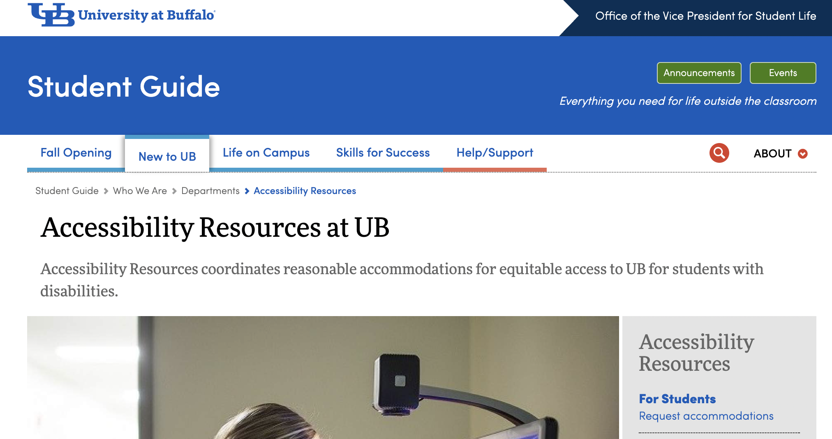
Syllabus: Accessibility & Inclusion

Slide 18
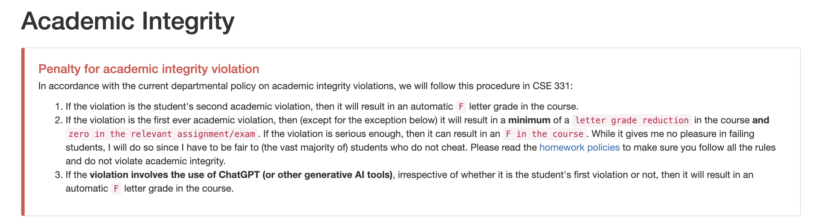
Syllabus: Academic Dishonesty

Slide 19
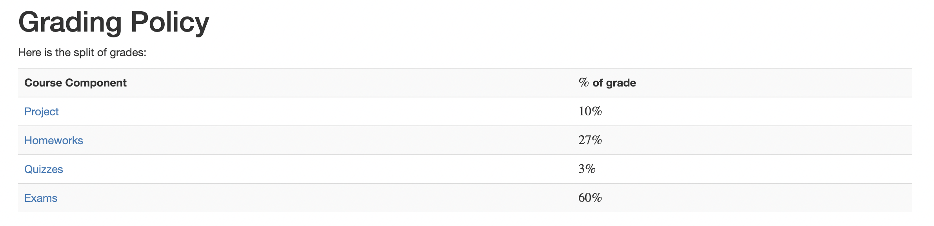
Syllabus: Grading Breakdown
There might be a curve, but you will fail if you get below a 20% and you will only get an A if you get above a 90%.
I reserve the right to adopt additional grading policies that improve everyone’s grade.

Slide 20

Syllabus: Grading Breakdown Homeworks
Quantity | % | Details | Due Date(s)
6 You will complete 8, but your two lowest-scoring homeworks will be dropped. | 27 | The homework will consist of one programming question (which can be submitted in C++, Java, or Python, and will be autograded by Autolab and two proof based questions | Assigned Tuesdays and Due Tuesdays
Homework 0 is just to give you feedback on your solutions; it will be graded but will not count towards your final grade.
No late submission will be accepted.

Slide 21

Syllabus: Grading Breakdown Project
Quantity | % | Details | Due Date(s)
1 There are five problems, each of which involves coding and reflection. | 10 | Coding Component (4%): programming tasks and work in group. Reflection Component (1%): group will reflect on ethical and societal considerations. Individual Component (5%): At the end of the project, you will rate your own and your other group member's contribution to the project. | Weeks 10, 11, 12, 13, and 14

Slide 22

Syllabus: Grading Breakdown Quizzes
Quantity | % | Details | Due Date(s)
2 Both quizzes will be solved in class. | 3 | The quizzes will consist of one or two true/false (with justification) questions. Such questions will be on the exams. These quizzes will be an opportunity for you to try and solve such questions before the exams. | Weeks 7 and 15

Slide 23

Syllabus: Grading Breakdown Exams
Quantity | % | Details | Due Date(s)
2 | 60 | The mid-term is worth 25% of your grade and the final exam is worth 35% of your grade. However, if it is to your advantage, then the final exam will be worth 60% of your grade. | Weeks 8 and 16 or 17
No makeup exams will be given except in provably extreme circumstances.
Read details on the syllabus.

Slide 24
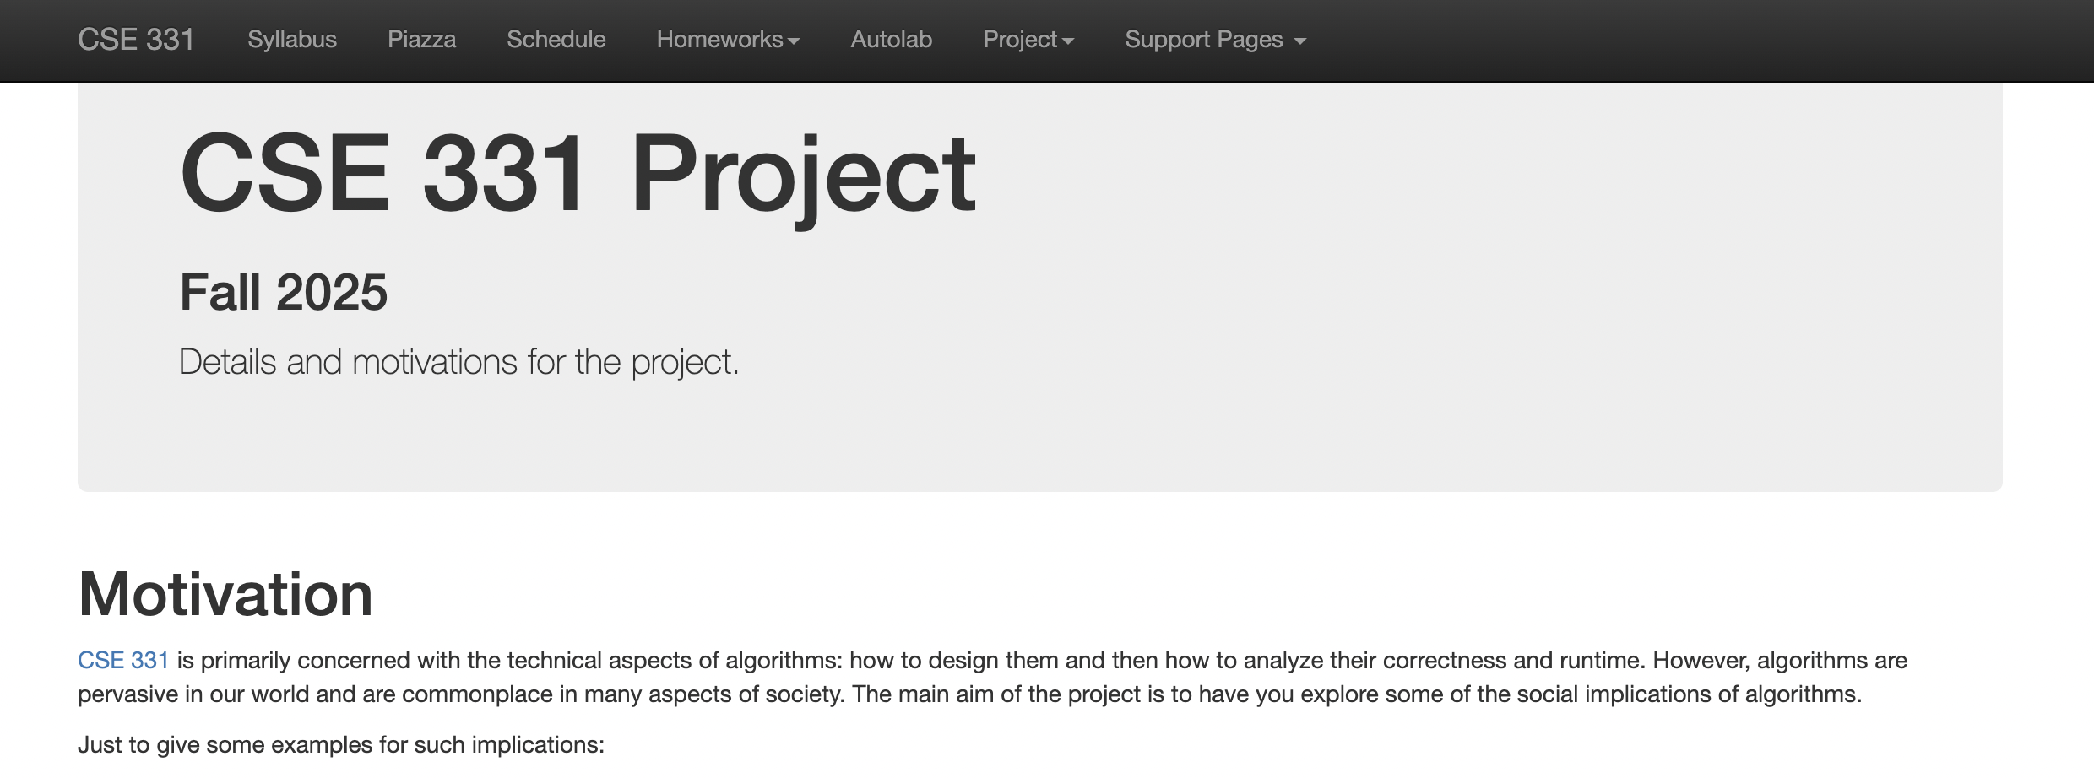
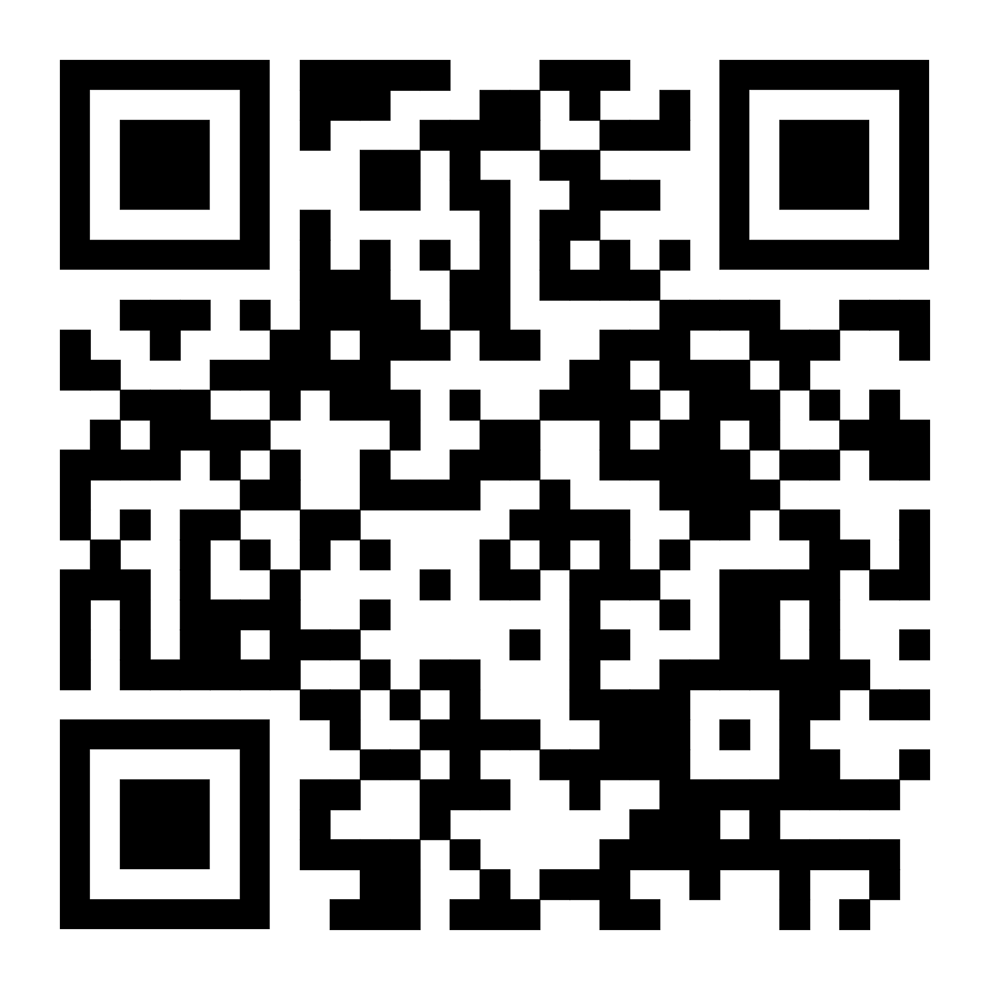
Syllabus: Project

Slide 25
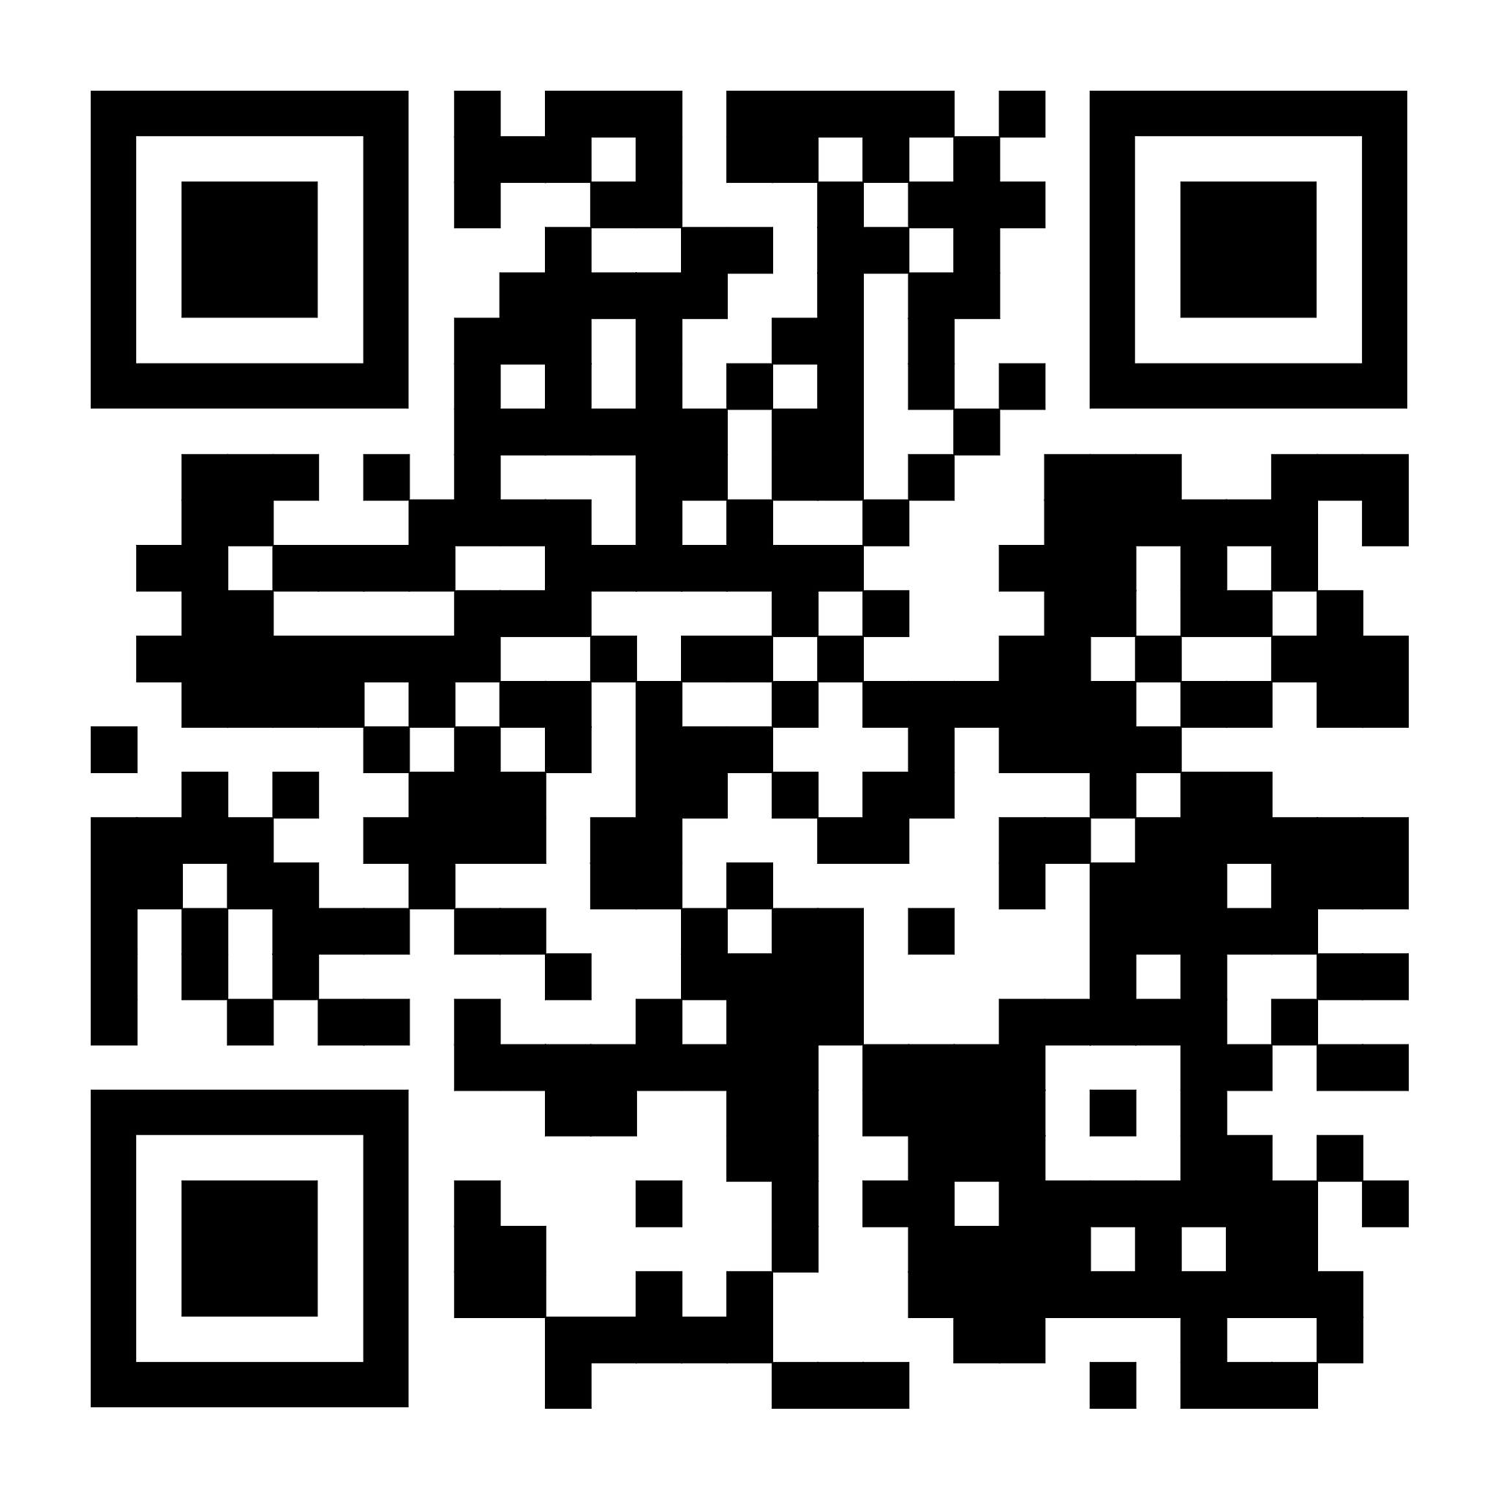
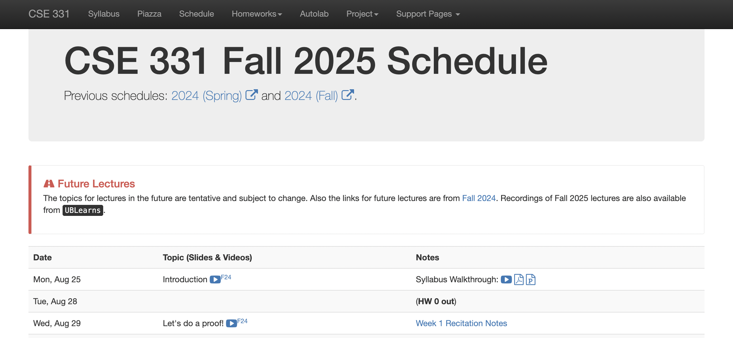
Syllabus: Schedule

Slide 26
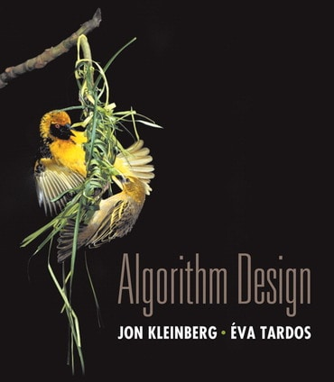
Syllabus: Textbook
Introduction [KT, Chap 1] (2 weeks).
Graph Basics [KT, Chap 3] (1.5 weeks).
Greedy Algorithms [KT, Chap 4] (2.5 weeks).
Divide and Conquer Algorithms [KT, Chap 5] (2 weeks).
Dynamic Programming [KT, Chap 6] (2.5 weeks).
NP-completeness [KT, Chap 8] and undecidability (2.5 weeks).

Slide 27
Syllabus: Recitations
Start this week!
Notes are available online.
First week is going to be about proofs.
Will often talk about homework problems or adjacent problems.
Great place to ask questions, see worked examples, and practice being wrong.
Recitations are not recorded.

Slide 28
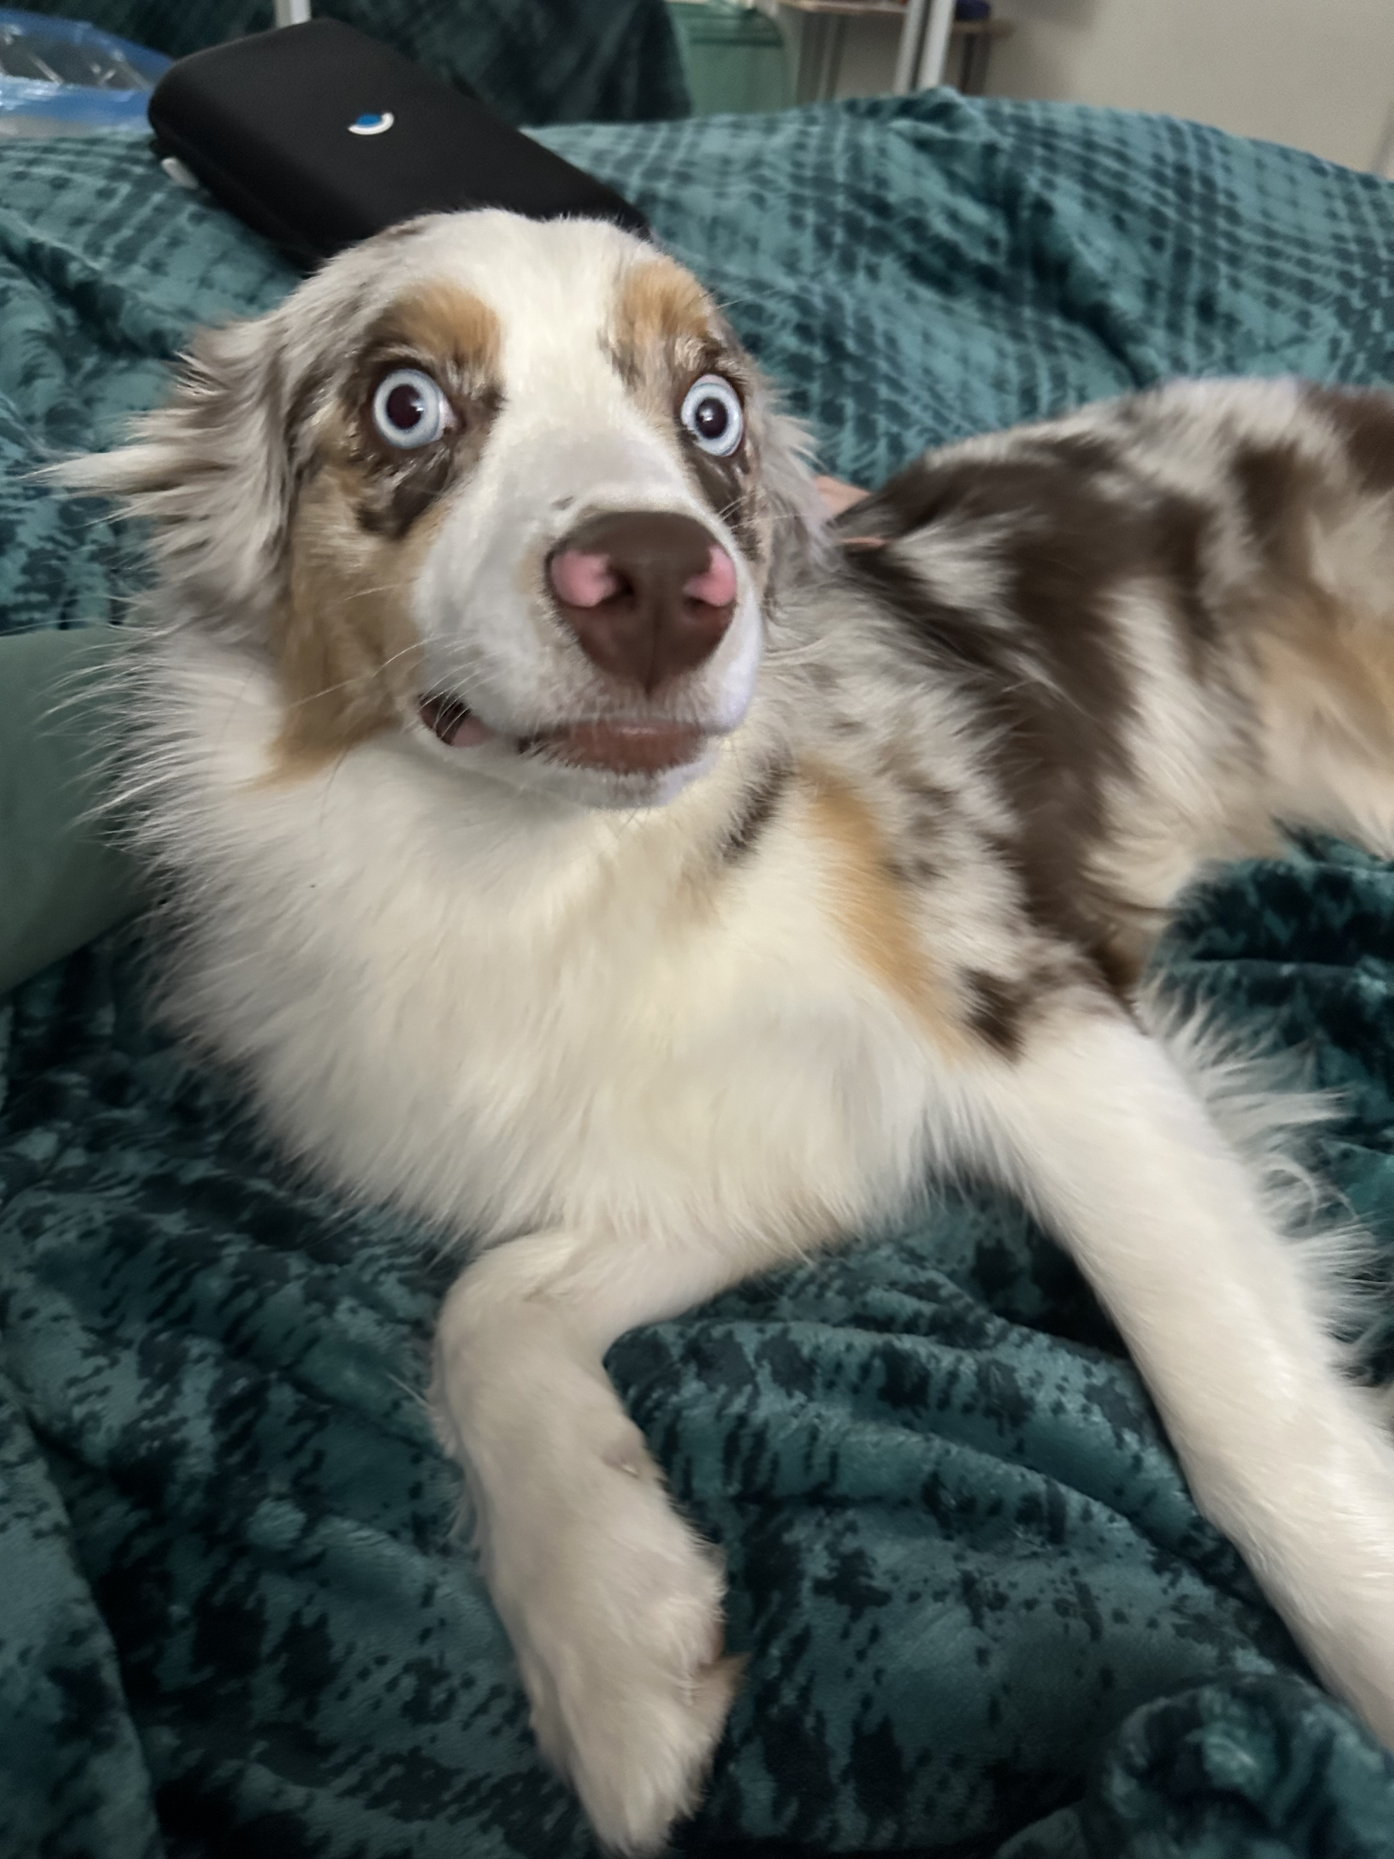
Questions?

