Slide 1

CSE 331: Algorithms & Complexity
“A Proof”
Prof. Charlie Anne Carlson (She/Her)
Lecture 1
Monday August 27th, 2025

Slide 2

Schedule
Course Updates
Advice
Halting Problem

Slide 3
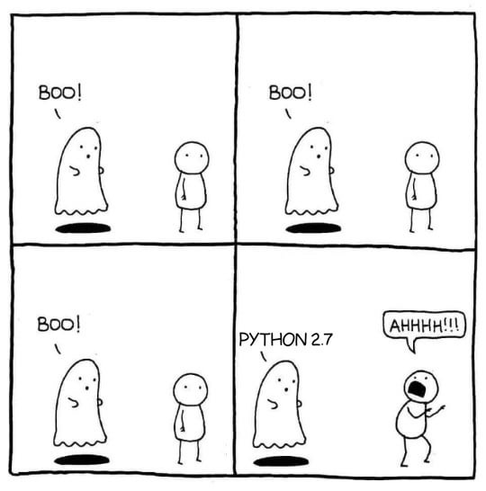
Course Updates: Syllabus Quiz Fixed!
MrSavagePotato. “Python 2.7.” Reddit, July 25, 2018. https://www.reddit.com/r/ProgrammerHumor/comments/91vtas/python_27/

Slide 4
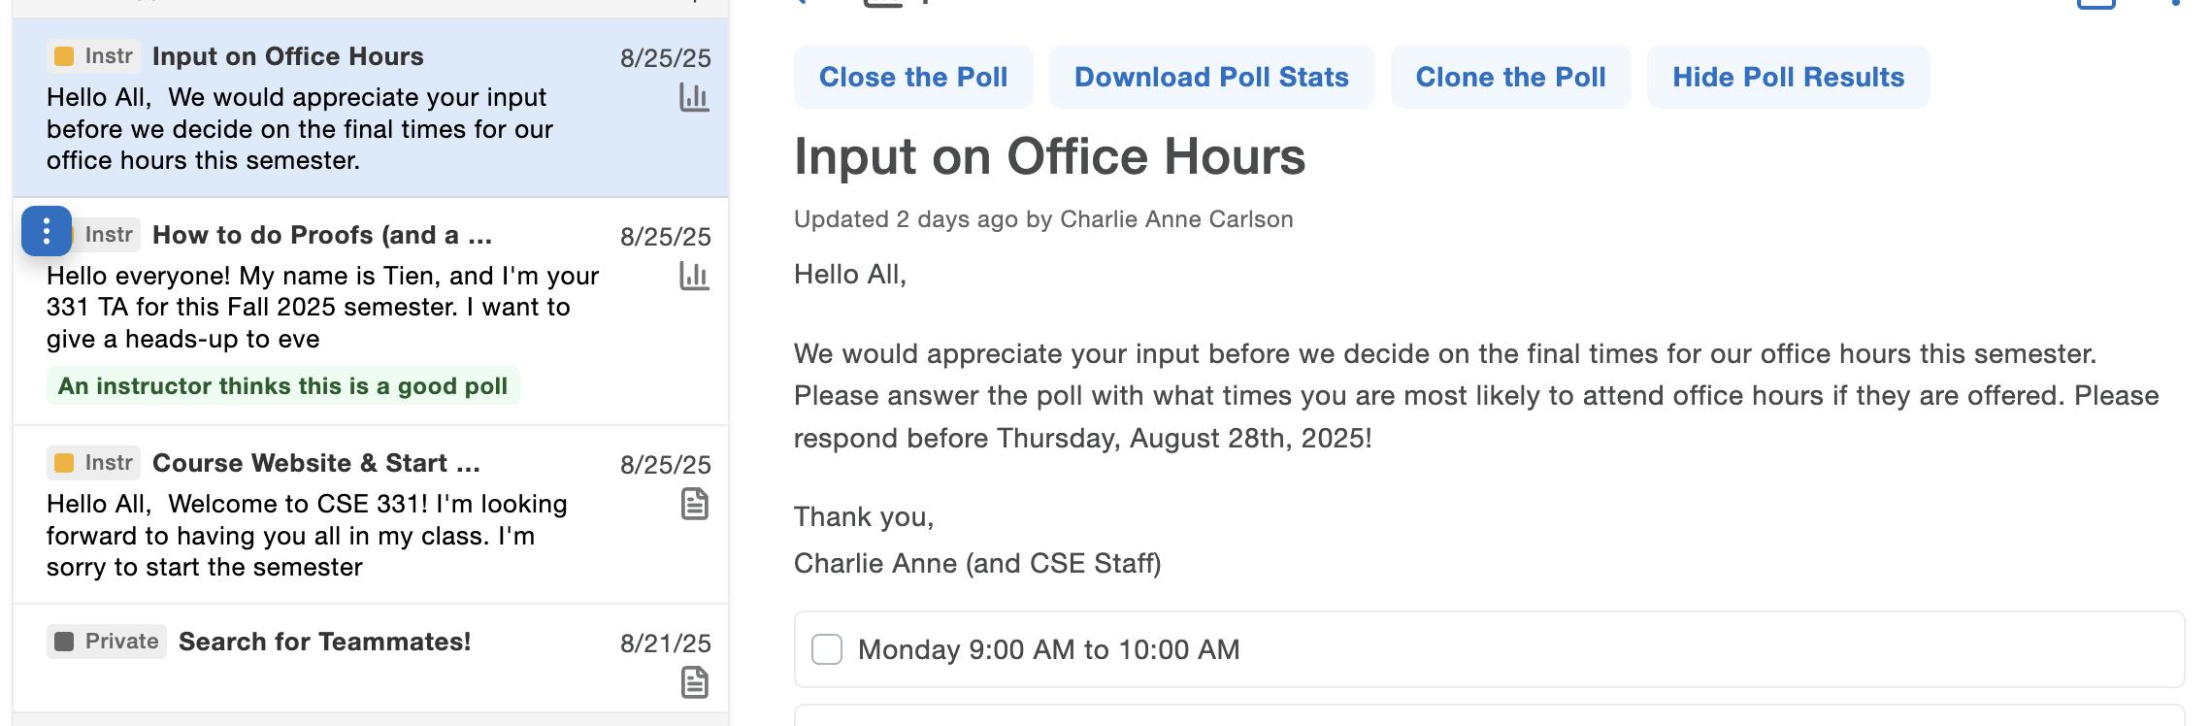
Course Updates: Piazza Polls

Slide 5
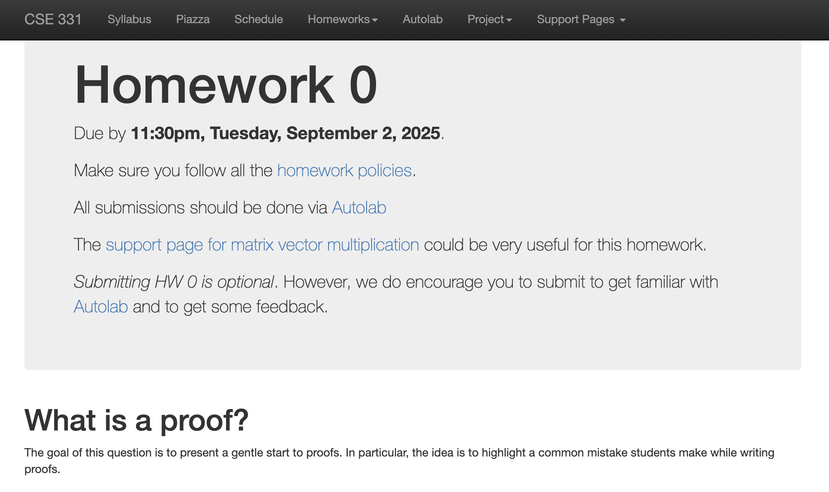
Course Updates: HW0 is out

Slide 6
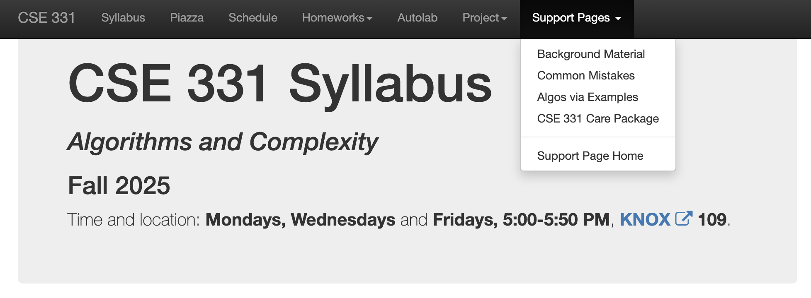
Advice: Support Materials

Slide 7
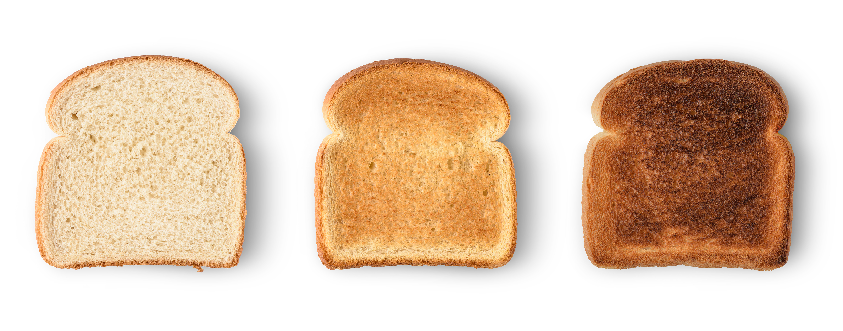
Advice: Solving Problems
Read problem carefully!
Think about problem for a few minutes.
Keep notes about ideas.
Step away when stuck.
Schedule time in advance to work on problems.
Go to office hours if stuck.
Turn in what you have before the deadline.

Slide 8
Advice: Big Three
Read Carefully
Don’t Cheat
Work Hard

Slide 9
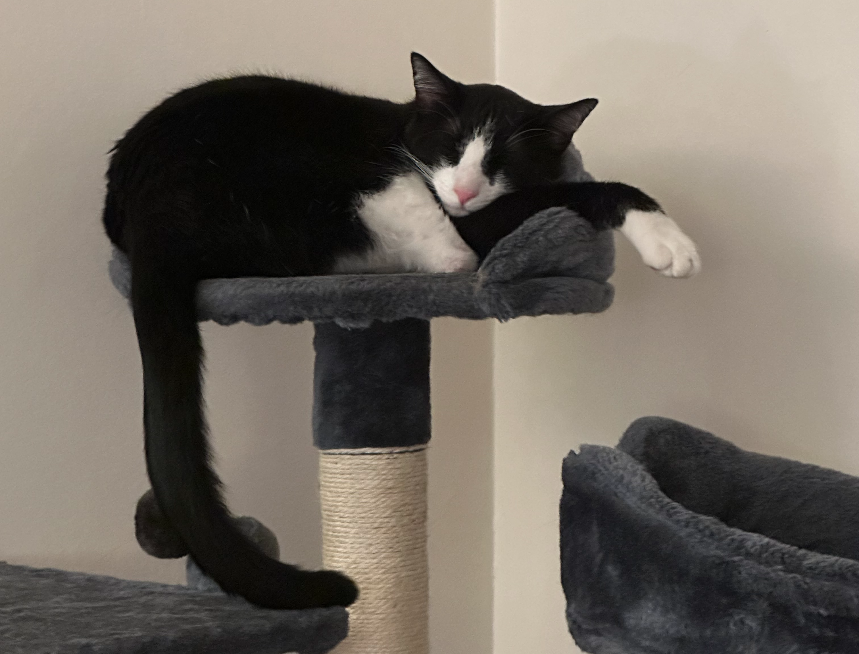
Questions?

Slide 10

Does it halt?
Q1: What does it mean for a program to “terminate?”
Q2: Can you think of program which does not terminate on any input?
Q3: Can you think of a program that terminates on all but one specific input?

Slide 11

Does it halt?
def add (a,b):
c = a+b
return c
def badd (a,b):
c = a+b
while (True):
continue
return c
def badd2 (a,b):
c = a+b
if (c == 2):
return c
while (True):
continue

Slide 12
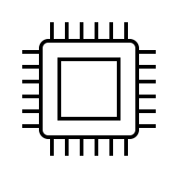


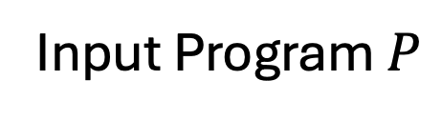
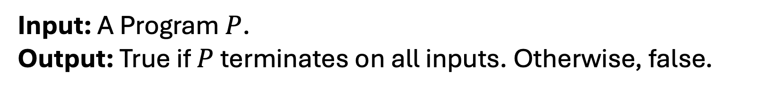
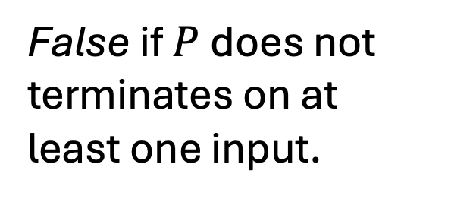
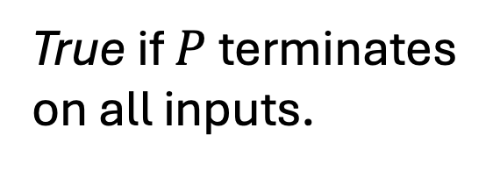
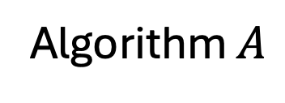
Does it halt?
Input: A Program $P$.
Output: True if $P$ terminates on all inputs. Otherwise, false.
True if $P$ terminates on all inputs.
Input Program $P$
False if $P$ does not terminates on at least one input.
Algorithm $A$

Slide 13
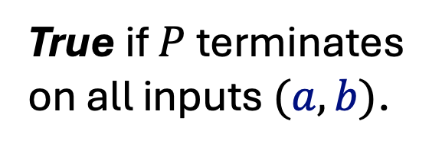
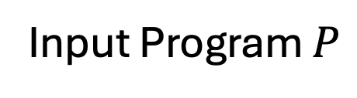
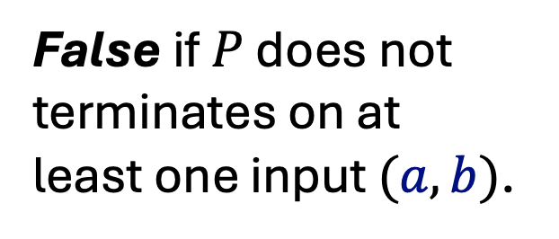
Does it halt?
Input: A Program $P$.
Output: True if $P$ terminates on all inputs. Otherwise, false.
True if $P$ terminates on all inputs $(a,b)$.
def add (a,b):
c = a+b
return c
Input Program $P$
False if $P$ does not terminates on at least one input $(a,b)$.
Algorithm $A$

Slide 14
Does it halt?
Q4: How would you try to solve this problem?
A4: You would not…
Q5: What could you do instead?

Slide 15
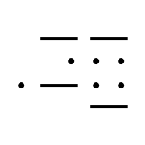
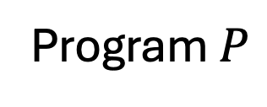
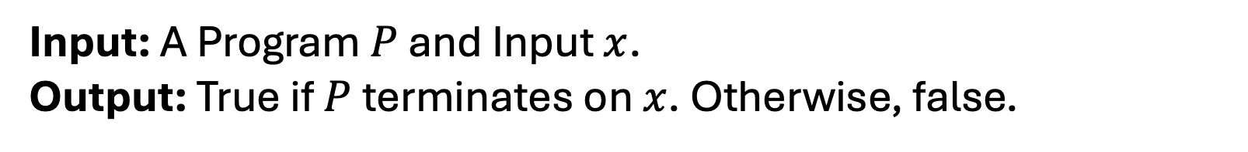
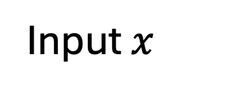
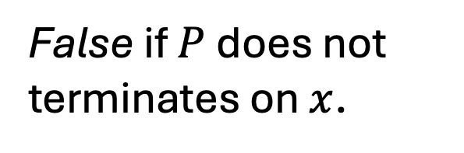
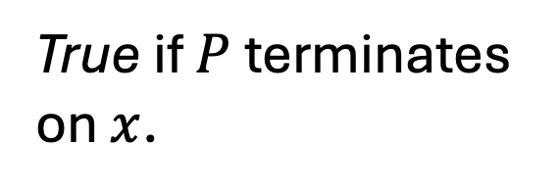
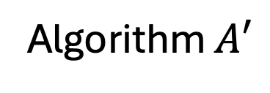

Does it halt 2.0?
Input: A Program $P$ and Input $x$.
Output: True if $P$ terminates on $x$. Otherwise, false.
Program $P$
True if $P$ terminates on $x$.
$$+$$
False if $P$ does not terminates on $x$.
Input $x$
Algorithm $A′$

Slide 16
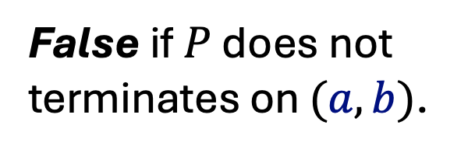
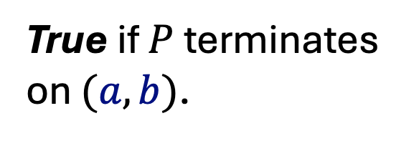
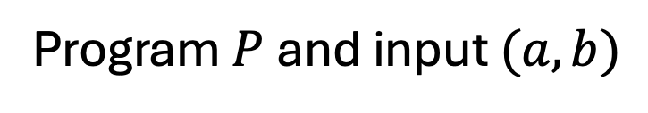
Does it halt 2.0?
Input: A Program $P$ and Input $x$.
Output: True if $P$ terminates on $x$. Otherwise, false.
True if $P$ terminates on $(a,b)$.
def add (a,b):
c = a+b
return c
Program $P$ and input $(a,b)$
False if $P$ does not terminates on $(a,b)$.
Algorithm $A′$

Slide 17
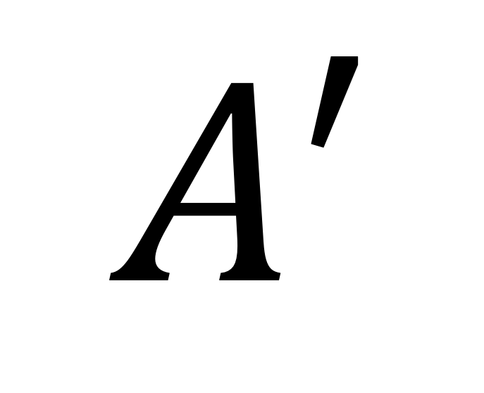
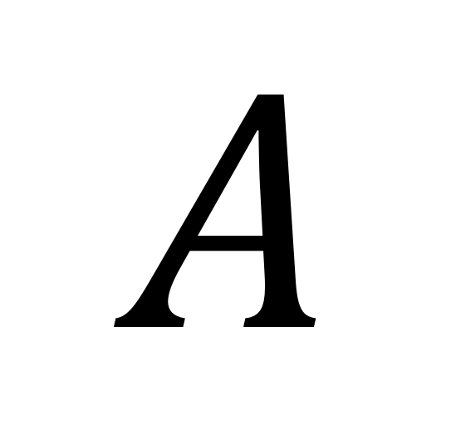
Does it halt?
Q5: Which is harder to write? Why?
$$A′$$
$$A$$

Slide 18
Does it halt?
Q5: Which is harder to write? Why?
$$A′$$
$$A$$

Slide 19
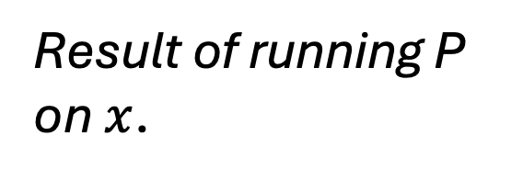
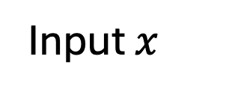
Universal Turing Machine
Program $P$
Result of running P on $x$.
$$+$$
Input $x$
UTM

Slide 20

Universal Turing Machine
Data
Program $P$
Result of running P on $x$.
$$+$$
Input $x$
UTM Computer

Slide 21
A Wild Theorem
Theorem: There exist no algorithm/program that will always halt and will always correctly decide Halting Problem 2.0.

Slide 22
A Wild Theorem
Q6: How would you prove this?
Theorem: There exist no algorithm/program that will always halt and will always correctly decide Halting Problem 2.0.

Slide 23
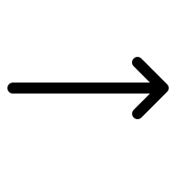
Proof by Contradiction
Assume negation of proposition.
Derive a contradiction from such an assumption.
Conclude that the original assumption is wrong and thus… proposition is true.

Slide 24
Theorem Proof
Suppose there exists an algo/program MAGIC(P,I) that decides if program P terminates on input I.
def magic( P, I):
# This is a magic box so there is no real code here!
''' Return True if P halts on I and False otherwise'''

Slide 25
Theorem Proof
That means MAGIC(P,I)always terminates and returns the correct answer.
def magic( P, I):
# This is a magic box so there is no real code here!
''' Return True if P halts on I and False otherwise'''

Slide 26
Theorem Proof
Define Contradiction(P):
def contradiction ( P ): # This function takes a program as an input
#Run magic on (P,P)
if magic(P,P): # Use an UTM to make this call
while True:
continue # Do nothing
return # Just terminate if magic(P,P) returns False

Slide 27
That’s not right…
Q7: What if we run Contradiction(Contradiction)on the UTM?
def contradiction ( P ): # This function takes a program as an input
#Run magic on (P,P)
if magic(P,P): # Use an UTM to make this call
while True:
continue # Do nothing
return # Just terminate if magic(P,P) returns False

Slide 28
Case I: P terminates on P
Q8: What happens if Contradiction terminates on Contradiction?
def contradiction ( P ): # This function takes a program as an input
#Run magic on (P,P)
if magic(P,P): # Use an UTM to make this call
while True:
continue # Do nothing
return # Just terminate if magic(P,P) returns False

Slide 29
Case I: P terminates on P
Q8: What happens if Contradiction terminates on Contradiction?
def contradiction ( P ): # This function takes a program as an input
#Run magic on (P,P)
if magic(P,P) True: # Use an UTM to make this call
while True:
continue # Do nothing
return # Just terminate if magic(P,P) returns False
Does not terminate!

Slide 30
Case II: P does not terminates on P
Q9: What happens if Contradiction does not terminate on Contradiction?
def contradiction ( P ): # This function takes a program as an input
#Run magic on (P,P)
if magic(P,P): # Use an UTM to make this call
while True:
continue # Do nothing
return # Just terminate if magic(P,P) returns False

Slide 31
Case II: P does not terminates on P
Q9: What happens if Contradiction does not terminate on Contradiction?
def contradiction ( P ): # This function takes a program as an input
#Run magic on (P,P)
if magic(P,P) False : # Use an UTM to make this call
while True:
continue # Do nothing
return # Just terminate if magic(P,P) returns False
Does terminate!

Slide 32
Proof Conclusion
Assume MAGIC exists.
Use MAGIC to construct Contradiction.
“Law of excluded middle”
If Contradiction(Contradiction) terminates then does not…
If Contradiction(Contradiction) does not terminate then does…
Thus, something we said must be wrong.
Q10: What could be wrong?

Slide 33
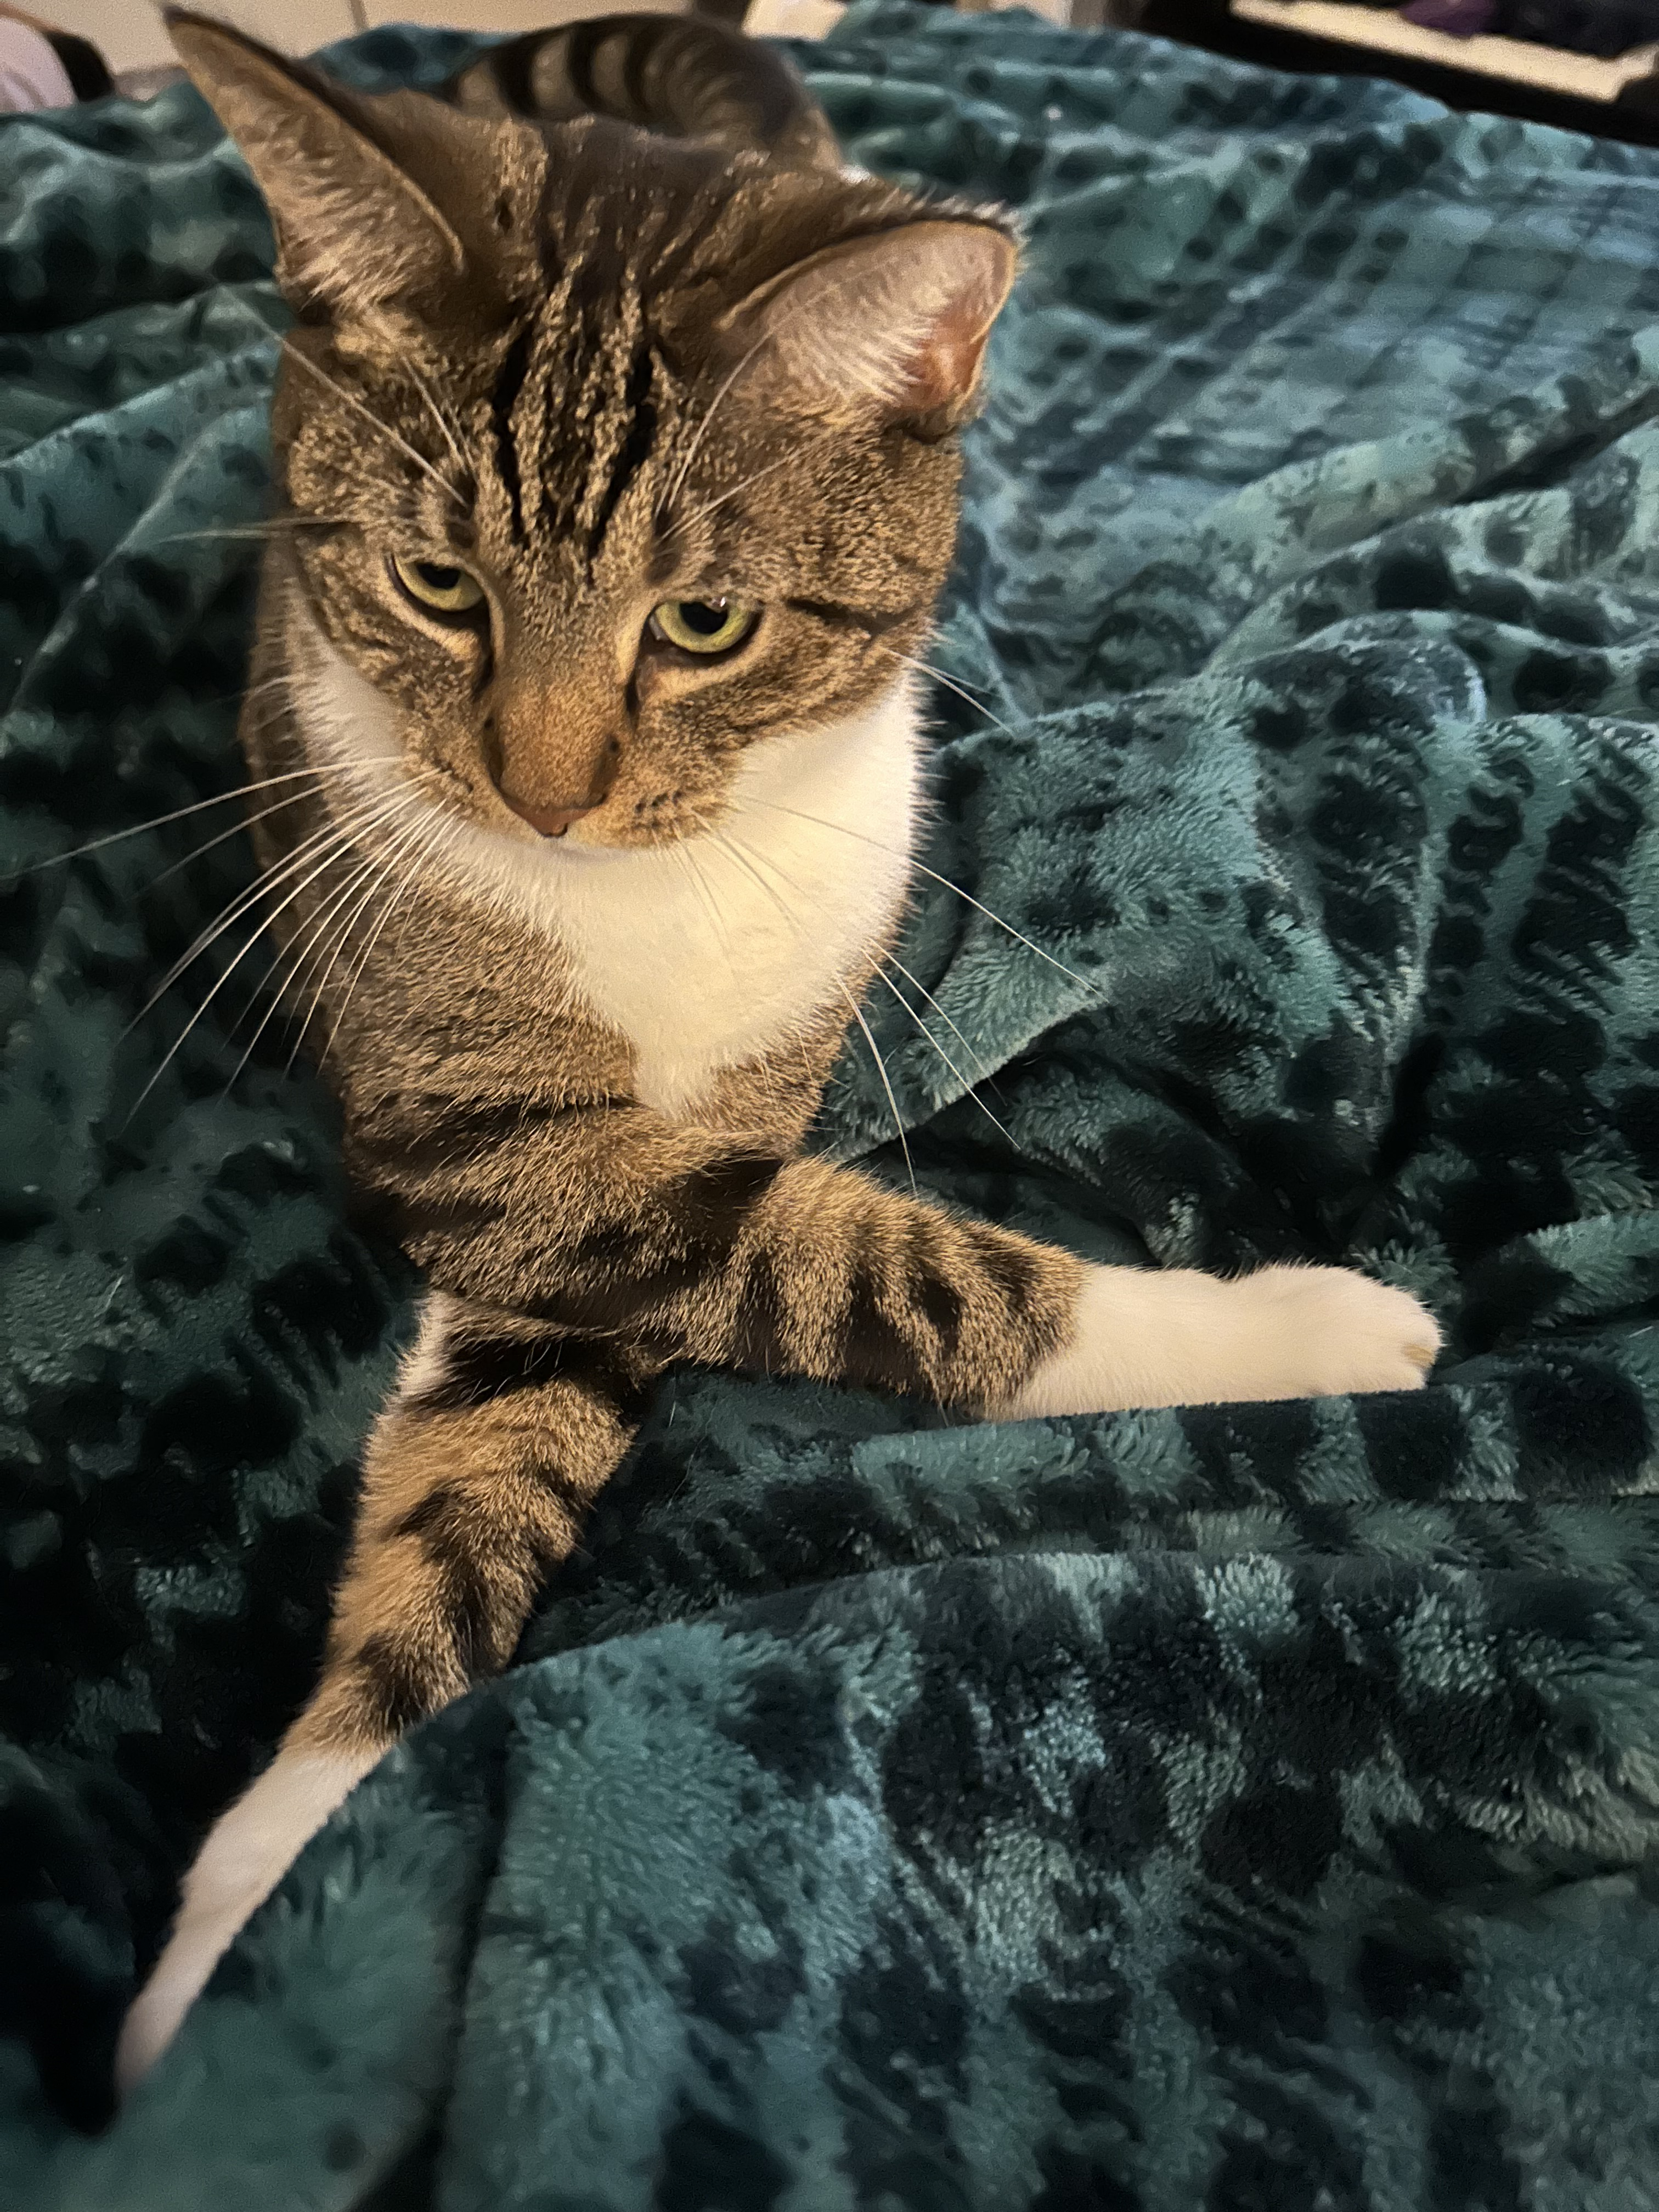
Questions?

Slide 34

Celebrate!

Slide 35
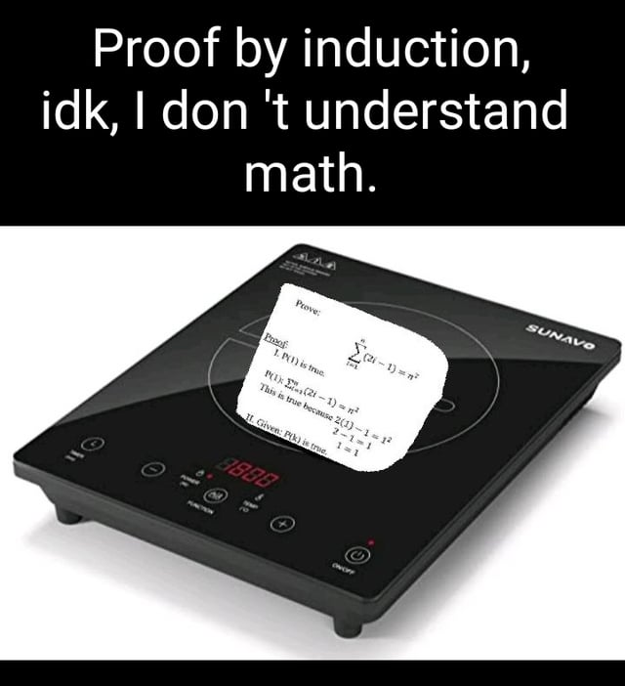
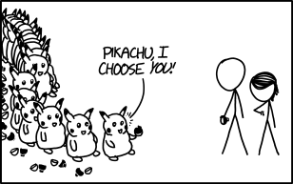
Proof by Induction
Bongcloudforthewin. “Proof by induction.” Reddit, August 16, 2020. https://www.reddit.com/r/mathmemes/comments/iasdsb/proof_by_induction/
https://xkcd.com/1516/

