Slide 1

CSE 331: Algorithms & Complexity
“Graph Theory”
Prof. Charlie Anne Carlson (She/Her)
Lecture 10
Friday September 19th, 2025

Slide 2

Schedule
Course Updates
Finish GS Analysis
Graphs
Connectivity
Trees
Traversal

Slide 3

Course Updates
HW 1 Solutions Out
HW 2 Out
Project Signup end of day
First Quiz Monday Sept 29
In class
Check Piazza for practice problems

Slide 4
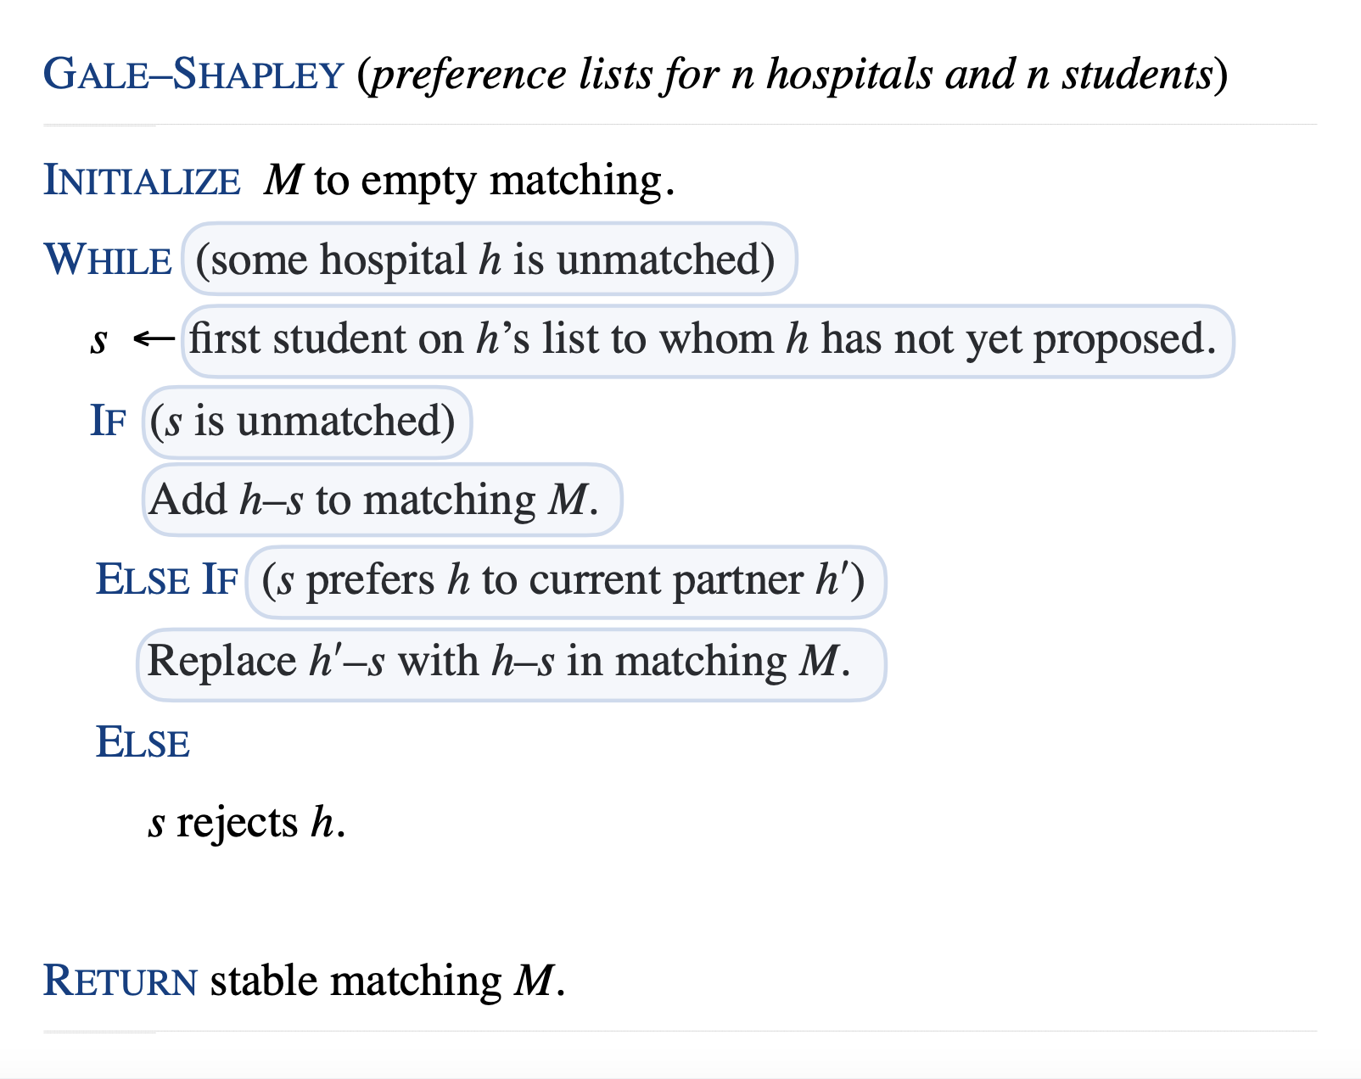
Student’s Current State
H[i,j] is hospital i’s jth preferered student.
S[i,j] is student i’s jth preferred hospital.
Unmatched Hospitals stored in a linked list called H_unmatched.
Next[i] is hospital i’s “next preference” to ask.
Current[i] is student i’s current “matched preference.”
These are not the indices of hospitals or students but preferences.

Slide 5
Student’s Current State
How do we do this check?

Slide 6
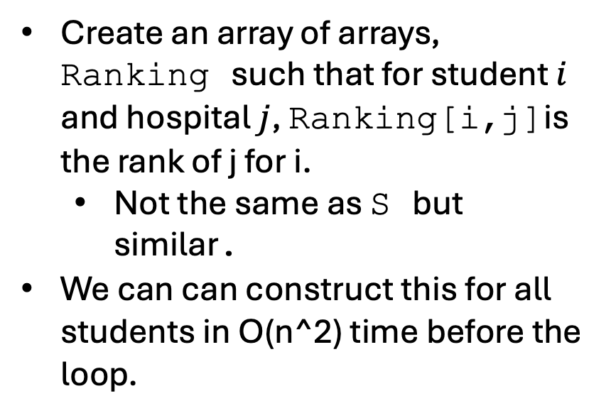
Student’s Current State
Create an array of arrays, Ranking such that for student $i$ and hospital $j$, Ranking[i,j]is the rank of j for i.
Not the same as S but similar.
We can can construct this for all students in O(n^2) time before the loop.

Slide 7
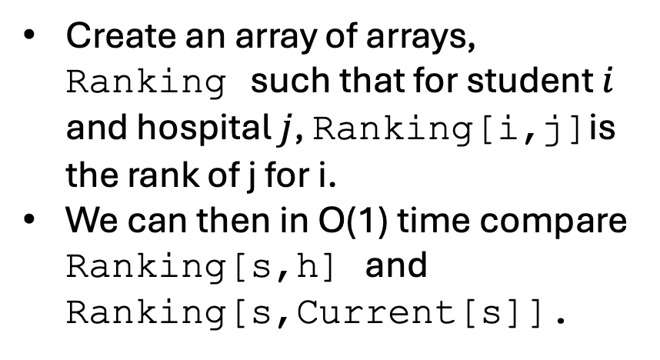
Student’s Current State
Create an array of arrays, Ranking such that for student $i$ and hospital $j$, Ranking[i,j]is the rank of j for i.
We can then in O(1) time compare Ranking[s,h] and Ranking[s,Current[s]].

Slide 8
Returning Matching
Where is our matching?

Slide 9
Returning Matching
The matching is stored in Current
You can convert this into a list of pairs by looping over all students, finding the current match and adding the pair to M.
This takes O(n) time.

Slide 10

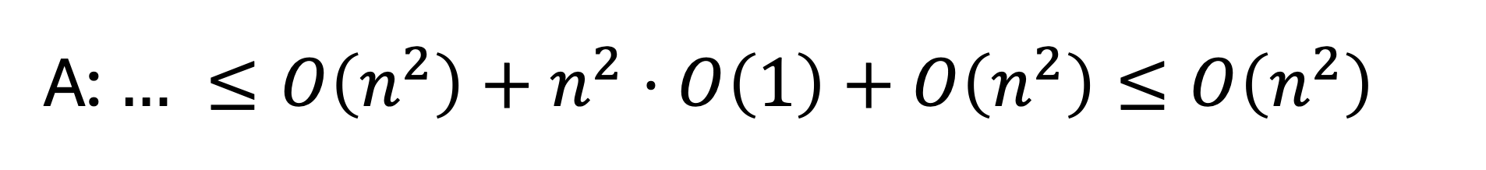



A: $… ≤O\left(n^{2}\right)+n^{2}⋅O\left(1\right)+O\left(n^{2}\right)≤O\left(n^{2}\right)$
$T_{0}∈O(n^{2})$ Computations
$T_{1}≤n^{2}$ Number Loops
$T_{2}∈O\left(1\right)$ Computations
$T_{3}∈O(n^{2})$ Computations

Slide 11
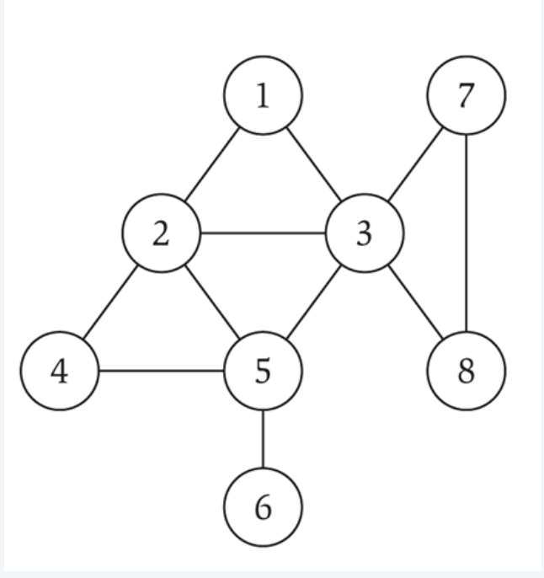
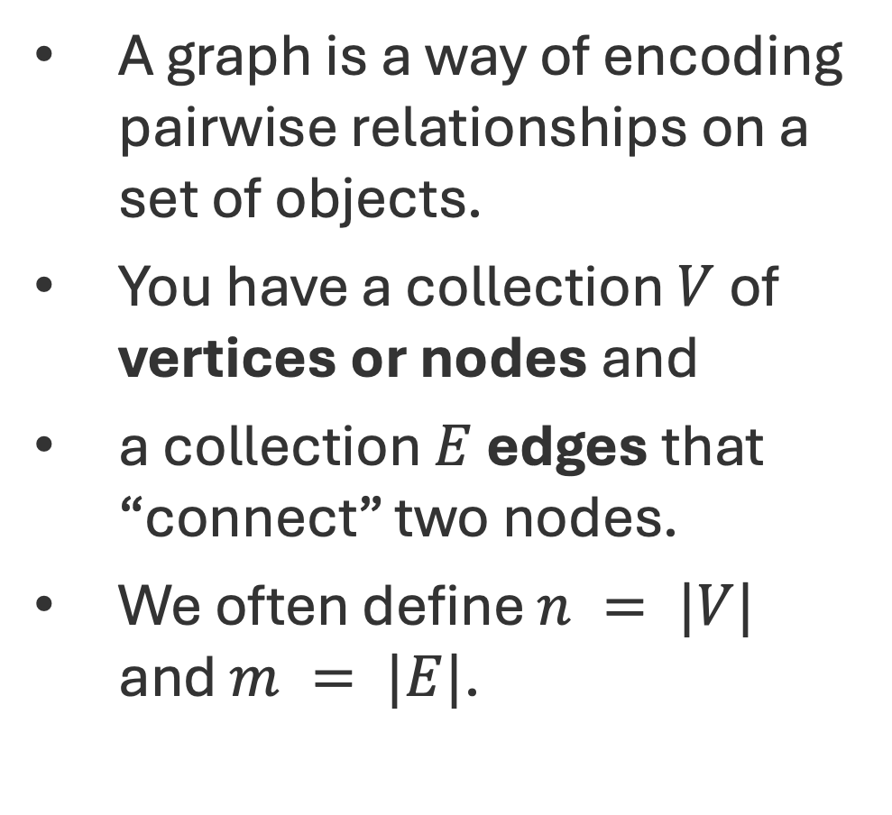
Graph G = (V,E)
A graph is a way of encoding pairwise relationships on a set of objects.
You have a collection $V$ of vertices or nodes and
a collection $E$ edges that “connect” two nodes.
We often define $n = |V|$ and $m = |E|$.

Slide 12
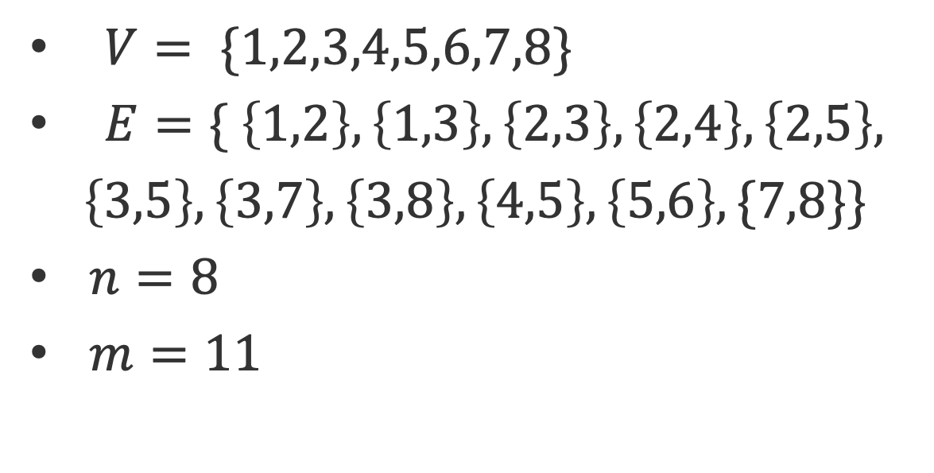
Graph G = (V,E)
$V= \{1,2,3,4,5,6,7,8\}$
$E=\{ \left\{1,2\right\},\left\{1,3\right\},\left\{2,3\right\},\left\{2,4\right\},\left\{2,5\right\},$
$$\left\{3,5\right\},\left\{3,7\right\},\left\{3,8\right\},\left\{4,5\right\},\left\{5,6\right\},\{7,8\}\}$$
$n=8$
$m=11$

Slide 13

Examples of Graphs
Social Networks
Maps
Computer Networks
Neural Networks
Circuits
Molecules Representations
”Everything”

Slide 14
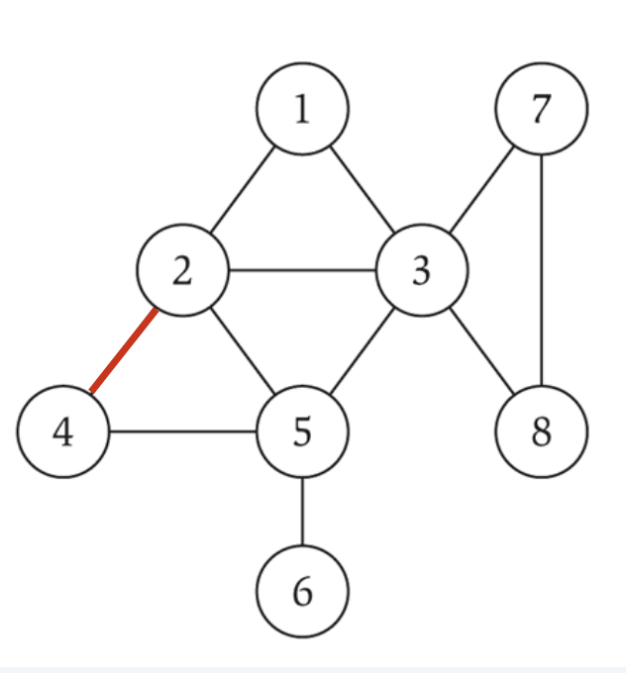
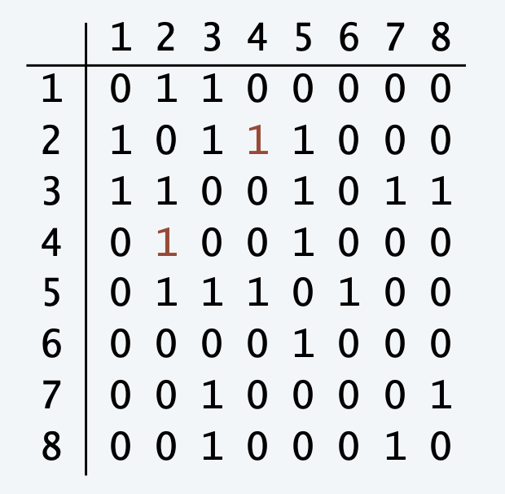
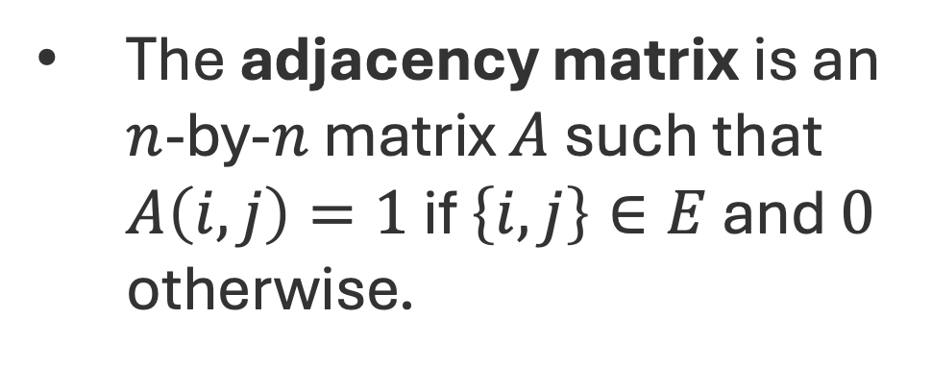
Graph Representation: Adjacency Matrix
The adjacency matrix is an $n$-by-$n$ matrix $A$ such that $A\left(i,j\right)=1$ if $\left\{i,j\right\}∈E$ and $0$ otherwise.

Slide 15
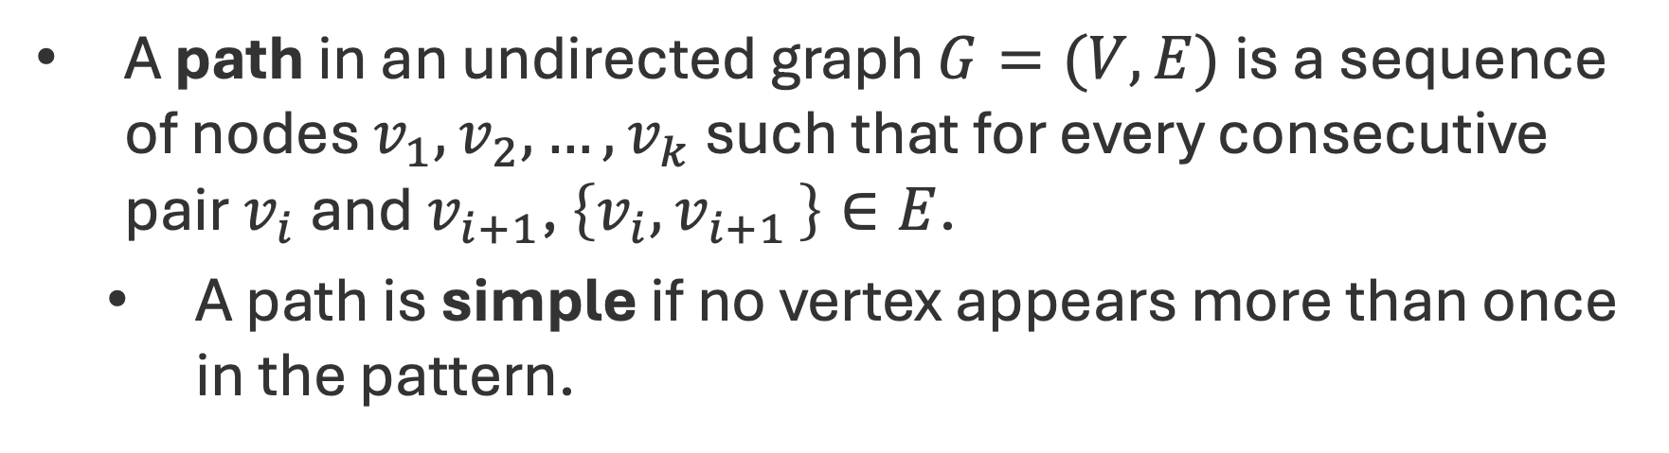
Paths and Connectivity
A path in an undirected graph $G=(V,E)$ is a sequence of nodes $v_{1},v_{2},…, v_{k}$ such that for every consecutive pair $v_{i}$ and $v_{i+1}$, $\left\{v_{i},v_{i+1 }\right\}∈E$.
A path is simple if no vertex appears more than once in the pattern.
s
t

Slide 16
Paths and Connectivity
A path in an undirected graph $G=(V,E)$ is a sequence of nodes $v_{1},v_{2},…, v_{k}$ such that for every consecutive pair $v_{i}$ and $v_{i+1}$, $\left\{v_{i},v_{i+1 }\right\}∈E$.
A path is simple if no vertex appears more than once in the pattern.
s
t

Slide 17
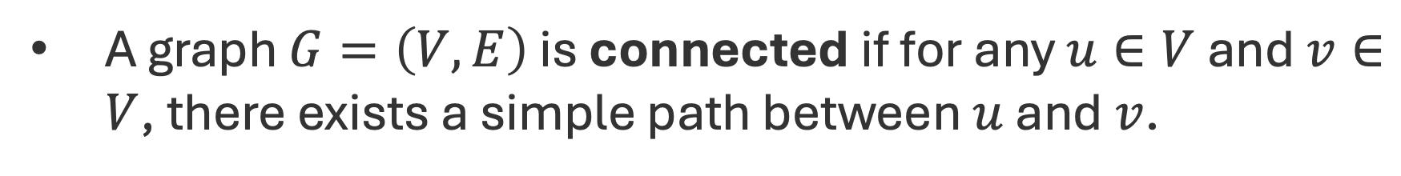
Paths and Connectivity
A graph $G=\left(V,E\right)$ is connected if for any $u∈V$ and $v∈V$, there exists a simple path between $u$ and $v$.

Slide 18
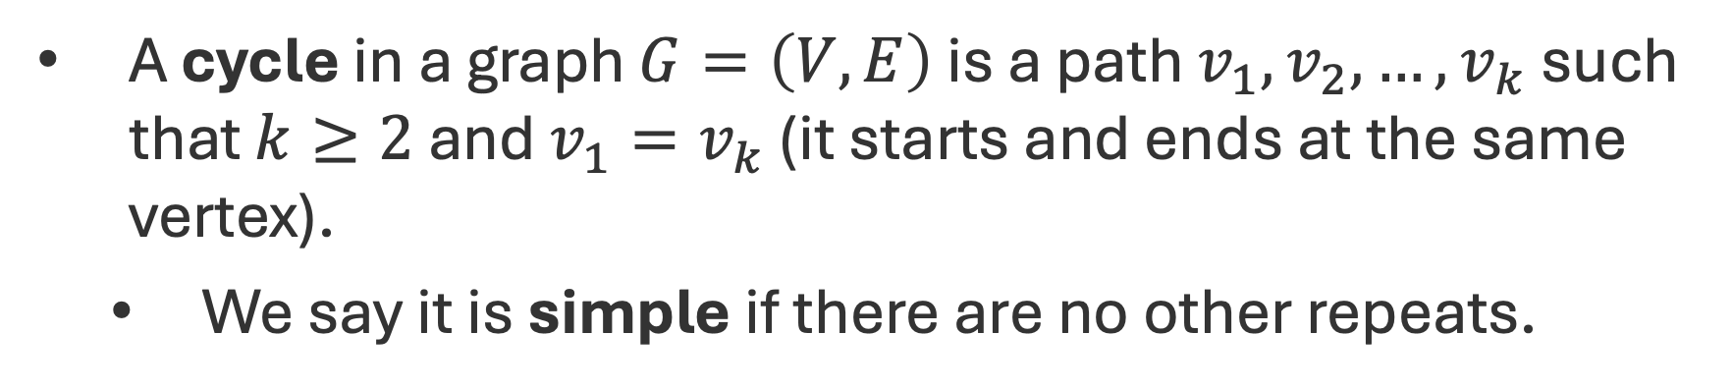
Cycles
A cycle in a graph $G=\left(V,E\right)$ is a path $v_{1},v_{2},…,v_{k}$ such that $k≥2$ and $v_{1}=v_{k}$ (it starts and ends at the same vertex).
We say it is simple if there are no other repeats.

Slide 19
Trees
An undirected graph is a tree if it is connected and does not contain a cycle.
A graph that doesn’t contain a cycle is called acyclic.
A vertex with degree 1 is called a leaf.

Slide 20
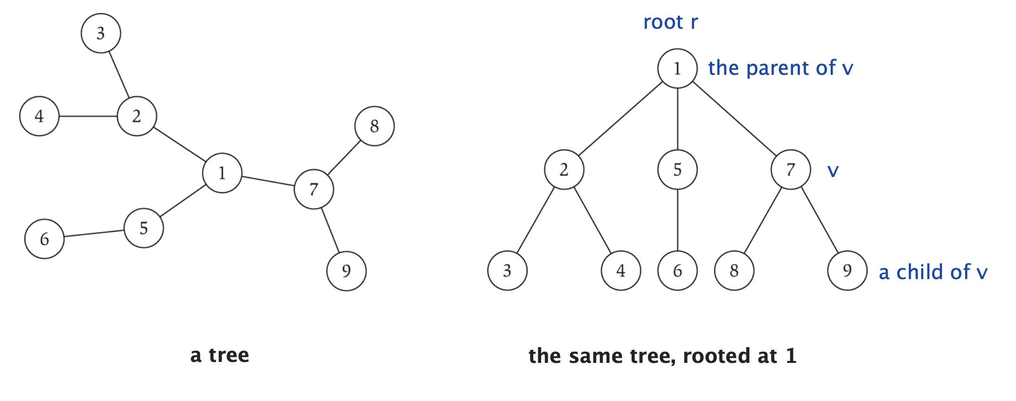

Rooted Trees
A rooted tree is a tree with some node $r$ fixed as the root. We think of it as a hierarchical structure.

Slide 21

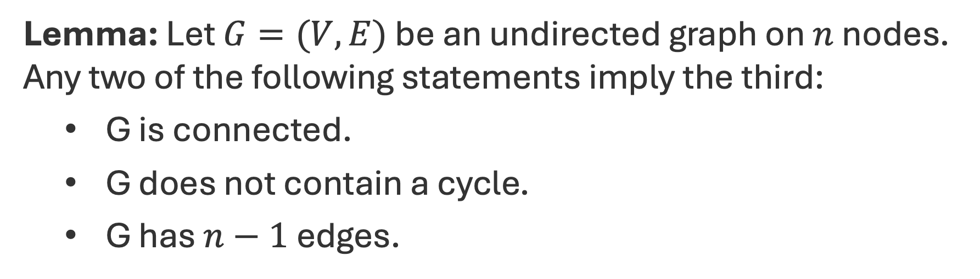
Trees
Lemma: Let $G=(V,E)$ be an undirected graph on $n$ nodes. Any two of the following statements imply the third:
G is connected.
G does not contain a cycle.
G has $n−1$ edges.

Slide 22
Trees (Proof on Website)
Lemma: Let $G=(V,E)$ be an undirected graph on $n$ nodes. Any two of the following statements imply the third:
G is connected.
G does not contain a cycle.
G has $n−1$ edges.

Slide 23
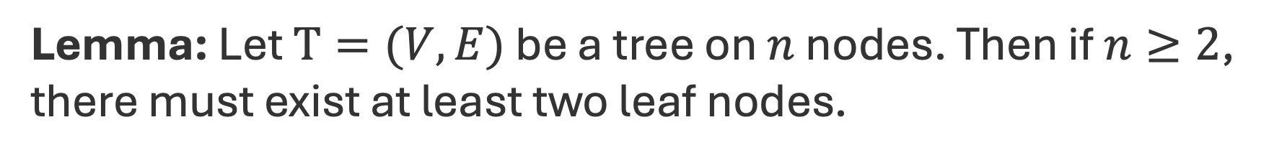
Trees
Lemma: Let $T=(V,E)$ be a tree on $n$ nodes. Then if $n≥2$, there must exist at least two leaf nodes.

Slide 24
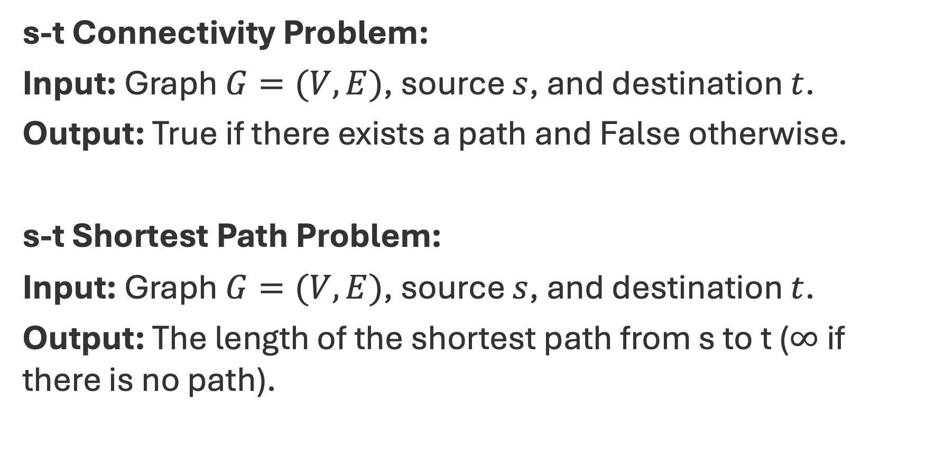
Connectivity Problem(s)
s-t Connectivity Problem:
Input: Graph $G=(V,E)$, source $s$, and destination $t$.
Output: True if there exists a path and False otherwise.
s-t Shortest Path Problem:
Input: Graph $G=(V,E)$, source $s$, and destination $t$.
Output: The length of the shortest path from s to t ($∞$ if there is no path).

Slide 25
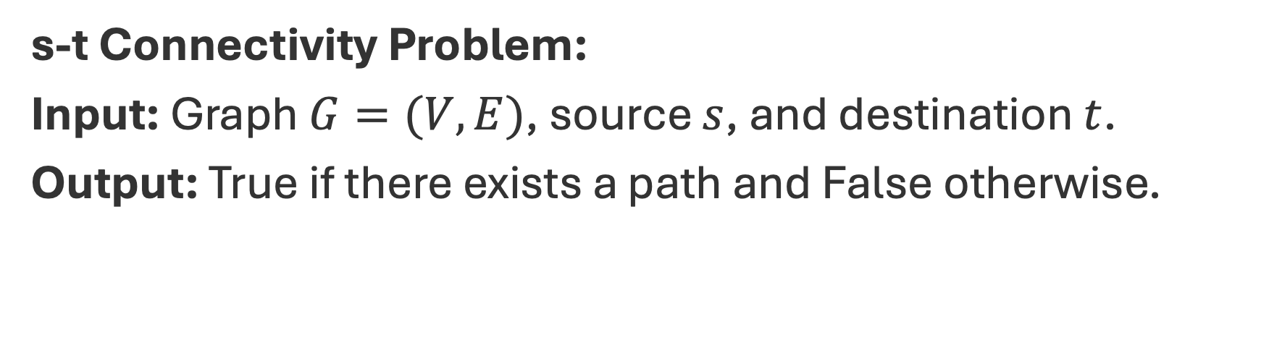
Q: What is a brute force solution?
s-t Connectivity Problem:
Input: Graph $G=(V,E)$, source $s$, and destination $t$.
Output: True if there exists a path and False otherwise.
S
t

Slide 26
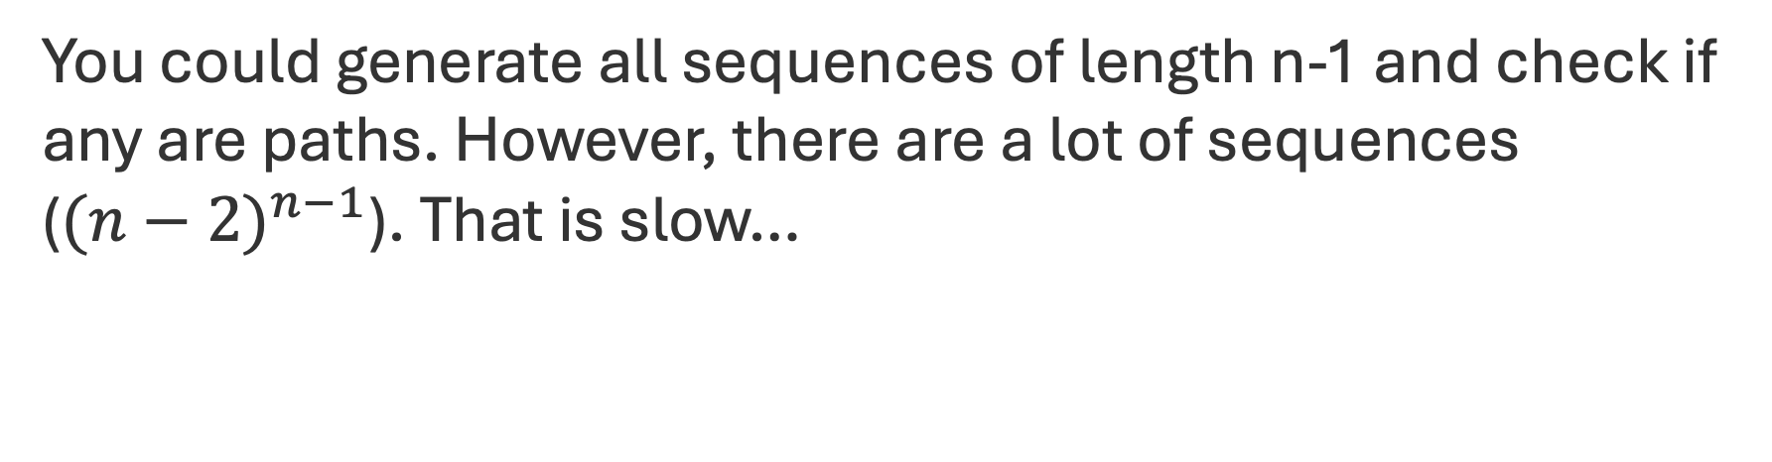
Q: What is a brute force solution?
You could generate all sequences of length n-1 and check if any are paths. However, there are a lot of sequences (${(n−2)}^{n−1}$). That is slow…
S
t

Slide 27
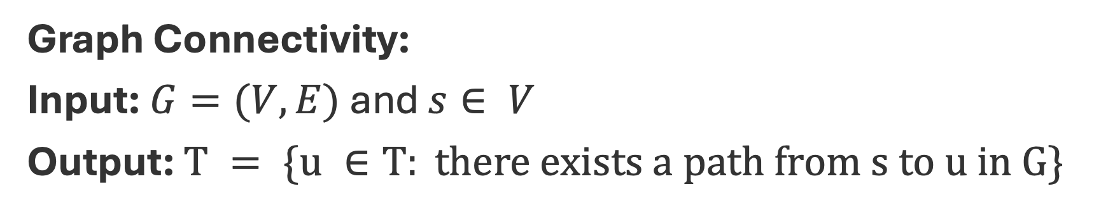
Another Connectivity Problem
Graph Connectivity:
Input: $G=(V,E)$and $s∈ V$
Output: $T = \{u ∈T: there exists a path from s to u in G\}$
S
t
t

Slide 28
Another Connectivity Problem
Observation: If we solve the graph connectivity problem, then we can solve the s-t connectivity problem by checking if t is in T.
S
t
t

Slide 29
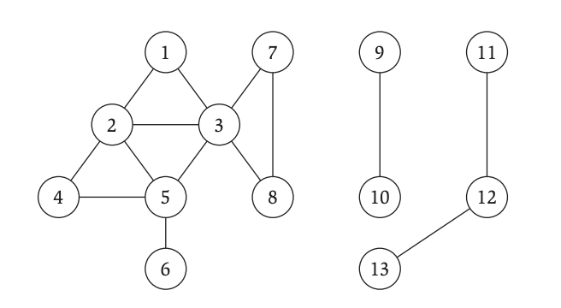
Breadth First Search
Q: How do you find all nodes reachable from node 1?
t

Slide 30
Breadth First Search
Idea:
What can 1 reach?
What can those nodes reach?
What can those nodes reach?
….
t

Slide 31
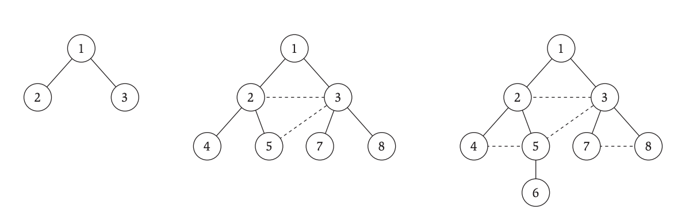

Breadth First Search (Layers)
$L_{0}=s$
$L_{1}=$ neighbors of $L_{0}$.
$L_{2}=$ neighbors of $L_{1}$ that are not in $L_{0}$.
$L_{i}=$ neighbors of $L_{i-1}$ that are not in previous layer.

Slide 32

Breadth First Search (“Algorithm”)
Input: $G=(V,E)$and $s ∈ V$
Let $L_{0}=\{s\}$
Assume $L_{0},…,L_{i}$ have been constructed:
Let $L_{i+1}$ be nodes do not appear in $L_{0},…,L_{i}$ and have an edge to $L_{i}$.
If $L_{i+1}$ is empty, stop.
Return all layers.

Slide 33

Breadth First Search (Properties)
For each $j ≥0$, layer $L_{j}$ produced by BFS consists of all nodes at distance $j$ from $s$.
There is a path from $s$ to $t$ if and only if $t$ appears in some layer.
For any $\{u,v\} ∈E$, if $u∈L_{i}$ and $v∈L_{j}$ then $i$ and $j$ differ by at most 1.
You can think of the output as a tree! We call this the BFS (discovery) Tree.

Slide 34
Breadth First Search (Tree)
Original Graph
Search Tree

