Slide 1

CSE 331: Algorithms & Complexity
“BFS”
Prof. Charlie Anne Carlson (She/Her)
Lecture 11
Monday September 22nd, 2025

Slide 2

Schedule
Course Updates
Graph Connectivity
Graph Traversal
BFS
DFS
WFS

Slide 3

Course Updates
HW 1 Grading Out Tomorrow
HW 2 Due Tomorrow
HW 3 Out Tomorrow
Group Project
Team Emails Soon
No Autolab Registration
First Quiz NEXT Monday!

Slide 4
Connectivity Problem(s)
s-t Connectivity Problem:
Input: Graph $G=(V,E)$, source $s$, and destination $t$.
Output: True if there exists a path and False otherwise.
s-t Shortest Path Problem:
Input: Graph $G=(V,E)$, source $s$, and destination $t$.
Output: The length of the shortest path from s to t ($∞$ if there is no path).

Slide 5
Another Connectivity Problem
Graph Connectivity:
Input: $G=(V,E)$and $s∈ V$
Output: $T = \{u ∈T: there exists a path from s to u in G\}$
S
t
t

Slide 6
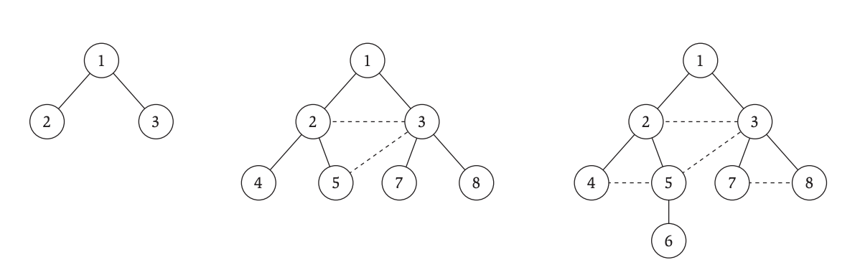
Breadth First Search (Layers)
$L_{0}=s$
$L_{1}=$ neighbors of $L_{0}$.
$L_{2}=$ neighbors of $L_{1}$ that are not in $L_{0}$.
$L_{i}=$ neighbors of $L_{i−1}$ that are not in previous layer.

Slide 7
Breadth First Search (“Algorithm”)
Input: $G=(V,E)$and $s ∈ V$
Let $L_{0}=\{s\}$
Assume $L_{0},…,L_{i}$ have been constructed:
Let $L_{i+1}$ be nodes do not appear in $L_{0},…,L_{i}$ and have an edge to $L_{i}$.
If $L_{i+1}$ is empty, stop.
Return all layers.

Slide 8
Breadth First Search (Properties)
For each $j ≥0$, layer $L_{j}$ produced by BFS consists of all nodes at distance $j$ from $s$.
There is a path from $s$ to $t$ if and only if $t$ appears in some layer.
For any $\{u,v\} ∈E$, if $u∈L_{i}$ and $v∈L_{j}$ then $i$ and $j$ differ by at most 1.
You can think of the output as a tree! We call this the BFS (discovery) Tree.

Slide 9

Breadth First Search (Properties)
Claim: For any $\{u,v\} ∈E$, if $u∈L_{i}$ and $v∈L_{j}$ then $i$ and $j$ differ by at most 1.

Slide 10

Breadth First Search (Properties)
Claim: For any $\{u,v\} ∈E$, if $u∈L_{i}$ and $v∈L_{j}$ then $i$ and $j$ differ by at most 1.
Proof Outline:
Without loss of generality, we assume that $i ≤j$.
Suppose for the sake of contradiction that $d(i,j) > 1$.

Slide 11








Breadth First Search (Properties)
Proof Outline:
Without loss of generality, we assume that $i <j$.
Suppose for the sake of contradiction that $d(i,j) > 1$.
$$u$$
$$⋯$$
$$v$$
$$\{s\}$$
$$L_{i}$$
$$L_{i+1}$$
$$L_{j}$$

Slide 12
Breadth First Search (Properties)
Proof Outline:
Without loss of generality, we assume that $i <j$.
Suppose for the sake of contradiction that $d(i,j) > 1$.
$$u$$
$$⋯$$
$$v$$
$$\{s\}$$
$$L_{i}$$
$$L_{i+1}$$
$$L_{j}$$

Slide 13

Breadth First Search (Properties)
Proof:
Without loss of generality, we assume that $i <j$.
Suppose for the sake of contradiction that $d(i,j) > 1$.
This implies $i+1<j$.
Then $u∈L_{i}, v∉L_{0},L_{1},…,L_{i}$, and $\{u,v\} ∈E$.
Hence, BFS would have put $v∈L_{i+1}$.
This contradicts initial assumption that $v∈L_{j}$ and $j > i+1$.

Slide 14
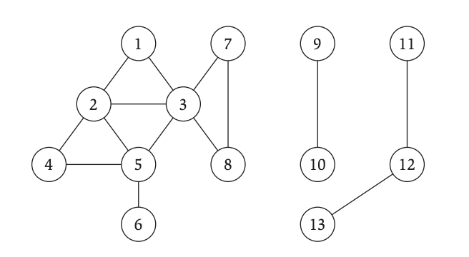
Breadth First Search (Tree)
Original Graph
Search Tree

Slide 15
Breadth First Search (Tree)
“Tree Edges”
“Not Tree Edges”
Original Graph
Search Tree

Slide 16
Connected Component of (s) (CC(s))
The CC(s) is the set of all vertices that are connected to s by a path.
“The set of vertices that you can reach from s using a simple path.”

Slide 17
Connected Component of (s) (CC(s))
The CC(s) is the set of all vertices that are connected to s by a path.
“The set of vertices that you can reach from s using a simple path.”
CC(1)

Slide 18

Explore Algorithm
Input: $G=(V,E)$and $s ∈ V$
Output: CC(s)
Let $R=\{s\}$
While there exists $\{u,v\} ∈E$ such that $u∈R$ and $v ∉R:$
Add $v$ to $R$
Return $R$

Slide 19

Explore Algorithm
Input: $G=(V,E)$and $s ∈ V$
Output: CC(s)
Let $R=\{s\}$
While there exists $\{u,v\} ∈E$ such that $u∈R$ and $v ∉R:$
Add $v$ to $R$
Return $R$
R

Slide 20
Explore Algorithm
Input: $G=(V,E)$and $s ∈ V$
Output: CC(s)
Let $R=\{s\}$
While there exists $\{u,v\} ∈E$ such that $u∈R$ and $v ∉R:$
Add $v$ to $R$
Return $R$
R

Slide 21
Explore Algorithm
Input: $G=(V,E)$and $s ∈ V$
Output: CC(s)
Let $R=\{s\}$
While there exists $\{u,v\} ∈E$ such that $u∈R$ and $v ∉R:$
Add $v$ to $R$
Return $R$
R

Slide 22
Explore Algorithm
Input: $G=(V,E)$and $s ∈ V$
Output: CC(s)
Let $R=\{s\}$
While there exists $\{u,v\} ∈E$ such that $u∈R$ and $v ∉R:$
Add $v$ to $R$
Return $R$
R

Slide 23
Explore Algorithm
Input: $G=(V,E)$and $s ∈ V$
Output: CC(s)
Let $R=\{s\}$
While there exists $\{u,v\} ∈E$ such that $u∈R$ and $v ∉R:$
Add $v$ to $R$
Return $R$
R

Slide 24
Explore Algorithm
Input: $G=(V,E)$and $s ∈ V$
Output: CC(s)
Let $R=\{s\}$
While there exists $\{u,v\} ∈E$ such that $u∈R$ and $v ∉R:$
Add $v$ to $R$
Return $R$
R

Slide 25
Explore Algorithm
Input: $G=(V,E)$and $s ∈ V$
Output: CC(s)
Let $R=\{s\}$
While there exists $\{u,v\} ∈E$ such that $u∈R$ and $v ∉R:$
Add $v$ to $R$
Return $R$
R

Slide 26
Explore Algorithm
Input: $G=(V,E)$and $s ∈ V$
Output: CC(s)
Let $R=\{s\}$
While there exists $\{u,v\} ∈E$ such that $u∈R$ and $v ∉R:$
Add $v$ to $R$
Return $R$
R

Slide 27
Explore Algorithm
Input: $G=(V,E)$and $s ∈ V$
Output: CC(s)
Let $R=\{s\}$
While there exists $\{u,v\} ∈E$ such that $u∈R$ and $v ∉R:$
Add $v$ to $R$
Return $R$
CC(1)

Slide 28

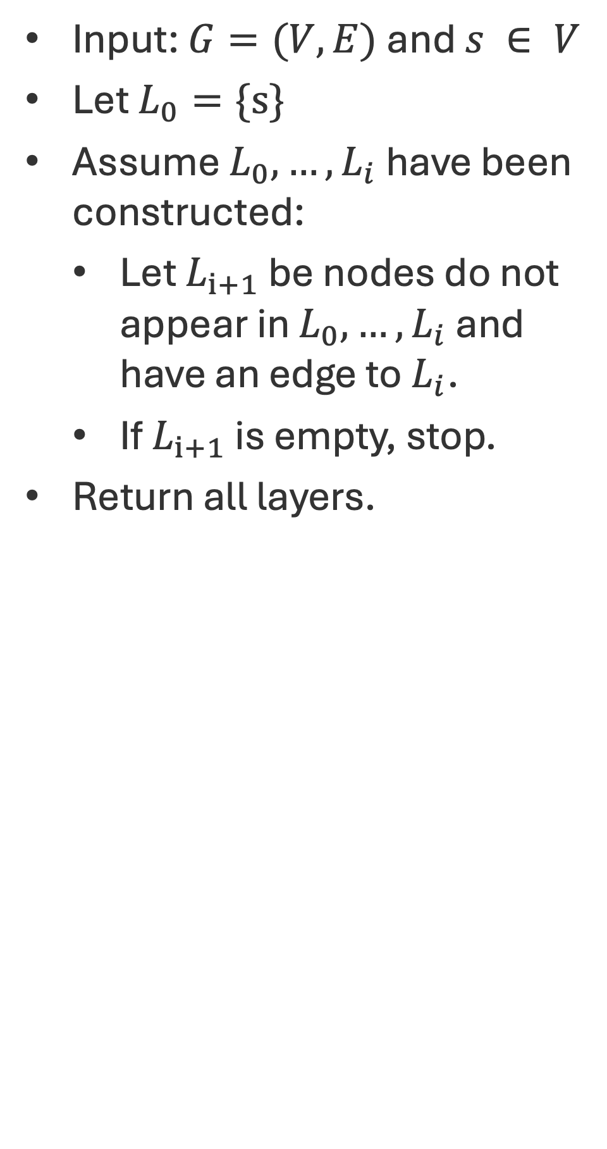
Q: What is the difference? (BFS vs Explore)
Input: $G=(V,E)$and $s ∈ V$
Output: CC(s)
Let $R=\{s\}$
While there exists $\{u,v\} ∈E$ such that $u∈R$ and $v ∉R:$
Add $v$ to $R$
Return $R$
Input: $G=(V,E)$and $s ∈ V$
Let $L_{0}=\{s\}$
Assume $L_{0},…,L_{i}$ have been constructed:
Let $L_{i+1}$ be nodes do not appear in $L_{0},…,L_{i}$ and have an edge to $L_{i}$.
If $L_{i+1}$ is empty, stop.
Return all layers.

Slide 29
Q: What is the difference? (BFS vs Explore)
Input: $G=(V,E)$and $s ∈ V$
Output: CC(s)
Let $R=\{s\}$
While there exists $\{u,v\} ∈E$ such that $u∈R$ and $v ∉R:$
Add $v$ to $R$
Return $R$
Input: $G=(V,E)$and $s ∈ V$
Let $L_{0}=\{s\}$
Assume $L_{0},…,L_{i}$ have been constructed:
Let $L_{i+1}$ be nodes do not appear in $L_{0},…,L_{i}$ and have an edge to $L_{i}$.
If $L_{i+1}$ is empty, stop.
Return all layers.
BFS is Explore but Explore isn’t necessarily BFS!

Slide 30
Q: How do we show this solves Connectivity?
Input: $G=(V,E)$and $s ∈ V$
Output: CC(s)
Let $R=\{s\}$
While there exists $\{u,v\} ∈E$ such that $u∈R$ and $v ∉R:$
Add $v$ to $R$
Return $R$

Slide 31
Q: How do we show this solves Connectivity?
Input: $G=(V,E)$and $s ∈ V$
Output: CC(s)
Let $R=\{s\}$
While there exists $\{u,v\} ∈E$ such that $u∈R$ and $v ∉R:$
Add $v$ to $R$
Return $R$
Argue that R = CC(s)!
Q: How do we do this?

Slide 32

Q: How do we show this solves Connectivity?
Input: $G=(V,E)$and $s ∈ V$
Output: CC(s)
Let $R=\{s\}$
While there exists $\{u,v\} ∈E$ such that $u∈R$ and $v ∉R:$
Add $v$ to $R$
Return $R$
Argue that R = CC(s)!
Show $R ⊆CC(s)$
Show $CC(s)⊆R$

Slide 33

Breadth First Search (Properties)
Claim:$R ⊆CC(s)$
Proof Idea:
This wants us to show that everything reached by Explore is in the connected component of s.
Let’s do induction on iteration of the algorithm.
Do you believe the first iteration.
Given any iteration is true, how do you feel about the next iteration?

Slide 34
Q: Does this always terminate?
Input: $G=(V,E)$and $s ∈ V$
Output: CC(s)
Let $R=\{s\}$
While there exists $\{u,v\} ∈E$ such that $u∈R$ and $v ∉R:$
Add $v$ to $R$
Return $R$
Well, we must be adding a vertex in each iteration and there are only so many vertices, right?

Slide 35
Q: Does this always terminate?
Input: $G=(V,E)$and $s ∈ V$
Output: CC(s)
Let $R=\{s\}$
While there exists $\{u,v\} ∈E$ such that $u∈R$ and $v ∉R:$
Add $v$ to $R$
Return $R$

Slide 36

Explore Proofs
Claim:$CC(s) ⊆R$
Proof:
This saying that every vertex in the connected component is added to $R$ by Explore.
This is saying that for every vertex $v$ such that there is a path from $s$ to $v$, $v$ is added to $R$ by Explore.

Slide 37



Explore Proofs
Claim:$CC(s) ⊆R$
Proof:
Suppose to the contrary that there exists $v∈CC(s)$ such that $v ∉R$.
Then there must exist a path that starts at $s$ (inside $R$) and ends at $v$ (outside $R$).
$$s$$
$$v$$

Slide 38



Explore Proofs
Claim:$CC(s) ⊆R$
Proof:
There then must exist $\{x,y\} ∈E$ such that $x∈R$ and $y ∉R$.
$$s$$
$$x$$
$$y$$
$$v$$

Slide 39

Explore Proofs
Claim:$CC(s) ⊆R$
Proof:
There then must exist $\{x,y\} ∈E$ such that $x∈R$ and $y ∉R$.
If this the case, then the algorithm wouldn’t have terminated and would have instead added $y$. =><=
$$s$$
$$s$$
$$x$$
$$y$$
$$v$$

Slide 40
Q: How would you describe BFS?
$L_{0}=s$
$L_{1}=$ neighbors of $L_{0}$.
$L_{2}=$ neighbors of $L_{1}$ that are not in $L_{0}$.
$L_{i}=$ neighbors of $L_{i−1}$ that are not in previous layer.

Slide 41

Depth First Search
Input: The current vertex $u ∈V$
Global: An array of exploration $A∈{\{0,1\}}^{V}$
Mark current vertex as explored ($A[u] = 1$).
For each $\{u,v\} ∈E$:
If v is not explored ($A[v] == 0$):
DFS(v,A)

Slide 42
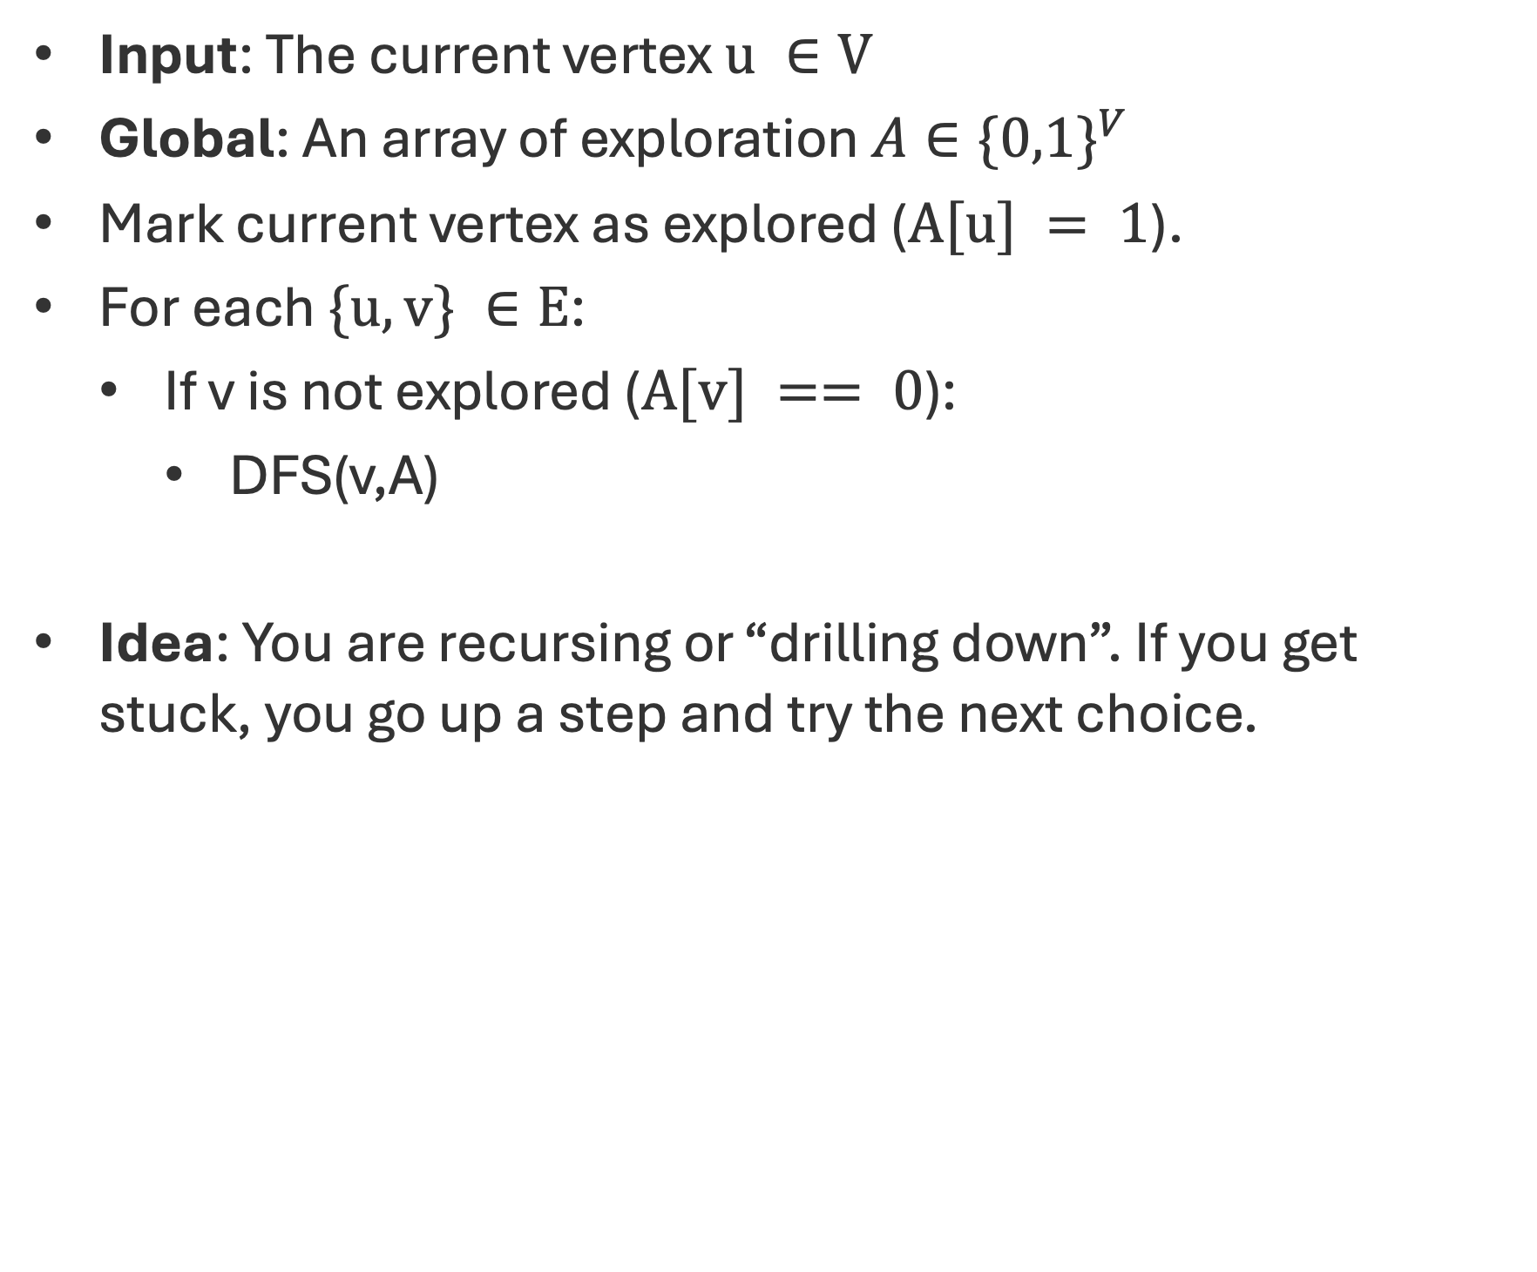
Depth First Search
Input: The current vertex $u ∈V$
Global: An array of exploration $A∈{\{0,1\}}^{V}$
Mark current vertex as explored ($A[u] = 1$).
For each $\{u,v\} ∈E$:
If v is not explored ($A[v] == 0$):
DFS(v,A)
Idea: You are recursing or “drilling down”. If you get stuck, you go up a step and try the next choice.

Slide 43
Depth First Search
A = {1}

Slide 44
Depth First Search
A = {1,2}

Slide 45
Depth First Search
A = {1,2,4}

Slide 46
Depth First Search
A = {1,2,4,5}

Slide 47
Depth First Search
A = {1,2,4,5,6}

Slide 48
Depth First Search
A = {1,2,4,5,6,3}

Slide 49
Depth First Search
A = {1,2,4,5,6,3,7}

Slide 50
Depth First Search
A = {1,2,4,5,6,3,7,8}

Slide 51
DFS Trees vs BFS Trees

Slide 52
Q: How can you compute all the connected components of a graph?

