Slide 1

CSE 331:
Algorithms & Complexity
“More BFS and DFS”
Prof. Charlie Anne Carlson (She/Her)
Lecture 12
Wednesday September 24th, 2025

Slide 2

Schedule
Course Updates
Graph Traversal
  BFS
  DFS
  Stacks & Queues
Coloring

Slide 3

Course Updates
HW 1 Grading Out
HW 2 Solutions Out Soon
HW 3 Out
Group Project
  Team Emails Soon
  No Autolab Registration
First Quiz NEXT Monday!
Sample Midterms

Slide 4

Q: How do we show this solves Connectivity?
Input: $G=(V,E)$and $s ∈ V$
Output: CC(s)
Let $R=\{s\}$
While there exists $\{u,v\} ∈E$ such that $u∈R$ and $v ∉R:$
  Add $v$ to $R$
Return $R$

Slide 5

Q: How do we show this solves Connectivity?
Input: $G=(V,E)$and $s ∈ V$
Output: CC(s)
Let $R=\{s\}$
While there exists $\{u,v\} ∈E$ such that $u∈R$ and $v ∉R:$
  Add $v$ to $R$
Return $R$
Argue that R = CC(s)!
  Show $R ⊆CC(s)$
  Show $CC(s)⊆R$

Slide 6
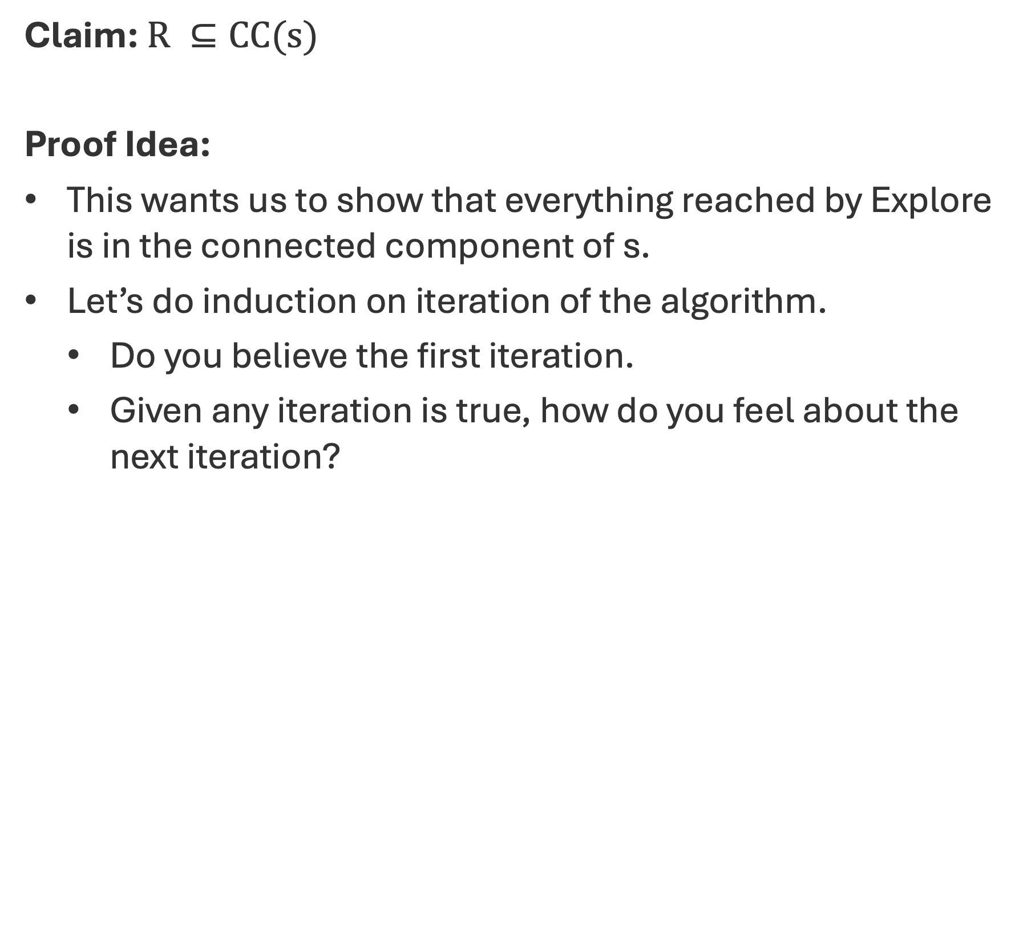
Breadth First Search (Properties)
Claim:$R ⊆CC(s)$
Proof Idea:
This wants us to show that everything reached by Explore is in the connected component of s.
Let’s do induction on iteration of the algorithm.
  Do you believe the first iteration.
  Given any iteration is true, how do you feel about the next iteration?

Slide 7
Q: Does this always terminate?
Input: $G=(V,E)$and $s ∈ V$
Output: CC(s)
Let $R=\{s\}$
While there exists $\{u,v\} ∈E$ such that $u∈R$ and $v ∉R:$
  Add $v$ to $R$
Return $R$

Slide 8
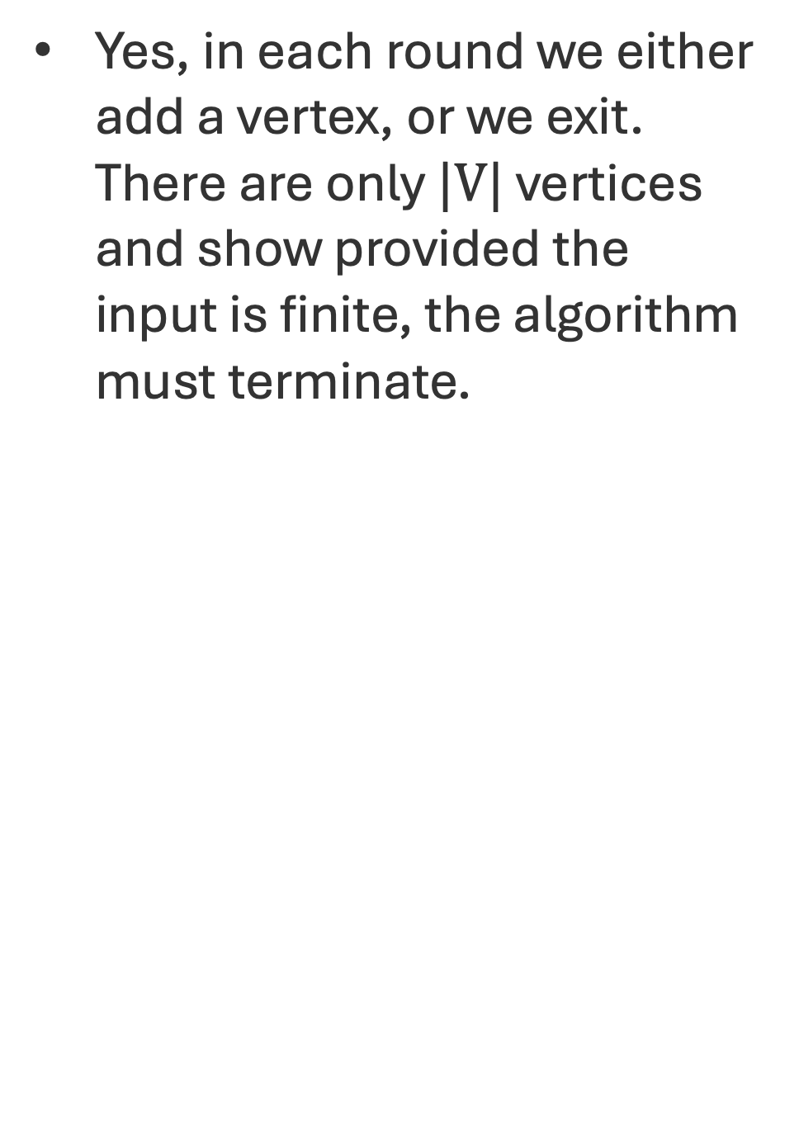
Q: Does this always terminate?
Input: $G=(V,E)$and $s ∈ V$
Output: CC(s)
Let $R=\{s\}$
While there exists $\{u,v\} ∈E$ such that $u∈R$ and $v ∉R:$
  Add $v$ to $R$
Return $R$
Yes, in each round we either add a vertex, or we exit. There are only $|V|$ vertices and show provided the input is finite, the algorithm must terminate.

Slide 9

Explore Proofs
Claim:$CC(s) ⊆R$
Proof:
This says that every vertex in the connected component is added to $R$ by Explore.
That is, for every vertex $v$ such that there is a path from $s$ to $v$, $v$ is added to $R$ by Explore.

Slide 10



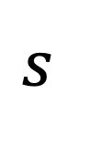
Explore Proofs
Claim:$CC(s) ⊆R$
Proof:
Suppose to the contrary that there exists $v∈CC(s)$ such that $v∉R$.
  Then there must exist a path that starts at $s$ (inside $R$) and ends at $v$ (outside $R$).
$$R$$
$$s$$
$$v$$

Slide 11


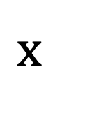
Explore Proofs
Claim:$CC(s) ⊆R$
Proof:
There then must exist $\{x,y\} ∈E$ such that $x∈R$ and $y ∉R$.
$$R$$
$$s$$
$$x$$
$$y$$
$$v$$

Slide 12

Q: What is wrong with such an $\{x,y\}$ existing?
Input: $G=(V,E)$and $s ∈ V$
Output: CC(s)
Let $R=\{s\}$
While there exists $\{u,v\} ∈E$ such that $u∈R$ and $v ∉R:$
  Add $v$ to $R$
Return $R$

Slide 13

Explore Proofs
Claim:$CC(s) ⊆R$
Proof:
There then must exist $\{x,y\} ∈E$ such that $x∈R$ and $y ∉R$.
If this the case, then the algorithm wouldn’t have terminated and would have instead added $y$. =><=
$$R$$
$$s$$
$$s$$
$$x$$
$$y$$
$$v$$

Slide 14
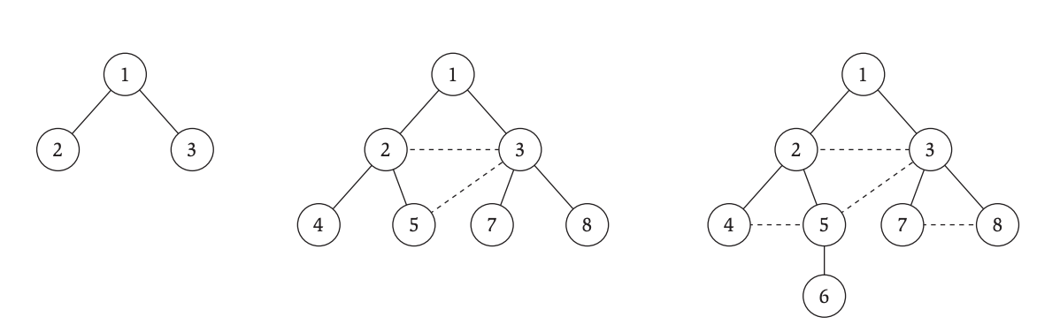
Q: How would you describe BFS?
$L_{0}=s$
$L_{1}=$ neighbors of $L_{0}$.
$L_{2}=$ neighbors of $L_{1}$ that are not in $L_{0}$.
$L_{i}=$ neighbors of $L_{i−1}$ that are not in previous layer.

Slide 15

Depth First Search
Input: The current vertex $u ∈V$
Global: An array of exploration $A∈{\{0,1\}}^{V}$
Mark current vertex as explored ($A[u] = 1$).
For each $\{u,v\} ∈E$:
  If v is not explored ($A[v] == 0$):
    DFS(v)

Slide 16
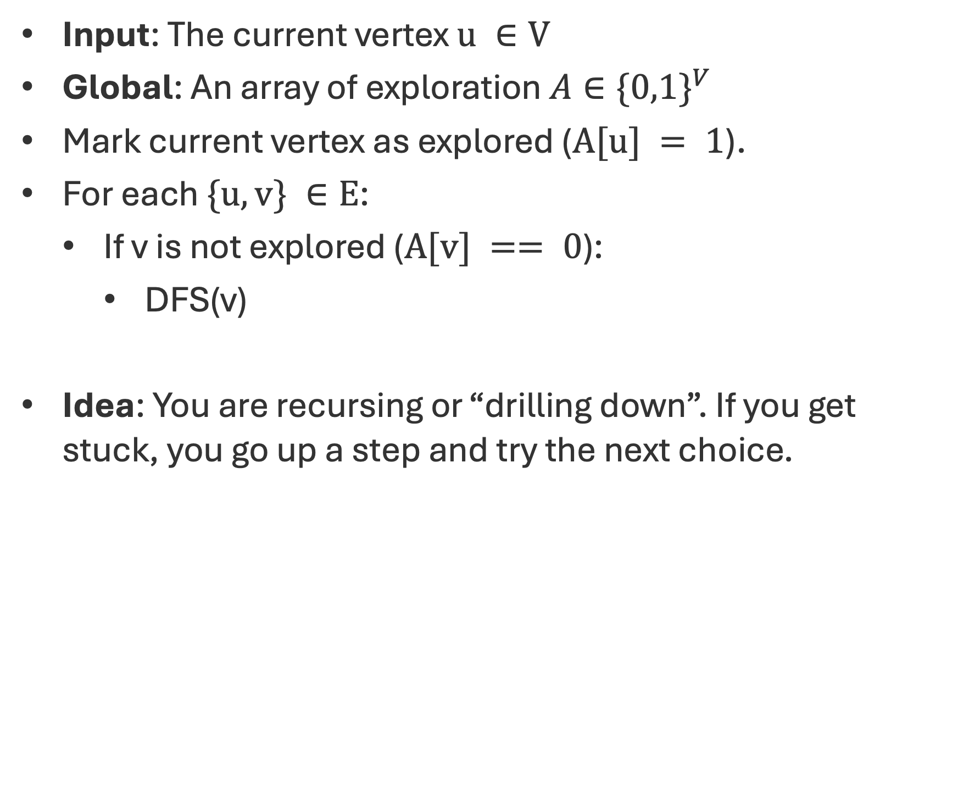
Depth First Search
Input: The current vertex $u ∈V$
Global: An array of exploration $A∈{\{0,1\}}^{V}$
Mark current vertex as explored ($A[u] = 1$).
For each $\{u,v\} ∈E$:
  If v is not explored ($A[v] == 0$):
    DFS(v)
Idea: You are recursing or “drilling down”. If you get stuck, you go up a step and try the next choice.

Slide 17
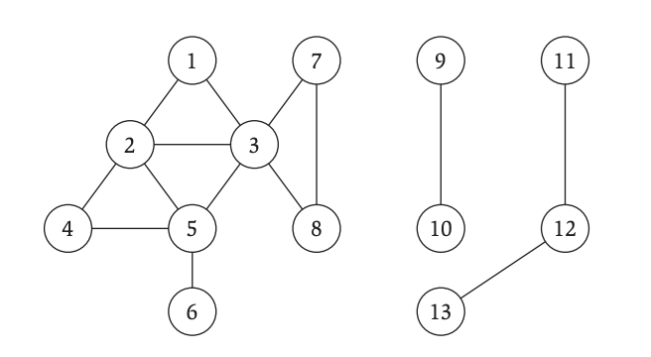
Depth First Search
A = {1}

Slide 18
Depth First Search
A = {1,2}

Slide 19
Depth First Search
A = {1,2,4}

Slide 20
Depth First Search
A = {1,2,4,5}

Slide 21
Depth First Search
A = {1,2,4,5,6}

Slide 22
Depth First Search
A = {1,2,4,5,6,3}

Slide 23
Depth First Search
A = {1,2,4,5,6,3,7}

Slide 24
Depth First Search
A = {1,2,4,5,6,3,7,8}

Slide 25
DFS Trees vs BFS Trees

Slide 26
Q: How can you compute all the connected components of a graph?

Slide 27
A: Run Explore on a vertex. Keep track of all visited vertices. Run Explore on unvisited vertex. Stop when everyone is visited.

Slide 28


Q: What is the difference? (DFS vs Explore)
Input: $G=(V,E)$and $s ∈ V$
Output: CC(s)
Let $R=\{s\}$
While there exists $\{u,v\} ∈E$ such that $u∈R$ and $v ∉R:$
  Add $v$ to $R$
Return $R$
Input: The current vertex $u ∈V$
Global: An array $A∈{\{0,1\}}^{V}$
Mark current vertex ($A[u] = 1$).
For each $\{u,v\} ∈E$:
  If ($A[v] == 0$):
    DFS(v)

Slide 29
Q: What is the difference? (DFS vs Explore)
Input: $G=(V,E)$and $s ∈ V$
Output: CC(s)
Let $R=\{s\}$
While there exists $\{u,v\} ∈E$ such that $u∈R$ and $v ∉R:$
  Add $v$ to $R$
Return $R$
Input: The current vertex $u ∈V$
Global: An array $A∈{\{0,1\}}^{V}$
Mark current vertex ($A[u] = 1$).
For each $\{u,v\} ∈E$:
  If ($A[v] == 0$):
    DFS(v)
DFS is Explore but Explore isn’t necessarily DFS!

Slide 30
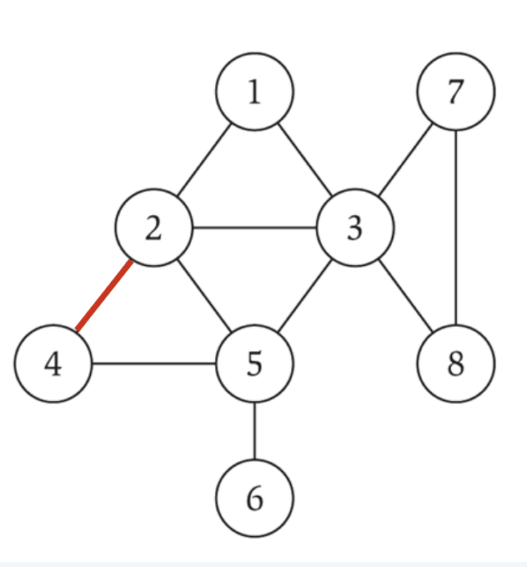
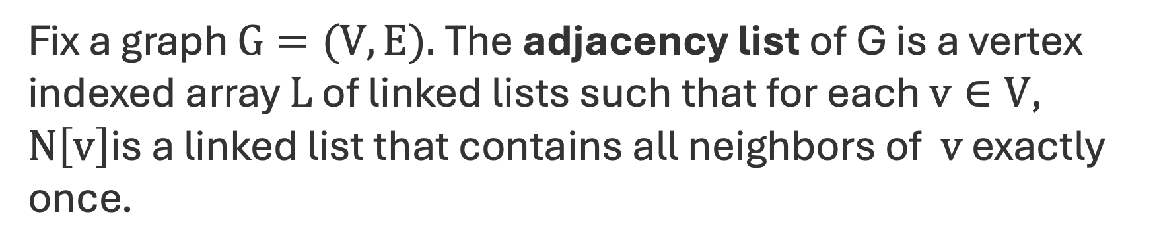
Adjacency List
Fix a graph $G=(V,E).$The adjacency list of G is a vertex indexed array $L$ of linked lists such that for each $v∈V$, $N\left[v\right]$is a linked list that contains all neighbors of $v$ exactly once.
N[1] : [2] -> [3]
N[2] : [1] -> [3] -> [5] -> [4]
N[3] : [1] -> [2] -> [5] -> [7] -> [8]
N[4] : [2] -> [5]
N[5] : [2] -> [3] -> [4] -> [6]
N[6] : [5]
N[7] : [3] -> [8]
N[8] : [3] -> [7]

Slide 31
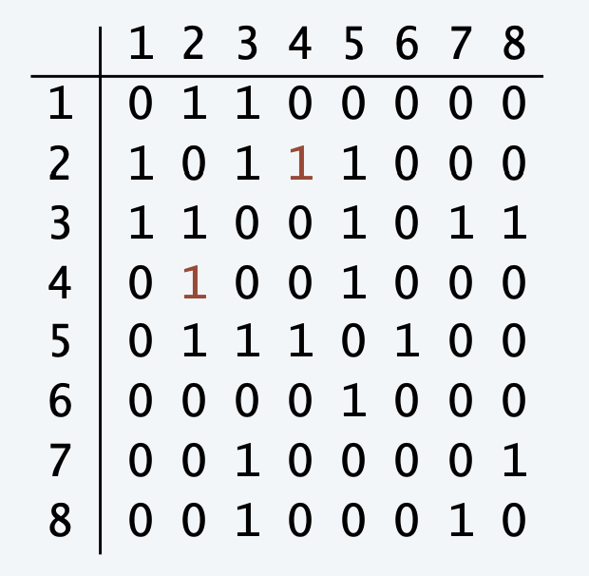
Adjacency List vs Adjacency Matrix
Space:
Lookup:
List Neighbors:
Space:
Lookup:
List Neighbors:
N[1] : [2] -> [3]
N[2] : [1] -> [3] -> [5] -> [4]
N[3] : [1] -> [2] -> [5] -> [7] -> [8]
N[4] : [2] -> [5]
N[5] : [2] -> [3] -> [4] -> [6]
N[6] : [5]
N[7] : [3] -> [8]
N[8] : [3] -> [7]

Slide 32
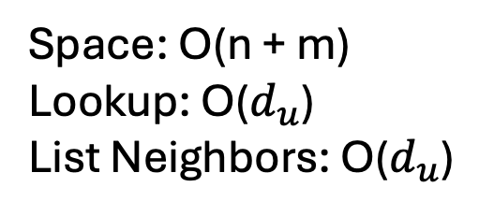
Adjacency List vs Adjacency Matrix
Space: O(n^2)
Lookup: O(1)
List Neighbors: O(n)
Space: O(n + m)
Lookup: O($d_{u}$)
List Neighbors: O($d_{u}$)
N[1] : [2] -> [3]
N[2] : [1] -> [3] -> [5] -> [4]
N[3] : [1] -> [2] -> [5] -> [7] -> [8]
N[4] : [2] -> [5]
N[5] : [2] -> [3] -> [4] -> [6]
N[6] : [5]
N[7] : [3] -> [8]
N[8] : [3] -> [7]

Slide 33
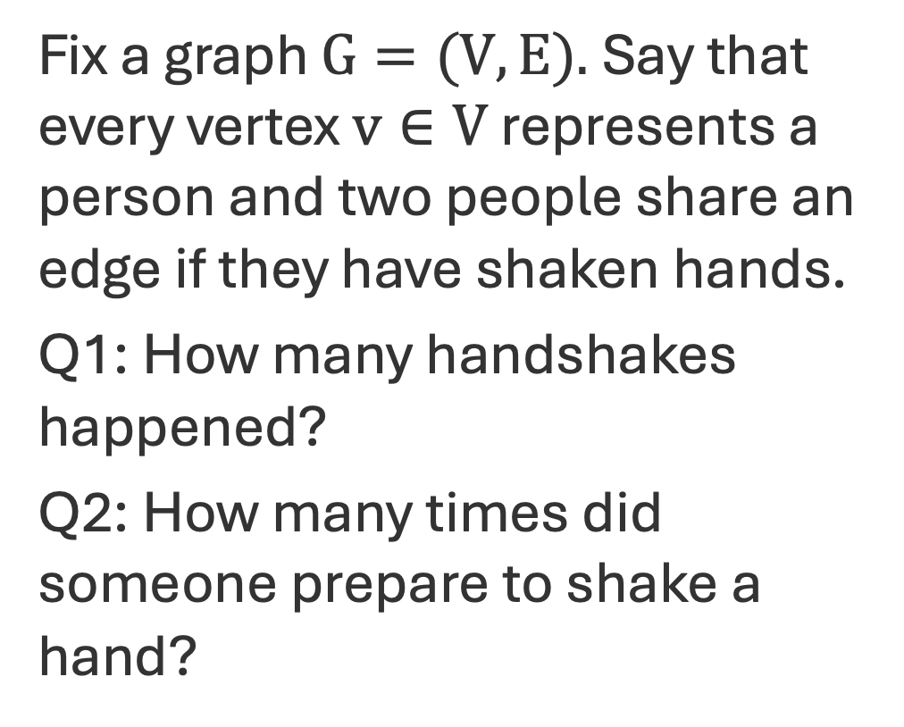
Degree Sum Formula or “Handshaking Lemma”
Fix a graph $G=(V,E).$Say that every vertex $v∈V$ represents a person and two people share an edge if they have shaken hands.
Q1: How many handshakes happened?
Q2: How many times did someone prepare to shake a hand?

Slide 34
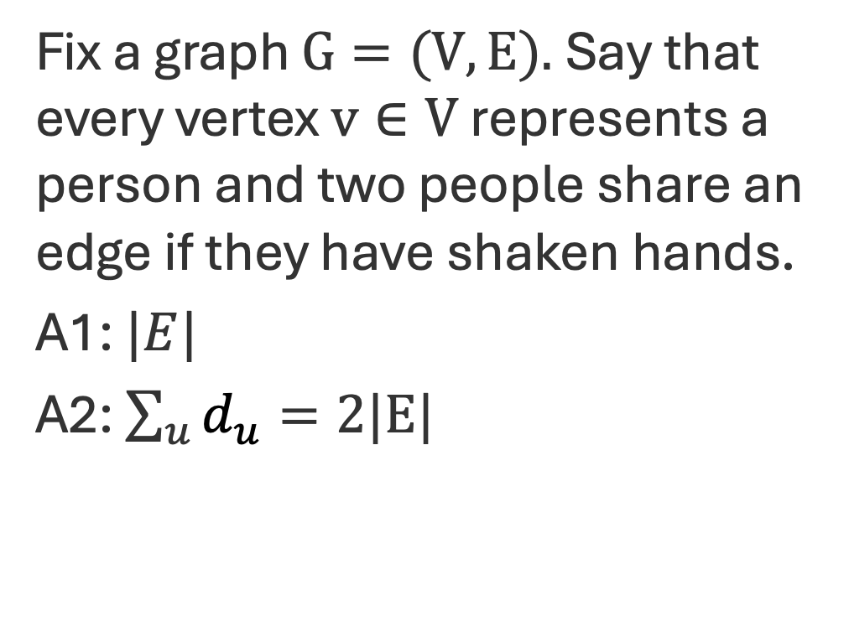
Degree Sum Formula or “Handshaking Lemma”
Fix a graph $G=(V,E).$Say that every vertex $v∈V$ represents a person and two people share an edge if they have shaken hands.
A1: $|E|$
A2: $\sum_{u}{d_{u}}=2|E|$

Slide 35

Q: What is a stack?
A data structure for maintaining a set of elements.
We can add and remove elements from the stack in constant time.
When we remove an element, we get the last element that was added.
  “last-in, first-out” or LIFO

Slide 36
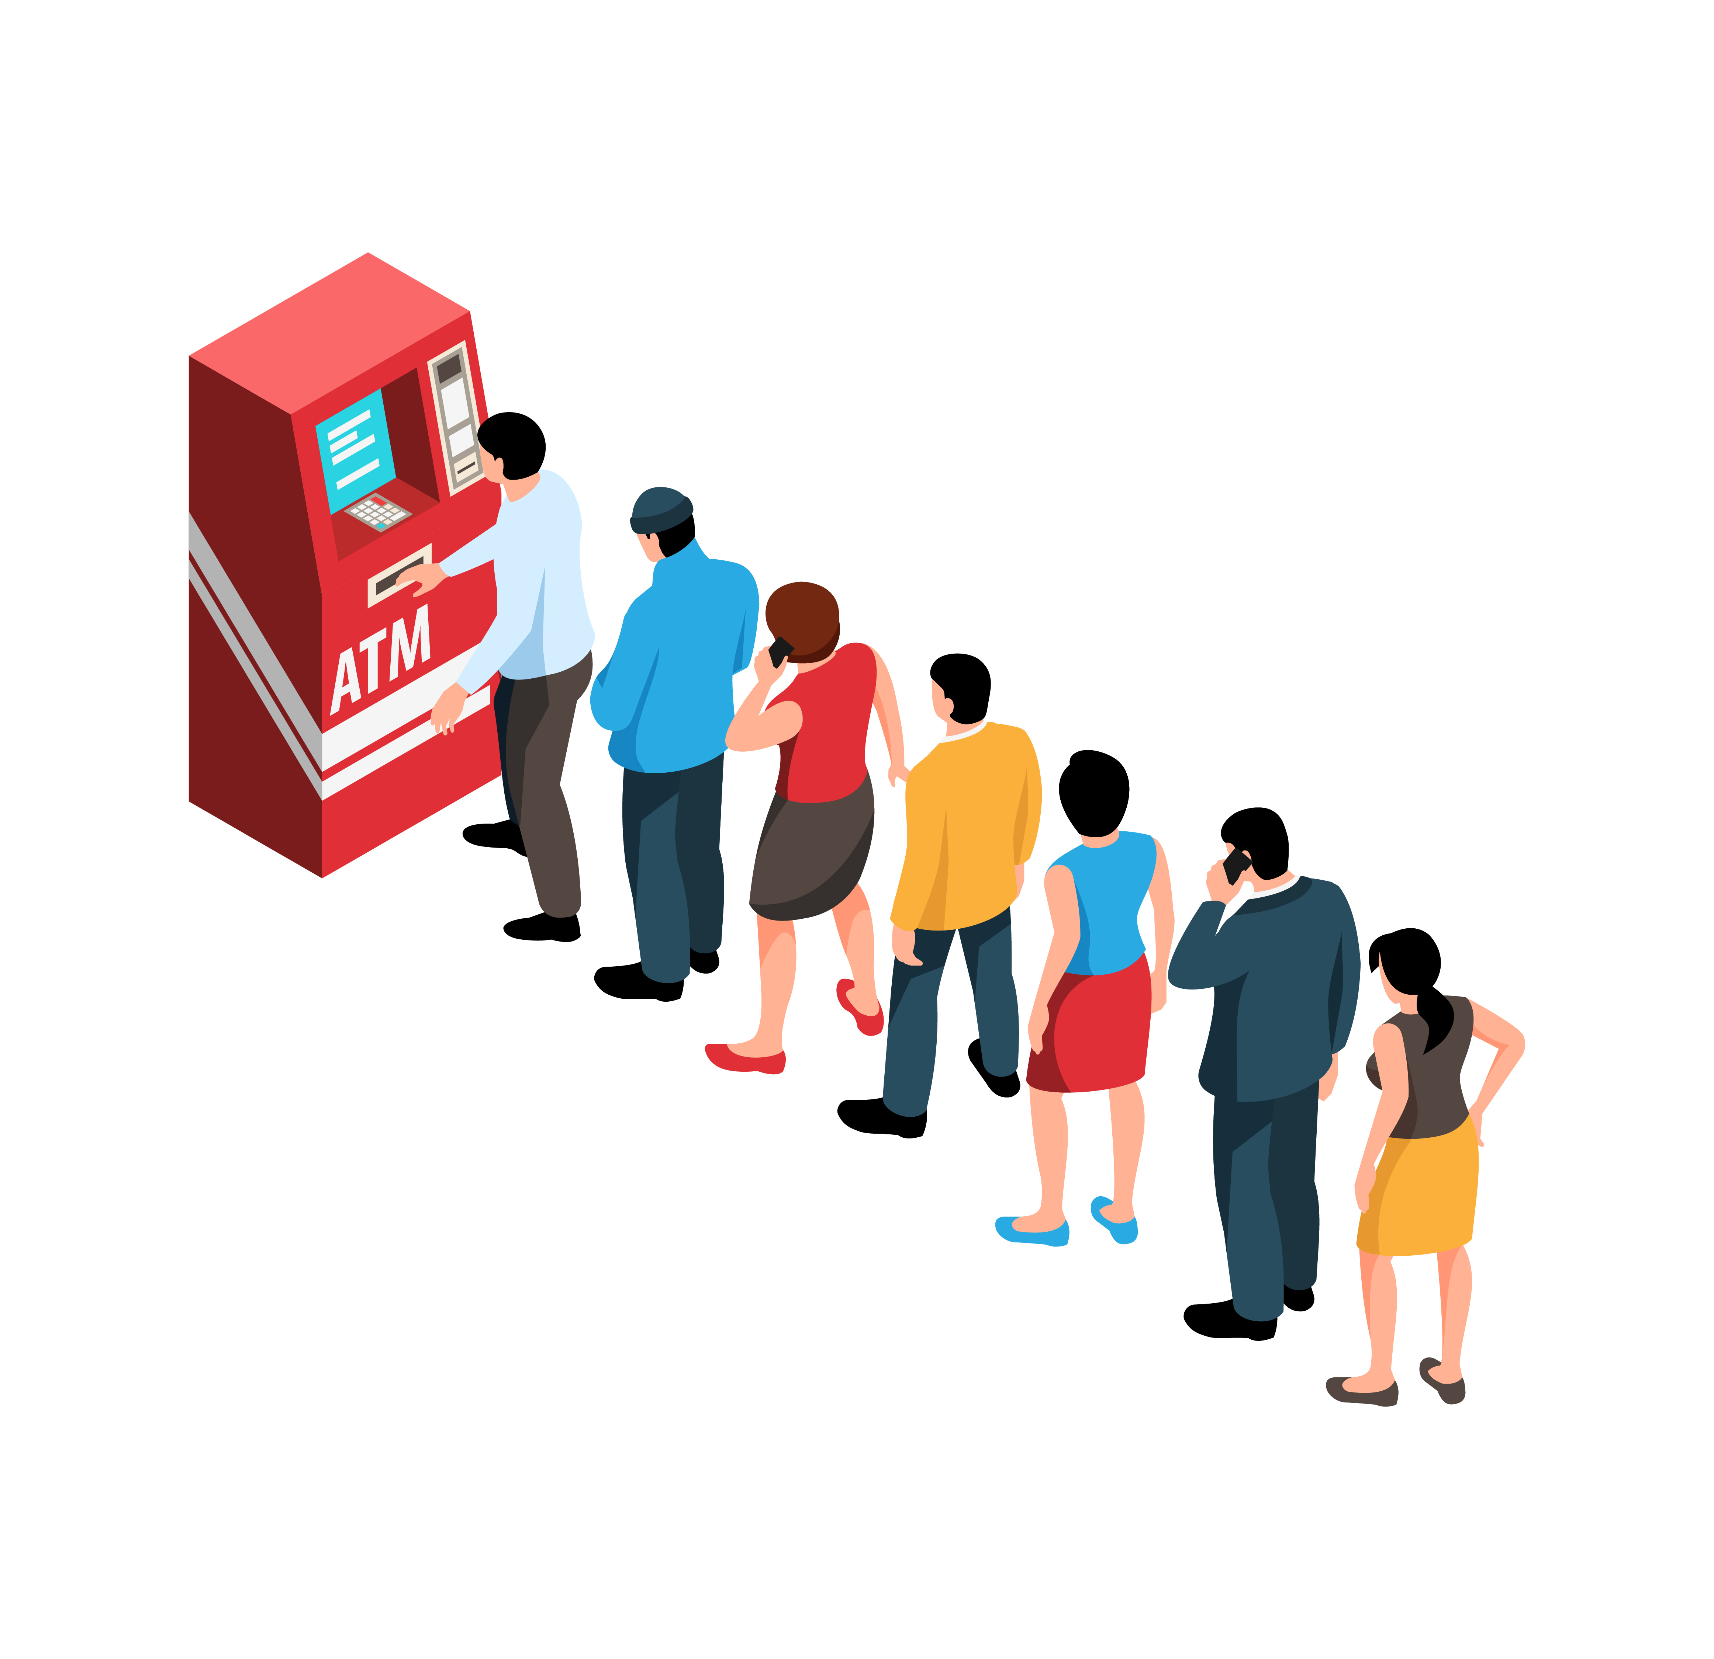
Q: What is Queue?
A data structure for maintaining a set of elements.
We can add and remove elements from the stack in constant time.
When we remove an element, we get the first element that was added (and is still in the set).
  “first-in, first-out” or FIFO

Slide 37
Stack vs Queue
Both can be implemented with a (doubly) linked list.
Let’s assume that both implement the remove function to take the first element of the linked list.
Q: How do we implement the add function for Stack vs Queue?

Slide 38
Stack vs Queue
Both can be implemented with a (doubly) linked list.
Let’s assume that both implement the remove function to take the first element of the linked list.
A: For a Stack we insert at the front and for a Queue we insert at the end.

Slide 39

Breadth First Search
Input: $G=(V,E)$and $s ∈ V$
Output: BFS Tree
Let $L_{0}=\{s\}$
Assume $L_{0},…,L_{i}$ have been constructed:
  Let $L_{i+1}$ be nodes do not appear in $L_{0},…,L_{i}$ and have an edge to $L_{i}$.
  If $L_{i+1}$ is empty, stop.
Return all layers.

Slide 40
A more specific BFS
BFS(s):
  Initialize Discovered to be a node index array of false
  Set Discovered[s] = true
  Initialize L[0] to be a linked list with one element s
  Initialize i to be 0
  While L[i] is not empty:
  Initialize L[i+1] to be empty linked list
    For u in L[i]:
    For each edge (u, v) incident to u:
    If Discovered[v] = false:
    Set Discovered[u] = true
    Add v to L[i+1]
    ++i

Slide 41
Q: What is the runtime?
BFS(s):
  Initialize Discovered to be a node index array of false
  Set Discovered[s] = true
  Initialize L[0] to be a linked list with one element s
  Initialize i to be 0
  While L[i] is not empty:
  Initialize L[i+1] to be empty linked list
    For u in L[i]:
    For each edge (u, v) incident to u:
    If Discovered[v] = false:
    Set Discovered[u] = true
    Add v to L[i+1]
    ++i

Slide 42
Q: What is the runtime?
Total Time:
BFS(s):
  Initialize Discovered to be a node index array of false
  Set Discovered[s] = true
  Initialize L[0] to be a linked list with one element s
  Initialize i to be 0
  While L[i] is not empty:
  Initialize L[i+1] to be empty linked list
    For u in L[i]:
    For each edge (u, v) incident to u:
    If Discovered[v] = false:
    Set Discovered[u] = true
    Add v to L[i+1]
    ++i
O(n)

Slide 43
Q: What is the runtime?
Total Time:
BFS(s):
  Initialize Discovered to be a node index array of false
  Set Discovered[s] = true
  Initialize L[0] to be a linked list with one element s
  Initialize i to be 0
  While L[i] is not empty:
  Initialize L[i+1] to be empty linked list
    For u in L[i]:
    For each edge (u, v) incident to u:
    If Discovered[v] = false:
    Set Discovered[u] = true
    Add v to L[i+1]
    ++i
O(n)
O(1)

Slide 44
Q: What is the runtime?
Total Time:
BFS(s):
  Initialize Discovered to be a node index array of false
  Set Discovered[s] = true
  Initialize L[0] to be a linked list with one element s
  Initialize i to be 0
  While L[i] is not empty:
  Initialize L[i+1] to be empty linked list
    For u in L[i]:
    For each edge (u, v) incident to u:
    If Discovered[v] = false:
    Set Discovered[u] = true
    Add v to L[i+1]
    ++i
O(n)
O(1)
O(1)

Slide 45
Q: What is the runtime?
Total Time:
BFS(s):
  Initialize Discovered to be a node index array of false
  Set Discovered[s] = true
  Initialize L[0] to be a linked list with one element s
  Initialize i to be 0
  While L[i] is not empty:
  Initialize L[i+1] to be empty linked list
    For u in L[i]:
    For each edge (u, v) incident to u:
    If Discovered[v] = false:
    Set Discovered[u] = true
    Add v to L[i+1]
    ++i
O(n)
O(1)
O(1)
O(1)

Slide 46
Q: What is the runtime?
Total Time:
BFS(s):
  Initialize Discovered to be a node index array of false
  Set Discovered[s] = true
  Initialize L[0] to be a linked list with one element s
  Initialize i to be 0
  While L[i] is not empty:
  Initialize L[i+1] to be empty linked list
    For u in L[i]:
    For each edge (u, v) incident to u:
    If Discovered[v] = false:
    Set Discovered[u] = true
    Add v to L[i+1]
    ++i
O(n)
O(1)
O(1)
O(1)
Q: How many times does this loop run?

Slide 47
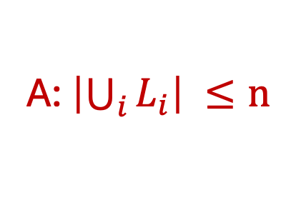
Q: What is the runtime?
Total Time:
BFS(s):
  Initialize Discovered to be a node index array of false
  Set Discovered[s] = true
  Initialize L[0] to be a linked list with one element s
  Initialize i to be 0
  While L[i] is not empty:
  Initialize L[i+1] to be empty linked list
    For u in L[i]:
    For each edge (u, v) incident to u:
    If Discovered[v] = false:
    Set Discovered[u] = true
    Add v to L[i+1]
    ++i
O(n)
O(1)
O(1)
O(1)
A: $\left|\bigcup_{i}{L_{i}}\right| ≤n$

Slide 48
Q: What is the runtime?
Total Time:
BFS(s):
  Initialize Discovered to be a node index array of false
  Set Discovered[s] = true
  Initialize L[0] to be a linked list with one element s
  Initialize i to be 0
  While L[i] is not empty:
  Initialize L[i+1] to be empty linked list
    For u in L[i]:
    For each edge (u, v) incident to u:
    If Discovered[v] = false:
    Set Discovered[u] = true
    Add v to L[i+1]
    ++i
O(n)
O(1)
O(1)
O(1)
O(n)
Q: How many layers max?

Slide 49
Q: What is the runtime?
Total Time:
BFS(s):
  Initialize Discovered to be a node index array of false
  Set Discovered[s] = true
  Initialize L[0] to be a linked list with one element s
  Initialize i to be 0
  While L[i] is not empty:
  Initialize L[i+1] to be empty linked list
    For u in L[i]:
    For each edge (u, v) incident to u:
    If Discovered[v] = false:
    Set Discovered[u] = true
    Add v to L[i+1]
    ++i
O(n)
O(1)
O(1)
O(1)
O(n)
O(n)
A: One for each vertex.

Slide 50
Q: What is the runtime?
Total Time:
BFS(s):
  Initialize Discovered to be a node index array of false
  Set Discovered[s] = true
  Initialize L[0] to be a linked list with one element s
  Initialize i to be 0
  While L[i] is not empty:
  Initialize L[i+1] to be empty linked list
    For u in L[i]:
    For each edge (u, v) incident to u:
    If Discovered[v] = false:
    Set Discovered[u] = true
    Add v to L[i+1]
    ++i
O(n)
O(1)
O(1)
O(1)
O(n)
O(n)
Q: How many times does this loop run?

Slide 51
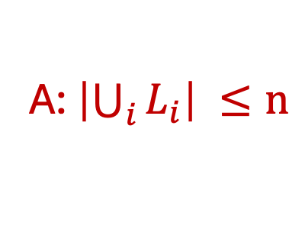
Q: What is the runtime?
Total Time:
BFS(s):
  Initialize Discovered to be a node index array of false
  Set Discovered[s] = true
  Initialize L[0] to be a linked list with one element s
  Initialize i to be 0
  While L[i] is not empty:
  Initialize L[i+1] to be empty linked list
    For u in L[i]:
    For each edge (u, v) incident to u:
    If Discovered[v] = false:
    Set Discovered[u] = true
    Add v to L[i+1]
    ++i
O(n)
O(1)
O(1)
O(1)
O(n)
O(n)
O(n)
A: $\left|\bigcup_{i}{L_{i}}\right| ≤n$

Slide 52
Q: What is the runtime?
Total Time:
BFS(s):
  Initialize Discovered to be a node index array of false
  Set Discovered[s] = true
  Initialize L[0] to be a linked list with one element s
  Initialize i to be 0
  While L[i] is not empty:
  Initialize L[i+1] to be empty linked list
    For u in L[i]:
    For each edge (u, v) incident to u:
    If Discovered[v] = false:
    Set Discovered[u] = true
    Add v to L[i+1]
    ++i
O(n)
O(1)
O(1)
O(1)
O(n)
O(n)
O(n)
Q: How do we do this?

Slide 53
Q: Which should we use?
Space: O(n^2)
Lookup: O(1)
List Neighbors: O(n)
Space: O(n + m)
Lookup: O($d_{u}$)
List Neighbors: O($d_{u}$)
N[1] : [2] -> [3]
N[2] : [1] -> [3] -> [5] -> [4]
N[3] : [1] -> [2] -> [5] -> [7] -> [8]
N[4] : [2] -> [5]
N[5] : [2] -> [3] -> [4] -> [6]
N[6] : [5]
N[7] : [3] -> [8]
N[8] : [3] -> [7]

Slide 54
Adjacency List vs Adjacency Matrix
Space: O(n^2)
Lookup: O(1)
List Neighbors: O(n)
Space: O(n + m)
Lookup: O($d_{u}$)
List Neighbors: O($d_{u}$)
N[1] : [2] -> [3]
N[2] : [1] -> [3] -> [5] -> [4]
N[3] : [1] -> [2] -> [5] -> [7] -> [8]
N[4] : [2] -> [5]
N[5] : [2] -> [3] -> [4] -> [6]
N[6] : [5]
N[7] : [3] -> [8]
N[8] : [3] -> [7]

Slide 55
Q: What is the runtime?
Total Time:
BFS(s):
  Initialize Discovered to be a node index array of false
  Set Discovered[s] = true
  Initialize L[0] to be a linked list with one element s
  Initialize i to be 0
  While L[i] is not empty:
  Initialize L[i+1] to be empty linked list
    For u in L[i]:
    For each edge (u, v) incident to u:
    If Discovered[v] = false:
    Set Discovered[u] = true
    Add v to L[i+1]
    ++i
O(n)
O(1)
O(1)
O(1)
O(n)
O(n)
O(n)
A: Linked List

Slide 56
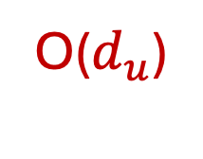
Q: What is the runtime?
Total Time:
BFS(s):
  Initialize Discovered to be a node index array of false
  Set Discovered[s] = true
  Initialize L[0] to be a linked list with one element s
  Initialize i to be 0
  While L[i] is not empty:
  Initialize L[i+1] to be empty linked list
    For u in L[i]:
    For each edge (u, v) incident to u:
    If Discovered[v] = false:
    Set Discovered[u] = true
    Add v to L[i+1]
    ++i
O(n)
O(1)
O(1)
O(1)
O(n)
O(n)
O(n)
O($d_{u}$)
Q: How many times does this loop run for u?

Slide 57
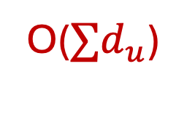
Q: What is the runtime?
Total Time:
BFS(s):
  Initialize Discovered to be a node index array of false
  Set Discovered[s] = true
  Initialize L[0] to be a linked list with one element s
  Initialize i to be 0
  While L[i] is not empty:
  Initialize L[i+1] to be empty linked list
    For u in L[i]:
    For each edge (u, v) incident to u:
    If Discovered[v] = false:
    Set Discovered[u] = true
    Add v to L[i+1]
    ++i
O(n)
O(1)
O(1)
O(1)
O(n)
O(n)
O(n)
A: One time for each u!
O(${∑d}_{u}$)

Slide 58
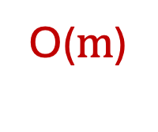
Q: What is the runtime?
Total Time:
BFS(s):
  Initialize Discovered to be a node index array of false
  Set Discovered[s] = true
  Initialize L[0] to be a linked list with one element s
  Initialize i to be 0
  While L[i] is not empty:
  Initialize L[i+1] to be empty linked list
    For u in L[i]:
    For each edge (u, v) incident to u:
    If Discovered[v] = false:
    Set Discovered[u] = true
    Add v to L[i+1]
    ++i
O(n)
O(1)
O(1)
O(1)
O(n)
O(n)
O(n)
O($m$)

Slide 59
Q: What is the runtime?
Total Time:
BFS(s):
  Initialize Discovered to be a node index array of false
  Set Discovered[s] = true
  Initialize L[0] to be a linked list with one element s
  Initialize i to be 0
  While L[i] is not empty:
  Initialize L[i+1] to be empty linked list
    For u in L[i]:
    For each edge (u, v) incident to u:
    If Discovered[v] = false:
    Set Discovered[u] = true
    Add v to L[i+1]
    ++i
O(n)
O(1)
O(1)
O(1)
O(n)
O(n)
O(n)
O($m$)
O(1)
O(1)
O(1)
O(1)

Slide 60
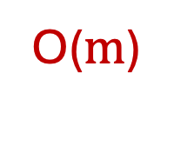

Q: What is the runtime?
Total Time:
BFS(s):
  Initialize Discovered to be a node index array of false
  Set Discovered[s] = true
  Initialize L[0] to be a linked list with one element s
  Initialize i to be 0
  While L[i] is not empty:
  Initialize L[i+1] to be empty linked list
    For u in L[i]:
    For each edge (u, v) incident to u:
    If Discovered[v] = false:
    Set Discovered[u] = true
    Add v to L[i+1]
    ++i
O(n)
O(1)
O(1)
O(1)
O(n)
O(n)
O(n)
O($m$)
O($m$)
O($m$)
O($m$)
O(n)

Slide 61
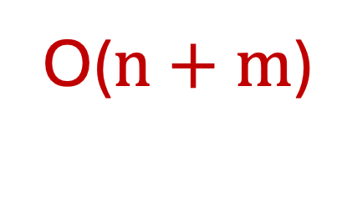
Q: What is the runtime?
Total Time:
O($n+m$)
BFS(s):
  Initialize Discovered to be a node index array of false
  Set Discovered[s] = true
  Initialize L[0] to be a linked list with one element s
  Initialize i to be 0
  While L[i] is not empty:
  Initialize L[i+1] to be empty linked list
    For u in L[i]:
    For each edge (u, v) incident to u:
    If Discovered[v] = false:
    Set Discovered[u] = true
    Add v to L[i+1]
    ++i
O(n)
O(1)
O(1)
O(1)
O(n)
O(n)
O(n)
O($m$)
O($m$)
O($m$)
O($m$)
O(n)

Slide 62
Q: What if I use a matrix?
BFS(s):
  Initialize Discovered to be a node index array of false
  Set Discovered[s] = true
  Initialize L[0] to be a linked list with one element s
  Initialize i to be 0
  While L[i] is not empty:
  Initialize L[i+1] to be empty linked list
    For u in L[i]:
    For each edge (u, v) incident to u:
    If Discovered[v] = false:
    Set Discovered[u] = true
    Add v to L[i+1]
    ++i

Slide 63
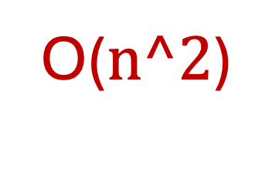



Q: What if I use a matrix?
O($n^2$)
BFS(s):
  Initialize Discovered to be a node index array of false
  Set Discovered[s] = true
  Initialize L[0] to be a linked list with one element s
  Initialize i to be 0
  While L[i] is not empty:
  Initialize L[i+1] to be empty linked list
    For u in L[i]:
    For each edge (u, v) incident to u:
    If Discovered[v] = false:
    Set Discovered[u] = true
    Add v to L[i+1]
    ++i
O($n^2$)
O($n^2$)
O($n^2$)
O($n^2$)

Slide 64
A New BFS
BFS(s):
  Initialize Discovered to be a node index array of false
  Set Discovered[s] = true
  Initialize Q to be a Queue with one element s
  While Q is not empty:
    u = Q.dequeue()
  For each edge (u, v) incident to u:
  If Discovered[v] = false:
  Set Discovered[u] = true
  Add v to Q
    ++i

Slide 65
Q: What is the runtime? (Assume Linked List)
BFS(s):
  Initialize Discovered to be a node index array of false
  Set Discovered[s] = true
  Initialize Q to be a Queue with one element s
  While Q is not empty:
    u = Q.dequeue()
  For each edge (u, v) incident to u:
  If Discovered[v] = false:
  Set Discovered[u] = true
  Add v to Q
    ++i

Slide 66
Q: What is the runtime? O(m+n)
BFS(s):
  Initialize Discovered to be a node index array of false
  Set Discovered[s] = true
  Initialize Q to be a Queue with one element s
  While Q is not empty:
    u = Q.dequeue()
  For each edge (u, v) incident to u:
  If Discovered[v] = false:
  Set Discovered[u] = true
  Add v to Q
    ++i

Slide 67
Q: What if we change the queue to a stack?
???(s):
  Initialize Explored to be a node index array of false
  Set Explored[s] = true
  Initialize Q to be a Stack with one element s
  While Q is not empty:
    u = Q.remove()
    If Explored[u] = false:
  For each edge (u, v) incident to u:
Add v to Q
    ++i

Slide 68
A: We DFS
DFSs):
  Initialize Explored to be a node index array of false
  Set Explored[s] = true
  Initialize Q to be a Stack with one element s
  While Q is not empty:
    u = Q.remove()
    If Explored[u] = false:
  For each edge (u, v) incident to u:
Add v to Q
    ++i

Slide 69
Q: What is the runtime of DFS?
DFSs):
  Initialize Explored to be a node index array of false
  Set Explored[s] = true
  Initialize Q to be a Stack with one element s
  While Q is not empty:
    u = Q.remove()
    If Explored[u] = false:
  For each edge (u, v) incident to u:
Add v to Q
    ++i

Slide 70
Q: What is the runtime of DFS? O(m+n)
DFSs):
  Initialize Explored to be a node index array of false
  Set Explored[s] = true
  Initialize Q to be a Stack with one element s
  While Q is not empty:
    u = Q.remove()
    If Explored[u] = false:
  For each edge (u, v) incident to u:
Add v to Q
    ++i
Q: How many times does this loop run for u?

Slide 71
Q: What is the runtime of DFS? O(m+n)
DFSs):
  Initialize Explored to be a node index array of false
  Set Explored[s] = true
  Initialize Q to be a Stack with one element s
  While Q is not empty:
    u = Q.remove()
    If Explored[u] = false:
  For each edge (u, v) incident to u:
Add v to Q
    ++i
A: At most once for each edge

Slide 72
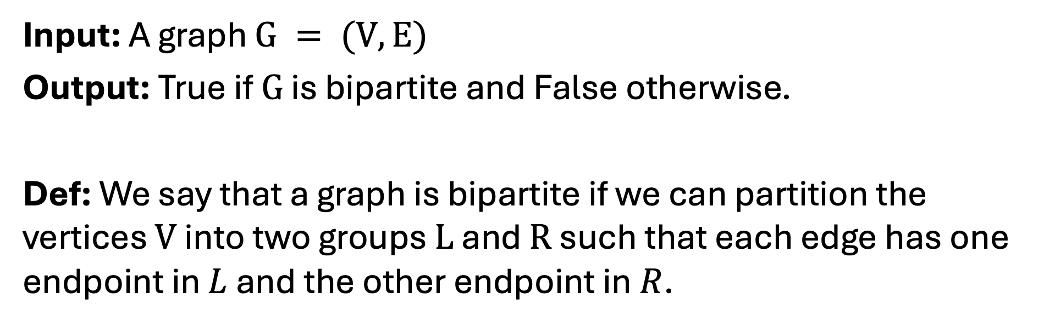
Problem: Bipartite Graph
Input: A graph $G = (V,E)$
Output: True if $G$ is bipartite and False otherwise.
Def: We say that a graph is bipartite if we can partition the vertices $V$ into two groups $L$ and $R$ such that each edge has one endpoint in $L$ and the other endpoint in $R$.

Slide 73
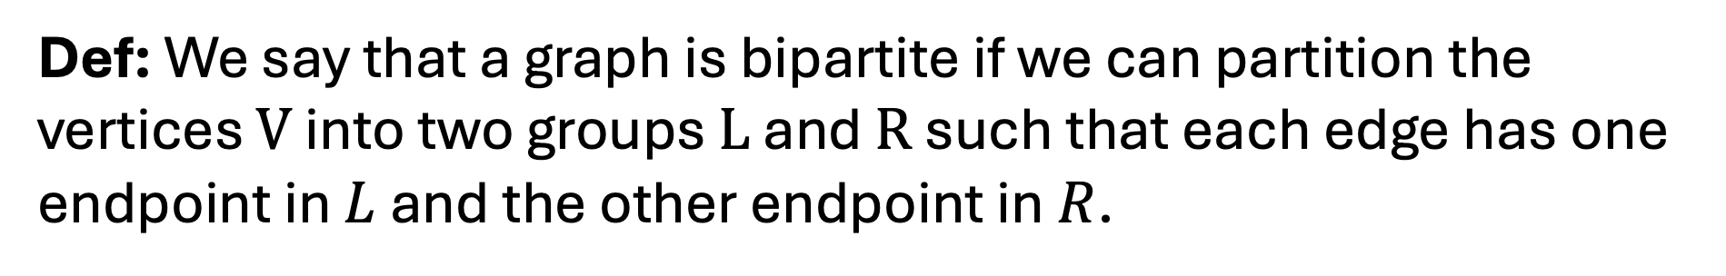
Problem: Bipartite Graph
Def: We say that a graph is bipartite if we can partition the vertices $V$ into two groups $L$ and $R$ such that each edge has one endpoint in $L$ and the other endpoint in $R$.
Bipartite
Not Bipartite

Slide 74
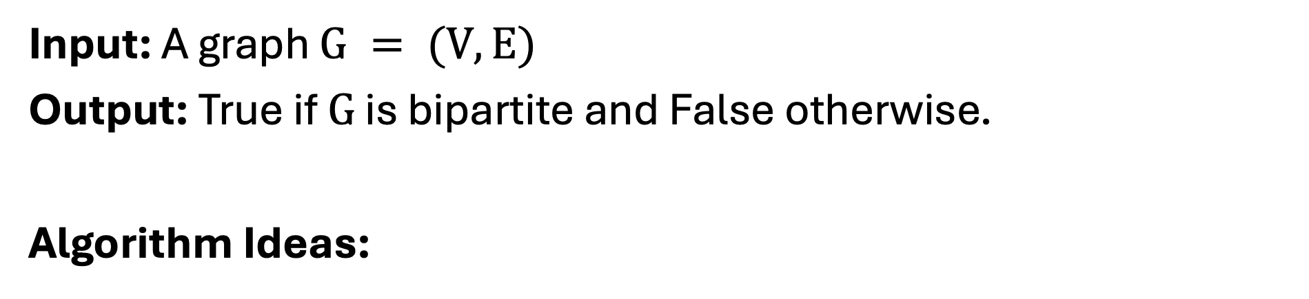
Problem: Bipartite Graph
Input: A graph $G = (V,E)$
Output: True if $G$ is bipartite and False otherwise.
Algorithm Ideas:

Slide 75
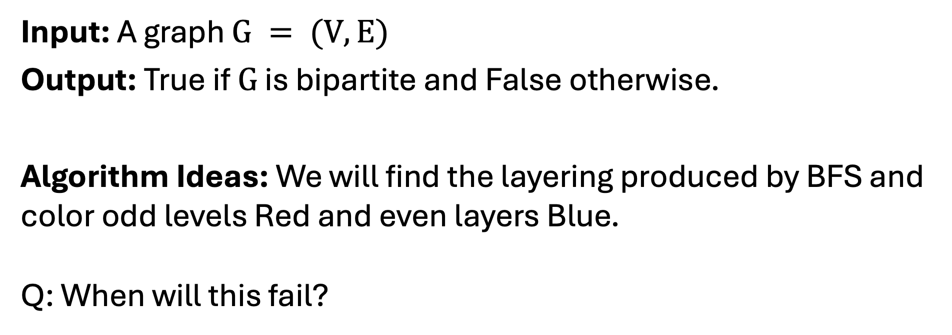
Problem: Bipartite Graph
Input: A graph $G = (V,E)$
Output: True if $G$ is bipartite and False otherwise.
Algorithm Ideas: We will find the layering produced by BFS and color odd levels Red and even layers Blue.
Q: When will this fail?

Slide 76
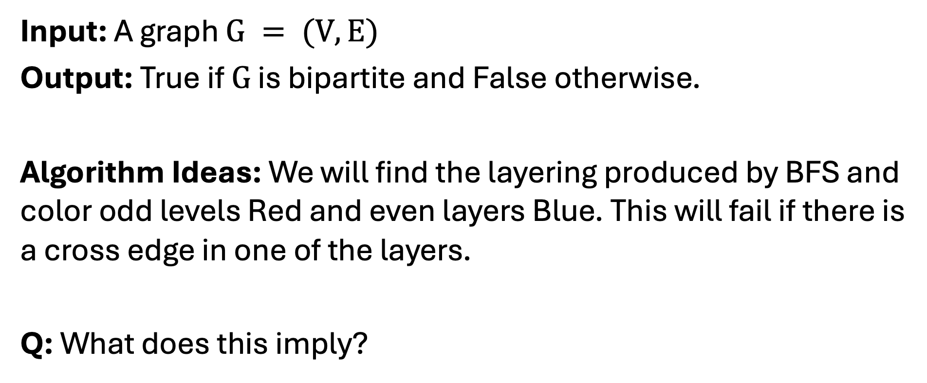
Problem: Bipartite Graph
Input: A graph $G = (V,E)$
Output: True if $G$ is bipartite and False otherwise.
Algorithm Ideas: We will find the layering produced by BFS and color odd levels Red and even layers Blue. This will fail if there is a cross edge in one of the layers.
Q: What does this imply?

Slide 77
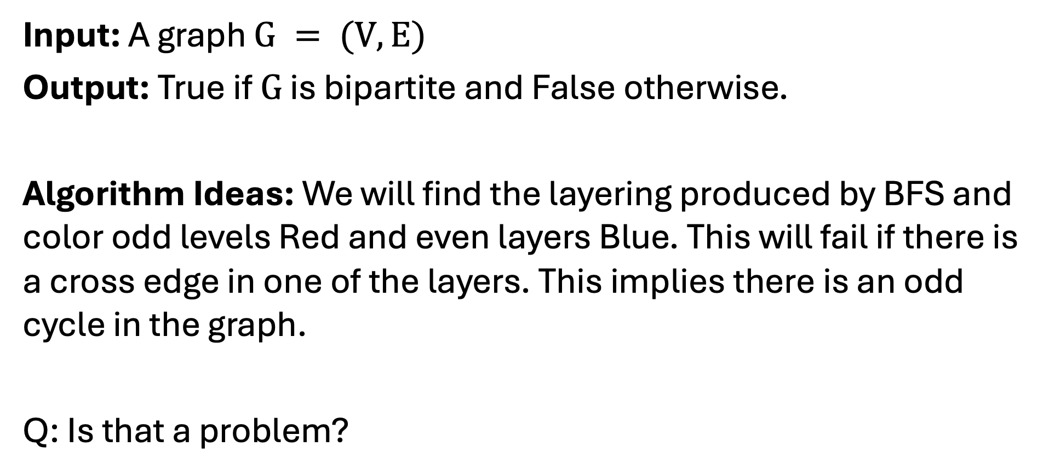
Problem: Bipartite Graph
Input: A graph $G = (V,E)$
Output: True if $G$ is bipartite and False otherwise.
Algorithm Ideas: We will find the layering produced by BFS and color odd levels Red and even layers Blue. This will fail if there is a cross edge in one of the layers. This implies there is an odd cycle in the graph.
Q: Is that a problem?

Slide 78
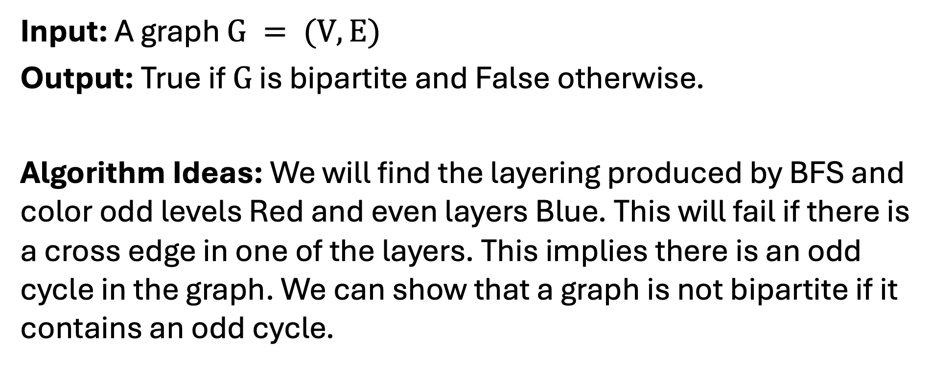
Problem: Bipartite Graph
Input: A graph $G = (V,E)$
Output: True if $G$ is bipartite and False otherwise.
Algorithm Ideas: We will find the layering produced by BFS and color odd levels Red and even layers Blue. This will fail if there is a cross edge in one of the layers. This implies there is an odd cycle in the graph. We can show that a graph is not bipartite if it contains an odd cycle.

