Slide 1

CSE 331: Algorithms & Complexity
“BFS and DFS Runtime”
Prof. Charlie Anne Carlson (She/Her)
Lecture 13
Friday September 26th, 2025

Slide 2

Schedule
Course Updates
Stacks & Queues
Another BFS
Runtime Analysis
BFS
DFS
Coloring

Slide 3

Course Updates
HW 2 Solutions Soon
HW 3 Out
Group Project
Team Emails Soon
No Autolab Registration
First Quiz NEXT Monday!
Quiz Solutions Soon
Sample Midterms Soon-ish
Soon = Today… or before I go to sleep

Slide 4

Q: What is a stack?
A data structure for maintaining a set of elements.
We can add and remove elements from the stack in constant time.
When we remove an element, we get the last element that was added.
“last-in, first-out” or LIFO

Slide 5

Q: What is Queue?
A data structure for maintaining a set of elements.
We can add and remove elements from the stack in constant time.
When we remove an element, we get the first element that was added (and is still in the set).
“first-in, first-out” or FIFO

Slide 6
Stack vs Queue
Both can be implemented with a (doubly) linked list.
Let’s assume that both implement the remove function to take the first element of the linked list.
Q: How do we implement the add function for Stack vs Queue?

Slide 7
Stack vs Queue
Both can be implemented with a (doubly) linked list.
Let’s assume that both implement the remove function to take the first element of the linked list.
A: For a Stack we insert at the front and for a Queue we insert at the end.

Slide 8

Breadth First Search
Input: $G=(V,E)$and $s ∈ V$
Output: BFS Tree
Let $L_{0}=\{s\}$
Assume $L_{0},…,L_{i}$ have been constructed:
Let $L_{i+1}$ be nodes do not appear in $L_{0},…,L_{i}$ and have an edge to $L_{i}$.
If $L_{i+1}$ is empty, stop.
Return all layers.

Slide 9
A more specific BFS
BFS(s):
Initialize Discovered to be a node index array of false
Set Discovered[s] = true
Initialize L[0] to be a linked list with one element s
Initialize i to be 0
While L[i] is not empty:
Initialize L[i+1] to be empty linked list
For u in L[i]:
For each edge (u, v) incident to u:
If Discovered[v] = false:
Set Discovered[u] = true
Add v to L[i+1]
++i

Slide 10
Q: What is the runtime?
BFS(s):
Initialize Discovered to be a node index array of false
Set Discovered[s] = true
Initialize L[0] to be a linked list with one element s
Initialize i to be 0
While L[i] is not empty:
Initialize L[i+1] to be empty linked list
For u in L[i]:
For each edge (u, v) incident to u:
If Discovered[v] = false:
Set Discovered[u] = true
Add v to L[i+1]
++i

Slide 11
Q: What is the runtime?
Total Time:
BFS(s):
Initialize Discovered to be a node index array of false
Set Discovered[s] = true
Initialize L[0] to be a linked list with one element s
Initialize i to be 0
While L[i] is not empty:
Initialize L[i+1] to be empty linked list
For u in L[i]:
For each edge (u, v) incident to u:
If Discovered[v] = false:
Set Discovered[u] = true
Add v to L[i+1]
++i
O(n)

Slide 12
Q: What is the runtime?
Total Time:
BFS(s):
Initialize Discovered to be a node index array of false
Set Discovered[s] = true
Initialize L[0] to be a linked list with one element s
Initialize i to be 0
While L[i] is not empty:
Initialize L[i+1] to be empty linked list
For u in L[i]:
For each edge (u, v) incident to u:
If Discovered[v] = false:
Set Discovered[u] = true
Add v to L[i+1]
++i
O(n)
O(1)

Slide 13
Q: What is the runtime?
Total Time:
BFS(s):
Initialize Discovered to be a node index array of false
Set Discovered[s] = true
Initialize L[0] to be a linked list with one element s
Initialize i to be 0
While L[i] is not empty:
Initialize L[i+1] to be empty linked list
For u in L[i]:
For each edge (u, v) incident to u:
If Discovered[v] = false:
Set Discovered[u] = true
Add v to L[i+1]
++i
O(n)
O(1)
O(1)

Slide 14
Q: What is the runtime?
Total Time:
BFS(s):
Initialize Discovered to be a node index array of false
Set Discovered[s] = true
Initialize L[0] to be a linked list with one element s
Initialize i to be 0
While L[i] is not empty:
Initialize L[i+1] to be empty linked list
For u in L[i]:
For each edge (u, v) incident to u:
If Discovered[v] = false:
Set Discovered[u] = true
Add v to L[i+1]
++i
O(n)
O(1)
O(1)
O(1)

Slide 15
Q: What is the runtime?
Total Time:
BFS(s):
Initialize Discovered to be a node index array of false
Set Discovered[s] = true
Initialize L[0] to be a linked list with one element s
Initialize i to be 0
While L[i] is not empty:
Initialize L[i+1] to be empty linked list
For u in L[i]:
For each edge (u, v) incident to u:
If Discovered[v] = false:
Set Discovered[u] = true
Add v to L[i+1]
++i
O(n)
O(1)
O(1)
O(1)
Q: How many times does this loop run?

Slide 16
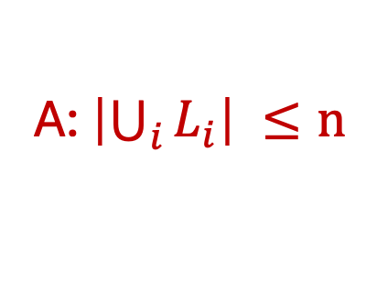
Q: What is the runtime?
Total Time:
BFS(s):
Initialize Discovered to be a node index array of false
Set Discovered[s] = true
Initialize L[0] to be a linked list with one element s
Initialize i to be 0
While L[i] is not empty:
Initialize L[i+1] to be empty linked list
For u in L[i]:
For each edge (u, v) incident to u:
If Discovered[v] = false:
Set Discovered[u] = true
Add v to L[i+1]
++i
O(n)
O(1)
O(1)
O(1)
A: $\left|\bigcup_{i}{L_{i}}\right| ≤n$

Slide 17
Q: What is the runtime?
Total Time:
BFS(s):
Initialize Discovered to be a node index array of false
Set Discovered[s] = true
Initialize L[0] to be a linked list with one element s
Initialize i to be 0
While L[i] is not empty:
Initialize L[i+1] to be empty linked list
For u in L[i]:
For each edge (u, v) incident to u:
If Discovered[v] = false:
Set Discovered[u] = true
Add v to L[i+1]
++i
O(n)
O(1)
O(1)
O(1)
O(n)
Q: How many layers max?

Slide 18
Q: What is the runtime?
Total Time:
BFS(s):
Initialize Discovered to be a node index array of false
Set Discovered[s] = true
Initialize L[0] to be a linked list with one element s
Initialize i to be 0
While L[i] is not empty:
Initialize L[i+1] to be empty linked list
For u in L[i]:
For each edge (u, v) incident to u:
If Discovered[v] = false:
Set Discovered[u] = true
Add v to L[i+1]
++i
O(n)
O(1)
O(1)
O(1)
O(n)
O(n)
A: One for each vertex.

Slide 19
Q: What is the runtime?
Total Time:
BFS(s):
Initialize Discovered to be a node index array of false
Set Discovered[s] = true
Initialize L[0] to be a linked list with one element s
Initialize i to be 0
While L[i] is not empty:
Initialize L[i+1] to be empty linked list
For u in L[i]:
For each edge (u, v) incident to u:
If Discovered[v] = false:
Set Discovered[u] = true
Add v to L[i+1]
++i
O(n)
O(1)
O(1)
O(1)
O(n)
O(n)
Q: How many times does this loop run?

Slide 20
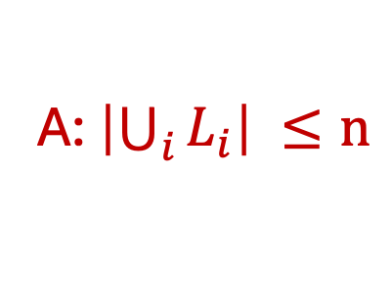
Q: What is the runtime?
Total Time:
BFS(s):
Initialize Discovered to be a node index array of false
Set Discovered[s] = true
Initialize L[0] to be a linked list with one element s
Initialize i to be 0
While L[i] is not empty:
Initialize L[i+1] to be empty linked list
For u in L[i]:
For each edge (u, v) incident to u:
If Discovered[v] = false:
Set Discovered[u] = true
Add v to L[i+1]
++i
O(n)
O(1)
O(1)
O(1)
O(n)
O(n)
O(n)
A: $\left|\bigcup_{i}{L_{i}}\right| ≤n$

Slide 21
Q: What is the runtime?
Total Time:
BFS(s):
Initialize Discovered to be a node index array of false
Set Discovered[s] = true
Initialize L[0] to be a linked list with one element s
Initialize i to be 0
While L[i] is not empty:
Initialize L[i+1] to be empty linked list
For u in L[i]:
For each edge (u, v) incident to u:
If Discovered[v] = false:
Set Discovered[u] = true
Add v to L[i+1]
++i
O(n)
O(1)
O(1)
O(1)
O(n)
O(n)
O(n)
Q: How do we do this?

Slide 22
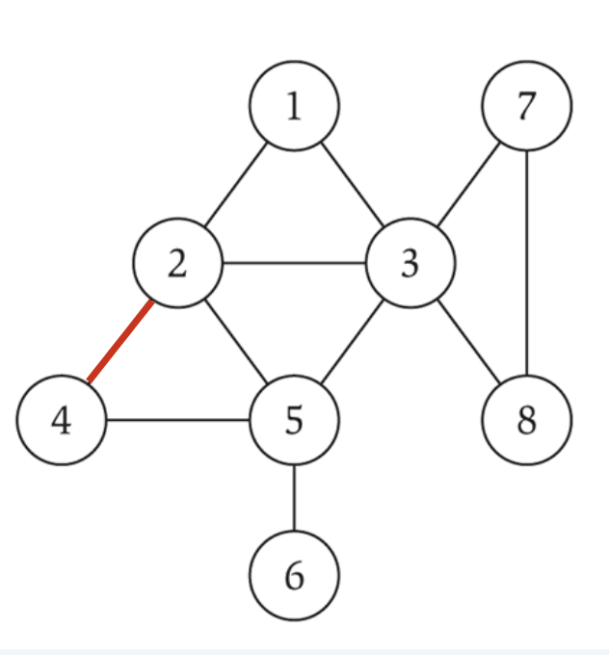
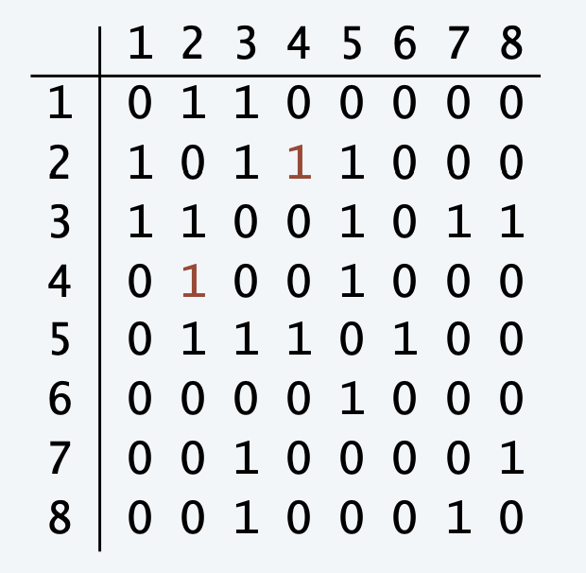
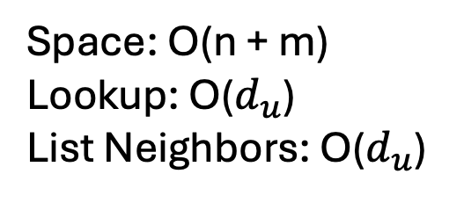
Q: Which should we use?
Space: O(n^2)
Lookup: O(1)
List Neighbors: O(n)
Space: O(n + m)
Lookup: O($d_{u}$)
List Neighbors: O($d_{u}$)
N[1] : [2] -> [3]
N[2] : [1] -> [3] -> [5] -> [4]
N[3] : [1] -> [2] -> [5] -> [7] -> [8]
N[4] : [2] -> [5]
N[5] : [2] -> [3] -> [4] -> [6]
N[6] : [5]
N[7] : [3] -> [8]
N[8] : [3] -> [7]

Slide 23
Adjacency List vs Adjacency Matrix
Space: O(n^2)
Lookup: O(1)
List Neighbors: O(n)
Space: O(n + m)
Lookup: O($d_{u}$)
List Neighbors: O($d_{u}$)
N[1] : [2] -> [3]
N[2] : [1] -> [3] -> [5] -> [4]
N[3] : [1] -> [2] -> [5] -> [7] -> [8]
N[4] : [2] -> [5]
N[5] : [2] -> [3] -> [4] -> [6]
N[6] : [5]
N[7] : [3] -> [8]
N[8] : [3] -> [7]

Slide 24
Q: What is the runtime?
Total Time:
BFS(s):
Initialize Discovered to be a node index array of false
Set Discovered[s] = true
Initialize L[0] to be a linked list with one element s
Initialize i to be 0
While L[i] is not empty:
Initialize L[i+1] to be empty linked list
For u in L[i]:
For each edge (u, v) incident to u:
If Discovered[v] = false:
Set Discovered[u] = true
Add v to L[i+1]
++i
O(n)
O(1)
O(1)
O(1)
O(n)
O(n)
O(n)
A: Linked List

Slide 25
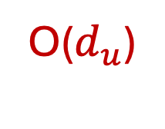
Q: What is the runtime?
Total Time:
BFS(s):
Initialize Discovered to be a node index array of false
Set Discovered[s] = true
Initialize L[0] to be a linked list with one element s
Initialize i to be 0
While L[i] is not empty:
Initialize L[i+1] to be empty linked list
For u in L[i]:
For each edge (u, v) incident to u:
If Discovered[v] = false:
Set Discovered[u] = true
Add v to L[i+1]
++i
O(n)
O(1)
O(1)
O(1)
O(n)
O(n)
O(n)
O($d_{u}$)
Q: How many times does this loop run for u?

Slide 26
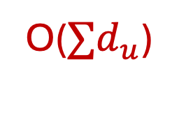
Q: What is the runtime?
Total Time:
BFS(s):
Initialize Discovered to be a node index array of false
Set Discovered[s] = true
Initialize L[0] to be a linked list with one element s
Initialize i to be 0
While L[i] is not empty:
Initialize L[i+1] to be empty linked list
For u in L[i]:
For each edge (u, v) incident to u:
If Discovered[v] = false:
Set Discovered[u] = true
Add v to L[i+1]
++i
O(n)
O(1)
O(1)
O(1)
O(n)
O(n)
O(n)
A: One time for each u!
O(${∑d}_{u}$)

Slide 27
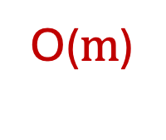
Q: What is the runtime?
Total Time:
BFS(s):
Initialize Discovered to be a node index array of false
Set Discovered[s] = true
Initialize L[0] to be a linked list with one element s
Initialize i to be 0
While L[i] is not empty:
Initialize L[i+1] to be empty linked list
For u in L[i]:
For each edge (u, v) incident to u:
If Discovered[v] = false:
Set Discovered[u] = true
Add v to L[i+1]
++i
O(n)
O(1)
O(1)
O(1)
O(n)
O(n)
O(n)
O($m$)

Slide 28
Q: What is the runtime?
Total Time:
BFS(s):
Initialize Discovered to be a node index array of false
Set Discovered[s] = true
Initialize L[0] to be a linked list with one element s
Initialize i to be 0
While L[i] is not empty:
Initialize L[i+1] to be empty linked list
For u in L[i]:
For each edge (u, v) incident to u:
If Discovered[v] = false:
Set Discovered[u] = true
Add v to L[i+1]
++i
O(n)
O(1)
O(1)
O(1)
O(n)
O(n)
O(n)
O($m$)
O(1)
O(1)
O(1)
O(1)

Slide 29
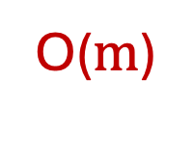

Q: What is the runtime?
Total Time:
BFS(s):
Initialize Discovered to be a node index array of false
Set Discovered[s] = true
Initialize L[0] to be a linked list with one element s
Initialize i to be 0
While L[i] is not empty:
Initialize L[i+1] to be empty linked list
For u in L[i]:
For each edge (u, v) incident to u:
If Discovered[v] = false:
Set Discovered[u] = true
Add v to L[i+1]
++i
O(n)
O(1)
O(1)
O(1)
O(n)
O(n)
O(n)
O($m$)
O($m$)
O($m$)
O($m$)
O(n)

Slide 30
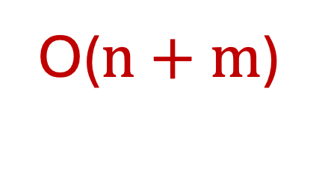
Q: What is the runtime?
Total Time:
O($n+m$)
BFS(s):
Initialize Discovered to be a node index array of false
Set Discovered[s] = true
Initialize L[0] to be a linked list with one element s
Initialize i to be 0
While L[i] is not empty:
Initialize L[i+1] to be empty linked list
For u in L[i]:
For each edge (u, v) incident to u:
If Discovered[v] = false:
Set Discovered[u] = true
Add v to L[i+1]
++i
O(n)
O(1)
O(1)
O(1)
O(n)
O(n)
O(n)
O($m$)
O($m$)
O($m$)
O($m$)
O(n)

Slide 31
Q: What if I use a matrix?
BFS(s):
Initialize Discovered to be a node index array of false
Set Discovered[s] = true
Initialize L[0] to be a linked list with one element s
Initialize i to be 0
While L[i] is not empty:
Initialize L[i+1] to be empty linked list
For u in L[i]:
For each edge (u, v) incident to u:
If Discovered[v] = false:
Set Discovered[u] = true
Add v to L[i+1]
++i

Slide 32
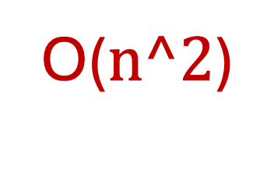



Q: What if I use a matrix?
O($n^2$)
BFS(s):
Initialize Discovered to be a node index array of false
Set Discovered[s] = true
Initialize L[0] to be a linked list with one element s
Initialize i to be 0
While L[i] is not empty:
Initialize L[i+1] to be empty linked list
For u in L[i]:
For each edge (u, v) incident to u:
If Discovered[v] = false:
Set Discovered[u] = true
Add v to L[i+1]
++i
O($n^2$)
O($n^2$)
O($n^2$)
O($n^2$)

Slide 33
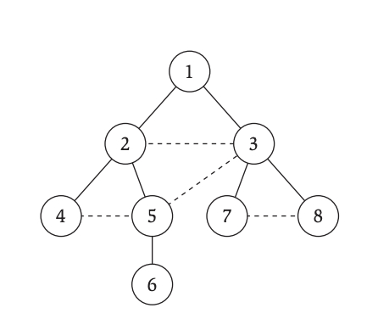
A New BFS
BFS(s):
Initialize Discovered to be a node index array of false
Set Discovered[s] = true
Initialize Q to be a Queue with one element s
While Q is not empty:
u = Q.dequeue()
For each edge (u, v) incident to u:
If Discovered[v] = false:
Set Discovered[u] = true
Add v to Q
Discovered :
Queue :
u :
v :

Slide 34
A New BFS
BFS(s):
Initialize Discovered to be a node index array of false
Set Discovered[s] = true
Initialize Q to be a Queue with one element s
While Q is not empty:
u = Q.dequeue()
For each edge (u, v) incident to u:
If Discovered[v] = false:
Set Discovered[u] = true
Add v to Q
Discovered : {1}
Queue : {1}
u :
v :

Slide 35
A New BFS
BFS(s):
Initialize Discovered to be a node index array of false
Set Discovered[s] = true
Initialize Q to be a Queue with one element s
While Q is not empty:
u = Q.dequeue()
For each edge (u, v) incident to u:
If Discovered[v] = false:
Set Discovered[u] = true
Add v to Q
Discovered : {1}
Queue : {1}
u :
v :

Slide 36
A New BFS
BFS(s):
Initialize Discovered to be a node index array of false
Set Discovered[s] = true
Initialize Q to be a Queue with one element s
While Q is not empty:
u = Q.dequeue()
For each edge (u, v) incident to u:
If Discovered[v] = false:
Set Discovered[u] = true
Add v to Q
Discovered : {1}
Queue : {}
u : {1}
v :

Slide 37
A New BFS
BFS(s):
Initialize Discovered to be a node index array of false
Set Discovered[s] = true
Initialize Q to be a Queue with one element s
While Q is not empty:
u = Q.dequeue()
For each edge (u, v) incident to u:
If Discovered[v] = false:
Set Discovered[u] = true
Add v to Q
Discovered : {1}
Queue : {}
u : 1
v : 2

Slide 38
A New BFS
BFS(s):
Initialize Discovered to be a node index array of false
Set Discovered[s] = true
Initialize Q to be a Queue with one element s
While Q is not empty:
u = Q.dequeue()
For each edge (u, v) incident to u:
If Discovered[v] = false:
Set Discovered[u] = true
Add v to Q
Discovered : {1}
Queue : {}
u : 1
v : 2

Slide 39
A New BFS
BFS(s):
Initialize Discovered to be a node index array of false
Set Discovered[s] = true
Initialize Q to be a Queue with one element s
While Q is not empty:
u = Q.dequeue()
For each edge (u, v) incident to u:
If Discovered[v] = false:
Set Discovered[u] = true
Add v to Q
Discovered : {1,2}
Queue : {}
u : 1
v : 2

Slide 40
A New BFS
BFS(s):
Initialize Discovered to be a node index array of false
Set Discovered[s] = true
Initialize Q to be a Queue with one element s
While Q is not empty:
u = Q.dequeue()
For each edge (u, v) incident to u:
If Discovered[v] = false:
Set Discovered[u] = true
Add v to Q
Discovered : {1,2}
Queue : {2}
u : 1
v : 2

Slide 41
A New BFS
BFS(s):
Initialize Discovered to be a node index array of false
Set Discovered[s] = true
Initialize Q to be a Queue with one element s
While Q is not empty:
u = Q.dequeue()
For each edge (u, v) incident to u:
If Discovered[v] = false:
Set Discovered[u] = true
Add v to Q
Discovered : {1,2}
Queue : {2}
u : 1
v : 3

Slide 42
A New BFS
BFS(s):
Initialize Discovered to be a node index array of false
Set Discovered[s] = true
Initialize Q to be a Queue with one element s
While Q is not empty:
u = Q.dequeue()
For each edge (u, v) incident to u:
If Discovered[v] = false:
Set Discovered[u] = true
Add v to Q
Discovered : {1,2}
Queue : {2}
u : 1
v : 3

Slide 43
A New BFS
BFS(s):
Initialize Discovered to be a node index array of false
Set Discovered[s] = true
Initialize Q to be a Queue with one element s
While Q is not empty:
u = Q.dequeue()
For each edge (u, v) incident to u:
If Discovered[v] = false:
Set Discovered[u] = true
Add v to Q
Discovered : {1,2,3}
Queue : {2}
u : 1
v : 3

Slide 44
A New BFS
BFS(s):
Initialize Discovered to be a node index array of false
Set Discovered[s] = true
Initialize Q to be a Queue with one element s
While Q is not empty:
u = Q.dequeue()
For each edge (u, v) incident to u:
If Discovered[v] = false:
Set Discovered[u] = true
Add v to Q
Discovered : {1,2,3}
Queue : {2, 3}
u : 1
v : 3

Slide 45
A New BFS
BFS(s):
Initialize Discovered to be a node index array of false
Set Discovered[s] = true
Initialize Q to be a Queue with one element s
While Q is not empty:
u = Q.dequeue()
For each edge (u, v) incident to u:
If Discovered[v] = false:
Set Discovered[u] = true
Add v to Q
Discovered : {1,2,3}
Queue : {3}
u : 2
v : …

Slide 46
A New BFS
BFS(s):
Initialize Discovered to be a node index array of false
Set Discovered[s] = true
Initialize Q to be a Queue with one element s
While Q is not empty:
u = Q.dequeue()
For each edge (u, v) incident to u:
If Discovered[v] = false:
Set Discovered[u] = true
Add v to Q
Discovered : {1,2,3, 4, 5}
Queue : {3, 4, 5}
u : 2
v : …

Slide 47
A New BFS
BFS(s):
Initialize Discovered to be a node index array of false
Set Discovered[s] = true
Initialize Q to be a Queue with one element s
While Q is not empty:
u = Q.dequeue()
For each edge (u, v) incident to u:
If Discovered[v] = false:
Set Discovered[u] = true
Add v to Q
Discovered : {1,2,3, 4, 5}
Queue : {4, 5}
u : 3
v : …

Slide 48
A New BFS
BFS(s):
Initialize Discovered to be a node index array of false
Set Discovered[s] = true
Initialize Q to be a Queue with one element s
While Q is not empty:
u = Q.dequeue()
For each edge (u, v) incident to u:
If Discovered[v] = false:
Set Discovered[u] = true
Add v to Q
Discovered : {1,2,3,4,5,7,8,6}
Queue : {7, 8}
u : 5
v : …

Slide 49
A New BFS
BFS(s):
Initialize Discovered to be a node index array of false
Set Discovered[s] = true
Initialize Q to be a Queue with one element s
While Q is not empty:
u = Q.dequeue()
For each edge (u, v) incident to u:
If Discovered[v] = false:
Set Discovered[u] = true
Add v to Q
Discovered : {1,2,3,4,5,7,8,6}
Queue : {}
u : …
v : …
Note: We never visit anything in level i before i – 1.

Slide 50
Q: What is the runtime? (Assume Linked List)
BFS(s):
Initialize Discovered to be a node index array of false
Set Discovered[s] = true
Initialize Q to be a Queue with one element s
While Q is not empty:
u = Q.dequeue()
For each edge (u, v) incident to u:
If Discovered[v] = false:
Set Discovered[u] = true
Add v to Q

Slide 51
Q: What is the runtime? O(m+n)
BFS(s):
Initialize Discovered to be a node index array of false
Set Discovered[s] = true
Initialize Q to be a Queue with one element s
While Q is not empty:
u = Q.dequeue()
For each edge (u, v) incident to u:
If Discovered[v] = false:
Set Discovered[u] = true
Add v to Q
Note: We only do this outer loop at most once per vertex.
Note: We only do this inner loop at most twice per edge.

Slide 52
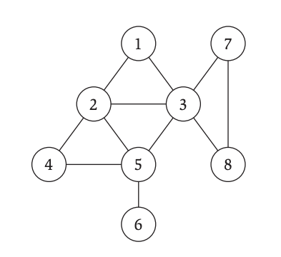
Q: What if we change the queue to a stack?
???(s):
Initialize Explored to be a node index array of false
Set Explored[s] = true
Initialize Q to be a Stack with one element s
While Q is not empty:
u = Q.remove()
If Explored[u] = false:
Explored[u] = true
For each edge (u, v) incident to u:
Add v to Q

Slide 53
Q: What if we change the queue to a stack?
???(s):
Initialize Explored to be a node index array of false
Set Explored[s] = true
Initialize Q to be a Stack with one element s
While Q is not empty:
u = Q.remove()
If Explored[u] = false:
Explored[u] = true
For each edge (u, v) incident to u:
Add v to Q

Slide 54
Q: What if we change the queue to a stack?
???(s):
Initialize Explored to be a node index array of false
Set Explored[s] = true
Initialize Q to be a Stack with one element s
While Q is not empty:
u = Q.remove()
If Explored[u] = false:
Explored[u] = true
For each edge (u, v) incident to u:
Add v to Q

Slide 55
A: We DFS
DFS(s):
Initialize Explored to be a node index array of false
Set Explored[s] = true
Initialize Q to be a Stack with one element s
While Q is not empty:
u = Q.remove()
If Explored[u] = false:
Explored[u] = true
For each edge (u, v) incident to u:
Add v to Q

Slide 56
Q: What is the runtime of DFS?
DFSs):
Initialize Explored to be a node index array of false
Set Explored[s] = true
Initialize Q to be a Stack with one element s
While Q is not empty:
u = Q.remove()
If Explored[u] = false:
Explored[u] = true
For each edge (u, v) incident to u:
Add v to Q

Slide 57
Q: What is the runtime of DFS? O(m+n)
DFSs):
Initialize Explored to be a node index array of false
Set Explored[s] = true
Initialize Q to be a Stack with one element s
While Q is not empty:
u = Q.remove()
If Explored[u] = false:
Explored[u] = true
For each edge (u, v) incident to u:
Add v to Q
Q: How many times does this loop run for u?

Slide 58
Q: What is the runtime of DFS? O(m+n)
DFSs):
Initialize Explored to be a node index array of false
Set Explored[s] = true
Initialize Q to be a Stack with one element s
While Q is not empty:
u = Q.remove()
If Explored[u] = false:
Explored[u] = true
For each edge (u, v) incident to u:
Add v to Q
A: At most once for each edge

Slide 59
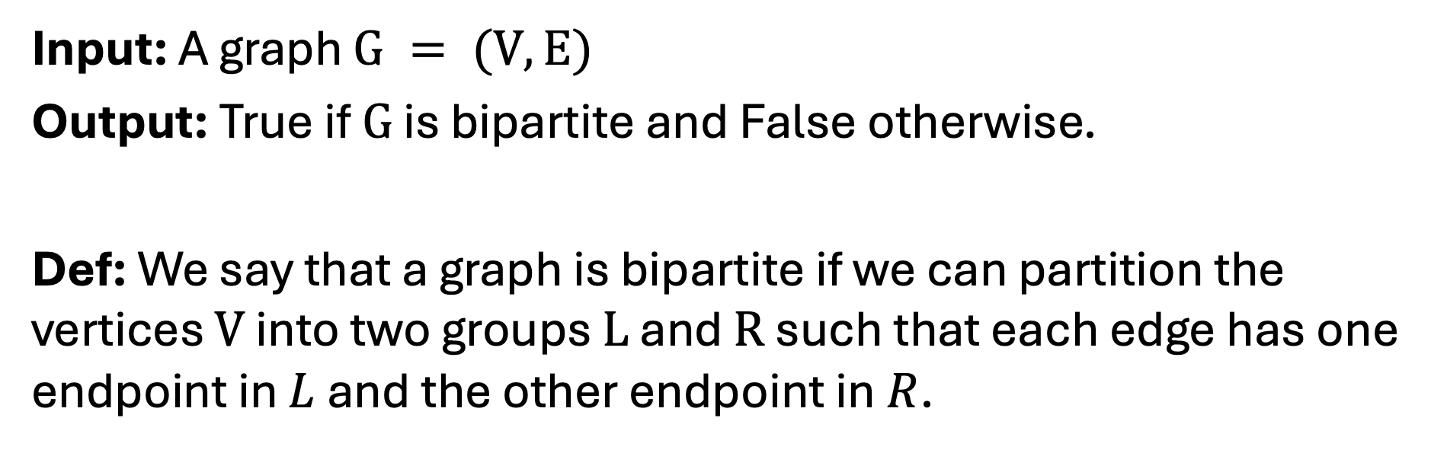
Problem: Bipartite Graph
Input: A graph $G = (V,E)$
Output: True if $G$ is bipartite and False otherwise.
Def: We say that a graph is bipartite if we can partition the vertices $V$ into two groups $L$ and $R$ such that each edge has one endpoint in $L$ and the other endpoint in $R$.

Slide 60
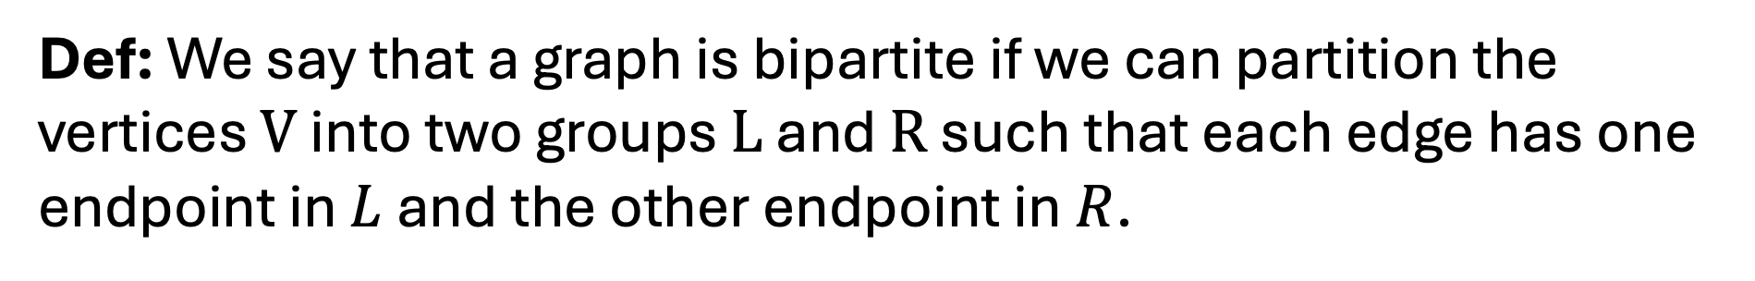
Problem: Bipartite Graph
Def: We say that a graph is bipartite if we can partition the vertices $V$ into two groups $L$ and $R$ such that each edge has one endpoint in $L$ and the other endpoint in $R$.
Bipartite
Not Bipartite

Slide 61
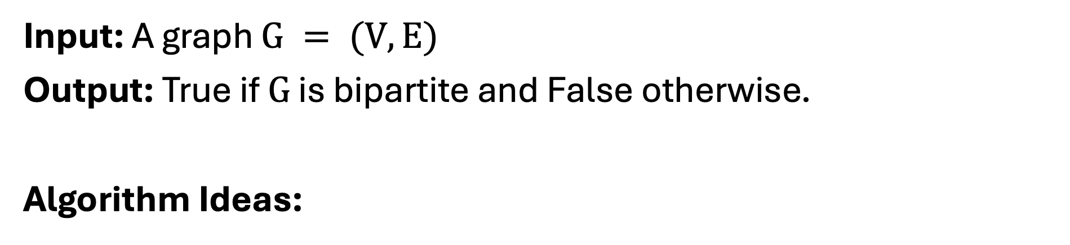
Problem: Bipartite Graph
Input: A graph $G = (V,E)$
Output: True if $G$ is bipartite and False otherwise.
Algorithm Ideas:

Slide 62
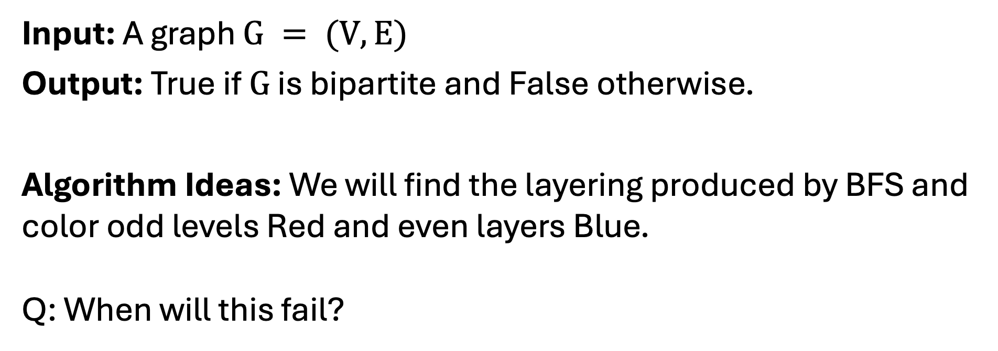
Problem: Bipartite Graph
Input: A graph $G = (V,E)$
Output: True if $G$ is bipartite and False otherwise.
Algorithm Ideas: We will find the layering produced by BFS and color odd levels Red and even layers Blue. Q: When will this fail?

Slide 63
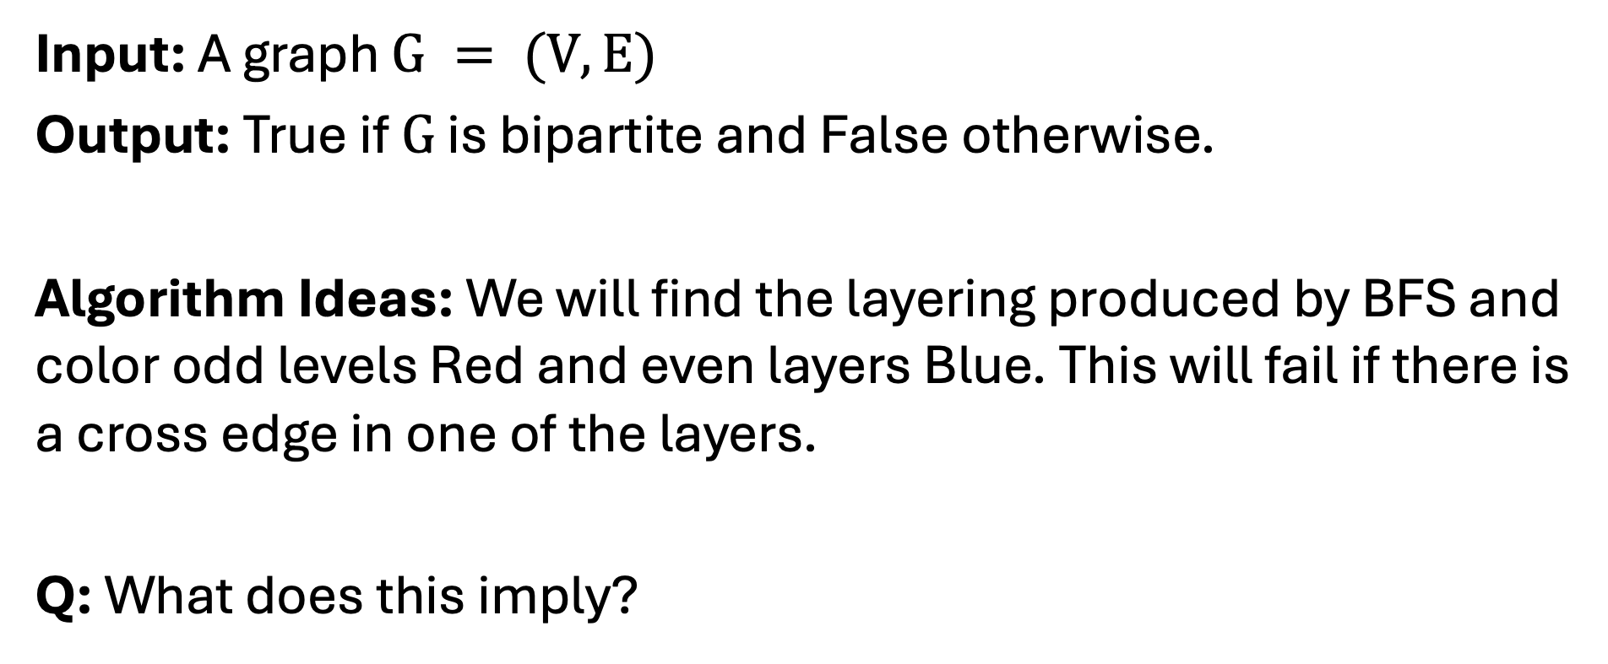
Problem: Bipartite Graph
Input: A graph $G = (V,E)$
Output: True if $G$ is bipartite and False otherwise.
Algorithm Ideas: We will find the layering produced by BFS and color odd levels Red and even layers Blue. This will fail if there is a cross edge in one of the layers.
Q: What does this imply?

Slide 64
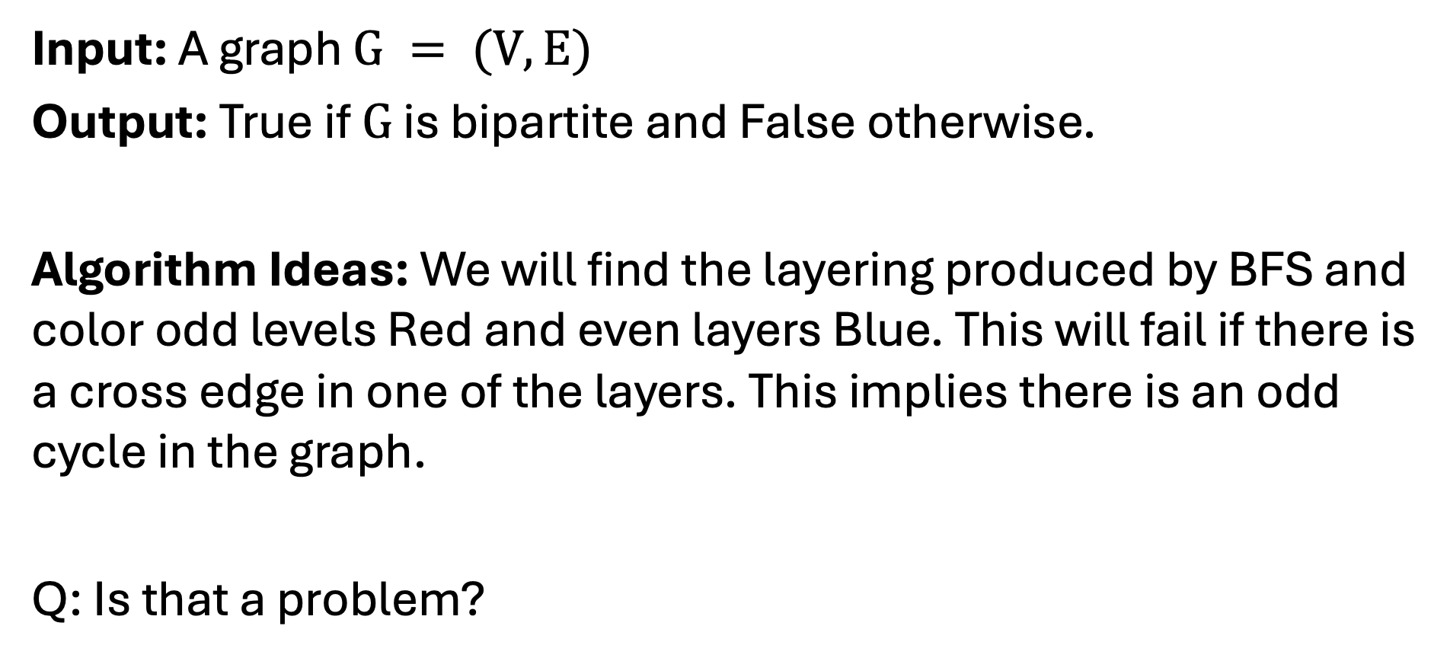
Problem: Bipartite Graph
Input: A graph $G = (V,E)$
Output: True if $G$ is bipartite and False otherwise.
Algorithm Ideas: We will find the layering produced by BFS and color odd levels Red and even layers Blue. This will fail if there is a cross edge in one of the layers. This implies there is an odd cycle in the graph.
Q: Is that a problem?

Slide 65
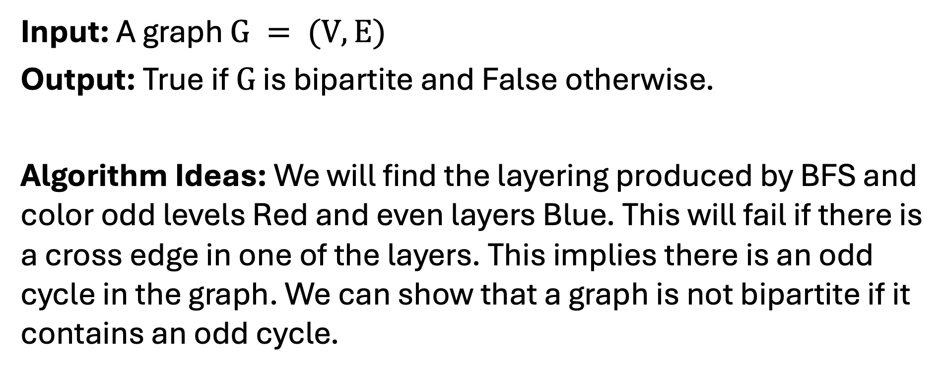
Problem: Bipartite Graph
Input: A graph $G = (V,E)$
Output: True if $G$ is bipartite and False otherwise.
Algorithm Ideas: We will find the layering produced by BFS and color odd levels Red and even layers Blue. This will fail if there is a cross edge in one of the layers. This implies there is an odd cycle in the graph. We can show that a graph is not bipartite if it contains an odd cycle.

Slide 66
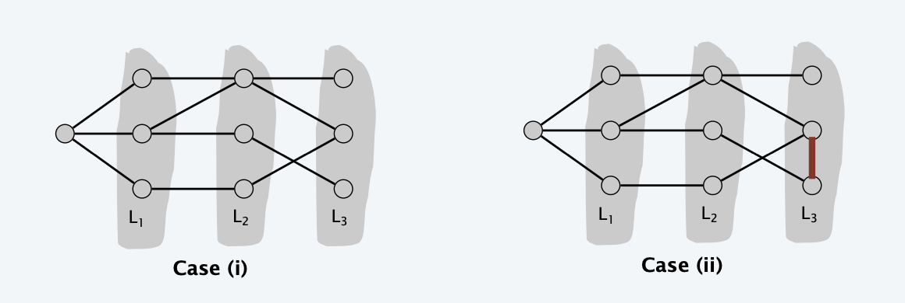
Problem: Bipartite Graph

Slide 67
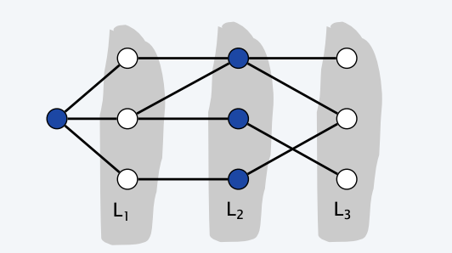
Problem: Bipartite Graph
Is bipartite!
Is not bipartite!

Slide 68
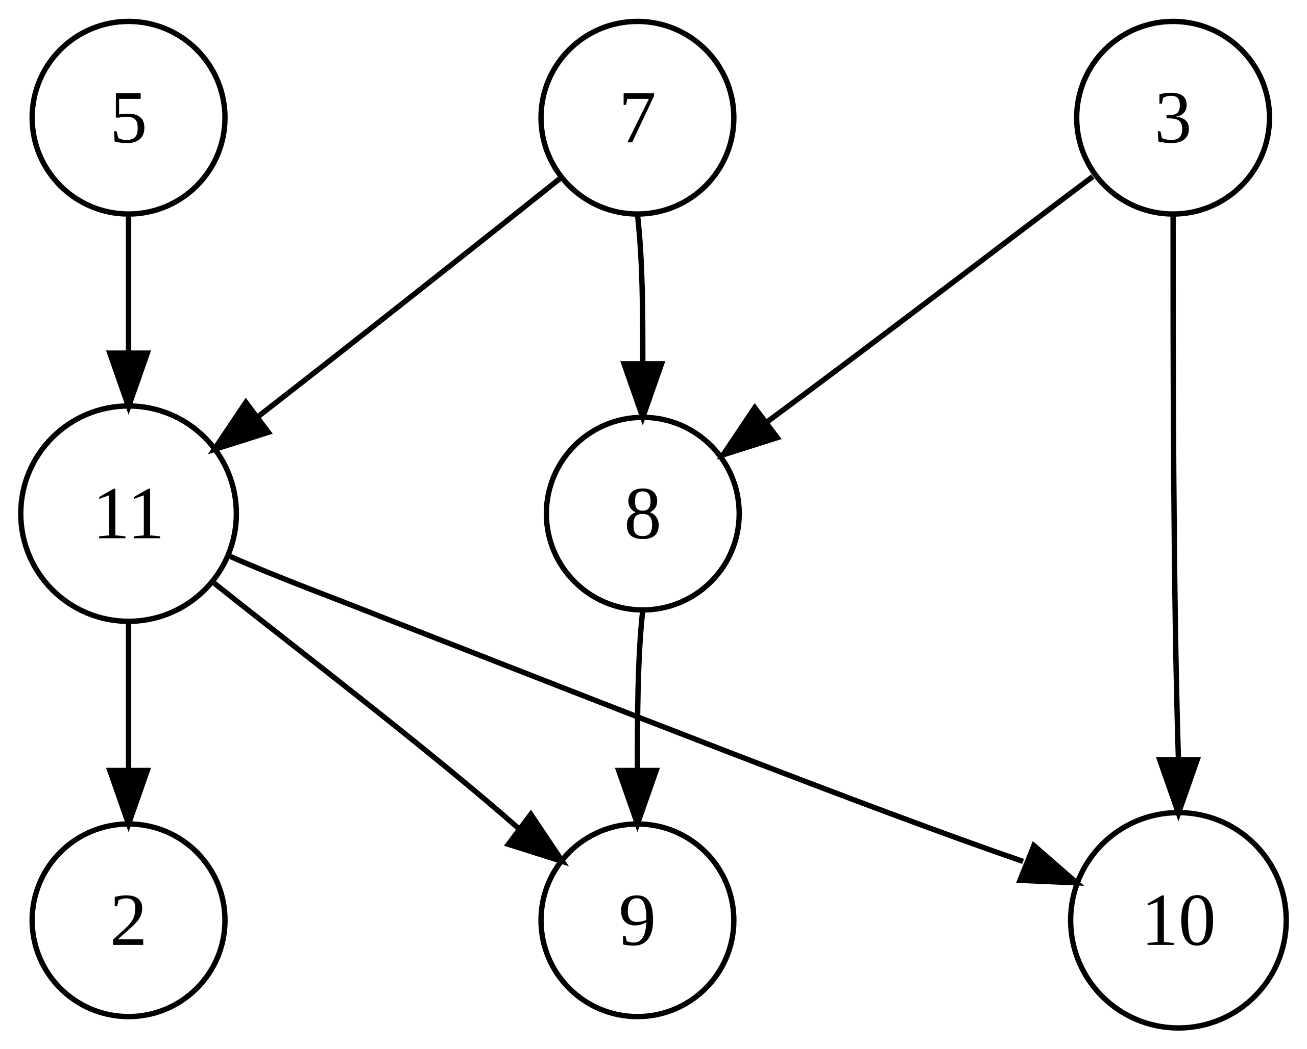
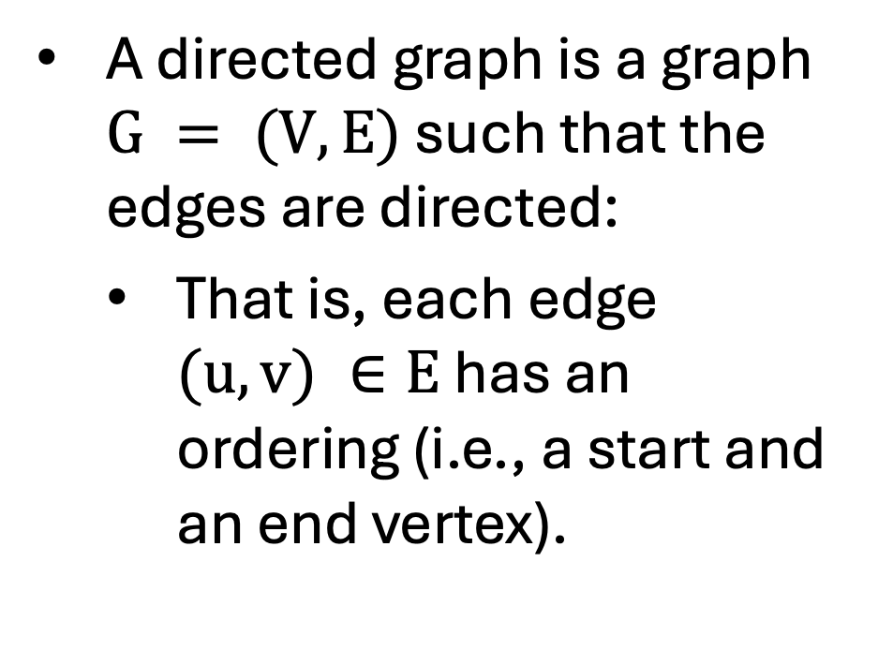
Directed Graphs
A directed graph is a graph $G = (V,E)$ such that the edges are directed:
That is, each edge $(u,v) ∈E$ has an ordering (i.e., a start and an end vertex).
By Johannes Rössel (talk) - Own work, Public Domain, https://commons.wikimedia.org/w/index.php?curid=5559952

Slide 69
Examples Directed Graphs
What might the nodes represent?
What might the edges represent?
By Johannes Rössel (talk) - Own work, Public Domain, https://commons.wikimedia.org/w/index.php?curid=5559952

