Slide 1

CSE 331:
Algorithms & Complexity
“More BFS and DFS”
Prof. Charlie Anne Carlson (She/Her)
Lecture 14
Monday September 29th, 2025

Slide 2

Schedule
Quiz #1
Course Updates
Bipartite Graph
Directed Graphs

Slide 3

Quiz #1
You will have 10 minutes once I say start.
I will remind you at 5,2, and 1 minute.
Do not cheat!

Slide 4

Course Updates
HW 2 Grading Out Soon
HW 3 Solutions Out Wednesday
HW 4 Out Tomorrow
Group Project
  Team Emails Out
  First Autolab Up Soon
Sample Midterms Out
Midterms Oct 6 and Oct 8

Slide 5
Midterms
Two days during normal lecture times in this room.
What do you need to know?
  KT Chapters 1 – 3
    Stable Matchings
    Algorithm Analysis
    Graph Basics
  Lectures up until Today/Wednesday

Slide 6
Midterms
There are sample midterms on Piazza along with solutions
  These tell you the format and give you some nice sample problems but don’t tell you everything you need to know.
You get a reference sheet!

Slide 7
Problem: Bipartite Graph
Input: A graph $G = (V,E)$
Output: True if $G$ is bipartite and False otherwise.
Def: We say that a graph is bipartite if we can partition the vertices $V$ into two groups $L$ and $R$ such that each edge has one endpoint in $L$ and the other endpoint in $R$.

Slide 8
Problem: Bipartite Graph
Def: We say that a graph is bipartite if we can partition the vertices $V$ into two groups $L$ and $R$ such that each edge has one endpoint in $L$ and the other endpoint in $R$.
Bipartite
Not Bipartite

Slide 9
Problem: Bipartite Graph
Input: A graph $G = (V,E)$
Output: True if $G$ is bipartite and False otherwise.
Algorithm Ideas:

Slide 10
Problem: Bipartite Graph
Input: A graph $G = (V,E)$
Output: True if $G$ is bipartite and False otherwise.
Algorithm Ideas: We will find the layering produced by BFS and color odd levels Red and even layers Blue.
Q: When will this fail?

Slide 11
Problem: Bipartite Graph
Input: A graph $G = (V,E)$
Output: True if $G$ is bipartite and False otherwise.
Algorithm Ideas: We will find the layering produced by BFS and color odd levels Red and even layers Blue. This will fail if there is a cross edge in one of the layers.
Q: What does this imply?

Slide 12
Problem: Bipartite Graph
Input: A graph $G = (V,E)$
Output: True if $G$ is bipartite and False otherwise.
Algorithm Ideas: We will find the layering produced by BFS and color odd levels Red and even layers Blue. This will fail if there is a cross edge in one of the layers. This implies there is an odd cycle in the graph.
Q: Is that a problem?

Slide 13
Problem: Bipartite Graph
Input: A graph $G = (V,E)$
Output: True if $G$ is bipartite and False otherwise.
Algorithm Ideas: We will find the layering produced by BFS and color odd levels Red and even layers Blue. This will fail if there is a cross edge in one of the layers. This implies there is an odd cycle in the graph. We can show that a graph is not bipartite if it contains an odd cycle.

Slide 14
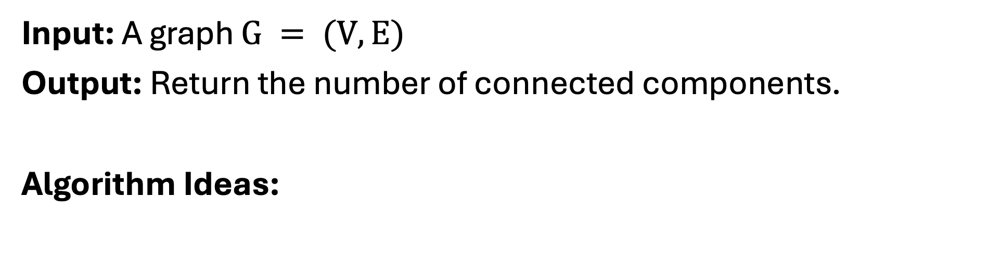
Problem: Connected Components
Input: A graph $G = (V,E)$
Output: Return the number of connected components.
Algorithm Ideas:

Slide 15
Problem: Connected Components
Algorithm Ideas:
Use an array to track of which nodes have been discovered.
Use an array of arrays to keep track of connected components.
While there is an undiscovered node, run BFS (or DFS) on node.
  Mark nodes in connected component as discovered.
  Add connected component to the array of connected components.

Slide 16
Question: What is the runtime?
Algorithm Ideas:
Use an array to track of which nodes have been discovered.
Use an array of arrays to keep track of connected components.
While there is an undiscovered node, run BFS (or DFS) on node.
  Mark nodes in connected component as discovered.
  Add connected component to the array of connected components.

Slide 17
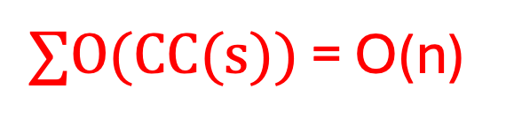


Answer: O(m+n)
Algorithm Ideas:
Use an array to track of which nodes have been discovered.
Use an array of arrays to keep track of connected components.
While there is an undiscovered node s
  Run BFS (or DFS) on node s to find CC(S).
  Mark nodes in connected component as discovered.
  Add connected component to the array of connected components.
O(n)
O(1)
O(n)
$∑O(CC(s))$ = O(n)
$$“”$$
$$“”$$

Slide 18
Question: What do graphs represent?

Slide 19

Answer: Symmetric relationships
E.g.: Each node represents a player, and an edge represents if they have played a game together today.

Slide 20
Question: How can we make graphs more general?

Slide 21
Answer: Asymmetric relationships
E.g.: Each node represents a player, and an edge represents if they have played a game together today and who won!

Slide 22
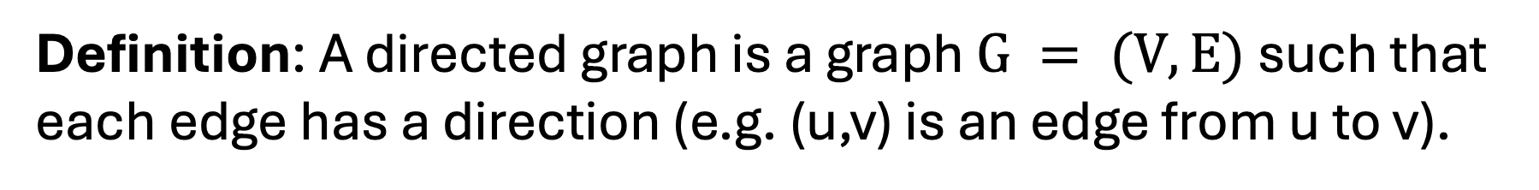
Answer: Asymmetric relationships
Definition: A directed graph is a graph $G = (V,E)$ such that each edge has a direction (e.g. (u,v) is an edge from u to v).

Slide 23
Answer: Asymmetric relationships
Notes: Adj. matrix is not symmetric, and adj. list has two lists per vertex.

Slide 24
Question: Can we do BFS and DFS?

Slide 25
Answer: BFS and DFS mostly work.
Only look at outgoing edges from a vertex.
BFS and DFS return the nodes that can be reached from a starting vertex s but not every node in that set can reach s.
S
T

Slide 26
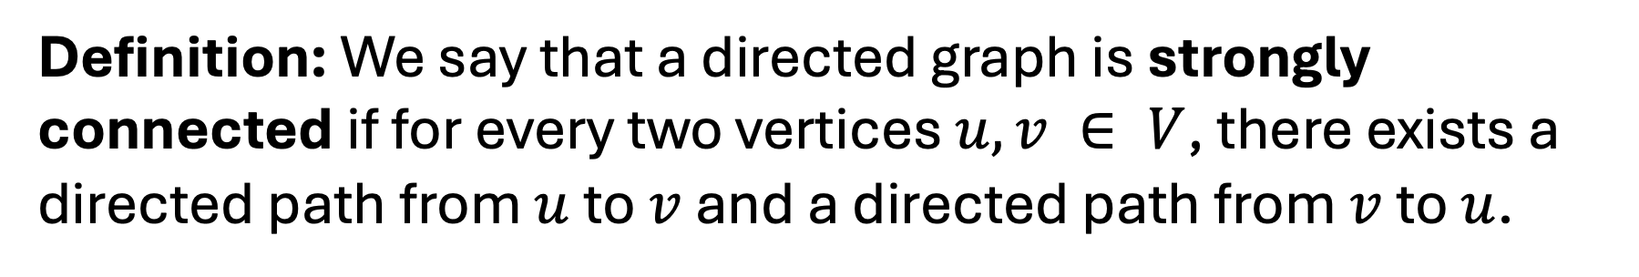
Strong Connectivity
Definition: We say that a directed graph is strongly connected if for every two vertices $u,v ∈ V$, there exists a directed path from $u$ to $v$ and a directed path from $v$ to $u$.
S
T

Slide 27
Strong Connectivity
Definition: We say that a directed graph is strongly connected if for every two vertices $u,v ∈ V$, there exists a directed path from $u$ to $v$ and a directed path from $v$ to $u$.
S
NOT STRONGLY CONNECTED
T

Slide 28
Strong Connectivity Property
Claim: If u and v are mutually reachable, and v and w are mutually reachable, then u and w are mutually reachable.
Proof Idea:
u
v
w

Slide 29
Strong Connectivity Property
Claim: If u and v are mutually reachable, and v and w are mutually reachable, then u and w are mutually reachable.
Proof Idea:
u
v
w

Slide 30
Strong Connectivity Property
Claim: If u and v are mutually reachable, and v and w are mutually reachable, then u and w are mutually reachable.
Proof Idea:
u
v
w

Slide 31
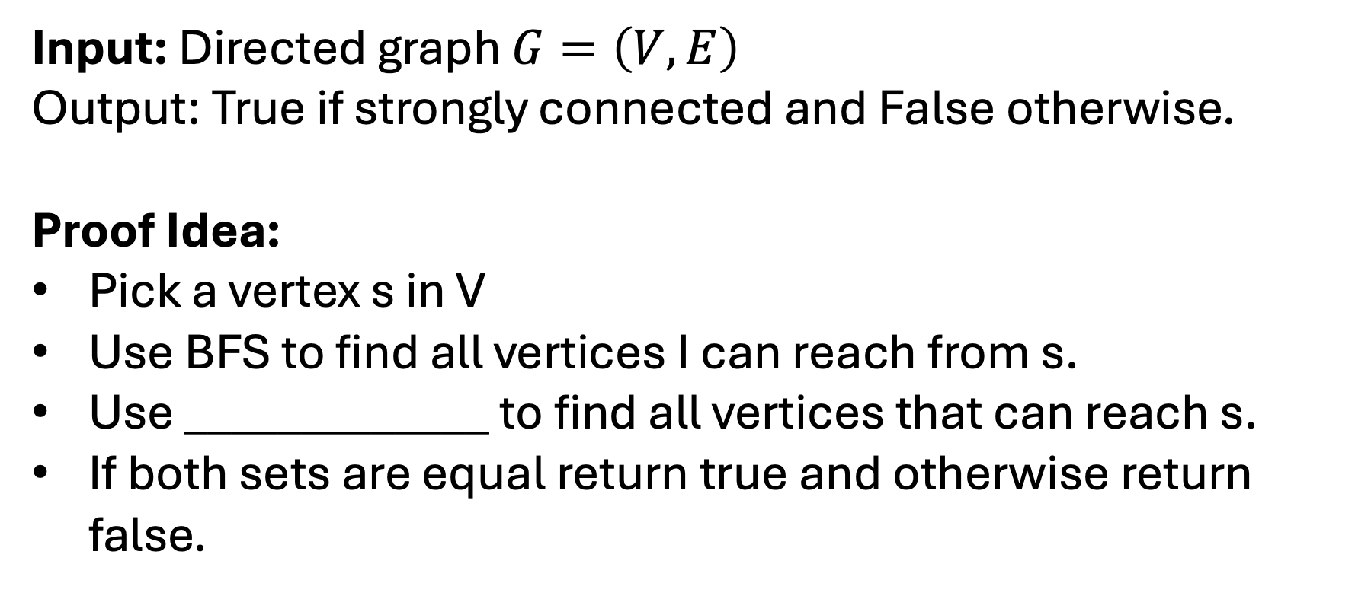
Strong Connectivity Algorithm
Input: Directed graph $G=\left(V,E\right)$
Output: True if strongly connected and False otherwise.
Proof Idea:
Pick a vertex s in V
Use BFS to find all vertices I can reach from s.
Use _____________ to find all vertices that can reach s.
If both sets are equal return true and otherwise return false.

Slide 32
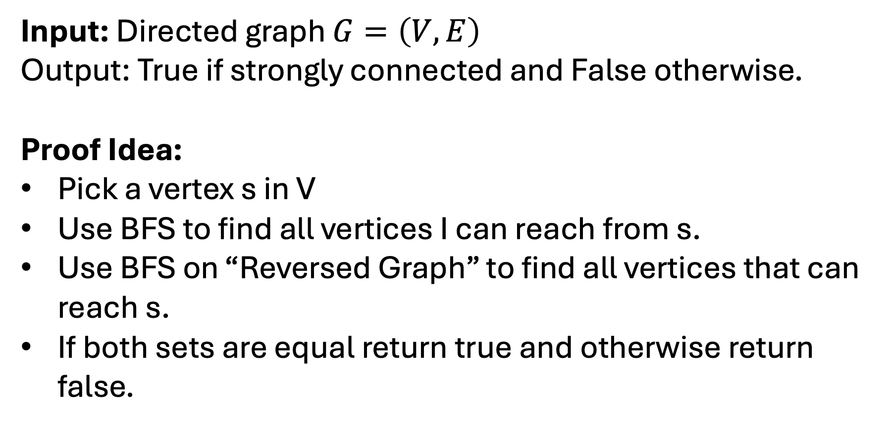
Strong Connectivity Algorithm
Input: Directed graph $G=\left(V,E\right)$
Output: True if strongly connected and False otherwise.
Proof Idea:
Pick a vertex s in V
Use BFS to find all vertices I can reach from s.
Use BFS on “Reversed Graph” to find all vertices that can reach s.
If both sets are equal return true and otherwise return false.

Slide 33
Strong Connectivity Algorithm
Input: Directed graph $G=\left(V,E\right)$
Output: True if strongly connected and False otherwise.
Proof Idea:
Pick a vertex s in V
Use BFS to find all vertices I can reach from s.
Use BFS on “Reversed Graph” to find all vertices that can reach s.
If both sets are equal return true and otherwise return false.
For each edge (u,v) replace with edge (v,u)

Slide 34
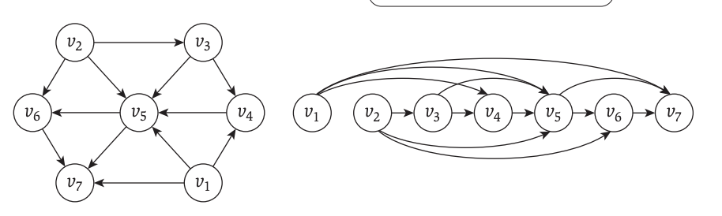
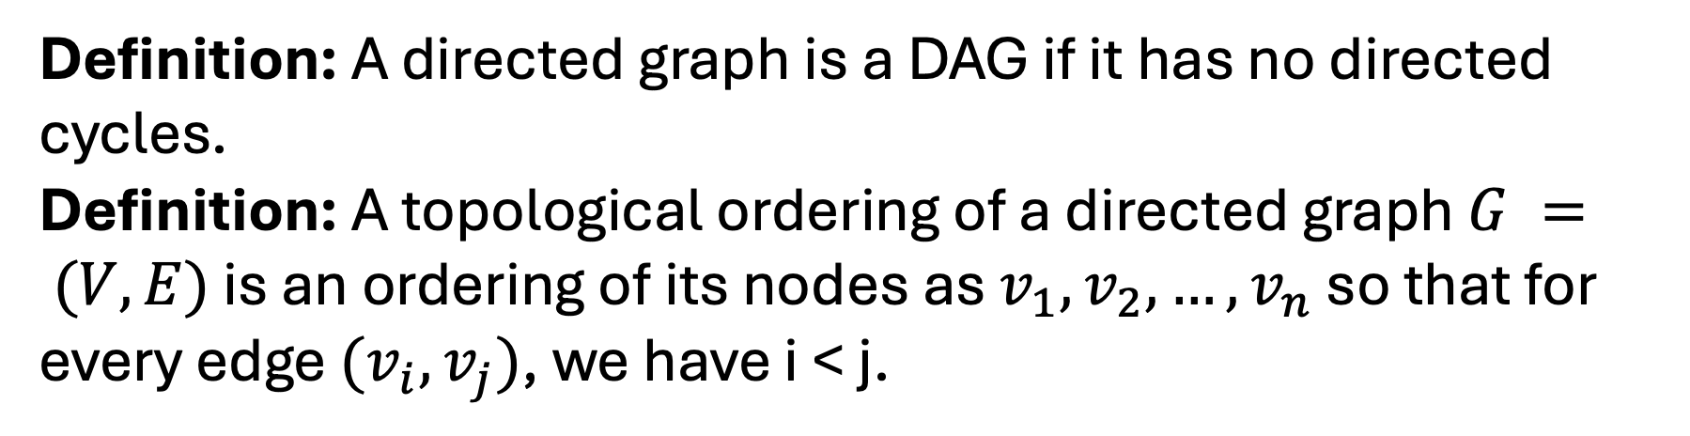
Directed Acyclic Graphs (DAGs)
Definition: A directed graph is a DAG if it has no directed cycles.
Definition: A topological ordering of a directed graph $G = (V,E)$ is an ordering of its nodes as $v_{1},v_{2},…,v_{n}$ so that for every edge $(v_{i},v_{j})$, we have i < j.

Slide 35
Directed Acyclic Graphs (DAGs)
Definition: A directed graph is a DAG if it has no directed cycles.
Definition: A topological ordering of a directed graph $G = (V,E)$ is an ordering of its nodes as $v_{1},v_{2},…,v_{n}$ so that for every edge $(v_{i},v_{j})$, we have i < j.
All edges are going “forward”

Slide 36
Directed Acyclic Graphs (DAGs)
Definition: A directed graph is a DAG if it has no directed cycles.
Definition: A topological ordering of a directed graph $G = (V,E)$ is an ordering of its nodes as $v_{1},v_{2},…,v_{n}$ so that for every edge $(v_{i},v_{j})$, we have i < j.
Read KT Section 3.6 and Review Care Packaged on Topological Ordering
All edges are going “forward”

Slide 37

Midterm Check Point

Slide 38

What is next?
Greedy Algorithms
Divide and Conquer
Dynamic Programming
Network Flows (maybe)
Computation Complexity

Slide 39
“How do we design new algorithms?”
Greedy Algorithms
Divide and Conquer
Dynamic Programming
Network Flows (maybe)
Computation Complexity

Slide 40
“How do we use reduce another problem?”
Greedy Algorithms
Divide and Conquer
Dynamic Programming
Network Flows (maybe)
Computation Complexity

Slide 41
“How do we know when to give up?”
Greedy Algorithms
Divide and Conquer
Dynamic Programming
Network Flows (maybe)
Computation Complexity

Slide 42

What are Greedy Algorithm?

Slide 43
What are Greedy Algorithm?
Build solution one piece at a time.
Only look at immediate information to make choices.
Never go back on a decision.
NOT ALWAYS THE BEST CHOICE!

Slide 44
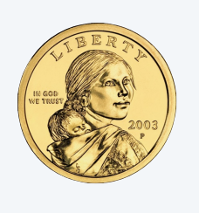



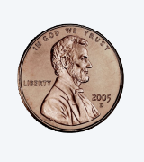
Coin Change Problem
Problem: Given U.S. currency denominations {1.00, 0.25, 0.10, 0.05, 0.01} find an algorithm to pay an amount to a customer using the fewest coins possible.

Slide 45
Coin Change Problem
Problem: Given U.S. currency denominations {1.00, 0.25, 0.10, 0.05, 0.01} find an algorithm to pay an amount to a customer using the fewest coins possible.
Algorithm: At each iteration, add a coin of the largest value that is less than the amount needed to be paid.

Slide 46
Q: Is this algorithm always optimal?
Problem: Given U.S. currency denominations {1.00, 0.25, 0.10, 0.05, 0.01} find an algorithm to pay an amount to a customer using the fewest coins possible.
Algorithm: At each iteration, add a coin of the largest value that is less than the amount needed to be paid.

