Slide 1

CSE 331:
Algorithms & Complexity
“Greedy Algorithms”
Prof. Charlie Anne Carlson (She/Her)
Lecture 15
Wednesday October 1st, 2025

Slide 2

Schedule
Course Updates
Strong Connectivity
Greedy Algorithms
Change Making
Interval Scheduling

Slide 3

Course Updates
HW 2 Grading Out
HW 3 Solutions Out
HW 4 Out Soon
  Not Due Next Week!
Group Project
  First Problems Oct 31st
Sample Midterms Out
Midterms Oct 6 and Oct 8

Slide 4
Midterms
Advice:
  Start Studying
  Go to Recitations this Week
  Review Book Chapters
  Review Solutions to HW/Quiz
  Try Sample Midterm
  Make Good Use of Time

Slide 5
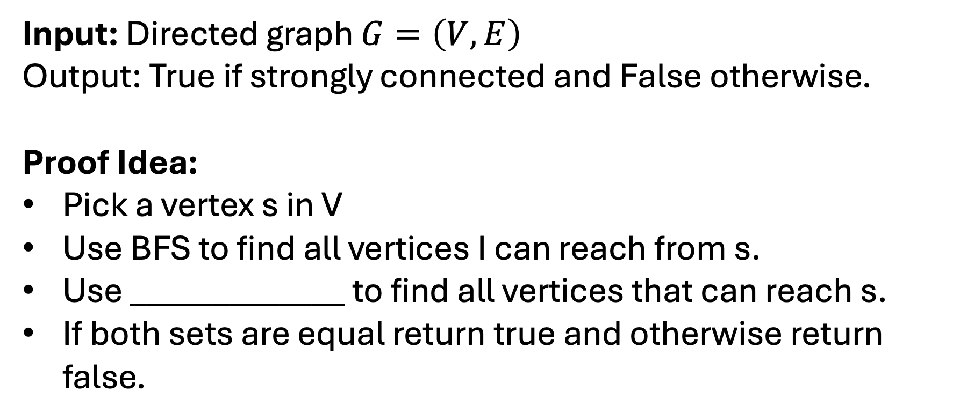
Strong Connectivity Problem
Input: Directed graph $G=\left(V,E\right)$
Output: True if strongly connected and False otherwise.
Proof Idea:
Pick a vertex s in V
Use BFS to find all vertices I can reach from s.
Use _____________ to find all vertices that can reach s.
If both sets are equal return true and otherwise return false.

Slide 6
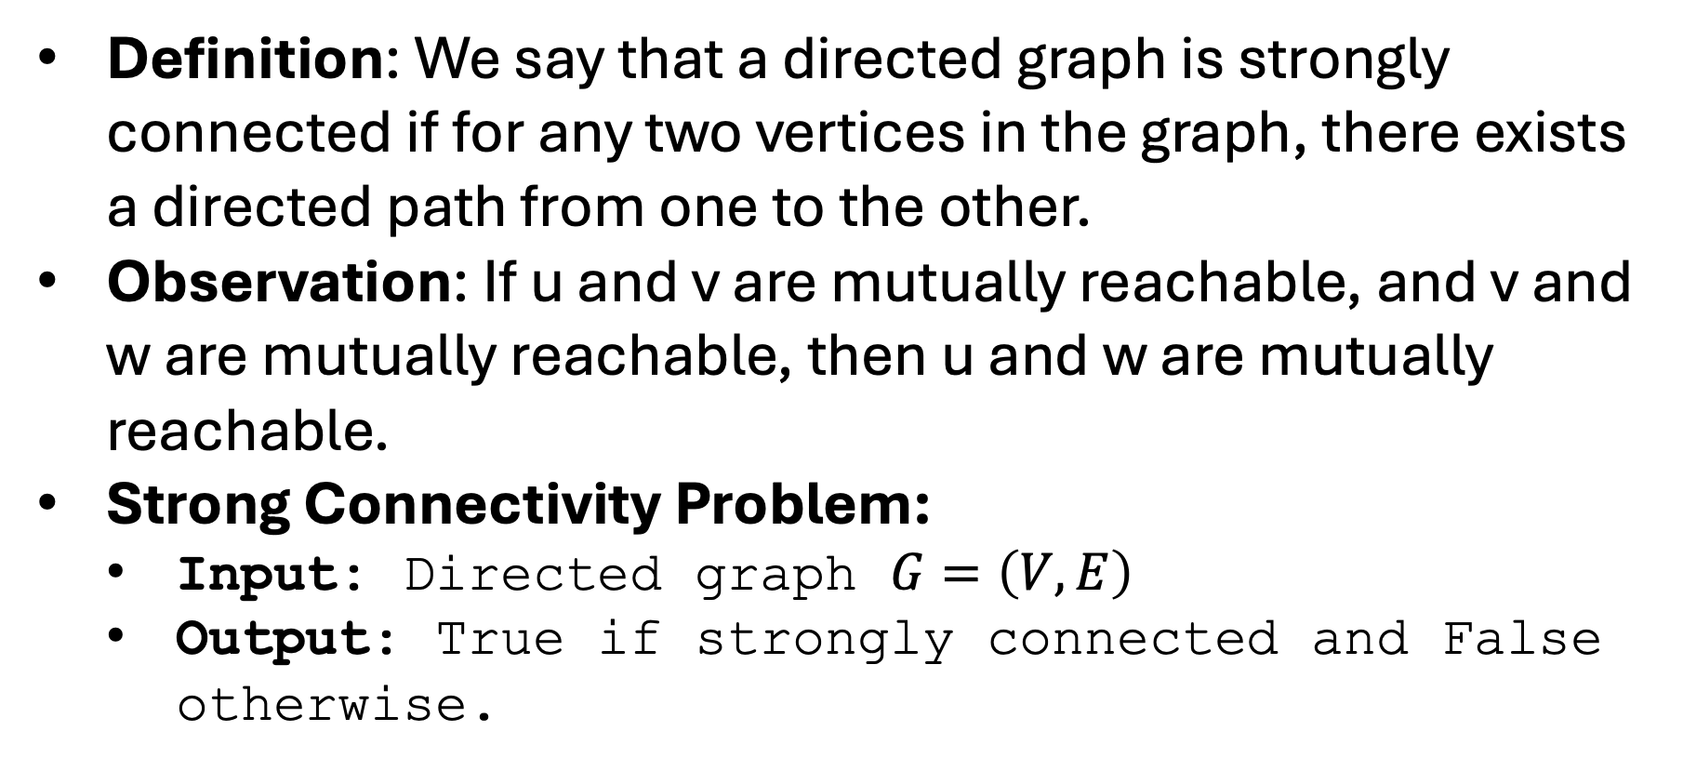
Strong Connectivity Algorithm
Definition: We say that a directed graph is strongly connected if for any two vertices in the graph, there exists a directed path from one to the other.
Observation: If u and v are mutually reachable, and v and w are mutually reachable, then u and w are mutually reachable.
Strong Connectivity Problem:
  Input: Directed graph $G=\left(V,E\right)$
  Output: True if strongly connected and False otherwise.

Slide 7
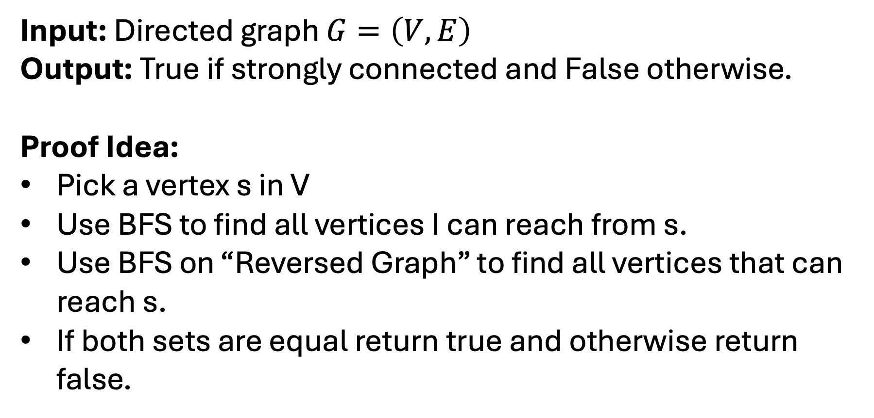
Strong Connectivity Algorithm
Input: Directed graph $G=\left(V,E\right)$
Output: True if strongly connected and False otherwise.
Proof Idea:
Pick a vertex s in V
Use BFS to find all vertices I can reach from s.
Use BFS on “Reversed Graph” to find all vertices that can reach s.
If both sets are equal return true and otherwise return false.
For each edge (u,v) replace with edge (v,u)

Slide 8
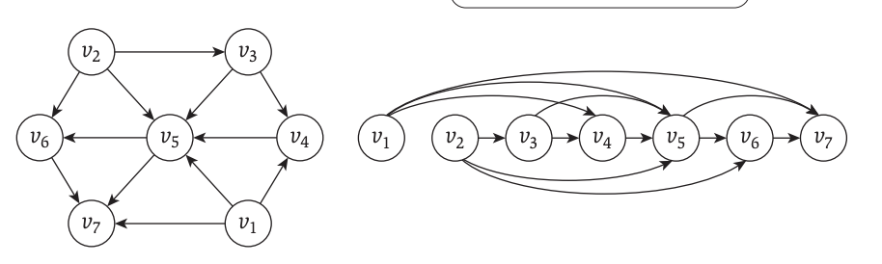
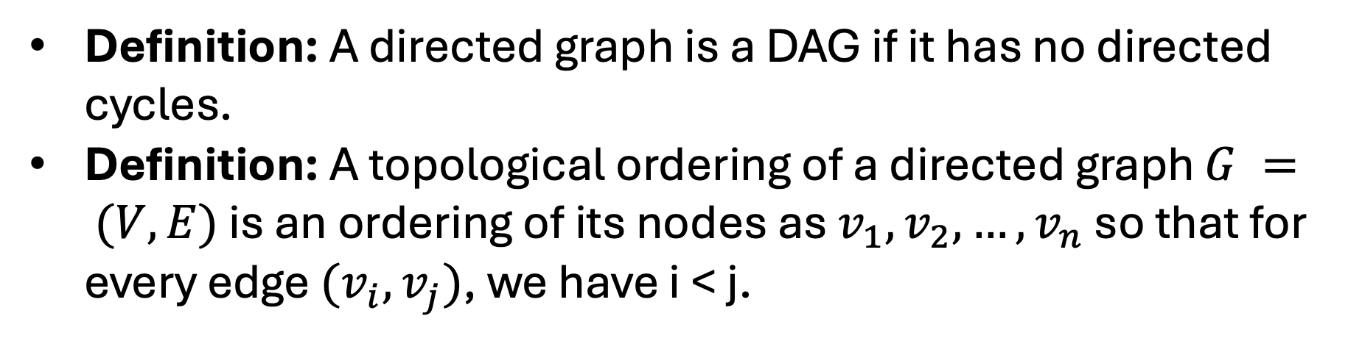
Directed Acyclic Graphs (DAGs)
Definition: A directed graph is a DAG if it has no directed cycles.
Definition: A topological ordering of a directed graph $G = (V,E)$ is an ordering of its nodes as $v_{1},v_{2},…,v_{n}$ so that for every edge $(v_{i},v_{j})$, we have i < j.

Slide 9
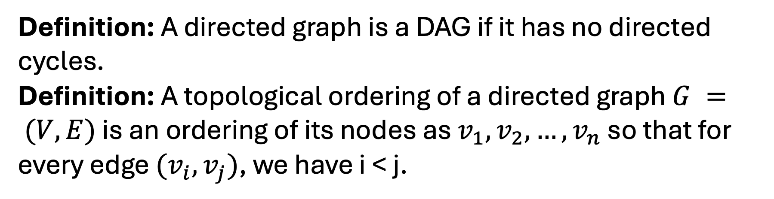
Directed Acyclic Graphs (DAGs)
Definition: A directed graph is a DAG if it has no directed cycles.
Definition: A topological ordering of a directed graph $G = (V,E)$ is an ordering of its nodes as $v_{1},v_{2},…,v_{n}$ so that for every edge $(v_{i},v_{j})$, we have i < j.
All edges are going “forward”

Slide 10
Directed Acyclic Graphs (DAGs)
Definition: A directed graph is a DAG if it has no directed cycles.
Definition: A topological ordering of a directed graph $G = (V,E)$ is an ordering of its nodes as $v_{1},v_{2},…,v_{n}$ so that for every edge $(v_{i},v_{j})$, we have i < j.
Read KT Section 3.6 and Review Care Packaged on Topological Ordering
All edges are going “forward”

Slide 11

Midterm Check Point

Slide 12

What is next?
Greedy Algorithms
Divide and Conquer
Dynamic Programming
Network Flows (maybe)
Computation Complexity

Slide 13
“How do we design new algorithms?”
Greedy Algorithms
Divide and Conquer
Dynamic Programming
Network Flows (maybe)
Computation Complexity

Slide 14
“How do we use reduce another problem?”
Greedy Algorithms
Divide and Conquer
Dynamic Programming
Network Flows (maybe)
Computation Complexity

Slide 15
“How do we know when to give up?”
Greedy Algorithms
Divide and Conquer
Dynamic Programming
Network Flows (maybe)
Computation Complexity

Slide 16

What are Greedy Algorithm?

Slide 17
What are Greedy Algorithm?
Build solution one piece at a time.
Only look at immediate information to make choices.
Never go back on a decision.
NOT ALWAYS THE BEST CHOICE!

Slide 18
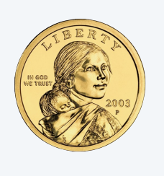



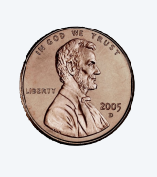
Coin Change Problem
Problem: Given U.S. currency denominations {1.00, 0.25, 0.10, 0.05, 0.01} find an algorithm to pay an amount to a customer using the fewest coins possible.

Slide 19
Coin Change Problem
Problem: Given U.S. currency denominations {1.00, 0.25, 0.10, 0.05, 0.01} find an algorithm to pay an amount to a customer using the fewest coins possible.
Algorithm: At each iteration, add a coin of the largest value that is less than the amount needed to be paid.

Slide 20
Q: Is this algorithm always optimal?
Problem: Given U.S. currency denominations {1.00, 0.25, 0.10, 0.05, 0.01} find an algorithm to pay an amount to a customer using the fewest coins possible.
Algorithm: At each iteration, add a coin of the largest value that is less than the amount needed to be paid.

Slide 21
Proof Ideas for Optimality
Proof Idea:
  Suppose there it wasn’t optimal.
    Then there exists a budget B such that the algorithm returns S and the answer is S’ (S != S’).

Slide 22
Proof Ideas for Optimality
Proof Ideas:
  Suppose there it wasn’t optimal.
    Then there exists a budget B such that the algorithm returns a set S(B) and the answer is a different set S’(B).
  If S’(B) has the largest coin that S(B) has, then you can remove it and you get a smaller bad budget B’ = B - <large coin value>

Slide 23
Proof Ideas for Optimality
Proof Ideas:
  Suppose there it wasn’t optimal.
    Then there exists a budget B such that the algorithm returns a set S(B) and the answer is a different set S’(B).
  If S’(B) has the largest coin that S(B) has, then you can remove it and you get a smaller bad budget B’ = B - <large coin value>
Use Induction on That!

Slide 24
Proof Ideas for Optimality
Proof Ideas:
  If S’(B) has the largest coin that S(B) has, then you can remove it and you get a smaller bad budget B’ = B - <large coin value>
  We now show that S’(B) has to have the largest coin that S(B) has.
    That is, the greedy choice was good!

Slide 25
Proof Ideas for Optimality
Proof Ideas:
  We now show that S’(B) has to have the largest coin that S(B) has.
  If S’(B) doesn’t have the largest coin that can fit in the budget, then it must be replaced with smaller coins.
    We can check optimal for restricted settings of coins.
Sounds like a few base cases

Slide 26
Proof Ideas for Optimality
Proof Ideas:
  We can show that in an optimal solution we have:
    At most 4 pennies
    At most 1 nickel
    At most 2 nickels + dimes
    At most 3 quarters
  We show these by contradicting the optimality!
Sounds like a few base cases

Slide 27
Proof Ideas for Optimality
Proof Ideas:
  We can show that in an optimal solution we have:
    At most 4 pennies
    At most 1 nickel
    At most 2 nickels + dimes
    At most 3 quarters
  We show these by contradicting the optimality!
Sounds like a few base cases

Slide 28
Big Ideas
Sometimes Greedy Works but sometimes it doesn’t…
  If you use a different set of coins, you may not be able to use the cashier algorithm.
  Consider {1,10,21,34,70,100,350,1225} and the budget 140.

Slide 29
Big Ideas
Sometimes Greedy Works but sometimes it doesn’t…
  If you use a different set of coins, you may not be able to use the cashier algorithm.
  Consider {1,10,21,34,70,100,350,1225} and the budget 140.
    Algorithm Output: 100, 34, 1x6
    Answer: 70 x 2

Slide 30
Interval Scheduling
Consider an interval of time (e.g. Wednesday).
Time:
Start
End

Slide 31
Interval Scheduling
Consider an interval of time (e.g. Wednesday)
Consider tasks that need to be completed during specific times (e.g. classes)
ENG 110
CSE 9001
CSE 331
EE 312
MATH 610
Time:
Start
End

Slide 32
Interval Scheduling
Consider an interval of time (e.g. Wednesday).
Consider tasks that need to be completed during specific times (e.g. classes).
We want to fit as many tasks as possible into the day such that no two overlap.
ENG 110
CSE 9001
CSE 331
EE 312
MATH 610
Time:
Start
End

Slide 33
Interval Scheduling
Consider an interval of time (e.g. Wednesday).
Consider tasks that need to be completed during specific times (e.g. classes).
We want to fit as many tasks as possible into the day such that no two overlap.
ENG 110
CSE 9001
CSE 331
EE 312
MATH 610
Time:
Start
End

Slide 34
Interval Scheduling
Consider an interval of time (e.g. Wednesday).
Consider tasks that need to be completed during specific times (e.g. classes).
We want to fit as many tasks as possible into the day such that no two overlap.
Q: Do we ever pick CSE 9001?
ENG 110
CSE 9001
CSE 331
EE 312
MATH 610
Time:
Start
End

Slide 35
Interval Scheduling
Consider an interval of time (e.g. Wednesday).
Consider tasks that need to be completed during specific times (e.g. classes).
We want to fit as many tasks as possible into the day such that no two overlap.
A: No, because it blocks two classes!
ENG 110
CSE 9001
CSE 331
EE 312
MATH 610
Time:
Start
End

Slide 36
Optimal Solution #1
Consider an interval of time (e.g. Wednesday).
Consider tasks that need to be completed during specific times (e.g. classes).
We want to fit as many tasks as possible into the day such that no two overlap.
ENG 110
CSE 9001
CSE 331
EE 312
MATH 610
Time:
Start
End

Slide 37
Optimal Solution #2
Consider an interval of time (e.g. Wednesday).
Consider tasks that need to be completed during specific times (e.g. classes).
We want to fit as many tasks as possible into the day such that no two overlap.
ENG 110
CSE 9001
CSE 331
EE 312
MATH 610
Time:
Start
End

Slide 38
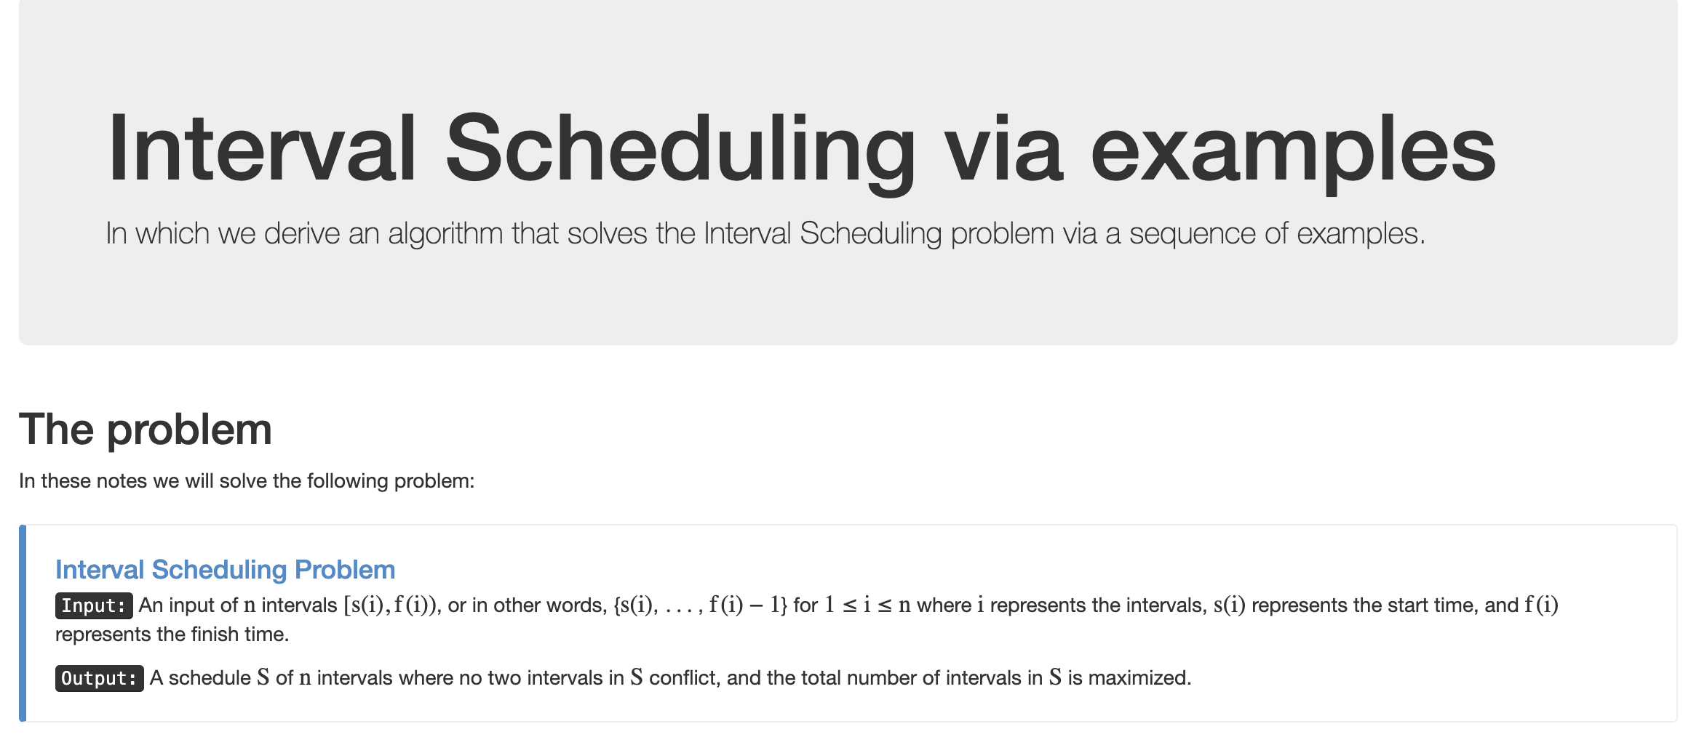
Interval Scheduling Problem (Support Page)

Slide 39
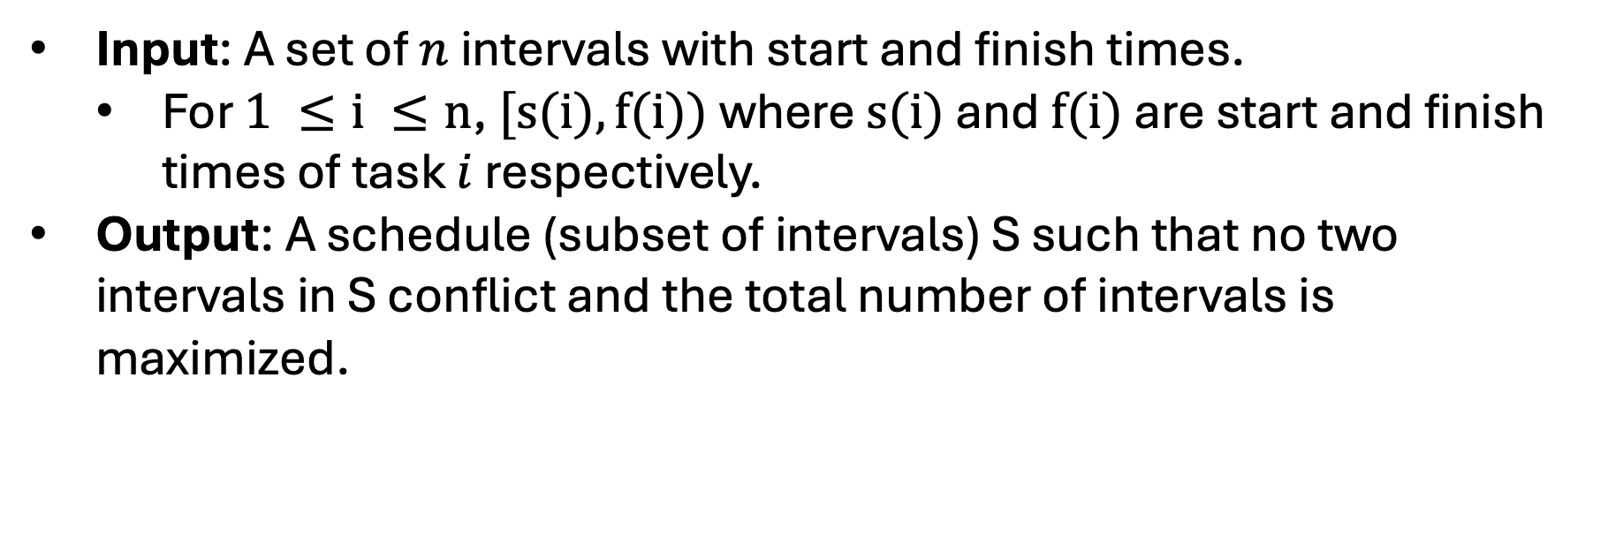
Interval Scheduling Problem
Input: A set of $n$ intervals with start and finish times.
  For $1 ≤i ≤n$, $[s(i),f(i))$ where $s(i)$ and $f(i)$ are start and finish times of task $i$ respectively.
Output: A schedule (subset of intervals) S such that no two intervals in S conflict and the total number of intervals is maximized.
ENG 110
CSE 9001
CSE 331
EE 312
MATH 610
Time:
EE 312 and MATH 610 don’t conflict
Start
End

Slide 40
Interval Scheduling Problem
Input: A set of $n$ intervals with start and finish times.
  For $1 ≤i ≤n$, $[s(i),f(i))$ where $s(i)$ and $f(i)$ are start and finish times of task $i$ respectively.
Output: A schedule (subset of intervals) S such that no two intervals in S conflict and the total number of intervals is maximized.
ENG 110
CSE 9001
CSE 331
EE 312
MATH 610
Time:
CSE 9001 and EE 312 Conflict
Start
End

Slide 41
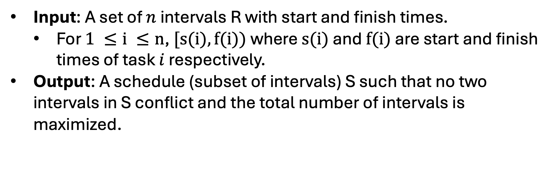
Q: How should we try to solve this?
Input: A set of $n$ intervals R with start and finish times.
  For $1 ≤i ≤n$, $[s(i),f(i))$ where $s(i)$ and $f(i)$ are start and finish times of task $i$ respectively.
Output: A schedule (subset of intervals) S such that no two intervals in S conflict and the total number of intervals is maximized.
ENG 110
CSE 9001
CSE 331
EE 312
MATH 610
Time:
Start
End

Slide 42
Q: How should we try to solve this?
A: Let’s try to generate some examples and see what works and what doesn’t.
CSE 331
EE 312
MATH 610
Time:
Start
End

Slide 43
Build an Algorithm
Basic Algorithm Outline:
  S is empty
  While R is not empty:
    Pick i in R
    Add i to S
    Remove i from R
CSE 331
EE 312
MATH 610
Time:
Start
End

Slide 44
Build an Algorithm
Basic Algorithm Outline:
  S is empty
  While R is not empty:
    Pick i in R
    Add i to S
    Remove i from R
You might add conflicts!
LIT 101
LIT 101
CSE 331
EE 312
MATH 610
Time:
Start
End

Slide 45
Build an Algorithm
Basic Algorithm Outline:
  S is empty
  While R is not empty:
    Pick i in R
    Add i to S
    Remove all tasks that conflict with i from R
LIT 101
LIT 101
CSE 331
EE 312
MATH 610
Time:
Start
End

Slide 46
Build an Algorithm
Basic Algorithm Outline:
  S is empty
  While R is not empty:
    Pick i in R
    Add i to S
    Remove all tasks that conflict with i from R
Q: How do we do this?
LIT 101
LIT 101
CSE 331
EE 312
MATH 610
Time:
Start
End

Slide 47
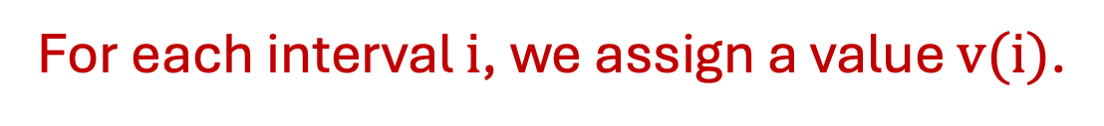
Build a Greedy Algorithm
Basic Algorithm Outline:
  S is empty
  While R is not empty:
    Pick i in R that minimizes v(i)
    Add i to S
    Remove all tasks that conflict with i from R
LIT 101
LIT 101
CSE 331
EE 312
MATH 610
Time:
For each interval $i$, we assign a value $v(i)$.
Start
End

Slide 48
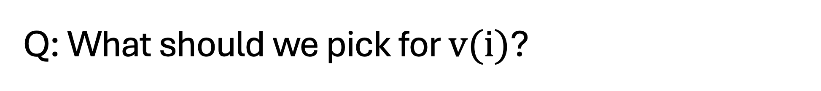

Q: What should we pick for $v(i)$?
Basic Algorithm Outline:
  S is empty
  While R is not empty:
    Pick i in R that minimizes v(i)
    Add i to S
    Remove all tasks that conflict with i from R
LIT 101
LIT 101
CSE 331
EE 312
MATH 610
Time:
For each interval $i$, $v(i) = ?$
Start
End

Slide 49
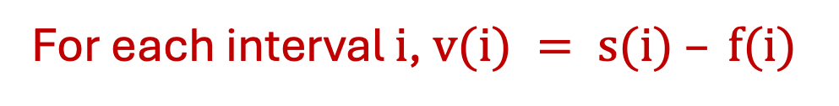
Attempt I: Interval Length (Okay)
Basic Algorithm Outline:
  S is empty
  While R is not empty:
    Pick i in R that minimizes v(i)
    Add i to S
    Remove all tasks that conflict with i from R
LIT 101
CSE 331
EE 312
MATH 610
Time:
For each interval $i$, $v(i) = s(i) – f(i)$
Start
End

Slide 50
Attempt I: Interval Length (Oh no!)
Basic Algorithm Outline:
  S is empty
  While R is not empty:
    Pick i in R that minimizes v(i)
    Add i to S
    Remove all tasks that conflict with i from R
LIT 101
ART 322
CSE 331
EE 312
MATH 610
Time:
For each interval $i$, $v(i) = s(i) – f(i)$
Start
End

Slide 51

Attempt II: Start Time (Okay)
Basic Algorithm Outline:
  S is empty
  While R is not empty:
    Pick i in R that minimizes v(i)
    Add i to S
    Remove all tasks that conflict with i from R
LIT 101
ART 322
CSE 331
EE 312
MATH 610
Time:
For each interval $i$, $v(i) = s(i)$
Start
End

Slide 52
Attempt II: Start Time (Oh no!)
Basic Algorithm Outline:
  S is empty
  While R is not empty:
    Pick i in R that minimizes v(i)
    Add i to S
    Remove all tasks that conflict with i from R
LIT 101
ART 322
CSE 331
EE 312
MATH 610
Time:
For each interval $i$, $v(i) = s(i)$
Start
End

Slide 53
Attempt III: Min Conflicts (Okay)
Basic Algorithm Outline:
  S is empty
  While R is not empty:
    Pick i in R that minimizes v(i)
    Add i to S
    Remove all tasks that conflict with i from R
LIT 101
ART 322
CSE 331
EE 312
MATH 610
Time:
For each interval $i$, $v(i) = \# conflicts (and min s(i))$
Start
End

Slide 54
Attempt III: Min Conflicts (Okay)
Basic Algorithm Outline:
  S is empty
  While R is not empty:
    Pick i in R that minimizes v(i)
    Add i to S
    Remove all tasks that conflict with i from R
ART 322
CSE 331
EE 312
MATH 610
Time:
For each interval $i$, $v(i) = \# conflicts (and min s(i))$
Start
End

Slide 55
Attempt III: Min Conflicts (Okay)
Basic Algorithm Outline:
  S is empty
  While R is not empty:
    Pick i in R that minimizes v(i)
    Add i to S
    Remove all tasks that conflict with i from R
ART 322
CSE 331
EE 312
MATH 610
Time:
For each interval $i$, $v(i) = \# conflicts (and min s(i))$
Start
End

Slide 56
Attempt III: Min Conflicts (Okay)
Basic Algorithm Outline:
  S is empty
  While R is not empty:
    Pick i in R that minimizes v(i)
    Add i to S
    Remove all tasks that conflict with i from R
CSE 331
EE 312
MATH 610
Time:
For each interval $i$, $v(i) = \# conflicts (and min s(i))$
Start
End

Slide 57
Attempt III: Min Conflicts (Okay)
Basic Algorithm Outline:
  S is empty
  While R is not empty:
    Pick i in R that minimizes v(i)
    Add i to S
    Remove all tasks that conflict with i from R
LIT 101
ART 322
CSE 331
EE 312
MATH 610
Time:
For each interval $i$, $v(i) = \# conflicts (and min s(i))$
Start
End

Slide 58
Attempt III: Min Conflicts (Oh no!)
JPN 203
GEO 189
HIST 345
PHYS 311
LIT 101
ART 322
CHEM 405
CSE 331
EE 312
MATH 610
BIO 810
Time:
For each interval $i$, $v(i) = \# conflicts (and min s(i))$
Start
End

Slide 59
Attempt III: Min Conflicts (Oh no!)
JPN 203
GEO 189
HIST 345
PHYS 311
LIT 101
ART 322
CHEM 405
CSE 331
BIO 810
Time:
For each interval $i$, $v(i) = \# conflicts (and min s(i))$
Start
End

Slide 60
Attempt III: Min Conflicts (Oh no!)
JPN 203
GEO 189
HIST 345
PHYS 311
LIT 101
ART 322
CHEM 405
CSE 331
BIO 810
Time:
For each interval $i$, $v(i) = \# conflicts (and min s(i))$
Start
End

Slide 61
Attempt III: Min Conflicts (Oh no!)
GEO 189
PHYS 311
ART 322
CHEM 405
CSE 331
BIO 810
Time:
For each interval $i$, $v(i) = \# conflicts (and min s(i))$
Start
End

Slide 62
Attempt III: Min Conflicts (Oh no!)
GEO 189
PHYS 311
ART 322
CHEM 405
CSE 331
BIO 810
Time:
For each interval $i$, $v(i) = \# conflicts (and min s(i))$
Start
End

Slide 63
Attempt III: Min Conflicts (Oh no!)
JPN 203
GEO 189
HIST 345
PHYS 311
LIT 101
ART 322
CHEM 405
CSE 331
EE 312
MATH 610
BIO 810
Time:
For each interval $i$, $v(i) = \# conflicts (and min s(i))$
Start
End

Slide 64
Attempt III: Min Conflicts (Oh no!)
JPN 203
GEO 189
HIST 345
PHYS 311
LIT 101
ART 322
CHEM 405
CSE 331
EE 312
MATH 610
BIO 810
Time:
For each interval $i$, $v(i) = \# conflicts (and min s(i))$
Start
End

Slide 65

I GIVE UP!!!!
JPN 203
GEO 189
HIST 345
PHYS 311
LIT 101
ART 322
CHEM 405
CSE 331
EE 312
MATH 610
BIO 810
Time:
For each interval $i$, $v(i) = \# conflicts (and min s(i))$
Start
End

Slide 66
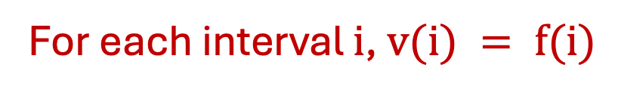
Attempt IV: Finish Time (Okay)
JPN 203
GEO 189
HIST 345
PHYS 311
LIT 101
ART 322
CHEM 405
CSE 331
EE 312
MATH 610
BIO 810
Time:
For each interval $i$, $v(i) = f(i)$
Start
End

Slide 67
Attempt IV: Finish Time (….)
Wait… does that actually work?
JPN 203
GEO 189
HIST 345
PHYS 311
LIT 101
ART 322
CHEM 405
CSE 331
EE 312
MATH 610
BIO 810
Time:
For each interval $i$, $v(i) = f(i)$
Start
End

Slide 68
Claim: The Finish First Algorithm is Optimal
Proof Ideas:
  Let A be the set returned by the algorithm and O be the optimal list.
  Let i_1, \ldots, i_k be the tasks in A sorted by add time.
  Let j_1, \ldots, j_m be the tasks in O sorted by finish time.
JPN 203
GEO 189
HIST 345
PHYS 311
LIT 101
ART 322
CHEM 405
CSE 331
EE 312
MATH 610
BIO 810
Time:
For each interval $i$, $v(i) = f(i)$
Start
End

Slide 69
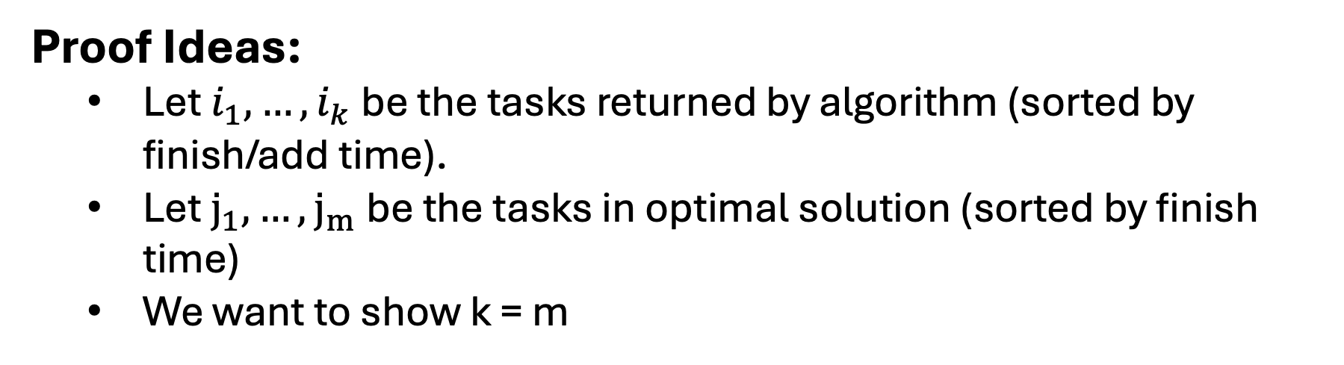
Claim: The Finish First Algorithm is Optimal
Proof Ideas:
  Let $i_{1},…,i_{k}$ be the tasks returned by algorithm (sorted by finish/add time).
  Let $j_{1},…,j_{m}$be the tasks in optimal solution (sorted by finish time)
  We want to show k = m
Q: $What can we say about the first job in each list?$
Time:
Start
End

Slide 70
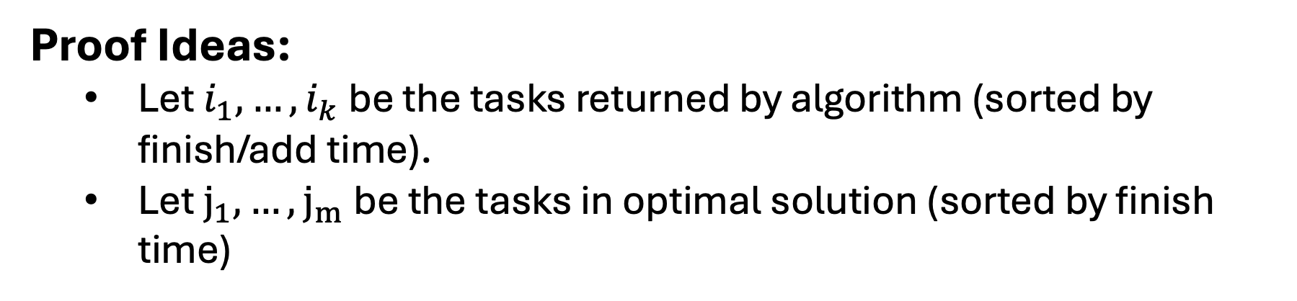
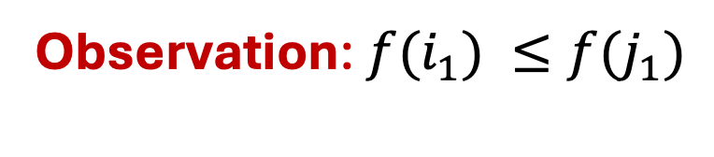


Claim: The Finish First Algorithm is Optimal
Proof Ideas:
  Let $i_{1},…,i_{k}$ be the tasks returned by algorithm (sorted by finish/add time).
  Let $j_{1},…,j_{m}$be the tasks in optimal solution (sorted by finish time)
$$i_{1}$$
Observation: ${f(i}_{1}) ≤f(j_{1})$
$$j_{1}$$
Time:
Start
End

Slide 71
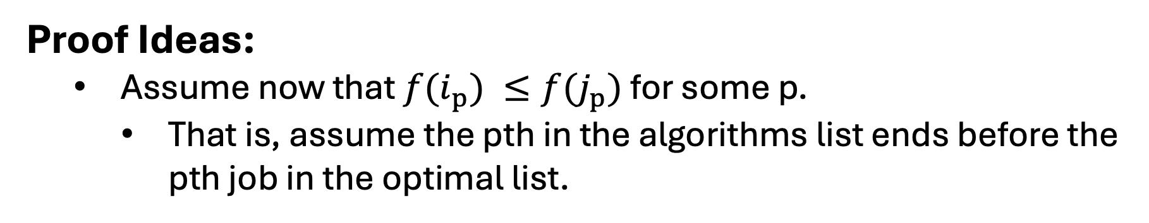


Claim: The Finish First Algorithm is Optimal
Proof Ideas:
  Assume now that ${f(i}_{p}) ≤f(j_{p})$ for some p.
    That is, assume the pth in the algorithms list ends before the pth job in the optimal list.
Q: $What can we say about the p+1 job in each list?$
$$i_{p}$$
$$j_{p}$$
Time:
Start
End

Slide 72


Claim: The Finish First Algorithm is Optimal
Proof Ideas:
  Assume now that ${f(i}_{p}) ≤f(j_{p})$ for some p.
    That is, assume the pth in the algorithms list ends before the pth job in the optimal list.
Observation: The algorithm could have added $j_{p+1}$!
$$i_{p}$$
$$i_{p+1}$$
$$j_{p}$$
$$j_{p+1}$$
Time:
Start
End

Slide 73




Claim: The Finish First Algorithm is Optimal
Proof Ideas:
  Assume now that ${f(i}_{k}) ≤f(j_{k})$ and m > k.
Q: Why is this a problem?
$$i_{k}$$
$$j_{k}$$
$$j_{k+1}$$
Time:
Start
End

Slide 74
Claim: The Finish First Algorithm is Optimal
Proof Ideas:
  Assume now that ${f(i}_{k}) ≤f(j_{k})$ and m > k.
Observation: The algorithm could have added $j_{k+1}$!
$$i_{k}$$
$$j_{k}$$
$$j_{k+1}$$
Time:
Start
End

