Slide 1

CSE 331: Algorithms & Complexity
“Greedy Algorithms II”
Prof. Charlie Anne Carlson (She/Her)
Lecture 16
Wednesday October 3rd, 2025

Slide 2

Schedule
Course Updates
Greedy Algorithms
Interval Scheduling
Greedy Algorithm
Runtime Analysis

Slide 3

Course Updates
HW 3 & Quiz #1 Grading
HW 4 Out Soon
Not Due Next Week!
Group Project
First Problems Oct 31st
Sample Midterms Out
Midterms Oct 6 and Oct 8

Slide 4
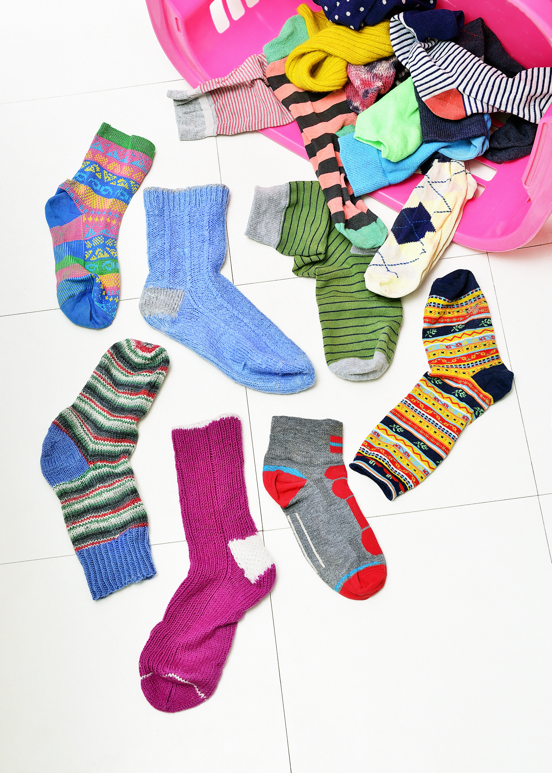
Midterm Advice
Midterms Oct 6 and Oct 8.
You get a reference sheet.
Exams are in class during regular class time.
Don’t panic!
Sleep, eat, drink water, and study what you can even it that isn’t everything!

Slide 5

What are Greedy Algorithm?
Build solution one piece at a time.
Only look at immediate information to make choices.
Never go back on a decision.
NOT ALWAYS THE BEST CHOICE!

Slide 6
Interval Scheduling
Consider an interval of time (e.g. Wednesday).
Time:
Start
End

Slide 7
Interval Scheduling
Consider an interval of time (e.g. Wednesday)
Consider tasks that need to be completed during specific times (e.g. classes)
ENG 110
CSE 9001
CSE 331
EE 312
MATH 610
Time:
Start
End

Slide 8
Interval Scheduling
Consider an interval of time (e.g. Wednesday).
Consider tasks that need to be completed during specific times (e.g. classes).
We want to fit as many tasks as possible into the day such that no two overlap.
ENG 110
CSE 9001
CSE 331
EE 312
MATH 610
Time:
Start
End

Slide 9
Interval Scheduling
Consider an interval of time (e.g. Wednesday).
Consider tasks that need to be completed during specific times (e.g. classes).
We want to fit as many tasks as possible into the day such that no two overlap.
ENG 110
CSE 9001
CSE 331
EE 312
MATH 610
Time:
Start
End

Slide 10
Interval Scheduling
Consider an interval of time (e.g. Wednesday).
Consider tasks that need to be completed during specific times (e.g. classes).
We want to fit as many tasks as possible into the day such that no two overlap.
Q: Do we ever pick CSE 9001?
ENG 110
CSE 9001
CSE 331
EE 312
MATH 610
Time:
Start
End

Slide 11
Interval Scheduling
Consider an interval of time (e.g. Wednesday).
Consider tasks that need to be completed during specific times (e.g. classes).
We want to fit as many tasks as possible into the day such that no two overlap.
A: No, because it blocks two classes!
ENG 110
CSE 9001
CSE 331
EE 312
MATH 610
Time:
Start
End

Slide 12
Optimal Solution #1
Consider an interval of time (e.g. Wednesday).
Consider tasks that need to be completed during specific times (e.g. classes).
We want to fit as many tasks as possible into the day such that no two overlap.
ENG 110
CSE 9001
CSE 331
EE 312
MATH 610
Time:
Start
End

Slide 13
Optimal Solution #2
Consider an interval of time (e.g. Wednesday).
Consider tasks that need to be completed during specific times (e.g. classes).
We want to fit as many tasks as possible into the day such that no two overlap.
ENG 110
CSE 9001
CSE 331
EE 312
MATH 610
Time:
Start
End

Slide 14
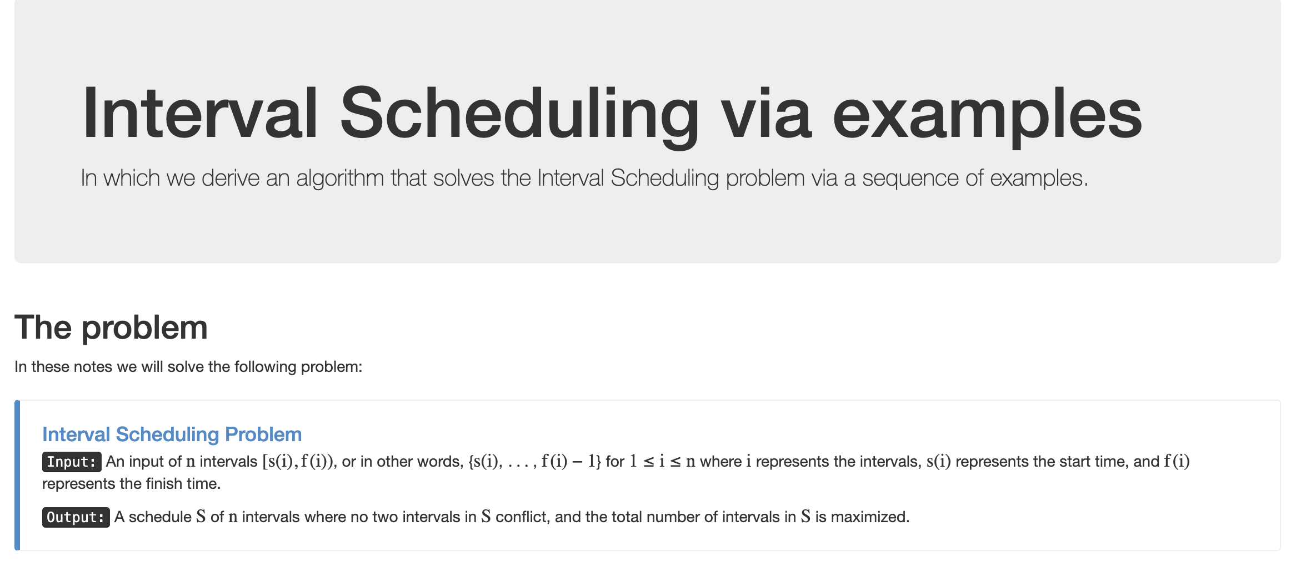
Interval Scheduling Problem (Support Page)

Slide 15
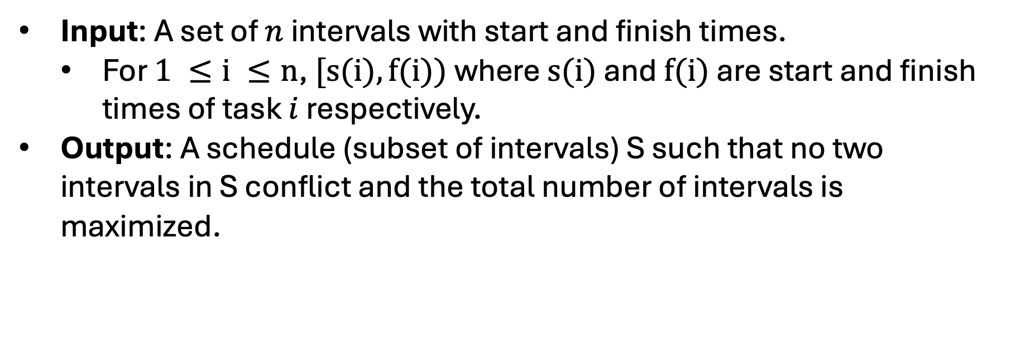
Interval Scheduling Problem
Input: A set of $n$ intervals with start and finish times.
For $1 ≤i ≤n$, $[s(i),f(i))$ where $s(i)$ and $f(i)$ are start and finish times of task $i$ respectively.
Output: A schedule (subset of intervals) S such that no two intervals in S conflict and the total number of intervals is maximized.
ENG 110
CSE 9001
CSE 331
EE 312
MATH 610
Time:
EE 312 and MATH 610 don’t conflict
Start
End

Slide 16
Interval Scheduling Problem
Input: A set of $n$ intervals with start and finish times.
For $1 ≤i ≤n$, $[s(i),f(i))$ where $s(i)$ and $f(i)$ are start and finish times of task $i$ respectively.
Output: A schedule (subset of intervals) S such that no two intervals in S conflict and the total number of intervals is maximized.
ENG 110
CSE 9001
CSE 331
EE 312
MATH 610
Time:
CSE 9001 and EE 312 Conflict
Start
End

Slide 17
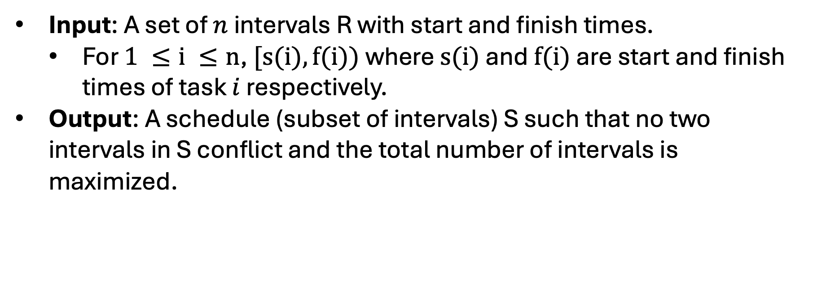
Q: How should we try to solve this?
Input: A set of $n$ intervals R with start and finish times.
For $1 ≤i ≤n$, $[s(i),f(i))$ where $s(i)$ and $f(i)$ are start and finish times of task $i$ respectively.
Output: A schedule (subset of intervals) S such that no two intervals in S conflict and the total number of intervals is maximized.
ENG 110
CSE 9001
CSE 331
EE 312
MATH 610
Time:
Start
End

Slide 18
Q: How should we try to solve this?
A: Let’s try to generate some examples and see what works and what doesn’t.
CSE 331
EE 312
MATH 610
Time:
Start
End

Slide 19
Build an Algorithm
Basic Algorithm Outline:
S is empty
While R is not empty:
Pick i in R
Add i to S
Remove i from R
CSE 331
EE 312
MATH 610
Time:
Start
End

Slide 20
Build an Algorithm
Basic Algorithm Outline:
S is empty
While R is not empty:
Pick i in R
Add i to S
Remove i from R
You might add conflicts!
LIT 101
LIT 101
CSE 331
EE 312
MATH 610
Time:
Start
End

Slide 21
Build an Algorithm
Basic Algorithm Outline:
S is empty
While R is not empty:
Pick i in R
Add i to S
Remove all tasks that conflict with i from R
LIT 101
LIT 101
CSE 331
EE 312
MATH 610
Time:
Start
End

Slide 22
Build an Algorithm
Basic Algorithm Outline:
S is empty
While R is not empty:
Pick i in R
Add i to S
Remove all tasks that conflict with i from R
Q: How do we do this?
LIT 101
LIT 101
CSE 331
EE 312
MATH 610
Time:
Start
End

Slide 23
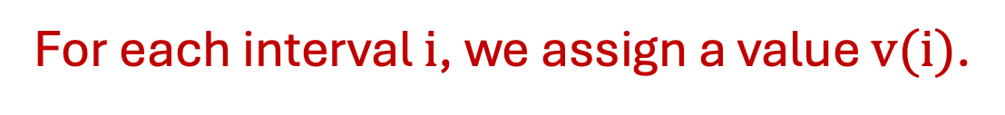
Build a Greedy Algorithm
Basic Algorithm Outline:
S is empty
While R is not empty:
Pick i in R that minimizes v(i)
Add i to S
Remove all tasks that conflict with i from R
LIT 101
LIT 101
CSE 331
EE 312
MATH 610
Time:
For each interval $i$, we assign a value $v(i)$.
Start
End

Slide 24
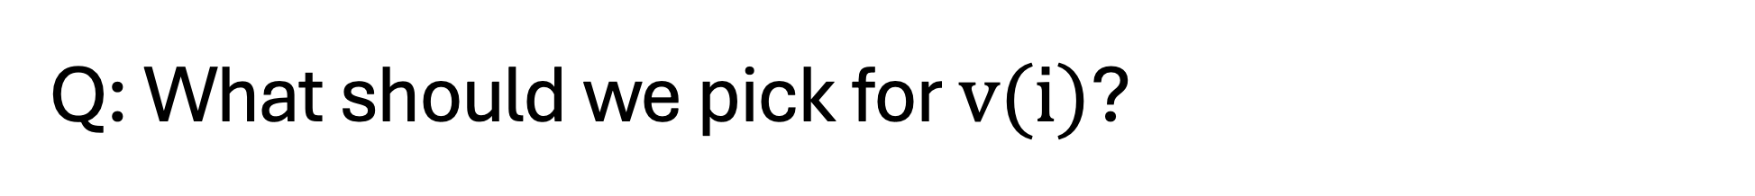

Q: What should we pick for $v(i)$?
Basic Algorithm Outline:
S is empty
While R is not empty:
Pick i in R that minimizes v(i)
Add i to S
Remove all tasks that conflict with i from R
LIT 101
LIT 101
CSE 331
EE 312
MATH 610
Time:
For each interval $i$, $v(i) = ?$
Start
End

Slide 25

Attempt I: Interval Length (Okay)
Basic Algorithm Outline:
S is empty
While R is not empty:
Pick i in R that minimizes v(i)
Add i to S
Remove all tasks that conflict with i from R
LIT 101
CSE 331
EE 312
MATH 610
Time:
For each interval $i$, $v(i) = s(i) – f(i)$
Start
End

Slide 26
Attempt I: Interval Length (Oh no!)
Basic Algorithm Outline:
S is empty
While R is not empty:
Pick i in R that minimizes v(i)
Add i to S
Remove all tasks that conflict with i from R
LIT 101
ART 322
CSE 331
EE 312
MATH 610
Time:
For each interval $i$, $v(i) = s(i) – f(i)$
Start
End

Slide 27

Attempt II: Start Time (Okay)
Basic Algorithm Outline:
S is empty
While R is not empty:
Pick i in R that minimizes v(i)
Add i to S
Remove all tasks that conflict with i from R
LIT 101
ART 322
CSE 331
EE 312
MATH 610
Time:
For each interval $i$, $v(i) = s(i)$
Start
End

Slide 28
Attempt II: Start Time (Oh no!)
Basic Algorithm Outline:
S is empty
While R is not empty:
Pick i in R that minimizes v(i)
Add i to S
Remove all tasks that conflict with i from R
LIT 101
ART 322
CSE 331
EE 312
MATH 610
Time:
For each interval $i$, $v(i) = s(i)$
Start
End

Slide 29
Attempt III: Min Conflicts (Okay)
Basic Algorithm Outline:
S is empty
While R is not empty:
Pick i in R that minimizes v(i)
Add i to S
Remove all tasks that conflict with i from R
LIT 101
ART 322
CSE 331
EE 312
MATH 610
Time:
For each interval $i$, $v(i) = \# conflicts (and min s(i))$
Start
End

Slide 30
Attempt III: Min Conflicts (Okay)
Basic Algorithm Outline:
S is empty
While R is not empty:
Pick i in R that minimizes v(i)
Add i to S
Remove all tasks that conflict with i from R
ART 322
CSE 331
EE 312
MATH 610
Time:
For each interval $i$, $v(i) = \# conflicts (and min s(i))$
Start
End

Slide 31
Attempt III: Min Conflicts (Okay)
Basic Algorithm Outline:
S is empty
While R is not empty:
Pick i in R that minimizes v(i)
Add i to S
Remove all tasks that conflict with i from R
ART 322
CSE 331
EE 312
MATH 610
Time:
For each interval $i$, $v(i) = \# conflicts (and min s(i))$
Start
End

Slide 32
Attempt III: Min Conflicts (Okay)
Basic Algorithm Outline:
S is empty
While R is not empty:
Pick i in R that minimizes v(i)
Add i to S
Remove all tasks that conflict with i from R
CSE 331
EE 312
MATH 610
Time:
For each interval $i$, $v(i) = \# conflicts (and min s(i))$
Start
End

Slide 33
Attempt III: Min Conflicts (Okay)
Basic Algorithm Outline:
S is empty
While R is not empty:
Pick i in R that minimizes v(i)
Add i to S
Remove all tasks that conflict with i from R
LIT 101
ART 322
CSE 331
EE 312
MATH 610
Time:
For each interval $i$, $v(i) = \# conflicts (and min s(i))$
Start
End

Slide 34
Attempt III: Min Conflicts (Oh no!)
JPN 203
GEO 189
HIST 345
PHYS 311
LIT 101
ART 322
CHEM 405
CSE 331
EE 312
MATH 610
BIO 810
Time:
For each interval $i$, $v(i) = \# conflicts (and min s(i))$
Start
End

Slide 35
Attempt III: Min Conflicts (Oh no!)
JPN 203
GEO 189
HIST 345
PHYS 311
LIT 101
ART 322
CHEM 405
CSE 331
BIO 810
Time:
For each interval $i$, $v(i) = \# conflicts (and min s(i))$
Start
End

Slide 36
Attempt III: Min Conflicts (Oh no!)
JPN 203
GEO 189
HIST 345
PHYS 311
LIT 101
ART 322
CHEM 405
CSE 331
BIO 810
Time:
For each interval $i$, $v(i) = \# conflicts (and min s(i))$
Start
End

Slide 37
Attempt III: Min Conflicts (Oh no!)
GEO 189
PHYS 311
ART 322
CHEM 405
CSE 331
BIO 810
Time:
For each interval $i$, $v(i) = \# conflicts (and min s(i))$
Start
End

Slide 38
Attempt III: Min Conflicts (Oh no!)
GEO 189
PHYS 311
ART 322
CHEM 405
CSE 331
BIO 810
Time:
For each interval $i$, $v(i) = \# conflicts (and min s(i))$
Start
End

Slide 39
Attempt III: Min Conflicts (Oh no!)
JPN 203
GEO 189
HIST 345
PHYS 311
LIT 101
ART 322
CHEM 405
CSE 331
EE 312
MATH 610
BIO 810
Time:
For each interval $i$, $v(i) = \# conflicts (and min s(i))$
Start
End

Slide 40
Attempt III: Min Conflicts (Oh no!)
JPN 203
GEO 189
HIST 345
PHYS 311
LIT 101
ART 322
CHEM 405
CSE 331
EE 312
MATH 610
BIO 810
Time:
For each interval $i$, $v(i) = \# conflicts (and min s(i))$
Start
End

Slide 41

I GIVE UP!!!!
JPN 203
GEO 189
HIST 345
PHYS 311
LIT 101
ART 322
CHEM 405
CSE 331
EE 312
MATH 610
BIO 810
Time:
For each interval $i$, $v(i) = \# conflicts (and min s(i))$
Start
End

Slide 42

Attempt IV: Finish Time (Okay)
JPN 203
GEO 189
HIST 345
PHYS 311
LIT 101
ART 322
CHEM 405
CSE 331
EE 312
MATH 610
BIO 810
Time:
For each interval $i$, $v(i) = f(i)$
Start
End

Slide 43
Attempt IV: Finish Time (….)
Wait… does that actually work?
JPN 203
GEO 189
HIST 345
PHYS 311
LIT 101
ART 322
CHEM 405
CSE 331
EE 312
MATH 610
BIO 810
Time:
For each interval $i$, $v(i) = f(i)$
Start
End

Slide 44
Claim: The Finish First Algorithm is Optimal
Proof Ideas:
Let A be the set returned by the algorithm and O be the optimal list.
Let i_1, \ldots, i_k be the tasks in A sorted by add time.
Let j_1, \ldots, j_m be the tasks in O sorted by finish time.
JPN 203
GEO 189
HIST 345
PHYS 311
LIT 101
ART 322
CHEM 405
CSE 331
EE 312
MATH 610
BIO 810
Time:
For each interval $i$, $v(i) = f(i)$
Start
End

Slide 45
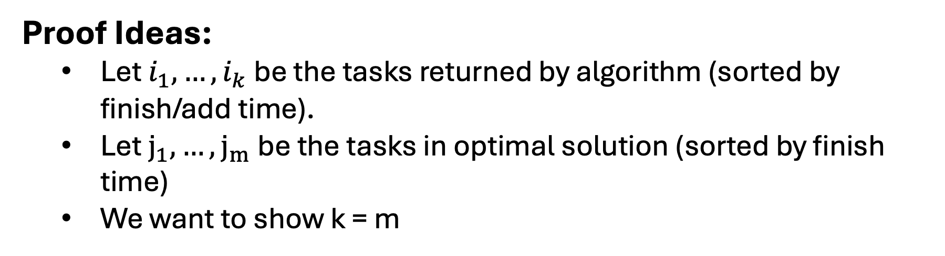
Claim: The Finish First Algorithm is Optimal
Proof Ideas:
Let $i_{1},…,i_{k}$ be the tasks returned by algorithm (sorted by finish/add time).
Let $j_{1},…,j_{m}$be the tasks in optimal solution (sorted by finish time)
We want to show k = m
Q: $What can we say about the first job in each list?$
Time:
Start
End

Slide 46
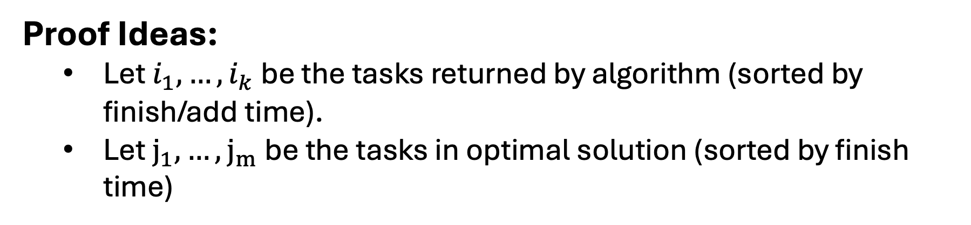
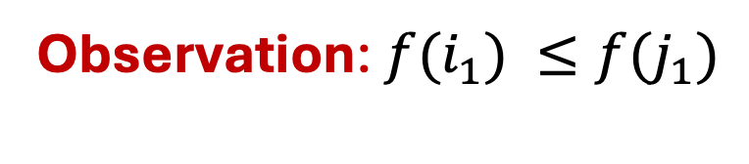


Claim: The Finish First Algorithm is Optimal
Proof Ideas:
Let $i_{1},…,i_{k}$ be the tasks returned by algorithm (sorted by finish/add time).
Let $j_{1},…,j_{m}$be the tasks in optimal solution (sorted by finish time)
$$i_{1}$$
Observation: ${f(i}_{1}) ≤f(j_{1})$
$$j_{1}$$
Time:
Start
End

Slide 47
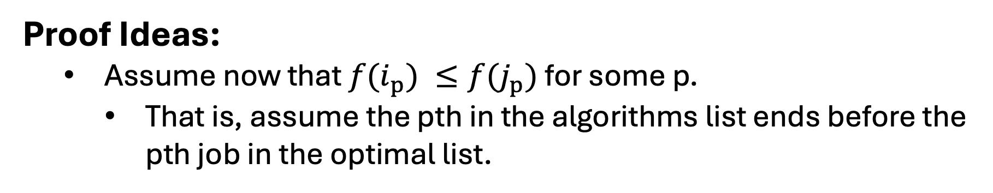


Claim: The Finish First Algorithm is Optimal
Proof Ideas:
Assume now that ${f(i}_{p}) ≤f(j_{p})$ for some p.
That is, assume the pth in the algorithms list ends before the pth job in the optimal list.
Q: $What can we say about the p+1 job in each list?$
$$i_{p}$$
$$j_{p}$$
Time:
Start
End

Slide 48


Claim: The Finish First Algorithm is Optimal
Proof Ideas:
Assume now that ${f(i}_{p}) ≤f(j_{p})$ for some p.
That is, assume the pth in the algorithms list ends before the pth job in the optimal list.
Observation: The algorithm could have added $j_{p+1}$!
$$i_{p}$$
$$i_{p+1}$$
$$j_{p}$$
$$j_{p+1}$$
Time:
Start
End

Slide 49




Claim: The Finish First Algorithm is Optimal
Proof Ideas:
Assume now that ${f(i}_{k}) ≤f(j_{k})$ and m > k.
Q: Why is this a problem?
$$i_{k}$$
$$j_{k}$$
$$j_{k+1}$$
Time:
Start
End

Slide 50
Claim: The Finish First Algorithm is Optimal
Proof Ideas:
Assume now that ${f(i}_{k}) ≤f(j_{k})$ and m > k.
Observation: The algorithm could have added $j_{k+1}$!
$$i_{k}$$
$$j_{k}$$
$$j_{k+1}$$
Time:
Start
End

Slide 51
Runtime Analysis
Basic Algorithm Outline:
S is empty
While R is not empty:
Pick i in R
Add i to S
Remove all tasks that conflict with i from R
CSE 331
EE 312
MATH 610
Time:
Start
End

Slide 52
Runtime Analysis
Input: List of tasks R
S is empty
While R is not empty:
Find i in R with earliest finish time
Add i to S
Remove all tasks that conflict with i from R
Return S
CSE 331
EE 312
MATH 610
Time:
Start
End

Slide 53
Runtime Analysis
Input: List of tasks R
S is empty list <- O(1) time
While R is not empty: <- O(n) iterations
Find i in R with earliest finish time <- O(n) time to search
Add i to S <- O(1) time
Remove all tasks that conflict with i from R <- O(n) time
Return S <- O(1) time
CSE 331
EE 312
MATH 610
Time:
Start
End

Slide 54
Runtime Analysis: O(n^2)
Input: List of tasks R
S is empty list <- O(1) time
While R is not empty: <- O(n) iterations
Find i in R with earliest finish time <- O(n) time to search
Add i to S <- O(1) time
Remove all tasks that conflict with i from R <- O(n) time
Return S <- O(1) time
Q: Can we do this faster?
CSE 331
EE 312
MATH 610
Time:
Start
End

Slide 55
Runtime Analysis: O(nlog(n))
Input: List of tasks R
Sort R by finish time <- O(nlog(n)) time
S is empty list <- O(1) time
Set last_job_fin to be 0 <- O(1) time
For j = 1 up to n: <- O(n) iterations
if s(j) > last_job_fin: <- O(1) time
Add i to S <- O(1) time
Set last_job_fin to be f(i) <- O(1) time
Return S <- O(1) time

