Slide 1

CSE 331: Algorithms & Complexity
“Shortest Path”
Prof. Charlie Anne Carlson (She/Her)
Lecture 17
Wednesday October 10th, 2025

Slide 2

Schedule
Course Updates
Interval Scheduling
Stay Ahead
Runtime Analysis
Shortest Path

Slide 3

Course Updates
All Grading Before Tuesday
HW 4 Out
Not Due Next Week!
Group Project
First Problems Oct 31st

Slide 4
Interval Scheduling
Consider an interval of time (e.g. Wednesday).
Consider tasks that need to be completed during specific times (e.g. classes).
We want to fit as many tasks as possible into the day such that no two overlap.
ENG 110
CSE 9001
CSE 331
EE 312
MATH 610
Time:
Start
End

Slide 5
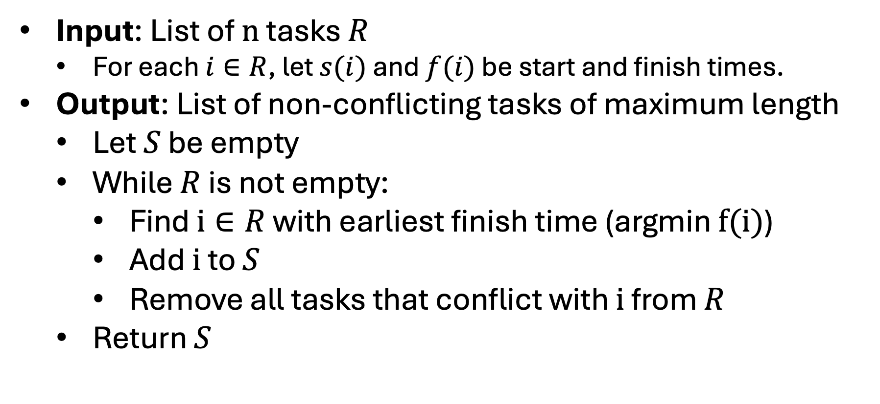
Finish First Algorithm
Input: List of $n$ tasks $R$
For each $i∈R$, let $s(i)$ and $f(i)$ be start and finish times.
Output: List of non-conflicting tasks of maximum length
Let $S$ be empty
While $R$ is not empty:
Find $i∈R$ with earliest finish time (argmin $f(i)$)
Add $i$ to $S$
Remove all tasks that conflict with $i$ from $R$
Return $S$

Slide 6
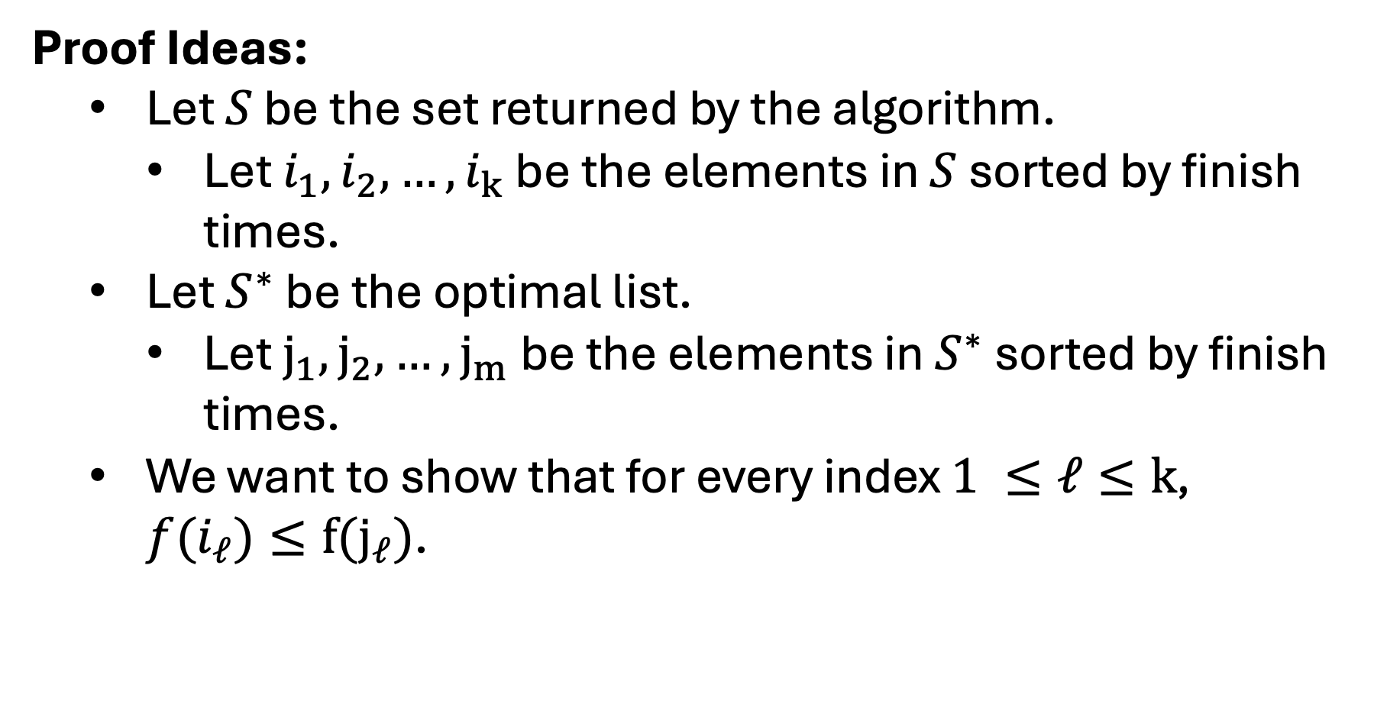
Claim: The Finish First Algorithm is Optimal
Proof Ideas:
Let $S$ be the set returned by the algorithm.
Let $i_{1},i_{2},…,i_{k}$ be the elements in $S$ sorted by finish times.
Let $S^{∗}$ be the optimal list.
Let $j_{1},j_{2},…,j_{m}$ be the elements in $S^{∗}$ sorted by finish times.
We want to show that for every index $1 ≤ℓ≤k$, $f(i_{ℓ})≤f(j_{ℓ})$.

Slide 7
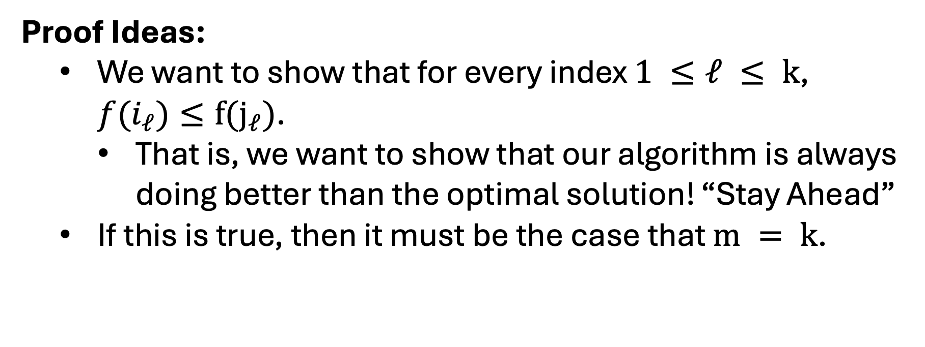
Claim: The Finish First Algorithm is Optimal
Proof Ideas:
We want to show that for every index $1 ≤ℓ ≤ k$, $f(i_{ℓ})≤f(j_{ℓ})$.
That is, we want to show that our algorithm is always doing better than the optimal solution! “Stay Ahead”
If this is true, then it must be the case that $m = k$.

Slide 8
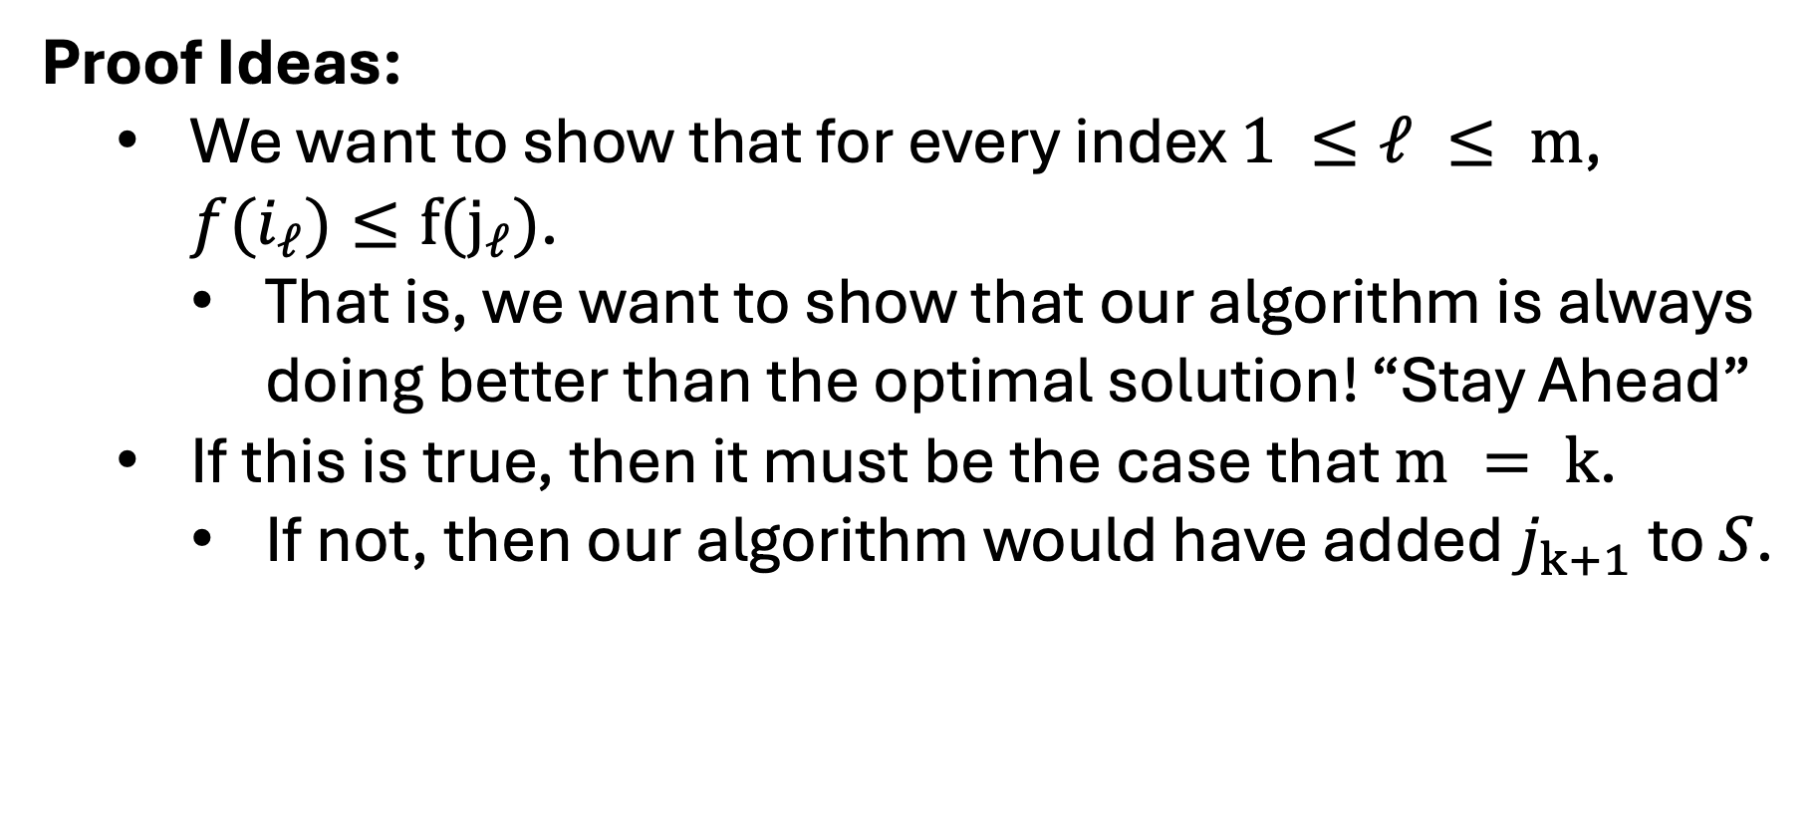
Claim: The Finish First Algorithm is Optimal
Proof Ideas:
We want to show that for every index $1 ≤ℓ ≤ m$, $f(i_{ℓ})≤f(j_{ℓ})$.
That is, we want to show that our algorithm is always doing better than the optimal solution! “Stay Ahead”
If this is true, then it must be the case that $m = k$.
If not, then our algorithm would have added $j_{k+1}$ to $S$.

Slide 9
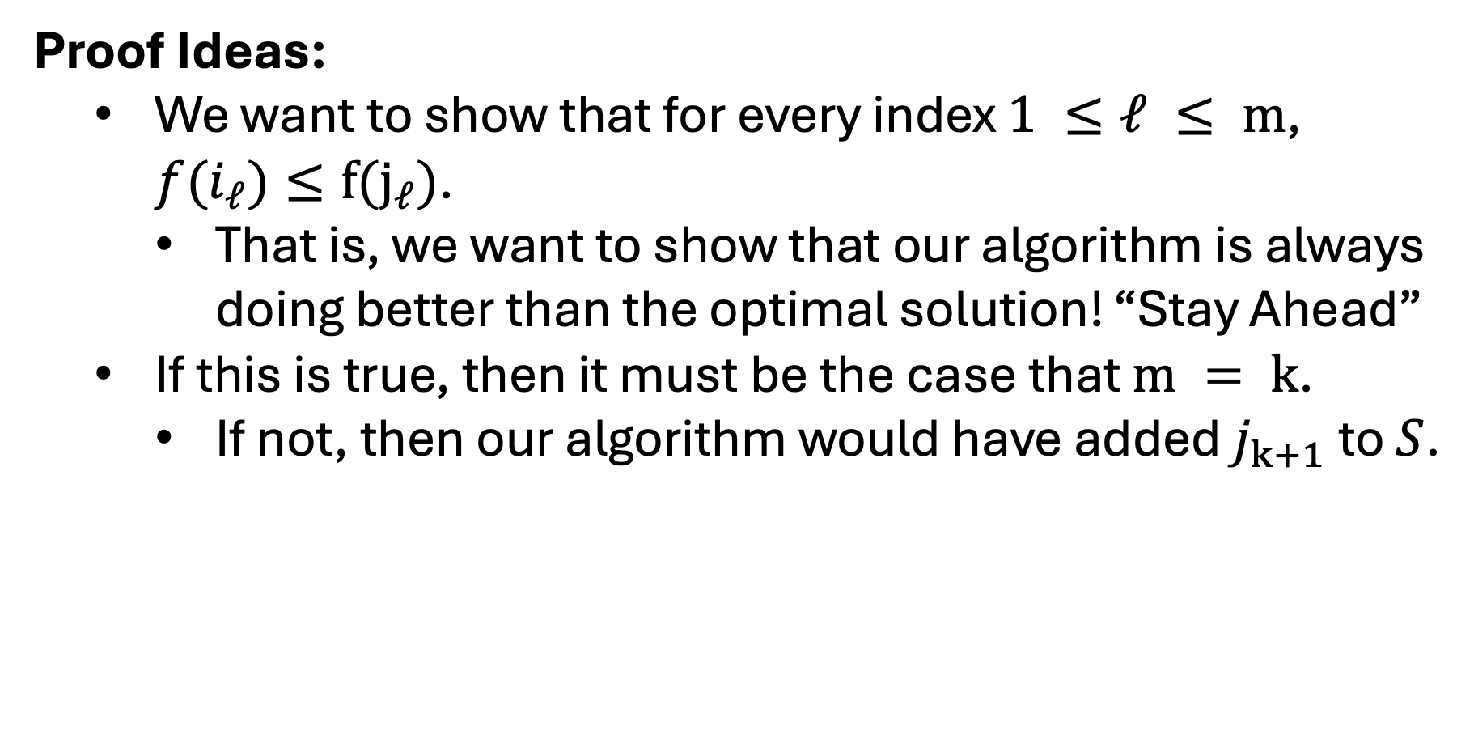
Claim: The Finish First Algorithm is Optimal
Proof Ideas:
We want to show that for every index $1 ≤ℓ ≤ m$, $f(i_{ℓ})≤f(j_{ℓ})$.
That is, we want to show that our algorithm is always doing better than the optimal solution! “Stay Ahead”
If this is true, then it must be the case that $m = k$.
If not, then our algorithm would have added $j_{k+1}$ to $S$.

Slide 10
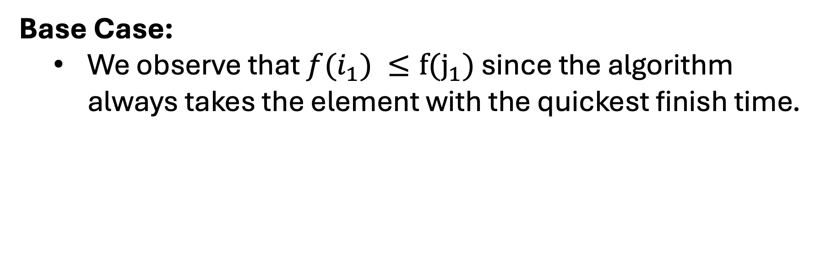


Claim: The Finish First Algorithm is Optimal
Base Case:
We observe that $f(i_{1}) ≤f(j_{1})$ since the algorithm always takes the element with the quickest finish time.
$$i_{1}$$
$$j_{1}$$
Time:
Start
End

Slide 11





Claim: The Finish First Algorithm is Optimal
Inductive Hypothesis:
Assume that ${f(i}_{p}) ≤f(j_{p})$ for some $1 ≤p<k$.
We will prove that ${f(i}_{p+1}) ≤f(j_{p+1})$
$$i_{p}$$
$$i_{p+1}$$
$$j_{p}$$
$$j_{p+1}$$
Time:
Start
End

Slide 12
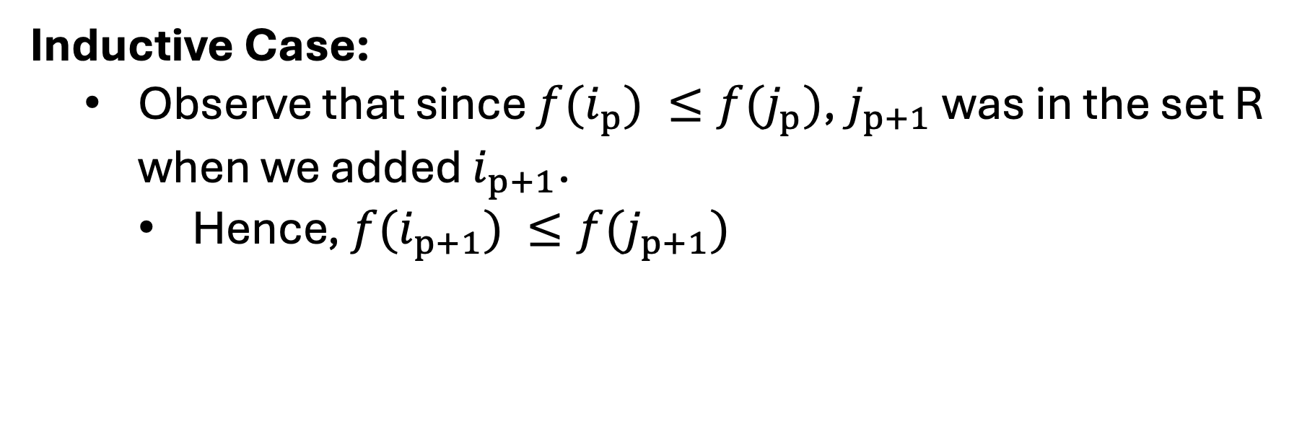
Claim: The Finish First Algorithm is Optimal
Inductive Case:
Observe that since ${f(i}_{p}) ≤f(j_{p})$, $j_{p+1}$ was in the set R when we added $i_{p+1}$.
Hence, ${f(i}_{p+1}) ≤f(j_{p+1})$
$$i_{p}$$
$$i_{p+1}$$
$$j_{p}$$
$$j_{p+1}$$
Time:
Start
End

Slide 13
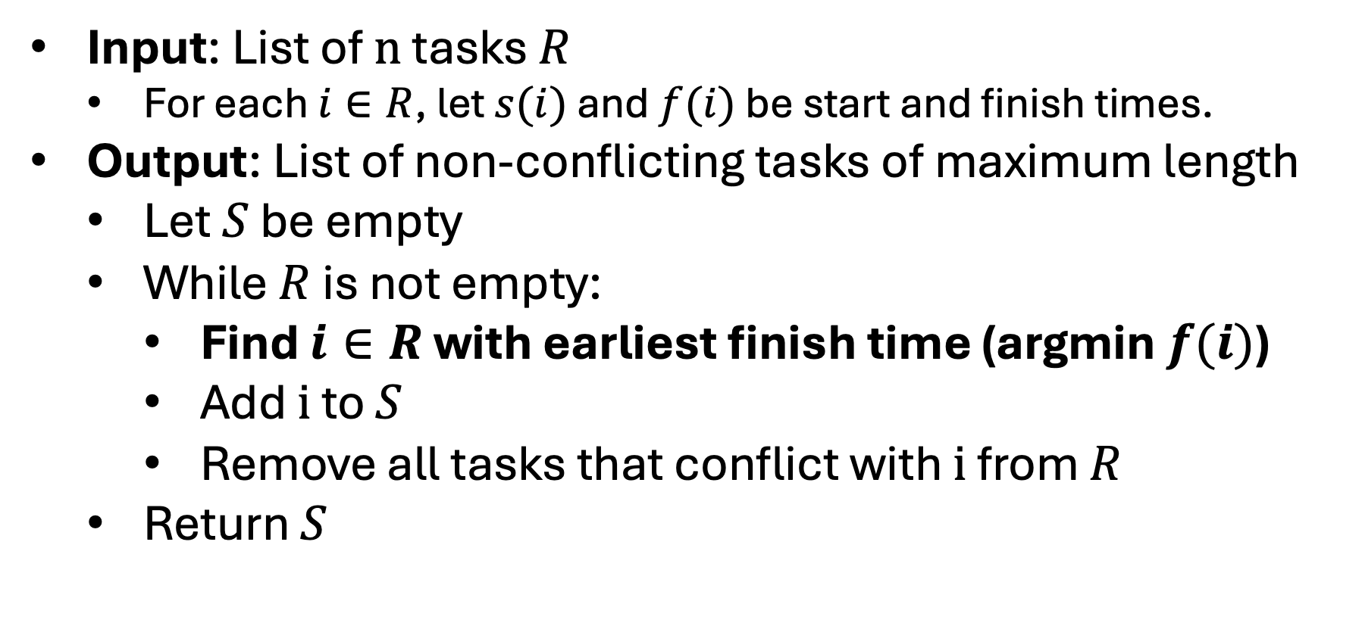
Finish First Algorithm
Input: List of $n$ tasks $R$
For each $i∈R$, let $s(i)$ and $f(i)$ be start and finish times.
Output: List of non-conflicting tasks of maximum length
Let $S$ be empty
While $R$ is not empty:
Find $i∈R$ with earliest finish time (argmin $f(i)$)
Add $i$ to $S$
Remove all tasks that conflict with $i$ from $R$
Return $S$

Slide 14
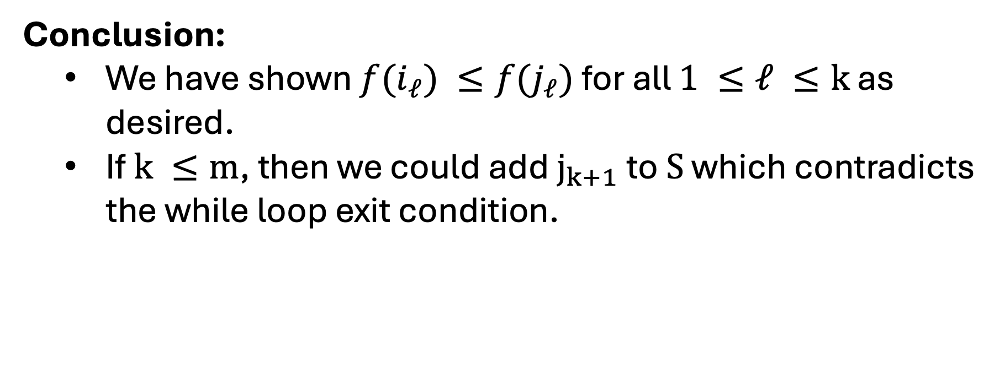
Claim: The Finish First Algorithm is Optimal
Conclusion:
We have shown ${f(i}_{ℓ}) ≤f(j_{ℓ})$ for all $1 ≤ℓ ≤k$ as desired.
If $k ≤m$, then we could add $j_{k+1}$ to $S$ which contradicts the while loop exit condition.
$$i_{p}$$
$$i_{p+1}$$
$$j_{p}$$
$$j_{p+1}$$
Time:
Start
End

Slide 15
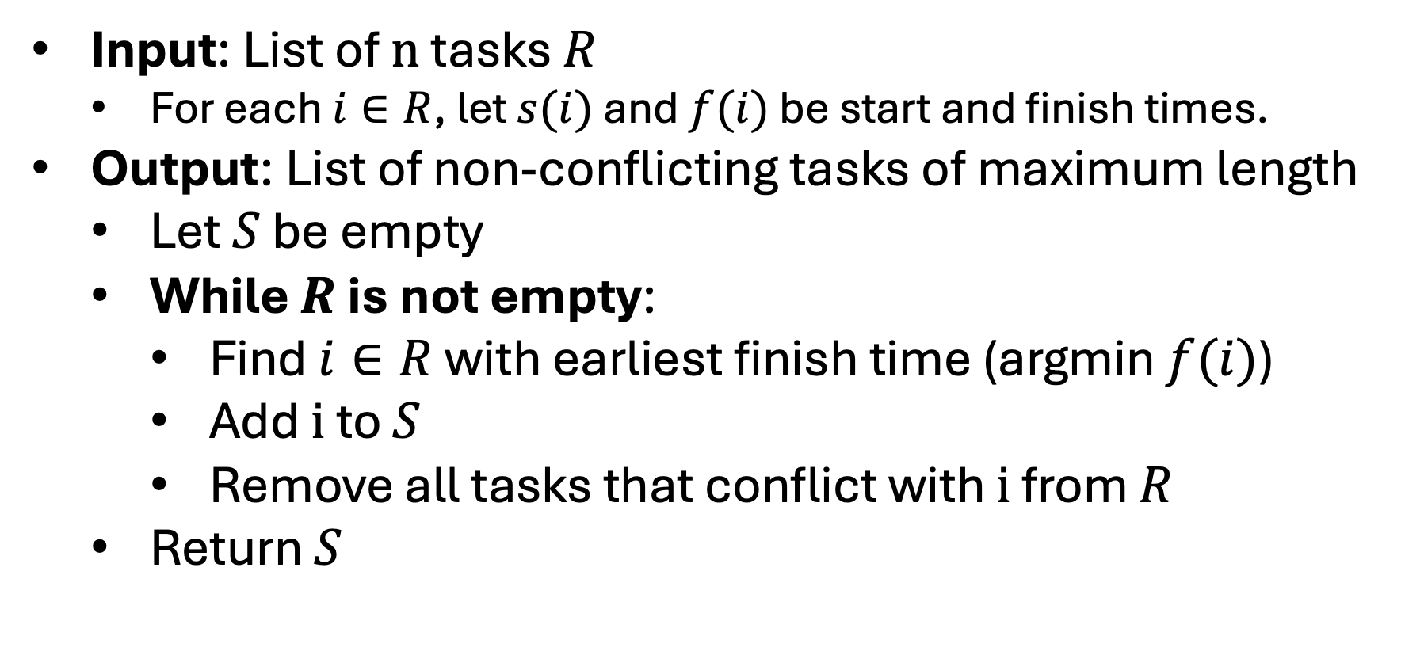
Finish First Algorithm
Input: List of $n$ tasks $R$
For each $i∈R$, let $s(i)$ and $f(i)$ be start and finish times.
Output: List of non-conflicting tasks of maximum length
Let $S$ be empty
While $R$ is not empty:
Find $i∈R$ with earliest finish time (argmin $f(i)$)
Add $i$ to $S$
Remove all tasks that conflict with $i$ from $R$
Return $S$

Slide 16
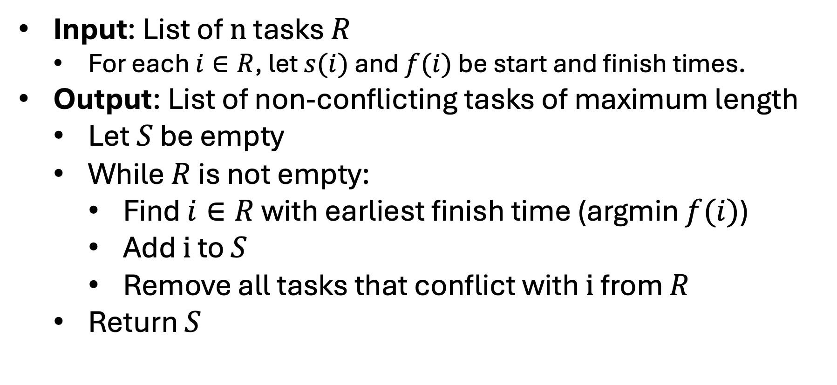
Runtime
Input: List of $n$ tasks $R$
For each $i∈R$, let $s(i)$ and $f(i)$ be start and finish times.
Output: List of non-conflicting tasks of maximum length
Let $S$ be empty
While $R$ is not empty:
Find $i∈R$ with earliest finish time (argmin $f(i)$)
Add $i$ to $S$
Remove all tasks that conflict with $i$ from $R$
Return $S$

Slide 17
Runtime
Input: List of $n$ tasks $R$
For each $i∈R$, let $s(i)$ and $f(i)$ be start and finish times.
Output: List of non-conflicting tasks of maximum length
Let $S$ be empty
While $R$ is not empty:
Find $i∈R$ with earliest finish time (argmin $f(i)$)
Add $i$ to $S$
Remove all tasks that conflict with $i$ from $R$
Return $S$
These look like O(n) steps!

Slide 18
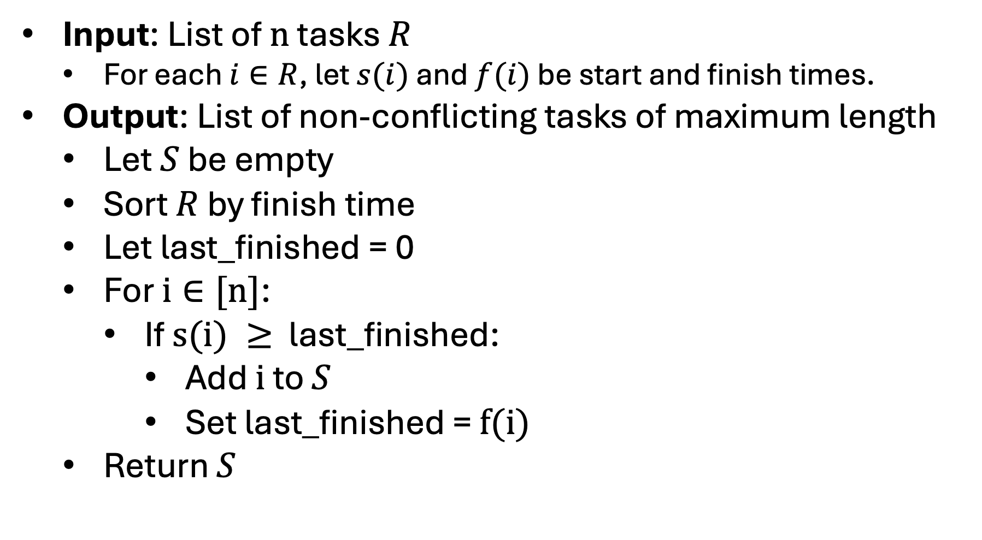
Runtime
Input: List of $n$ tasks $R$
For each $i∈R$, let $s(i)$ and $f(i)$ be start and finish times.
Output: List of non-conflicting tasks of maximum length
Let $S$ be empty
Sort $R$ by finish time
Let last_finished = 0
For $i∈[n]$:
If $s(i) ≥$ last_finished:
Add $i$ to $S$
Set last_finished = $f(i)$
Return $S$
Because we sorted, this is next task to finish that won’t conflict!

Slide 19
Runtime
Input: List of $n$ tasks $R$
For each $i∈R$, let $s(i)$ and $f(i)$ be start and finish times.
Output: List of non-conflicting tasks of maximum length
Let $S$ be empty
Sort $R$ by finish time
Let last_finished = 0
For $i∈[n]$:
If $s(i) ≥$ last_finished:
Add $i$ to $S$
Set last_finished = $f(i)$
Return $S$
This only takes O(nlog(n)) time!

Slide 20
Runtime O(nlog(n))
Input: List of $n$ tasks $R$
For each $i∈R$, let $s(i)$ and $f(i)$ be start and finish times.
Output: List of non-conflicting tasks of maximum length
Let $S$ be empty
Sort $R$ by finish time
Let last_finished = 0
For $i∈[n]$:
If $s(i) ≥$ last_finished:
Add $i$ to $S$
Set last_finished = $f(i)$
Return $S$
Each step in this loop is constant time!

Slide 21
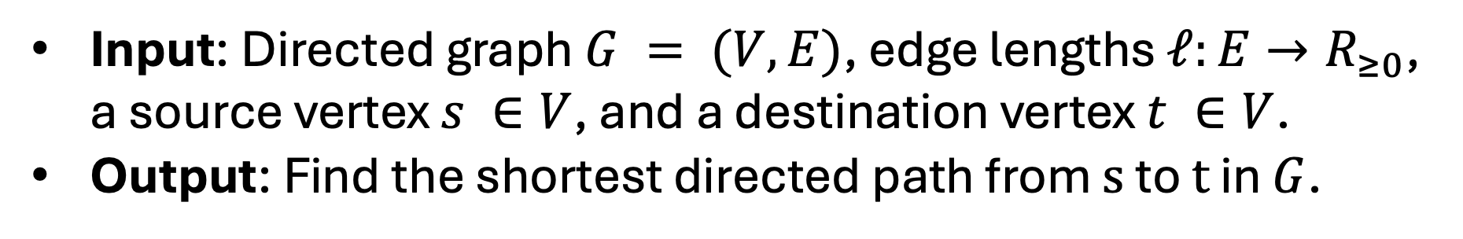


Shortest Path
Input: Directed graph $G = (V,E)$, edge lengths $ℓ:E→R_{≥0}$, a source vertex $s ∈V$, and a destination vertex $t ∈V$.
Output: Find the shortest directed path from $s$ to $t$ in $G$.
$$s$$
11
5
6
2
5
1
3
5
4
3
2
12
$$t$$

Slide 22
Single Pair Shortest Path
Input: Directed graph $G = (V,E)$, edge lengths $ℓ:E→R_{≥0}$, a source vertex $s ∈V$, and a destination vertex $t ∈V$.
Output: Find the shortest directed path from $s$ to $t$ in $G$.
$$s$$
11
5
6
2
5
1
3
5
4
3
2
12
$$t$$

Slide 23
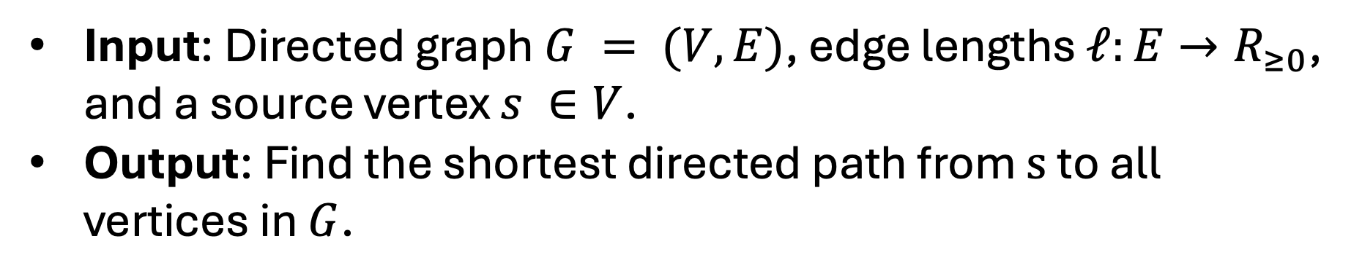
Single Pair Shortest Path
Input: Directed graph $G = (V,E)$, edge lengths $ℓ:E→R_{≥0}$, and a source vertex $s ∈V$.
Output: Find the shortest directed path from $s$ to all vertices in $G$.
$$s$$
11
5
6
2
5
1
3
5
4
3
2
12

Slide 24
Single Pair Shortest Path
Input: Directed graph $G = (V,E)$, edge lengths $ℓ:E→R_{≥0}$, and a source vertex $s ∈V$.
Output: Find the shortest directed path from $s$ to all vertices in $G$.
$$s$$
11
5
6
2
5
1
3
5
4
3
2
12
Shortest Path Tree

Slide 25
Questions
Q1: How do you solve one problem with the answer to the other?
Q2: What happens to the tree when you add 100 to each edge?
$$s$$
11
5
6
2
5
1
3
5
4
3
2
12

Slide 26
Questions
A1: You can lookup t or run with t for each vertex.)
A2: The shortest paths may change!
$$s$$
111
105
106
102
105
101
103
105
104
103
102
112

Slide 27
Questions
Q3: How can you solve this if each edge has length 1?
Q2: What happens to the tree when you multiply each length by 2?
$$s$$
11
5
6
2
5
1
3
5
4
3
2
12

Slide 28
Questions
Q3: You can run BFS.
Q2: The shortest path is still the shortest path but twice as long.
$$s$$
22
10
12
4
10
2
6
10
8
6
4
24

Slide 29
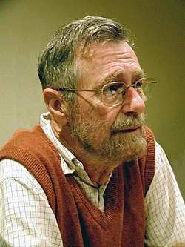
Dijkstra’s Greedy Algorithm
We will describe a greedy algorithm that is named after its discoverer, Edsger Wybe Dijkstra. ->
The algorithm runs in O(|E| + |V|log(|V|)) time when implemented with a priority queue.
We will assume no negative edge weights.

Slide 30
Dijkstra’s Algorithm Idea
Prompt: What edge do we always know is going to be part of a shortest path?
$$s$$
11
5
6
2
5
1
3
5
4
3
2
12

Slide 31
Dijkstra’s Algorithm Idea
Observation: The shortest edge leaving the source vertex is always in a shortest path.
$$s$$
11
5
6
2
5
1
3
5
4
3
2
12

Slide 32
Dijkstra’s Algorithm Idea
Motivation: You know that the shortest path from where you are to anywhere else is important.
$$s$$
11
5
6
2
5
1
3
5
4
3
2
12

Slide 33

Dijkstra’s Algorithm Idea
Proof: Suppose the shortest edge leaving s went to w. Now suppose there is another path from s to w. It must use another edge leaving s.
$$s$$
5
5
5
3
$$w$$

Slide 34
Dijkstra’s Algorithm Idea
If it uses another edge leaving s then it must be just as long or longer of a path!
$$s$$
5
5
5
3
$$w$$

Slide 35
Dijkstra’s Algorithm Idea
Prompt: What can we say about the shortest path tree with respect to s and w?
$$s$$
11
5
6
2
5
1
3
5
4
3
2
12
$$w$$

Slide 36
Dijkstra’s Algorithm Idea
Observation: The shortest path tree must include an edge leaving s and/or w. Otherwise, you can’t reach everything.
$$s$$
11
5
6
2
5
1
3
5
4
3
2
12
$$w$$

Slide 37


Dijkstra’s Algorithm Idea
Prompt: Which is closer to s?
$$x$$
$$s$$
11
5
6
2
5
1
3
5
4
3
2
12
$$w$$
$$y$$

Slide 38
Dijkstra’s Algorithm Idea
Observation: There are both 5 away from s. We don’t want to assume that the distance from w is the same as the distance from s.
$$x$$
$$s$$
11
5
6
2
5
1
3
5
4
3
2
12
$$w$$
$$y$$

Slide 39
Dijkstra’s Algorithm Idea
Observation: The s to x edge and the w to y edge should both be in the shortest path tree. (We need non-negative edge weights)
$$x$$
$$s$$
11
5
6
2
5
1
3
5
4
3
2
12
$$w$$
$$y$$

Slide 40
Dijkstra’s Algorithm Idea
Prompt: How do we generalize these observation as a greedy rule?
$$x$$
$$s$$
11
5
6
2
5
1
3
5
4
3
2
12
$$w$$
$$y$$

Slide 41
Dijkstra’s Algorithm Idea
Algorithm Idea: In each iteration, pick an edge from my shortest path tree to the “nearest” vertex not yet in the tree.
$$x$$
$$s$$
11
5
6
2
5
1
3
5
4
3
2
12
$$w$$
$$y$$

Slide 42
Dijkstra’s Algorithm Idea
Algorithm Idea: Keep track of the shortest path tree. In each iteration, add an edge from the tree to the nearest neighbor (with respect to s).
$$x$$
$$s$$
11
5
6
2
5
1
3
5
4
3
2
12
$$w$$
$$y$$

Slide 43
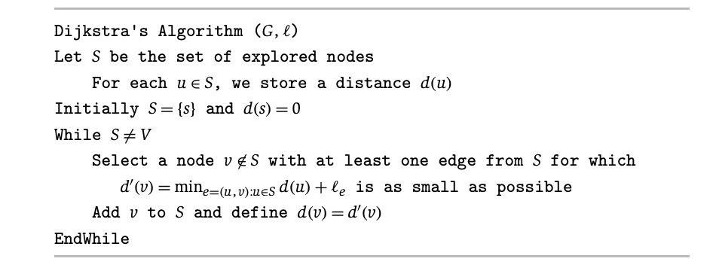
Dijkstra’s Algorithm
$$x$$
$$s$$
11
5
6
2
5
1
3
5
4
3
2
12
$$w$$
$$y$$

Slide 44




Dijkstra’s Algorithm Idea
Look at all neighbors of S. Determine which has the shortest path from s. Add that to S. Repeat.
$$S$$
$$x$$
$$s$$
$$z$$
$$y$$

Slide 45

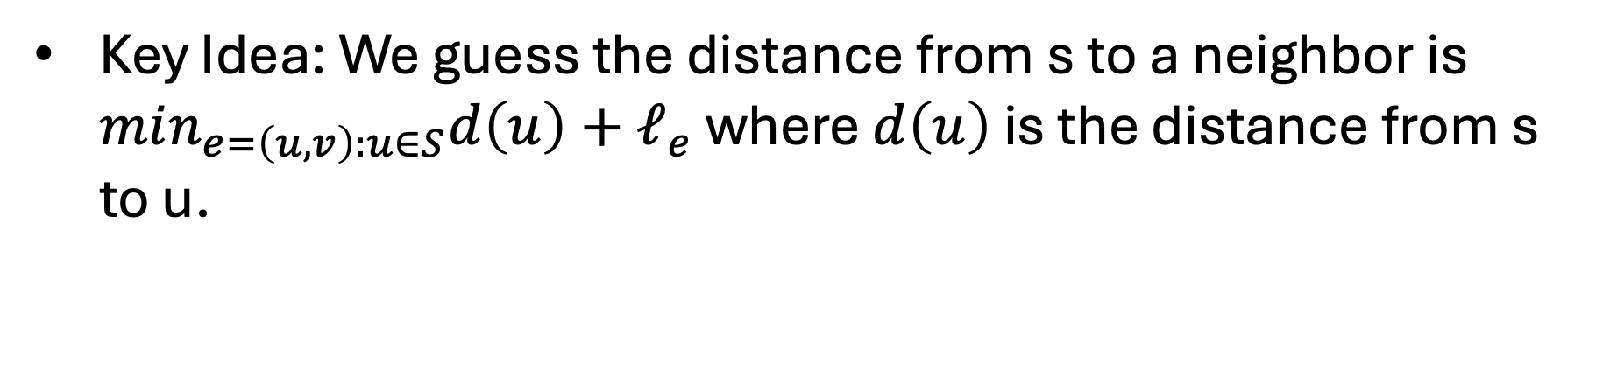
Dijkstra’s Algorithm Idea
Key Idea: We guess the distance from s to a neighbor is $min_{e=\left(u,v\right):u∈S}d\left(u\right)+ℓ_{e}$ where $d\left(u\right)$ is the distance from s to u.
$$x$$
$$S$$
$$s$$
$$z$$
$$y$$

Slide 46






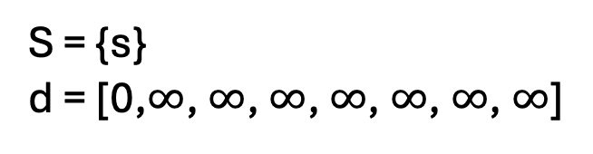


Dijkstra’s Algorithm Idea
S = {s} d = [0,$∞$, $∞$, $∞$, $∞$, $∞$, $∞$, $∞$]
$$s$$
$$v_{2}$$
11
5
$$v_{4}$$
6
$$v_{6}$$
$$v_{0}$$
2
5
1
3
$$v_{3}$$
5
4
3
$$v_{1}$$
2
$$v_{5}$$
12
$$v_{7}$$

Slide 47


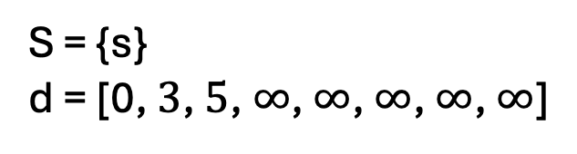
Dijkstra’s Algorithm Idea
S = {s} d = [0, $3$, $5$, $∞$, $∞$, $∞$, $∞$, $∞$]
$$s$$
$$v_{2}$$
11
5
$$v_{4}$$
6
$$v_{6}$$
$$v_{0}$$
2
5
1
3
$$v_{3}$$
5
4
3
$$v_{1}$$
2
$$v_{5}$$
12
$$v_{7}$$

Slide 48
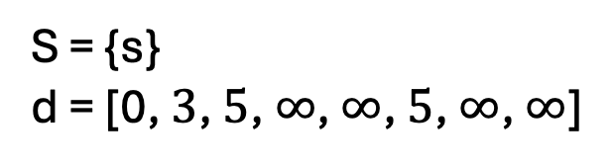
Dijkstra’s Algorithm Idea
S = {s} d = [0, $3$, $5$, $∞$, $∞$, $5$, $∞$, $∞$]
$$s$$
$$v_{2}$$
11
5
$$v_{4}$$
6
$$v_{6}$$
$$v_{0}$$
2
5
1
3
$$v_{3}$$
5
4
3
$$v_{1}$$
2
$$v_{5}$$
12
$$v_{7}$$

Slide 49

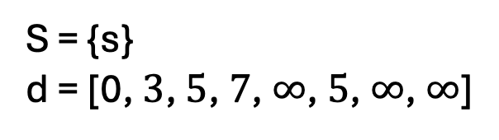
Dijkstra’s Algorithm Idea
S = {s} d = [0, $3$, $5$, $7$, $∞$, $5$, $∞$, $∞$]
$$s$$
$$v_{2}$$
11
5
$$v_{4}$$
6
$$v_{6}$$
$$v_{0}$$
2
5
1
3
$$v_{3}$$
5
4
3
$$v_{1}$$
2
$$v_{5}$$
12
$$v_{7}$$

Slide 50

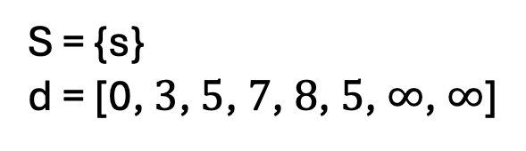

Dijkstra’s Algorithm Idea
S = {s} d = [0, $3$, $5$, $7$, $8$, $5$, $∞$, $∞$]
$$s$$
$$v_{2}$$
11
5
$$v_{4}$$
6
$$v_{6}$$
$$v_{0}$$
2
5
1
3
$$v_{3}$$
5
4
3
$$v_{1}$$
2
$$v_{5}$$
12
$$v_{7}$$

Slide 51
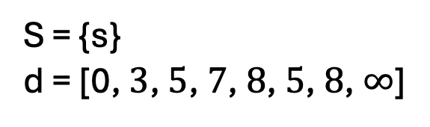
Dijkstra’s Algorithm Idea
S = {s} d = [0, $3$, $5$, $7$, $8$, $5$, $8$, $∞$]
$$s$$
$$v_{2}$$
11
5
$$v_{4}$$
6
$$v_{6}$$
$$v_{0}$$
2
5
1
3
$$v_{3}$$
5
4
3
$$v_{1}$$
2
$$v_{5}$$
12
$$v_{7}$$

Slide 52
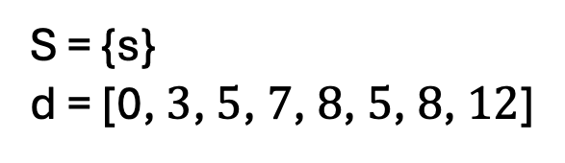
Dijkstra’s Algorithm Idea
S = {s} d = [0, $3$, $5$, $7$, $8$, $5$, $8$, $12$]
$$s$$
$$v_{2}$$
11
5
$$v_{4}$$
6
$$v_{6}$$
$$v_{0}$$
2
5
1
3
$$v_{3}$$
5
4
3
$$v_{1}$$
2
$$v_{5}$$
12
$$v_{7}$$

Slide 53
Paths?
Q: How do we return the paths?
$$s$$
$$v_{2}$$
11
5
$$v_{4}$$
6
$$v_{6}$$
$$v_{0}$$
2
5
1
3
$$v_{3}$$
5
4
3
$$v_{1}$$
2
$$v_{5}$$
12
$$v_{7}$$

Slide 54
Paths?
Q: How do we return the paths?
$$s$$
$$v_{2}$$
11
5
$$v_{4}$$
6
$$v_{6}$$
$$v_{0}$$
2
5
1
3
$$v_{3}$$
5
4
3
$$v_{1}$$
2
$$v_{5}$$
12
$$v_{7}$$

Slide 55
Paths?
Let P a n length array.
Set P[s] to be -1.
A: When we add v to S, we can also keep track of what edge was used.
Set P[v] = u such that (u,v) was min.
$$s$$
$$v_{2}$$
11
5
$$v_{4}$$
6
$$v_{6}$$
$$v_{0}$$
2
5
1
3
$$v_{3}$$
5
4
3
$$v_{1}$$
2
$$v_{5}$$
12
$$v_{7}$$

Slide 56
Paths?
Let P a n length array.
Set P[s] to be -1.
Q: How do we get the shortest path from s to w?
Set P[v] = u such that (u,v) was min.
$$s$$
$$v_{2}$$
11
5
$$v_{4}$$
6
$$v_{6}$$
$$v_{0}$$
2
5
1
3
$$v_{3}$$
5
4
3
$$v_{1}$$
2
$$v_{5}$$
12
$$v_{7}$$

Slide 57
Paths?
Let P a n length array.
Set P[s] to be Null.
A: We can recursively construct it by looking at taking the edge (P[w],w) and the shortest path from s to P[w].
Set P[v] = u such that (u,v) was min.
$$s$$
$$v_{2}$$
11
5
$$v_{4}$$
6
$$v_{6}$$
$$v_{0}$$
2
5
1
3
$$v_{3}$$
5
4
3
$$v_{1}$$
2
$$v_{5}$$
12
$$v_{7}$$

Slide 58
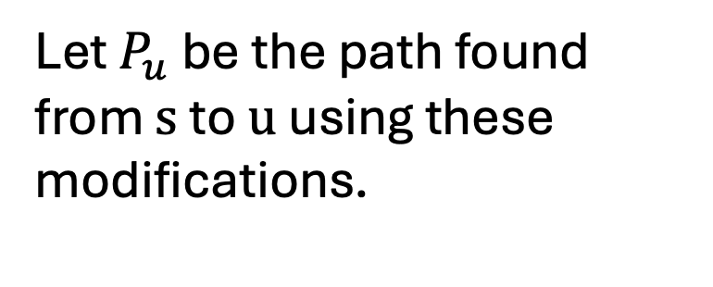
Paths
Let P a n length array.
Set P[s] to be -1.
Let $P_{u}$ be the path found from $s$ to $u$ using these modifications.
Set P[v] = u such that (u,v) was min.
$$s$$
$$v_{2}$$
11
5
$$v_{4}$$
6
$$v_{6}$$
$$v_{0}$$
2
5
1
3
$$v_{3}$$
5
4
3
$$v_{1}$$
2
$$v_{5}$$
12
$$v_{7}$$

Slide 59
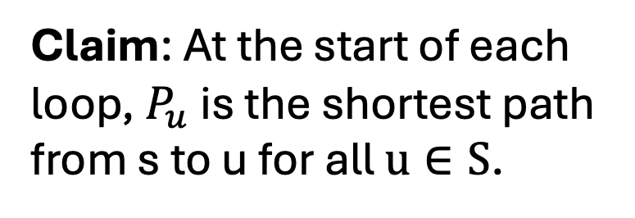
Correctness
Claim: At the start of each loop, $P_{u}$ is the shortest path from s to u for all $u∈S$.
$$s$$
$$v_{2}$$
11
5
$$v_{4}$$
6
$$v_{6}$$
$$v_{0}$$
2
5
1
3
$$v_{3}$$
5
4
3
$$v_{1}$$
2
$$v_{5}$$
12
$$v_{7}$$

Slide 60
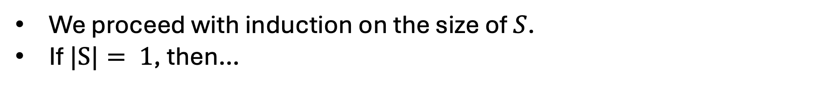
Proof Idea
We proceed with induction on the size of $S$.
If $|S|= 1$, then…

Slide 61

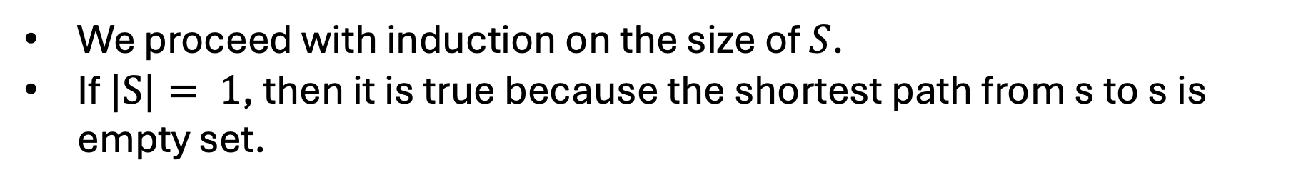
Proof Idea
We proceed with induction on the size of $S$.
If $|S|= 1$, then it is true because the shortest path from s to s is empty set.
$$s$$

Slide 62

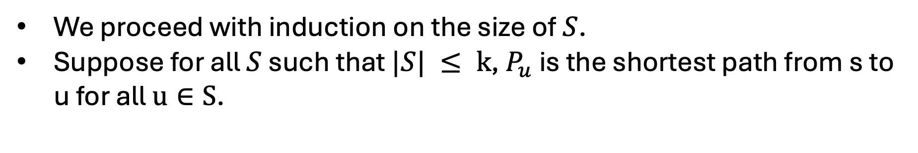
Proof Idea
We proceed with induction on the size of $S$.
Suppose for all $S$ such that $|S| ≤ k$, $P_{u}$ is the shortest path from s to u for all $u∈S$.
$$S$$
$$s$$

Slide 63

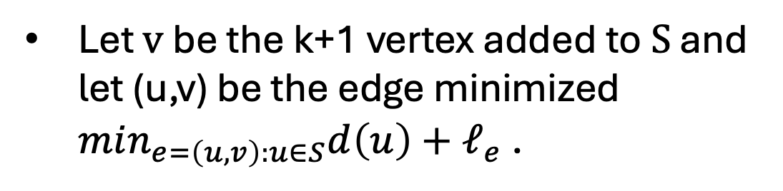

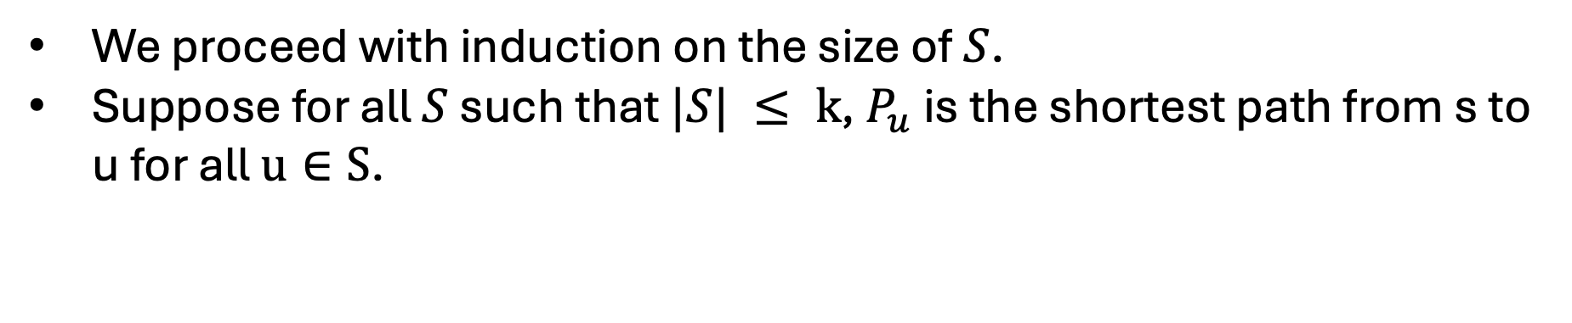
Proof Idea
We proceed with induction on the size of $S$.
Suppose for all $S$ such that $|S| ≤ k$, $P_{u}$ is the shortest path from s to u for all $u∈S$.
$$S$$
Let $v$ be the k+1 vertex added to $S$ and let (u,v) be the edge minimized $min_{e=\left(u,v\right):u∈S}d\left(u\right)+ℓ_{e}$ .
$$s$$
$$v$$
$$u$$

Slide 64
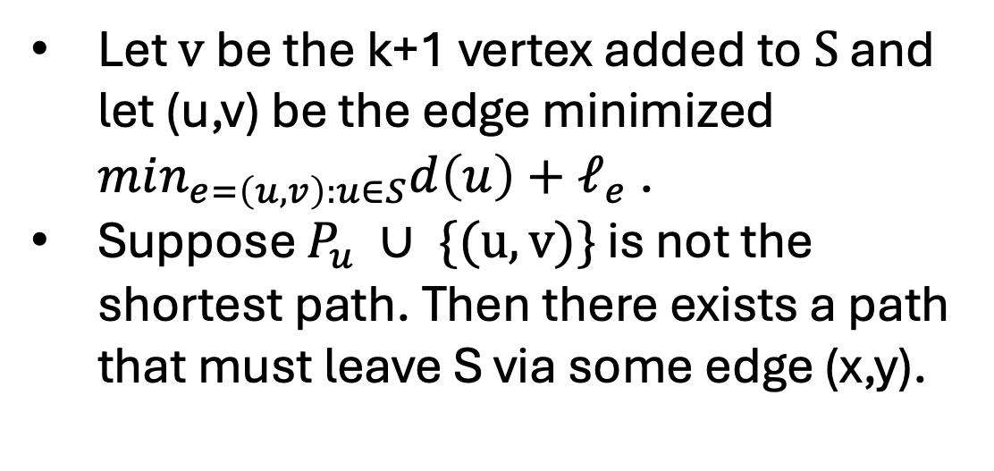


Proof Idea
We proceed with induction on the size of $S$.
Suppose for all $S$ such that $|S| ≤ k$, $P_{u}$ is the shortest path from s to u for all $u∈S$.
$$S$$
Let $v$ be the k+1 vertex added to $S$ and let (u,v) be the edge minimized $min_{e=\left(u,v\right):u∈S}d\left(u\right)+ℓ_{e}$ .
Suppose $P_{u} ∪ \{(u,v)\}$ is not the shortest path. Then there exists a path that must leave S via some edge (x,y).
$$s$$
$$v$$
$$u$$
$$x$$
$$y$$

Slide 65
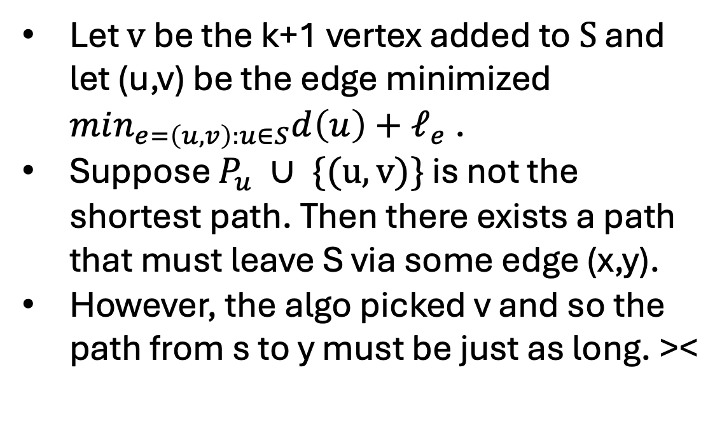
Proof Idea
We proceed with induction on the size of $S$.
Suppose for all $S$ such that $|S| ≤ k$, $P_{u}$ is the shortest path from s to u for all $u∈S$.
$$S$$
Let $v$ be the k+1 vertex added to $S$ and let (u,v) be the edge minimized $min_{e=\left(u,v\right):u∈S}d\left(u\right)+ℓ_{e}$ .
Suppose $P_{u} ∪ \{(u,v)\}$ is not the shortest path. Then there exists a path that must leave S via some edge (x,y).
However, the algo picked v and so the path from s to y must be just as long. ><
$$s$$
$$v$$
$$u$$
$$x$$
$$y$$

Slide 66
Q: What about negative edge weights?
$$s$$
$$v_{2}$$
11
5
$$v_{4}$$
6
$$v_{6}$$
$$v_{0}$$
2
5
1
3
$$v_{3}$$
5
4
3
$$v_{1}$$
2
$$v_{5}$$
12
$$v_{7}$$

