Slide 1

CSE 331: Algorithms & Complexity
“Dijkstra’s Algorithm”
Prof. Charlie Anne Carlson (She/Her)
Lecture 18
Wednesday October 15, 2025

Slide 2

Schedule
Course Updates
Shortest Path
Dijkstra’s Algorithm
Proof of Correctness
Runtime

Slide 3

Course Updates
Everything Besides Midterm Graded
Midterm Grades this week
HW 4 Out
Due Next Week!
Group Project
First Problems Oct 31st

Slide 4

Mid Updates
You got mid semester grades based only on HW1, HW2, HW3, and Quiz 1 (no drops).
I will give you more formal grades once midterms are graded.
Midterms seemed to have been a stumble for a lot of people.
This is a chance to do better and not a chance to give up.

Slide 5
Cheating!
F
“If the violation involves the use of ChatGPT (or other generative AI tools), irrespective of whether it is the student's first violation or not, then it will result in an automatic F letter grade in the course.” <- Course Syllabus
We know of a few people who are using generative AI tools on homework assignments.
Just because you got a grade, doesn’t mean I don’t know you cheated and you are in the clear.

Slide 6

Single Pair Shortest Path
Input: ?
Output: ?
$$s$$
11
5
6
2
5
1
3
5
4
3
2
12

Slide 7
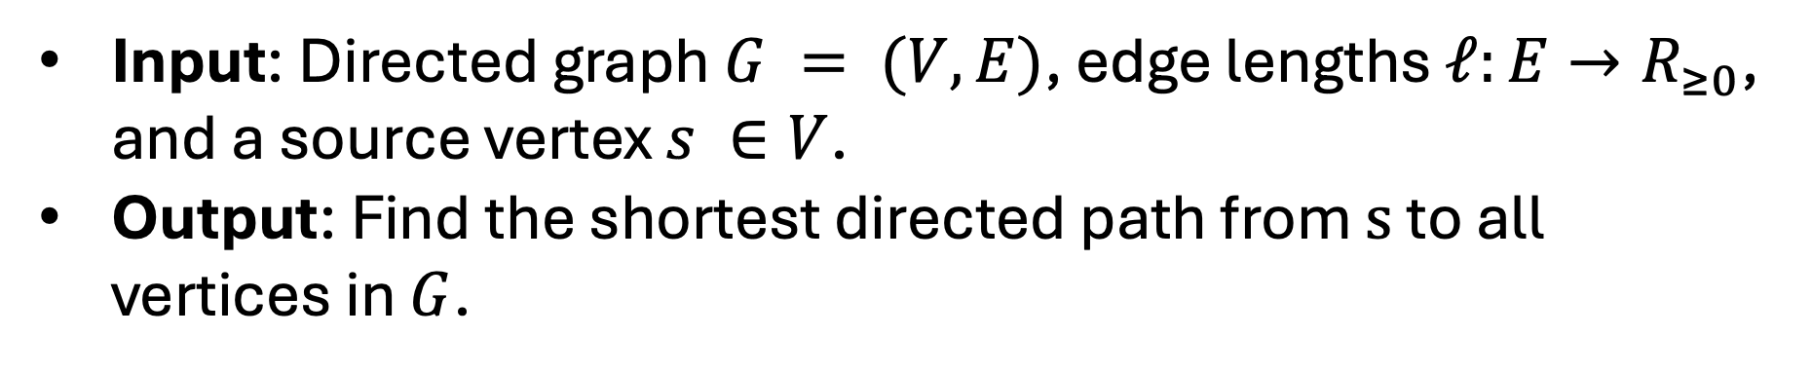
Single Pair Shortest Path
Input: Directed graph $G = (V,E)$, edge lengths $ℓ:E→R_{≥0}$, and a source vertex $s ∈V$.
Output: Find the shortest directed path from $s$ to all vertices in $G$.
$$s$$
11
5
6
2
5
1
3
5
4
3
2
12
Shortest Path Tree

Slide 8



Dijkstra’s Algorithm Idea
Algorithm Idea: ?
$$x$$
$$s$$
11
5
6
2
5
1
3
5
4
3
2
12
$$w$$
$$y$$

Slide 9
Dijkstra’s Algorithm Idea
Algorithm Idea: In each iteration, pick an edge from my shortest path tree to the “nearest” vertex not yet in the tree. Nearest means distance to the root, s.
$$x$$
$$s$$
11
5
6
2
5
1
3
5
4
3
2
12
$$w$$
$$y$$

Slide 10
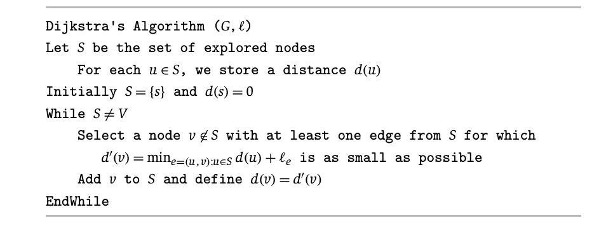
Dijkstra’s Algorithm
$$x$$
$$s$$
11
5
6
2
5
1
3
5
4
3
2
12
$$w$$
$$y$$

Slide 11
Dijkstra’s Algorithm
$$x$$
This is the distance from s to something on the “frontier”.
$$s$$
11
5
6
2
5
1
3
5
4
3
2
12
$$w$$
$$y$$

Slide 12




Dijkstra’s Algorithm Idea
Look at all neighbors of S. Determine which has the shortest path from s. Add that to S. Repeat.
$$S$$
$$x$$
$$s$$
$$z$$
$$y$$

Slide 13






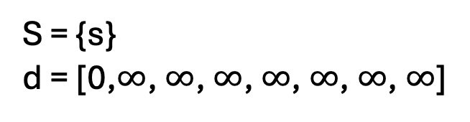


Dijkstra’s Algorithm Idea
S = {s} d = [0,$∞$, $∞$, $∞$, $∞$, $∞$, $∞$, $∞$]
$$s$$
$$v_{2}$$
11
5
$$v_{4}$$
6
$$v_{6}$$
$$v_{0}$$
2
5
1
3
$$v_{3}$$
5
4
3
$$v_{1}$$
2
$$v_{5}$$
12
$$v_{7}$$

Slide 14


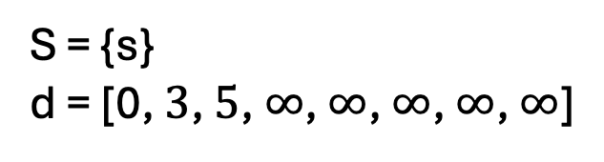
Dijkstra’s Algorithm Idea
S = {s} d = [0, $3$, $5$, $∞$, $∞$, $∞$, $∞$, $∞$]
$$s$$
$$v_{2}$$
11
5
$$v_{4}$$
6
$$v_{6}$$
$$v_{0}$$
2
5
1
3
$$v_{3}$$
5
4
3
$$v_{1}$$
2
$$v_{5}$$
12
$$v_{7}$$

Slide 15
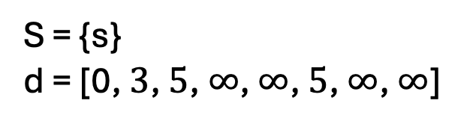
Dijkstra’s Algorithm Idea
S = {s} d = [0, $3$, $5$, $∞$, $∞$, $5$, $∞$, $∞$]
$$s$$
$$v_{2}$$
11
5
$$v_{4}$$
6
$$v_{6}$$
$$v_{0}$$
2
5
1
3
$$v_{3}$$
5
4
3
$$v_{1}$$
2
$$v_{5}$$
12
$$v_{7}$$

Slide 16

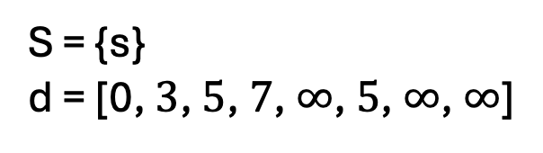
Dijkstra’s Algorithm Idea
S = {s} d = [0, $3$, $5$, $7$, $∞$, $5$, $∞$, $∞$]
$$s$$
$$v_{2}$$
11
5
$$v_{4}$$
6
$$v_{6}$$
$$v_{0}$$
2
5
1
3
$$v_{3}$$
5
4
3
$$v_{1}$$
2
$$v_{5}$$
12
$$v_{7}$$

Slide 17

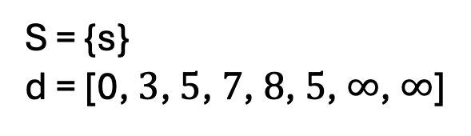

Dijkstra’s Algorithm Idea
S = {s} d = [0, $3$, $5$, $7$, $8$, $5$, $∞$, $∞$]
$$s$$
$$v_{2}$$
11
5
$$v_{4}$$
6
$$v_{6}$$
$$v_{0}$$
2
5
1
3
$$v_{3}$$
5
4
3
$$v_{1}$$
2
$$v_{5}$$
12
$$v_{7}$$

Slide 18
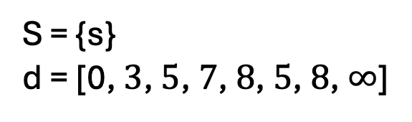
Dijkstra’s Algorithm Idea
S = {s} d = [0, $3$, $5$, $7$, $8$, $5$, $8$, $∞$]
$$s$$
$$v_{2}$$
11
5
$$v_{4}$$
6
$$v_{6}$$
$$v_{0}$$
2
5
1
3
$$v_{3}$$
5
4
3
$$v_{1}$$
2
$$v_{5}$$
12
$$v_{7}$$

Slide 19
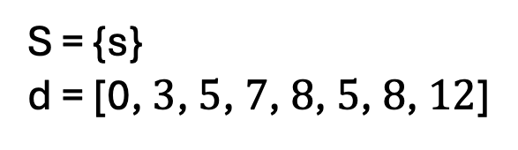
Dijkstra’s Algorithm Idea
S = {s} d = [0, $3$, $5$, $7$, $8$, $5$, $8$, $12$]
$$s$$
$$v_{2}$$
11
5
$$v_{4}$$
6
$$v_{6}$$
$$v_{0}$$
2
5
1
3
$$v_{3}$$
5
4
3
$$v_{1}$$
2
$$v_{5}$$
12
$$v_{7}$$

Slide 20
Paths?
Q: How do we return the paths?
$$s$$
$$v_{2}$$
11
5
$$v_{4}$$
6
$$v_{6}$$
$$v_{0}$$
2
5
1
3
$$v_{3}$$
5
4
3
$$v_{1}$$
2
$$v_{5}$$
12
$$v_{7}$$

Slide 21
Paths?
Let P a n length array of Null.
A: When we add v to S, we can also keep track of what edge was used.
Set P[v] = u such that (u,v) was min.
$$s$$
$$v_{2}$$
11
5
$$v_{4}$$
6
$$v_{6}$$
$$v_{0}$$
2
5
1
3
$$v_{3}$$
5
4
3
$$v_{1}$$
2
$$v_{5}$$
12
$$v_{7}$$

Slide 22
Paths?
Let P a n length array of Null.
Q: How do we get the shortest path from s to w?
Set P[v] = u such that (u,v) was min.
$$s$$
$$v_{2}$$
11
5
$$v_{4}$$
6
$$v_{6}$$
$$v_{0}$$
2
5
1
3
$$v_{3}$$
5
4
3
$$v_{1}$$
2
$$v_{5}$$
12
$$v_{7}$$

Slide 23
Paths?
Let P a n length array of Null.
A: We can recursively construct it by looking at taking the edge (P[w],w) and the shortest path from s to P[w].
Set P[v] = u such that (u,v) was min.
$$s$$
$$v_{2}$$
11
5
$$v_{4}$$
6
$$v_{6}$$
$$v_{0}$$
2
5
1
3
$$v_{3}$$
5
4
3
$$v_{1}$$
2
$$v_{5}$$
12
$$v_{7}$$

Slide 24
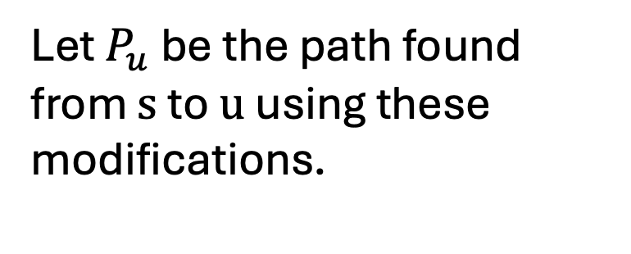
Paths
Let P a n length array of Null.
Let $P_{u}$ be the path found from $s$ to $u$ using these modifications.
Set P[v] = u such that (u,v) was min.
$$s$$
$$v_{2}$$
11
5
$$v_{4}$$
6
$$v_{6}$$
$$v_{0}$$
2
5
1
3
$$v_{3}$$
5
4
3
$$v_{1}$$
2
$$v_{5}$$
12
$$v_{7}$$

Slide 25
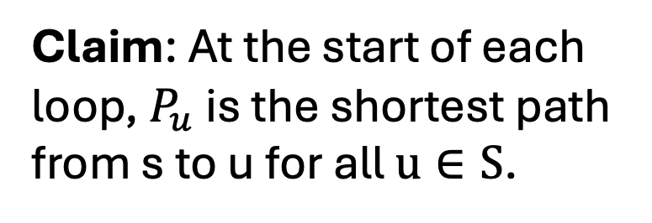
Correctness
Claim: At the start of each loop, $P_{u}$ is the shortest path from s to u for all $u∈S$.
$$s$$
$$v_{2}$$
11
5
$$v_{4}$$
6
$$v_{6}$$
$$v_{0}$$
2
5
1
3
$$v_{3}$$
5
4
3
$$v_{1}$$
2
$$v_{5}$$
12
$$v_{7}$$

Slide 26

Proof Idea
We proceed with induction on the size of $S$.
If $|S|= 1$, then…

Slide 27

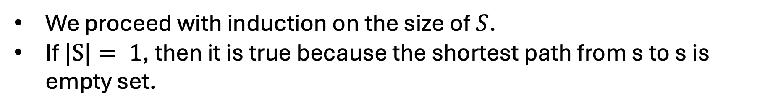
Proof Idea
We proceed with induction on the size of $S$.
If $|S|= 1$, then it is true because the shortest path from s to s is empty set.
$$s$$

Slide 28

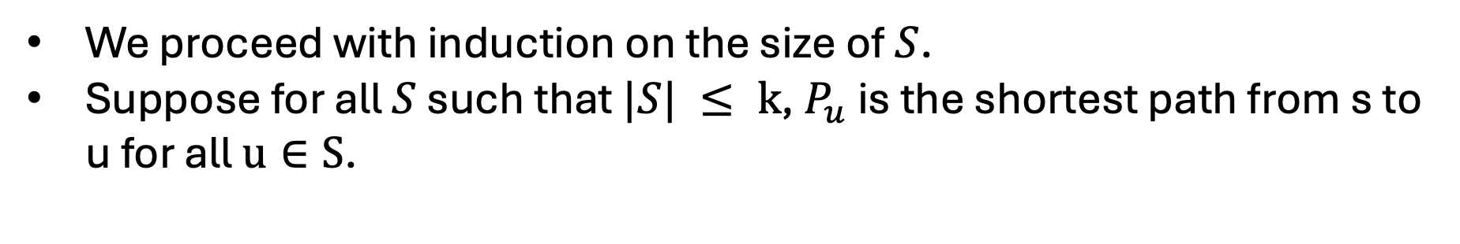
Proof Idea
We proceed with induction on the size of $S$.
Suppose for all $S$ such that $|S| ≤ k$, $P_{u}$ is the shortest path from s to u for all $u∈S$.
$$S$$
$$s$$

Slide 29

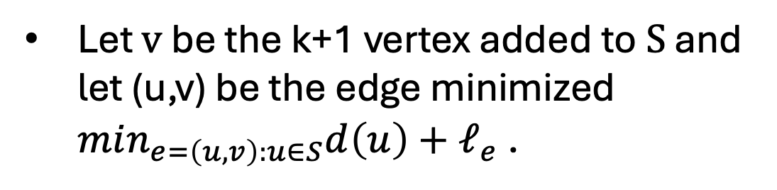

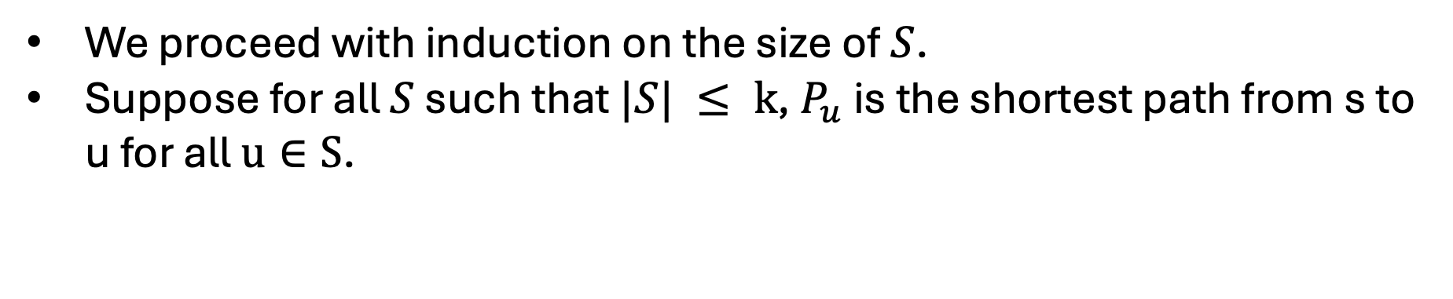
Proof Idea
We proceed with induction on the size of $S$.
Suppose for all $S$ such that $|S| ≤ k$, $P_{u}$ is the shortest path from s to u for all $u∈S$.
$$S$$
Let $v$ be the k+1 vertex added to $S$ and let (u,v) be the edge minimized $min_{e=\left(u,v\right):u∈S}d\left(u\right)+ℓ_{e}$ .
$$s$$
$$v$$
$$u$$

Slide 30
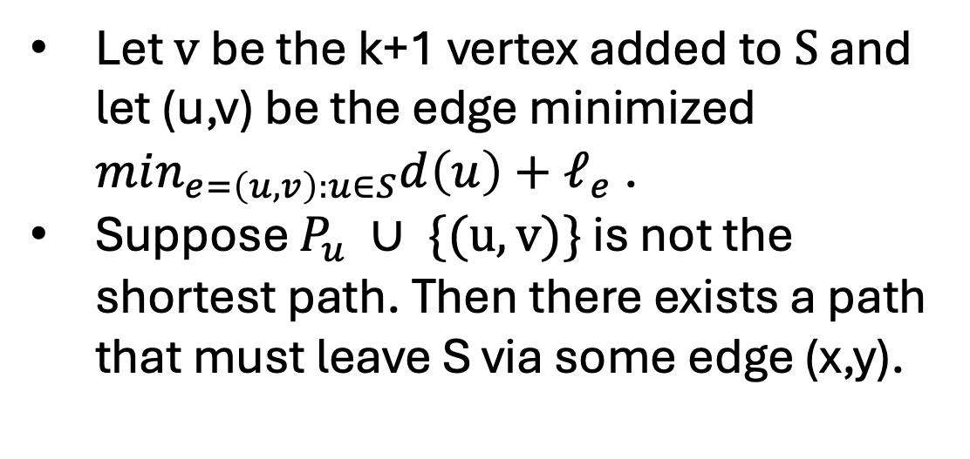


Proof Idea
We proceed with induction on the size of $S$.
Suppose for all $S$ such that $|S| ≤ k$, $P_{u}$ is the shortest path from s to u for all $u∈S$.
$$S$$
Let $v$ be the k+1 vertex added to $S$ and let (u,v) be the edge minimized $min_{e=\left(u,v\right):u∈S}d\left(u\right)+ℓ_{e}$ .
Suppose $P_{u} ∪ \{(u,v)\}$ is not the shortest path. Then there exists a path that must leave S via some edge (x,y).
$$s$$
$$v$$
$$u$$
$$x$$
$$y$$

Slide 31
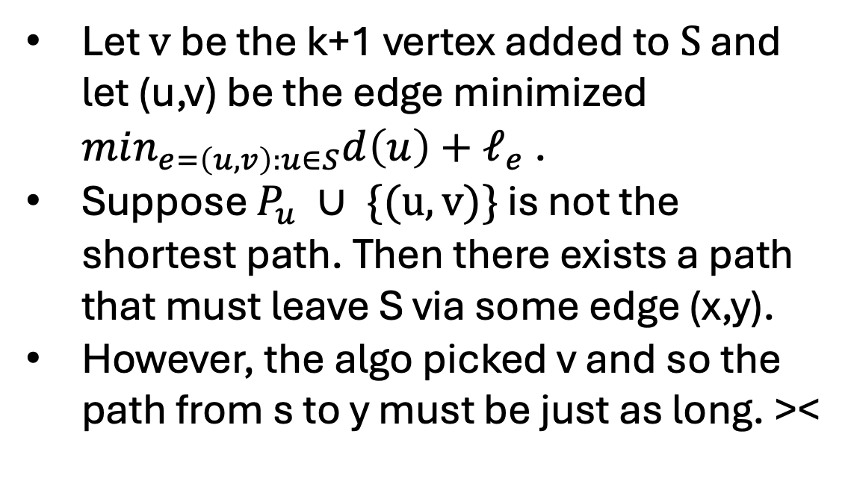
Proof Idea
We proceed with induction on the size of $S$.
Suppose for all $S$ such that $|S| ≤ k$, $P_{u}$ is the shortest path from s to u for all $u∈S$.
$$S$$
Let $v$ be the k+1 vertex added to $S$ and let (u,v) be the edge minimized $min_{e=\left(u,v\right):u∈S}d\left(u\right)+ℓ_{e}$ .
Suppose $P_{u} ∪ \{(u,v)\}$ is not the shortest path. Then there exists a path that must leave S via some edge (x,y).
However, the algo picked v and so the path from s to y must be just as long. ><
$$s$$
$$v$$
$$u$$
$$x$$
$$y$$

Slide 32

Q: What about negative edge weights?
A: If you have negative edge weights then you can have negative cycles and the minimum distance becomes “weird or hard to find."
$$s$$
$$v_{2}$$
-11
5
$$v_{4}$$
6
$$v_{6}$$
$$v_{0}$$
2
5
1
3
$$v_{3}$$
5
4
3
$$v_{1}$$
2
$$v_{5}$$
12
$$v_{7}$$

Slide 33
Q: What about negative edge weights?
A: If you have negative edge weights then you can have negative cycles, and the minimum distance becomes “weird or hard to find."
$$s$$
$$v_{2}$$
-11
5
$$v_{4}$$
6
$$v_{6}$$
$$v_{0}$$
2
5
1
3
$$v_{3}$$
5
4
3
$$v_{1}$$
2
$$v_{5}$$
12
$$v_{7}$$

Slide 34
Dijkstra’s Algorithm
$$x$$
Q: How many times might we compute this?
$$s$$
11
5
6
2
5
1
3
5
4
3
2
12
$$w$$
$$y$$

Slide 35
Dijkstra’s Algorithm
$$x$$
A: We may do it several times because of large frontier.
$$s$$
11
5
6
2
5
1
3
5
4
3
2
12
$$w$$
$$y$$

Slide 36



Dijkstra’s Algorithm Idea
$$c$$
$$b$$
Observation: A vertex could be in the frontier a lot!
Idea: Don’t recompute every time!
$$a$$
$$S$$
$$x$$
$$s$$
$$z$$
$$y$$

Slide 37
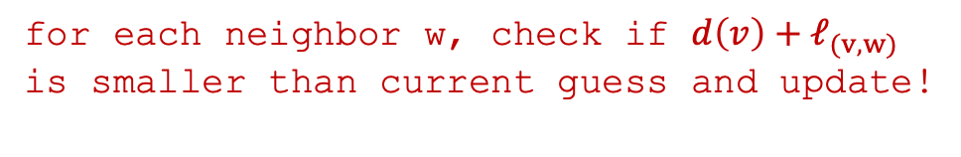
Dijkstra’s Algorithm Optimization
$$x$$
$$s$$
11
and $d\left(w\right)=ℓ_{(s,w)}$for everyone neighbors of s
5
6
2
5
1
3
5
4
3
for each neighbor w, check if $d\left(v\right)+ℓ_{(v,w)}$
is smaller than current guess and update!
2
12
$$w$$

Slide 38
Dijkstra’s Algorithm Optimization
$$x$$
Q: How long to find the min?
$$s$$
11
and $d\left(w\right)=ℓ_{(s,w)}$for everyone neighbors of s
5
6
2
5
1
3
5
4
3
for each neighbor w, check if $d\left(v\right)+ℓ_{(v,w)}$
is smaller than current guess and update!
2
12
$$w$$

Slide 39
Dijkstra’s Algorithm Optimization
$$x$$
A: Still loop over everything in frontier (O(n)).
$$s$$
11
and $d\left(w\right)=ℓ_{(s,w)}$for everyone neighbors of s
5
6
2
5
1
3
5
4
3
for each neighbor w, check if $d\left(v\right)+ℓ_{(v,w)}$
is smaller than current guess and update!
2
12
$$w$$

Slide 40
Priority Queue
A priority queue is a data structure that supports the following operations:
Insert(PQ, v, p): Inserts element v into PQ with priority p.
Pop-Min(PQ): Returns element with minimum priority and removes it from PQ.
Decrease-Key(PQ,v,p): Updates the priority of v in PQ to be p.
Recall: You can implement this using a Heap data structure.

Slide 41
Input: graph G = (V,E), lengths L, and start s
Initialize Priority Queue PQ, arrays P and d
For Each v in V:
Let P[v] = Null and d[v] = INFINITY
Insert v into PQ with priority d[v]
Let d[s] = 0
While PQ is not empty:
u = Pop-Min(PQ)
For each edge e = (u,v) in E leaving u:
If d[v] > d[u] + L[e]:
Decrease-Key(PQ, v, d[u] + L[e])
d[v] = d[u] + L[e]
P[v] = u

Slide 42
Dijkstra’s Algorithm Runtime
The runtime depends on the priority queue used.
Using a priority queue, Dijkstra’s Algorithm can be implemented on a graph with n nodes and m edges to run in O(m) time plus the time for n Pop-Min and m Decrease-Priority operations.
Using the heap-based priority queue, each priority queue operation can be implemented in log(n) time giving a total runtime of O(mlog(n)).

Slide 43
Input: graph G = (V,E), lengths L, and start s
Initialize Priority Queue PQ, arrays P and d
For Each v in V:
Let P[v] = Null and d[v] = INFINITY
Insert v into PQ with priority d[v]
Let d[s] = 0
While PQ is not empty:
u = Pop-Min(PQ)
For each edge e = (u,v) in E leaving u:
If d[v] > d[u] + L[e]:
Decrease-Key(PQ, v, d[u] + L[e])
d[v] = d[u] + L[e]
P[v] = u

Slide 44
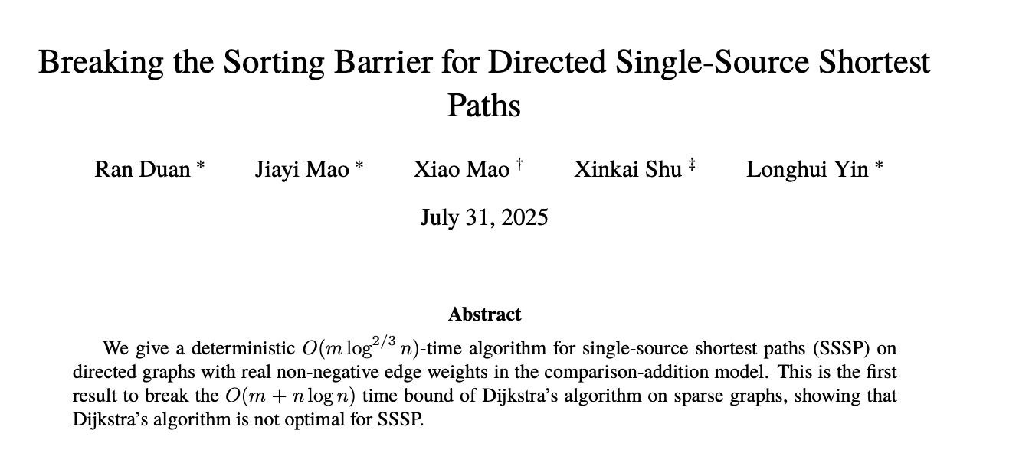
Even Better?

