Slide 1

CSE 331: Algorithms & Complexity
“Dijkstra’s Algorithm”
Prof. Charlie Anne Carlson (She/Her)
Lecture 18
Wednesday October 15, 2025

Slide 2

Schedule
Course Updates
Dijkstra’s Algorithm
Proof of Correctness
Min Spanning Trees
Kruskal’s Algorithm
Prim’s Algorithm

Slide 3

Course Updates
Everything Besides Midterm Graded
Midterm Grades
HW 4 Out
Due Next Week!
Group Project
First Problems Oct 31st

Slide 4
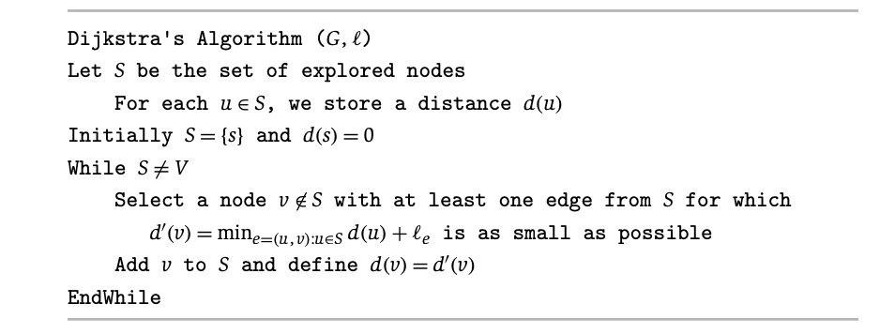
Paths
Let P a n length array of Null.
Let $P_{u}$ be the path found from $s$ to $u$ using these modifications.
Set P[v] = u such that (u,v) was min.
$$s$$
$$v_{2}$$
11
5
$$v_{4}$$
6
$$v_{6}$$
$$v_{0}$$
2
5
1
3
$$v_{3}$$
5
4
3
$$v_{1}$$
2
$$v_{5}$$
12
$$v_{7}$$

Slide 5
Correctness
Claim: At the start of each loop, $P_{u}$ is the shortest path from s to u for all $u∈S$.
$$s$$
$$v_{2}$$
11
5
$$v_{4}$$
6
$$v_{6}$$
$$v_{0}$$
2
5
1
3
$$v_{3}$$
5
4
3
$$v_{1}$$
2
$$v_{5}$$
12
$$v_{7}$$

Slide 6
Proof Idea
We proceed with induction on the size of $S$.
If $|S|= 1$, then…

Slide 7
Proof Idea
We proceed with induction on the size of $S$.
If $|S|= 1$, then it is true because the shortest path from s to s is empty set.
$$s$$

Slide 8
Proof Idea
We proceed with induction on the size of $S$.
Suppose for all $S$ such that $|S| ≤ k$, $P_{u}$ is the shortest path from s to u for all $u∈S$.
$$S$$
$$s$$

Slide 9
Proof Idea
We proceed with induction on the size of $S$.
Suppose for all $S$ such that $|S| ≤ k$, $P_{u}$ is the shortest path from s to u for all $u∈S$.
$$S$$
Let $v$ be the k+1 vertex added to $S$ and let (u,v) be the edge minimized $min_{e=\left(u,v\right):u∈S}d\left(u\right)+ℓ_{e}$ .
$$s$$
$$v$$
$$u$$

Slide 10
Proof Idea
We proceed with induction on the size of $S$.
Suppose for all $S$ such that $|S| ≤ k$, $P_{u}$ is the shortest path from s to u for all $u∈S$.
$$S$$
Let $v$ be the k+1 vertex added to $S$ and let (u,v) be the edge minimized $min_{e=\left(u,v\right):u∈S}d\left(u\right)+ℓ_{e}$ .
Suppose $P_{u} ∪ \{(u,v)\}$ is not the shortest path. Then there exists a path that must leave S via some edge (x,y).
$$s$$
$$v$$
$$u$$
$$x$$
$$y$$

Slide 11
Proof Idea
We proceed with induction on the size of $S$.
Suppose for all $S$ such that $|S| ≤ k$, $P_{u}$ is the shortest path from s to u for all $u∈S$.
$$S$$
Let $v$ be the k+1 vertex added to $S$ and let (u,v) be the edge minimized $min_{e=\left(u,v\right):u∈S}d\left(u\right)+ℓ_{e}$ .
Suppose $P_{u} ∪ \{(u,v)\}$ is not the shortest path. Then there exists a path that must leave S via some edge (x,y).
However, the algo picked v and so the path from s to y must be just as long. ><
$$s$$
$$v$$
$$u$$
$$x$$
$$y$$

Slide 12

Q: What about negative edge weights?
A: If you have negative edge weights then you can have negative cycles and the minimum distance becomes “weird or hard to find."
$$s$$
$$v_{2}$$
-11
5
$$v_{4}$$
6
$$v_{6}$$
2
$$v_{0}$$
1
5
3
$$v_{3}$$
5
4
3
$$v_{1}$$
2
$$v_{5}$$
12
$$v_{7}$$

Slide 13
Q: What about negative edge weights?
A: If you have negative edge weights then you can have negative cycles, and the minimum distance becomes “weird or hard to find."
$$s$$
$$v_{2}$$
-11
5
$$v_{4}$$
6
$$v_{6}$$
$$v_{0}$$
2
5
1
3
$$v_{3}$$
5
4
3
$$v_{1}$$
2
$$v_{5}$$
12
$$v_{7}$$

Slide 14
Dijkstra’s Algorithm
$$x$$
Q: How many times might we compute this?
$$s$$
11
5
6
2
5
1
3
5
4
3
2
12
$$w$$
$$y$$

Slide 15
Dijkstra’s Algorithm
$$x$$
A: We may do it several times because of large frontier.
$$s$$
11
5
6
2
5
1
3
5
4
3
2
12
$$w$$
$$y$$

Slide 16
Dijkstra’s Algorithm Idea
$$c$$
$$b$$
Observation: A vertex could be in the frontier a lot!
Idea: Don’t recompute every time!
$$a$$
$$S$$
$$x$$
$$s$$
$$z$$
$$y$$

Slide 17
Dijkstra’s Algorithm Optimization
$$x$$
$$s$$
11
and $d\left(w\right)=ℓ_{(s,w)}$for everyone neighbors of s
5
6
2
5
1
3
5
4
3
for each neighbor w, check if $d\left(v\right)+ℓ_{(v,w)}$
is smaller than current guess and update!
2
12
$$w$$

Slide 18
Dijkstra’s Algorithm Optimization
$$x$$
Q: How long to find the min?
$$s$$
11
and $d\left(w\right)=ℓ_{(s,w)}$for everyone neighbors of s
5
6
2
5
1
3
5
4
3
for each neighbor w, check if $d\left(v\right)+ℓ_{(v,w)}$
is smaller than current guess and update!
2
12
$$w$$

Slide 19
Dijkstra’s Algorithm Optimization
$$x$$
A: Still loop over everything in frontier (O(n)).
$$s$$
11
and $d\left(w\right)=ℓ_{(s,w)}$for everyone neighbors of s
5
6
2
5
1
3
5
4
3
for each neighbor w, check if $d\left(v\right)+ℓ_{(v,w)}$
is smaller than current guess and update!
2
12
$$w$$

Slide 20
Priority Queue
A priority queue is a data structure that supports the following operations:
Insert(PQ, v, p): Inserts element v into PQ with priority p.
Pop-Min(PQ): Returns element with minimum priority and removes it from PQ.
Decrease-Key(PQ,v,p): Updates the priority of v in PQ to be p.
Recall: You can implement this using a Heap data structure.

Slide 21
Input: graph G = (V,E), lengths L, and start s
Initialize Priority Queue PQ, arrays P and d
For Each v in V:
Let P[v] = Null and d[v] = INFINITY
Insert v into PQ with priority d[v]
Let d[s] = 0
While PQ is not empty:
u = Pop-Min(PQ)
For each edge e = (u,v) in E leaving u:
If d[v] > d[u] + L[e]:
Decrease-Key(PQ, v, d[u] + L[e])
d[v] = d[u] + L[e]
P[v] = u

Slide 22
Dijkstra’s Algorithm Runtime
The runtime depends on the priority queue used.
Using a priority queue, Dijkstra’s Algorithm can be implemented on a graph with n nodes and m edges to run in O(m) time plus the time for n Pop-Min and m Decrease-Priority operations.
Using the heap-based priority queue, each priority queue operation can be implemented in log(n) time giving a total runtime of O(mlog(n)).

Slide 23
Input: graph G = (V,E), lengths L, and start s
Initialize Priority Queue PQ, arrays P and d
For Each v in V:
Let P[v] = Null and d[v] = INFINITY
Insert v into PQ with priority d[v]
Let d[s] = 0
While PQ is not empty:
u = Pop-Min(PQ)
For each edge e = (u,v) in E leaving u:
If d[v] > d[u] + L[e]:
Decrease-Key(PQ, v, d[u] + L[e])
d[v] = d[u] + L[e]
P[v] = u

Slide 24
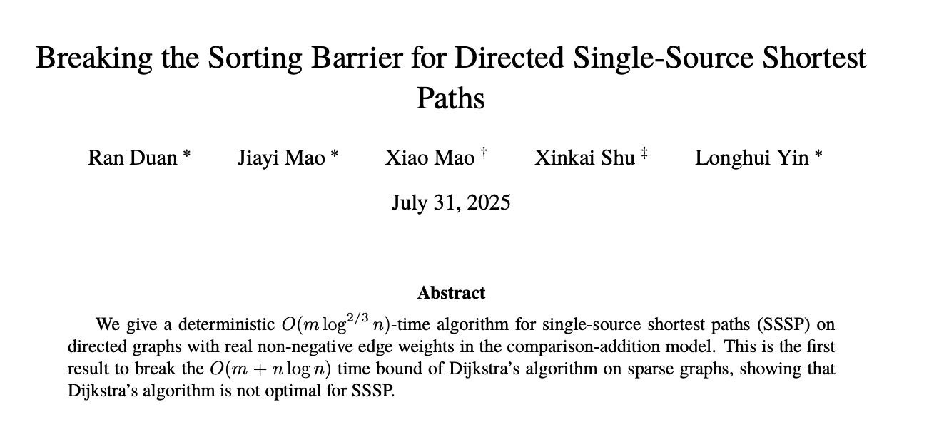
Even Better?

Slide 25
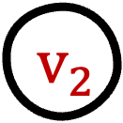


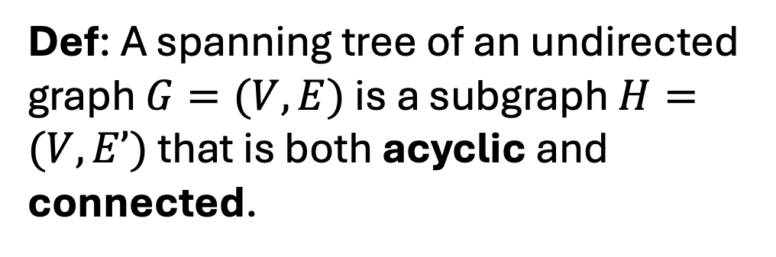


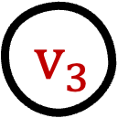
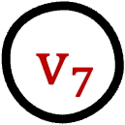


Spanning Trees
$$v_{8}$$
$$v_{3}$$
Super Graph
$$v_{0}$$
$$v_{6}$$
$$v_{5}$$
$$v_{2}$$
$$v_{4}$$
Def: A spanning tree of an undirected graph $G=(V,E)$ is a subgraph $H=(V,E’)$ that is both acyclic and connected.
$$v_{1}$$
$$v_{7}$$

Slide 26
Spanning Trees
$$v_{8}$$
$$v_{3}$$
Spanning Tree
$$v_{0}$$
$$v_{6}$$
$$v_{5}$$
$$v_{2}$$
$$v_{4}$$
Def: A spanning tree of an undirected graph $G=(V,E)$ is a subgraph $H=(V,E’)$ that is both acyclic and connected.
$$v_{1}$$
$$v_{7}$$

Slide 27
Q: How many edges does a spanning tree have?
$$v_{8}$$
$$v_{3}$$
Spanning Tree
$$v_{0}$$
$$v_{6}$$
$$v_{5}$$
$$v_{2}$$
$$v_{4}$$
Def: A spanning tree of an undirected graph $G=(V,E)$ is a subgraph $H=(V,E’)$ that is both acyclic and connected.
$$v_{1}$$
$$v_{7}$$

Slide 28
A: It has |V| - 1 because it is a tree!
$$v_{8}$$
$$v_{3}$$
Spanning Tree
$$v_{0}$$
$$v_{6}$$
$$v_{5}$$
$$v_{2}$$
$$v_{4}$$
Def: A spanning tree of an undirected graph $G=(V,E)$ is a subgraph $H=(V,E’)$ that is both acyclic and connected.
$$v_{1}$$
$$v_{7}$$

Slide 29
Q: Can you have more than one spanning tree?
$$v_{8}$$
$$v_{3}$$
Spanning Tree
$$v_{0}$$
$$v_{6}$$
$$v_{5}$$
$$v_{2}$$
$$v_{4}$$
Def: A spanning tree of an undirected graph $G=(V,E)$ is a subgraph $H=(V,E’)$ that is both acyclic and connected.
$$v_{1}$$
$$v_{7}$$

Slide 30
A: Can you have more than one spanning tree?
$$v_{8}$$
$$v_{3}$$
Spanning Tree
$$v_{0}$$
$$v_{6}$$
$$v_{5}$$
$$v_{2}$$
$$v_{4}$$
Def: A spanning tree of an undirected graph $G=(V,E)$ is a subgraph $H=(V,E’)$ that is both acyclic and connected.
$$v_{1}$$
$$v_{7}$$

Slide 31
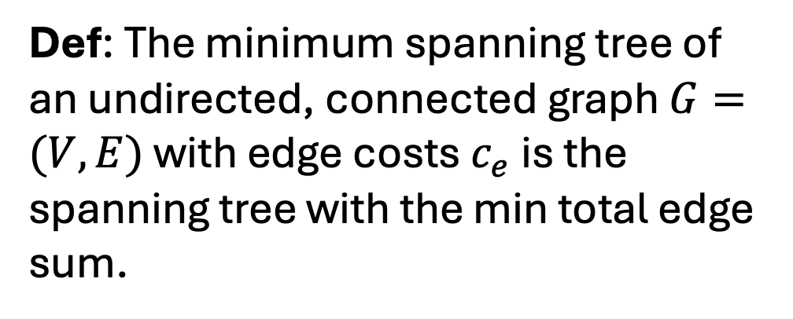
Minimum Spanning Trees
$$v_{8}$$
$$v_{3}$$
1
Super Graph
3
$$v_{0}$$
5
$$v_{6}$$
4
4
8
3
$$v_{5}$$
1
$$v_{2}$$
1
2
2
7
$$v_{4}$$
Def: The minimum spanning tree of an undirected, connected graph $G=(V,E)$ with edge costs $c_{e}$ is the spanning tree with the min total edge sum.
$$v_{1}$$
5
1
1
$$v_{7}$$

Slide 32
Minimum Spanning Trees (MST)
$$v_{8}$$
$$v_{3}$$
1
MST
3
$$v_{0}$$
5
$$v_{6}$$
4
4
8
3
$$v_{5}$$
1
$$v_{2}$$
1
2
2
7
$$v_{4}$$
Def: The minimum spanning tree of an undirected, connected graph $G=(V,E)$ with edge costs $c_{e}$ is the spanning tree with the min total edge sum.
$$v_{1}$$
5
1
1
$$v_{7}$$

Slide 33
Minimum Spanning Trees (MST)
$$v_{8}$$
$$v_{3}$$
1
MST
3
$$v_{0}$$
5
$$v_{6}$$
4
4
8
3
$$v_{5}$$
1
$$v_{2}$$
1
2
2
7
$$v_{4}$$
$$v_{1}$$
5
Q: What if I add 100 to each edge?
Q: What if I mult each edge by 23?
Q: What if I take log of each edge?
1
1
$$v_{7}$$

Slide 34
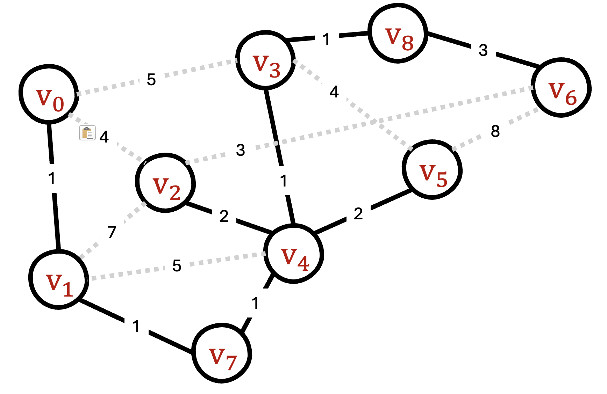
MST Algorithms (Greedy) Ideas:
Start with empty graph:
Kruskal: Add small edge that connect components.
Prim: Grow a component by taking smallest edge leaving it.
Borůvka: Add min weight edge leaving each component.
Start With G:
Reverse Kruskal: Remove big edges that aren’t needed.
MST

Slide 35
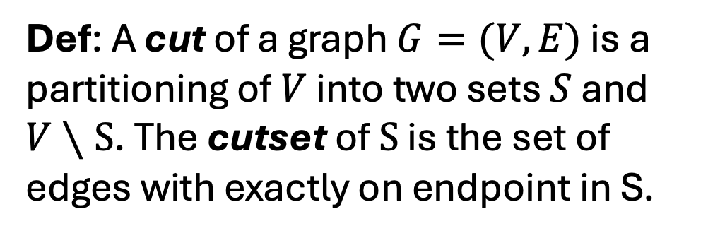
Cut (Sets)
$$v_{8}$$
1
MST
$$v_{3}$$
3
Super Graph
$$v_{0}$$
5
$$v_{6}$$
4
4
8
3
$$v_{5}$$
1
$$v_{2}$$
1
2
2
7
$$v_{4}$$
Def: A cut of a graph $G=(V,E)$ is a partitioning of $V$ into two sets $S$ and $V∖S$. The cutset of $S$ is the set of edges with exactly on endpoint in S.
$$v_{1}$$
5
1
1
$$v_{7}$$

Slide 36



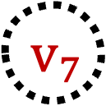

Cut (Sets)
S
$$v_{8}$$
1
MST
$$v_{3}$$
3
Cut Set of S
$$v_{0}$$
5
$$v_{6}$$
4
4
8
3
$$v_{5}$$
1
$$v_{2}$$
1
2
2
7
$$v_{4}$$
Def: A cut of a graph $G=(V,E)$ is a partitioning of $V$ into two sets $S$ and $V∖S$. The cutset of $S$ is the set of edges with exactly on endpoint in S.
$$v_{1}$$
5
1
1
$$v_{7}$$

Slide 37
Q: Can a cycle intersect a cut set an odd number of times?
$$v_{8}$$
1
MST
$$v_{3}$$
3
Cut Set of S
$$v_{0}$$
5
$$v_{6}$$
4
4
8
3
$$v_{5}$$
1
$$v_{2}$$
1
2
2
7
$$v_{4}$$
Def: A cut of a graph $G=(V,E)$ is a partitioning of $V$ into two sets $S$ and $V∖S$. The cutset of $S$ is the set of edges with exactly on endpoint in S.
$$v_{1}$$
5
1
1
$$v_{7}$$

