Slide 1

CSE 331: Algorithms & Complexity
“More Concerns…”
Prof. Charlie Anne Carlson (She/Her)
Lecture 2
Monday August 29th, 2025

Slide 2

Schedule
Course Updates
Notation
Halting Problem
Note on Induction
Learning Outcomes
When to Algorithm
Matchings

Slide 3

Course Updates
Office Hours Posted Soon
Complete Syllabus Quiz
HW0 is Due on Tuesday
Next Week Project Talk

Slide 4
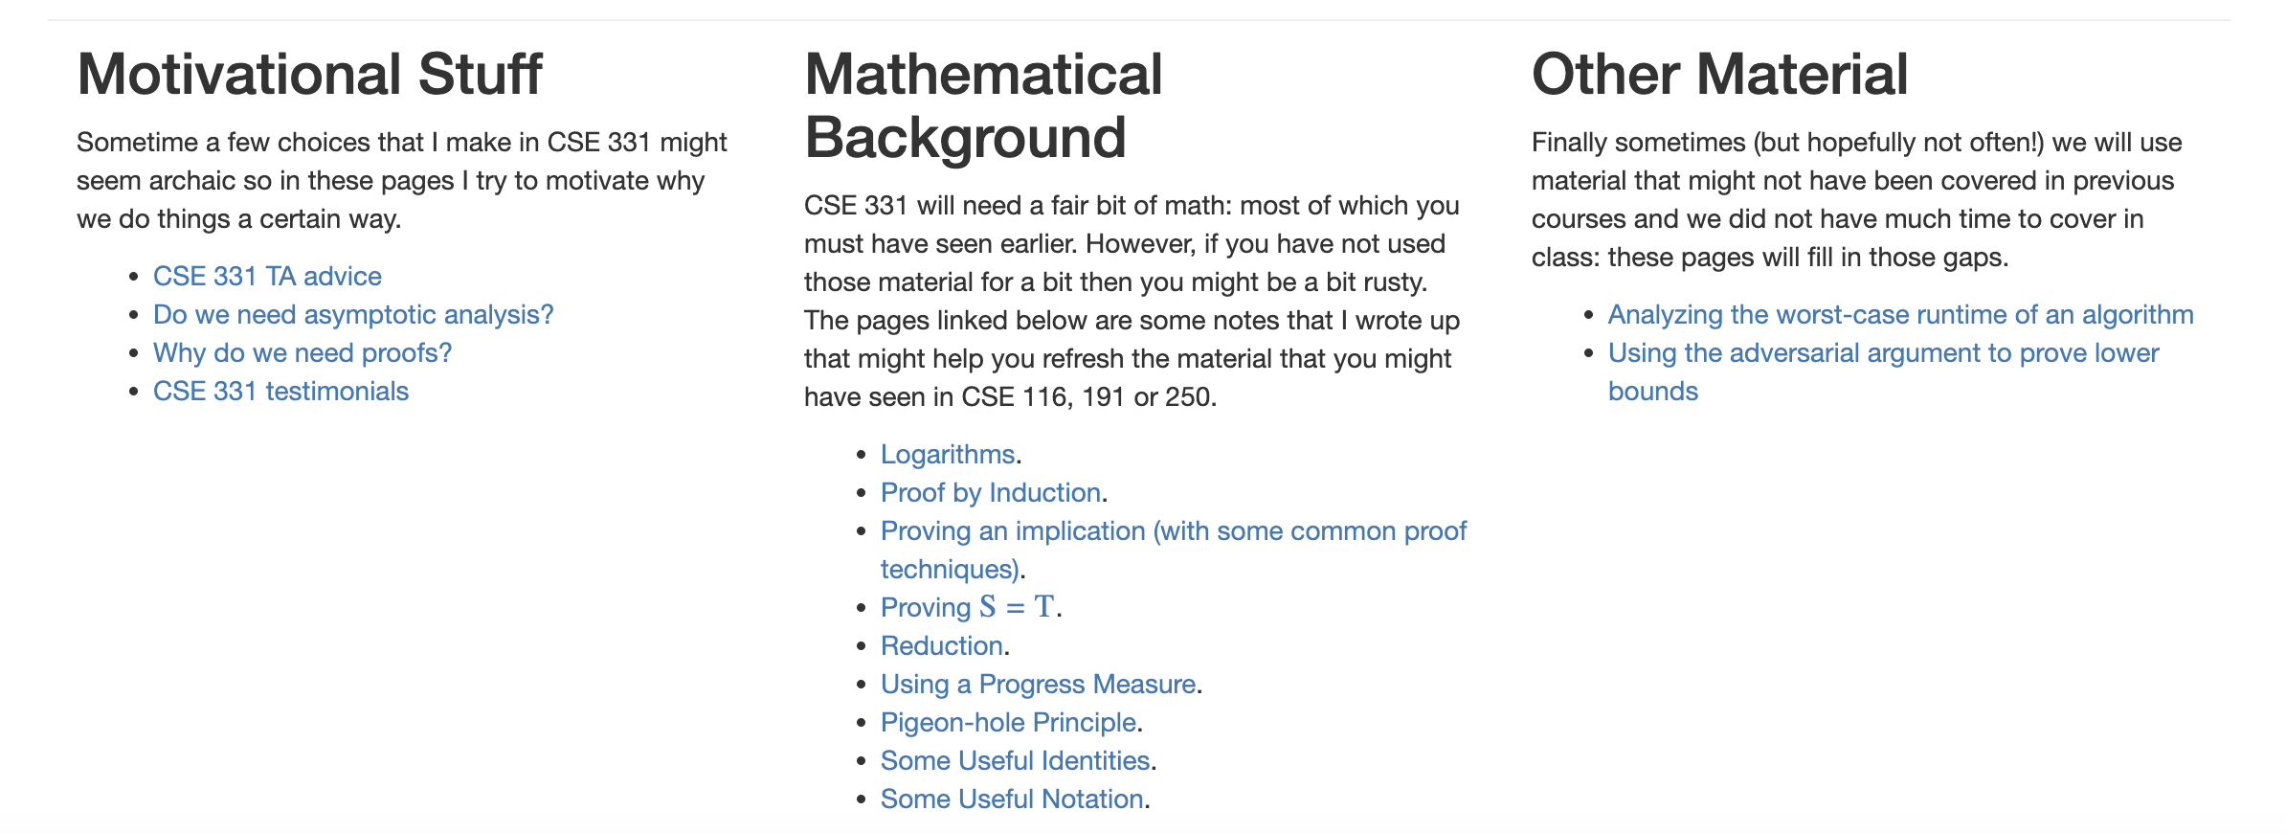
Notation

Slide 5
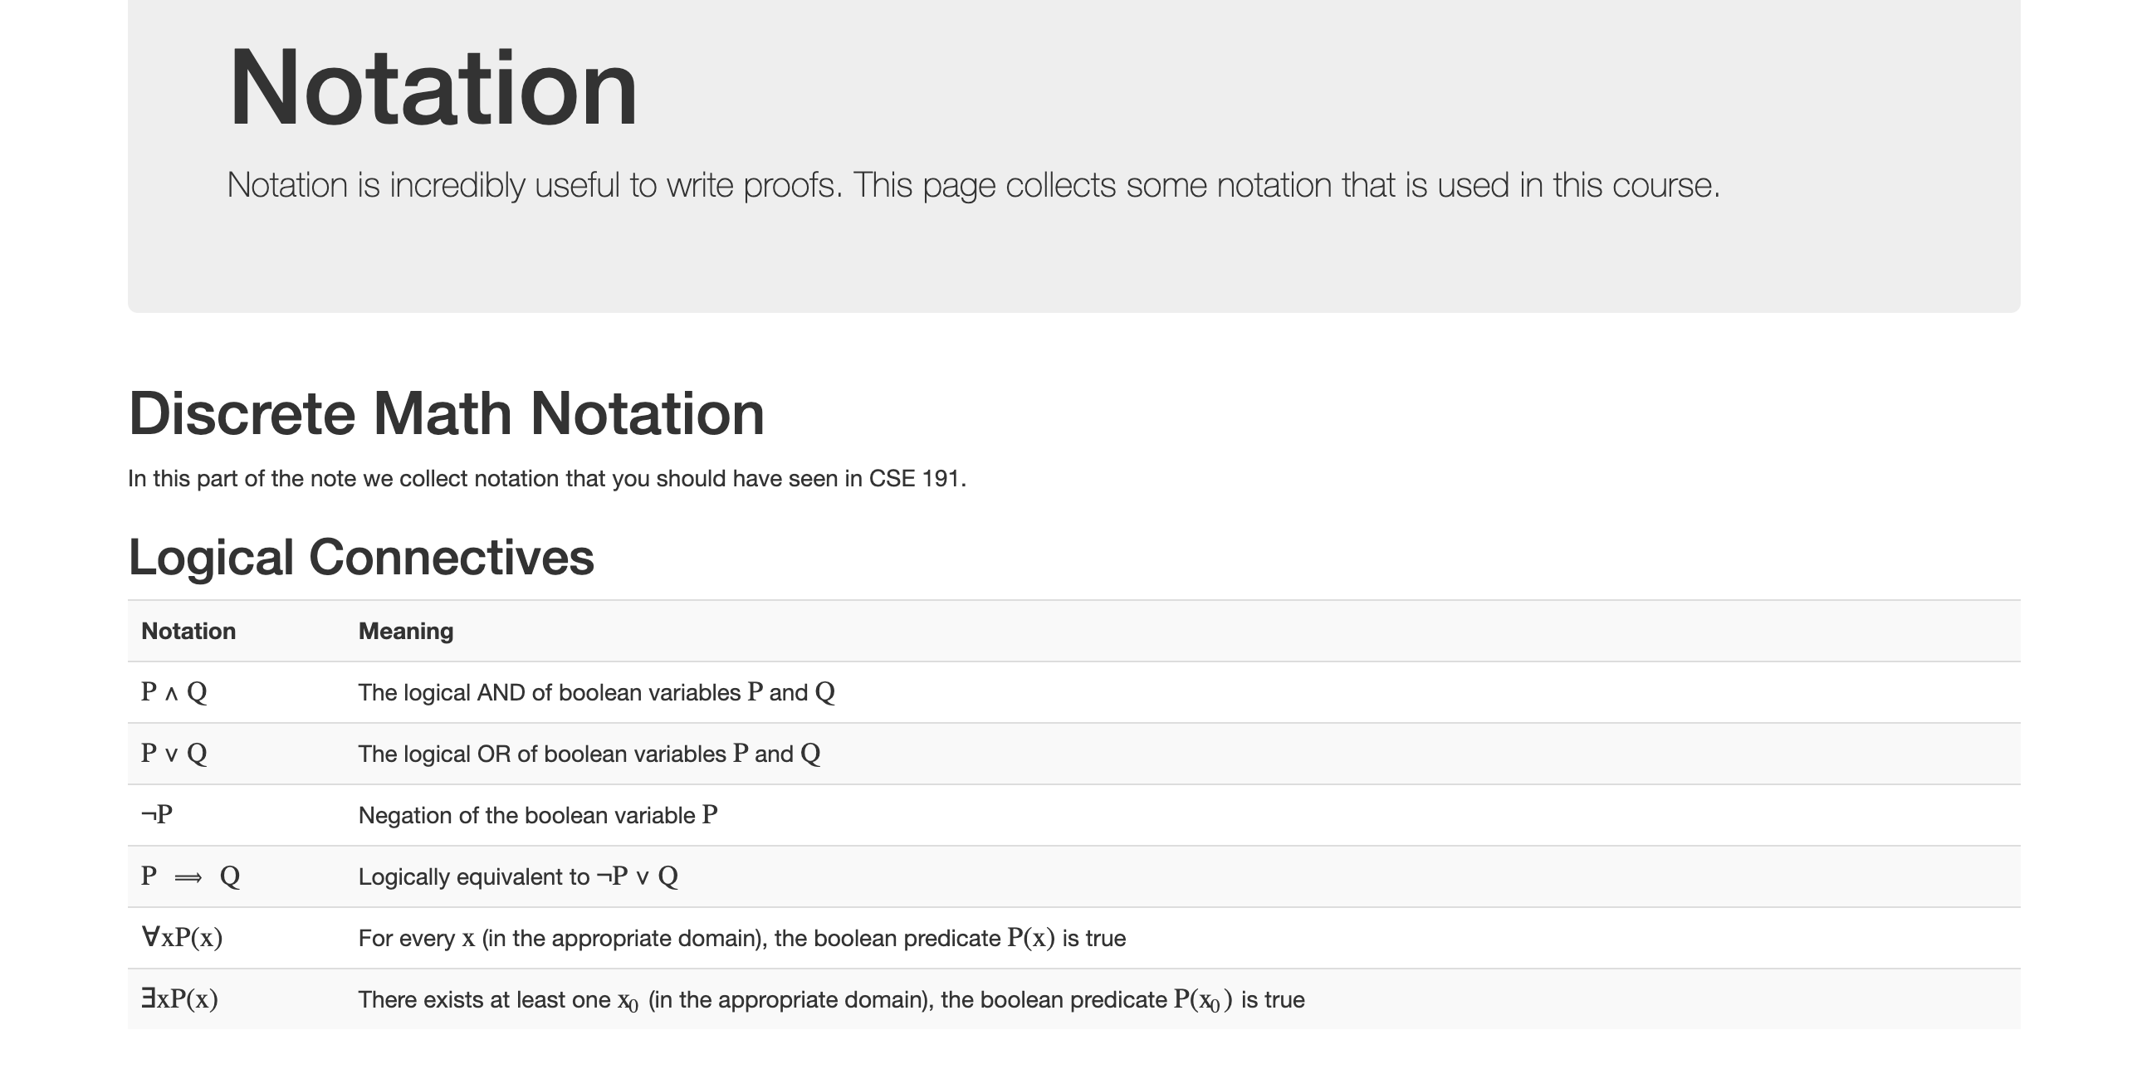
Notation

Slide 6



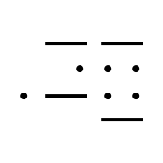
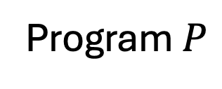
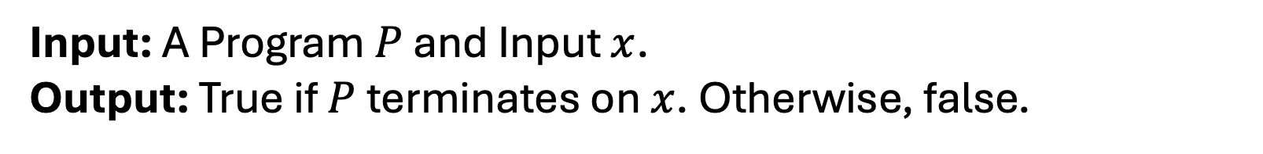
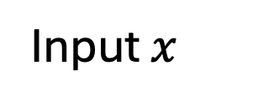
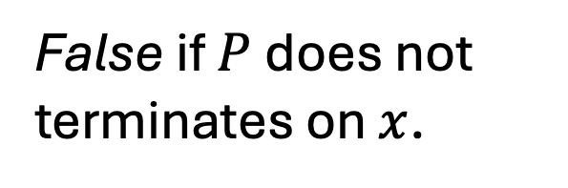
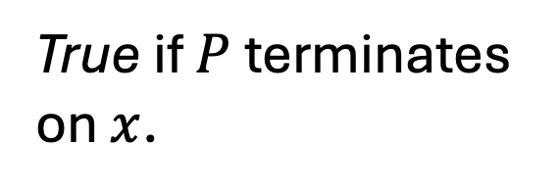
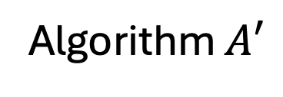

Halting Problem 2.0
Input: A Program $P$ and Input $x$.
Output: True if $P$ terminates on $x$. Otherwise, false.
Program $P$
True if $P$ terminates on $x$.
$$+$$
False if $P$ does not terminates on $x$.
Input $x$
Algorithm $A′$

Slide 7
Halting Problem 2.0 is “impossible”
Theorem: There exist no algorithm/program that will always halt and will always correctly decide Halting Problem 2.0.

Slide 8
Proof (by contradiction)
Assume the opposite: There is a problem that solves Halting Problem 2.0. Call this magic(P,I).
It must always return something.
It must always return the right answer.
Use magic to construct a contradiction.
Conclude that original assumption was wrong.

Slide 9
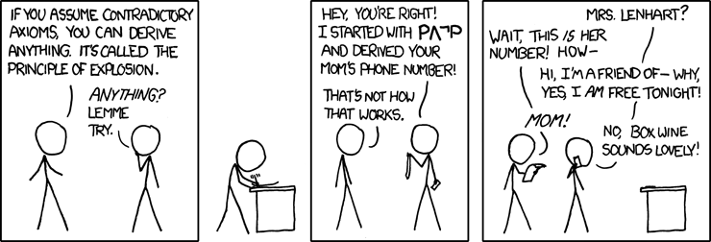

You keep using that word…
Q1: What is a contradiction?
https://xkcd.com/704/

Slide 10

Proof (by contradiction)
def contradiction ( P ): # This function takes a program as an input
#Run magic on (P,P)
if magic(P,P): # Use an UTM to make this call
while True:
continue # Do nothing
return # Just terminate if magic(P,P) returns False
Q2: What happens when we run contradiction(contradiction)?

Slide 11
Proof (by contradiction)
Assume the opposite: There is a problem that solves Halting Problem 2.0. Call this magic(P,I).
It must always return something.
It must always return the right answer.
Use magic to construct a contradiction.
Conclude that original assumption was wrong.

Slide 12
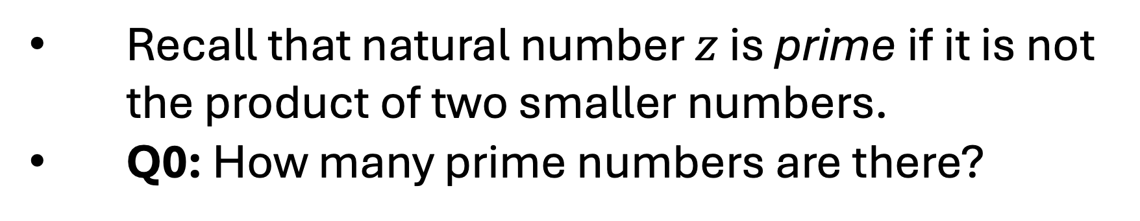
Prime Numbers
Recall that natural number $z$ is prime if it is not the product of two smaller numbers.
Q0: How many prime numbers are there?
2, 3, 5, 7, 11, 13, 17, 19, 23, 29, 31, 37, 41, 43, 47, 53, 59, 61, 67, 71, 73, 79, 83, 89, 97, 101, 103, 107, 109, 113, 127, 131, 137, 139, 149, 151, 157, 163, 167, 173, 179, 181, 191, 193, 197, 199, 211, 223, 227, 229, 233, 239, 241, 251, 257, 263, 269, 271, 277, 281, 283, 293, 307, 311, 313, 317, 331, 337, 347, 349, 353, 359, 367, 373, 379, 383, 389, 397, 401, 409, 419, 421, 431, 433, 439, 443, 449, 457, 461, 463, 467, 479, 487, 491, 499, 503, 509, 521, 523, 541, 547, 557, 563, 569, 571, 577, 587, 593, 599…

Slide 13
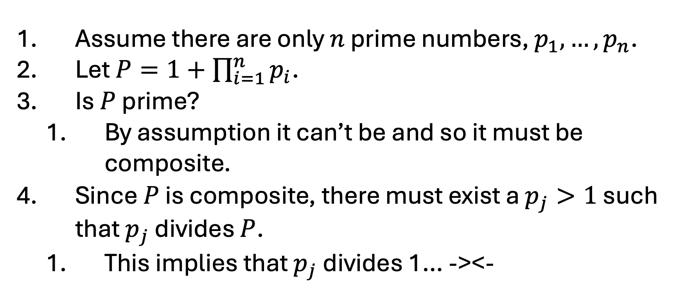
Prime Numbers
Assume there are only $n$ prime numbers, $p_{1},…, p_{n}$.
Let $P=1+\prod_{i=1}^{n}{p_{i}}$.
Is $P$ prime?
By assumption it can’t be and so it must be composite.
Since $P$ is composite, there must exist a $p_{j}>1$ such that $p_{j}$ divides $P$.
This implies that $p_{j}$ divides 1… -><-

Slide 14
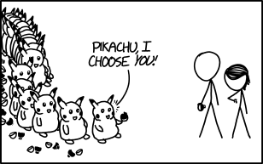
Proof by Induction
https://xkcd.com/1516/

Slide 15
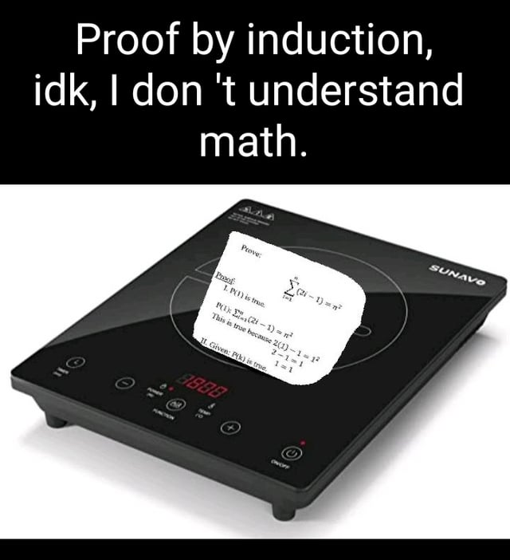
Proof by Induction
Statement of Intent
Base Case
Inductive Hypothesis
Inductive Step
Conclusion
Bongcloudforthewin. “Proof by induction.” Reddit, August 16, 2020. https://www.reddit.com/r/mathmemes/comments/iasdsb/proof_by_induction/

Slide 16
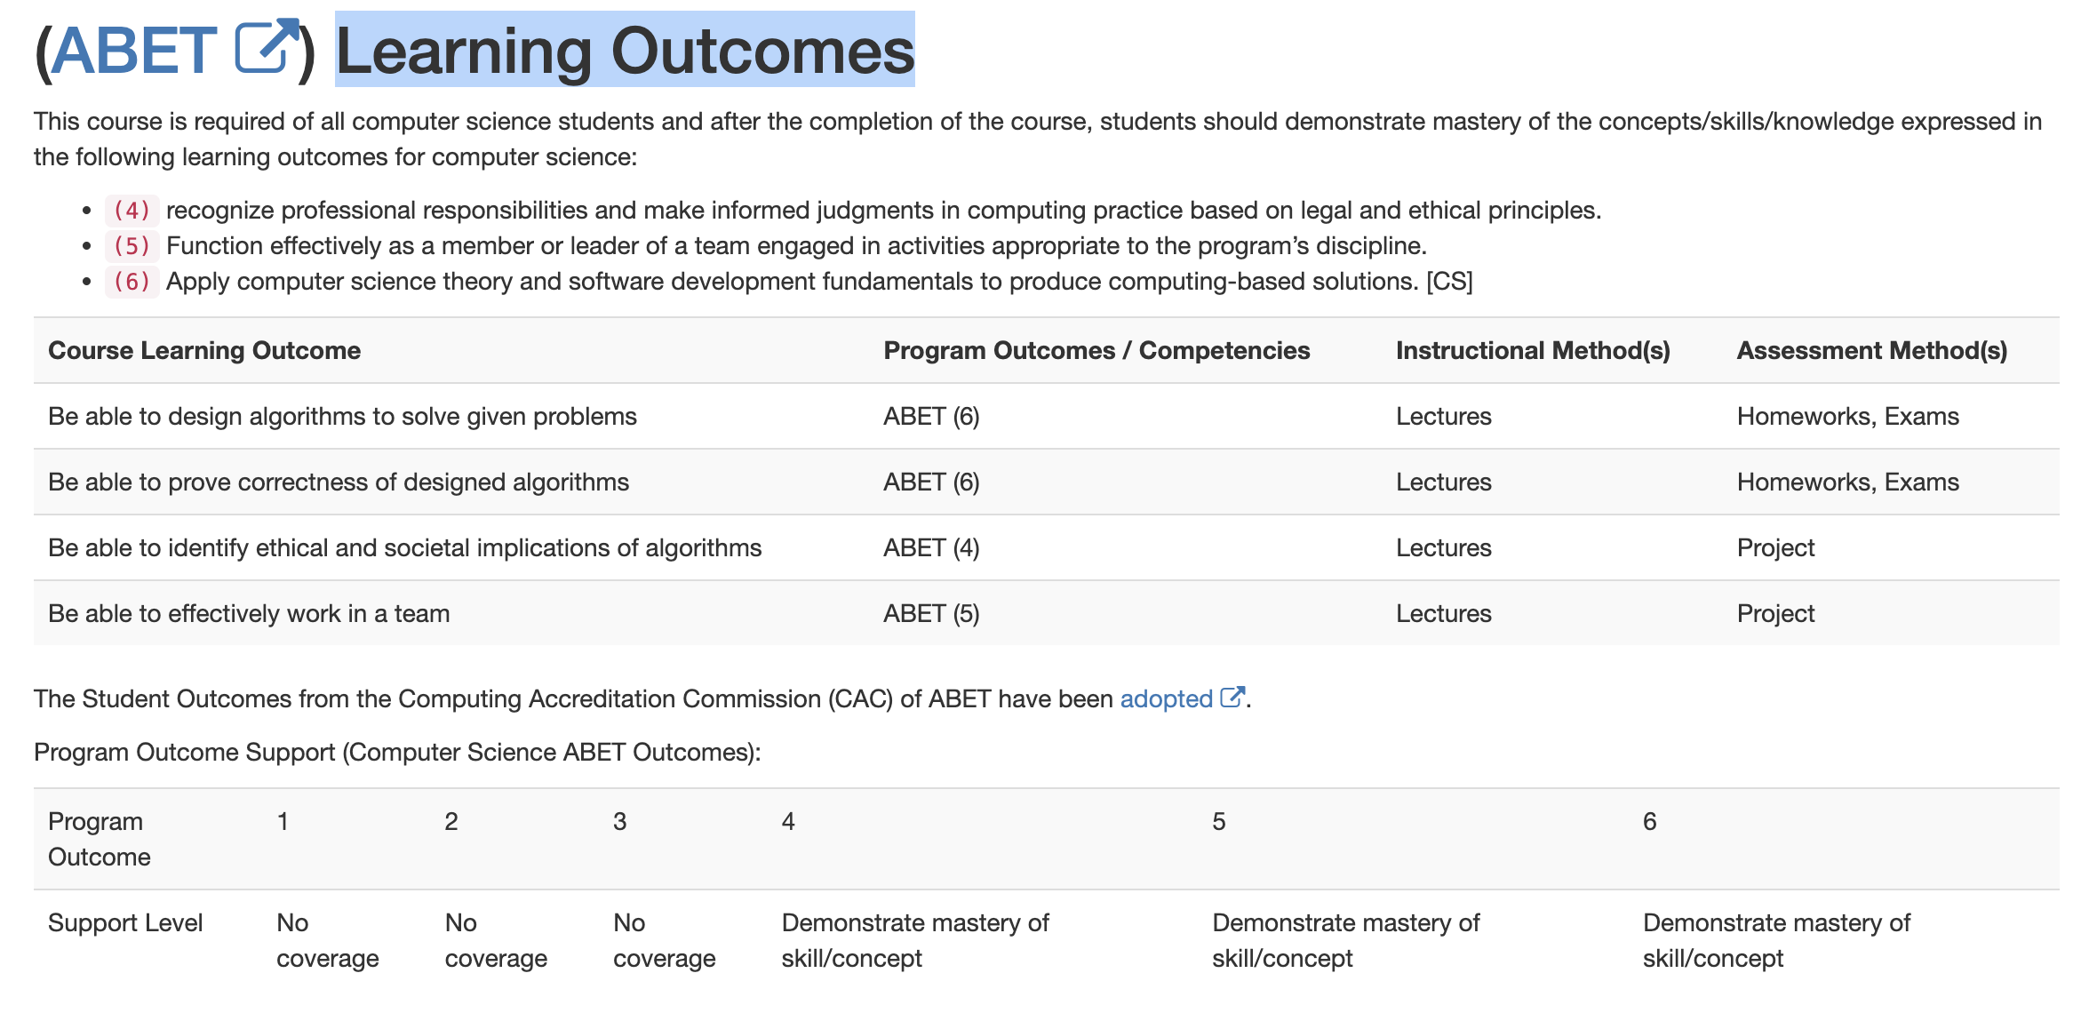
Learning Outcomes

Slide 17
Learning Outcomes

Slide 18
When to Algorithm?
Identify a problem/need/desire
Convert to formal “math” definition:
Identify the inputs
Identify the outputs/goals
Make assumptions and identify limitations.
Design an algorithm to solve the problem
Analyze the algorithm.

Slide 19
When to Algorithm?
Identify a problem/need/desire
Convert to formal “math” definition:
Identify the inputs
Identify the outputs/goals
Make assumptions and identify limitations.
Design an algorithm to solve the problem
Analyze the algorithm.
Consider wider impact of solution?!

Slide 20

Too Fast/Too Slow
An instructor with a big class wants live feedback from their class on if they are going too fast or too slow. To this end, the instructor decides to create a phone app that lets students vote during class on if the instructor should speed up or slow down.
Q3: How would you go about creating this app/algorithm?

Slide 21
When to Algorithm?
Identify a problem/need/desire
Convert to formal “math” definition:
Identify the inputs
Identify the outputs/goals
Make assumptions and identify limitations.
Design an algorithm to solve the problem
Analyze the algorithm.
Consider wider impact of solution?!

Slide 22
Graphs

Slide 23
Graphs
NODE
EDGE

Slide 24
Devs + Testers = Success
Testers
Devs

Slide 25
Matching
Testers
Devs
Definition: A matching is a collection of edges such that no two share a node.

Slide 26
Perfect Matching
Testers
Devs
Definition: A perfect matching is a matching such that every node is incident to an edge.

