Slide 1

CSE 331: Algorithms & Complexity
“MSTs”
Prof. Charlie Anne Carlson (She/Her)
Lecture 20
Monday October 20, 2025

Slide 2

Schedule
Course Updates
Min Spanning Trees
Cut Property
Kruskal’s Algorithm
Prim’s Algorithm

Slide 3

Course Updates
Midterm Part I Out
Midterm Part II Out – Soonish
Post Midterm Grades – Before Wednesday
HW 4 Due Tomorrow
Group Project
First Problems Oct 31st

Slide 4





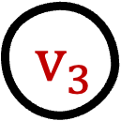
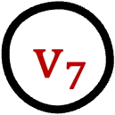


Minimum Spanning Trees (MST)
$$v_{8}$$
$$v_{3}$$
1
MST
3
$$v_{0}$$
5
$$v_{6}$$
4
4
8
3
$$v_{5}$$
1
$$v_{2}$$
1
2
2
7
$$v_{4}$$
$$v_{1}$$
5
Q: What if I add 100 to each edge?
Q: What if I mult each edge by 23?
Q: What if I take log of each edge?
1
1
$$v_{7}$$

Slide 5
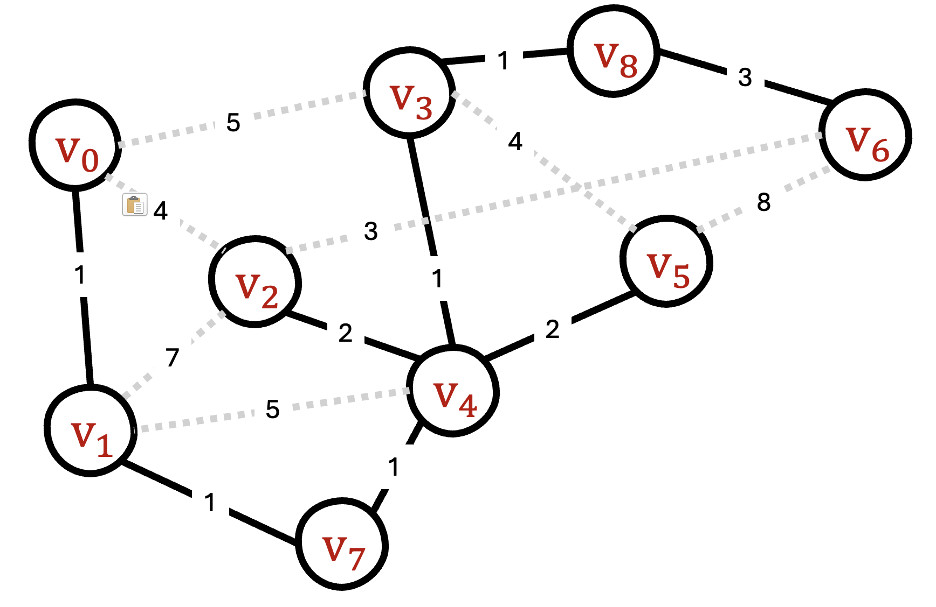
MST Algorithms (Greedy) Ideas:
Start with empty graph:
Kruskal: Add small edge that connect components.
Prim: Grow a component by taking smallest edge leaving it.
Borůvka: Add min weight edge leaving each component.
Start With G:
Reverse Kruskal: Remove big edges that aren’t needed.
MST

Slide 6
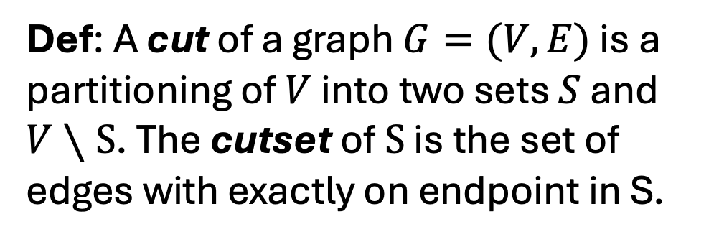
Cut (Sets)
$$v_{8}$$
1
MST
$$v_{3}$$
3
Super Graph
$$v_{0}$$
5
$$v_{6}$$
4
4
8
3
$$v_{5}$$
1
$$v_{2}$$
1
2
2
7
$$v_{4}$$
Def: A cut of a graph $G=(V,E)$ is a partitioning of $V$ into two sets $S$ and $V∖S$. The cutset of $S$ is the set of edges with exactly on endpoint in S.
$$v_{1}$$
5
1
1
$$v_{7}$$

Slide 7



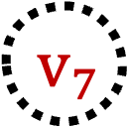

Cut (Sets)
S
$$v_{8}$$
1
MST
$$v_{3}$$
3
Cut Set of S
$$v_{0}$$
5
$$v_{6}$$
4
4
8
3
$$v_{5}$$
1
$$v_{2}$$
1
2
2
7
$$v_{4}$$
Def: A cut of a graph $G=(V,E)$ is a partitioning of $V$ into two sets $S$ and $V∖S$. The cutset of $S$ is the set of edges with exactly on endpoint in S.
$$v_{1}$$
5
1
1
$$v_{7}$$

Slide 8
Q: Can a cycle intersect a cut set an odd number of times?
$$v_{8}$$
1
MST
$$v_{3}$$
3
Cut Set of S
$$v_{0}$$
5
$$v_{6}$$
4
4
8
3
$$v_{5}$$
1
$$v_{2}$$
1
2
2
7
$$v_{4}$$
Def: A cut of a graph $G=(V,E)$ is a partitioning of $V$ into two sets $S$ and $V∖S$. The cutset of $S$ is the set of edges with exactly on endpoint in S.
$$v_{1}$$
5
1
1
$$v_{7}$$

Slide 9
A: No. “If it enters, it must leave.”

Slide 10
Spanning Trees
$$v_{8}$$
$$v_{3}$$
1
Tree
3
$$v_{0}$$
5
$$v_{6}$$
4
4
8
3
$$v_{5}$$
1
$$v_{2}$$
1
2
2
7
$$v_{4}$$
Q: What happens when I add an edge to a tree?
$$v_{1}$$
5
1
1
$$v_{7}$$

Slide 11
Spanning Not Trees
$$v_{8}$$
$$v_{3}$$
1
Not Tree
3
$$v_{0}$$
5
$$v_{6}$$
4
4
8
3
$$v_{5}$$
1
$$v_{2}$$
1
2
2
7
$$v_{4}$$
A: You get a spanning graph with one cycle.
Q: How do I get a tree again?
$$v_{1}$$
5
1
1
$$v_{7}$$

Slide 12
Spanning Trees
$$v_{8}$$
$$v_{3}$$
1
Tree
3
$$v_{0}$$
5
$$v_{6}$$
4
4
8
3
$$v_{5}$$
1
$$v_{2}$$
1
2
2
7
$$v_{4}$$
A: You remove any edge in the cycle!
Q: How many connected components do I get when I remove an edge?
$$v_{1}$$
5
1
1
$$v_{7}$$

Slide 13
Spanning Forest
S
$$v_{8}$$
$$v_{3}$$
1
Forest/Cut
3
$$v_{0}$$
5
$$v_{6}$$
4
4
8
3
$$v_{5}$$
1
$$v_{2}$$
1
2
2
7
$$v_{4}$$
A: You get two connected components.
Q: How do I get back a tree?
$$v_{1}$$
5
1
1
$$v_{7}$$

Slide 14
Spanning Tree
S
$$v_{8}$$
$$v_{3}$$
1
Forest/Cut
3
$$v_{0}$$
5
$$v_{6}$$
4
4
8
3
$$v_{5}$$
1
$$v_{2}$$
1
2
2
7
$$v_{4}$$
A: You add any edge in the cut set!
$$v_{1}$$
5
1
1
$$v_{7}$$

Slide 15
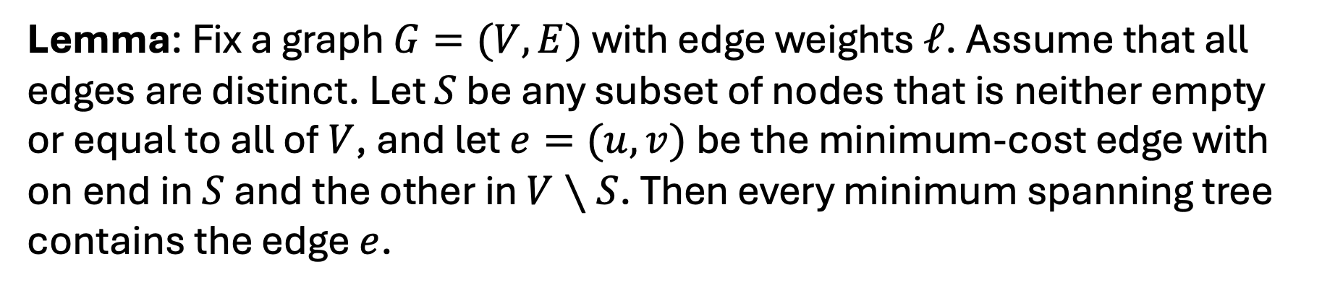
Cut Property
Lemma: Fix a graph $G=(V,E)$with edge weights $ℓ$. Assume that all edges are distinct. Let $S$ be any subset of nodes that is neither empty or equal to all of $V$, and let $e=(u,v)$be the minimum-cost edge with on end in $S$ and the other in $V∖S$. Then every minimum spanning tree contains the edge $e$.

Slide 16
Proof of Cut Property
We will do an exchange argument.
Let T be a spanning tree that doesn’t contain e = (u,v).
We will show that we can construct a tree T’ that does include e that has strictly less total weight.
To this end, we will identify another edge e’ = (x,y) that is in T and be be “exchanged” with e.

Slide 17




Proof of Cut Property
Tree T’
V \ S
S
e
$$v$$
$$u$$
e’
$$x$$
$$y$$

Slide 18
Proof of Cut Property
Tree T’
V \ S
S
e
$$v$$
$$u$$
e’
$$x$$
$$y$$
Idea: Take cycle that forms by adding e to T.

Slide 19
Proof of Cut Property
Tree T’
V \ S
S
e
$$v$$
$$u$$
e’
$$x$$
$$y$$
This cycle must cross S an even number of times.

Slide 20
Proof of Cut Property
Tree T’
V \ S
S
e
$$v$$
$$u$$
e’
$$x$$
$$y$$
Let e’ be another edge.

Slide 21
Proof of Cut Property
Tree T’
V \ S
S
e
$$v$$
$$u$$
e’
$$x$$
$$y$$
Swap these edges to break cycle and form new Tree.

Slide 22
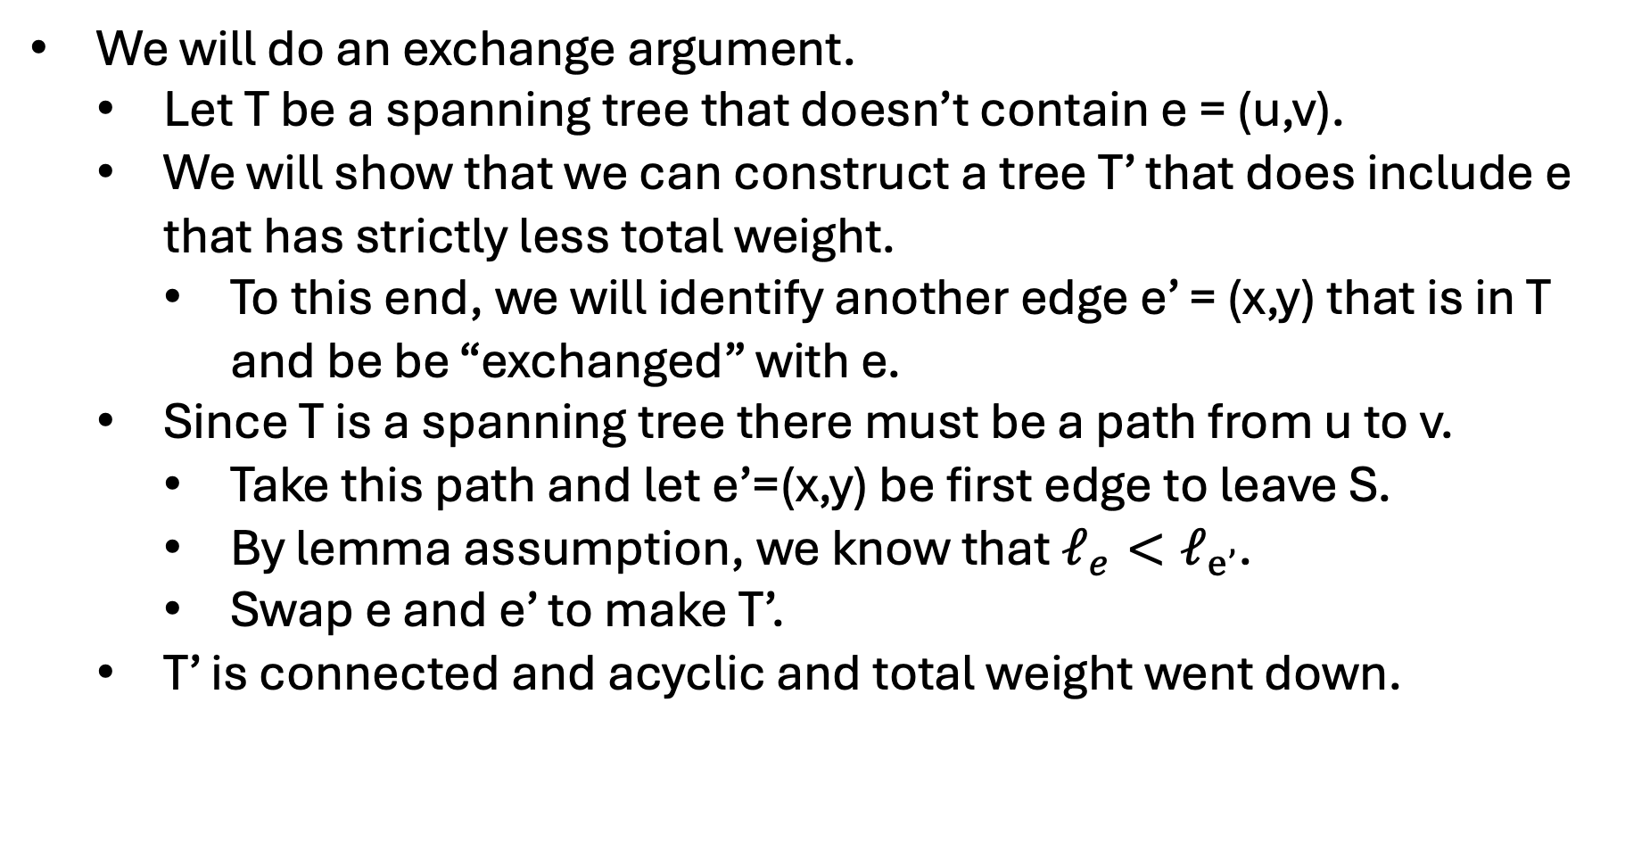
Proof of Cut Property
We will do an exchange argument.
Let T be a spanning tree that doesn’t contain e = (u,v).
We will show that we can construct a tree T’ that does include e that has strictly less total weight.
To this end, we will identify another edge e’ = (x,y) that is in T and be be “exchanged” with e.
Since T is a spanning tree there must be a path from u to v.
Take this path and let e’=(x,y) be first edge to leave S.
By lemma assumption, we know that $ℓ_{e}<ℓ_{e’}$.
Swap e and e’ to make T’.
T’ is connected and acyclic and total weight went down.

Slide 23
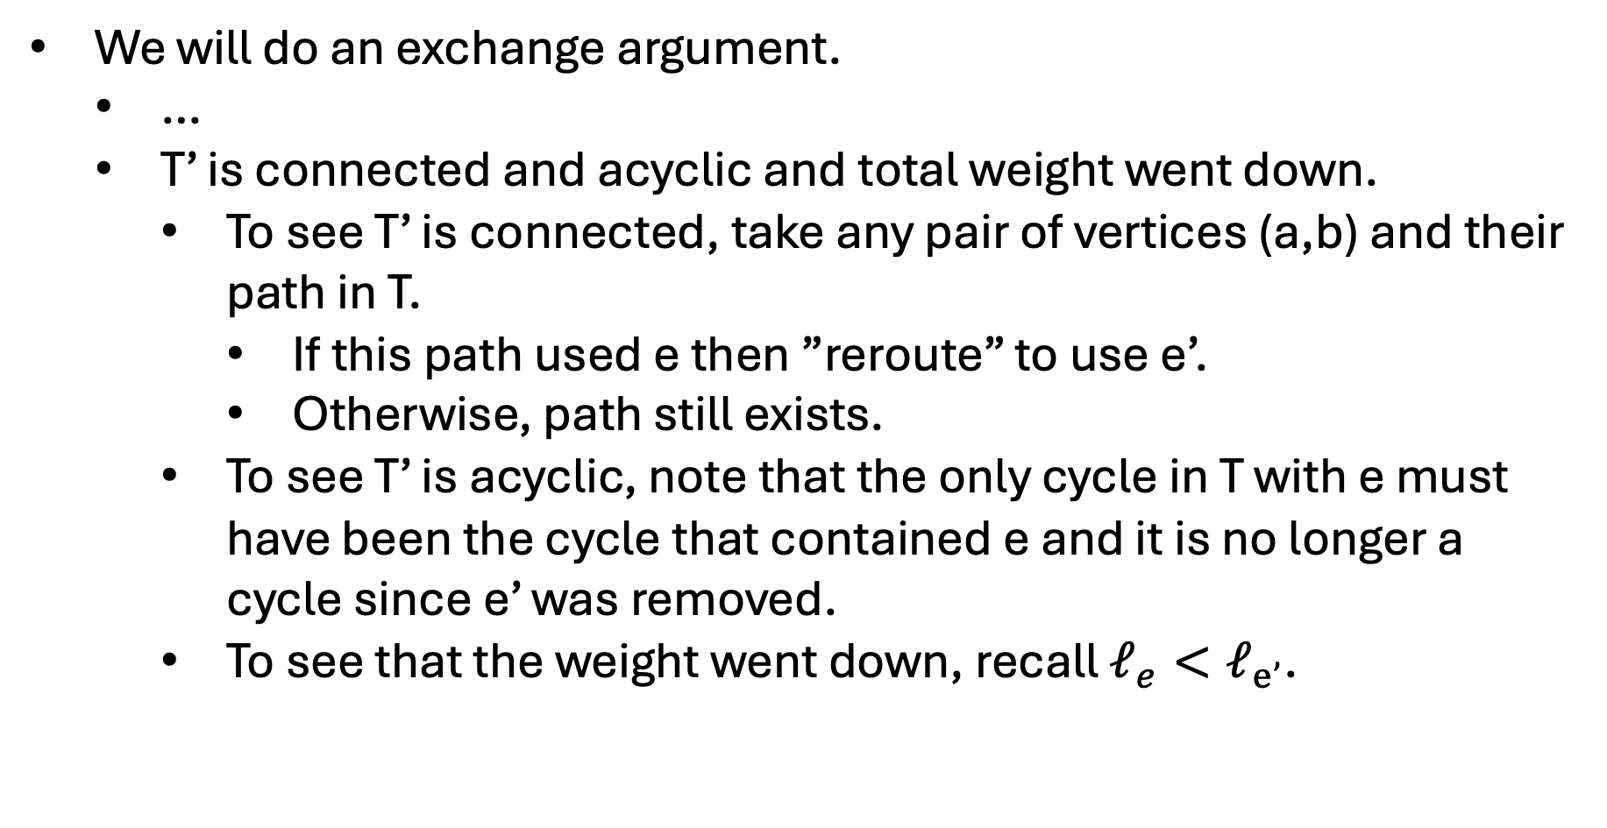
Proof of Cut Property
We will do an exchange argument.
…
T’ is connected and acyclic and total weight went down.
To see T’ is connected, take any pair of vertices (a,b) and their path in T.
If this path used e then ”reroute” to use e’.
Otherwise, path still exists.
To see T’ is acyclic, note that the only cycle in T with e must have been the cycle that contained e and it is no longer a cycle since e’ was removed.
To see that the weight went down, recall $ℓ_{e}<ℓ_{e’}$.

Slide 24
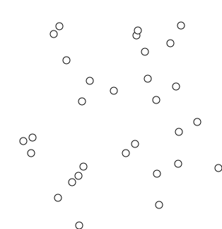
Kruskal’s Algorithm
Input: Undirected graph G = (V,E) and weights L
Output: MST of G
Sort E using values in L
Break ties arbitrarily
Let T be an empty graph
For e in E:
If adding e to T doesn’t case a cycle, add it.
https://en.wikipedia.org/wiki/File:KruskalDemo.gif

Slide 25
Kruskal’s Algorithm
$$v_{8}$$
$$v_{3}$$
1
MST
3
$$v_{0}$$
5
$$v_{6}$$
4
4
8
3
$$v_{5}$$
1
$$v_{2}$$
1
2
2
7
$$v_{4}$$
$$v_{1}$$
5
1
1
$$v_{7}$$

Slide 26
Kruskal’s Algorithm
$$v_{8}$$
$$v_{3}$$
1
MST
3
$$v_{0}$$
5
$$v_{6}$$
4
4
8
3
$$v_{5}$$
1
$$v_{2}$$
1
2
2
7
$$v_{4}$$
$$v_{1}$$
5
1
1
$$v_{7}$$

Slide 27
Kruskal’s Algorithm
$$v_{8}$$
$$v_{3}$$
1
MST
3
$$v_{0}$$
5
$$v_{6}$$
4
4
8
3
$$v_{5}$$
1
$$v_{2}$$
1
2
2
7
$$v_{4}$$
$$v_{1}$$
5
1
1
$$v_{7}$$

Slide 28
Kruskal’s Algorithm
$$v_{8}$$
$$v_{3}$$
1
MST
3
$$v_{0}$$
5
$$v_{6}$$
4
4
8
3
$$v_{5}$$
1
$$v_{2}$$
1
2
2
7
$$v_{4}$$
$$v_{1}$$
5
1
1
$$v_{7}$$

Slide 29
Kruskal’s Algorithm
$$v_{8}$$
$$v_{3}$$
1
MST
3
$$v_{0}$$
5
$$v_{6}$$
4
4
8
3
$$v_{5}$$
1
$$v_{2}$$
1
2
2
7
$$v_{4}$$
$$v_{1}$$
5
1
1
$$v_{7}$$

Slide 30
Kruskal’s Algorithm
$$v_{8}$$
$$v_{3}$$
1
MST
3
$$v_{0}$$
5
$$v_{6}$$
4
4
8
3
$$v_{5}$$
1
$$v_{2}$$
1
2
2
7
$$v_{4}$$
$$v_{1}$$
5
1
1
$$v_{7}$$

Slide 31
Kruskal’s Algorithm
$$v_{8}$$
$$v_{3}$$
1
MST
3
$$v_{0}$$
5
$$v_{6}$$
4
4
8
3
$$v_{5}$$
1
$$v_{2}$$
1
2
2
7
$$v_{4}$$
$$v_{1}$$
5
1
1
$$v_{7}$$

Slide 32
Kruskal’s Algorithm
$$v_{8}$$
$$v_{3}$$
1
MST
3
$$v_{0}$$
5
$$v_{6}$$
4
4
8
3
$$v_{5}$$
1
$$v_{2}$$
1
2
2
7
$$v_{4}$$
$$v_{1}$$
5
1
1
$$v_{7}$$

Slide 33
Kruskal’s Algorithm
$$v_{8}$$
$$v_{3}$$
1
MST
3
$$v_{0}$$
5
$$v_{6}$$
4
4
8
3
$$v_{5}$$
1
$$v_{2}$$
1
2
2
7
$$v_{4}$$
$$v_{1}$$
5
1
1
$$v_{7}$$

Slide 34
Kruskal’s Algorithm
$$v_{8}$$
$$v_{3}$$
1
MST
3
$$v_{0}$$
5
$$v_{6}$$
4
4
8
3
$$v_{5}$$
1
$$v_{2}$$
1
2
2
7
$$v_{4}$$
$$v_{1}$$
5
1
1
$$v_{7}$$

Slide 35
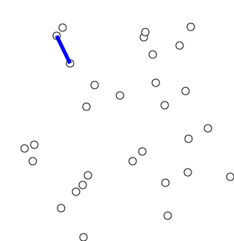
Prim’s Algorithm
Input: Undirected graph G = (V,E) and weights L
Output: MST of G
Pick s in V arbitrarily
Let S = {s}
While S != V:
Find minimum weight edge e = (u,v) where u is in S but v is not.
Add v to S
https://en.wikipedia.org/wiki/File:PrimAlgDemo.gif

Slide 36
Prim’s Algorithm
$$v_{8}$$
$$v_{3}$$
1
MST
3
$$v_{0}$$
5
$$v_{6}$$
4
4
8
3
$$v_{5}$$
1
$$v_{2}$$
1
2
2
7
$$v_{4}$$
$$v_{1}$$
5
1
1
$$v_{7}$$

Slide 37
Prim’s Algorithm
$$v_{8}$$
$$v_{3}$$
1
MST
3
$$v_{0}$$
5
$$v_{6}$$
4
4
8
3
$$v_{5}$$
1
$$v_{2}$$
1
2
2
7
$$v_{4}$$
$$v_{1}$$
5
1
1
$$v_{7}$$

Slide 38
Prim’s Algorithm
$$v_{8}$$
$$v_{3}$$
1
MST
3
$$v_{0}$$
5
$$v_{6}$$
4
4
8
3
$$v_{5}$$
1
$$v_{2}$$
1
2
2
7
$$v_{4}$$
$$v_{1}$$
5
1
1
$$v_{7}$$

Slide 39
Prim’s Algorithm
$$v_{8}$$
$$v_{3}$$
1
MST
3
$$v_{0}$$
5
$$v_{6}$$
4
4
8
3
$$v_{5}$$
1
$$v_{2}$$
1
2
2
7
$$v_{4}$$
$$v_{1}$$
5
1
1
$$v_{7}$$

Slide 40
Prim’s Algorithm
$$v_{8}$$
$$v_{3}$$
1
MST
3
$$v_{0}$$
5
$$v_{6}$$
4
4
8
3
$$v_{5}$$
1
$$v_{2}$$
1
2
2
7
$$v_{4}$$
$$v_{1}$$
5
1
1
$$v_{7}$$

Slide 41
Prim’s Algorithm
$$v_{8}$$
$$v_{3}$$
1
MST
3
$$v_{0}$$
5
$$v_{6}$$
4
4
8
3
$$v_{5}$$
1
$$v_{2}$$
1
2
2
7
$$v_{4}$$
$$v_{1}$$
5
1
1
$$v_{7}$$

Slide 42
Prim’s Algorithm
$$v_{8}$$
$$v_{3}$$
1
MST
3
$$v_{0}$$
5
$$v_{6}$$
4
4
8
3
$$v_{5}$$
1
$$v_{2}$$
1
2
2
7
$$v_{4}$$
$$v_{1}$$
5
1
1
$$v_{7}$$

Slide 43
Prim’s Algorithm
$$v_{8}$$
$$v_{3}$$
1
MST
3
$$v_{0}$$
5
$$v_{6}$$
4
4
8
3
$$v_{5}$$
1
$$v_{2}$$
1
2
2
7
$$v_{4}$$
$$v_{1}$$
5
1
1
$$v_{7}$$

Slide 44
Other Algorithms
Reverse Kruskal’s
Input: Undirected graph G = (V,E) and weights L
Output: MST of G
Sort E using values in L
Break ties arbitrarily
Let T be a copy of G
For e in E backwards:
If removing e from T doesn’t disconnect the graph, remove it.
Borůvka's
Input: Undirected graph G = (V,E) and weights L
Output: MST of G
Let T be an empty graph
For c in CC(T):
Find edge e leaving c with smallest weight
Add e to T
MST

Slide 45
Kruskal’s Algorithm
Input: Undirected graph G = (V,E) and weights L
Output: MST of G
Sort E using values in L
Break ties arbitrarily
Let T be an empty graph
For e in E:
If adding e to T doesn’t case a cycle, add it.
https://en.wikipedia.org/wiki/File:KruskalDemo.gif

Slide 46
Claim: Kruskal’s Algorithm is Correct
Proof:
Let e = (u,v) be an edge added by Kruskal’s algorithm
Consider the T just before adding e.
Let S be the connected component of T that contains u.
Then e was the minimum weight edge leaving S and by the Cut Property it must be in the MST.
Hence, Kruskal’s algorithm only adds edges that must be in the MST.
MST

Slide 47
Claim: Kruskal’s Algorithm is Correct
Proof:
Let e = (u,v) be an edge added by Kruskal’s algorithm
Consider the T just before adding e.
Let S be the connected component of T that contains u.
Then e was the minimum weight edge leaving S and by the Cut Property it must be in the MST.
Hence, Kruskal’s algorithm only adds edges that must be in the MST.
Finally, we note that if T was not connected then there would have been edge that could have been added without forming a cycle.
It follows that T is the MST at the end of the algorithm.
MST

Slide 48
Claim: Prim’s Algorithm is Correct
Proof:
Let e = (u,v) be an edge added by Kruskal’s algorithm
Consider the T just before adding e.
Let S be the connected component of T that contains u.
Then e was the minimum weight edge leaving S and by the Cut Property it must be in the MST.
Hence, Prim’s algorithm only adds edges that must be in the MST.
Finally, we note that if T was not connected then there would have been edge that could have been added without forming a cycle.
It follows that T is the MST at the end of the algorithm.
MST

