Slide 1

CSE 331: Algorithms & Complexity
“MST Correctness”
Prof. Charlie Anne Carlson (She/Her)
Lecture 21
Wednesday October 22nd, 2025

Slide 2

Schedule
Course Updates
Cut Property
Kruskal’s Algorithm
Prim’s Algorithm
Divide & Conquer

Slide 3

Course Updates
Midterm Out
Post Midterm Grades
HW 5 Out
Group Project
First Problems Oct 31st

Slide 4
Midterm Grades
Grade = (P1+P2)

Slide 5
Midterm Evals Grades (One HW Drop)
Grade Includes:
Midterm (45%)
Top HW (49%)
Up To HW 3
Per Part
QUIZ (6%)
Quiz 1

Slide 6
1-on-1 Meeting With Me
I am happy to meet to discuss your course performance and help make a plan on how to move forward.
When I make a plan for pushing out midterm eval grades, I will also make a piazza post with specific instructions on how to set up a meeting with me.
You are free to email me now but please include a long list of times you are available so we can schedule a zoom chat.

Slide 7

Feedback Survey

Slide 8
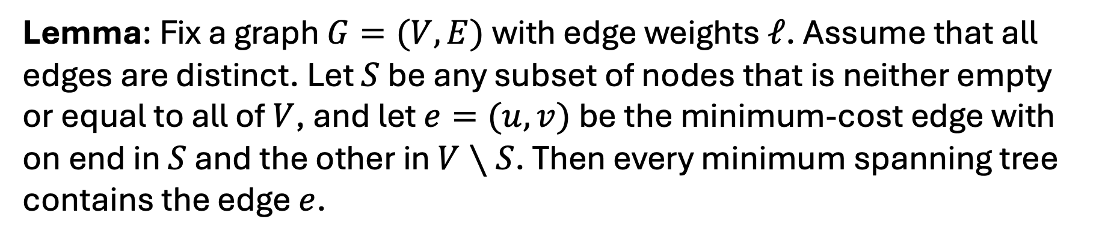
Cut Property
Lemma: Fix a graph $G=(V,E)$with edge weights $ℓ$. Assume that all edges are distinct. Let $S$ be any subset of nodes that is neither empty or equal to all of $V$, and let $e=(u,v)$be the minimum-cost edge with on end in $S$ and the other in $V∖S$. Then every minimum spanning tree contains the edge $e$.

Slide 9
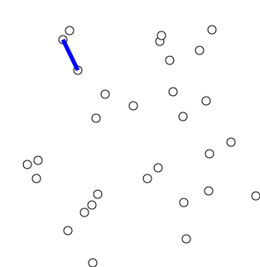
Prim’s Algorithm
Input: Undirected graph G = (V,E) and weights L
Output: MST of G
Pick s in V arbitrarily
Let S = {s}
While S != V:
Find minimum weight edge e = (u,v) where u is in S but v is not.
Add v to S
https://en.wikipedia.org/wiki/File:PrimAlgDemo.gif

Slide 10
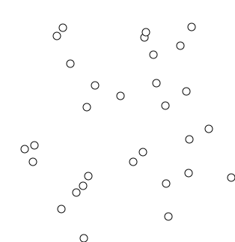
Kruskal’s Algorithm
Input: Undirected graph G = (V,E) and weights L
Output: MST of G
Sort E using values in L
Break ties arbitrarily
Let T be an empty graph
For e in E:
If adding e to T doesn’t case a cycle, add it.
https://en.wikipedia.org/wiki/File:KruskalDemo.gif

Slide 11
Claim: Kruskal’s Algorithm is Correct
Proof:
Let e = (u,v) be an edge added by Kruskal’s algorithm
Consider the T just before adding e.
Let S be the connected component of T that contains u.
Then e was the minimum weight edge leaving S and by the Cut Property it must be in the MST.
Hence, Kruskal’s algorithm only adds edges that must be in the MST.
MST

Slide 12
Claim: Kruskal’s Algorithm is Correct
Proof:
Let e = (u,v) be an edge added by Kruskal’s algorithm
Consider the T just before adding e.
Let S be the connected component of T that contains u.
Then e was the minimum weight edge leaving S and by the Cut Property it must be in the MST.
Hence, Kruskal’s algorithm only adds edges that must be in the MST.
Finally, we note that if T was not connected then there would have been edge that could have been added without forming a cycle.
It follows that T is the MST at the end of the algorithm.
MST

Slide 13
Claim: Prim’s Algorithm is Correct
Proof:
Let e = (u,v) be an edge added by Kruskal’s algorithm
Consider the T just before adding e.
Let S be the connected component of T that contains u.
Then e was the minimum weight edge leaving S and by the Cut Property it must be in the MST.
Hence, Prim’s algorithm only adds edges that must be in the MST.
Finally, we note that if T was not connected then there would have been edge that could have been added without forming a cycle.
It follows that T is the MST at the end of the algorithm.
MST

Slide 14
Prim’s Algorithm Runtime
Input: Undirected graph G = (V,E) and weights L
Output: MST of G
Pick s in V arbitrarily
Let S = {s}
While S != V:
Find minimum weight edge e = (u,v) where u is in S but v is not.
Add v to S
https://en.wikipedia.org/wiki/File:PrimAlgDemo.gif

Slide 15
Prim’s Algorithm Runtime O(m log(n))
Claim: Using a priority queue, Prim’s Algorithm can be implemented on a graph with n nodes and m edges to run in O(m) time, plus the time for n PopMin and m DecreasePriority operations.
Corollary: Using a heap-based priority queue we get a running time of O(m log(n)).
https://en.wikipedia.org/wiki/File:PrimAlgDemo.gif

Slide 16
Kruskal’s Algorithm Runtime
Input: Undirected graph G = (V,E) and weights L
Output: MST of G
Sort E using values in L
Break ties arbitrarily
Let T be an empty graph
For e in E:
If adding e to T doesn’t case a cycle, add it.
https://en.wikipedia.org/wiki/File:KruskalDemo.gif

Slide 17
Kruskal’s Algorithm Runtime O(m log(n))
Input: Undirected graph G = (V,E) and weights L
Output: MST of G
Sort E using values in L
Break ties arbitrarily
Let T be an empty graph
For e in E:
If adding e to T doesn’t case a cycle, add it.
https://en.wikipedia.org/wiki/File:KruskalDemo.gif

Slide 18
Kruskal’s Algorithm Runtime O(m log(n))
To prove this running time, we need a Union-Find data structure.
Keeps track of which elements in a ground set belong to the same subsets.
Find(u): Returns name of set that contains u.
Union(A,B) combine sets A and B into one set.
Read KT 4.6!
https://en.wikipedia.org/wiki/File:KruskalDemo.gif

Slide 19
Divide & Conquer (KT 5.1 and KT 5.2)
Problem
Divide
Problem 1
Problem 2
Problem k
Conquer
Solution 1
Solution 2
Solution k
Unite
Solution

Slide 20
Why Divide & Conquer?
Problem
O(n)
Problem 1
Problem 2
Recursion
Solution 1
Solution 2
O(n)
Solution

Slide 21
Why Divide & Conquer?
Problem
Idea: If you can easily break apart problems and combine those solutions then recursion can let you avoid slow algorithms on big problems and instead only run slow algorithms on small problems.
O(n)
Problem 1
Problem 2
Recursion
Solution 1
Solution 2
O(n)
Solution

Slide 22
Why Divide & Conquer?
Problem N
O(n)
Problem 1 N/2
Problem 2 N/2
Recursion
Solution 1
Solution 2
O(n)
Solution

Slide 23
Why Divide & Conquer?
Problem 1 N/2
O(n)
Problem 11 N/4
Problem 12 N/4
Recursion
Solution 11
Solution 12
O(n)
Solution 1

Slide 24
Why Divide & Conquer?
Problem 111…1 O(1)
O(1)
Problem 111…11
Problem 111…12
Brute Force
Solution 111…11
Solution 111…12
O(1)
Solution 111…1

Slide 25
Q: How many times can you split in half?
Problem 111…1 O(1)
O(1)
Problem 111…11
Problem 111…12
Brute Force
Solution 111…11
Solution 111…12
O(1)
Solution 111…1

Slide 26
A: After log times, you will get a constant!
Problem 111…1 O(1)
O(1)
Problem 111…11
Problem 111…12
Brute Force
Solution 111…11
Solution 111…12
O(1)
Solution 111…1

Slide 27

Sorting
Problem: Given a list of n numbers L, rearrange them in ascending order.
E.g.
Input: [3,2,5,5,1,6,7,8]
Output: [1,2,3,5,5,6,7,8]

Slide 28
Sorting
Problem: Given a list of n numbers L, rearrange them in ascending order.
Sorting Algorithms:
Bubble Sort
Insertion Sort
Mergesort
Radix Sort
Quicksort
Introsort

Slide 29
Sorting
Problem: Given a list of n numbers L, rearrange them in ascending order.
Sorting Algorithms:
Bubble Sort
Insertion Sort
Mergesort
Radix Sort
Quicksort
Introsort

Slide 30
Mergesort
Divides: Divides input into two pieces of equal size in linear time.
Assume even length for now.
Conquer: Recursively calls mergesort on each piece.
Unite: Merges the two sorted lists in linear time.

Slide 31
Mergesort
Base Case: If array has length less than 2, brute force.
Divides: Divides input into two pieces of equal size in linear time.
Assume even length for now.
Conquer: Recursively calls mergesort on each piece.
Unite: Merges the two sorted lists in linear time.

Slide 32


Sorting
Problem: Given two sorted lists A and B, find a sorted list of their union.

Slide 33
Merging
Input: Two sorted lists A and B of length n/2
Output: Sorted list of A and B
Initialize list C to be empty
Let i = 0 and j = 0
While (i < n/2 or j < n/2):
If j == n/2 or A[i] <= B[j]:
C.append(A[i])
i += 1
Else:
C.append(B[j])
j += 1

Slide 34
Mergesort Runtime?
Base Case: If array has length less than 2, brute force.
Divides: Divides input into two pieces of equal size in linear time.
Assume even length for now.
Conquer: Recursively calls mergesort on each piece.
Unite: Merges the two sorted lists in linear time.

Slide 35
Let T(n) be runtime of Mergesort.
Base Case: If array has length less than 2, brute force. O(1)
Divides: Divides input into two pieces of equal size in linear time. O(n)
Assume even length for now.
Conquer: Recursively calls mergesort on each piece. T(n/2)
Unite: Merges the two sorted lists in linear time. O(n)

Slide 36
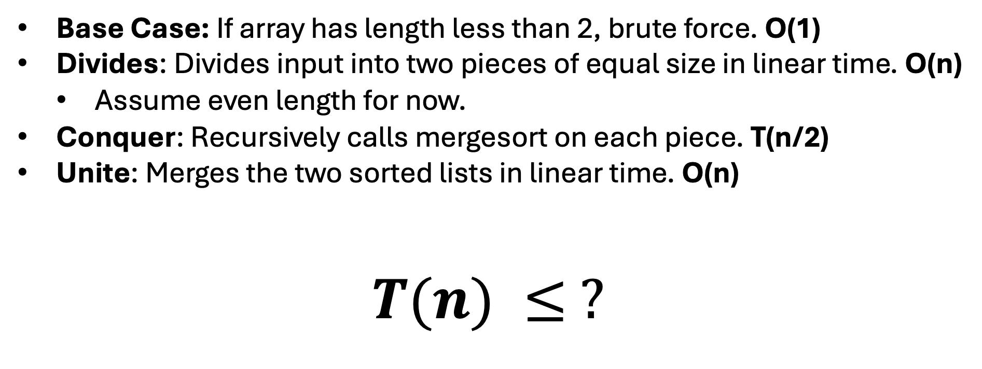
Let T(n) be runtime of Mergesort.
Base Case: If array has length less than 2, brute force. O(1)
Divides: Divides input into two pieces of equal size in linear time. O(n)
Assume even length for now.
Conquer: Recursively calls mergesort on each piece. T(n/2)
Unite: Merges the two sorted lists in linear time. O(n)
$$T(n) ≤ ?$$

Slide 37
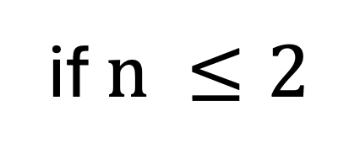
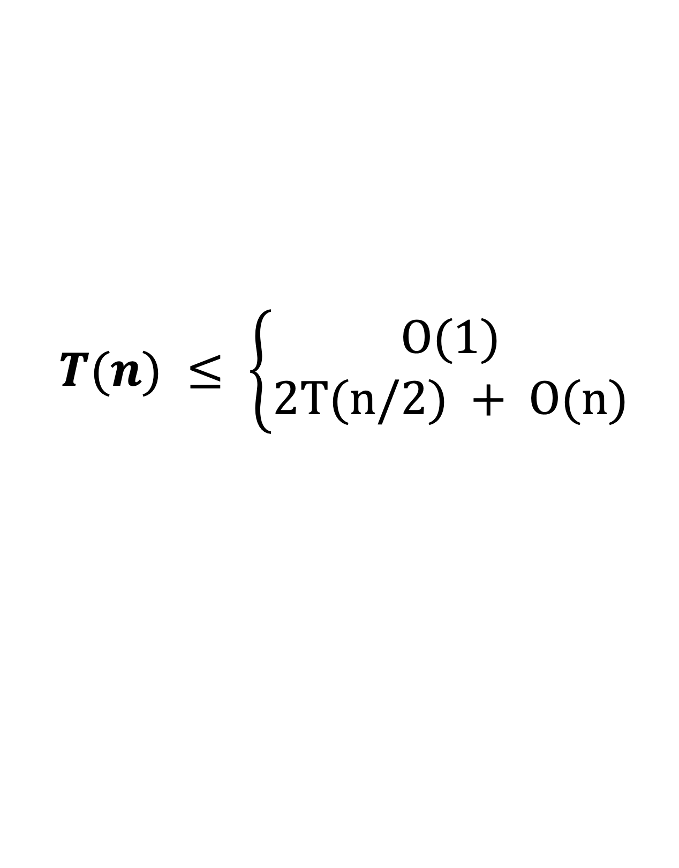
Let T(n) be runtime of Mergesort.
Base Case: If array has length less than 2, brute force. O(1)
Divides: Divides input into two pieces of equal size in linear time. O(n)
Assume even length for now.
Conquer: Recursively calls mergesort on each piece. T(n/2)
Unite: Merges the two sorted lists in linear time. O(n)
$$T(n) ≤ \left\{\begin{aligned}O(1) \\ 2T(n/2) + O(n)\end{aligned}\right.$$
if $n ≤2$
o.w.

Slide 38
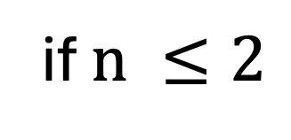
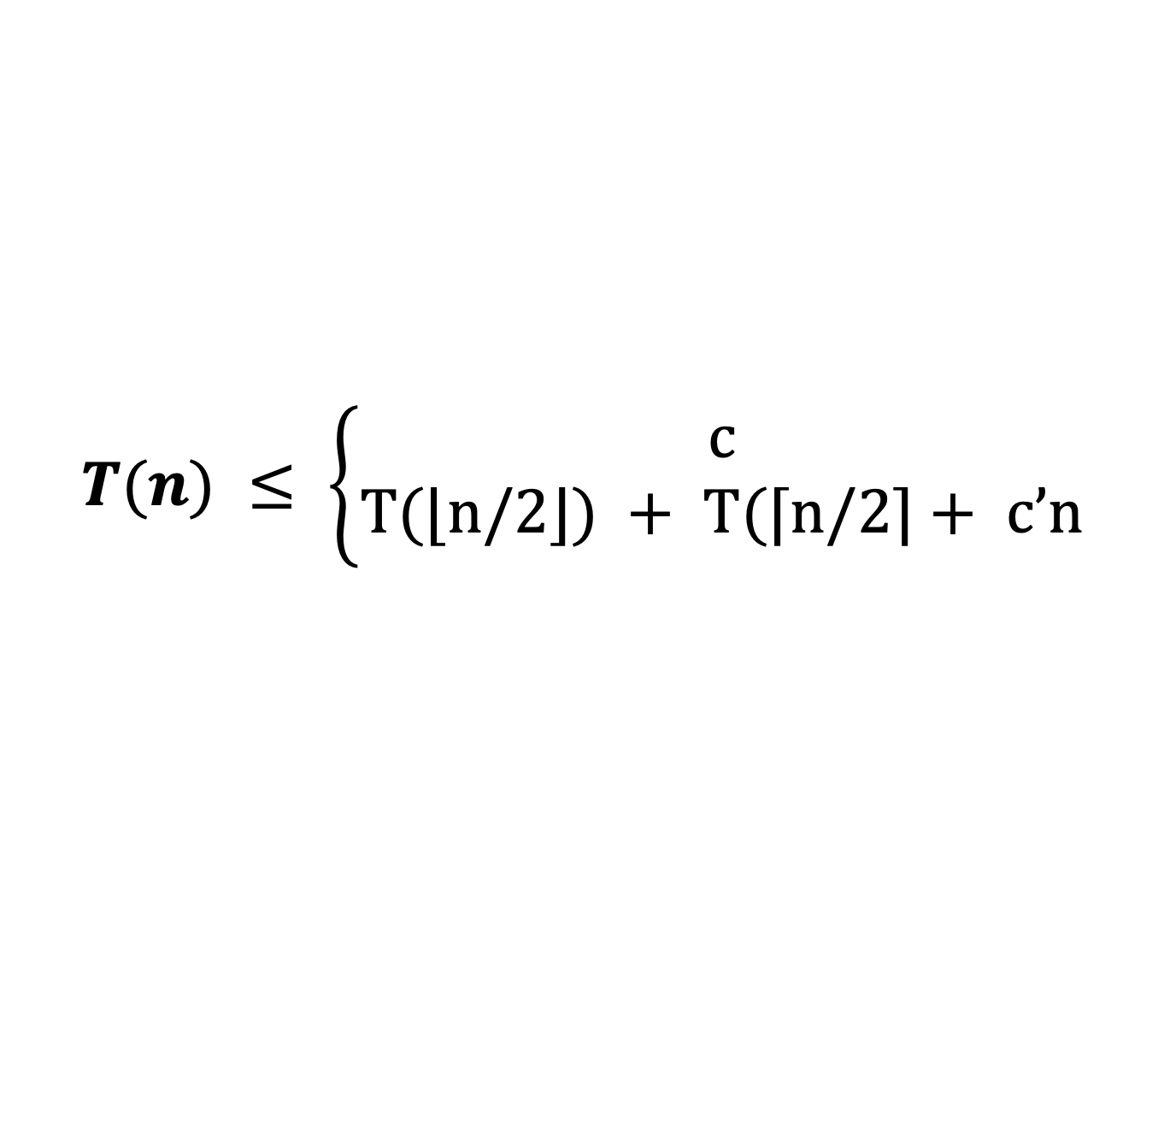
Let T(n) be runtime of Mergesort.
Base Case: If array has length less than 2, brute force. O(1)
Divides: Divides input into two pieces of equal size in linear time. O(n)
Conquer: Recursively calls mergesort on each piece. T(n/2)
Unite: Merges the two sorted lists in linear time. O(n)
$$T(n) ≤ \left\{\begin{aligned}c \\ T(⌊n/2⌋) + T(⌈n/2⌉+ c’n\end{aligned}\right.$$
if $n ≤2$
o.w.

Slide 39
How do you solve a recurrence?
Unrolling: We analyze the first few ”levels” of the recursion, find a pattern and then prove that the pattern is correct.
Guess and Check: We guess what the answer and the substitute it in to check that it works. That is, we prove it works.
We will talk about these next time but read KT 5.1 and KT 5.2!
$$T(n) ≤ \left\{\begin{aligned}c \\ T(⌊n/2⌋) + T(⌈n/2⌉+ c’n\end{aligned}\right.$$
if $n ≤2$
o.w.

