Slide 1

CSE 331:
Algorithms & Complexity
“Divide & Conquer”
Prof. Charlie Anne Carlson (She/Her)
Lecture 22
Friday October 24th, 2025

Slide 2

Schedule
Course Updates
Divide & Conquer
Merge Sort
Solving Recurrences

Slide 3

Course Updates
Post Midterm Grades In Progress
Feedback Survey Soon
HW 4 Solutions Soon
HW 5 Out
Group Project
  First Problems Oct 31st
More Example Quizes

Slide 4
Midterm Evals Grades (One HW Drop)
Grade Includes:
Midterm (45%)
Top HW (49%)
  Up To HW 3
  Per Part
QUIZ (6%)
  Quiz 1

Slide 5
Midterm Evals Grades (One HW Drop)
Grade Includes:
Midterm (45%)
Top HW (49%)
  Up To HW 3
  Per Part
QUIZ (6%)
  Quiz 1
WE ARE NOT DONE!

Slide 6

Reading
You should have read:
  Finished KT 5.1
  Started KT 5.2
Before Next Class:
  Finish KT 5.2
  Start KT 5.3

Slide 7
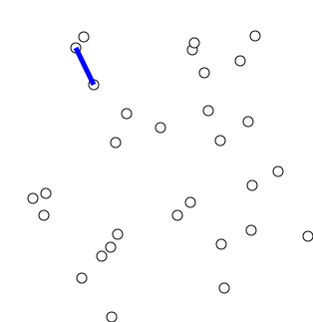
Prim’s Algorithm Runtime
Input: Undirected graph G = (V,E) and weights L
Output: MST of G
  Pick s in V arbitrarily
  Let S = {s}
  While S != V:
    Find minimum weight edge e = (u,v) where u is in S but v is not.
    Add v to S
https://en.wikipedia.org/wiki/File:PrimAlgDemo.gif

Slide 8
Prim’s Algorithm Runtime O(m log(n))
Claim: Using a priority queue, Prim’s Algorithm can be implemented on a graph with n nodes and m edges to run in O(m) time, plus the time for n PopMin and m DecreasePriority operations.
Corollary: Using a heap-based priority queue we get a running time of O(m log(n)).
https://en.wikipedia.org/wiki/File:PrimAlgDemo.gif

Slide 9
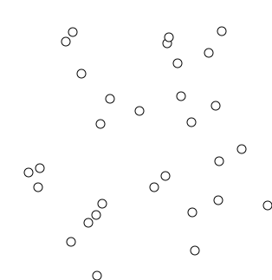
Kruskal’s Algorithm Runtime
Input: Undirected graph G = (V,E) and weights L
Output: MST of G
  Sort E using values in L
    Break ties arbitrarily
  Let T be an empty graph
  For e in E:
    If adding e to T doesn’t case a cycle, add it.
https://en.wikipedia.org/wiki/File:KruskalDemo.gif

Slide 10
Kruskal’s Algorithm Runtime O(m log(n))
Input: Undirected graph G = (V,E) and weights L
Output: MST of G
  Sort E using values in L
    Break ties arbitrarily
  Let T be an empty graph
  For e in E:
    If adding e to T doesn’t case a cycle, add it.
https://en.wikipedia.org/wiki/File:KruskalDemo.gif

Slide 11
Kruskal’s Algorithm Runtime O(m log(n))
To prove this running time, we need a Union-Find data structure.
  Keeps track of which elements in a ground set belong to the same subsets.
  Find(u): Returns name of set that contains u.
  Union(A,B) combine sets A and B into one set.
  Read KT 4.6!
https://en.wikipedia.org/wiki/File:KruskalDemo.gif

Slide 12
Divide & Conquer (KT 5.1 and KT 5.2)
Problem
Divide
Problem 1
Problem 2
Problem k
Conquer
Solution 1
Solution 2
Solution k
Unite
Solution

Slide 13
Why Divide & Conquer?
Problem
O(n)
Problem 1
Problem 2
Recursion
Solution 1
Solution 2
O(n)
Solution

Slide 14
Why Divide & Conquer?
Problem
Idea: If you can easily break apart problems and combine the solution to those problems then recursion can let you avoid slow algorithms on big problems and instead only run slow algorithms on several small problems.
O(n)
Problem 1
Problem 2
Recursion
Solution 1
Solution 2
O(n)
Solution

Slide 15
Why Divide & Conquer?
Problem N
O(n)
Problem 1 N/2
Problem 2 N/2
Recursion
Solution 1
Solution 2
O(n)
Solution

Slide 16
Why Divide & Conquer?
Problem 1 N/2
O(n)
Problem 11 N/4
Problem 12 N/4
Recursion
Solution 11
Solution 12
O(n)
Solution 1

Slide 17
Why Divide & Conquer?
Problem 111…1 O(1)
O(1)
Problem 111…11
Problem 111…12
Brute Force
Solution 111…11
Solution 111…12
O(1)
Solution 111…1

Slide 18
Q: How many times can you split in half?
Problem 111…1 O(1)
O(1)
Problem 111…11
Problem 111…12
Brute Force
Solution 111…11
Solution 111…12
O(1)
Solution 111…1

Slide 19
A: After log times, you will get a constant!
Problem 111…1 O(1)
O(1)
Problem 111…11
Problem 111…12
Brute Force
Solution 111…11
Solution 111…12
O(1)
Solution 111…1

Slide 20
Another Look
Consider a thermotical problem PROBLEM.
Suppose we have an algorithm for PROBLEM that takes N^2 time to run on an input of size N.
Suppose that we can in N time break PROBLEM into two small problems of size N/2 such that if we find their solutions we get the solution the original problem in N time (we can combine the solutions).
N
N/2
N/2

Slide 21
Another Look
N
N/2
N/2
N/4
N/4
N/4
N/4
N/8
N/8
N/8
N/8
N/8
N/8
N/8
N/8
N/16
N/16
N/16
N/16
N/16
N/16
N/16
N/16
N/16
N/16
N/16
N/16
N/16
N/16
N/16
N/16

Slide 22
Another Look
Observe that it would take N^2 time to use the algorithm for PROBLEM on the initial input.
Instead consider running the same algorithm on the subproblems of size N/16.
  How much work is done?
N/16
N/16
N/16
N/16
N/16
N/16
N/16
N/16
N/16
N/16
N/16
N/16
N/16
N/16
N/16
N/16

Slide 23
It takes 8N to do splitting and combining
N
2N
N/2
N/2
2N
N/4
N/4
N/4
N/4
2N
N/8
N/8
N/8
N/8
N/8
N/8
N/8
N/8
2N
N/16
N/16
N/16
N/16
N/16
N/16
N/16
N/16
N/16
N/16
N/16
N/16
N/16
N/16
N/16
N/16

Slide 24
It takes N^2/16 to do algorithm on small parts.
N
N/2
N/2
N/4
N/4
N/4
N/4
N/8
N/8
N/8
N/8
N/8
N/8
N/8
N/8
N/16
N/16
N/16
N/16
N/16
N/16
N/16
N/16
N/16
N/16
N/16
N/16
N/16
N/16
N/16
N/16
16 Problems each of size N/16 and each taking time (N/16)^2 time.

Slide 25
Another Look
Observe that it would take N^2 time to use the algorithm for PROBLEM on the initial input.
Instead consider running the same algorithm on the subproblems of size N/16.
  Q: How much work is done?
    A: It takes a total of N^2/16 + 10N time.
Q: When is N^2 > N^2/16 + 10N?
N/16
N/16
N/16
N/16
N/16
N/16
N/16
N/16
N/16
N/16
N/16
N/16
N/16
N/16
N/16
N/16

Slide 26
Another Look
Observe that it would take N^2 time to use the algorithm for PROBLEM on the initial input.
Instead consider running the same algorithm on the subproblems of size N/16.
  Q: How much work is done?
    A: It takes a total of N^2/16 + 10N time.
Q: When is N^2 > N^2/16 + 10N?
  A: When N > 32/3
N/16
N/16
N/16
N/16
N/16
N/16
N/16
N/16
N/16
N/16
N/16
N/16
N/16
N/16
N/16
N/16

Slide 27
Another Look
Observe that it would take N^2 time to use the algorithm for PROBLEM on the initial input.
Instead consider running the same algorithm on the subproblems of size N/16.
  Q: How much work is done?
    A: It takes a total of N^2/16 + 10N time.
Q: When is N^2 > N^2/16 + 10N?
  A: When N > 32/3 <- So there is speedup as N grows!
N/16
N/16
N/16
N/16
N/16
N/16
N/16
N/16
N/16
N/16
N/16
N/16
N/16
N/16
N/16
N/16

Slide 28

Sorting
Problem: Given a list of n numbers L, rearrange them in ascending order.
E.g.
  Input: [3,2,5,5,1,6,7,8]
  Output: [1,2,3,5,5,6,7,8]

Slide 29
Sorting
Problem: Given a list of n numbers L, rearrange them in ascending order.
Sorting Algorithms:
  Bubble Sort
  Insertion Sort
  Mergesort
  Radix Sort
  Quicksort
  Introsort

Slide 30
Sorting
Problem: Given a list of n numbers L, rearrange them in ascending order.
Sorting Algorithms:
  Bubble Sort
  Insertion Sort
  Mergesort
  Radix Sort
  Quicksort
  Introsort

Slide 31
Mergesort
Divides: Divides input into two pieces of equal size in linear time.
  Assume even length for now.
Conquer: Recursively calls mergesort on each piece.
Unite: Merges the two sorted lists in linear time.

Slide 32
Mergesort
Base Case: If array has length less than 2, brute force.
Divides: Divides input into two pieces of equal size in linear time.
  Assume even length for now.
Conquer: Recursively calls mergesort on each piece.
Unite: Merges the two sorted lists in linear time.

Slide 33
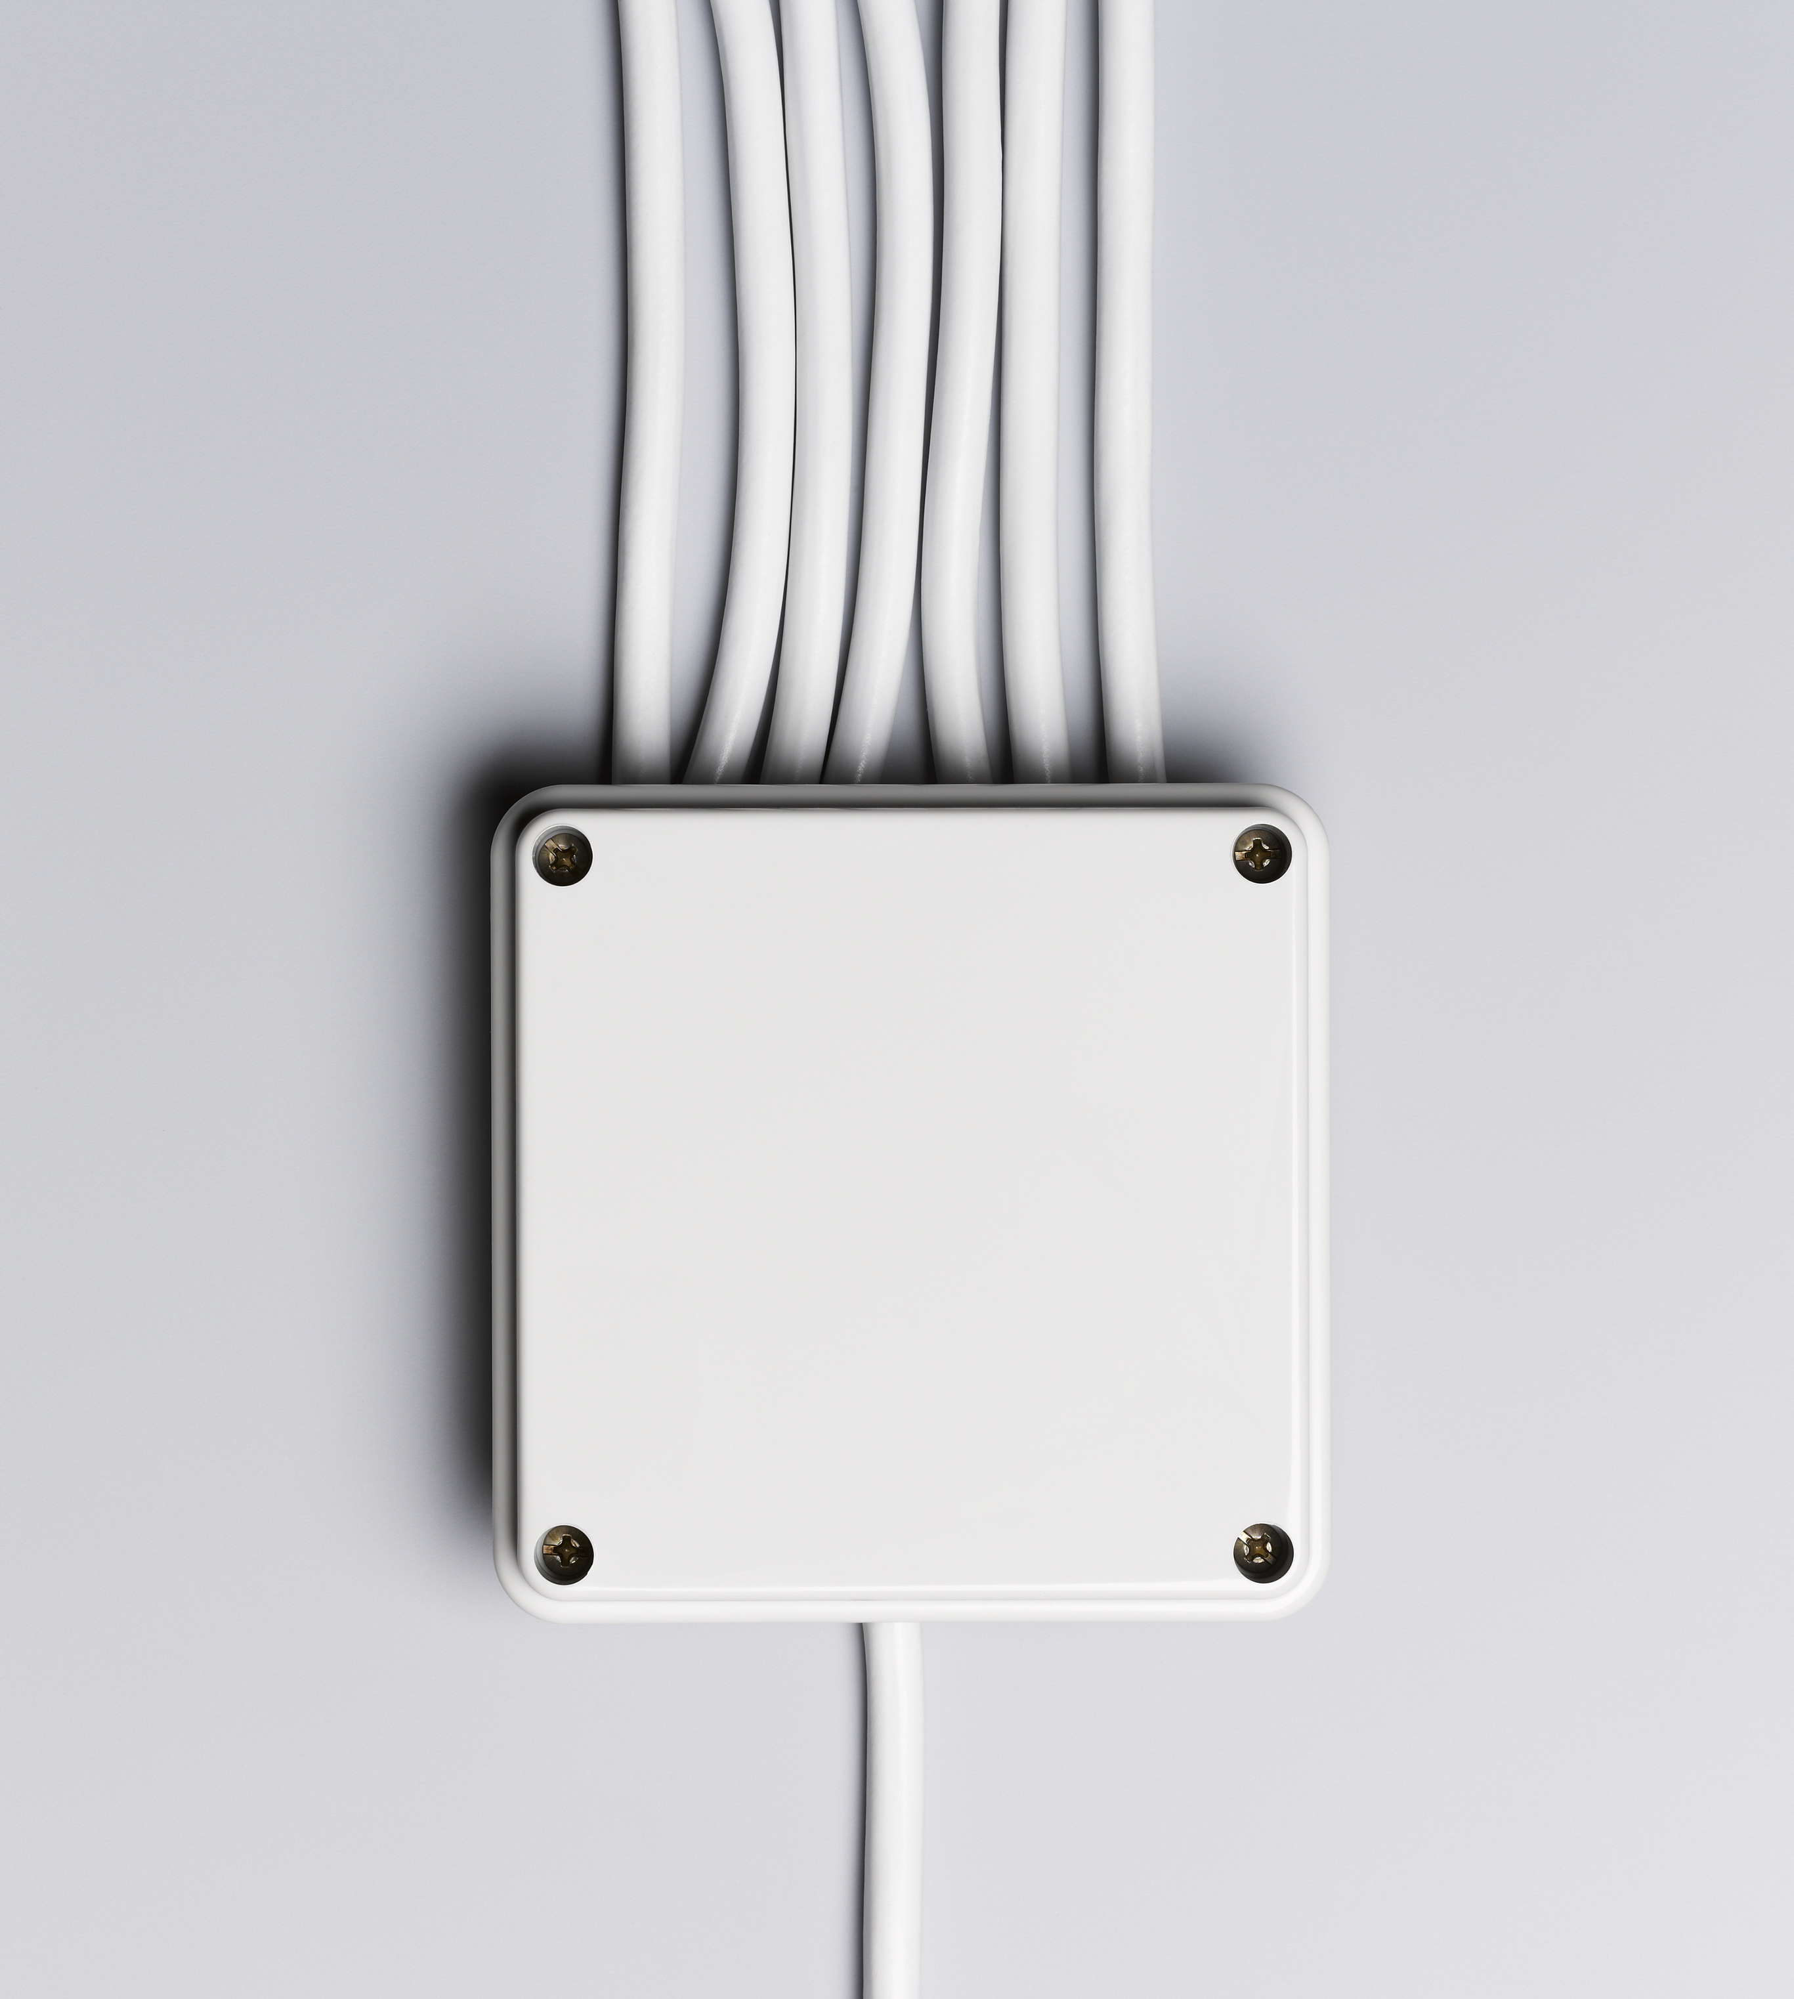

Sorting
Problem: Given two sorted lists A and B, find a sorted list of their union.

Slide 34
Merging
Input: Two sorted lists A and B of length n/2
Output: Sorted list of A and B
Initialize list C to be empty
Let i = 0 and j = 0
While (i < n/2 or j < n/2):
  If j == n/2 or A[i] <= B[j]:
    C.append(A[i])
    i += 1
  Else:
    C.append(B[j])
    j += 1

Slide 35
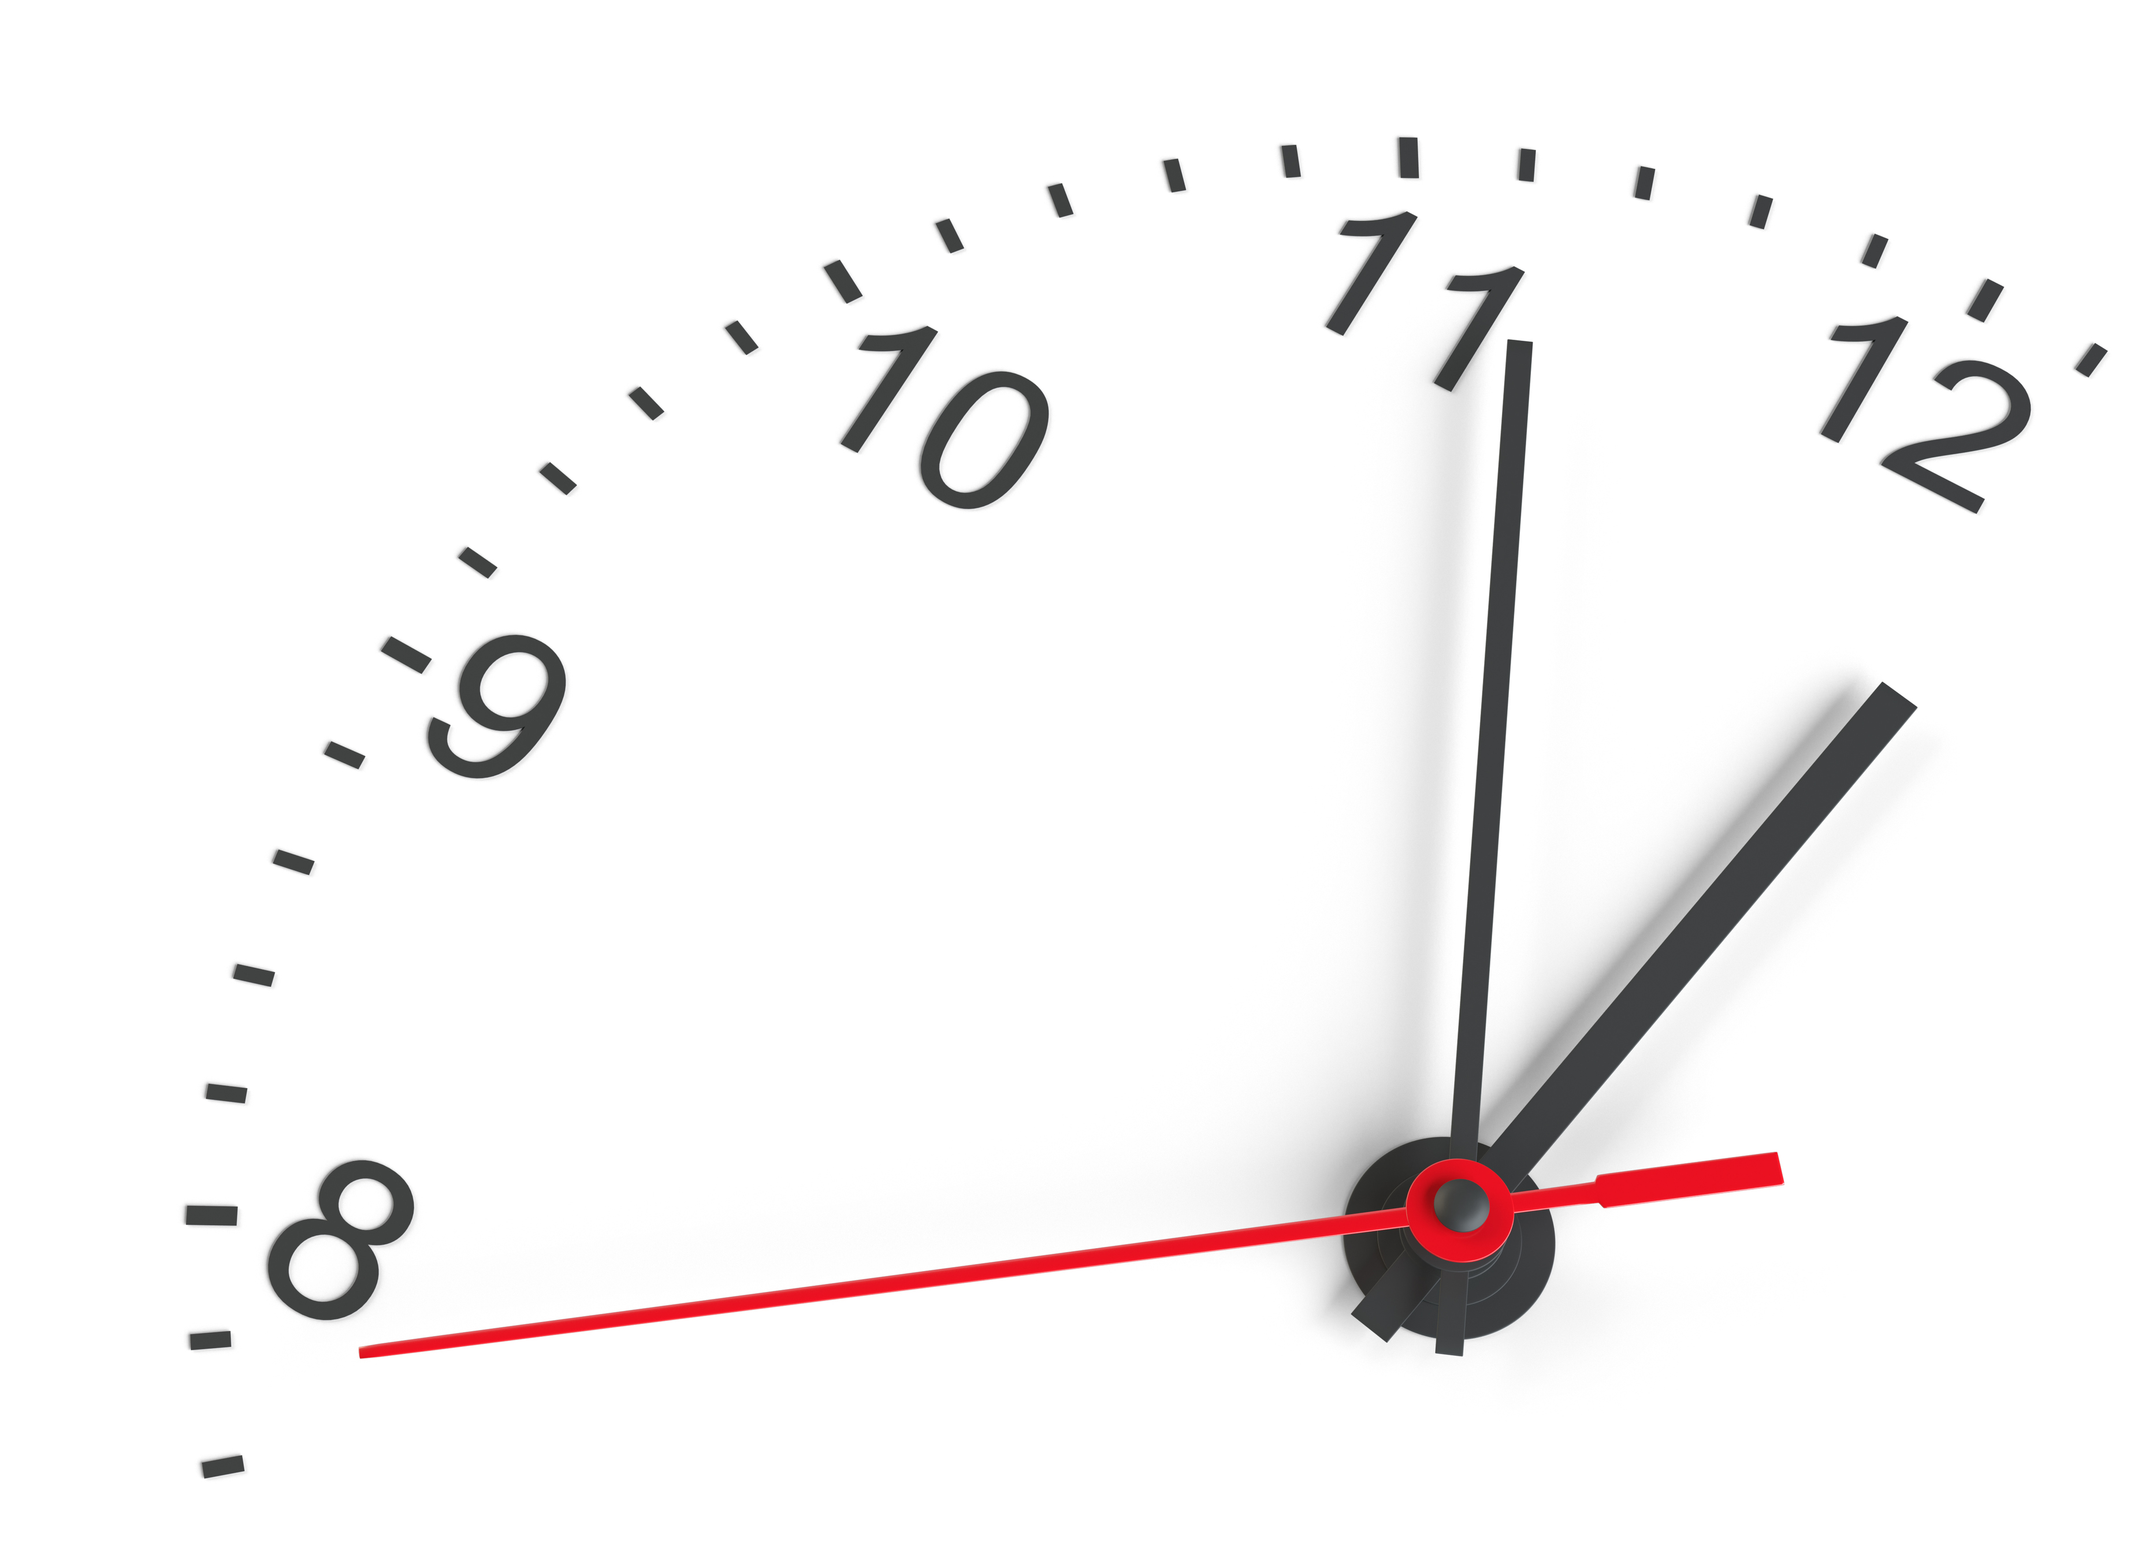
Mergesort Runtime?
Base Case: If array has length less than 2, brute force.
Divides: Divides input into two pieces of equal size in linear time.
  Assume even length for now.
Conquer: Recursively calls mergesort on each piece.
Unite: Merges the two sorted lists in linear time.

Slide 36
Let T(n) be runtime of Mergesort.
Base Case: If array has length less than 2, brute force. O(1)
Divides: Divides input into two pieces of equal size in linear time. O(n)
  Assume even length for now.
Conquer: Recursively calls mergesort on each piece. T(n/2)
Unite: Merges the two sorted lists in linear time. O(n)
N
N/2
N/2

Slide 37
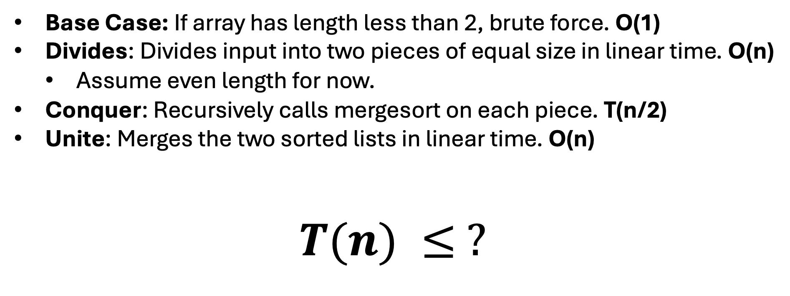
Let T(n) be runtime of Mergesort.
Base Case: If array has length less than 2, brute force. O(1)
Divides: Divides input into two pieces of equal size in linear time. O(n)
  Assume even length for now.
Conquer: Recursively calls mergesort on each piece. T(n/2)
Unite: Merges the two sorted lists in linear time. O(n)
$$T(n) ≤ ?$$

Slide 38
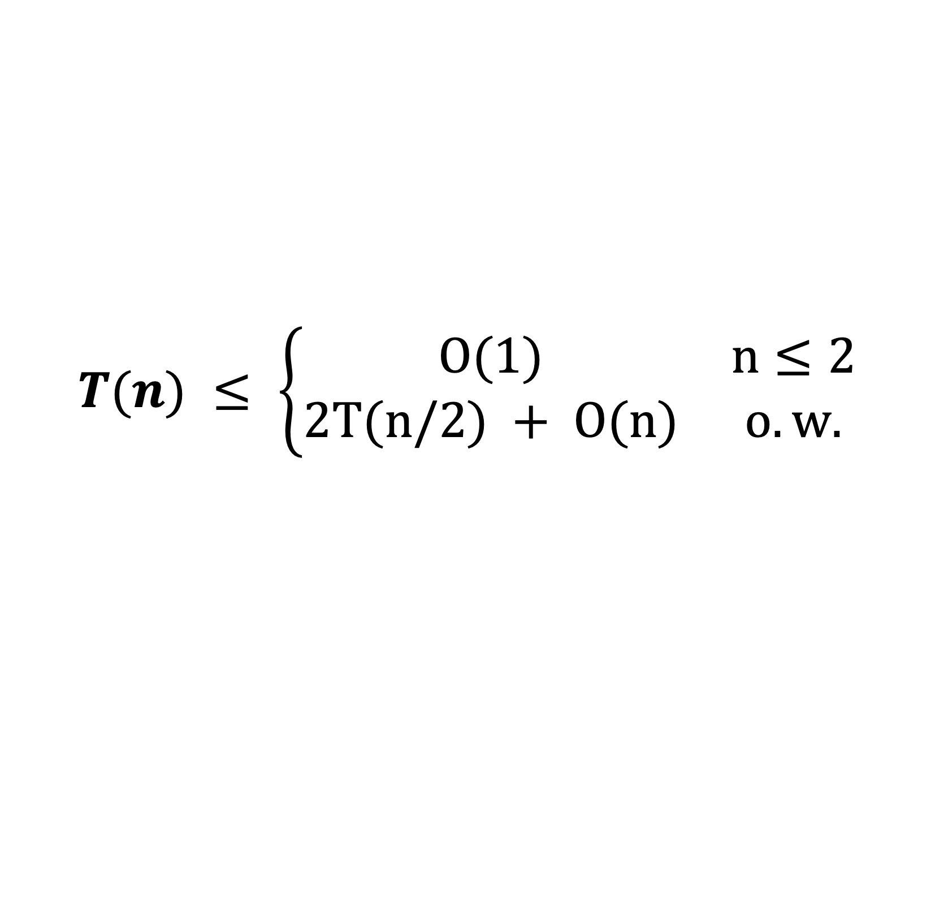
Let T(n) be runtime of Mergesort.
Base Case: If array has length less than 2, brute force. O(1)
Divides: Divides input into two pieces of equal size in linear time. O(n)
  Assume even length for now.
Conquer: Recursively calls mergesort on each piece. T(n/2)
Unite: Merges the two sorted lists in linear time. O(n)
$$T(n) ≤ \left\{\begin{matrix}O(1) & n≤2 \\ 2T(n/2) + O(n) & o.w.\end{matrix}\right.$$

Slide 39
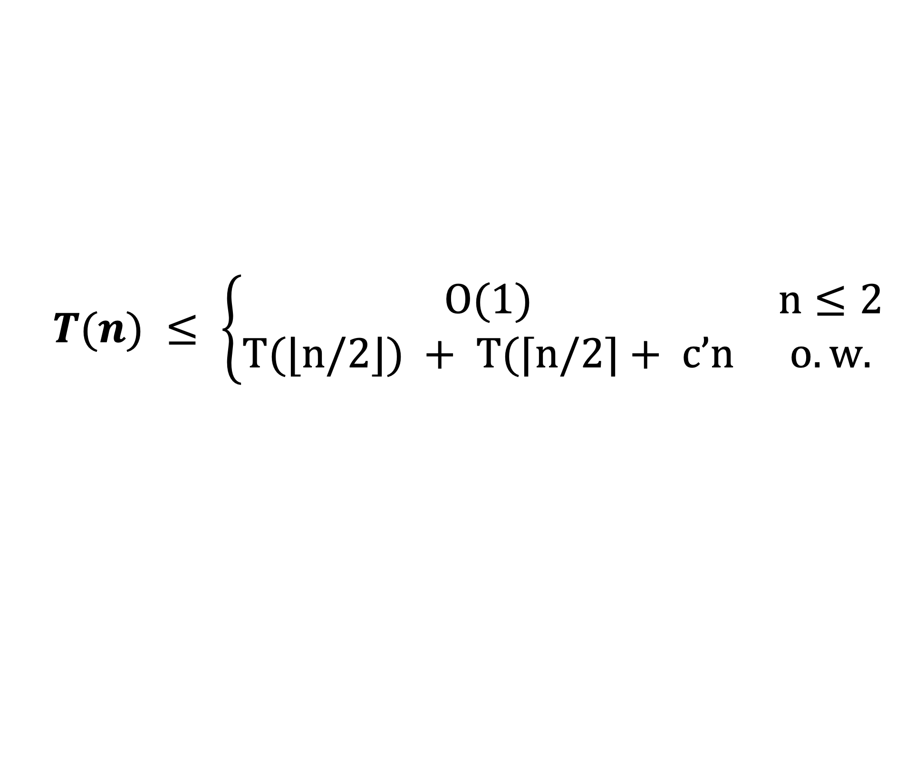
Let T(n) be runtime of Mergesort.
Base Case: If array has length less than 2, brute force. O(1)
Divides: Divides input into two pieces of equal size in linear time. O(n)
Conquer: Recursively calls mergesort on each piece. T(n/2)
Unite: Merges the two sorted lists in linear time. O(n)
$$T(n) ≤ \left\{\begin{matrix}O(1) & n≤2 \\ T(⌊n/2⌋) + T(⌈n/2⌉+ c’n & o.w.\end{matrix}\right.$$

Slide 40
How do you solve a recurrence?
Unrolling: We analyze the first few ”levels” of the recursion, find a pattern and then prove that the pattern is correct.
Guess and Check: We guess what the answer and the substitute it in to check that it works. That is, we prove it works.
REVIEW KT 5.1 and KT 5.2 IF YOU HAVEN’T ALREADY!
$$T(n) ≤ \left\{\begin{matrix}O(1) & n≤2 \\ T(⌊n/2⌋) + T(⌈n/2⌉+ c’n & o.w.\end{matrix}\right.$$

Slide 41

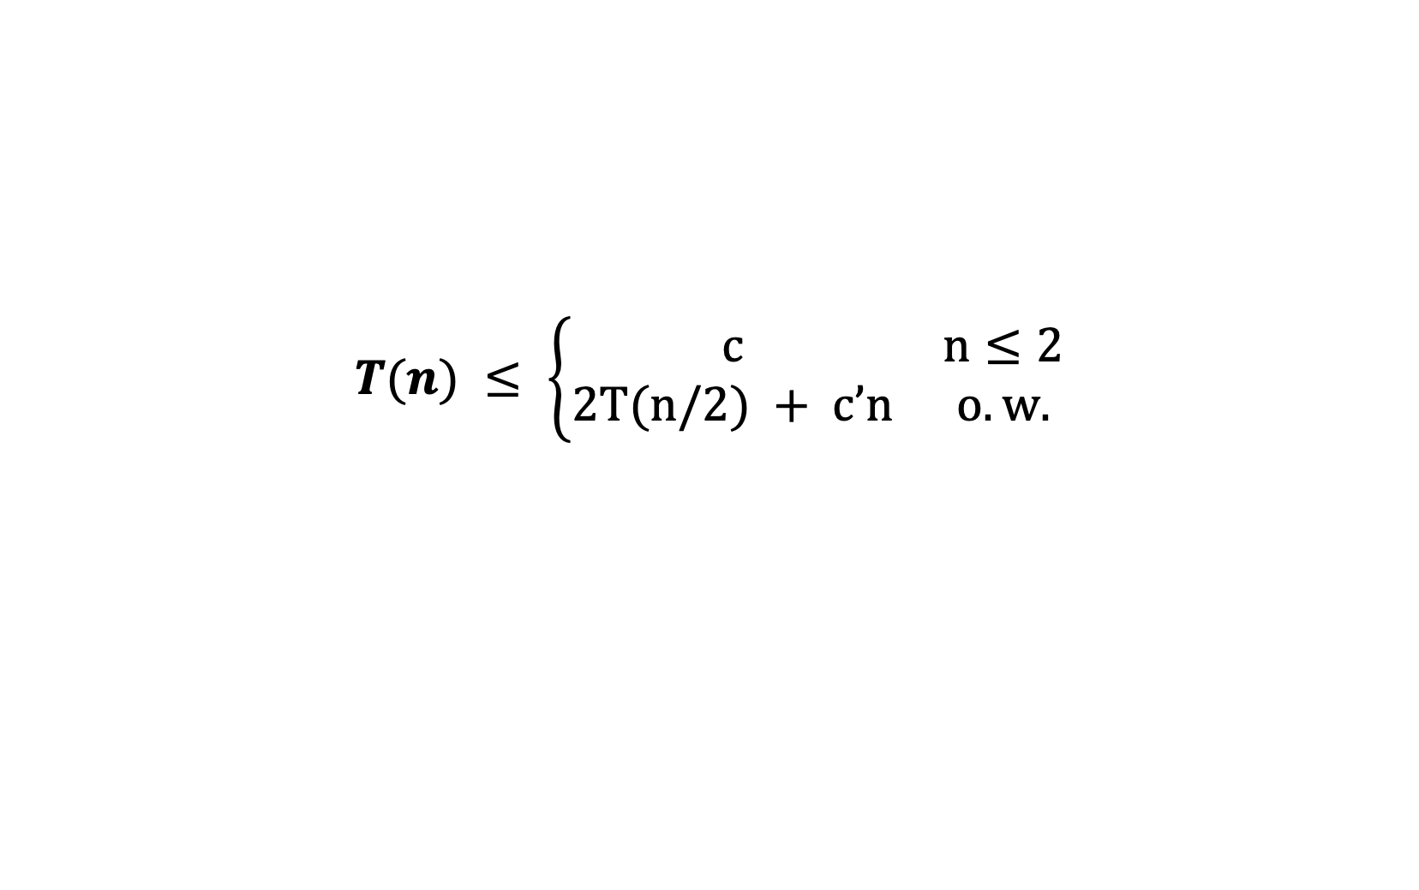


Unrolling
Unrolling:
  Sketch out a few levels of the ”recursion tree”
  Identify how many problems on each level.
  Identify how much work done at each level.
  Identify how small each problem is at each level.
  Identify how many levels before base case.
$$T(n)$$
$$T(n/2)$$
$$T(n/2)$$
$$T(n) ≤ \left\{\begin{matrix}c & n≤2 \\ 2T(n/2) + c’n & o.w.\end{matrix}\right.$$

Slide 42
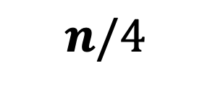
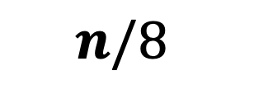


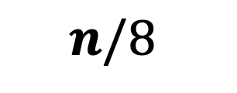
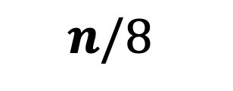
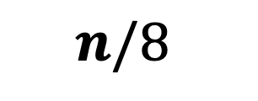
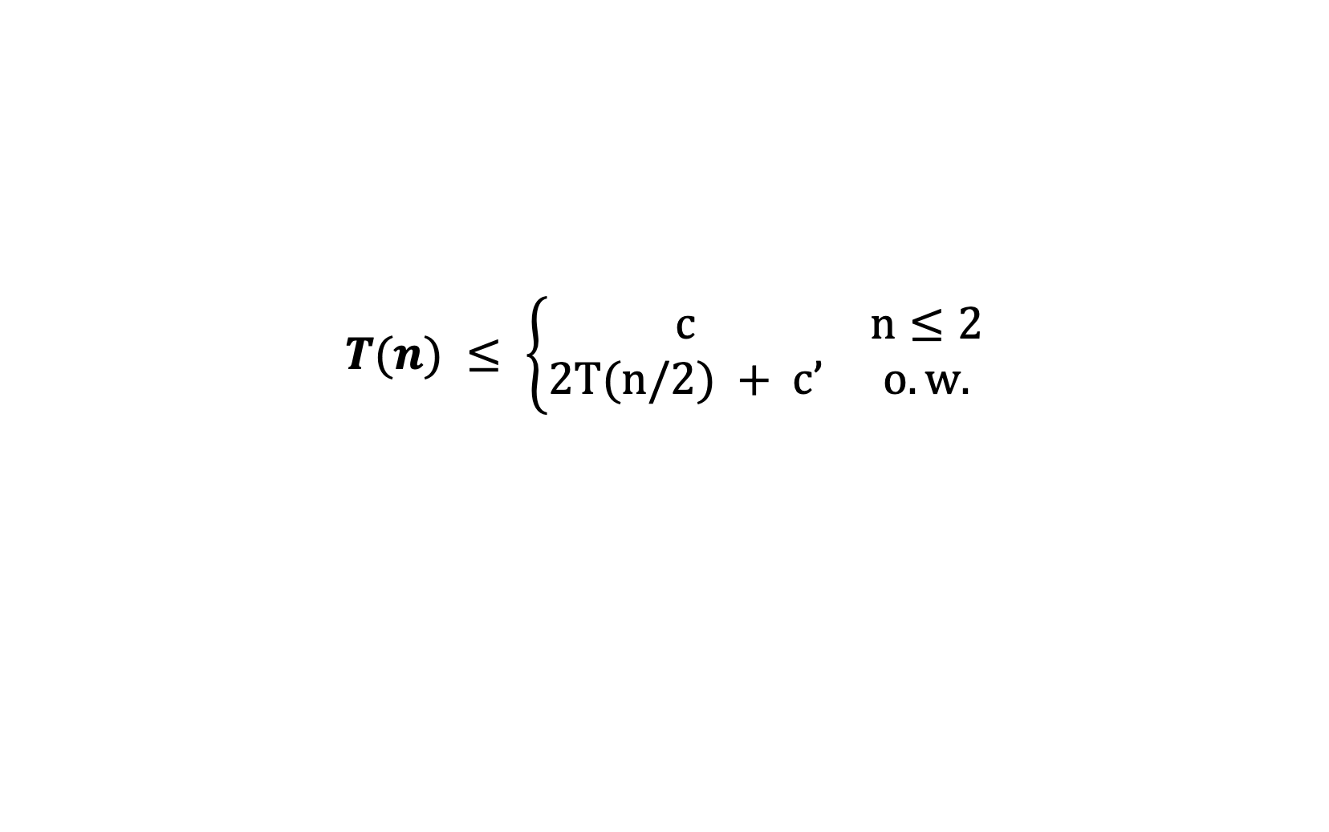
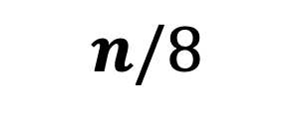
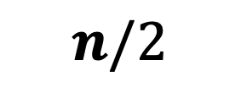
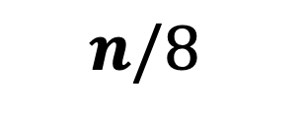

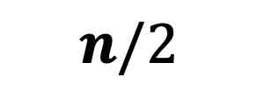
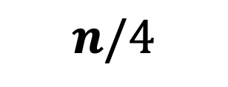
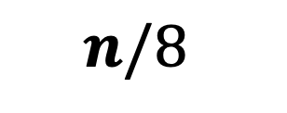
Unrolling a few levels
$$T(n) ≤ \left\{\begin{matrix}c & n≤2 \\ 2T(n/2) + c’ & o.w.\end{matrix}\right.$$
$$n$$
$$n/2$$
$$n/2$$
$$n/4$$
$$n/4$$
$$n/4$$
$$n/4$$
$$n/8$$
$$n/8$$
$$n/8$$
$$n/8$$
$$n/8$$
$$n/8$$
$$n/8$$
$$n/8$$

Slide 43
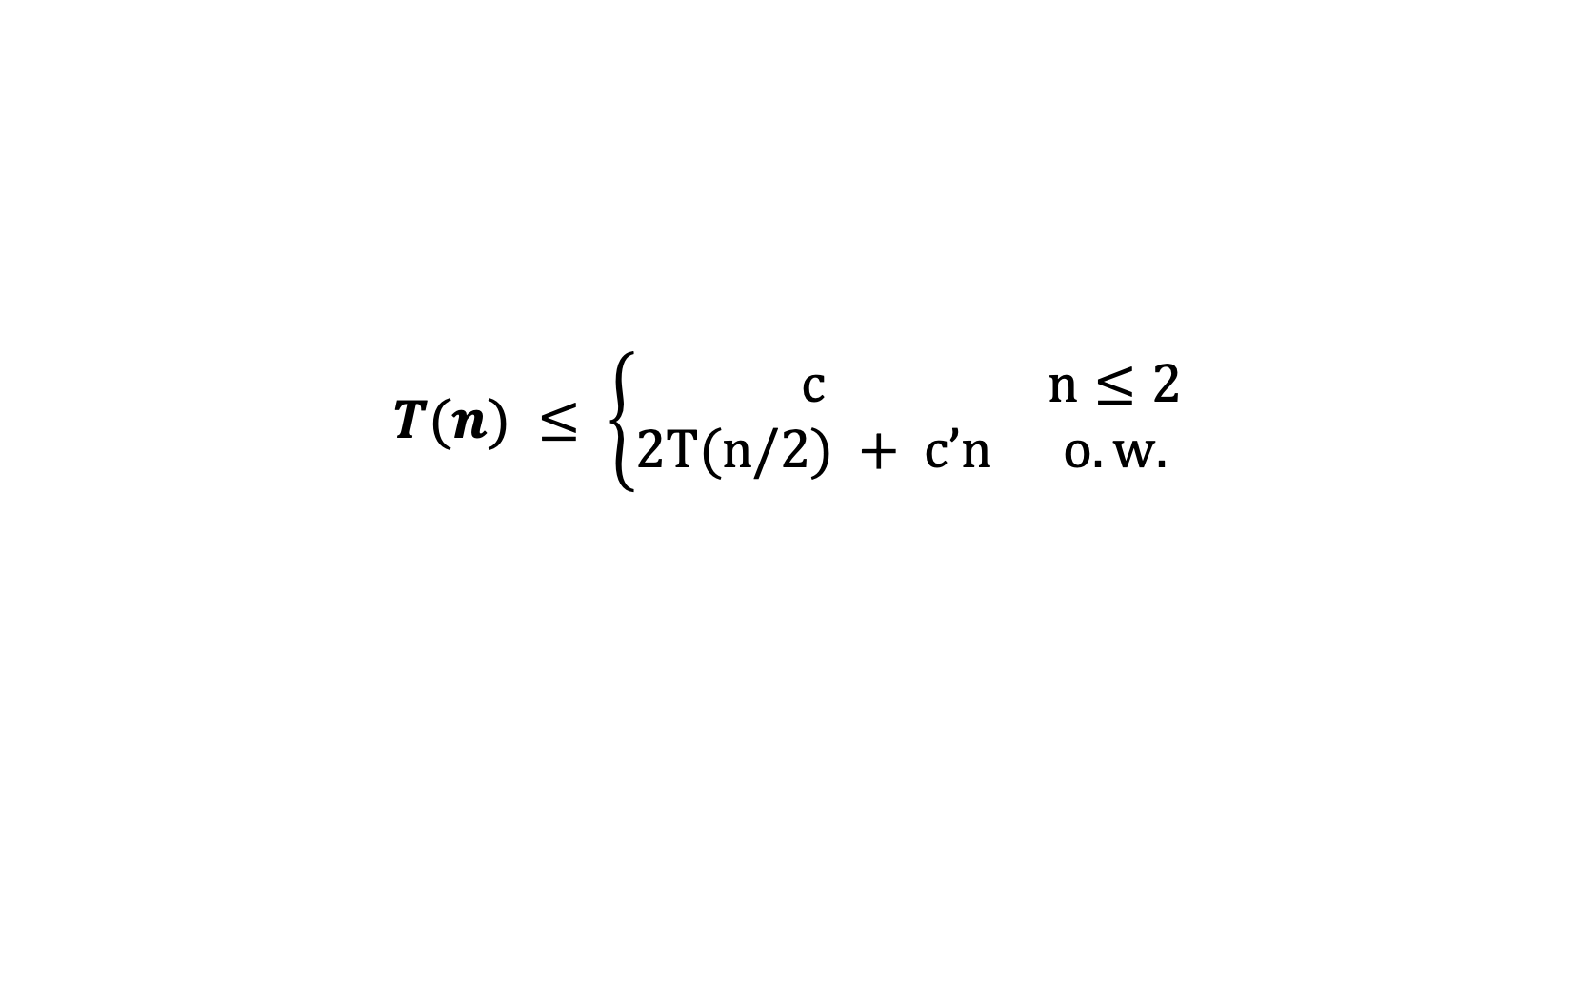
Unrolling a few levels
$$T(n) ≤ \left\{\begin{matrix}c & n≤2 \\ 2T(n/2) + c’n & o.w.\end{matrix}\right.$$
$$n$$
$$n/2$$
$$n/2$$
$$n/4$$
$$n/4$$
$$n/4$$
$$n/4$$
$$n/8$$
$$n/8$$
$$n/8$$
$$n/8$$
$$n/8$$
$$n/8$$
$$n/8$$
$$n/8$$

Slide 44
Unrolling a few levels
$$T(n) ≤ \left\{\begin{matrix}c & n≤2 \\ 2T(n/2) + c’n & o.w.\end{matrix}\right.$$
$$n$$
$$n/2$$
$$n/2$$
$$n/4$$
$$n/4$$
$$n/4$$
$$n/4$$
$$n/8$$
$$n/8$$
$$n/8$$
$$n/8$$
$$n/8$$
$$n/8$$
$$n/8$$
$$n/8$$

Slide 45
Unrolling a few levels
$$T(n) ≤ \left\{\begin{matrix}c & n≤2 \\ 2T(n/2) + c’n & o.w.\end{matrix}\right.$$
$$n$$
$$n/2$$
$$n/2$$
$$n/4$$
$$n/4$$
$$n/4$$
$$n/4$$
$$n/8$$
$$n/8$$
$$n/8$$
$$n/8$$
$$n/8$$
$$n/8$$
$$n/8$$
$$n/8$$

Slide 46
Unrolling a few levels
$$T(n) ≤ \left\{\begin{matrix}c & n≤2 \\ 2T(n/2) + c’n & o.w.\end{matrix}\right.$$
$$n$$
$$n/2$$
$$n/2$$
$$n/4$$
$$n/4$$
$$n/4$$
$$n/4$$
$$n/8$$
$$n/8$$
$$n/8$$
$$n/8$$
$$n/8$$
$$n/8$$
$$n/8$$
$$n/8$$

Slide 47
Unrolling a few levels
$$T(n) ≤ \left\{\begin{matrix}c & n≤2 \\ 2T(n/2) + c’n & o.w.\end{matrix}\right.$$
Level
Problem Size
Total Work
0 ? ?
1 ? ?
2 ? ?
3 ? ?

Slide 48
Unrolling a few levels
$$T(n) ≤ \left\{\begin{matrix}c & n≤2 \\ 2T(n/2) + c’n & o.w.\end{matrix}\right.$$
Level
Problem Size
Total Work
0 n ?
1 n/2 ?
2 n/4 ?
3 n/8 ?

Slide 49
Unrolling a few levels
$$T(n) ≤ \left\{\begin{matrix}c & n≤2 \\ 2T(n/2) + c’n & o.w.\end{matrix}\right.$$
Level
Problem Size
Total Work
0 n c’n
1 n/2 2*(c’n/2)
2 n/4 4*(c’n/4)
3 n/8 8*(c’n/8)

Slide 50
Unrolling a few levels
$$T(n) ≤ \left\{\begin{matrix}c & n≤2 \\ 2T(n/2) + c’n & o.w.\end{matrix}\right.$$
Level
Problem Size
Total Work
0 n c’n
1 n/2 c’n
2 n/4 c’n
3 n/8 c’n

Slide 51
Unrolling a few levels
$$T(n) ≤ \left\{\begin{matrix}c & n≤2 \\ 2T(n/2) + c’n & o.w.\end{matrix}\right.$$
Q: What will be the problem size and total work done at level i?
Level
Problem Size
Total Work
0 n c’n
1 n/2 c’n
2 n/4 c’n
3 n/8 c’n

Slide 52
Unrolling a few levels
$$T(n) ≤ \left\{\begin{matrix}c & n≤2 \\ 2T(n/2) + c’n & o.w.\end{matrix}\right.$$
A: At level i, the problem size (if not the base case) will be n/2^i. The total work done will be c’n.
Level
Problem Size
Total Work
0 n c’n
1 n/2 c’n
2 n/4 c’n
3 n/8 c’n

Slide 53
Unrolling a few levels
$$T(n) ≤ \left\{\begin{matrix}c & n≤2 \\ 2T(n/2) + c’n & o.w.\end{matrix}\right.$$
Q: How many levels until base case?
Level
Problem Size
Total Work
0 n c’n
1 n/2 c’n
2 n/4 c’n
3 n/8 c’n

Slide 54
Unrolling a few levels
$$T(n) ≤ \left\{\begin{matrix}c & n≤2 \\ 2T(n/2) + c’n & o.w.\end{matrix}\right.$$
A: After O(log(n)) levels, the problem size will be at most c and we can do the base case.
Level
Problem Size
Total Work
0 n c’n
1 n/2 c’n
2 n/4 c’n
3 n/8 c’n

Slide 55
Unrolling a few levels
$$T(n) ≤ \left\{\begin{matrix}c & n≤2 \\ 2T(n/2) + c’n & o.w.\end{matrix}\right.$$
Q: How much total work done over all levels?
Level
Problem Size
Total Work
0 n c’n
1 n/2 c’n
2 n/4 c’n
3 n/8 c’n

Slide 56
Unrolling a few levels
$$T(n) ≤ \left\{\begin{matrix}c & n≤2 \\ 2T(n/2) + c’n & o.w.\end{matrix}\right.$$
A: The work done at each level is c’n and the total number of levels is O(log(n)).
Hence, O(n log(n)).
Level
Problem Size
Total Work
0 n c’n
1 n/2 c’n
2 n/4 c’n
3 n/8 c’n

Slide 57
Unrolling a few levels
$$T(n) ≤ \left\{\begin{matrix}c & n≤2 \\ 2T(n/2) + c’n & o.w.\end{matrix}\right.$$
Work Done is the sum of work done at each level and we “showed” that the work done at each level is c’n and there are at most O(log(n)) levels.
Level
Problem Size
Total Work
0 n c’n
1 n/2 c’n
2 n/4 c’n
3 n/8 c’n

Slide 58
Guess & Check
$$T(n) ≤ \left\{\begin{matrix}c & n≤2 \\ 2T(n/2) + c’n & o.w.\end{matrix}\right.$$
You might have guessed T(n) = O(nlog(n)) because you’ve been told that before or because you recognize the recurrence.
How could you directly prove T(n) = c’’nlog(n) if you suspected it was true?

Slide 59
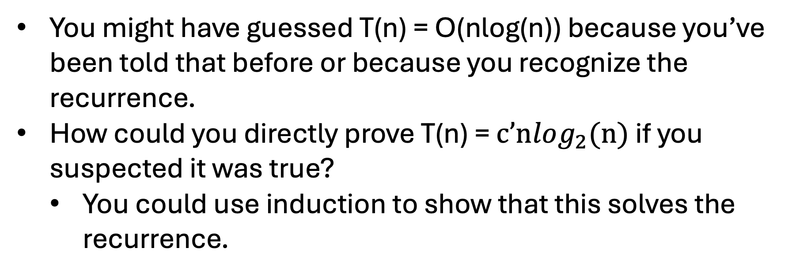
Guess & Check
$$T(n) ≤ \left\{\begin{matrix}c & n≤2 \\ 2T(n/2) + c’n & o.w.\end{matrix}\right.$$
You might have guessed T(n) = O(nlog(n)) because you’ve been told that before or because you recognize the recurrence.
How could you directly prove T(n) = $c’nlog_{2}(n)$ if you suspected it was true?
  You could use induction to show that this solves the recurrence.

Slide 60
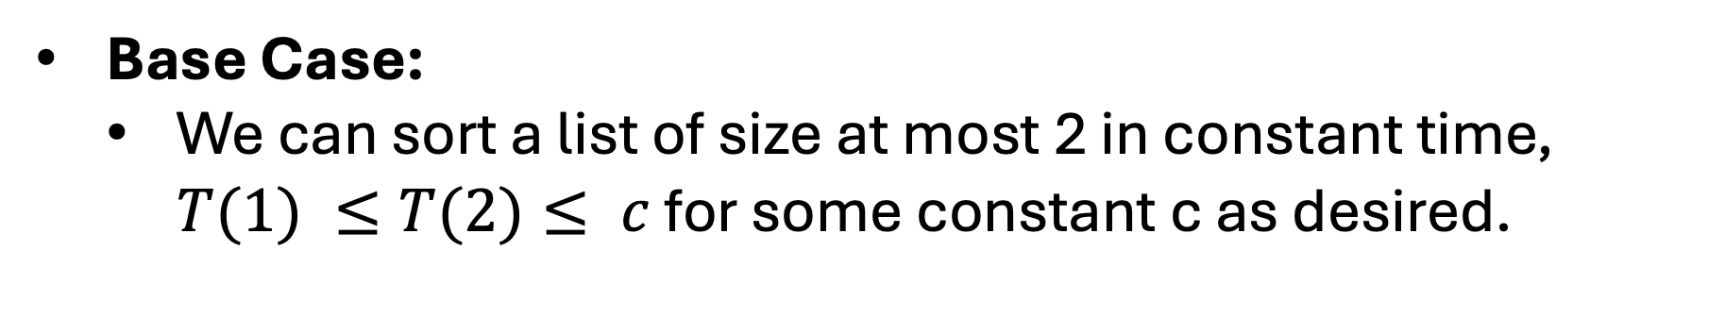
Guess & Check
$$T(n) ≤ \left\{\begin{matrix}c & n≤2 \\ 2T(n/2) + c’n & o.w.\end{matrix}\right.$$
Base Case:
  We can sort a list of size at most 2 in constant time, $T(1) ≤T(2)≤ c$ for some constant c as desired.

Slide 61
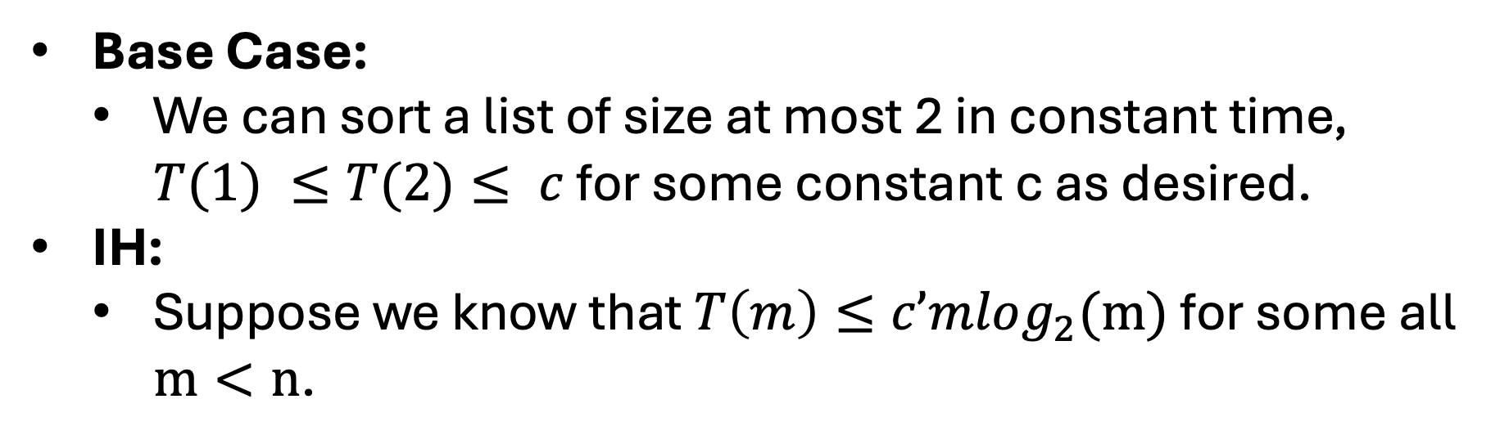
Guess & Check
$$T(n) ≤ \left\{\begin{matrix}c & n≤2 \\ 2T(n/2) + c’n & o.w.\end{matrix}\right.$$
Base Case:
  We can sort a list of size at most 2 in constant time, $T(1) ≤T(2)≤ c$ for some constant c as desired.
IH:
  Suppose we know that $T\left(m\right)≤c’mlog_{2}(m)$ for some all $m<n$.

Slide 62
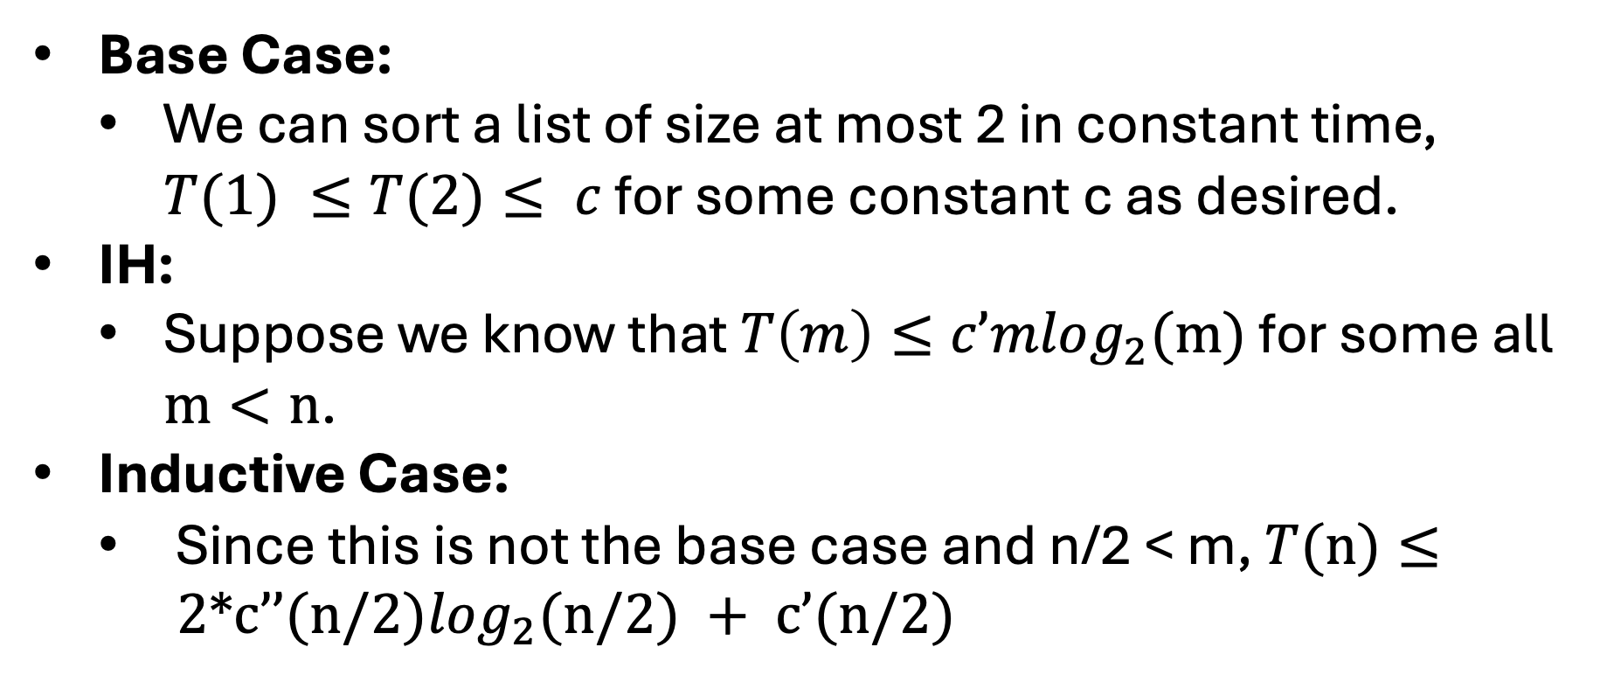
Guess & Check
$$T(n) ≤ \left\{\begin{matrix}c & n≤2 \\ 2T(n/2) + c’n & o.w.\end{matrix}\right.$$
Base Case:
  We can sort a list of size at most 2 in constant time, $T(1) ≤T(2)≤ c$ for some constant c as desired.
IH:
  Suppose we know that $T\left(m\right)≤c’mlog_{2}(m)$ for some all $m<n$.
Inductive Case:
  Since this is not the base case and n/2 < m, $T(n)≤ 2*c’’(n/2)log_{2}(n/2) + c’(n/2)$

Slide 63





Guess & Check
$$T(n) ≤ \left\{\begin{matrix}c & n≤2 \\ 2T(n/2) + c’n & o.w.\end{matrix}\right.$$
Inductive Case:
  Since this is not the base case and n/2 < m,
  $$T\left(n\right)≤2∗c’\left(n/2\right)log_{2}\left(n/2\right)+c’n$$
This concludes the proof.
$$≤c’nlog_{2}\left(n/2\right)+c’n$$
$$≤c’n (log_{2}\left(n\right)-1)+c’n$$
$$≤c’n log_{2}\left(n\right)-c’n+c’n$$
$$≤c’n log_{2}\left(n\right)$$

Slide 64




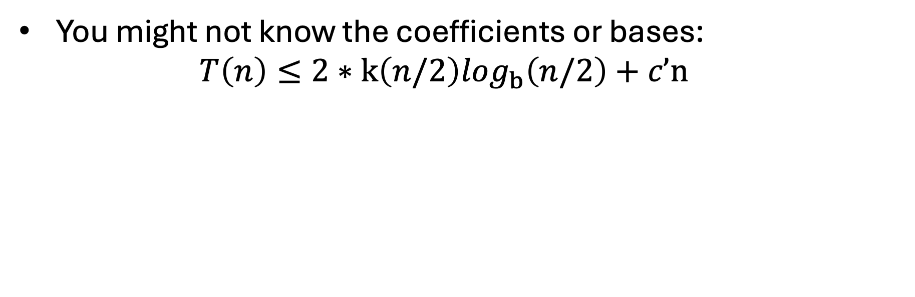
Partial Guess
$$T(n) ≤ \left\{\begin{matrix}c & n≤2 \\ 2T(n/2) + c’n & o.w.\end{matrix}\right.$$
You might not know the coefficients or bases:
  $$T\left(n\right)≤2∗k\left(n/2\right)log_{b}\left(n/2\right)+c’n$$
$$≤k n log_{b}\left(n/2\right)+c’n$$
Seems like b = 2
$$≤kn (log_{2}\left(n\right)-1)+c’n$$
$$≤kn log_{2}\left(n\right)-kn+c’n$$
Seems like k = c’
$$≤c’n log_{2}\left(n\right)$$

Slide 65
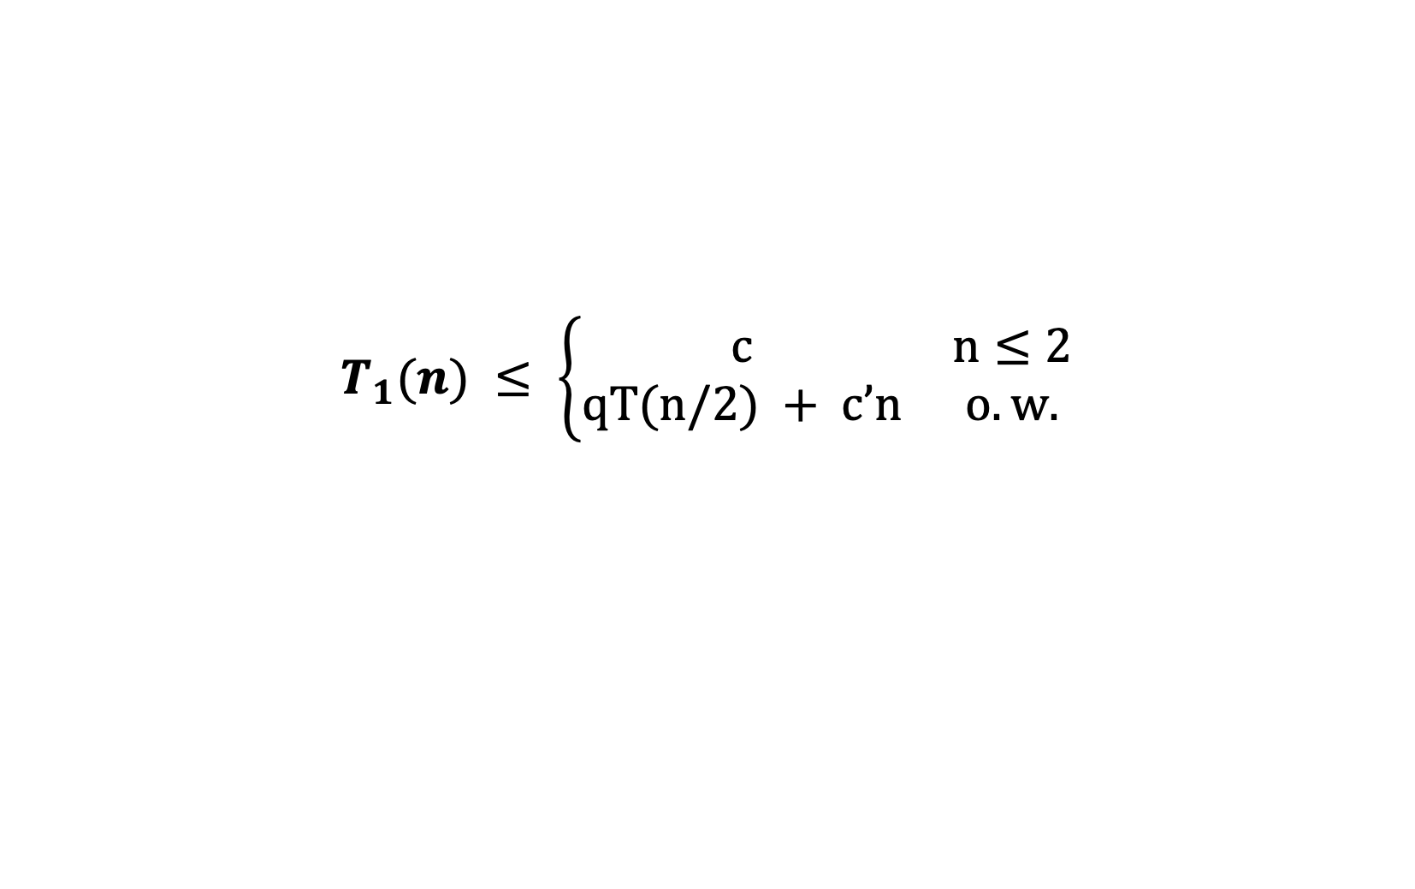
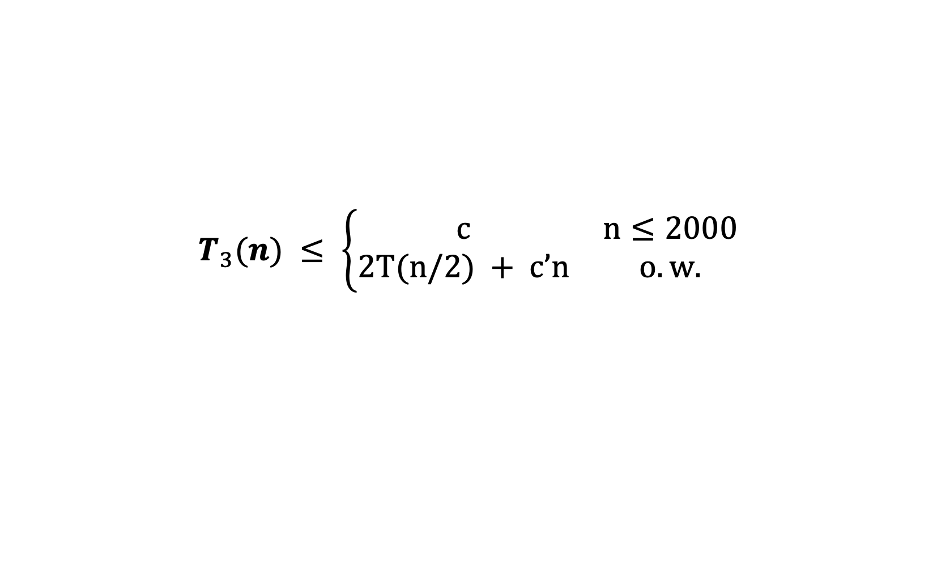
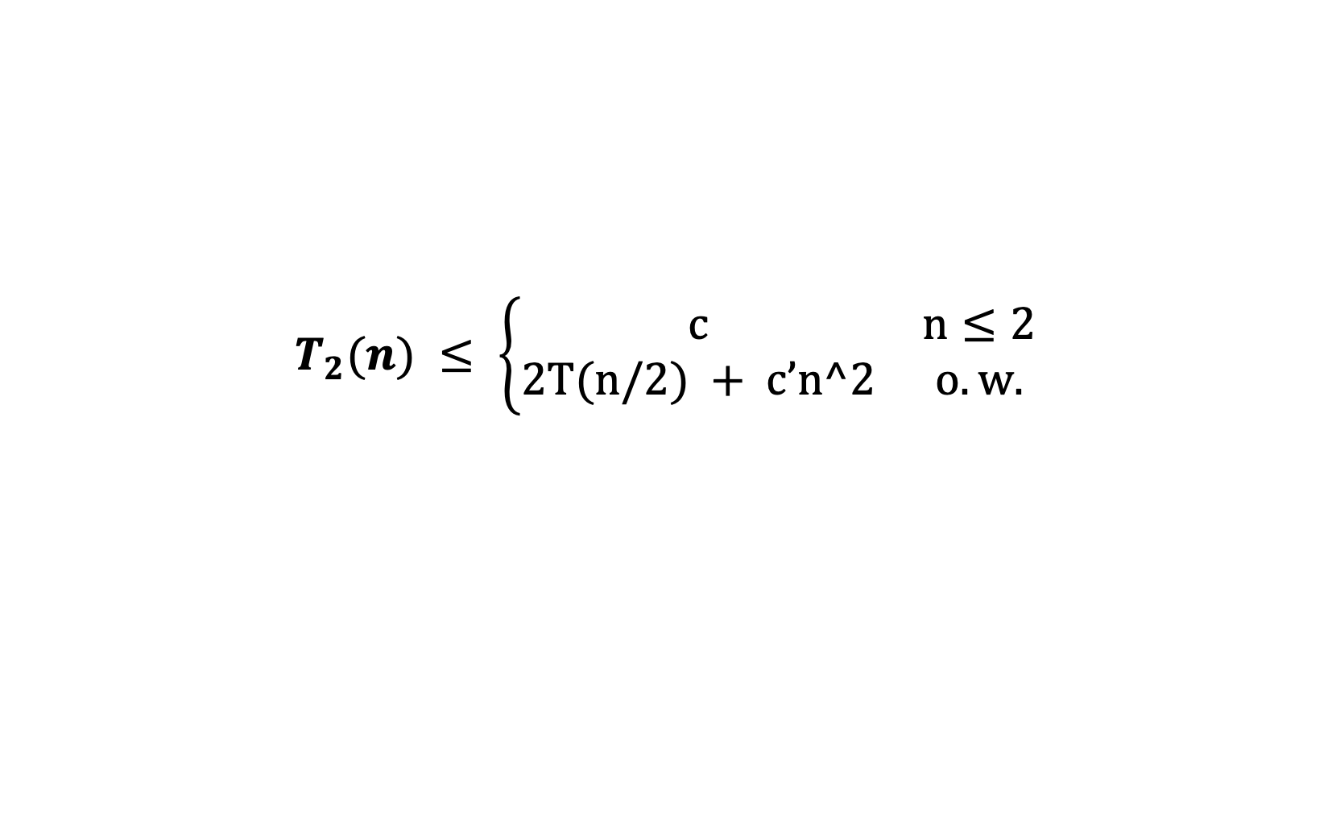
Q: What happens?
$$T_{1}(n) ≤ \left\{\begin{matrix}c & n≤2 \\ qT(n/2) + c’n & o.w.\end{matrix}\right.$$
$$T_{2}(n) ≤ \left\{\begin{matrix}c & n≤2 \\ 2T(n/2) + c’n^2 & o.w.\end{matrix}\right.$$
$$T_{3}(n) ≤ \left\{\begin{matrix}c & n≤2000 \\ 2T(n/2) + c’n & o.w.\end{matrix}\right.$$

