Slide 1

CSE 331:
Algorithms & Complexity
“Solving recurrence relations”
Prof. Charlie Anne Carlson (She/Her)
Lecture 23
Monday October 27th, 2025

Slide 2

Schedule
Course Updates
Mergesort
Recurrences

Slide 3

Course Updates
Midterm Out
Post Midterm Grades <-piazza
HW 5 Due Tomorrow
HW 6 Out Tomorrow
Group Project
  First Problems Oct 31st

Slide 4

Reading
You should have read:
  Finished KT 5.1
  Finished KT 5.2
  Started 5.3
Before Next Class:
  Finish KT 5.3
  Start KT 5.5

Slide 5
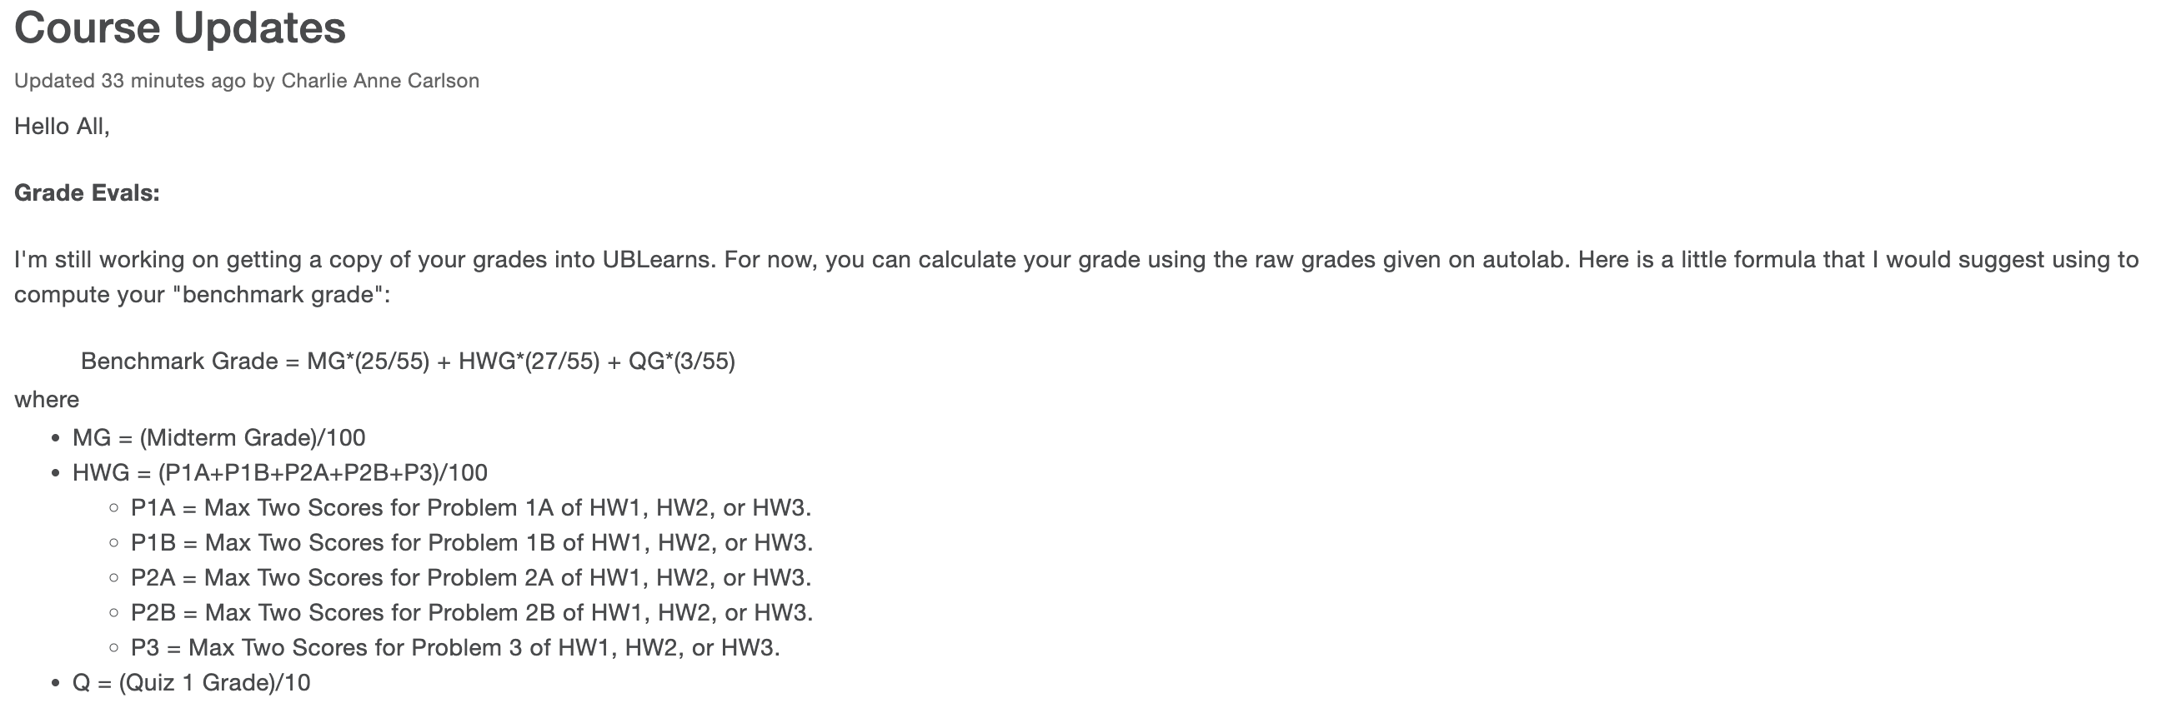
Course Update
Check Piazza!

Slide 6

Sorting
Problem: Given a list of n numbers L, rearrange them in ascending order.
E.g.
  Input: [3,2,5,5,1,6,7,8]
  Output: [1,2,3,5,5,6,7,8]

Slide 7
Sorting
Problem: Given a list of n numbers L, rearrange them in ascending order.
Sorting Algorithms:
  Bubble Sort
  Insertion Sort
  Mergesort
  Radix Sort
  Quicksort
  Introsort

Slide 8
Sorting
Problem: Given a list of n numbers L, rearrange them in ascending order.
Sorting Algorithms:
  Bubble Sort
  Insertion Sort
  Mergesort
  Radix Sort
  Quicksort
  Introsort

Slide 9
Mergesort
Divides: Divides input into two pieces of equal size in linear time.
  Assume even length for now.
Conquer: Recursively calls mergesort on each piece.
Unite: Merges the two sorted lists in linear time.

Slide 10
Mergesort
Base Case: If array has length less than 2, brute force.
Divides: Divides input into two pieces of equal size in linear time.
  Assume even length for now.
Conquer: Recursively calls mergesort on each piece.
Unite: Merges the two sorted lists in linear time.

Slide 11
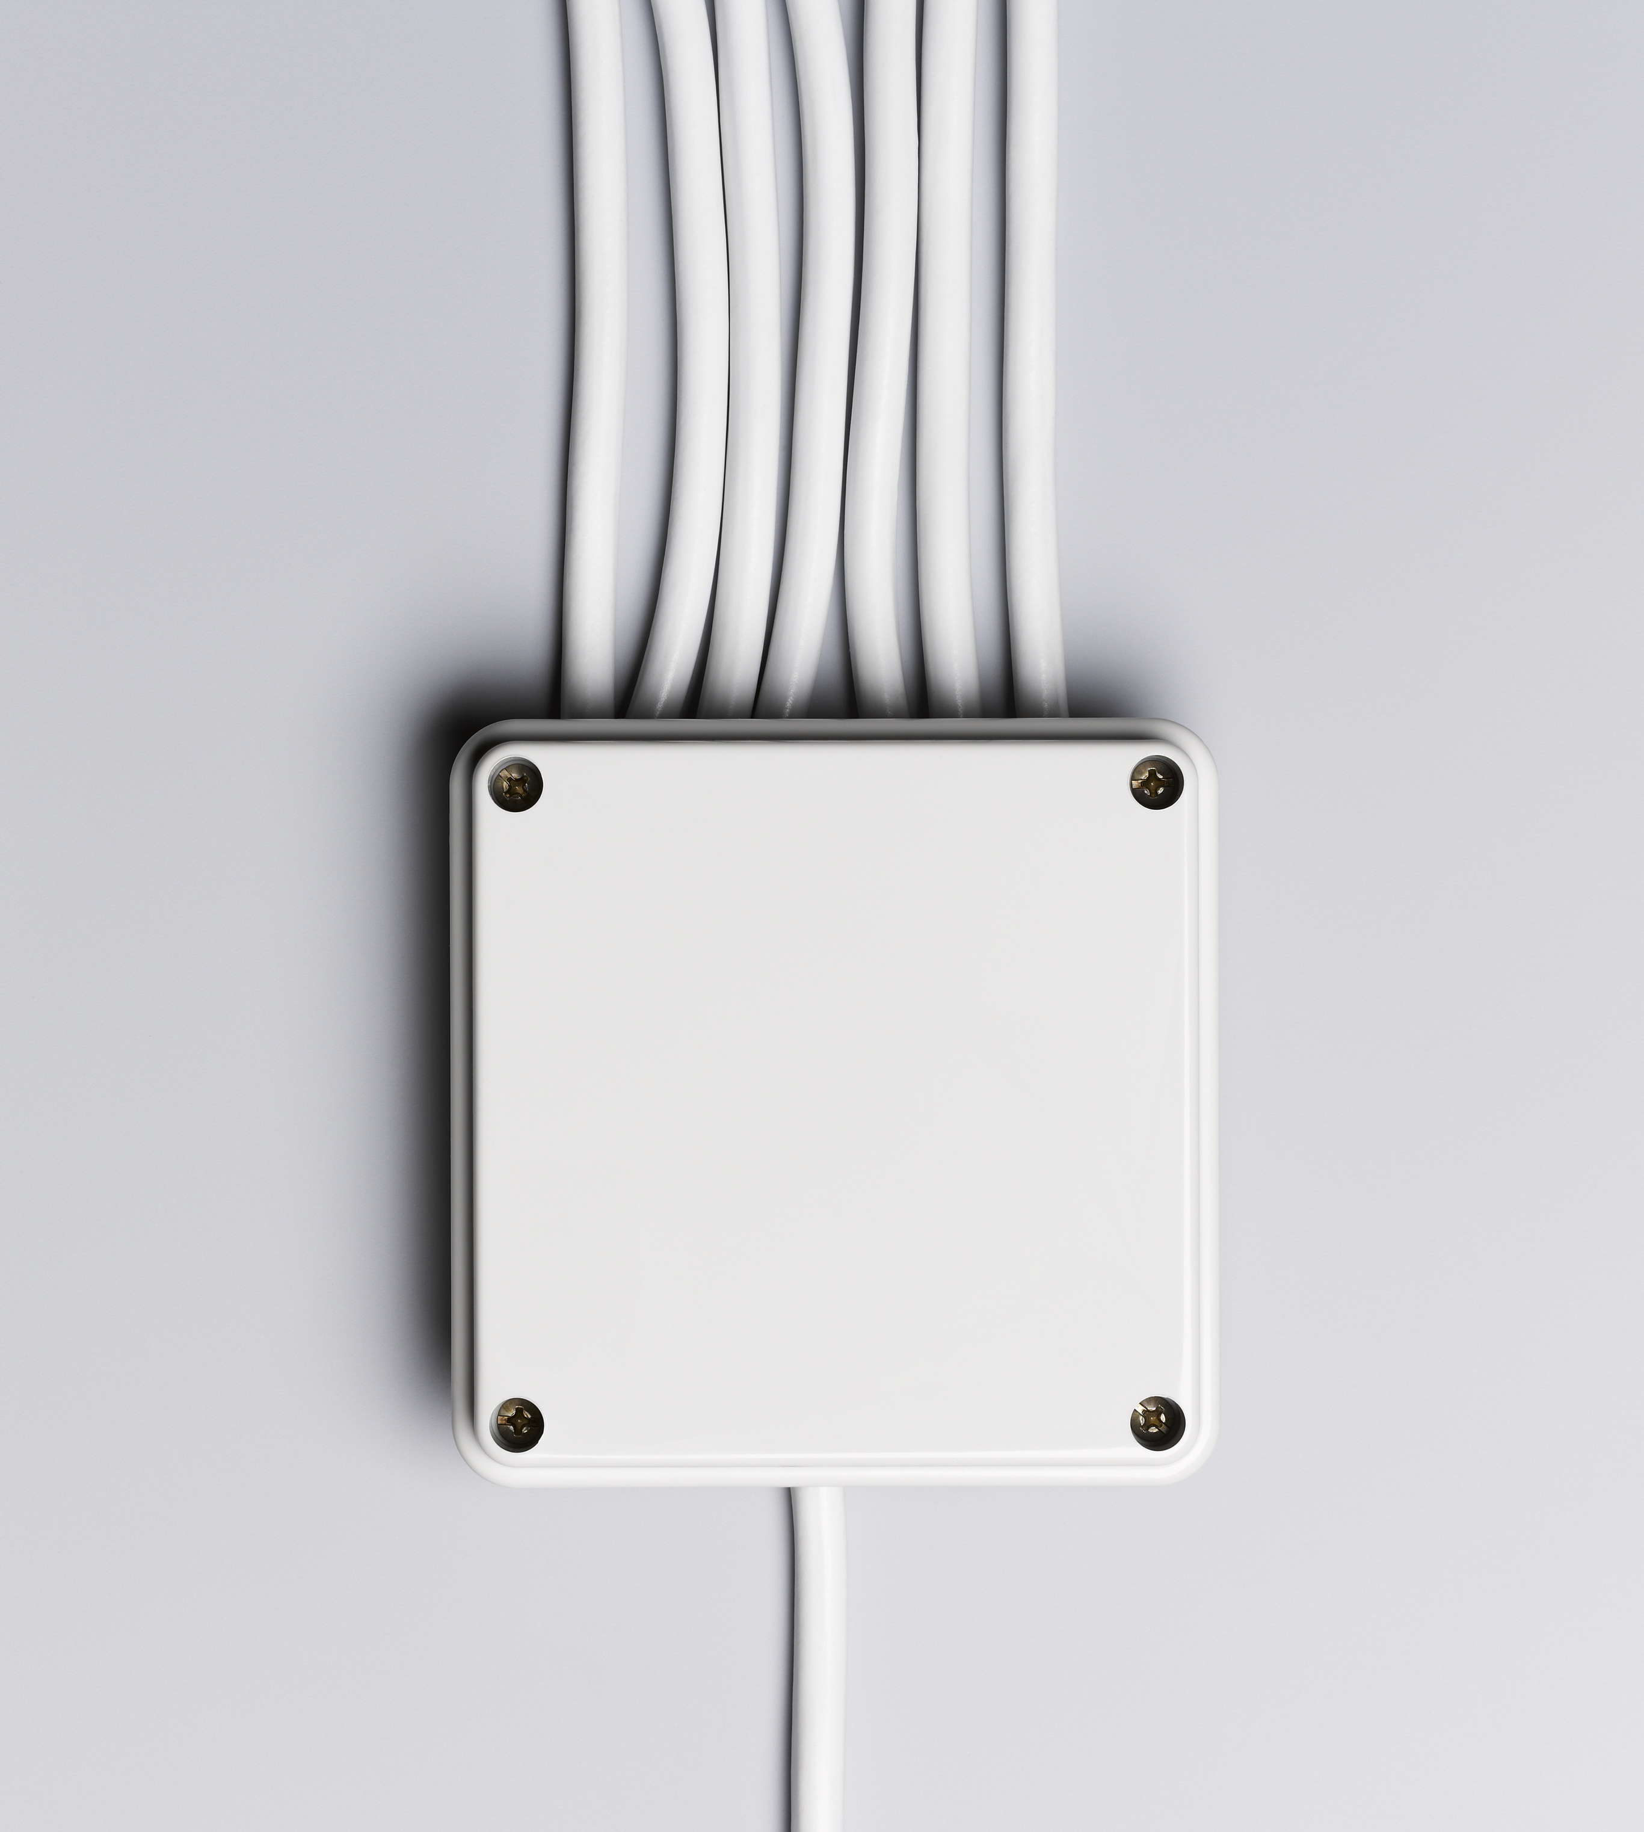

Sorting
Problem: Given two sorted lists A and B, find a sorted list of their union.

Slide 12
Merging
Input: Two sorted lists A and B of length n/2
Output: Sorted list of A and B
Initialize list C to be empty
Let i = 0 and j = 0
While (i < n/2 or j < n/2):
  If j == n/2 or A[i] <= B[j]:
    C.append(A[i])
    i += 1
  Else:
    C.append(B[j])
    j += 1

Slide 13
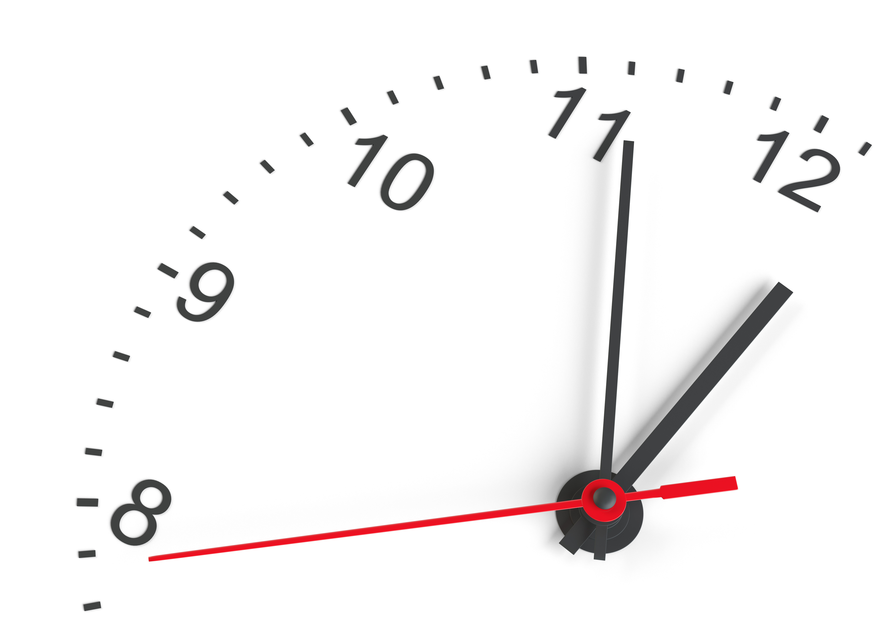
Mergesort Runtime?
Base Case: If array has length less than 2, brute force.
Divides: Divides input into two pieces of equal size in linear time.
  Assume even length for now.
Conquer: Recursively calls mergesort on each piece.
Unite: Merges the two sorted lists in linear time.

Slide 14
Let T(n) be runtime of Mergesort.
Base Case: If array has length less than 2, brute force. O(1)
Divides: Divides input into two pieces of equal size in linear time. O(n)
  Assume even length for now.
Conquer: Recursively calls mergesort on each piece. T(n/2)
Unite: Merges the two sorted lists in linear time. O(n)
N
N/2
N/2

Slide 15
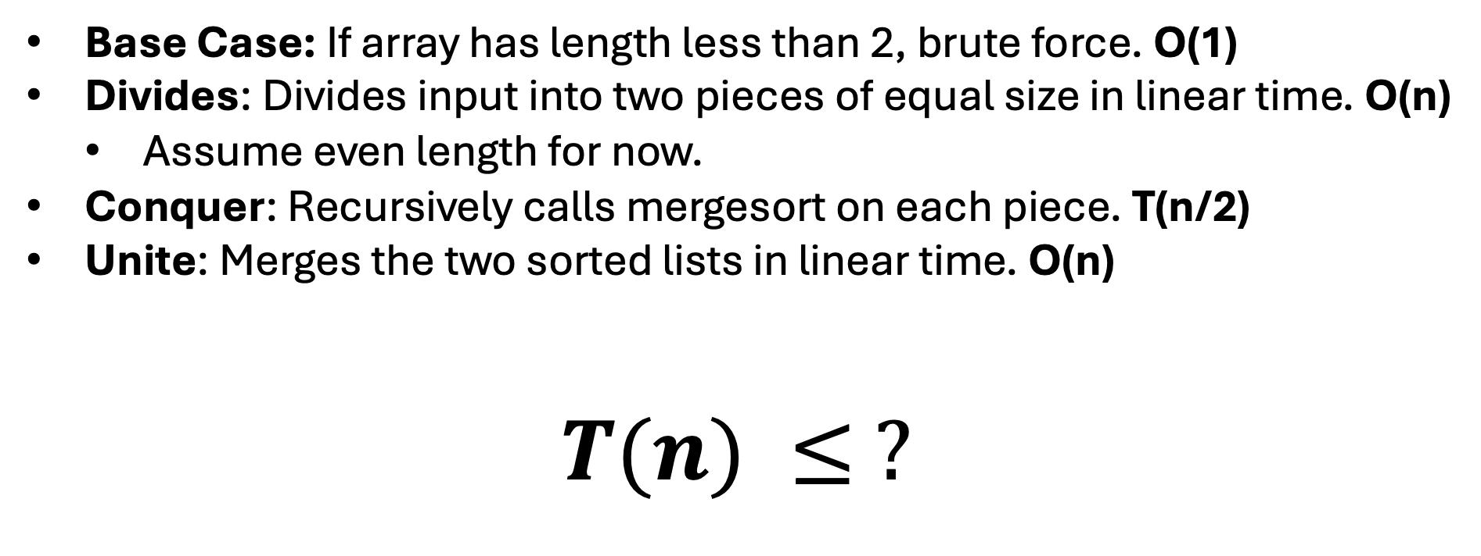
Let T(n) be runtime of Mergesort.
Base Case: If array has length less than 2, brute force. O(1)
Divides: Divides input into two pieces of equal size in linear time. O(n)
  Assume even length for now.
Conquer: Recursively calls mergesort on each piece. T(n/2)
Unite: Merges the two sorted lists in linear time. O(n)
$$T(n) ≤ ?$$

Slide 16
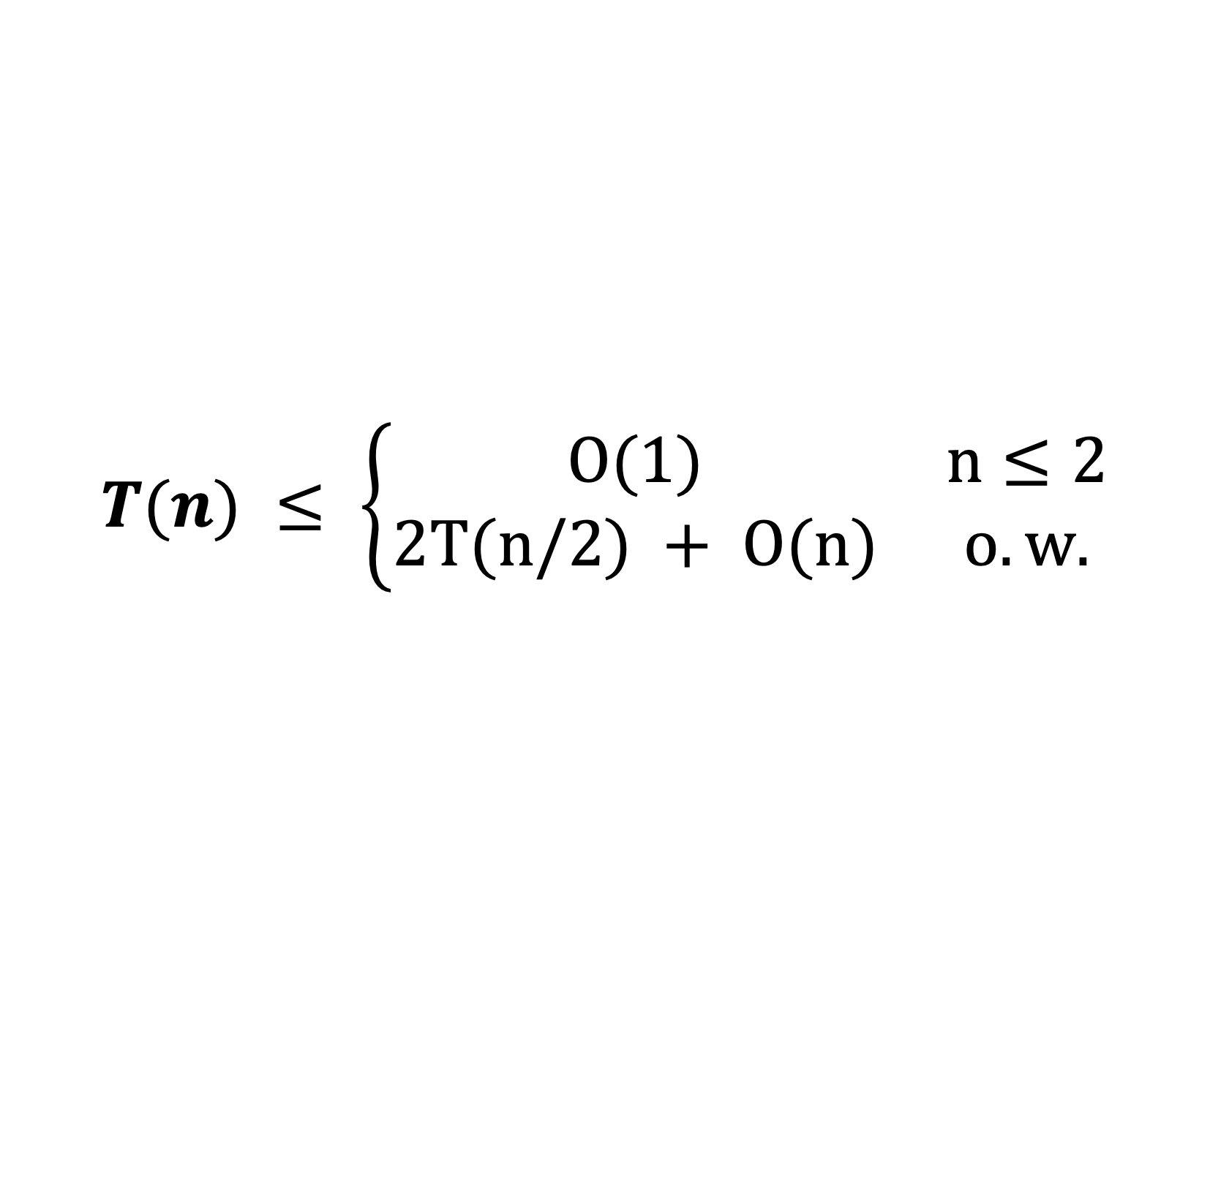
Let T(n) be runtime of Mergesort.
Base Case: If array has length less than 2, brute force. O(1)
Divides: Divides input into two pieces of equal size in linear time. O(n)
  Assume even length for now.
Conquer: Recursively calls mergesort on each piece. T(n/2)
Unite: Merges the two sorted lists in linear time. O(n)
$$T(n) ≤ \left\{\begin{matrix}O(1) & n≤2 \\ 2T(n/2) + O(n) & o.w.\end{matrix}\right.$$

Slide 17
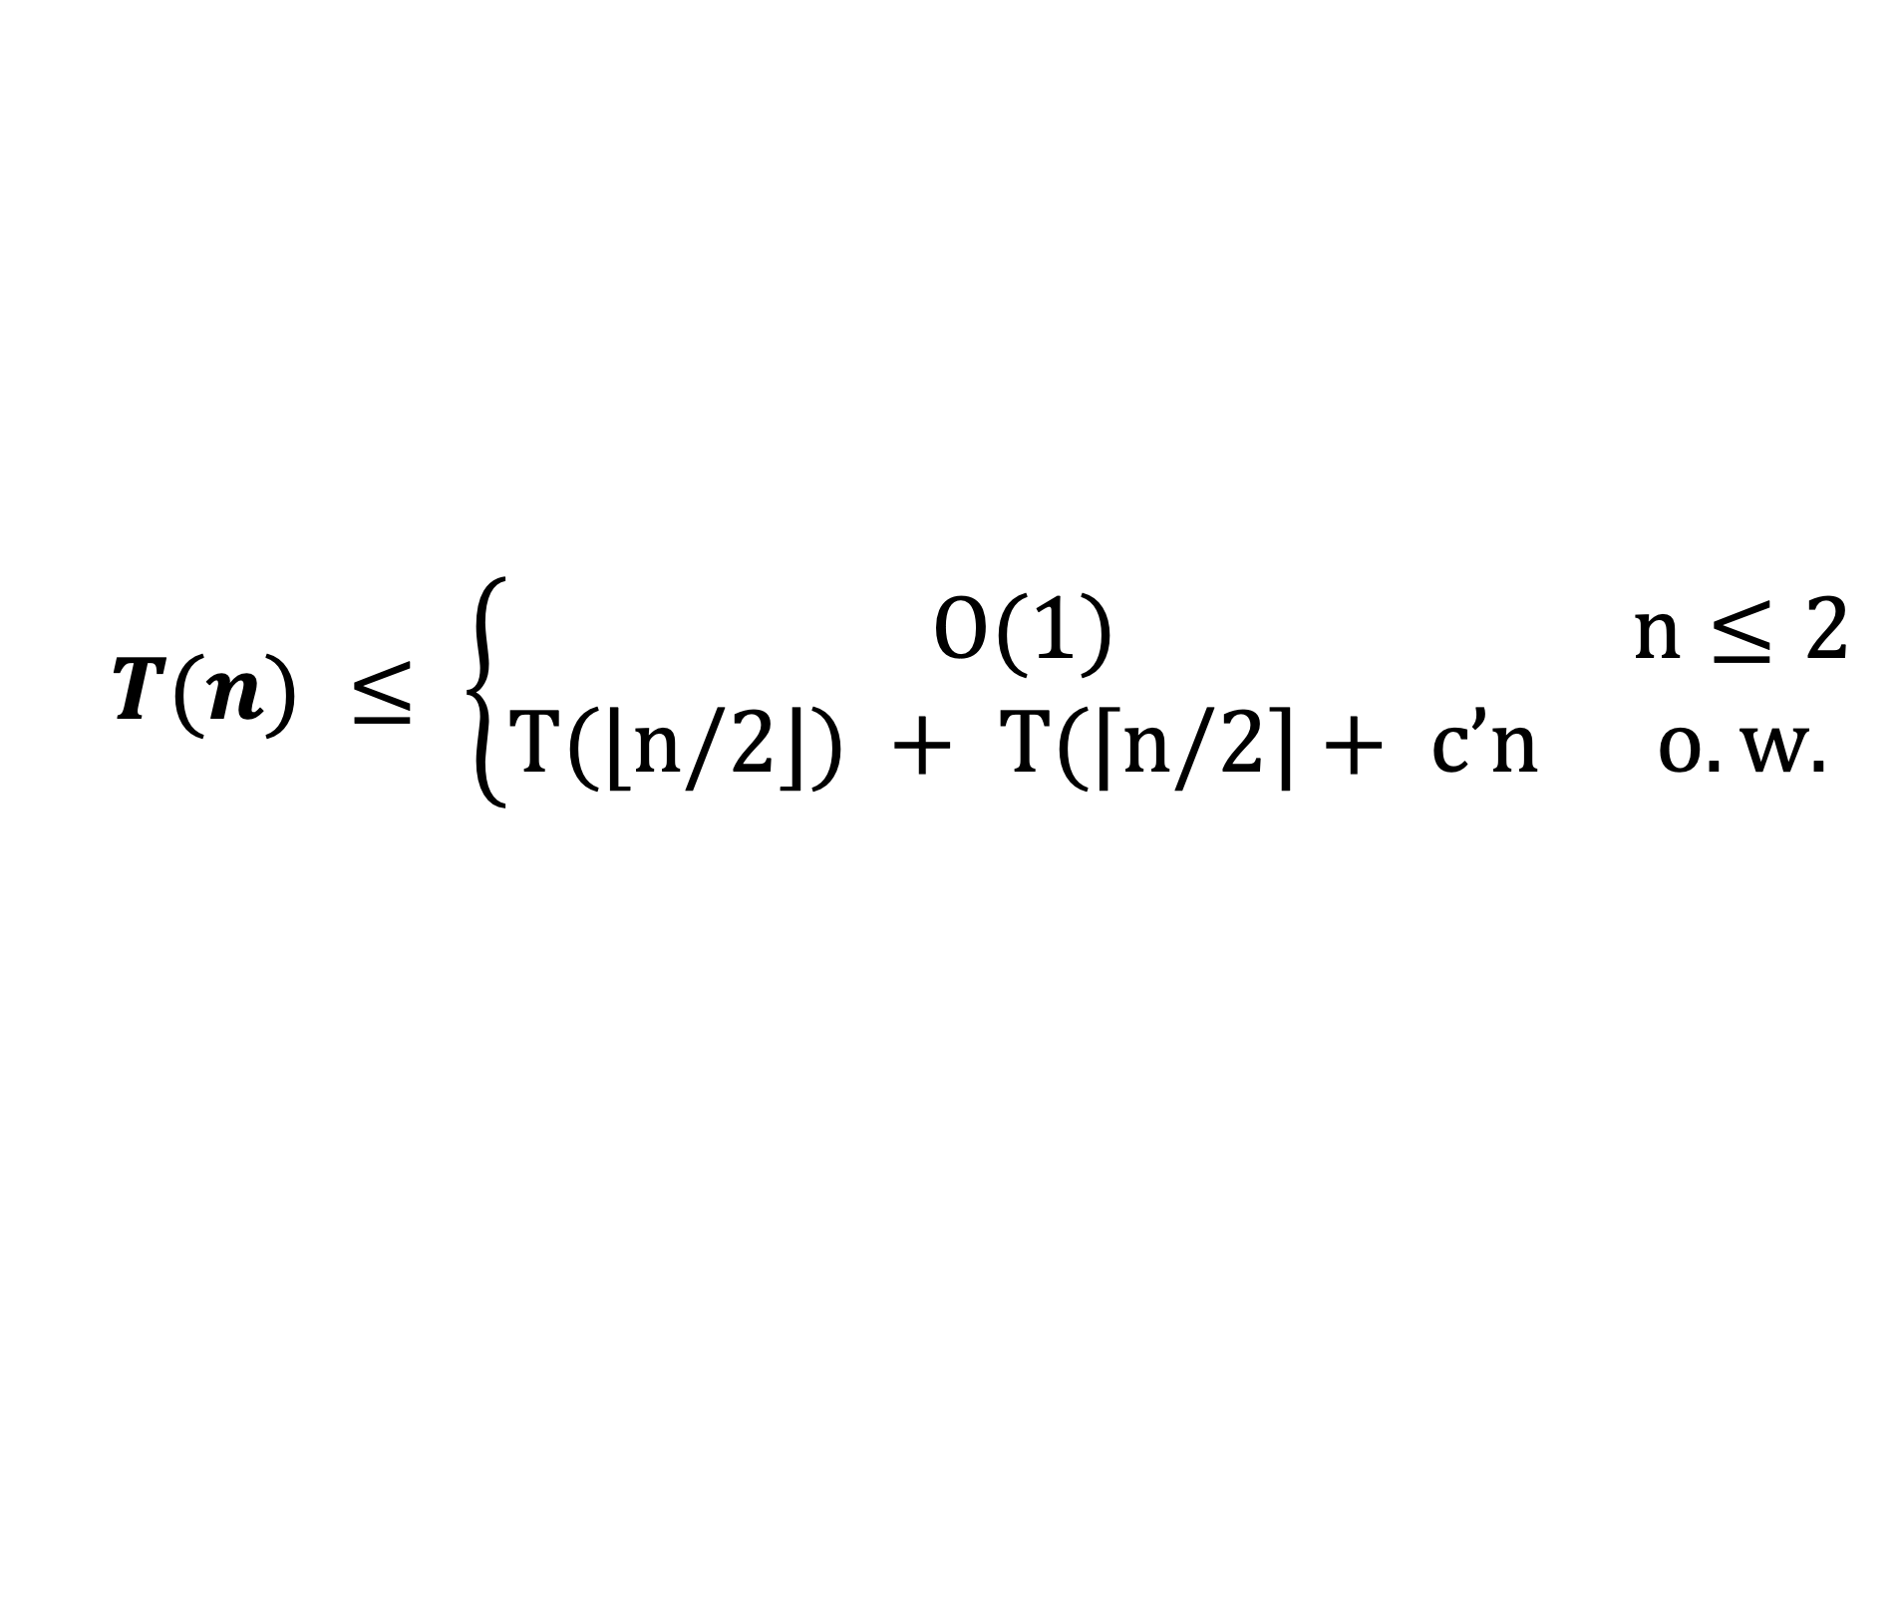
Let T(n) be runtime of Mergesort.
Base Case: If array has length less than 2, brute force. O(1)
Divides: Divides input into two pieces of equal size in linear time. O(n)
Conquer: Recursively calls mergesort on each piece. T(n/2)
Unite: Merges the two sorted lists in linear time. O(n)
$$T(n) ≤ \left\{\begin{matrix}O(1) & n≤2 \\ T(⌊n/2⌋) + T(⌈n/2⌉+ c’n & o.w.\end{matrix}\right.$$

Slide 18
How do you solve a recurrence?
Unrolling: We analyze the first few ”levels” of the recursion, find a pattern and then prove that the pattern is correct.
Guess and Check: We guess what the answer and the substitute it in to check that it works. That is, we prove it works.
REVIEW KT 5.1 and KT 5.2 IF YOU HAVEN’T ALREADY!
$$T(n) ≤ \left\{\begin{matrix}O(1) & n≤2 \\ T(⌊n/2⌋) + T(⌈n/2⌉+ c’n & o.w.\end{matrix}\right.$$

Slide 19

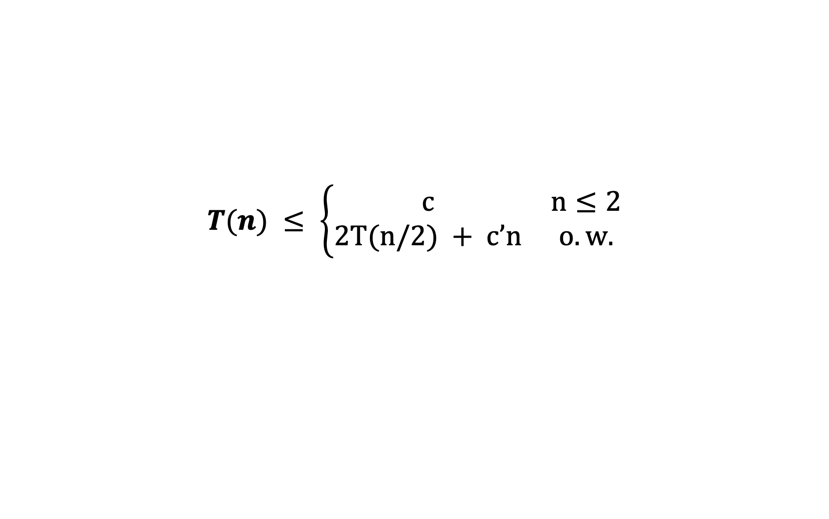


Unrolling
Unrolling:
  Sketch out a few levels of the ”recursion tree”
  Identify how many problems on each level.
  Identify how much work done at each level.
  Identify how small each problem is at each level.
  Identify how many levels before base case.
$$T(n)$$
$$T(n/2)$$
$$T(n/2)$$
$$T(n) ≤ \left\{\begin{matrix}c & n≤2 \\ 2T(n/2) + c’n & o.w.\end{matrix}\right.$$

Slide 20
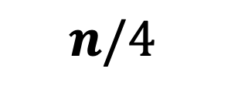
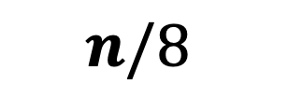


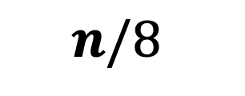
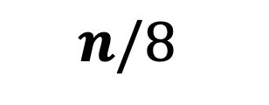
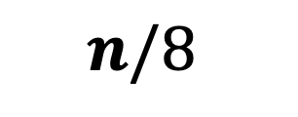
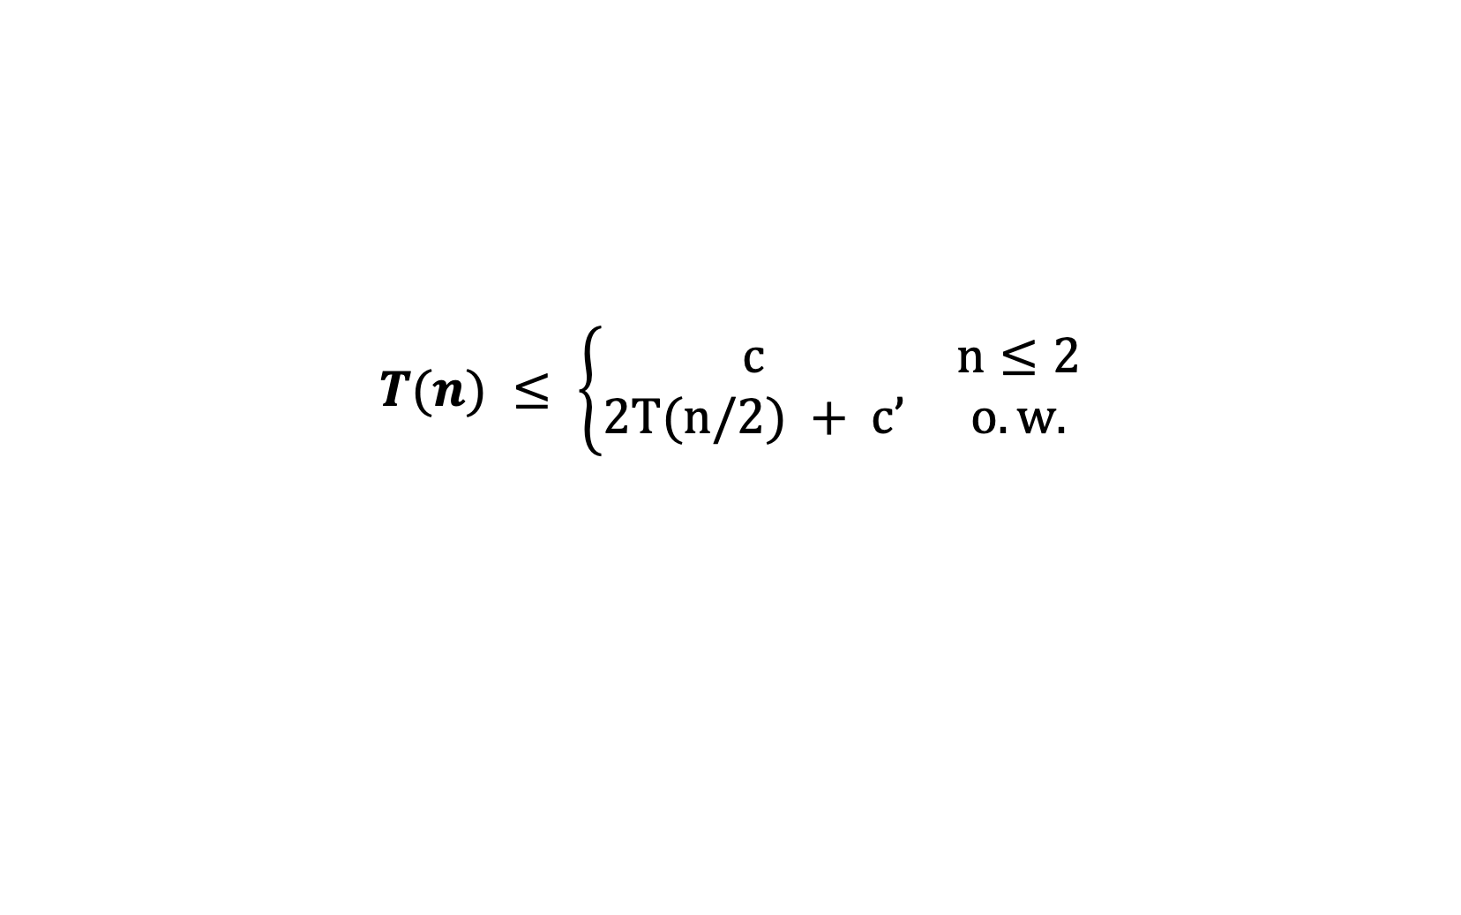
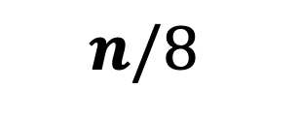
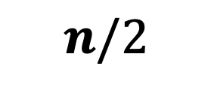
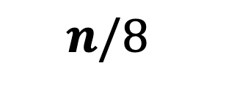

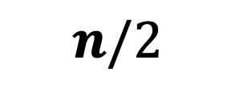
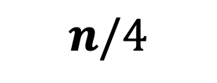
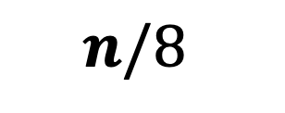
Unrolling a few levels
$$T(n) ≤ \left\{\begin{matrix}c & n≤2 \\ 2T(n/2) + c’ & o.w.\end{matrix}\right.$$
$$n$$
$$n/2$$
$$n/2$$
$$n/4$$
$$n/4$$
$$n/4$$
$$n/4$$
$$n/8$$
$$n/8$$
$$n/8$$
$$n/8$$
$$n/8$$
$$n/8$$
$$n/8$$
$$n/8$$

Slide 21
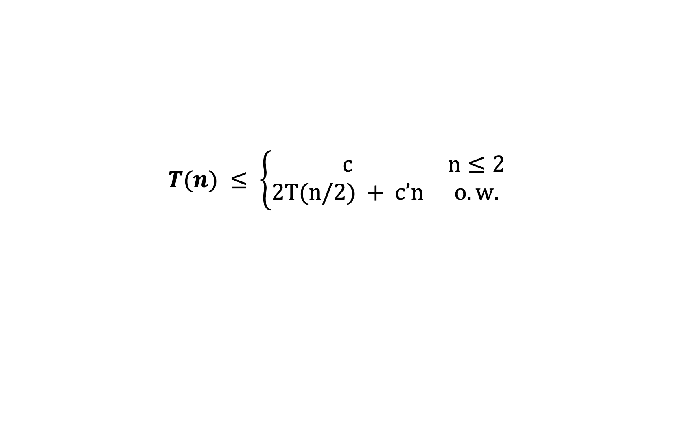
Unrolling a few levels
$$T(n) ≤ \left\{\begin{matrix}c & n≤2 \\ 2T(n/2) + c’n & o.w.\end{matrix}\right.$$
$$n$$
$$n/2$$
$$n/2$$
$$n/4$$
$$n/4$$
$$n/4$$
$$n/4$$
$$n/8$$
$$n/8$$
$$n/8$$
$$n/8$$
$$n/8$$
$$n/8$$
$$n/8$$
$$n/8$$

Slide 22
Unrolling a few levels
$$T(n) ≤ \left\{\begin{matrix}c & n≤2 \\ 2T(n/2) + c’n & o.w.\end{matrix}\right.$$
$$n$$
$$n/2$$
$$n/2$$
$$n/4$$
$$n/4$$
$$n/4$$
$$n/4$$
$$n/8$$
$$n/8$$
$$n/8$$
$$n/8$$
$$n/8$$
$$n/8$$
$$n/8$$
$$n/8$$

Slide 23
Unrolling a few levels
$$T(n) ≤ \left\{\begin{matrix}c & n≤2 \\ 2T(n/2) + c’n & o.w.\end{matrix}\right.$$
$$n$$
$$n/2$$
$$n/2$$
$$n/4$$
$$n/4$$
$$n/4$$
$$n/4$$
$$n/8$$
$$n/8$$
$$n/8$$
$$n/8$$
$$n/8$$
$$n/8$$
$$n/8$$
$$n/8$$

Slide 24
Unrolling a few levels
$$T(n) ≤ \left\{\begin{matrix}c & n≤2 \\ 2T(n/2) + c’n & o.w.\end{matrix}\right.$$
$$n$$
$$n/2$$
$$n/2$$
$$n/4$$
$$n/4$$
$$n/4$$
$$n/4$$
$$n/8$$
$$n/8$$
$$n/8$$
$$n/8$$
$$n/8$$
$$n/8$$
$$n/8$$
$$n/8$$

Slide 25
Unrolling a few levels
$$T(n) ≤ \left\{\begin{matrix}c & n≤2 \\ 2T(n/2) + c’n & o.w.\end{matrix}\right.$$
Level
Problem Size
Total Work
0 ? ?
1 ? ?
2 ? ?
3 ? ?

Slide 26
Unrolling a few levels
$$T(n) ≤ \left\{\begin{matrix}c & n≤2 \\ 2T(n/2) + c’n & o.w.\end{matrix}\right.$$
Level
Problem Size
Total Work
0 n ?
1 n/2 ?
2 n/4 ?
3 n/8 ?

Slide 27
Unrolling a few levels
$$T(n) ≤ \left\{\begin{matrix}c & n≤2 \\ 2T(n/2) + c’n & o.w.\end{matrix}\right.$$
Level
Problem Size
Total Work
0 n c’n
1 n/2 2*(c’n/2)
2 n/4 4*(c’n/4)
3 n/8 8*(c’n/8)

Slide 28
Unrolling a few levels
$$T(n) ≤ \left\{\begin{matrix}c & n≤2 \\ 2T(n/2) + c’n & o.w.\end{matrix}\right.$$
Level
Problem Size
Total Work
0 n c’n
1 n/2 c’n
2 n/4 c’n
3 n/8 c’n

Slide 29
Unrolling a few levels
$$T(n) ≤ \left\{\begin{matrix}c & n≤2 \\ 2T(n/2) + c’n & o.w.\end{matrix}\right.$$
Q: What will be the problem size and total work done at level i?
Level
Problem Size
Total Work
0 n c’n
1 n/2 c’n
2 n/4 c’n
3 n/8 c’n

Slide 30
Unrolling a few levels
$$T(n) ≤ \left\{\begin{matrix}c & n≤2 \\ 2T(n/2) + c’n & o.w.\end{matrix}\right.$$
A: At level i, the problem size (if not the base case) will be n/2^i. The total work done will be c’n.
Level
Problem Size
Total Work
0 n c’n
1 n/2 c’n
2 n/4 c’n
3 n/8 c’n

Slide 31
Unrolling a few levels
$$T(n) ≤ \left\{\begin{matrix}c & n≤2 \\ 2T(n/2) + c’n & o.w.\end{matrix}\right.$$
Q: How many levels until base case?
Level
Problem Size
Total Work
0 n c’n
1 n/2 c’n
2 n/4 c’n
3 n/8 c’n

Slide 32
Unrolling a few levels
$$T(n) ≤ \left\{\begin{matrix}c & n≤2 \\ 2T(n/2) + c’n & o.w.\end{matrix}\right.$$
A: After O(log(n)) levels, the problem size will be at most c and we can do the base case.
Level
Problem Size
Total Work
0 n c’n
1 n/2 c’n
2 n/4 c’n
3 n/8 c’n

Slide 33
Unrolling a few levels
$$T(n) ≤ \left\{\begin{matrix}c & n≤2 \\ 2T(n/2) + c’n & o.w.\end{matrix}\right.$$
Q: How much total work done over all levels?
Level
Problem Size
Total Work
0 n c’n
1 n/2 c’n
2 n/4 c’n
3 n/8 c’n

Slide 34
Unrolling a few levels
$$T(n) ≤ \left\{\begin{matrix}c & n≤2 \\ 2T(n/2) + c’n & o.w.\end{matrix}\right.$$
A: The work done at each level is c’n and the total number of levels is O(log(n)).
Hence, O(n log(n)).
Level
Problem Size
Total Work
0 n c’n
1 n/2 c’n
2 n/4 c’n
3 n/8 c’n

Slide 35
Unrolling a few levels
$$T(n) ≤ \left\{\begin{matrix}c & n≤2 \\ 2T(n/2) + c’n & o.w.\end{matrix}\right.$$
Work Done is the sum of work done at each level and we “showed” that the work done at each level is c’n and there are at most O(log(n)) levels.
Level
Problem Size
Total Work
0 n c’n
1 n/2 c’n
2 n/4 c’n
3 n/8 c’n

Slide 36
Guess & Check
$$T(n) ≤ \left\{\begin{matrix}c & n≤2 \\ 2T(n/2) + c’n & o.w.\end{matrix}\right.$$
You might have guessed T(n) = O(nlog(n)) because you’ve been told that before or because you recognize the recurrence.
How could you directly prove T(n) = c’’nlog(n) if you suspected it was true?

Slide 37
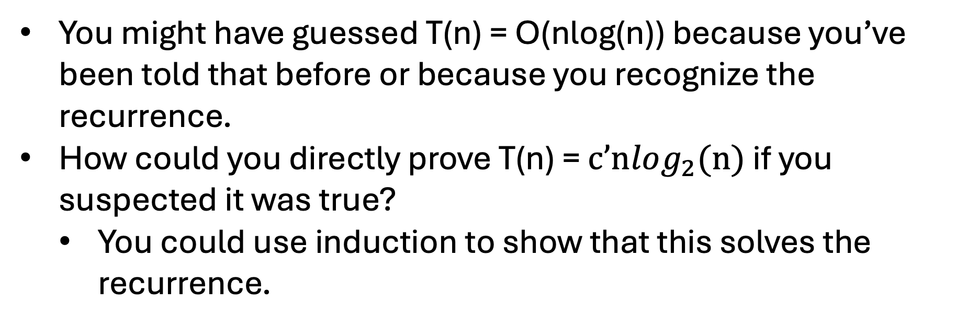
Guess & Check
$$T(n) ≤ \left\{\begin{matrix}c & n≤2 \\ 2T(n/2) + c’n & o.w.\end{matrix}\right.$$
You might have guessed T(n) = O(nlog(n)) because you’ve been told that before or because you recognize the recurrence.
How could you directly prove T(n) = $c’nlog_{2}(n)$ if you suspected it was true?
  You could use induction to show that this solves the recurrence.

Slide 38
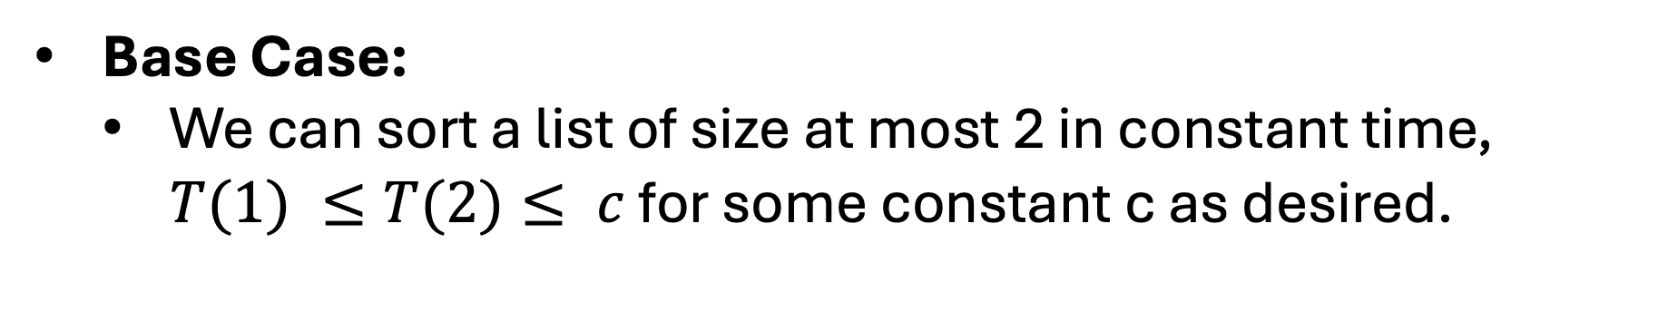
Guess & Check
$$T(n) ≤ \left\{\begin{matrix}c & n≤2 \\ 2T(n/2) + c’n & o.w.\end{matrix}\right.$$
Base Case:
  We can sort a list of size at most 2 in constant time, $T(1) ≤T(2)≤ c$ for some constant c as desired.

Slide 39
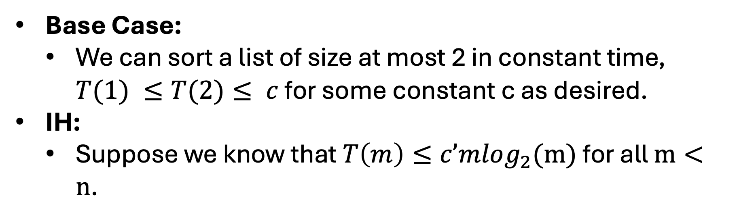
Guess & Check
$$T(n) ≤ \left\{\begin{matrix}c & n≤2 \\ 2T(n/2) + c’n & o.w.\end{matrix}\right.$$
Base Case:
  We can sort a list of size at most 2 in constant time, $T(1) ≤T(2)≤ c$ for some constant c as desired.
IH:
  Suppose we know that $T\left(m\right)≤c’mlog_{2}(m)$ for all $m<n$.

Slide 40
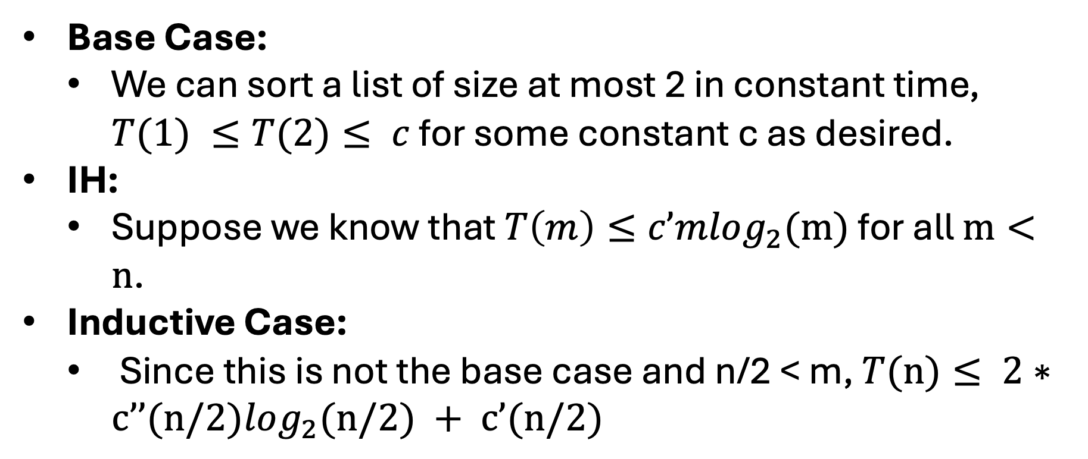
Guess & Check
$$T(n) ≤ \left\{\begin{matrix}c & n≤2 \\ 2T(n/2) + c’n & o.w.\end{matrix}\right.$$
Base Case:
  We can sort a list of size at most 2 in constant time, $T(1) ≤T(2)≤ c$ for some constant c as desired.
IH:
  Suppose we know that $T\left(m\right)≤c’mlog_{2}(m)$ for all $m<n$.
Inductive Case:
  Since this is not the base case and n/2 < m, $T(n)≤ 2∗c’’(n/2)log_{2}(n/2) + c’(n/2)$

Slide 41





Guess & Check
$$T(n) ≤ \left\{\begin{matrix}c & n≤2 \\ 2T(n/2) + c’n & o.w.\end{matrix}\right.$$
Inductive Case:
  Since this is not the base case and n/2 < m,
  $$T\left(n\right)≤2∗c’\left(n/2\right)log_{2}\left(n/2\right)+c’n$$
This concludes the proof.
$$≤c’nlog_{2}\left(n/2\right)+c’n$$
$$≤c’n (log_{2}\left(n\right)−1)+c’n$$
$$≤c’n log_{2}\left(n\right)−c’n+c’n$$
$$≤c’n log_{2}\left(n\right)$$

Slide 42




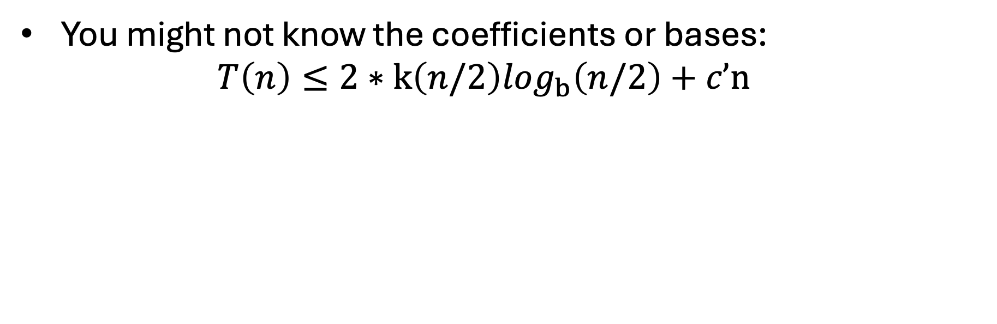
Partial Guess
$$T(n) ≤ \left\{\begin{matrix}c & n≤2 \\ 2T(n/2) + c’n & o.w.\end{matrix}\right.$$
You might not know the coefficients or bases:
  $$T\left(n\right)≤2∗k\left(n/2\right)log_{b}\left(n/2\right)+c’n$$
$$≤k n log_{b}\left(n/2\right)+c’n$$
Seems like b = 2
$$≤kn (log_{2}\left(n\right)−1)+c’n$$
$$≤kn log_{2}\left(n\right)−kn+c’n$$
Seems like k = c’
$$≤c’n log_{2}\left(n\right)$$

Slide 43
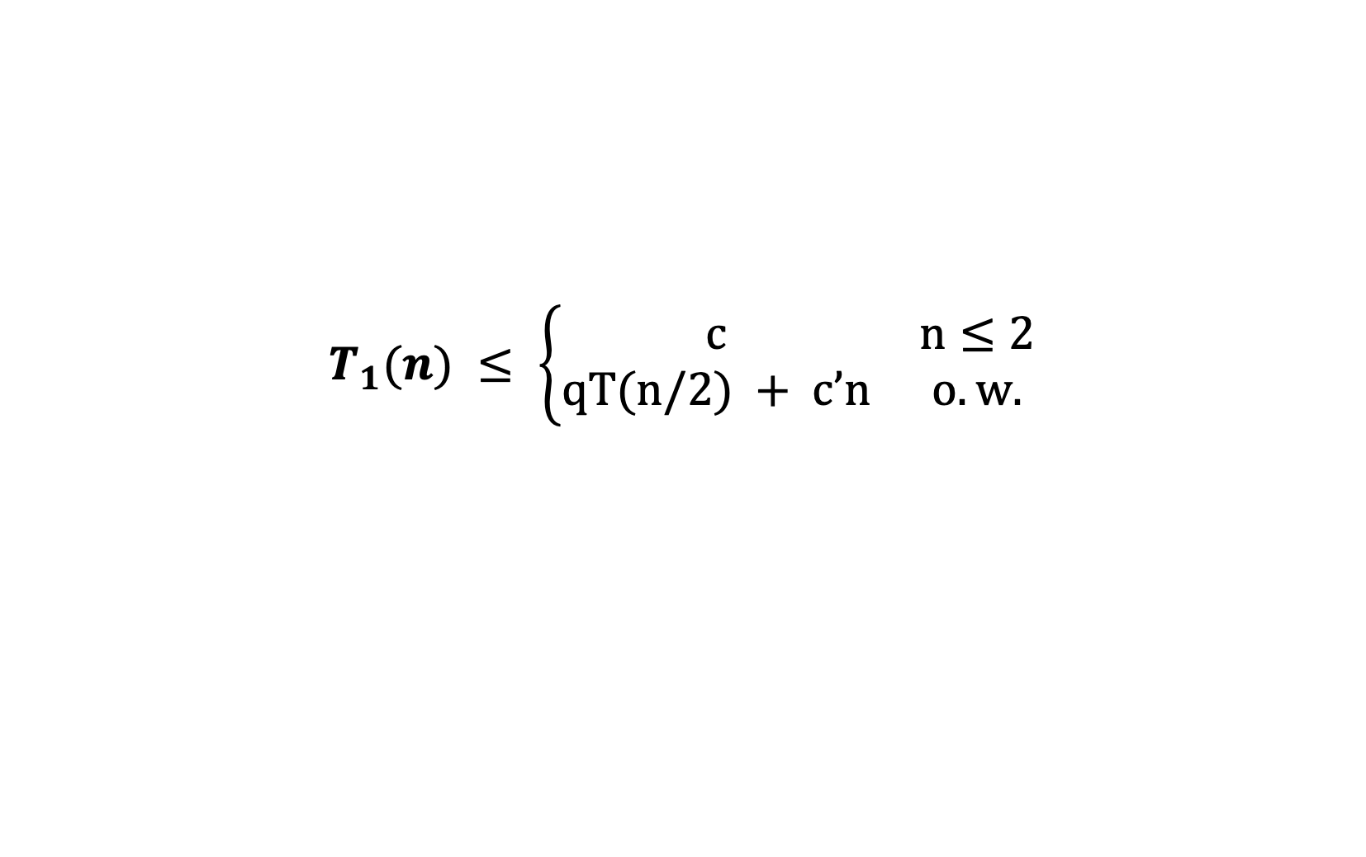
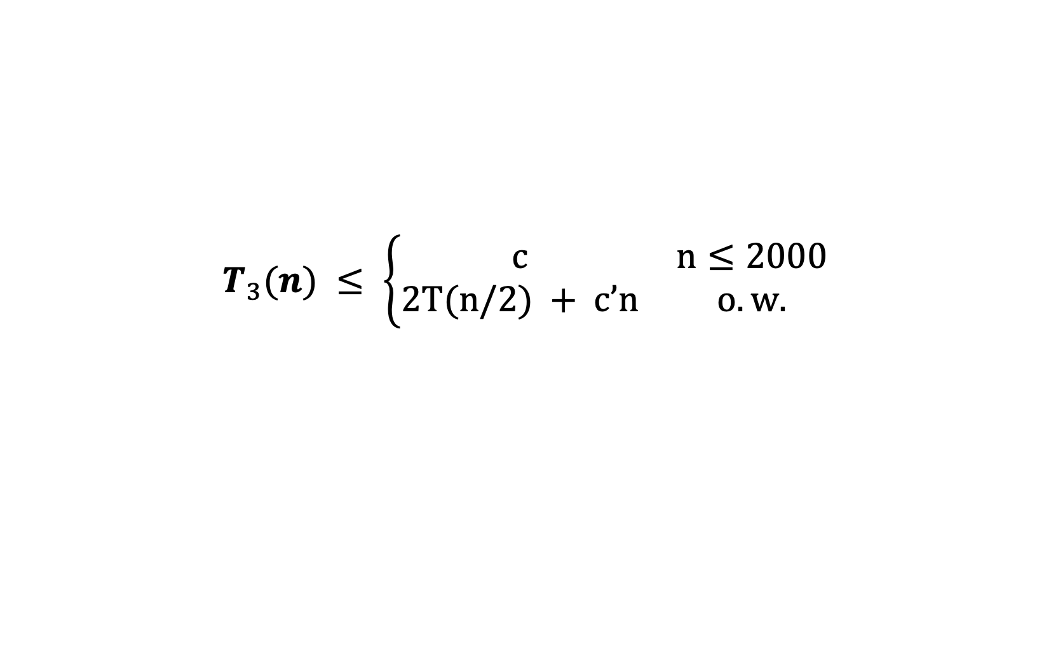
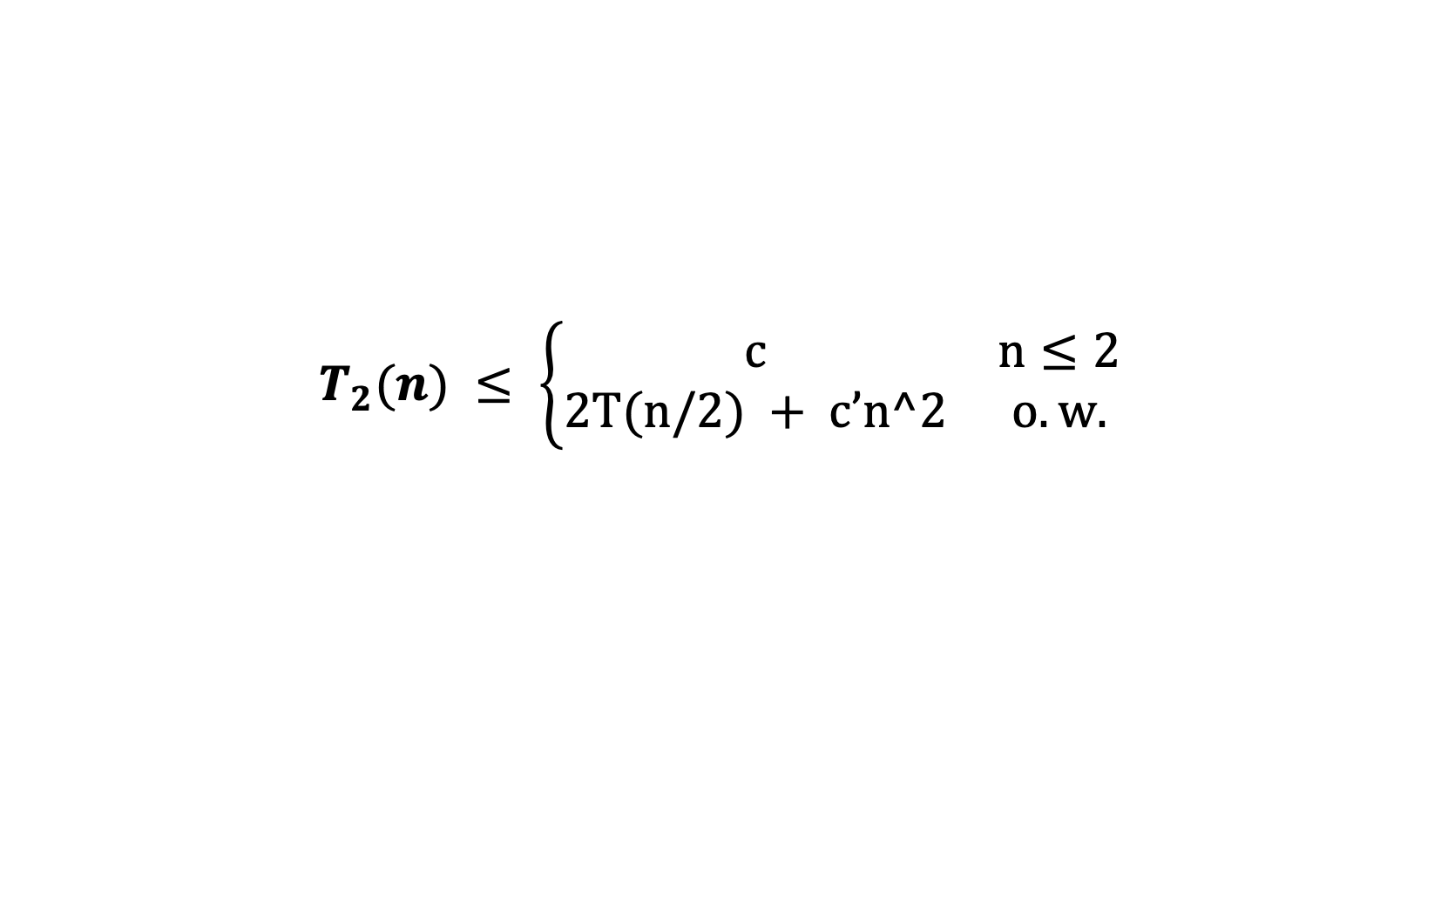
Q: What happens?
$$T_{1}(n) ≤ \left\{\begin{matrix}c & n≤2 \\ qT(n/2) + c’n & o.w.\end{matrix}\right.$$
$$T_{2}(n) ≤ \left\{\begin{matrix}c & n≤2 \\ 2T(n/2) + c’n^2 & o.w.\end{matrix}\right.$$
$$T_{3}(n) ≤ \left\{\begin{matrix}c & n≤2000 \\ 2T(n/2) + c’n & o.w.\end{matrix}\right.$$

