Slide 1

CSE 331:
Algorithms & Complexity
“Counting Inversions”
Prof. Charlie Anne Carlson (She/Her)
Lecture 24
Wednesday October 29th, 2025

Slide 2

Schedule
Course Updates
Counting Inversions

Slide 3

Course Updates
Post Midterm Grades <-piazza
HW4 Grades Out
HW4 Solutions Out
HW 6 Out Soon
Group Project
  Code Problems Oct 31st
  Reflections November 3rd

Slide 4

Reading
You should have read:
  Finished KT 5.1
  Finished KT 5.2
  Finished KT 5.3
Before Next Class:
  Start KT 5.5
  Start KT 5.4

Slide 5

Rankings
Fix a set of objects and consider ordering them by some known preference.
E.g. Given the following “animals,” rank your preference for having them as pets:
  Cat
  Dog
  Snake
  Rock

Slide 6
Rankings
Twp people may have very different preferences for pets.
Question: How can you measure the difference between two people’s preferences/ranks?
Charlie
Not-Charlie
Cat
Dog
Dog
Rock
Snake
Cat
Rock
Snake

Slide 7
Rankings
Twp people may have very different preferences for pets.
Answer: You might create a measure that is 0 when the preferences match and increases the more different they are.
Charlie
Not-Charlie
Cat
Dog
Dog
Rock
Snake
Cat
Rock
Snake

Slide 8
Rankings
Twp people may have very different preferences for pets.
Answer: You might create a measure that is 0 when the preferences match and increases the more different they are.
Let’s fix Charlie’s preference as the ”ordering”.
Charlie
Not-Charlie
1. Cat
2. Dog
2. Dog
4. Rock
3. Snake
1. Cat
4. Rock
3. Snake

Slide 9
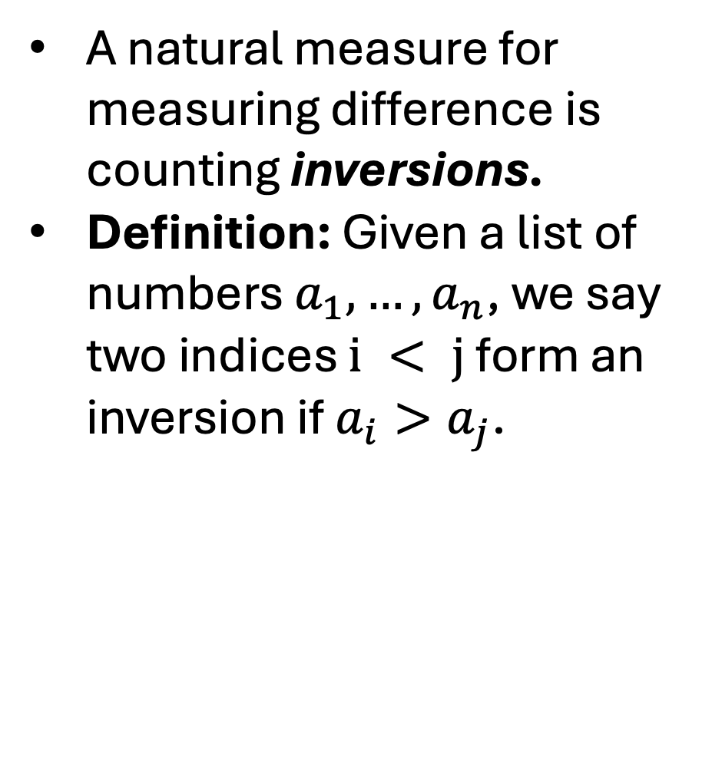
Inversions
A natural measure for measuring difference is counting inversions.
Definition: Given a list of numbers $a_{1},…,a_{n}$, we say two indices $i < j$ form an inversion if $a_{i}>a_{j}$.

Slide 10
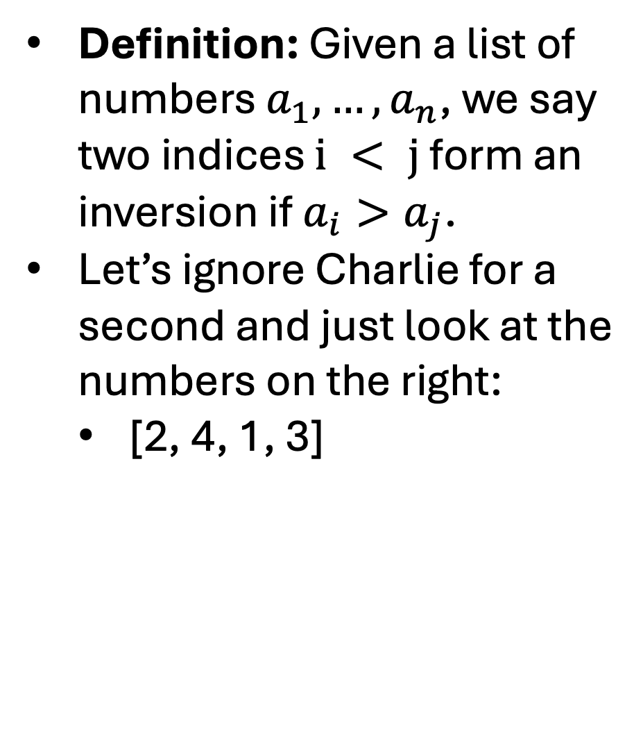
Inversions
Definition: Given a list of numbers $a_{1},…,a_{n}$, we say two indices $i < j$ form an inversion if $a_{i}>a_{j}$.
Let’s ignore Charlie for a second and just look at the numbers on the right:
  [2, 4, 1, 3]

Slide 11
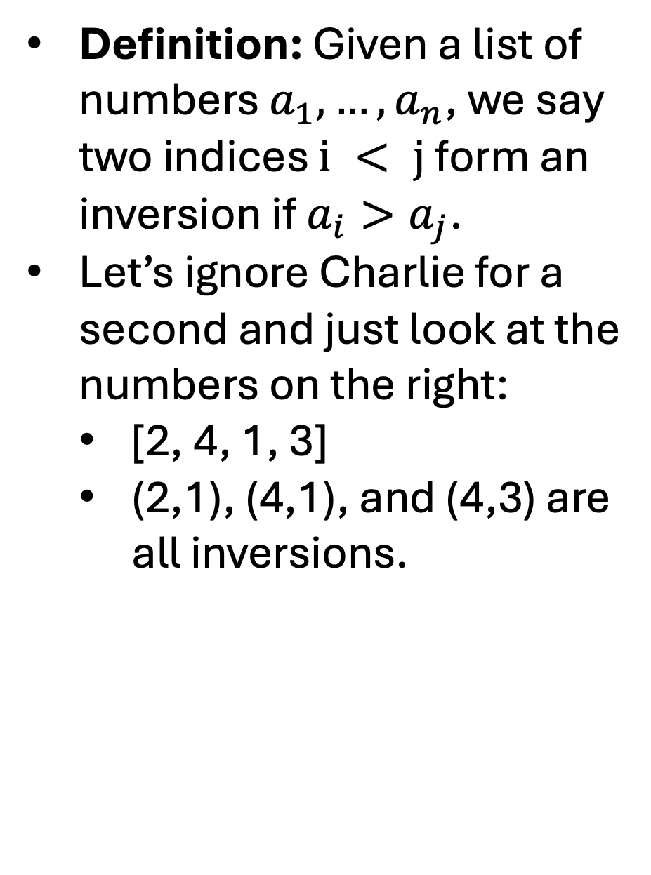
Inversions
Definition: Given a list of numbers $a_{1},…,a_{n}$, we say two indices $i < j$ form an inversion if $a_{i}>a_{j}$.
Let’s ignore Charlie for a second and just look at the numbers on the right:
  [2, 4, 1, 3]
  (2,1), (4,1), and (4,3) are all inversions.

Slide 12
Inversions
Let’s ignore Charlie for a second and just look at the numbers on the right:
  [2, 4, 1, 3]
  (2,1), (4,1), and (4,3) are all inversions.
Observe that if you look at the lines, an inversion is marked by a crossing.

Slide 13


Problem: Finding Inversions
Input: List of elements A
Goal: Find all the inversions in A

Slide 14
Problem: Finding Inversions
Input: List of elements A
Goal: Find all the inversions in A
Input: List A
Inversions = []
For i in [n]:
For j in [i+1..n]:
if A[i] > A[j]:
inversions.append((i,j))
Return Inversions

Slide 15
Problem: Finding Inversions
Input: List of elements A
Goal: Find all the inversions in A
This will take n^2 time to compute the list of inversions!
Input: List A
Inversions = []
For i in [n]:
For j in [i+1..n]:
if A[i] > A[j]:
inversions.append((i,j))
Return Inversions

Slide 16
Problem: Finding Inversions
Input: List of elements A
Goal: Find number of inversions in A

Slide 17
Recursive Algorithm
The same algorithm works, just return the size of the final inversions list.
However, we can use recursion to do better.
Let’s make a few observations about the problem before we decide how to use recursion.

Slide 18
Simple Case
How many inversions can we have if our list is empty?
How many inversions can we have if our list is size 1?
How many inversions can we have if our list is size 2?
  How can you solve this small case?
[]
[2]
[3,1]

Slide 19
Divide & Conquer
If we aren’t in the simple/base case, then we want to break the problem into smaller problems and recurse.
1
7
3
12
2
5
6
9
3
7
1
7
3
12
2
5
6
9
3
7

Slide 20
Merging
If we aren’t in the simple/base case, then we want to break the problem into smaller problems and recurse.
1
7
3
12
2
5
6
9
4
7
1
7
3
12
2
5
6
9
4
7
There are 3 inversions: (7,3), (3,2), and (12, 2)
There is 4 inversions: (5,4), (6,4), (9,4), and (9,7)
Question: Are these all the inversions?

Slide 21
Merging
If we aren’t in the simple/base case, then we want to break the problem into smaller problems and recurse.
1
7
3
12
2
5
6
9
4
7
1
7
3
12
2
5
6
9
4
7
There are 3 inversions: (7,3), (3,2), and (12, 2)
There is 4 inversions: (5,4), (6,4), (9,4), and (9,7)
Answer: No!

Slide 22
More Merging
Once we have the solution to our subproblems, we have to find a way to combine them together.
1
7
3
12
2
5
6
9
4
7
1
7
3
12
2
5
6
9
4
7
There are 3 inversions: (7,3), (3,2), and (12, 2)
There is 4 inversions: (5,4), (6,4), (9,4), and (9,7)

Slide 23
Naive Idea
Question: How long could it take to check all of this “spanning” inversions?
1
7
3
12
2
5
6
9
4
7
1
7
3
12
2
5
6
9
4
7
There are 3 inversions: (7,3), (3,2), and (12, 2)
There is 4 inversions: (5,4), (6,4), (9,4), and (9,7)

Slide 24
Naive Idea
Answer: If we assume that n is even then it would take (n/2)^2 comparisons.
1
7
3
12
2
5
6
9
4
7
1
7
3
12
2
5
6
9
4
7
There are 3 inversions: (7,3), (3,2), and (12, 2)
There is 4 inversions: (5,4), (6,4), (9,4), and (9,7)

Slide 25
Easy Case
Question: What if we knew that both lists were sorted?
1
7
3
12
2
5
6
9
4
7
1
7
3
12
2
5
6
9
4
7
There are 3 inversions: (7,3), (3,2), and (12, 2)
There is 4 inversions: (5,4), (6,4), (9,4), and (9,7)

Slide 26
Easy Case
Question: What if we knew that both sublists were sorted?
1
2
3
7
12
4
5
6
7
9
1
2
3
7
12
4
5
6
7
9
There are 0 inversions.
There is 0 inversions.

Slide 27
Easy Case
Answer: No inversions in each sublist but we can count the spanning inversions easier.
1
2
3
7
12
4
5
6
7
9
1
2
3
7
12
4
5
6
7
9
There are 0 inversions.
There is 0 inversions.

Slide 28
Merge & Count
Let’s do something like our merge step from mergesort but also count the number of inversions.
Work through both lists and add the smallest element to the merged list.
  Now, we also compute the number of inversions when we add the smallest element
1
2
3
7
12
4
5
6
7
9

Slide 29
Merge & Count
Question: How many inversions involving 1?
1
2
3
7
12
4
5
6
7
9
1

Slide 30
Merge & Count
Answer: None because smaller than everything?
1
2
3
7
12
4
5
6
7
9
1

Slide 31
Merge & Count
1
2
3
7
12
4
5
6
7
9
1

Slide 32
Merge & Count
1
2
3
7
12
4
5
6
7
9
1
2

Slide 33
Merge & Count
1
2
3
7
12
4
5
6
7
9
1
2

Slide 34
Merge & Count
1
2
3
7
12
4
5
6
7
9
1
2
3

Slide 35
Merge & Count
Question: How many inversions involving 4?
1
2
3
7
12
4
5
6
7
9
1
2
3

Slide 36
Merge & Count
Answer: There are two: (7,4) and (12,4)
1
2
3
7
12
4
5
6
7
9
1
2
3
4

Slide 37
Merge & Count
Question: How may inversion involving 5?
1
2
3
7
12
4
5
6
7
9
1
2
3
4

Slide 38
Merge & Count
Answer: There are two: (7,5) and (12,5)
1
2
3
7
12
4
5
6
7
9
1
2
3
4
5

Slide 39
Merge & Count
Question: How may inversion involving 6?
1
2
3
7
12
4
5
6
7
9
1
2
3
4
5

Slide 40
Merge & Count
Answer: There are two: (7,6) and (12,6)
1
2
3
7
12
4
5
6
7
9
1
2
3
4
5
6

Slide 41
Merge & Count
Question: How may inversion involving the top 7?
1
2
3
7
12
4
5
6
7
9
1
2
3
4
5
6

Slide 42
Merge & Count
Answer: There were 3, but we already listed them.
x
2
3
7
12
4
5
6
7
9
1
2
3
4
5
6
7

Slide 43
Merge & Count
Question: How may inversion involving the bottom 7?
x
2
3
7
12
4
5
6
7
9
1
2
3
4
5
6
7

Slide 44
Merge & Count
Answer: There is 1: (12,7)
x
2
3
7
12
4
5
6
7
9
1
2
3
4
5
6
7
7

Slide 45
Merge & Count
Question: How many involving 9?
x
2
3
7
12
4
5
6
7
9
1
2
3
4
5
6
7
7

Slide 46
Merge & Count
Answer: There is 1: (12,9)
x
2
3
7
12
4
5
6
7
9
1
2
3
4
5
6
7
7
9

Slide 47
Merge & Count
Question: How many involving 12?
x
2
3
7
12
4
5
6
7
9
1
2
3
4
5
6
7
7
9

Slide 48
Merge & Count
Answer: There were 5 but we listed them already.
x
2
3
7
12
4
5
6
7
9
1
2
3
4
5
6
7
7
9
12

Slide 49
Merge & Count
Question: How would you describe our new merge process?
Question: What was the rule for counting inversions?
x
2
3
7
12
4
5
6
7
9
1
2
3
4
5
6
7
7
9
12

Slide 50
Merge & Count
Answer: When we added to our list from the second smaller list, we knew that there was going to be a new inversion for every remaining element in the top list.
x
2
3
7
12
4
5
6
7
9
1
2
3
4
5
6
7
7
9
12

Slide 51
Merge & Count
Observation: If b_j < a_i then we know that b_j is going to be in |A|-i inversions.
a_i
b_j
?

Slide 52
Merge & Count
Observation: If b_j < a_i then we know that b_j is going to be in |A|-i inversions.
a_i
b_j

Slide 53
Merge & Count
We can see that a_(i-1) must have been smaller
We can also see that a_(i+1) must be bigger.
Not an inversion
a_i
b_j
Is an inversion

Slide 54
Divide & Conquer
Question: How should we use this merge and count algorithm?
1
7
3
12
2
5
6
9
3
7
1
7
3
12
2
5
6
9
3
7

Slide 55
Divide & Conquer Algorithm
We will use the logic of the previous few slides to make a Merge-and-Count(A,B) algorithm that will merge two sorted lists and count the number of “spanning” inversions.
We will now make a new algorithm called Sort-and-Count(L) that will take a list and return the list sorted and return the number of inversions before being sorted.

Slide 56
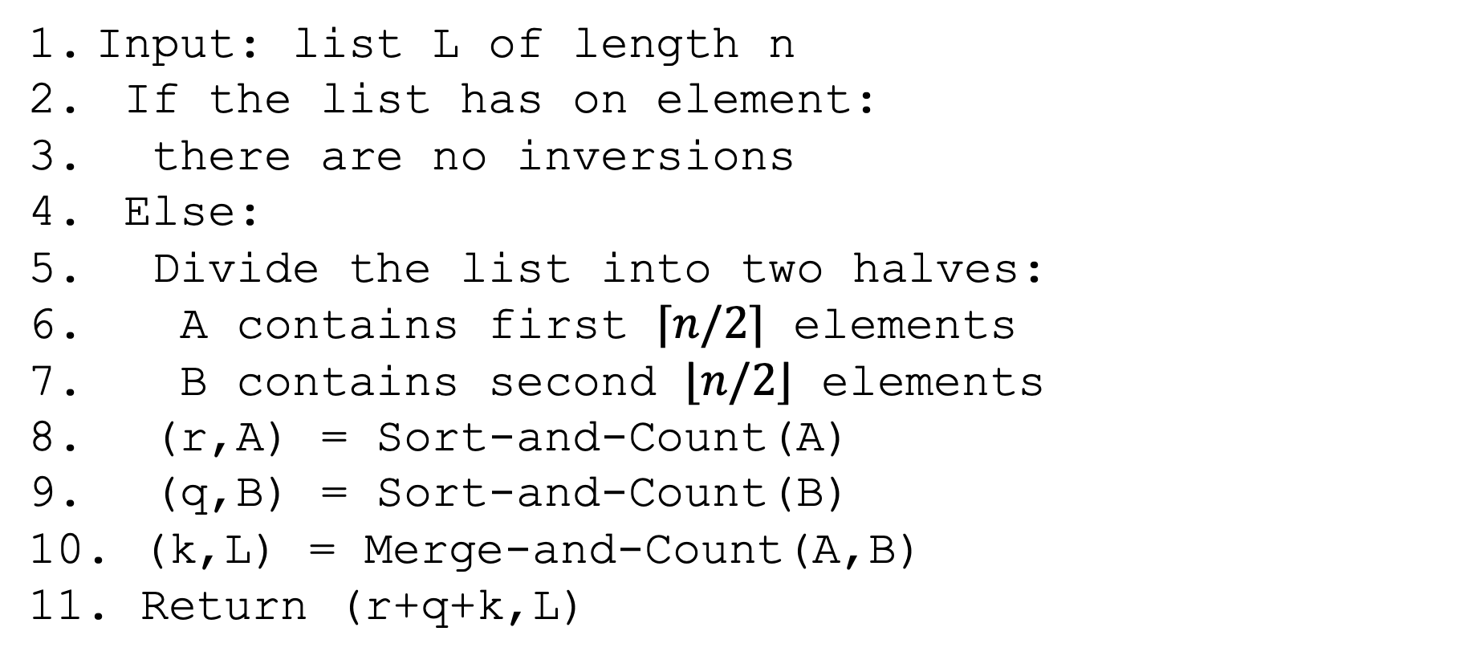
Sort-and-Count
Input: list L of length n
If the list has on element:
there are no inversions
Else:
Divide the list into two halves:
A contains first $⌈n/2⌉$ elements
B contains second $⌊n/2⌋$ elements
(r,A) = Sort-and-Count(A)
(q,B) = Sort-and-Count(B)
(k,L) = Merge-and-Count(A,B)
Return (r+q+k,L)

Slide 57
When is each type of inversion counted?
1
7
3
12
2
5
6
9
3
7

Slide 58
Sort-and-Count Runtime?
Input: list L of length n
If the list has on element:
there are no inversions
Else:
Divide the list into two halves:
A contains first $⌈n/2⌉$ elements
B contains second $⌊n/2⌋$ elements
(r,A) = Sort-and-Count(A)
(q,B) = Sort-and-Count(B)
(k,L) = Merge-and-Count(A,B)
Return (r+q+k,L)

Slide 59
Sort-and-Count Runtime?
Observations:
  Takes O(n) time to divide.
  Takes 2T(n/2) time to do recursive calls.
  Takes O(n) time to merge.
  Takes O(1) time to do base case.

Slide 60
Sort-and-Count Runtime
We have the same recurrence we had for mergesort and if we solve it using the methods from before, we get the same runtime of O(nlog(n)).

Slide 61
Sort-and-Count Runtime?
Question: What would you change to get the list of all inversions?
Question: How would this change the runtime?

Slide 62
Sort-and-Count Runtime?
Answer: You’d want to change your Sort-and-Count to return list of inversions.
Answer: This would take longer because we do have to list all pairs in some cases.

