Slide 1

CSE 331:
Algorithms & Complexity
“Multiplication”
Prof. Charlie Anne Carlson (She/Her)
Lecture 25
Friday Dec 25th, 2025

Slide 2

Schedule
Course Updates
Counting Inversions
Multiplication

Slide 3

Course Updates
HW 6 Out
Group Project
  Code 1 & 2 Due ?
  Reflections 1 & 2 Due ?

Slide 4
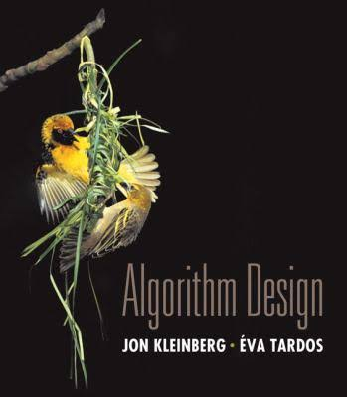
Reading
You should have read:
  Started 5.5
  Started 5.4
Before Next Class:
  Finished KT 5.5
  Finished KT 5.4
  Read Unraveling the mystery behind the identity

Slide 5
Divide & Conquer Algorithm
We will use the logic of the previous lecture to make a Merge-and-Count(A,B) algorithm that will merge two sorted lists and count the number of “spanning” inversions.
We will now make a new algorithm called Sort-and-Count(L) that will take a list and return the list sorted and return the number of inversions before being sorted.

Slide 6
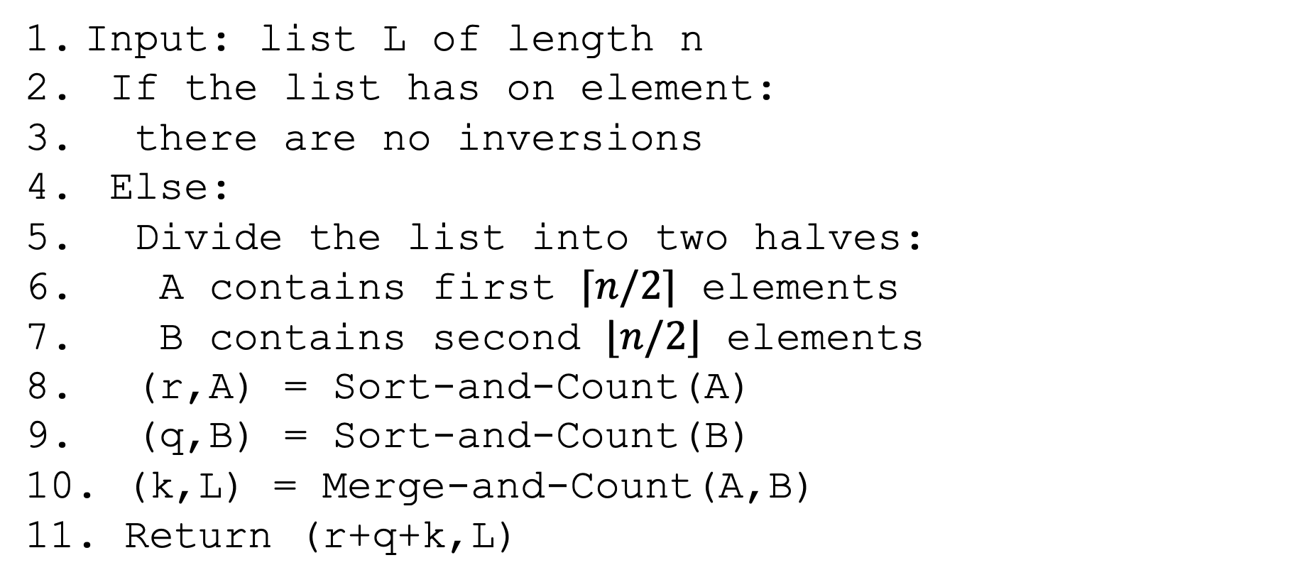
Sort-and-Count
Input: list L of length n
If the list has on element:
there are no inversions
Else:
Divide the list into two halves:
A contains first $⌈n/2⌉$ elements
B contains second $⌊n/2⌋$ elements
(r,A) = Sort-and-Count(A)
(q,B) = Sort-and-Count(B)
(k,L) = Merge-and-Count(A,B)
Return (r+q+k,L)

Slide 7
When is each type of inversion counted?
1
7
3
12
2
5
6
9
3
7

Slide 8
Sort-and-Count Runtime?
Input: list L of length n
If the list has on element:
there are no inversions
Else:
Divide the list into two halves:
A contains first $⌈n/2⌉$ elements
B contains second $⌊n/2⌋$ elements
(r,A) = Sort-and-Count(A)
(q,B) = Sort-and-Count(B)
(k,L) = Merge-and-Count(A,B)
Return (r+q+k,L)

Slide 9
Sort-and-Count Runtime?
Observations:
  Takes O(n) time to divide.
  Takes 2T(n/2) time to do recursive calls.
  Takes O(n) time to merge.
  Takes O(1) time to do base case.

Slide 10
Sort-and-Count Runtime
We have the same recurrence we had for mergesort and if we solve it using the methods from before, we get the same runtime of O(nlog(n)).

Slide 11
Sort-and-Count Runtime?
Question: What would you change to get the list of all inversions?
Question: How would this change the runtime?

Slide 12
Sort-and-Count Runtime?
Answer: You’d want to change your Sort-and-Count to return list of inversions.
Answer: This would take longer because we do have to list all pairs in some cases.

Slide 13
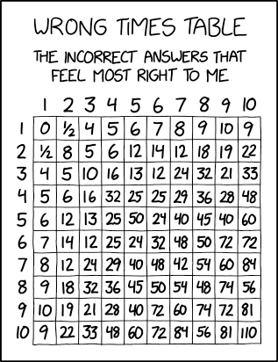
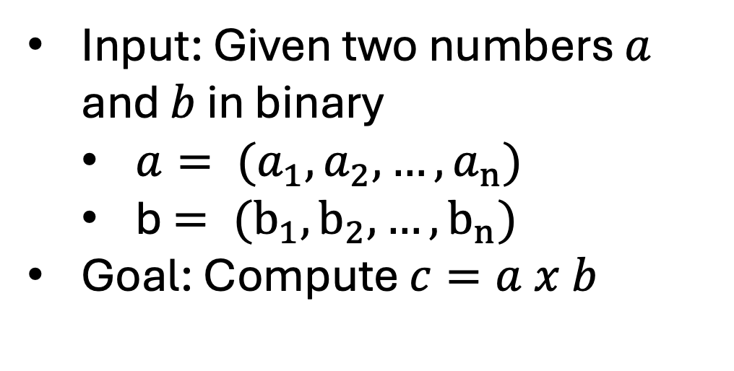
Multiplication
Input: Given two numbers $a$ and $b$ in binary
  $a= (a_{1},a_{2}, …,a_{n})$
  b$= (b_{1},b_{2}, …,b_{n})$
Goal: Compute $c=a x b$
https://xkcd.com/2313/

Slide 14
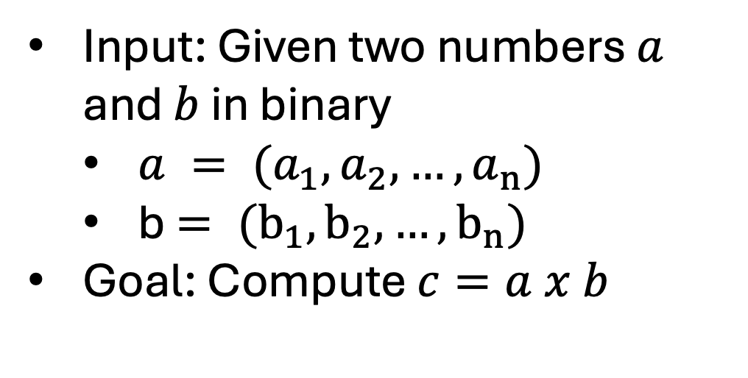
Multiplication
Input: Given two numbers $a$ and $b$ in binary
  $a = (a_{1},a_{2}, …,a_{n})$
  b$= (b_{1},b_{2}, …,b_{n})$
Goal: Compute $c=a x b$
https://xkcd.com/2313/

Slide 15
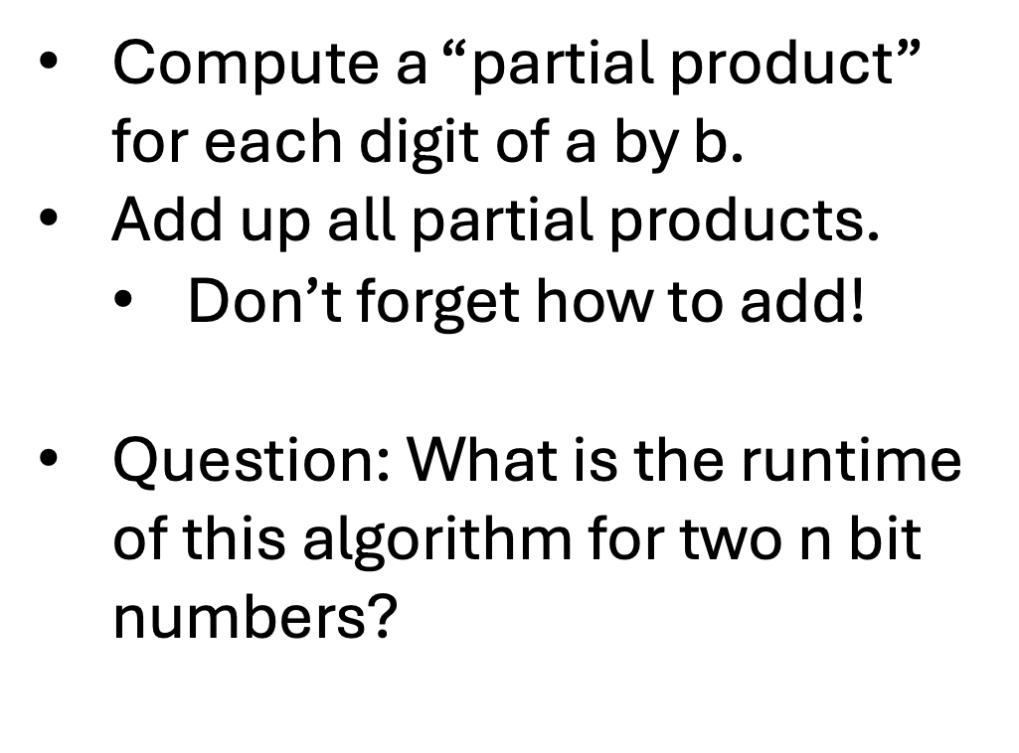
Grade School Algorithm
Compute a “partial product” for each digit of a by b.
Add up all partial products.
  Don’t forget how to add!
Question: What is the runtime of this algorithm for two n bit numbers?
1100
x
1101
1100
0000
1100
+
1100
10011100

Slide 16
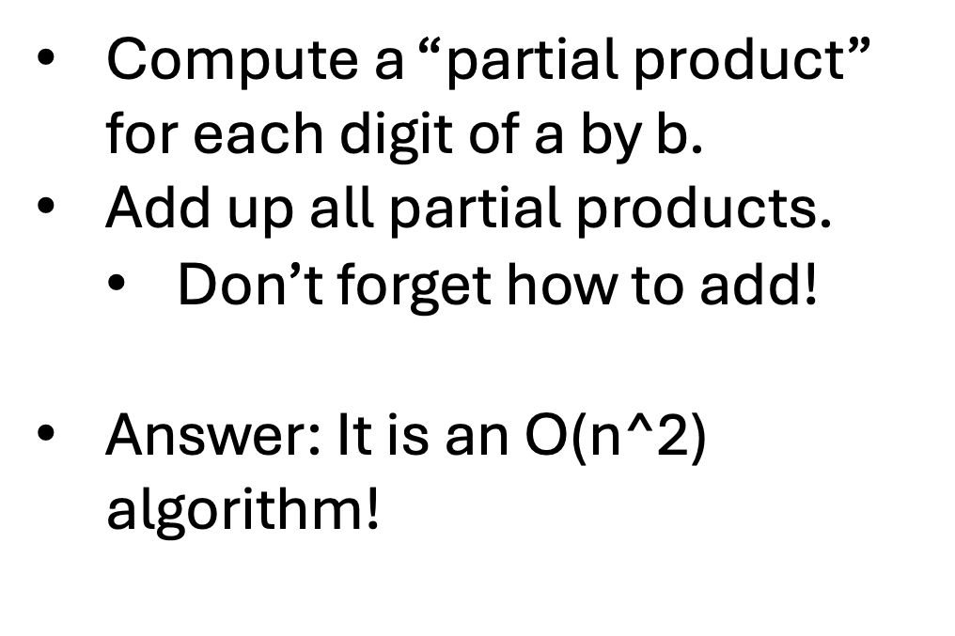
Grade School Algorithm
Compute a “partial product” for each digit of a by b.
Add up all partial products.
  Don’t forget how to add!
Answer: It is an O(n^2) algorithm!
1100
x
1101
1100
0000
1100
+
1100
10011100

Slide 17
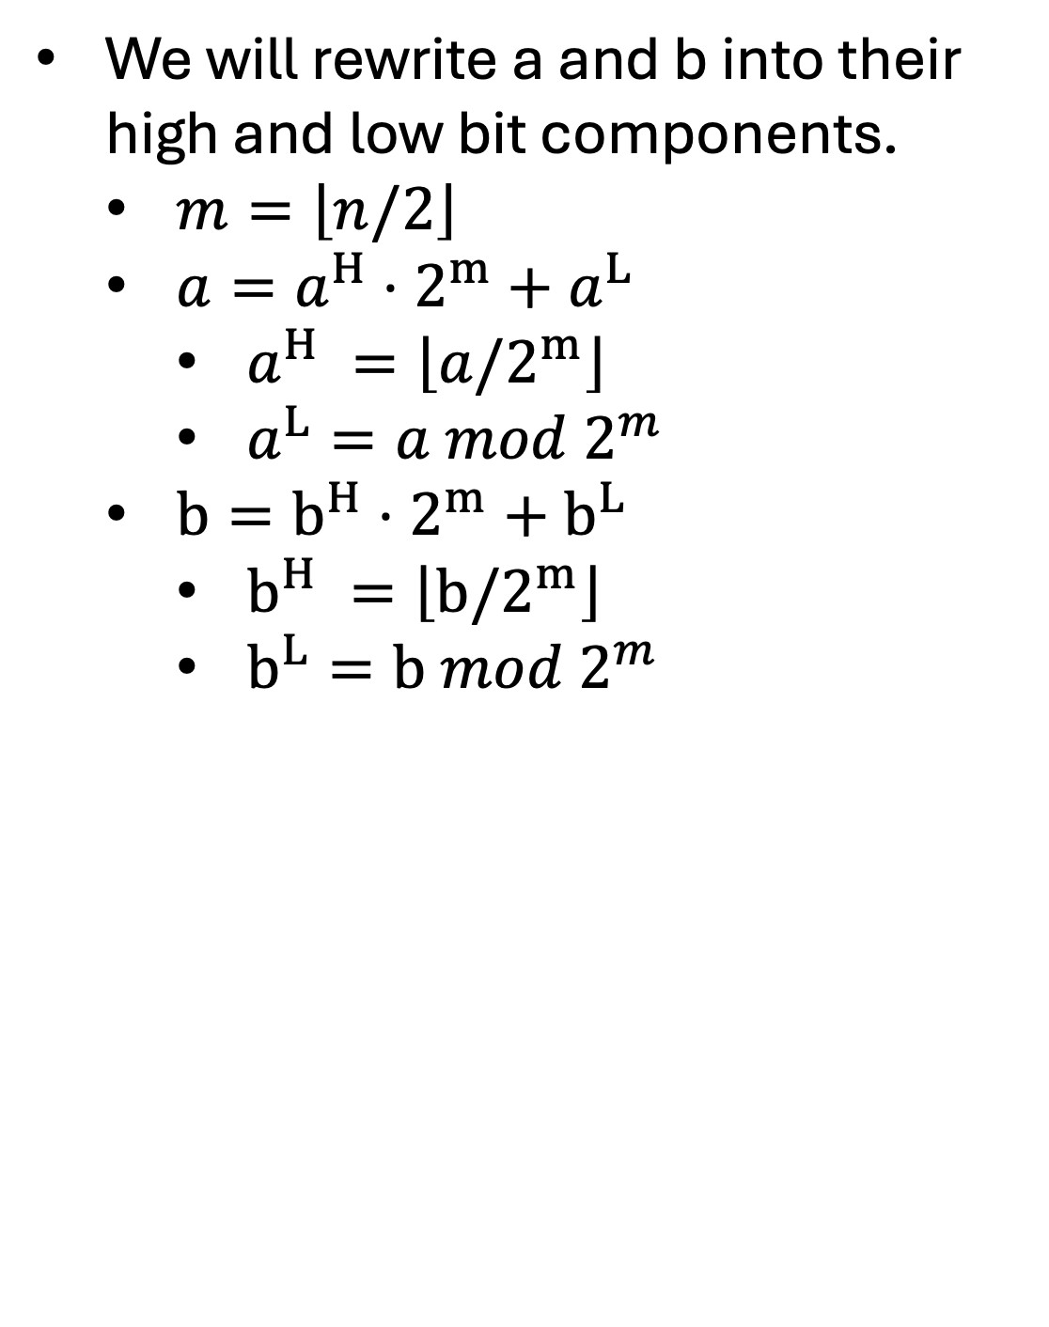
Divide and Conquer Algorithm
We will rewrite a and b into their high and low bit components.
  $m=\left\lfloor n/2\right\rfloor$
  $a=a^{H}⋅2^{m}+a^{L}$
    $a^{H} =\left\lfloor a/2^{m}\right\rfloor$
    $a^{L}=a mod{ 2}^{m}$
  $b=b^{H}⋅2^{m}+b^{L}$
    $b^{H} =\left\lfloor b/2^{m}\right\rfloor$
    $b^{L}=b mod{ 2}^{m}$
a^{H}
a^{L}
E.g.:
a = 10001101
b = 11100001
b^{L}
b^{H}

Slide 18

Divide and Conquer Algorithm
We can now write:
$$a⋅b=\left(a^{H}⋅2^{m}+a^{L}\right)\left(b^{H}⋅2^{m}+b^{L}\right)$$
$$=a^{H}⋅b^{H}⋅2^{\left(2m\right)}+\left(a^{H}⋅b^{L}+a^{L}⋅b^{H}\right)⋅2^{m}+a^{L}⋅b^{L}$$

Slide 19
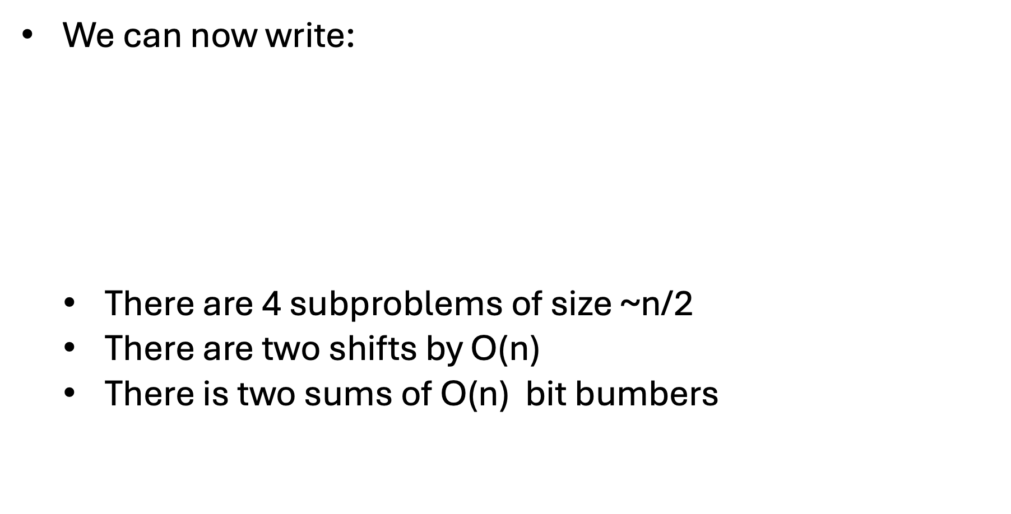
Divide and Conquer Algorithm
We can now write:
  There are 4 subproblems of size ~n/2
  There are two shifts by O(n)
  There is two sums of O(n) bit bumbers
$$a⋅b=\left(a^{H}⋅2^{m}+a^{L}\right)\left(b^{H}⋅2^{m}+b^{L}\right)$$
$$=a^{H}⋅b^{H}⋅2^{\left(2m\right)}+\left(a^{H}⋅b^{L}+a^{L}⋅b^{H}\right)⋅2^{m}+a^{L}⋅b^{L}$$

Slide 20
What is the runtime, T(n)?
We can now write:
  There are 4 subproblems of size ~n/2
  There are two shifts by O(n)
  There is two sums of O(n) bit bumbers
$$a⋅b=\left(a^{H}⋅2^{m}+a^{L}\right)\left(b^{H}⋅2^{m}+b^{L}\right)$$
$$=a^{H}⋅b^{H}⋅2^{\left(2m\right)}+\left(a^{H}⋅b^{L}+a^{L}⋅b^{H}\right)⋅2^{m}+a^{L}⋅b^{L}$$

Slide 21
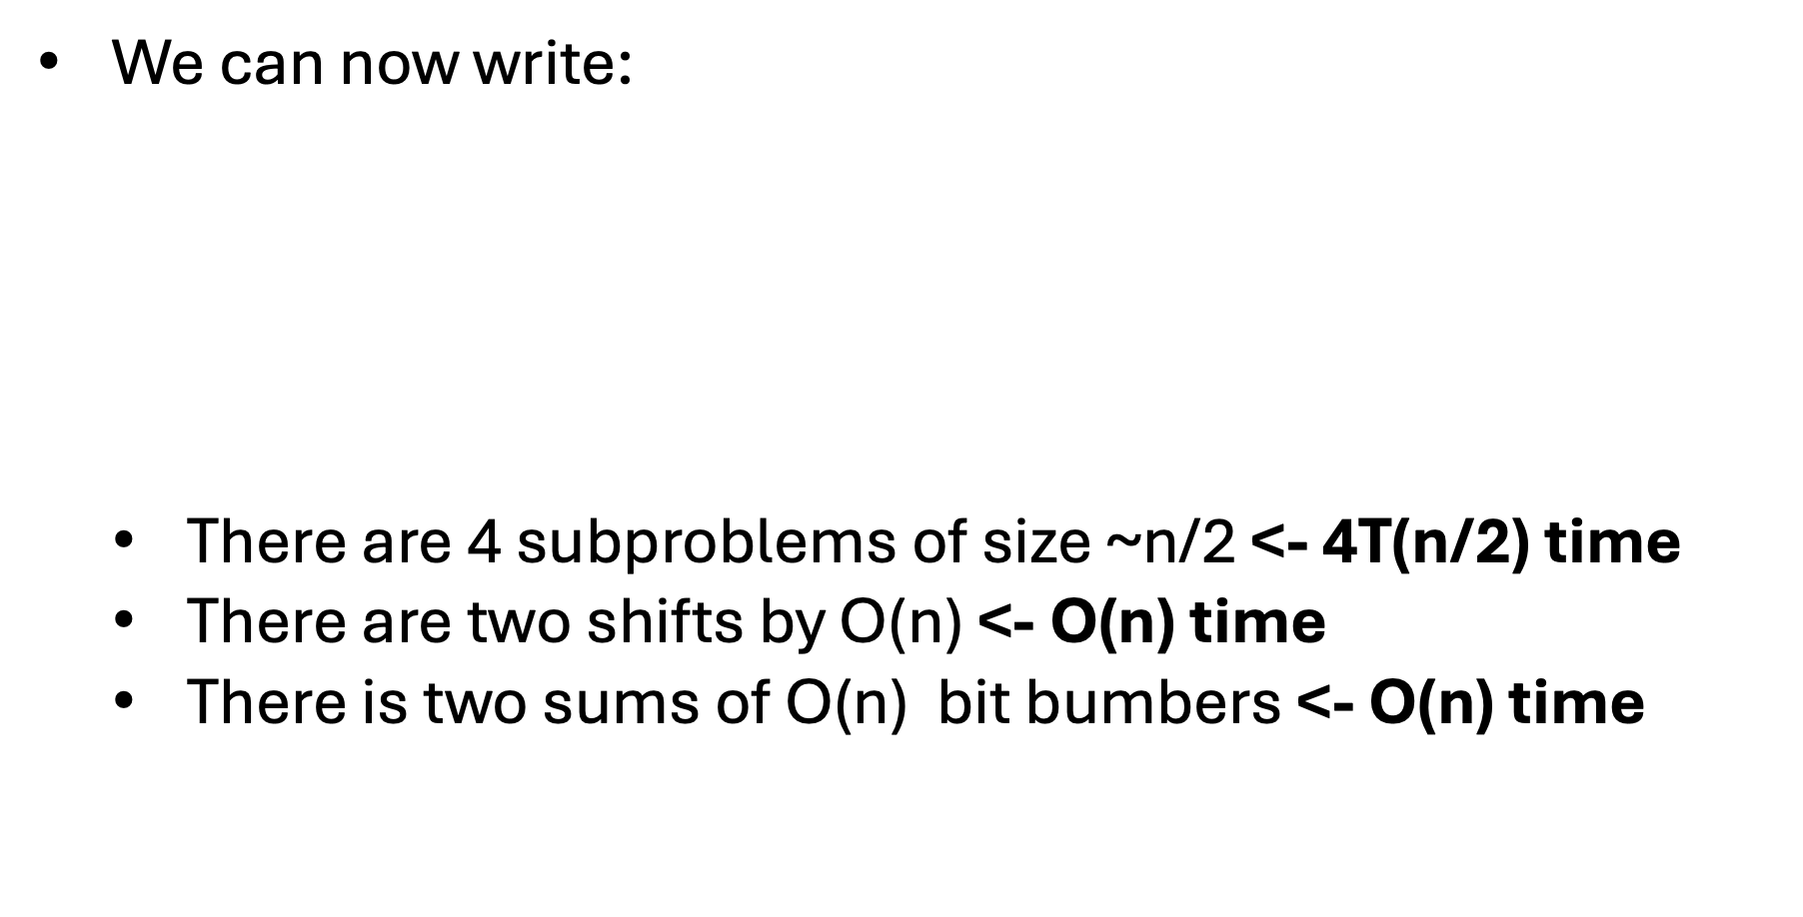
What is the runtime, T(n)?
We can now write:
  There are 4 subproblems of size ~n/2 <- 4T(n/2) time
  There are two shifts by O(n) <- O(n) time
  There is two sums of O(n) bit bumbers <- O(n) time
$$a⋅b=\left(a^{H}⋅2^{m}+a^{L}\right)\left(b^{H}⋅2^{m}+b^{L}\right)$$
$$=a^{H}⋅b^{H}⋅2^{\left(2m\right)}+\left(a^{H}⋅b^{L}+a^{L}⋅b^{H}\right)⋅2^{m}+a^{L}⋅b^{L}$$

Slide 22
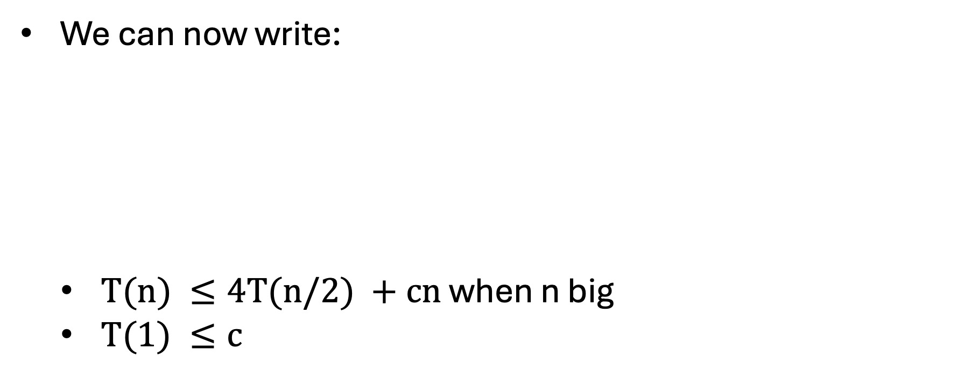
What is the runtime, T(n)?
We can now write:
  $T(n) ≤4T(n/2) +cn$ when n big
  $T(1) ≤c$
$$a⋅b=\left(a^{H}⋅2^{m}+a^{L}\right)\left(b^{H}⋅2^{m}+b^{L}\right)$$
$$=a^{H}⋅b^{H}⋅2^{\left(2m\right)}+\left(a^{H}⋅b^{L}+a^{L}⋅b^{H}\right)⋅2^{m}+a^{L}⋅b^{L}$$

Slide 23
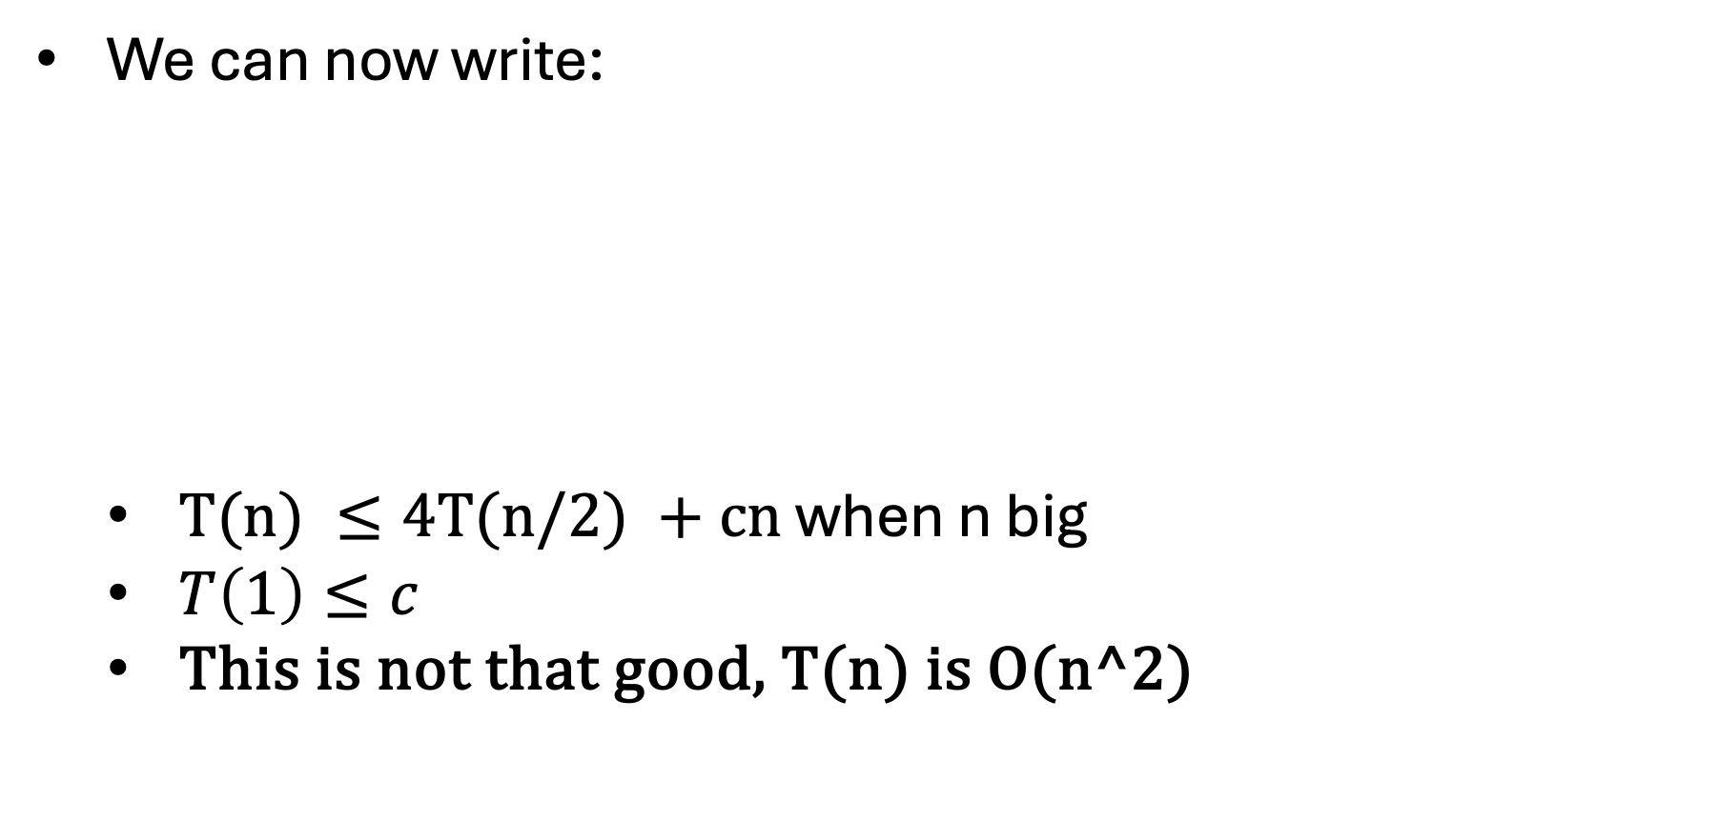
What is the runtime, T(n)?
We can now write:
  $T(n) ≤4T(n/2) +cn$ when n big
  $T\left(1\right)≤c$
  This is not that good, T(n) is O(n^2)
$$a⋅b=\left(a^{H}⋅2^{m}+a^{L}\right)\left(b^{H}⋅2^{m}+b^{L}\right)$$
$$=a^{H}⋅b^{H}⋅2^{\left(2m\right)}+\left(a^{H}⋅b^{L}+a^{L}⋅b^{H}\right)⋅2^{m}+a^{L}⋅b^{L}$$

Slide 24
What is the runtime, T(n)?
We can now write:
  $T(n) ≤4T(n/2) +cn$ when n big
  $T\left(1\right)≤c$
  This is not that good, T(n) is O(n^2)
$$a⋅b=\left(a^{H}⋅2^{m}+a^{L}\right)\left(b^{H}⋅2^{m}+b^{L}\right)$$
$$=a^{H}⋅b^{H}⋅2^{\left(2m\right)}+\left(a^{H}⋅b^{L}+a^{L}⋅b^{H}\right)⋅2^{m}+a^{L}⋅b^{L}$$

Slide 25
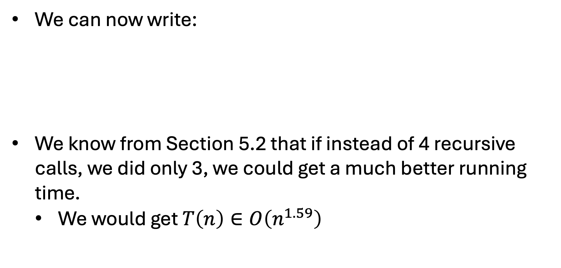
What is the runtime, T(n)?
We can now write:
We know from Section 5.2 that if instead of 4 recursive calls, we did only 3, we could get a much better running time.
  We would get $T\left(n\right)∈O\left(n^{1.59}\right)$
$$a⋅b=\left(a^{H}⋅2^{m}+a^{L}\right)\left(b^{H}⋅2^{m}+b^{L}\right)$$
$$=a^{H}⋅b^{H}⋅2^{\left(2m\right)}+\left(a^{H}⋅b^{L}+a^{L}⋅b^{H}\right)⋅2^{m}+a^{L}⋅b^{L}$$

Slide 26
Reducing Calls
We can now write:
Key Observation:
$$a⋅b=\left(a^{H}⋅2^{m}+a^{L}\right)\left(b^{H}⋅2^{m}+b^{L}\right)$$
$$=a^{H}⋅b^{H}⋅2^{\left(2m\right)}+\left(a^{H}⋅b^{L}+a^{L}⋅b^{H}\right)⋅2^{m}+a^{L}⋅b^{L}$$
$$\left(a^{H}+a^{L}\right)⋅\left(b^{H}+b^{L}\right)=a^{H}⋅b^{H}+a^{H}⋅b^{L}+a^{L}⋅b^{H}+a^{L}⋅b^{L}$$

Slide 27
Reducing Calls
We can now write:
Key Observation:
$$a⋅b=\left(a^{H}⋅2^{m}+a^{L}\right)\left(b^{H}⋅2^{m}+b^{L}\right)$$
$$=a^{H}⋅b^{H}⋅2^{\left(2m\right)}+\left(a^{H}⋅b^{L}+a^{L}⋅b^{H}\right)⋅2^{m}+a^{L}⋅b^{L}$$
$$\left(a^{H}+a^{L}\right)⋅\left(b^{H}+b^{L}\right)=a^{H}⋅b^{H}+a^{H}⋅b^{L}+a^{L}⋅b^{H}+a^{L}⋅b^{L}$$

Slide 28

Reducing Calls
We can now write:
Key Observation:
We can compute $a^{H}⋅b^{H}$ and $a^{L}⋅b^{L}$ and then use all these values to compute $a^{H}⋅b^{L}+a^{L}⋅b^{H}$!
$$a⋅b=\left(a^{H}⋅2^{m}+a^{L}\right)\left(b^{H}⋅2^{m}+b^{L}\right)$$
$$=a^{H}⋅b^{H}⋅2^{\left(2m\right)}+\left(a^{H}⋅b^{L}+a^{L}⋅b^{H}\right)⋅2^{m}+a^{L}⋅b^{L}$$
$$\left(a^{H}+a^{L}\right)⋅\left(b^{H}+b^{L}\right)=a^{H}⋅b^{H}+a^{H}⋅b^{L}+a^{L}⋅b^{H}+a^{L}⋅b^{L}$$

Slide 29
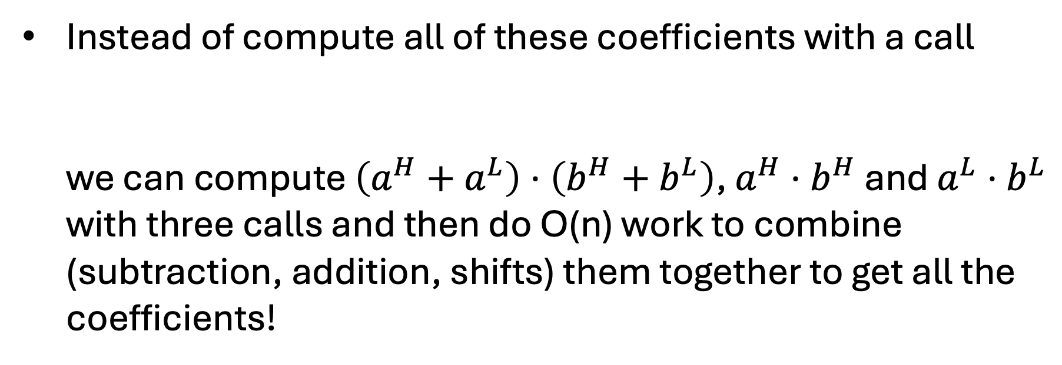
Reducing Calls
Instead of compute all of these coefficients with a call
  we can compute $\left(a^{H}+a^{L}\right)⋅\left(b^{H}+b^{L}\right)$, $a^{H}⋅b^{H}$ and $a^{L}⋅b^{L}$ with three calls and then do O(n) work to combine (subtraction, addition, shifts) them together to get all the coefficients!
$$a^{H}⋅b^{H}⋅2^{\left(2m\right)}+\left(a^{H}⋅b^{L}+a^{L}⋅b^{H}\right)⋅2^{m}+a^{L}⋅b^{L}$$
$$\left(a^{H}+a^{L}\right)⋅\left(b^{H}+b^{L}\right)=a^{H}⋅b^{H}+a^{H}⋅b^{L}+a^{L}⋅b^{H}+a^{L}⋅b^{L}$$

Slide 30
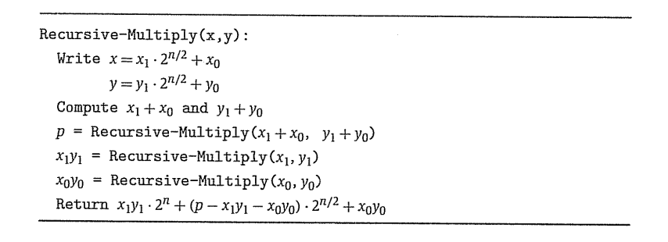
Recursive Algorithm

Slide 31
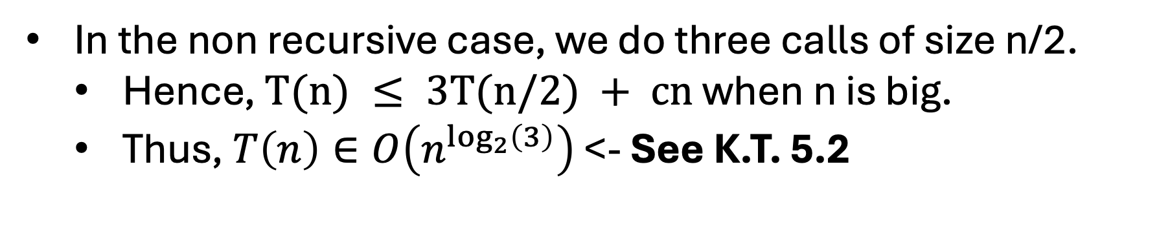
Runtime
In the non recursive case, we do three calls of size n/2.
  Hence, $T(n) ≤ 3T(n/2) + cn$ when n is big.
  Thus, $T\left(n\right)∈O\left(n^{\log_{2}\left(3\right)}\right)$ <- See K.T. 5.2

Slide 32
Runtime
In the non recursive case, we do three calls of size n/2.
  Hence, $T(n) ≤ 3T(n/2) + cn$ when n is big.
  Thus, $T\left(n\right)∈O\left(n^{\log_{2}\left(3\right)}\right)$ <- See K.T. 5.2

Slide 33
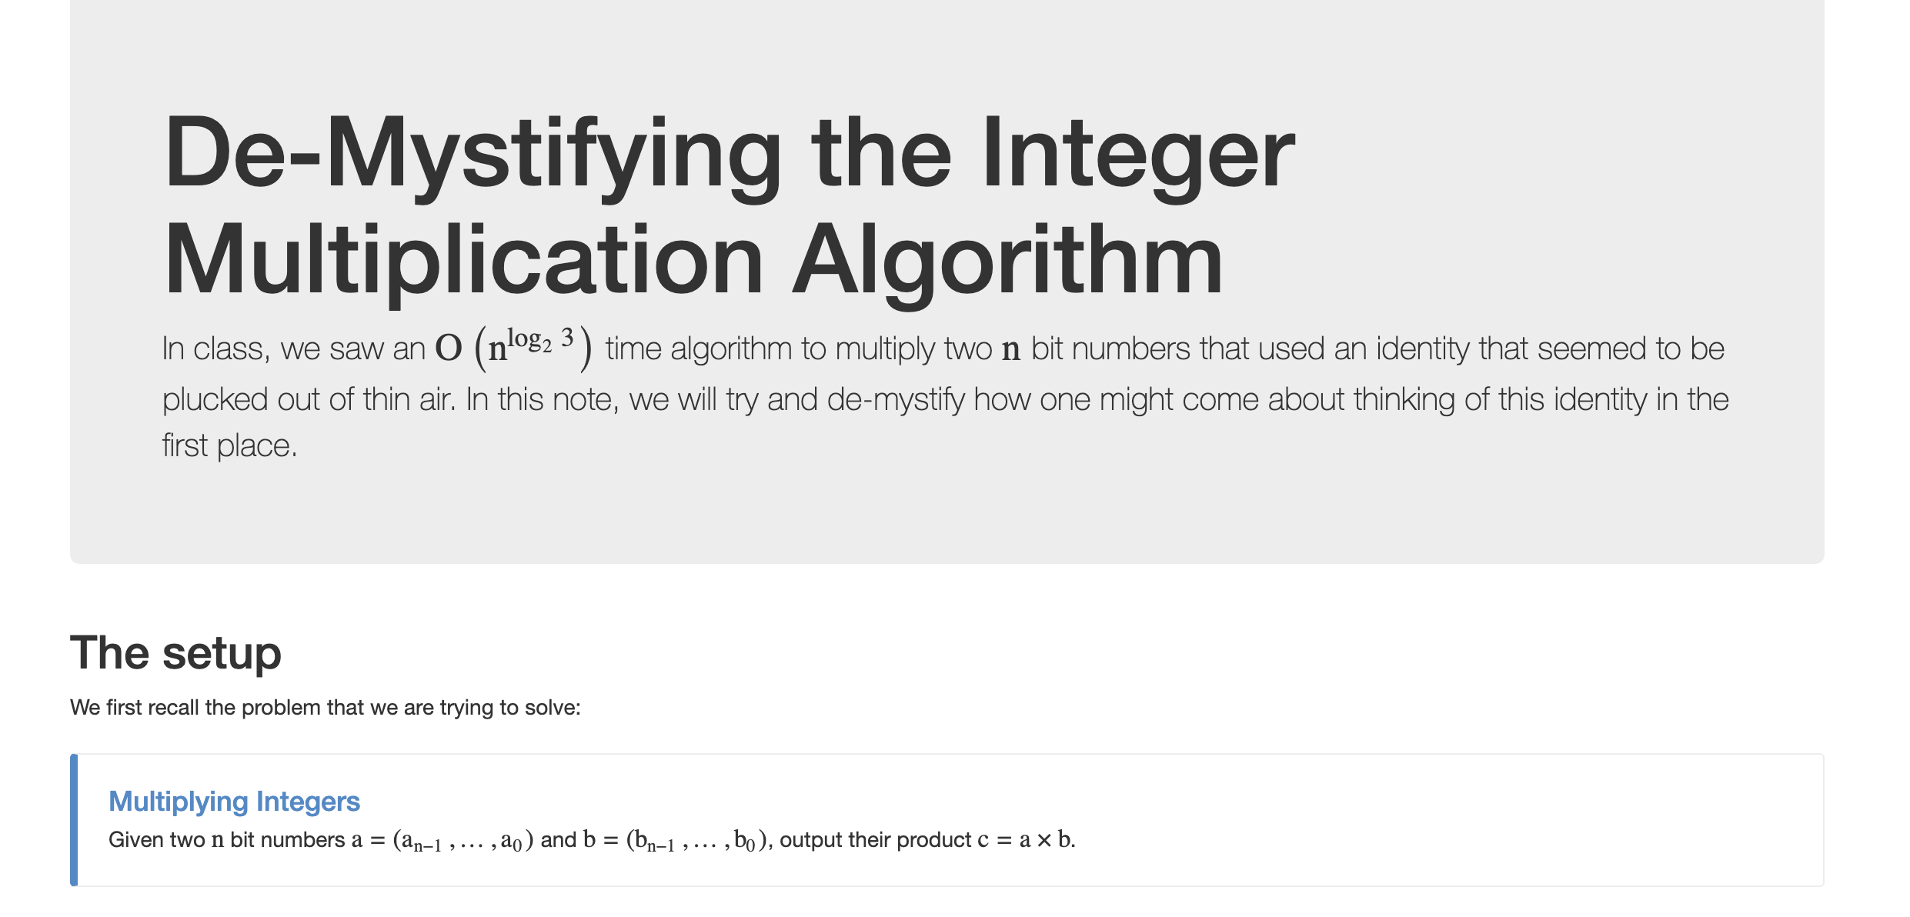
Want to know more?

