Slide 1

CSE 331:
Algorithms & Complexity
“Closest Pair”
Prof. Charlie Anne Carlson (She/Her)
Lecture 26
Monday Nov 3, 2025

Slide 2

Schedule
Course Updates
Closest Pair

Slide 3

Course Updates
HW 6 Out
  Autolab Soon
  Due November 11th
Group Project
  Code 1 & 2 Due Today
  Reflections 1 & 2 Due Today
Check Piazza for Google Form Review Link

Slide 4

Reading
You should have read:
  Finished 5.5
  Finished 5.4
  Finished Unraveling the mystery behind the identity
Before Next Class:
  Start 6.1
  Start 6.2

Slide 5
Closest Pair 2D
Input: Given n points in the plane.
Goal: Find pair of points with smallest Euclidean distance between them.

Slide 6
Closest Pair 2D
Input: Given n points in the plane.
Goal: Find pair of points with smallest Euclidean distance between them.

Slide 7
Closest Pair 2D
Input: Given n points in the plane.
Goal: Find pair of points with smallest Euclidean distance between them.
Assumptions:
  No two points have same x and y coordinate.
y
x

Slide 8

Closest Pair 2D
Question: What is a simple algorithm that solves this problem in polynomial time?
y
x

Slide 9
Closest Pair 2D
Answer: Check all pairs in O(n^2) time.
y
x

Slide 10
Closest Pair 1D
Input: Given n points ON the LINE.
Goal: Find pair of points with smallest Euclidean distance between them.
Assumptions:
  No two points have same x coordinate.
x

Slide 11
Closest Pair 1D
Input: Given n points ON the LINE.
Goal: Find pair of points with smallest Euclidean distance between them.
Assumptions:
  No two points have same x coordinate.
x

Slide 12
Closest Pair 1D
Question: What is a simple algorithm that solves this problem in polynomial time?
x

Slide 13
Closest Pair 1D
Answer: Sort the list by x coordinate in O(nlog(n)) time and then loop over to find shortest distance in O(n) time.
x

Slide 14
Closest Pair 2D
Question: Can we use sorting to help with the 2D version of this problem?
y
x

Slide 15
Closest Pair 2D
Very close in x-coordinate!
Answer: Not without more work because being close in x-coordinate doesn’t mean they are very close.
y
Very close in y-coordinate!
x

Slide 16
Divide & Conquer Closest Pair
Question: How can we do divide and conquer here?
y
x

Slide 17
Divide & Conquer Closest Pair
Answer: Break plane into pieces and recurse. Then merge the answers together.
y
x

Slide 18
Divide Closest Pair
Find line L to separate SET in half.

Slide 19
Divide Closest Pair
Will be n/2 = 7 points in each part.

Slide 20
Divide Closest Pair
Pieces aren’t always equal size.

Slide 21
Divide Closest Pair
Can’t always break into 4 equal pieces.

Slide 22
Conquer Closest Pair
Find closest pair in each part.

Slide 23
Merge Closest Pair
Take shortest amongst the two.

Slide 24
Closest Pair Algo Idea
Break plane into two parts with equal number of points using line L.
Recursively find closest pair in each part.
Return the nearest of the two pairs.
Question: Does this work?

Slide 25
Closest Pair Algo Idea
Break plane into two parts with equal number of points using line L.
Recursively find closest pair in each part.
Return the nearest of the two pairs.
Question: Not always!
The closest pair may span the cut!

Slide 26
Closest Pair Algo Idea
So, our merge step idea doesn’t work.
  We need to consider pairs that span the line L.
Question: What is a naïve way of considering those vertices?

Slide 27
Closest Pair Algo Idea
So, our merge step idea doesn’t work.
  We need to consider pairs that span the line L.
Answer: We could just check every pair but that is O(n^2) again and we don’t like that.

Slide 28
Closest Pair Algo Idea
So, our merge step idea doesn’t work.
  We need to consider pairs that span the line L.
Answer: We could just check every pair but that is O(n^2) again and we don’t like that.

Slide 29
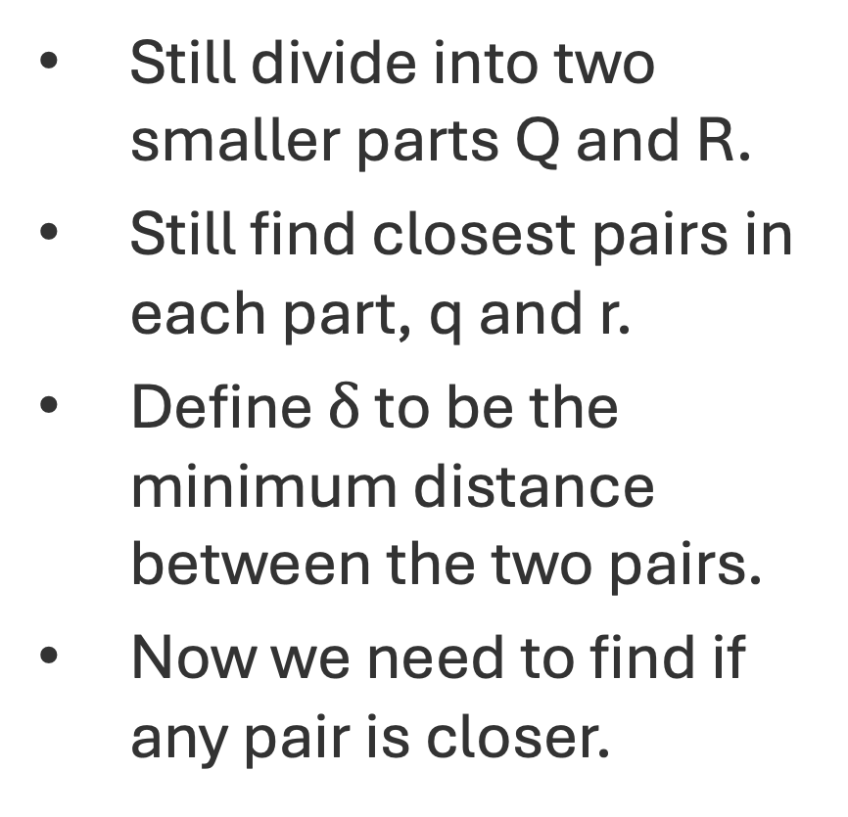

New Algo Idea
Still divide into two smaller parts Q and R.
Still find closest pairs in each part, q and r.
Define $δ$ to be the minimum distance between the two pairs.
Now we need to find if any pair is closer.
$$δ$$

Slide 30
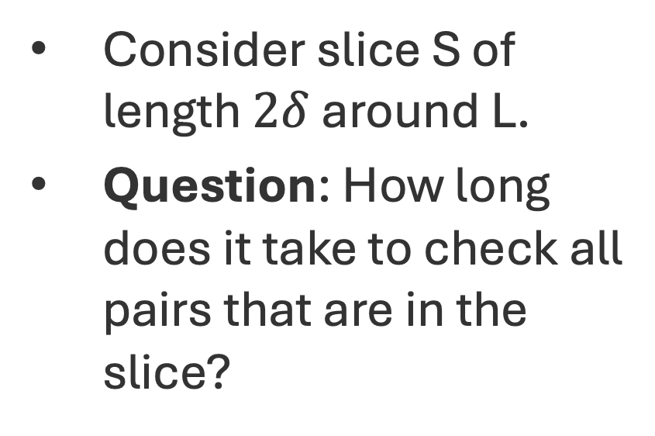

Finding Closer Pairs
Consider slice S of length $2δ$ around L.
Question: How long does it take to check all pairs that are in the slice?
$$δ$$

Slide 31
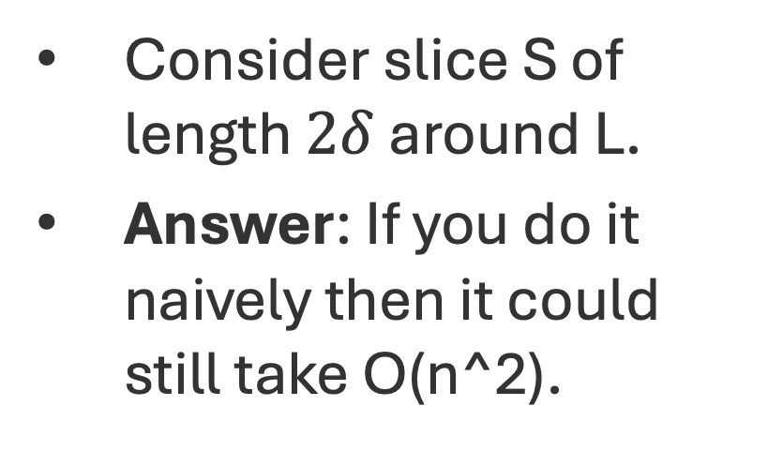
Finding Closer Pairs
Consider slice S of length $2δ$ around L.
Answer: If you do it naively then it could still take O(n^2).
$$δ$$

Slide 32
Finding Closer Pairs
Let’s assume that you had an algorithm that could check the slice in O(n) time.
Question: Can you come up with a O(n log(n)) algorithm for Closest Pair 2D?
$$δ$$

Slide 33
Closest Pair Algo Idea
Break plane into two parts with equal number of points using line L.
  Can be O(n) time if you sort by x-coordinate first.
  Find n/2 item with smallest x-coordinate for one side…

Slide 34
Closest Pair Algo Idea
Recurse on each of the smaller planes to get closest pair.
  This takes 2T(n/2) time if you assume n even.
Use the min distance from these two closest pairs to define slice S.

Slide 35
Closest Pair Algo Idea
Assume you can find closest pair in slice in time O(n).
If slice has closer point, return it. Otherwise return closest pair from amongst the two recursive calls.
Don’t forget base case!

Slide 36
Closest Pair Algo Idea
Observe that you only need to sort once.
Question: What is the runtime of our algorithm if we assume that we can search the slice in O(n) time?

Slide 37
Closest Pair Algo Idea
Observe that you only need to sort once.
Answer: Since the base case can be handled in constant time, we have the same recurrence as mergesort and thus, the same running time.

Slide 38
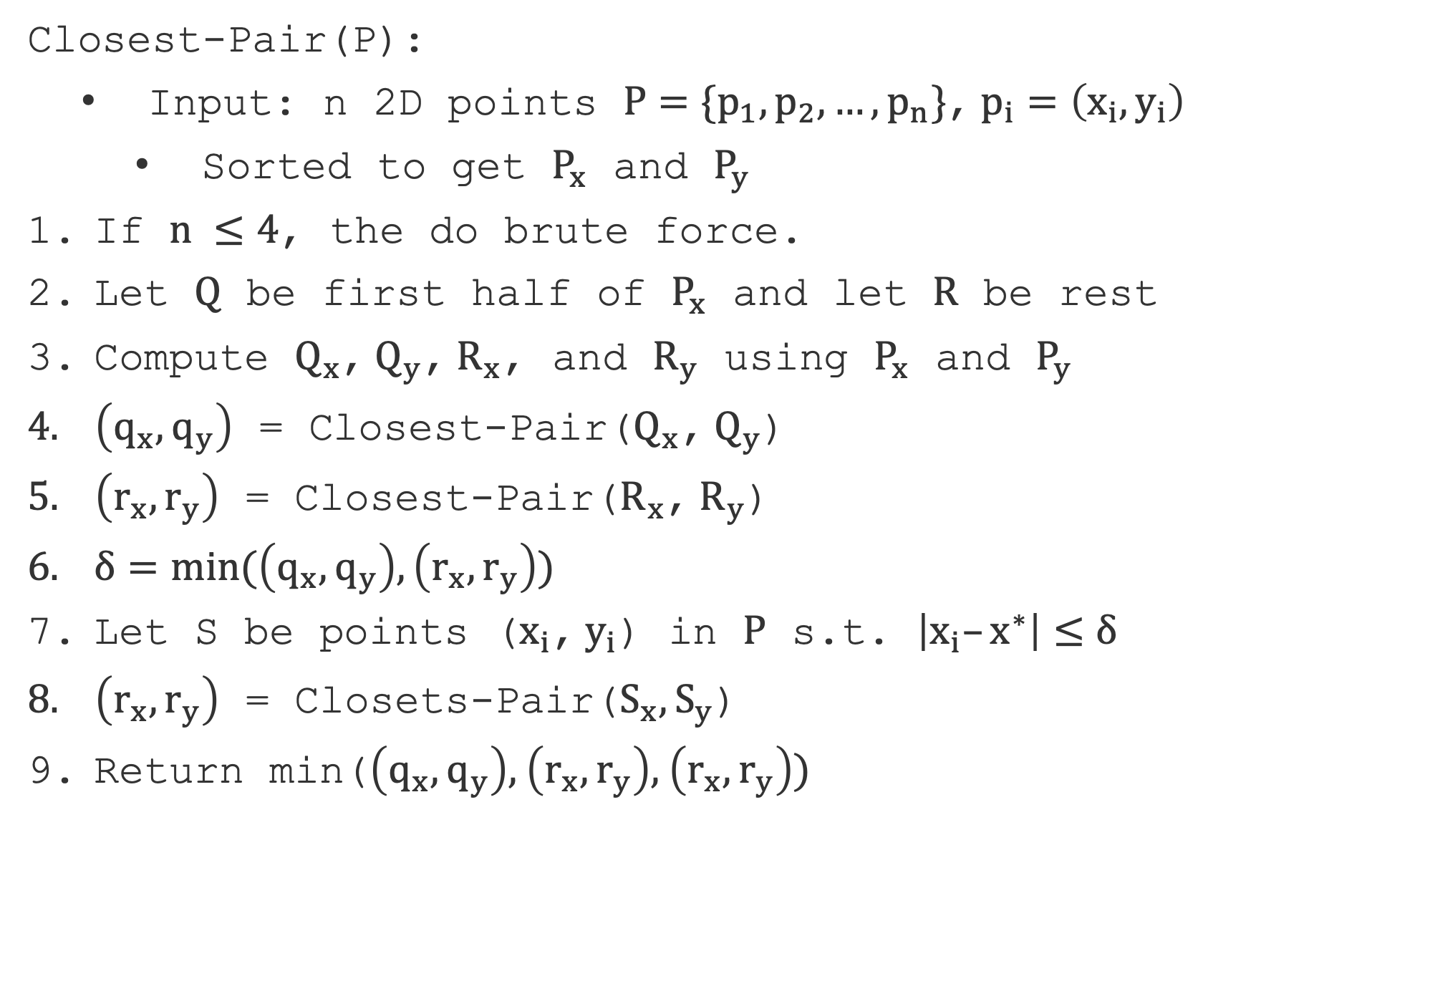
Closest-Pair(P):
  Input: n 2D points $P=\{p_{1},p_{2},…,p_{n}\}$, $p_{i}=\left(x_{i},y_{i}\right)$
    Sorted to get $P_{x}$ and $P_{y}$
If $n ≤4$, the do brute force.
Let $Q$ be first half of $P_{x}$ and let $R$ be rest
Compute $Q_{x}$, $Q_{y}$, $R_{x}$, and $R_{y}$ using $P_{x}$ and $P_{y}$
$\left(q_{x},q_{y}\right)$ = Closest-Pair($Q_{x}$, $Q_{y}$)
$\left(r_{x},r_{y}\right)$ = Closest-Pair($R_{x}$, $R_{y}$)
$δ=min(\left(q_{x},q_{y}\right),\left(r_{x},r_{y}\right))$
Let S be points ($x_{i}$, $y_{i}$) in $P$ s.t. $\left|x_{i}–x^{∗}\right|≤δ$
$\left(r_{x},r_{y}\right)$ = Closets-Pair($S_{x},S_{y}$)
Return min($\left(q_{x},q_{y}\right),$ $\left(r_{x},r_{y}\right),$ $\left(r_{x},r_{y}\right))$

Slide 39
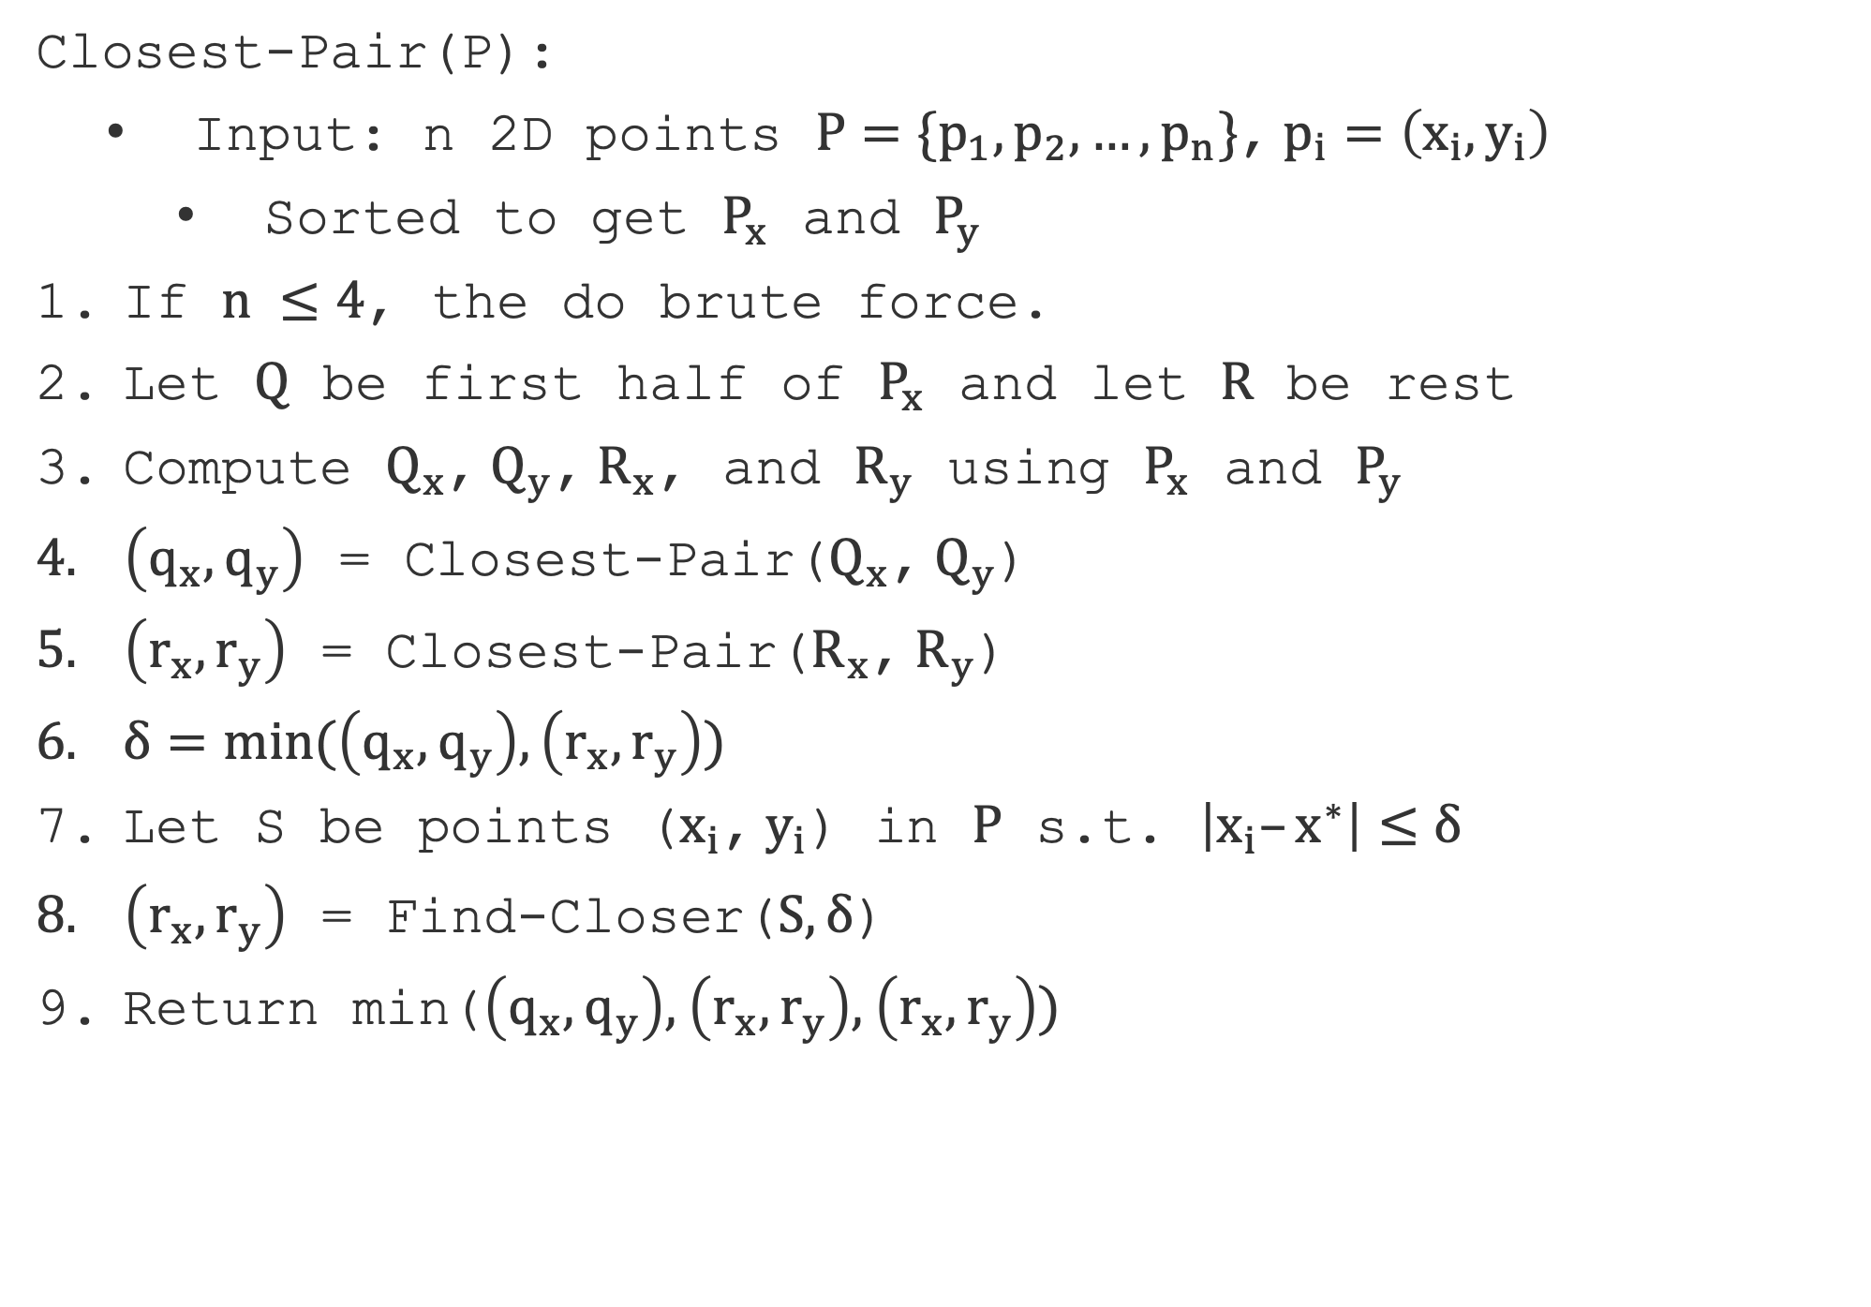
Closest-Pair(P):
  Input: n 2D points $P=\{p_{1},p_{2},…,p_{n}\}$, $p_{i}=\left(x_{i},y_{i}\right)$
    Sorted to get $P_{x}$ and $P_{y}$
If $n ≤4$, the do brute force.
Let $Q$ be first half of $P_{x}$ and let $R$ be rest
Compute $Q_{x}$, $Q_{y}$, $R_{x}$, and $R_{y}$ using $P_{x}$ and $P_{y}$
$\left(q_{x},q_{y}\right)$ = Closest-Pair($Q_{x}$, $Q_{y}$)
$\left(r_{x},r_{y}\right)$ = Closest-Pair($R_{x}$, $R_{y}$)
$δ=min(\left(q_{x},q_{y}\right),\left(r_{x},r_{y}\right))$
Let S be points ($x_{i}$, $y_{i}$) in $P$ s.t. $\left|x_{i}–x^{∗}\right|≤δ$
$\left(r_{x},r_{y}\right)$ = Find-Closer($S,δ$)
Return min($\left(q_{x},q_{y}\right),$ $\left(r_{x},r_{y}\right),$ $\left(r_{x},r_{y}\right))$

Slide 40
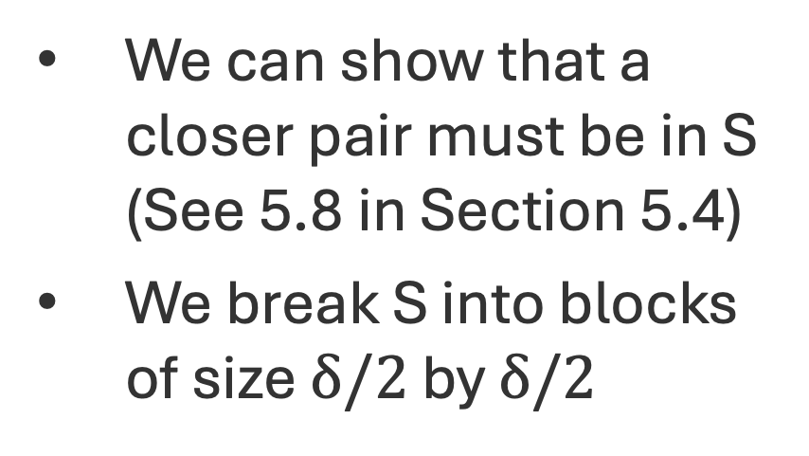
Clever Closer Pairs
We can show that a closer pair must be in S (See 5.8 in Section 5.4)
We break S into blocks of size $δ/2$ by $δ/2$

Slide 41
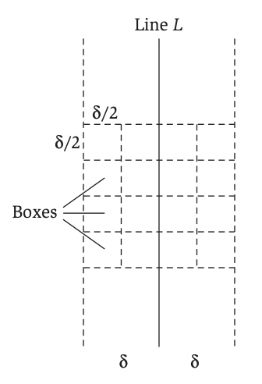
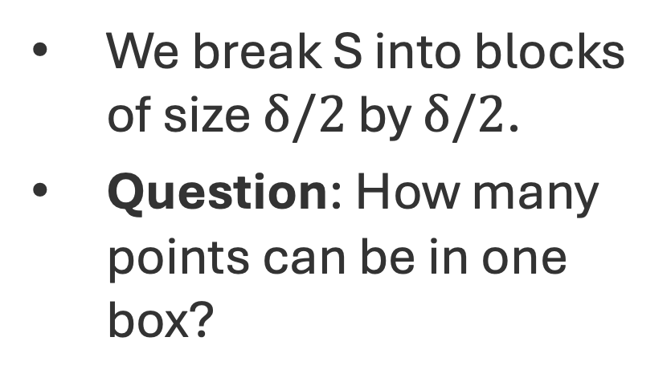
Find-Closer
We break S into blocks of size $δ/2$ by $δ/2$.
Question: How many points can be in one box?

Slide 42
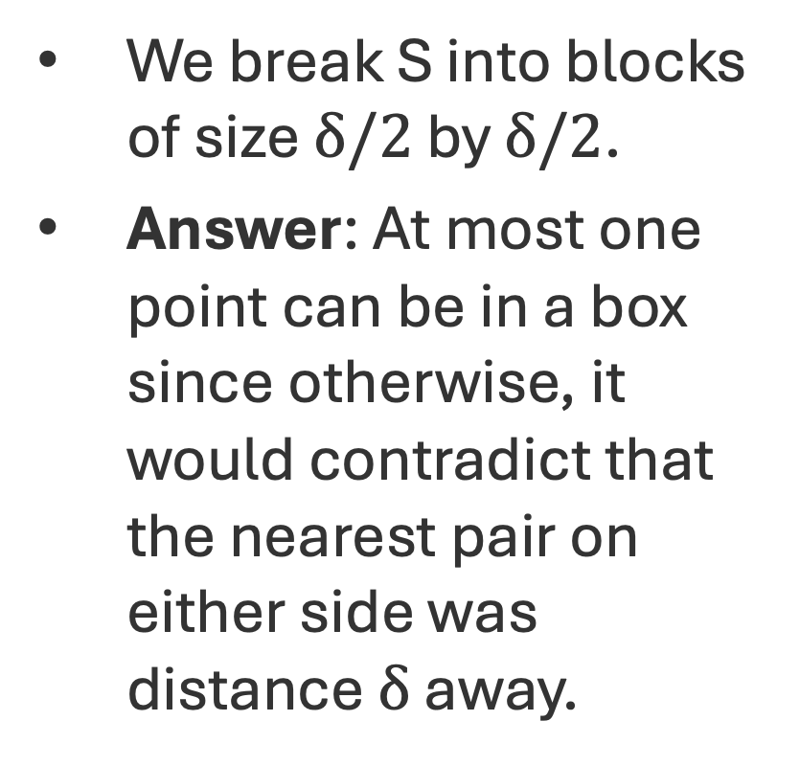
Find-Closer
We break S into blocks of size $δ/2$ by $δ/2$.
Answer: At most one point can be in a box since otherwise, it would contradict that the nearest pair on either side was distance $δ$ away.

Slide 43
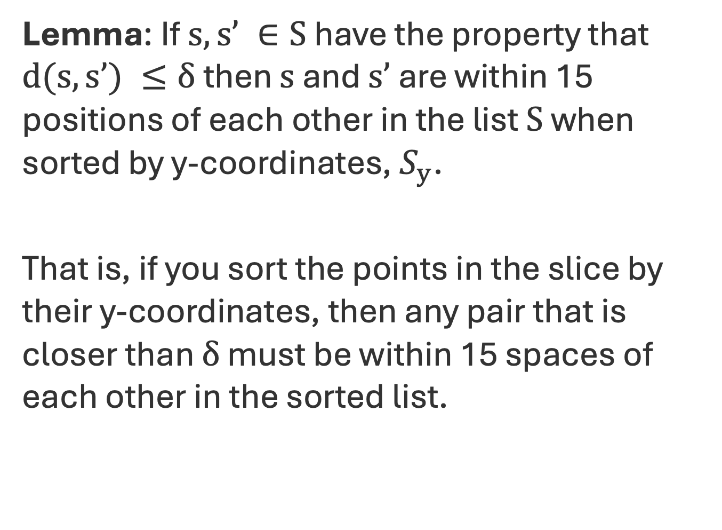
Kickass Property Lemma (KT 5.10 in S 5.4)
Lemma: If $s,s’ ∈S$ have the property that $d(s,s’) ≤δ$ then $s$ and $s’$ are within 15 positions of each other in the list $S$ when sorted by y-coordinates, $S_{y}$.
That is, if you sort the points in the slice by their y-coordinates, then any pair that is closer than $δ$ must be within 15 spaces of each other in the sorted list.

Slide 44
Kickass Property Lemma Picture
Fix a point a.

Slide 45
Kickass Property Lemma Picture
Fix a point a.
Recall at most one point per box.

Slide 46
Kickass Property Lemma Picture
Fix a point a.
Recall at most one point per box.
Any point b that is at least 15 spaces away in sorted array must be down here.

Slide 47
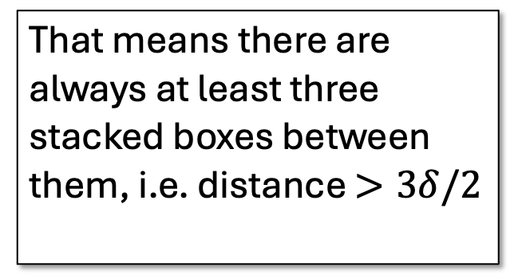
Kickass Property Lemma Picture
That means there are always at least three stacked boxes between them, i.e. distance $>3δ/2$
Fix a point a.
Recall at most one point per box.
Any point b that is at least 15 spaces away in sorted array must be down here.

