Slide 1

CSE 331: Algorithms & Complexity
“KPL”
Prof. Charlie Anne Carlson (She/Her)
Lecture 27
Monday Nov 5th, 2025

Slide 2

Schedule
Course Updates
Closest Pair
KPL

Slide 3

Course Updates
HW 6 Out
Autolab Up
Due November 11th
Group Project
Code 3 Due November 24th
Reflections 3 Due December 1st
Check Piazza for Google Form Review Link (before Friday)
Next Quiz is December 1st

Slide 4

Reading
You should have read:
Finished 5.4
Before Next Class:
Continue 6.1
Continue 6.2

Slide 5
Closest Pair 2D
Input: Given n points in the plane.
Goal: Find pair of points with smallest Euclidean distance between them.

Slide 6
Closest Pair Algo Idea
Break plane into two parts with equal number of points using line L.
Can be O(n) time if you sort by x-coordinate first.
Find n/2 item with smallest x-coordinate for one side…

Slide 7
Closest Pair Algo Idea
Recurse on each of the smaller planes to get closest pair.
This takes 2T(n/2) time if you assume n even.
Use the min distance from these two closest pairs to define slice S.

Slide 8
Closest Pair Algo Idea
Assume you can find closest pair in slice in time O(n).
If slice has closer point, return it. Otherwise return closest pair from amongst the two recursive calls.
Don’t forget base case!

Slide 9
Closest Pair Algo Idea
Observe that you only need to sort once.
Question: What is the runtime of our algorithm if we assume that we can search the slice in O(n) time?

Slide 10
Closest Pair Algo Idea
Observe that you only need to sort once.
Answer: Since the base case can be handled in constant time, we have the same recurrence as mergesort and thus, the same running time.

Slide 11
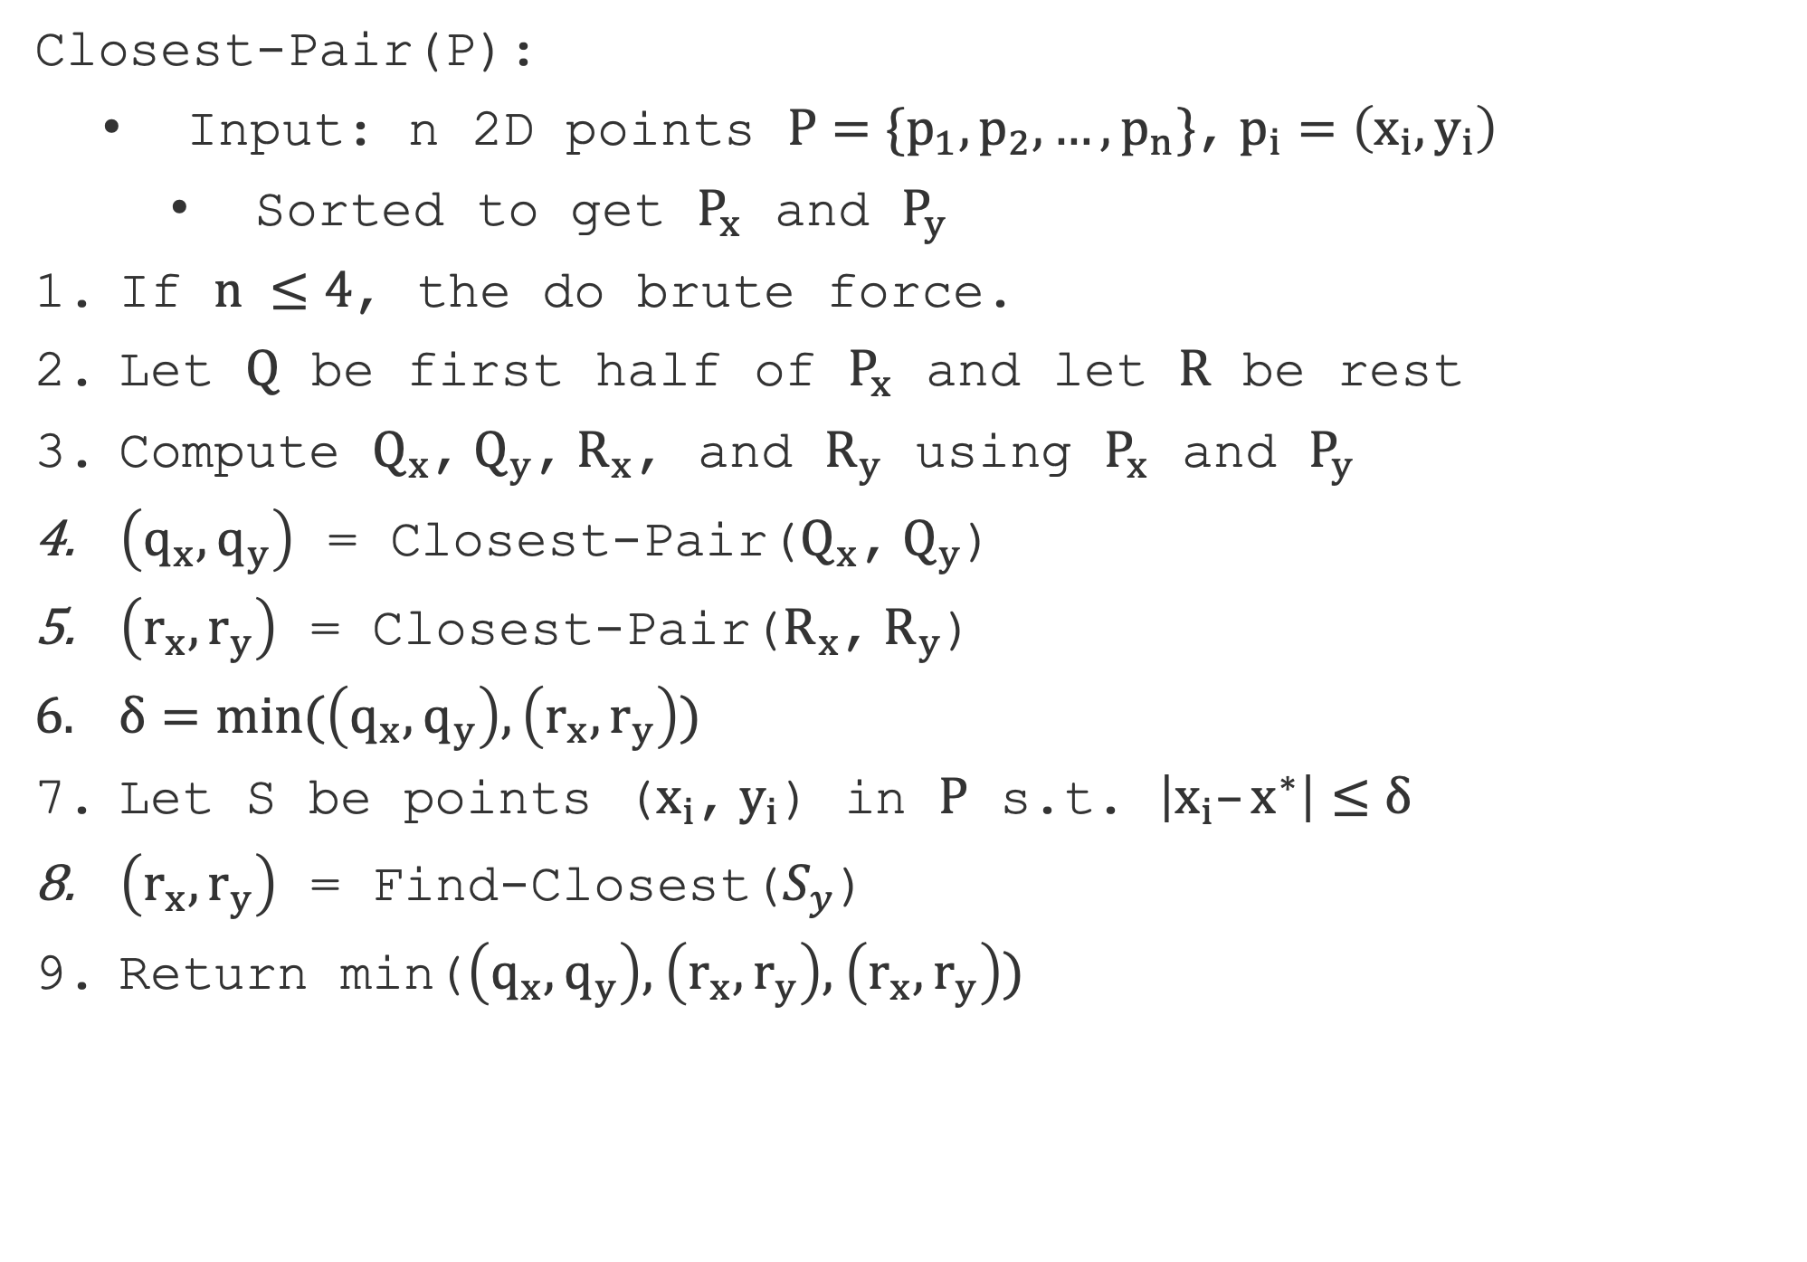
Closest-Pair(P):
Input: n 2D points $P=\{p_{1},p_{2},…,p_{n}\}$, $p_{i}=\left(x_{i},y_{i}\right)$
Sorted to get $P_{x}$ and $P_{y}$
If $n ≤4$, the do brute force.
Let $Q$ be first half of $P_{x}$ and let $R$ be rest
Compute $Q_{x}$, $Q_{y}$, $R_{x}$, and $R_{y}$ using $P_{x}$ and $P_{y}$
$\left(q_{x},q_{y}\right)$ = Closest-Pair($Q_{x}$, $Q_{y}$)
$\left(r_{x},r_{y}\right)$ = Closest-Pair($R_{x}$, $R_{y}$)
$δ=min(\left(q_{x},q_{y}\right),\left(r_{x},r_{y}\right))$
Let S be points ($x_{i}$, $y_{i}$) in $P$ s.t. $\left|x_{i}–x^{∗}\right|≤δ$
$\left(r_{x},r_{y}\right)$ = Find-Closest($S_{y}$)
Return min($\left(q_{x},q_{y}\right),$ $\left(r_{x},r_{y}\right),$ $\left(r_{x},r_{y}\right))$

Slide 12
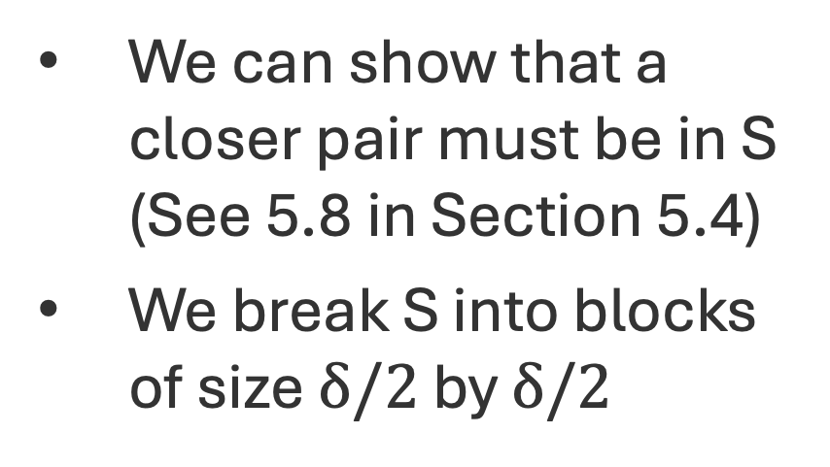
Clever Closer Pairs
We can show that a closer pair must be in S (See 5.8 in Section 5.4)
We break S into blocks of size $δ/2$ by $δ/2$

Slide 13
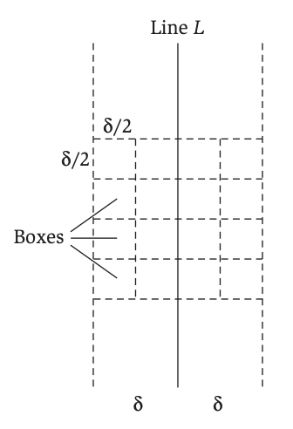
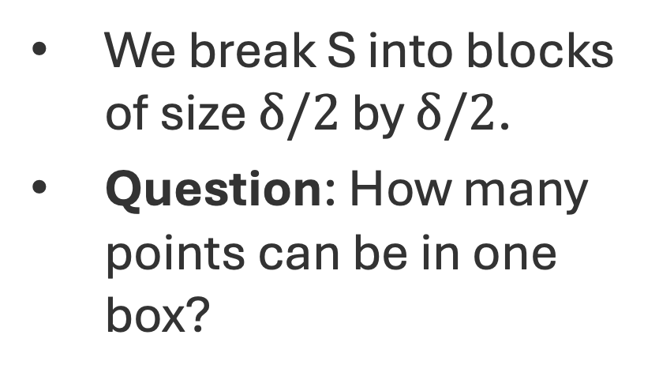
Clever Closer Pairs
We break S into blocks of size $δ/2$ by $δ/2$.
Question: How many points can be in one box?

Slide 14
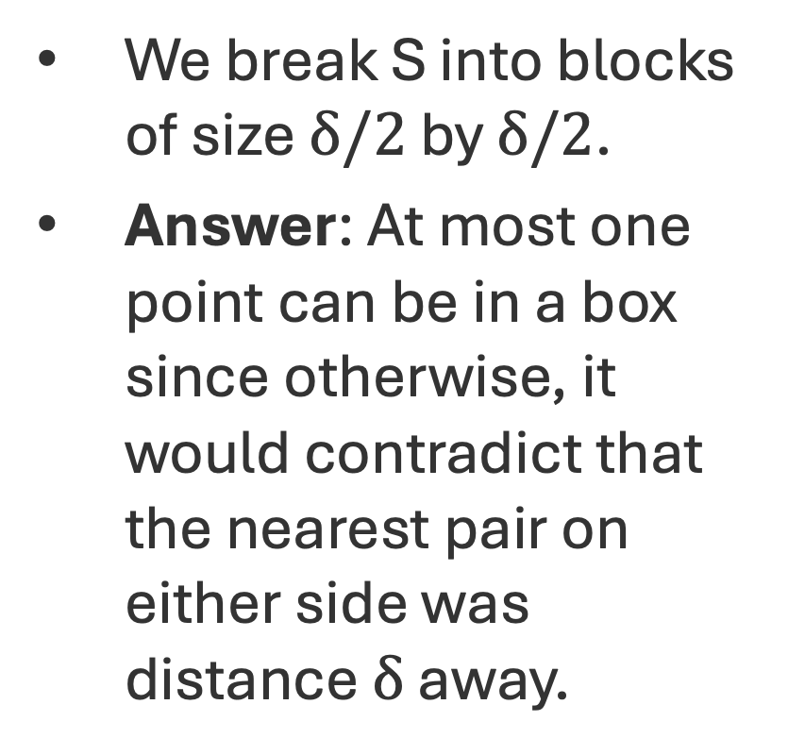
Clever Closer Pairs
We break S into blocks of size $δ/2$ by $δ/2$.
Answer: At most one point can be in a box since otherwise, it would contradict that the nearest pair on either side was distance $δ$ away.

Slide 15
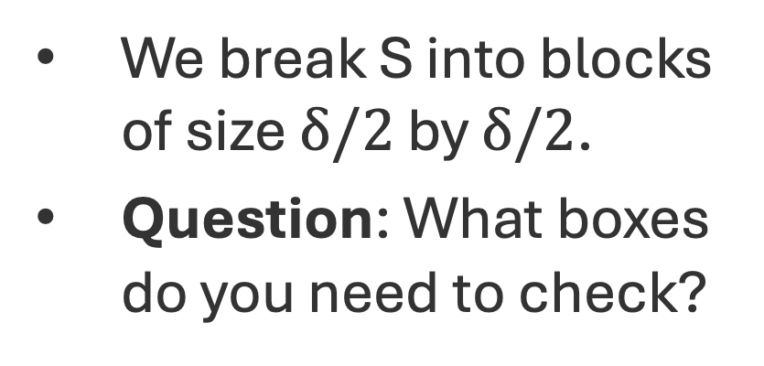
Clever Closer Pairs
We break S into blocks of size $δ/2$ by $δ/2$.
Question: What boxes do you need to check?

Slide 16
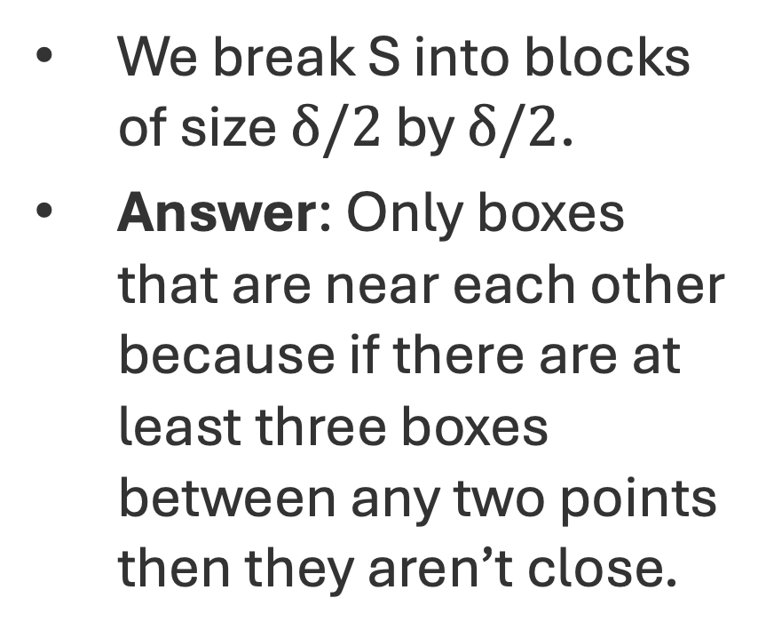
Clever Closer Pairs
We break S into blocks of size $δ/2$ by $δ/2$.
Answer: Only boxes that are near each other because if there are at least three boxes between any two points then they aren’t close.

Slide 17
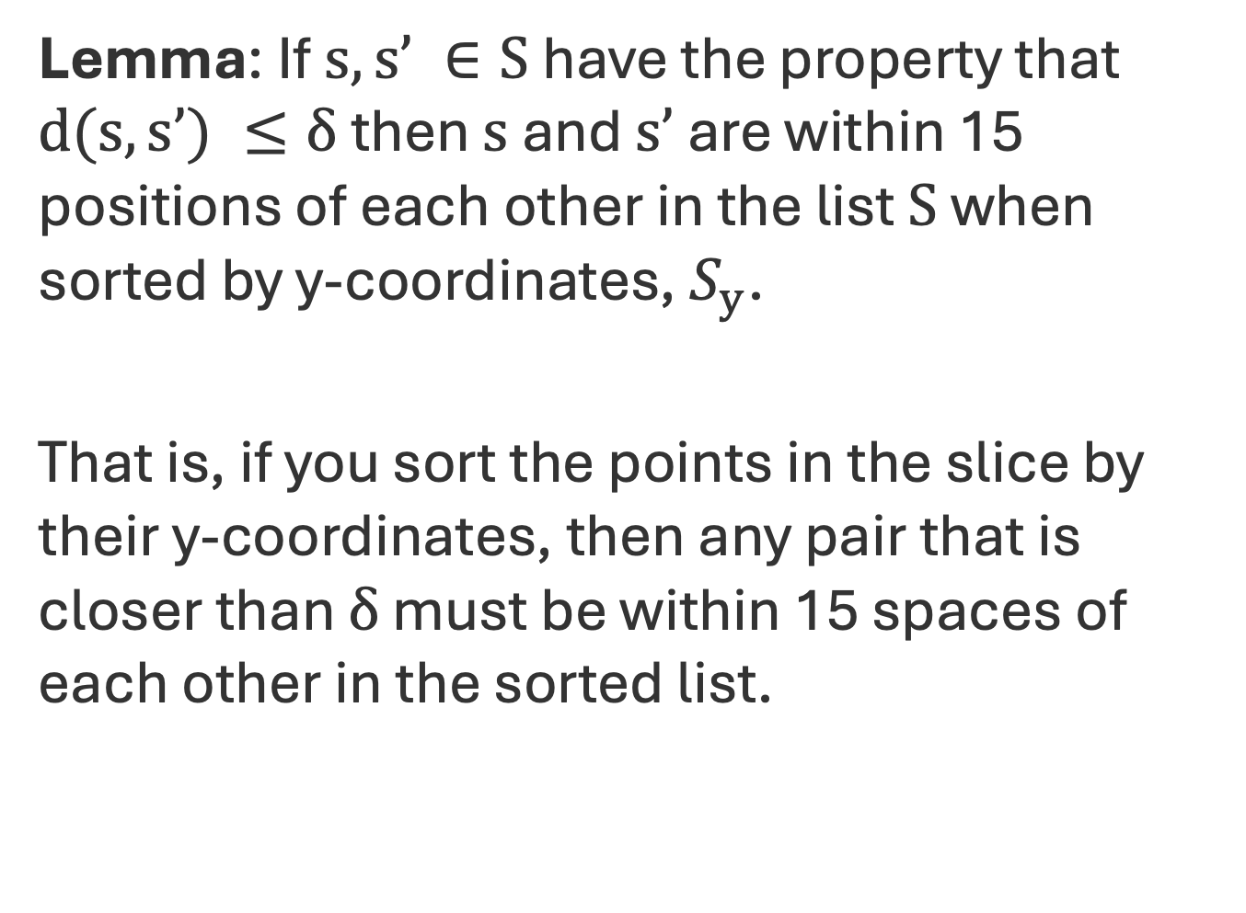
Kickass Property Lemma (KT 5.10 in S 5.4)
Lemma: If $s,s’ ∈S$ have the property that $d(s,s’) ≤δ$ then $s$ and $s’$ are within 15 positions of each other in the list $S$ when sorted by y-coordinates, $S_{y}$.
That is, if you sort the points in the slice by their y-coordinates, then any pair that is closer than $δ$ must be within 15 spaces of each other in the sorted list.

Slide 18
Kickass Property Lemma (KT 5.10 in S 5.4)
Lemma: If $s,s’ ∈S$ have the property that $d(s,s’) ≤δ$ then $s$ and $s’$ are within 15 positions of each other in the list $S$ when sorted by y-coordinates, $S_{y}$.
That is, if you sort the points in the slice by their y-coordinates, then any pair that is closer than $δ$ must be within 15 spaces of each other in the sorted list.
1
2
3
4
5
6
7
8
9
10
11
12
13
14
15

Slide 19
Kickass Property Lemma Picture
Fix a point a.

Slide 20
Kickass Property Lemma Picture
Fix a point a.
Recall at most one point per box.

Slide 21
Kickass Property Lemma Picture
Fix a point a.
Recall at most one point per box.
Any point b that is at least 15 spaces away in sorted array must be down here.

Slide 22
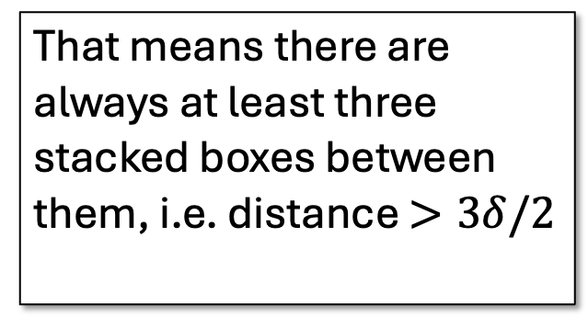
Kickass Property Lemma Picture
That means there are always at least three stacked boxes between them, i.e. distance $>3δ/2$
Fix a point a.
Recall at most one point per box.
Any point b that is at least 15 spaces away in sorted array must be down here.

Slide 23
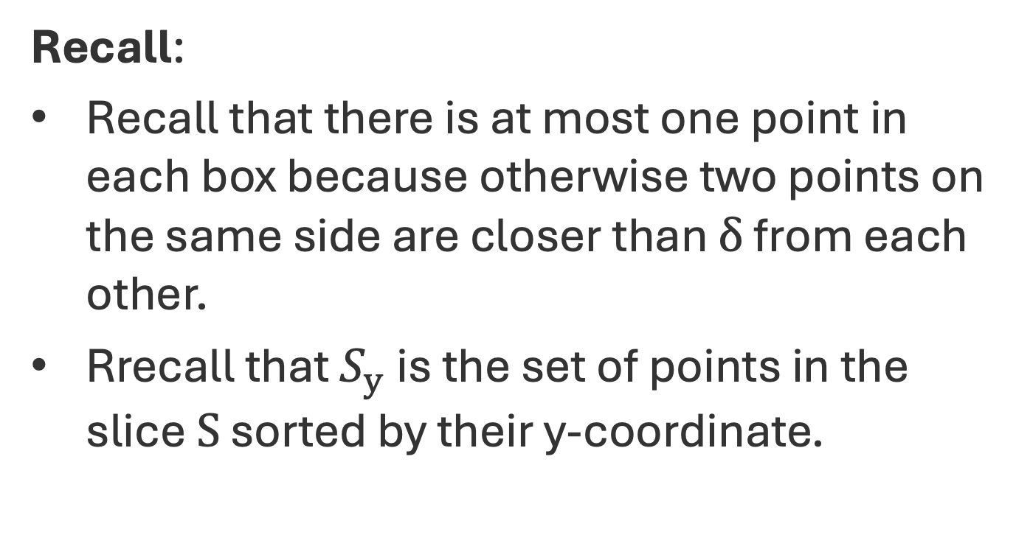
Kickass Property Lemma Proof
Recall:
Recall that there is at most one point in each box because otherwise two points on the same side are closer than $δ$ from each other.
Rrecall that $S_{y}$ is the set of points in the slice $S$ sorted by their y-coordinate.
1
2
3
4
5
6
7
8
9
10
11
12
13
14
15

Slide 24
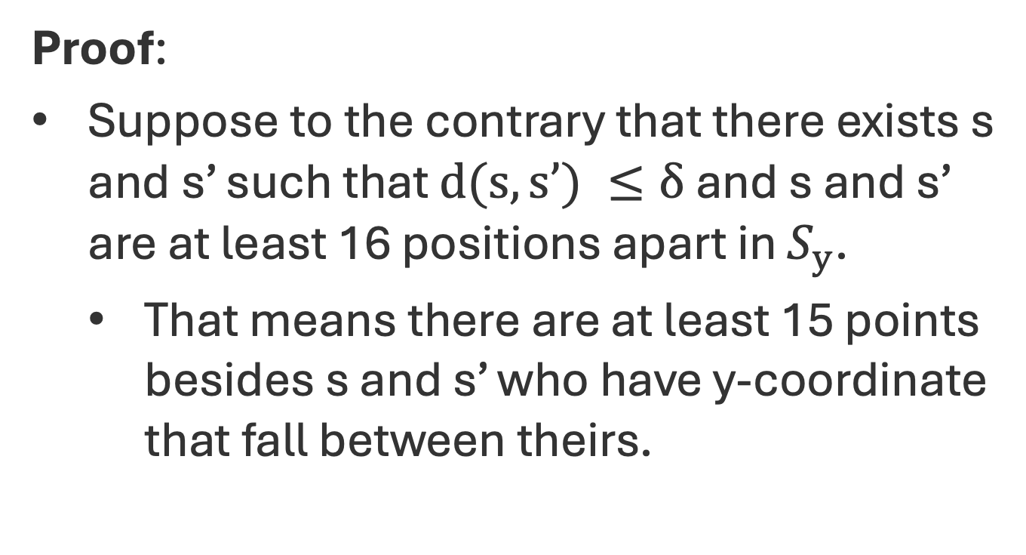
Kickass Property Lemma Proof
Proof:
Suppose to the contrary that there exists s and s’ such that $d(s,s’) ≤δ$ and s and s’ are at least 16 positions apart in $S_{y}$.
That means there are at least 15 points besides s and s’ who have y-coordinate that fall between theirs.
1
2
3
4
5
6
7
8
9
10
11
12
13
14
15

Slide 25
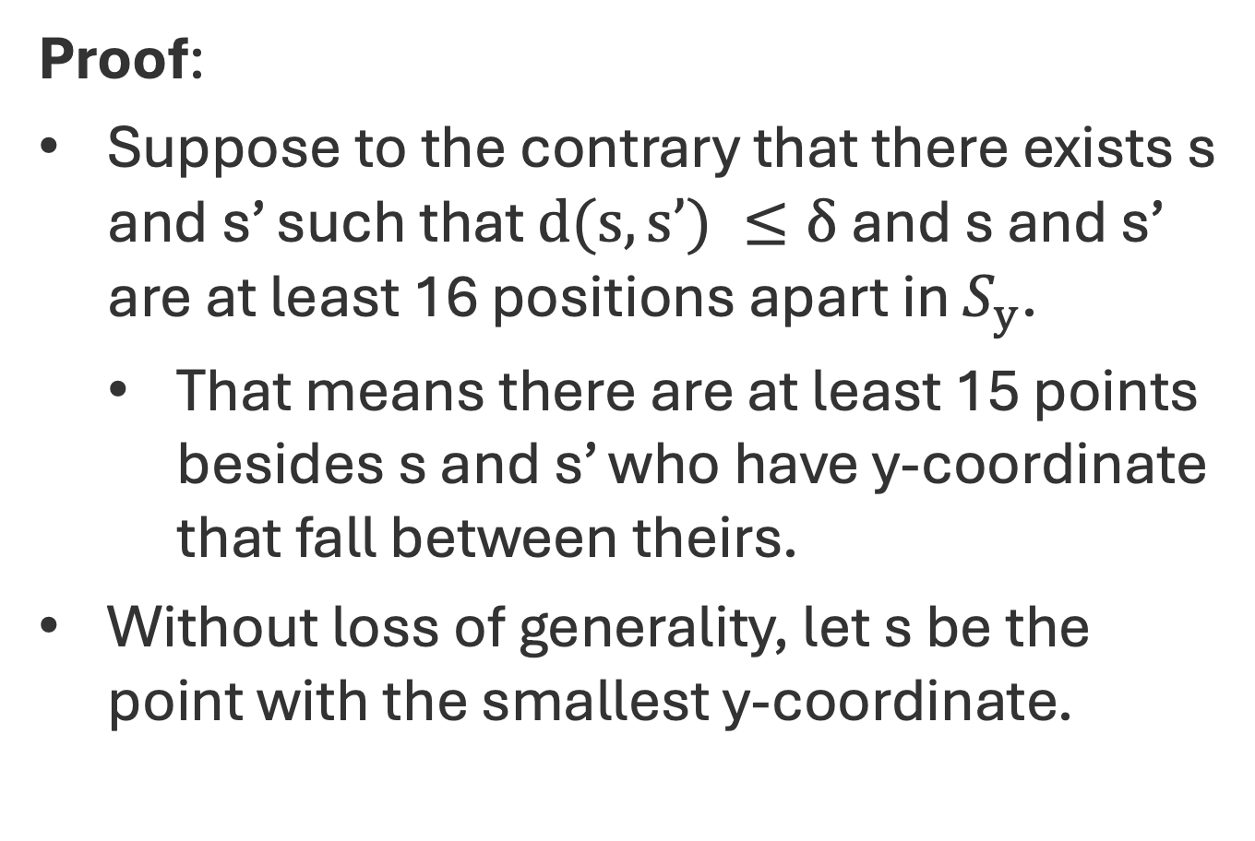
Kickass Property Lemma Proof
Proof:
Suppose to the contrary that there exists s and s’ such that $d(s,s’) ≤δ$ and s and s’ are at least 16 positions apart in $S_{y}$.
That means there are at least 15 points besides s and s’ who have y-coordinate that fall between theirs.
Without loss of generality, let s be the point with the smallest y-coordinate.
s’
1
2
3
4
5
6
7
8
9
10
11
12
13
14
15
s

Slide 26
Kickass Property Lemma Proof
Proof:
Suppose to the contrary that there exists s and s’ such that $d(s,s’) ≤δ$ and s and s’ are at least 16 positions apart in $S_{y}$.
That means there are at least 15 points besides s and s’ who have y-coordinate that fall between theirs.
Without loss of generality, let s be the point with the smallest y-coordinate.
s’
1
2
3
4
5
6
7
8
9
10
11
12
13
14
15
s

Slide 27
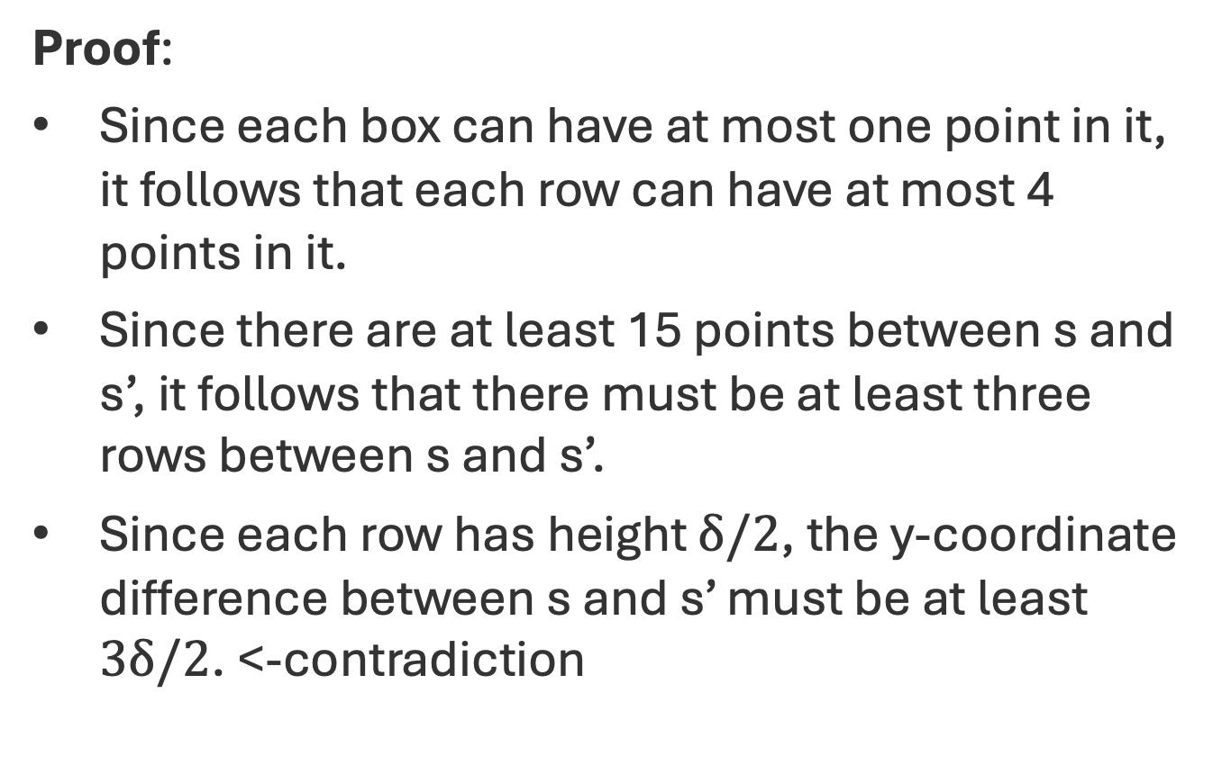
Kickass Property Lemma Proof
Proof:
Since each box can have at most one point in it, it follows that each row can have at most 4 points in it.
Since there are at least 15 points between s and s’, it follows that there must be at least three rows between s and s’.
Since each row has height $δ/2$, the y-coordinate difference between s and s’ must be at least $3δ/2$. <-contradiction
s’
1
2
3
4
5
6
7
8
9
10
11
12
13
14
15
s

Slide 28
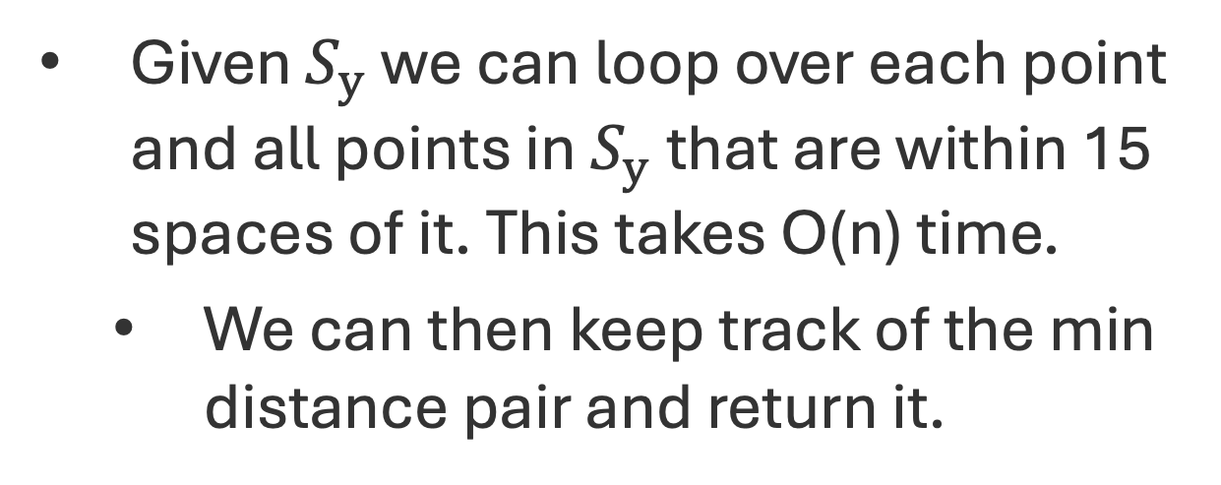
Find-Closest O(n)
Given $S_{y}$ we can loop over each point and all points in $S_{y}$ that are within 15 spaces of it. This takes O(n) time.
We can then keep track of the min distance pair and return it.

Slide 29
Closest-Pair(P):
Input: n 2D points $P=\{p_{1},p_{2},…,p_{n}\}$, $p_{i}=\left(x_{i},y_{i}\right)$
Sorted to get $P_{x}$ and $P_{y}$
If $n ≤4$, the do brute force.
Let $Q$ be first half of $P_{x}$ and let $R$ be rest
Compute $Q_{x}$, $Q_{y}$, $R_{x}$, and $R_{y}$ using $P_{x}$ and $P_{y}$
$\left(q_{x},q_{y}\right)$ = Closest-Pair($Q_{x}$, $Q_{y}$)
$\left(r_{x},r_{y}\right)$ = Closest-Pair($R_{x}$, $R_{y}$)
$δ=min(\left(q_{x},q_{y}\right),\left(r_{x},r_{y}\right))$
Let S be points ($x_{i}$, $y_{i}$) in $P$ s.t. $\left|x_{i}–x^{∗}\right|≤δ$
$\left(r_{x},r_{y}\right)$ = Find-Closest($S_{y}$)
Return min($\left(q_{x},q_{y}\right),$ $\left(r_{x},r_{y}\right),$ $\left(r_{x},r_{y}\right))$

Slide 30
Closest Pair 2D Algorithm Runtime
Make sure to sort all points by x and y—coordinates in a pre-processing step.
Then when we break or split the set of points, we can easily construct the subsets in sorted order in O(n) time.
The overall runtime of the algorithm will account for the initial sorting O(nlog(n)).
Then it runs a divide and conquer algorithm with a recurrence that matches mergesort.
Hence, the runtime is O(nlog(n)).
s’
1
2
3
4
5
6
7
8
9
10
11
12
13
14
15
s

Slide 31
Closest Pair 2D Algorithm Correctness
To show correctness we induct on the size of P:
If |P| < 4 than three then we know our algorithm is correct since it is just checking all possible pairs.
Suppose the algorithm is correct for all |P| < n.
For |P| = n, we divide the plane into two disjoint regions Q and R of size < n.
Using our IH we find the closets pair in Q and R.
s’
1
2
3
4
5
6
7
8
9
10
11
12
13
14
15
s

Slide 32
Closest Pair 2D Algorithm Correctness
We check the middle slice S for pairs that are closer than the closest pair in Q and R.
By the KPL we know that our closer pair algorithm finds a closer pair if one exists.
We return the min pair of the closets pair in Q, R, and the S.
If the closest pair was in Q or R then this works because it considers their closest pair.
Otherwise, it must be that the closest pair is in S and we also consider it.
s’
1
2
3
4
5
6
7
8
9
10
11
12
13
14
15
s

