Slide 1

CSE 331:
Algorithms & Complexity
“Dynamic Programming”
Prof. Charlie Anne Carlson (She/Her)
Lecture 28
Monday Nov 7th, 2025

Slide 2
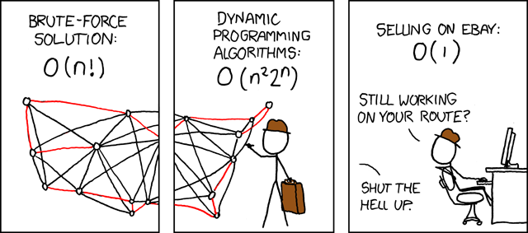
https://xkcd.com/399/

Slide 3

Schedule
Course Updates
Weighted Interval Scheduling
Memoization
Dynamic Programming

Slide 4

Course Updates
HW 6 Out
  Autolab Up
  Due November 11th
Group Project
  Code 3 Due November 24th
  Reflections 3 Due December 1st
Check Piazza for Google Form Review Link (before Friday)
Next Quiz is December 1st

Slide 5
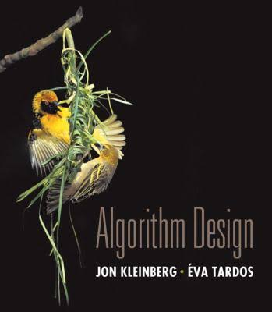
Reading
You should have read:
  Started 6.1
  Started 6.2
Before Next Class:
  Finish 6.1
  Finish 6.2

Slide 6

Weighted Interval Scheduling
Input: A list of n jobs L
  Each job $i$ has a start time $s_{i}$ and finish time $f_{i}$
  Two jobs are “compatible” if they don’t overlap
  Each job $i$ as a weight $v_{i}$
Goal: Find the max-weight subset of mutually compatible jobs.
Job 2 (5)
Job 4 (3)
Job 1 (1)
Job 3 (1)
Job 5 (1)
Time:
Start
End

Slide 7


Weighted Interval Scheduling
Input: A list of n jobs L
  Each job $i$ has a start time $s_{i}$ and finish time $f_{i}$
  Two jobs are “compatible” if they don’t overlap
  Each job $i$ as a weight $v_{i}$
Goal: Find the max-weight subset of mutually compatible jobs.
Job i ($v_{i}$)
Job 2 (1)
Job 4 (1)
Job 1 (1)
Job 3 (1)
Job 5 (1)
Time:
Start
End

Slide 8

Weighted Interval Scheduling
Input: A list of n jobs L
  Each job $i$ has a start time $s_{i}$ and finish time $f_{i}$
  Two jobs are “compatible” if they don’t overlap
  Each job $i$ as a weight $v$
Goal: Find the max-weight subset of mutually compatible jobs.
Job 2 (1)
Job 4 (1)
Job 1 (1)
Job 3 (1)
Job 5 (1)
Time:
Start
End

Slide 9
Unweighted Case
Question: What algorithm do we use to find the maximum weight subset when the weight of each job is 1?
Job 2 (1)
Job 4 (1)
Job 1 (1)
Job 3 (1)
Job 5 (1)
Time:
Start
End

Slide 10
Unweighted Case
Question: What algorithm do we use to find the maximum weight subset when the weight of each job is 1?
Answer: We use a greedy algorithm where we scan from left to right and always take the next job to finish.
Job 2 (1)
Job 4 (1)
Job 1 (1)
Job 3 (1)
Job 5 (1)
Time:
Start
End

Slide 11
Weighted Case
Question: Does this greedy algorithm work for other weights?
Job 2 (?)
Job 4 (?)
Job 1 (?)
Job 3 (?)
Job 5 (?)
Time:
Start
End

Slide 12
Weighted Case
Question: Does this greedy algorithm work for other weights?
Answer: No, there could be a situation where the number of jobs isn’t the thing to maximize.
Job 2 (5)
Job 4 (5)
Job 1 (1)
Job 3 (1)
Job 5 (1)
Time:
Start
End

Slide 13
Weighted Case
Question: Does this greedy algorithm work for other weights?
Answer: No, there could be a situation where the number of jobs isn’t the thing to maximize.
Job 2 (5)
Job 4 (5)
Job 1 (1)
Job 3 (1)
Job 5 (1)
Time:
Start
End

Slide 14
Divide & Conquer Approach
Question: How would divide and conquer work for this problem?
Job 2 (5)
Job 4 (5)
Job 1 (1)
Job 3 (1)
Job 5 (1)
Time:
Start
End

Slide 15
Divide & Conquer Approach
Question: How would divide and conquer work for this problem?
Answer: You might try to split the time in half or even put half of the jobs in both halves.
Job 2 (5)
Job 4 (5)
Job 1 (1)
Job 3 (1)
Job 5 (1)
Time:
Start
Cut
End

Slide 16
Divide & Conquer Approach
Question: How would divide and conquer work for this problem?
Answer: You might try to split the time in half or even put half of the jobs in both halves.
  However, some problems may not split as easily…
Job 4 (5)
Job 6 (1)
Job 2 (5)
Job 1 (1)
Job 3 (1)
Job 5 (1)
Time:
Start
Cut
End

Slide 17
Divide & Conquer Approach
Question: How would divide and conquer work for this problem?
Answer: You might try to split the time in half or even put half of the jobs in both halves.
  However, some problems may not split as easily…
Job 4 (5)
Job 6 (1)
Job 2 (5)
Job 1 (1)
Job 3 (1)
Job 5 (1)
Time:
Start
Cut
End

Slide 18
Divide & Conquer Approach
Question: Consider an arbitrary instance with optimal solution OPT. What do we know about job 1?
Job 6 (?)
Job 2 (?)
Job 4 (?)
Job 1 (?)
Job 3 (?)
Job 5 (?)
Time:
Start
End
End

Slide 19
Binary Choice
Question: Consider an arbitrary instance with optimal solution OPT. What do we know about job 1?
Answer: It is either in OPT or it is not.
Job 6 (?)
Job 2 (?)
Job 4 (?)
Job 1 (?)
Job 3 (?)
Job 5 (?)
Time:
Start
End
End

Slide 20
Binary Choice
In a greedy algorithm we are assuming about if job 1 is in the optimal solution.
  Our greedy rule doesn’t work anymore if we don’t know the weight.
Question: Why not try both options?
Job 6 (?)
Job 2 (?)
Job 4 (?)
Job 1 (?)
Job 3 (?)
Job 5 (?)
Time:
Start
End
End

Slide 21
Binary Choice
Suppose I gave you the hint that Job 1 was in OPT.
Question: What do you need to do to find the rest of OPT?
Job 6 (?)
Job 2 (?)
Job 4 (?)
Job 1 (?)
Job 3 (?)
Job 5 (?)
Time:
Start
End
End

Slide 22
Binary Choice
Suppose I gave you the hint that Job 1 was in OPT.
Question: What do you need to do to find the rest of OPT?
Answer: Recurse on a job without Job 1 or Job 2 (since they don’t agree).
Job 4 (?)
Job 6 (?)
Job 3 (?)
Job 5 (?)
Time:
Start
End
End

Slide 23
Binary Choice
Suppose I gave you the hint that Job 1 was in OPT.
Question: What do you need to do to find the rest of OPT?
Job 6 (?)
Job 2 (?)
Job 4 (?)
Job 1 (?)
Job 3 (?)
Job 5 (?)
Time:
Start
End
End

Slide 24
Binary Choice
Suppose I gave you the hint that Job 1 was not in OPT.
Question: What do you need to do to find the rest of OPT?
Answer: Recurse on a job without Job 1.
Job 6 (?)
Job 2 (?)
Job 4 (?)
Job 5 (?)
Job 3 (?)
Job 5 (?)
Job 3 (?)
Time:
Start
End
End

Slide 25
Binary Choice
Observation: In both cases, we found a smaller instance of the problem to consider!
Job 6 (?)
Job 2 (?)
Job 4 (?)
Job 5 (?)
Job 3 (?)
Job 5 (?)
Job 1 (?)
Job 3 (?)
Time:
Start
End
End

Slide 26
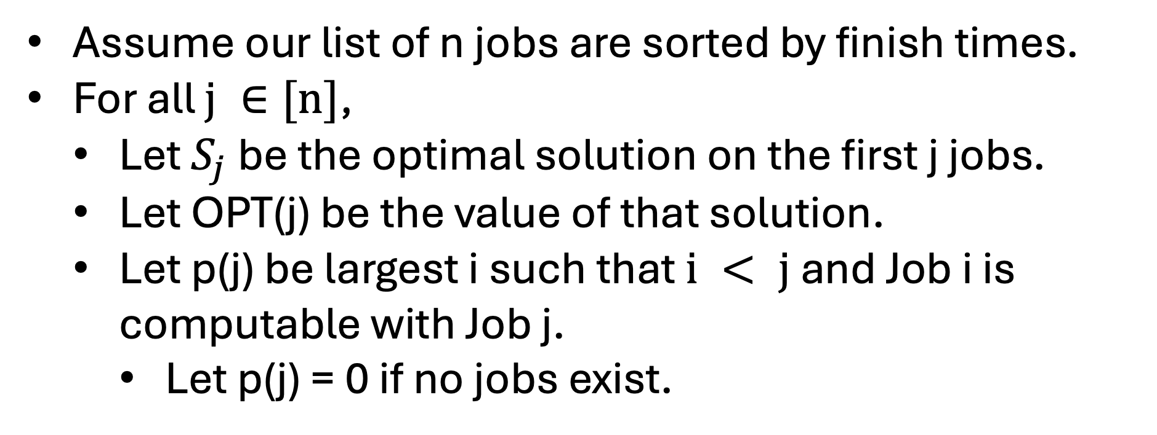
Binary Choice
Assume our list of n jobs are sorted by finish times.
For all $j ∈[n]$,
  Let $S_{j}$ be the optimal solution on the first j jobs.
  Let OPT(j) be the value of that solution.
  Let p(j) be largest i such that $i < j$ and Job i is computable with Job j.
    Let p(j) = 0 if no jobs exist.
Time:
Start
End
End

Slide 27
Binary Choice
p(1) = 0
p(2) = 0
p(3) = 2
p(4) = 2
p(5) = 3
p(6) = 1
Job 6 (?)
Job 2 (?)
Job 4 (?)
Job 5 (?)
Job 3 (?)
Job 5 (?)
Job 1 (?)
Job 3 (?)
Time:
Start
End
End

Slide 28
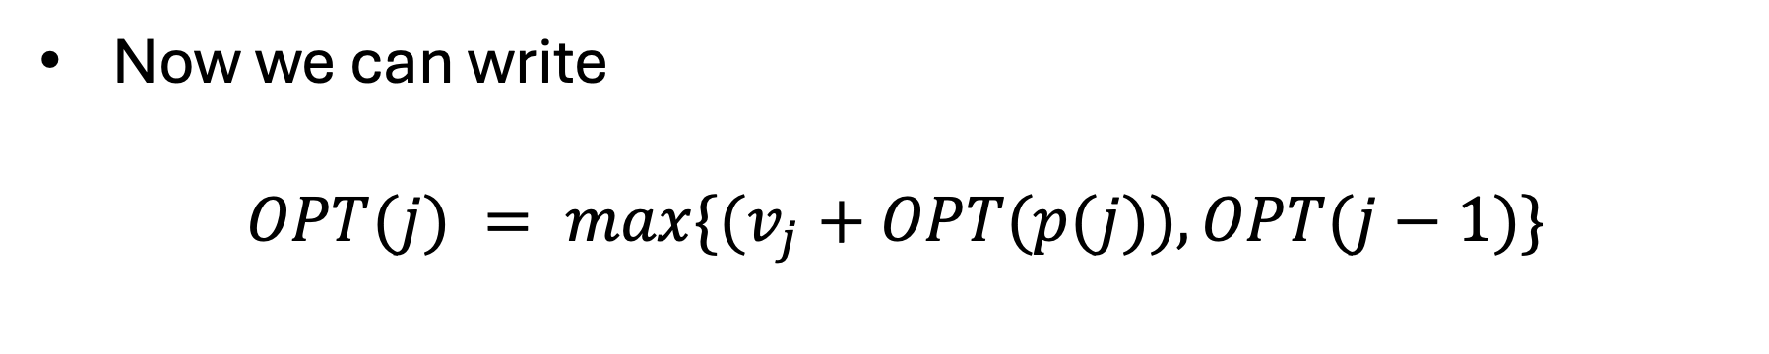
Binary Choice
Now we can write
$$OPT(j) = max\{(v_{j}+OPT(p(j)), OPT(j−1)\}$$
Time:
Start
End
End

Slide 29
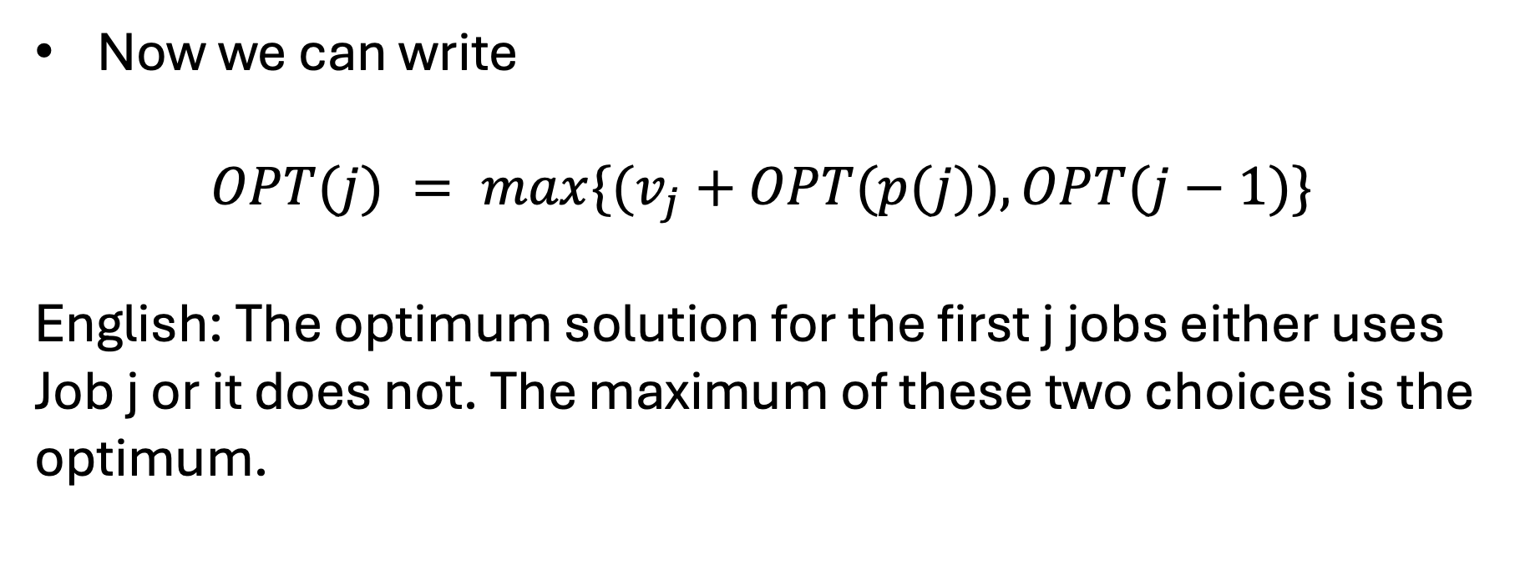
Binary Choice
Now we can write
$$OPT(j) = max\{(v_{j}+OPT(p(j)), OPT(j−1)\}$$
English: The optimum solution for the first j jobs either uses Job j or it does not. The maximum of these two choices is the optimum.
Time:
Start
End
End

Slide 30
Binary Choice
Now we can write
$$OPT(j) = max\{(v_{j}+OPT(p(j)), OPT(j−1)\}$$
English: The optimum solution for the first j jobs either uses Job j or it does not. The maximum of these two choices is the optimum.
We take Job J.
We consider the next job.
Time:
Start
End
End

Slide 31
Binary Choice Algorithm
Brute-Force(L):
Sort L by job finish times.
Compute p[i] for each i using binary search.
Return Compute-Opt(n)
Compute-Opt(j):
If (j == 0):
Return 0
else:
Return Max(Compute-Opt(j-1), v[j] + Compute-Opt(p[j])}
Time:
Start
End
End

Slide 32
Question: What is the runtime?
Brute-Force(L):
Sort L by job finish times.
Compute p[i] for each i using binary search.
Return Compute-Opt(n)
Compute-Opt(j):
If (j == 0):
Return 0
else:
Return Max(Compute-Opt(j-1), v[j] + Compute-Opt(p[j])}
Time:
Start
End
End

Slide 33
Question: What is the runtime?
Brute-Force(L):
Sort L by job finish times.
Compute p[i] for each i using binary search.
Return Compute-Opt(n)
Compute-Opt(j):
If (j == 0):
Return 0
else:
Return Max(Compute-Opt(j-1), v[j] + Compute-Opt(p[j])}
O(nlog(n))
Time:
Start
End
End

Slide 34
Answer: Could be exponential
Brute-Force(L):
Sort L by job finish times.
Compute p[i] for each i using binary search.
Return Compute-Opt(n)
Compute-Opt(j):
If (j == 0):
Return 0
else:
Return Max(Compute-Opt(j-1), v[j] + Compute-Opt(p[j])}
Time:
Start
End
End

Slide 35
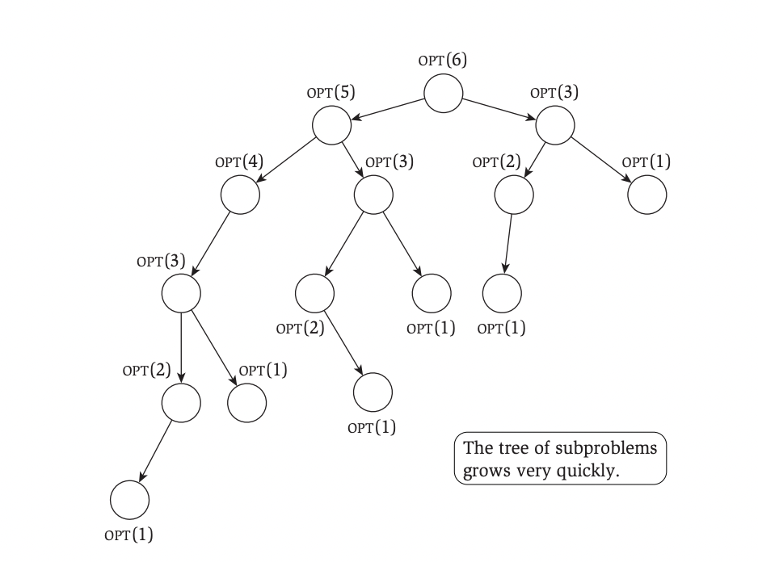
Recursion Tree
For each OPT(i) we draw an arrow to the subproblems we need to solve to solve it.
It is possible that the tree has linear depth, and each internal node has two children.
Notice that some problems appear more than once!

Slide 36
Memoization
Notice that some problems appear more than once!
What if our algorithm never computed the answer to the same subproblem more than once?
Let’s keep track of our answers using an array.

Slide 37
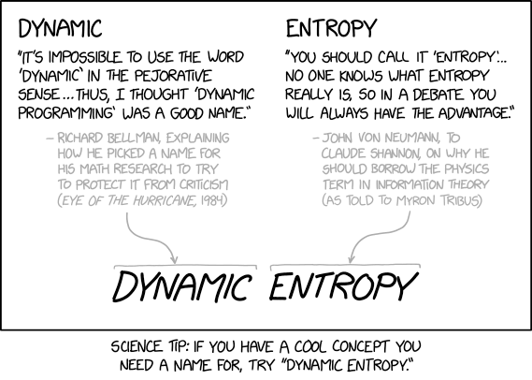
https://xkcd.com/2318/

Slide 38
Remember Remember
Brute-Force(L):
Sort L by job finish times.
Compute p[i] for each i using binary search.
Global M = [], M[0] = 0
Return Compute-Opt(n)
M-Compute-Opt(j):
If j not in M:
M[j] = Max(M-Compute-Opt(j-1), v[j] + M-Compute-Opt(p[j])}
Return M[j]
Time:
Start
End
End

Slide 39
Memoization Runtime
Brute-Force(L):
Sort L by job finish times.
Compute p[i] for each i using binary search.
Global M = [], M[0] = 0
Return Compute-Opt(n)
M-Compute-Opt(j):
If j not in M:
M[j] = Max(M-Compute-Opt(j-1), v[j] + M-Compute-Opt(p[j])}
Return M[j]
Time:
Start
End
End

Slide 40
Memoization Runtime
We will show that the runtime is O(nlog(n)).
  The preprocessing takes O(nlog(n)) time.
  The M-Compute-Opt(n) call takes O(n) time.
Time:
Start
End
End

Slide 41
Memoization Runtime
The M-Compute-Opt(n) call takes O(n) time.
  To bound the runtime, we will introduce a ”progress measure”. Namely, we will track how many entries in M are uninitialized.
  Each time we initialize an entry of M, we make two recursive calls which takes constant time.
  Since M will only have at most O(n) entries, it follows that the runtime is at most O(n) as desired.
Time:
Start
End
End

Slide 42
Top-Down Dynamic Programming
Brute-Force(L):
Sort L by job finish times.
Compute p[i] for each i using binary search.
Global M = [], M[0] = 0
Return Compute-Opt(n)
M-Compute-Opt(j):
If j not in M:
M[j] = Max(M-Compute-Opt(j-1), v[j] + M-Compute-Opt(p[j])}
Return M[j]
Time:
Start
End
End

Slide 43
Top-Down Dynamic Programming

Slide 44
Next Time
Recover Optimal Solutions
Bottom-Up Dynamic Programming
Process of coming up with Dynamic Programming algorithm.

