Slide 1

CSE 331: Algorithms & Complexity
“Top-Down DP”
Prof. Charlie Anne Carlson (She/Her)
Lecture 29
Monday Nov 10th, 2025

Slide 2
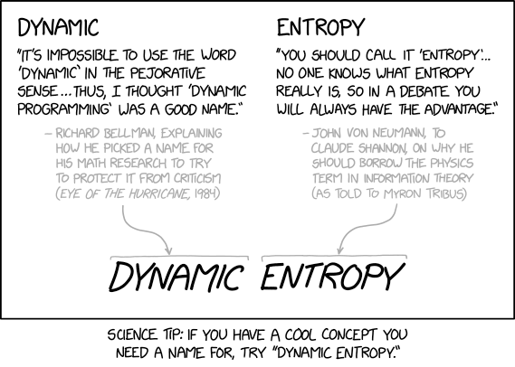
https://xkcd.com/2318/

Slide 3

Schedule
Course Updates
Weighted Interval Scheduling
Top-Down
Recovering Solution
Bottom-Up

Slide 4

Course Updates
HW 6 Due Tomorrow
HW 7 Out Tomorrow
Due November 18th
Group Project
Code 3 Due November 24th
Reflections 3 Due December 1st
Next Quiz is December 1st

Slide 5
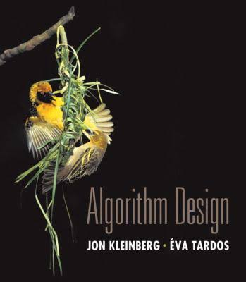
Reading
You should have read:
Finished 6.1
Finished 6.2
Before Next Class:
Start 6.4

Slide 6

Weighted Interval Scheduling
Input: A list of n jobs L
Each job $i$ has a start time $s_{i}$ and finish time $f_{i}$
Two jobs are “compatible” if they don’t overlap
Each job $i$ as a weight $v_{i}$
Goal: Find the max-weight subset of mutually compatible jobs.
Job 2 (5)
Job 4 (3)
Job 1 (1)
Job 3 (1)
Job 5 (1)
Time:
Start
End

Slide 7
Divide & Conquer Approach
Question: Consider an arbitrary instance with optimal solution OPT. What do we know about job 1?
Job 6 (?)
Job 2 (?)
Job 4 (?)
Job 1 (?)
Job 3 (?)
Job 5 (?)
Time:
Start
End
End

Slide 8
Binary Choice
Question: Consider an arbitrary instance with optimal solution OPT. What do we know about job 1?
Answer: It is either in OPT or it is not.
Job 6 (?)
Job 2 (?)
Job 4 (?)
Job 1 (?)
Job 3 (?)
Job 5 (?)
Time:
Start
End
End

Slide 9
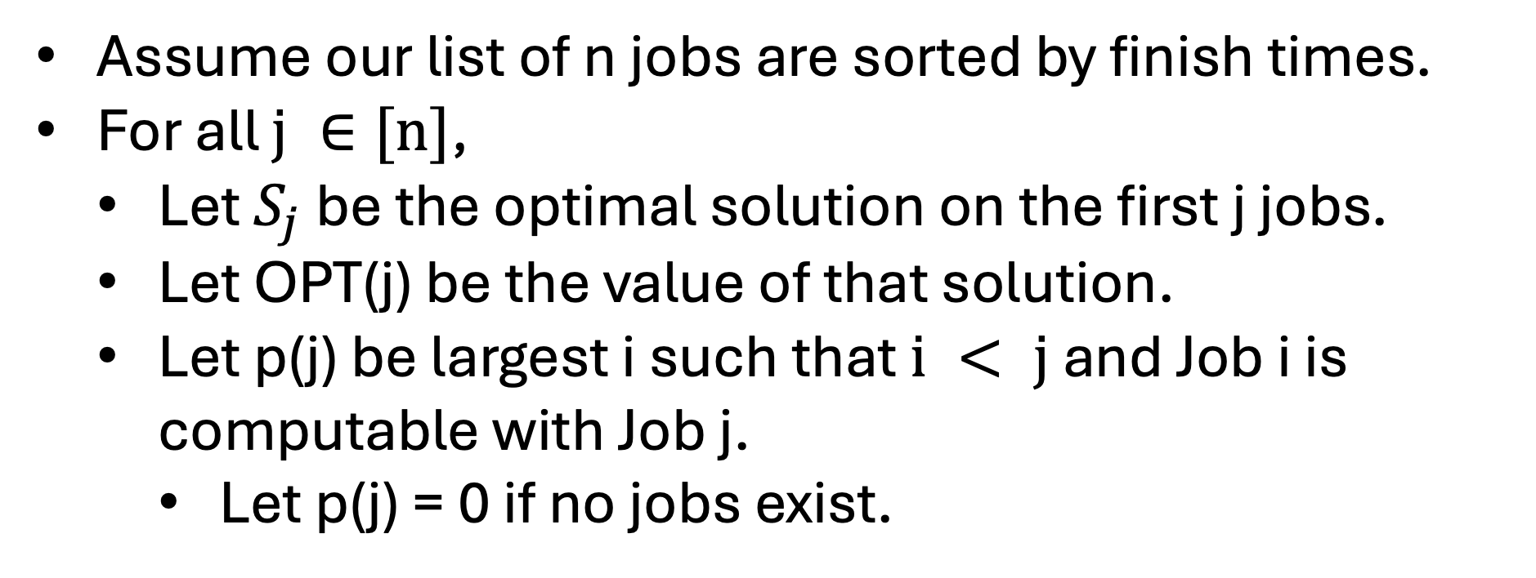
Binary Choice
Assume our list of n jobs are sorted by finish times.
For all $j ∈[n]$,
Let $S_{j}$ be the optimal solution on the first j jobs.
Let OPT(j) be the value of that solution.
Let p(j) be largest i such that $i < j$ and Job i is computable with Job j.
Let p(j) = 0 if no jobs exist.
Time:
Start
End
End

Slide 10
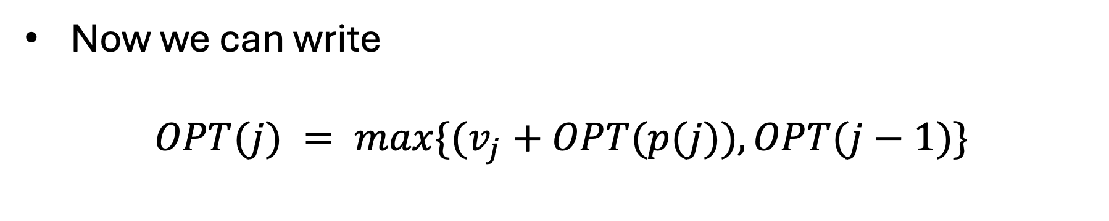
Binary Choice
Now we can write
$$OPT(j) = max\{(v_{j}+OPT(p(j)), OPT(j−1)\}$$
Time:
Start
End
End

Slide 11
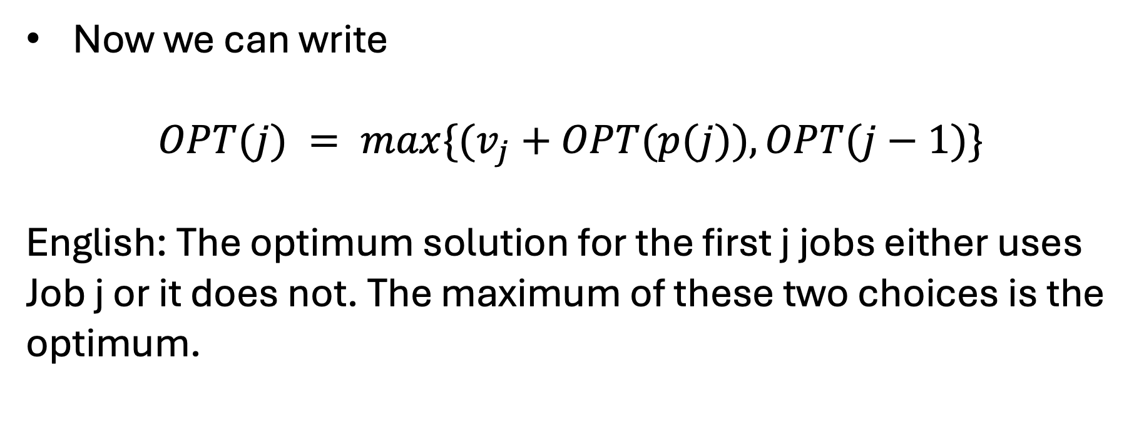
Binary Choice
Now we can write
$$OPT(j) = max\{(v_{j}+OPT(p(j)), OPT(j−1)\}$$
English: The optimum solution for the first j jobs either uses Job j or it does not. The maximum of these two choices is the optimum.
Time:
Start
End
End

Slide 12
Binary Choice
Now we can write
$$OPT(j) = max\{(v_{j}+OPT(p(j)), OPT(j−1)\}$$
English: The optimum solution for the first j jobs either uses Job j or it does not. The maximum of these two choices is the optimum.
We take Job J.
We consider the next job.
Time:
Start
End
End

Slide 13
Binary Choice Algorithm
Brute-Force(L):
Sort L by job finish times.
Compute p[i] for each i using binary search.
Return Compute-Opt(n)
Compute-Opt(j):
If (j == 0):
Return 0
else:
Return Max(Compute-Opt(j-1), v[j] + Compute-Opt(p[j])}
Time:
Start
End
End

Slide 14
Question: What is the runtime?
Brute-Force(L):
Sort L by job finish times.
Compute p[i] for each i using binary search.
Return Compute-Opt(n)
Compute-Opt(j):
If (j == 0):
Return 0
else:
Return Max(Compute-Opt(j-1), v[j] + Compute-Opt(p[j])}
Time:
Start
End
End

Slide 15
Question: What is the runtime?
Brute-Force(L):
Sort L by job finish times.
Compute p[i] for each i using binary search.
Return Compute-Opt(n)
Compute-Opt(j):
If (j == 0):
Return 0
else:
Return Max(Compute-Opt(j-1), v[j] + Compute-Opt(p[j])}
O(nlog(n))
Time:
Start
End
End

Slide 16
Answer: Could be exponential
Brute-Force(L):
Sort L by job finish times.
Compute p[i] for each i using binary search.
Return Compute-Opt(n)
Compute-Opt(j):
If (j == 0):
Return 0
else:
Return Max(Compute-Opt(j-1), v[j] + Compute-Opt(p[j])}
Time:
Start
End
End

Slide 17
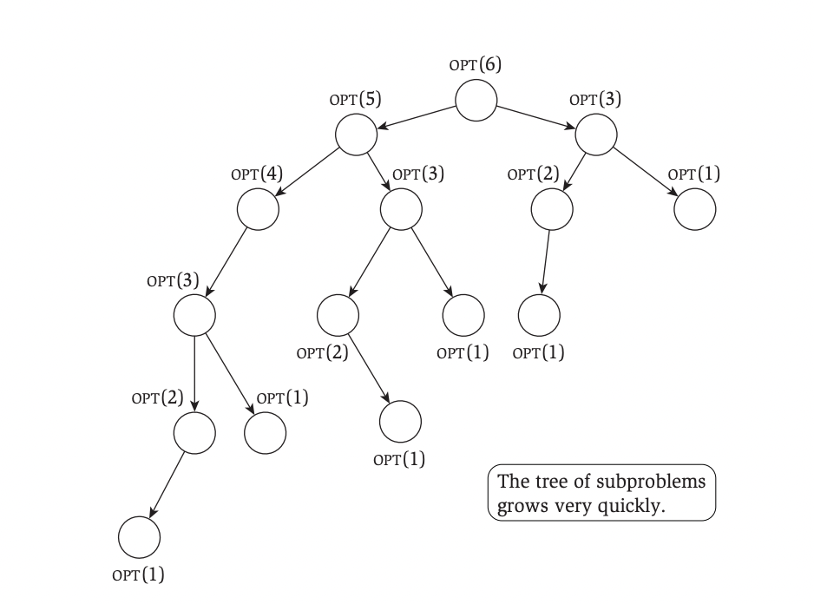
Recursion Tree
For each OPT(i) we draw an arrow to the subproblems we need to solve to solve it.
It is possible that the tree has linear depth, and each internal node has two children.
Notice that some problems appear more than once!

Slide 18
Memoization
Notice that some problems appear more than once!
What if our algorithm never computed the answer to the same subproblem more than once?
Let’s keep track of our answers using an array.

Slide 19
Memoization Runtime
Brute-Force(L):
Sort L by job finish times.
Compute p[i] for each i using binary search.
Global M = [], M[0] = 0
Return Compute-Opt(n)
M-Compute-Opt(j):
If j not in M:
M[j] = Max(M-Compute-Opt(j-1), v[j] + M-Compute-Opt(p[j])}
Return M[j]
Time:
Start
End
End

Slide 20
Memoization Runtime
We will show that the runtime is O(nlog(n)).
The preprocessing takes O(nlog(n)) time.
The M-Compute-Opt(n) call takes O(n) time.
Time:
Start
End
End

Slide 21
Memoization Runtime
The M-Compute-Opt(n) call takes O(n) time.
To bound the runtime, we will introduce a ”progress measure”. Namely, we will track how many entries in M are uninitialized.
Each time we initialize an entry of M, we make two recursive calls which takes constant time.
Since M will only have at most O(n) entries, it follows that the runtime is at most O(n) as desired.
Time:
Start
End
End

Slide 22
Top-Down Dynamic Programming
Brute-Force(L):
Sort L by job finish times.
Compute p[i] for each i using binary search.
Global M = [], M[0] = 0
Return Compute-Opt(n)
M-Compute-Opt(j):
If j not in M:
M[j] = Max(M-Compute-Opt(j-1), v[j] + M-Compute-Opt(p[j])}
Return M[j]
Time:
Start
End
End

Slide 23
Top-Down Dynamic Programming

Slide 24
Recovering Solution
Brute-Force(L):
Sort L by job finish times.
Compute p[i] for each i using binary search.
Global M = [], M[0] = 0
Return Compute-Opt(n)
M-Compute-Opt(j):
If j not in M:
M[j] = Max(M-Compute-Opt(j-1), v[j] + M-Compute-Opt(p[j])}
Return M[j]
Question: How do we recover the solution?

Slide 25
Recovering Solution
Brute-Force(L):
Sort L by job finish times.
Compute p[i] for each i using binary search.
Global M = [], M[0] = 0
Compute-Opt(n)
Return Find-Solution(n)
Find-Solution(j):
If j == 0:
return []
Else if v[j] + M-Compute-Opt(p[j])} > M-Compute-Opt(j-1):
return [j] ++ Find-Solution(p[j])
Else:
return Find-Solution(j-1)

Slide 26
Recovering Solution - O(n) Time
Brute-Force(L):
Sort L by job finish times.
Compute p[i] for each i using binary search.
Global M = [], M[0] = 0
Compute-Opt(n)
Return Find-Solution(n)
Find-Solution(j):
If j == 0:
return []
Else if v[j] + M-Compute-Opt(p[j])} > M-Compute-Opt(j-1):
return [j] ++ Find-Solution(p[j])
Else:
return Find-Solution(j-1)

Slide 27
Bottom-Up
Brute-Force(L):
Sort L by job finish times.
Compute p[i] for each i using binary search.
Global M = [], M[0] = 0
Return Compute-Opt(n)
M-Compute-Opt(j):
If j not in M:
M[j] = Max(M-Compute-Opt(j-1), v[j] + M-Compute-Opt(p[j])}
Return M[j]
Question: What can we say about M[1]?

Slide 28
Bottom-Up
Brute-Force(L):
Sort L by job finish times.
Compute p[i] for each i using binary search.
Global M = [], M[0] = 0
Return Compute-Opt(n)
M-Compute-Opt(j):
If j not in M:
M[j] = Max(M-Compute-Opt(j-1), v[j] + M-Compute-Opt(p[j])}
Return M[j]
Answer: To compute M[1], we only need M[0].

Slide 29
Bottom-Up
Brute-Force(L):
Sort L by job finish times.
Compute p[i] for each i using binary search.
Global M = [], M[0] = 0
Return Compute-Opt(n)
M-Compute-Opt(j):
If j not in M:
M[j] = Max(M-Compute-Opt(j-1), v[j] + M-Compute-Opt(p[j])}
Return M[j]
Question: What can we say about M[j]?

Slide 30
Bottom-Up
Brute-Force(L):
Sort L by job finish times.
Compute p[i] for each i using binary search.
Global M = [], M[0] = 0
Return Compute-Opt(n)
M-Compute-Opt(j):
If j not in M:
M[j] = Max(M-Compute-Opt(j-1), v[j] + M-Compute-Opt(p[j])}
Return M[j]
Answer: To compute M[j], we only need M[i] for i < j.

Slide 31
Bottom-Up
0 1 2 3 4 5
M =
0
M-Compute-Opt(j):
If j not in M:
M[j] = Max(M-Compute-Opt(j-1), v[j] + M-Compute-Opt(p[j])}
Return M[j]
Job 2 (5)
Job 4 (3)
Job 1 (1)
Job 3 (1)
Job 5 (1)
Start
End

Slide 32
Bottom-Up
0 1 2 3 4 5
M =
0
M-Compute-Opt(j):
If j not in M:
M[j] = Max(M-Compute-Opt(j-1), v[j] + M-Compute-Opt(p[j])}
Return M[j]
Job 2 (5)
Job 4 (3)
Job 1 (1)
Job 3 (1)
Job 5 (1)
Start
End

Slide 33
Bottom-Up
0 1 2 3 4 5
M =
0
1
M-Compute-Opt(j):
If j not in M:
M[j] = Max(M-Compute-Opt(j-1), v[j] + M-Compute-Opt(p[j])}
Return M[j]
Job 2 (5)
Job 4 (3)
Job 1 (1)
Job 3 (1)
Job 5 (1)
Start
End

Slide 34
Bottom-Up
0 1 2 3 4 5
M =
0
1
M-Compute-Opt(j):
If j not in M:
M[j] = Max(M-Compute-Opt(j-1), v[j] + M-Compute-Opt(p[j])}
Return M[j]
Job 2 (5)
Job 4 (3)
Job 1 (1)
Job 3 (1)
Job 5 (1)
Start
End

Slide 35
Bottom-Up
0 1 2 3 4 5
M =
0
1
5
M-Compute-Opt(j):
If j not in M:
M[j] = Max(M-Compute-Opt(j-1), v[j] + M-Compute-Opt(p[j])}
Return M[j]
Job 2 (5)
Job 4 (3)
Job 1 (1)
Job 3 (1)
Job 5 (1)
Start
End

Slide 36
Bottom-Up
0 1 2 3 4 5
M =
0
1
5
M-Compute-Opt(j):
If j not in M:
M[j] = Max(M-Compute-Opt(j-1), v[j] + M-Compute-Opt(p[j])}
Return M[j]
Job 2 (5)
Job 4 (3)
Job 1 (1)
Job 3 (1)
Job 5 (1)
Start
End

Slide 37
Bottom-Up
0 1 2 3 4 5
M =
0
1
5
6
M-Compute-Opt(j):
If j not in M:
M[j] = Max(M-Compute-Opt(j-1), v[j] + M-Compute-Opt(p[j])}
Return M[j]
Job 2 (5)
Job 4 (3)
Job 1 (1)
Job 3 (1)
Job 5 (1)
Start
End

Slide 38
Bottom-Up
0 1 2 3 4 5
M =
0
1
5
6
M-Compute-Opt(j):
If j not in M:
M[j] = Max(M-Compute-Opt(j-1), v[j] + M-Compute-Opt(p[j])}
Return M[j]
Job 2 (5)
Job 4 (3)
Job 1 (1)
Job 3 (1)
Job 5 (1)
Start
End

Slide 39
Bottom-Up
0 1 2 3 4 5
M =
0
1
5
6
8
M-Compute-Opt(j):
If j not in M:
M[j] = Max(M-Compute-Opt(j-1), v[j] + M-Compute-Opt(p[j])}
Return M[j]
Job 2 (5)
Job 4 (3)
Job 1 (1)
Job 3 (1)
Job 5 (1)
Start
End

Slide 40
Bottom-Up
0 1 2 3 4 5
M =
0
1
5
6
8
8
M-Compute-Opt(j):
If j not in M:
M[j] = Max(M-Compute-Opt(j-1), v[j] + M-Compute-Opt(p[j])}
Return M[j]
Job 2 (5)
Job 4 (3)
Job 1 (1)
Job 3 (1)
Job 5 (1)
Start
End

Slide 41
Bottom-Up
M-Compute-Opt(j):
If j not in M:
M[j] = Max(M-Compute-Opt(j-1), v[j] + M-Compute-Opt(p[j])}
Return M[j]
Instead of letting recursion decide the order, you compute them from the ”bottom” cases and work your way up:
M-Compute-Opt-Bottom-Up(j):
For i in [j]:
M[i] = Max(M-Compute-Opt(i-1), v[i] + M-Compute-Opt(p[i])}
Return M[j]

