Slide 1

CSE 331: Algorithms & Complexity
“Matchings”
Prof. Charlie Anne Carlson (She/Her)
Lecture 3
Monday September 3rd, 2025

Slide 2

Schedule
Course Updates
Group Project
Pet Assignments
Matchings
Gale-Shapely

Slide 3

Course Updates
Office Hours Posted
Complete Syllabus Quiz
HW 0 Solutions Up
HW 1 Posted Before Next Tuesday

Slide 4
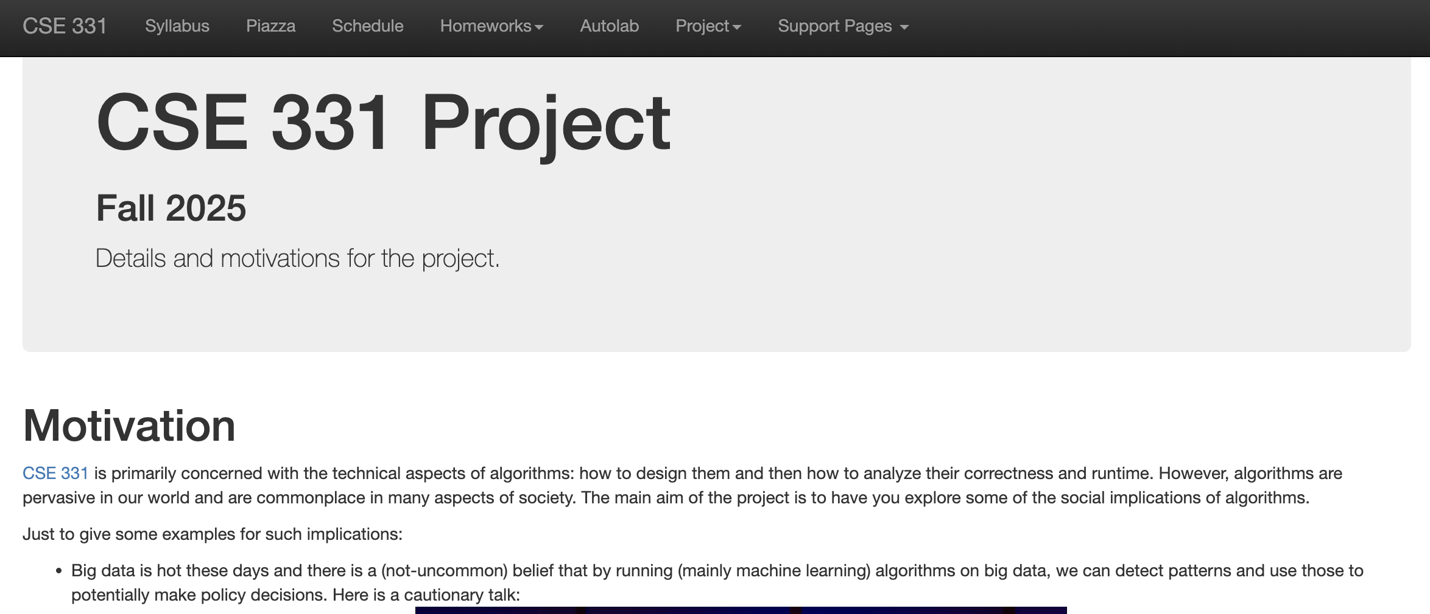
Group Project

Slide 5
Group Project: 3 Parts
Do five programming problems that involve making tradeoffs between various choices, some of which have ethical dimensions.
Each programming question will be paired with (a series of) reflection questions.
At the end of the project, each group member will fill in a survey rating their own and the other group members' contribution to the project.

Slide 6
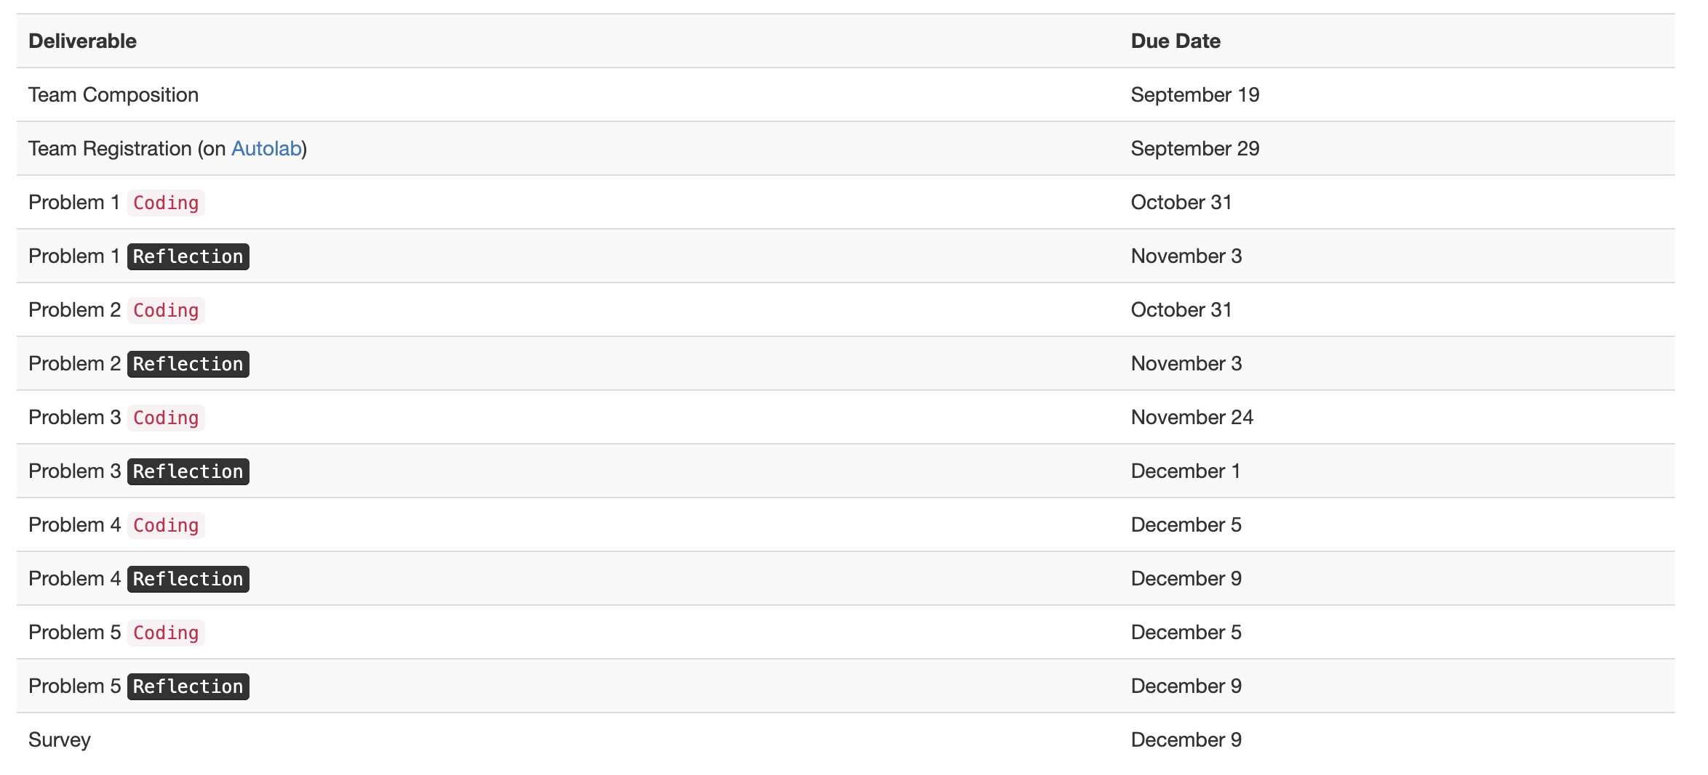
Group Project: Timeline

Slide 7
Group Project: Teams
Teams will consist of 3 people.
You can form and register your own team, or you can request to be formed into a team.
Teams will not change.
There is a google form under the project tab on the website to register team or request being added randomly to a team.
Register yourself or your team by September 19th at midnight or get a zero!

Slide 8
Group Project: Teams
Teams will consist of 3 people.
You can form and register your own team, or you can request to be formed into a team.
Teams will not change.
There is a google form under the project tab on the website to register team or request being added randomly to a team.
Register yourself or your team by September 19th at midnight or get a zero!

Slide 9
Graphs
NODE
EDGE

Slide 10
Devs + Testers = Success
Families
Pets

Slide 11
Matching
Families
Pets
Definition: A matching is a collection of edges such that no two share a node.

Slide 12
Perfect Matching
Families
Pets
Definition: A perfect matching is a matching such that every node is incident to an edge.

Slide 13




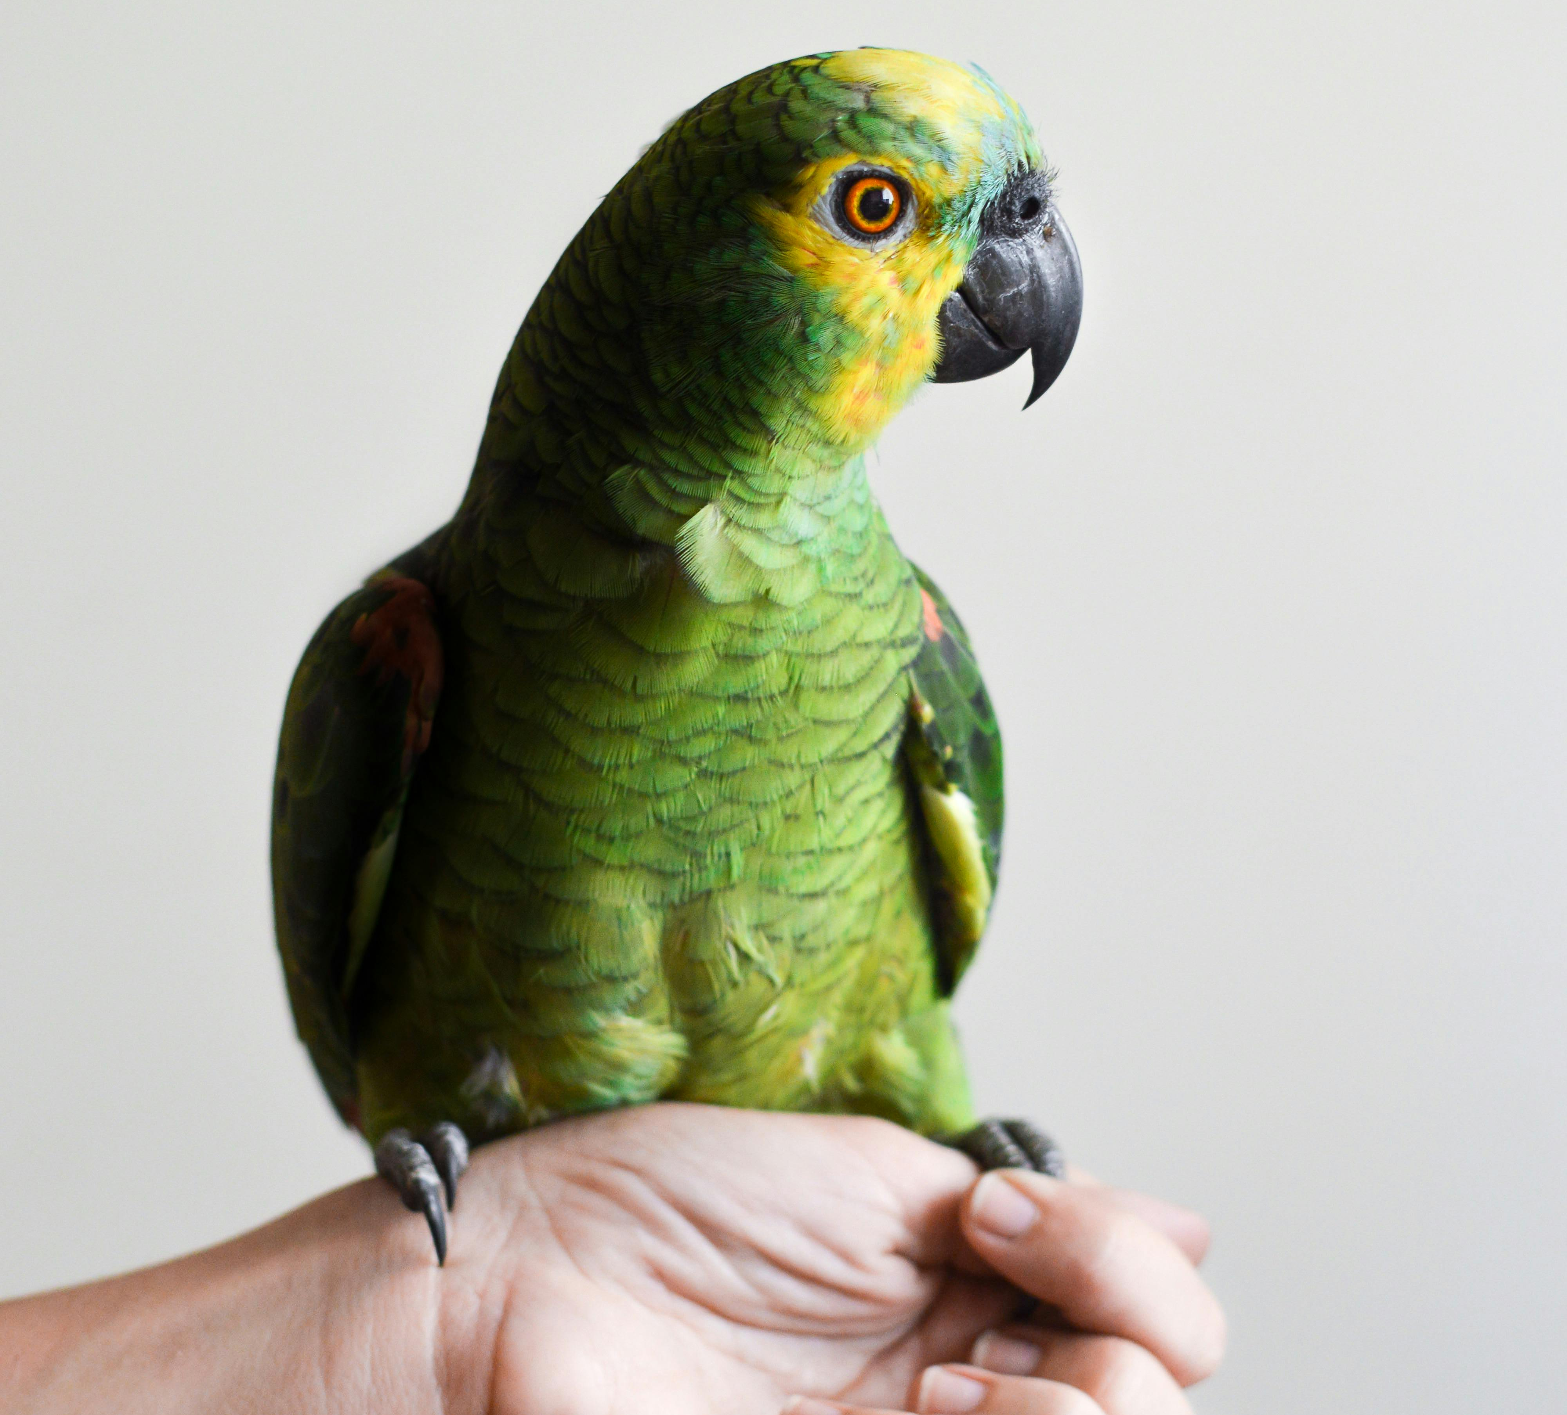

Pet Assignments
Peter
Family A
Kat
Family B
Avery
Family C

Slide 14
Pet Assignments
Peter
Family A
Kat
Family B
Avery
Family C

Slide 15
Pet Assignments
Peter
Family A
Kat
Family B
Avery
Family C

Slide 16
Pet Assignments
Peter
Family A
Kat
Family B
Avery
Family C

Slide 17

Pet Assignments
Peter
Family A
Kat
Family B
Avery
Family C

Slide 18
Pet Assignments
Peter
Family A
Kat
Family B
Avery
Family C

Slide 19
Pet Assignments
Peter
Family A
Kat
Family B
Avery
Family C

Slide 20
Pet Assignments
Peter
Family A
Kat
Family B
Avery
Family C

Slide 21
Pet Assignments
Peter
Family A
Kat
Family B
Avery
Family C

Slide 22
Pet Assignments
Peter
Family A
Kat
Family B
Avery
Family C

Slide 23
Pet Assignments
Peter
Family A
Kat
Family B
Avery
Family C

Slide 24
Pet Assignments (Stable State?)
Peter
Family A
Kat
Family B
Avery
Family C

Slide 25

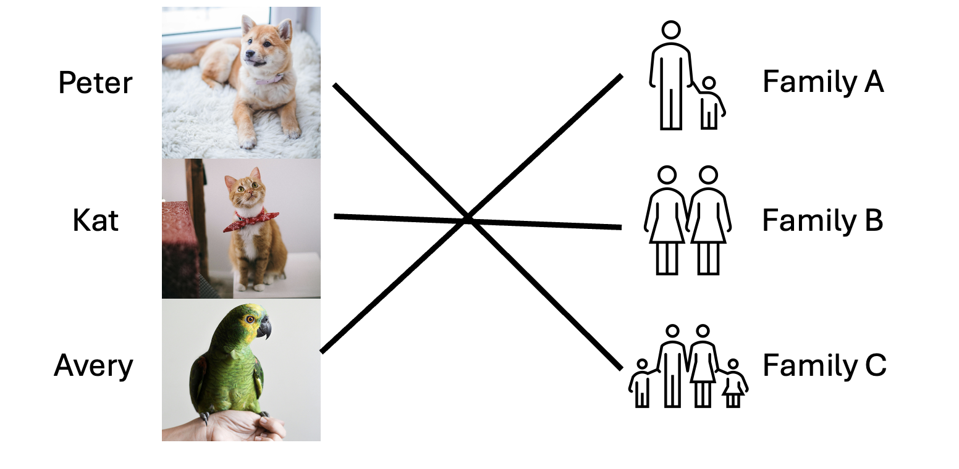

Pet Assignments Problem
Pets
Algorithm
“Stable Assignment”
Families

Slide 26



“Stable Marriage Problem”
Humans A
Algorithm
“Stable Pairing”
Humans B

Slide 27



Hospital Resident Assignments Problem
“Stable Hospitals”
Residents
Algorithm
Hospital

Slide 28


What is stability?
“You know I’ll never leave you. Not as long as she’s with someone else.”
https://xkcd.com/770/

Slide 29
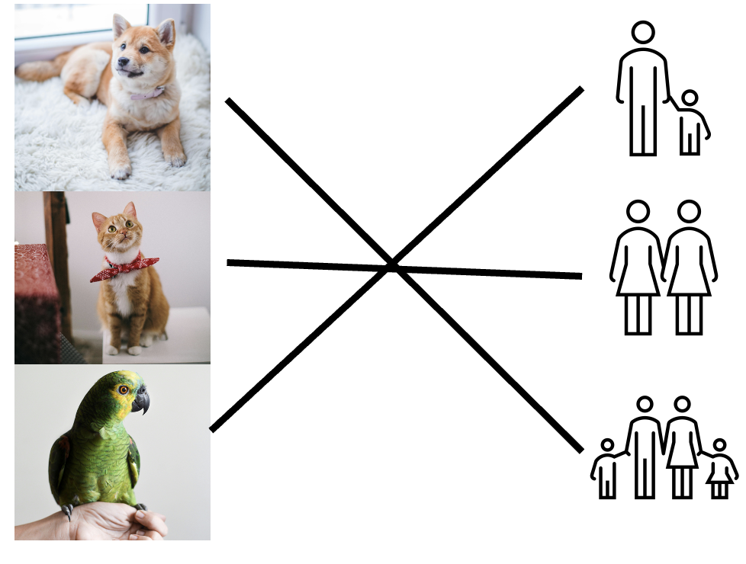
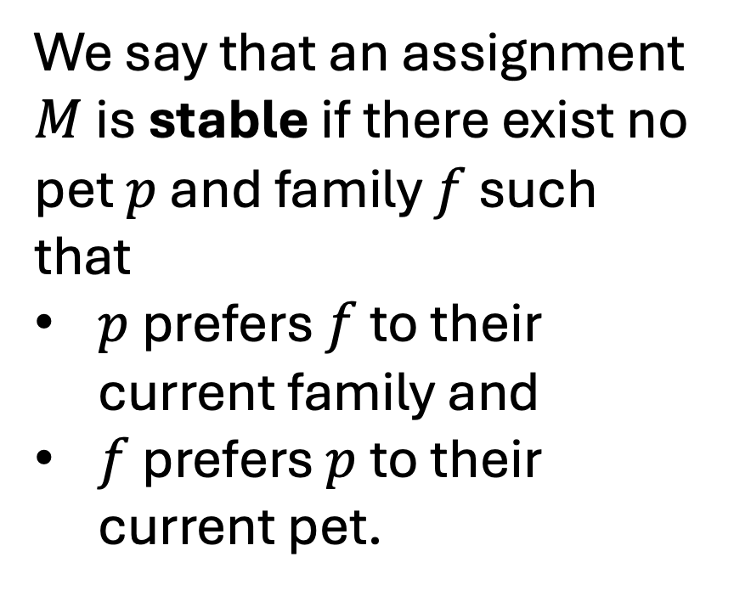
Pet Assignments (Stable State?)
We say that an assignment $M$ is stable if there exist no pet $p$ and family $f$ such that
$p$ prefers $f$ to their current family and
$f$ prefers $p$ to their current pet.

Slide 30

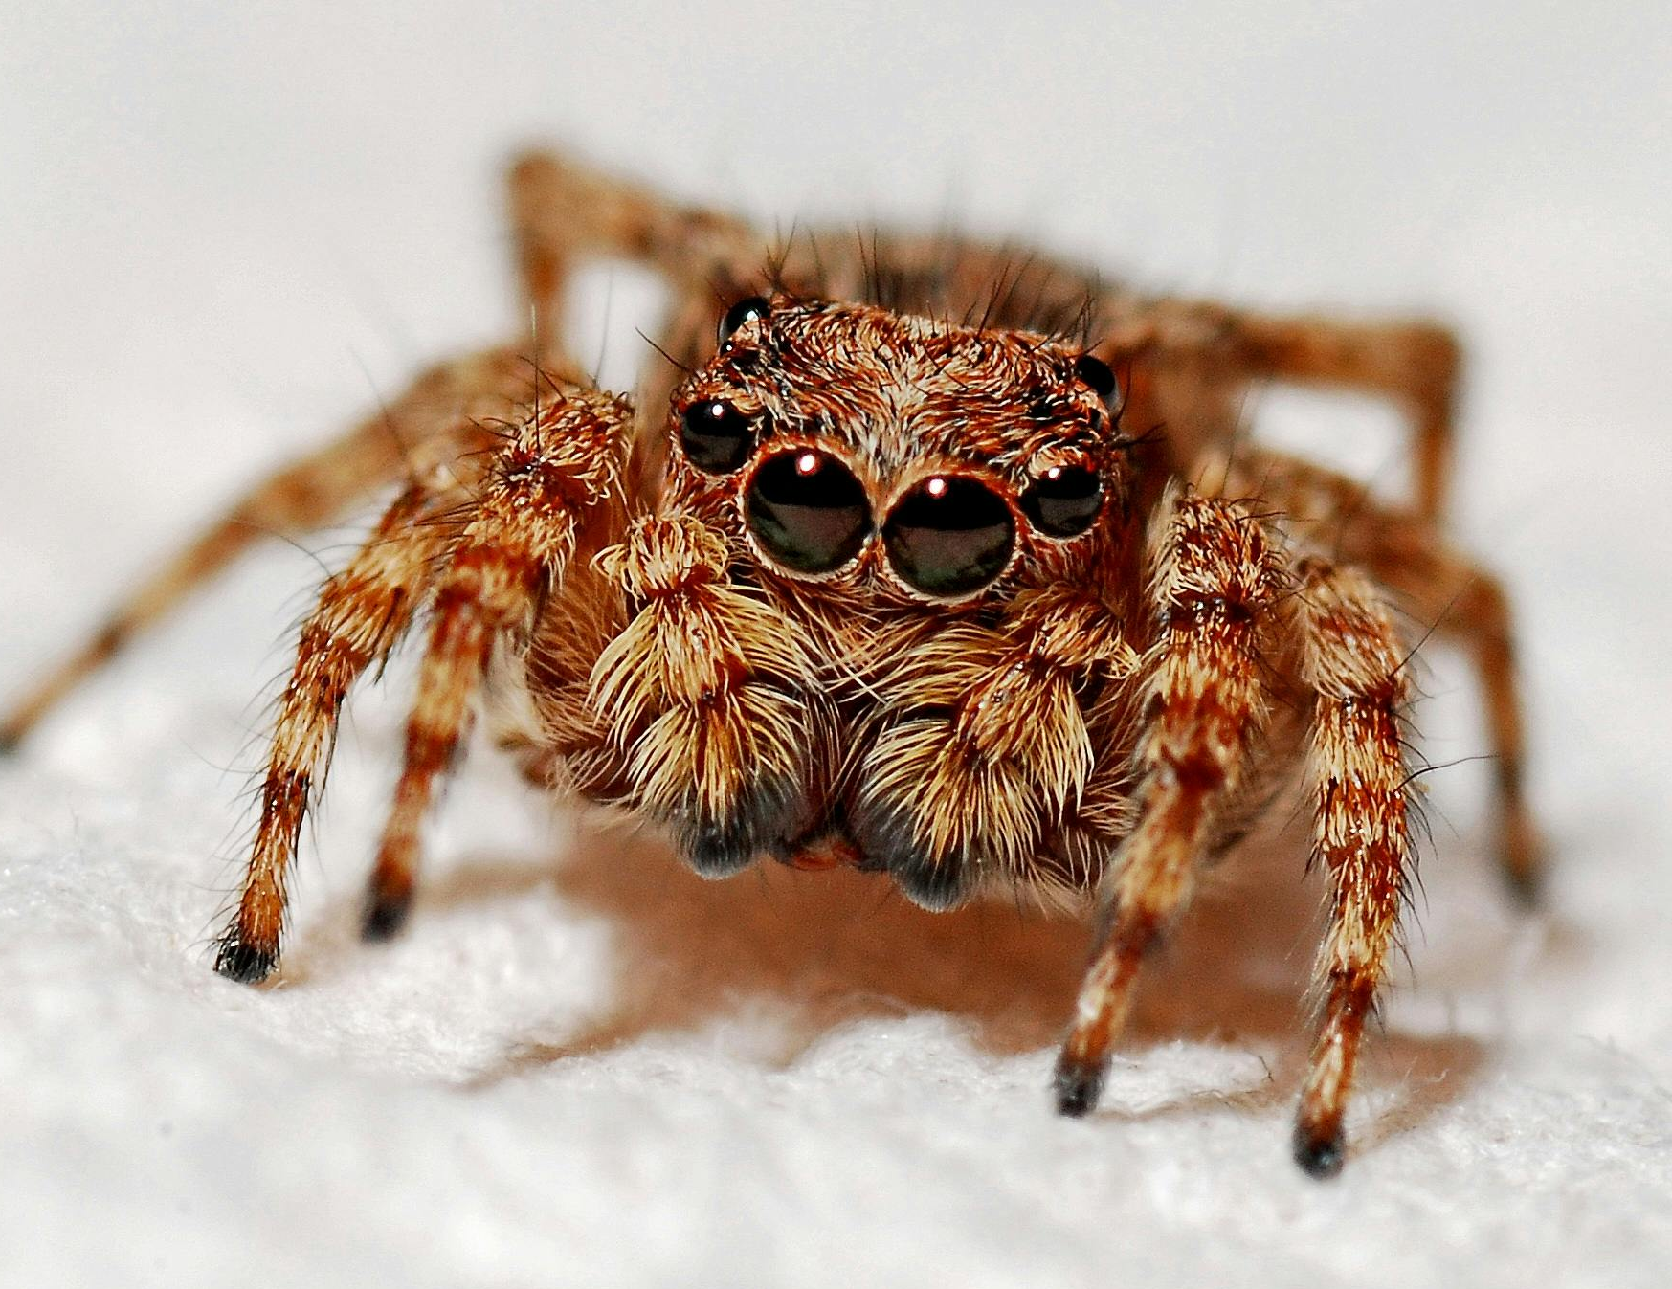

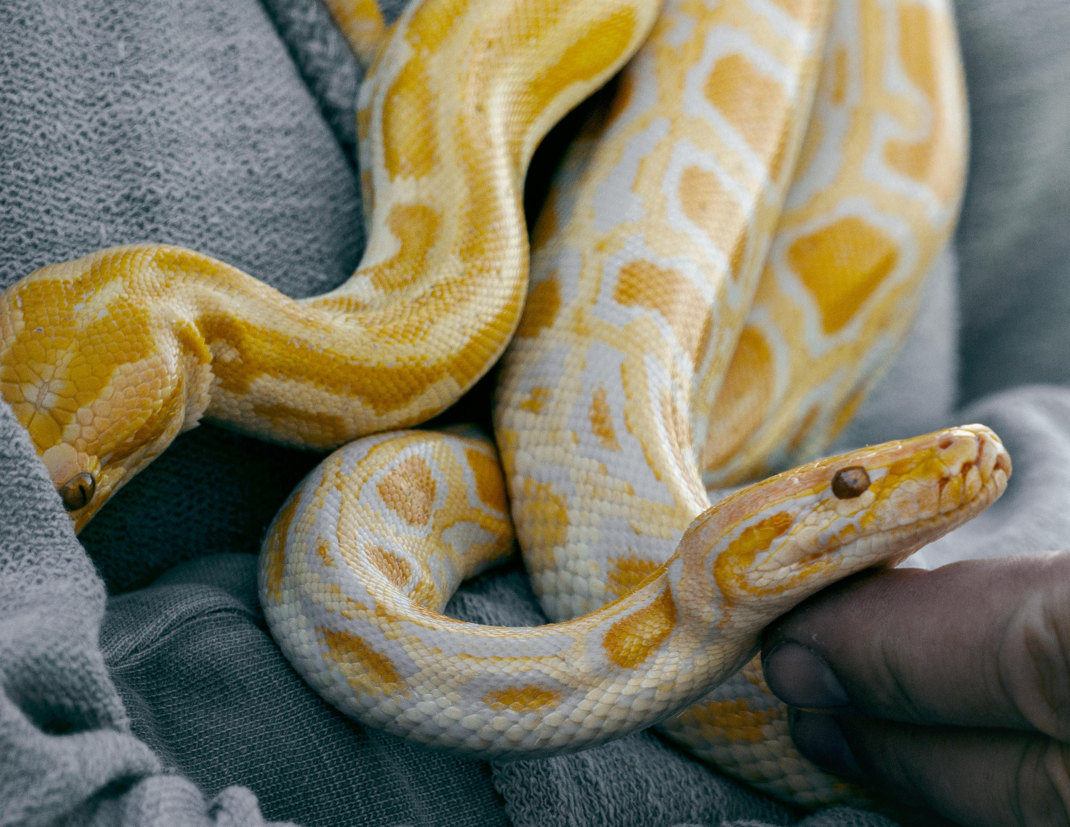

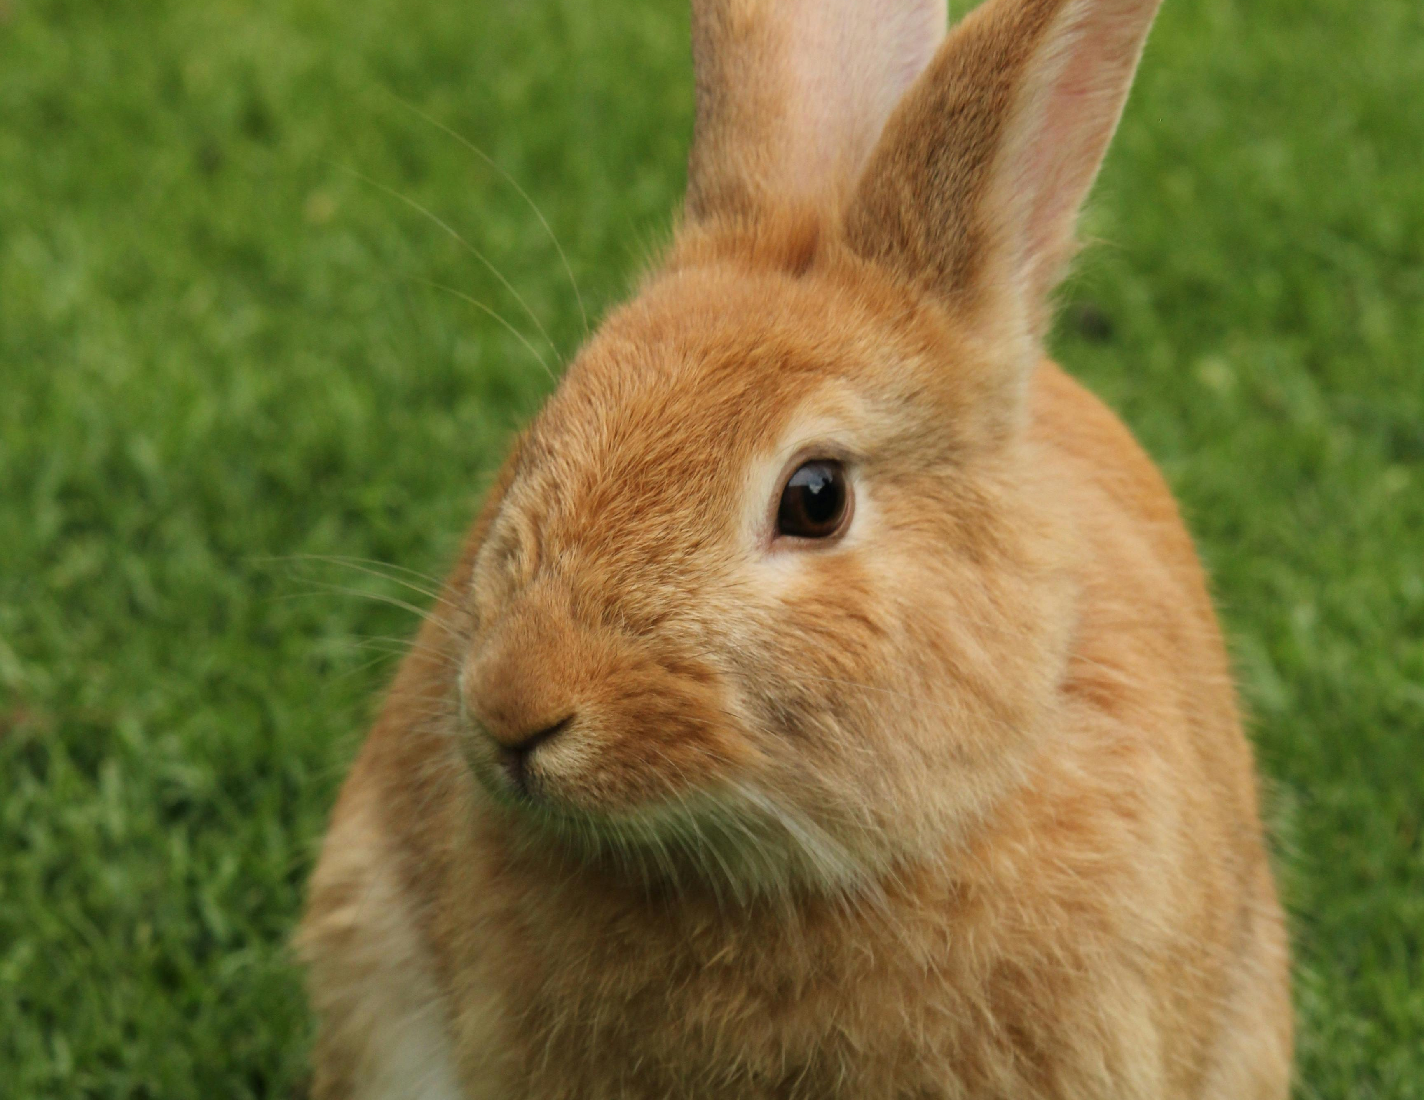

Pet Assignments (Unstable)
D > E > F
Spider > Bunny
Clover
Family D
Dr. Fluffy
Family E
Ronin
Family F

Slide 31
Pet Assignments (Unstable)
Clover
Family D
Dr. Fluffy
Family E
Ronin
Family F

Slide 32



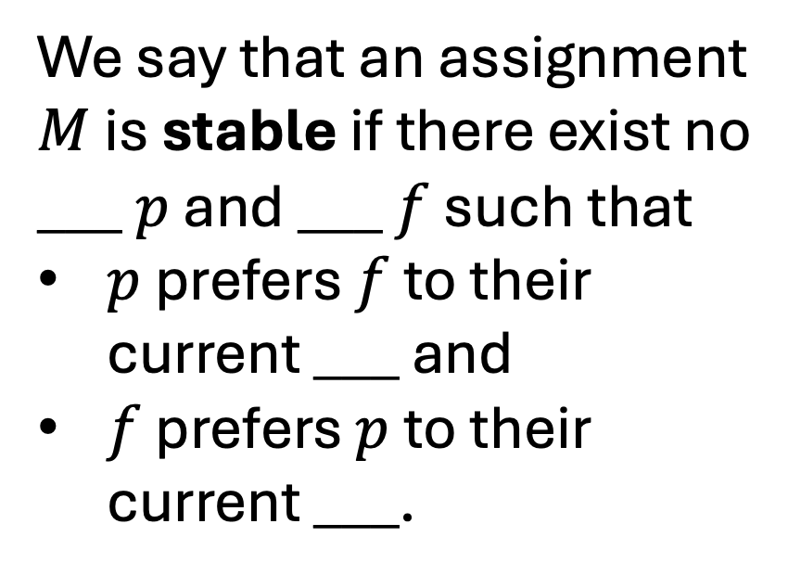
Hospital Assignments (Stable State?)
We say that an assignment $M$ is stable if there exist no ___ $p$ and ___ $f$ such that
$p$ prefers $f$ to their current ___ and
$f$ prefers $p$ to their current ___.

Slide 33
Can we always find a stable assignment?

Slide 34
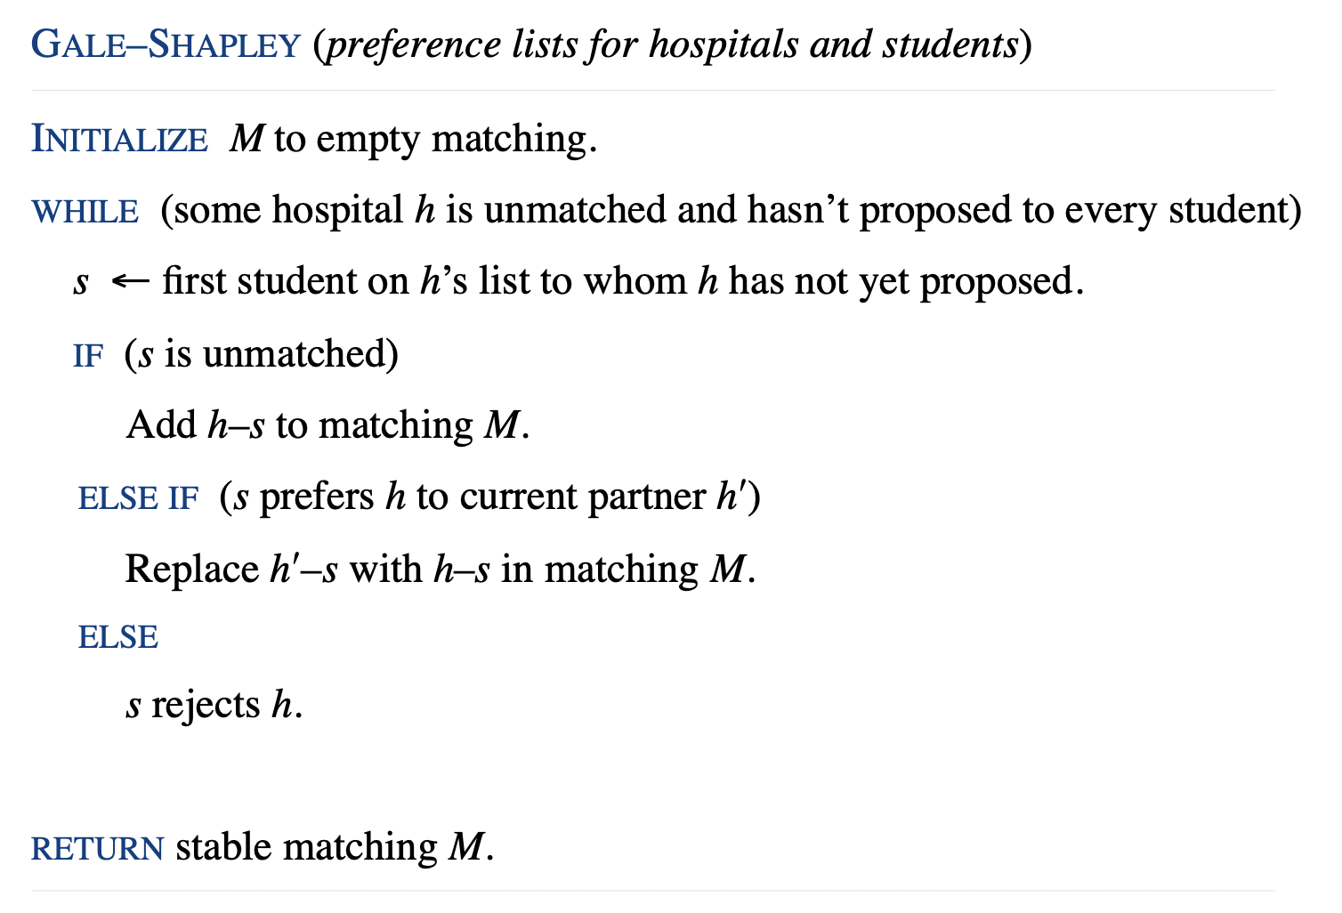
Can we always find a stable assignment?

Slide 35

Pet Assignments (Stable State?)
Dr. One
Hospital A
Dr. Two
Hospital B
Dr. Three
Hospital C

Slide 36
Pet Assignments (Stable State?)
Dr. One
Hospital A
A > B > C
2 > 1 > 3
Dr. Two
Hospital B
A > C > B
1 > 2 > 3
Dr. Three
Hospital C
C > A > B
3 > 2 > 1

Slide 37
Pet Assignments (Stable State?)
Dr. One
Hospital A
A > B > C
2 > 1 > 3
Dr. Two
Hospital B
A > C > B
1 > 2 > 3
Dr. Three
Hospital C
C > A > B
3 > 2 > 1

Slide 38
Pet Assignments (Stable State?)
Dr. One
Hospital A
A > B > C
2 > 1 > 3
Dr. Two
Hospital B
A > C > B
1 > 2 > 3
Dr. Three
Hospital C
C > A > B
3 > 2 > 1

Slide 39
Pet Assignments (Stable State?)
Dr. One
Hospital A
A > B > C
2 > 1 > 3
Dr. Two
Hospital B
A > C > B
1 > 2 > 3
Dr. Three
Hospital C
C > A > B
3 > 2 > 1

Slide 40
Pet Assignments (Stable State?)
Dr. One
Hospital A
A > B > C
2 > 1 > 3
Dr. Two
Hospital B
A > C > B
1 > 2 > 3
Dr. Three
Hospital C
C > A > B
3 > 2 > 1

Slide 41
Pet Assignments (Stable State?)
Dr. One
Hospital A
A > B > C
2 > 1 > 3
Dr. Two
Hospital B
A > C > B
3 > 2 > 1
Dr. Three
Hospital C
C > A > B
3 > 2 > 1

Slide 42
Pet Assignments (Stable State?)
Dr. One
Hospital A
A > B > C
2 > 1 > 3
Dr. Two
Hospital B
A > C > B
3 > 2 > 1
Dr. Three
Hospital C
C > A > B
3 > 2 > 1

Slide 43
Pet Assignments (Stable State?)
Dr. One
Hospital A
A > B > C
2 > 1 > 3
Dr. Two
Hospital B
A > C > B
3 > 2 > 1
Dr. Three
Hospital C
C > A > B
3 > 2 > 1

Slide 44
Pet Assignments (Stable State?)
Dr. One
Hospital A
A > B > C
2 > 1 > 3
Dr. Two
Hospital B
A > C > B
3 > 2 > 1
Dr. Three
Hospital C
C > A > B
3 > 2 > 1

Slide 45
Pet Assignments (Stable State?)
Dr. One
Hospital A
A > B > C
2 > 1 > 3
Dr. Two
Hospital B
A > C > B
3 > 2 > 1
Dr. Three
Hospital C
C > A > B
3 > 2 > 1

Slide 46
Pet Assignments (Stable State?)
Dr. One
Hospital A
A > B > C
2 > 1 > 3
Dr. Two
Hospital B
A > C > B
3 > 2 > 1
Dr. Three
Hospital C
C > A > B
3 > 2 > 1

