Slide 1

CSE 331: Algorithms & Complexity
“Dynamic Programming”
Prof. Charlie Anne Carlson (She/Her)
Lecture 30
Wednesday Nov 12th, 2025

Slide 2

Schedule
Course Updates
WIS
Dynamic Programming
Optimal Substructure
Overlapping Subproblems
Subproblem Ordering
Subset Sum

Slide 3

Course Updates
HW 7 Out
Due November 18th
Group Project
Code 3 Due November 24th
Reflections 3 Due December 1st
Next Quiz is December 1st

Slide 4

Reading
You should have read:
Finished 6.1
Finished 6.2
Before Next Class:
Finish 6.4

Slide 5

Weighted Interval Scheduling
Input: A list of n jobs L
Each job $i$ has a start time $s_{i}$ and finish time $f_{i}$
Two jobs are “compatible” if they don’t overlap
Each job $i$ as a weight $v_{i}$
Goal: Find the max-weight subset of mutually compatible jobs.
Job 2 (5)
Job 4 (3)
Job 1 (1)
Job 3 (1)
Job 5 (1)
Time:
Start
End

Slide 6
DP for WIS
Brute-Force(L):
Sort L by job finish times.
Compute p[i] for each i using binary search.
Global M = [], M[0] = 0
Return Compute-Opt(n)
M-Compute-Opt-Top-Down(j):
If j not in M:
M[j] = Max(M-Compute-Opt(j-1), v[j] + M-Compute-Opt(p[j])}
Return M[j]
M-Compute-Opt-Bottom-Up(j):
For i in [j]:
M[i] = Max(M-Compute-Opt(i-1), v[i] + M-Compute-Opt(p[i])}
Return M[j]

Slide 7
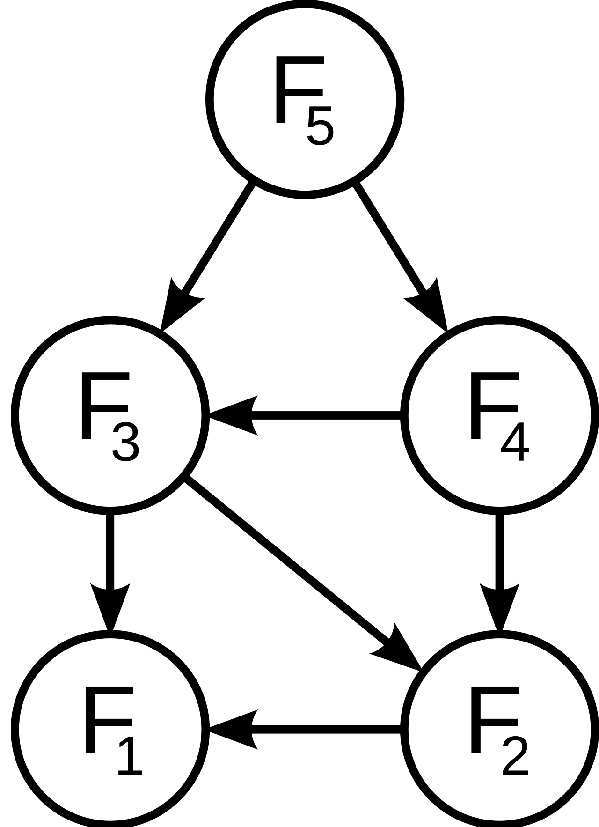
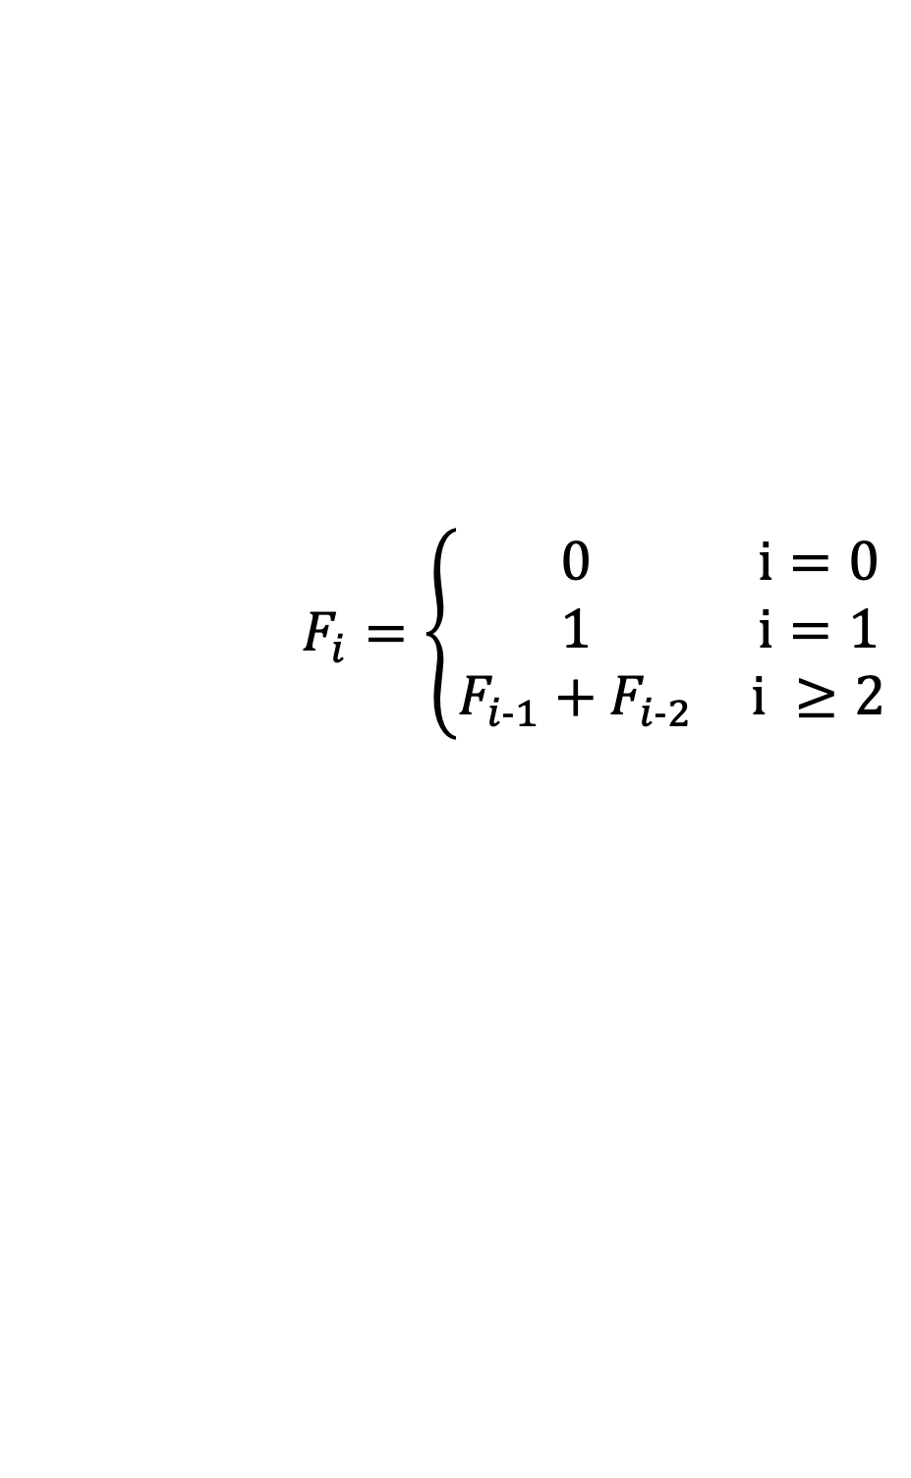
Dynamic Programming
Optimal Substructure
The solution to the original problem can be easily computed from the solutions to the subproblems.
Overlapping Subproblems
At most polynomial subproblems to solve.
Subproblem Ordering
There exists a natural order to solve subproblems without conflict.
$$F_{i}=\left\{\begin{matrix}0 & i=0 \\ 1 & i=1 \\ F_{i-1}+F_{i-2} & i ≥2\end{matrix}\right.$$

Slide 8
Dynamic Programming
Optimal Substructure
The solution to the original problem can be easily computed from the solutions to the subproblems.
Overlapping Subproblems
At most polynomial subproblems to solve.
Subproblem Ordering
There exists a natural order to solve subproblems without conflict.
$$F_{i}=\left\{\begin{matrix}0 & i=0 \\ 1 & i=1 \\ F_{i-1}+F_{i-2} & i ≥2\end{matrix}\right.$$

Slide 9
Dynamic Programming
Optimal Substructure
The solution to the original problem can be easily computed from the solutions to the subproblems.
Overlapping Subproblems
At most polynomial subproblems to solve.
Subproblem Ordering
There exists a natural order to solve subproblems without conflict.
$$F_{i}=\left\{\begin{matrix}0 & i=0 \\ 1 & i=1 \\ F_{i-1}+F_{i-2} & i ≥2\end{matrix}\right.$$

Slide 10
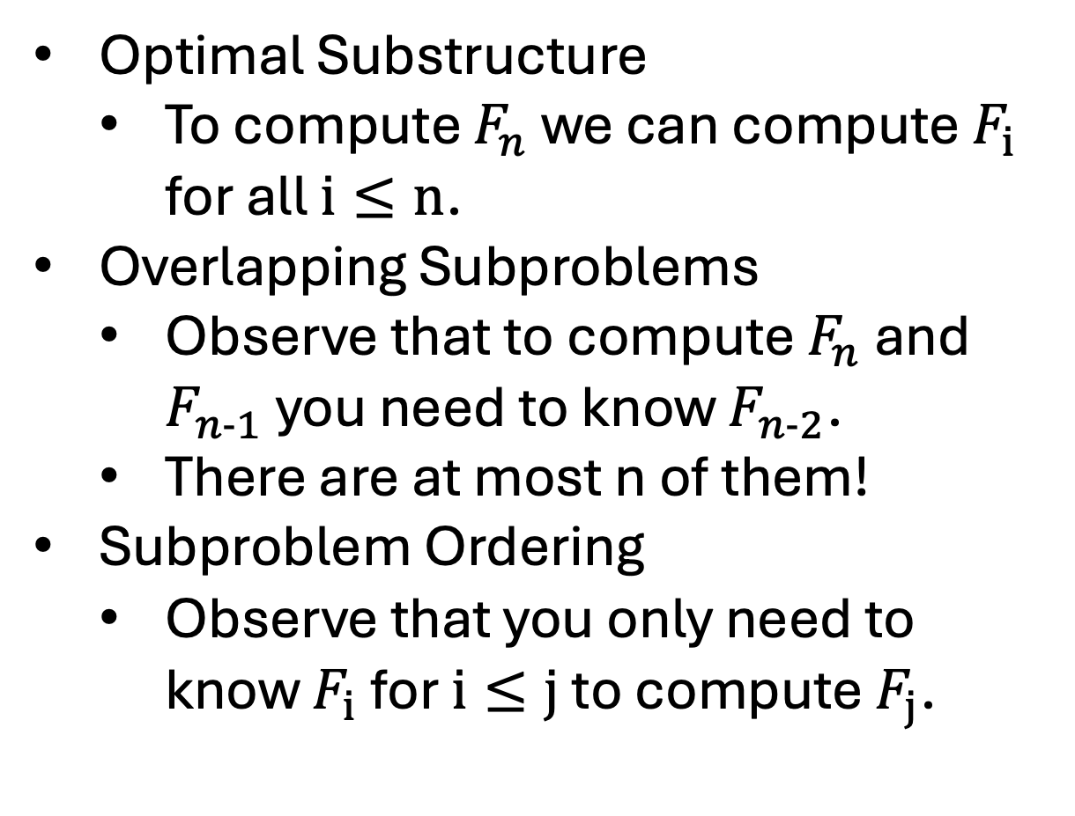
Dynamic Programming – Fibonacci
Optimal Substructure
To compute $F_{n}$ we can compute $F_{i}$ for all $i≤n$.
Overlapping Subproblems
Observe that to compute $F_{n}$ and $F_{n-1}$ you need to know $F_{n-2}$.
There are at most n of them!
Subproblem Ordering
Observe that you only need to know $F_{i}$ for $i≤j$ to compute $F_{j}$.
$$F_{i}=\left\{\begin{matrix}0 & i=0 \\ 1 & i=1 \\ F_{i-1}+F_{i-2} & i ≥2\end{matrix}\right.$$

Slide 11
Dynamic Programming – WIS
Optimal Substructure
?
Overlapping Subproblems
?
Subproblem Ordering
?

Slide 12
Dynamic Programming – WIS
Optimal Substructure
Define Subproblems:
Let OPT(i) be the best job schedule using only first i jobs.
Describe Using Subproblems:
Given OPT(i) for all i < n, we can compute:
OPT(n) = MAX(OPT(n-1), v[n]+ OPT(P[n]))

Slide 13
Dynamic Programming – WIS
Overlapping Subproblems
In many instances, it is easy to see that you will need OPT(i) multiple times.
You only ever need to consider i from 1 to n.
E.g.: You need OPT(2) to compute OPT(3) and OPT(4) in the following example:

Slide 14
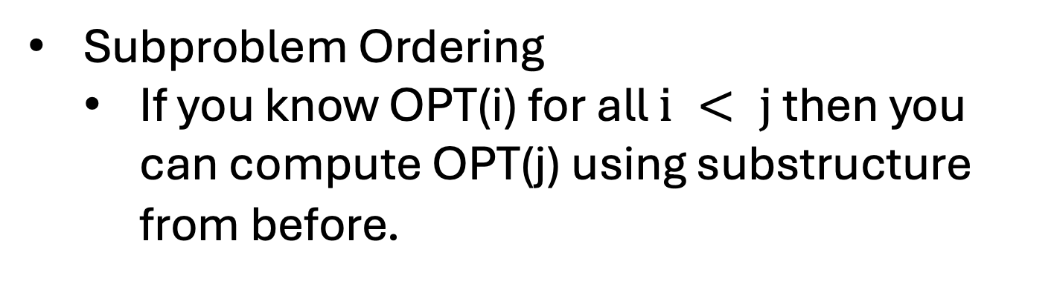
Dynamic Programming – WIS
Subproblem Ordering
If you know OPT(i) for all $i < j$ then you can compute OPT(j) using substructure from before.

Slide 15
Dynamic Programming – Tips
Describe subproblems in English:
“the optimal solution considering only the first i jobs.”
Make note of the format of subproblems:
Each subproblem was of the same type, WIS.

Slide 16
Dynamic Programming – Tips
Describe how solving all the subproblems gets you the solution:
“Once we have computed OPT(i) for all i, the answer to the problem is OPT(i).”
It is okay to do some preprocessing before you solve the problem.

Slide 17
Dynamic Programming – Tips
Make sure you consider the order of solving subproblems carefully.
We will see in our next problem a case where you have more than one variable.

Slide 18
Dynamic Programming – Tips
Don’t forget the base case!
Often you need to initialize the array/matrix/tree/graph with some values or you won't be able to fill in the next case!

Slide 19
Dynamic Programming vs Divide & Conquer
Question: What happens if you have optimal substructure, but you don’t have a lot of overlapping subproblems?

Slide 20
Dynamic Programming vs Divide & Conquer
Question: What happens if you have optimal substructure, but you don’t have a lot of overlapping subproblems?
Answer:
If you have few subproblems, you might get a good algorithm that is divide & conquer, decrease & conquer, or even brute force.
E.g. Mergesort
If you have many subproblems than you may not get an efficient algorithm.

Slide 21
Dynamic Programming Bottom-Up/Iterative
Describe and justify the subproblems.
Give a recurrence for the subproblems and specify where to find the final solution.
Determine the natural order to solve the subproblems.
Decide on a data structure to hold the solutions
E.g. We used an array for WIS
Write the code to fill in the data structure based on the natural order you found.

Slide 22
DP for WIS
Brute-Force(L):
Sort L by job finish times.
Compute p[i] for each i using binary search.
Global M = [], M[0] = 0
Return Compute-Opt-?(n)
M-Compute-Opt-Top-Down(j):
If j not in M:
M[j] = Max(M-Compute-Opt(j-1), v[j] + M-Compute-Opt(p[j])}
Return M[j]
M-Compute-Opt-Bottom-Up(j):
For i in [j]:
M[i] = Max(M-Compute-Opt(i-1), v[i] + M-Compute-Opt(p[i])}
Return M[j]

Slide 23
Dynamic Programming Choices
Often the key to writing a dynamic programming algorithm is identifying a recurrence.
To find a recurrence, you often want to find a choice.
E.g. “You either take the job i or you don’t.”
Once you’ve found your choice, you can then describe a subproblem based on the outcome of all choices.
E.g. “If you take it, you need to consider removing all conflicting jobs. If you don’t, you don’t need to consider it anymore.”
Sometimes the subproblem is natural and finding the recurrence is the hard part.

Slide 24
Weighted Interval Scheduling
Input: A list of n jobs L
Each job $i$ has a start time $s_{i}$ and finish time $f_{i}$
Two jobs are “compatible” if they don’t overlap
Each job $i$ as a weight $v_{i}$
Goal: Find the max-weight subset of mutually compatible jobs.
Job 2 (5)
Job 4 (3)
Job 1 (1)
Job 3 (1)
Job 5 (1)
Time:
Start
End

Slide 25

Subset Sum
Input: A list of n items {1,…,n} and a bound W.
Each item $i$ has a weight $w_{i}$
Goal: Find the max-weight subset S such that $\sum_{i∈S}{w_{i}}≤W$.

Slide 26
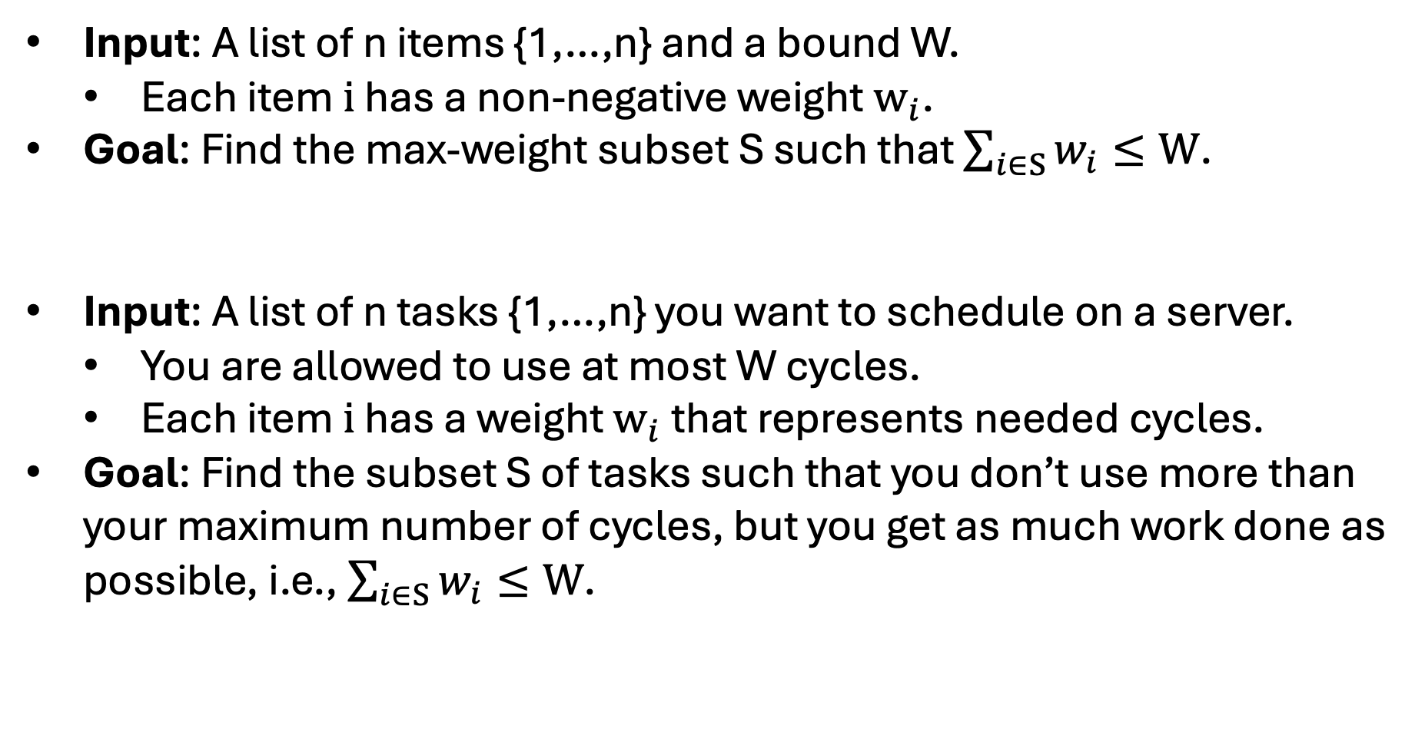
Subset Sum
Input: A list of n items {1,…,n} and a bound W.
Each item $i$ has a non-negative weight $w_{i}$.
Goal: Find the max-weight subset S such that $\sum_{i∈S}{w_{i}}≤W$.
Input: A list of n tasks {1,…,n} you want to schedule on a server.
You are allowed to use at most W cycles.
Each item $i$ has a weight $w_{i}$ that represents needed cycles.
Goal: Find the subset S of tasks such that you don’t use more than your maximum number of cycles, but you get as much work done as possible, i.e., $\sum_{i∈S}{w_{i}}≤W$.

Slide 27
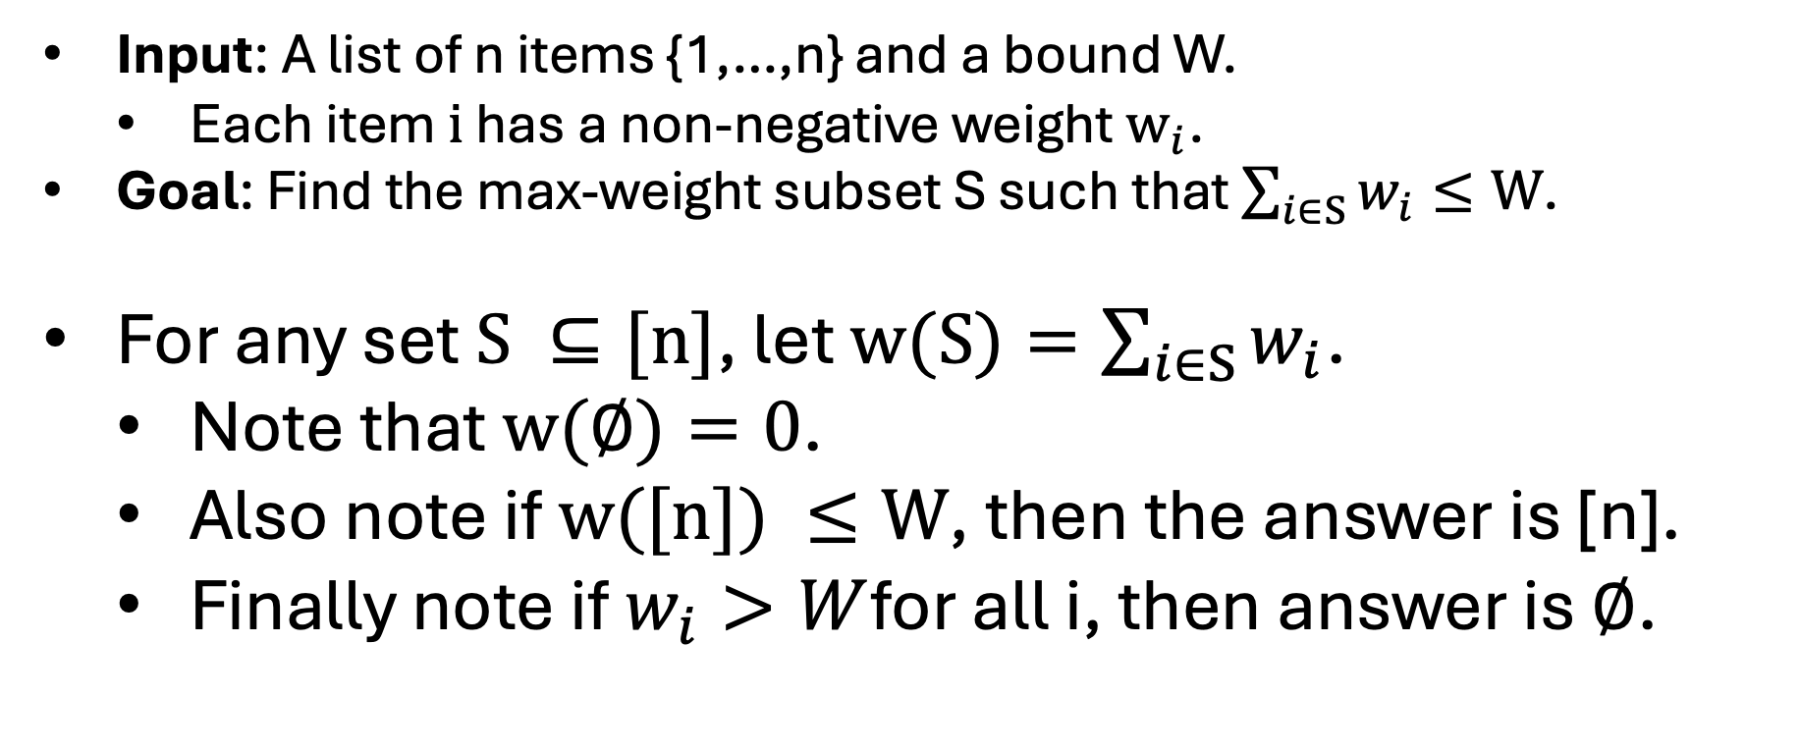
Subset Sum Notation & Observations
Input: A list of n items {1,…,n} and a bound W.
Each item $i$ has a non-negative weight $w_{i}$.
Goal: Find the max-weight subset S such that $\sum_{i∈S}{w_{i}}≤W$.
For any set $S ⊆[n]$, let $w(S)=\sum_{i∈S}{w_{i}}$.
Note that $w(∅)=0$.
Also note if $w([n]) ≤W$, then the answer is [n].
Finally note if $w_{i}>W$for all i, then answer is $∅$.

Slide 28
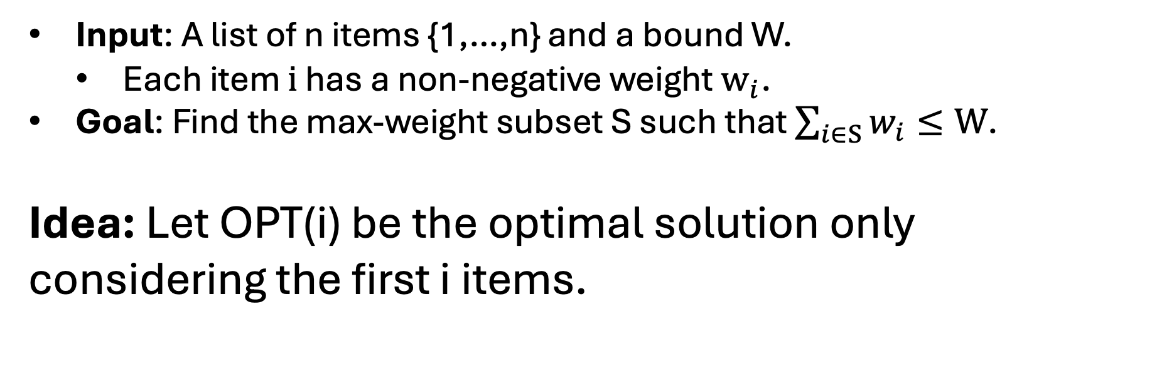
Subset Sum Subproblems
Input: A list of n items {1,…,n} and a bound W.
Each item $i$ has a non-negative weight $w_{i}$.
Goal: Find the max-weight subset S such that $\sum_{i∈S}{w_{i}}≤W$.
Idea: Let OPT(i) be the optimal solution only considering the first i items.

Slide 29
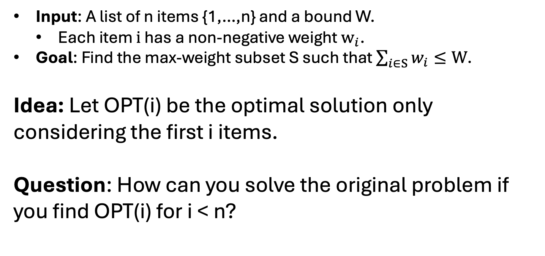
Subset Sum Subproblems
Input: A list of n items {1,…,n} and a bound W.
Each item $i$ has a non-negative weight $w_{i}$.
Goal: Find the max-weight subset S such that $\sum_{i∈S}{w_{i}}≤W$.
Idea: Let OPT(i) be the optimal solution only considering the first i items.
Question: How can you solve the original problem if you find OPT(i) for i < n?

Slide 30
Subset Sum Example
Idea: Let OPT(i) be the optimal solution only considering the first i items.
Example:
Item values = [1,4,7,2,5,12,14]
Bound = 10
Observations:
You can’t decide if you want to take item with value 5 based on the optimal solution to [1,4,7,2] with bound 10.
The optimal there is 9 but it can be 5.
If you don’t keep track of what you’ve used, you may overuse.

Slide 31
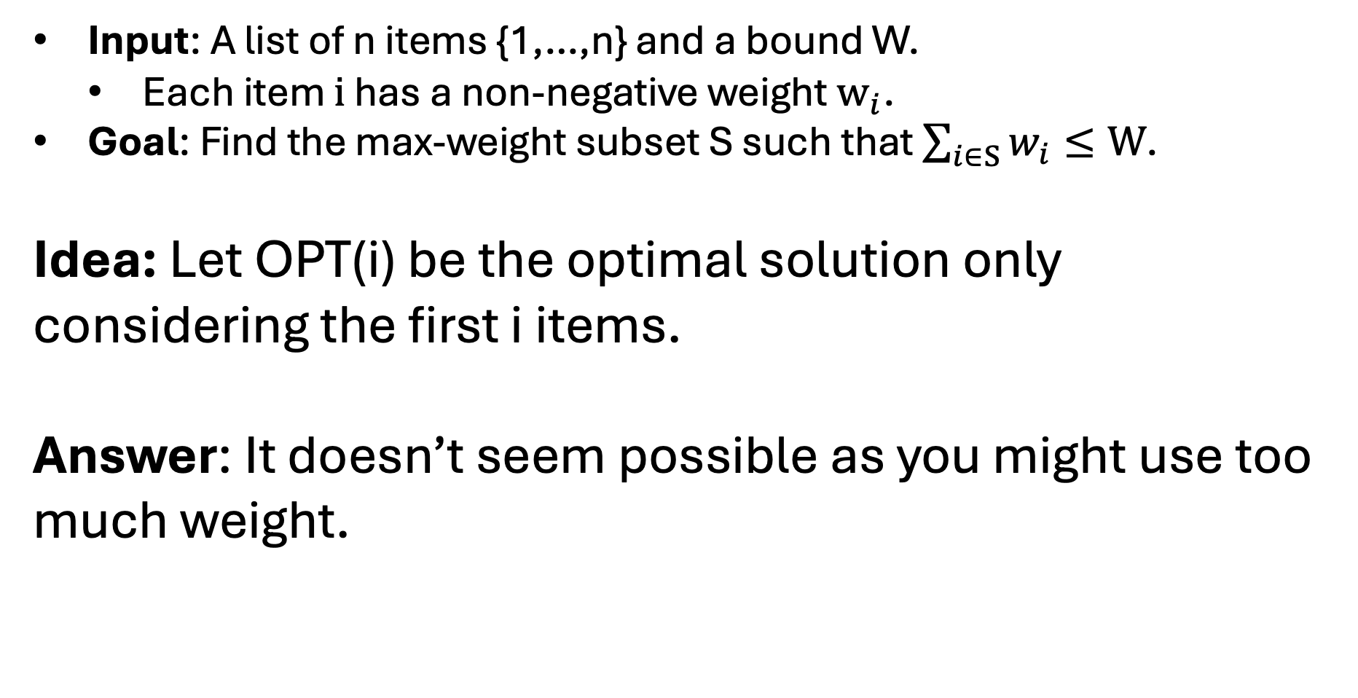
Subset Sum Subproblems
Input: A list of n items {1,…,n} and a bound W.
Each item $i$ has a non-negative weight $w_{i}$.
Goal: Find the max-weight subset S such that $\sum_{i∈S}{w_{i}}≤W$.
Idea: Let OPT(i) be the optimal solution only considering the first i items.
Answer: It doesn’t seem possible as you might use too much weight.

Slide 32
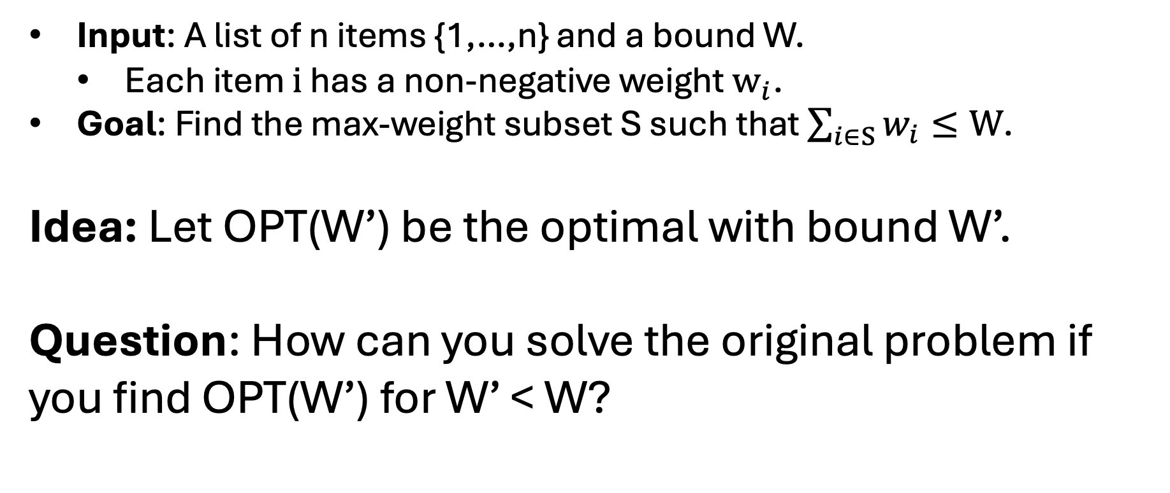
Subset Sum Subproblems
Input: A list of n items {1,…,n} and a bound W.
Each item $i$ has a non-negative weight $w_{i}$.
Goal: Find the max-weight subset S such that $\sum_{i∈S}{w_{i}}≤W$.
Idea: Let OPT(W’) be the optimal with bound W’.
Question: How can you solve the original problem if you find OPT(W’) for W’ < W?

Slide 33
Subset Sum Example
Idea: Let OPT(W’) be the optimal with bound W’.
Example:
Item values = [4,7,2,5,12,14]
Bound = 10
Observations:
You can’t decide if you want to take item with value 5 based on the optimal solution to [4,7,2,5,12,14] with bound 5.
The optimal there is 5 but it shouldn’t be combined with 5 again.
That is, if you aren’t keep track of the

Slide 34
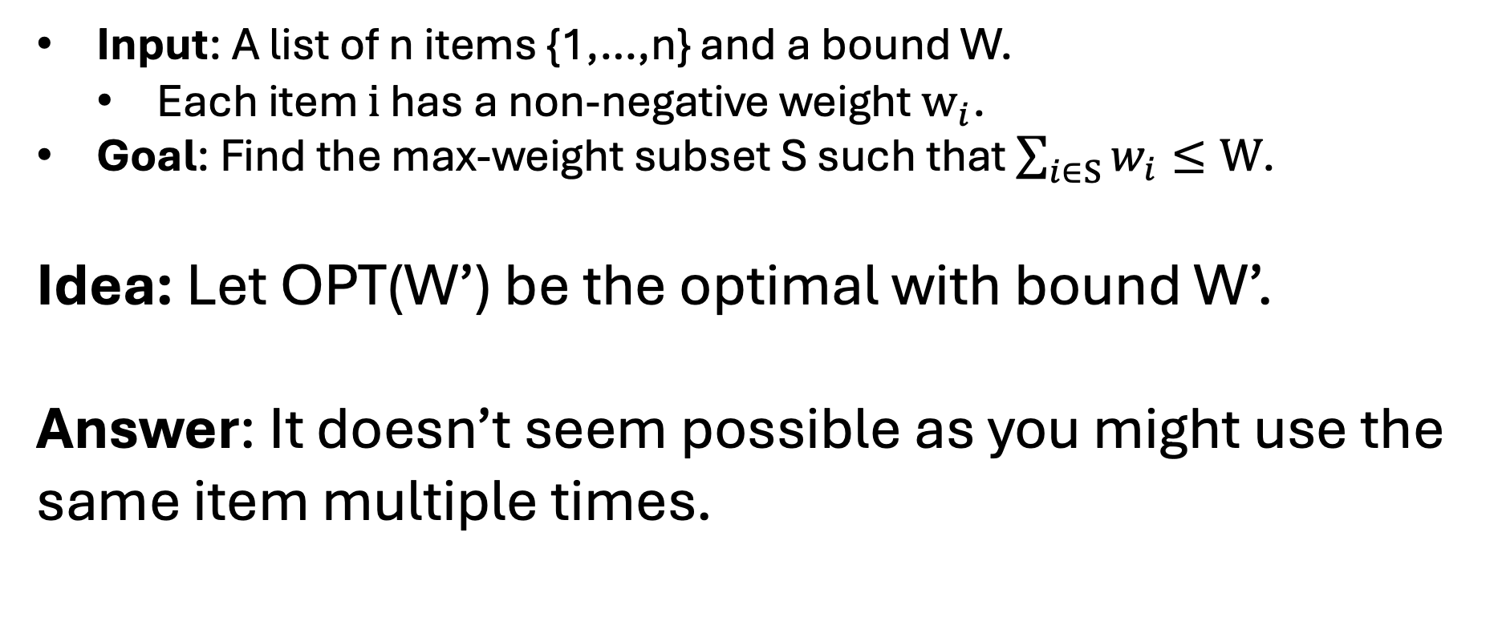
Subset Sum Subproblems
Input: A list of n items {1,…,n} and a bound W.
Each item $i$ has a non-negative weight $w_{i}$.
Goal: Find the max-weight subset S such that $\sum_{i∈S}{w_{i}}≤W$.
Idea: Let OPT(W’) be the optimal with bound W’.
Answer: It doesn’t seem possible as you might use the same item multiple times.

Slide 35
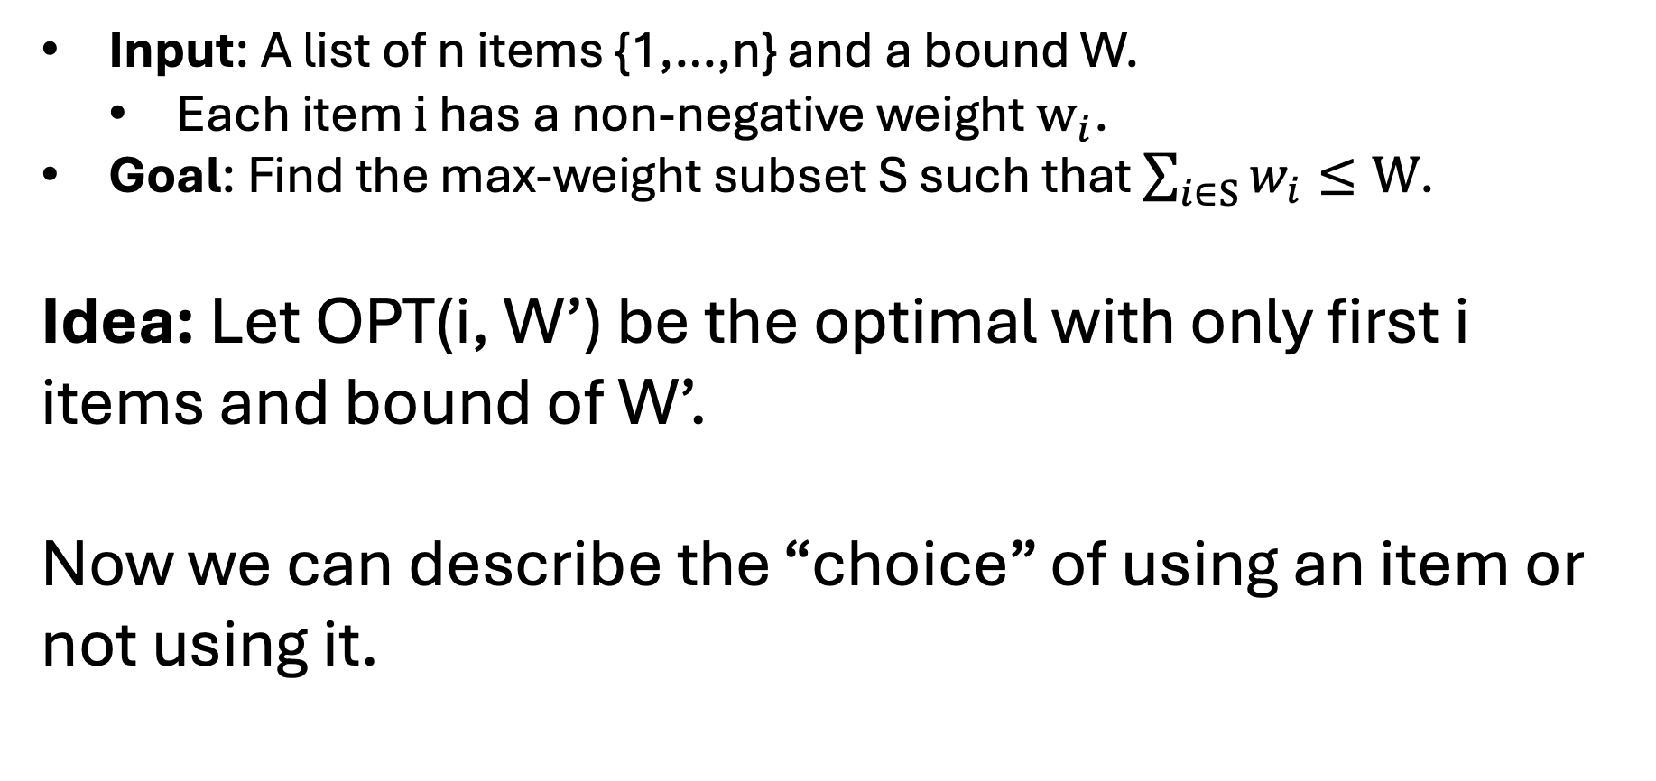
Subset Sum Subproblems
Input: A list of n items {1,…,n} and a bound W.
Each item $i$ has a non-negative weight $w_{i}$.
Goal: Find the max-weight subset S such that $\sum_{i∈S}{w_{i}}≤W$.
Idea: Let OPT(i, W’) be the optimal with only first i items and bound of W’.
Now we can describe the “choice” of using an item or not using it.

Slide 36
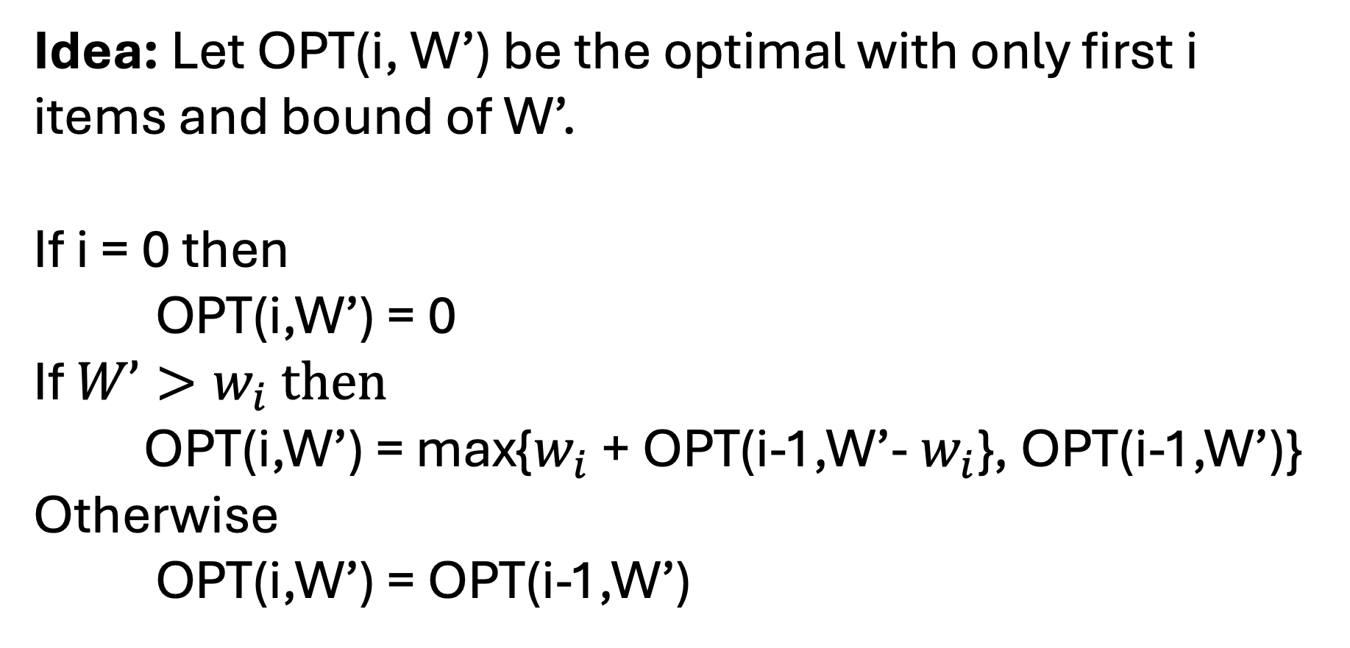
Subset Sum Optimal Substructure
Idea: Let OPT(i, W’) be the optimal with only first i items and bound of W’.
If i = 0 then
OPT(i,W’) = 0
If $W’>w_{i}$ then
OPT(i,W’) = max{$w_{i}$ + OPT(i-1,W’- $w_{i}$}, OPT(i-1,W’)}
Otherwise
OPT(i,W’) = OPT(i-1,W’)

Slide 37
Subset Sum Problem Overlap
It is believable that there will be instances where we have a lot of problem overlap.
Example:
Item values = [4,7,2,5,2,12,14]
Bound = 20
There are two different ways to eventually ask about OPT(4,6): Picking 14 or pick 12 and 2.

Slide 38
Subset Sum Problem Count
There will be n choices for i and W choices for W’ (provided everything is an integer).
Example:
Item values = [4,7,2,5,2,12,14]
Bound = 20
You only need to consider (i,20), (i,19), …, (i,0) for each i.

Slide 39
Subset Sum Ordering Subproblems
Idea: Let OPT(i, W’) be the optimal with only first i items and bound of W’.
If i = 0 then
OPT(i,W’) = 0
If $W’>w_{i}$ then
OPT(i,W’) = max{$w_{i}$ + OPT(i-1,W’- $w_{i}$}, OPT(i-1,W’)}
Otherwise
OPT(i,W’) = OPT(i-1,W’)

Slide 40
Subset Sum Ordering Subproblems
n
i
0
0
W’
W
OPT(i,W’) = max{$w_{i}$ + OPT(i-1,W’- $w_{i}$}, OPT(i-1,W’)}

Slide 41

Subset Sum Ordering Subproblems
We need to know for smaller W’ and smaller i.
n
i
i-1
0
0
W’-$w_{i}$
W’
W
OPT(i,W’) = max{$w_{i}$ + OPT(i-1,W’- $w_{i}$}, OPT(i-1,W’)}

Slide 42
Subset Sum Ordering Subproblems
Question:
How do we fill?
n
i
i-1
0
0
W’-$w_{i}$
W’
W
OPT(i,W’) = max{$w_{i}$ + OPT(i-1,W’- $w_{i}$}, OPT(i-1,W’)}

Slide 43
Subset Sum Ordering Subproblems
Answer:
Out for loop will be for i and inner for loop will be for W’.
n
i
i-1
0
Fill first layer with 0.
0
W’-$w_{i}$
W’
W
OPT(i,W’) = max{$w_{i}$ + OPT(i-1,W’- $w_{i}$}, OPT(i-1,W’)}

