Slide 1

CSE 331: Algorithms & Complexity
“Shortest Path… Again”
Prof. Charlie Anne Carlson (She/Her)
Lecture 32 & 33
Nov 17th & 19th, 2025

Slide 2

Schedule
Course Updates
Dynamic Programming
Subset Sum -> Knapsack
Shortest Path Problem
Bellman-Ford Algorithm

Slide 3

Course Updates
HW 7 Out
Due November 19th
Group Project (Autolab Up)
Groups Fixed
Code 3 Due November 24th
Reflections 3 Due December 1st
Next Quiz is December 1st

Slide 4
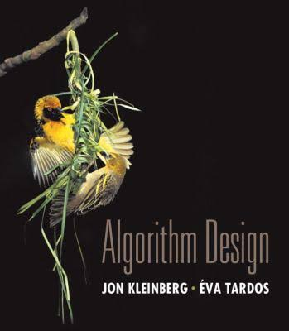
Reading
You should have read:
Finished 6.1
Finished 6.2
Finished 6.4
Finished 6.8
Before Next Class:
Start 8.1

Slide 5
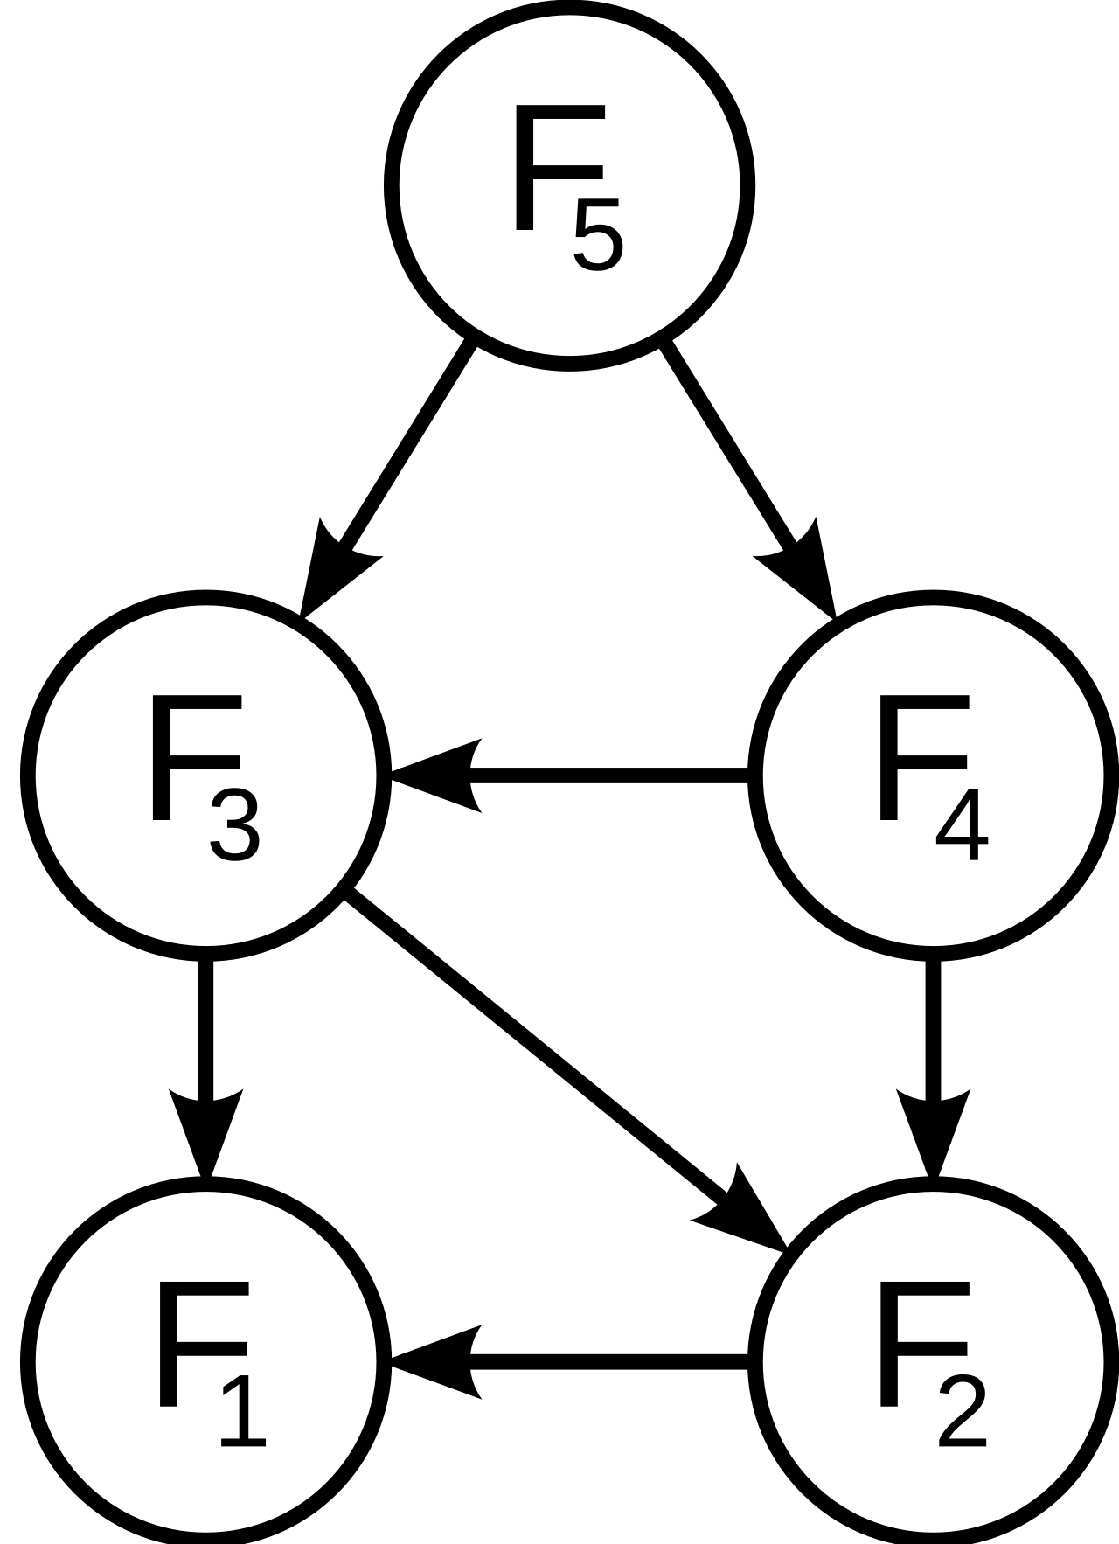
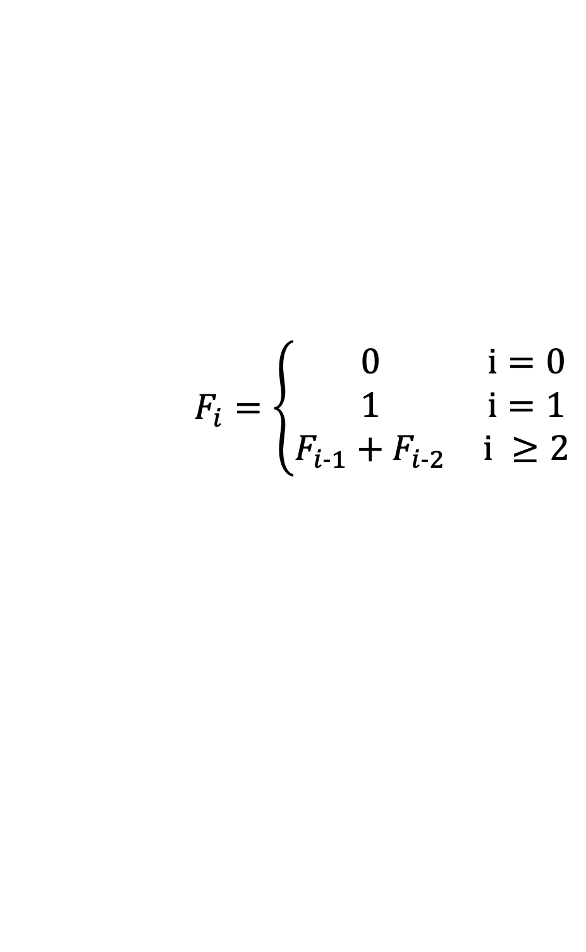
Dynamic Programming
Optimal Substructure
The solution to the original problem can be easily computed from the solutions to the subproblems.
Overlapping Subproblems
At most polynomial subproblems to solve.
Subproblem Ordering
There exists a natural order to solve subproblems without conflict.
$$F_{i}=\left\{\begin{matrix}0 & i=0 \\ 1 & i=1 \\ F_{i−1}+F_{i−2} & i ≥2\end{matrix}\right.$$

Slide 6
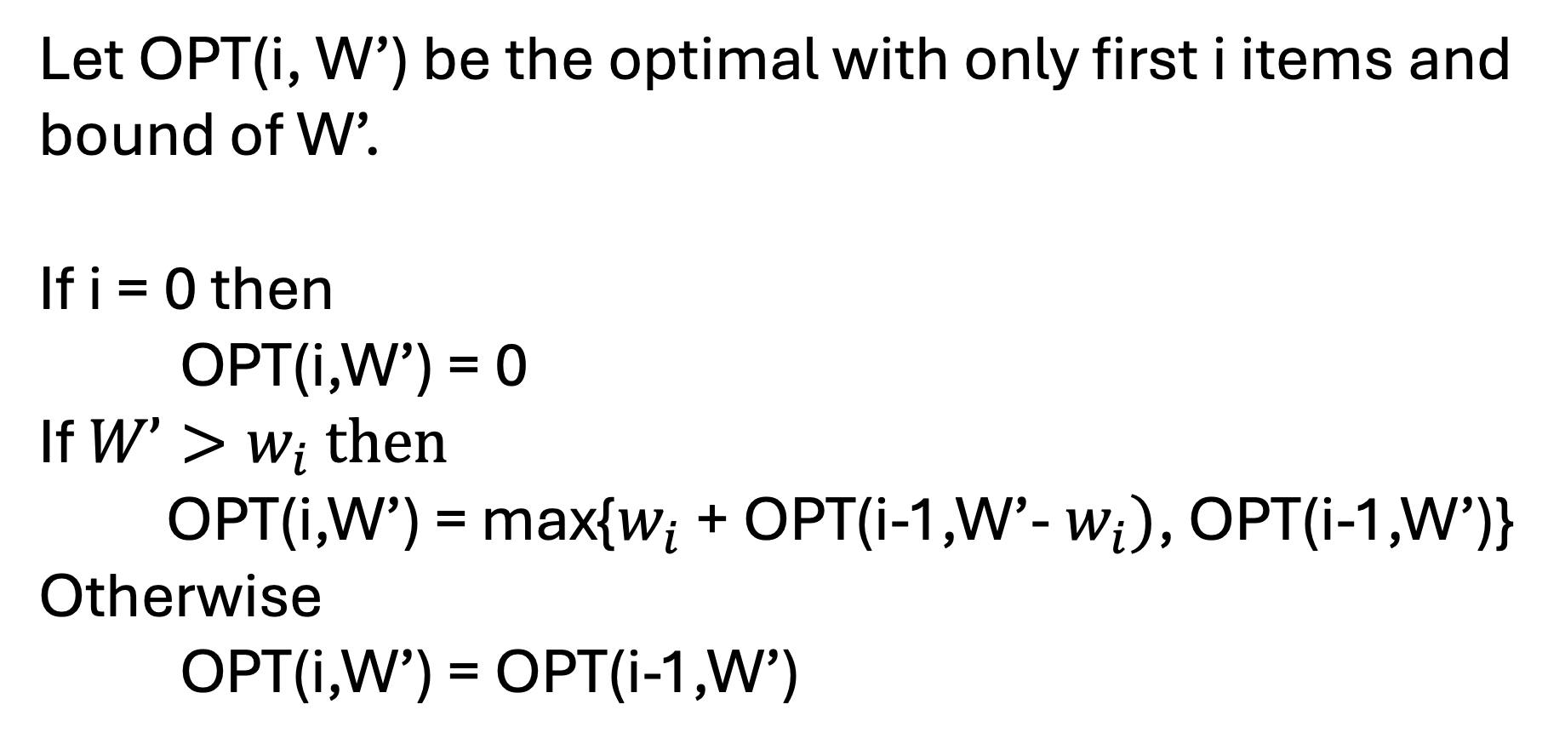
Subset Sum & Subproblems
Let OPT(i, W’) be the optimal with only first i items and bound of W’.
If i = 0 then
OPT(i,W’) = 0
If $W’>w_{i}$ then
OPT(i,W’) = max{$w_{i}$ + OPT(i-1,W’- $w_{i})$, OPT(i-1,W’)}
Otherwise
OPT(i,W’) = OPT(i-1,W’)

Slide 7

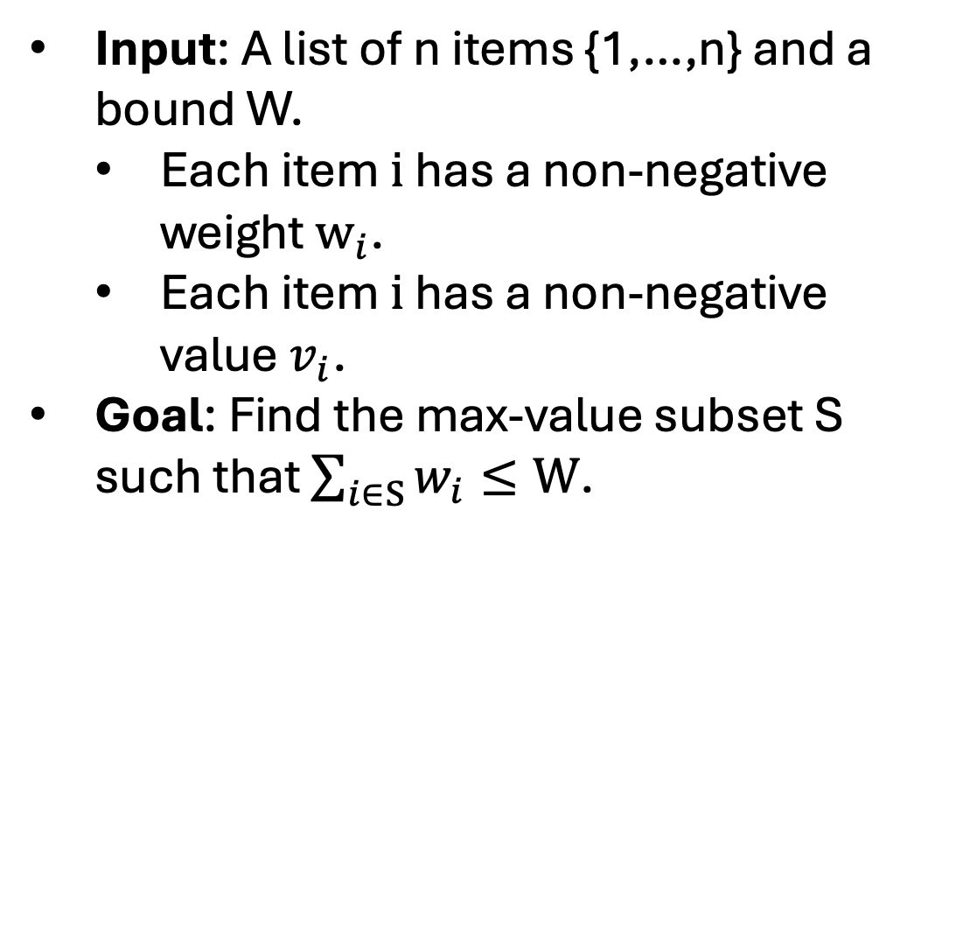
Knapsack
Input: A list of n items {1,…,n} and a bound W.
Each item $i$ has a non-negative weight $w_{i}$.
Each item $i$ has a non-negative value $v_{i}$.
Goal: Find the max-value subset S such that $\sum_{i∈S}{w_{i}}≤W$.

Slide 8
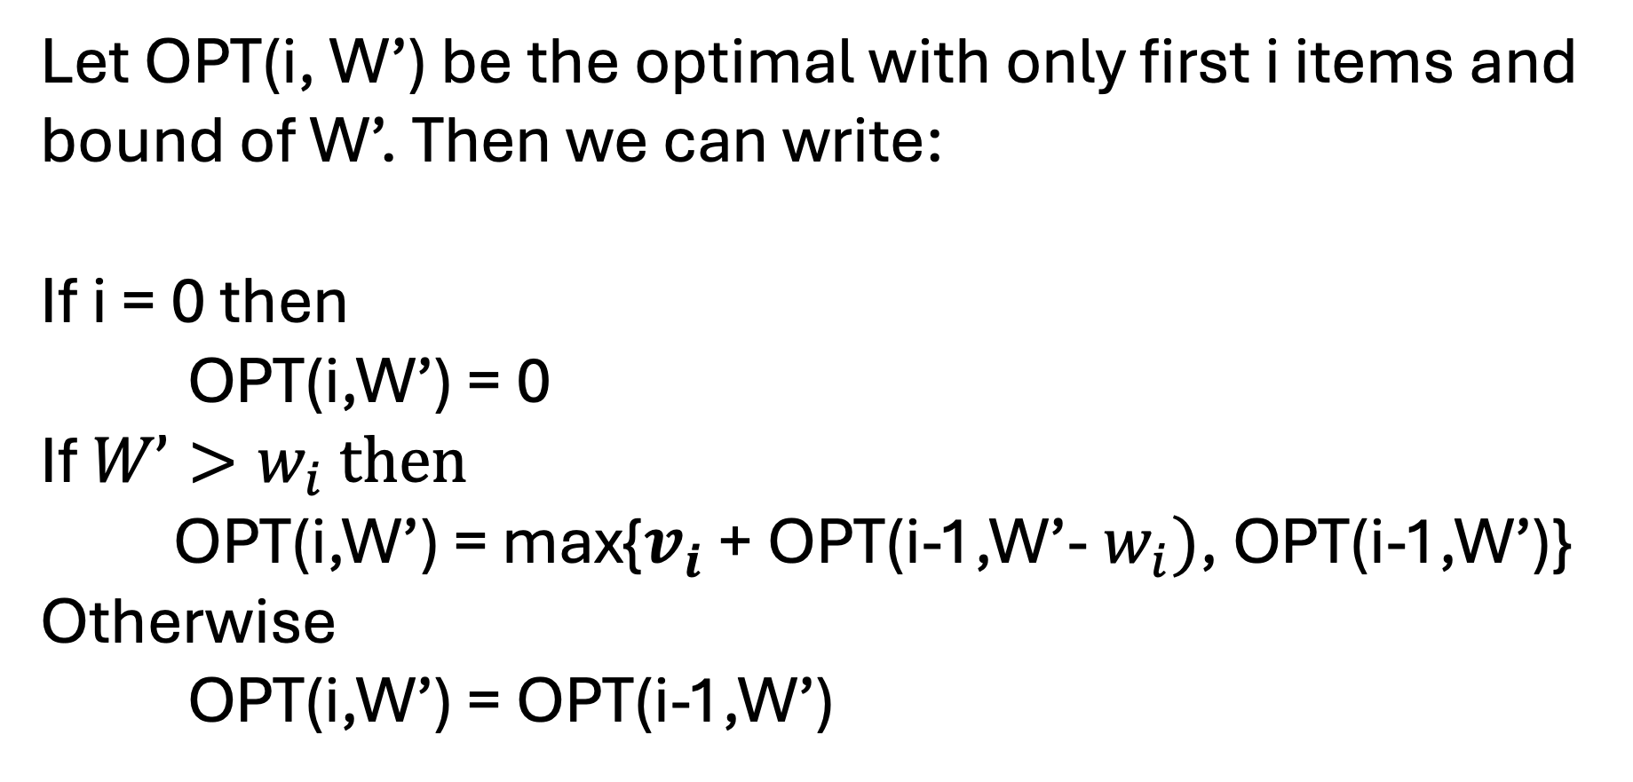
Knapsack & Subproblems
Let OPT(i, W’) be the optimal with only first i items and bound of W’. Then we can write:
If i = 0 then
OPT(i,W’) = 0
If $W’>w_{i}$ then
OPT(i,W’) = max{$v_{i}$ + OPT(i-1,W’- $w_{i})$, OPT(i-1,W’)}
Otherwise
OPT(i,W’) = OPT(i-1,W’)

Slide 9
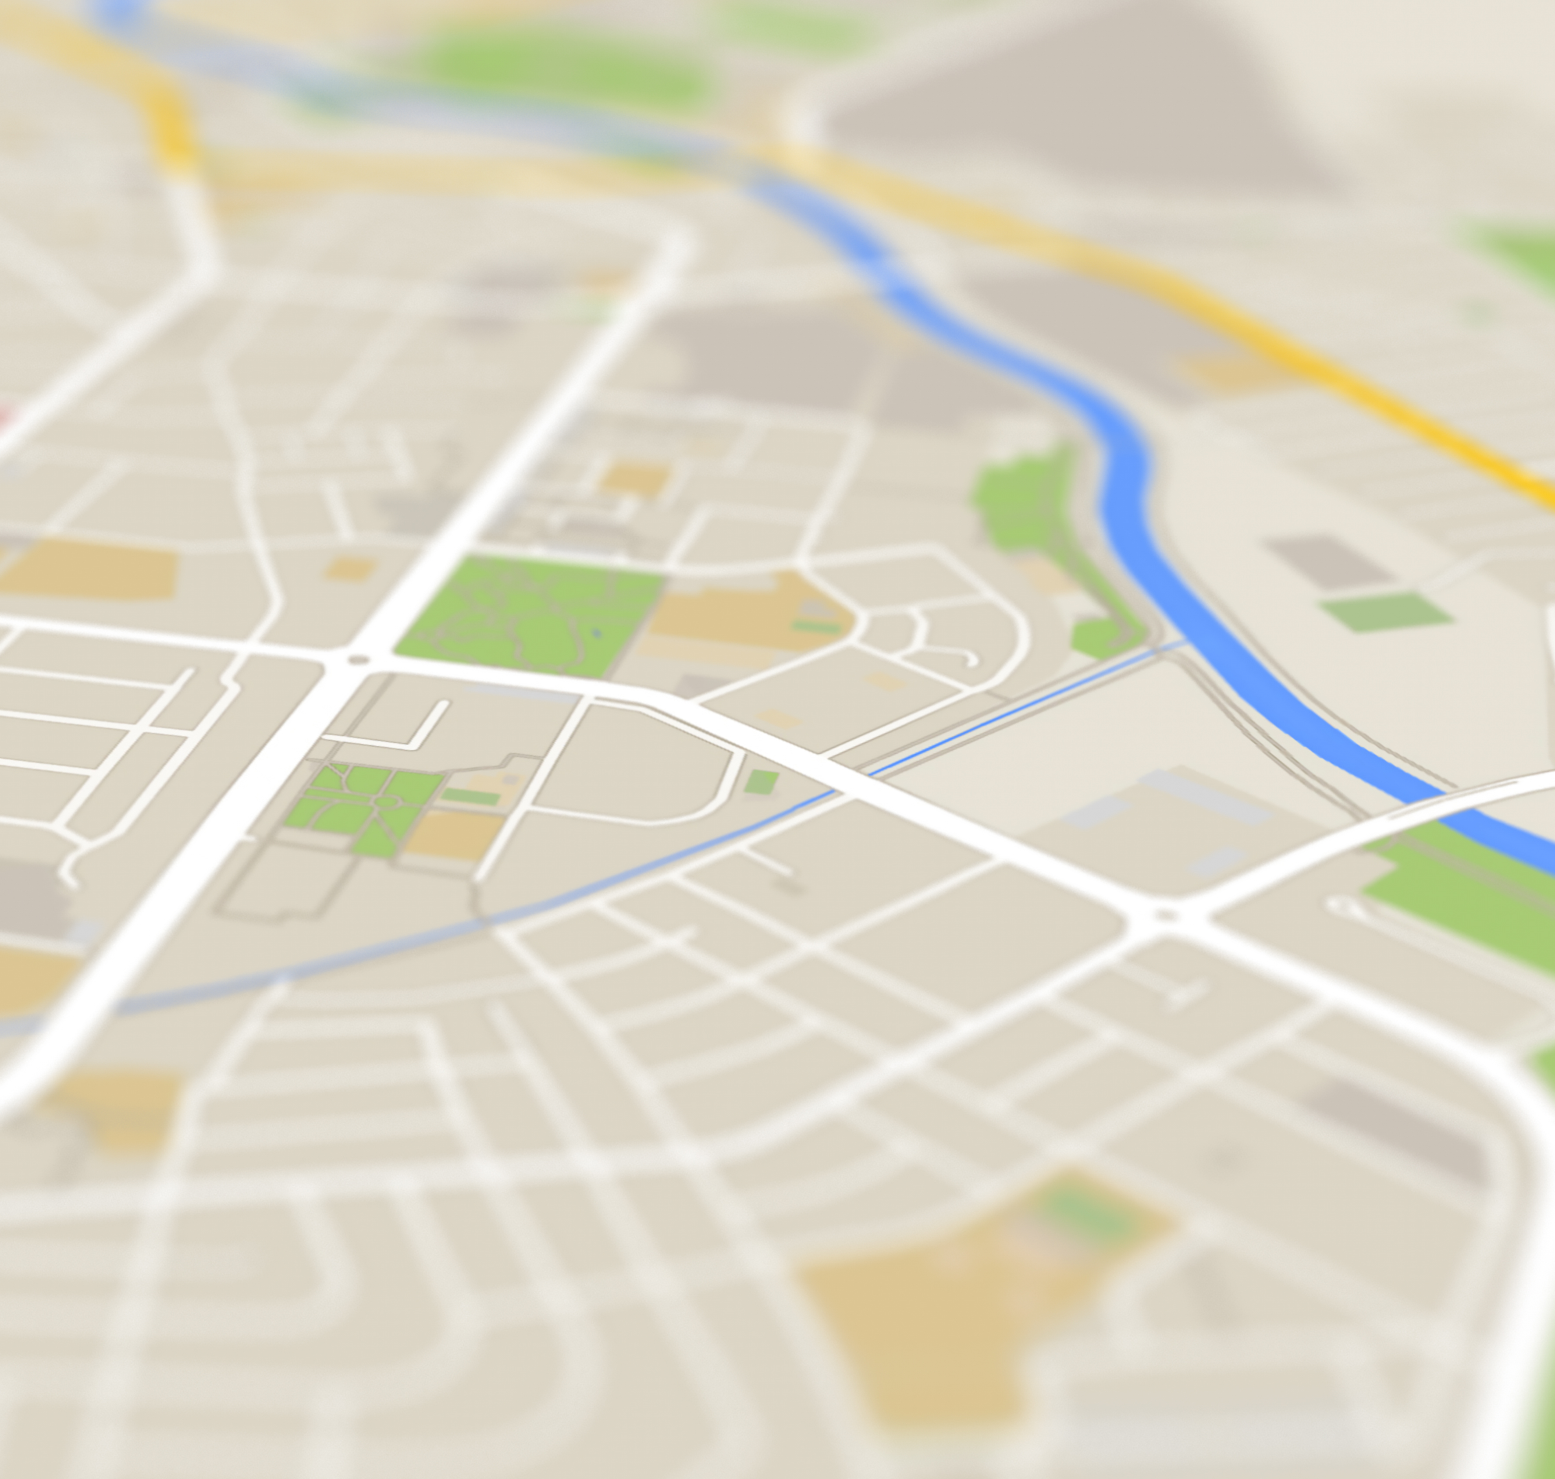
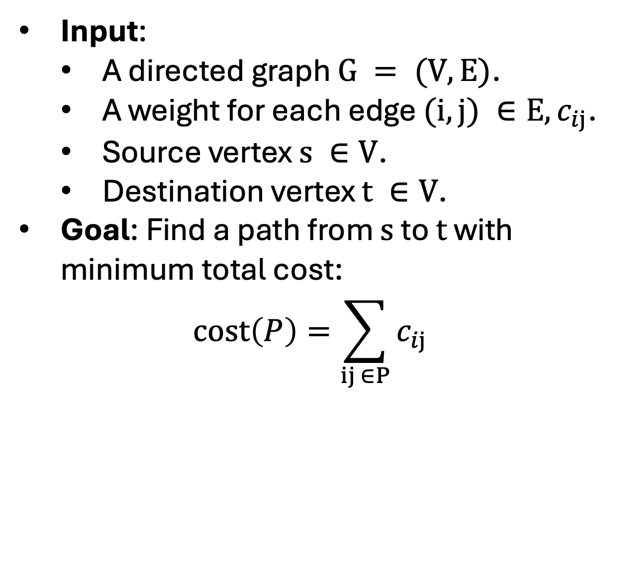
Shortest Path
Input:
A directed graph $G = (V,E)$.
A weight for each edge $(i,j) ∈E, c_{ij}$.
Source vertex $s ∈V$.
Destination vertex $t ∈V$.
Goal: Find a path from $s$ to $t$ with minimum total cost:
$$cost\left(P\right)=\sum_{ij ∈P}{c_{ij}}$$

Slide 10
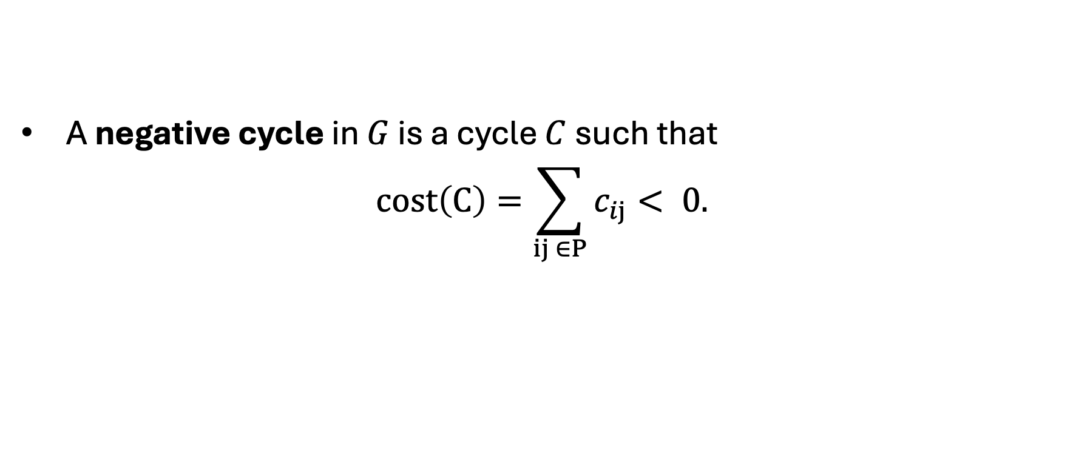
Negative Cycles
A negative cycle in $G$ is a cycle $C$ such that
$$cost\left(C\right)=\sum_{ij ∈P}{c_{ij}}< 0.$$
s
2
1
1
4
7
t
-1
-3
1

Slide 11
Negative Cycles
A negative cycle in $G$ is a cycle $C$ such that
$$cost\left(C\right)=\sum_{ij ∈P}{c_{ij}}< 0.$$
s
2
1
1
4
7
t
-1
-3
1

Slide 12
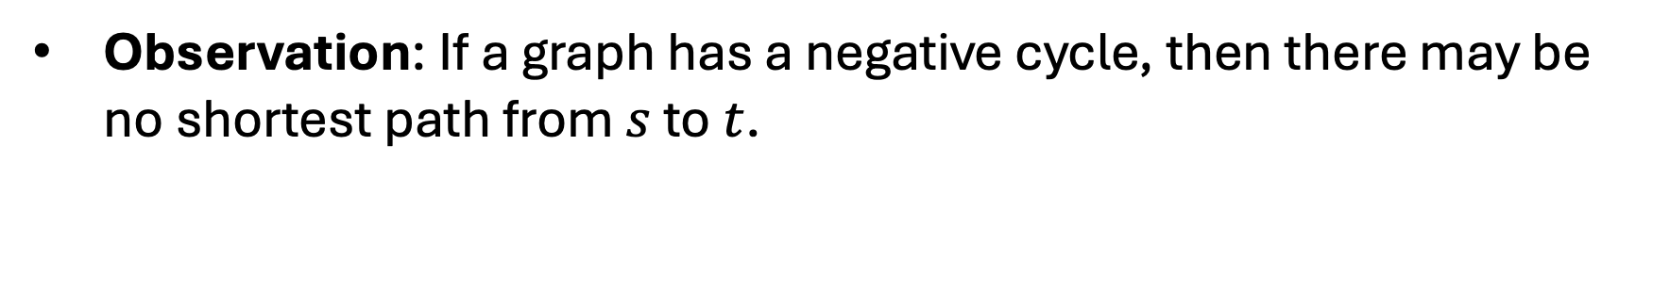
Negative Cycles
Observation: If a graph has a negative cycle, then there may be no shortest path from $s$ to $t$.
s
2
1
1
4
7
t
-1
-3
1

Slide 13
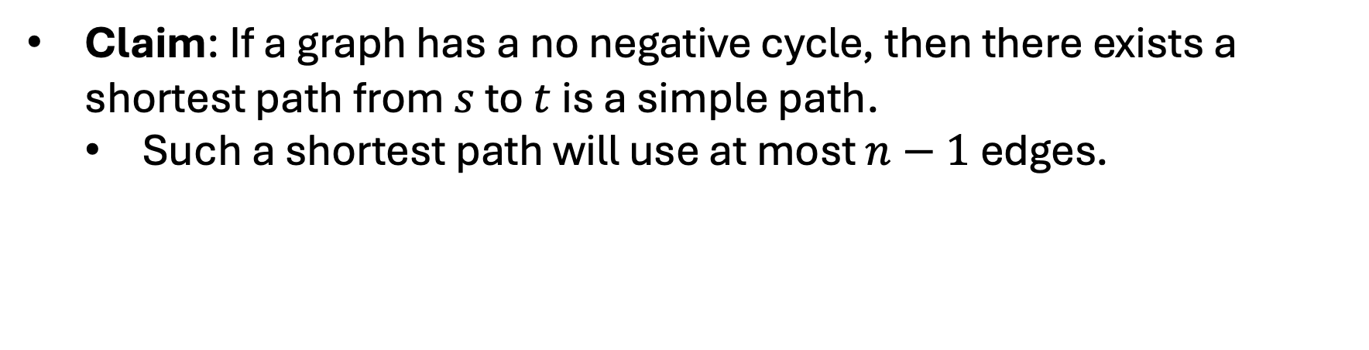
Negative Cycles
Claim: If a graph has a no negative cycle, then there exists a shortest path from $s$ to $t$ is a simple path.
Such a shortest path will use at most $n−1$ edges.
s
2
1
1
4
7
t
-1
-3
1

Slide 14
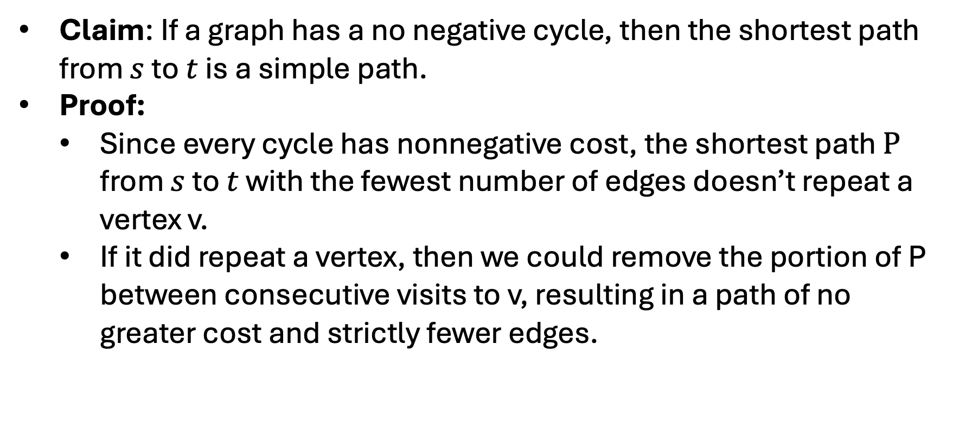
Negative Cycles
Claim: If a graph has a no negative cycle, then the shortest path from $s$ to $t$ is a simple path.
Proof:
Since every cycle has nonnegative cost, the shortest path $P$ from $s$ to $t$ with the fewest number of edges doesn’t repeat a vertex v.
If it did repeat a vertex, then we could remove the portion of P between consecutive visits to v, resulting in a path of no greater cost and strictly fewer edges.

Slide 15
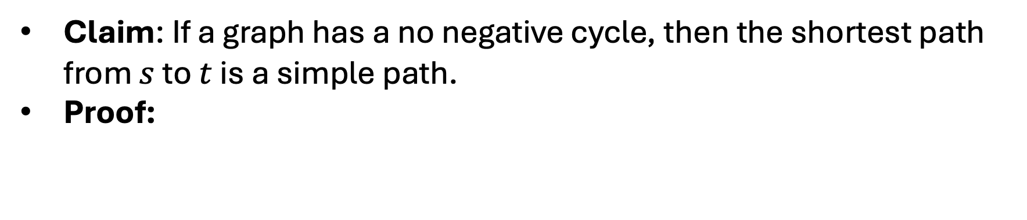
Negative Cycles
Claim: If a graph has a no negative cycle, then the shortest path from $s$ to $t$ is a simple path.
Proof:
s
t
P

Slide 16

Negative Cycles
Claim: If a graph has a no negative cycle, then the shortest path from $s$ to $t$ is a simple path.
Proof:
s
t
P

Slide 17
Negative Cycles
Claim: If a graph has a no negative cycle, then the shortest path from $s$ to $t$ is a simple path.
Proof:
s
t
P

Slide 18
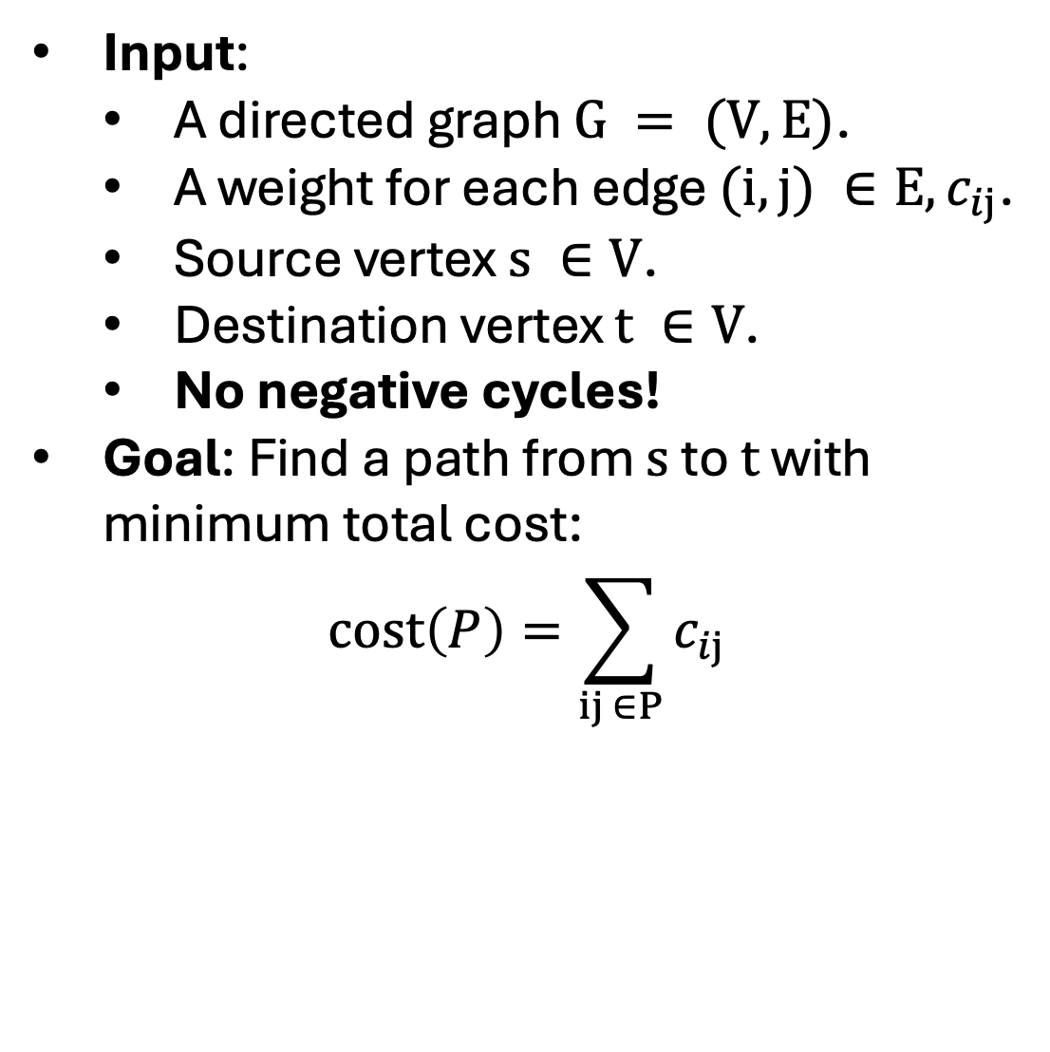
Shortest Path
Input:
A directed graph $G = (V,E)$.
A weight for each edge $(i,j) ∈E, c_{ij}$.
Source vertex $s ∈V$.
Destination vertex $t ∈V$.
No negative cycles!
Goal: Find a path from $s$ to $t$ with minimum total cost:
$$cost\left(P\right)=\sum_{ij ∈P}{c_{ij}}$$

Slide 19
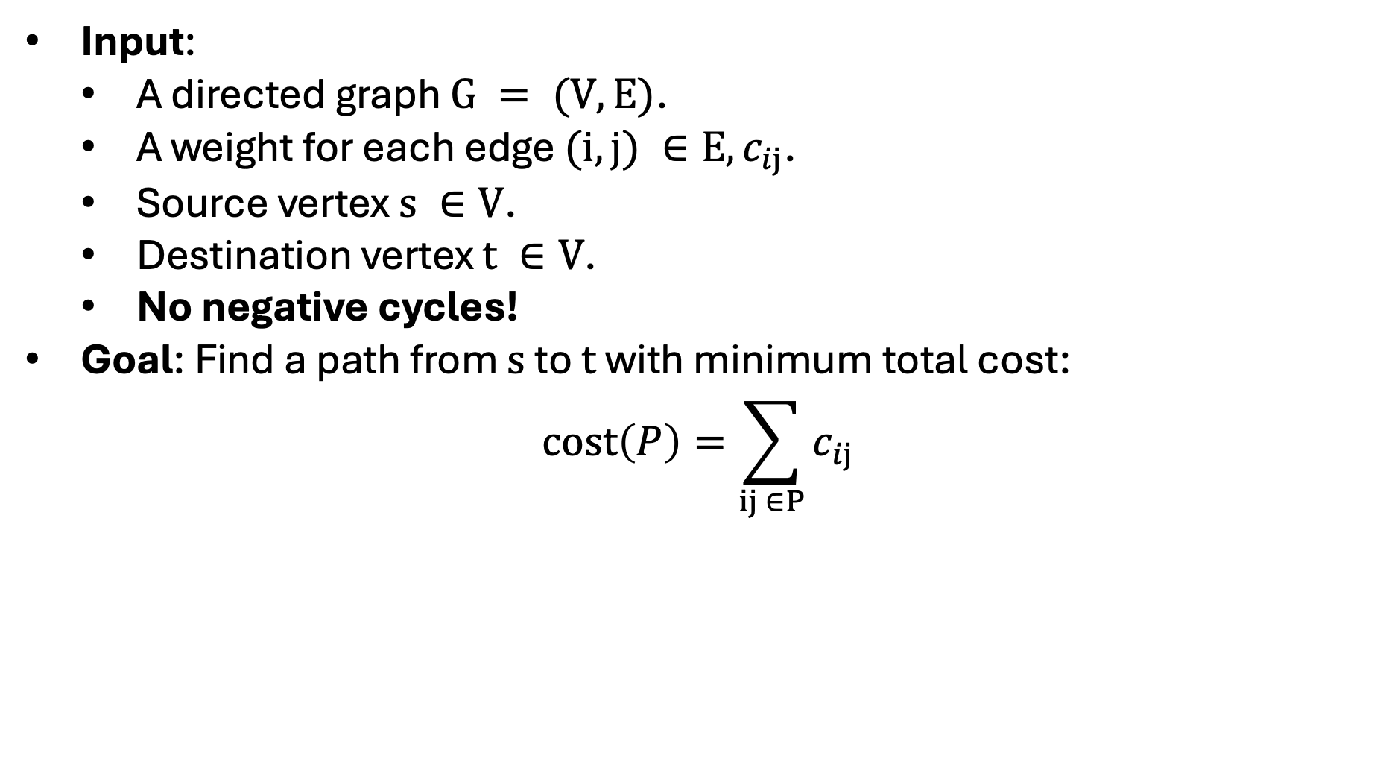
Shortest Path Subproblem
Input:
A directed graph $G = (V,E)$.
A weight for each edge $(i,j) ∈E, c_{ij}$.
Source vertex $s ∈V$.
Destination vertex $t ∈V$.
No negative cycles!
Goal: Find a path from $s$ to $t$ with minimum total cost:
$$cost\left(P\right)=\sum_{ij ∈P}{c_{ij}}$$

Slide 20
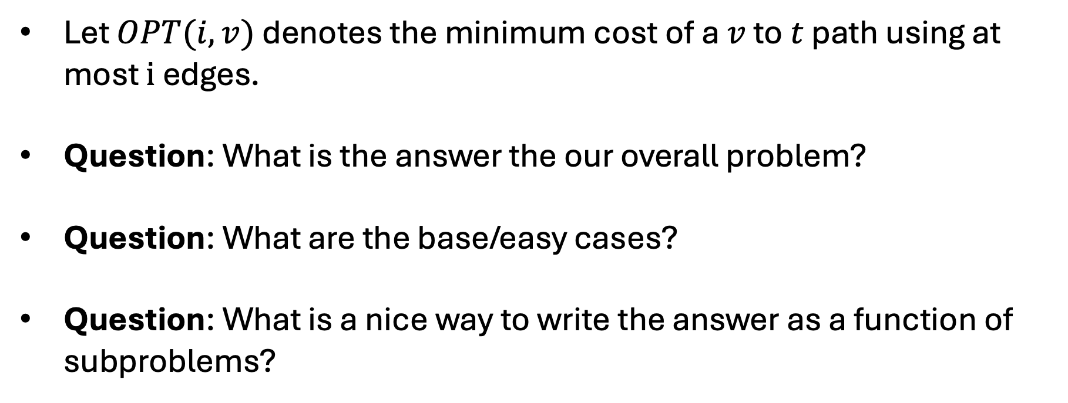
Shortest Path Subproblem
Let $OPT(i,v)$ denotes the minimum cost of a $v$ to $t$ path using at most $i$ edges.
Question: What is the answer the our overall problem?
Question: What are the base/easy cases?
Question: What is a nice way to write the answer as a function of subproblems?

Slide 21
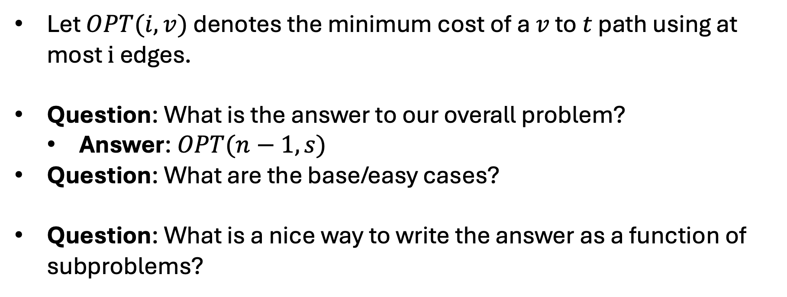
Shortest Path Subproblem
Let $OPT(i,v)$ denotes the minimum cost of a $v$ to $t$ path using at most $i$ edges.
Question: What is the answer to our overall problem?
Answer: $OPT(n−1,s)$
Question: What are the base/easy cases?
Question: What is a nice way to write the answer as a function of subproblems?

Slide 22
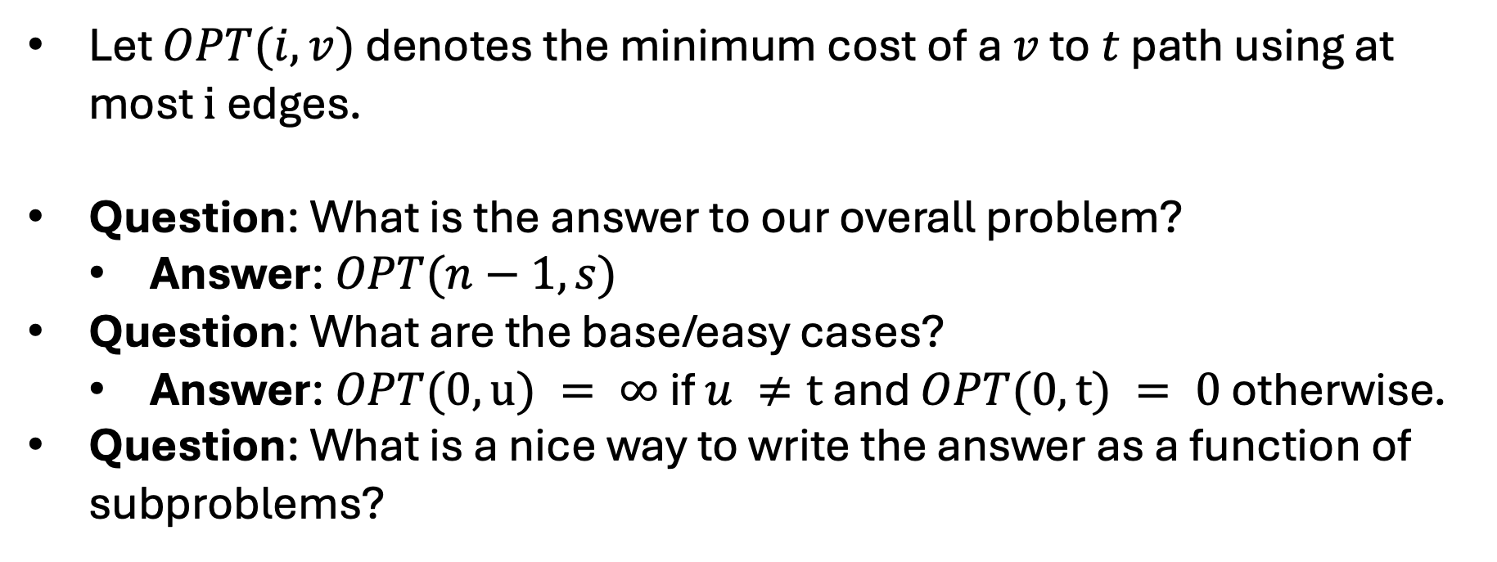
Shortest Path Subproblem
Let $OPT(i,v)$ denotes the minimum cost of a $v$ to $t$ path using at most $i$ edges.
Question: What is the answer to our overall problem?
Answer: $OPT(n−1,s)$
Question: What are the base/easy cases?
Answer: $OPT(0,u) = ∞$ if $u ≠t$ and $OPT(0,t) = 0$ otherwise.
Question: What is a nice way to write the answer as a function of subproblems?

Slide 23
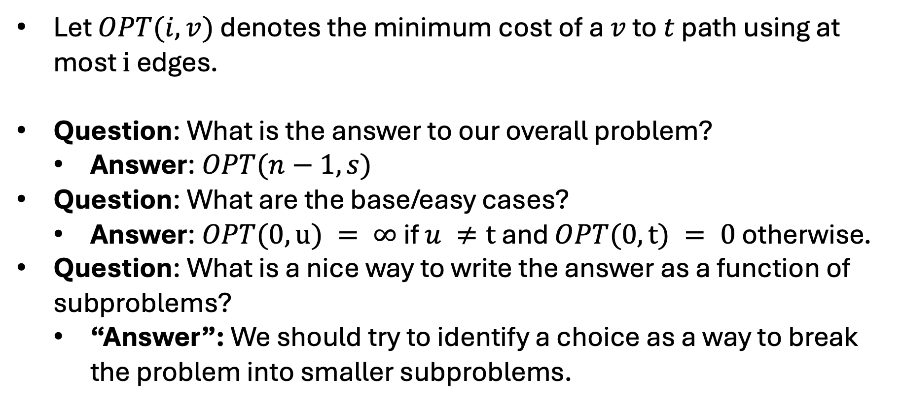
Shortest Path Subproblem
Let $OPT(i,v)$ denotes the minimum cost of a $v$ to $t$ path using at most $i$ edges.
Question: What is the answer to our overall problem?
Answer: $OPT(n−1,s)$
Question: What are the base/easy cases?
Answer: $OPT(0,u) = ∞$ if $u ≠t$ and $OPT(0,t) = 0$ otherwise.
Question: What is a nice way to write the answer as a function of subproblems?
“Answer”: We should try to identify a choice as a way to break the problem into smaller subproblems.

Slide 24
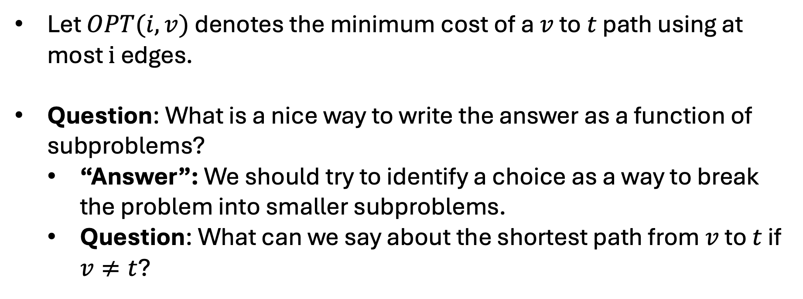
Shortest Path Subproblem
Let $OPT(i,v)$ denotes the minimum cost of a $v$ to $t$ path using at most $i$ edges.
Question: What is a nice way to write the answer as a function of subproblems?
“Answer”: We should try to identify a choice as a way to break the problem into smaller subproblems.
Question: What can we say about the shortest path from $v$ to $t$ if $v≠t$?

Slide 25
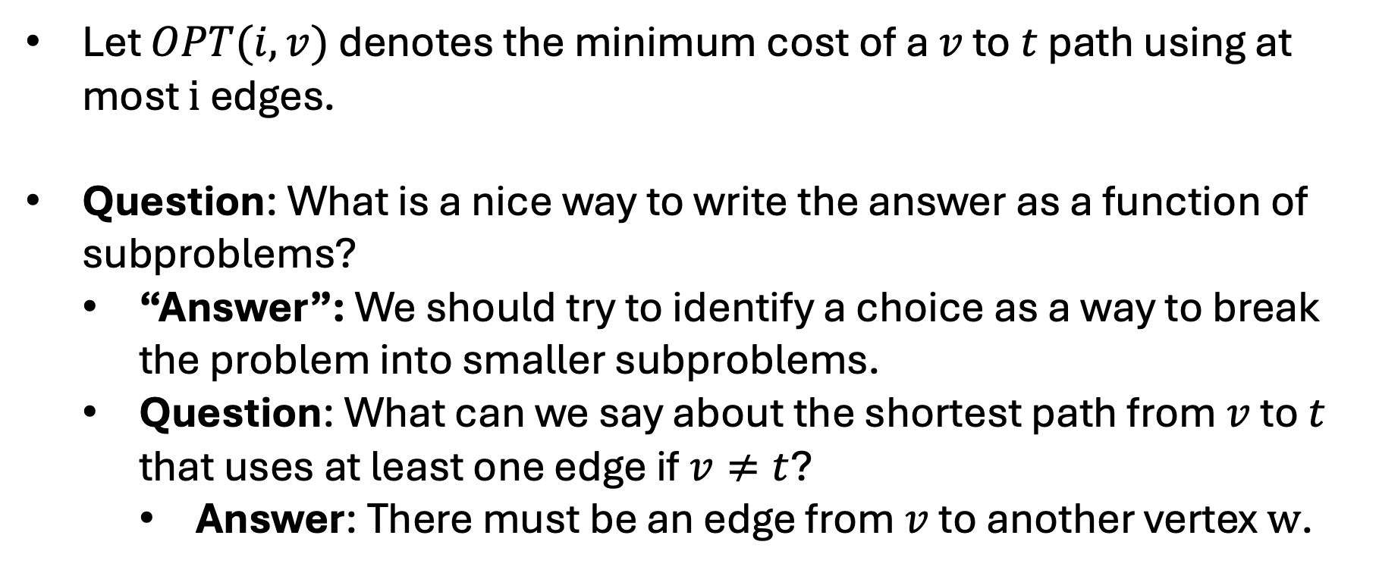
Shortest Path Subproblem
Let $OPT(i,v)$ denotes the minimum cost of a $v$ to $t$ path using at most $i$ edges.
Question: What is a nice way to write the answer as a function of subproblems?
“Answer”: We should try to identify a choice as a way to break the problem into smaller subproblems.
Question: What can we say about the shortest path from $v$ to $t$ that uses at least one edge if $v≠t$?
Answer: There must be an edge from $v$ to another vertex $w$.

Slide 26
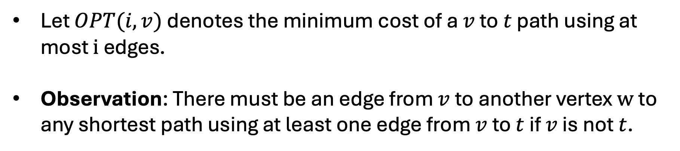
Shortest Path Subproblem
Let $OPT(i,v)$ denotes the minimum cost of a $v$ to $t$ path using at most $i$ edges.
Observation: There must be an edge from $v$ to another vertex $w$ to any shortest path using at least one edge from $v$ to $t$ if $v$ is not $t$.
v
2
w
1
1
4
7
t

Slide 27
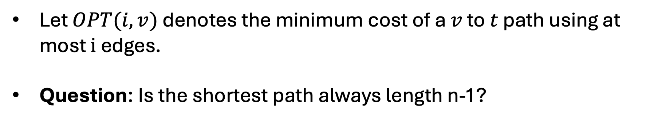
Shortest Path Subproblem
Let $OPT(i,v)$ denotes the minimum cost of a $v$ to $t$ path using at most $i$ edges.
Question: Is the shortest path always length n-1?
v
2
w
1
1
4
7
t

Slide 28
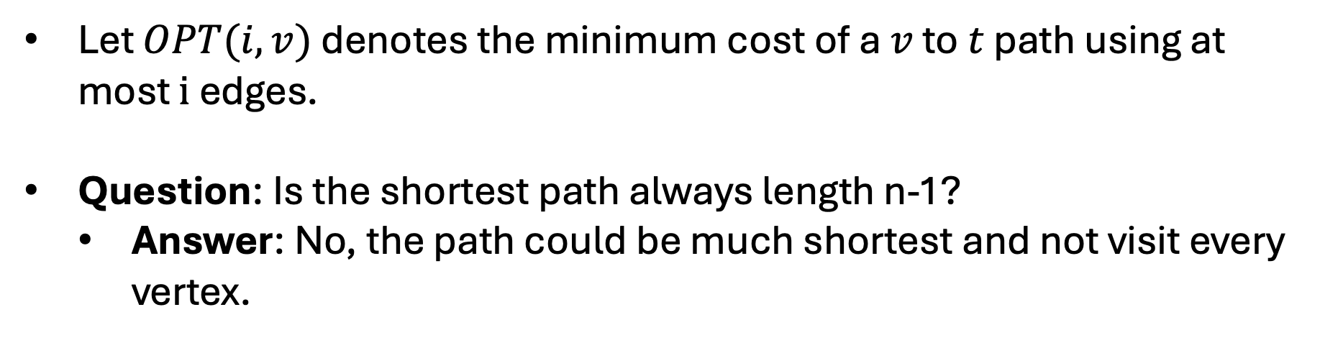
Shortest Path Subproblem
Let $OPT(i,v)$ denotes the minimum cost of a $v$ to $t$ path using at most $i$ edges.
Question: Is the shortest path always length n-1?
Answer: No, the path could be much shortest and not visit every vertex.
v
2
w
1
1
4
7
t

Slide 29
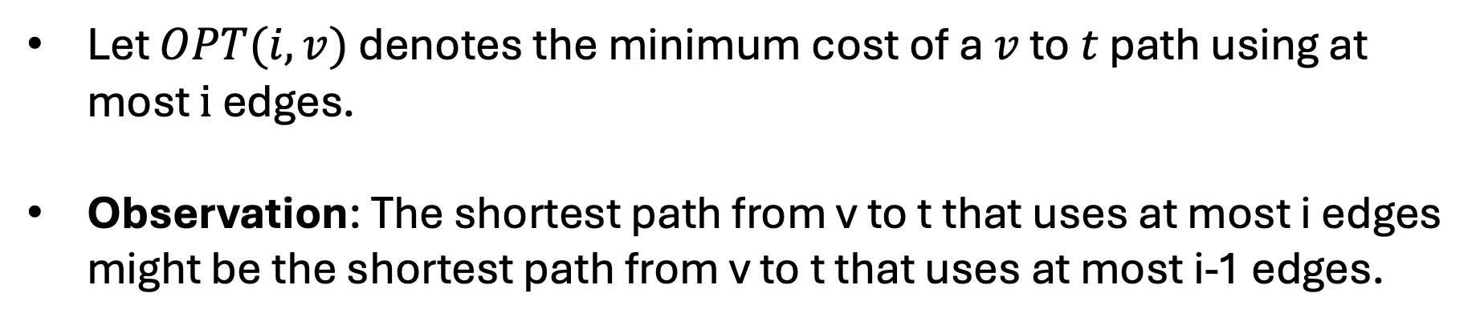
Shortest Path Subproblem
Let $OPT(i,v)$ denotes the minimum cost of a $v$ to $t$ path using at most $i$ edges.
Observation: The shortest path from v to t that uses at most i edges might be the shortest path from v to t that uses at most i-1 edges.
v
2
w
1
1
4
7
t

Slide 30
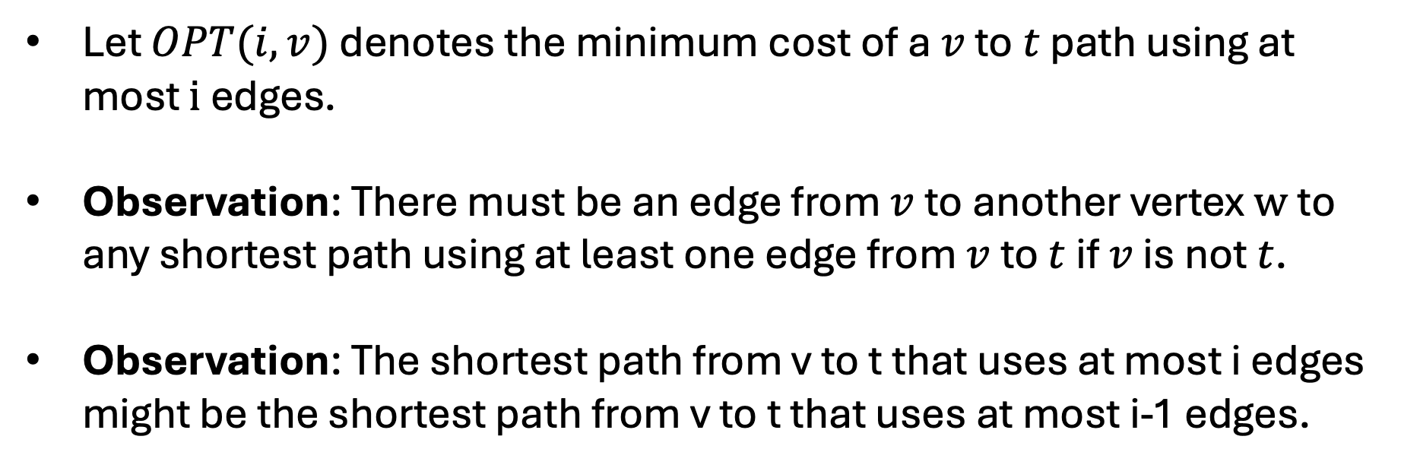
Shortest Path Subproblem
Let $OPT(i,v)$ denotes the minimum cost of a $v$ to $t$ path using at most $i$ edges.
Observation: There must be an edge from $v$ to another vertex $w$ to any shortest path using at least one edge from $v$ to $t$ if $v$ is not $t$.
Observation: The shortest path from v to t that uses at most i edges might be the shortest path from v to t that uses at most i-1 edges.

Slide 31
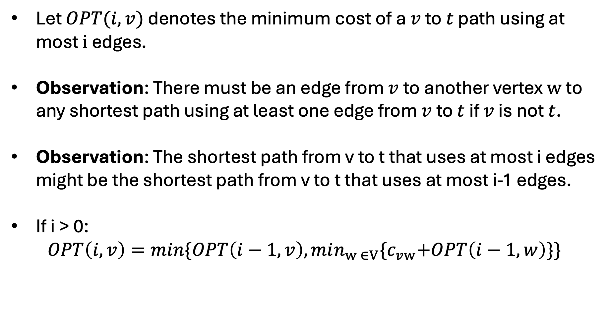
Shortest Path Recurrence
Let $OPT(i,v)$ denotes the minimum cost of a $v$ to $t$ path using at most $i$ edges.
Observation: There must be an edge from $v$ to another vertex $w$ to any shortest path using at least one edge from $v$ to $t$ if $v$ is not $t$.
Observation: The shortest path from v to t that uses at most i edges might be the shortest path from v to t that uses at most i-1 edges.
If i > 0:
$$OPT\left(i,v\right)=min\{OPT\left(i−1,v\right),min_{w ∈V}{\{c}_{vw}+OPT\left(i−1,w\right)\}\}$$

Slide 32
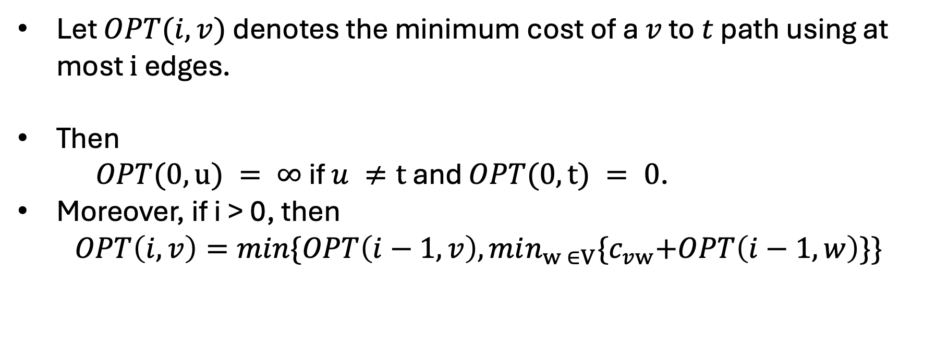
Shortest Path Ordering
Let $OPT(i,v)$ denotes the minimum cost of a $v$ to $t$ path using at most $i$ edges.
Then
$OPT(0,u) = ∞$ if $u ≠t$ and $OPT(0,t) = 0$.
Moreover, if i > 0, then
$$OPT\left(i,v\right)=min\{OPT\left(i−1,v\right),min_{w ∈V}{\{c}_{vw}+OPT\left(i−1,w\right)\}\}$$

Slide 33
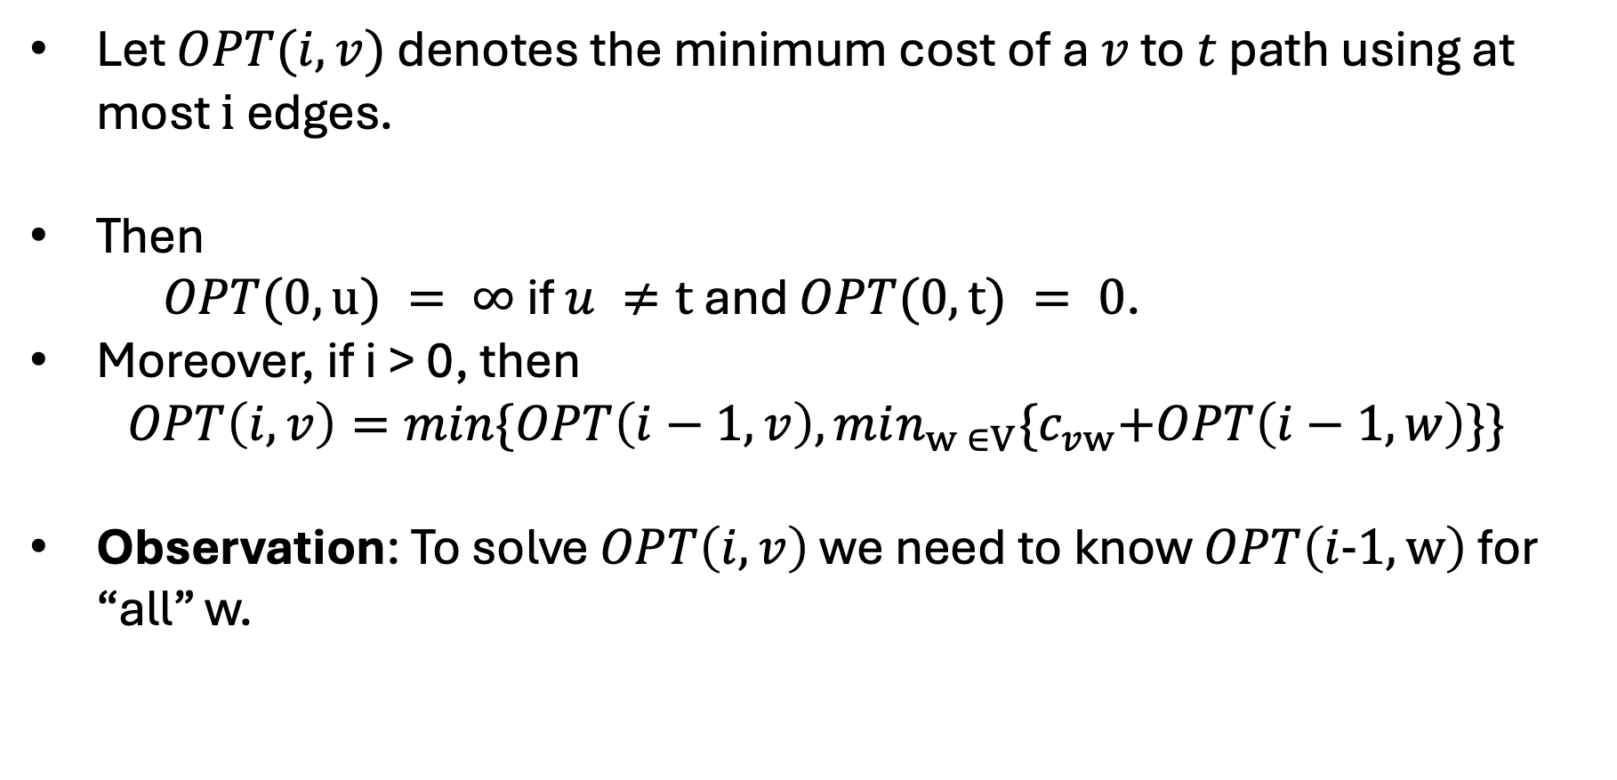
Shortest Path Ordering
Let $OPT(i,v)$ denotes the minimum cost of a $v$ to $t$ path using at most $i$ edges.
Then
$OPT(0,u) = ∞$ if $u ≠t$ and $OPT(0,t) = 0$.
Moreover, if i > 0, then
$$OPT\left(i,v\right)=min\{OPT\left(i−1,v\right),min_{w ∈V}{\{c}_{vw}+OPT\left(i−1,w\right)\}\}$$
Observation: To solve $OPT\left(i,v\right)$ we need to know $OPT\left(i-1,w\right)$ for “all” w.

Slide 34
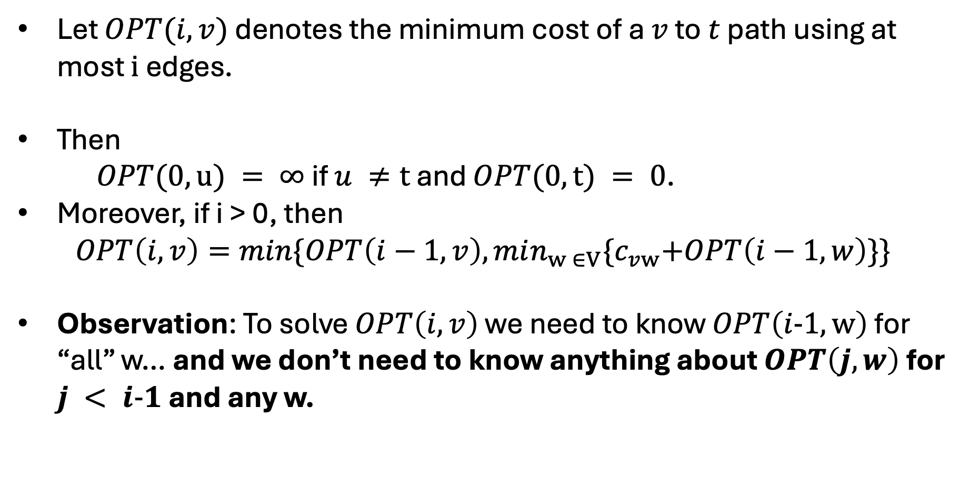
Shortest Path Ordering
Let $OPT(i,v)$ denotes the minimum cost of a $v$ to $t$ path using at most $i$ edges.
Then
$OPT(0,u) = ∞$ if $u ≠t$ and $OPT(0,t) = 0$.
Moreover, if i > 0, then
$$OPT\left(i,v\right)=min\{OPT\left(i−1,v\right),min_{w ∈V}{\{c}_{vw}+OPT\left(i−1,w\right)\}\}$$
Observation: To solve $OPT\left(i,v\right)$ we need to know $OPT\left(i-1,w\right)$ for “all” w… and we don’t need to know anything about $OPT\left(j,w\right)$ for $j < i-1$ and any w.

Slide 35
Shortest Path Algorithm
Shortest-Path(G,s,t):
N = number of nodes in G
2D Array M of length n x n
Set M[0,t] = ?
Set M[0,v] = ? for all v not t
For i = 1,...,n-1:
For v in V:
Compute M[i,v] using ?
Return ?

Slide 36
Shortest Path Algorithm
Shortest-Path(G,s,t):
N = number of nodes in G
2D Array M of length n x n
Set M[0,t] = 0
M[0,v] = INF for all v not t
For i = 1,...,n-1:
For v in V:
Compute M[i,v] using recurrence
Return M[n-1,s]

Slide 37
Shortest Path Algorithm
Shortest-Path(G,s,t):
N = number of nodes in G
2D Array M of length n x n
Set M[0,t] = 0
M[0,v] = INF for all v not t
For i = 1,...,n-1:
For v in V:
Compute M[i,v] using recurrence
Return M[n-1,s]
It is easy to see this algorithm has runtime at most O(n^3).

Slide 38
Shortest Path Algorithm
Shortest-Path(G,s,t):
N = number of nodes in G
2D Array M of length n x n
Set M[0,t] = 0
M[0,v] = INF for all v not t
For i = 1,...,n-1:
For v in V:
Compute M[i,v] using recurrence
Return M[n-1,s]
It is easy to see this algorithm has runtime at most O(n^3).

Slide 39
Shortest Path Algorithm
Shortest-Path(G,s,t):
N = number of nodes in G
2D Array M of length n x n
Set M[0,t] = 0
M[0,v] = INF for all v not t
For i = 1,...,n-1:
For v in V:
Compute M[i,v] using recurrence
Return M[n-1,s]
It isn’t too hard to see this algorithm has runtime at most O(nm) if we only consider neighbors on line 6.

Slide 40
Getting the Shortest Path with M
Question: How do we find the shortest path of length at most I form s to t given M?
Shortest-Path(G,s,t):
N = number of nodes in G
2D Array M of length n x n
Set M[0,t] = 0
M[0,v] = INF for all v not t
For i = 1,...,n-1:
For v in V:
Compute M[i,v] using recurrence
Return M[n-1,s]

Slide 41
Getting the Shortest Path with M
Answer: It takes O(in) time to track back optimal choices.
Find-Shortest-Path(i,v,M):
If i == 0 (and v == t):
Return [t]
Else if M[i,v] == M[i-1,v]:
Return Find-Shortest-Path(i-1,v,M)
Else:
Find w such that M[i,v] == c[v,w] + M[i-1,w]
Return [w] ++ Find-Shortest-Path(i-1,w,M)

Slide 42
Shortest Path Better Space
Let $OPT(i,v)$ denotes the minimum cost of a $v$ to $t$ path using at most $i$ edges.
Then
$OPT(0,u) = ∞$ if $u ≠t$ and $OPT(0,t) = 0$.
Moreover, if i > 0, then
$$OPT\left(i,v\right)=min\{OPT\left(i−1,v\right),min_{w ∈V}{\{c}_{vw}+OPT\left(i−1,w\right)\}\}$$
Observation: To solve $OPT\left(i,v\right)$ we need to know $OPT\left(i-1,w\right)$ for “all” w… and we don’t need to know anything about $OPT\left(j,w\right)$ for $j < i-1$ and any w.

Slide 43
Shortest Path Better Space
Shortest-Path(G,s,t):
N = number of nodes in G
2D Array M of length 2 x n
Set M[0,t] = 0
M[0,v] = INF for all v not t
For i = 1,...,n-1:
For v in V:
Compute M[1,v] using recurrence
M[0,v] = M[1,v] for all v.
Return M[0,s]

Slide 44
Shortest Path Better Space
Shortest-Path(G,s,t):
N = number of nodes in G
2D Array M of length 2 x n
Set M[0,t] = 0
M[0,v] = INF for all v not t
For i = 1,...,n-1: <- Still doing this n-1 times
For v in V:
Compute M[1,v] using recurrence
M[0,v] = M[1,v] for all v.
Return M[0,s]

Slide 45
Bellman-Ford Algorithm
Runs in time O(n(n+m)) time and uses at most O(n) space.
Shortest-Path(G,s,t):
N = number of nodes in G
2D Array M of length 2 x n
Set M[0,t] = 0
M[0,v] = INF for all v not t
For i = 1,...,n-1: <- Still doing this n-1 times
For v in V:
Compute M[1,v] using recurrence
M[0,v] = M[1,v] for all v.
Return M[0,s]

