Slide 1

CSE 331:
Algorithms & Complexity
“Reductions”
Prof. Charlie Anne Carlson (She/Her)
Lecture34
Friday Nov 21st, 2025

Slide 2

Schedule
Course Updates
Recap
Hardness
Reductions

Slide 3

Course Updates
HW 8 Out
  Due December 2nd
Group Project (Autolab Up)
  Groups Fixed
  Code 3 Due November 24th
  Reflections 3 Due December 1st
Next Quiz is December 1st
Final on December 10th (Info Next Week)

Slide 4
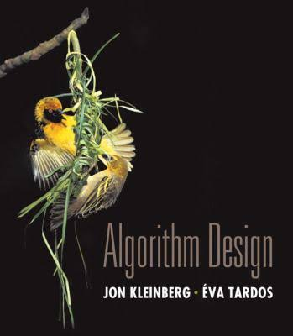
Reading
You should have read:
  Started 8.1
Before Next Class:
  Finish 8.1
  Start 8.2, 8.3, & 8.4

Slide 5
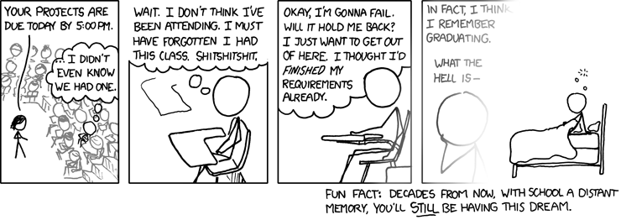
Schedule
https://xkcd.com/557/

Slide 6
Schedule
Monday Nov. 24th : P vs NP
Wednesday Nov. 26th : No Class
Friday Nov. 28th : No Class
Monday Dec. 1st : NP-Completeness
Wednesday Dec. 3rd : Satisfiability
Friday Dec. 5th : COLORING!!!!!!!
Monday Dec. 8th : Wrapup

Slide 7

Deadlines
Monday Nov. 24th :
  Project Code Problem 3
Monday Dec. 1st :
  Project Reflection Problem 3
  Quiz 2 (in class)
Tuesday Dec. 2nd :
  HW 8
Friday Dec. 5th :
  Project Code Problem 4 & 5
Tuesday Dec. 9th :
  Project Reflection Problem 4 & 5
  Project Survey
Wednesday Dec. 10th :
  Final Exam

Slide 8
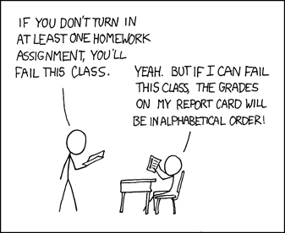
Feedback
Monday Nov. 24th :
  HW 6 Graded
  HW 6 & HW 7 Solutions Posted
  Reflection Problem 2 Graded
  Practice Final & Practice Quiz 2
Monday Dec. 1st :
  HW 7 Graded
  Project Reflection Problem 1 Graded
Tuesday Dec. 2nd :
  HW 8 Solutions Posted
Monday Dec. 10th :
  HW 8 Graded
  Reflection Problem 3 Graded
https://xkcd.com/336/

Slide 9
A Few Notes
Please ping me if you are still waiting for me to respond to an email. I think I caught up on most of them but if you have fallen through the cracks, let’s get it settled ASAP.
If you are going to miss the final exam (for an acceptable reason) let me know ASAP via email.
You will be given assigned seating for the final and must plan to bring your school ID.

Slide 10
Course Overview
Stable Matchings
Analysis
Graphs
Greedy Algorithms
Divide and Conquer
Dynamics Programming
NP and Computational Intractability
What can be done!
What can’t be done!

Slide 11

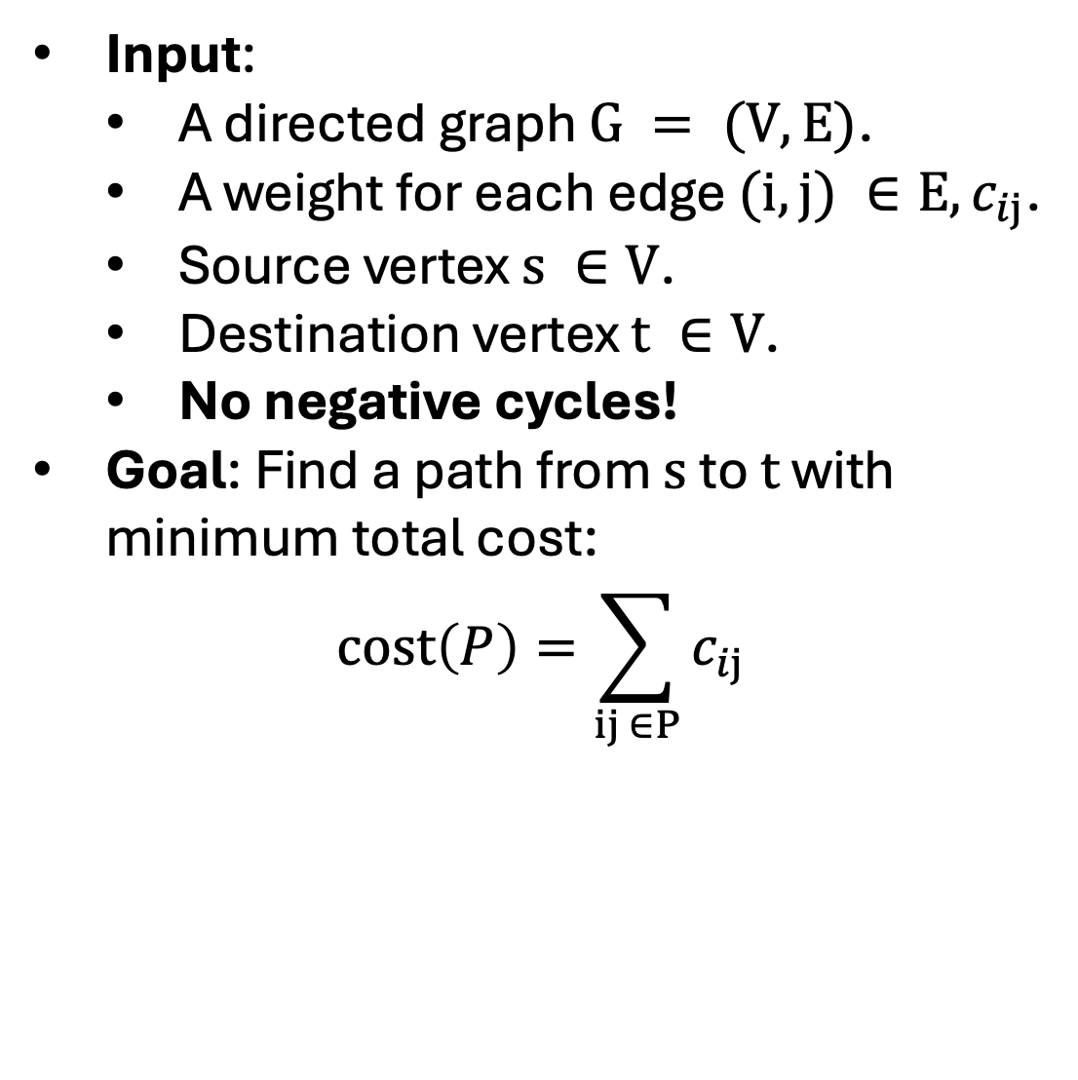
Shortest Path
Input:
  A directed graph $G = (V,E)$.
  A weight for each edge $(i,j) ∈E, c_{ij}$.
  Source vertex $s ∈V$.
  Destination vertex $t ∈V$.
  No negative cycles!
Goal: Find a path from $s$ to $t$ with minimum total cost:
$$cost\left(P\right)=\sum_{ij ∈P}{c_{ij}}$$

Slide 12
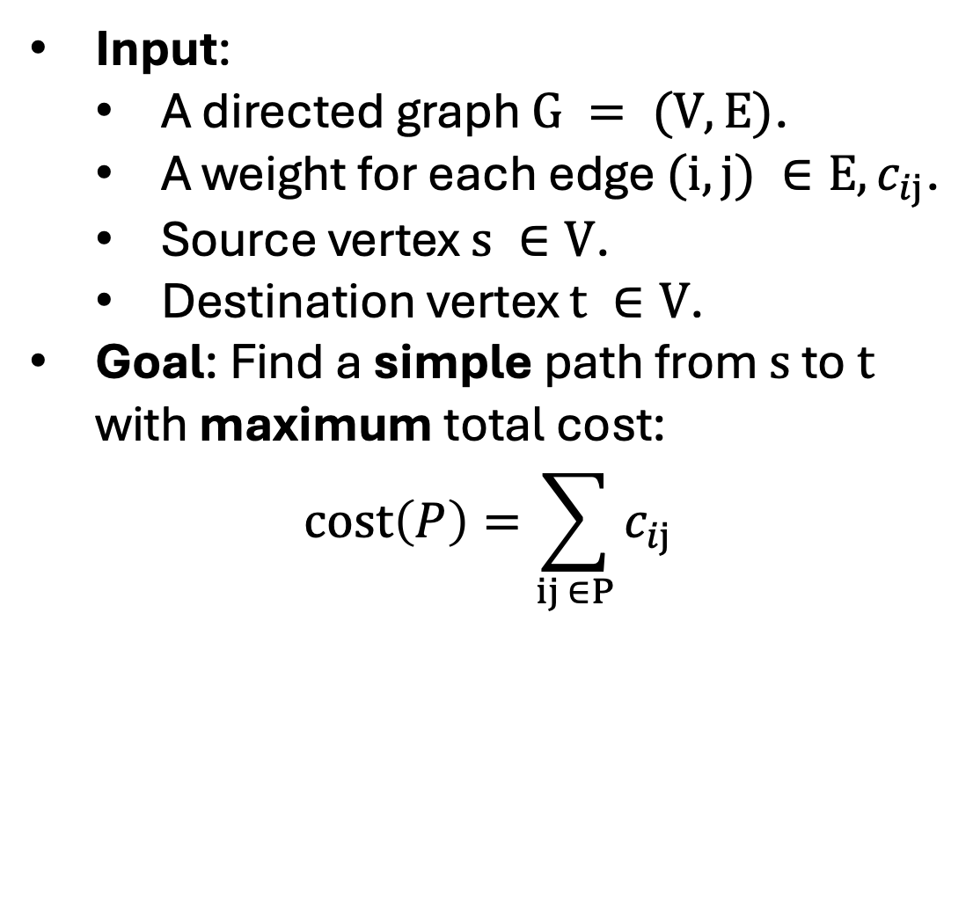
Longest Path
Input:
  A directed graph $G = (V,E)$.
  A weight for each edge $(i,j) ∈E, c_{ij}$.
  Source vertex $s ∈V$.
  Destination vertex $t ∈V$.
Goal: Find a simple path from $s$ to $t$ with maximum total cost:
$$cost\left(P\right)=\sum_{ij ∈P}{c_{ij}}$$

Slide 13

How hard could it be?

Slide 14
How hard could it be?
We have a polynomial time algorithm for the shortest path problem.
  BFS, Dijkstra’s, Bellman-Ford
We “believe” there is no polynomial time algorithm for the longest path problem.
  We say “believe” because we don’t know exactly but more on that soon…

Slide 15
Decision vs Optimization Problem
We have seen a lot of optimization problems in this class that ask for things like shortest, longest, or maximum weight objects.
  An optimization problem asks to find the “best” object in a set.

Slide 16
Decision vs Optimization Problem
We have seen a lot of optimization problems in this class that ask for things like shortest, longest, or maximum weight objects.
  An optimization problem asks to find the “best” object in a set.
We haven’t talked about decision problems as much which ask if there exist an object with specific property.

Slide 17
Decision vs Optimization Problem
Shortest Path Optimization Problem:
  What is the shortest path between s and t?
Shortest Path Decision Problem:
  Given a weight W, does there exist a path of length at most W between s and t?
Question: If you can solve one, can you solve the other?

Slide 18
Decision vs Optimization Problem
Shortest Path Optimization Problem:
  What is the shortest path between s and t?
Shortest Path Decision Problem:
  Given a weight W, does there exist a path of length at most W between s and t?
Question: If you can solve one, can you solve the other?
  Answer: Yes, check if shortest path is shortest or do a search.

Slide 19

Witness or Certificate
Question: How would you prove that there is a shortest path of length at most W?

Slide 20
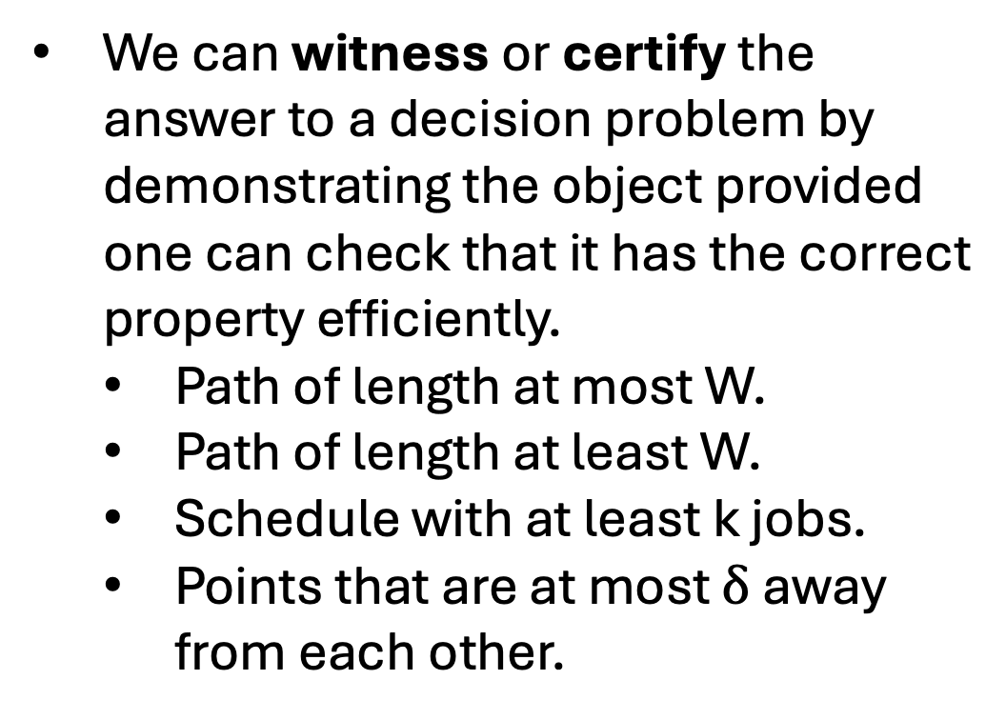
Witness or Certificate
We can witness or certify the answer to a decision problem by demonstrating the object provided one can check that it has the correct property efficiently.
  Path of length at most W.
  Path of length at least W.
  Schedule with at least k jobs.
  Points that are at most $δ$ away from each other.

Slide 21
P and NP
P: Decision problems for which there exist a polynomial time algorithm that solves it.
NP: Decision problems for which there is always a polynomial time verifiable certificate for the solution.
P ? NP

Slide 22
What?
P: “I can find the solution efficiently.”
NP: “I can verify the solution efficiently.”
P ? NP

Slide 23
NP = Nondeterministic Polynomial time
Question: If you can verify the solution quickly, how can you find the solution? How quick is it?
P ? NP

Slide 24
NP = Nondeterministic Polynomial time
Question: If you can verify the solution quickly, how can you find the solution? How quick is it?
Answer: I can guess/enumerate all possible solutions and efficiently check them to see if they are solutions. It is slow….
P ? NP

Slide 25
P vs NP
Both P and NP are sets of problems (languages).
We know that P is a subset of NP.
We don’t know if P = NP and if you solve this, you get money, fame, and respect!
P vs NP

Slide 26
P vs NP
People have been working on P vs NP for a long time.
While some may be less sure that P != NP, we can mostly all agree that even if it is, there are problems in NP that are going to be very “hard.”
Question: What might it help to know a problem is ”hard”?
P vs NP

Slide 27
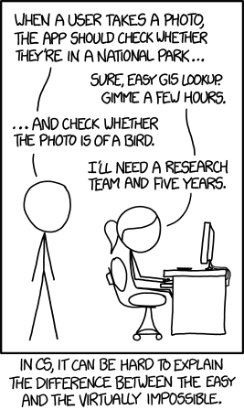
P vs NP
Question: What might it help to know a problem is ”hard”?
  Answer: We don’t want to waste time trying to solve problems that we know are very hard to solve.
https://xkcd.com/1425/

Slide 28
Reductions
You are given a network of computers to manage.
  You are given a list of computers along with a list of which computer are directly connected to each.
  Each connection has a cost for sending data over it.
Each computer has a unique archive of information.
Your boss wants you to figure out a way to find the cheapest way to send information from one computer to another upon request.

Slide 29
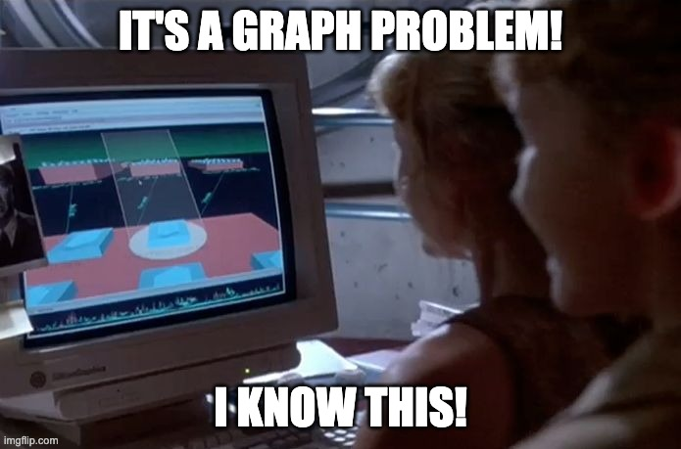
Reductions
You are given a network of computers to manage.
  You are given a list of computers along with a list of which computer are directly connected to each.
  Each connection has a cost for sending data over it.
Each computer has a unique archive of information.
Your boss wants you to figure out a way to find the cheapest way to send information from one computer to another upon request.

Slide 30
Reductions
You can easily map this to a graph problem.
  Each computer is a node in a graph where each direct connection is an edge.
  The cost of sending data across connection is a weight for the edge.
  Then finding the cheapest way to route data is just the shortest path problem.
    I know an algorithm for shortest path in this case!

Slide 31
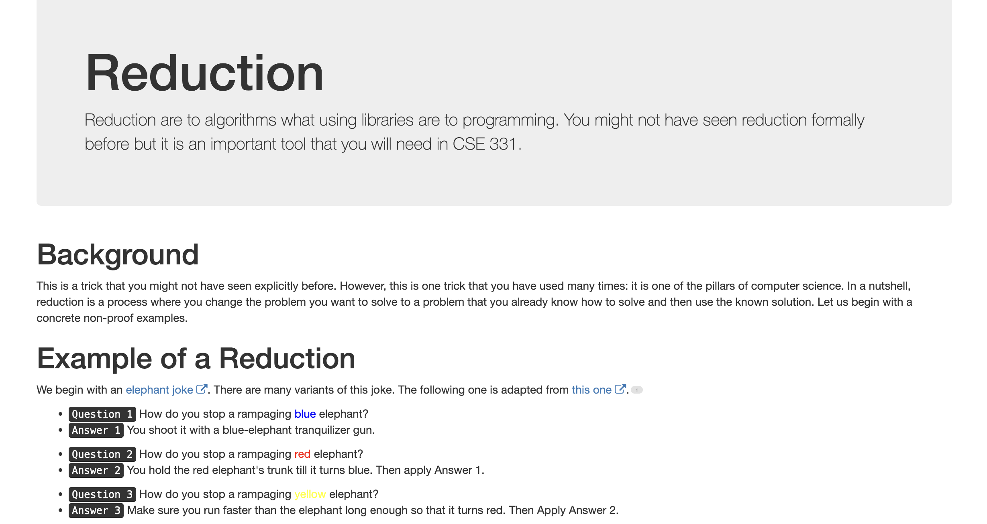
Reductions

Slide 32
Reasons to use Reduction
You want to show something is easy/possible:
  You have a real-world problem, and you want to reduce it to a simple graph problem you know how to solve.
  You have a new graph problem that seems harder but isn’t.
  You may also want to show how to use already existing algorithms for none graph problems.

Slide 33
Reasons to use Reduction
You want to show something is hard/impossible:
  Reductions give you a formal way to show that a problem may not be possible to solve.
  We may not have a proof that a problem is actually hard, but we do know that people have been trying for a long time to solve it with no success.
    If you have a new problem, you don’t want to have to fail to solve it for years to justify not being able to solve it. Instead, you reduce.

Slide 34

Oracles
Consider a problem X
  E.g. Shortest path, longest path, stable matching, coloring, sorting, etc.
Note that X has some input and desired output
  E.g. Graph + Weights => Shortest Path
An oracle is a black box that can solve X on any input.

Slide 35
Reduction
Consider problem Y that we assume can be solved in poly time.
Question: How can we use this assumption about Y to show that another problem is easy?

Slide 36
Reduction
Problem X polynomial-time (cook) reduces to problem Y if arbitrary instances of problem X can be solved using:
  Polynomial number of computational steps, plus
  Polynomial number of calls to an oracle that solves problem Y.

Slide 37
Reduction
Problem X polynomial-time (cook) reduces to problem Y if arbitrary instances of problem X can be solved using:
  Polynomial number of computational steps, plus
  Polynomial number of calls to an oracle that solves problem Y.
Instance I of X
Reduction
Oracle for Y
Reduction
Solution S of X
Algorithm for X

Slide 38
Reduction
We want both parts of the reduction to run in polynomial time.
  First part converts instance I of X to an instance J of Y.
  Second part converts solution T of Y to a solution S of X.
Instance I of X
Reduction
Oracle for Y
Reduction
Solution S of X
Algorithm for X

Slide 39

Reduction ($X≤_{p}Y$)
If we can prove that both parts of the reduction run in polynomial time, then if there is a polynomial time algorithm for Y there is a polynomial time algorithm for X.
“Problem X is at most as hard as Y with respect to poly-time.”
Instance I of X
Reduction
Oracle for Y
Reduction
Solution S of X
Algorithm for X

Slide 40
Reduction ($X≤_{p}Y$)
If we know there is no efficient algorithm for X, then it follows that there can’t be an efficient algorithm for Y.
“Problem X is at most as hard as Y with respect to poly-time.”
Instance I of X
Reduction
Oracle for Y
Reduction
Solution S of X
Algorithm for X

