Slide 1

CSE 331: Algorithms & Complexity
“NP-Completeness”
Prof. Charlie Anne Carlson (She/Her)
Lecture 35 – 37
November 24th 2025, Dec 1st 2025, and Dec 3rd 2025

Slide 2

Schedule
Course Updates
Recap
Hardness
Reductions
P vs NP
Completeness
NP-Complete Problems

Slide 3

Course Updates
HW 8 Out
Due December 2nd
Group Project (Autolab Up)
Groups Fixed
Reflections 3 Due December 3rd
Quiz is Today
Final on December 10th

Slide 4
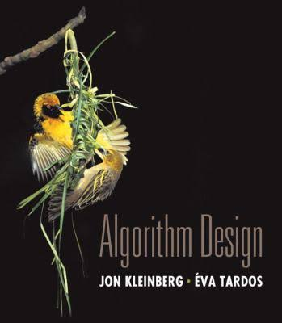
Reading
You should have read:
Finished 8.1
Finished 8.2
Finished 8.3
Finished 8.4
Before Next Class:
Finish 8.7

Slide 5
Schedule
Monday Nov. 24th : P vs NP
Wednesday Nov. 26th : No Class
Friday Nov. 28th : No Class
Monday Dec. 1st : NP-Completeness
Wednesday Dec. 3rd : Satisfiability
Friday Dec. 5th : Warpup
Monday Dec. 8th : “Review”

Slide 6

Deadlines
Monday Dec. 1st :
Quiz 2 (in class)
Tuesday Dec. 2nd :
HW 8
Problem 3 -> December 4th
Tuesday Dec. 3rd :
Project Reflection Problem 3
Friday Dec. 7th :
Project Code Problem 4 & 5 (updated)
Tuesday Dec. 9th :
Project Reflection Problem 4 & 5
Project Survey
Wednesday Dec. 10th :
Final Exam

Slide 7
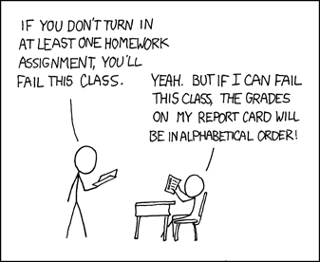
Goals:
End of Week:
HW 7 Graded
HW 8 Solutions
Quiz 2 Solutions
Before Next Week:
Project Reflection Problem 1 Graded
Before End of Next Week:
HW 8 Graded
Quiz 2 Graded
Reflection Graded
Before End of Following Week
Exam Graded
Final Grades Posted
https://xkcd.com/336/

Slide 8
Final
If you need to miss the final, let me know ASAP because I am scheduling a time for people with valid excuses now.
It will be 2 hours and 30 minutes
One part but both kinds of questions
Covers entire class
You will get two review sheets!
Bring ID and expected to be assigned a seat

Slide 9

Decision vs Optimization Problem
We have seen a lot of optimization problems in this class that ask for things like shortest, longest, or maximum weight objects.
An optimization problem asks to find the “best” object in a set.
We haven’t talked about decision problems as much which ask if there exist an object with specific property.

Slide 10
Decision vs Optimization Problem
Shortest Path Optimization Problem:
What is the shortest path between s and t?
Shortest Path Decision Problem:
Given a weight W, does there exist a path of length at most W between s and t?
Question: If you can solve one, can you solve the other?
Answer: Yes, check if shortest path is shortest or do a search.

Slide 11

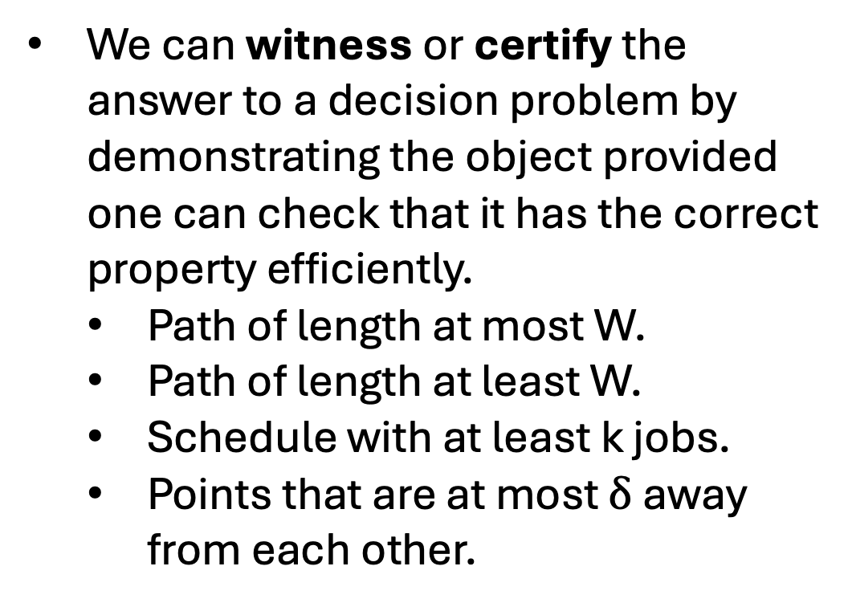
Witness or Certificate
We can witness or certify the answer to a decision problem by demonstrating the object provided one can check that it has the correct property efficiently.
Path of length at most W.
Path of length at least W.
Schedule with at least k jobs.
Points that are at most $δ$ away from each other.

Slide 12
P and NP
P: Decision problems for which there exist a polynomial time algorithm that solves it.
NP: Decision problems for which there is always a polynomial time verifiable certificate for the solution.
P ? NP

Slide 13
P vs NP
Both P and NP are sets of problems (languages).
We know that P is a subset of NP.
We don’t know if P = NP and if you solve this, you get money, fame, and respect!
P vs NP

Slide 14
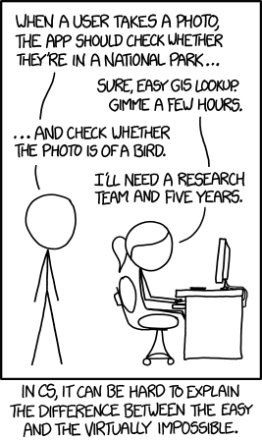
P vs NP
Question: What might it help to know a problem is ”hard”?
Answer: We don’t want to waste time trying to solve problems that we know are very hard to solve.
https://xkcd.com/1425/

Slide 15
Reductions Example
You are given a network of computers to manage.
You are given a list of computers along with a list of which computer are directly connected to each.
Each connection has a cost for sending data over it.
Each computer has a unique archive of information.
Your boss wants you to figure out a way to find the cheapest way to send information from one computer to another upon request.

Slide 16
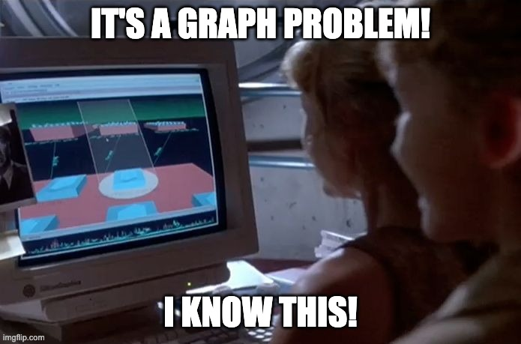
Reductions
You are given a network of computers to manage.
You are given a list of computers along with a list of which computer are directly connected to each.
Each connection has a cost for sending data over it.
Each computer has a unique archive of information.
Your boss wants you to figure out a way to find the cheapest way to send information from one computer to another upon request.

Slide 17
Reductions
You can easily map this to a graph problem.
Each computer is a node in a graph where each direct connection is an edge.
The cost of sending data across connection is a weight for the edge.
Then finding the cheapest way to route data is just the shortest path problem.
I know an algorithm for shortest path in this case!

Slide 18
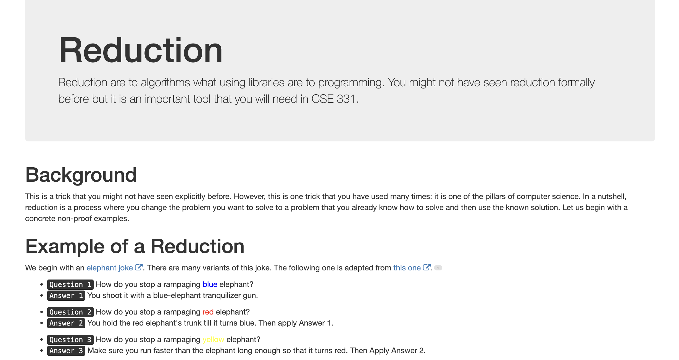
Reductions

Slide 19
Reasons to use Reduction I
You want to show something is easy/possible:
You have a real-world problem, and you want to reduce it to a simple graph problem you know how to solve.
You have a new graph problem that seems harder but isn’t.
You may also want to show how to use already existing algorithms for none graph problems.

Slide 20
Reasons to use Reduction II
You want to show something is hard/impossible:
Reductions give you a formal way to show that a problem may not be possible to solve.
We may not have a proof that a problem is actually hard, but we do know that people have been trying for a long time to solve it with no success.
If you have a new problem, you don’t want to have to fail to solve it for years to justify not being able to solve it. Instead, you reduce.

Slide 21

Oracles
Consider a problem X
E.g. Shortest path, longest path, stable matching, coloring, sorting, etc.
Note that X has some input and desired output
E.g. Graph + Weights => Shortest Path
An oracle is a black box that can solve X on any input.

Slide 22
Reduction
Consider problem Y that we assume can be solved in poly time.
Question: How can we use this assumption about Y to show that another problem is easy?

Slide 23
Reduction
Problem X polynomial-time (cook) reduces to problem Y if arbitrary instances of problem X can be solved using:
Polynomial number of computational steps, plus
Polynomial number of calls to an oracle that solves problem Y.

Slide 24
Reduction
Problem X polynomial-time (cook) reduces to problem Y if arbitrary instances of problem X can be solved using:
Polynomial number of computational steps, plus
Polynomial number of calls to an oracle that solves problem Y.
Instance I of X
Reduction
Oracle for Y
Reduction
Solution S of X
Algorithm for X

Slide 25
Reduction
We want both parts of the reduction to run in polynomial time.
First part converts instance I of X to an instance J of Y.
Second part converts solution T of Y to a solution S of X.
Instance I of X
Reduction
Oracle for Y
Reduction
Solution S of X
Algorithm for X

Slide 26

Reduction ($X≤_{p}Y$)
If we can prove that both parts of the reduction run in polynomial time, then if there is a polynomial time algorithm for Y there is a polynomial time algorithm for X.
“Problem X is at most as hard as Y with respect to poly-time.”
Instance I of X
Reduction
Oracle for Y
Reduction
Solution S of X
Algorithm for X

Slide 27
Reduction ($X≤_{p}Y$)
If we know there is no efficient algorithm for X, then it follows that there can’t be an efficient algorithm for Y.
“Problem X is at most as hard as Y with respect to poly-time.”
Instance I of X
Reduction
Oracle for Y
Reduction
Solution S of X
Algorithm for X

Slide 28
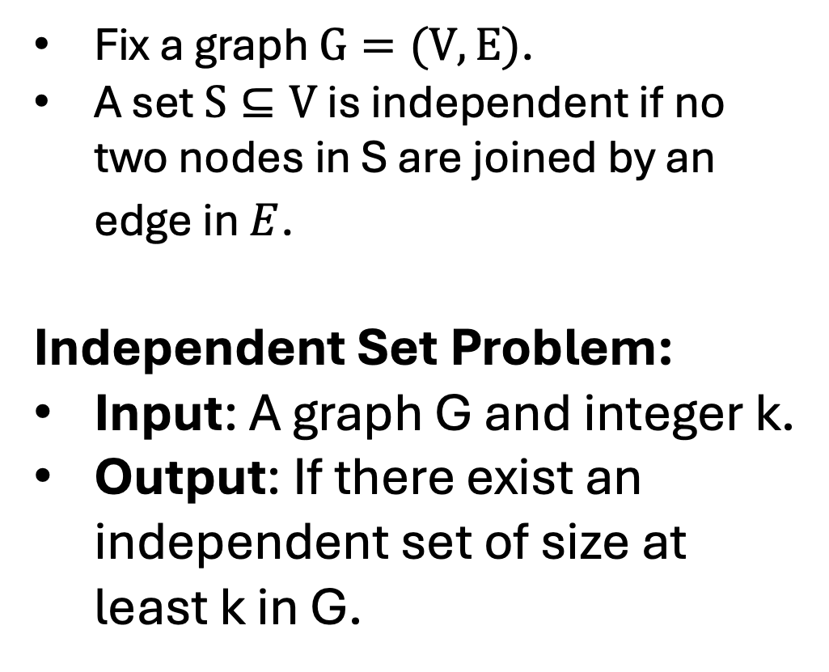
Independent Set
Fix a graph $G=(V,E)$.
A set $S⊆V$ is independent if no two nodes in S are joined by an edge in $E$.
Independent Set Problem:
Input: A graph G and integer k.
Output: If there exist an independent set of size at least k in G.

Slide 29
Independent Set
In Independent Set
Fix a graph $G=(V,E)$.
A set $S⊆V$ is independent if no two nodes in S are joined by an edge in $E$.
Independent Set Problem:
Input: A graph G and integer k.
Output: If there exist an independent set of size at least k in G.

Slide 30
Independent Set
In Independent Set
Fix a graph $G=(V,E)$.
A set $S⊆V$ is independent if no two nodes in S are joined by an edge in $E$.
Independent Set Problem:
Input: A graph G and integer k.
Output: If there exist an independent set of size at least k in G.

Slide 31
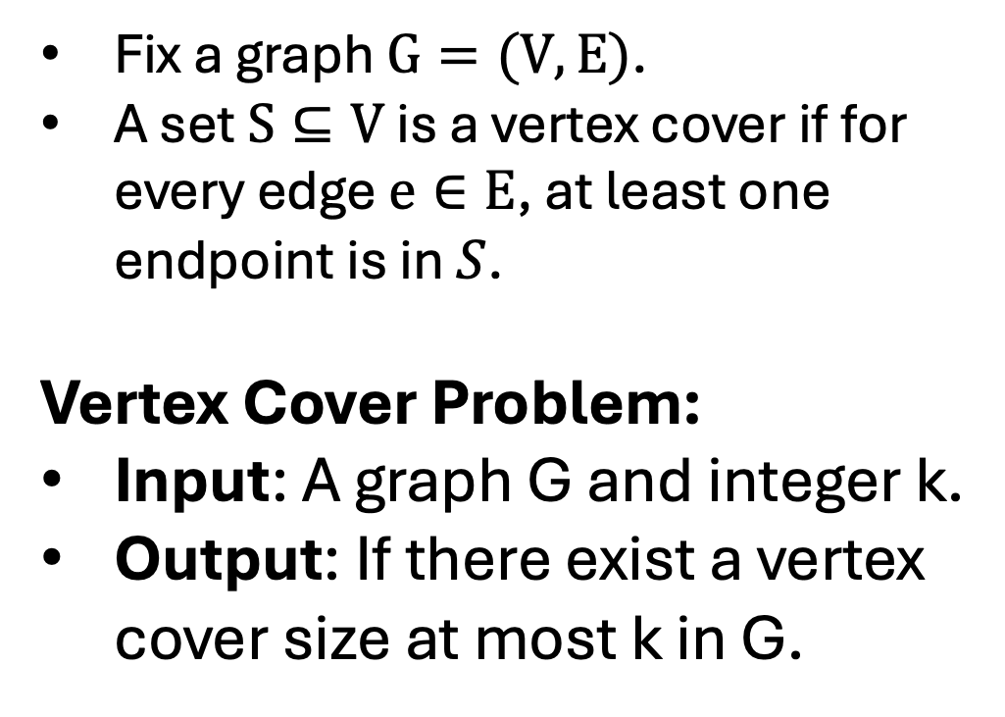
Vertex Cover
Fix a graph $G=(V,E)$.
A set $S⊆V$ is a vertex cover if for every edge $e∈E$, at least one endpoint is in $S$.
Vertex Cover Problem:
Input: A graph G and integer k.
Output: If there exist a vertex cover size at most k in G.

Slide 32
Vertex Cover
In Vertex Cover
Fix a graph $G=(V,E)$.
A set $S⊆V$ is independent if no two nodes in S are joined by an edge in $E$.
Independent Set Problem:
Input: A graph G and integer k.
Output: If there exist an independent set of size at least k in G.

Slide 33
Vertex Cover
In Vertex Cover
Fix a graph $G=(V,E)$.
A set $S⊆V$ is independent if no two nodes in S are joined by an edge in $E$.
Independent Set Problem:
Input: A graph G and integer k.
Output: If there exist an independent set of size at least k in G.

Slide 34
Independent Set vs Vertex Cover
In Independent Set
In Vertex Cover

Slide 35
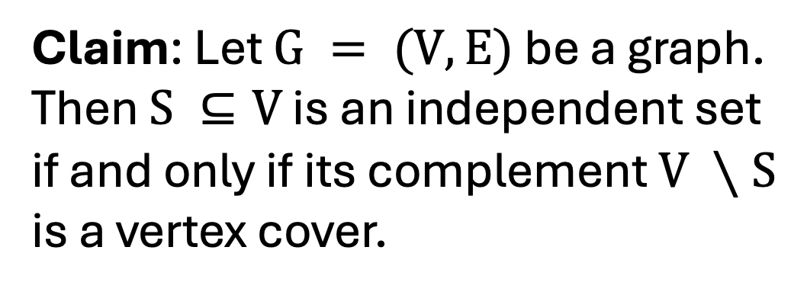
Independent Set vs Vertex Cover
Claim: Let $G = (V,E)$ be a graph. Then $S ⊆V$ is an independent set if and only if its complement $V ∖S$ is a vertex cover.
In Independent Set
In Vertex Cover

Slide 36
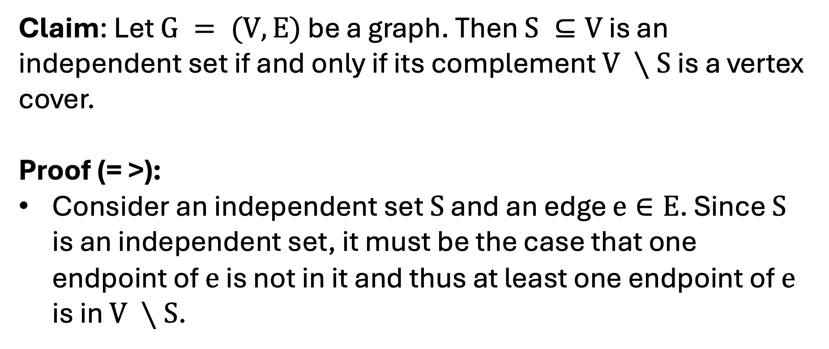
Proof Part (=>)
Claim: Let $G = (V,E)$ be a graph. Then $S ⊆V$ is an independent set if and only if its complement $V ∖S$ is a vertex cover.
Proof (= >):
Consider an independent set $S$ and an edge $e∈E$. Since $S$ is an independent set, it must be the case that one endpoint of $e$ is not in it and thus at least one endpoint of $e$ is in $V ∖S$.

Slide 37
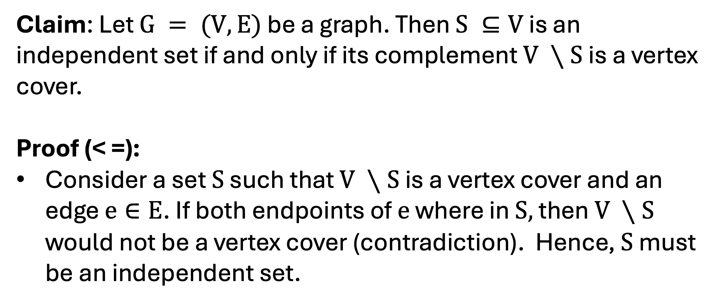
Proof Part (=>)
Claim: Let $G = (V,E)$ be a graph. Then $S ⊆V$ is an independent set if and only if its complement $V ∖S$ is a vertex cover.
Proof (< =):
Consider a set $S$ such that $V ∖S$ is a vertex cover and an edge $e∈E$. If both endpoints of $e$ where in $S,$ then $V ∖S$ would not be a vertex cover (contradiction). Hence, $S$ must be an independent set.

Slide 38
Independent Set to Vertex Cover
Claim: Independent Set $≤_{p}$ Vertex Cover.

Slide 39
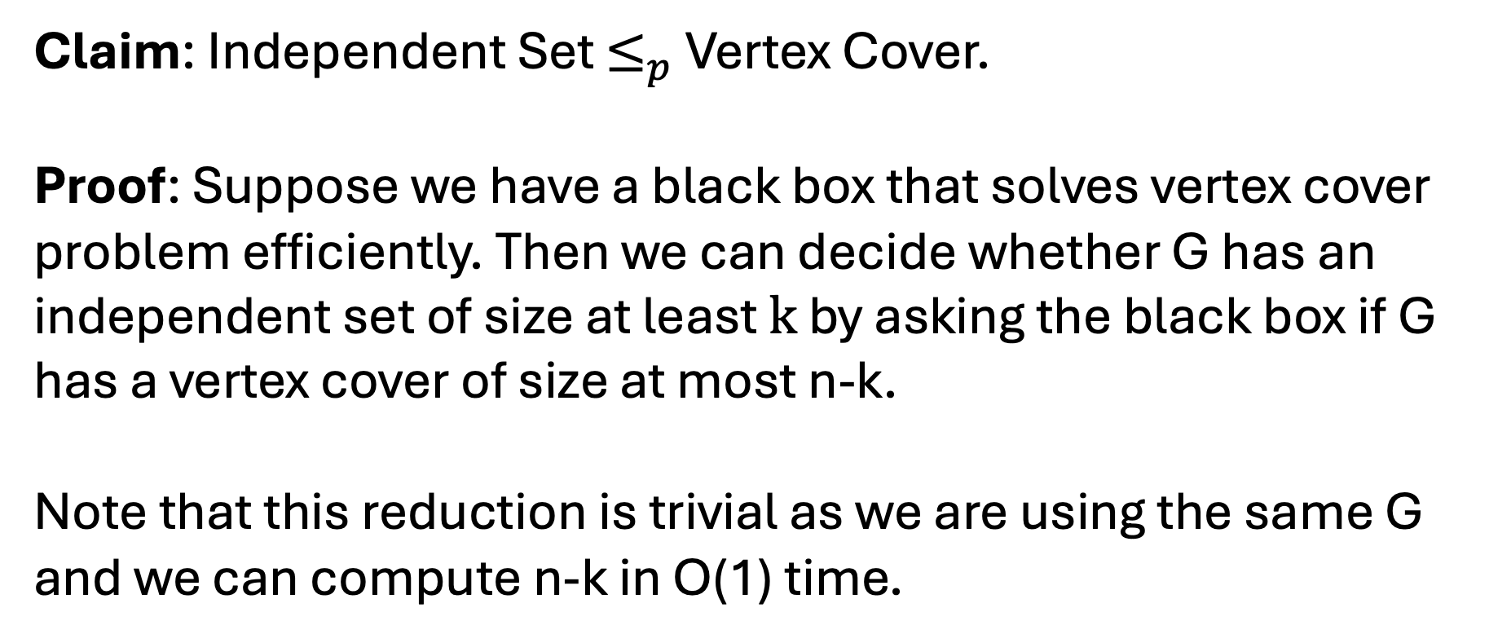
Independent Set to Vertex Cover
Claim: Independent Set $≤_{p}$ Vertex Cover.
Proof: Suppose we have a black box that solves vertex cover problem efficiently. Then we can decide whether G has an independent set of size at least $k$ by asking the black box if G has a vertex cover of size at most n-k.
Note that this reduction is trivial as we are using the same G and we can compute n-k in O(1) time.

Slide 40

Reduction (Ind Set $≤_{p}Vertex Cover$)
If we know there is no efficient algorithm for Independent Set, then it follows that there can’t be an efficient algorithm for Vertex Cover.
Instance I of VC
Reduction
Algorithm for IS
Reduction
Solution S of VC
Algorithm for VC

Slide 41
Independent Set from Vertex Cover
Claim: Vertex Cover $≤_{p}$ Independent Set.

Slide 42
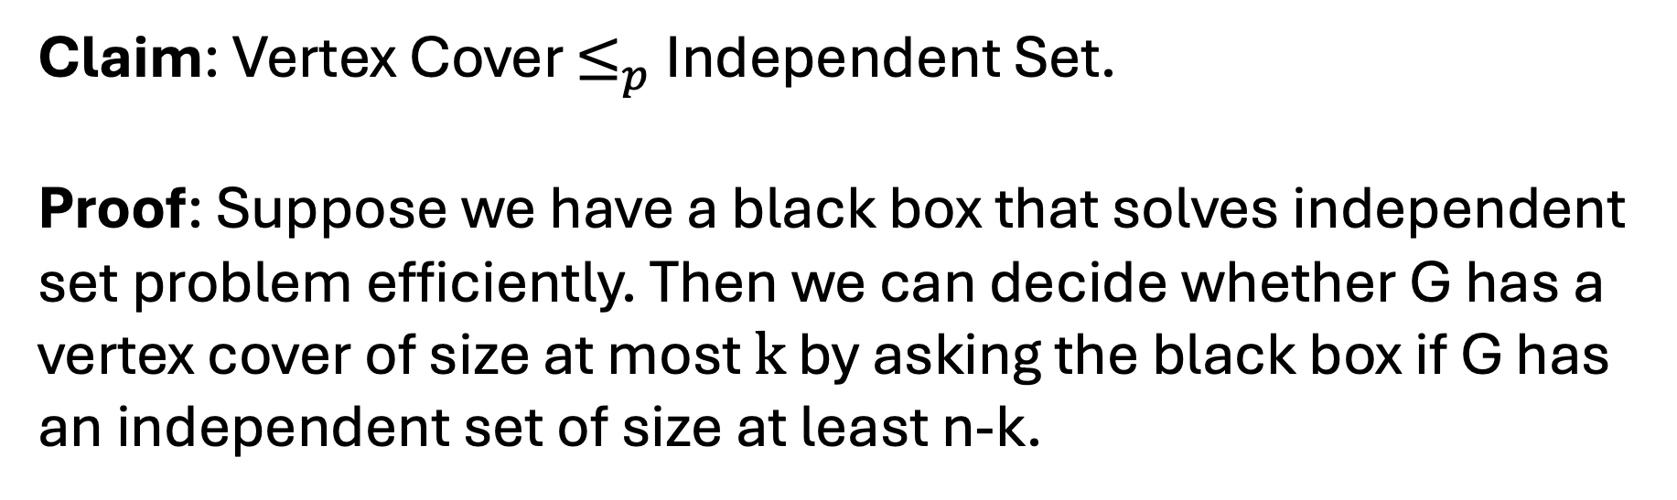
Independent Set from Vertex Cover
Claim: Vertex Cover $≤_{p}$ Independent Set.
Proof: Suppose we have a black box that solves independent set problem efficiently. Then we can decide whether G has a vertex cover of size at most $k$ by asking the black box if G has an independent set of size at least n-k.

Slide 43

Reduction (Vertex Cover $≤_{p}Ind. Set$)
If we know there is no efficient algorithm for Vertex Cover, then it follows that there can’t be an efficient algorithm for Independent Set.
Instance I of IS
Reduction
Algorithm for VC
Reduction
Solution S of IS
Algorithm for IS

Slide 44
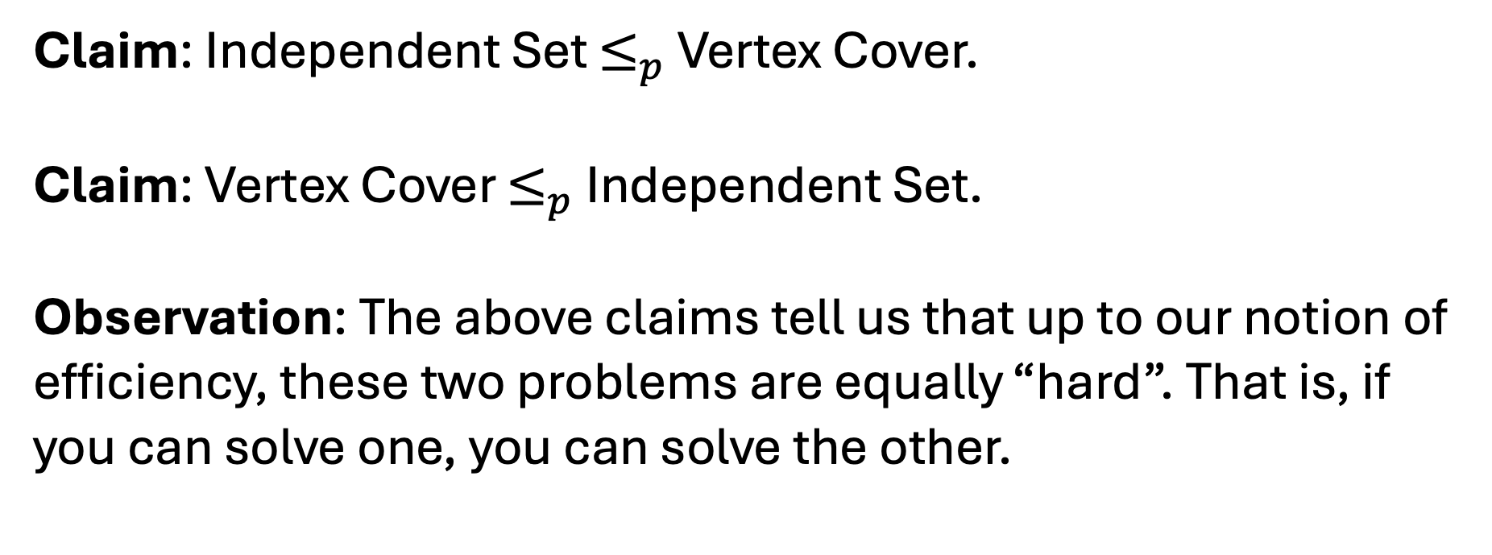
Independent Set & Vertex Cover
Claim: Independent Set $≤_{p}$ Vertex Cover.
Claim: Vertex Cover $≤_{p}$ Independent Set.
Observation: The above claims tell us that up to our notion of efficiency, these two problems are equally “hard”. That is, if you can solve one, you can solve the other.

Slide 45
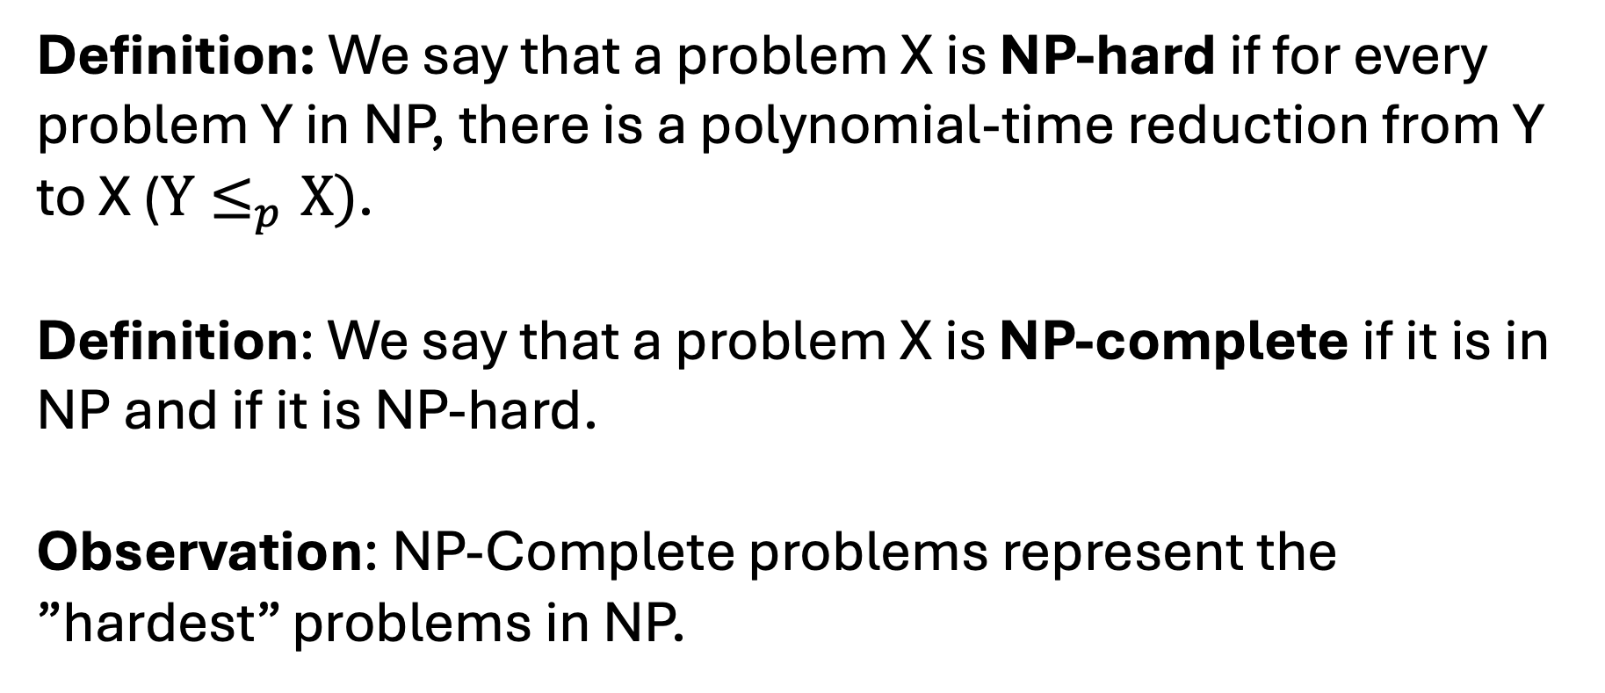
NP-hard & NP-complete
Definition: We say that a problem X is NP-hard if for every problem Y in NP, there is a polynomial-time reduction from Y to X ($Y≤_{p}X)$.
Definition: We say that a problem X is NP-complete if it is in NP and if it is NP-hard.
Observation: NP-Complete problems represent the ”hardest” problems in NP.

Slide 46
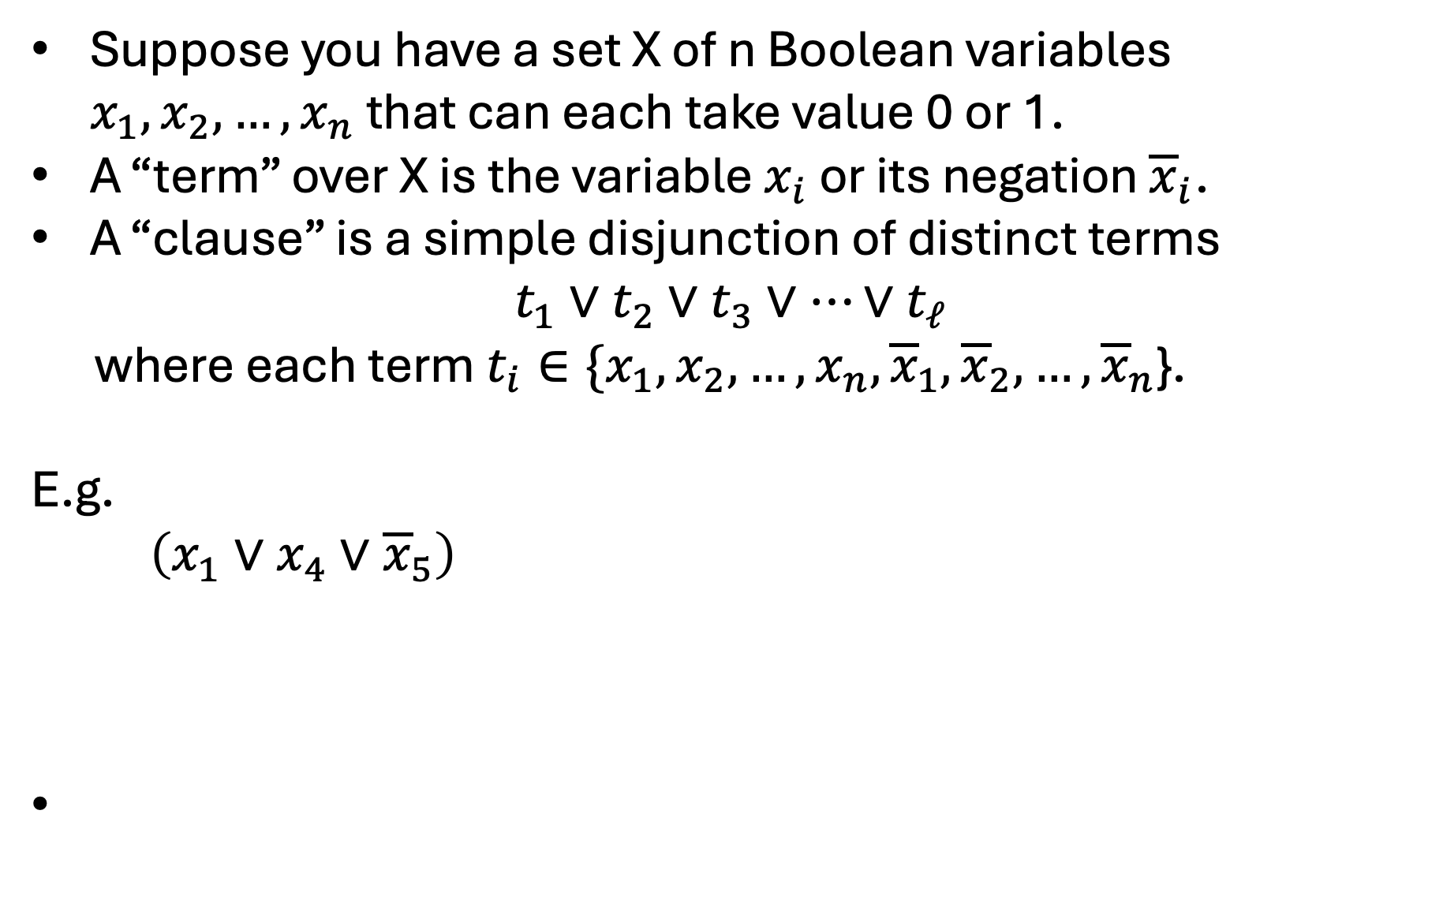
Boolean Formula
Suppose you have a set X of n Boolean variables $x_{1},x_{2},…,x_{n}$ that can each take value 0 or 1.
A “term” over X is the variable $x_{i}$ or its negation ${\overline{x}}_{i}$.
A “clause” is a simple disjunction of distinct terms
$$t_{1}∨t_{2}∨t_{3}∨⋯∨t_{ℓ}$$
where each term $t_{i}∈\{x_{1},x_{2},…,x_{n},{\overline{x}}_{1},{\overline{x}}_{2},…,{\overline{x}}_{n}$}.
E.g.
$\left(x_{1}∨x_{4}∨{\overline{x}}_{5}\right)$

Slide 47
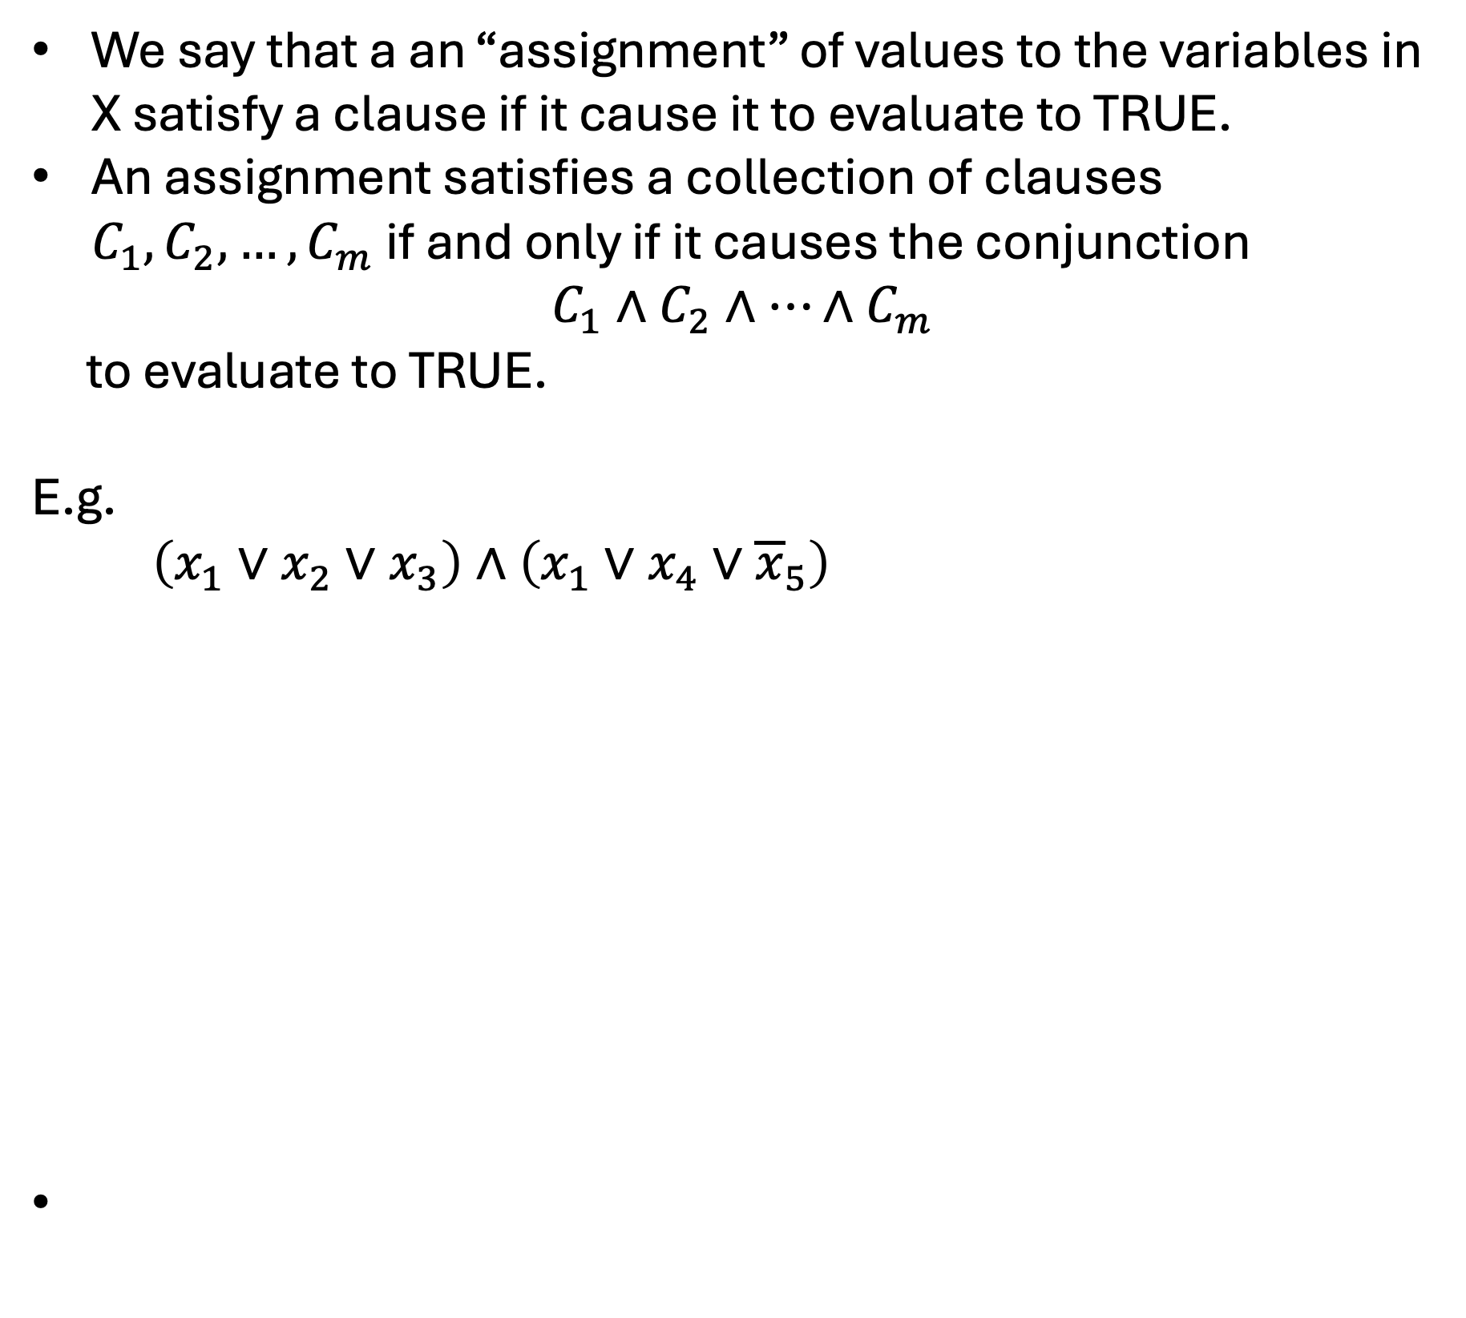
Boolean Formula
We say that a an “assignment” of values to the variables in X satisfy a clause if it cause it to evaluate to TRUE.
An assignment satisfies a collection of clauses $C_{1},C_{2},…,C_{m}$ if and only if it causes the conjunction
$$C_{1}∧C_{2}∧…∧C_{m}$$
to evaluate to TRUE.
E.g.
$\left(x_{1}∨x_{2}∨x_{3}\right)∧\left(x_{1}∨x_{4}∨{\overline{x}}_{5}\right)$

Slide 48
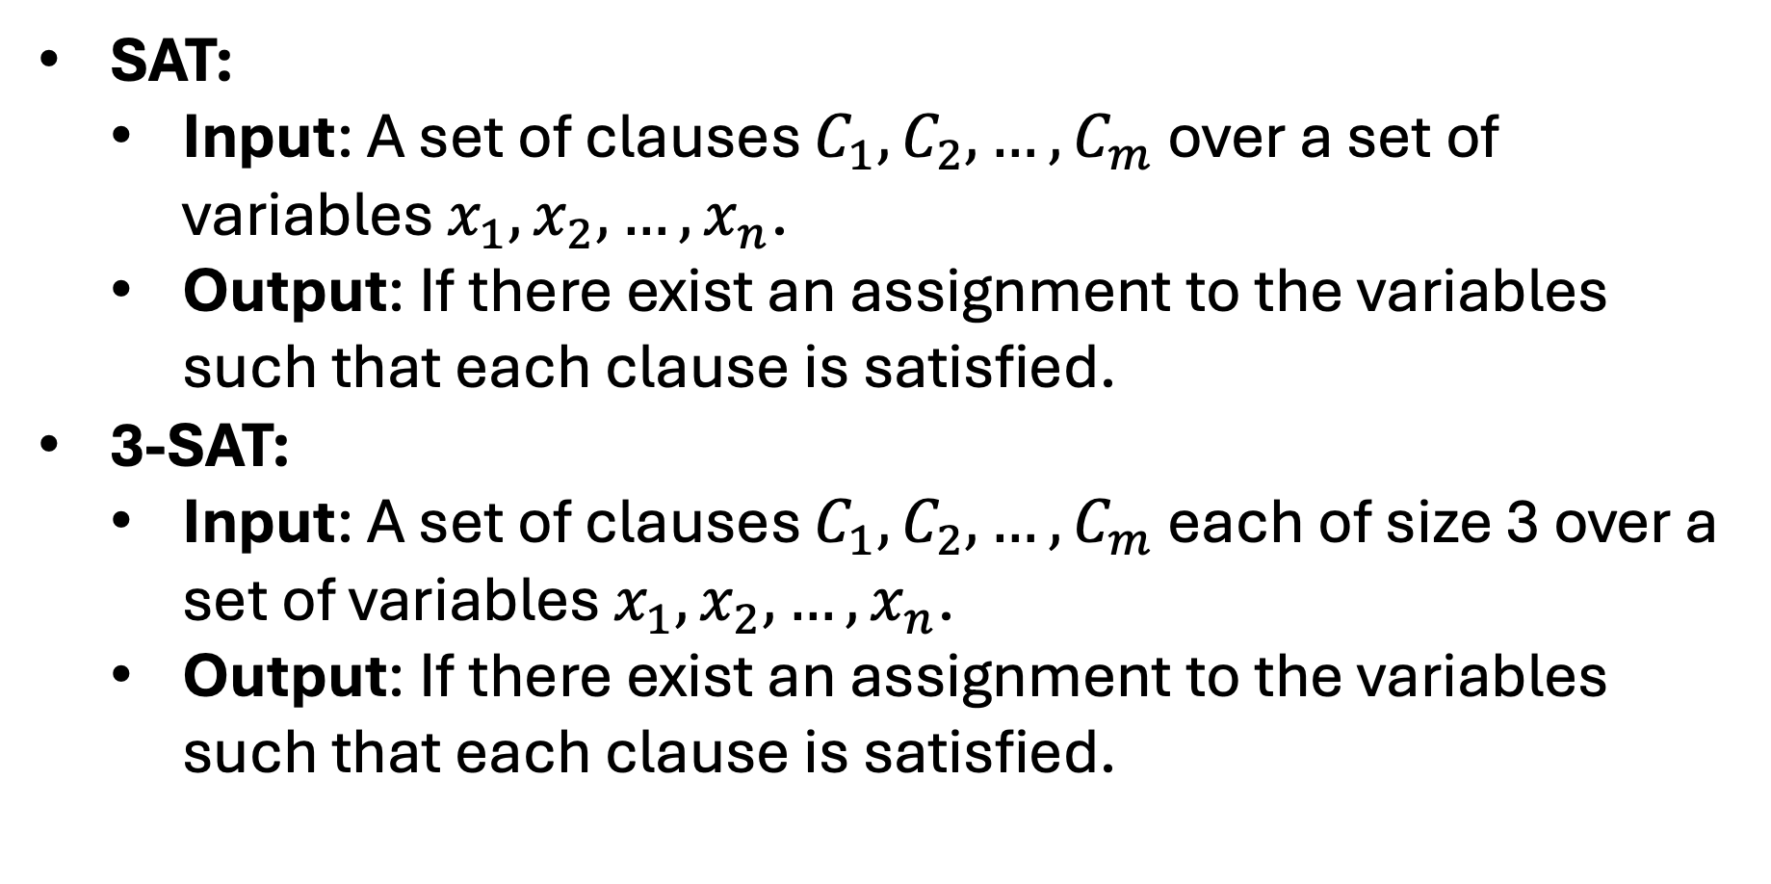
SAT Problems
SAT:
Input: A set of clauses $C_{1},C_{2},…,C_{m}$ over a set of variables $x_{1},x_{2},…,x_{n}$.
Output: If there exist an assignment to the variables such that each clause is satisfied.
3-SAT:
Input: A set of clauses $C_{1},C_{2},…,C_{m}$ each of size 3 over a set of variables $x_{1},x_{2},…,x_{n}$.
Output: If there exist an assignment to the variables such that each clause is satisfied.

Slide 49
Circuit:
A circuit is a labeled directed acyclic graph K such that
All sources (no incoming edges) are labeled with 0, 1, or a variable. <-inputs
All other nodes are labeled with AND, OR, or NOT.
Each AND and OR node has two incoming edges
Each NOT node has one incoming edge
There is a single sink (no outgoing edges). <- output

Slide 50








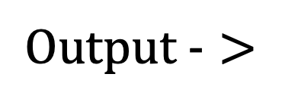



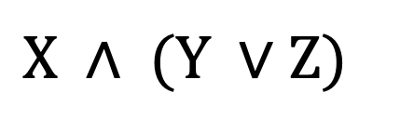
Circuit SAT
Circuit Sat Problem (SAT):
Input: A circuit K
Output: If there exist an assignment to the variables that makes that satisfies the circuit.
$$Output ->$$
$∧$
$¬$
$∧$
$∧$
$∨$
$∨$
$1$
$0$
$x$
$y$
$z$
$$X ∧ (Y ∨Z)$$

Slide 51
Circuit SAT
Claim: Circuit Satisfiability is NP-complete.
Not hard to show NP-hard.
To show NP-Complete, you have to reduce from an arbitrary NP-hard problem.
We wont talk about proof in this class, but the idea is that you can represent any verification algorithm as a circuit!

Slide 52
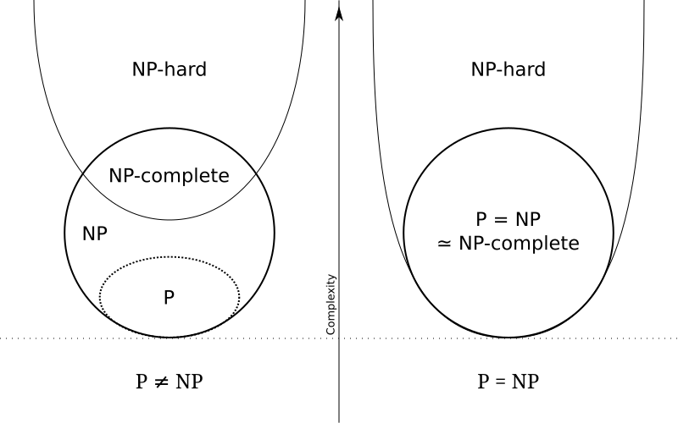
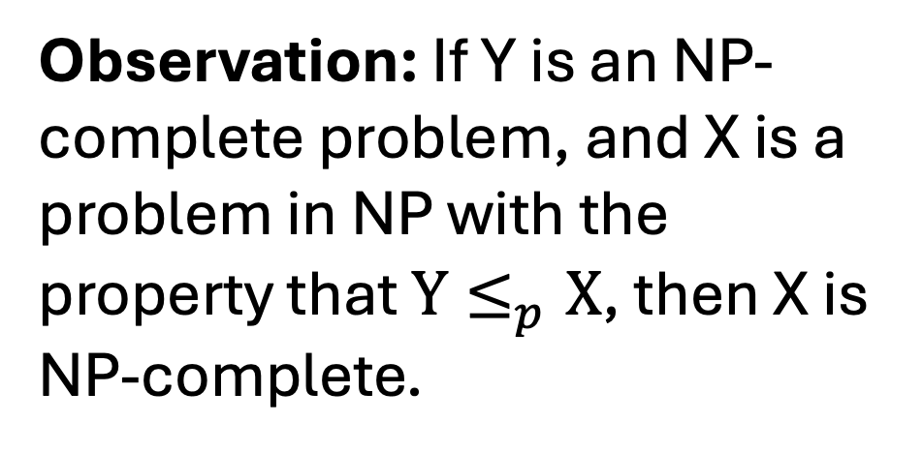
NP-complete
Observation: If Y is an NP-complete problem, and X is a problem in NP with the property that ${Y≤}_{p}X$, then X is NP-complete.
Behnam Esfahbod, CC BY-SA 3.0 <https://creativecommons.org/licenses/by-sa/3.0>, via Wikimedia Commons

Slide 53
NP-complete Problems
(Circuit) SAT
3-SAT
Independent Set
Vertex Cover
Set Cover
Behnam Esfahbod, CC BY-SA 3.0 <https://creativecommons.org/licenses/by-sa/3.0>, via Wikimedia Commons

