Slide 1

CSE 331: Algorithms & Complexity
“K-Colorings”
Prof. Charlie Anne Carlson (She/Her)
Lecture 38
Dec 5th 2025

Slide 2
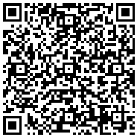
Course Evals
Course evals must be submitted before December 10th.
They are due on December 9th at 11:59 PM
Please consider filling them out.
Be honest!

Slide 3
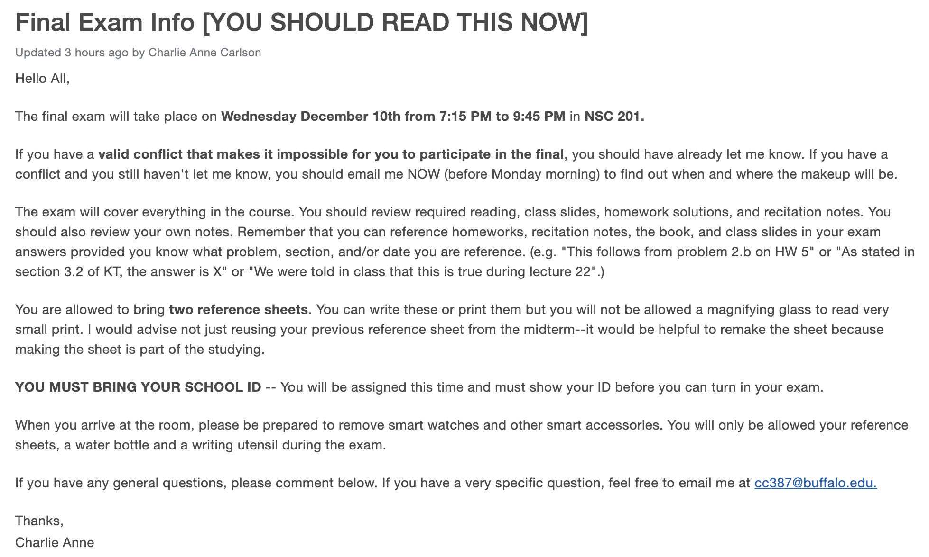
Final Exam Post

Slide 4
NP-complete
To show that a problem is NP-complete, you must do the following:
Show the problem is in NP
Show that the problem is has hard as any other problem in NP

Slide 5
NP-complete
To show that a problem is NP-complete, you must do the following:
Show that there exists a polynomial time verifier.
Show that you can reduce to it from a known NP-hard problem like 3-SAT.

Slide 6
NP-complete
(Circuit) SAT
3-SAT
Independent Set
Clique
Vertex Cover
Set Cover
K-coloring

Slide 7
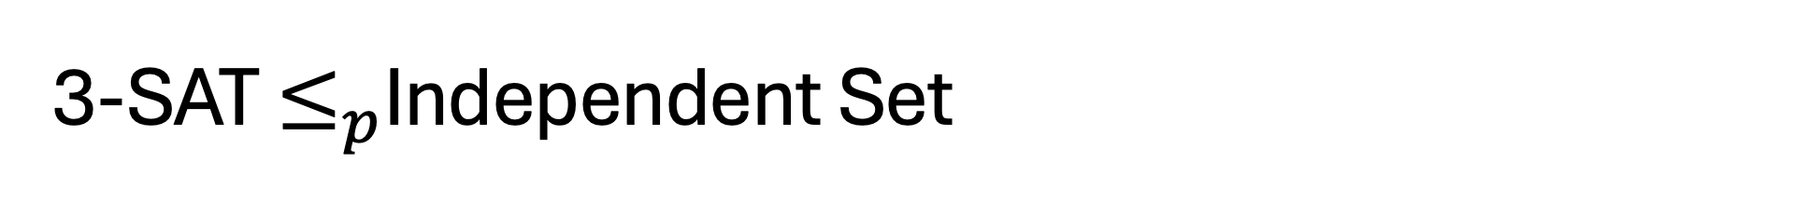
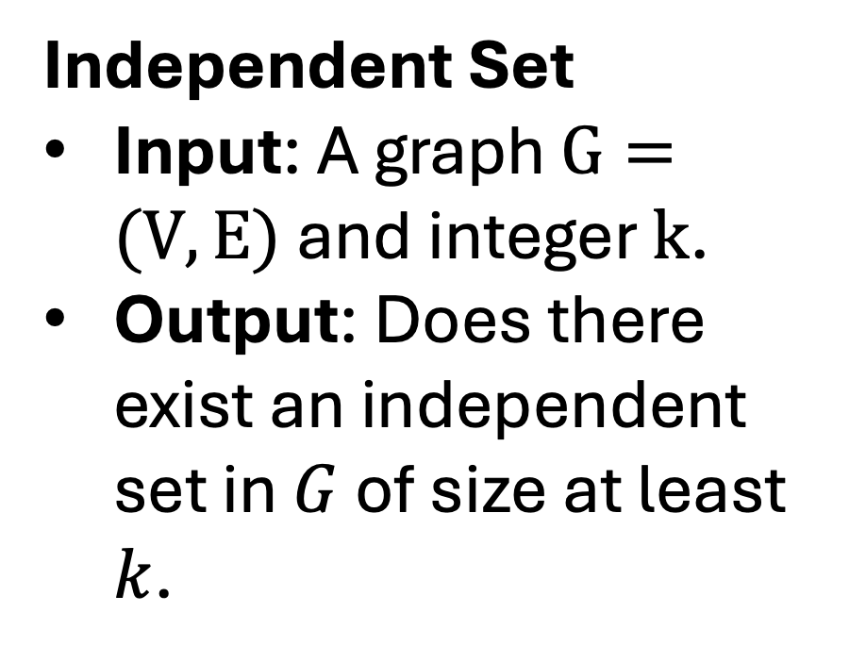
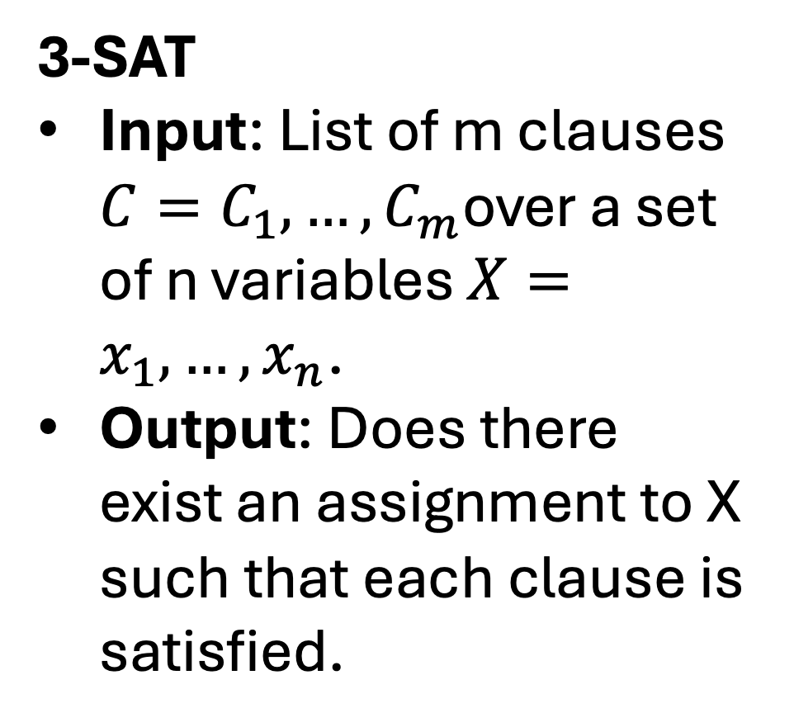
3-SAT $≤_{p}$Independent Set
3-SAT
Input: List of m clauses $C=C_{1},…,C_{m}$over a set of n variables $X=x_{1},…,x_{n}$.
Output: Does there exist an assignment to X such that each clause is satisfied.
Independent Set
Input: A graph $G=(V,E)$ and integer $k$.
Output: Does there exist an independent set in $G$ of size at least $k$.

Slide 8

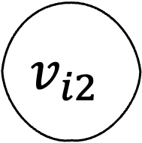
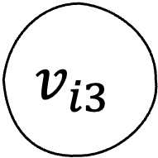
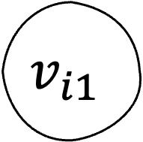
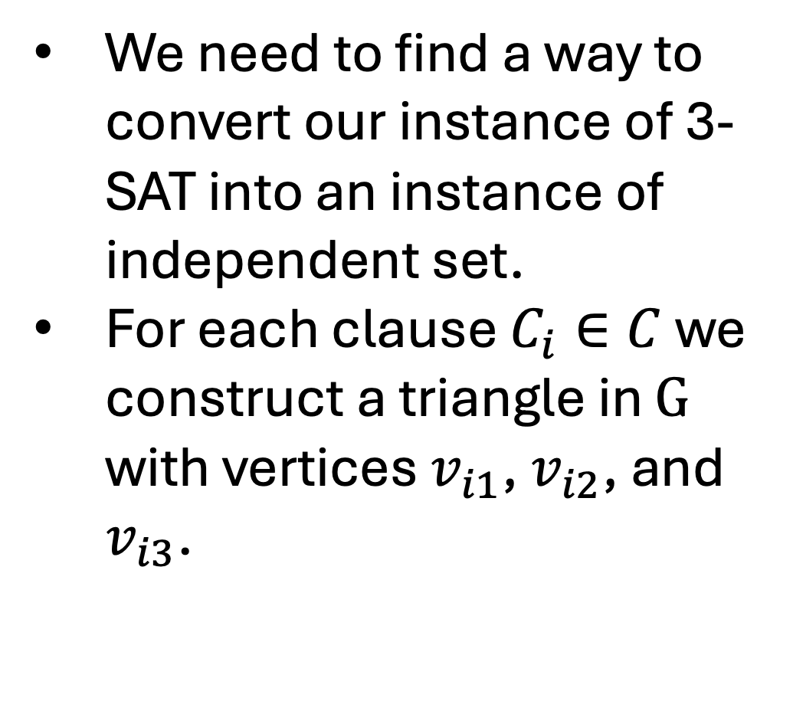
3-SAT $≤_{p}$Independent Set
We need to find a way to convert our instance of 3-SAT into an instance of independent set.
For each clause $C_{i}∈C$ we construct a triangle in $G$ with vertices $v_{i1}$, $v_{i2}$, and $v_{i3}$.
$$x_{1}∨{\overline{x}}_{2}∨{\overline{x}}_{4}$$
$$v_{i1}$$
$$v_{i2}$$
$$v_{i3}$$

Slide 9
3-SAT $≤_{p}$Independent Set
Observe that if there is an independent set of size m in G, then it must pick a single vertex from each triangle.
Think of this as saying that term it represents evaluates to true.
$$x_{1}∨{\overline{x}}_{2}∨{\overline{x}}_{4}$$
$$v_{i1}$$
$$v_{i2}$$
$$v_{i3}$$

Slide 10
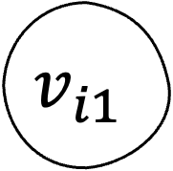
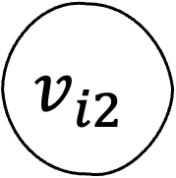

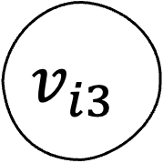

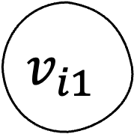
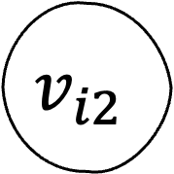
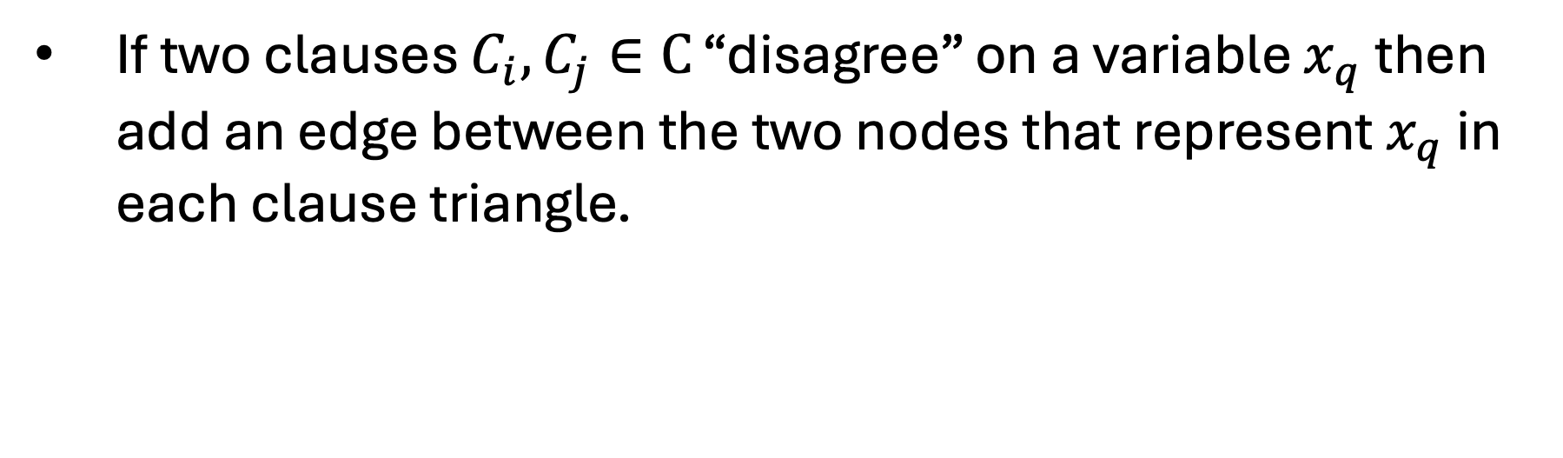
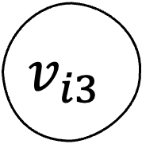
3-SAT $≤_{p}$Independent Set
If two clauses $C_{i},C_{j}∈C$ “disagree” on a variable $x_{q}$ then add an edge between the two nodes that represent $x_{q}$ in each clause triangle.
$$v_{i1}$$
$$v_{i2}$$
$$v_{i1}$$
$$v_{i2}$$
$$x_{2}∨x_{3}∨x_{5}$$
$$x_{1}∨{\overline{x}}_{2}∨{\overline{x}}_{4}$$
$$v_{i3}$$
$$v_{i3}$$

Slide 11
3-SAT $≤_{p}$Independent Set
If two clauses $C_{i},C_{j}∈C$ “disagree” on a variable $x_{q}$ then add an edge between the two nodes that represent $x_{q}$ in each clause triangle.
$$v_{i1}$$
$$v_{i2}$$
$$v_{i1}$$
$$v_{i2}$$
$$x_{2}∨x_{3}∨x_{5}$$
$$x_{1}∨{\overline{x}}_{2}∨{\overline{x}}_{4}$$
$$v_{i3}$$
$$v_{i3}$$

Slide 12
3-SAT $≤_{p}$Independent Set
Observe that if there exists an independent set of size m (number of clause) then each triangle must contain a single vertex in the the set.
$$v_{i1}$$
$$v_{i2}$$
$$v_{i1}$$
$$v_{i2}$$
$$x_{2}∨x_{3}∨x_{5}$$
$$x_{1}∨{\overline{x}}_{2}∨{\overline{x}}_{4}$$
$$v_{i3}$$
$$v_{i3}$$

Slide 13

3-SAT $≤_{p}$Independent Set
Moreover, for each variable $x_{q}∈X$ we the independent set can’t contain a vertex that represents it being 0 and 1 at the same time.
$$v_{i1}$$
$$v_{i2}$$
$$v_{i1}$$
$$v_{i2}$$
$$x_{2}∨x_{3}∨x_{5}$$
$$x_{1}∨{\overline{x}}_{2}∨{\overline{x}}_{4}$$
$$v_{i3}$$
$$v_{i3}$$

Slide 14
3-SAT $≤_{p}$Independent Set
You can map a satisfying assignment to the 3-SAT formula to an independent set of size m in G by looking at each clause and taking the first term that evaluates to be true and putting it in our set.
$$v_{i1}$$
$$v_{i2}$$
$$v_{i1}$$
$$v_{i2}$$
$$x_{2}∨x_{3}∨x_{5}$$
$$x_{1}∨{\overline{x}}_{2}∨{\overline{x}}_{4}$$
$$v_{i3}$$
$$v_{i3}$$

Slide 15
3-SAT $≤_{p}$Independent Set
You can map an independent set in G to a satisfying assignment by looking each each vertex in the set, reading its corresponding assignment, and setting all remaining variables to 1.
$$v_{i1}$$
$$v_{i2}$$
$$v_{i1}$$
$$v_{i2}$$
$$x_{2}∨x_{3}∨x_{5}$$
$$x_{1}∨{\overline{x}}_{2}∨{\overline{x}}_{4}$$
$$v_{i3}$$
$$v_{i3}$$

Slide 16
3-SAT $≤_{p}$Independent Set
Construct the graph as described above.
Ask to find an independent set of size k = m.
Observe this graph can be constructed in polynomial time.
$$v_{i1}$$
$$v_{i2}$$
$$v_{i1}$$
$$v_{i2}$$
$$x_{2}∨x_{3}∨x_{5}$$
$$x_{1}∨{\overline{x}}_{2}∨{\overline{x}}_{4}$$
$$v_{i3}$$
$$v_{i3}$$

Slide 17
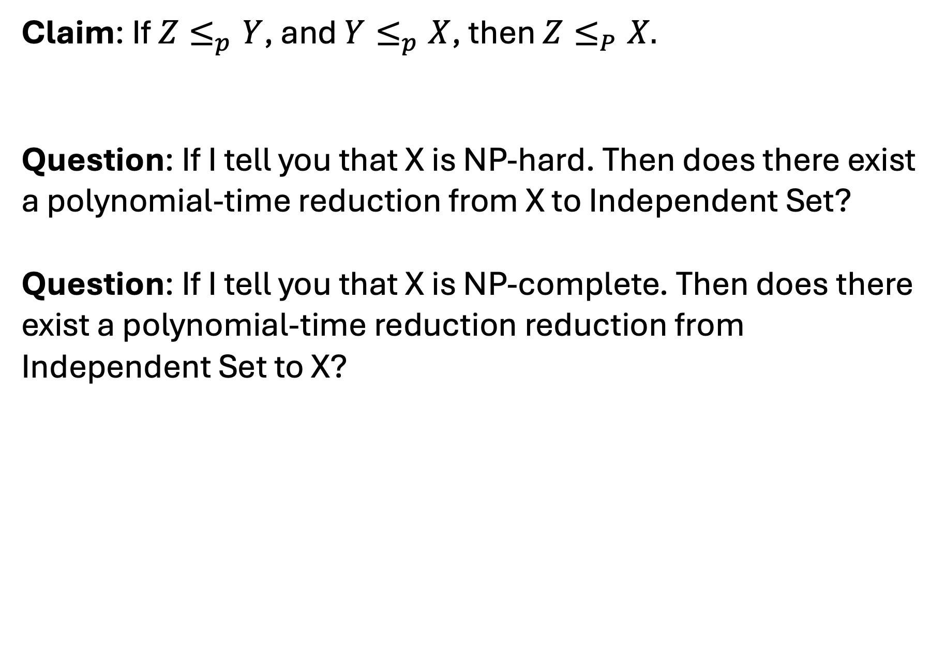
Transitivity
Claim: If $Z≤_{p}Y$, and $Y≤_{p}X$, then $Z≤_{P}X.$
Question: If I tell you that X is NP-hard. Then does there exist a polynomial-time reduction from X to Independent Set?
Question: If I tell you that X is NP-complete. Then does there exist a polynomial-time reduction reduction from Independent Set to X?

Slide 18
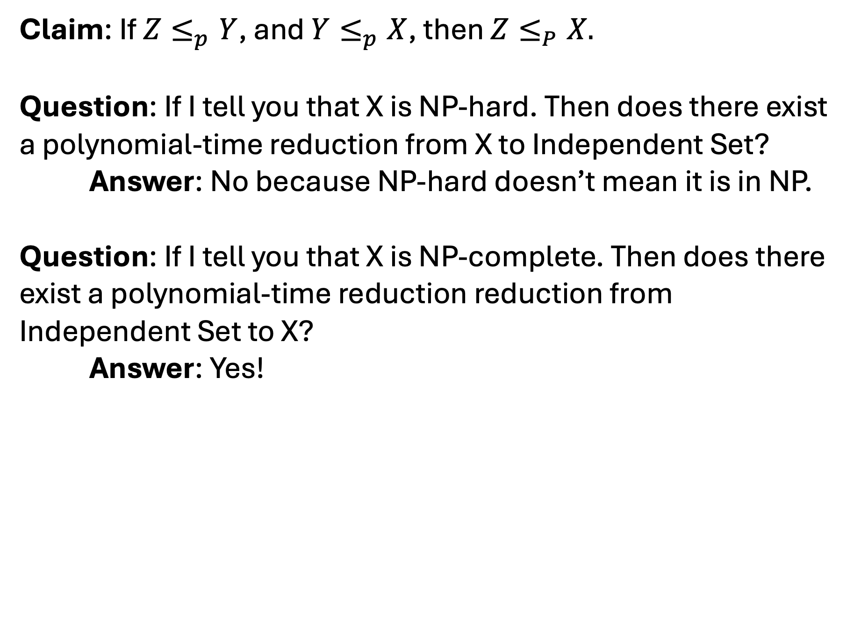
Transitivity
Claim: If $Z≤_{p}Y$, and $Y≤_{p}X$, then $Z≤_{P}X.$
Question: If I tell you that X is NP-hard. Then does there exist a polynomial-time reduction from X to Independent Set?
Answer: No because NP-hard doesn’t mean it is in NP.
Question: If I tell you that X is NP-complete. Then does there exist a polynomial-time reduction reduction from Independent Set to X?
Answer: Yes!

Slide 19
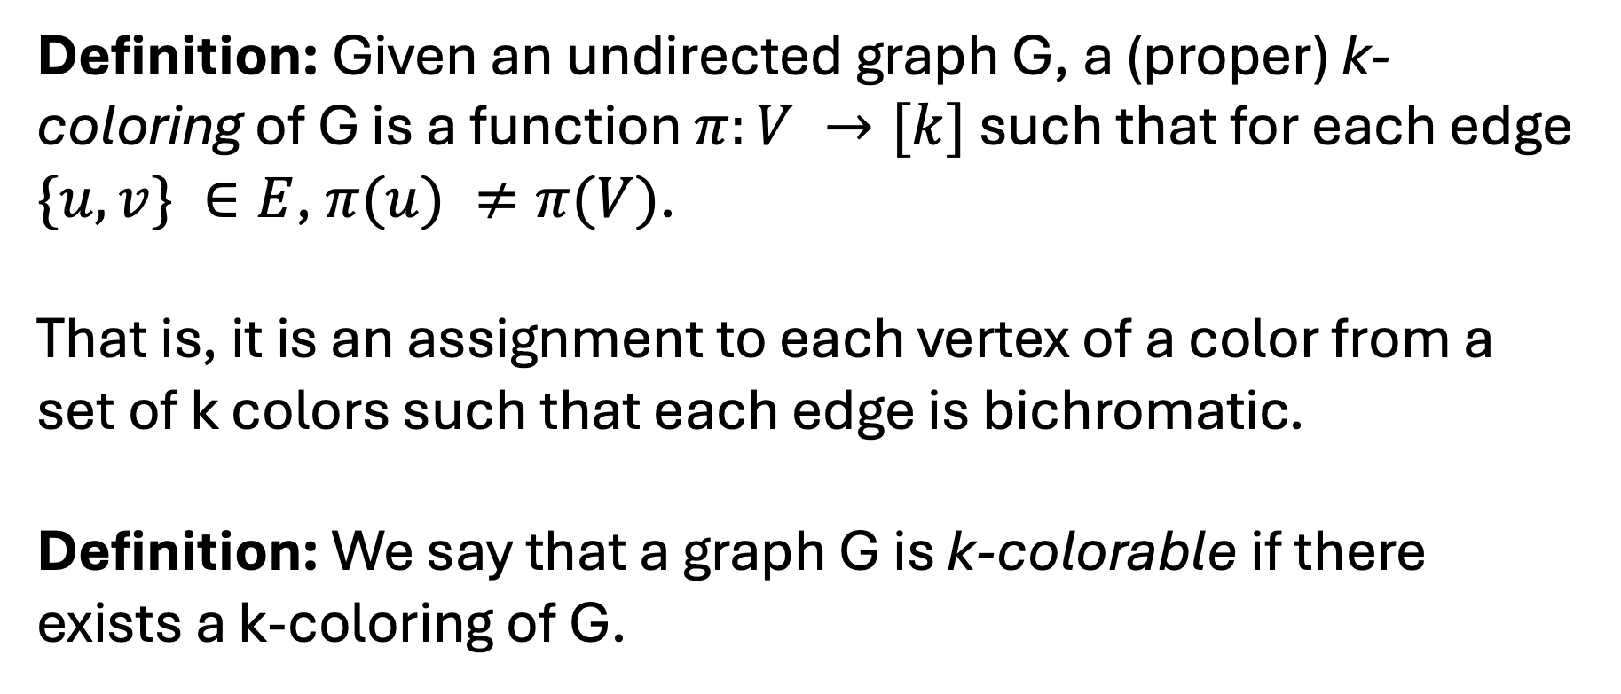
K-Coloring
Definition: Given an undirected graph G, a (proper) k-coloring of G is a function $π:V →[k]$ such that for each edge $\{u,v\} ∈E$, $π(u) ≠π(V)$.
That is, it is an assignment to each vertex of a color from a set of k colors such that each edge is bichromatic.
Definition: We say that a graph G is k-colorable if there exists a k-coloring of G.

Slide 20
3-Coloring

Slide 21
3-Coloring

Slide 22
4-Coloring

Slide 23
100-Coloring

Slide 24
No 2-Coloring

Slide 25
K-coloring
K-Coloring
Input: Graph G and integer k.
Output: Does there exist a k-coloring of G.

Slide 26
K-coloring
K-Coloring
Input: Graph G and integer k.
Output: Does there exist a k-coloring of G.
This in NP because you can check a coloring.

Slide 27
K-coloring
K-Coloring
Input: Graph G and integer k.
Output: Does there exist a k-coloring of G.
This in NP-hard because you can reduce from 3-SAT.

Slide 28
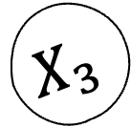
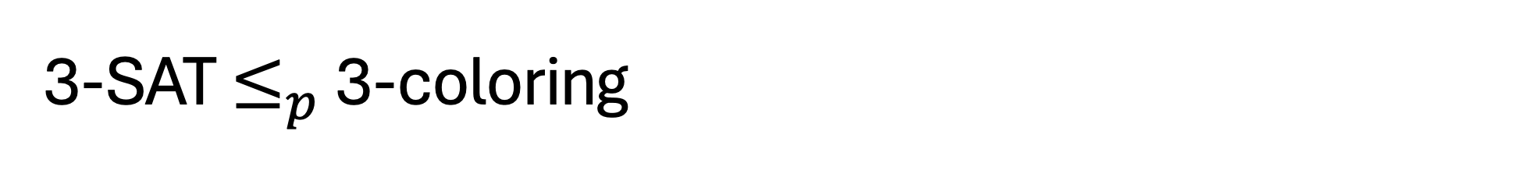
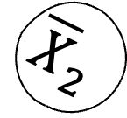
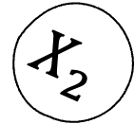
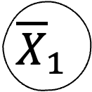
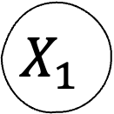
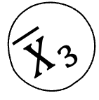
3-SAT $≤_{p}$ 3-coloring
T
$$X_{1}$$
Create a triangle for each variable.
Every vertex will be touching the B vertex and thus must only use on of the colors assigned to F or T.
$${\overline{X}}_{1}$$
F
B
$${\overline{X}}_{3}$$
$$X_{2}$$
$$X_{3}$$
$${\overline{X}}_{2}$$

Slide 29

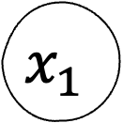
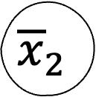
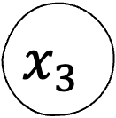
3-SAT $≤_{p}$ 3-coloring
For each clause we make a copy of this gadget!
$$F$$
$${\overline{x}}_{2}$$
$$x_{3}$$
$$x_{1}$$
T

Slide 30
3-SAT $≤_{p}$ 3-coloring
Only can be 3-colored if at least one term is not set to False color.
$$F$$
$${\overline{x}}_{2}$$
$$x_{3}$$
$$x_{1}$$
T

Slide 31
3-SAT $≤_{p}$ 3-coloring
Observe that we can construct the gadgets in O(m) time.
If there exists a 3-coloring then each variable will get an assignment in its triangle (it will match the color of T or F nodes).
If there is a satisfying assignment, then we can make all terms that evaluate to true Blue (1), all terms evaluate toe false Red (2), and everything else Green (3).

Slide 32
CSE 331: Algorithms & Complexity
Thank you

