Slide 1

CSE 331:
Algorithms & Complexity
“Gale-Shapley”
Prof. Charlie Anne Carlson (She/Her)
Lecture 4
Monday September 5th, 2025

Slide 2

Schedule
Course Updates
Group Project
Recap
Gale-Shapely

Slide 3

Course Updates
Office Hours Posted
Complete Syllabus Quiz
HW 2 Posted Tuesday

Slide 4
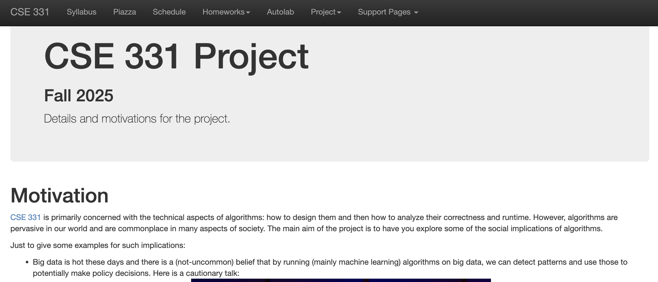
Group Project

Slide 5
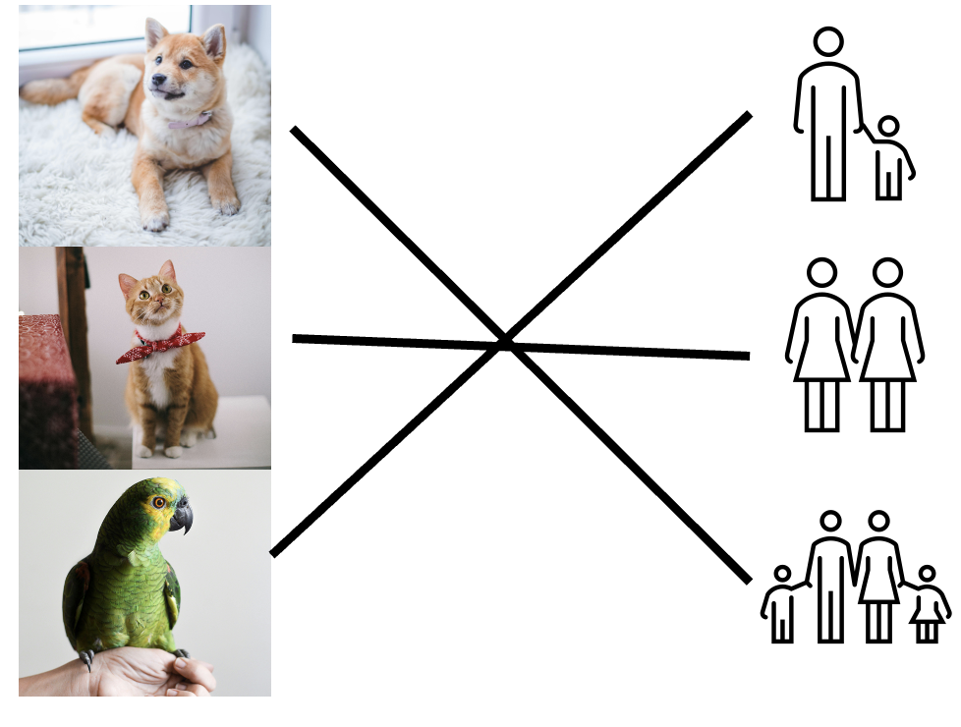



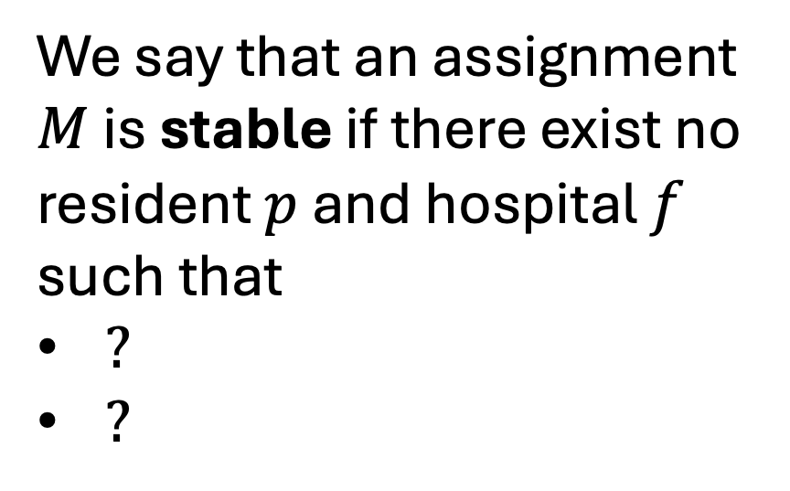
Hospital Assignments
We say that an assignment $M$ is stable if there exist no resident $p$ and hospital $f$ such that
$?$
$?$

Slide 6
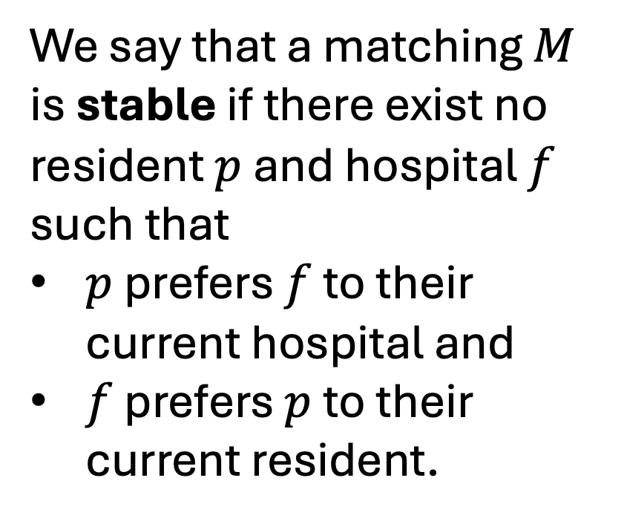
Hospital Assignments
We say that a matching $M$ is stable if there exist no resident $p$ and hospital $f$ such that
$p$ prefers $f$ to their current hospital and
$f$ prefers $p$ to their current resident.

Slide 7
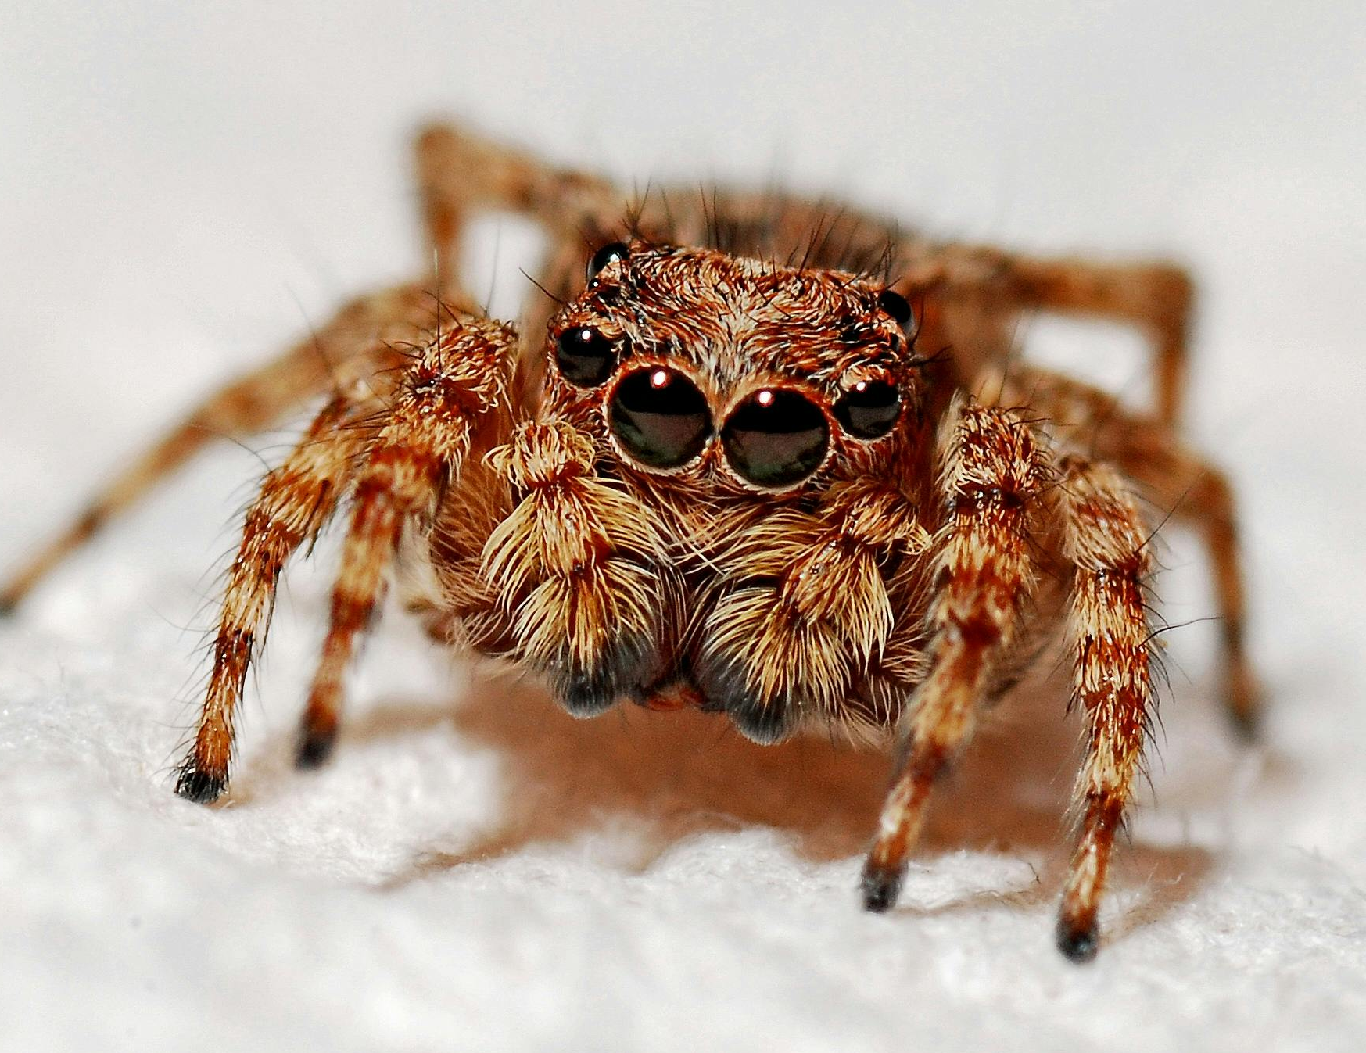

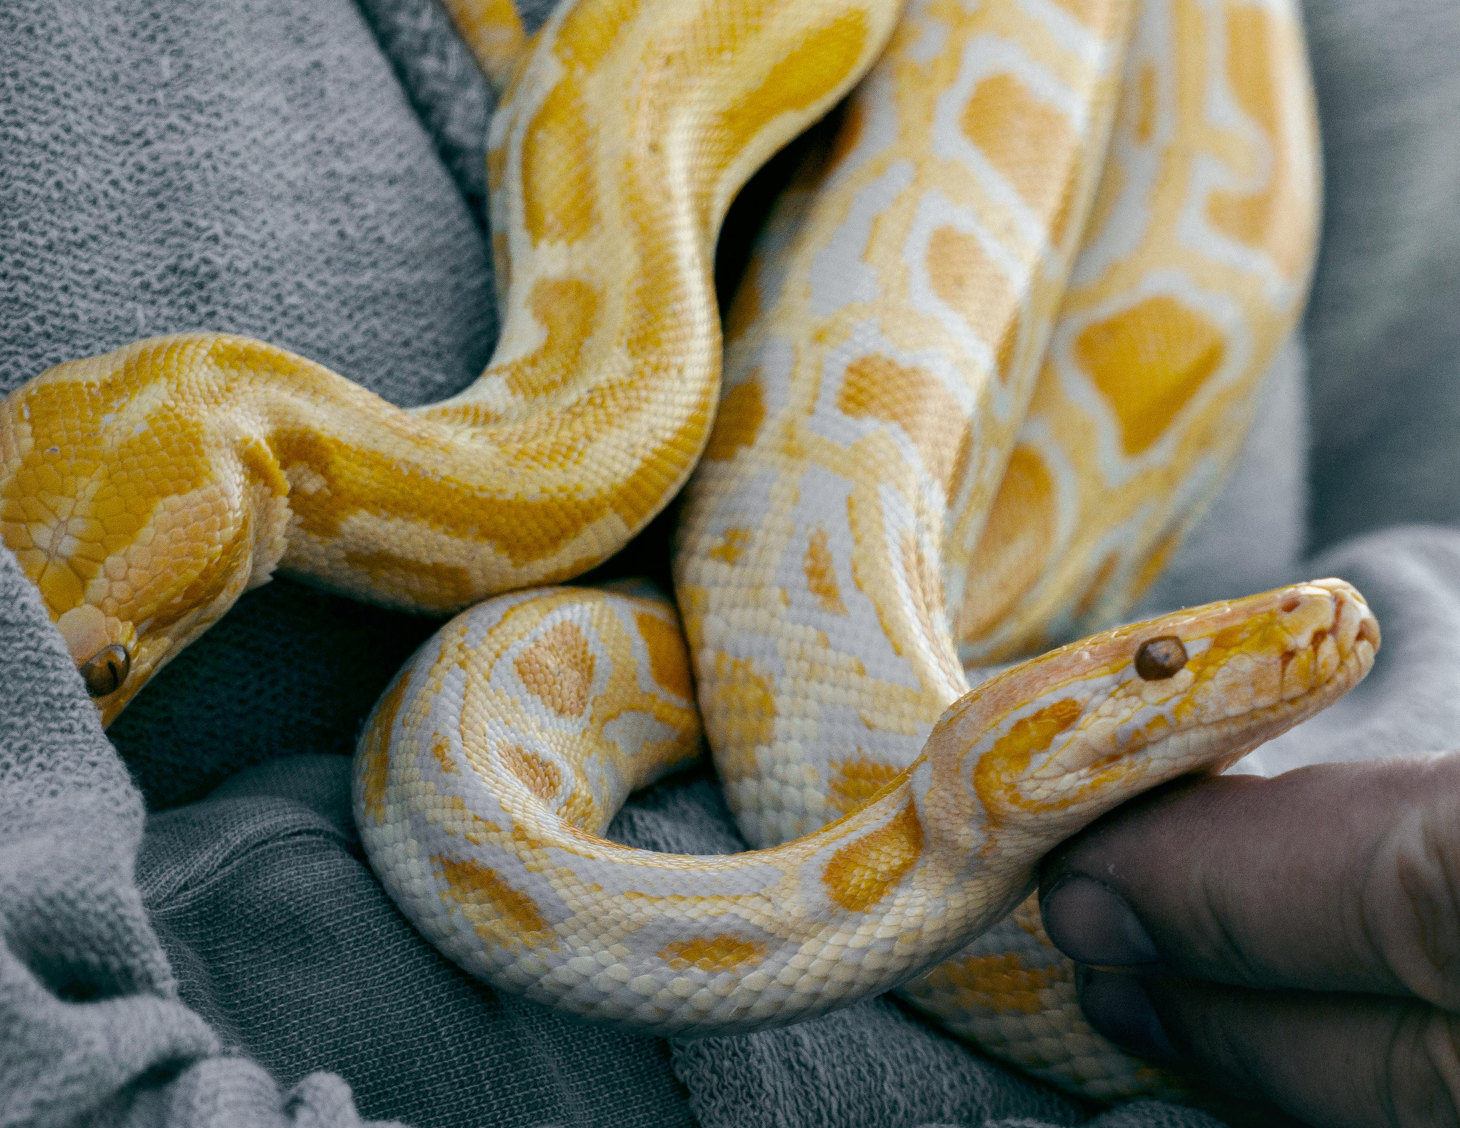

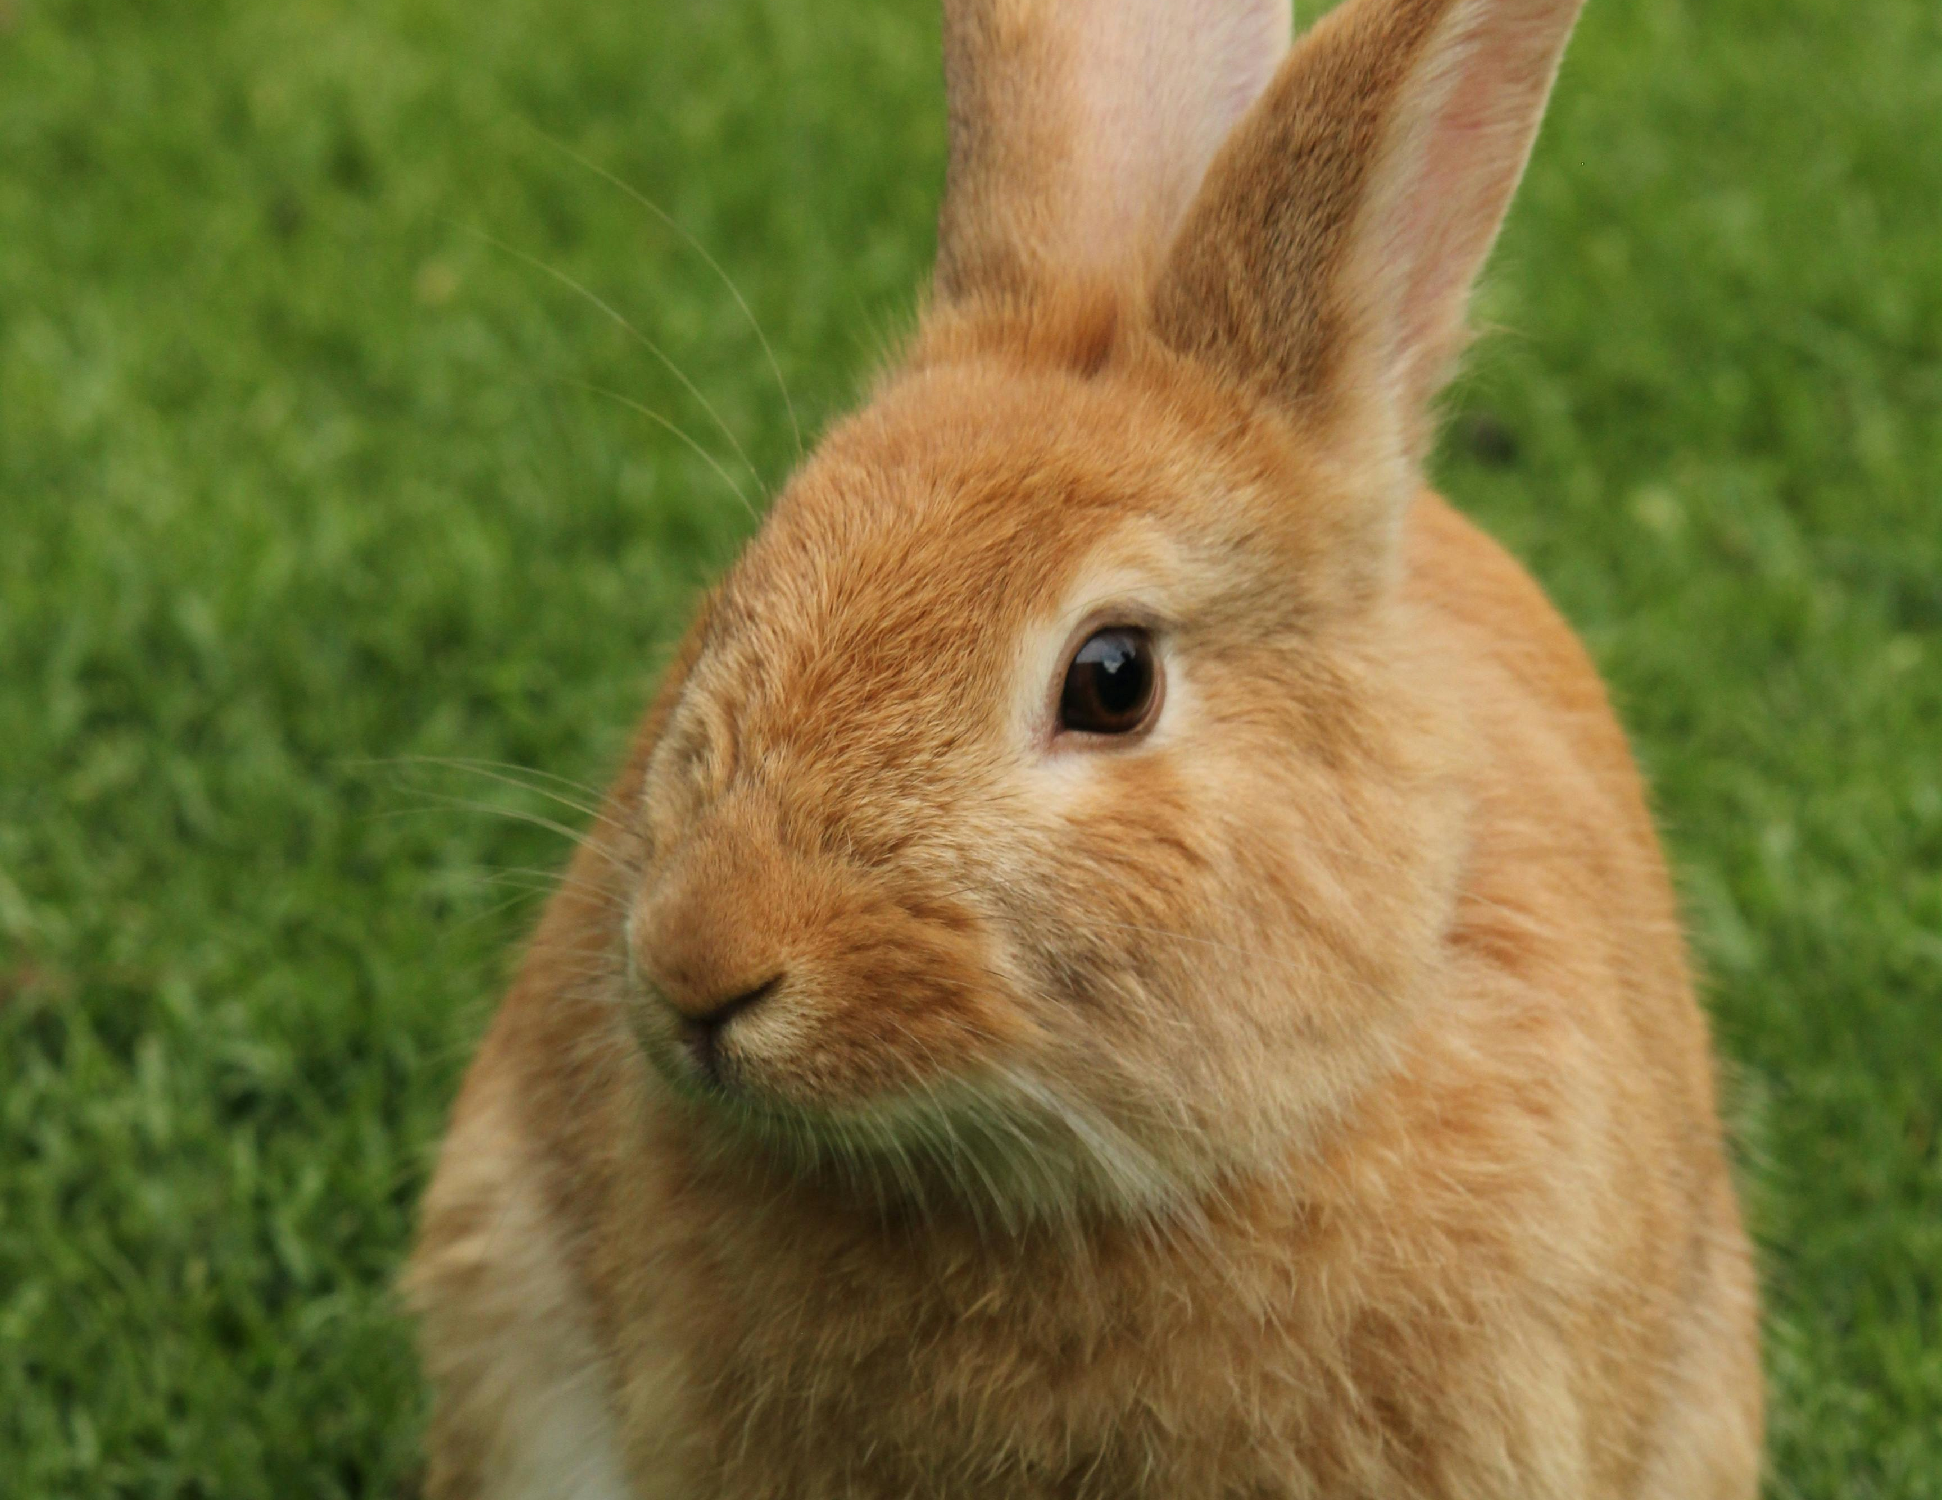

Who is Unstable?
Clover
Family D
D > E > F
Snake > Bunny > Spider
Dr. Fluffy
Family E
D > F > E
Bunny > Snake > Spider
Ronin
Family F
Spider > Bunny > Snake
E > D > F

Slide 8



Hospital Resident Assignments Problem
“Stable Hospitals”
Residents
Algorithm
Hospital

Slide 9

Resident Assignments
Dr. One
Hospital A
Dr. Two
Hospital B
Dr. Three
Hospital C

Slide 10
Q: What is missing?
“Stable Hospitals”
Residents
Algorithm
Hospital

Slide 11
Q: What is missing?
Resident’s Preferences
“Stable Hospitals”
Algorithm
Hospital’s Preferences

Slide 12
Resident Assignments
Dr. One
Hospital A
A > B > C
2 > 1 > 3
Dr. Two
Hospital B
A > C > B
1 > 2 > 3
Dr. Three
Hospital C
C > A > B
3 > 2 > 1

Slide 13
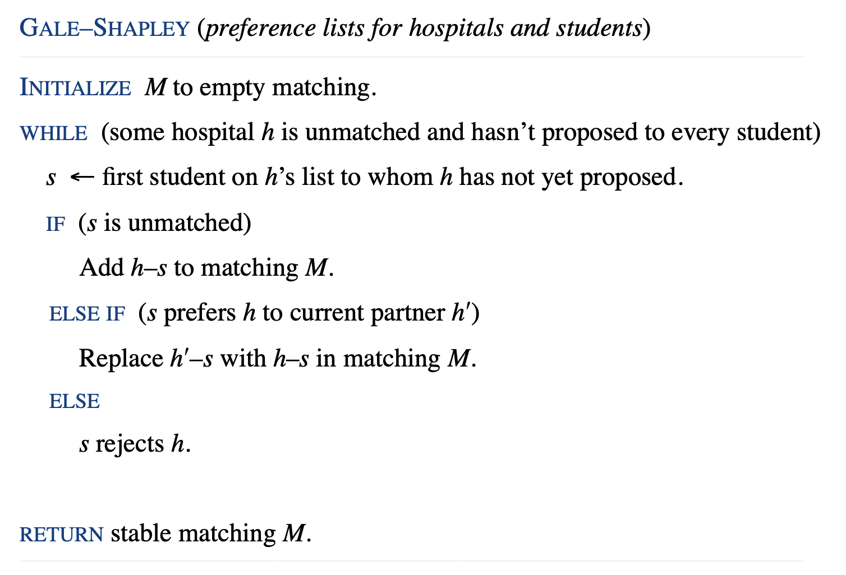
Gale-Shapley Algorithm

Slide 14
Resident Assignments
Dr. One
Hospital A
A > B > C
2 > 1 > 3
Dr. Two
Hospital B
A > C > B
1 > 2 > 3
Dr. Three
Hospital C
C > A > B
3 > 2 > 1

Slide 15
Gale-Shapley Algorithm

Slide 16
Resident Assignments
Dr. One
Hospital A
A > B > C
2 > 1 > 3
Dr. Two
Hospital B
A > C > B
1 > 2 > 3
Dr. Three
Hospital C
C > A > B
3 > 2 > 1

Slide 17

Resident Assignments
$$h$$
Dr. One
Hospital A
A > B > C
2 > 1 > 3
Dr. Two
Hospital B
A > C > B
1 > 2 > 3
Dr. Three
Hospital C
C > A > B
3 > 2 > 1

Slide 18
Gale-Shapley Algorithm

Slide 19
Resident Assignments
$$h$$
Dr. One
Hospital A
A > B > C
2 > 1 > 3
Dr. Two
Hospital B
A > C > B
1 > 2 > 3
Dr. Three
Hospital C
C > A > B
3 > 2 > 1

Slide 20
Resident Assignments
$$h$$
Dr. One
Hospital A
A > B > C
2 > 1 > 3
Dr. Two
Hospital B
A > C > B
1 > 2 > 3
Dr. Three
Hospital C
C > A > B
3 > 2 > 1

Slide 21
Gale-Shapley Algorithm

Slide 22
Resident Assignments
Dr. One
Hospital A
A > B > C
2 > 1 > 3
Dr. Two
Hospital B
A > C > B
1 > 2 > 3
Dr. Three
Hospital C
C > A > B
3 > 2 > 1

Slide 23
Gale-Shapley Algorithm

Slide 24
Resident Assignments
Dr. One
Hospital A
A > B > C
2 > 1 > 3
Dr. Two
Hospital B
A > C > B
1 > 2 > 3
Dr. Three
Hospital C
C > A > B
3 > 2 > 1

Slide 25
Gale-Shapley Algorithm

Slide 26
Resident Assignments
Dr. One
Hospital A
A > B > C
2 > 1 > 3
Dr. Two
Hospital B
A > C > B
3 > 2 > 1
Dr. Three
Hospital C
C > A > B
3 > 2 > 1

Slide 27
Resident Assignments
Dr. One
Hospital A
A > B > C
2 > 1 > 3
Dr. Two
Hospital B
A > C > B
3 > 2 > 1
Dr. Three
Hospital C
C > A > B
3 > 2 > 1

Slide 28
Resident Assignments
Dr. One
Hospital A
A > B > C
2 > 1 > 3
Dr. Two
Hospital B
A > C > B
3 > 2 > 1
Dr. Three
Hospital C
C > A > B
3 > 2 > 1

Slide 29
Resident Assignments
Dr. One
Hospital A
A > B > C
2 > 1 > 3
Dr. Two
Hospital B
A > C > B
3 > 2 > 1
Dr. Three
Hospital C
C > A > B
3 > 2 > 1

Slide 30
Resident Assignments
Dr. One
Hospital A
A > B > C
2 > 1 > 3
Dr. Two
Hospital B
A > C > B
3 > 2 > 1
Dr. Three
Hospital C
C > A > B
3 > 2 > 1

Slide 31
Resident Assignments
Dr. One
Hospital A
A > B > C
2 > 1 > 3
Dr. Two
Hospital B
A > C > B
3 > 2 > 1
Dr. Three
Hospital C
C > A > B
3 > 2 > 1

Slide 32
Resident Assignments
Dr. One
Hospital A
A > B > C
2 > 1 > 3
Dr. Two
Hospital B
A > C > B
3 > 2 > 1
Dr. Three
Hospital C
C > A > B
3 > 2 > 1

Slide 33
Resident Assignments
Dr. One
Hospital A
A > B > C
2 > 1 > 3
Dr. Two
Hospital B
A > C > B
3 > 2 > 1
Dr. Three
Hospital C
C > A > B
3 > 2 > 1

Slide 34

Q: Does a Stable Matching Always Exist?

Slide 35
Q: Does a Stable Matching Always Exist?
Observation 1: [Hint: What can we say about the order of proposals made by hospitals?]
Observation 2: [Hint: What can we say about a student’s status after they’ve been matched?]

Slide 36
Q: Does a Stable Matching Always Exist?
Observation 1: Hospitals propose in decreasing order of preference.
Observation 2: Once a student is matched, the student never becomes less happy.

Slide 37
Claim Time!
Claim: The algorithm terminates after at most __ iterations of the WHILE loop.

Slide 38

Claim Time!
Claim: The algorithm terminates after at most $n^{2}$ iterations of the WHILE loop.

Slide 39
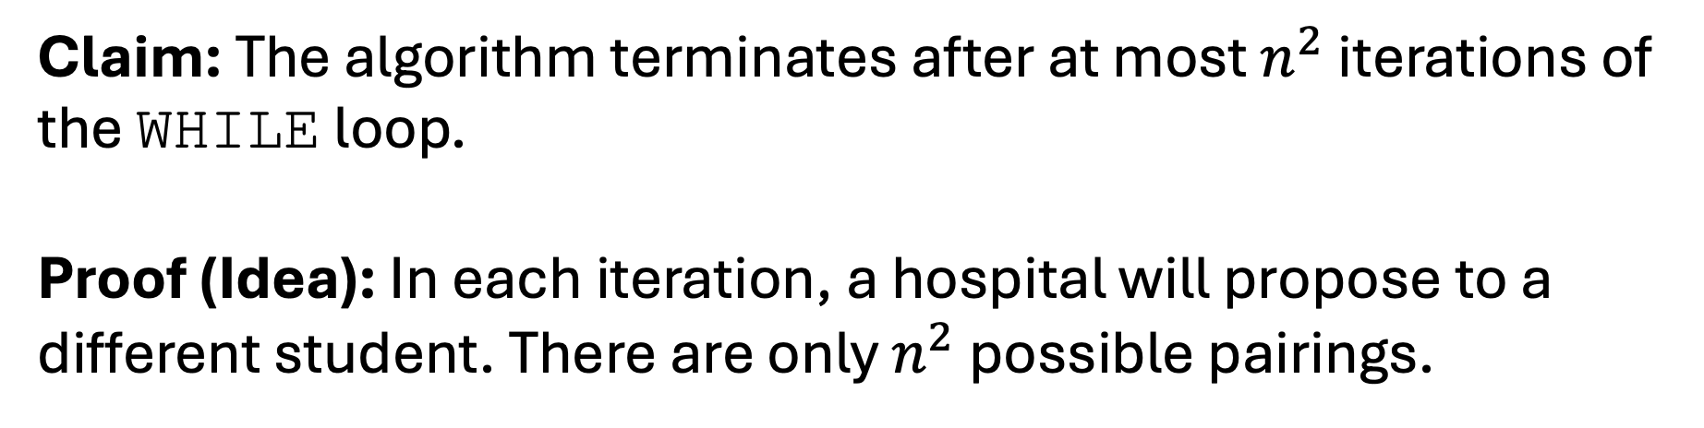
Proof Idea Time!
Claim: The algorithm terminates after at most $n^{2}$ iterations of the WHILE loop.
Proof (Idea): In each iteration, a hospital will propose to a different student. There are only $n^{2}$ possible pairings.

Slide 40
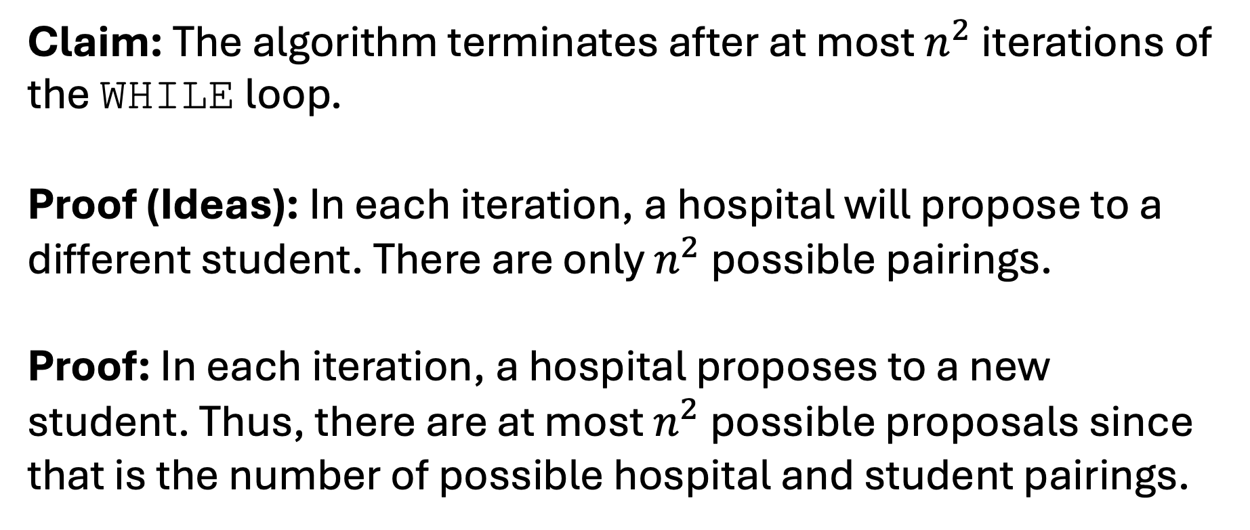
Proof Time!
Claim: The algorithm terminates after at most $n^{2}$ iterations of the WHILE loop.
Proof (Ideas): In each iteration, a hospital will propose to a different student. There are only $n^{2}$ possible pairings.
Proof: In each iteration, a hospital proposes to a new student. Thus, there are at most $n^{2}$ possible proposals since that is the number of possible hospital and student pairings.

Slide 41
Q: Are we done?
NO!

Slide 42
Claim Time!
Claim: The algorithm always outputs a matching.

Slide 43
Proof Idea Time!
Claim: The algorithm always outputs a matching.
Proof (Idea): Hospitals only ask to match when they are unmatched. Students only agree if they are unmatched or if they like the hospital better and drop the old hospital.

Slide 44
Proof Time!
Claim: The algorithm always outputs a matching.
Proof (Idea): Hospitals only ask to match when they are unmatched. Students only agree if they are unmatched or if they like the hospital better and drop the old hospital.
Proof: A hospital will only propose if it is unmatched. Hence, the degree of each hospital is at most one. A student will only stay matched with their most preferred hospital. Hence, the degree of each student is at most one.

Slide 45
Q: Are we done?
NO!

Slide 46
Claim Time!
Claim: The algorithm always outputs a perfect matching.

Slide 47
Proof Idea Time!
Claim: The algorithm always outputs a perfect matching.
Proof (Idea): We can show that every hospital is matched with a student. We know that each student is matched with at most one hospital. Since there are the same number, we could then conclude that the matching is perfect.

Slide 48
Subclaim Time!
Subclaim: The algorithm always outputs a matching such that each hospital is matched to a student.

Slide 49
Subclaim Time!
Subclaim: The algorithm always outputs a matching such that each hospital is matched to a student.
Proof: We proceed with a proof by contradiction.
Suppose to the contrary that….

Slide 50
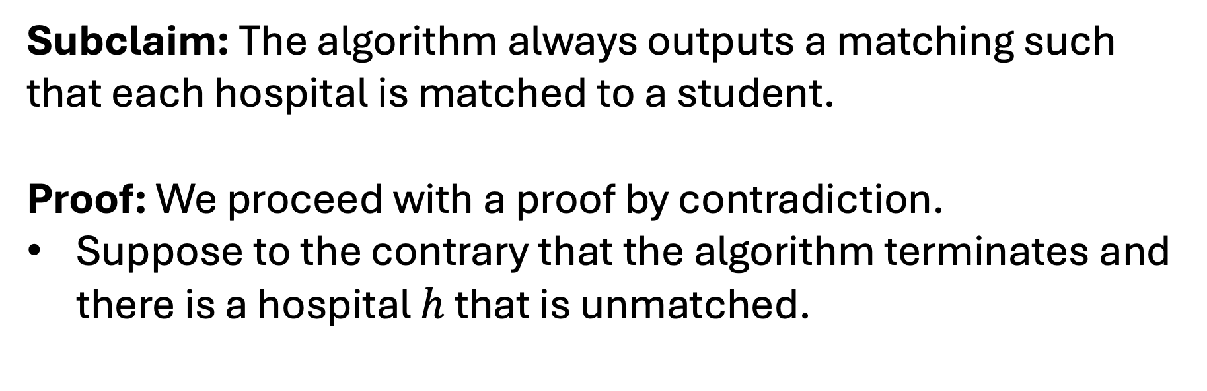
Subclaim Time!
Subclaim: The algorithm always outputs a matching such that each hospital is matched to a student.
Proof: We proceed with a proof by contradiction.
Suppose to the contrary that the algorithm terminates and there is a hospital $h$ that is unmatched.

Slide 51
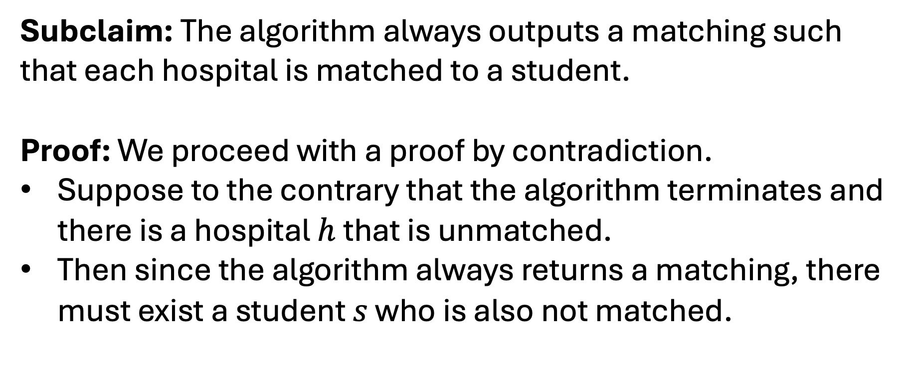
Subclaim Time!
Subclaim: The algorithm always outputs a matching such that each hospital is matched to a student.
Proof: We proceed with a proof by contradiction.
Suppose to the contrary that the algorithm terminates and there is a hospital $h$ that is unmatched.
Then since the algorithm always returns a matching, there must exist a student $s$ who is also not matched.

Slide 52
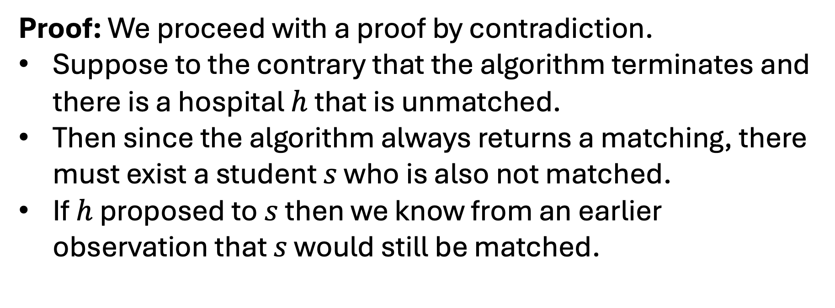
Subclaim Time!
Proof: We proceed with a proof by contradiction.
Suppose to the contrary that the algorithm terminates and there is a hospital $h$ that is unmatched.
Then since the algorithm always returns a matching, there must exist a student $s$ who is also not matched.
If $h$ proposed to $s$ then we know from an earlier observation that $s$ would still be matched.

Slide 53
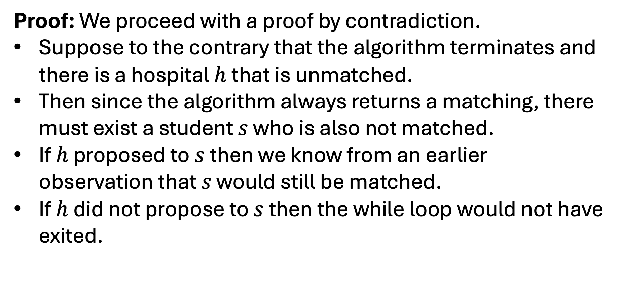
Subclaim Time!
Proof: We proceed with a proof by contradiction.
Suppose to the contrary that the algorithm terminates and there is a hospital $h$ that is unmatched.
Then since the algorithm always returns a matching, there must exist a student $s$ who is also not matched.
If $h$ proposed to $s$ then we know from an earlier observation that $s$ would still be matched.
If $h$ did not propose to $s$ then the while loop would not have exited.

Slide 54
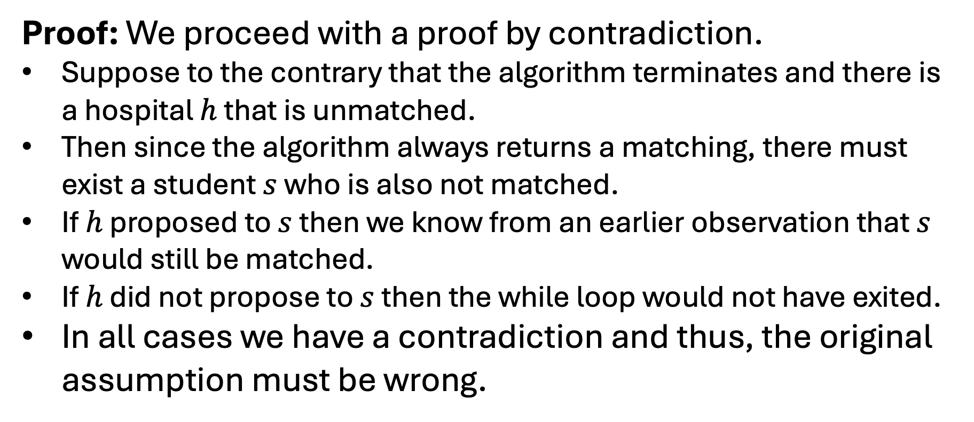
Subclaim Time!
Proof: We proceed with a proof by contradiction.
Suppose to the contrary that the algorithm terminates and there is a hospital $h$ that is unmatched.
Then since the algorithm always returns a matching, there must exist a student $s$ who is also not matched.
If $h$ proposed to $s$ then we know from an earlier observation that $s$ would still be matched.
If $h$ did not propose to $s$ then the while loop would not have exited.
In all cases we have a contradiction and thus, the original assumption must be wrong.

Slide 55
Subclaim Time!
Subclaim: The algorithm always outputs a matching such that each student is matched to a hospital.
Proof:

Slide 56
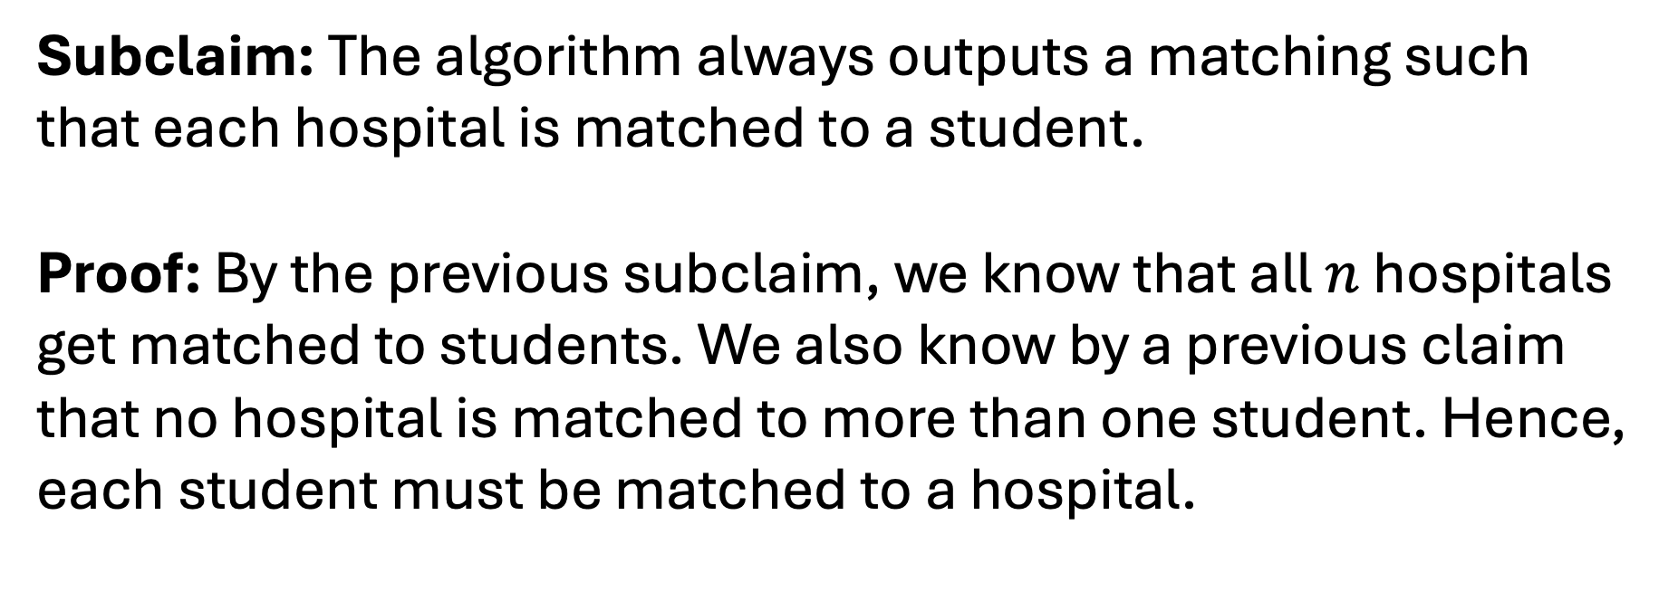
Subclaim Time!
Subclaim: The algorithm always outputs a matching such that each hospital is matched to a student.
Proof: By the previous subclaim, we know that all $n$ hospitals get matched to students. We also know by a previous claim that no hospital is matched to more than one student. Hence, each student must be matched to a hospital.

Slide 57
Big Proof Time!
Claim: The algorithm always outputs a Prefect matching.
Proof (Idea): We can show that every hospital is matched with a student. We know that each student is matched with at most one hospital. Since there are the same number, we could then conclude that the matching is perfect.
Proof: By both subclaims we know that the matching output by the algorithm matches every student and every hospital. saturates

Slide 58
Q: Are we done?
NO!

Slide 59
Claim Time!
Claim: The algorithm always outputs a stable matching.

Slide 60
Proof Idea Time!
Claim: The algorithm always outputs a stable matching.
Proof (Ideas):

Slide 61
Proof Idea Time!
Claim: The algorithm always outputs a stable matching.
Proof (Ideas):
Show that every unmatched pair is not unstable.
Show that the existence of an unstable pair would be a contradiction.

Slide 62
Proof Time!
Proof: We proceed with a proof by contradiction.
Suppose to the contrary that…

Slide 63
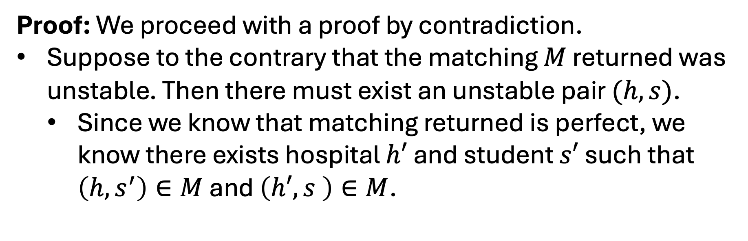
Proof Time!
Proof: We proceed with a proof by contradiction.
Suppose to the contrary that the matching $M$ returned was unstable. Then there must exist an unstable pair $(h,s)$.
  Since we know that matching returned is perfect, we know there exists hospital $h′$ and student $s′$ such that $\left(h,s^{′}\right)∈M$ and $\left(h′,s \right)∈M$.

Slide 64
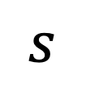
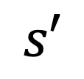
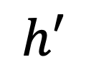
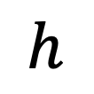
Proof Time!
Proof: We proceed with a proof by contradiction.
Suppose to the contrary that the matching $M$ returned was unstable. Then there must exist an unstable pair $(h,s)$.
  Since we know that matching returned is perfect, we know there exists hospital $h′$ and student $s′$ such that $\left(h,s^{′}\right)∈M$ and $\left(h′,s \right)∈M$.
$$h$$
$$s′$$
$$h′$$
$$s$$

Slide 65
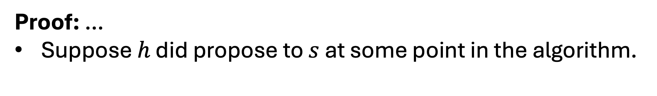
Proof Time!
Proof: …
Suppose $h$ did propose to $s$ at some point in the algorithm.
$$h$$
$$s′$$
$$h′$$
$$s$$

Slide 66
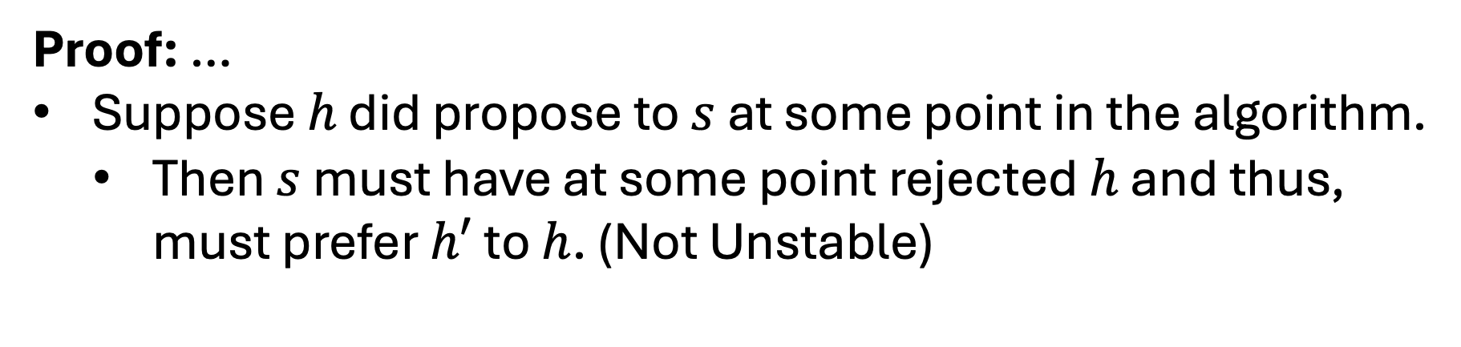
Proof Time!
Proof: …
Suppose $h$ did propose to $s$ at some point in the algorithm.
  Then $s$ must have at some point rejected $h$ and thus, must prefer $h′$ to $h$. (Not Unstable)
$$h$$
$$s′$$
$$h′$$
$$s$$

Slide 67
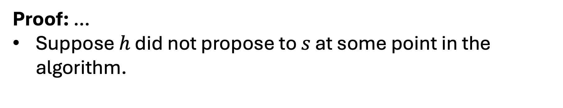
Proof Time!
Proof: …
Suppose $h$ did not propose to $s$ at some point in the algorithm.
$$h$$
$$s′$$
$$h′$$
$$s$$

Slide 68
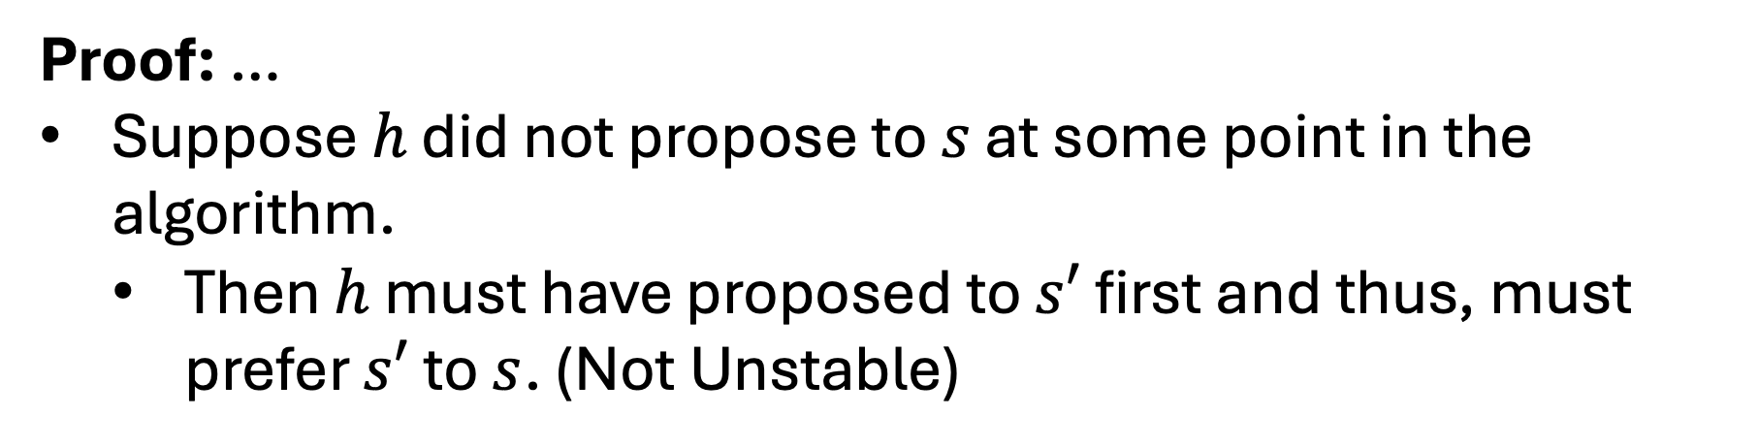
Proof Time!
Proof: …
Suppose $h$ did not propose to $s$ at some point in the algorithm.
  Then $h$ must have proposed to $s′$ first and thus, must prefer $s′$ to $s$. (Not Unstable)
$$h$$
$$s′$$
$$h′$$
$$s$$

Slide 69
Proof Time!
Proof: …
In all cases we have concluded that if there is an unstable pair then the pair is can’t be unstable. This is a contradiction and thus there can be no unstable pairs.
$$h$$
$$s′$$
$$h′$$
$$s$$

Slide 70
Proof Idea Time!
Claim: The algorithm always outputs a stable matching.
Proof (Ideas):
Show that every unmatched pair is not unstable.
Show that the existence of an unstable pair would be a contradiction.

