Slide 1

CSE 331:
Algorithms & Complexity
“Gale-Shapley II”
Prof. Charlie Anne Carlson (She/Her)
Lecture 5
Monday September 8th, 2025

Slide 2

Schedule
Course Updates
Recap
More Gale-Shapely

Slide 3

Course Updates
Complete Syllabus Quiz
HW 1 Posted Tomorrow
HW 0 Being Graded
Website Moving

Slide 4
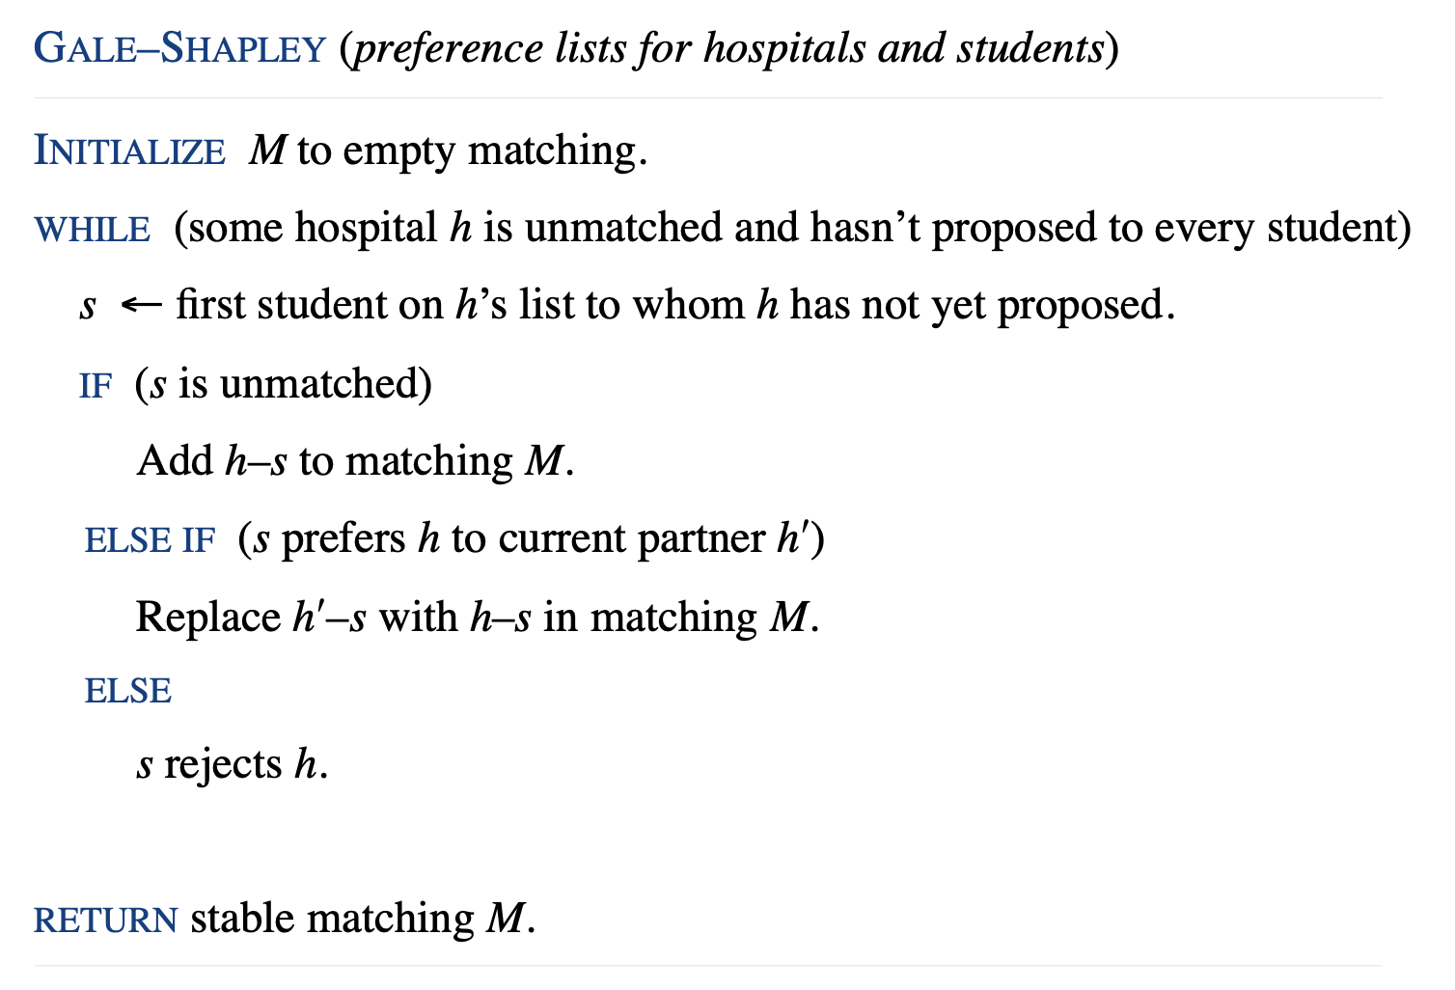
Gale-Shapley Algorithm

Slide 5



Resident Assignments
Dr. One
Hospital A
A > B > C
2 > 1 > 3
Dr. Two
Hospital B
A > C > B
3 > 2 > 1
Dr. Three
Hospital C
C > A > B
3 > 2 > 1

Slide 6
Q: Is this Stable?
Dr. One
Hospital A
A > B > C
2 > 1 > 3
Dr. Two
Hospital B
A > C > B
3 > 2 > 1
Dr. Three
Hospital C
C > A > B
3 > 2 > 1

Slide 7
Q: Does a Stable Matching Always Exist?
Observation 1: Hospitals propose in decreasing order of preference.
Observation 2: Once a student is matched, the student never becomes less happy.

Slide 8

Claim Time!
Claim: The algorithm terminates after at most $n^{2}$ iterations of the WHILE loop.

Slide 9
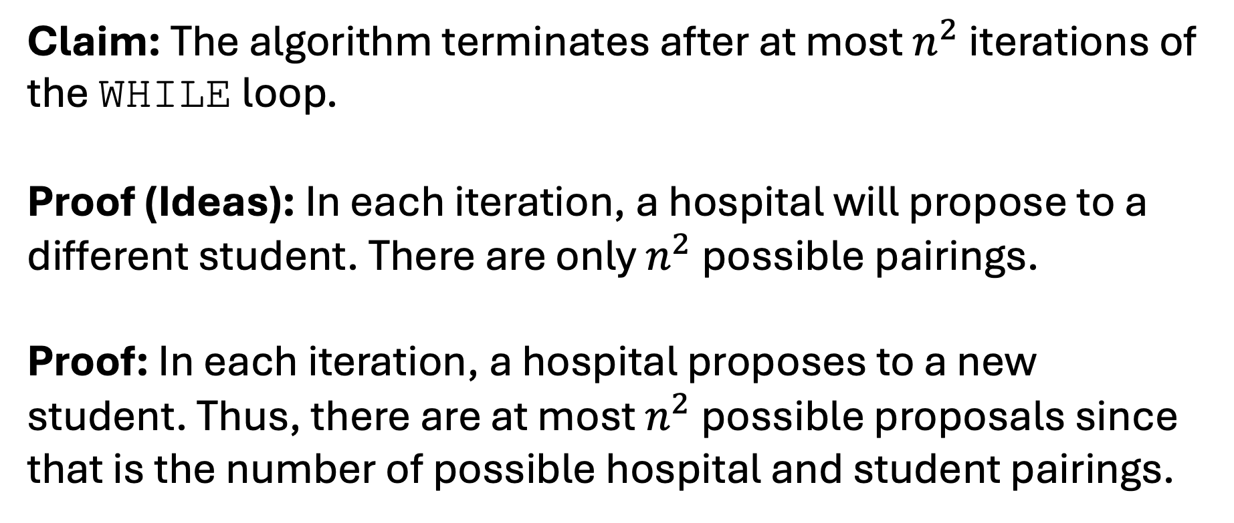
Proof Time!
Claim: The algorithm terminates after at most $n^{2}$ iterations of the WHILE loop.
Proof (Ideas): In each iteration, a hospital will propose to a different student. There are only $n^{2}$ possible pairings.
Proof: In each iteration, a hospital proposes to a new student. Thus, there are at most $n^{2}$ possible proposals since that is the number of possible hospital and student pairings.

Slide 10

Q: Are we done?
NO!

Slide 11
Claim Time!
Claim: The algorithm always outputs a matching.

Slide 12
Proof Time!
Claim: The algorithm always outputs a matching.
Proof (Idea): Hospitals only ask to match when they are unmatched. Students only agree if they are unmatched or if they like the hospital better and drop the old hospital.
Proof: A hospital will only propose if it is unmatched. Hence, the degree of each hospital is at most one. A student will only stay matched with their most preferred hospital. Hence, the degree of each student is at most one.

Slide 13
Q: Are we done?
NO!

Slide 14
Claim Time!
Claim: The algorithm always outputs a perfect matching.

Slide 15
Proof Idea Time!
Claim: The algorithm always outputs a perfect matching.
Proof (Idea): We can show that every hospital is matched with a student. We know that each student is matched with at most one hospital. Since there are the same number, we could then conclude that the matching is perfect.

Slide 16
Subclaim Time!
Subclaim: The algorithm always outputs a matching such that each hospital is matched to a student.

Slide 17
Subclaim Time!
Subclaim: The algorithm always outputs a matching such that each hospital is matched to a student.
Proof: We proceed with a proof by contradiction.
Suppose to the contrary that….

Slide 18
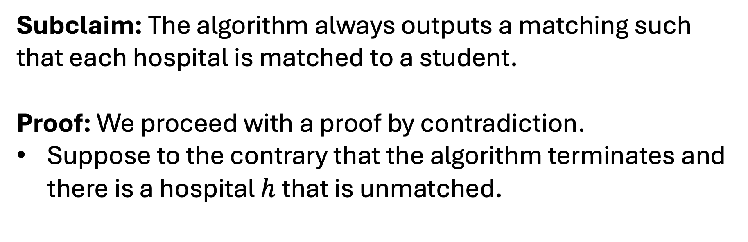
Subclaim Time!
Subclaim: The algorithm always outputs a matching such that each hospital is matched to a student.
Proof: We proceed with a proof by contradiction.
Suppose to the contrary that the algorithm terminates and there is a hospital $h$ that is unmatched.

Slide 19
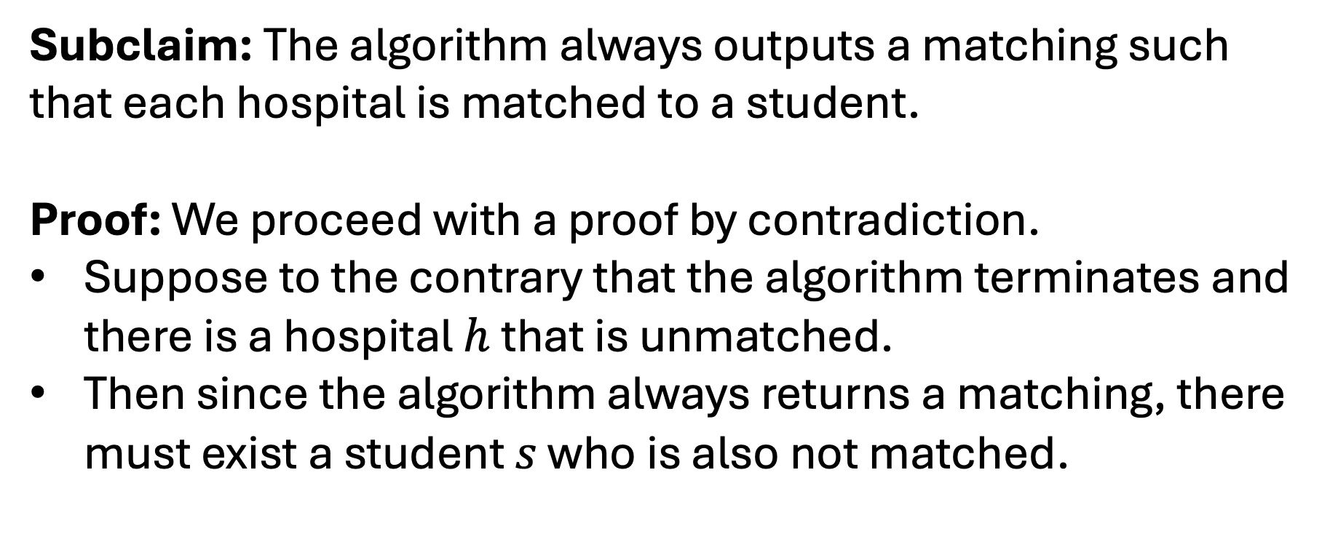
Subclaim Time!
Subclaim: The algorithm always outputs a matching such that each hospital is matched to a student.
Proof: We proceed with a proof by contradiction.
Suppose to the contrary that the algorithm terminates and there is a hospital $h$ that is unmatched.
Then since the algorithm always returns a matching, there must exist a student $s$ who is also not matched.

Slide 20
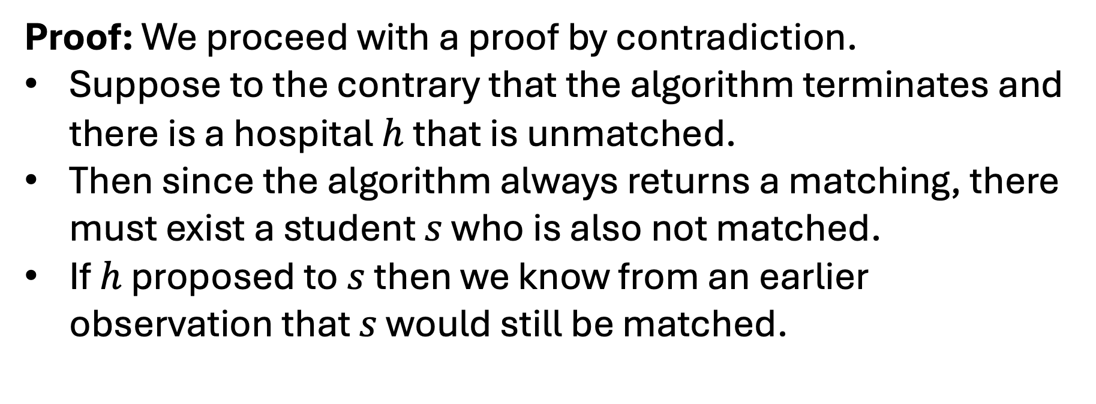
Subclaim Time!
Proof: We proceed with a proof by contradiction.
Suppose to the contrary that the algorithm terminates and there is a hospital $h$ that is unmatched.
Then since the algorithm always returns a matching, there must exist a student $s$ who is also not matched.
If $h$ proposed to $s$ then we know from an earlier observation that $s$ would still be matched.

Slide 21
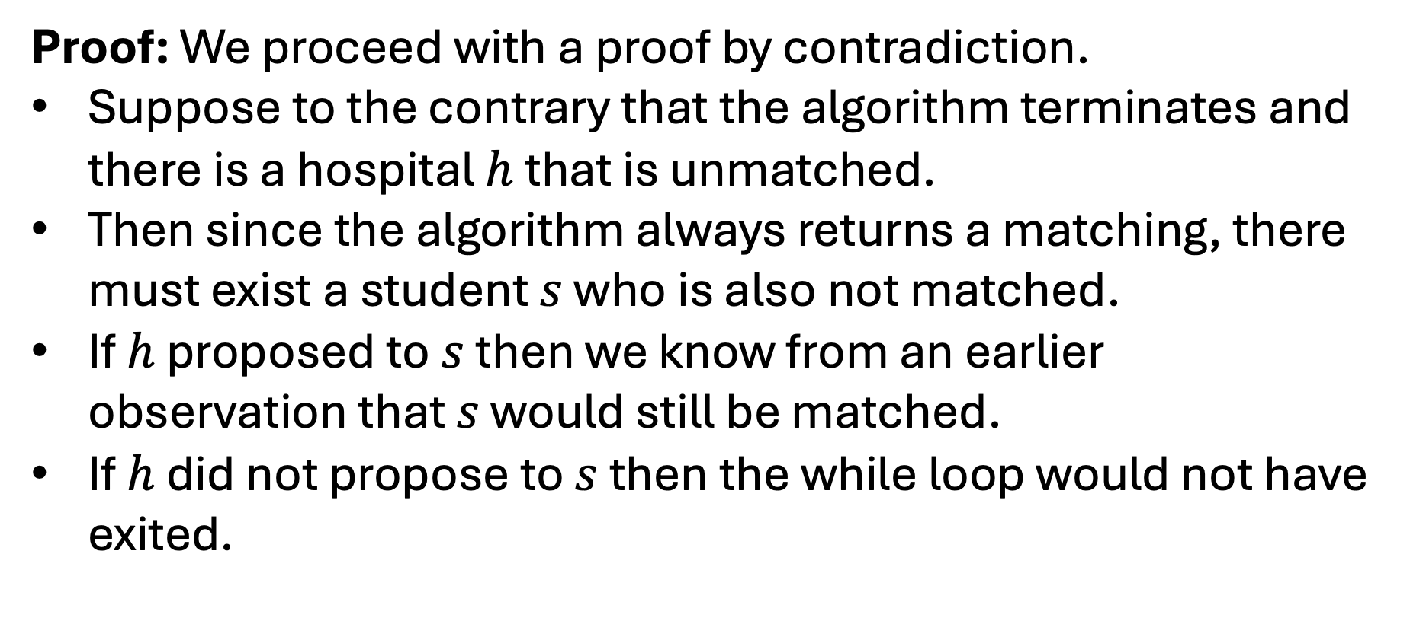
Subclaim Time!
Proof: We proceed with a proof by contradiction.
Suppose to the contrary that the algorithm terminates and there is a hospital $h$ that is unmatched.
Then since the algorithm always returns a matching, there must exist a student $s$ who is also not matched.
If $h$ proposed to $s$ then we know from an earlier observation that $s$ would still be matched.
If $h$ did not propose to $s$ then the while loop would not have exited.

Slide 22
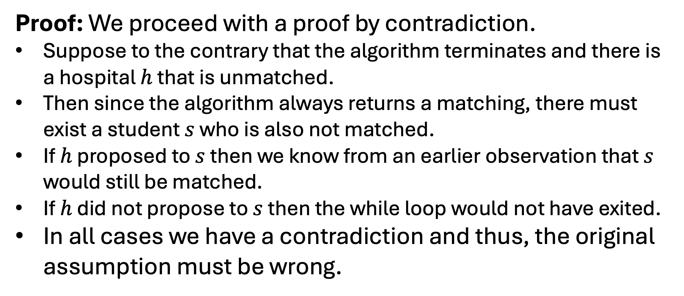
Subclaim Time!
Proof: We proceed with a proof by contradiction.
Suppose to the contrary that the algorithm terminates and there is a hospital $h$ that is unmatched.
Then since the algorithm always returns a matching, there must exist a student $s$ who is also not matched.
If $h$ proposed to $s$ then we know from an earlier observation that $s$ would still be matched.
If $h$ did not propose to $s$ then the while loop would not have exited.
In all cases we have a contradiction and thus, the original assumption must be wrong.

Slide 23
Subclaim Time!
Subclaim: The algorithm always outputs a matching such that each student is matched to a hospital.
Proof:

Slide 24
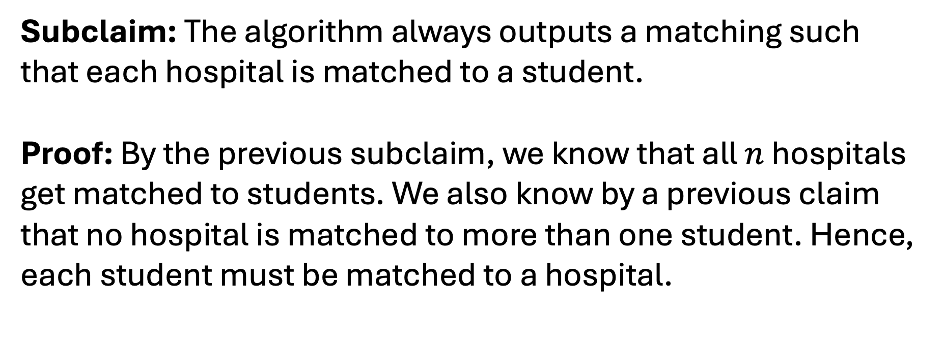
Subclaim Time!
Subclaim: The algorithm always outputs a matching such that each hospital is matched to a student.
Proof: By the previous subclaim, we know that all $n$ hospitals get matched to students. We also know by a previous claim that no hospital is matched to more than one student. Hence, each student must be matched to a hospital.

Slide 25
Big Proof Time!
Claim: The algorithm always outputs a Prefect matching.
Proof (Idea): We can show that every hospital is matched with a student. We know that each student is matched with at most one hospital. Since there are the same number, we could then conclude that the matching is perfect.
Proof: By both subclaims we know that the matching output by the algorithm matches every student and every hospital. saturates

Slide 26
Q: Are we done?
NO!

Slide 27
Claim Time!
Claim: The algorithm always outputs a stable matching.

Slide 28
Proof Idea Time!
Claim: The algorithm always outputs a stable matching.
Proof (Ideas):

Slide 29
Proof Idea Time!
Claim: The algorithm always outputs a stable matching.
Proof (Ideas):
Show that every unmatched pair is not unstable.
Show that the existence of an unstable pair would be a contradiction.

Slide 30
Proof Time!
Proof: We proceed with a proof by contradiction.
Suppose to the contrary that…

Slide 31
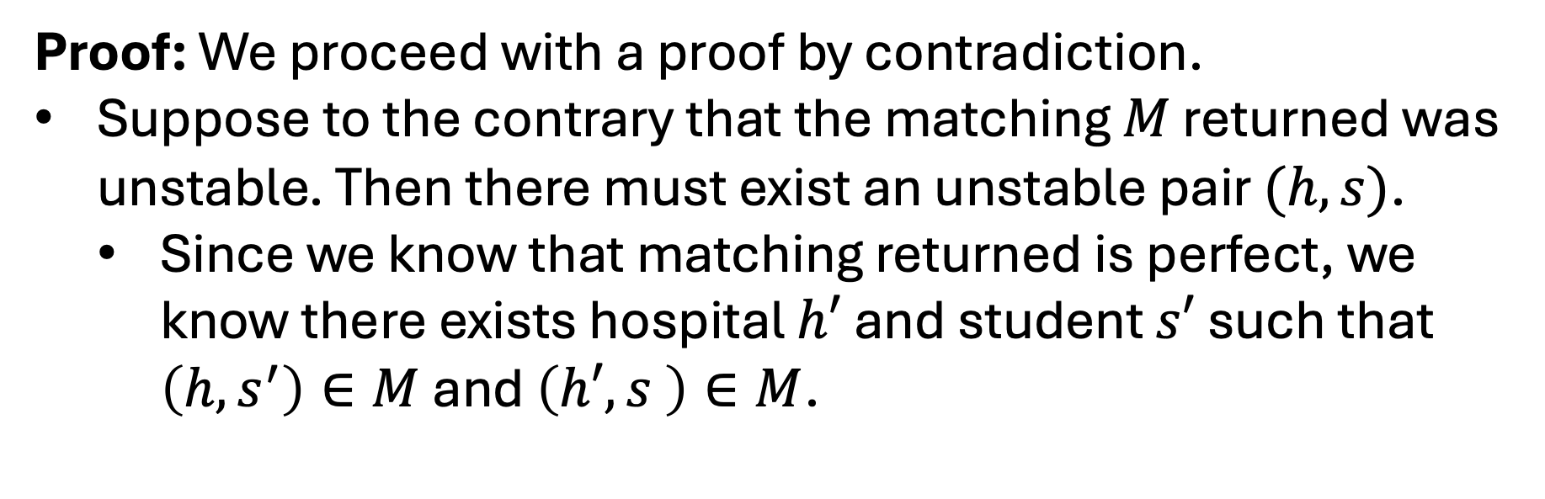
Proof Time!
Proof: We proceed with a proof by contradiction.
Suppose to the contrary that the matching $M$ returned was unstable. Then there must exist an unstable pair $(h,s)$.
  Since we know that matching returned is perfect, we know there exists hospital $h′$ and student $s′$ such that $\left(h,s^{′}\right)∈M$ and $\left(h′,s \right)∈M$.

Slide 32
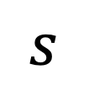
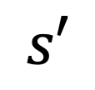
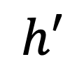
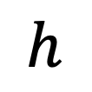
Proof Time!
Proof: We proceed with a proof by contradiction.
Suppose to the contrary that the matching $M$ returned was unstable. Then there must exist an unstable pair $(h,s)$.
  Since we know that matching returned is perfect, we know there exists hospital $h′$ and student $s′$ such that $\left(h,s^{′}\right)∈M$ and $\left(h′,s \right)∈M$.
$$h$$
$$s′$$
$$h′$$
$$s$$

Slide 33
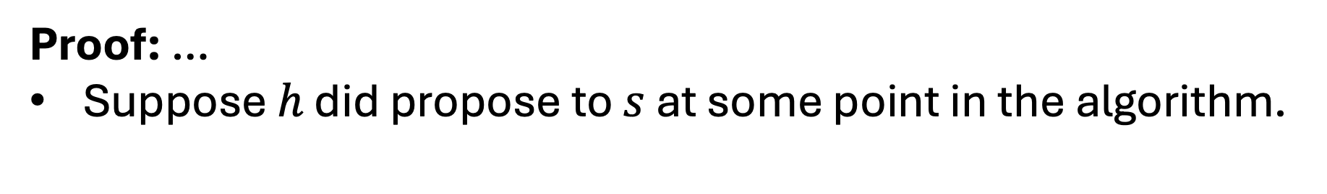
Proof Time!
Proof: …
Suppose $h$ did propose to $s$ at some point in the algorithm.
$$h$$
$$s′$$
$$h′$$
$$s$$

Slide 34
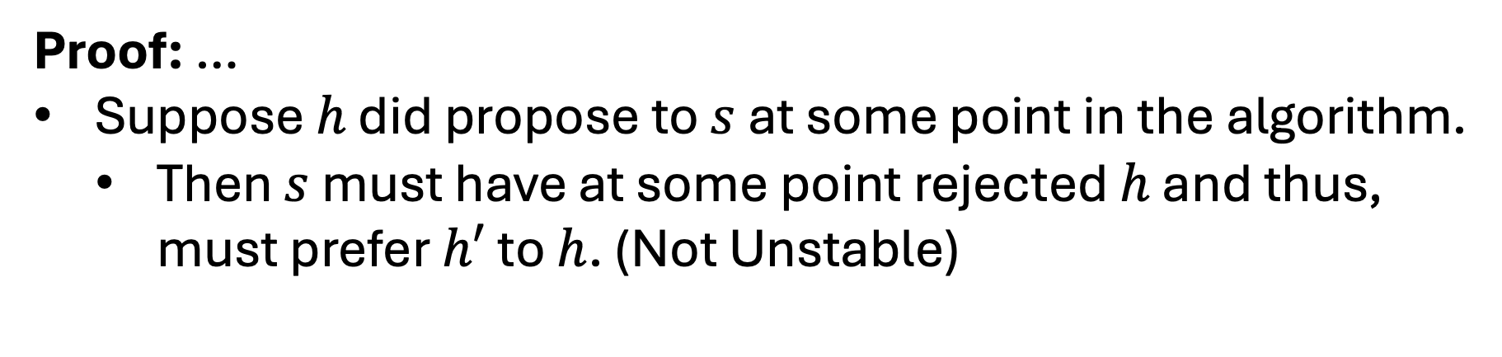
Proof Time!
Proof: …
Suppose $h$ did propose to $s$ at some point in the algorithm.
  Then $s$ must have at some point rejected $h$ and thus, must prefer $h′$ to $h$. (Not Unstable)
$$h$$
$$s′$$
$$h′$$
$$s$$

Slide 35
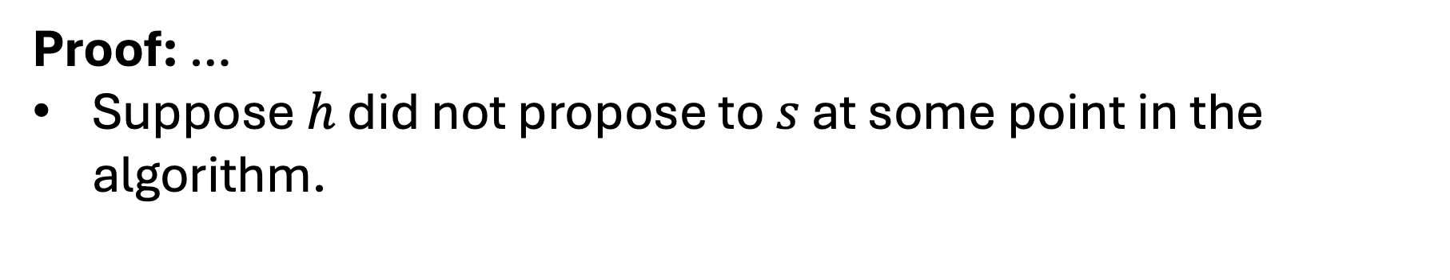
Proof Time!
Proof: …
Suppose $h$ did not propose to $s$ at some point in the algorithm.
$$h$$
$$s′$$
$$h′$$
$$s$$

Slide 36
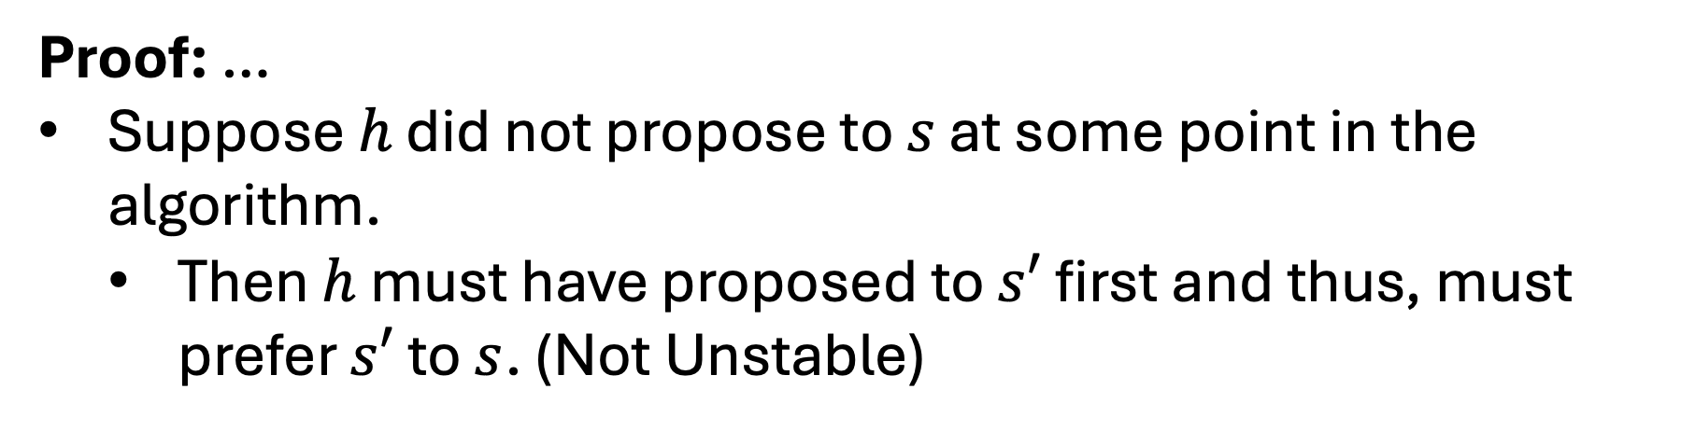
Proof Time!
Proof: …
Suppose $h$ did not propose to $s$ at some point in the algorithm.
  Then $h$ must have proposed to $s′$ first and thus, must prefer $s′$ to $s$. (Not Unstable)
$$h$$
$$s′$$
$$h′$$
$$s$$

Slide 37
Proof Time!
Proof: …
In all cases we have concluded that if there is an unstable pair then the pair is can’t be unstable. This is a contradiction and thus there can be no unstable pairs.
$$h$$
$$s′$$
$$h′$$
$$s$$

Slide 38
Proof Idea Time!
Claim: The algorithm always outputs a stable matching.
Proof (Ideas):
Show that every unmatched pair is not unstable.
Show that the existence of an unstable pair would be a contradiction.

Slide 39
Q: Are we done?
Maybe?

Slide 40
Q: Is there just one Stable Matching?
Dr. One
Hospital A
A > B > C
2 > 1 > 3
Dr. Two
Hospital B
B > A > C
1 > 2 > 3
Dr. Three
Hospital C
A > B > C
1 > 2 > 3

Slide 41
Matching I
Dr. One
Hospital A
A > B > C
2 > 1 > 3
Dr. Two
Hospital B
B > A > C
1 > 2 > 3
Dr. Three
Hospital C
A > B > C
1 > 2 > 3

Slide 42
Matching II
Dr. One
Hospital A
A > B > C
2 > 1 > 3
Dr. Two
Hospital B
B > A > C
1 > 2 > 3
Dr. Three
Hospital C
A > B > C
1 > 2 > 3

Slide 43
Matching I vs Matching II
Dr. One
Hospital A
A > B > C
2 > 1 > 3
Dr. Two
Hospital B
B > A > C
1 > 2 > 3
Dr. Three
Hospital C
A > B > C
1 > 2 > 3

Slide 44
Q: Is there a Stable Matching with this edge?
Dr. One
Hospital A
A > B > C
2 > 1 > 3
Dr. Two
Hospital B
B > A > C
1 > 2 > 3
Dr. Three
Hospital C
A > B > C
1 > 2 > 3

Slide 45
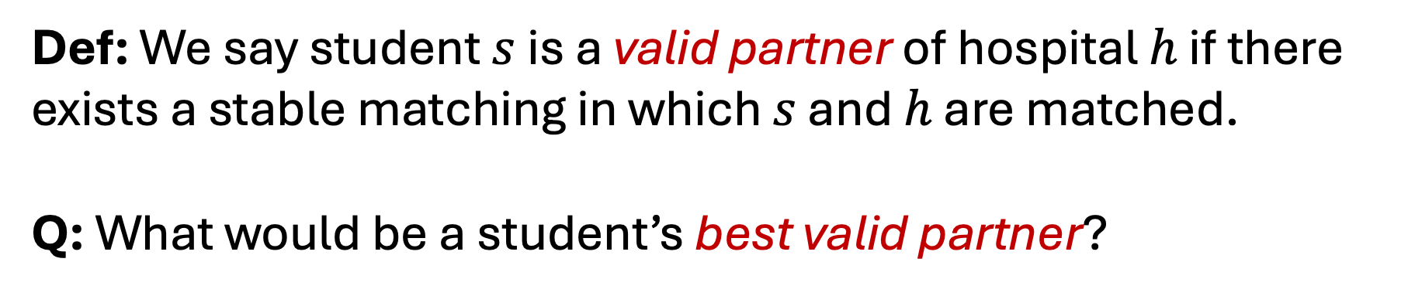
Valid Partners
Def: We say student $s$ is a valid partner of hospital $h$ if there exists a stable matching in which $s$ and $h$ are matched.
Q: What would be a student’s best valid partner?
E.g.:
Dr. Three
Hospital C
A > B > C
1 > 2 > 3

Slide 46
Q: Who is Dr. Two’s best valid partner?
Dr. One
Hospital A
A > B > C
2 > 1 > 3
Dr. Two
Hospital B
B > A > C
1 > 2 > 3
Dr. Three
Hospital C
A > B > C
1 > 2 > 3

Slide 47
Valid Partners
Def: The student optimal assignment is the one in which all students are matched with their best valid partner. The hospital optimal assignment is the one in which all hospitals are matched with their best valid partner.
Q: Are these optimal assignments stable matchings?
Q: Can we find them?

Slide 48
Claim Time!
Claim: The algorithm always outputs the hospital-optimal assignment.

Slide 49
Proof Idea Time!
Claim: The algorithm always outputs a stable matching.
Proof:
Suppose to the contrary that the output is not hospital optimal. We will show that….

Slide 50
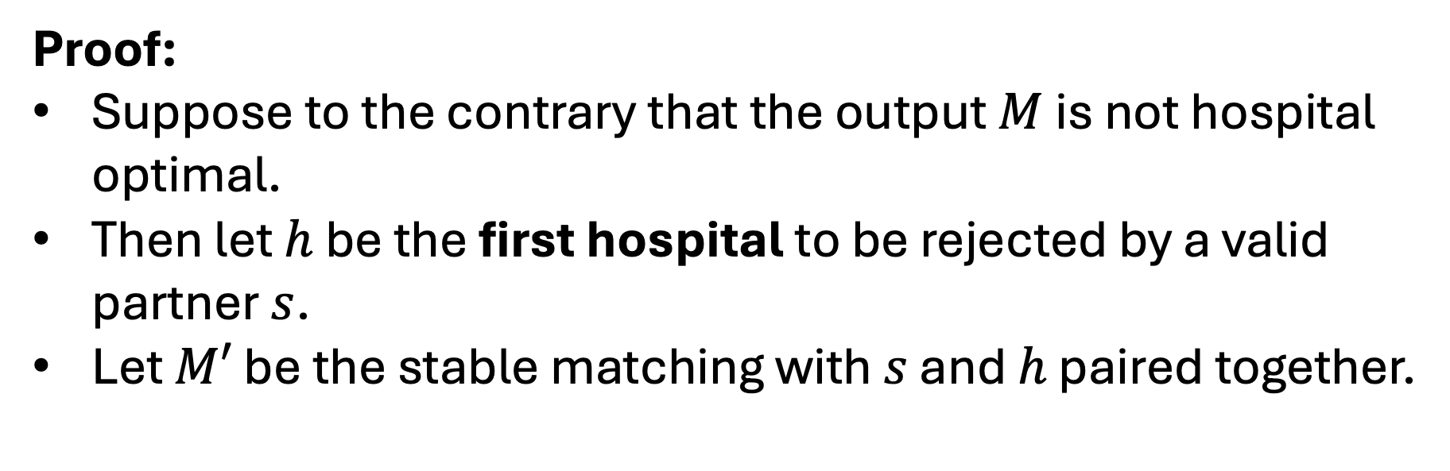

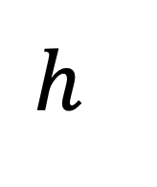

Proof Idea Time!
Proof:
Suppose to the contrary that the output $M$ is not hospital optimal.
Then let $h$ be the first hospital to be rejected by a valid partner $s$.
Let $M′$ be the stable matching with $s$ and $h$ paired together.
$$s$$
$$h$$
$$M′$$

Slide 51

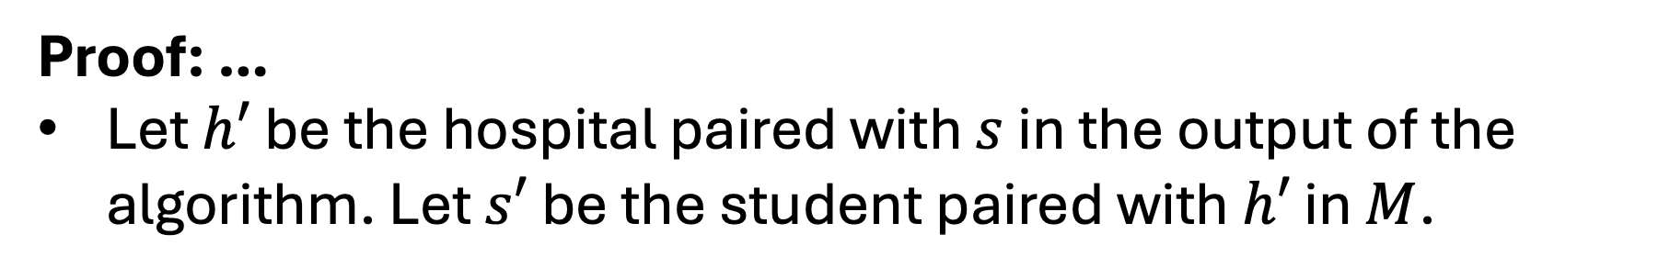

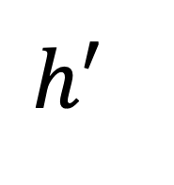

Proof Idea Time!
Proof: …
Let $h′$ be the hospital paired with $s$ in the output of the algorithm. Let $s′$ be the student paired with $h′$ in $M$.
$$s′$$
$$h′$$
$$M$$
$$s$$
$$h$$
$$M′$$

Slide 52
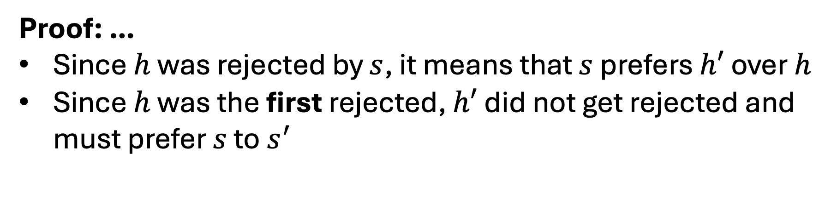
Proof Idea Time!
Proof: …
Since $h$ was rejected by $s$, it means that $s$ prefers $h′$ over $h$
Since $h$ was the first rejected, $h′$ did not get rejected and must prefer $s$ to $s^{′}$
$$s′$$
$$h′$$
$$M$$
$$s$$
$$h$$
$$M′$$

Slide 53
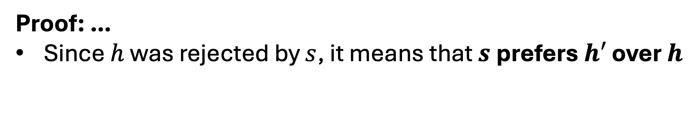
Proof Idea Time!
Proof: …
Since $h$ was rejected by $s$, it means that $s$ prefers $h′$ over $h$
$$s′$$
$$h′$$
$$M$$
$$s$$
$$h$$
$$M′$$

Slide 54
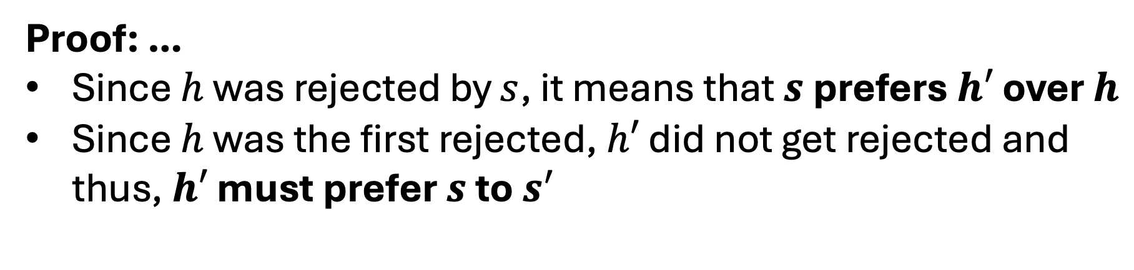
Proof Idea Time!
Proof: …
Since $h$ was rejected by $s$, it means that $s$ prefers $h′$ over $h$
Since $h$ was the first rejected, $h′$ did not get rejected and thus, $h′$ must prefer $s$ to $s^{′}$
$$s′$$
$$h′$$
$$M$$
$$s$$
$$h$$
$$M′$$

Slide 55
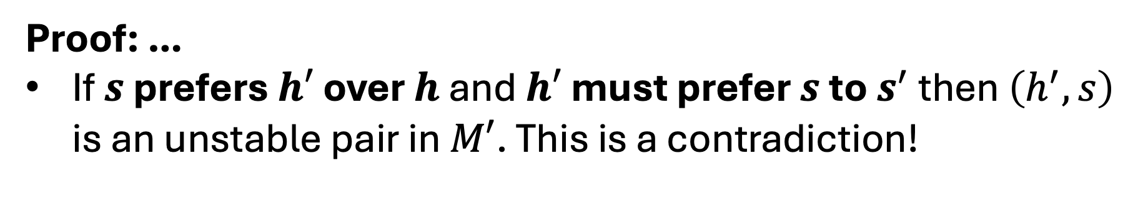
Proof Idea Time!
Proof: …
If $s$ prefers $h′$ over $h$ and $h′$ must prefer $s$ to $s^{′}$ then $\left(h^{′},s\right)$ is an unstable pair in $M′$. This is a contradiction!
$$s′$$
$$h′$$
$$M$$
$$s$$
$$h$$
$$M′$$

