Slide 1
Q: Can you determine if a graph contains a matching?

Slide 2

CSE 331:
Algorithms & Complexity
“Runtime Analysis”
Prof. Charlie Anne Carlson (She/Her)
Lecture 8
Monday September 15th, 2025

Slide 3

Schedule
Course Updates
Efficiency
Models of Comp.
Worst/Best/Average Case
Common Runtimes
Growth

Slide 4

Course Updates
Complete Syllabus Quiz
HW 0 Grades Out (Soon)
HW 1 Due Tomorrow
HW 2 Up Tomorrow
Project Signup before Friday
First Quiz Monday Sept 29
  in class

Slide 5
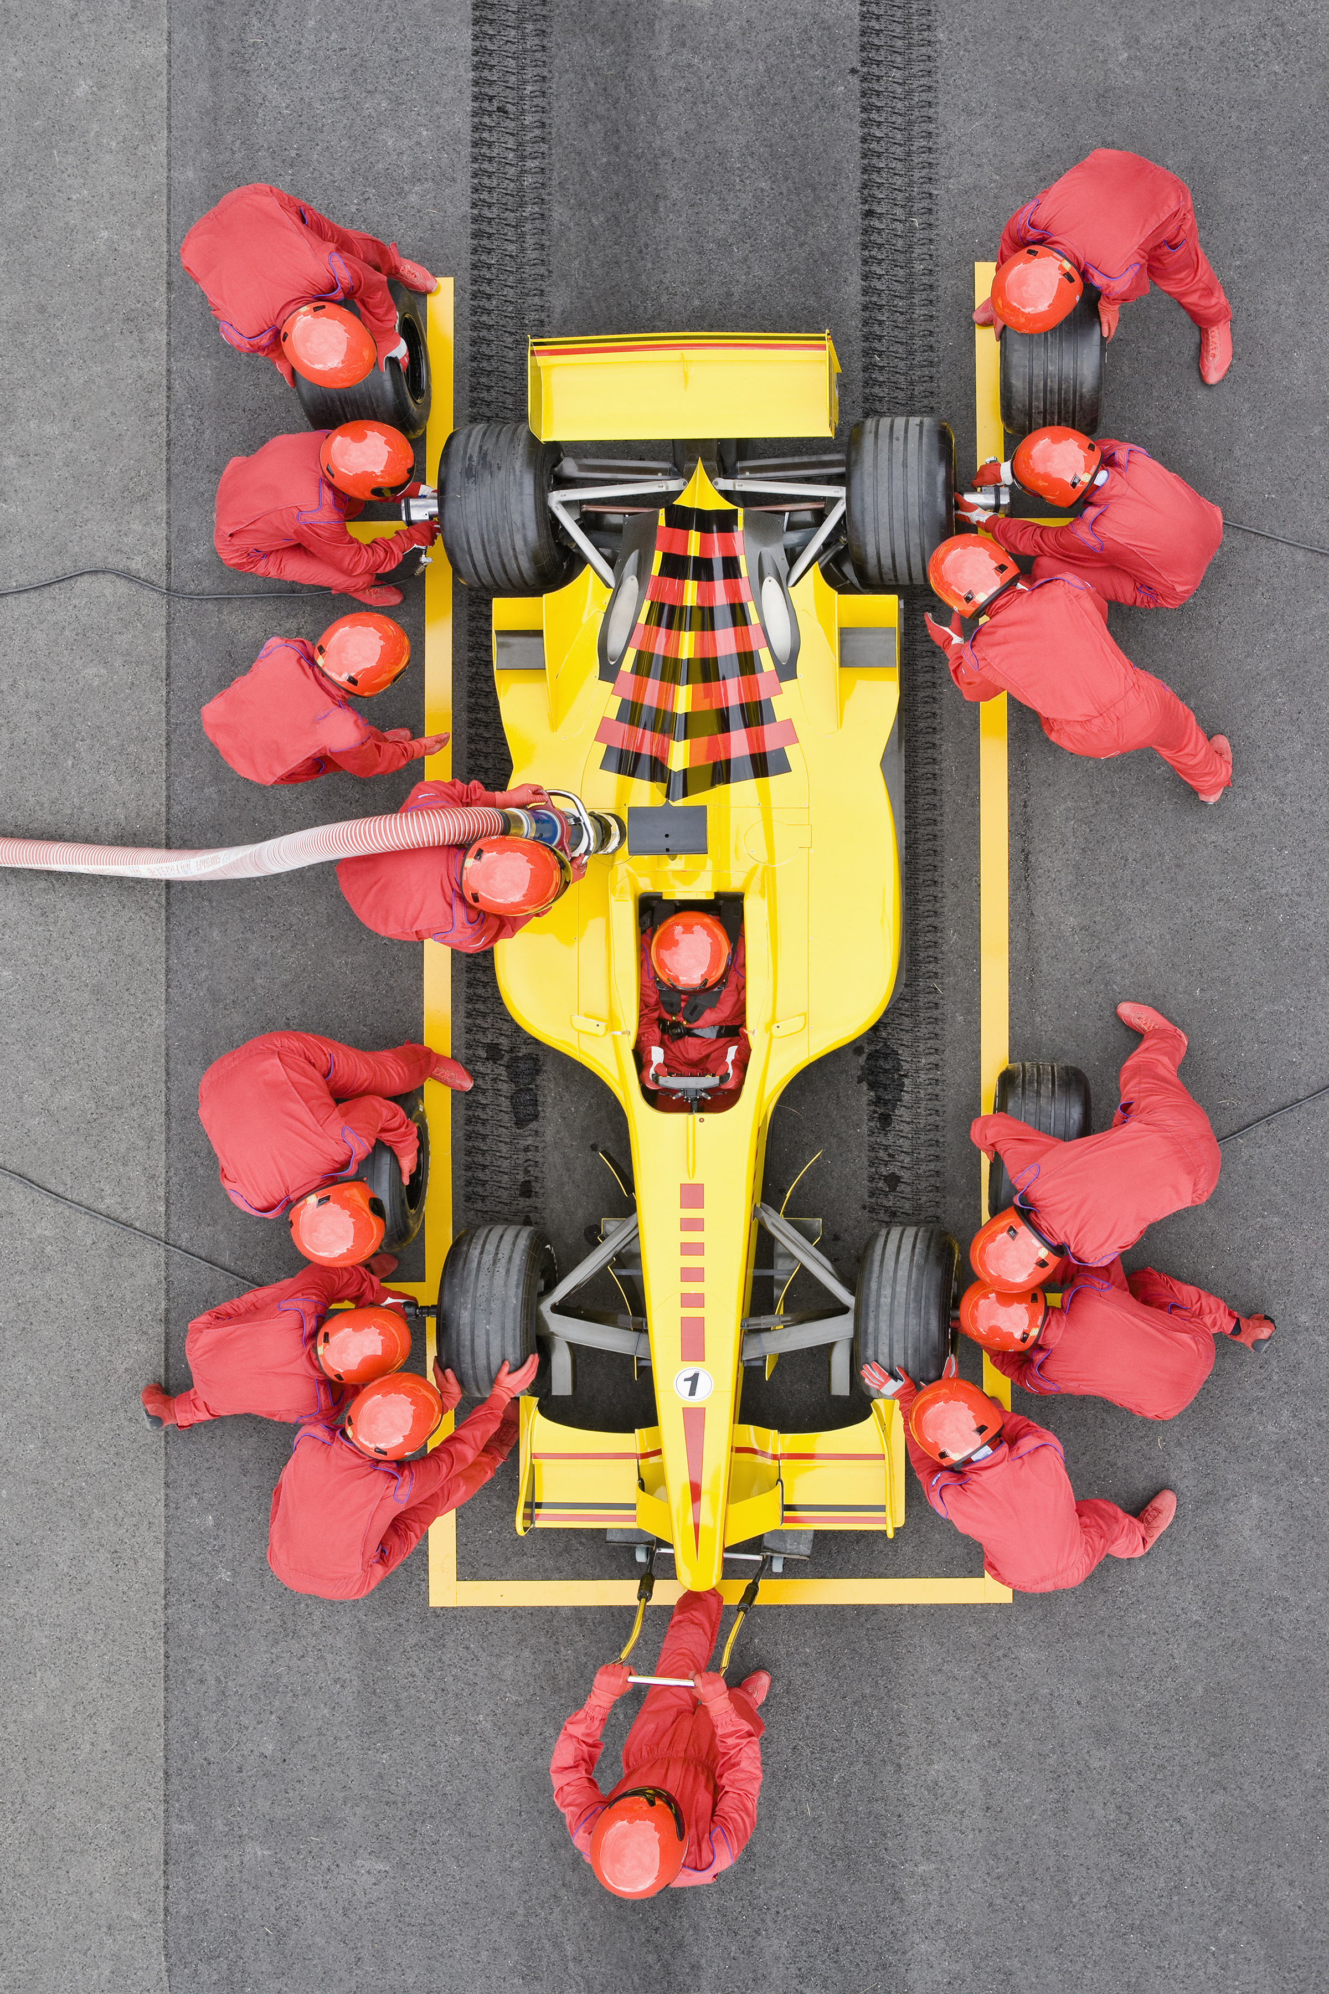
Q: What kind of algorithms do we want?

Slide 6
Q: What kind of algorithms do we want?
Efficient
  Time
  Space
  Other Resources:
    Randomness, Bandwidth, Errors, etc.
Correct

Slide 7
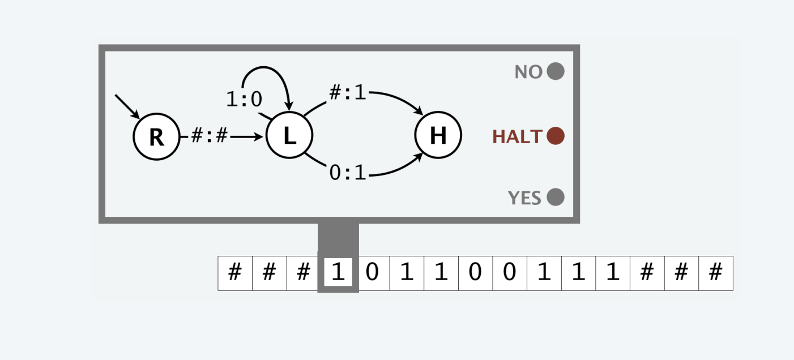
Models: Deterministic Turing Machine
Time: Number of Steps of Header
Memory: Number of tape cells.
Notes:
  No random access of memory.
  Computers don’t work like this.

Slide 8

Models: Word RAM
Time: Number of primitive operations.
  Arithmetic, logic, read, write, lookup, branching, etc.
Memory: Number of memory cells used.
  Each memory location and input/output cell stores a w-bit integer.
  We often assume w is sufficiently big but sometimes we require a more refined model.

Slide 9
Time Efficiency
First Try: “An algorithm is efficient if it runs quickly.”

Slide 10
Time Efficiency
First Try: “An algorithm is efficient if it runs quickly.”
Q: Do algorithms run?

Slide 11
Time Efficiency
First Try: “An algorithm is efficient if it runs quickly.”
Second Try: “An algorithm is efficient if, when implemented, it runs quickly.”
Q: Do algorithms run?

Slide 12
Time Efficiency
First Try: “An algorithm is efficient if it runs quickly.”
Second Try: “An algorithm is efficient if, when implemented, it runs quickly.”
Q: Do algorithms run?
Q: Always? Sometimes?

Slide 13
Time Efficiency
First Try: “An algorithm is efficient if it runs quickly.”
Second Try: “An algorithm is efficient if, when implemented, it runs quickly.”
Third Try: “An algorithm is efficient if, when implemented, it runs quickly on all real input instances.”
Q: Do algorithms run?
Q: Is this an exist or a for all idea?

Slide 14
Time Efficiency
First Try: “An algorithm is efficient if it runs quickly.”
Second Try: “An algorithm is efficient if, when implemented, it runs quickly.”
Third Try: “An algorithm is efficient if, when implemented, it runs quickly on all real input instances.”
Q: Do algorithms run?
Q: Is this an exist or a for all idea?
Q: What is a “real instance?”
Q: Implemented on what? By who?
Q: How quick is quick?

Slide 15
Time Efficiency
First Try: “An algorithm is efficient if it runs quickly.”
Second Try: “An algorithm is efficient if, when implemented, it runs quickly.”
Third Try: “An algorithm is efficient if, when implemented, it runs quickly on all real input instances.”
Q: Do algorithms run?
Q: Is this an exist or a for all idea?
Q: What is a “real instance?”
Q: Implemented on what? By who?
Q: How quick is quick?

Slide 16
Time Efficiency
Let’s measure time efficiency by counting primitive operations like the Word RAM model.
  Assume that each primitive operation can be implemented/run/executed in some small constant amount of time.
  From now on, when I asked for runtime, I am asking for a function that counts the number of primitive operations.
  Q: What should be the input to this function?

Slide 17
Time Efficiency
Let’s measure time efficiency by counting primitive operations like the Word RAM model.
  Assume that each primitive operation can be implemented/run/executed in some small constant amount of time.
  From now on, when I asked for runtime, I am asking for a function that counts the number of primitive operations.
INPUT
  Q: What should be the input to this function?

Slide 18
Time Efficiency
Desirable scaling property: When the input size doubles, the algorithm should slow down by at most some multiplicative constant factor C.
Q: What kind of functions have this property?

Slide 19
Time Efficiency
Desirable scaling property: When the input size doubles, the algorithm should slow down by at most some multiplicative constant factor C.
An algorithm is poly-time if the above scaling property holds.

Slide 20
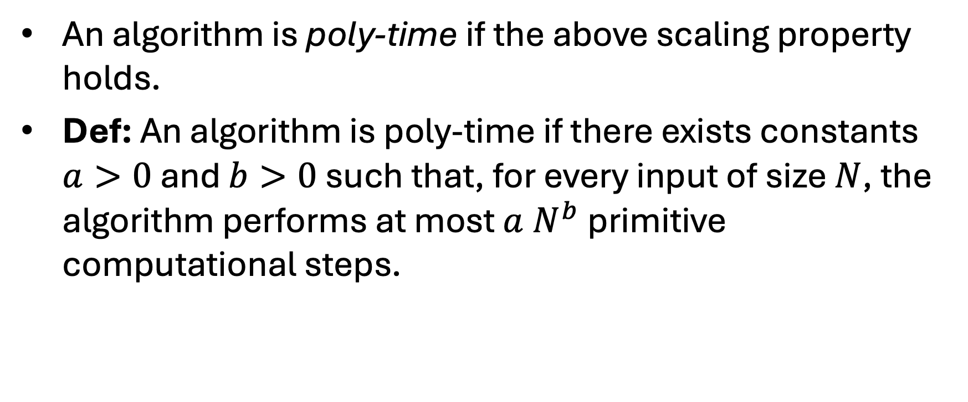
Time Efficiency
An algorithm is poly-time if the above scaling property holds.
Def: An algorithm is poly-time if there exists constants $a>0$ and $b>0$ such that, for every input of size $N$, the algorithm performs at most $a N^{b}$ primitive computational steps.

Slide 21
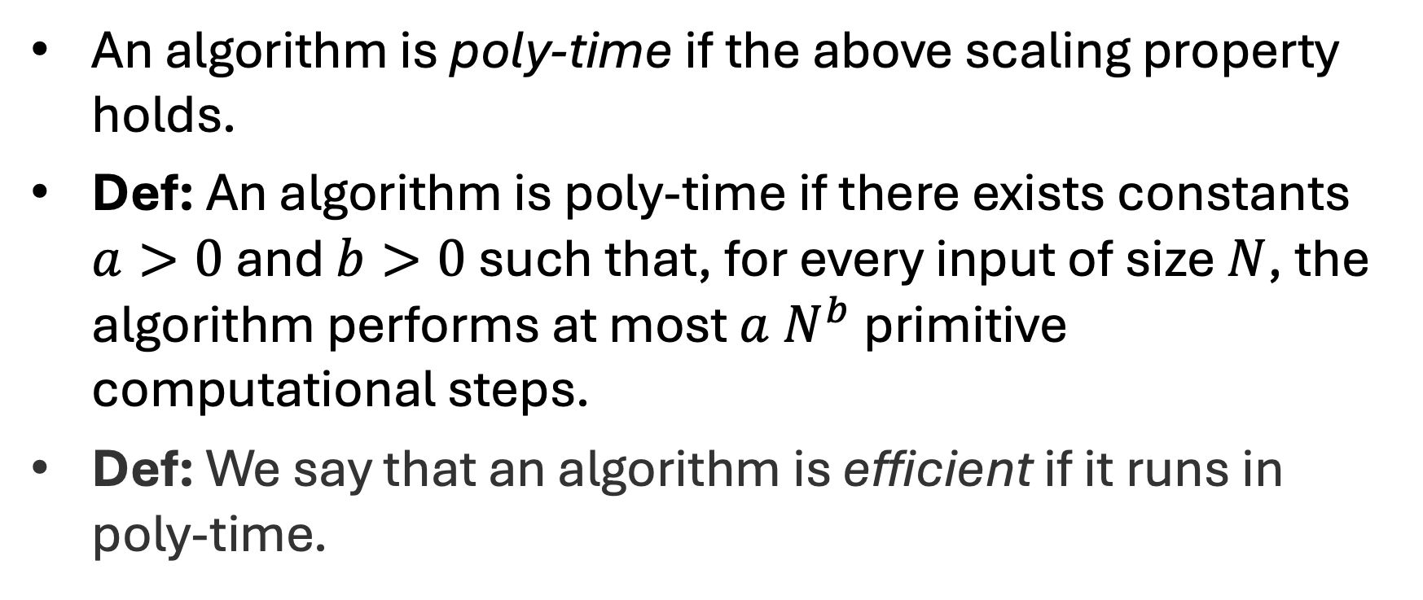
Time Efficiency
An algorithm is poly-time if the above scaling property holds.
Def: An algorithm is poly-time if there exists constants $a>0$ and $b>0$ such that, for every input of size $N$, the algorithm performs at most $a N^{b}$ primitive computational steps.
Def: We say that an algorithm is efficient if it runs in poly-time.

Slide 22
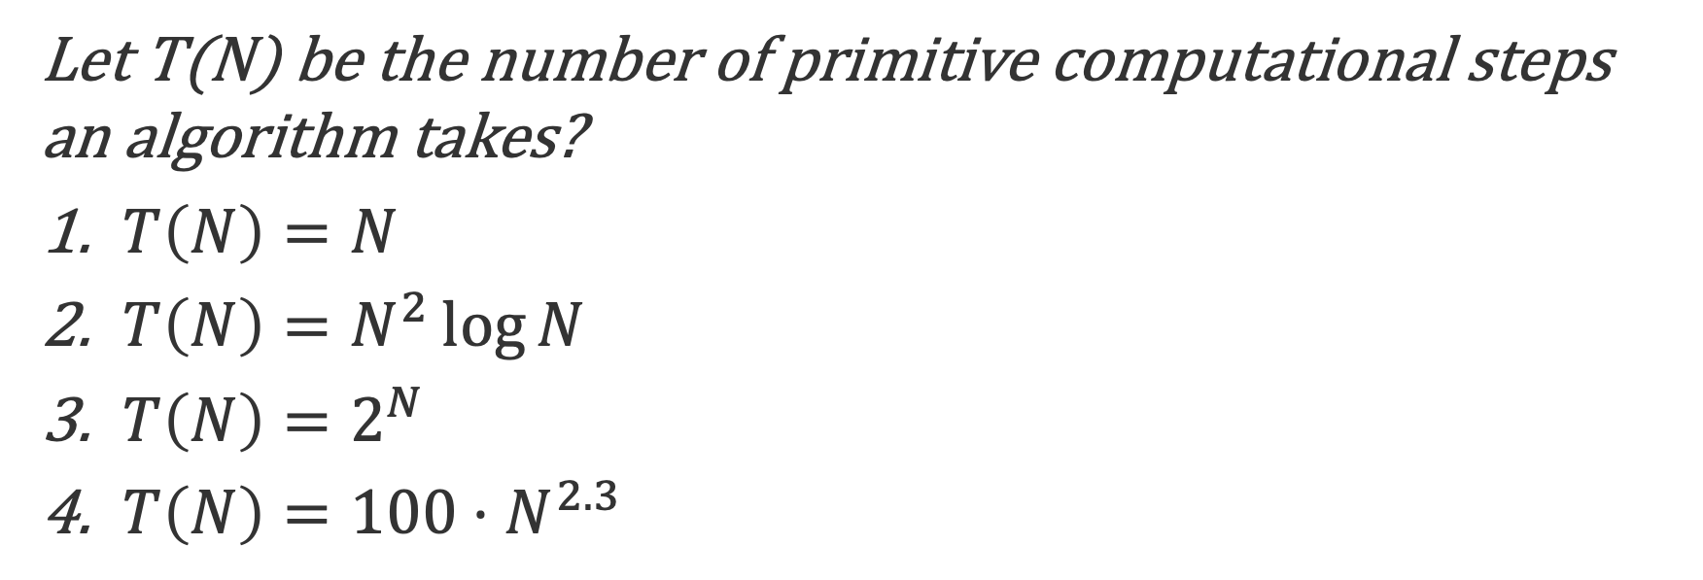
Q: Which if these are poly-time?
Let T(N) be the number of primitive computational steps an algorithm takes?
$T\left(N\right)=N$
$T\left(N\right)=N^{2}\log{N}$
$T\left(N\right)=2^{N}$
$T\left(N\right)=100⋅N^{2.3}$

Slide 23
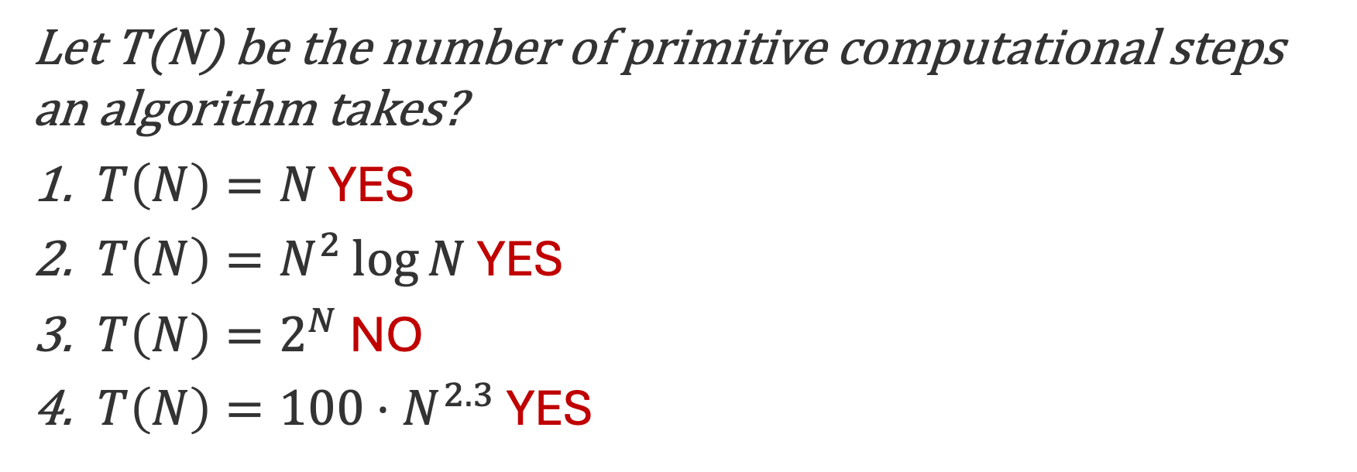
Q: Which if these are poly-time?
Let T(N) be the number of primitive computational steps an algorithm takes?
$T\left(N\right)=N$ YES
$T\left(N\right)=N^{2}\log{N}$ YES
$T\left(N\right)=2^{N}$ NO
$T\left(N\right)=100⋅N^{2.3}$ YES

Slide 24
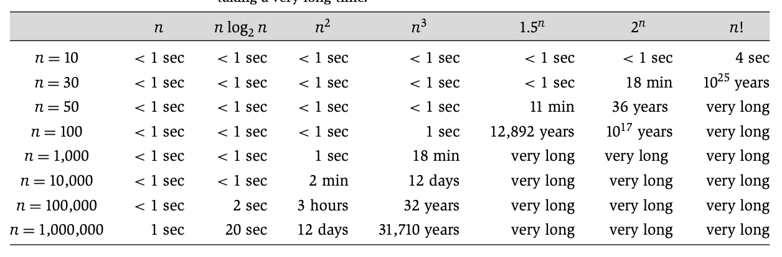
Time Efficiency

Slide 25
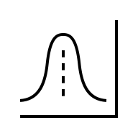


Q: What inputs should we consider?
Worst Case
Best Case
Average Case

Slide 26
Q: What inputs should we consider?
Worst Case
Best Case
Average Case

Slide 27
Worst-Case Analysis
We will focus on worst-case analysis because it gives you strong guarantees about the performance of our algorithms.
We may sometimes reason about the best-case scenario to help us understand just how bad an algorithm might be.
We may also reason about average case scenario to measure some other notion of efficiency.

Slide 28
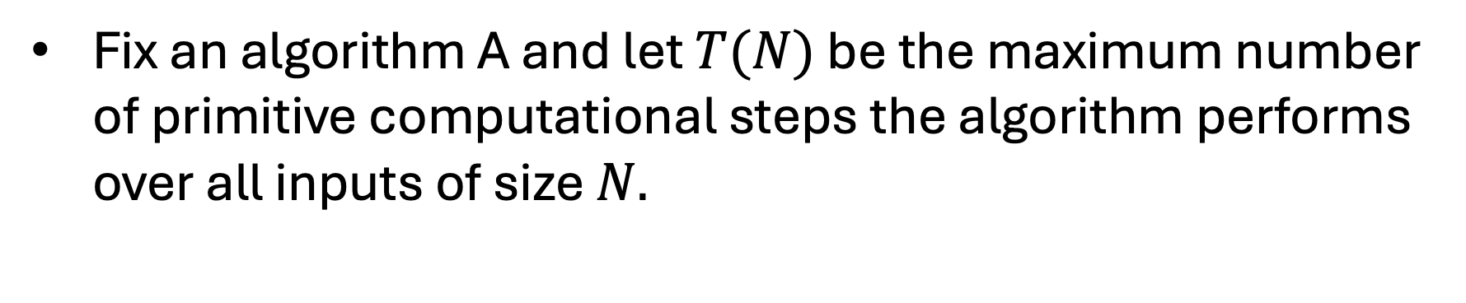
Asymptotic Notation
Fix an algorithm A and let $T(N)$ be the maximum number of primitive computational steps the algorithm performs over all inputs of size $N.$

Slide 29
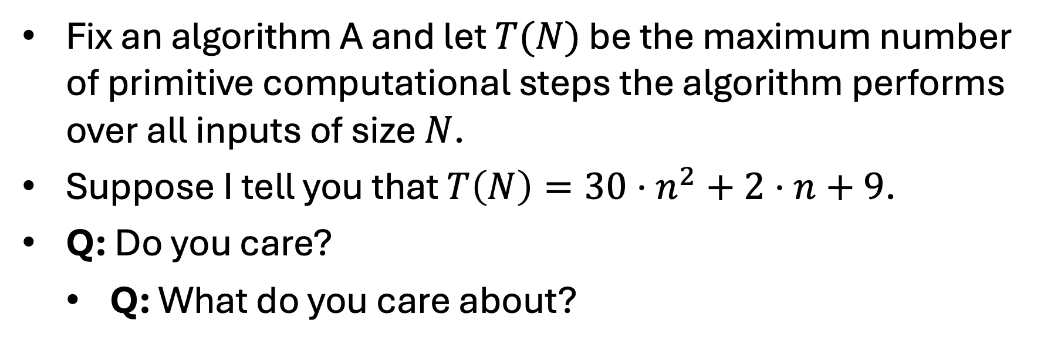
Asymptotic Notation
Fix an algorithm A and let $T(N)$ be the maximum number of primitive computational steps the algorithm performs over all inputs of size $N$.
Suppose I tell you that $T\left(N\right)=30⋅n^{2}+2⋅n+9$.
Q: Do you care?
  Q: What do you care about?

Slide 30
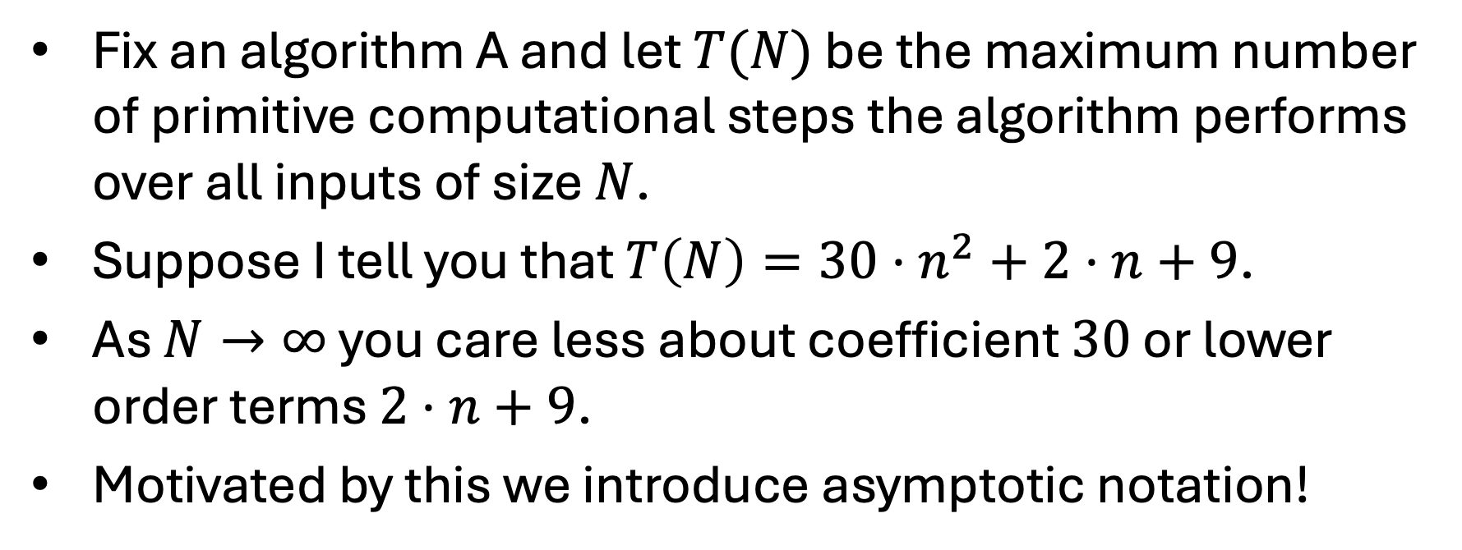
Asymptotic Notation
Fix an algorithm A and let $T(N)$ be the maximum number of primitive computational steps the algorithm performs over all inputs of size $N$.
Suppose I tell you that $T\left(N\right)=30⋅n^{2}+2⋅n+9$.
As $N→∞$ you care less about coefficient $30$ or lower order terms $2⋅n+9$.
Motivated by this we introduce asymptotic notation!

Slide 31
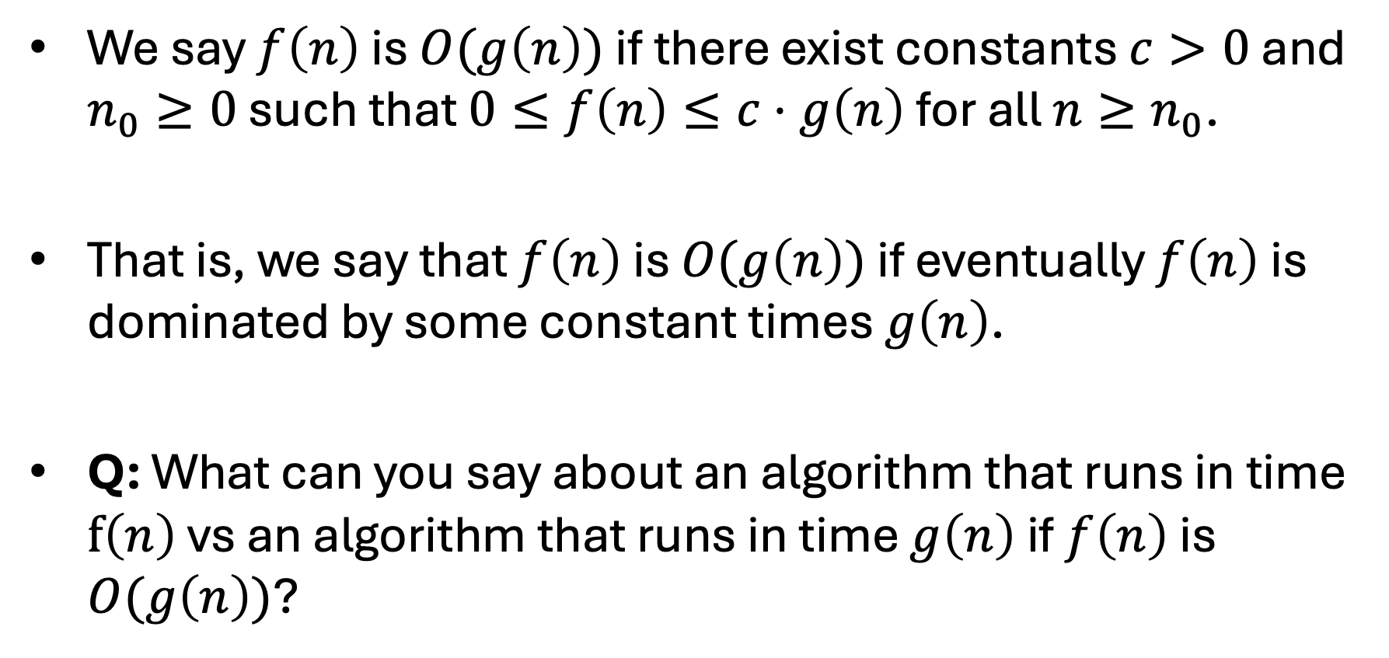
Big O notation
We say $f\left(n\right)$ is $O(g\left(n\right))$ if there exist constants $c>0$ and $n_{0}≥0$ such that $0≤f\left(n\right)≤c⋅g\left(n\right)$ for all $n≥n_{0}$.
That is, we say that $f\left(n\right)$ is $O(g\left(n\right))$ if eventually $f\left(n\right)$ is dominated by some constant times $g\left(n\right)$.
Q: What can you say about an algorithm that runs in time $f\left(n\right)$ vs an algorithm that runs in time $g\left(n\right)$ if $f\left(n\right)$ is $O(g\left(n\right))$?

Slide 32
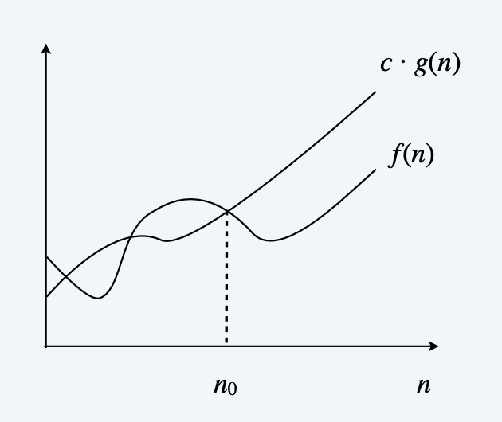
Big O notation

Slide 33
Big O notation
Q: What can you say about $f\left(n\right)=32⋅n^{2}+17⋅n+1$?

Slide 34
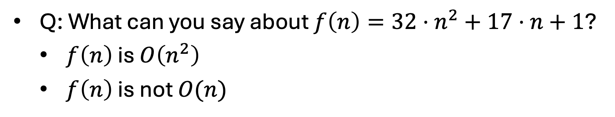
Big O notation
Q: What can you say about $f\left(n\right)=32⋅n^{2}+17⋅n+1$?
  $f\left(n\right)$ is $O\left(n^{2}\right)$
  $f\left(n\right)$ is not $O(n)$

Slide 35
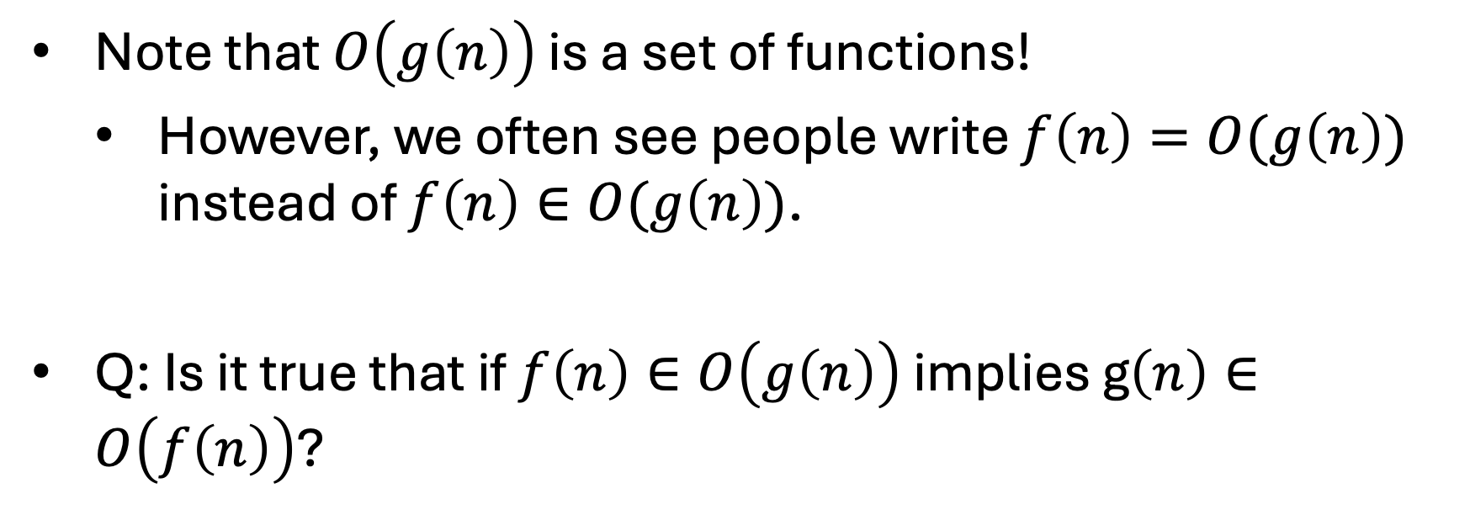
Big O notation
Note that $O\left(g\left(n\right)\right)$ is a set of functions!
  However, we often see people write $f\left(n\right)=O(g\left(n\right))$ instead of $f\left(n\right)∈O(g\left(n\right))$.
Q: Is it true that if $f\left(n\right)∈O\left(g\left(n\right)\right)$ implies g$\left(n\right)∈O\left(f\left(n\right)\right)$?

Slide 36
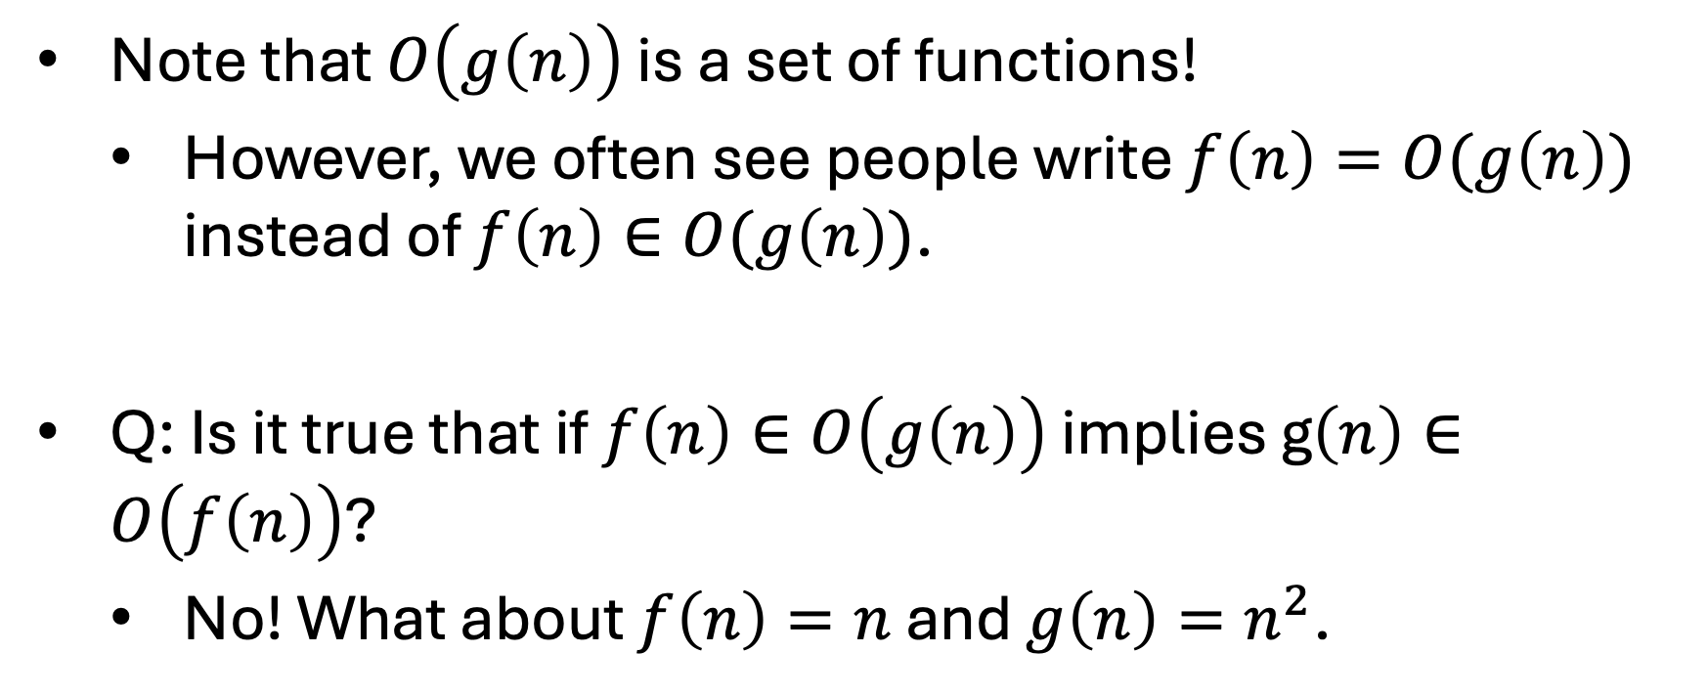
Big O notation
Note that $O\left(g\left(n\right)\right)$ is a set of functions!
  However, we often see people write $f\left(n\right)=O(g\left(n\right))$ instead of $f\left(n\right)∈O(g\left(n\right))$.
Q: Is it true that if $f\left(n\right)∈O\left(g\left(n\right)\right)$ implies g$\left(n\right)∈O\left(f\left(n\right)\right)$?
  No! What about $f\left(n\right)=n$ and $g\left(n\right)=n^{2}$.

Slide 37
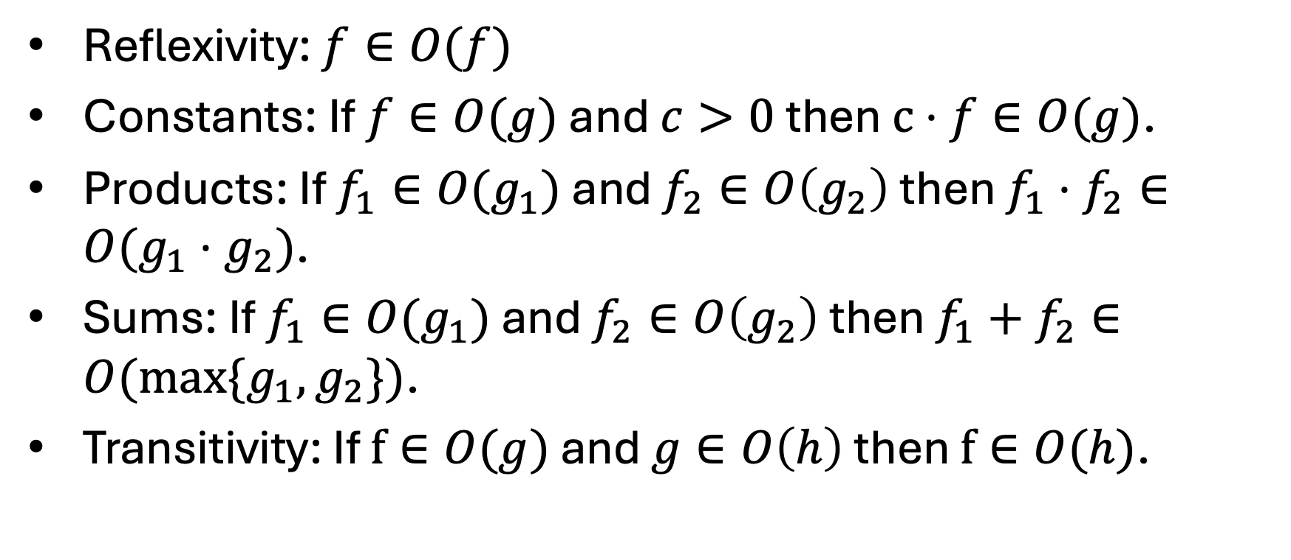
Big O notation
Reflexivity: $f∈O(f)$
Constants: If $f∈O(g)$ and $c>0$ then $c⋅f∈O(g)$.
Products: If $f_{1}∈O(g_{1})$ and $f_{2}∈O\left(g_{2}\right)$ then $f_{1}⋅f_{2}∈O(g_{1}⋅g_{2})$.
Sums: If $f_{1}∈O(g_{1})$ and $f_{2}∈O\left(g_{2}\right)$ then $f_{1}+f_{2}∈O(\max{\{g_{1},g_{2}\}})$.
Transitivity: If $f∈O(g)$ and $g∈O\left(h\right)$ then $f∈O(h)$.

Slide 38
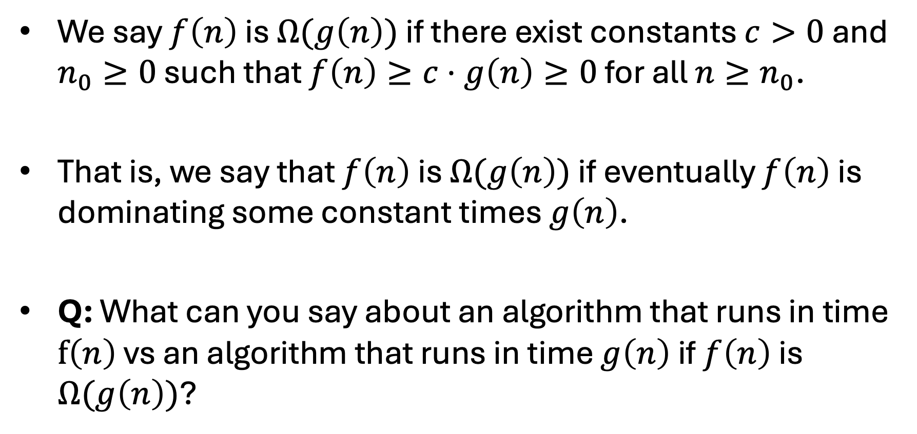
Big Omega notation
We say $f\left(n\right)$ is $Ω(g\left(n\right))$ if there exist constants $c>0$ and $n_{0}≥0$ such that $f\left(n\right)≥c⋅g\left(n\right)≥0$ for all $n≥n_{0}$.
That is, we say that $f\left(n\right)$ is $Ω(g\left(n\right))$ if eventually $f\left(n\right)$ is dominating some constant times $g\left(n\right)$.
Q: What can you say about an algorithm that runs in time $f\left(n\right)$ vs an algorithm that runs in time $g\left(n\right)$ if $f\left(n\right)$ is $Ω(g\left(n\right))$?

Slide 39
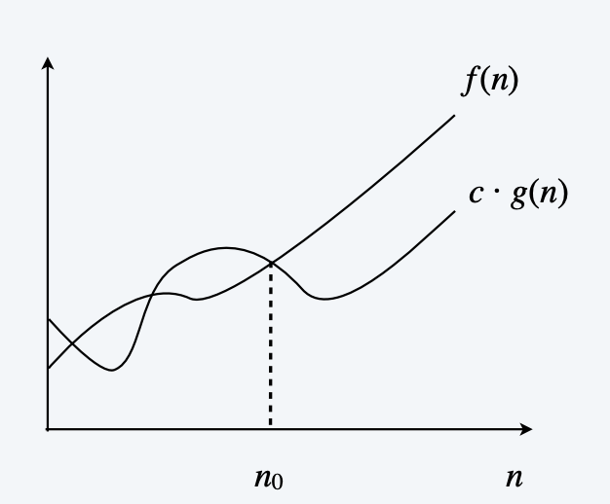
Big Omega notation

Slide 40
Big Omega notation
Q: What can you say about $f\left(n\right)=32⋅n^{2}+17⋅n+1$?

Slide 41
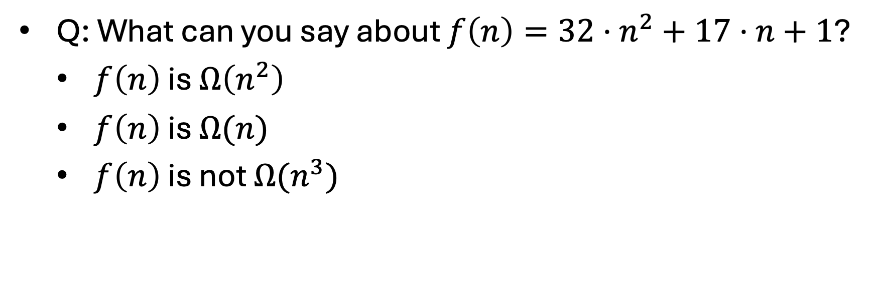
Big Omega notation
Q: What can you say about $f\left(n\right)=32⋅n^{2}+17⋅n+1$?
  $f\left(n\right)$ is $Ω\left(n^{2}\right)$
  $f\left(n\right)$ is $Ω(n)$
  $f\left(n\right)$ is not $Ω(n^{3})$

Slide 42
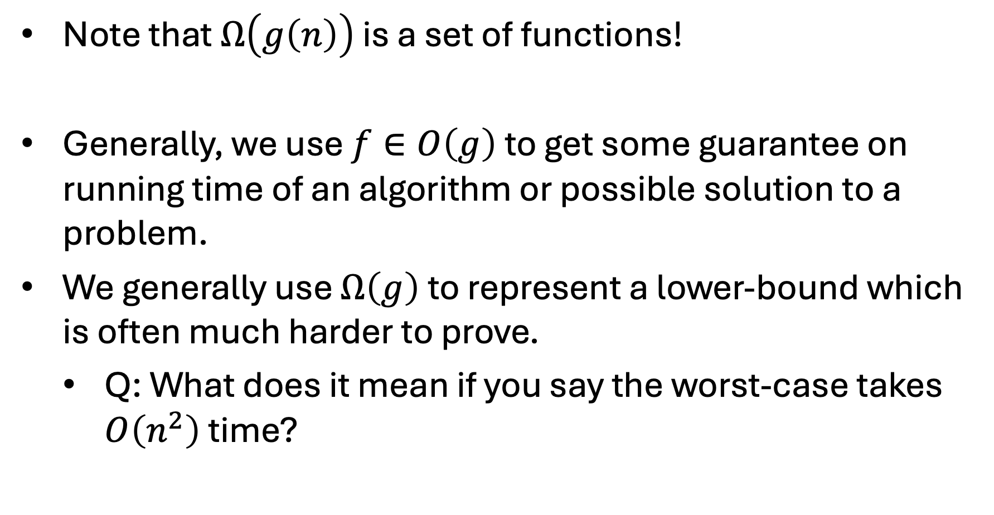
Big Omega notation
Note that $Ω\left(g\left(n\right)\right)$ is a set of functions!
Generally, we use $f∈O\left(g\right)$ to get some guarantee on running time of an algorithm or possible solution to a problem.
We generally use $Ω\left(g\right)$ to represent a lower-bound which is often much harder to prove.
  Q: What does it mean if you say the worst-case takes $O\left(n^{2}\right)$ time?

Slide 43
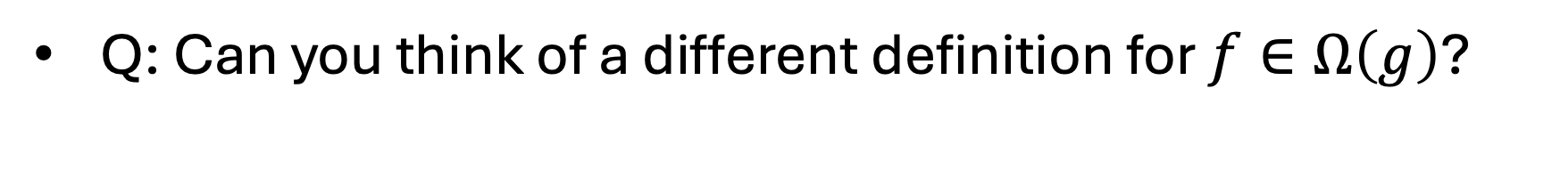
Big Omega notation
Q: Can you think of a different definition for $f∈Ω\left(g\right)$?

Slide 44
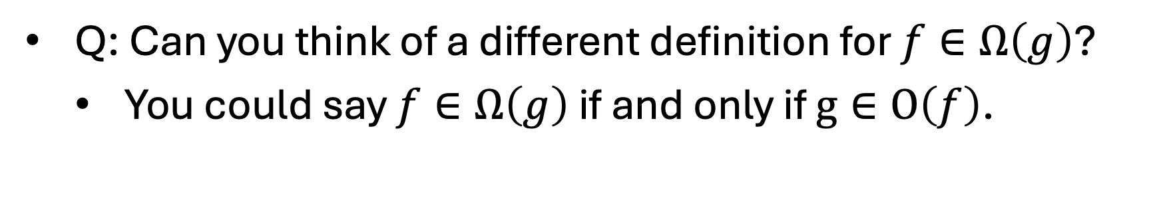
Big Omega notation
Q: Can you think of a different definition for $f∈Ω\left(g\right)$?
  You could say $f∈Ω\left(g\right)$ if and only if $g∈O\left(f\right)$.

Slide 45
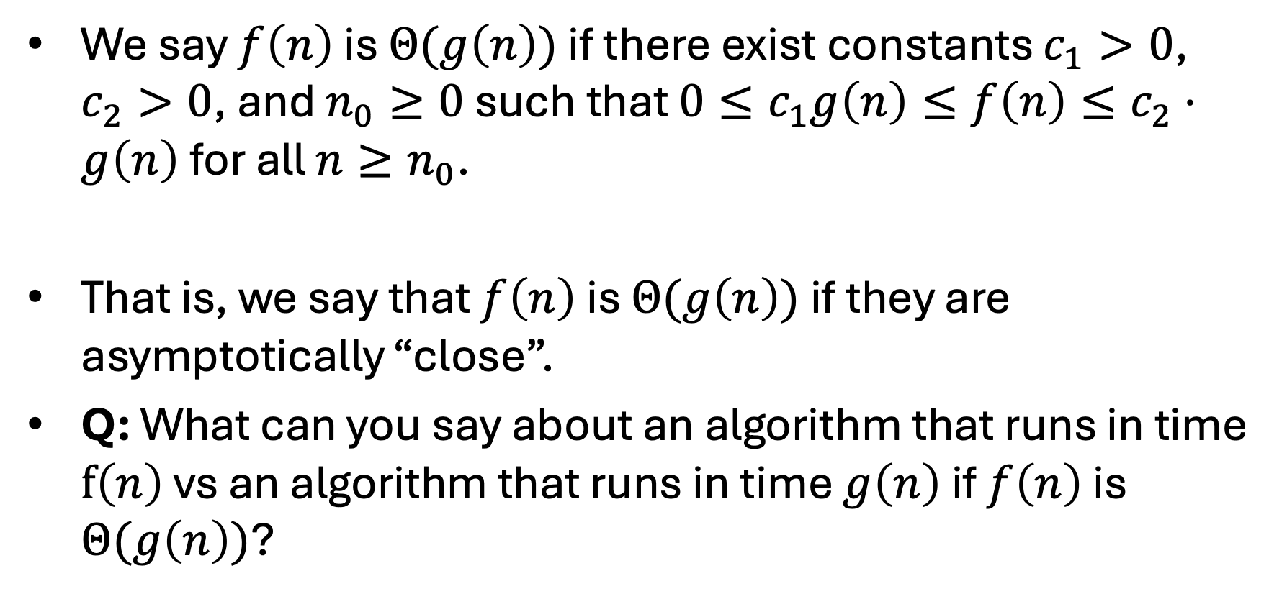
Big Theta notation
We say $f\left(n\right)$ is $Θ(g\left(n\right))$ if there exist constants $c_{1}>0$, $c_{2}>0$, and $n_{0}≥0$ such that $0≤c_{1}g\left(n\right)≤f\left(n\right)≤c_{2}⋅g\left(n\right)$ for all $n≥n_{0}$.
That is, we say that $f\left(n\right)$ is $Θ(g\left(n\right))$ if they are asymptotically “close”.
Q: What can you say about an algorithm that runs in time $f\left(n\right)$ vs an algorithm that runs in time $g\left(n\right)$ if $f\left(n\right)$ is $Θ(g\left(n\right))$?

Slide 46
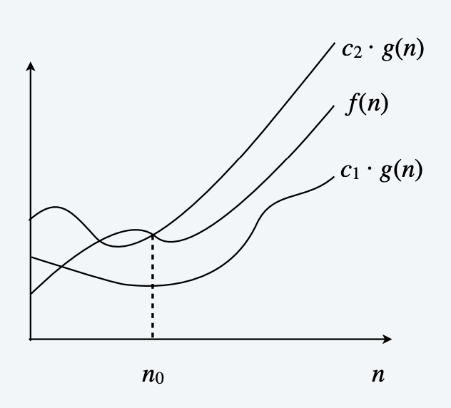
Big Theta notation

Slide 47
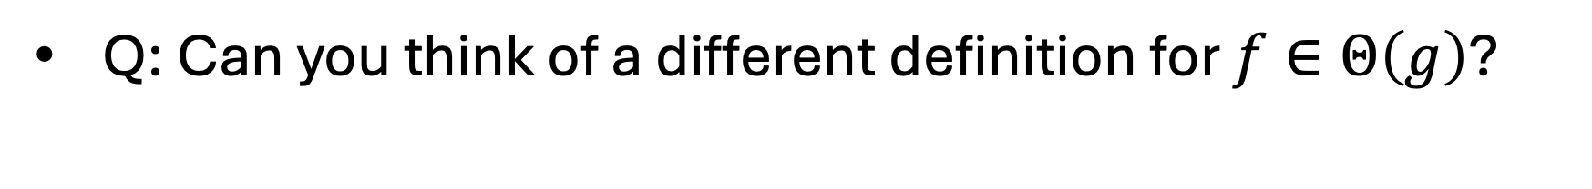
Big Omega notation
Q: Can you think of a different definition for $f∈Θ\left(g\right)$?

Slide 48
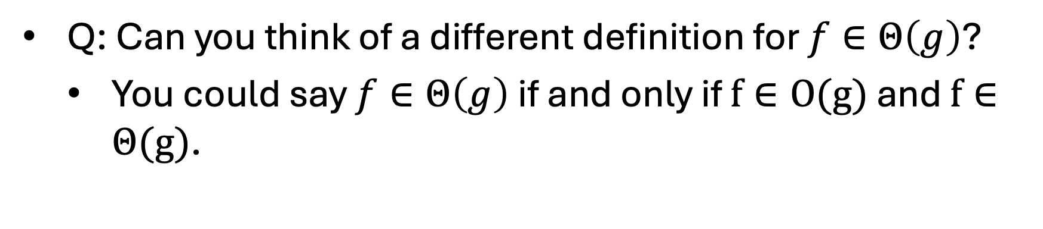
Big Omega notation
Q: Can you think of a different definition for $f∈Θ\left(g\right)$?
  You could say $f∈Θ\left(g\right)$ if and only if $f∈O(g)$ and $f∈Θ(g)$.

Slide 49
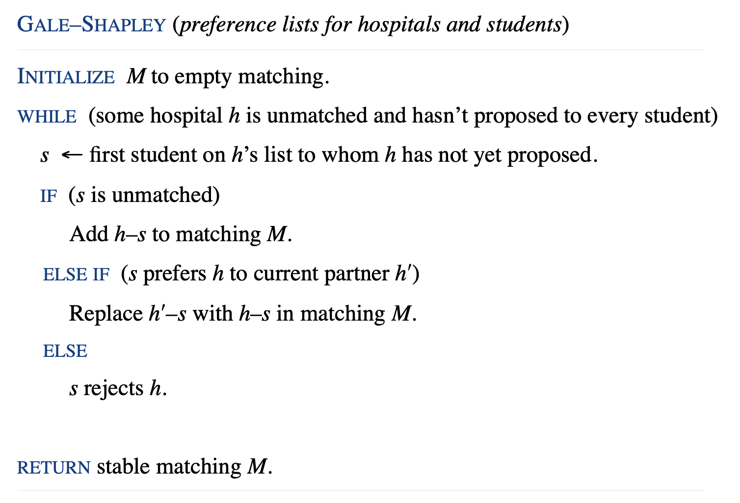
Runtime Analysis of GS

Slide 50
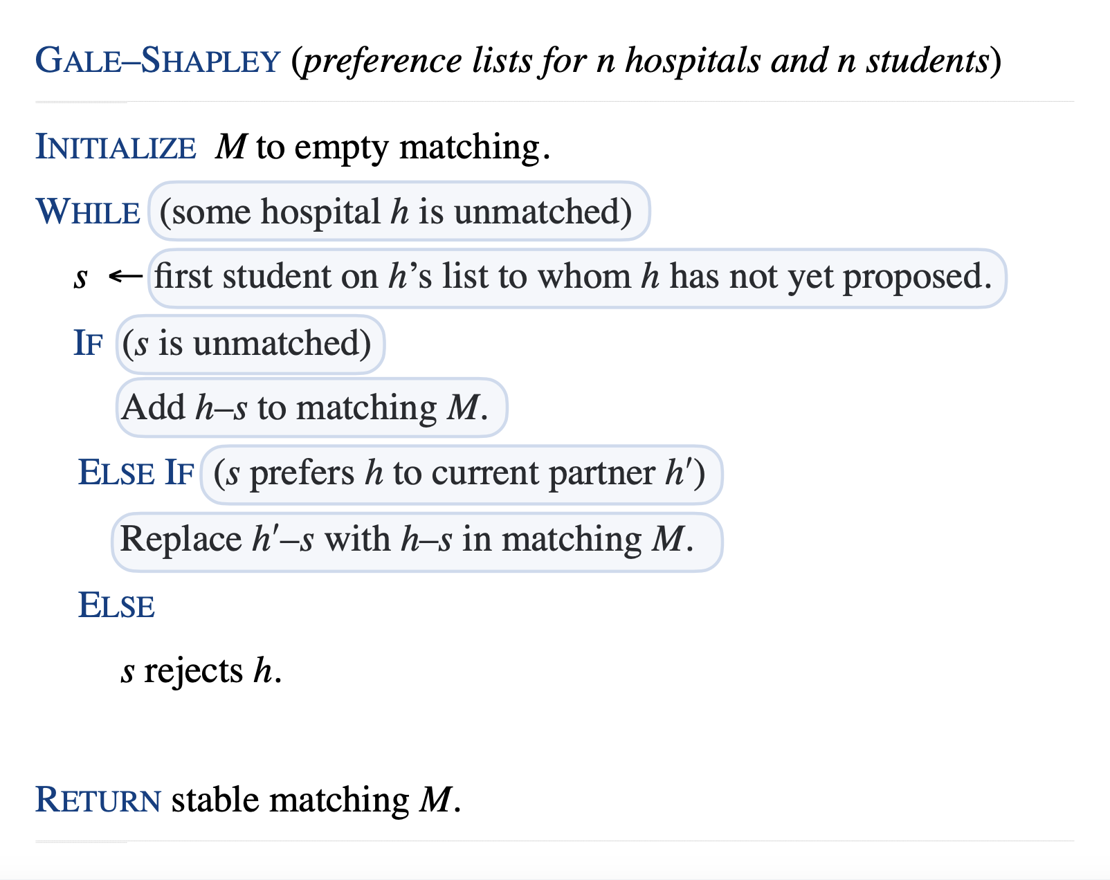
Runtime Analysis of GS

Slide 51
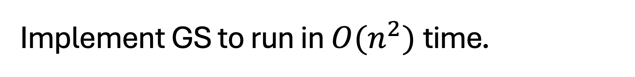
Implement GS to run in $O(n^{2})$time.
How do we identify unmatched hospital?
How do we identify “unproposed” student?
How do we decide if a student current is matched?
How do we decide if a students likes a hospital more?

