Slide 1
Traffic sign recognition with color image
Yiming Zhang
SUNY at Buffalo

Slide 2
Overview
Traffic sign is very important in navigation and homing
We are trying to recognize the traffic signs in order to navigate the robot or vehicle

Slide 3
Problem
With traffic sign, we can get correct information of the action we should take
Same kind of signs are made in certain color and shape
Traffic signs are always in complex environment and hard to be recognized

Slide 4
Why color image
Color image can be obtained directly from the camera
Gray-scale can also be used for this purpose, but the search is mainly based on shape and can be quite expensive in terms of computational time
Color-based segmentation is faster than the one based on shape，although requiring additional filtering.
RGB is a color space where R means red, G means green and B means blue
In most of signal recognition papers , they use the HSV or HSI color space to recognize the signal
HSV or HSI space is good, but will need transformation from original image which is in RGB space
We can easily implement the color recognition in the image we take with RGB space

Slide 5
process
Color segmentation
Extract blob
Smooth the image
Edge detect
Shape detect
Classification

Slide 6
Color segmentation
In an image , there will not only exist the road signal, but also other objects
We need to do something in order to focus on certain color we want, like red.
In reference [1], the authors mentioned an method called Red Minus Blue which is a kind of weighted sum of the red, green and blue image
In my project, to achieve the goal of extract stop sign from the image, I also minus 0.5*Green based on minus operation in order to eliminate the noise remained after RMB operation

Slide 7
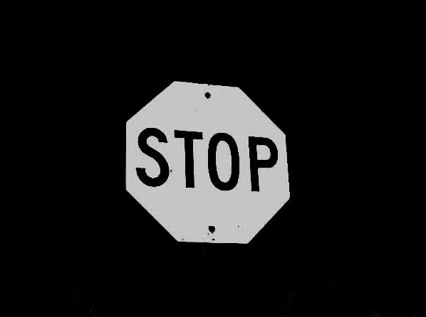


Color segmentation
And this works good:

Slide 8


Smooth the image
Original image from http://www.doobybrain.com/2009/06/02/blue-stop-sign/

Slide 9

Edge detection
Using canny edge operation to find the edge of the object in the smooth image
Using Freeman chain code to detect the shape

Slide 10
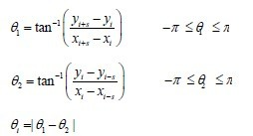
corner detect
In reference [3], the authors mentioned an operation to detect the corner with Freeman chain code
Define the code difference d_{i} = a_{i+1} + a_{i}
D_{i} = |b_{i}| if |b_{i}| <4
D_{i} = |b_{i}|-8 if |b_{i}| > 4
D_{i} = 4 if |b_{i}| = 4
Using curvature to eliminate suspect corner point

Slide 11
classification
Combine the color feature and shape feature to classify the sign we detected
Suppose we have two sets, one for colors and the other one contains shape information

Slide 12
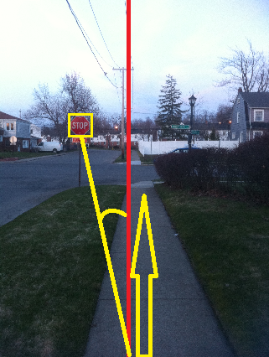
Further thinking

Slide 13
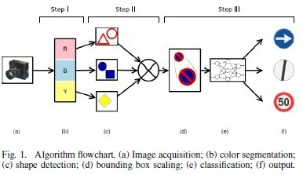

Other color segmentation method

Slide 14
Goal of this project
In this project , I want to extract road signal signs from images and recognize these signs in order to use them to navigate the robot or vehicle
The minimum goal of this project is to recognize traffic signs in certain color and shape
The extensive goal of this project is to recognize other useful traffic signs in different shapes and colors, and also implement other efficient method to do comparison and improvement

Slide 15
Reference
[1]. Matthew A. Turk, David G Morgenthaler, Keith D.Gremban and Martin Marra “VITS-A Vision System for Autonomous Land Vehicle Navigation”(IEEE, 1988)
[2]. Alberto Broggi, Pietro Cerri, Paolo Medici, Pier Paolo Porta and Guido Ghisio
“Real Time Road Signs Recognition”, 2007, IEEE Intelligent Vehicles Symposium
[3]. Wang Jian, Pi You-guo,Liu Ming-you “A Corner Detection Method about Contour of Character Image Based on Freeman Chain Code” , College of Automation Science and Engineering, South China Univ. of Tech, Guangzhou, China

