Slide 1
Coding Theory
CSE 445/545
January 31, 2022

Slide 2
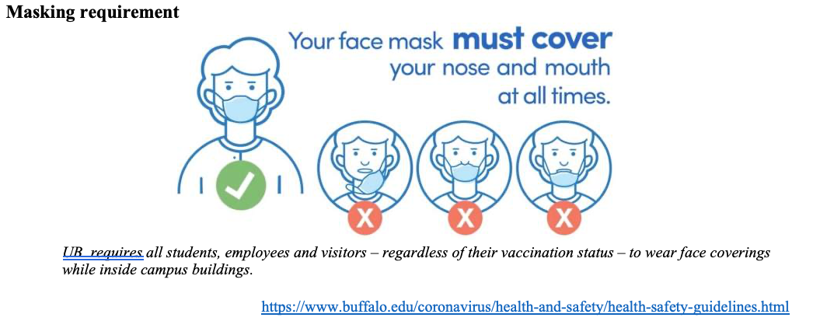
Please have a face mask on

Slide 3
Let’s do some introductions
Atri Rudra
  319 Davis Hall
  atri@buffalo.edu
  645-2464
  Office hours: Wed 3-3:50pm (virtual: see zoom link on piazza)
  Fri, 11-11:50am (in-person)

Slide 4
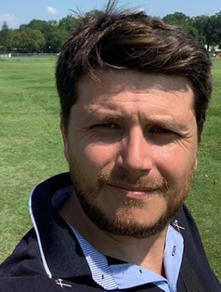
Your awesome TA: Yunus Esencayi
Office hours: look out for piazza poll!
NO office hours this week

Slide 5

Lectures will be videotaped
Still take notes!
http://www.imdb.com/title/tt0363510/mediaviewer/rm2499681792

Slide 6
Handouts for today
Syllabus
  Linked from the course webpage
Feedback polls
  Up on piazza

Slide 7
Plug for feedback polls
Completing the form is voluntary & anonymous
Purpose of the form
  For me to get an idea of your technical background

Slide 8
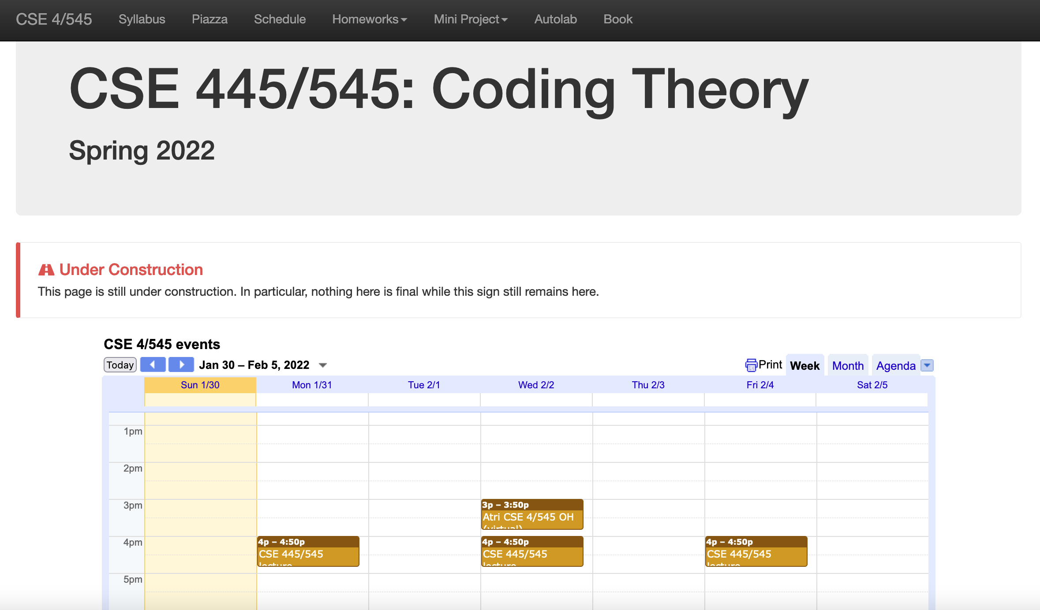
One Stop Shop for the course
https://cse.buffalo.edu/faculty/atri/courses/coding-theory/webpage/spr22/

Slide 9
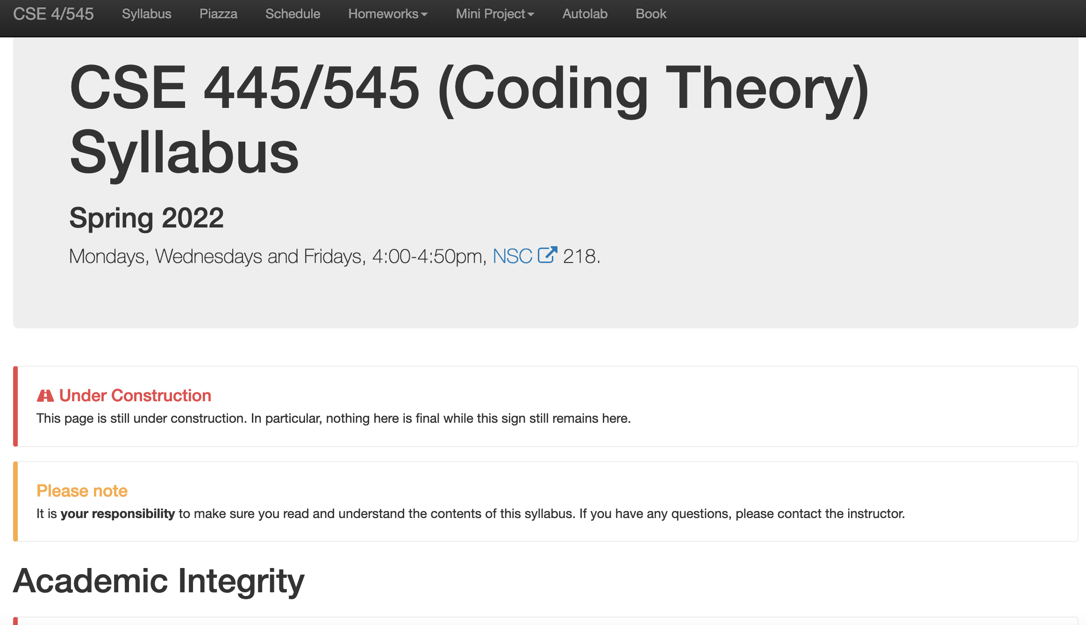
Syllabus

Slide 10
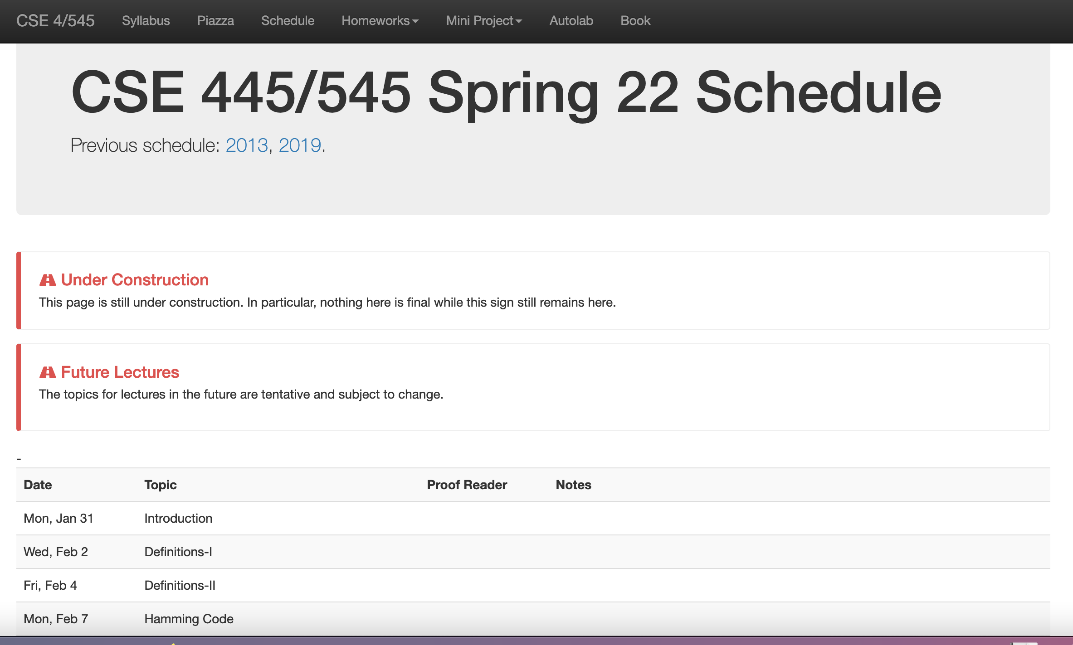
Schedule

Slide 11
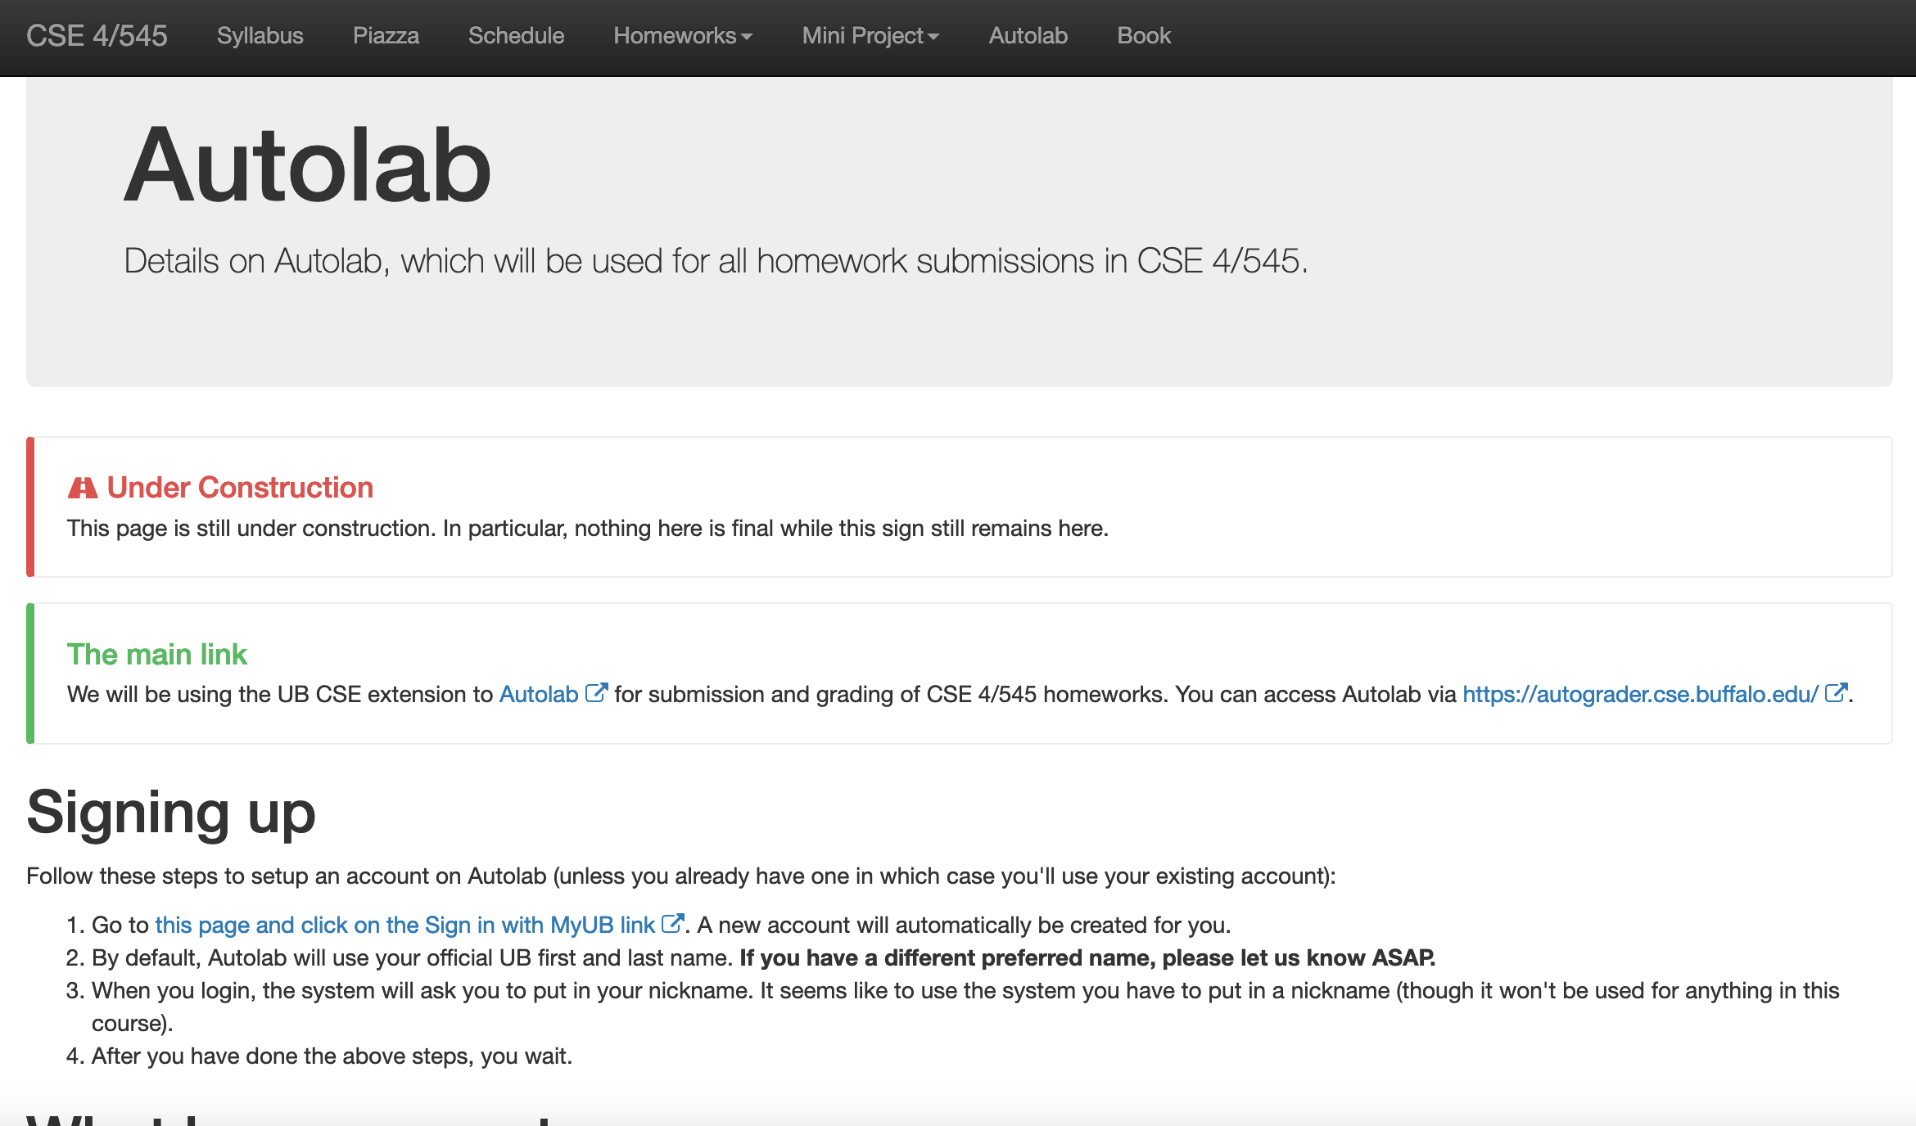
Autolab

Slide 12
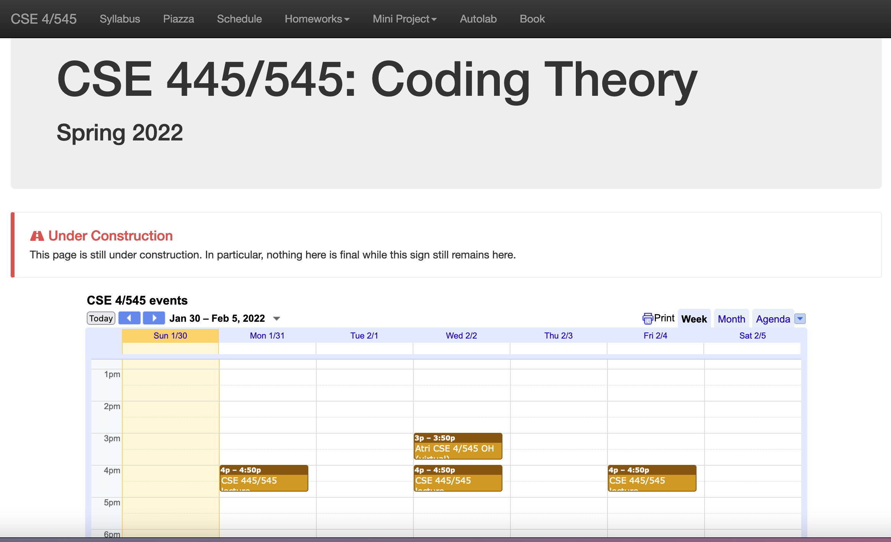
Piazza

Slide 13
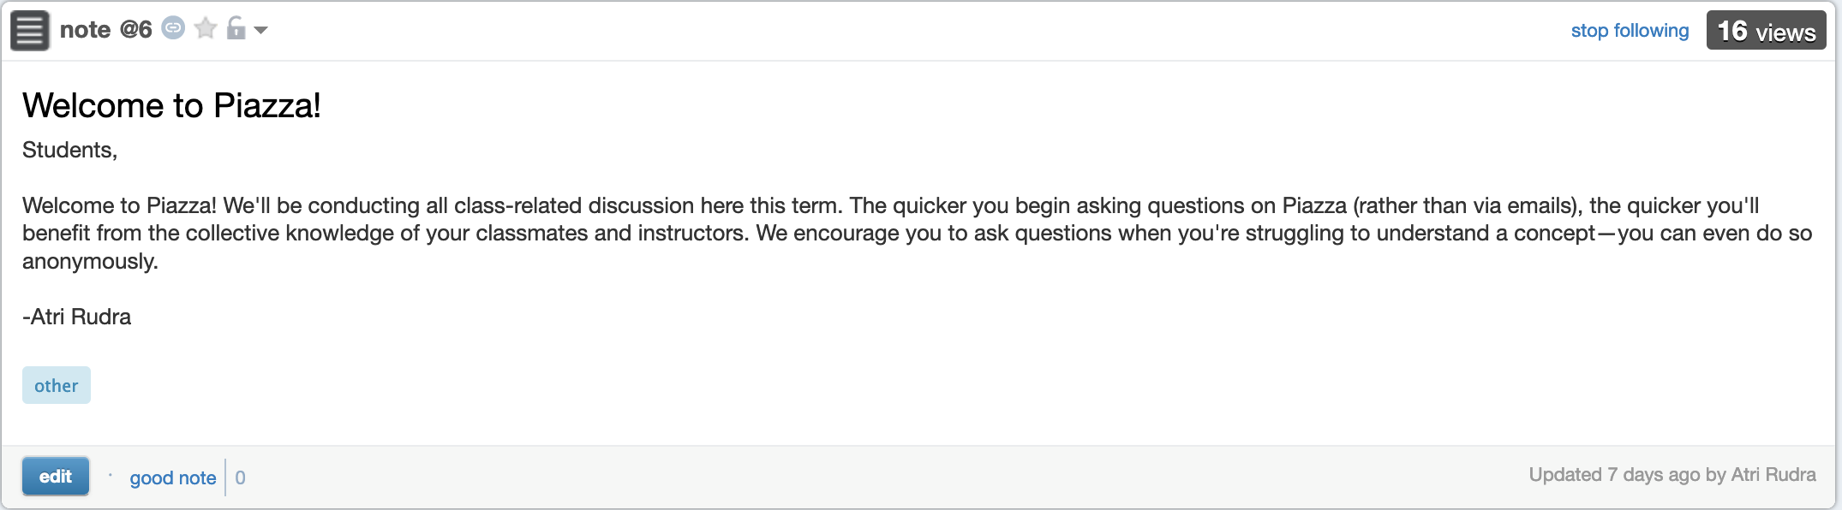
Piazza for discussion
Please use your UB email ID to sign up

Slide 14
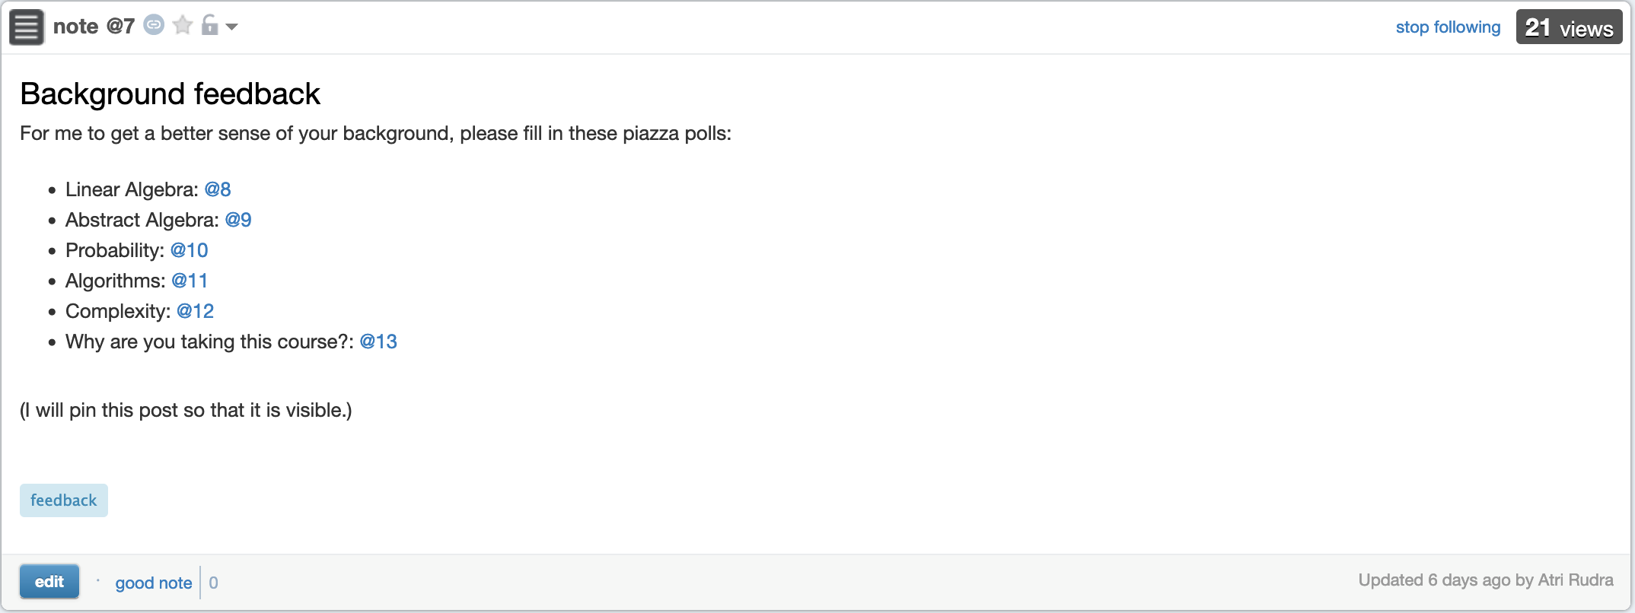
Feedback polls already up

Slide 15
Questions/Comments?
If something doesn’t work (e.g. you cannot post a comment), let me know

Slide 16
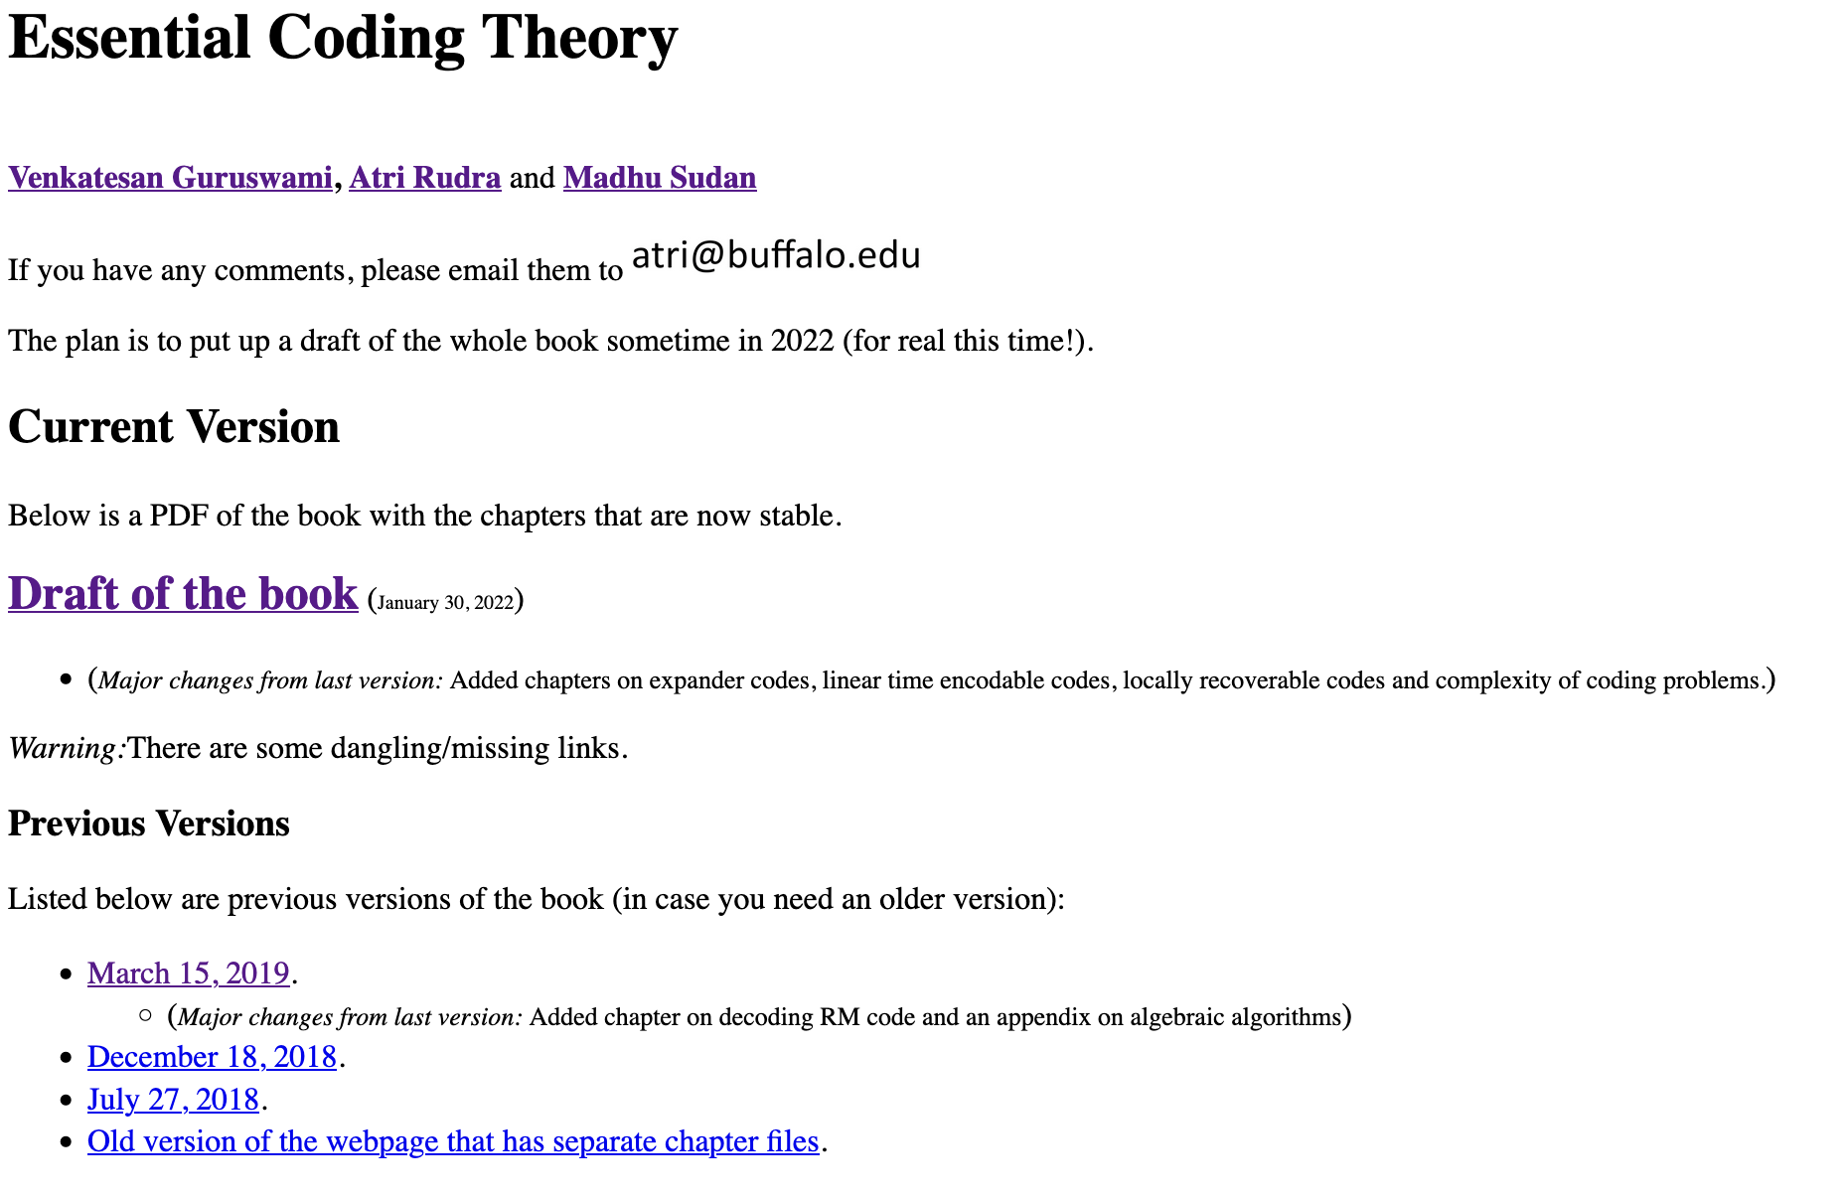




References
Draft of a book I’m writing
  With Guruswami+Sudan
Standard coding theory texts
  MacWilliams and Sloane
  van Lint
  Blahut
  Handbook of coding theory

Slide 17
Pre-requisites
No formal pre-requisites for 545/ CSE 331 for 445
  Probably no one will have all the pre-req’s
Mathematical maturity
  Comfortable with proofs
  Willing to pick up basics of new areas
Will spend one lecture on the pre-req’s
  Linear Algebra
  Finite Fields
  Probability
  Algorithms/ Asymptotic Analysis
Go slower in the first half of the course

Slide 18
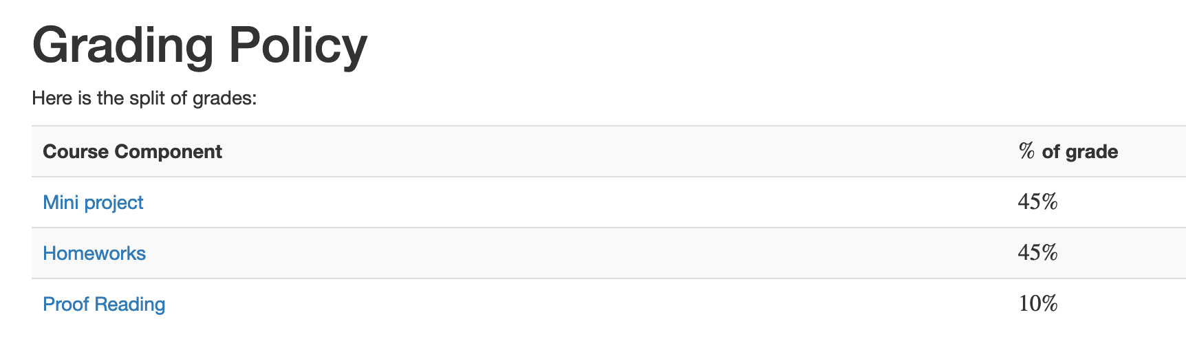
Grades and such like

Slide 19
Mini Project
Groups of size = 3
Create a Youtube video related to coding theory
Bunch of other details in syllabus

Slide 20
Deadlines

Slide 21
Proof-reading
Proof-read relevant part of the book
Once during the course
  Unless class size decreases below 40
Submit typos, suggestions for improvement
They are due in by 1pm before next lecture
Notes will be graded on timeliness & quality
Will ask for a volunteer
See syllabus for more details

Slide 22
Questions/Comments?
Check out the syllabus for more details

Slide 23
Homework
6 short ones (545)/ 5 short ones (445)
Collaboration generally allowed
  Work in groups of size at most 3
  Write up your own solutions
  Acknowledge your collaborators
  No source other than book and your notes
  Breaking these rules will be considered as cheating
More details when they are handed out

Slide 24
My homework philosophy for 4/545
NOT to make sure you understand what I teach in the lectures
Homework problems either
  Proofs that were not done in the class; or
  Material that is not covered in the class
    Closely related to something that is

Slide 25
Questions/Comments?
Check out the syllabus for more details

Slide 26
Accessibility Resources
Information included in the syllabus
In short, let me know and consult with Accessibility Resources

Slide 27
Preferred Name
If you prefer using name diff from UB records
Let me know and we’ll make a note of it.

Slide 28
Some comments
Decide on a Video topic early
  Different topics might need different prep. work
  Come talk to me
Homeworks might take time
  Do not wait for the last moment

Slide 29
Academic Dishonesty
All your submissions must be your own work
Penalty:
  Minimum: An grade reduction in course
  Possible: F (or higher penalty) if warranted
YOUR responsibility to know what is cheating, plagiarism etc.
  If not sure, come talk to me
Excuses like “I have a job,” “This was OK earlier/in my country,” “This course is hard,” etc. WON’T WORK
I DO NOT HAVE ANY PATIENCE WITH ANY CHEATING :
YOU WILL GET A GRADE REDUCTION IN THE COURSE
FOR YOUR FIRST MISTAKE

Slide 30
If grades are all you care about
You’ll be fine if
  You do your assignments honestly
  Make a reasonable attempt at them

Slide 31
If you took CSE 331
I’m assuming you’re in this class because you wanted to be here
Less scaffolding/support material
Am happy to give pointers but if you need to makeup on some background
knowledge, I expect you to pick up the material on your own

Slide 32
Apologies for any (small) bumps
The previous highest enrollment for the course was 12
Please bear with if I need to smoothen some bumps in the course ☺

Slide 33
Questions/Comments?
Check out the syllabus for more details

Slide 34
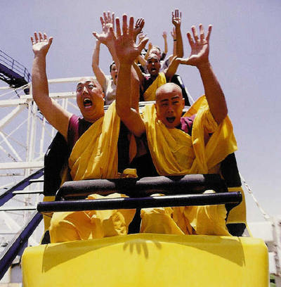
Let the fun begin!

Slide 35
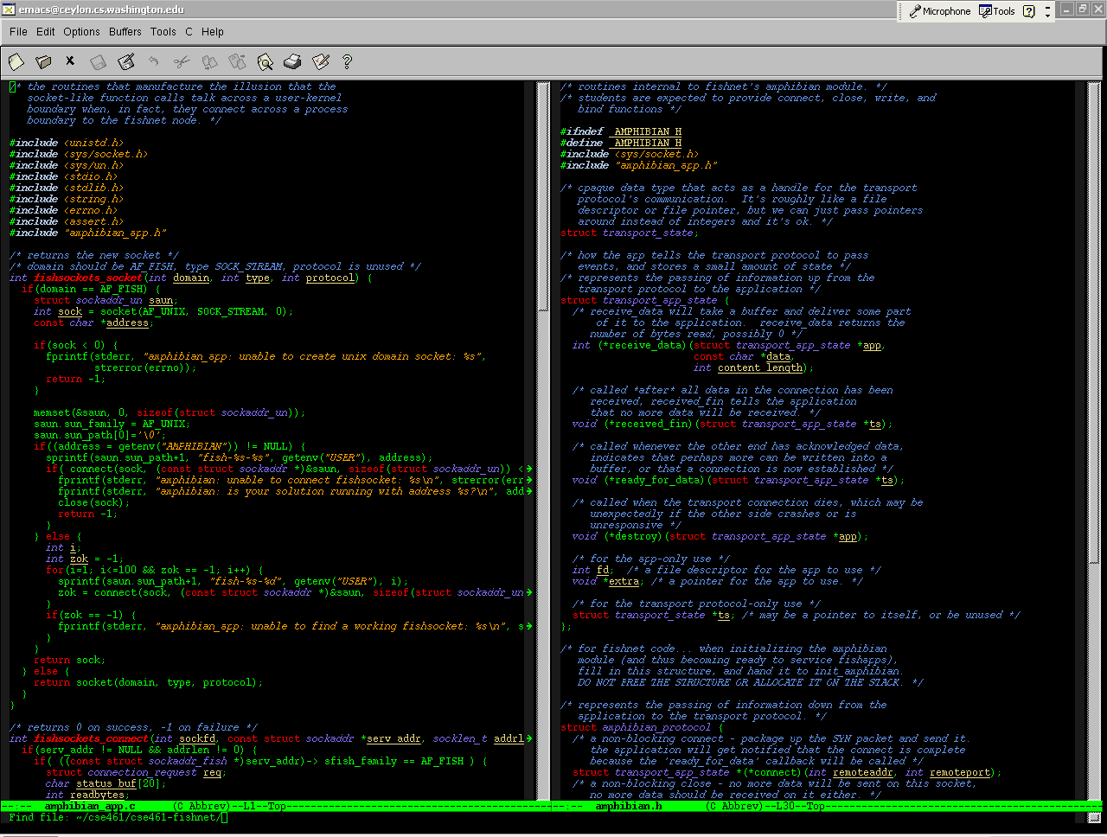
Coding theory
http://catalyst.washington.edu/

Slide 36
What does this say?
W*lcome to the cl*ss. I h*pe you w*ll h*ve as mu*h f*n as I wi*l hav* t*ach*ng it!
Welcome to the class. I hope you will have as much fun as I will have teaching it!

Slide 37
Why did the example work?
English has in built redundancy
Can tolerate “errors”

Slide 38
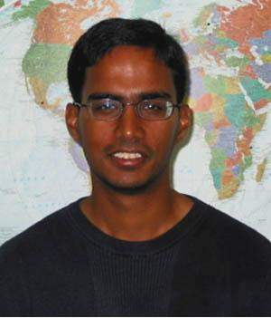
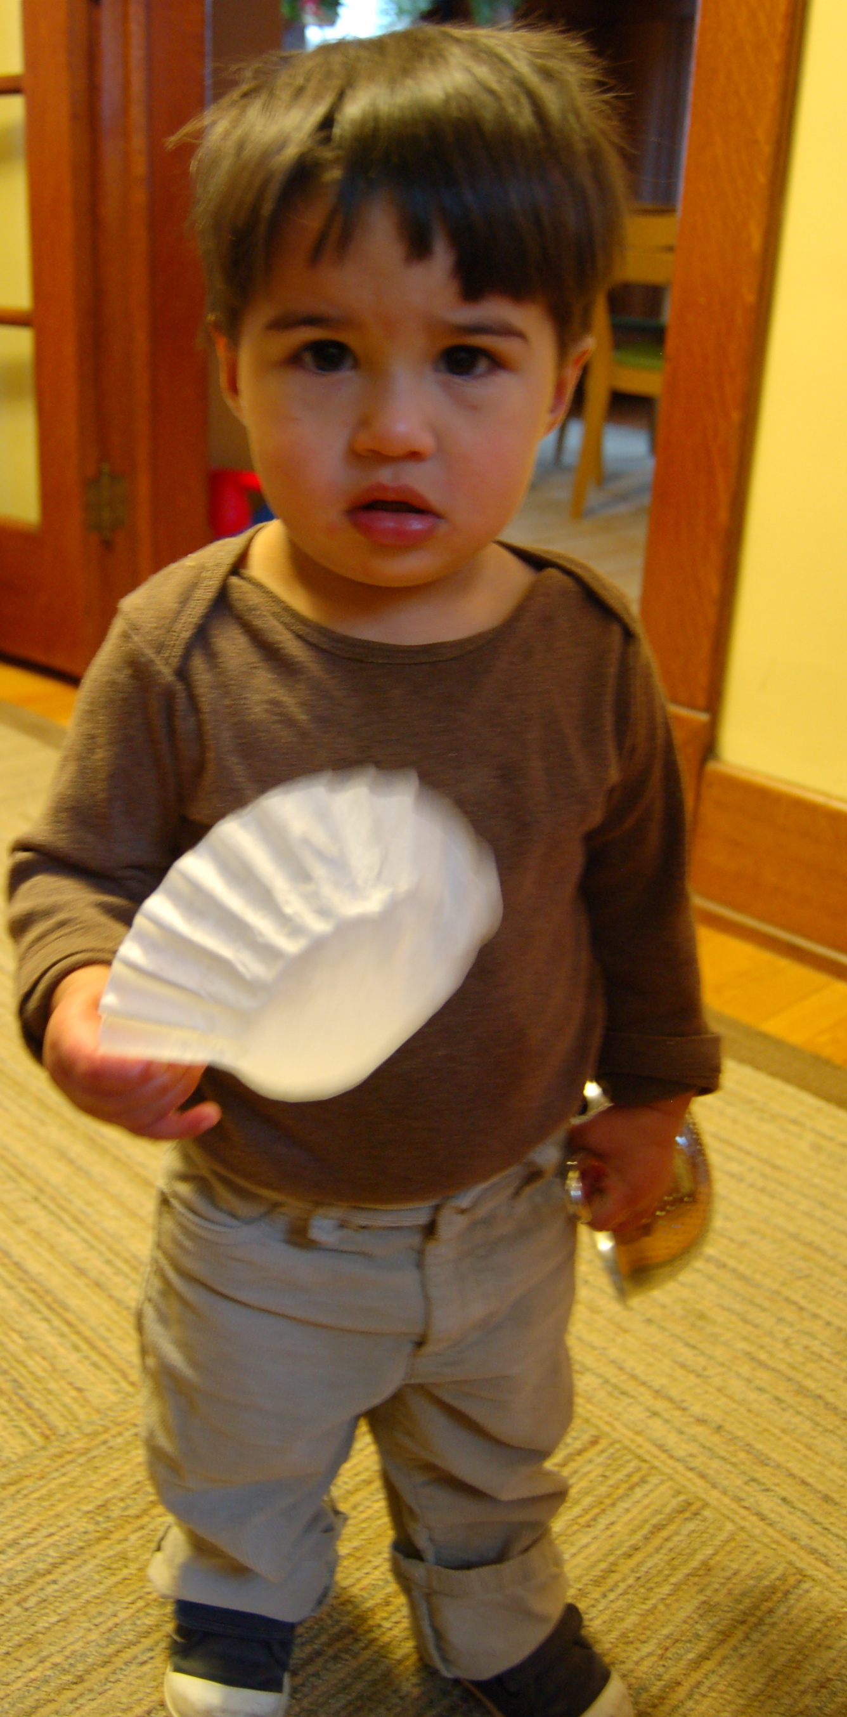
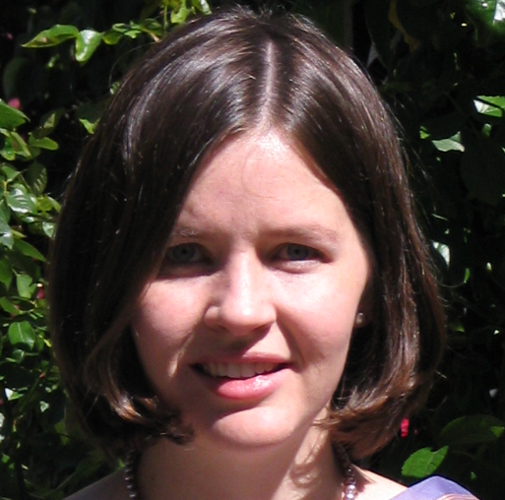
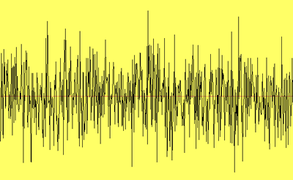
The setup
C(x)
x
y = C(x)+error
Mapping C
  Error-correcting code or just code
  Encoding: x → C(x)
  Decoding: y → x
  C(x) is a codeword
x
Give up
Notes:
Put codeword in color. And say form now on will talk about codeword.

Slide 39
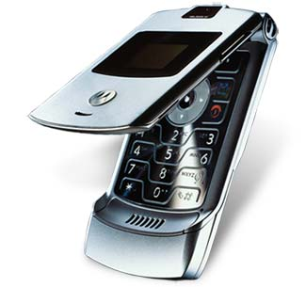
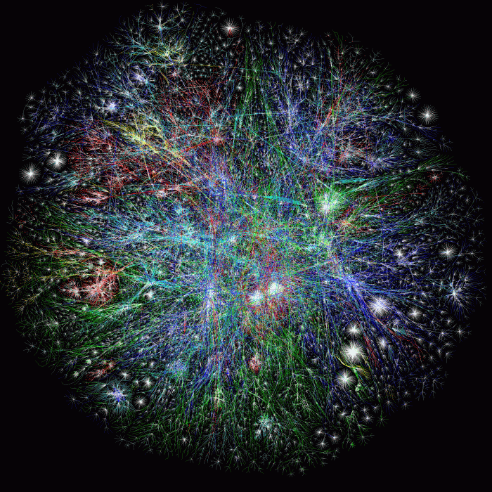
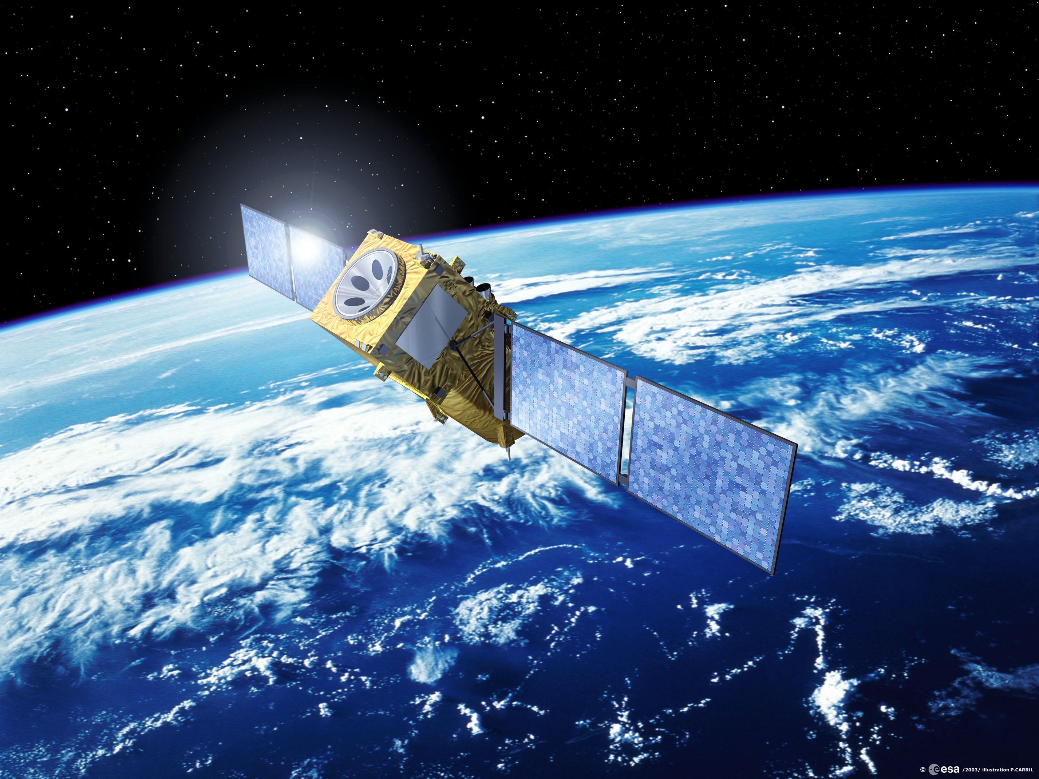
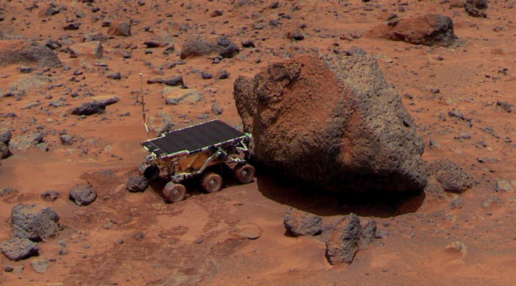
Communication
Internet
  Checksum used in multiple layers of TCP/IP stack
Cell phones
Satellite broadcast
  TV
Deep space telecommunications
  Mars Rover

Slide 40

Codes and 5G

Slide 41
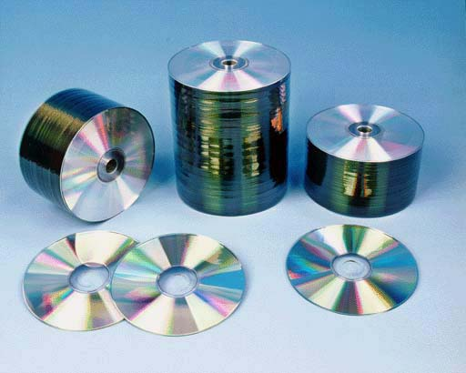
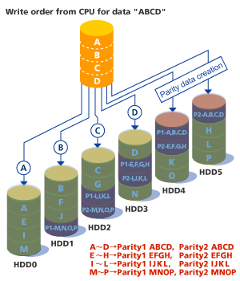
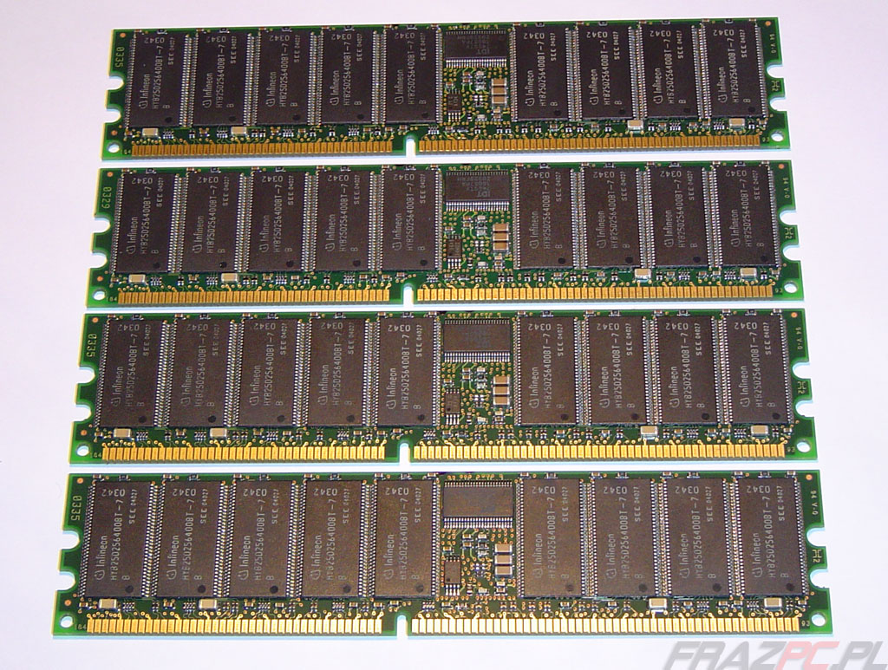
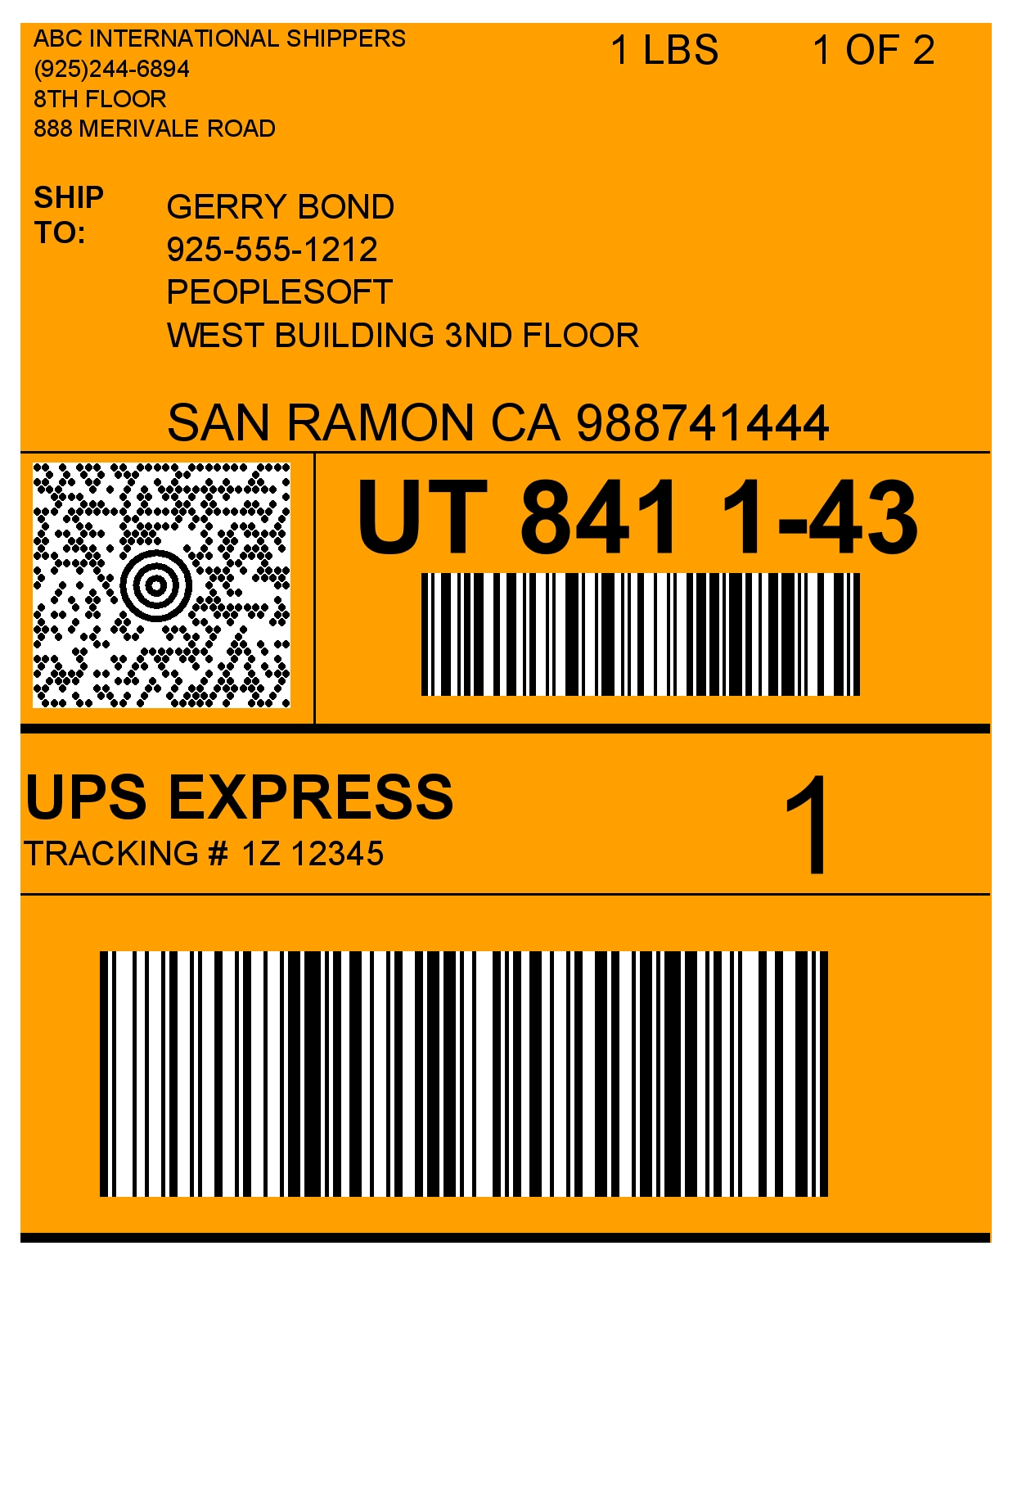

“Unusual” applications
Data Storage
  CDs and DVDs
  RAID
  ECC memory
Paper bar codes
  UPS (MaxiCode)
Codes are all around us

Slide 42
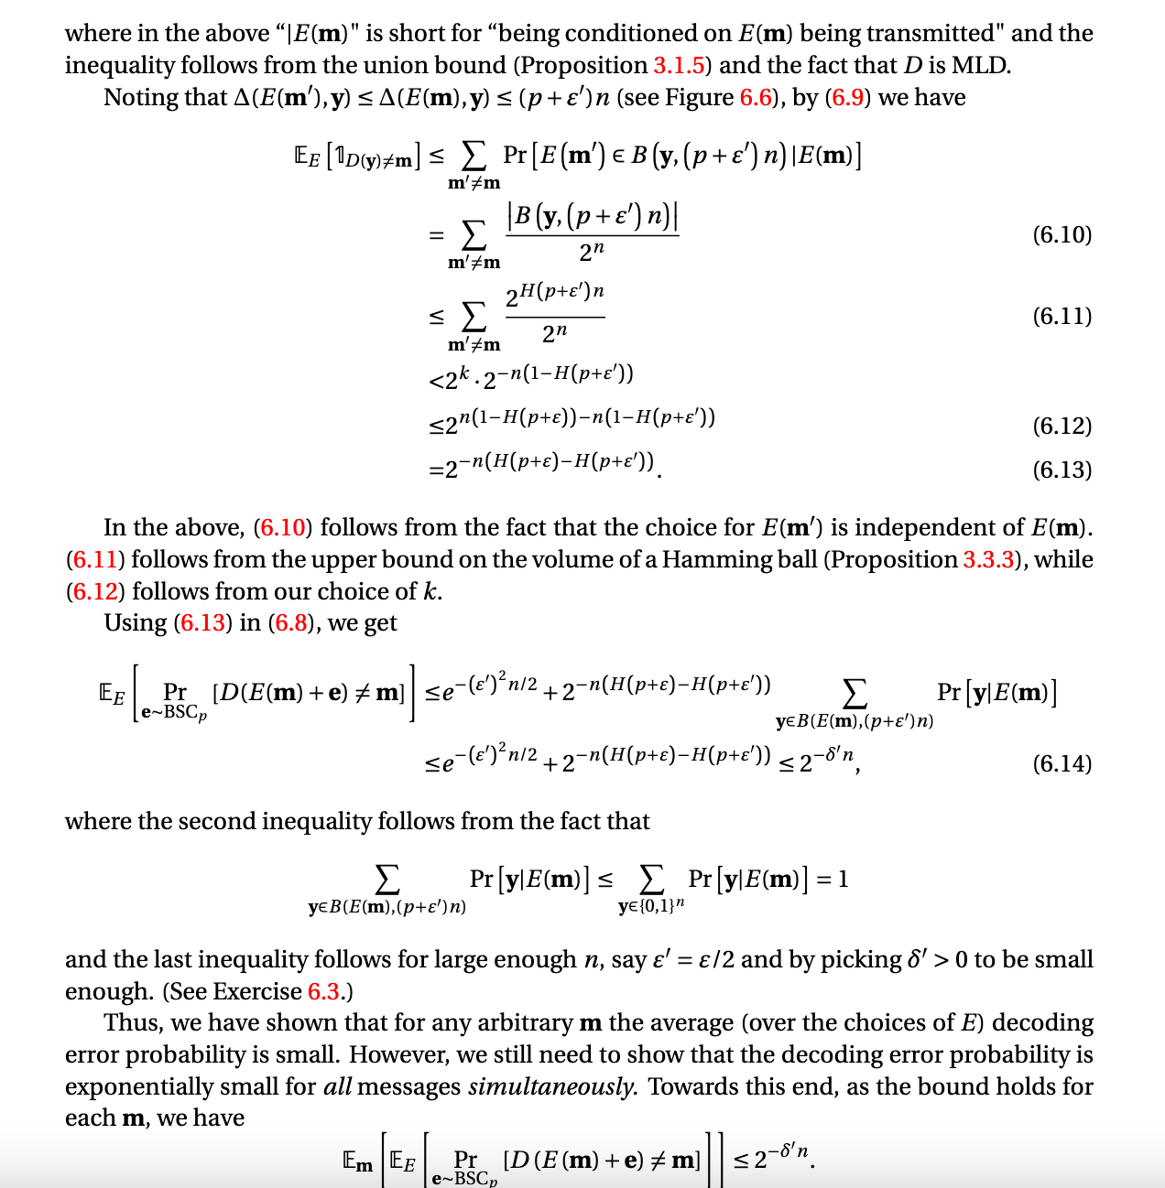
While applications are numerous…
This course will basically focus ONLY on proofs

Slide 43
Other applications of codes
Outside communication/storage domain
Tons of applications in theory
  Complexity Theory
  Cryptography
  Algorithms
Coding theory is a good tool to have in your arsenal

