Slide 1
Coding Theory
CSE 445/545
February 2, 2022

Slide 2
Please have a face mask on

Slide 3
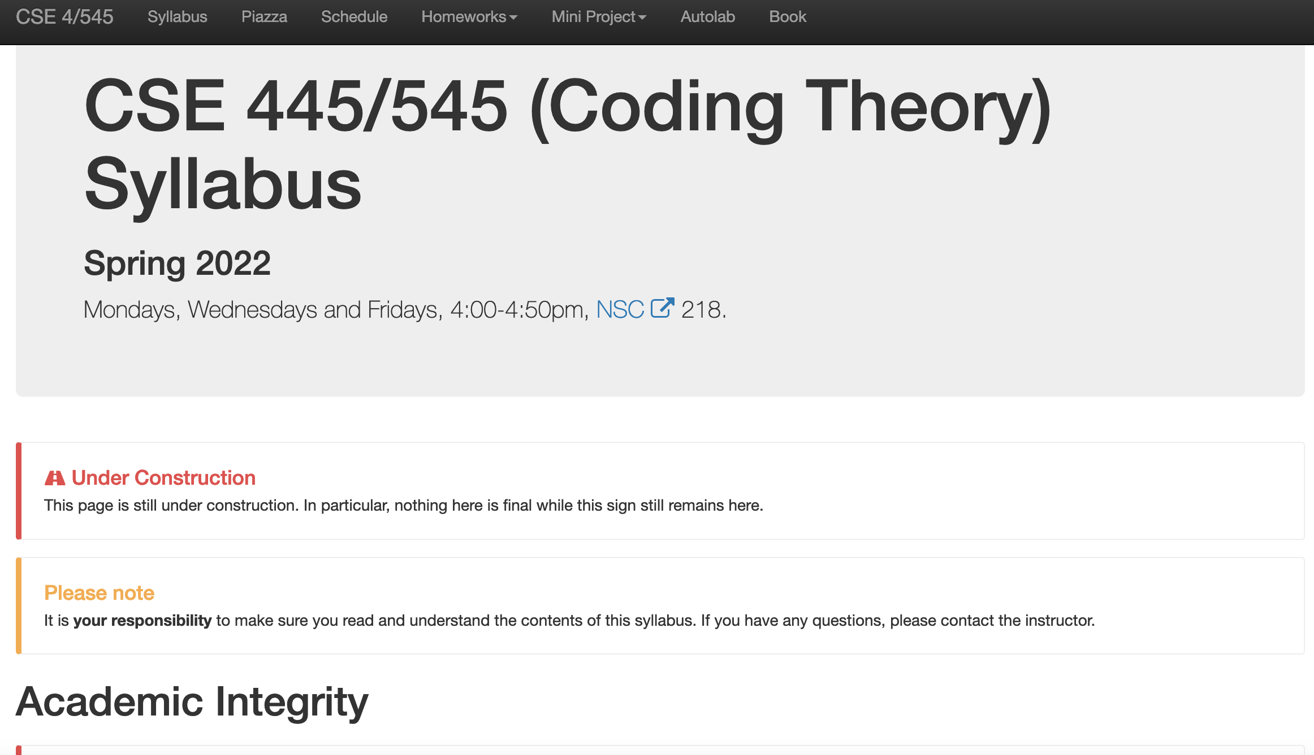
Make sure to check out the syllabus!

Slide 4
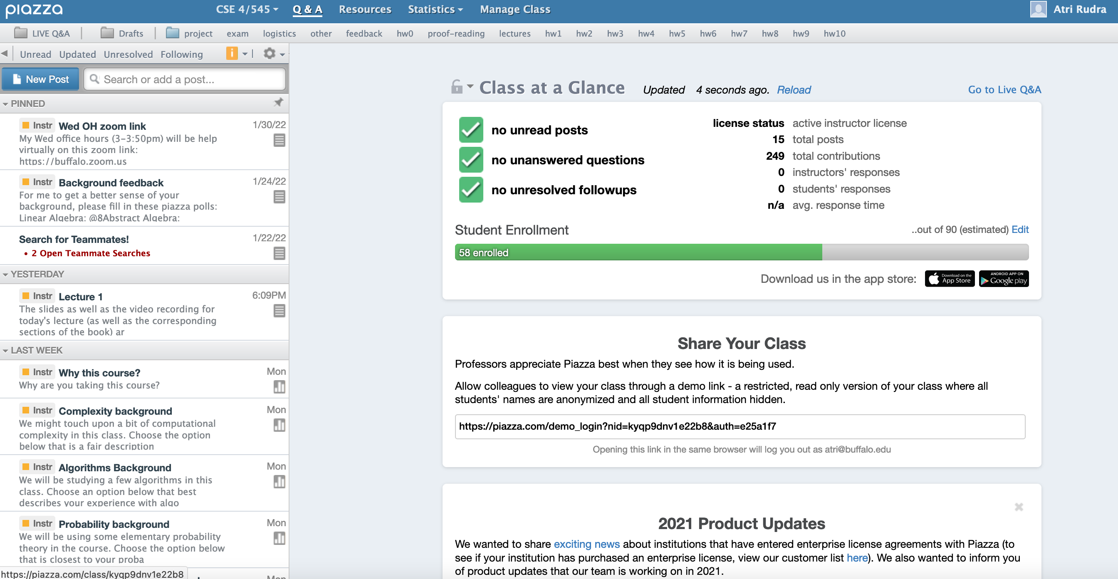
Signup on piazza

Slide 5
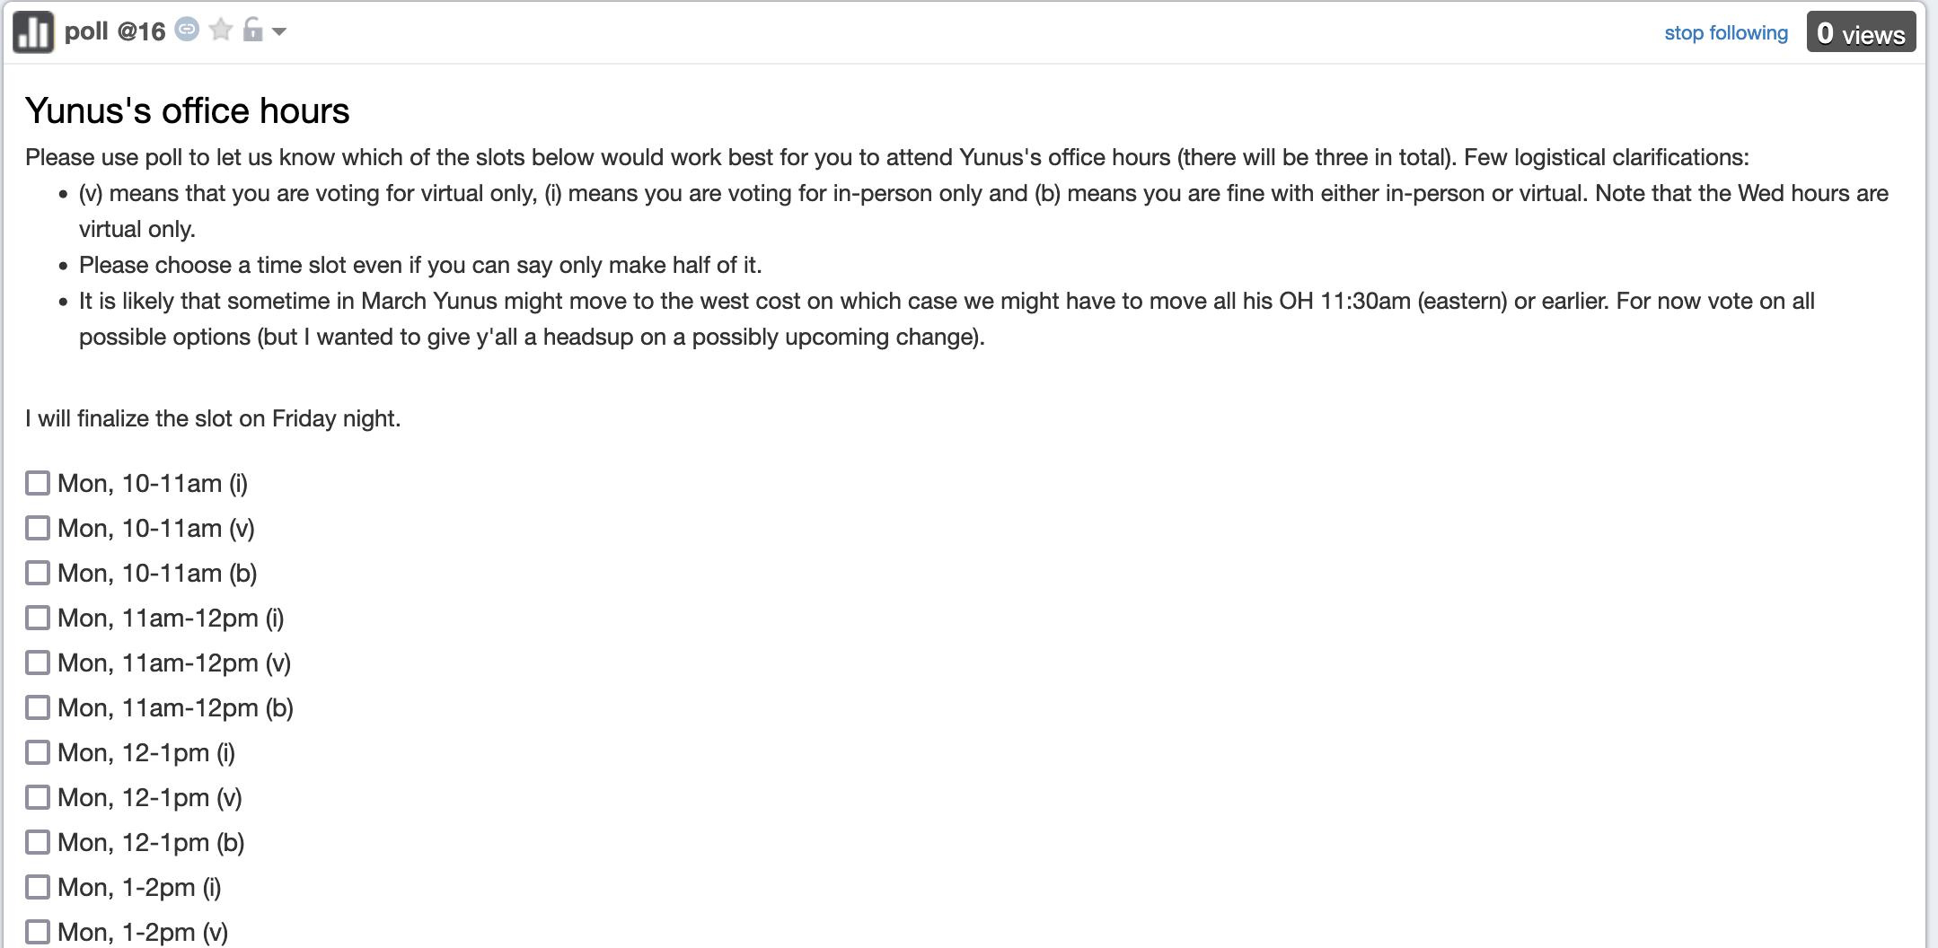
Poll up for Yunus’ office hours

Slide 6
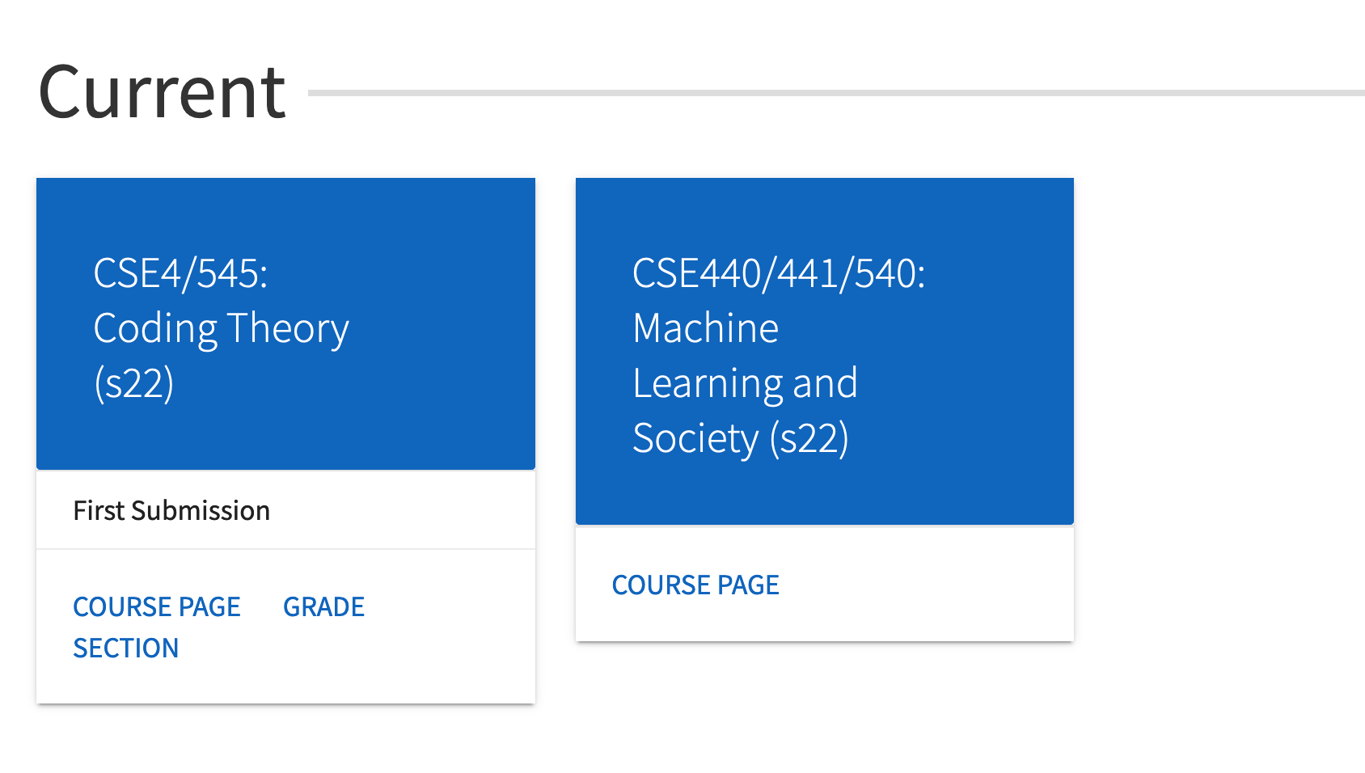
Make sure you see 4/545 on Autolab

Slide 7
Proof readers for today
Julia and Luca

Slide 8
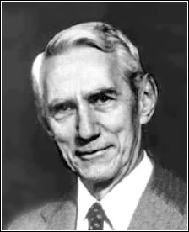
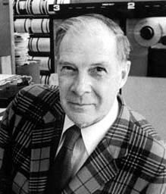
The birth of coding theory
Claude E. Shannon
“A Mathematical Theory of Communication”
1948
Gave birth to Information theory
Richard W. Hamming
“Error Detecting and Error Correcting Codes”
1950

Slide 9
Structure of the course
Part I: Combinatorics
What can and cannot be done with codes
Part II: Algorithms
How to use codes efficiently
Part III: Applications
Applications in (theoretical) Computer Science

Slide 10
Redundancy vs. Error-correction
Repetition code: Repeat every bit say 100 times
Good error correcting properties
Too much redundancy
Parity code: Add a parity bit
Minimum amount of redundancy
Bad error correcting properties
Two errors go completely undetected
Neither of these codes are satisfactory
1 1 1 0 0
1
1 0 0 0 0
1
Notes:
Give an example of the parity code – two close by codewords

Slide 11
Two main challenges in coding theory
Problem with parity example
Messages mapped to codewords which do not differ in many places
Need to pick a lot of codewords that differ a lot from each other
Efficient decoding
Naive algorithm: check received word with all codewords
Notes:
Need to explain the spheres more.Next idea after repetitions and parity

Slide 12
The fundamental tradeoff
Correct as many errors as possible with as little redundancy as possible
Can one achieve the “optimal” tradeoff with
efficient encoding and decoding ?
Notes:
Mention that encoding is generally easy

Slide 13
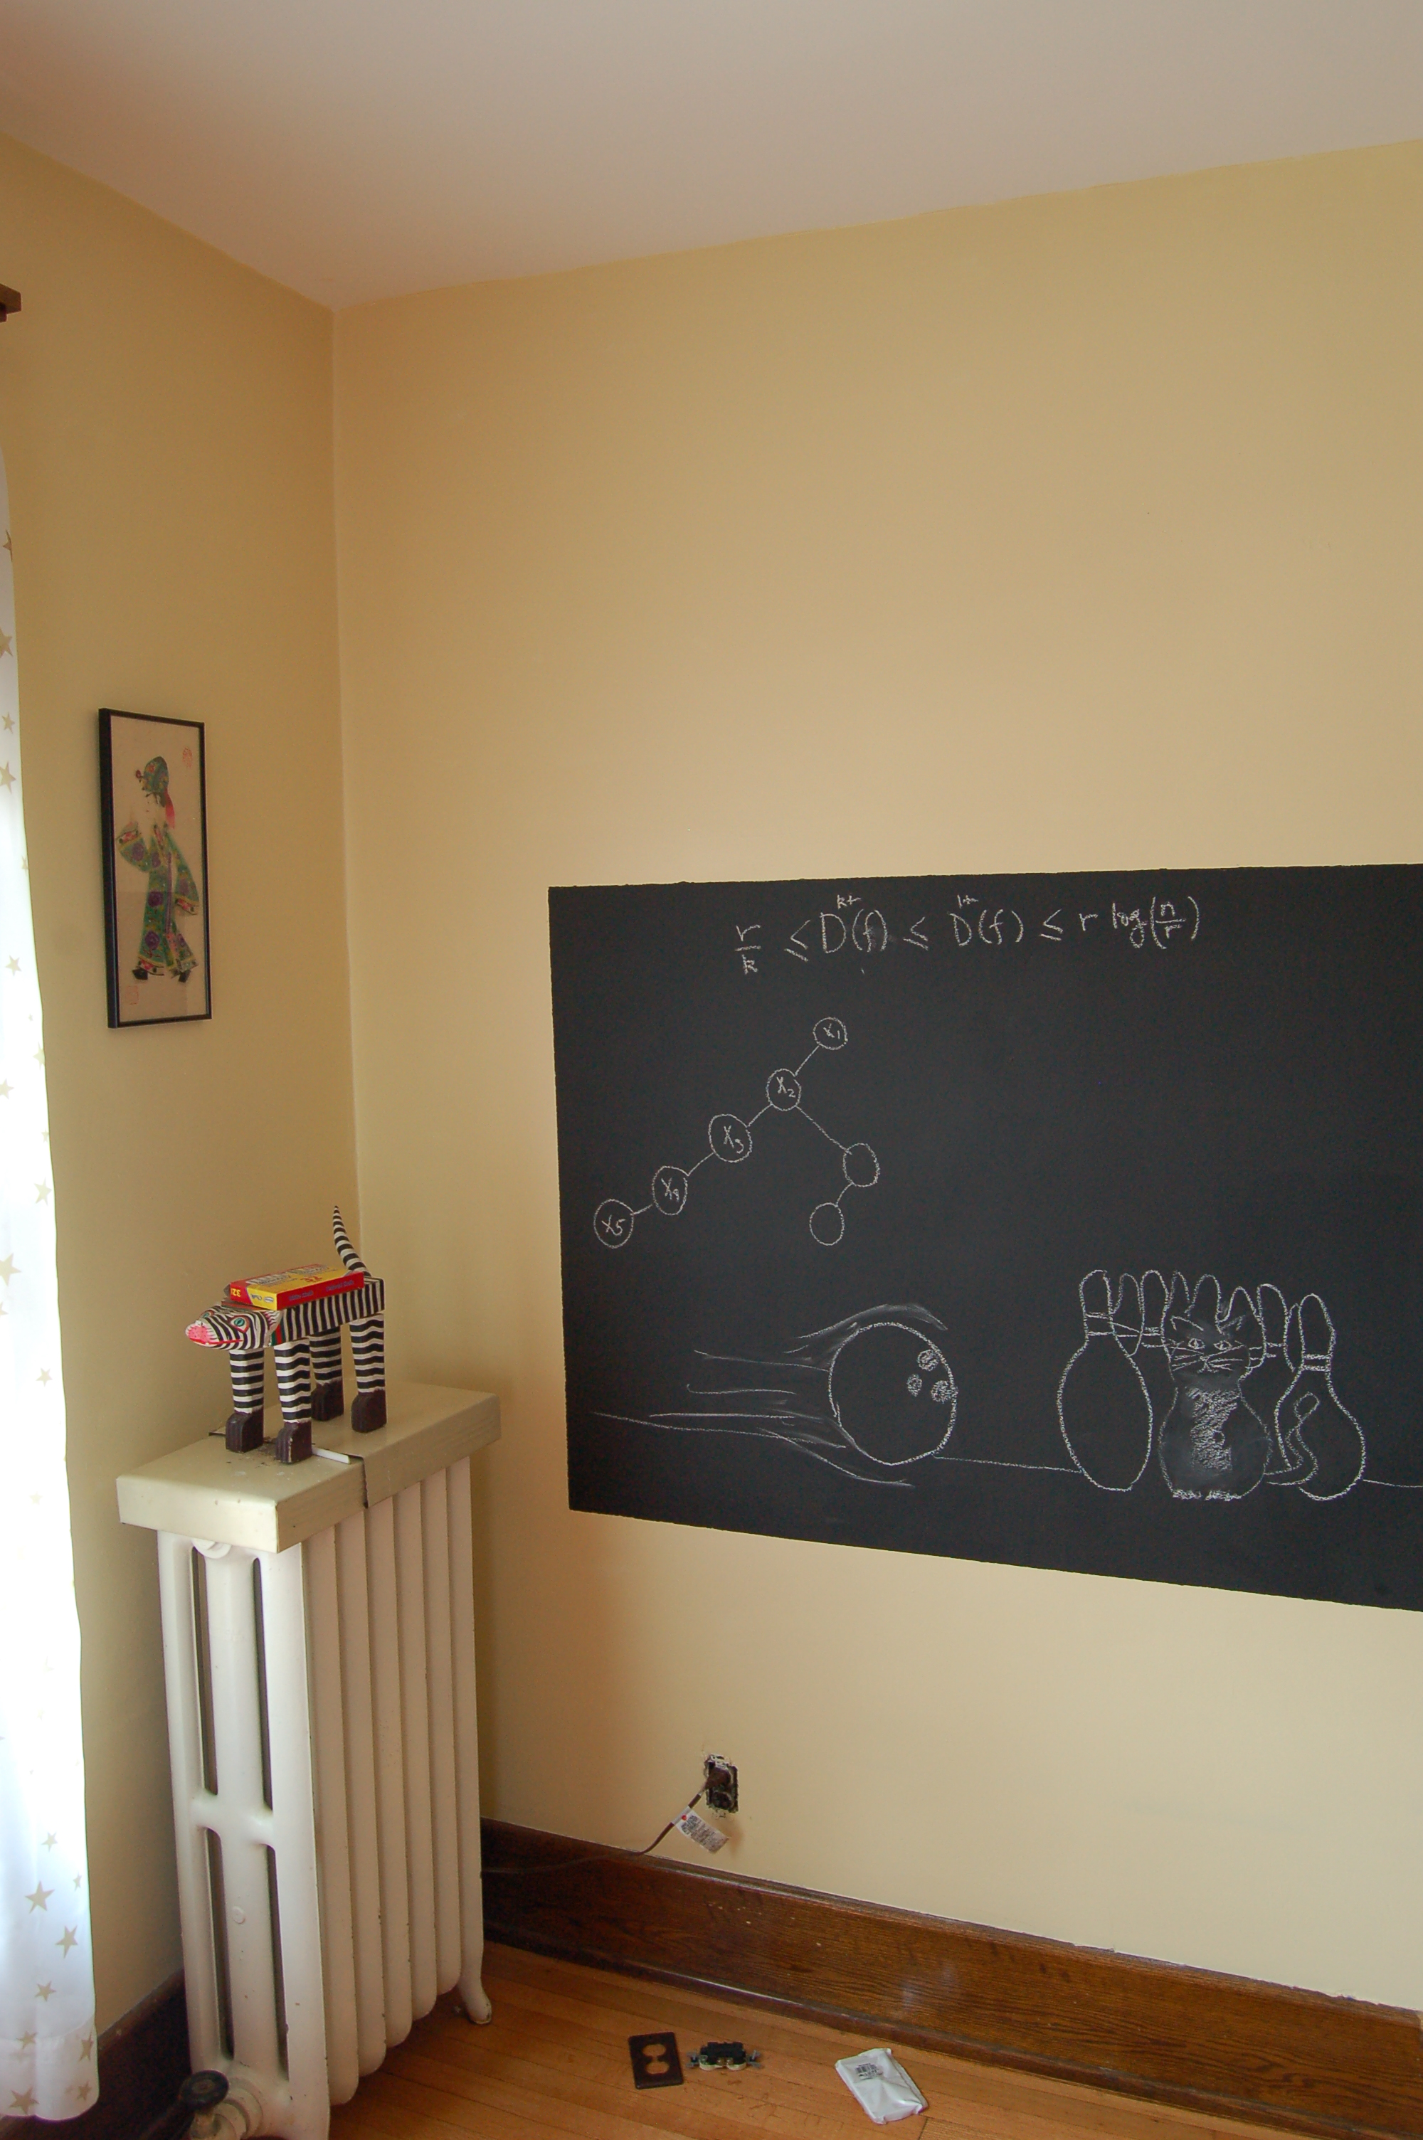
Rest (of the semester) on the board…

