Slide 1
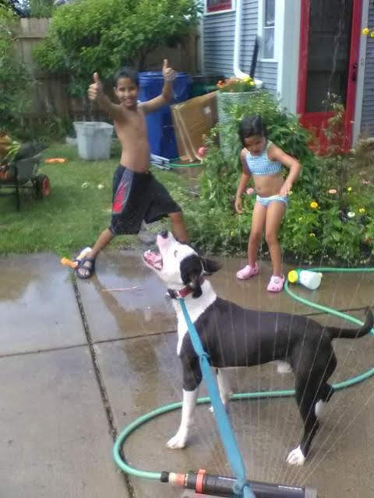
Welcome
to
CSE 331

Slide 2

Let’s do some introductions
http://www.zazzle.com/warning_teaching_assistant_bag-149882665435161818

Slide 3
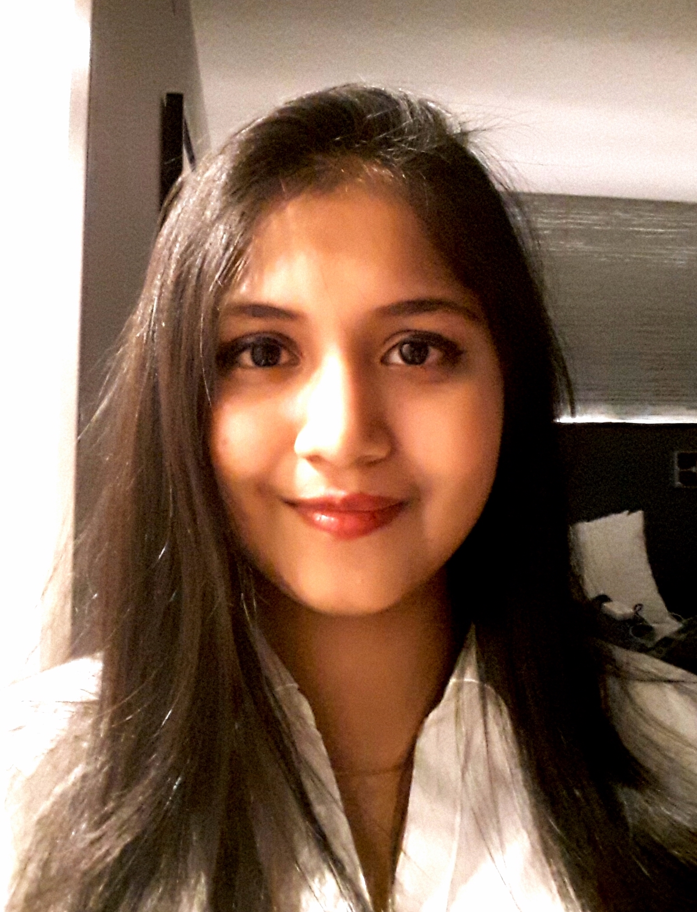
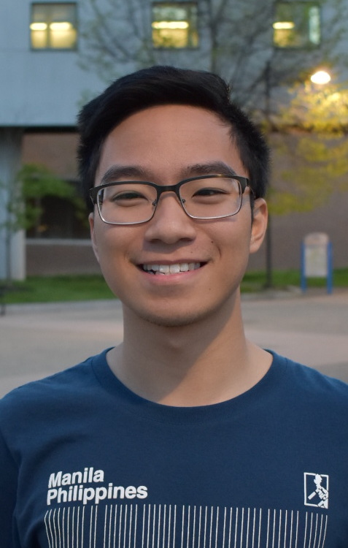
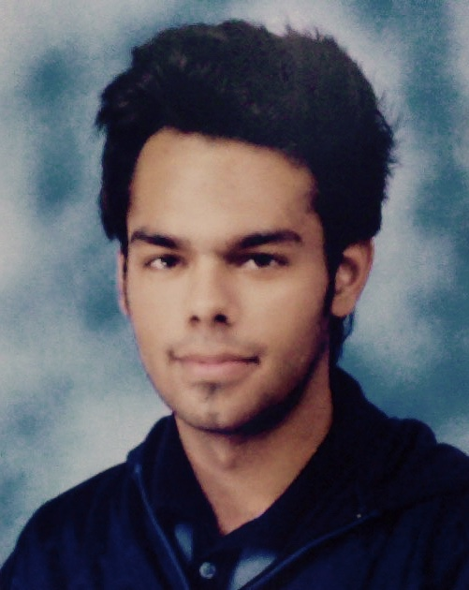
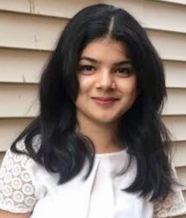
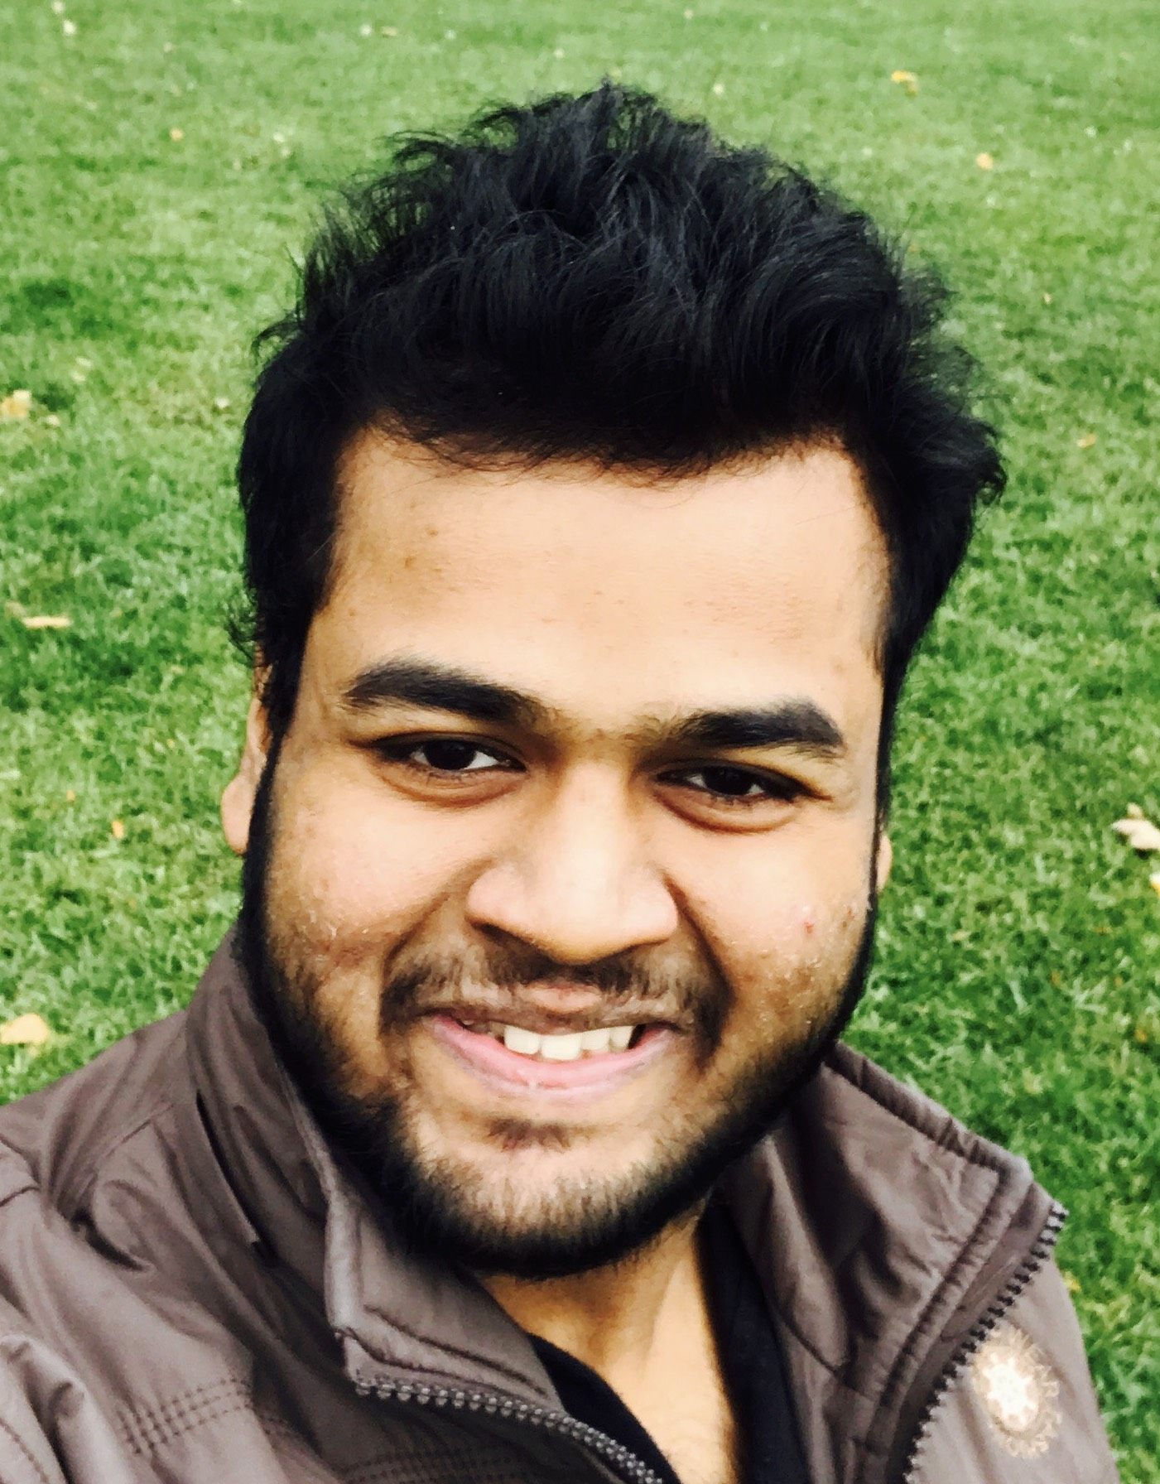
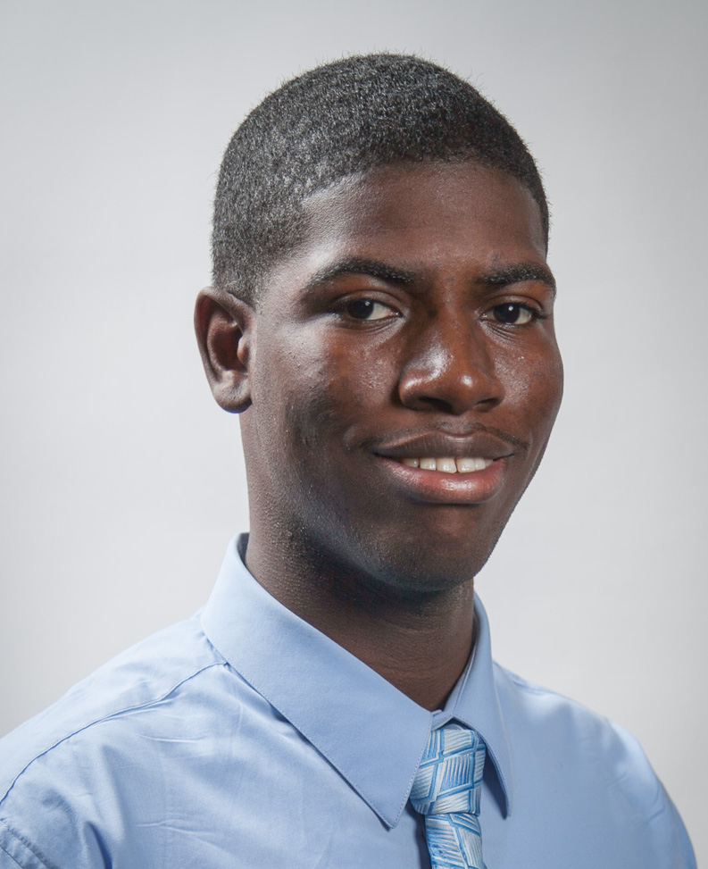
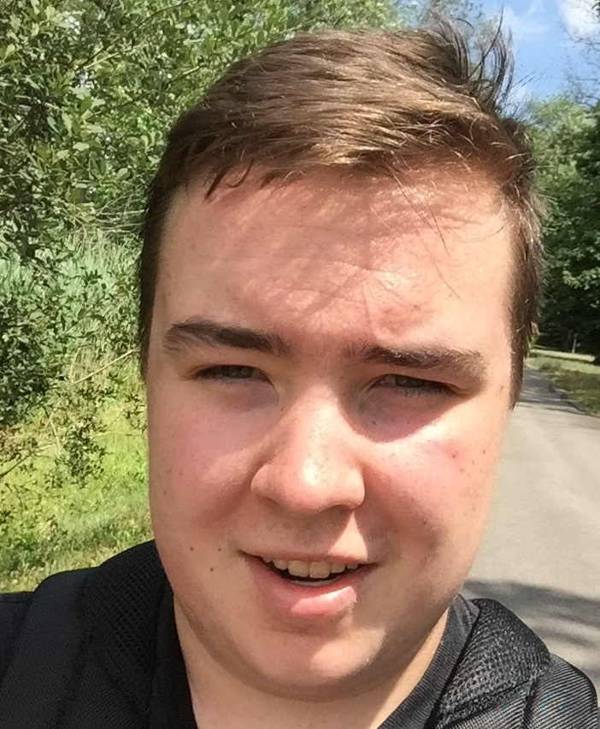
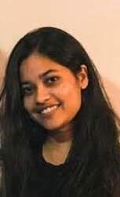
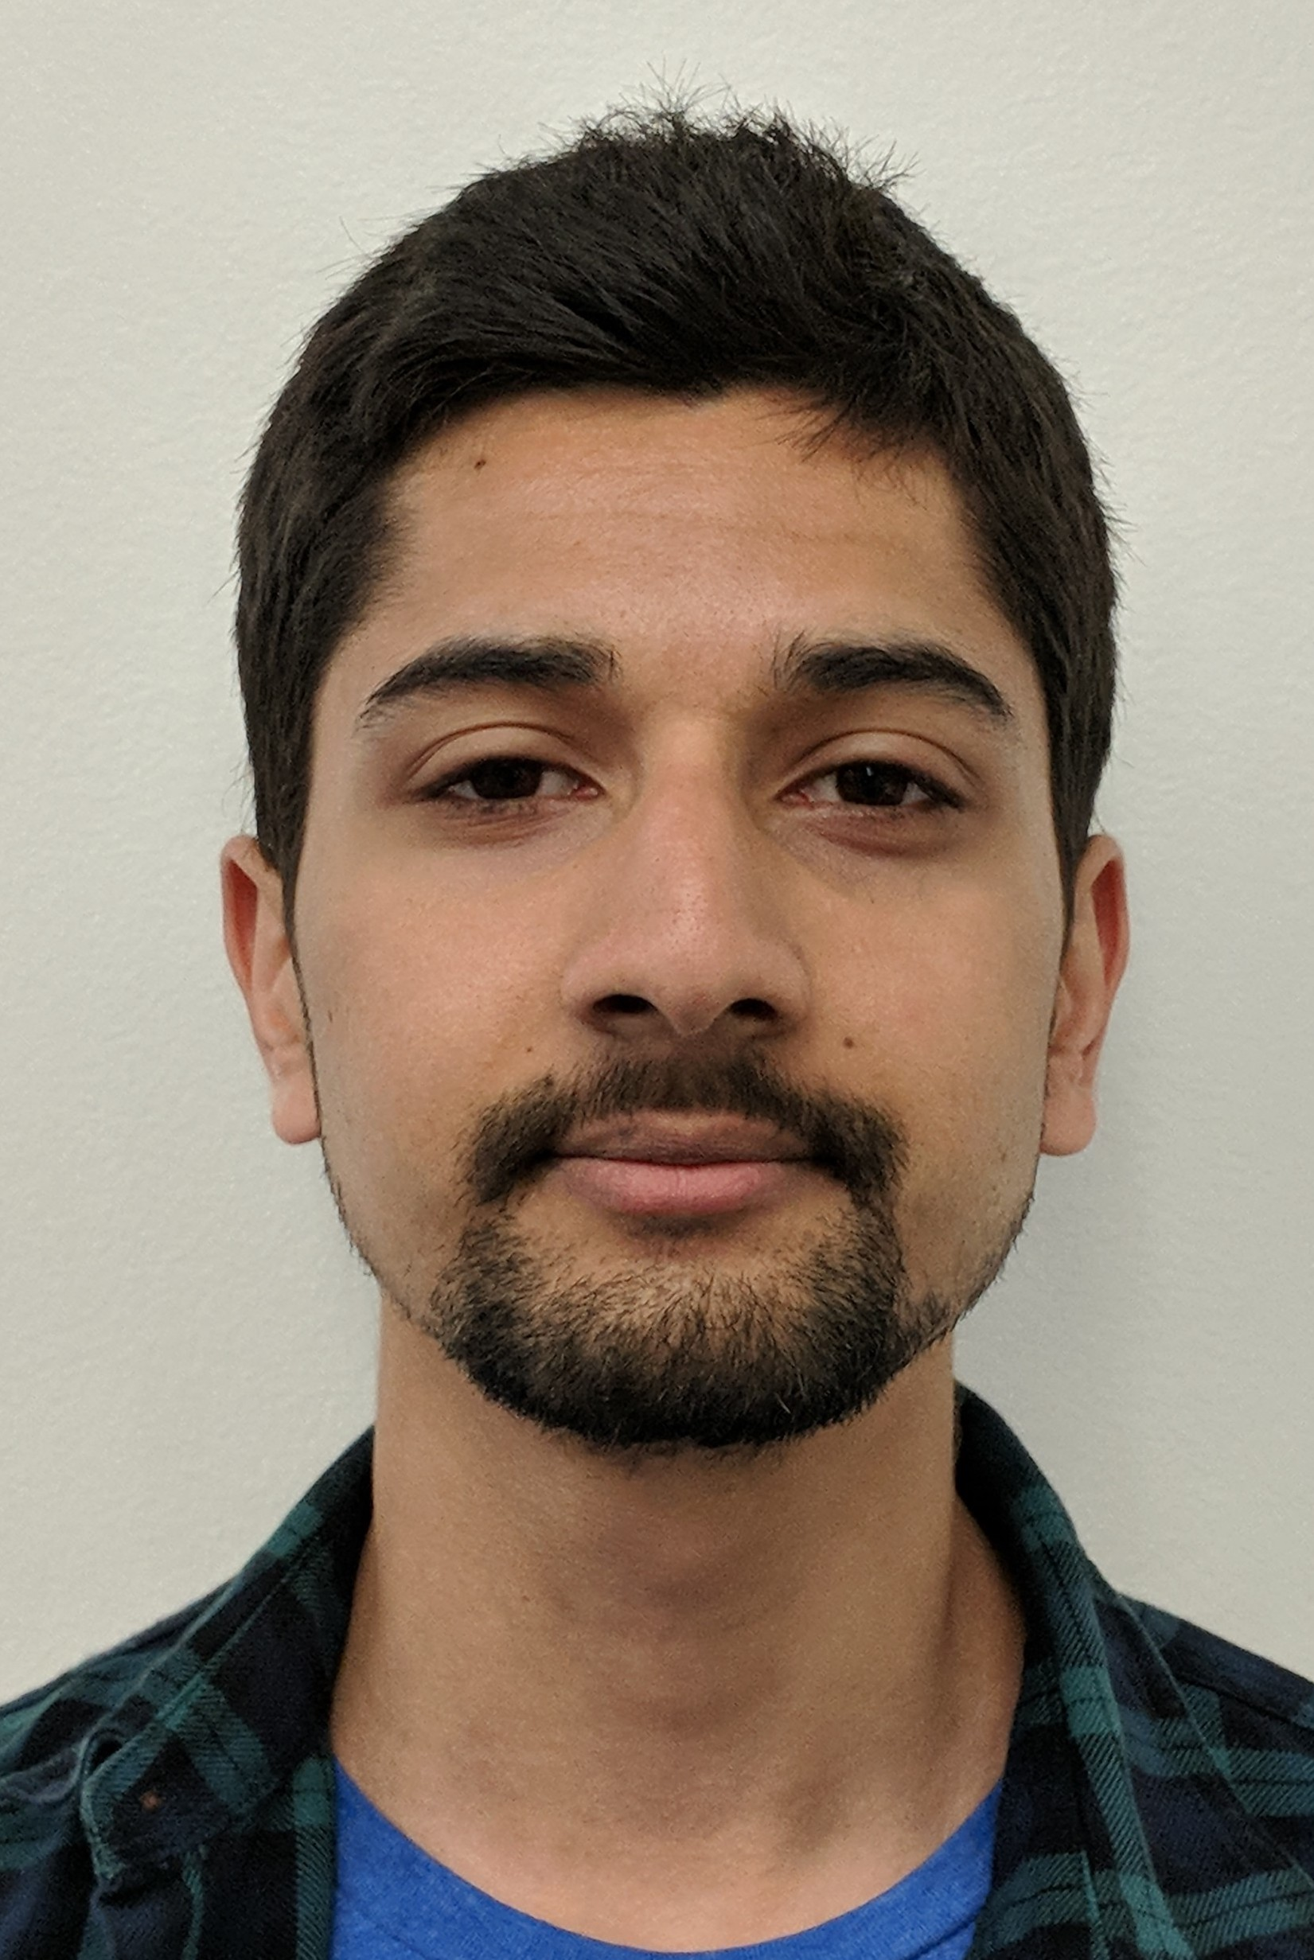
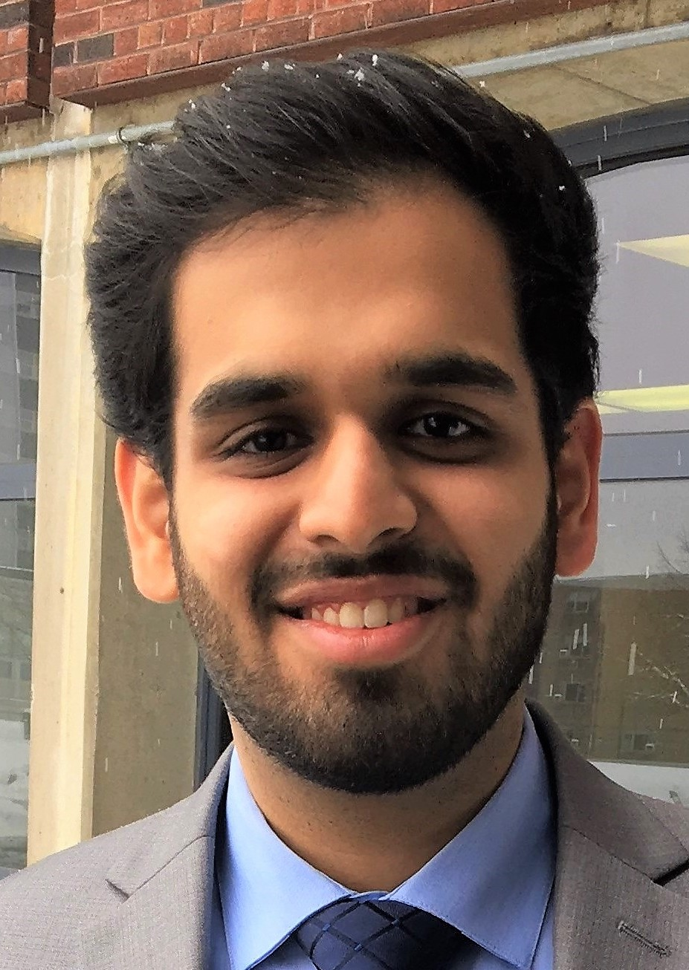
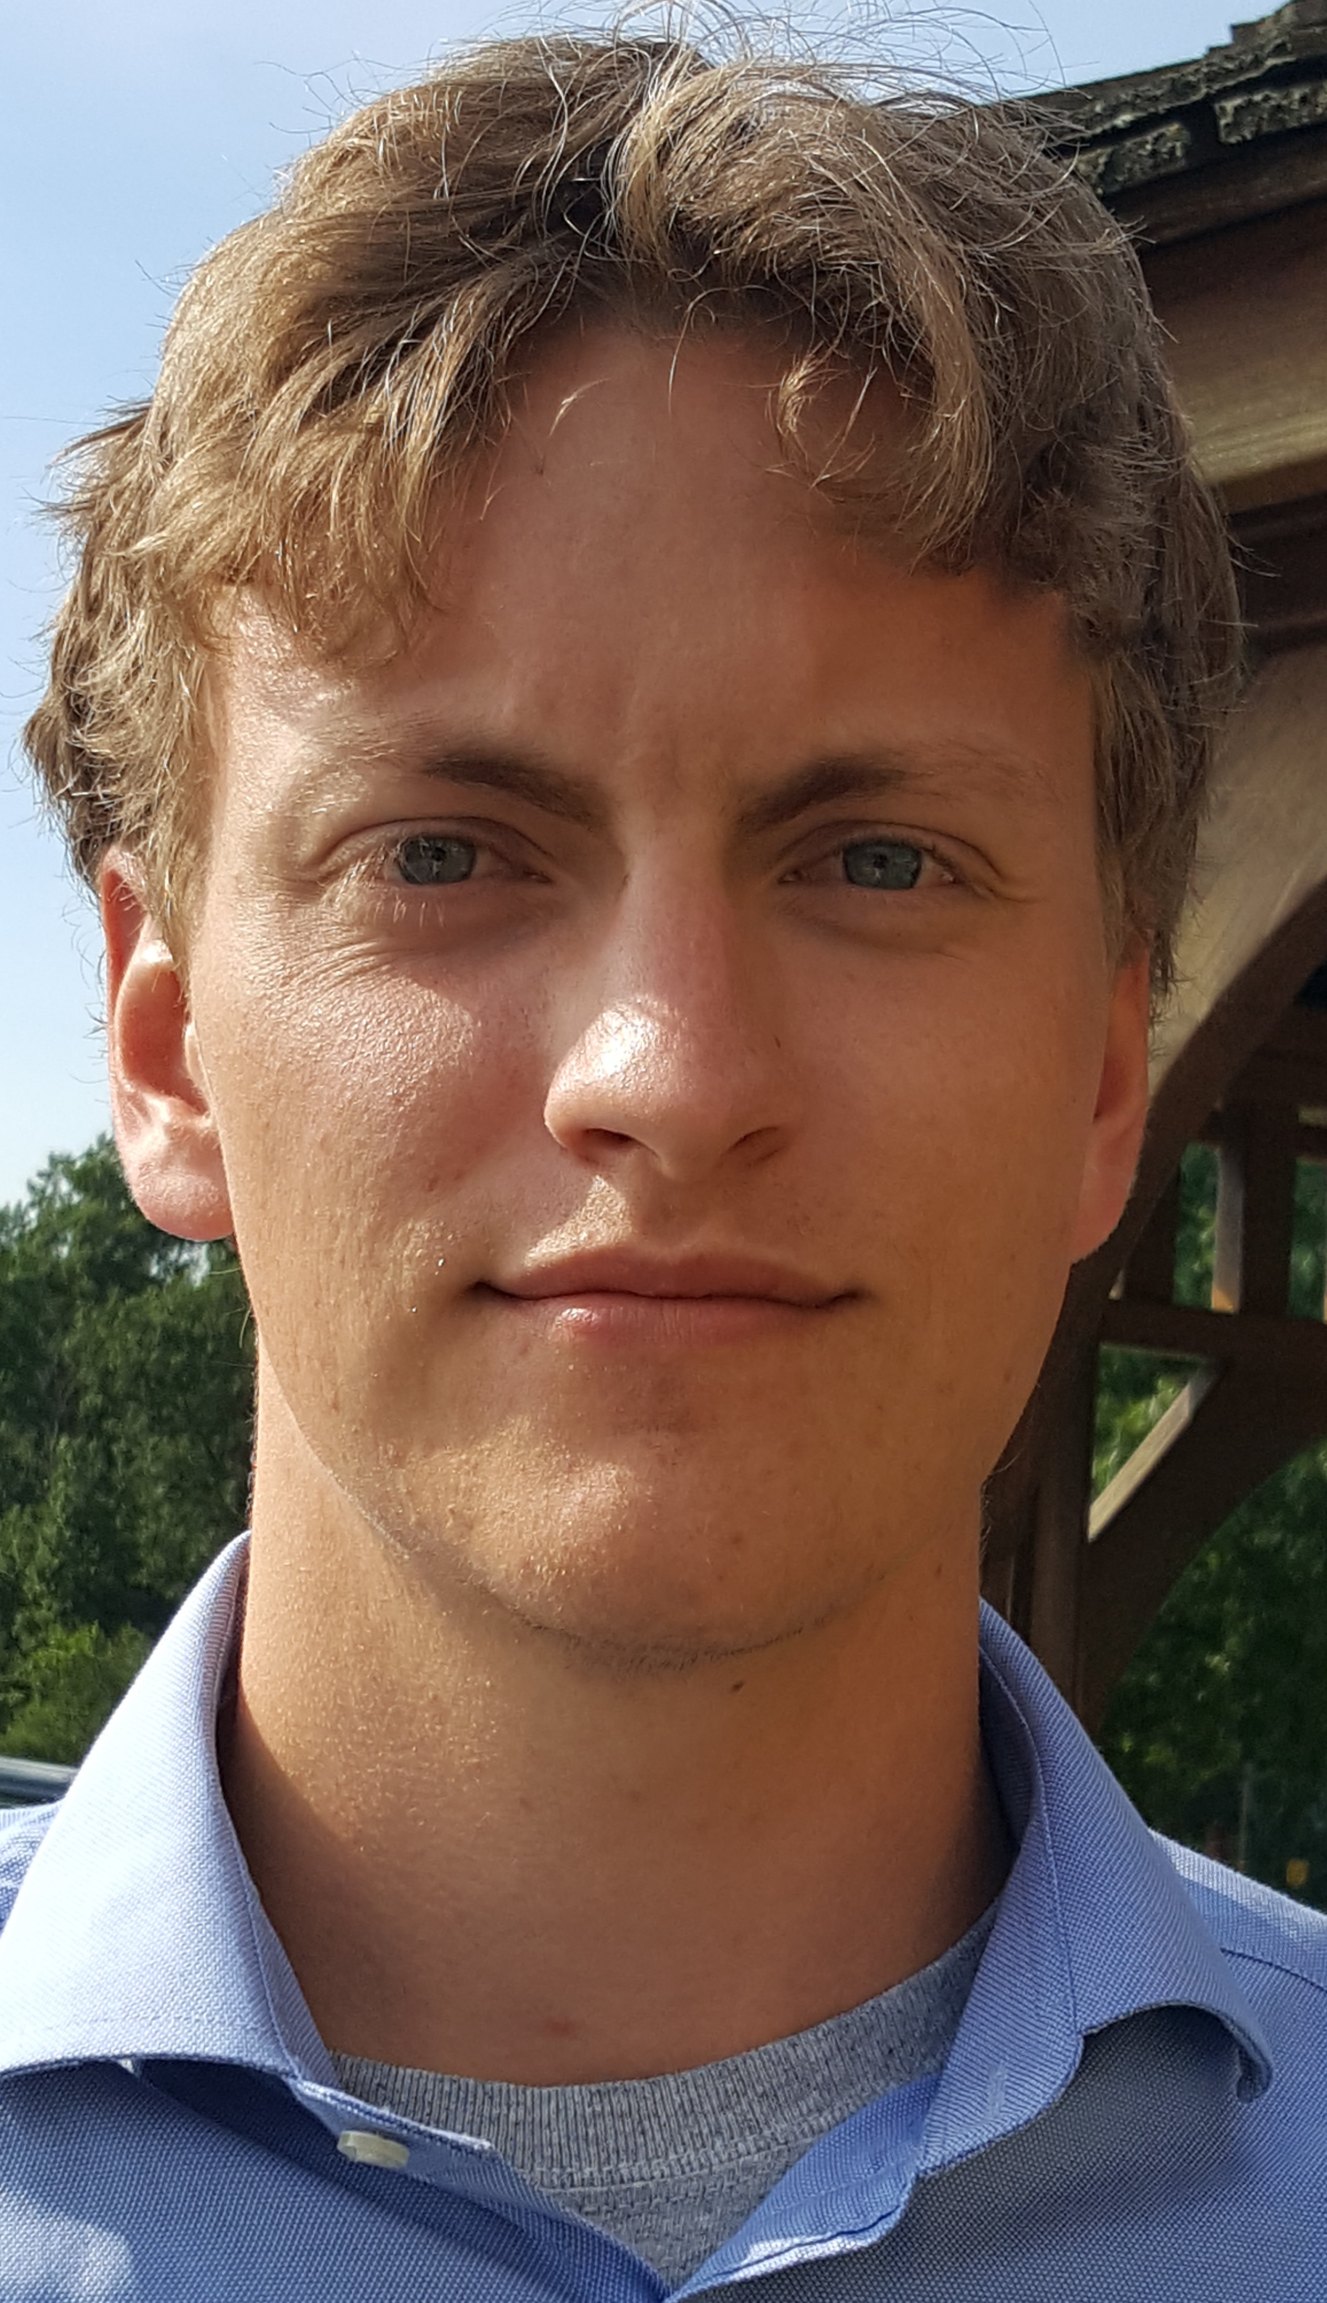
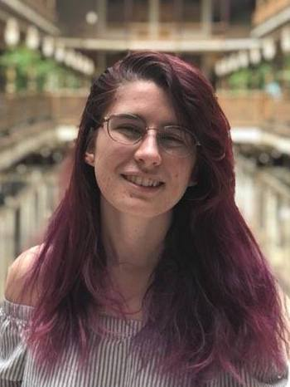
TAs first
Chinmayee
Hans
Sanchit
Priyanka
Elijah
Stephen
Nick
Sean
Rishi
Gitanjali
Supratik
Animesh
Tom
Veronica

Slide 4

Lectures will be videotaped
http://www.imdb.com/title/tt0363510/mediaviewer/rm2499681792

Slide 5
About Me
Atri Rudra
atri@buffalo.edu
Office: 319 Davis
Office hours: Mon 2-2:50pm; Wed, 3:00-3:50pm
OH starts today

Slide 6
Contact us all at
Or use piazza!
cse-331-staff@buffalo.edu
TAs will not respond to individual emails (except for re-grading requests)

Slide 7
Handouts for today
Syllabus (online)
Homework Policy document (online)
Homework 0 (online)

Slide 8
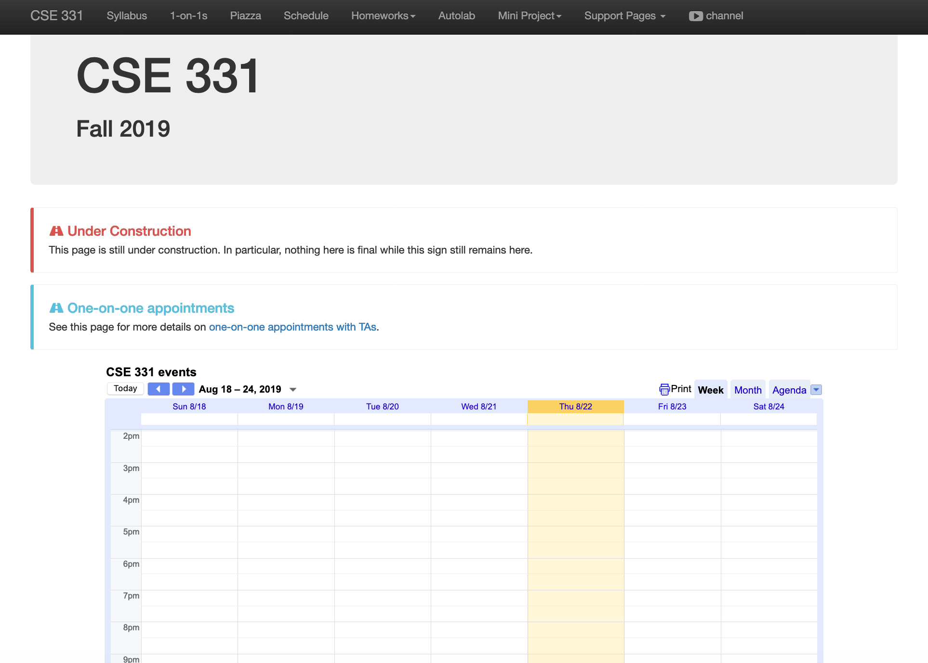
One Stop Shop for the Course
http://www-student.cse.buffalo.edu/~atri/cse331/fall19/index.html

Slide 9
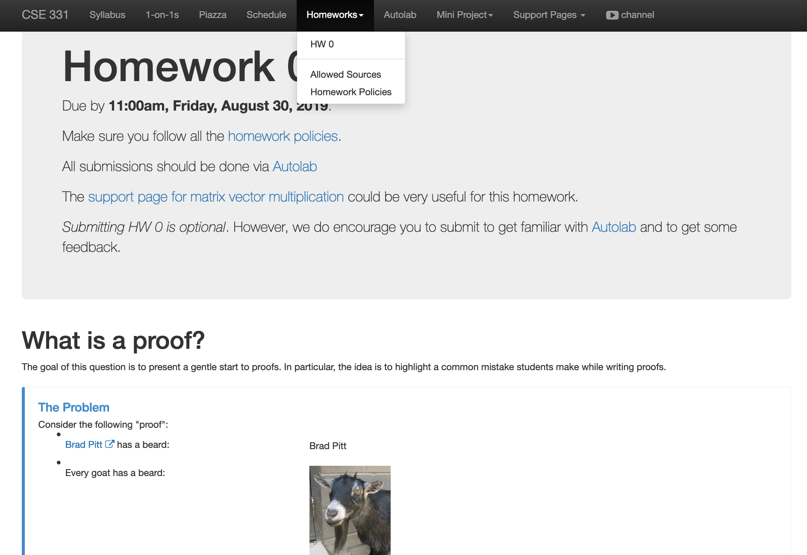
Homework 0 (Optional)
Due: this Friday 11am

Slide 10
Three things to remember
WORK HARD!
DO NOT CHEAT!
READ CAREFULLY!

Slide 11
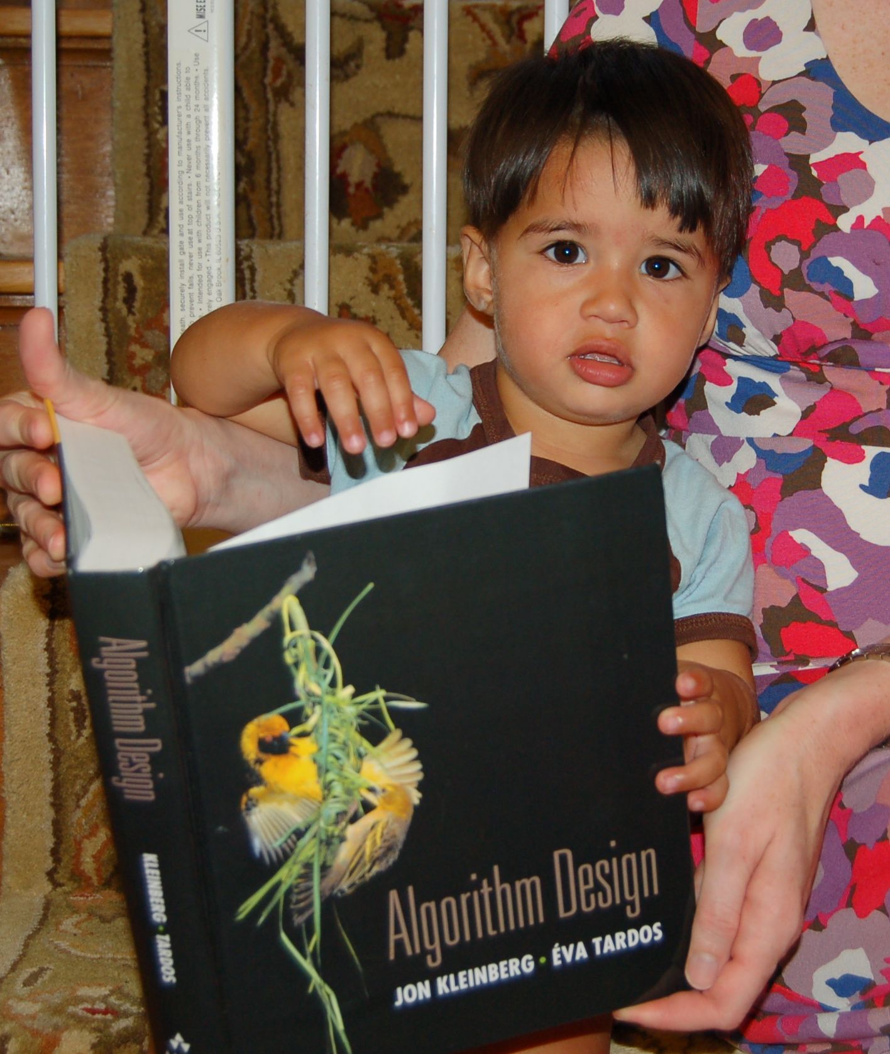
Wait.. What???
Make sure you follow submission
instructions
Two most common ways of losing points
Make sure you read problem
statements carefully

Slide 12
Academic Dishonesty
All your submissions must be your own work
Penalty:
Minimum: An grade reduction in course
Possible: F (or higher penalty) if warranted
YOUR responsibility to know what is cheating, plagiarism etc.
If not sure, come talk to me
Excuses like “I have a job,” “This was OK earlier/in my country,” “This course is hard,” etc. WON’T WORK
I DO NOT HAVE ANY PATIENCE WITH ANY CHEATING :
YOU WILL GET A GRADE REDUCTION IN THE COURSE
FOR YOUR FIRST MISTAKE

Slide 13
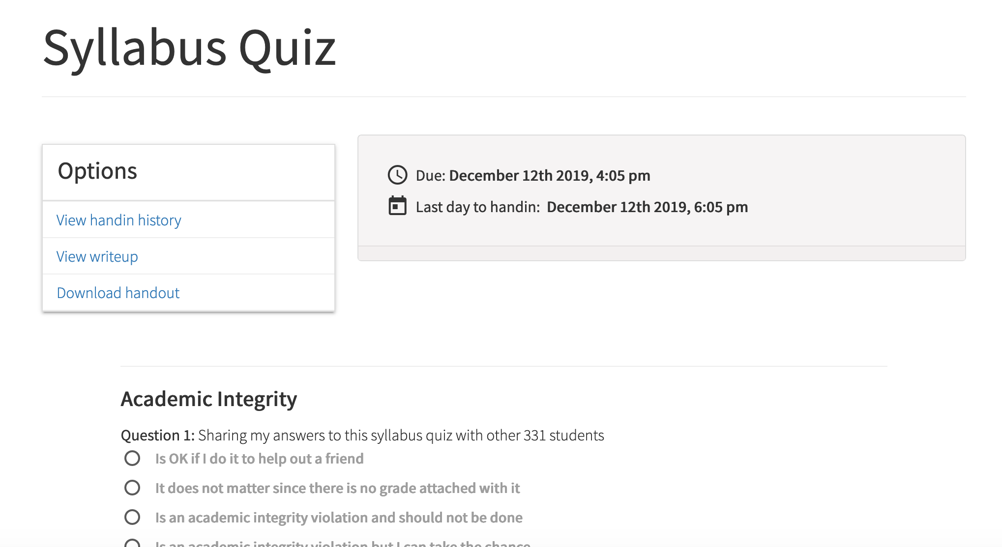
Read the syllabus CAREFULLY!
No graded material will be handed back till you pass the syllabus quiz!

Slide 14
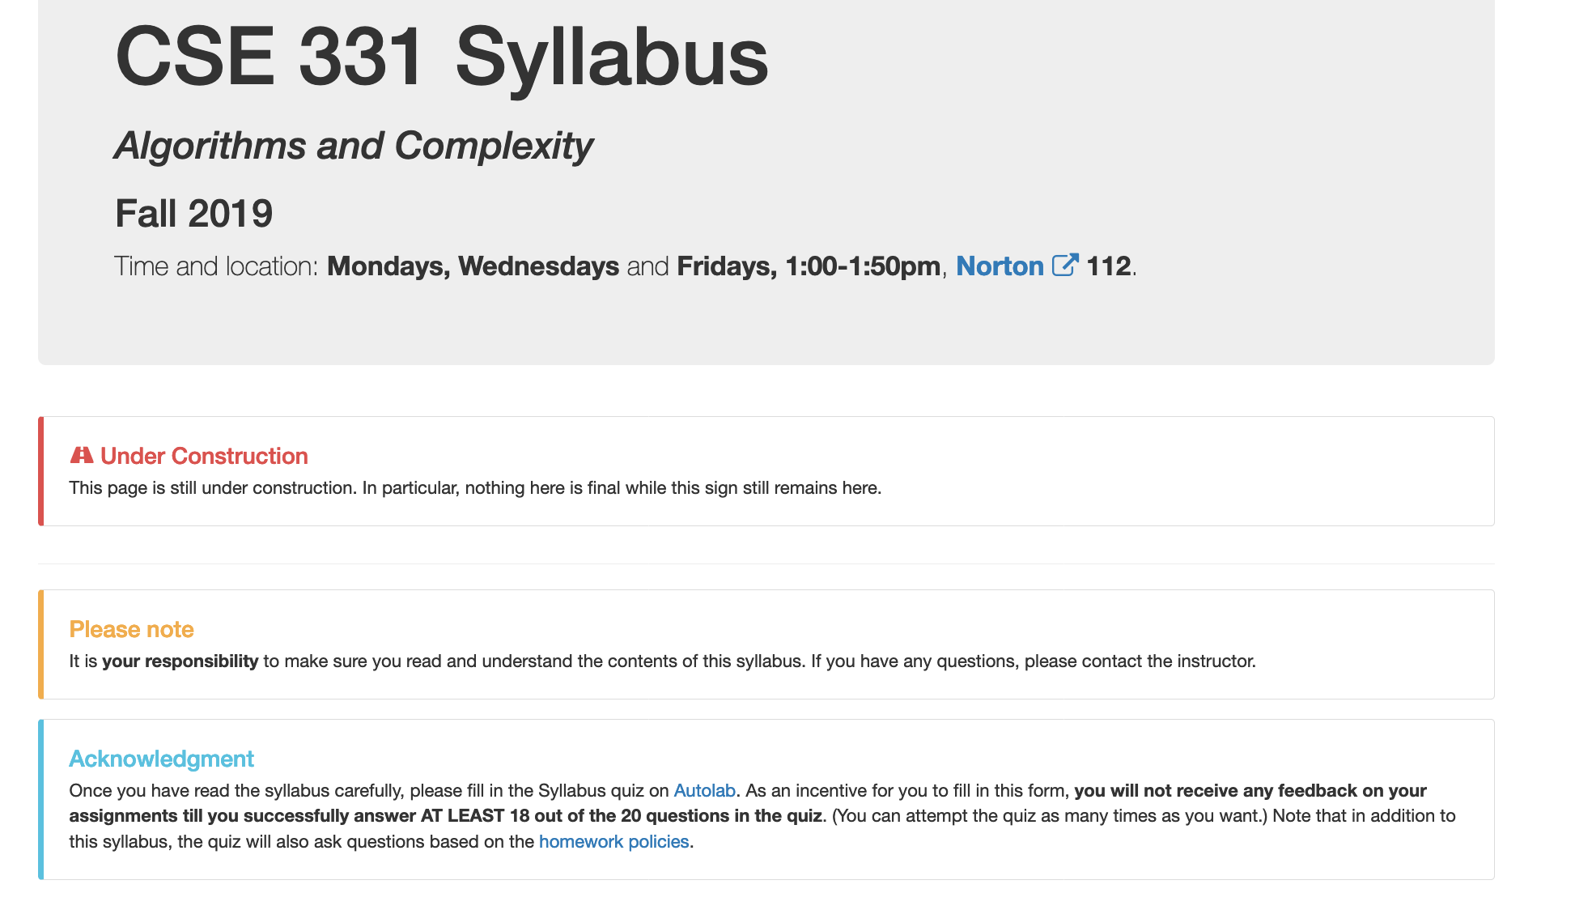
More information on the quiz

Slide 15
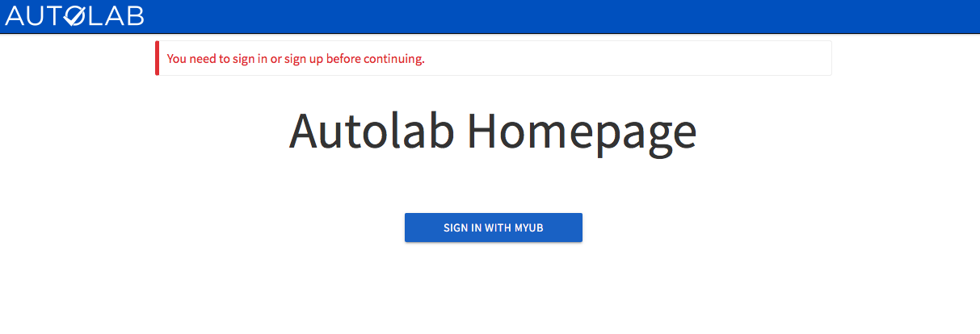
Autolab
https://autograder.cse.buffalo.edu/

Slide 16
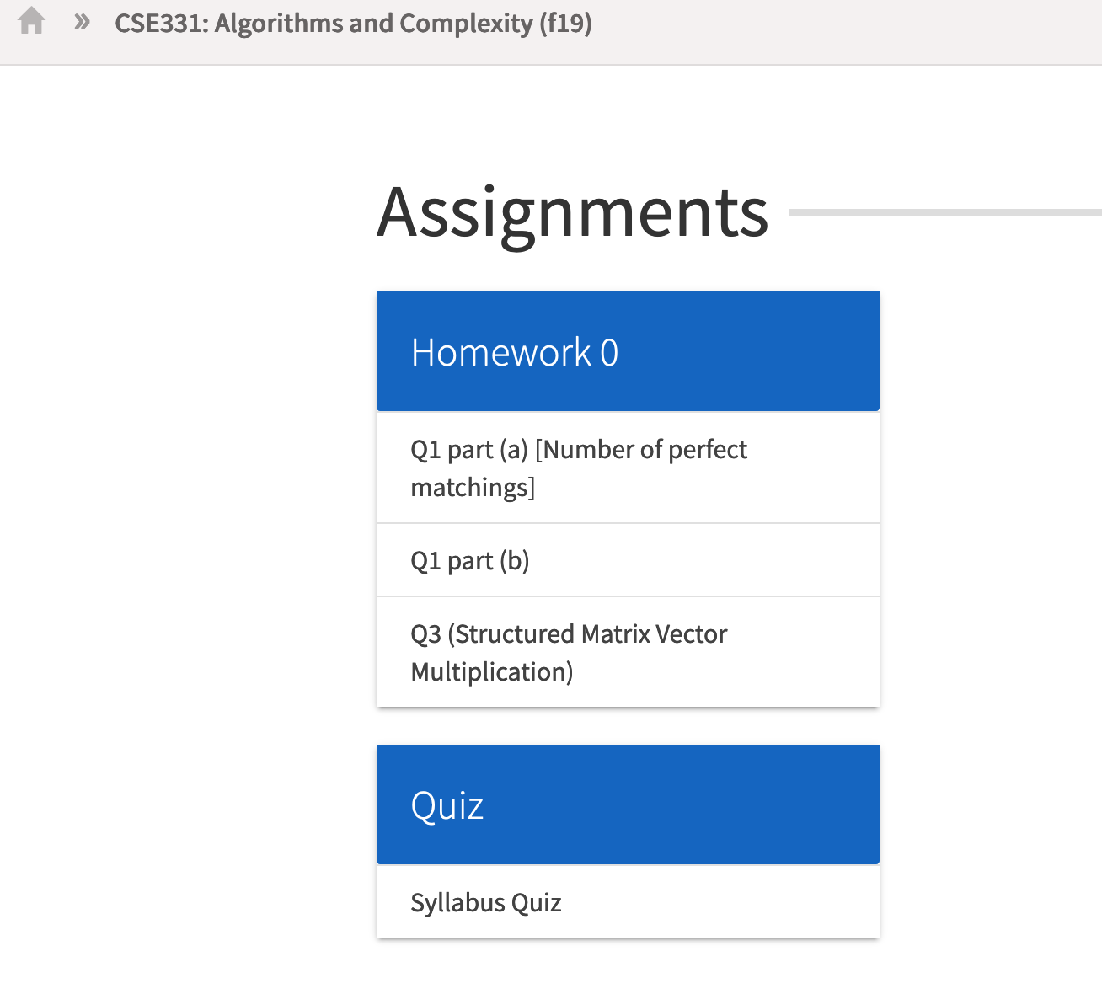
You can submit the following now
If you were registered by 9am on Monday, Aug 19 you should be on Autolab

Slide 17
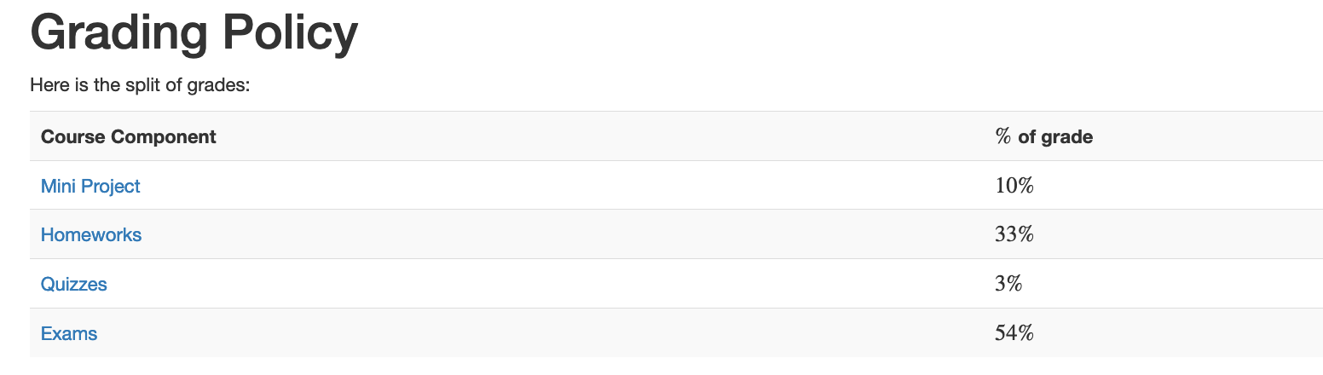
Grading break-down

Slide 18
Pre-requisites
Required (officially)
CSE 250, [CSE 191 or MTH 311] and MTH 142
At least a C-
Required (for practical purposes)
Comfort with proofs
Willingness to work hard!

Slide 19
Accessibility Resources
Information included in the syllabus
In short, let me know and consult with Accessibility Resources

Slide 20
Preferred Name
If you prefer using name diff from UB records
Let me know and we’ll make a note of it.

Slide 21
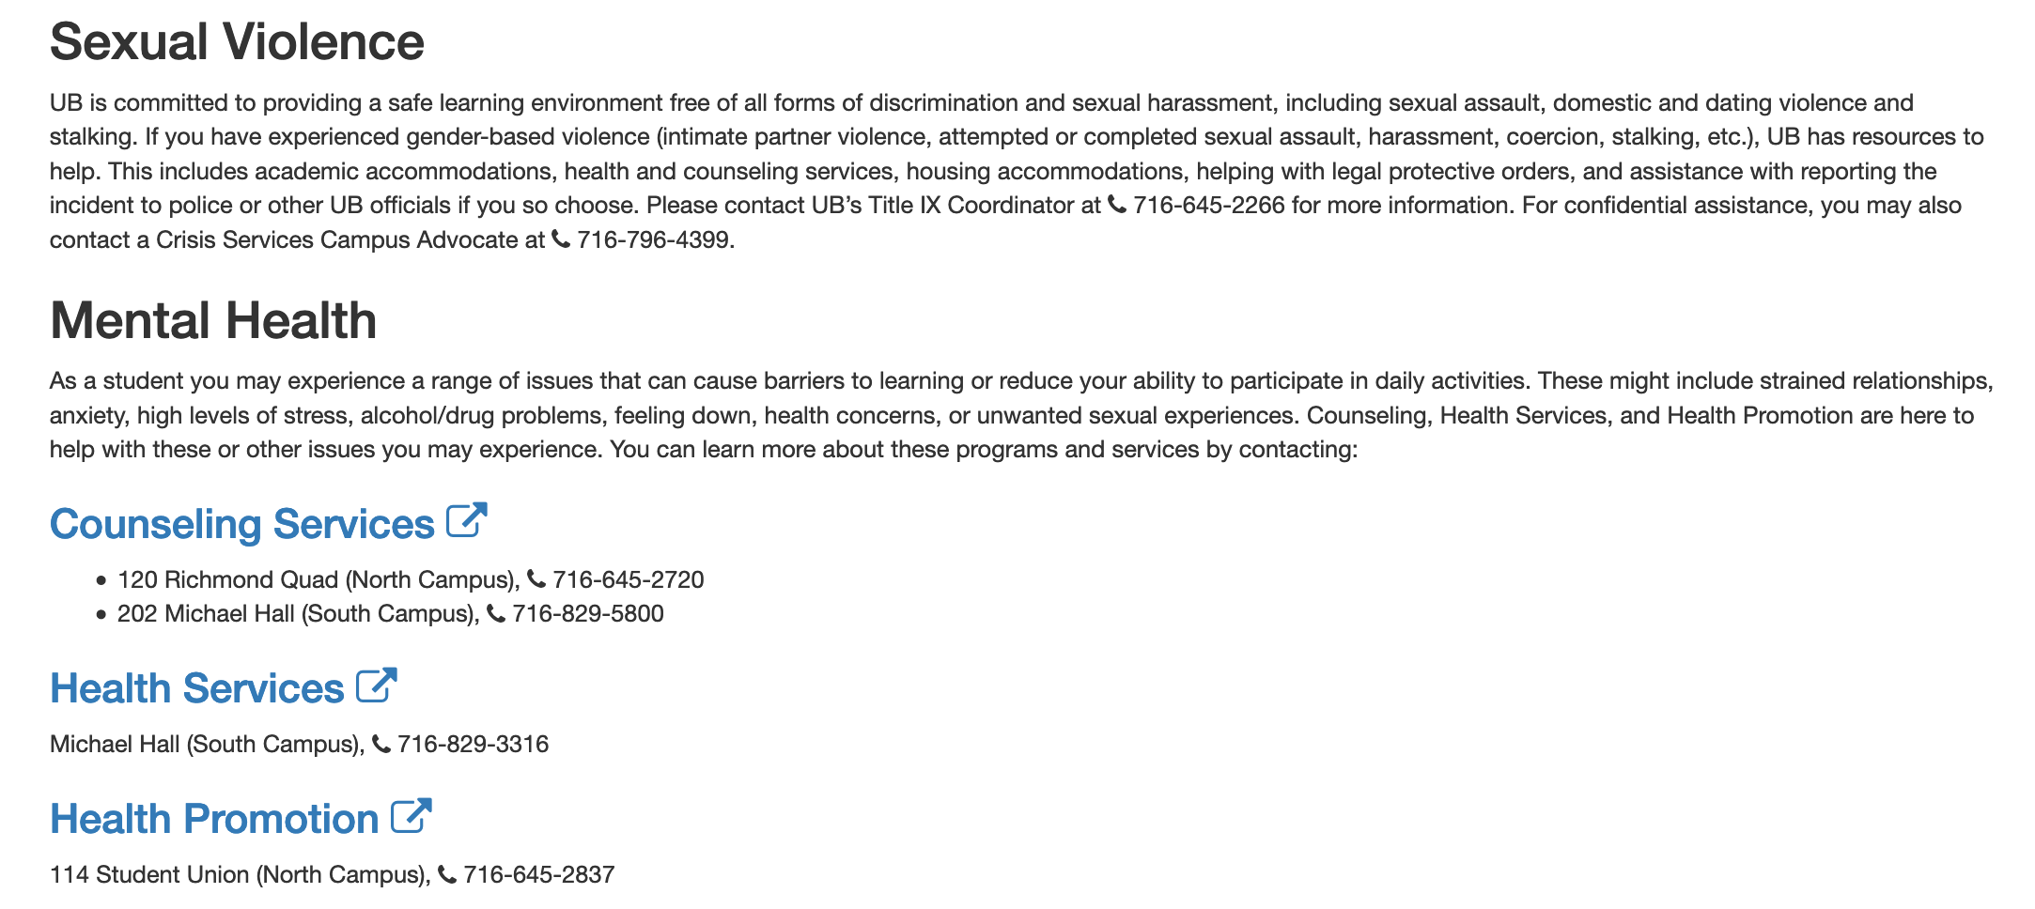
Critical Campus Resources

Slide 22
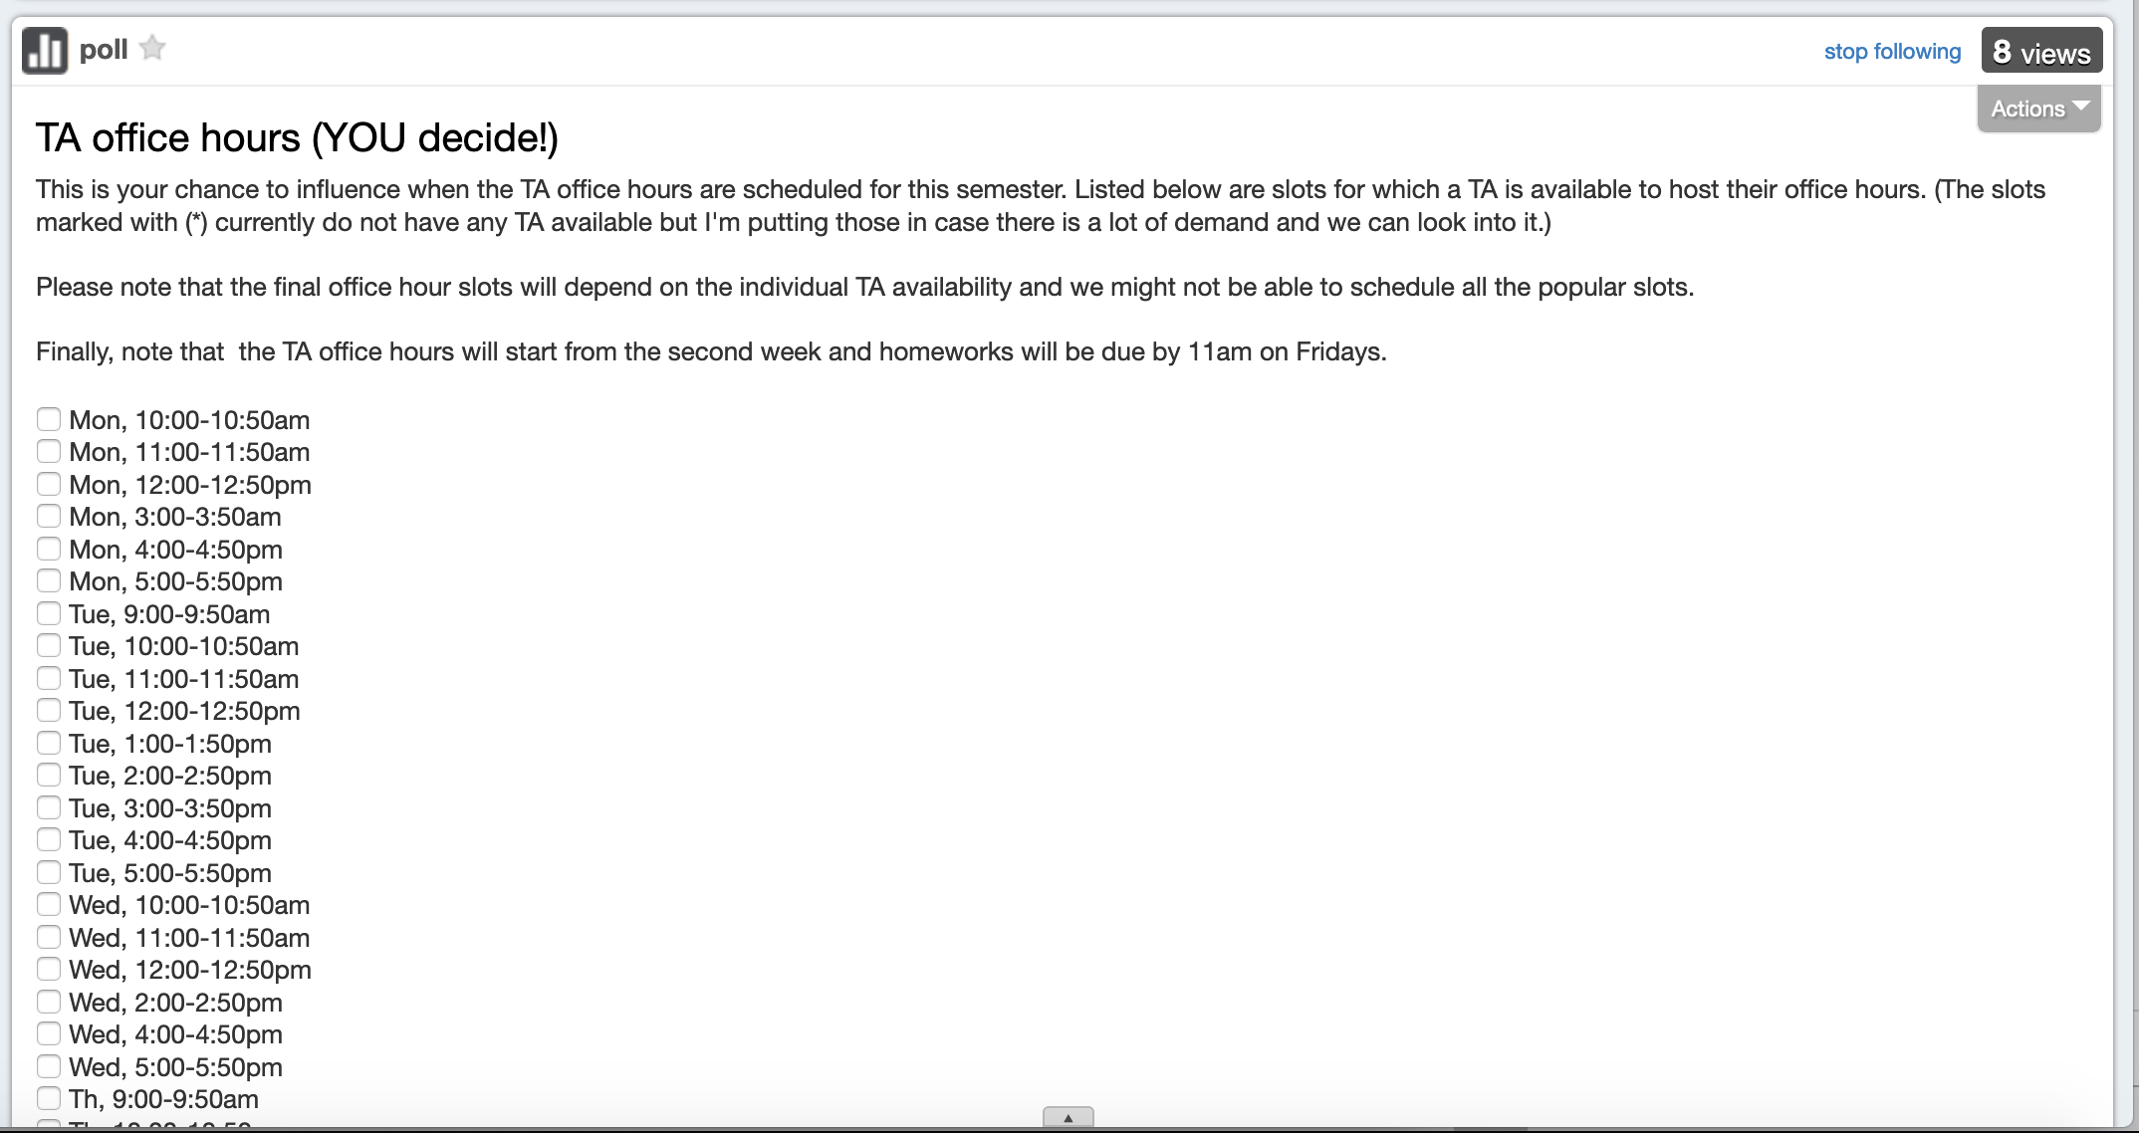
TA Office hours
YOU decide!

Slide 23
Recitations
Are on for this week!
RECITATIONS

Slide 24
Please stick to your recitation section
At least for the first month since all sections are full

Slide 25
Exams
Mid term (two parts)
Mon, Oct 14 and Wed, Oct 16, 2019. Usual place and time.
Final exam
Fri, Dec 13, 2018. Norton 112, 12:00-2:30pm

Slide 26
Things new to HWs in Fall 19
The dreaded Q3 is no more!
It survives as Q2 ☺
Q1 worth 50 points
The hard proof based Q2 and programming Q3 worth 25 points each
HWs due by 11:00am on Fridays

Slide 27
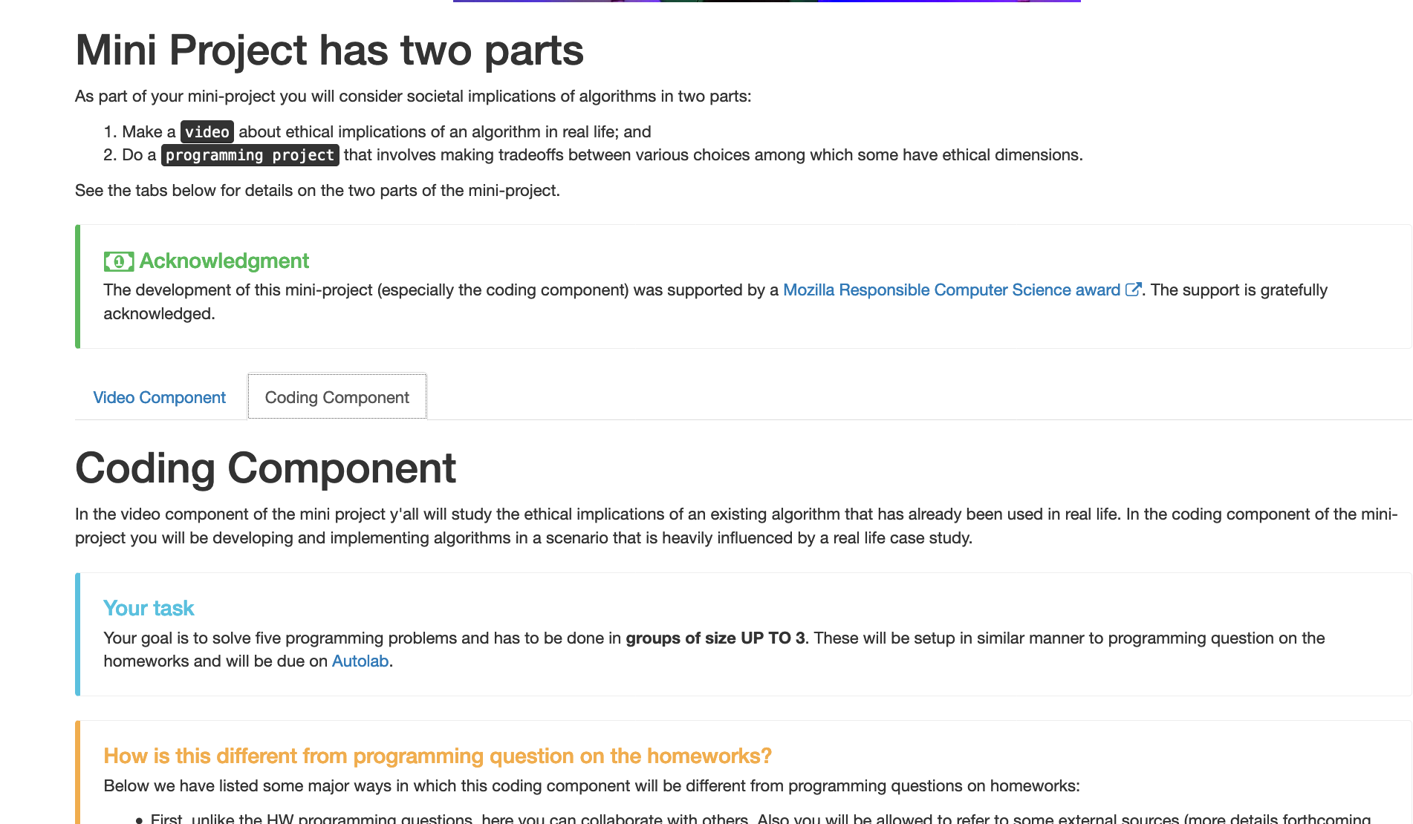

Other big change in Fall 18

Slide 28
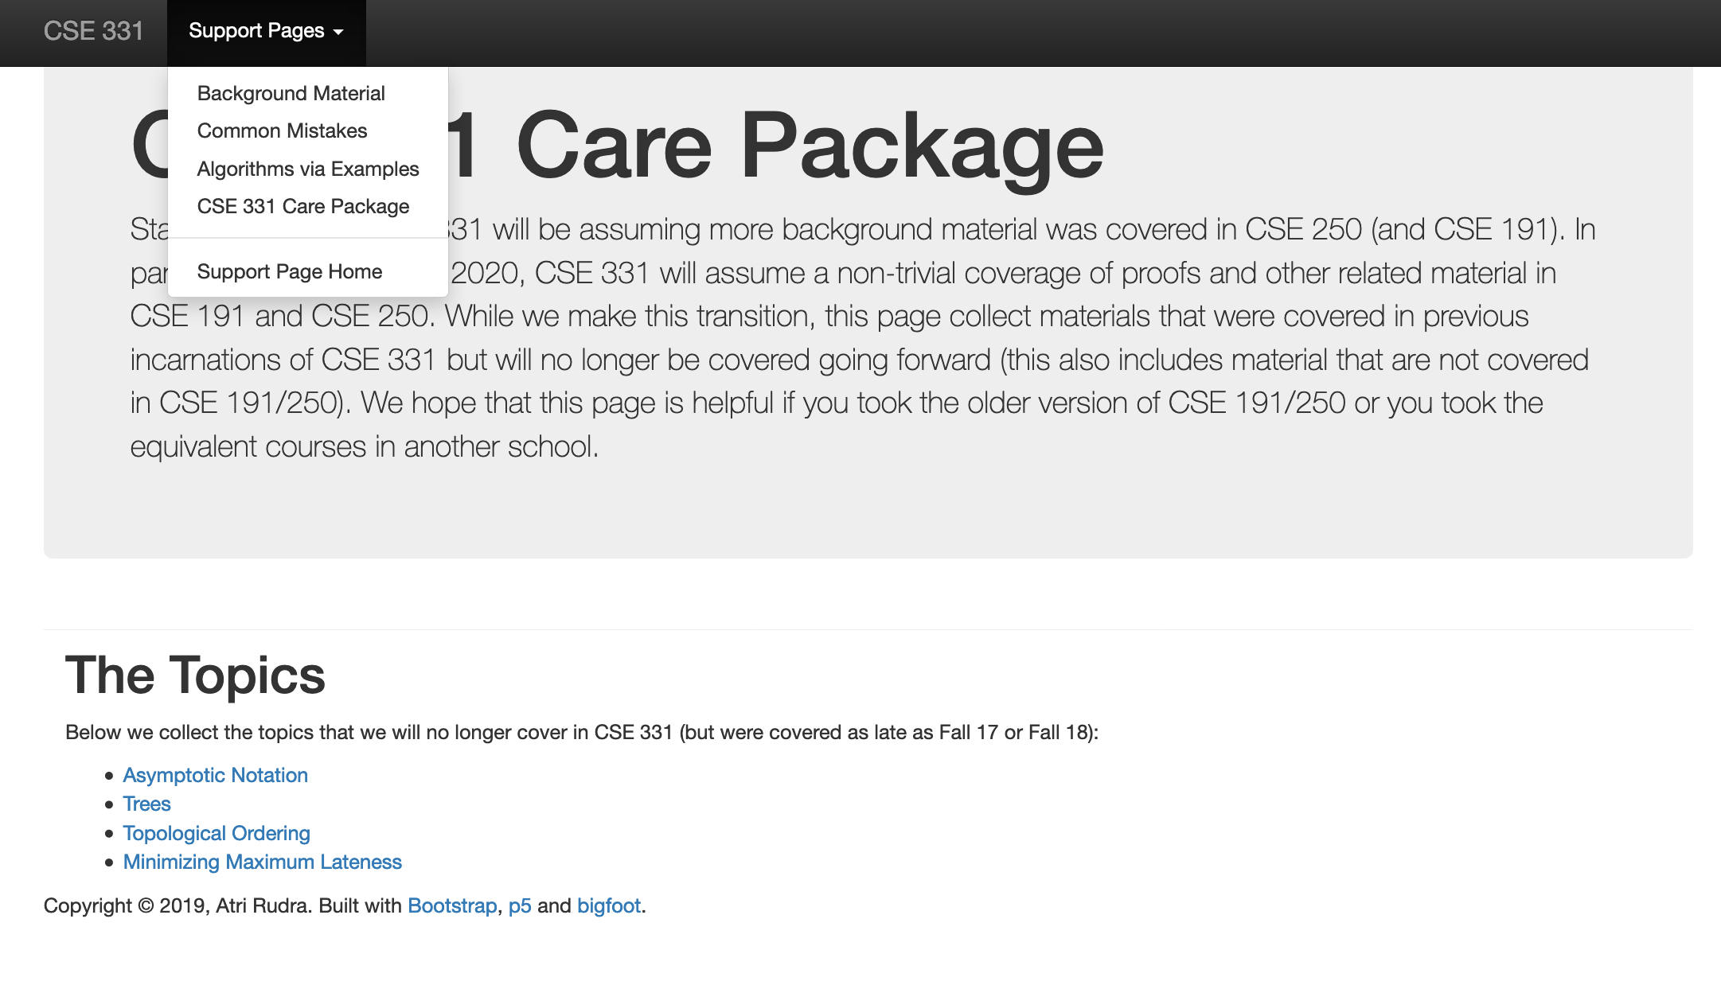
Topic Coverage will change

Slide 29
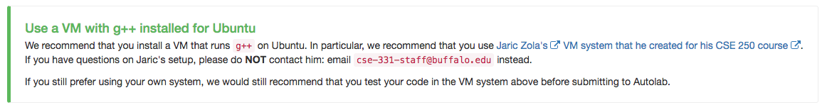
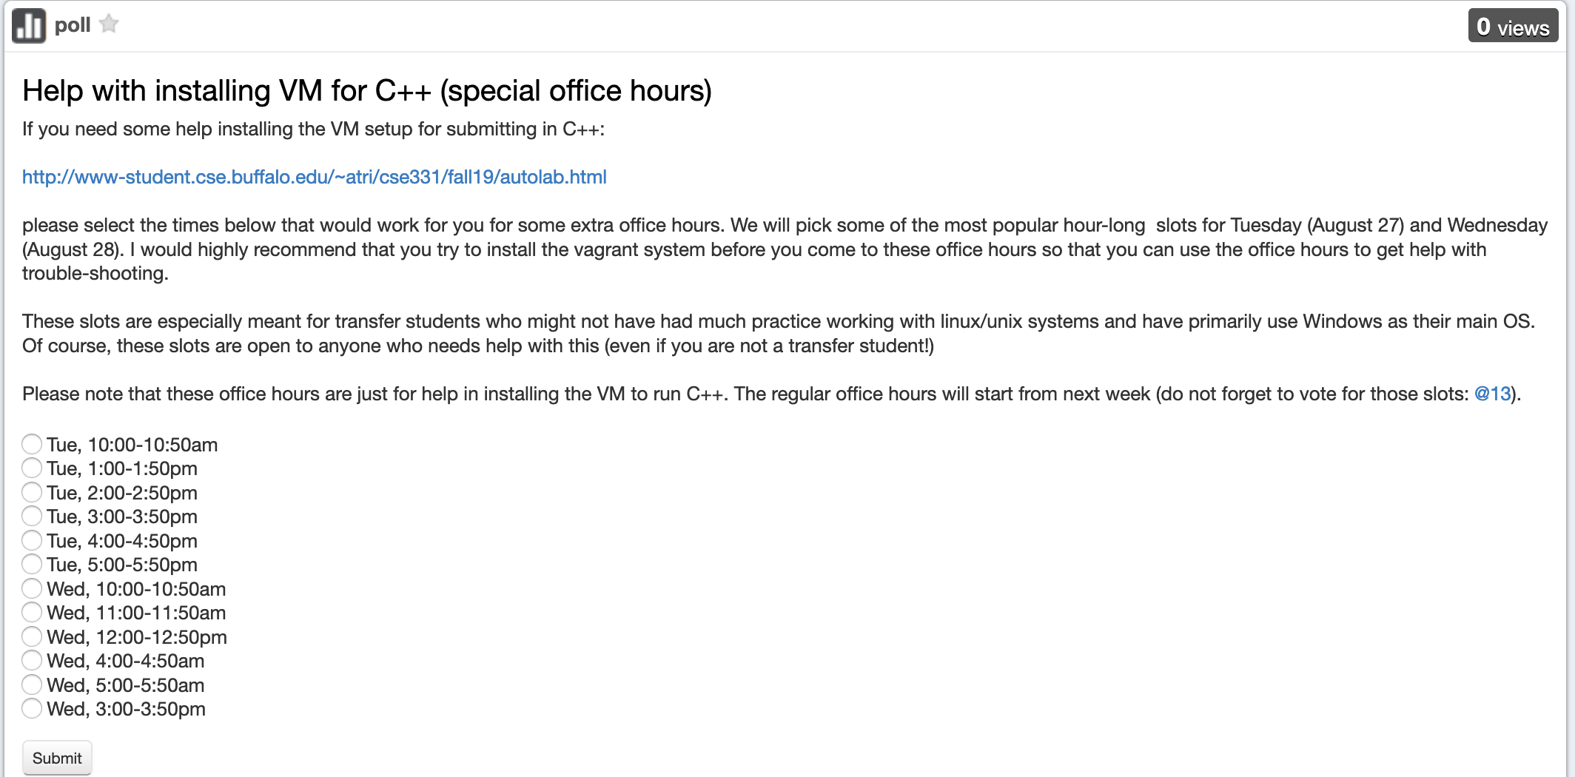
C++ vs Java/Python
Use Java/Python if as you just as comfortable with as C++

Slide 30
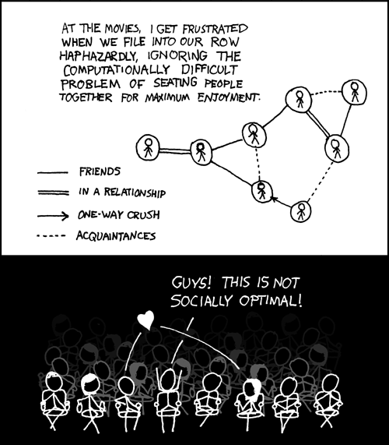
This course: how to solve problems!
http://xkcd.com/173/

Slide 31
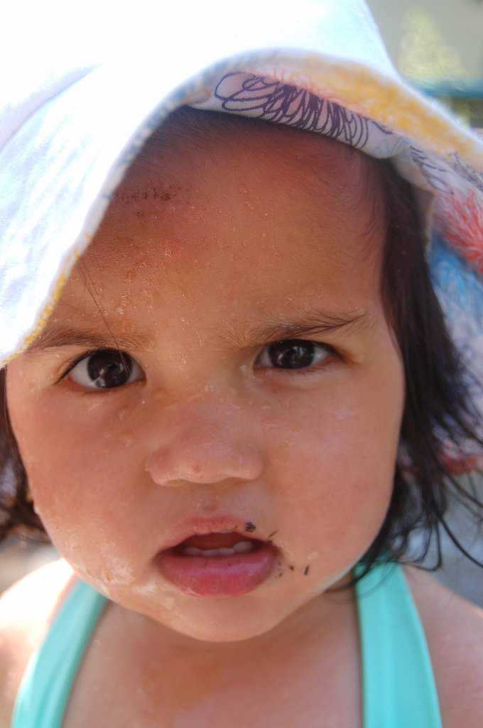
Why should I care ?

Slide 32

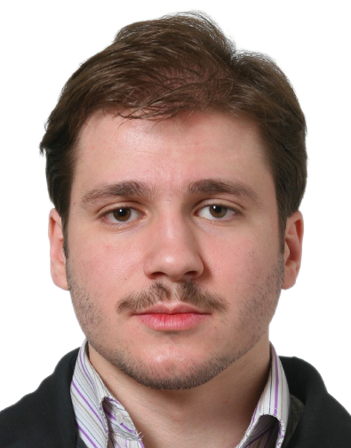
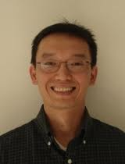
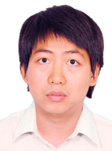
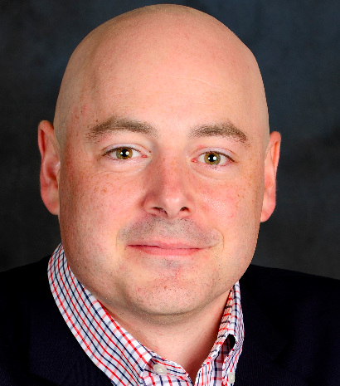


Combining Shadows to Understanding the network

Slide 33
The key technical problem
Given the three projections, what is the largest size of the original set of points?

Slide 34
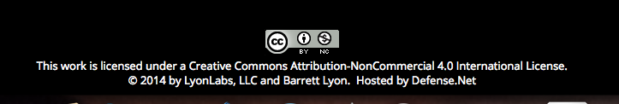
Detecting Communities

Slide 35
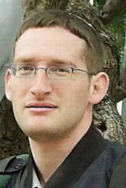
Conquering Shadows to Conquering the Internet
Algorithmically compute the missing set

Slide 36




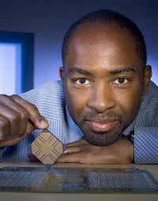
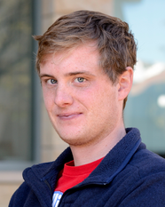
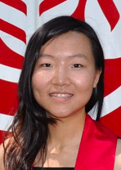

The proof is in the performance
>
10x faster
Better algorithm with little hacking will beat a worse algorithm with tons of hacking

Slide 37
The key technical problem
Highly trivial: 4³ = 64
Still trivial: 4² = 16
Correct answer: 4^{1.5} = 8

Slide 38



If detecting communities is not for you

Slide 39
From someone who got a Google job
“You can let your algorithms class know that the phone interviews are essentially like a difficult algorithms test.
Lots of data structures, specifying the algorithm, analyzing the
run time and space requirements... And all on the phone and
you're supposed to talk through your thought process.”

Slide 40
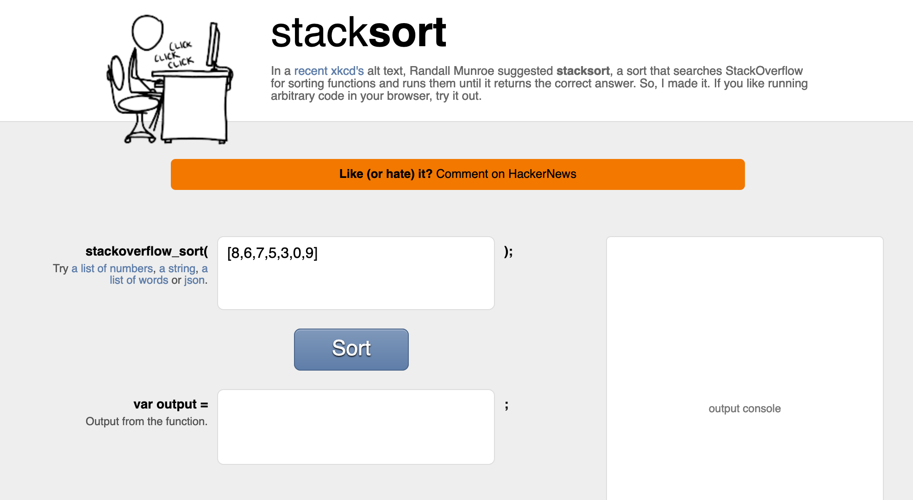
Coding jobs will be done by AI

Slide 41
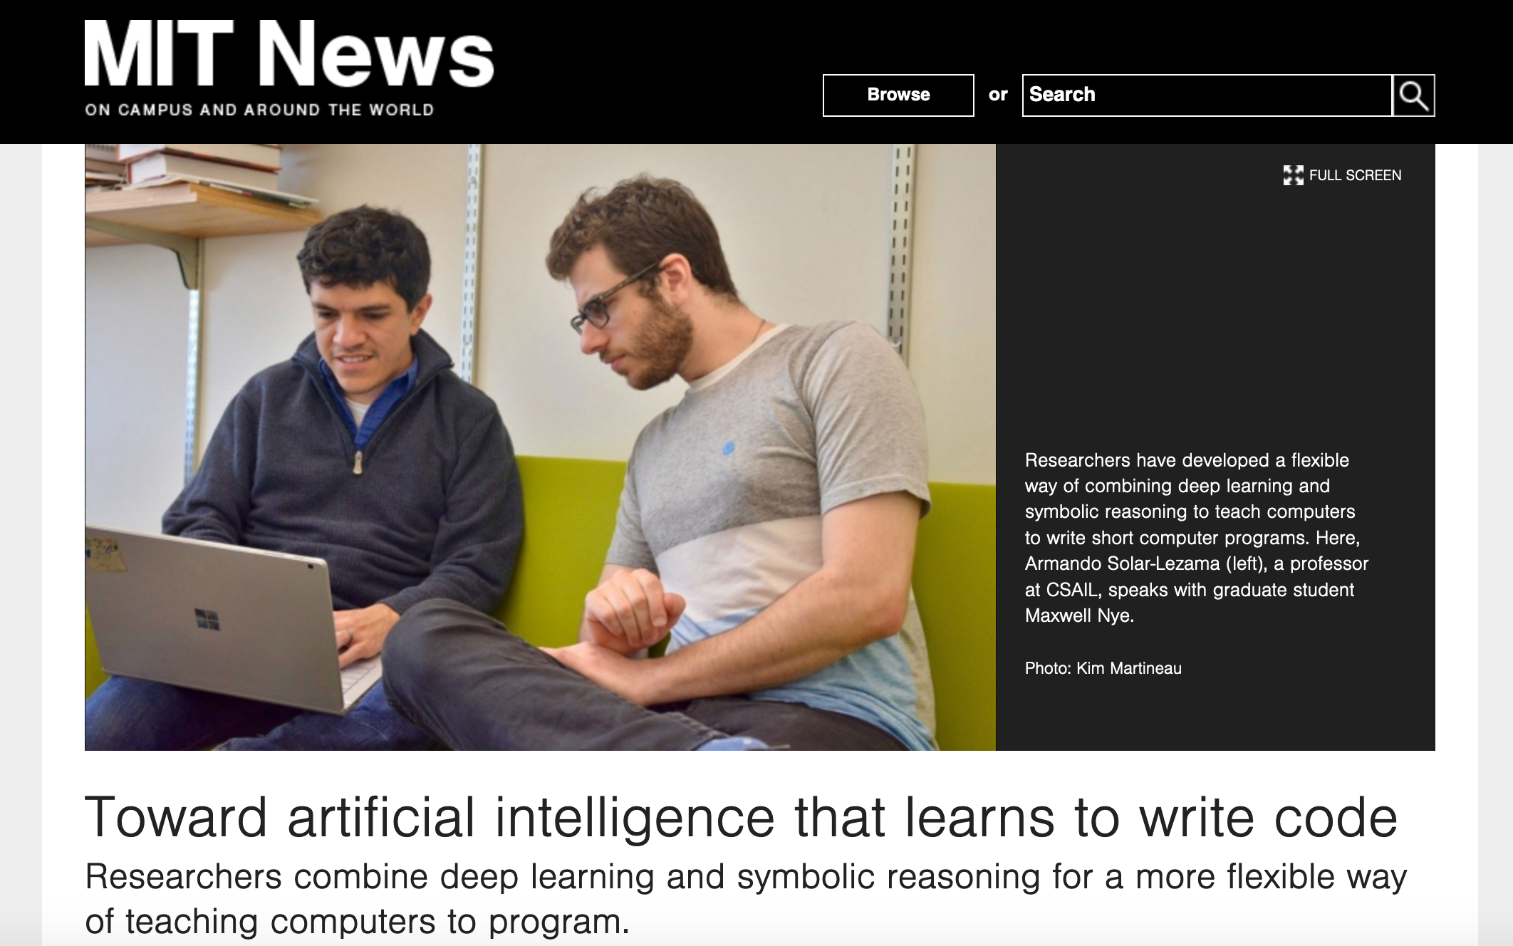
Coding jobs will be done by AI

Slide 42
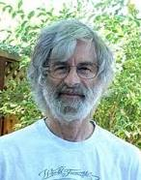

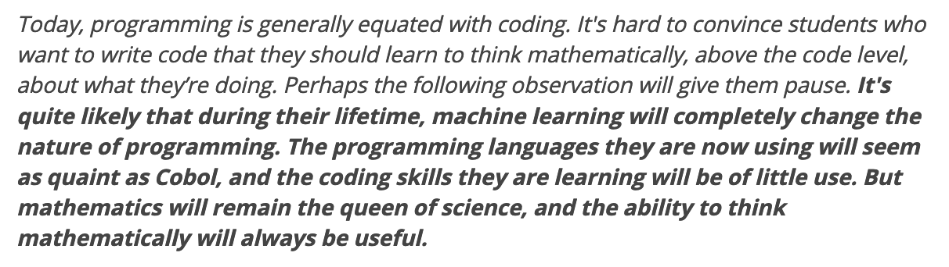
So am I doomed?
There will still be room for high level algorithmic thinking!

Slide 43
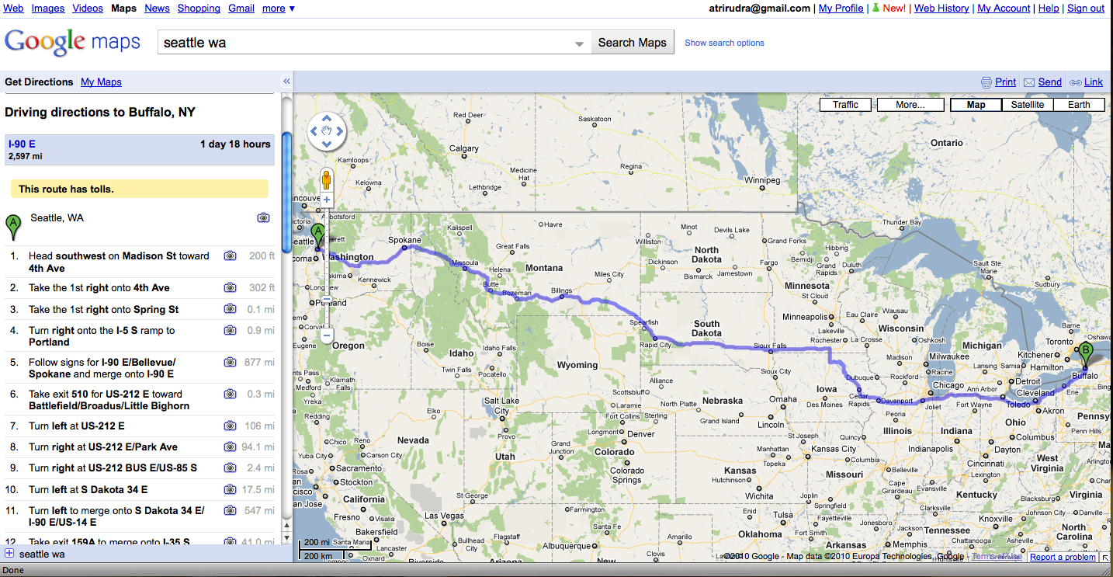
Why care about algorithms?
Driving directions

Slide 44
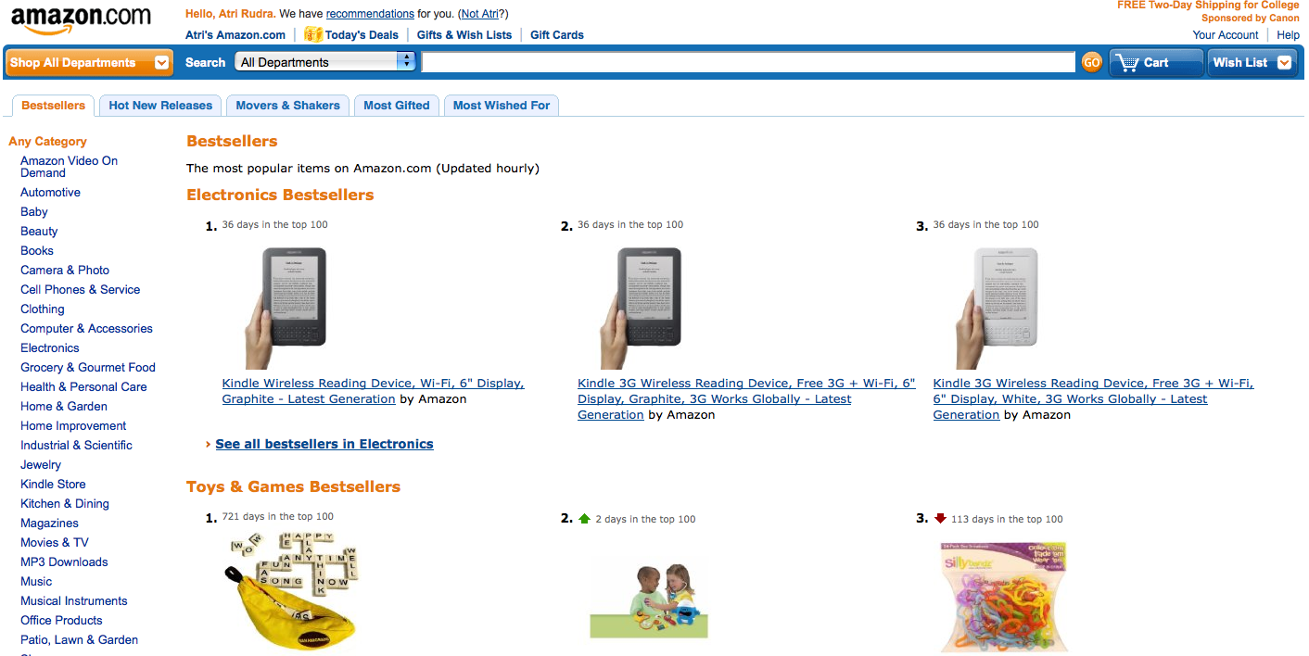
Why care about algorithms?
Computing Bestsellers on the fly

Slide 45
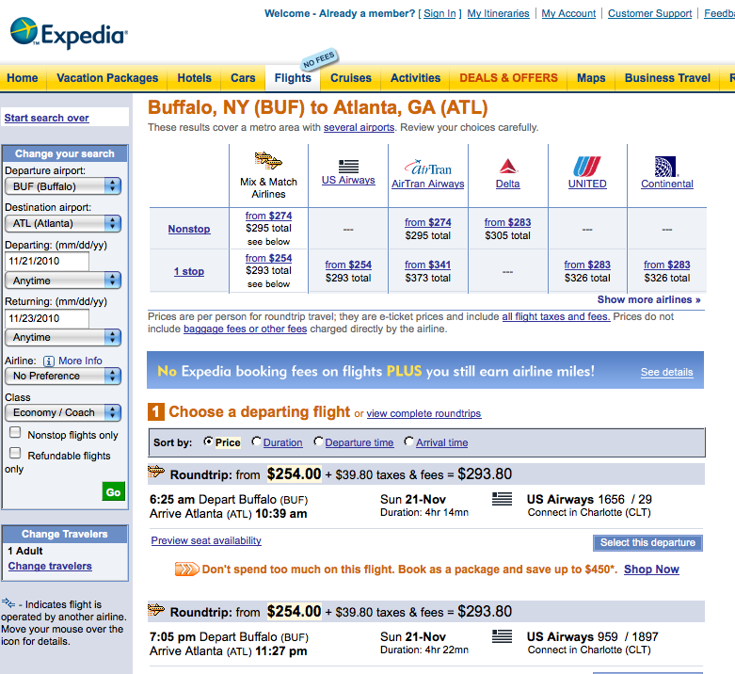
Why care about algorithms?
Booking cheapest air tickets

Slide 46
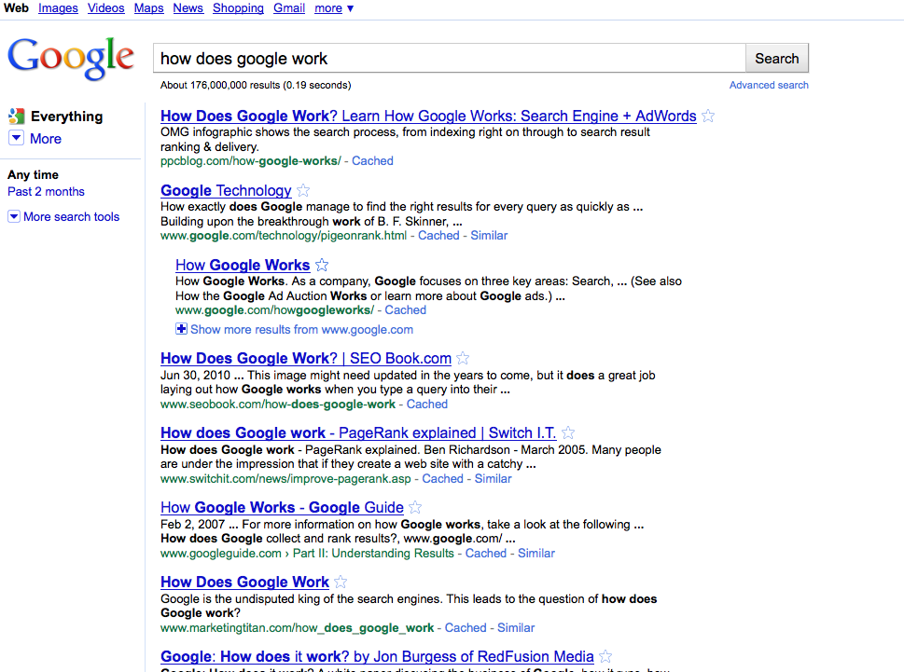
Why care about algorithms?
Google searches

Slide 47
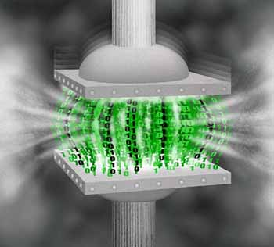
Why care about algorithms?
http://www.di.ens.fr/~cherniav/teaching.html
Data compression

Slide 48
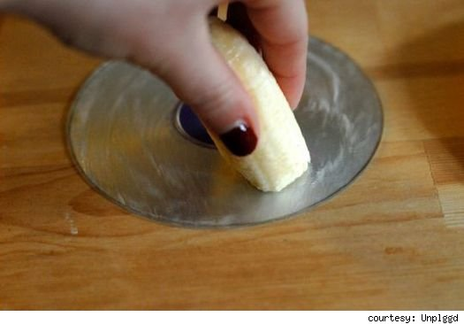
Why care about algorithms?
http://www.switched.com/2010/02/11/fix-dvd-scratches-using-a-banana-and-toothpaste/
Error correction

Slide 49

(And I could) go on…
http://www.movieposter.com/poster/MPW-33672/Titanic.html

Slide 50
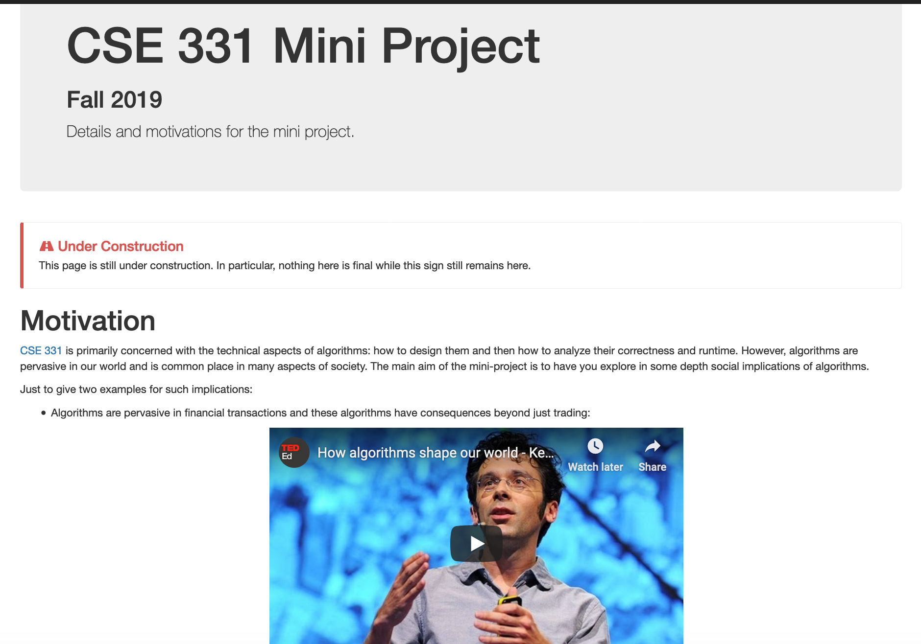
Find out for yourself
Mini project: Video on ethical impacts of algorithm. Groups of size = 3

Slide 51
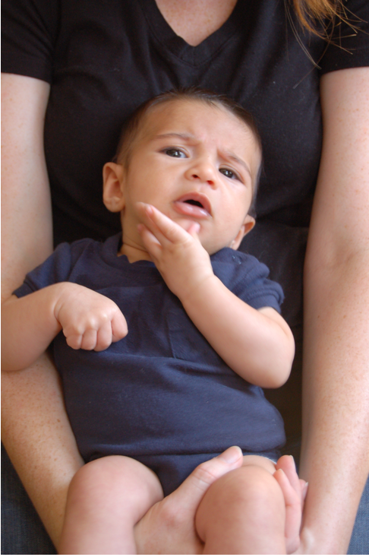
Questions/Comments?

Slide 52

Now about the course
IT’LL BE

Slide 53

We’ll do loads of
s
http://www.impawards.com/2005/proof.html
Writing down your thought process formally and precisely!

Slide 54

An incorrect “proof”

Slide 55


A more subtle incorrect “proof”
Brad Pitt had a beard
waleg.com
Every goat has a beard
animaldiversity.org
Hence, Brad Pitt is a goat.

Slide 56
Why do proofs?
Makes you think logically about problems and solutions
From a friend who works on Google Maps:
Proving that the algorithm I am implementing is correct helps me
identify corner cases

Slide 57

http://www-student.cse.buffalo.edu/~atri/cse331/support/proofs/index.html

Slide 58
A common complaint
Your examples in class look nothing
like HW questions.

Slide 59

True because….
zazzle.com

Slide 60
False because…
HWs and exams will test your
understanding of the material

Slide 61
To get an A in the class
Have to get at least 90.0000000000000000000000%
Rest graded on the curve

Slide 62

A cautionary tale…
When I was an undergrad
Took algorithms as a sophomore
Understood all the lectures
Did not study outside of lectures
(We had no homeworks)
Did decent on the mid-term
Nearly flunked the finals
Got a C

Slide 63
Questions/Comments?

Slide 64

How we will make 331
RIDING

Slide 65
What we’ll strive to do
Help you with your questions and/or doubts
If need be, email us for time outside of regular office hours

Slide 66

We’re not mind readers

Slide 67

If you need it, ask for help

Slide 68
More chances to recover
Lowest three HW scores will be dropped
If you do better on the final exam than the mid-term exam
then only final exam score will count

Slide 69
Follow the Textbook

Slide 70

http://www-student.cse.buffalo.edu/~atri/cse331/support/index.html

Slide 71

The cautionary tale has asilver lining…
Ph.D. in algorithms/complexity
C in undergrad algorithms

Slide 72

The only way to do well is to work hard

