Slide 1

Welcome
to
CSE 331

Slide 2
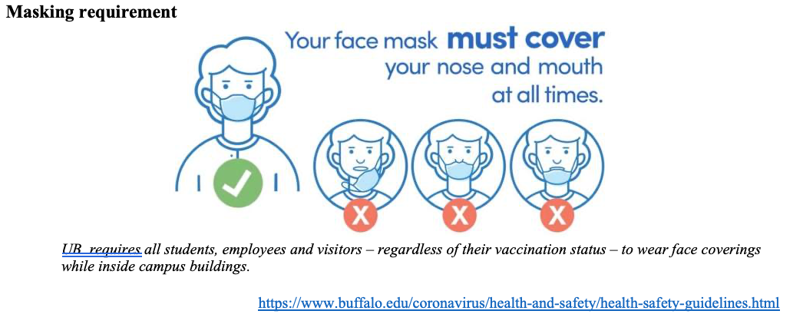
Please have a face mask on

Slide 3
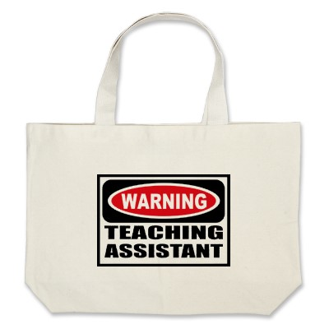
Let’s do some introductions
http://www.zazzle.com/warning_teaching_assistant_bag-149882665435161818

Slide 4
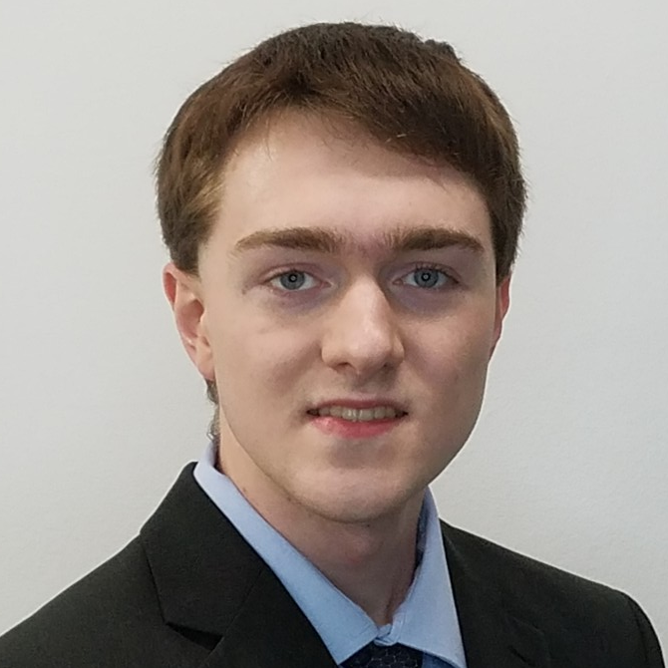
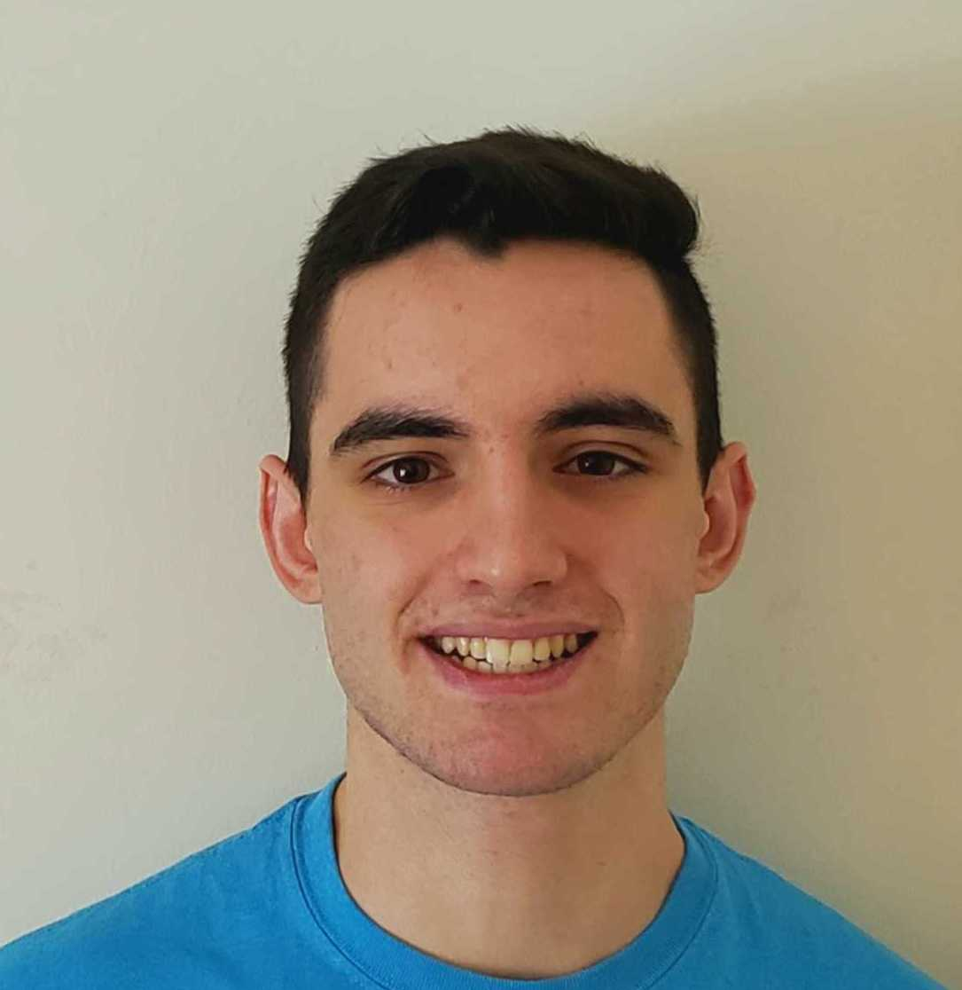

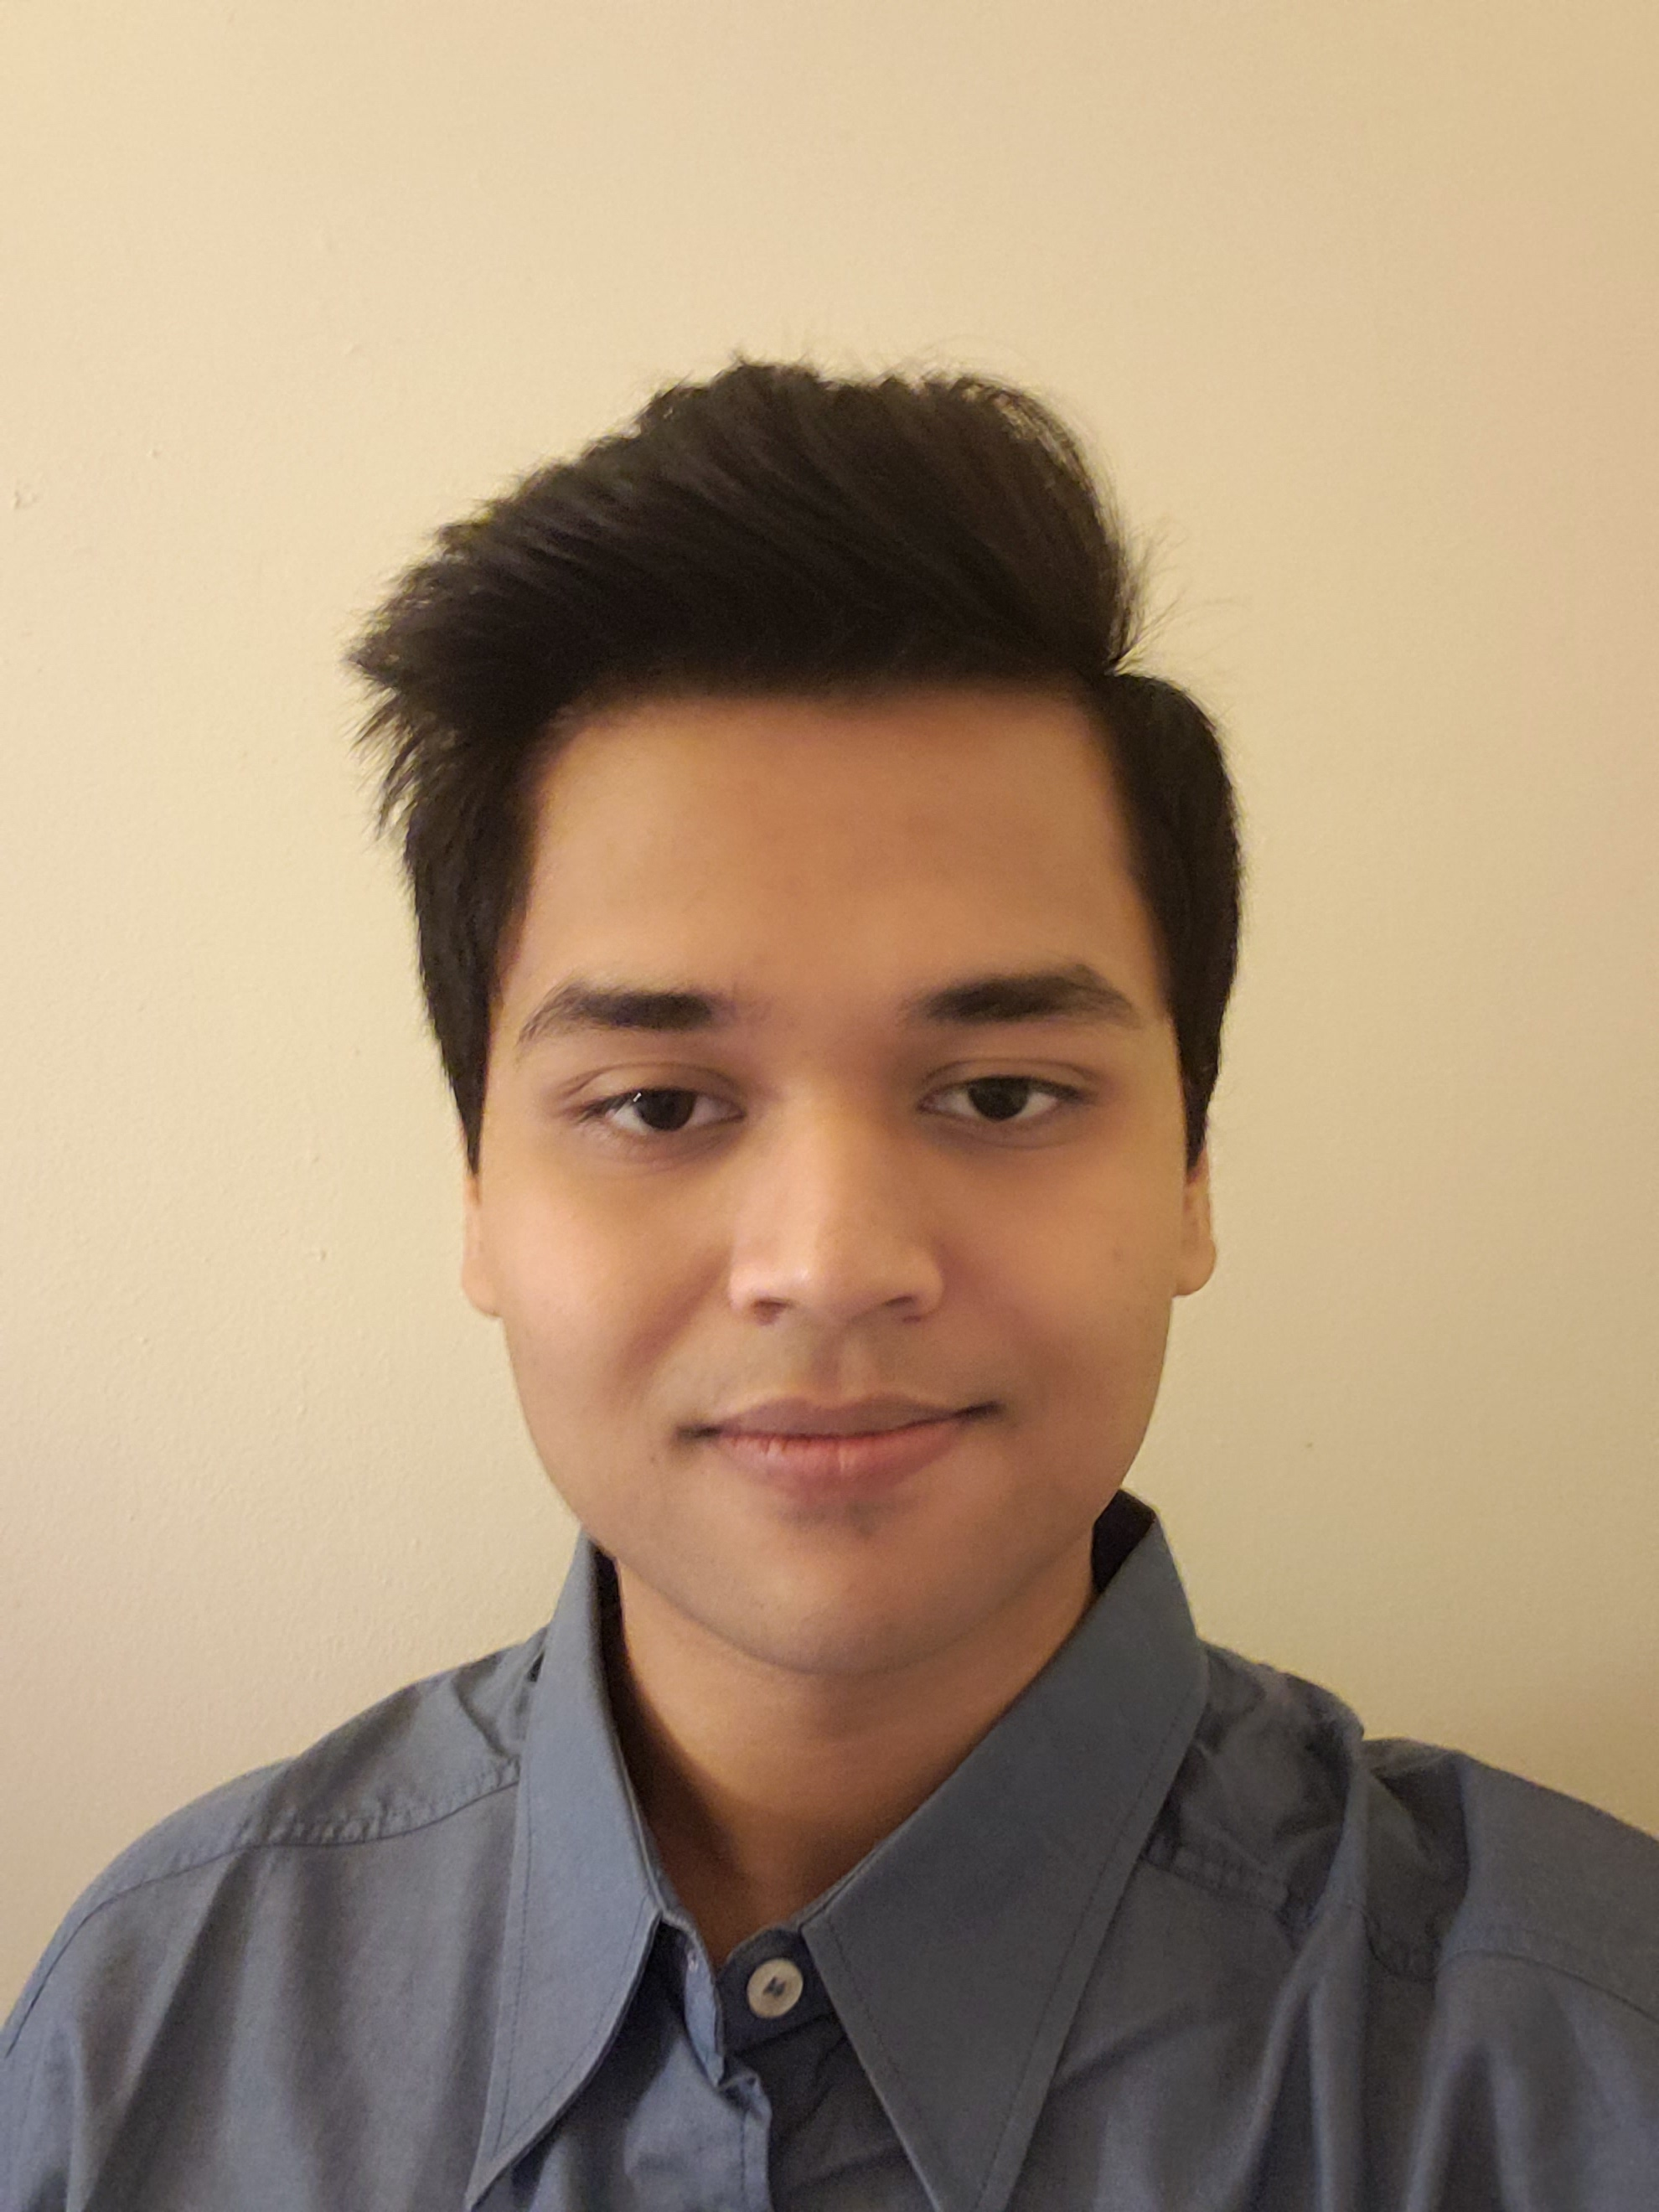

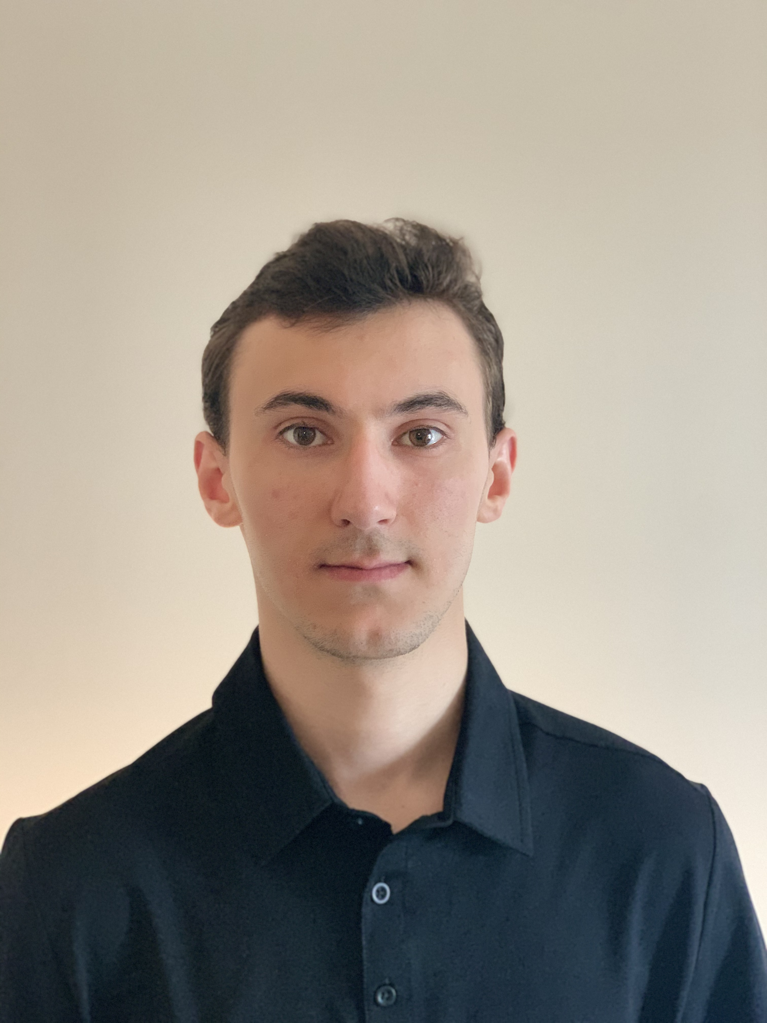


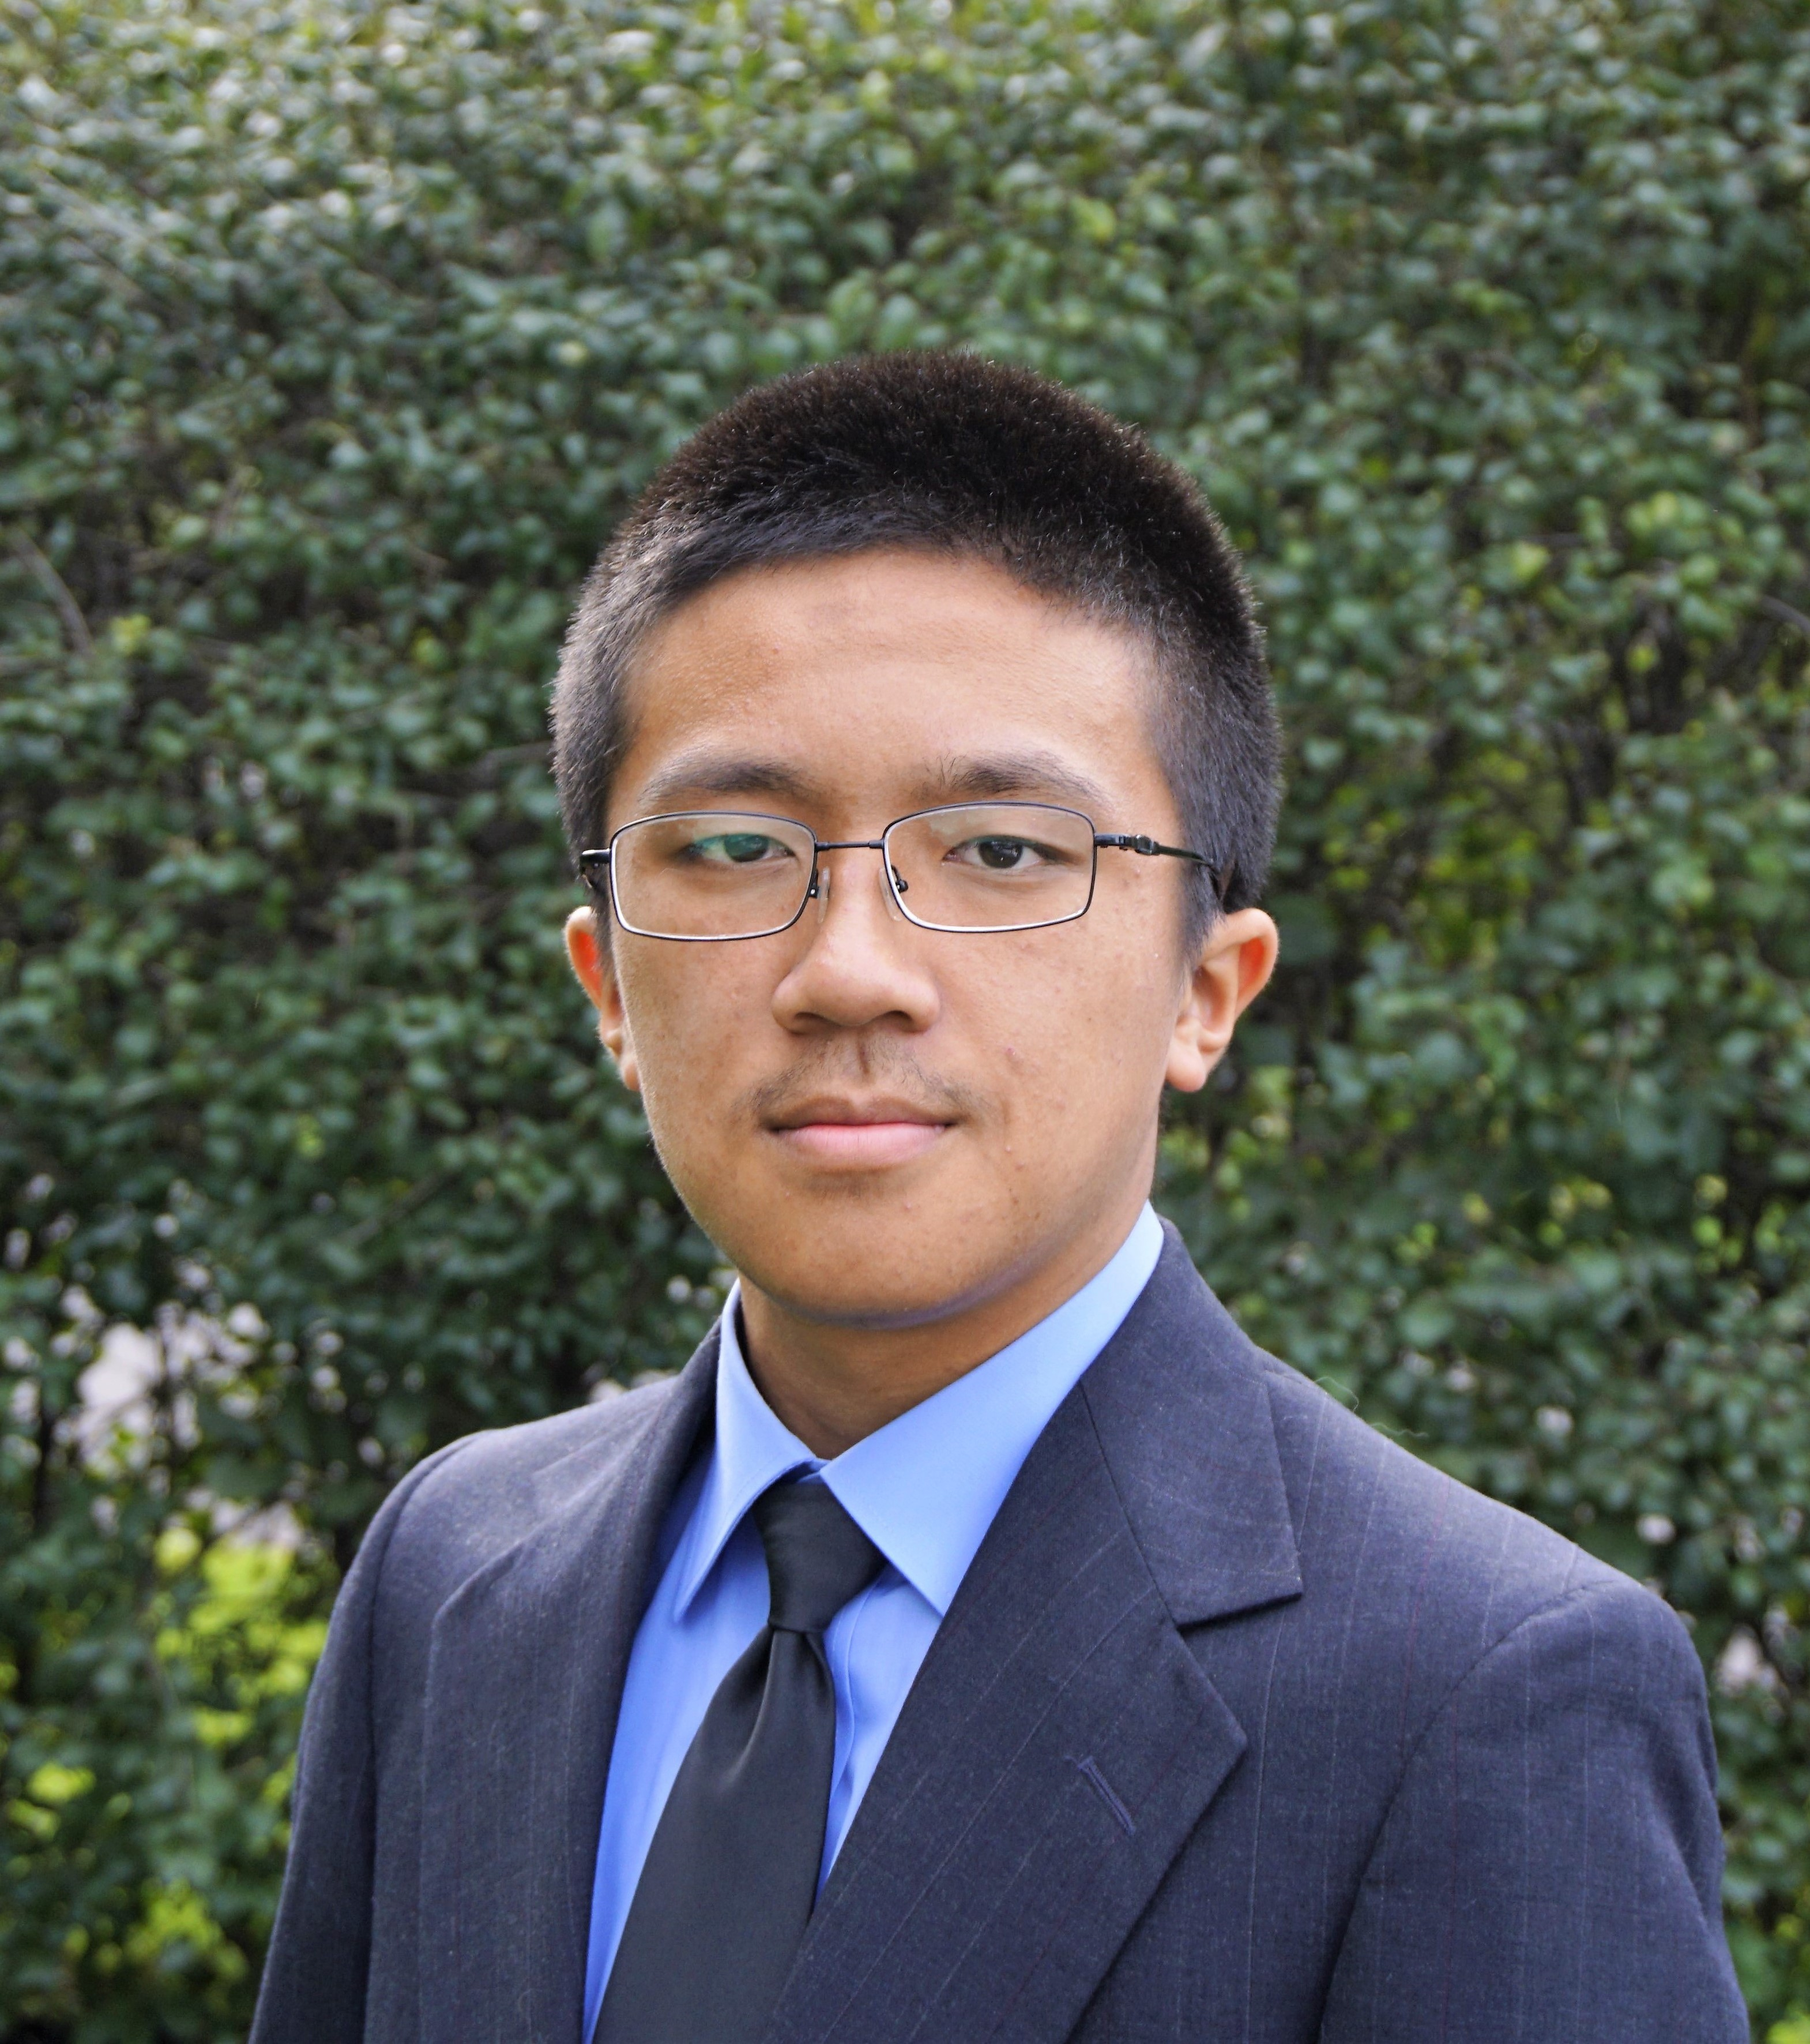
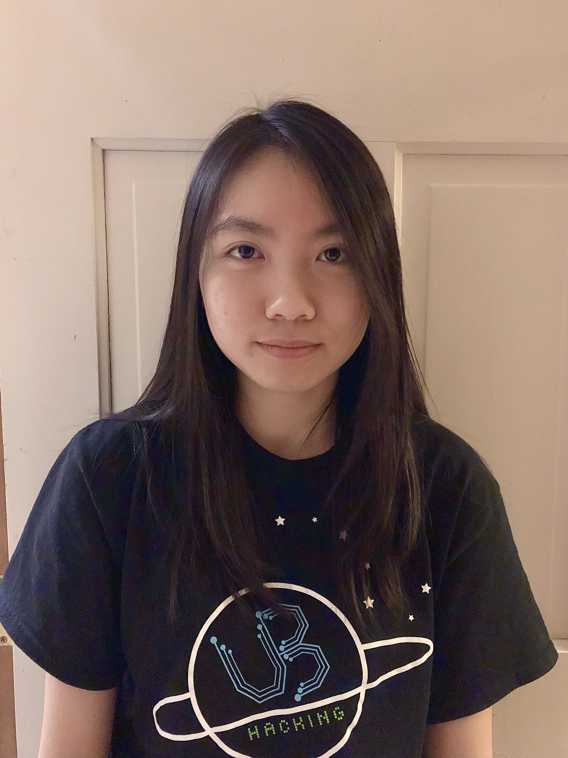
TAs first
Robert
Nitya
Alex
Asif
Snigdha
Ben
Aman
Connor
Joseph
Megan

Slide 5

Lectures will be videotaped
http://www.imdb.com/title/tt0363510/mediaviewer/rm2499681792

Slide 6
About Me
Atri Rudra
atri@buffalo.edu
Office: See piazza for location
Office hours: Mon 4:30-5:20pm; Fri, 1:00-1:50pm
OH starts today

Slide 7
Contact us all at
Or use piazza!
cse-331-staff@buffalo.edu
TAs will not respond to individual emails (except for re-grading requests)

Slide 8
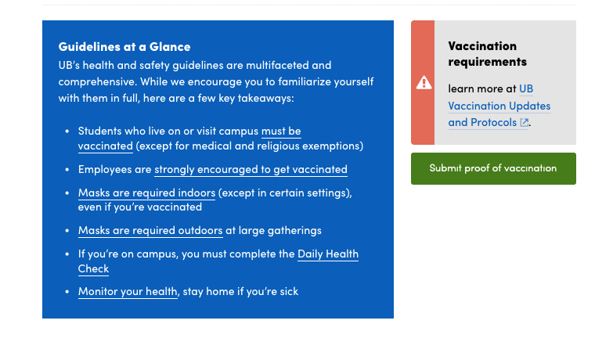
COVID-19 makes it non-ideal

Slide 9
CSE 331 in times of COVID
Lectures and recitations will be in-person
Office hours will be a mix of in-person and virtual locations
Exams and Quizzes will be in-person

Slide 10
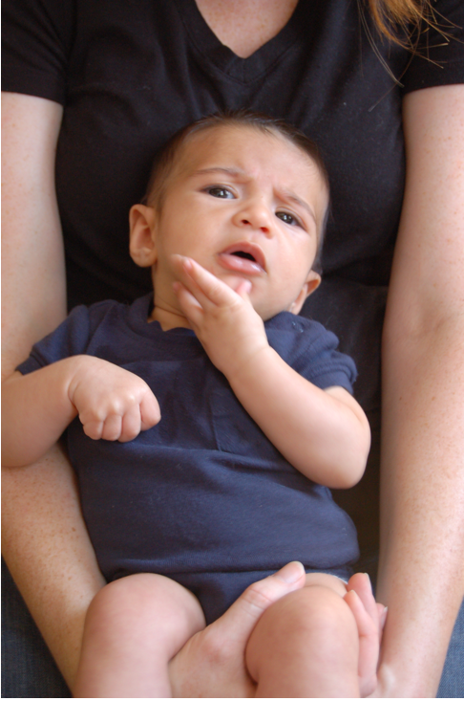
Questions/Comments?

Slide 11
Handouts for today
Syllabus (online)
Homework Policy document (online)

Slide 12
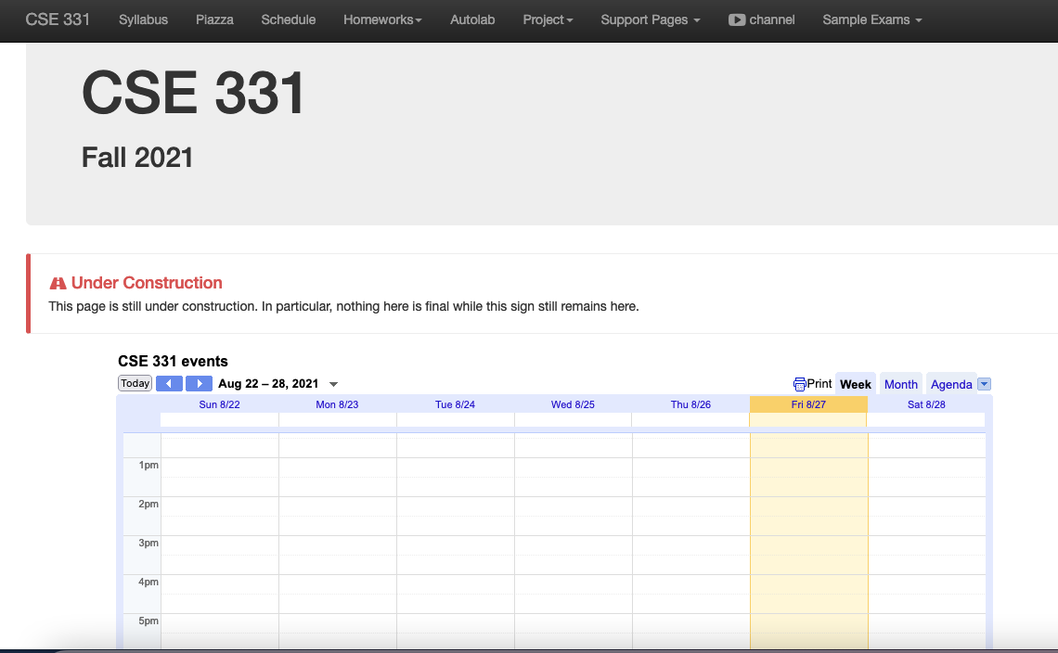
One Stop Shop for the Course
http://www-student.cse.buffalo.edu/~atri/cse331/fall21/index.html

Slide 13
Three things to remember
WORK HARD!
DO NOT CHEAT!
READ CAREFULLY!

Slide 14
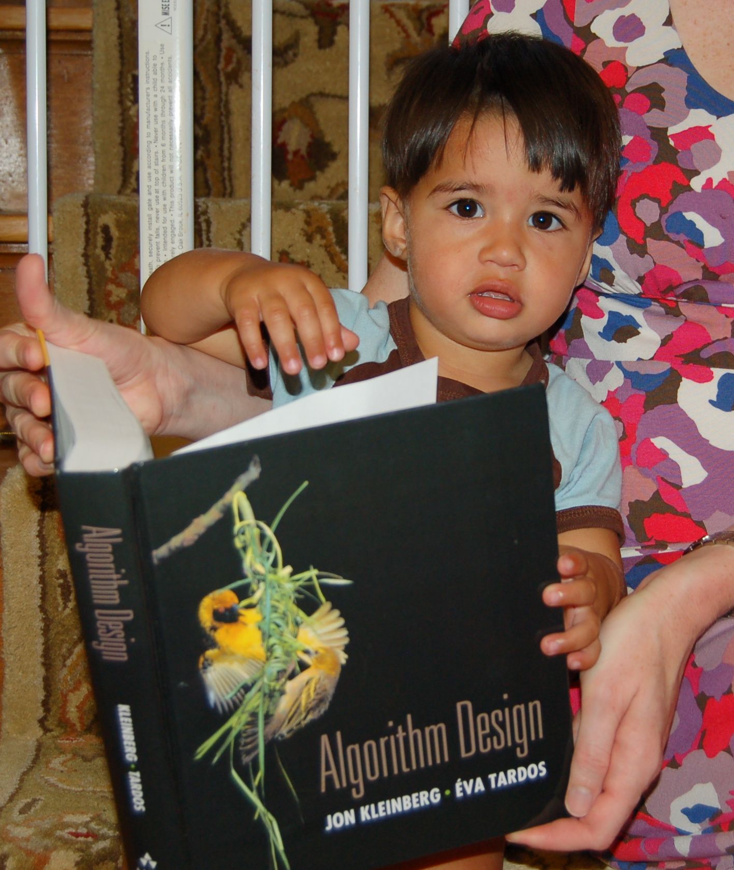
Wait.. What???
Make sure you follow submission
instructions
Two most common ways of losing points
Make sure you read problem
statements carefully

Slide 15
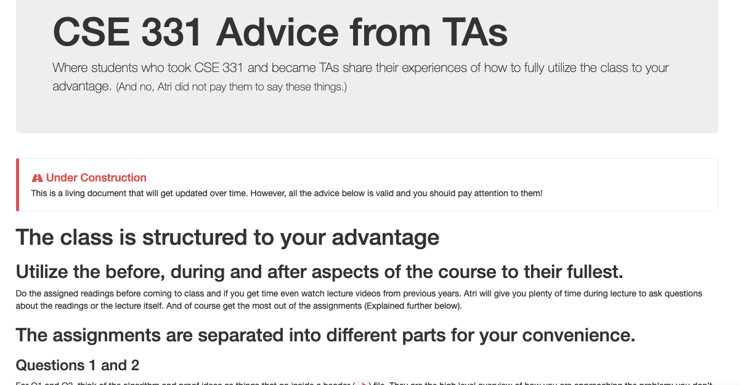
Advice from 331 TAs
http://www-student.cse.buffalo.edu/~atri/cse331/support/advice/index.html

Slide 16
Academic Dishonesty
All your submissions must be your own work
Penalty:
Minimum: A grade reduction in course
Possible: F (or higher penalty) if warranted
YOUR responsibility to know what is cheating, plagiarism etc.
If not sure, come talk to me
Excuses like “I have a job,” “This was OK earlier/in my country,” “This course is hard,” etc. WON’T WORK
I DO NOT HAVE ANY PATIENCE WITH ANY CHEATING :
YOU WILL GET A GRADE REDUCTION IN THE COURSE
FOR YOUR FIRST MISTAKE

Slide 17
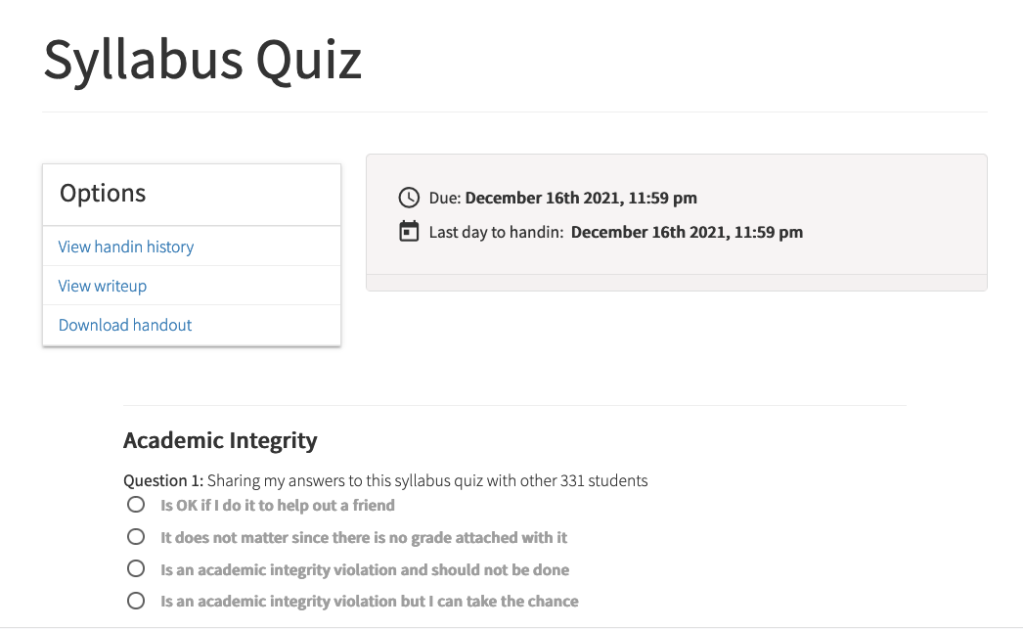
Read the syllabus CAREFULLY!
No graded material will be handed back till you pass the syllabus quiz!

Slide 18
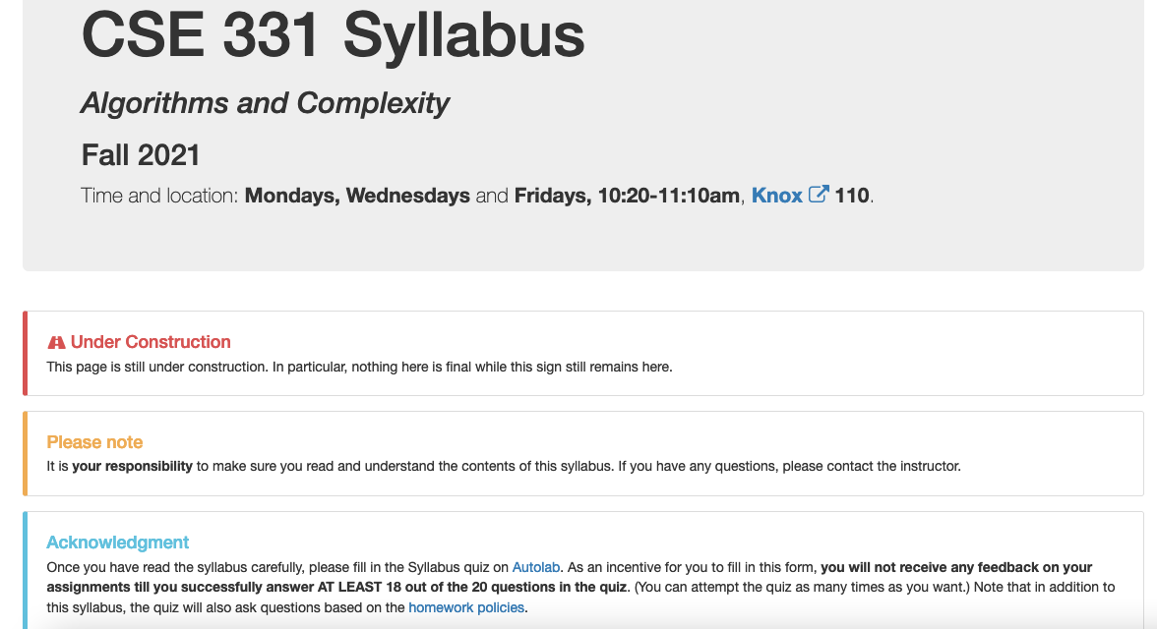
More information on the quiz

Slide 19
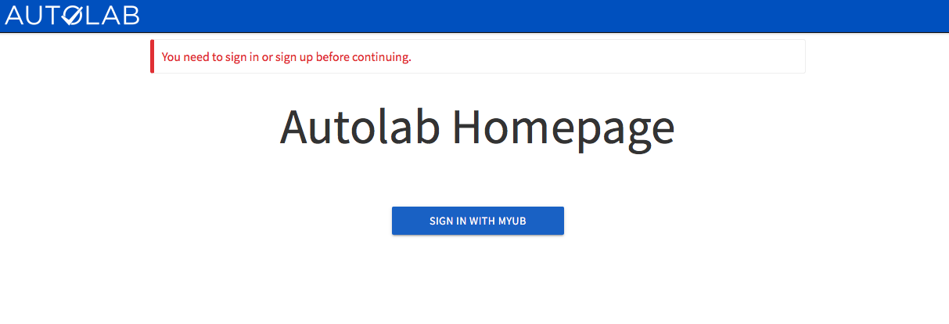
Autolab
https://autograder.cse.buffalo.edu/

Slide 20
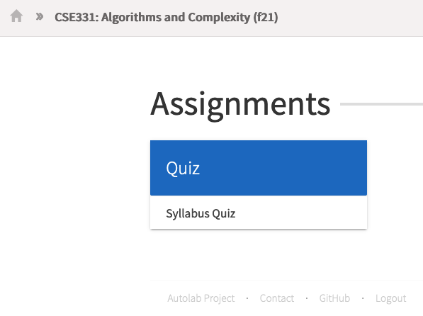
You can submit the following now
If you were registered by 9pm on Friday, Aug 27 you should be on Autolab

Slide 21
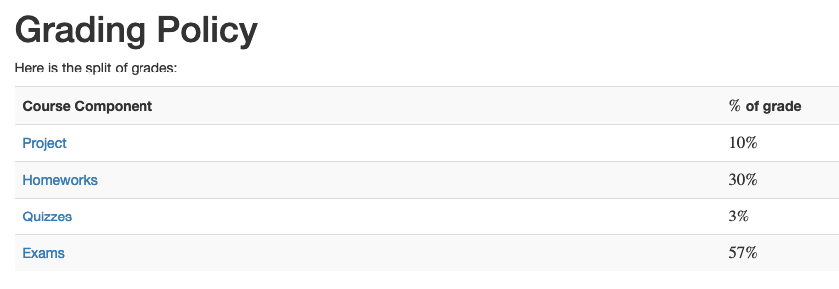
Grading break-down

Slide 22
Questions/Comments?

Slide 23
Pre-requisites
Required (officially)
CSE 250, [CSE 191 or MTH 311] and MTH 142
At least a C- (this is recommended)
Required (for practical purposes)
Comfort with proofs
Willingness to work hard!

Slide 24
Accessibility Resources
Information included in the syllabus
In short, let me know and consult with Accessibility Resources

Slide 25
Preferred Name
If you prefer using name diff from UB records
Let me know and we’ll make a note of it.

Slide 26

Critical Campus Resources

Slide 27
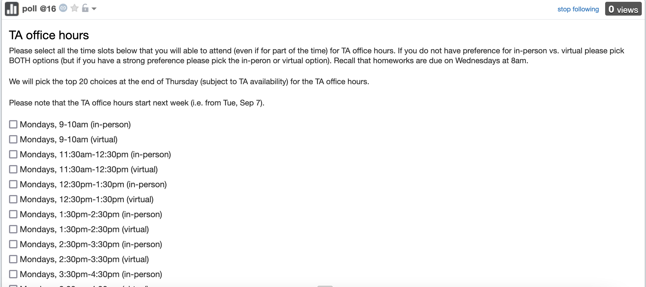
TA Office hours
YOU decide!

Slide 28
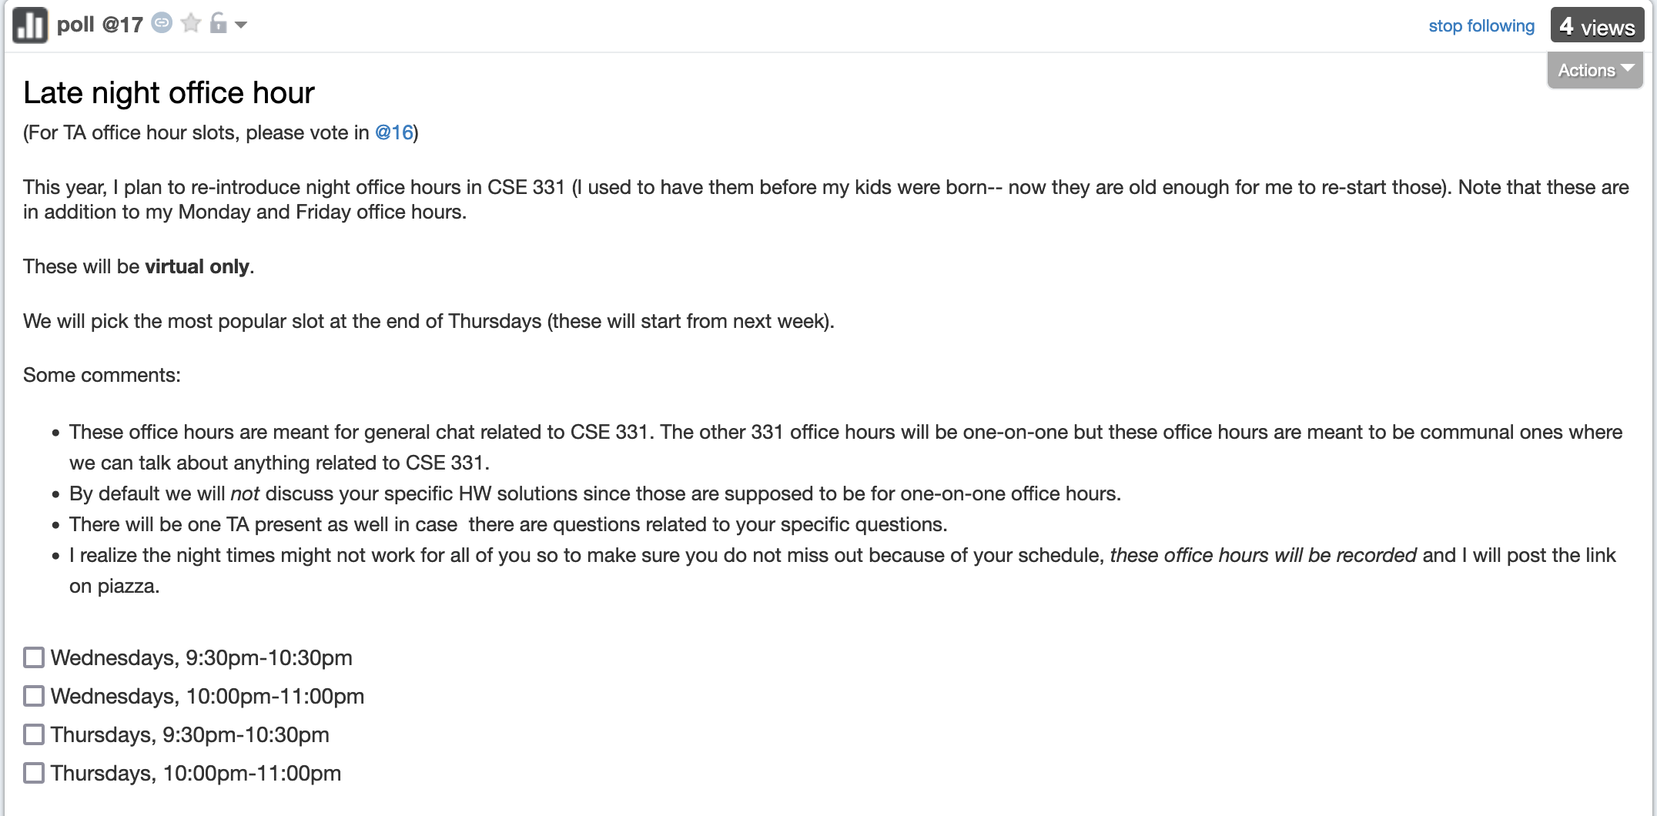
Late night office hour
YOU decide!

Slide 29
Recitations
Are on for this week!
RECITATIONS

Slide 30
Please stick to your recitation section
At least for the first month since all sections are full

Slide 31
Exams
Mid term (two parts)
Mon, Oct 11 and Wed, Oct 13, 2021. Usual place and time.
Final exam
Fri, Dec 17, 2021. Knox 110, 8:30-11:00am
I had NO say in choosing the time

Slide 32
The HW structure
DROP lowest 2 out of 8 HW scores
Three questions
Q1 and Q2 are proof based while Q3 is programming
Q1 worth 50 points
The hard proof based Q2 and programming Q3 worth 25 points each
HWs due by 8:00am on Wednesdays

Slide 33
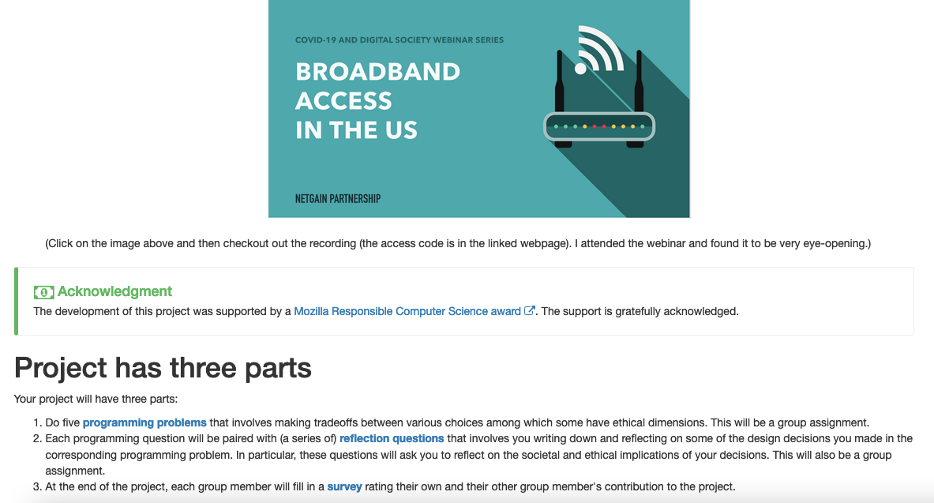
Big change from Spring 21: project!

Slide 34
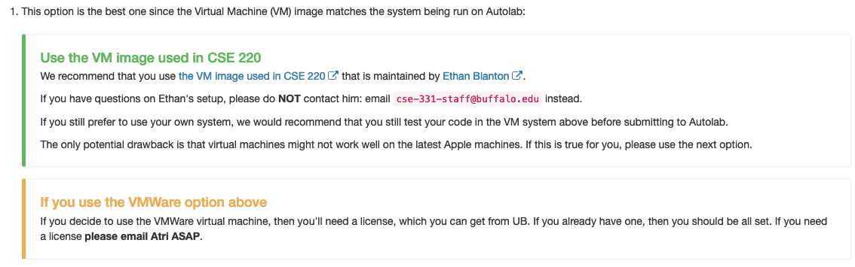
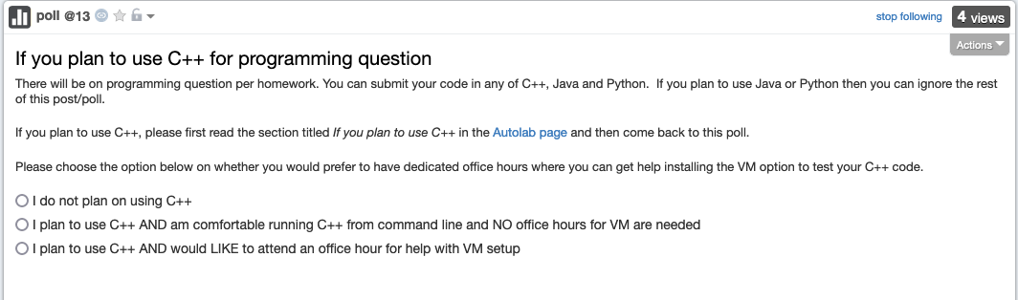
C++ vs Java/Python
Use Java/Python if as you just as comfortable with as C++
There might be a how to use Unix session next week
If want to use VMware, please email me to get a license
License requests submitted every Tue morning

Slide 35
Questions/Comments?

Slide 36
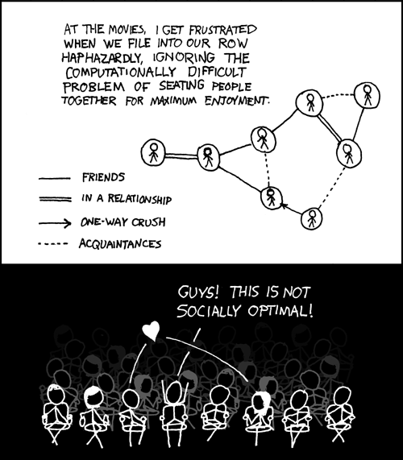
This course: how to solve problems!
http://xkcd.com/173/

Slide 37
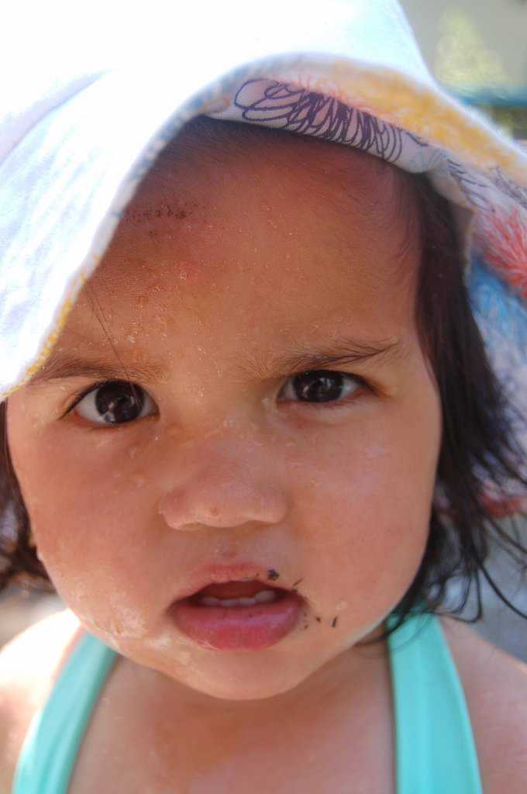
Why should I care ?

Slide 38

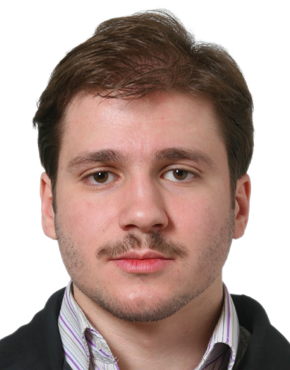
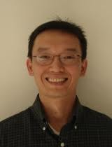
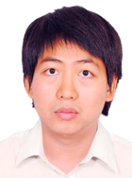
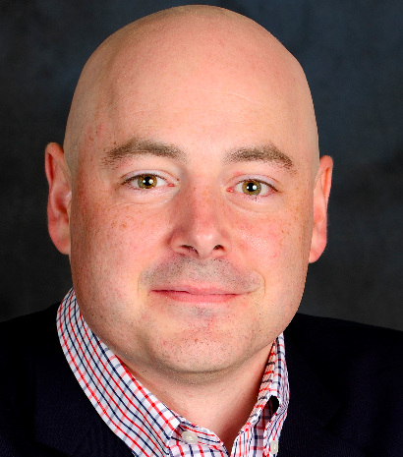


Combining Shadows to Understanding the network

Slide 39
The key technical problem
Given the three projections, what is the largest size of the original set of points?

Slide 40
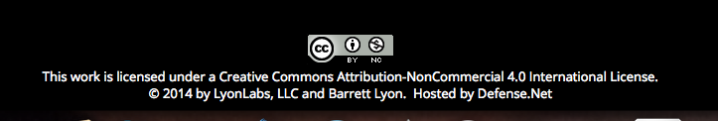
Detecting Communities

Slide 41
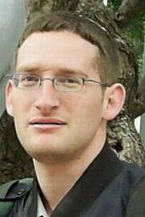
Conquering Shadows to Conquering the Internet
Algorithmically compute the missing set

Slide 42




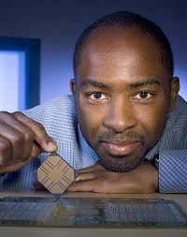

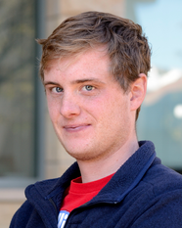
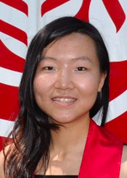

The proof is in the performance
>
10x faster
Better algorithm with little hacking will beat a worse algorithm with tons of hacking

Slide 43
The key technical problem
Highly trivial: 4³ = 64
Still trivial: 4² = 16
Correct answer: 4^{1.5} = 8

Slide 44



If detecting communities is not for you

Slide 45
From someone who got a Google job
“You can let your algorithms class know that the phone interviews are essentially like a difficult algorithms test.
Lots of data structures, specifying the algorithm, analyzing the
run time and space requirements... And all on the phone and
you're supposed to talk through your thought process.”

Slide 46
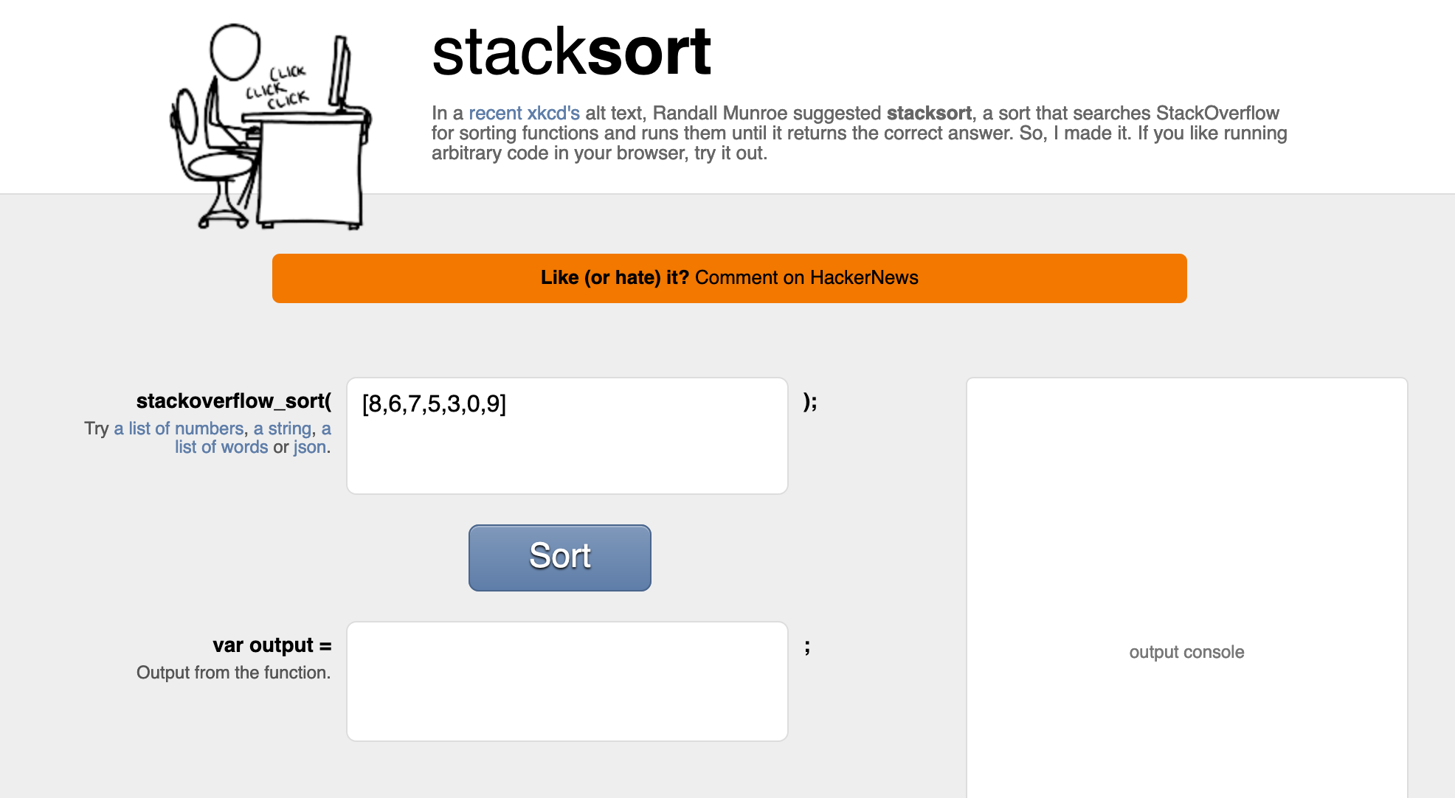
Coding jobs will be done by AI

Slide 47
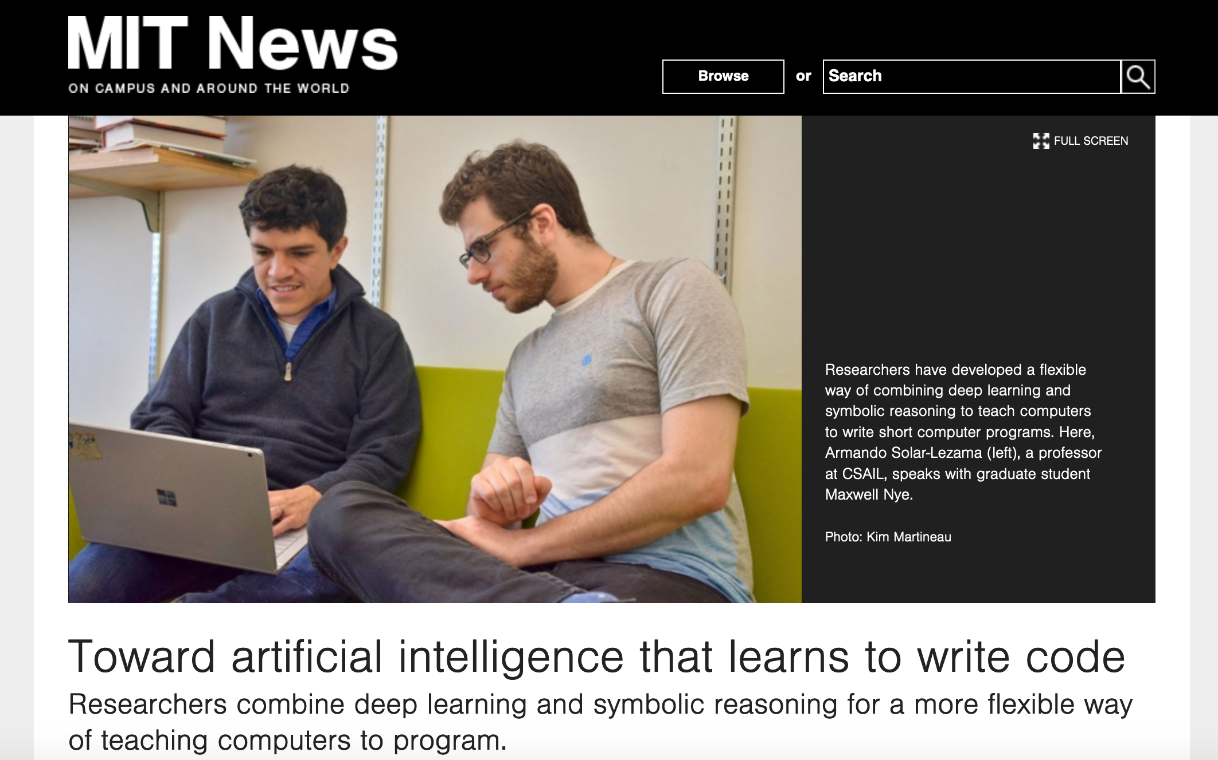
Coding jobs will be done by AI

Slide 48
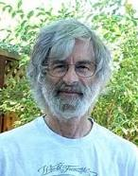

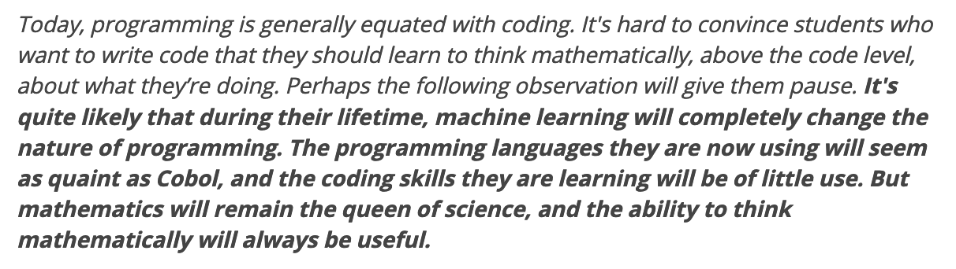
So am I doomed?
There will still be room for high level algorithmic thinking!

Slide 49
Questions/Comments?

