Slide 1
Lecture 20
CSE 331
Oct 20, 2021

Slide 2

Please have a face mask on

Slide 3
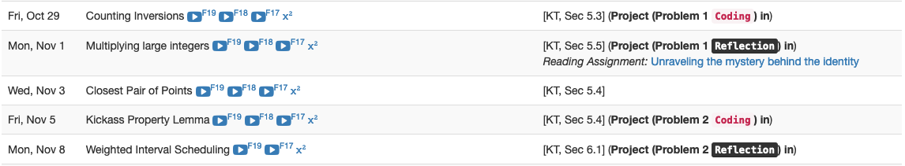
Project deadlines coming up

Slide 4
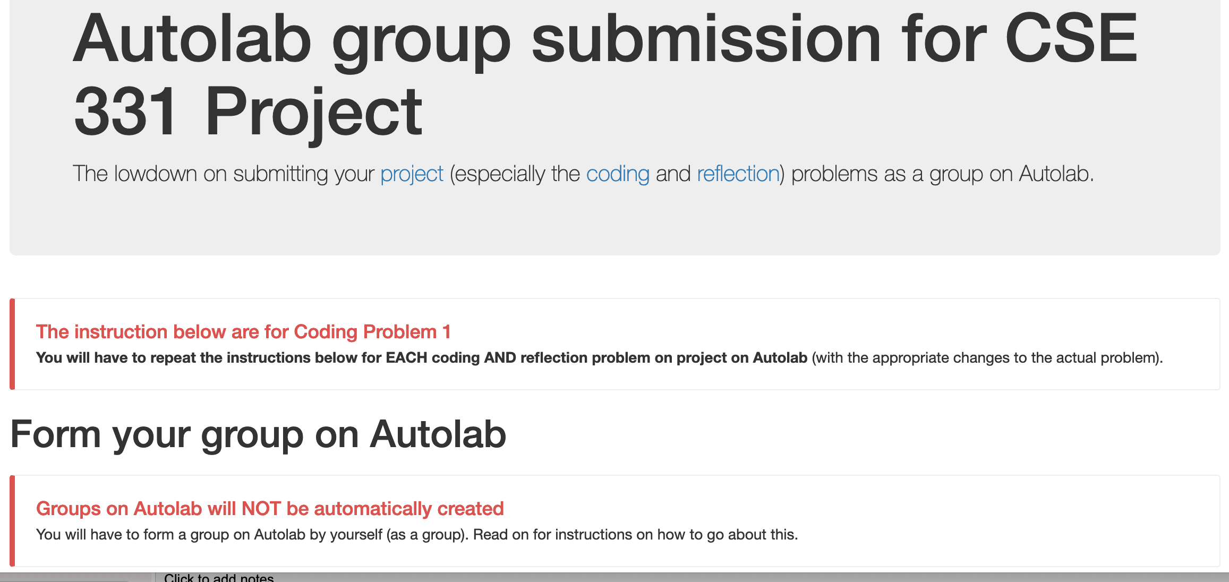
Group formation instructions
Follow instructions EXACTLY as they are stated

Slide 5
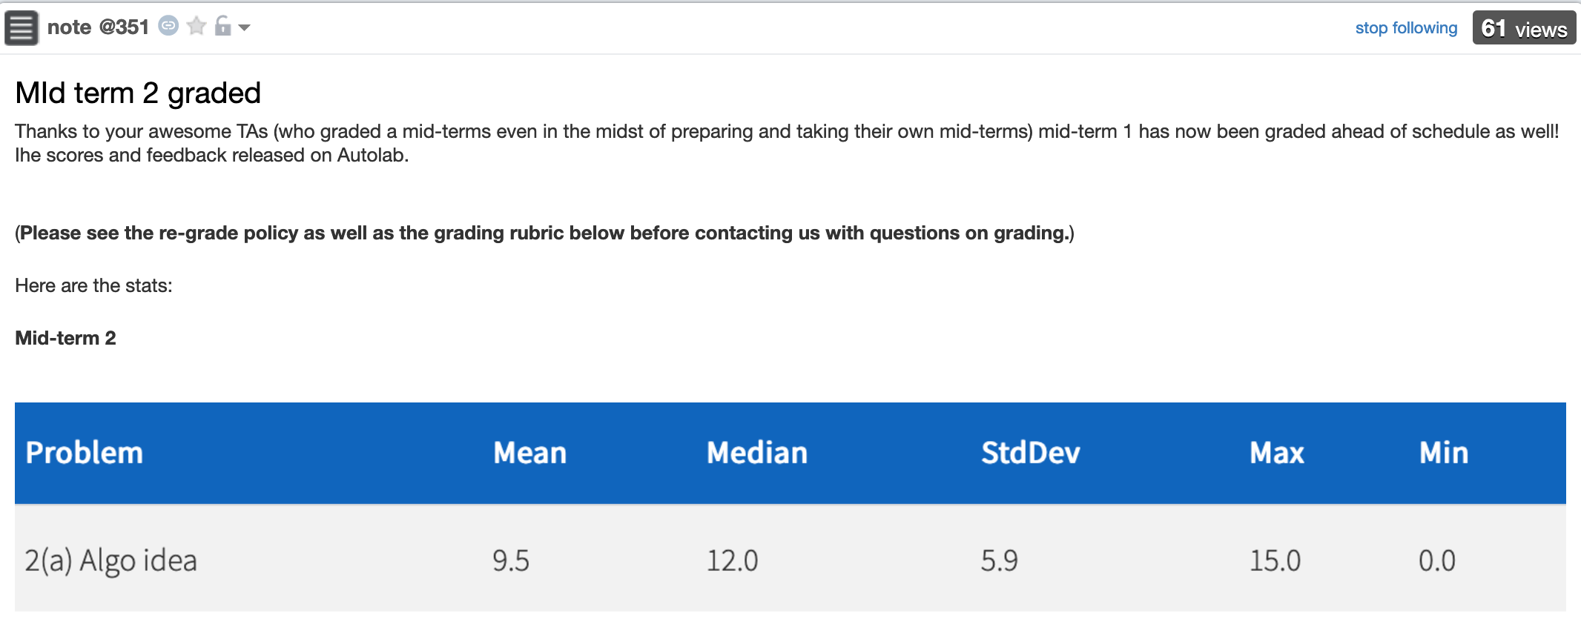
Mid-terms graded

Slide 6
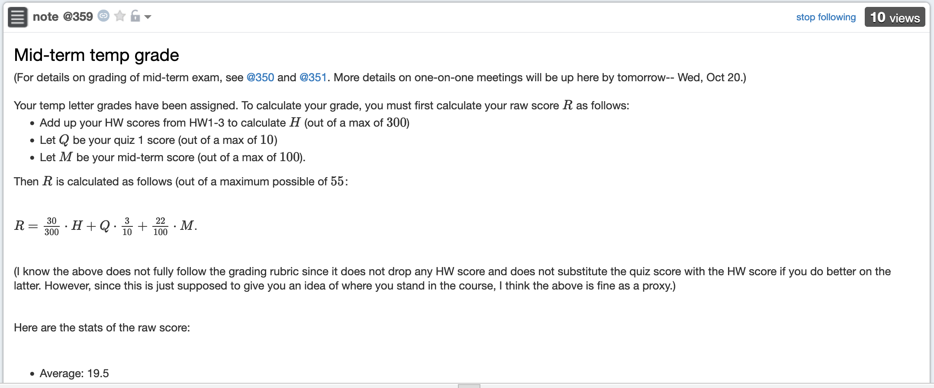
Mid-term temp grades

Slide 7
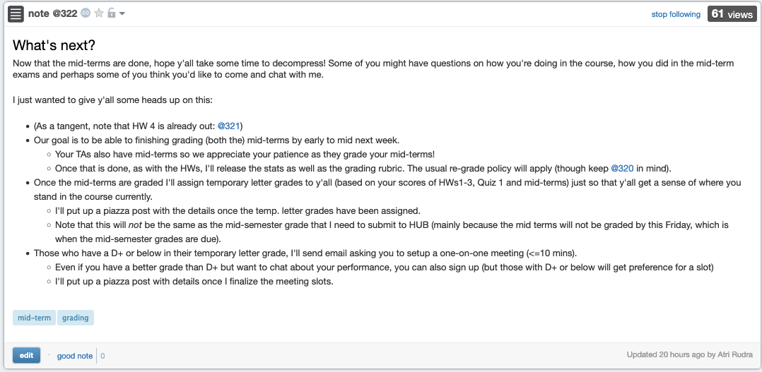
Some other stuff coming up

Slide 8
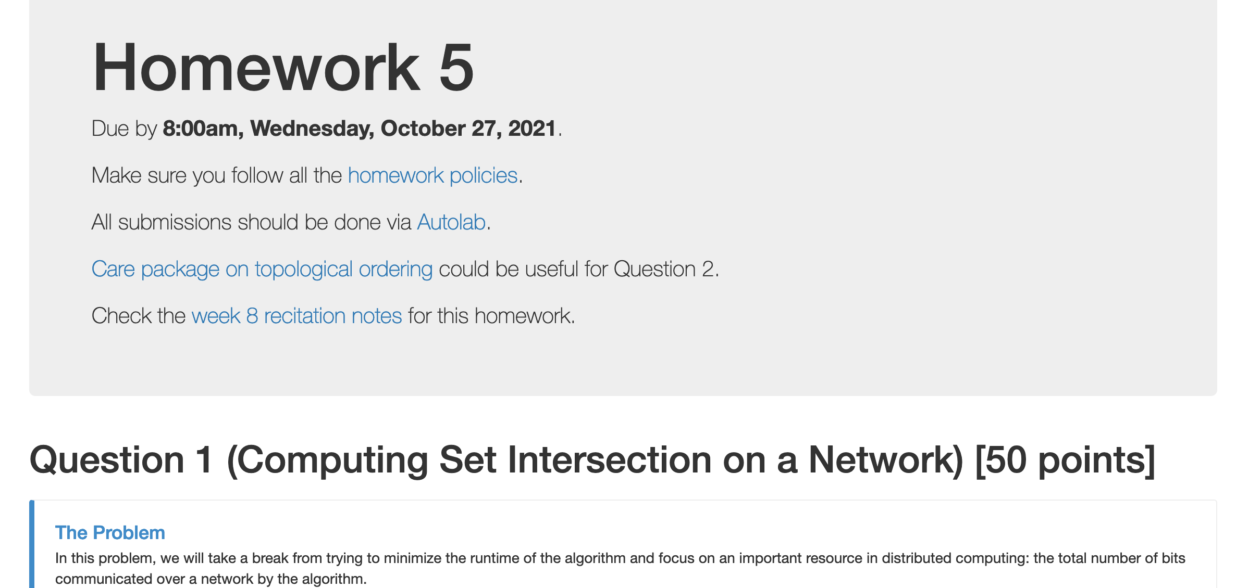
HW 5 is out

Slide 9
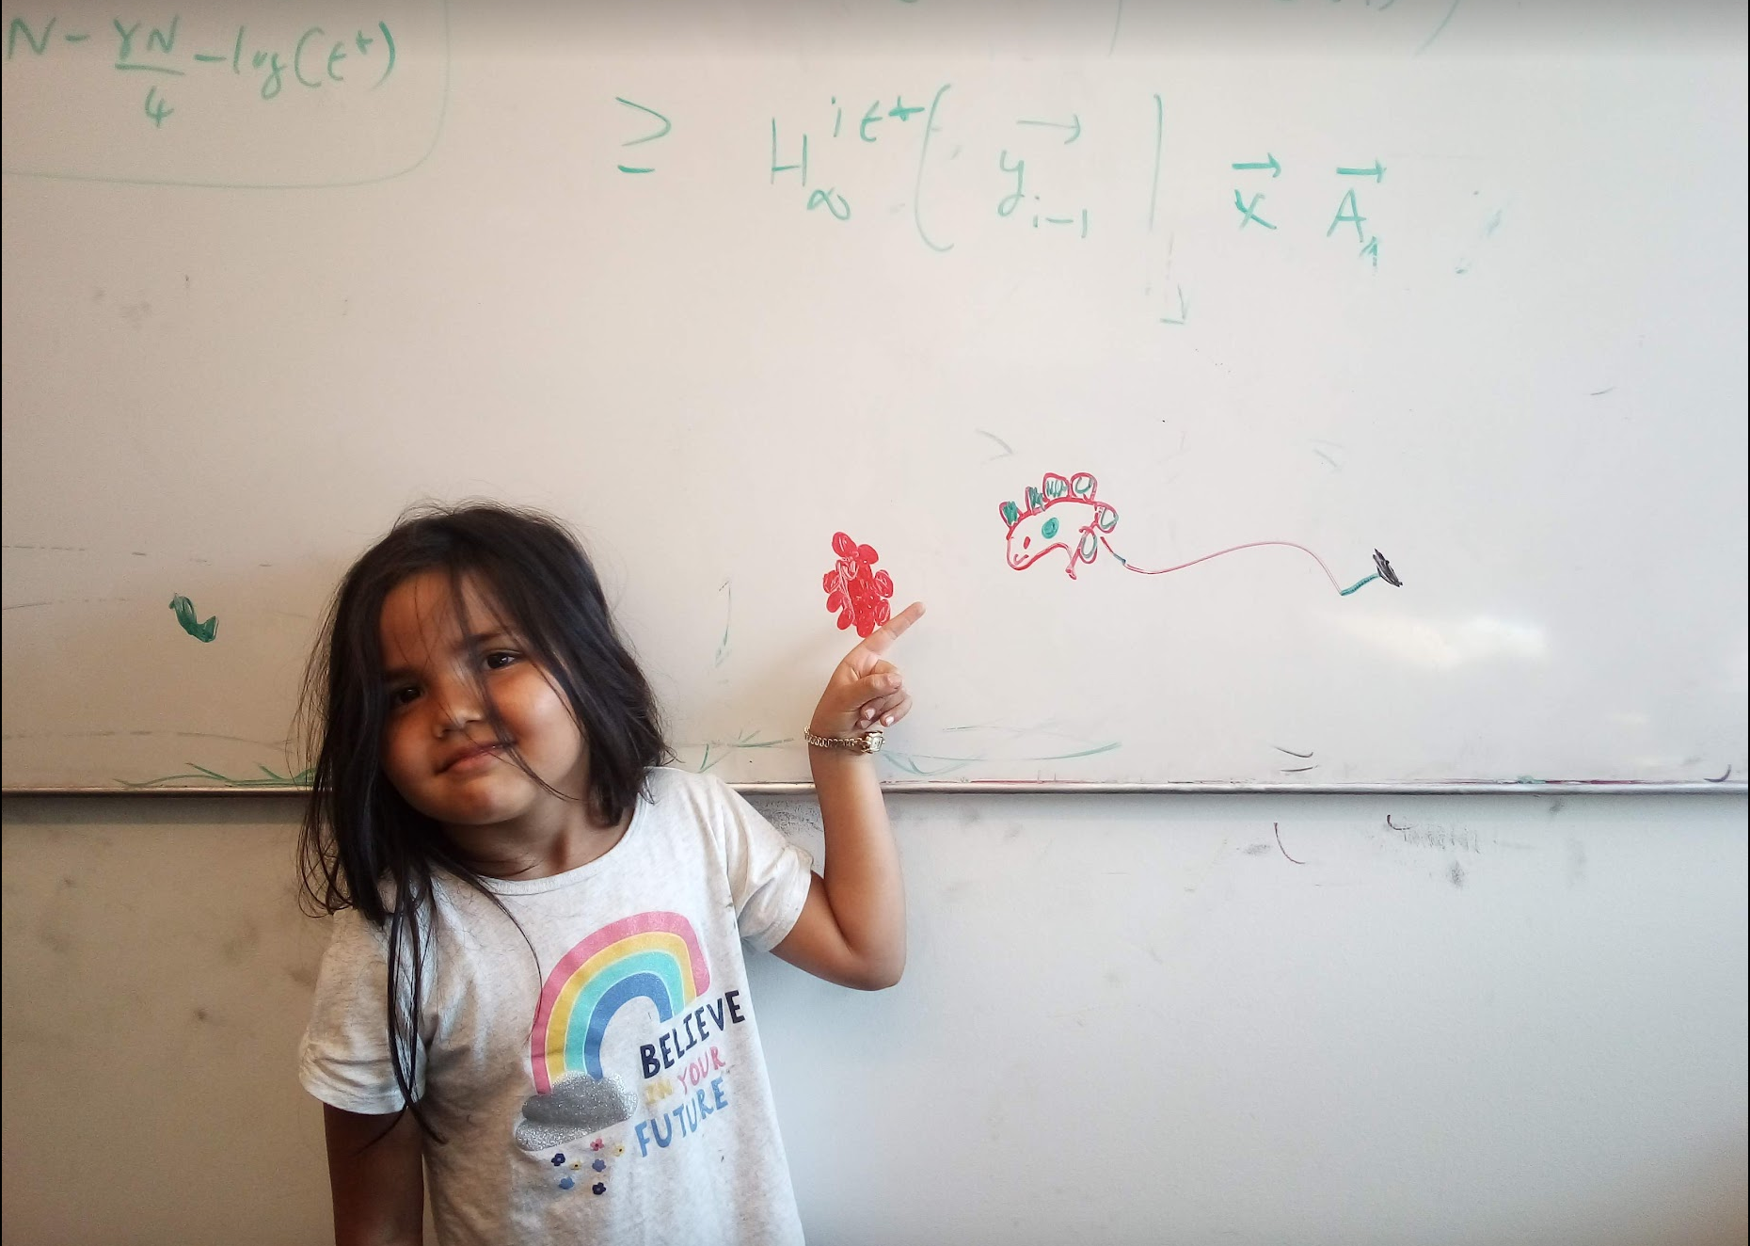
Questions/Comments?

Slide 10
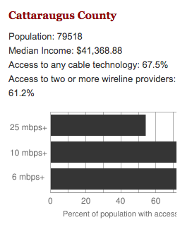
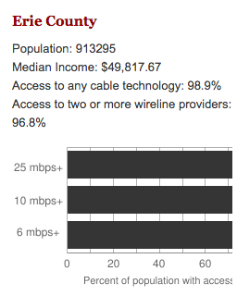
Make broadband more available
BOTH technical and societal issues
Say you are tasked to come up with the infrastructure

Slide 11
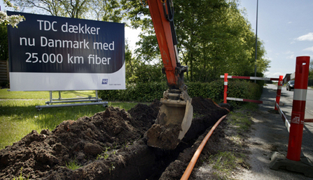
Building a fiber network
Lay down fibers to connect n locations
All n locations should be connected
Laying down a fiber costs money
What is the cheapest way to lay down the fibers?

Slide 12
Today’s agenda
Minimum Spanning Tree (MST) Problem
Greedy algorithm(s) for MST problem

Slide 13
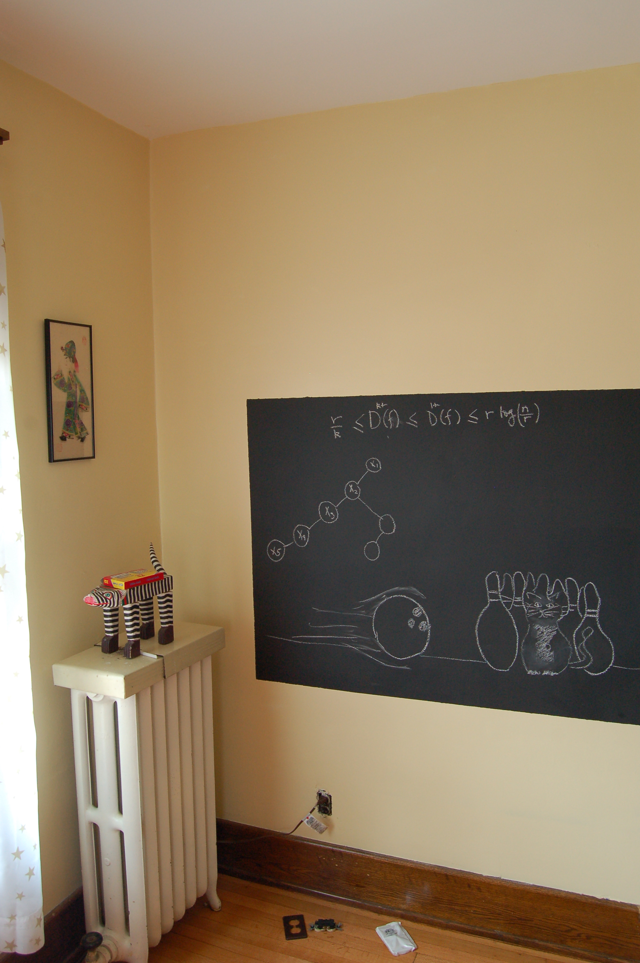
On to the board…

Slide 14
Minimum Spanning Tree Problem
Input: Undirected, connected G = (V,E), edge costs c_{e}
Output: Subset E’ ⊆ E), s.t. T = (V,E’) is connected
C(T) is minimized
If all c_{e} > 0, then T is indeed a tree

Slide 15
Rest of today’s agenda
Greedy algorithm(s) for MST problem

Slide 16

Discuss: Greedy algorithm!

Slide 17
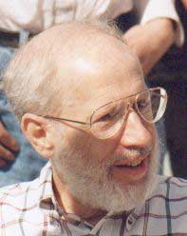
Kruskal’s Algorithm
Input: G=(V,E), c_{e}> 0 for every e in E
T = Ø
Sort edges in increasing order of their cost
Joseph B. Kruskal
Consider edges in sorted order
If an edge can be added to T without adding a cycle then add it to T

Slide 18
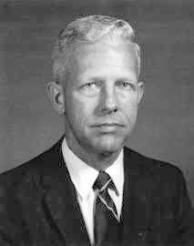
Prim’s algorithm
Similar to Dijkstra’s algorithm
2
0.5
1
3
50
51
Robert Prim
2
0.5
Input: G=(V,E), c_{e}> 0 for every e in E
S = {s}, T = Ø
1
50
While S is not the same as V
Among edges e= (u,w) with u in S and w not in S, pick one with minimum cost
Add w to S, e to T

Slide 19
Reverse-Delete Algorithm
2
0.5
1
3
50
51
Input: G=(V,E), c_{e}> 0 for every e in E
2
0.5
T = E
1
3
50
Sort edges in decreasing order of their cost
51
Consider edges in sorted order
If an edge can be removed T without disconnecting T then remove it

Slide 20
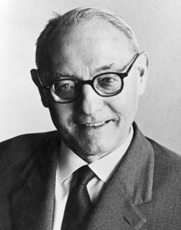
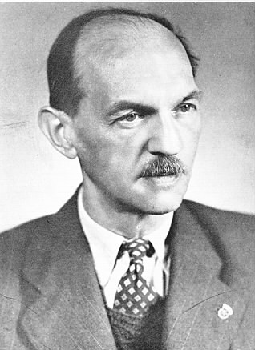
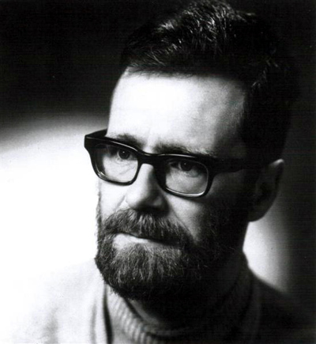
(Old) History of MST algorithms
1920: Otakar Borůvka
1930: Vojtěch Jarník
Same algo!
1956: Kruskal
1957: Prim
1959: Dijkstra

