Slide 1
Lecture 25
CSE 331
Nov 1, 2021

Slide 2

Please have a face mask on

Slide 3
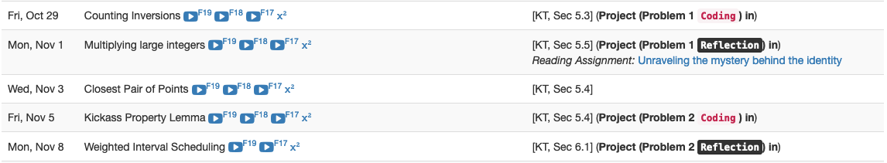
Reflection P1 due TODAY!

Slide 4
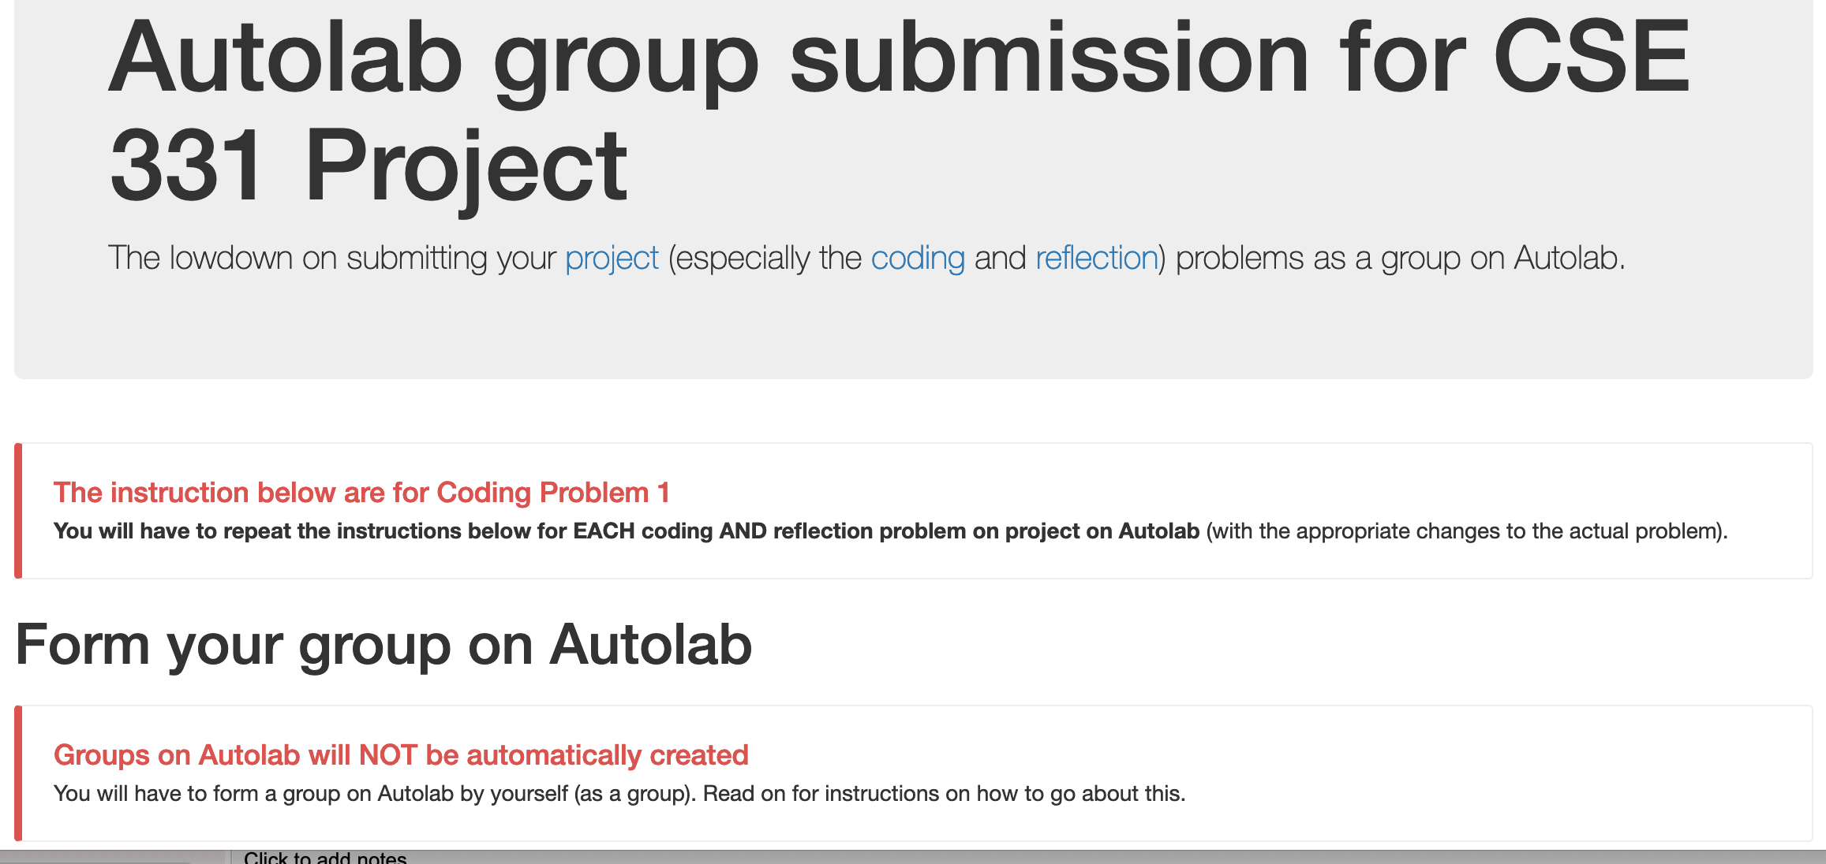
Group formation instructions
Follow instructions EXACTLY as they are stated

Slide 5
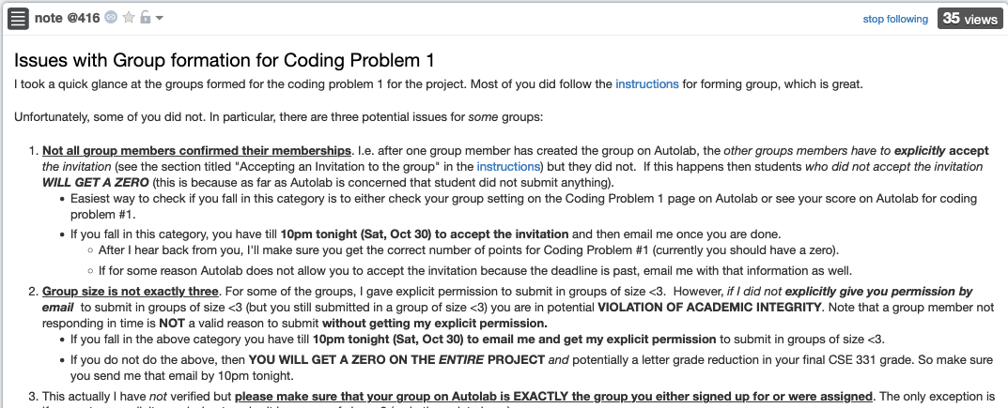
Including accepting the invitation

Slide 6

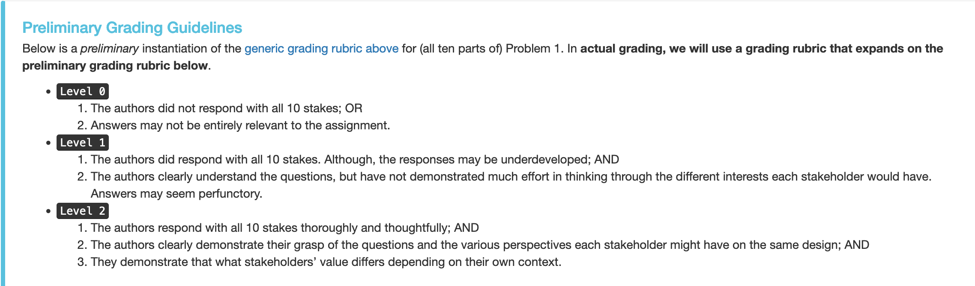
Preliminary grading rubric

Slide 7
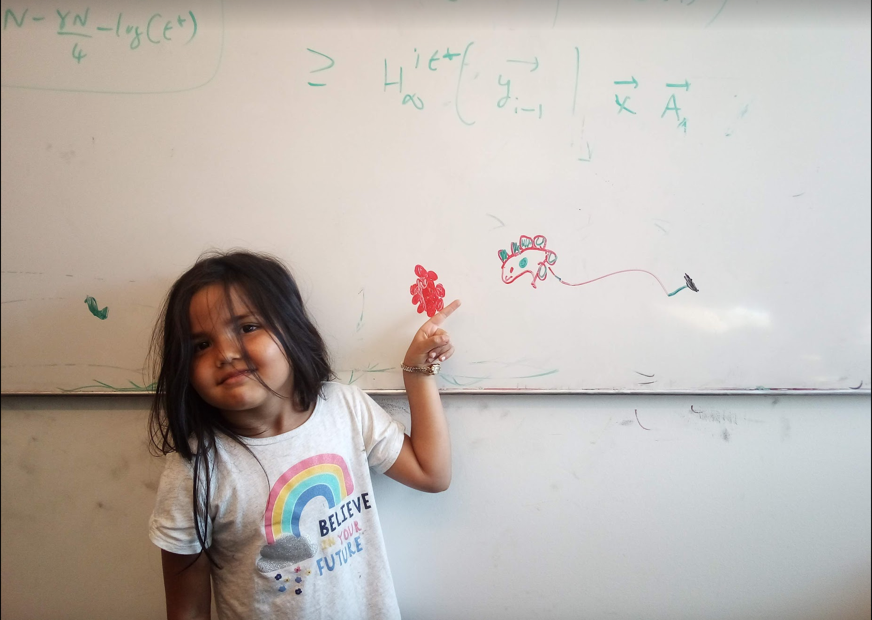
Questions/Comments?

Slide 8
Solving the bad case
Try to modify the MERGE algorithm
First element of a_{L} is larger than first element of a_{R}
5
6
…..
1
a_{L}
a_{R}
First element of a_{L} is smaller than first element of a_{R}
1
5
6
…..
a_{L}
a_{R}
a_{L}
a_{R}

Slide 9


MERGE-COUNT(a_{L},a_{R})
a_{L} = l₁,…, l_{n’}
a_{R} = r₁,…, r_{m}
c = 0
i,j = 1
if l_{i} $≤$ r_{j}
1
5
6
…..
i ++
a_{L}
a_{R}
add l_{i} to output
else
add r_{j} to output
5
6
…..
1
j ++
c += n’- i +1
a_{L}
a_{R}
Output any remaining items
return c

Slide 10
Divide and Conquer
Divide up the problem into at least two sub-problems
Solve all sub-problems: Mergesort
Recursively solve the sub-problems
Solve stronger sub-problems: Inversions
“Patch up” the solutions to the sub-problems for the final solution

Slide 11
MergeSortCount algorithm
Input: a₁, a₂, …, a_{n}
Output: Numbers in sorted order+ #inversion
T(2) = c
MergeSortCount( a, n )
T(n) = 2T(n/2) + cn
If n = 1 return ( 0 , a₁)
If n = 2 return ( a1 > a2, min(a₁,a₂); max(a₁,a₂))
O(n log n) time
a_{L} = a₁,…, a_{n/2}
a_{R} = a_{n/2+1},…, a_{n}
(c_{L}, a_{L}) = MergeSortCount(a_{L}, n/2)
O(n)
(c_{R}, a_{R}) = MergeSortCount(a_{R}, n/2)
Counts #crossing-inversions+ MERGE
(c, a) = MERGE-COUNT(a_{L},a_{R})
return (c+c_{L}+c_{R},a)

Slide 12
Questions/Comments?

Slide 13
Divide and Conquer
Divide up the problem into at least two sub-problems
Recursively solve the sub-problems
“Patch up” the solutions to the sub-problems for the final solution

Slide 14
Improvements on a smaller scale
Greedy algorithms: exponential → poly time
(Typical) Divide and Conquer: O(n²) → asymptotically smaller running time

Slide 15
Multiplying two numbers
Given two numbers a and b in binary
a=(a_{n-1},..,a₀) and b = (b_{n-1},…,b₀)
Elementary school algorithm is O(n²)
Compute c = a x b

Slide 16
The current algorithm scheme
Shift by O(n) bits
Adding O(n) bit numbers
Mult over n bits
a • b = a¹b¹ •2^{2[n/2]} + (a¹b⁰+a⁰b¹)•2^{[n/2]} + a⁰b⁰
Multiplication over n/2 bit inputs
T(n) is O(n²)
T(n) ≤ 4T(n/2) + cn
T(1) ≤ c

