Slide 1
Lecture 35
CSE 331
Nov 29, 2021

Slide 2
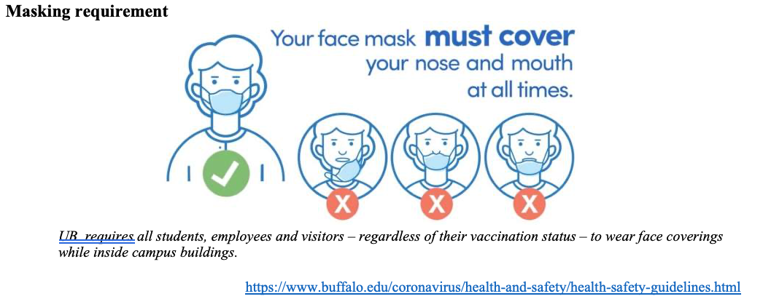
Please have a face mask on

Slide 3
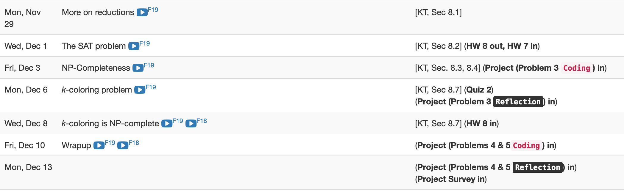
Remaining two weeks are packed

Slide 4
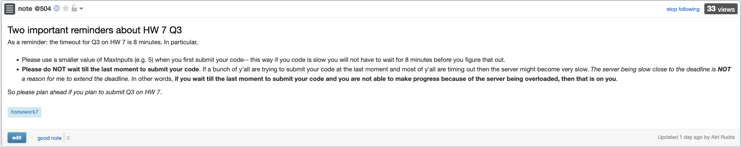
Reminders about HW 7

Slide 5
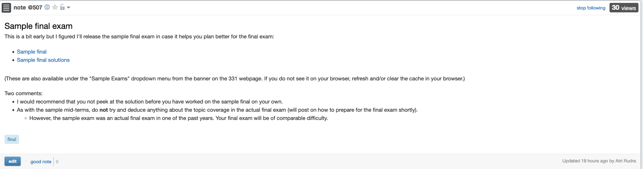
Sample final exam

Slide 6
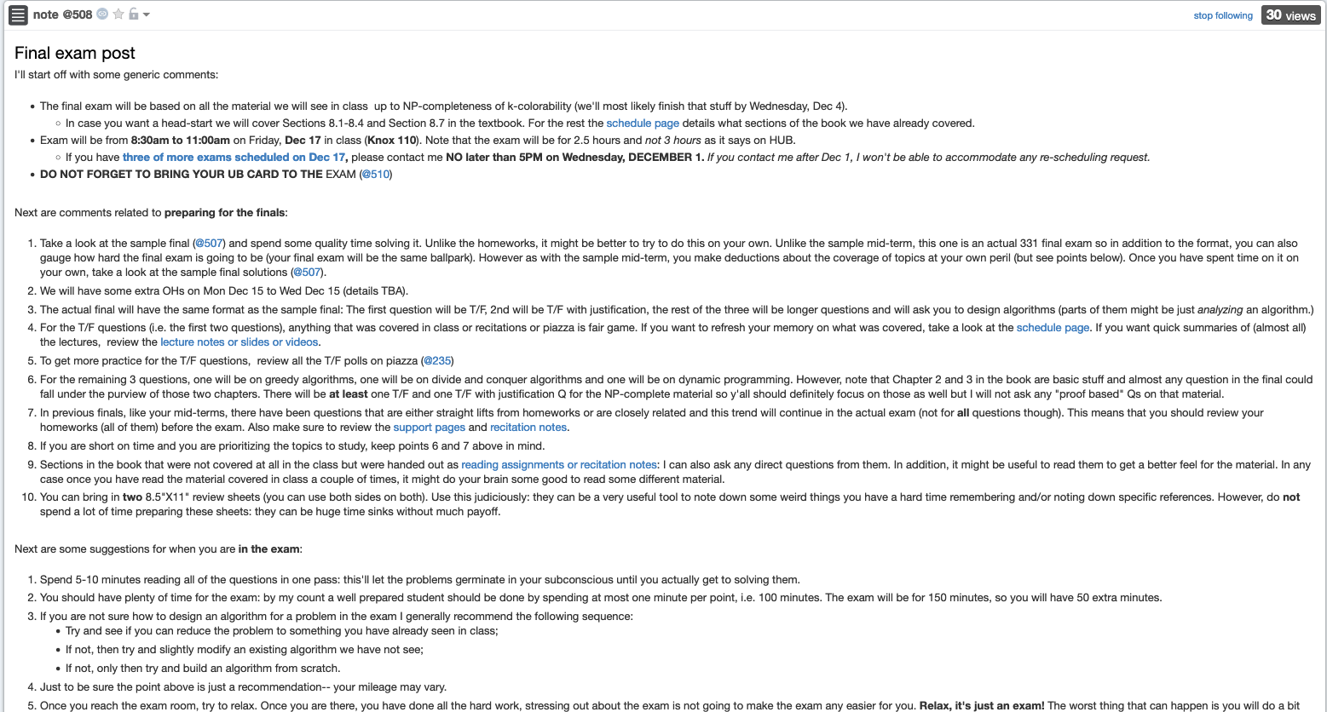
Final exam post

Slide 7
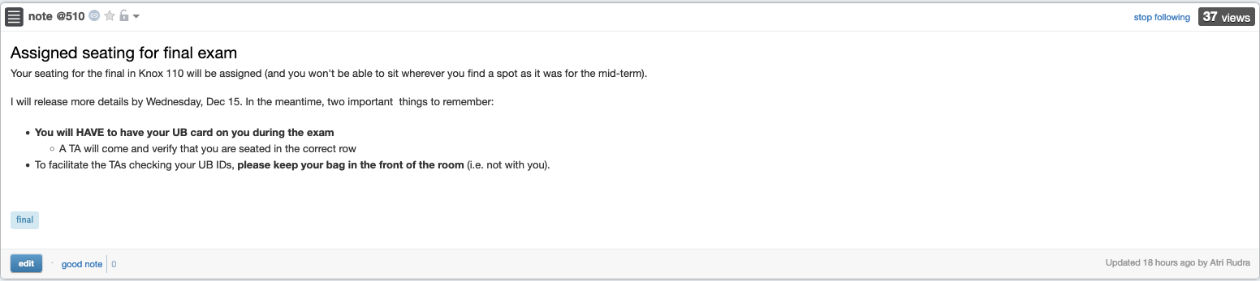
Bring your UB card to final

Slide 8
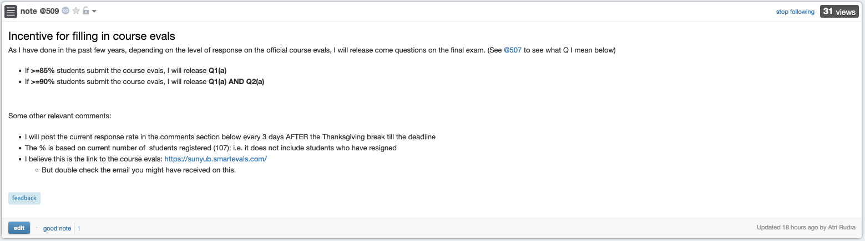
Incentive to complete course evals

Slide 9
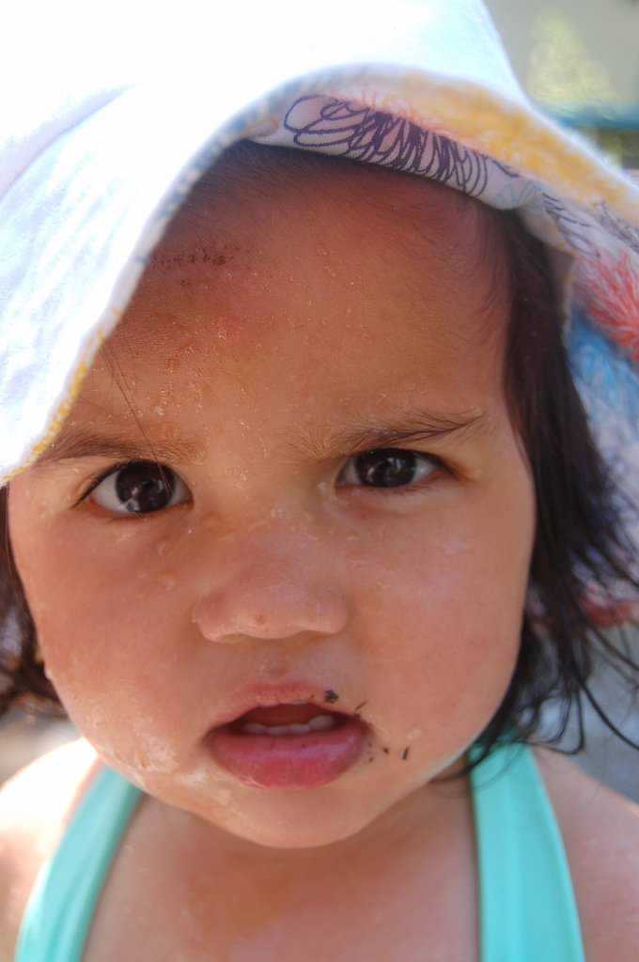
Questions?

Slide 10




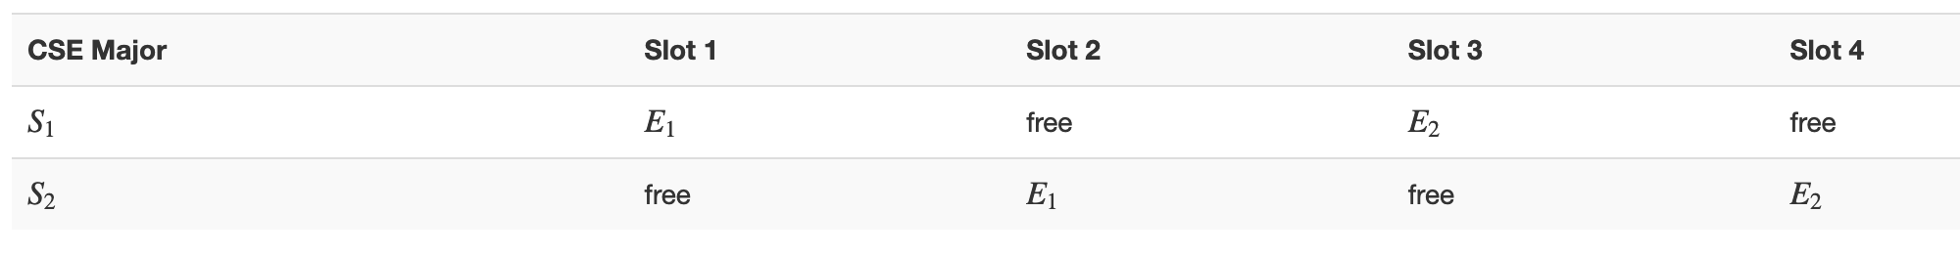
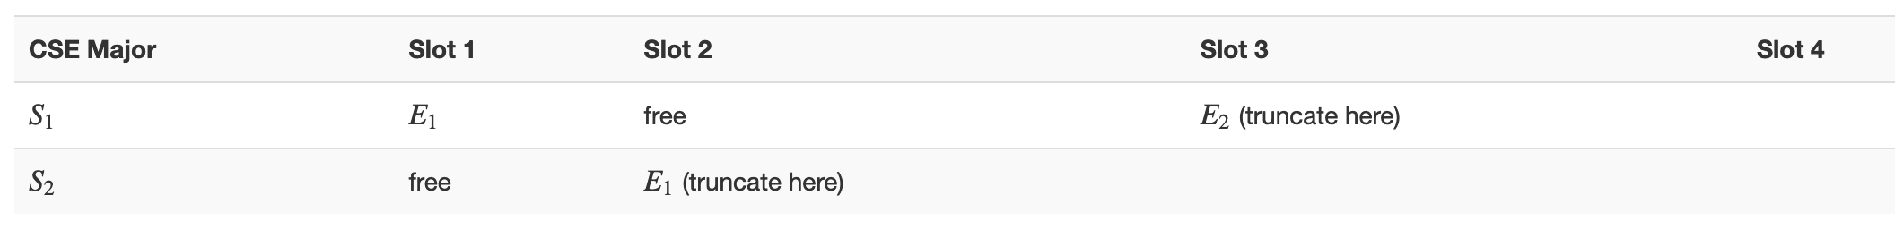



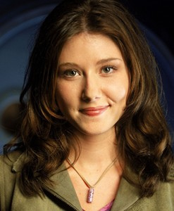
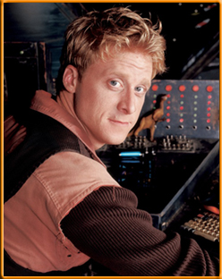

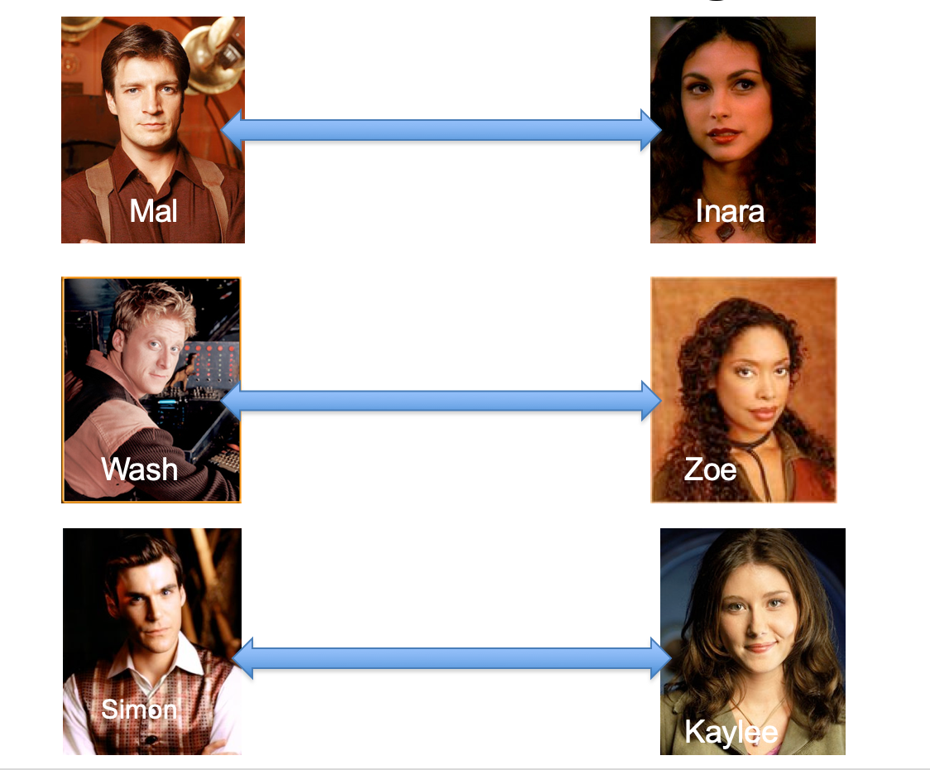
Poly time steps
Arbitrary Y instance
ANY algo for stable matching problem works!
Pre-process the input
Output for Y instance
All processing
is poly-time
Algo for X
Post-process the output

Slide 11

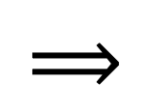
!B !A

Slide 12



No poly time algo for Y
Poly time algo for X
Arbitrary Y instance
No poly time algo for X
Poly time algo for Y
Pre-process the input
Output for Y instance
All processing
is poly-time
Algo for X
Post-process the output

