Slide 1
Lecture 36
CSE 331
Dec 1, 2021

Slide 2
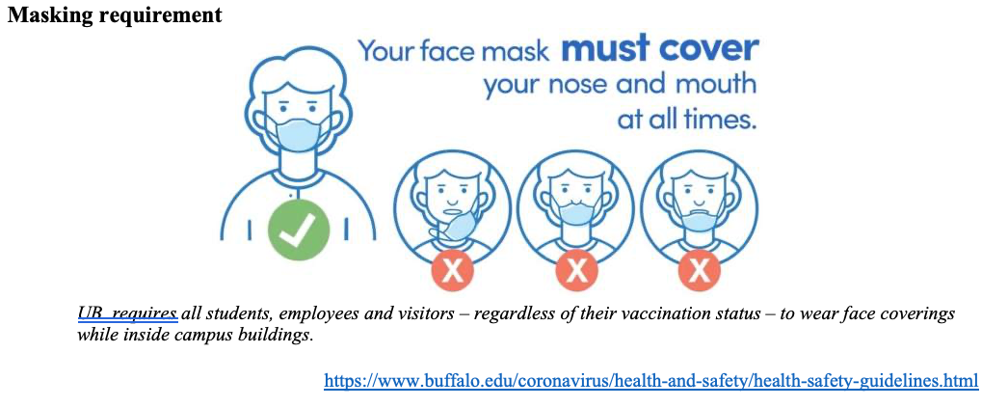
Please have a face mask on

Slide 3
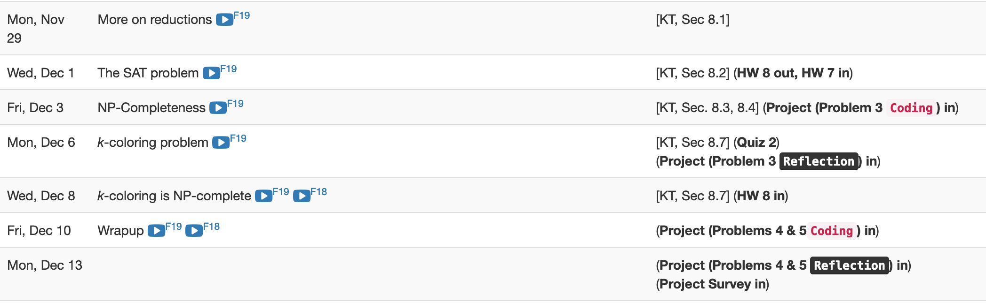
Remaining two weeks are packed

Slide 4
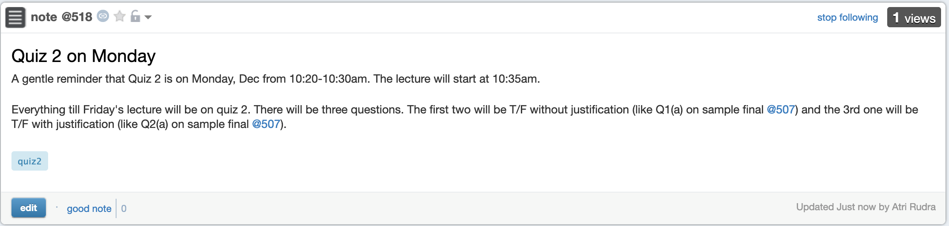
Quiz 2 on Monday

Slide 5
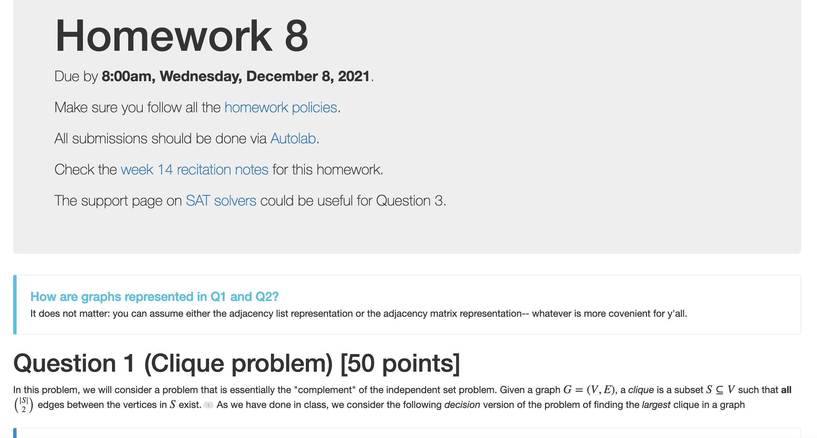
HW 8 (last one!) out

Slide 6
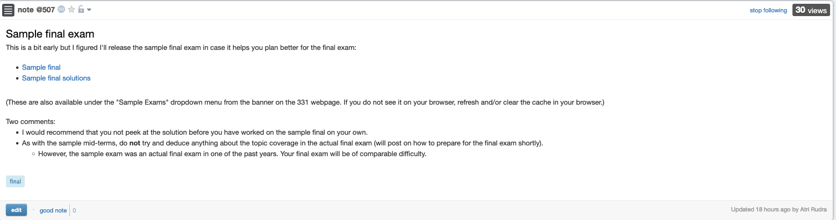
Sample final exam

Slide 7
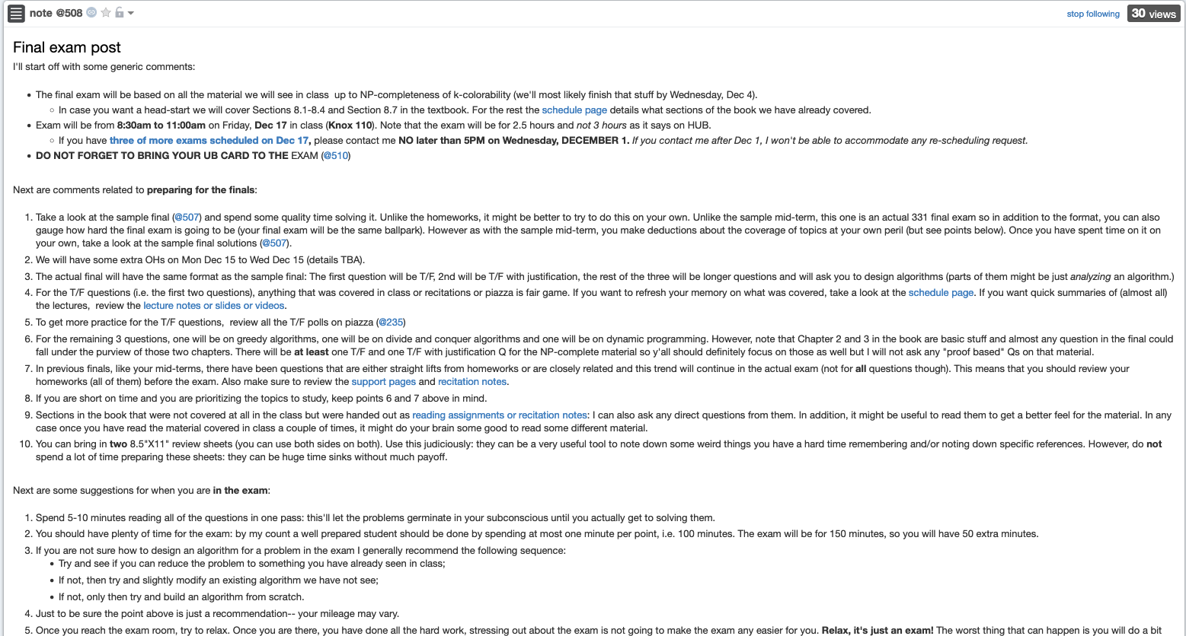
Final exam post

Slide 8
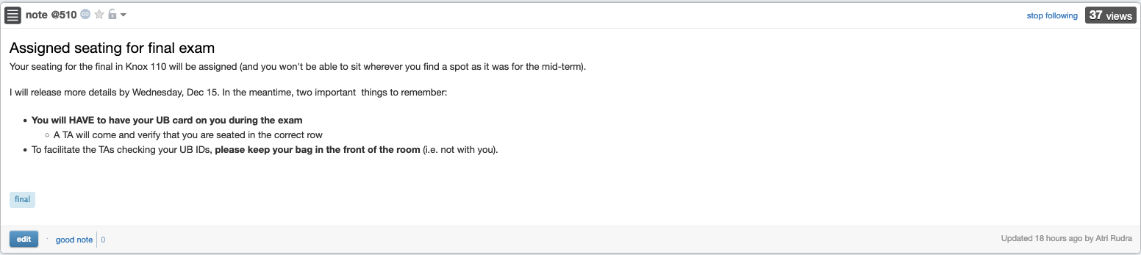
Bring your UB card to final

Slide 9

Questions?

Slide 10




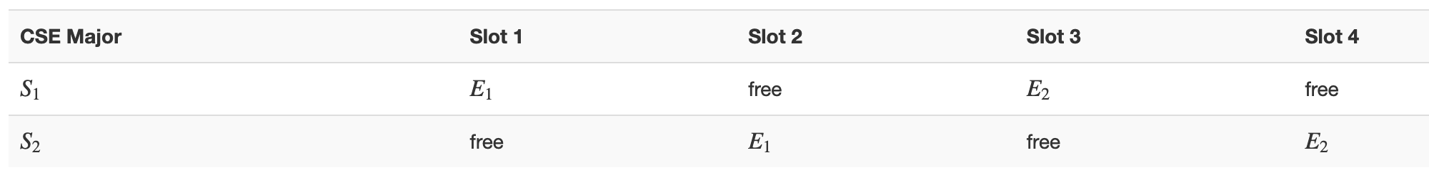
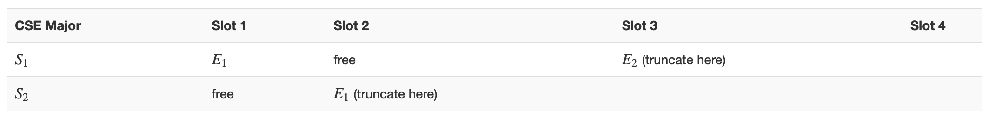




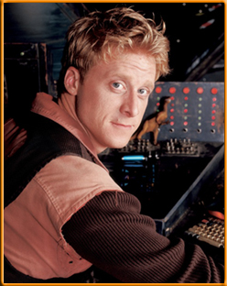

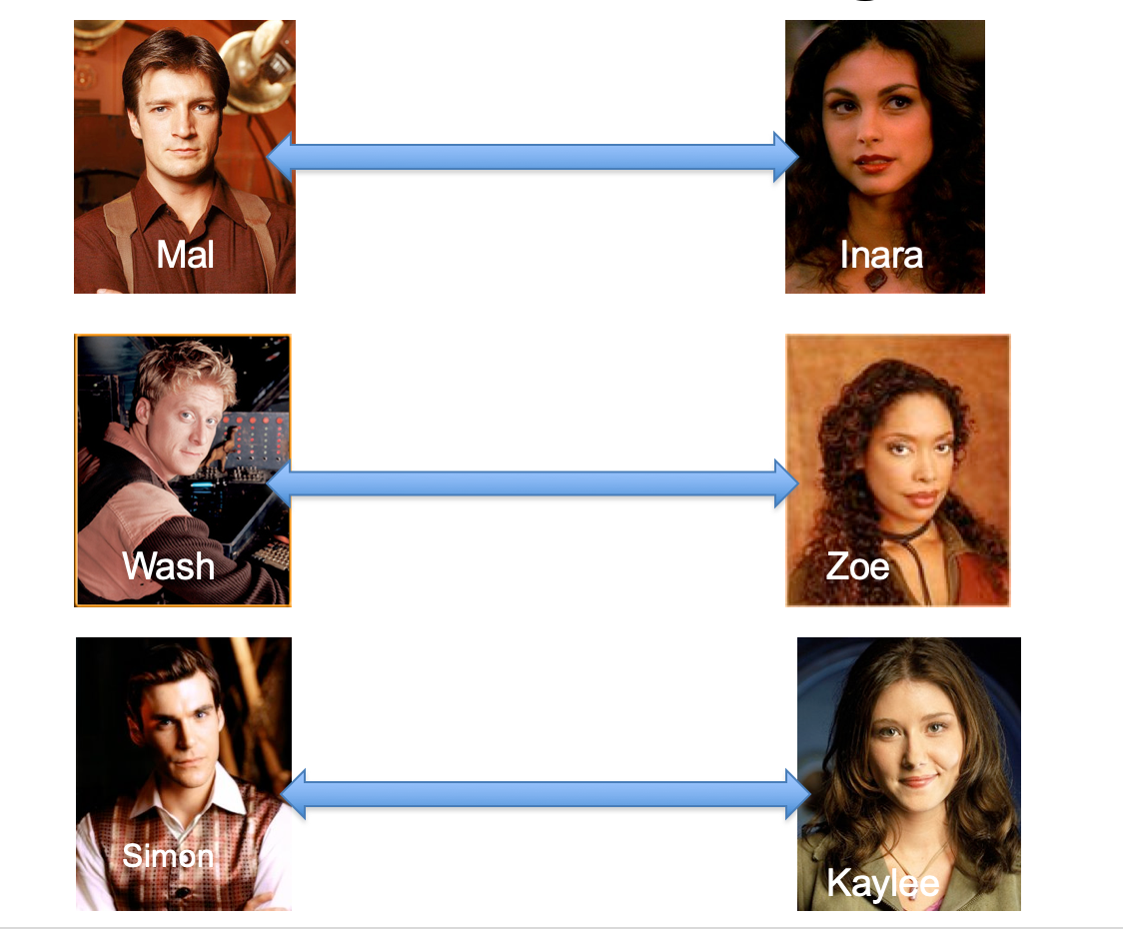
Poly time steps
Arbitrary Y instance
ANY algo for stable matching problem works!
Pre-process the input
Output for Y instance
All processing
is poly-time
Algo for X
Post-process the output

Slide 11



No poly time algo for Y
Poly time algo for X
Arbitrary Y instance
No poly time algo for X
Poly time algo for Y
Pre-process the input
Output for Y instance
All processing
is poly-time
Algo for X
Post-process the output
Mostly trivial

Slide 12
P vs NP question
P: problems that can be solved by poly time algorithms
Is P=NP?
NP: problems that have polynomial time verifiable witness to optimal solution

