Slide 1
Lecture 37
CSE 331
Dec 3, 2021

Slide 2
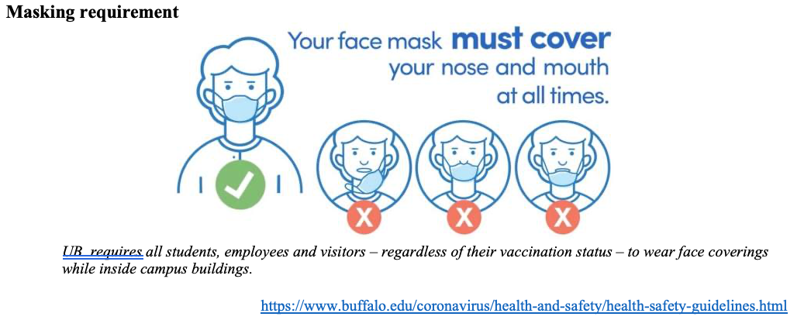
Please have a face mask on

Slide 3
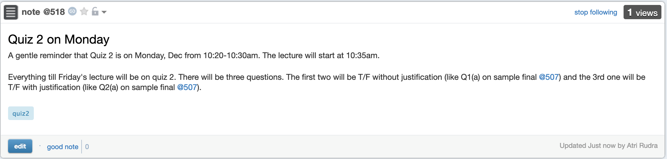
Quiz 2 on Monday

Slide 4
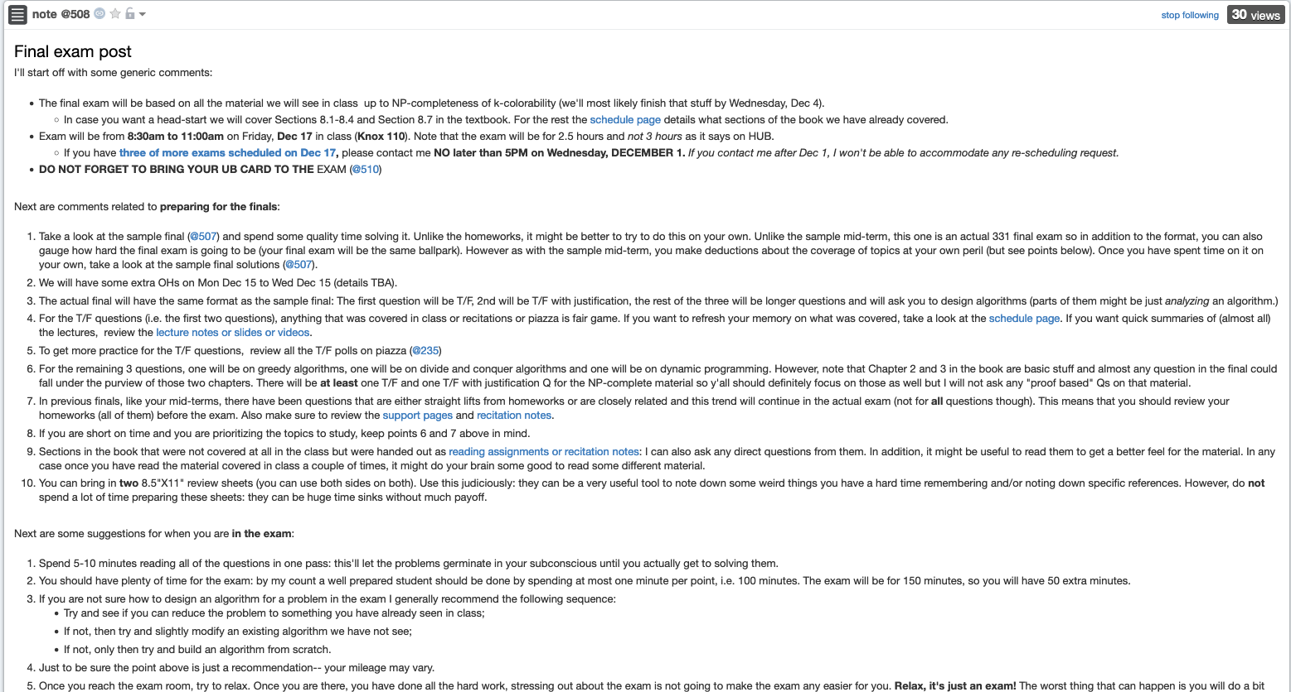
Final exam post

Slide 5
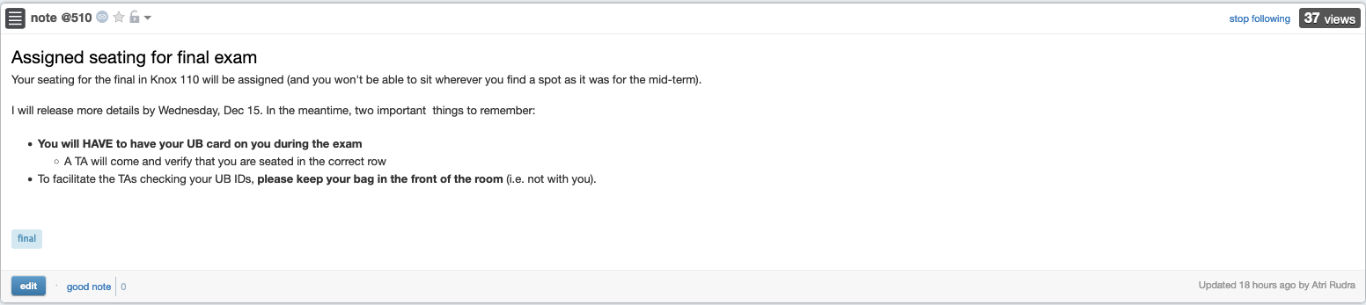
Bring your UB card to final

Slide 6
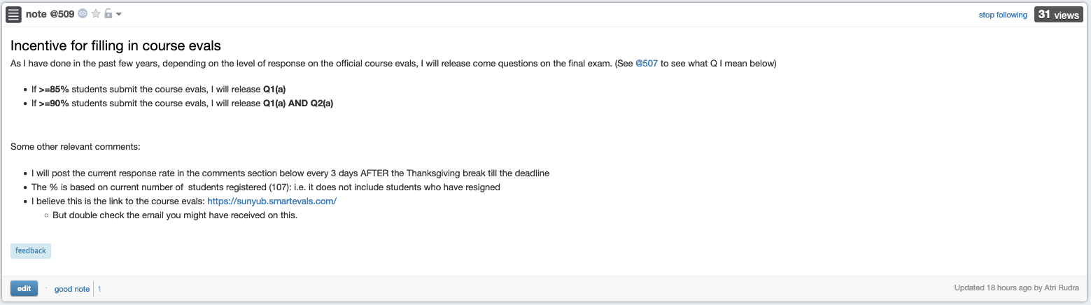
Incentive to complete course evals

Slide 7
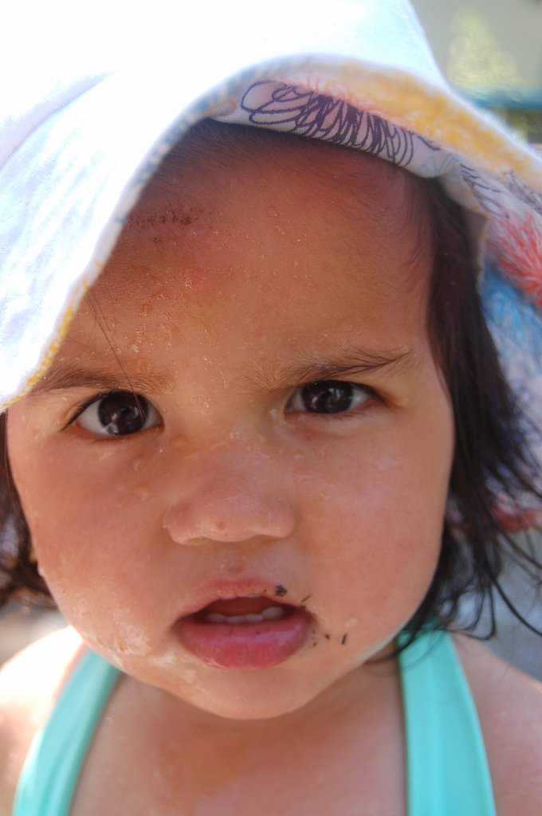
Questions?

Slide 8




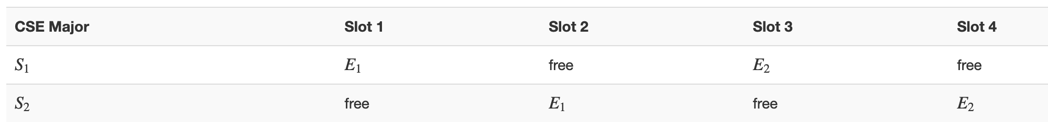
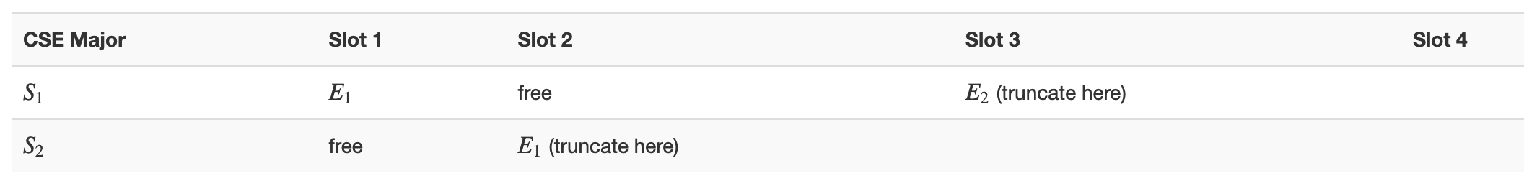



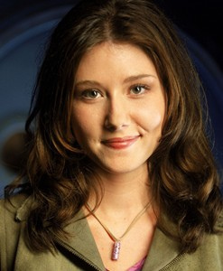
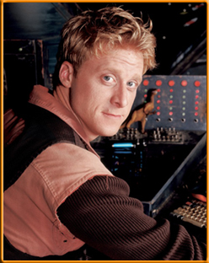

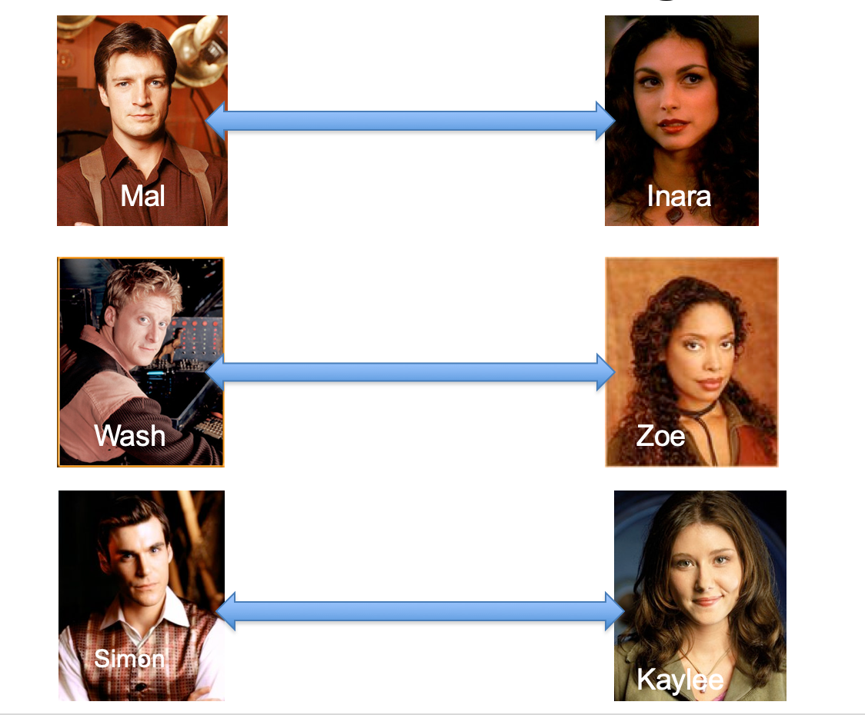
Poly time steps
Arbitrary Y instance
ANY algo for stable matching problem works!
Pre-process the input
Output for Y instance
All processing
is poly-time
Algo for X
Post-process the output

Slide 9



No poly time algo for Y
Poly time algo for X
Arbitrary Y instance
No poly time algo for X
Poly time algo for Y
Pre-process the input
Output for Y instance
All processing
is poly-time
Algo for X
Post-process the output
Mostly trivial

Slide 10
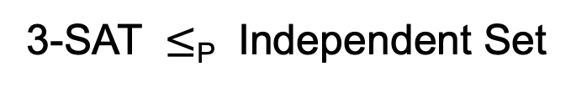
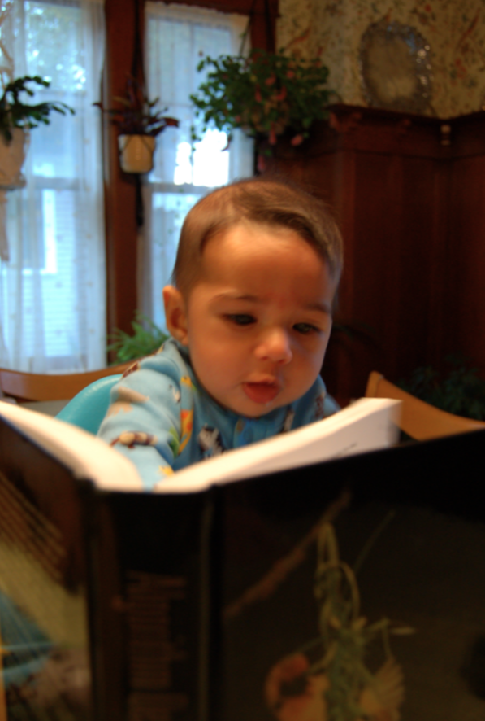
On Wednesday
Sec 8.2 of [KT]

Slide 11
P vs NP question
P: problems that can be solved by poly time algorithms
Is P=NP?
NP: problems that have polynomial time verifiable witness to optimal solution

