Slide 1
Lecture 38
CSE 331
Dec 6, 2021

Slide 2
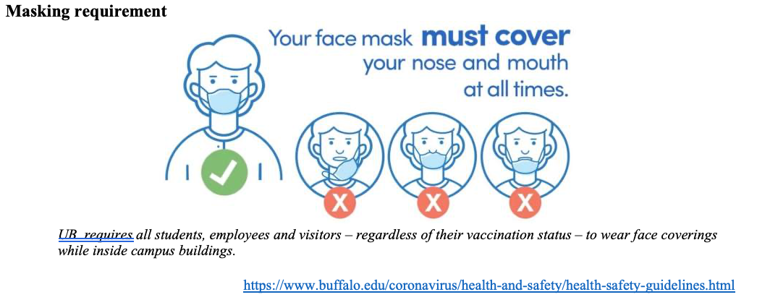
Please have a face mask on

Slide 3
Quiz starts at 10:20 am
and ends at 10:30am

Slide 4
Lecture starts
at 10:35am

Slide 5
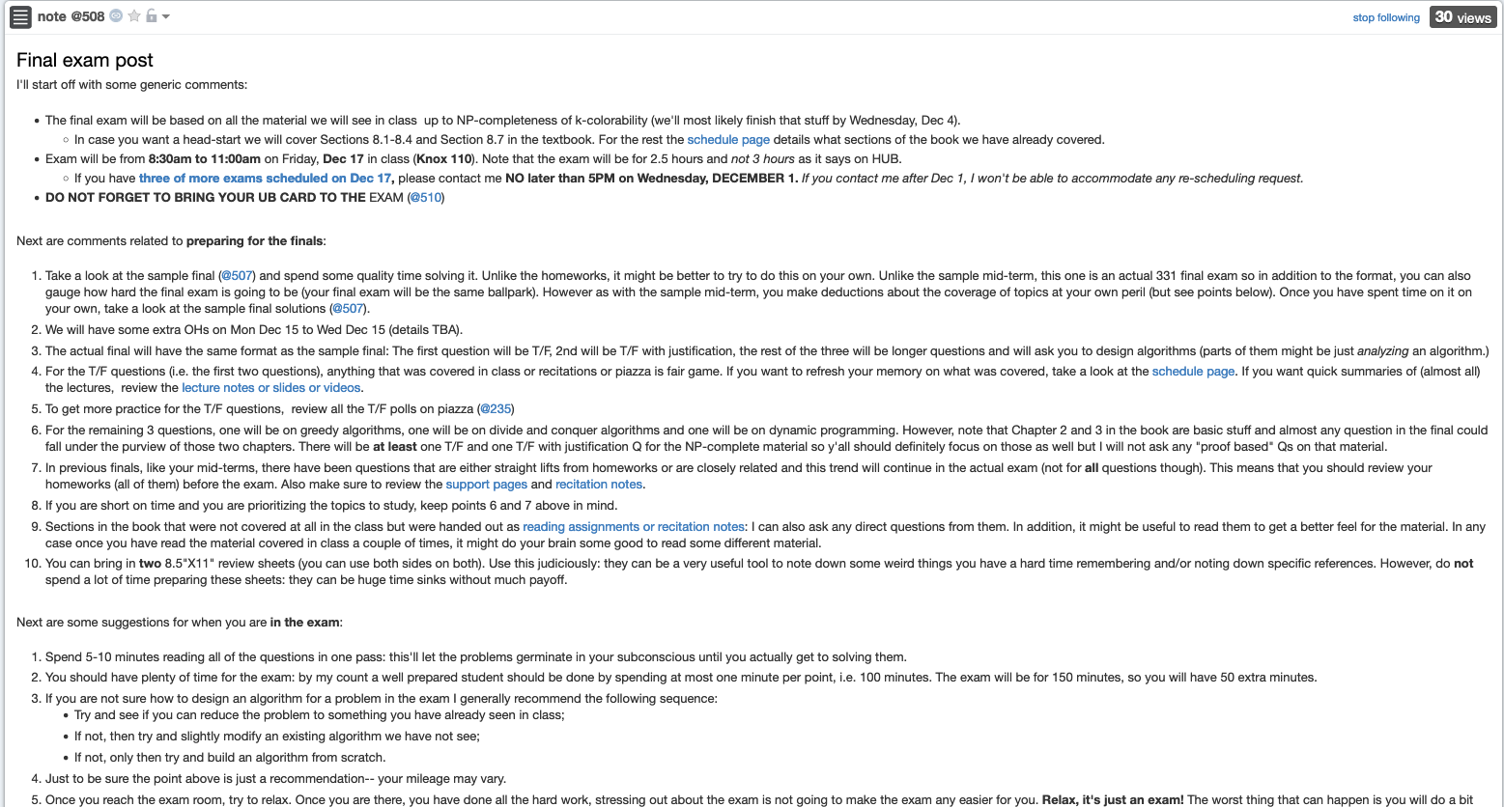
Final exam post

Slide 6
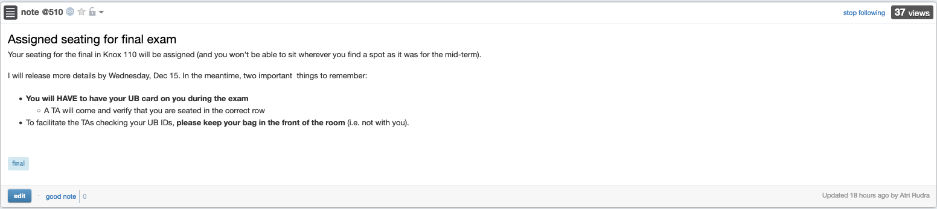
Bring your UB card to final

Slide 7
Grading of Quiz 2 might be delayed

Slide 8
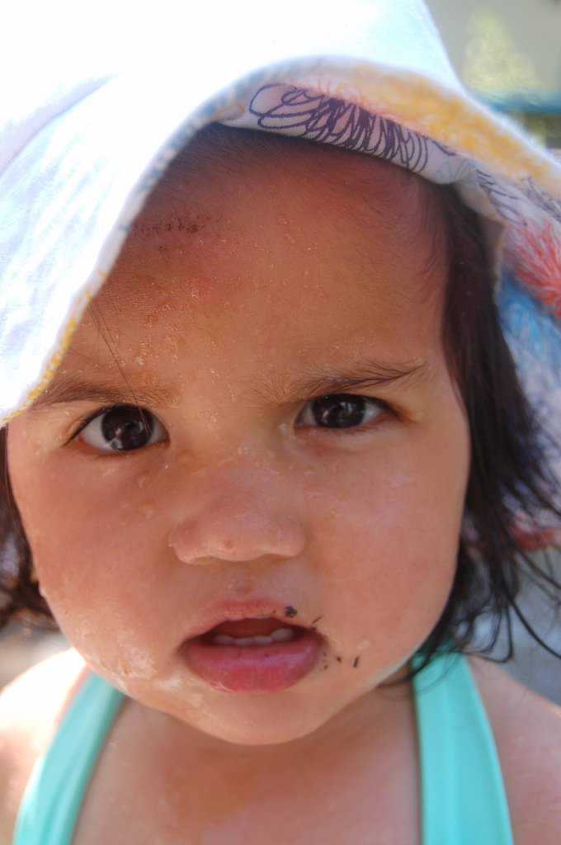
Questions?

Slide 9




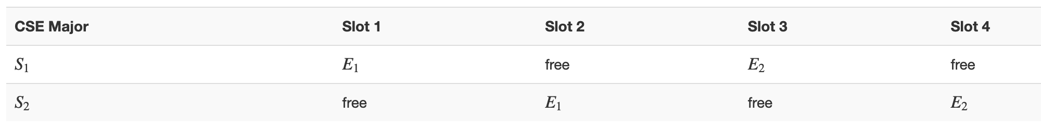
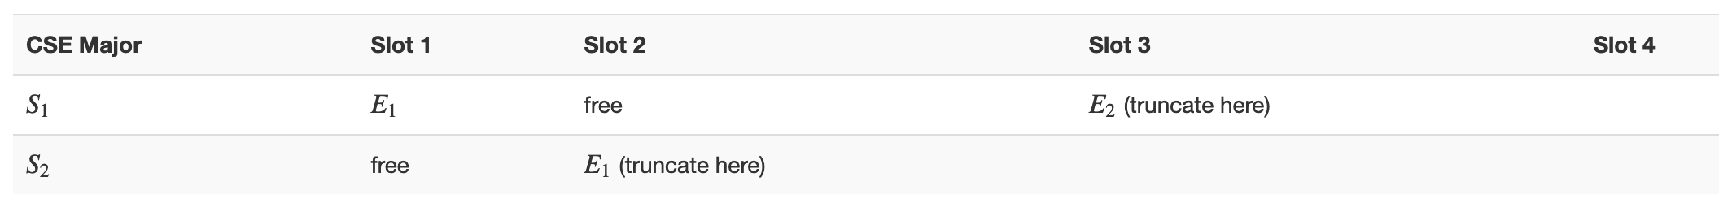


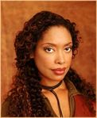
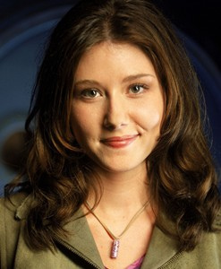
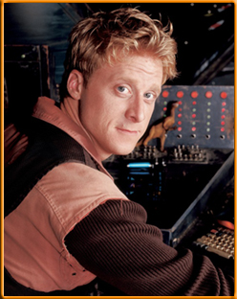

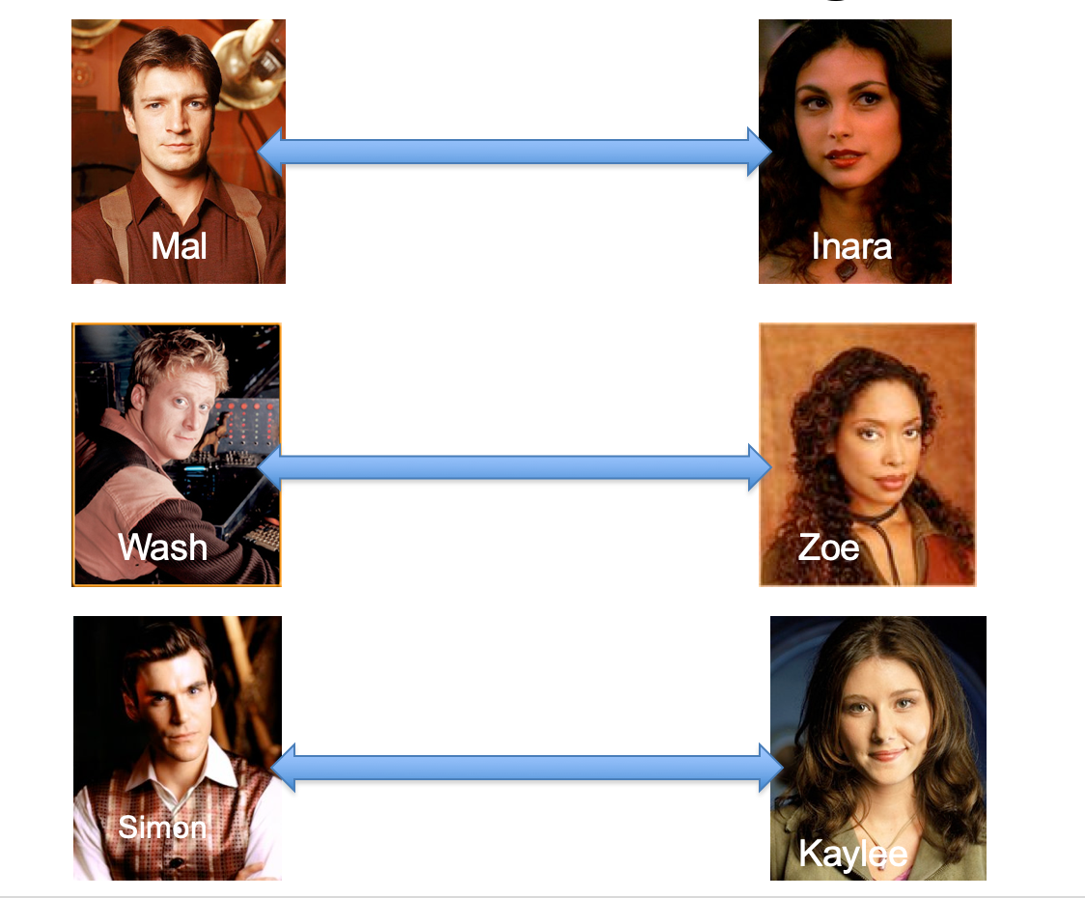
Poly time steps
Arbitrary Y instance
ANY algo for stable matching problem works!
Pre-process the input
Output for Y instance
All processing
is poly-time
Algo for X
Post-process the output

Slide 10



Poly time algo for X
Y is NP-hard
Arbitrary Y instance
Poly time algo for Y
X is NP-hard
Pre-process the input
Output for Y instance
All processing
is poly-time
Algo for X
Post-process the output
Mostly trivial

Slide 11
Today’s agenda
Recap of NP-completeness
NP-completeness of k-colorability

